Slide 1
Experience of establishing a reliability programme in the fusion community
Accelerator Performance and Concept Workshop (Frankfurt am Main Dec. 2018)
Tonio PINNA

Slide 2
Data collection on operating experiences relevant for fusion facilities
Objective of the activity
To develop a specific component failure database useful to
quantify probabilistic safety assessment,
support design activity,
perform reliability, availability, maintenability and inspectability (RAMI) analyses, and
support any other uses where field experience can provide feedback to fusion facility design and operation, e.g. estimation of occupational radiation exposure (ORE).

Slide 3
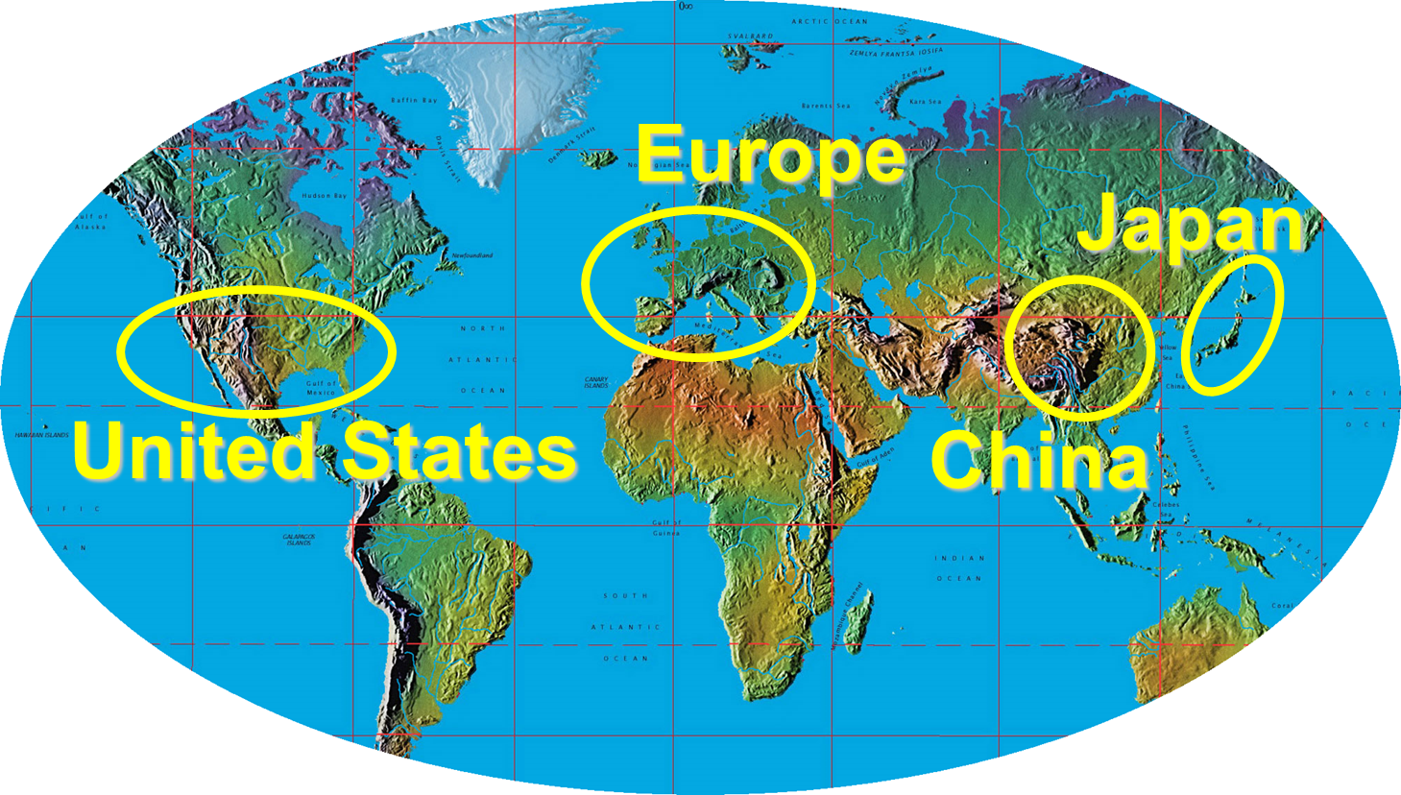
Data collection on operating experiences relevant for fusion facilities
Supported by fusion programs
The activity is set in the frame of the International Energy Agency Agreement on the Environmental, Safety and Economic Aspects of Fusion Power (IEA ESE) – Task 5.

Slide 4
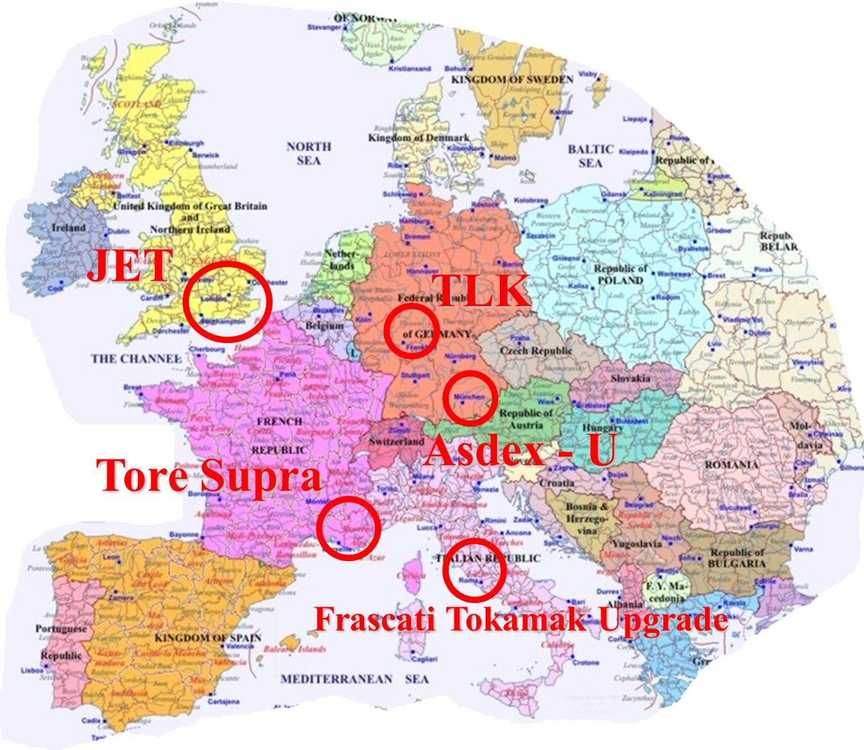
Data collection and analysis
European data retrieval and
analyses interested:

Slide 5
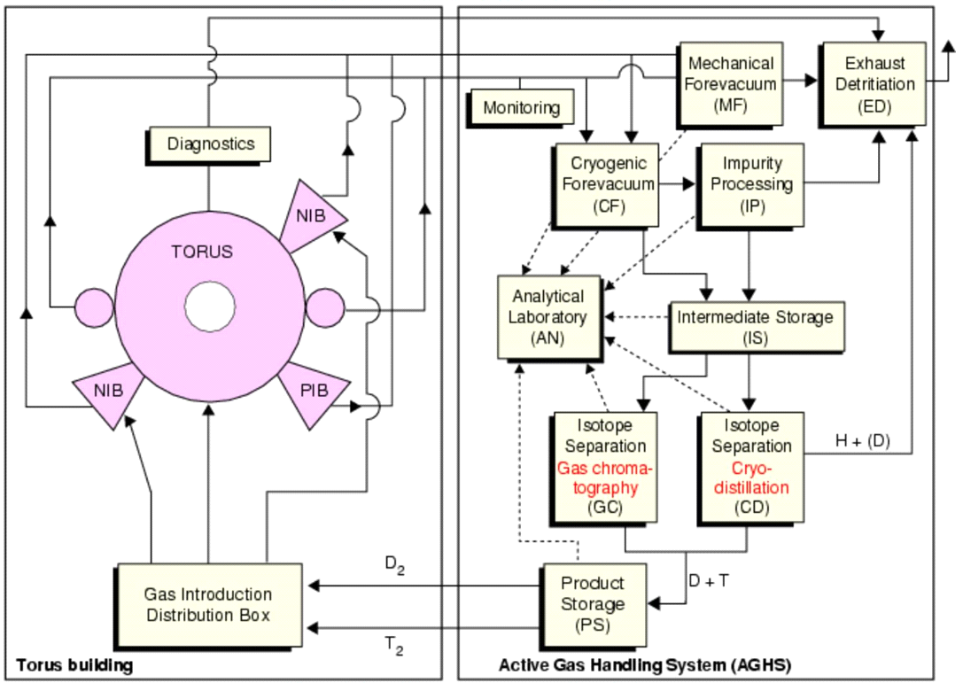
The systems analysed at JET (Joint European Torus)
Active Gas Handling
Vacuum
Coil and NBI PS
Ion Cyclotron Resonant Heating (ICRH)
Neutral Beam Injectors

Slide 6
Data collection and analysis
The data retrieval followed sequential steps:
  • reach a general understanding about available information
  • collect all the information available about troubles
  • identify causes, consequences, and maintenance actions
  • identify the complete “reference set” of components, their classification, operating times and cycles

Slide 7
Data collection and analysis
Goal of the statistical assessments of failures is to define:
  • failure rates (λ) and related uncertainty distributions,
  • mean time between failures (MTBF),
  • failure probability on demand (pD),
  • mean time to repair (MTTR)

Slide 8
Data collection and analysis
Historical data on failures searched in various sources specific to the plant under investigation:
  • hand-written log-books
  • electronic database
  • incident investigation reports
  • maintenance and repair records/database
  • annual and technical reports
  • plant personnel interviews

Slide 9
Big problems in searching historical data
  • Log-books hand-written by different people with different calligraphy and in different languages
  • Electronic database could be outdated or not aligned with old data recorded in paper form
  • Incident investigation reports often hand-written and not easy to find in the plant library. Some time they are not officially documented
  • Maintenance and repair records/database are very often summary and are hardly exhaustive in explaining the operations performed
  • Annual and technical reports are not specific in the identification of failures and in the repairing actions

Slide 10
Big problems in searching historical data
  • Plant personnel interviews: people think the study is a check on their work, so they tend to leave out and minimize information and data
  • External data analyst could get a more critical analysis of data, independent from internal conditioning, but he/she has great difficulty in understanding and finding the data to be analyzed
  • Internal data analyst could produce untruthful statistics, with data knowingly or unknowingly not considered and beneficial in attributing satisfactory plant performance

Slide 11
Identify “reference set” of components
6200 components, pointed out for the JET Active Gas Handling System

Slide 12
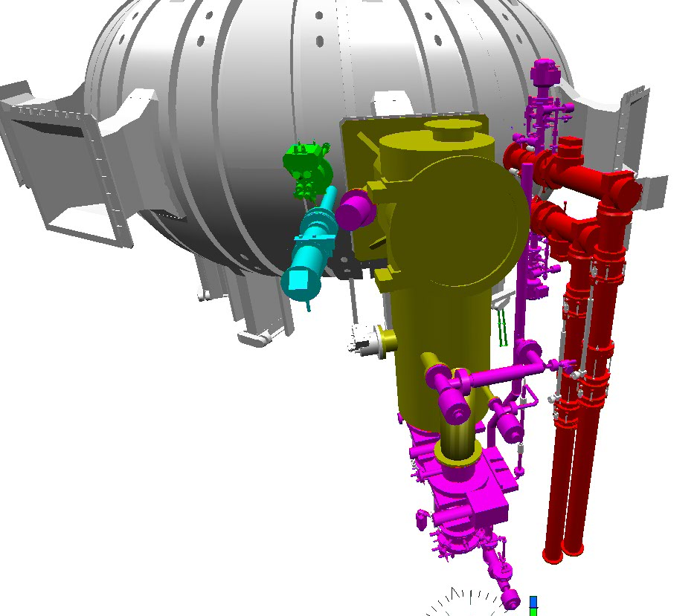
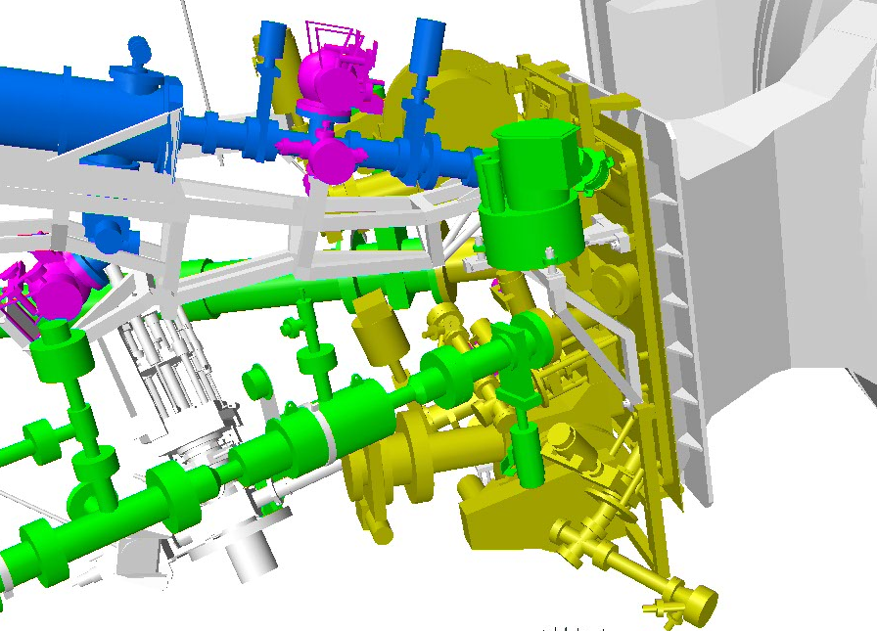
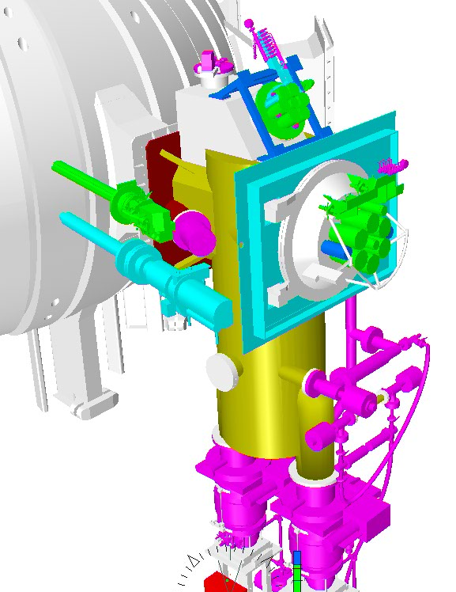
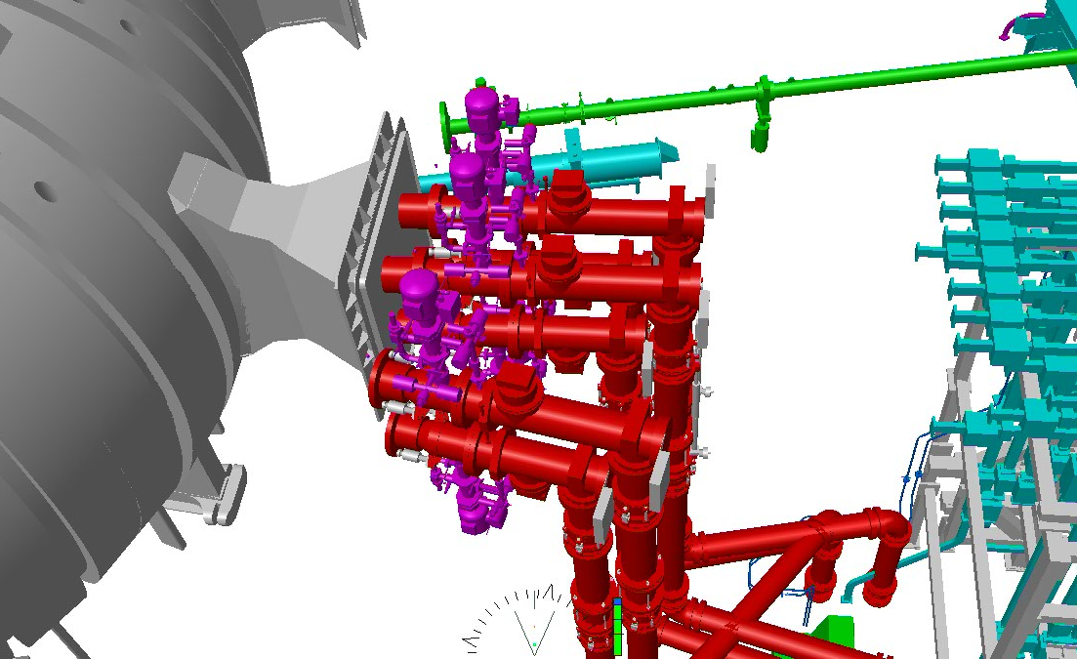
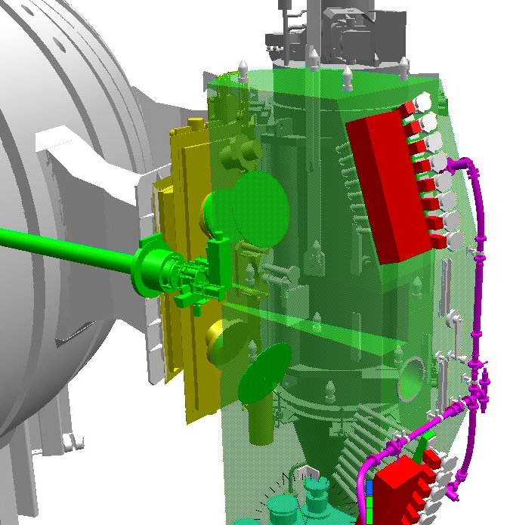
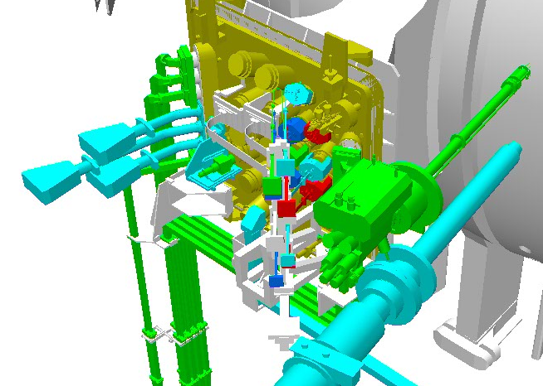
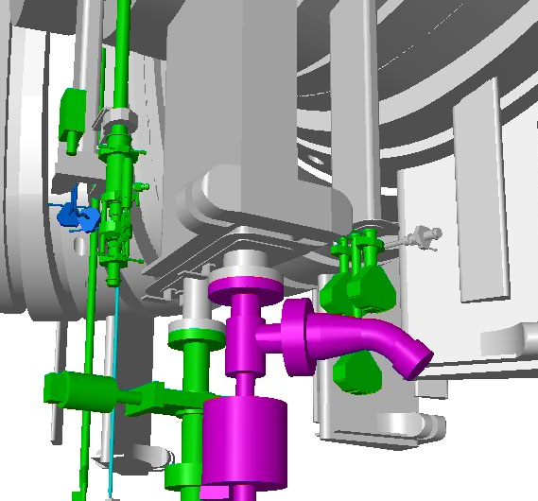
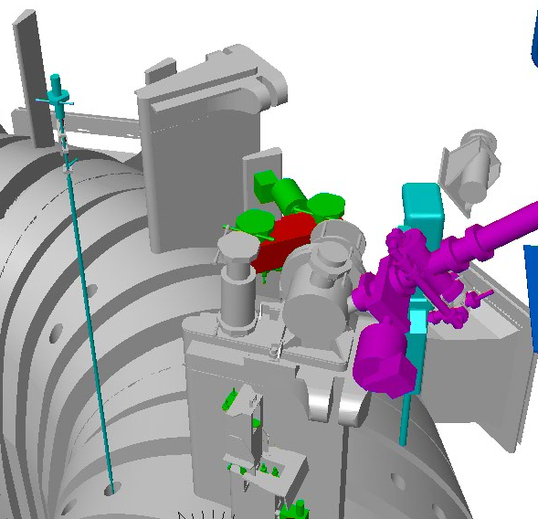
Big efforts in searching the complete “reference set” of components, e.g. welds, bellows, flanges
Detailed study of the executive drawings and manufacturing documents
often in paper form

Slide 13
Some example of found data
JET Active Gas Handling System
About 460 failures on a set of more than 6200 components, operating for about 215,000,000 hours, were pointed out since 1995 up to 2006

Slide 14
Some example of found data
JET Active Gas Handling System
Know how on preventive maintenance needs:
The largest number of failures/malfunctions (103) concerns “fail to open/close” and “external leaks” of small air actuated valves and solenoid valves, which are easily replaced. A large increase of these failures in 1997-1999 due to fatigue. A preventative maintenance programme started in 2001.

Slide 15
Some example of found data
JET Active Gas Handling System
Know how on preventive maintenance needs:
There are more than 40 cooling fans in the plant to cool down electrical boards in PLCs and in distributed control system. They all run continuously. Since the first fan failures in July 1997, a preventative maintenance program has started and fans are replaced every 12 months.

Slide 16
Some example of found data
JET Active Gas Handling System
Know how on some causes of failures:
Three of the five large scroll vacuum pumps stopped and then were replaced with screw pumps, respectively after about 29000, 22000 and 24000 hours of operating life. The failures were induced by the build up of debris inside the pump, probably due to corrosion.

Slide 17
Some example of found data
Statistics outcomes

Slide 18
Some example of found data
Active Gas Handling System
Two analyses made at a distance of 4 years:
slight deterioration of components with their age

Slide 19
Some example of found data
JET Vacuum Systems
Generalized decreasing of failure rates and an increasing of the performance of the system, probably due to the improved practice in managing the different seals.
In any case, the trend of leaks does not yet highlight effects of the aging of the system.

Slide 20
Some example of found data
JET Vacuum Systems

Slide 21
Some example of found data
JET Vacuum Systems
Operations vs Installations phases

Slide 22
Some example of found data
JET NBI Systems
About 100 failures in 1985 ÷ 2004
Cooling channels (electrodeposited → drilled)
Bellows (single → twin)
Cooling line layout to avoid water freeze-ups
Inability to accurately predict power densities in the duct region under the different magnetic fields

Slide 23
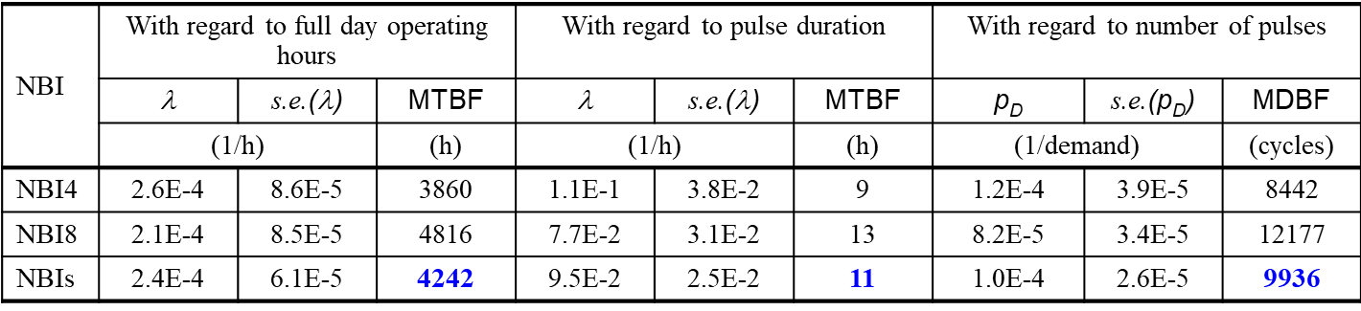
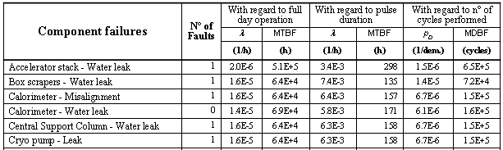
Some example of found data
JET NBI Systems
Global data
265 days
Specific data

Slide 24
Some example of found data
JET ICRH System: 12000 plasma pulses in which the ICRH was operated
20 hand written tick sheets between 1996 ÷ May 2003,
electronic tick sheets between May 2003 ÷ 2005.

Slide 25
Comparison between different sources
Results of comparisons are generally fair to good, giving confidence that the collected data are yielding valuable failure rate information that can be pooled for use in probabilistic safety assessment and system reliability analyses

Slide 26
Data on maintenance activities:
Operating experience versus worker exposures
Occupational radiation exposure (ORE) experience from existing fusion facilities represents a valuable source of information to assist in the development of ORE estimates for future fusion machines, and, possibly, in validating them.
Sample of data for maintenance in JET AGHS:

Slide 27
Fusion Component Failure Rate Database:
Data sources → currently 4207 records
Reference | Description | Records
ENEA Tec. Reports | Analysis of systems of the JET, TLK and ASDEX facilities: Tritium, Vacuum, NBI, Power Supply, ICRH, ECRH systems | 1271
INEL (USA) Technical Reports | Screening of valuable data for fusion and analysis of systems of the DIII-D, TSTA (Tritium Systems Test Assembly), NSTX (National Spherical Torus Experiment) and TFTR (Tokamak Fusion Test Reactor) facilities: Tritium, Cooling, Vacuum, Sensors systems | 917
CEA Tech. Reports | Analysis of Tore Supra systems: Plasma Facing Components & Cryogenic systems | 82
IAEA-TECDOC-478 | Component reliability data for use in probabilistic safety assessment (1988) | 1010
CIEMAT data coll. | Screening of valuable data for IFMIF accelerator | 188
From literature | ENEA screening of valuable data for fusion. Data source: AICHE,EIReDA98,IEEE Std 500, IREP-NUREG, OREDA, WASH1400,... | 500

Slide 28

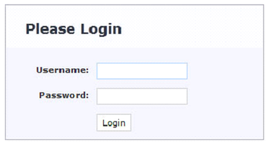
Fusion Component Failure Rate Database:
LOGIN
The “Fusion Component Failure Rate Database” supported by the European Communities under the contract of Association between EURATOM/ENEA was carried out within the framework of the European Joint Undertaking for ITER and the Development of Fusion Energy (F4E). The overall activity of data collection, analysis and recording is also set in the frame of the International Energy Agreement (IEA), Task 5. Purpose of the database is to have a common set of data for probabilistic assessment in fusion field.
The access to the database is restricted to Users operating in the fusion field, typically, Entities cooperating in ITER or IEA members. Contact us to require key words for the access if you meet such requirements.

Slide 29
Fusion Component Failure Rate Database:
Functions & Responsibilities
Responsibility | Functions
Administrator | Manage Users Read, Write and Update all records and related tables Export to Excel spreadsheet Delete records
Read User | Read all records and related tables Export to Excel spreadsheet (max set = 20 records/export) Send comments or requests to Administrator
Read/Write User | Read all records and related tables Write new records and data in the related tables Update own records Delete own records if the records have not yet approved Delete and Update own data in related tables only in case other Users have not yet used them Export to Excel spreadsheet (max set = 20 records/export) Send comments or requests to Administrator

Slide 30
Fusion Component Failure Rate Database:
Functions & Responsibilities
Responsibility | Functions
Administrator | Manage Users Read, Write and Update all records and related tables Export to Excel spreadsheet Delete records
Read User | Read all records and related tables Export to Excel spreadsheet (max set = 20 records/export) Send comments or requests to Administrator
Read/Write User | Read all records and related tables Write new records and data in the related tables Update own records Delete own records if the records have not yet approved Delete and Update own data in related tables only in case other Users have not yet used them Export to Excel spreadsheet (max set = 20 records/export) Send comments or requests to Administrator
It is convenient to simplify the data entry process and leave the recording functions only to the Administrator

Slide 31
Fusion Component Failure Rate Database:
Record composition
Family Name | Type |  | Sub-class1 |  | Sub-class2 | Sub-class3 | Sub-class4
Function | Short Description |  | Failure Mode |  | Cause | Reference
Operation Mode | Component Boundaries |  | Design Characteristics |  | Application Characteristics | Note
Failure Rate/Probability - Mean |  |  | FR/P Unit
Probability distribution
1st Param | 1st Par Value |  | 2nd Param |  | 2nd Par Value | 3rd Param | 3rd Par Value
MTTF | MTTF Unit |  | MDTF |  | MDTF Unit | Mean Time To Repair | MTTR Unit
MTTR Probability distribution
1st Param |  | 1st Par Value | 2nd Param |  | 2nd Par Value | 3rd Param | 3rd Par Value
Mean Repair Rate |  | MRR Unit | Preventive Maintenance Policy |  |  | Test / Inspection interval
No of Failures |  | No of Components | Cumulative working time |  |  | Cumulative working Demands
Validation |  | IEA Consensus | First data entry | Created by |  | Last modification date

Slide 32
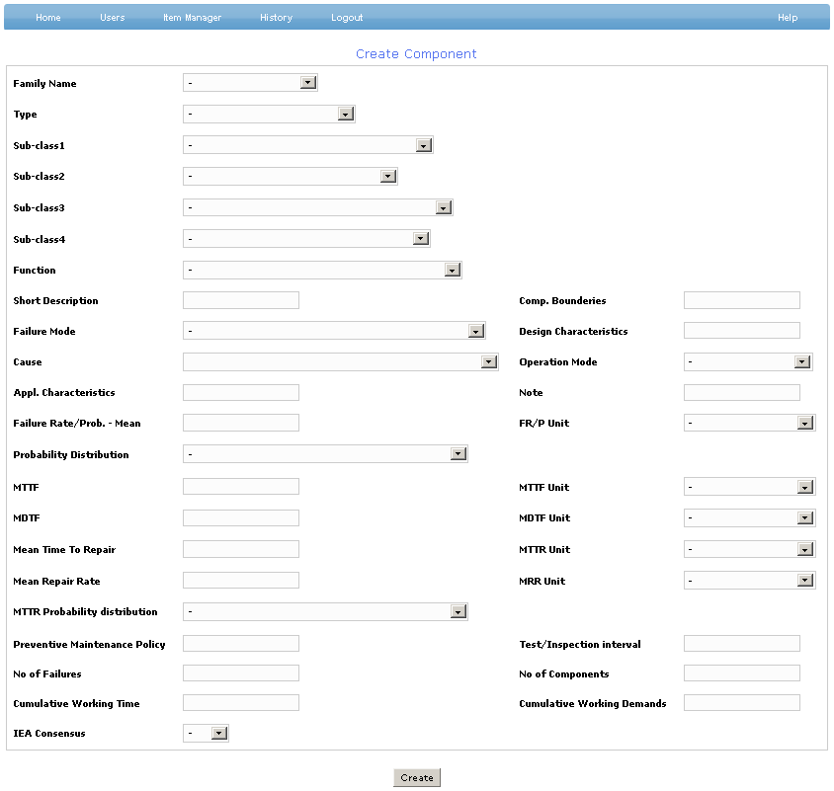
Fusion Component Failure Rate Database:
Record of component

Slide 33
Fusion Component Failure Rate Database:
Taxonomy (about 700 records)
Family Name
Type
Sub-class1
Sub-class2
Sub-class3
Sub-class4
Family Name
Building | 7
Chemical | 8
Electric | 88
Fusion specific device | 172
I&C | 121
Mechanic | 299

Slide 34
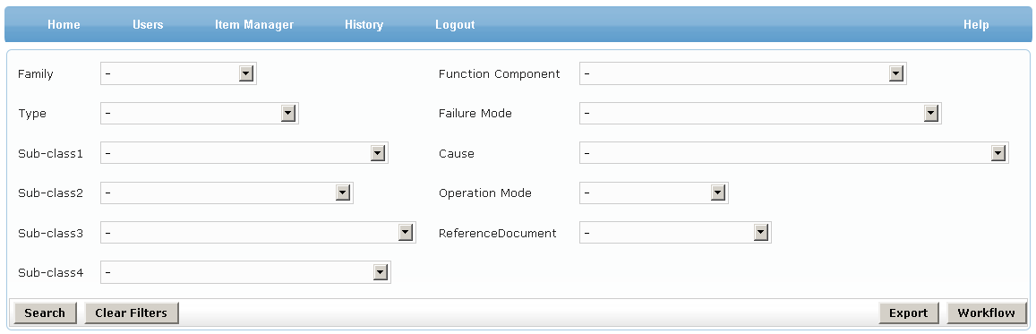
Fusion Component Failure Rate Database:
HOME PAGE
Home Page -> Search Components by Parameters

Slide 35
Fusion Component Failure Rate Database:
HOW TO USE THE DATA?
At first we made weighted averages of values in defining the distribution of the failures in terms of FR and MTTF

Slide 36
Fusion Component Failure Rate Database:
HOW TO USE THE DATA?
Sensitivity analysis approach providing results for 2 scenarios:
Results based on the lower mean failure rate between the set of available reference data (relies on the high quality of the components and items that will be used in future facilities) and
More conservative results based on higher failure rate values of the same set of data (it gives credit that components/items will behave better than of what has been found in the past operational life in similar technological systems from the point of view of failures)

Slide 37
Fusion Component Failure Rate Database:
HOW TO USE THE DATA?
Sensitivity analysis approach providing results for 2 scenarios:
The two values can be considered as the 5th and 95th percentile of a failure distribution, e.g. Lognormal, Weibull, Gamma
Component | Failure mode | Failure rate
 |  | Min | Max | Unit
Accelerator grid | Leak/Rupture | 1.0E-6 | 2.0E-6 | /h
Bellow | Leak/Rupture | 3.0E-8 | 3.7E-7 | /h
Busbar ac | Short | 1.0E-7 | 6.7E-7 | /h
Busbar dc | All failure modes | 2.9E-7 | 5.2E-7 | /h
Capacitor | All failure modes | 5.6E-6 | 3.9E-5 | /h
Capacitor spurious discharge | Spurious discharge | 2.8E-6 | 5.6E-6 | /h
Centrifugal pump | All failure modes | 1.8E-6 | 3.8E-6 | /h
Check Valve | External Leak/Rupture | 2.7E-8 | 1.0E-7 | /h
Check Valve | Internal Leak | 1.0E-8 | 5.0E-7 | /h
Circuit breaker HV | Failure to remain in position | 2.4E-6 | 6.9E-5 | /h
Circuit breaker LV | Failure to remain in position | 1.1E-7 | 1.3E-6 | /h
Circuit breaker MV | Failure to remain in position | 9.9E-8 | 3.5E-7 | /h
Coil conductor | All failure modes | 1.0E-7 | 4.5E-6 | /h
Coil jacket | Leak/Rupture | 1.2E-8 | 2.5E-6 | /h
Coil termination joints | Short | 2.7E-8 | 3.0E-7 | /h
Compressor | Failure to function/operate | 3.0E-5 | 1.0E-4 | /h

Slide 38
Fusion Component Failure Rate Database:
HOW TO USE THE DATA?
Failure Rate data estimation for components with operational experience under different load conditions
    Mixing of literature FR data and failure model engineering knowledge about failure causes most likely enhanced by fusion operational loads:
    → “Failure Rate modelling using Fault Tree analysis and Bayesian Network: DEMO pulsed operation Turbine study case” - https://doi.org/10.1016/j.fusengdes.2016.02.036

Slide 39
Our plans for the future
  Record new data we have available from last studies
  Continue to analyse historical data from fusion facilities

Slide 40
Our plans for the future
  Record new data we have available from last studies
  Continue to analyse historical data from fusion facilities
  Set the procedures to collect and analyse data from tests of components to be installed in ITER
Failure Rate estimation for new components without operational experience
Step-Stress Accelerated Life Testing (SSALT) within Bayesian framework to estimate FR resulting from component qualification tests involving accelerated cycling under operational loads and beyond:
    Ref. Exploiting information of fusion component tests for failure rate estimation: Divertor Inner Vertical Target component study case
    https://doi.org/10.1016/j.fusengdes.2018.05.077 )

Slide 41
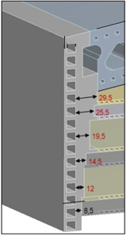
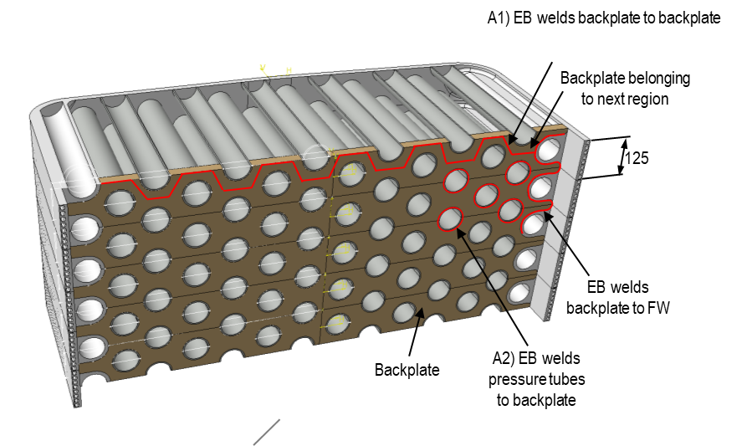
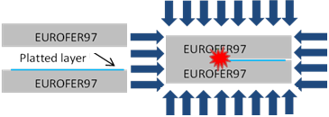
Our plans for the future
  Record new data we have available from last studies
  Continue to analyse historical data from fusion facilities
  Set the procedures to collect and analyse data from tests of components to be installed in ITER
  Promote test and analysis on new components (e.g. HIP welds) and evaluate geometric effect on some components

Slide 42
Our plans for the future
  Record new data we have available from last studies
  Continue to analyse historical data from fusion facilities
  Set the procedures to collect and analyse data from tests of components to be installed in ITER
  Promote test and analysis on new components (e.g. HIP welds) and evaluate geometric effect on some components
  Enlarge our data sets with data coming from other fields of applications, e.g. Accelerators > accelerator equipment, magnets, cryogenic systems

Slide 43
Our plans for the future
  Record new data we have available from last studies
  Continue to analyse historical data from fusion facilities
  Set the procedures to collect and analyse data from tests of components to be installed in ITER
  Promote test and analysis on new components (e.g. HIP welds) and evaluate geometric effect on some components
  Enlarge our data sets with data coming from other fields of applications, e.g. Accelerators > accelerator equipment, magnets, cryogenic systems
We are interested in co-operate / perform analyses on data from CERN and from other high tech facilities

Slide 44
Thanks for your attention

