Slide 1
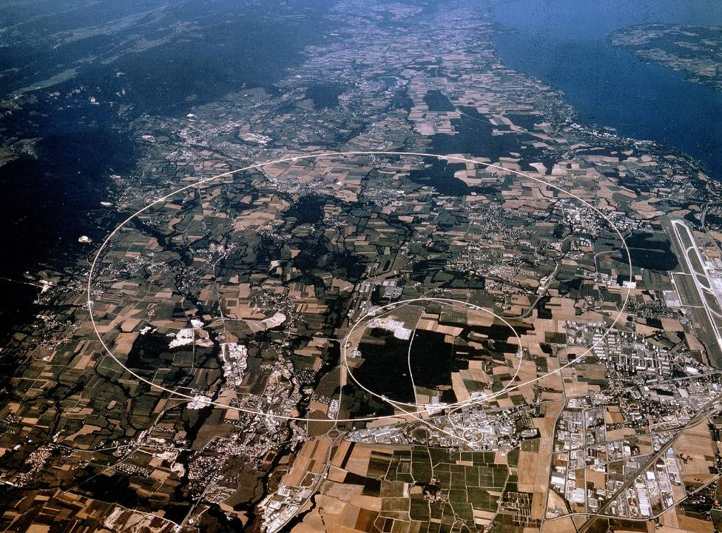
Towards Common Terminology and Concepts
A. Apollonio
CERN Machine Protection Group (TE-MPE)
Accelerator Performance and Concepts Workshop
12/12/2018
andrea.apollonio@cern.ch
Acknowledgements: TE-MPE Group, CERN Availability Working Group, Accelerator Fault Tracking team.

Slide 2
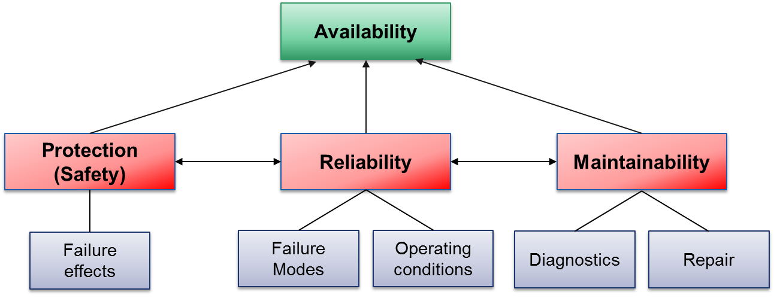
R-A-M-S(P)
“Dependability”
NB: in the context of particle accelerators, we speak about ‘Protection’ rather than ‘Safety’, if no personnel is involved
Discussions are ongoing in the particle accelerator community to tailor these definitions to different machines (Accelerator Reliability Workshop)

Slide 3
Requirements for Particle Accelerators
Availability
Reliability
Protection
Low Importance
Relative Importance
High Importance

Slide 4
R-A-S(P) Requirements for Accelerators
Large-Scale Colliders
Synchrotron Light Sources
Availability
Availability
Protection
Reliability
Protection
Reliability

Slide 5
R-A-S(P) Requirements for Accelerators
Spallation Neutron Sources
Accelerator Driven Systems
Availability
Availability
Reliability
Reliability
Protection
Protection
Why is availability a concern for the scientific output of all facilities?
Costs, Reputation, Damage potential

Slide 6
Cost vs Availability
Cost
Total life-cycle costs
Min. Costs
Design, purchase and maintenance costs
Operation costs
Opt. Availability
Availability
Given a target performance reach (neutron fluence, number of patients treated, luminosity production, …), an optimal balance between capital costs and operation costs must be found
This is an absolute MUST for the feasibility of next-generation machines

Slide 7
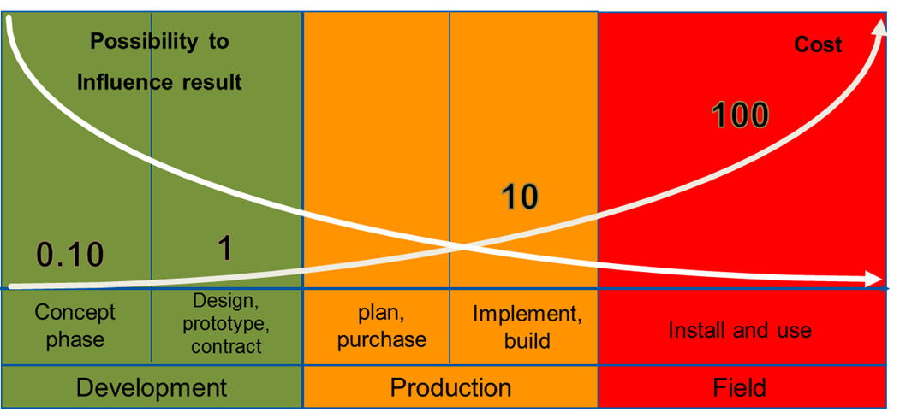
Dependability Studies: if yes, when?
Prof. Dr. B. Bertsche, Dr. P. Zeiler, T. Herzig, IMA, Universität Stuttgart, CERN Reliability Training, 2016
Product Lifecycle: ‘Power-of-10 Law’
The earlier reliability constraints are included in the design, the more effective the resulting measures will be

Slide 8
Today: Dependability Studies
Technology Feasibility Assessment
Concept Phase
Technology Definition and Implementation
Design Phase
Exploitation Phase
Technology Field Use & Optimization
Reliability Studies
New Technology Definition and Implementation
Upgrade Phase

Slide 9
Future: Dependability Studies
Technology Feasibility Assessment
Concept Phase
Reliability Studies
Technology Definition and Implementation
Design Phase
Exploitation Phase
Technology Field Use & Optimization
New Technology Definition and Implementation
Upgrade Phase

Slide 10
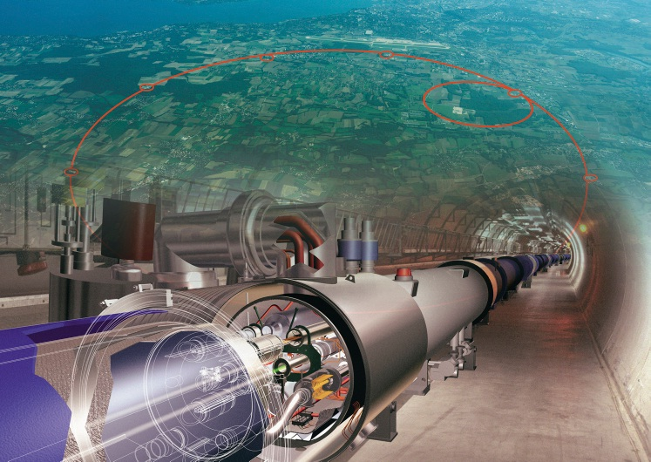
Reliability and Protection Analyses: LHC was a Game Changer
First particle accelerator with damage potential beyond repair
Requirement 1: Must have Machine Protection Systems (MPS)
Requirement 2: MPS must meet very strict reliability requirements
Requirement 3: MPS must not trigger unnecessary beam interruptions

Slide 11
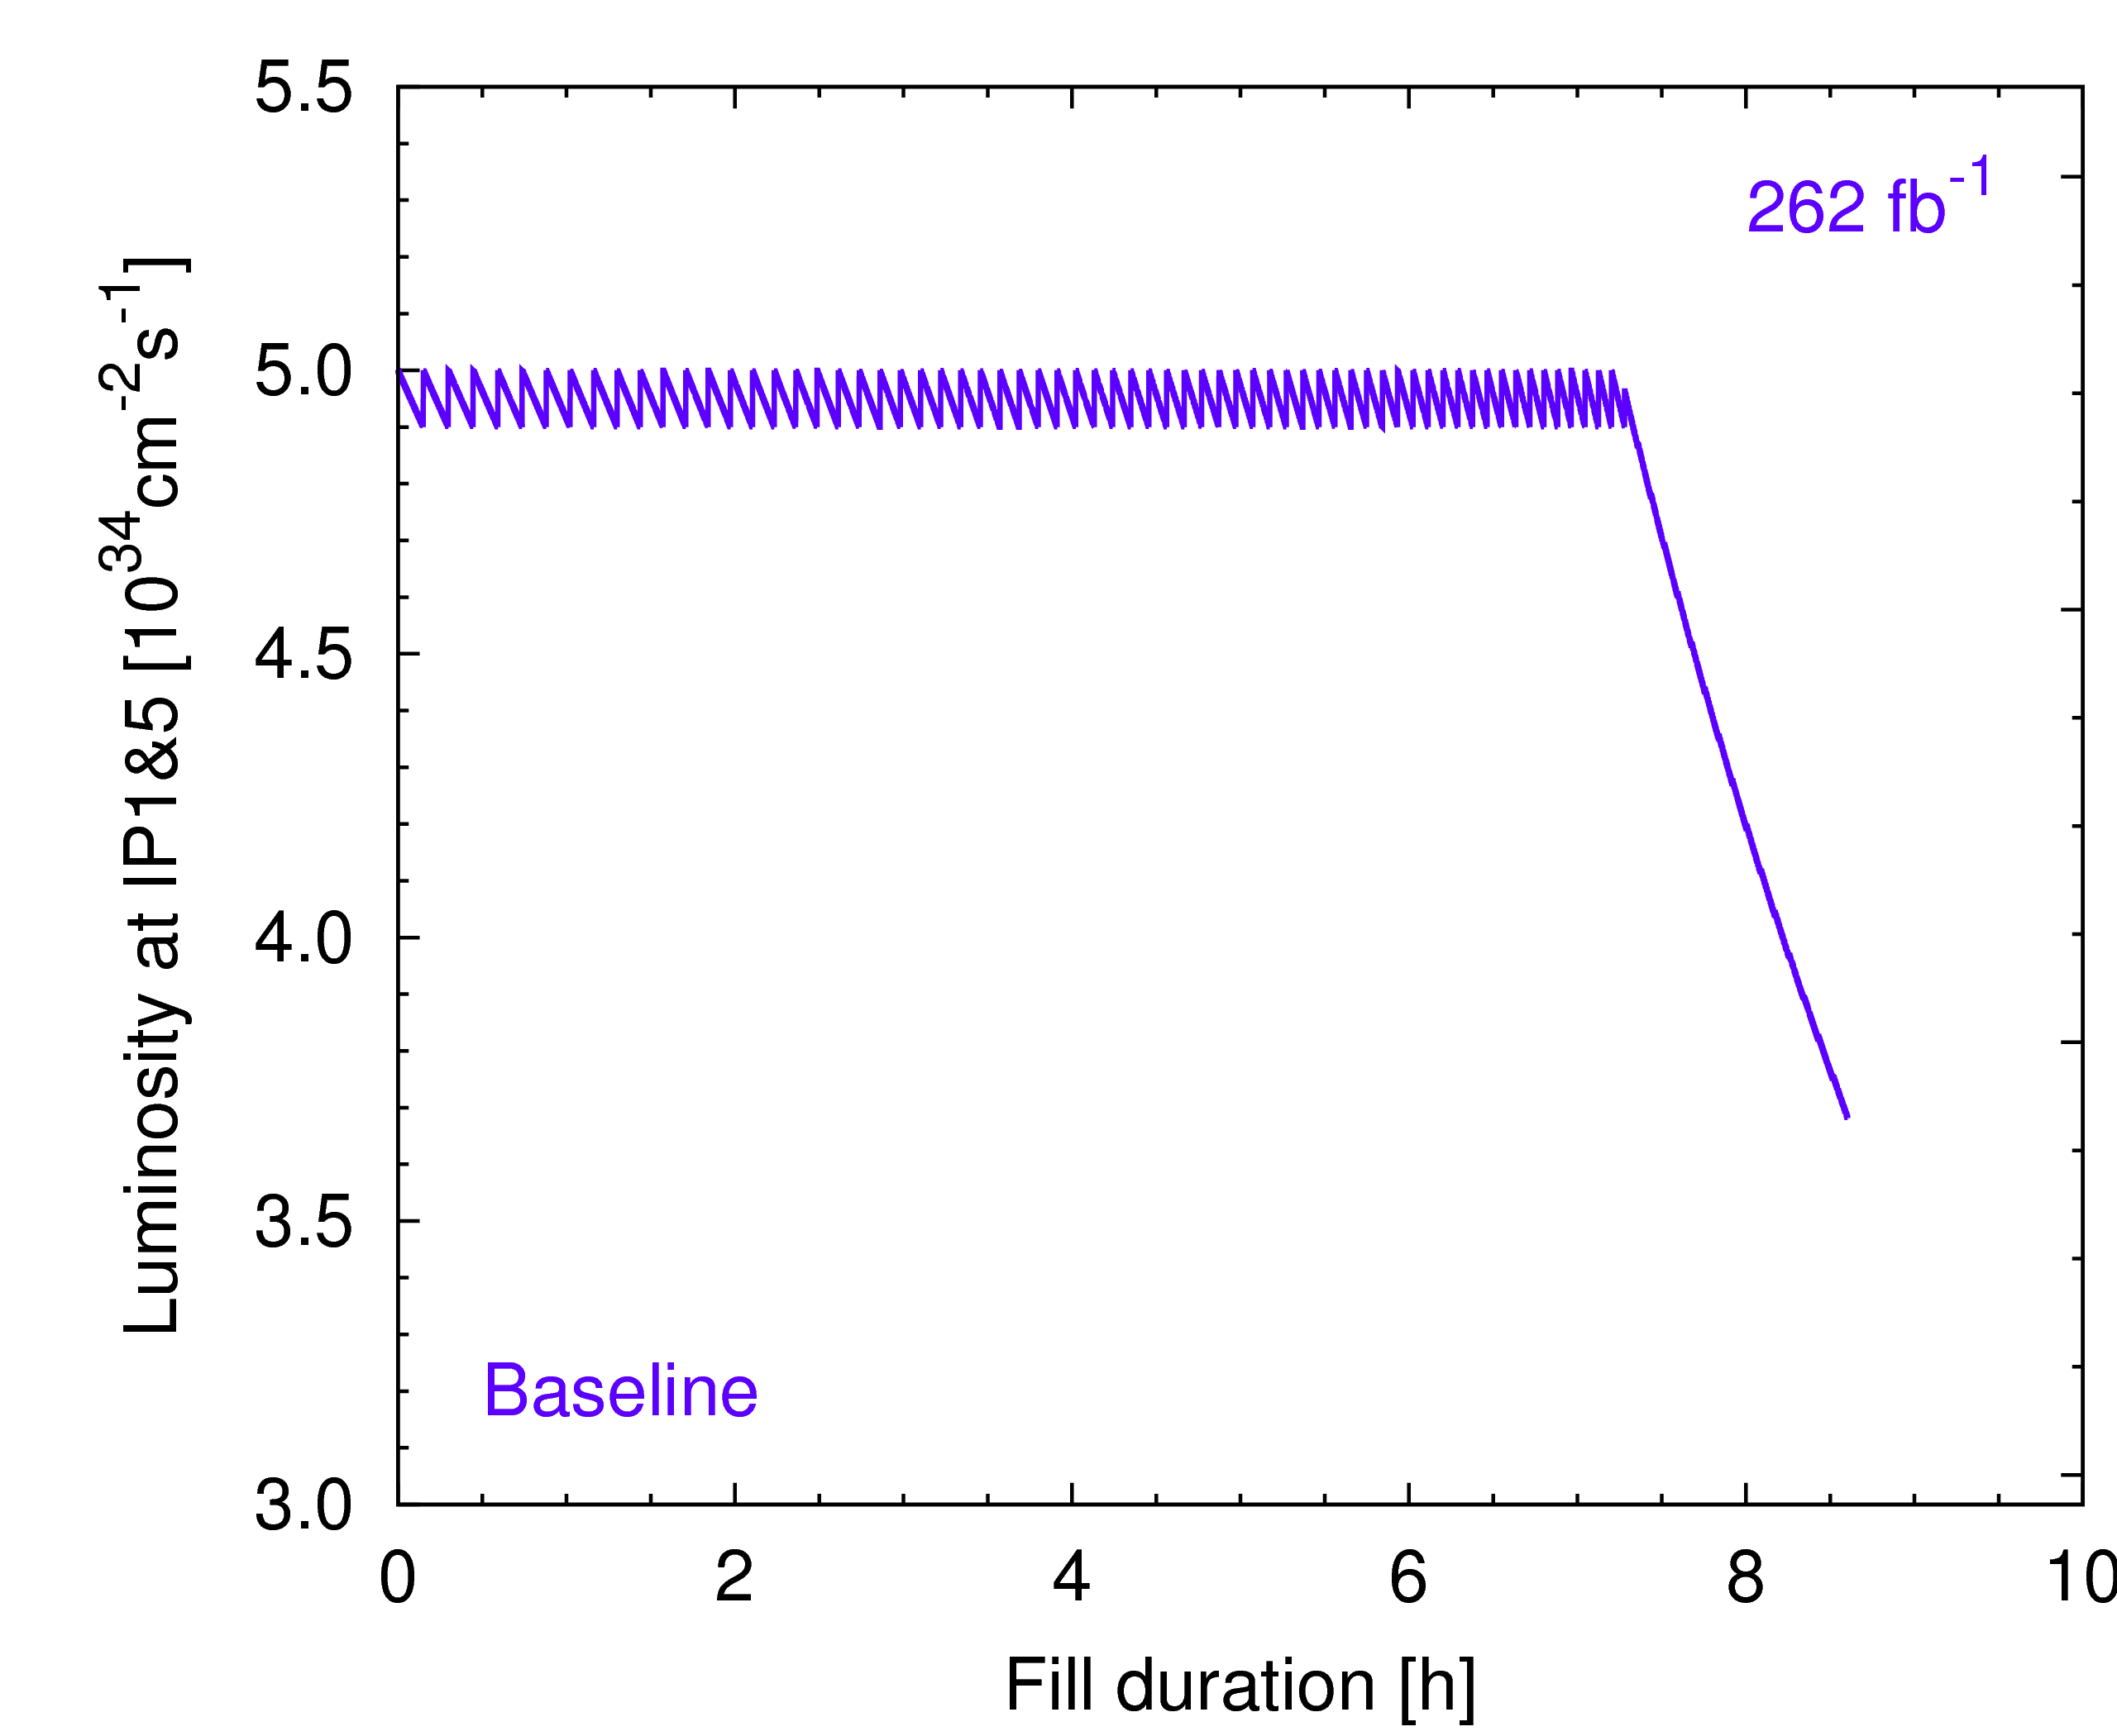

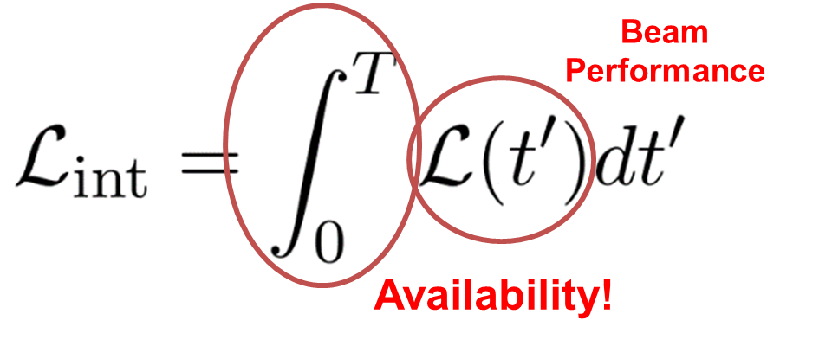
Availability: HL-LHC is a Game Changer
Courtesy L. Medina Medrano
Explicit Integrated Luminosity Production Goal
3000 fb⁻¹ over HL-LHC Lifetime
The adoption of luminosity levelling shifts the focus on increasing availability to increase luminosity production
STEP1: Measure availability
STEP2: Predict performance (model) as a function of availability

Slide 12
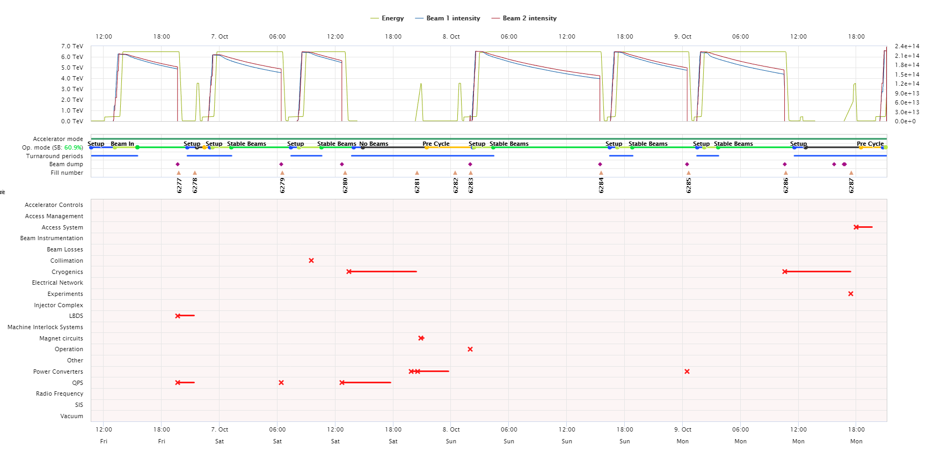
Step 1: Failure Tracking
Since 2015 at CERN, Accelerator Fault Tracker in use to keep consistent records of accelerator system reliability and availability during LHC lifetime
Used to estimate system failure rates and recovery times
Consolidated over 3 years of operation, now widely accepted by system experts
‘Cardiogram’ of LHC operation

Slide 13
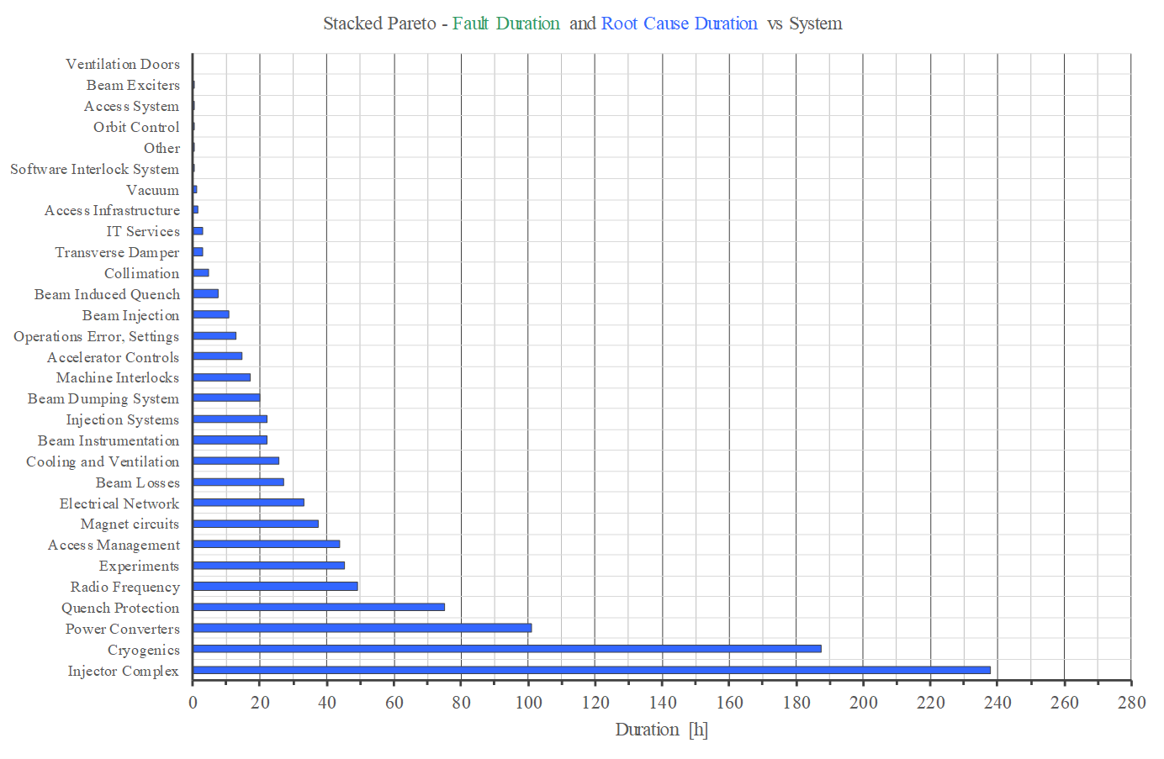
LHC System Downtime in 2018
Prioritize consolidation activities according to impact on availability

Slide 14
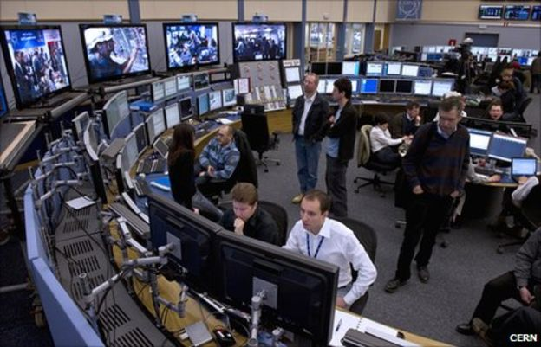
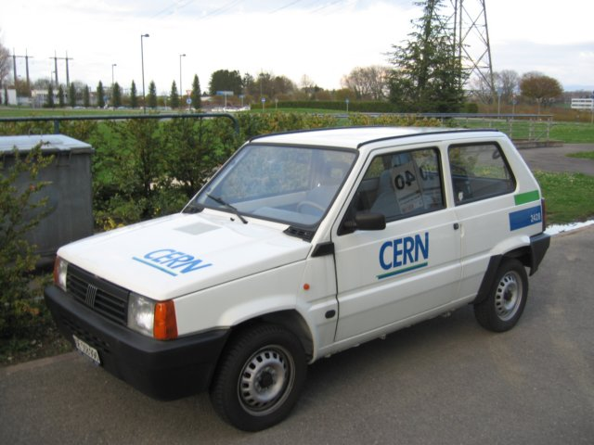

Maintainability: Failure Duration
Failure Duration
Identification
Diagnostics
Logistics
Repair
Accelerator specific: some time might be required to recover nominal operating conditions (e.g. source stabilization, magnetic pre-cycles, accelerator thermal stabilization)
Optimising accelerator maintainability will be fundamental for future large-scale machines

Slide 15
Step 2: From Data to Models
Shutdown
Operation
Shutdown
Operation
Years
HW Commissioning
Beam Commissioning
‘Production’
Technical Stop
Machine Studies
Weeks
Cycle
‘Delivery’
Failure
Hours

Slide 16

Monte Carlo Simulation Concept
Recovery
Ramp Down
Idle
Injection
Premature
Dump
Operator
Dump
Idle
Injection
Ramp
Stable Beams
Ramp Down
Idle
Injection
Ramp
Premature
Dump
Ramp Down
Idle
Injection
Recovery
Random failures (phase specific) + random recovery times

Slide 17
Input Data
From AFT (2017-18): phase dependent Mean Time To Fail (MTTF) and Mean Time To Repair (MTTR)
[…All other LHC systems…]
Many uncertainties for extrapolation to HL + new systems

Slide 18
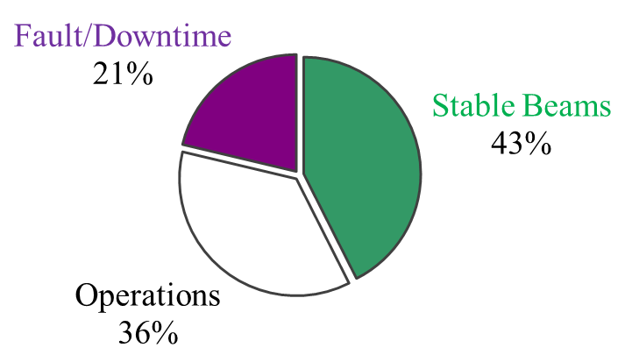
HL-LHC Availability Model Predictions
Time
X 100 times
[…until 160 days of operation are reached…]

Slide 19
Application: Protection vs Availability
Dust macro-particles interacting with the beam (UFOs)
Losses are detected by Beam Loss Monitors (BLMs)
Premature beam dumps + (in some cases) a magnet quench
Thresholds of BLMs should be optimized to limit impact on operation
High
Low
Low
UFO rate
High

Slide 20
Outlook
Achieving high availability will be a key requirement for the success of next-generation particle accelerators and needs to be pursued from early design phases
High Reliability and Protection
High Maintainability
Redundancy Fault Tolerance
Failure Prediction Advanced Diagnostics
Remote/Robotic Maintenance
TOTAL AVAILABILITY
(B. Todd, R. Schmidt, L. Felsberger)

Slide 21
Conclusions
Costs
Reputation
Damage Potential
Continuous Dependability Analysis & Assessment
Invest in ‘reliability culture’
Develop system and accelerator models
Improve failure data recording
Trainings, Workshops
Accelerator Fault Tracker
Predict Performance

