Slide 2
Availability for Particle Accelerators:
How to Break through the Limits?
Rossano Giachino ,Benjamin Todd CERN
rossano.giachino@cern.ch
Accelerator Performance Concept Workshop (APEC) – December 2018

Slide 3
Outline
Accelerator Reliability Community
Industrial examples
My ideas to break trough

Slide 4
Scope
The community attending these workshops and concerned about reliability is generally:
Light Sources
Spallation Sources
Therapy Machines
Hadron Colliders
Accelerator Driven Systems
Future Machines – colliders – energy systems
there is a big difference in designing a machine to be reliable from the start
Starting a machine then trying to make it reliable
Academically – design it to be reliable, then make it.
Reality – design to meet budget and time constraints, make it, then improve it.

Slide 5
What do we Mean?
Reliability = ???
Reliability?
Dependability?
Availability?
Safety?
Maintainability?
Risk?
We have been discussing this through the ages, since the 60s in accelerators!
A workshop for these discussions was established almost 20 years ago….

Slide 6
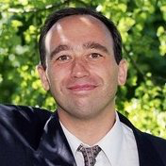
Accelerator Reliability Workshop (ARW)
2002
ESRF
Grenoble
L. Hardy – (European Synchrotron Radiation Facility)
triggered the community and organised first workshop
need a community to share reliability aspects, ≈ 80 experts attended, from:
        Accelerator Driven Systems
        X-Ray Sources
        Medical and Industrial Accelerators
        Spallation sources
        High energy physics
        Nuclear Physics
        Space
Reliability gaining in priority for accelerator designers

Slide 7
History of ARW
2002
2009
ESRF
Grenoble
TRIUMF
Vancouver
Community re-born after a hiatus, extended topics:
  Engineering and design for reliability
  Software reliability
  Quality assurance
  Machine protection
  Beam Interlock System
  Hardware reliability

Slide 8


History of ARW
2002
2009
2011
ESRF
Grenoble
TRIUMF
Vancouver
iThemba
Cape Town
The scientific program expanding
Structure shows different accelerator reliability aspects.
Accelerator systems, Magnets survey, Software, Faults investigation
Community interest to have a workshop every 2 years
Three candidate labs to host next ARW...
iThemba LABS provides accelerator and ancillary facilities that are used for research and training in nuclear and accelerator physics, radiation biophysics, radiochemical and material sciences, radio nuclide production and radiotherapy.
Proton beams are accelerated to an energy of 66 MeV in the K = 200 separated sector cyclotron (SSC) with a solid-pole injector cyclotron (K=8) for use in the production of radio nuclides and neutron therapy.

Slide 9

History of ARW
2002
2009
2011
2013
ESRF
Grenoble
TRIUMF
Vancouver
iThemba
Cape Town
Australian
Synchrotron
Happy User Index A.Ludeke (PSI)
More to happy users than beam availability
Beam Quality for experiments performance
Each facility needs “Figure of Merit”
Triggered the idea to compare Light Sources.
A survey of several light sources reveals that the calculation of availability varies significantly between facility.

Slide 10
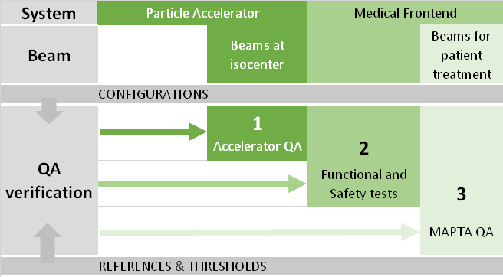
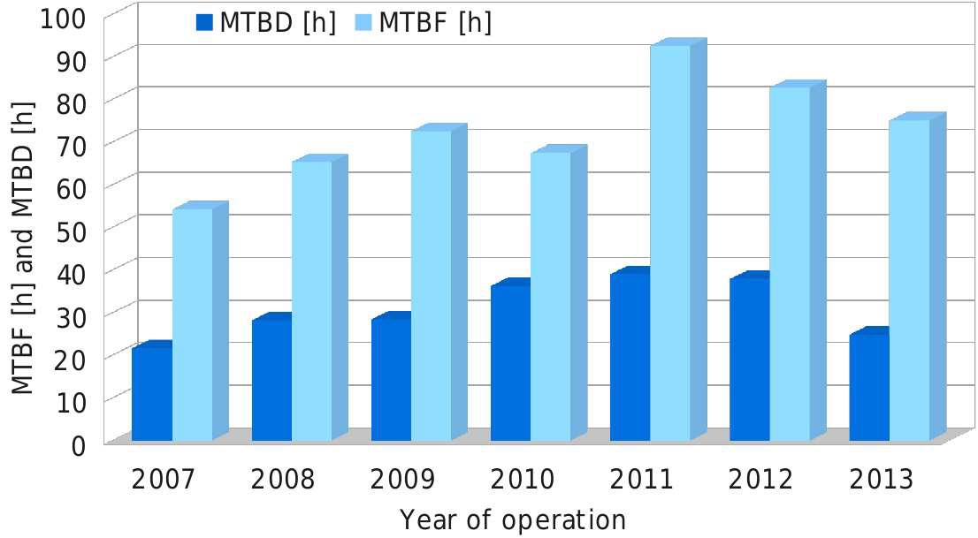
Happy user index
A metric to quantify the reliability of an accelerator must
take the speciﬁc application of the facility in to account.
An operation metric should strongly correlate with the demands of the users.
These demands depend on the particular purpose of the facility,
therefore every type of accelerator facility needs to ﬁnd its
own metric: the speciﬁc happy-user-index of that type of
(PDF) FINDING YOUR HAPPY-USER-INDEX. Available https://www.researchgate.net/publication/264864979_FINDING_YOUR_HAPPY-USER INDEX

Slide 11

History of ARW
2002
2009
2011
2013
2015
ESRF
Grenoble
TRIUMF
Vancouver
iThemba
Cape Town
Australian
Synchrotron
ORNL, SNS
Knoxville
Organization and program quality a new milestone.
New labs: ITER, Myrrha, IFMIF, CIEMAT, ESS, Chinese Academy of Science, Ganil, Medical
High participation of equipment specialists and reliability experts .
MYRRHA specifications:
Beam trips longer than 3s must be very rare
<10 beam trips in three month operation period MTBF > 250h
Above present high power proton accelerator performances
Far above similar specifications in US or Japan

Slide 12

History of ARW
2002
2009
2011
2013
2013
2017
ESRF
Grenoble
TRIUMF
Vancouver
iThemba
Cape Town
Australian
Synchrotron
ORNL, SNS
Knoxville
SOLEIL
Paris
More than 140 participants - had to close the inscription early!
Scientific program balanced; Oral, Posters and Discussions
Aries: J. Gutleber presented Ambitions of Open Data Infrastructure for accelerator reliability

Slide 13
Synergies
There are many synergies across machines and domains: all are areas influencing “reliability/availability”
Power Supplies
Control Systems
Infrastructure
Cooling & ventilation
…
Technical equipment:
Proven industrial methods
Cryogenics & Magnets
Protection Systems
Collimators
…
Accelerator Specific Technical Equipment:
Beam losses
Beam physics
Beam Instrumentation
…
Beam related:
Plans
Cycles
Human Factors
Optimisations (& Mistakes)
…
Operationally:

Slide 14
Brief Examples of Industrial Methods

Slide 15
Design for High Availability
Awareness & Mitigation of weakness
Consideration of system/subsystem architecture
Fail-safe
De-rating
Managing lessons learned
Avoiding error prone solutions
Redundancy and hot spares
Diagnostics
Repair and maintenance friendly designs
General Considerations:
Adapted from F. Willeke

Slide 16
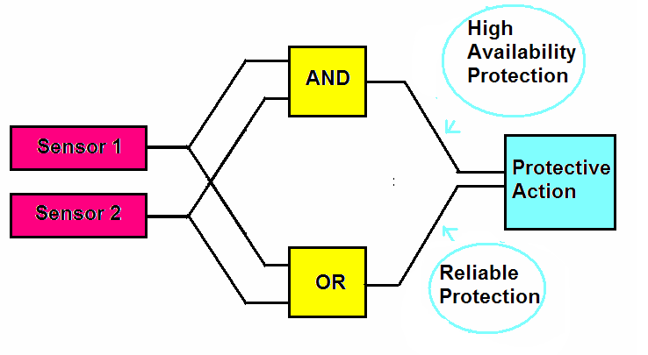
Smart Fail Safe Design
Fail Safe Design = Good Engineering Practice
System Trips are an important factor
in operational efficiency especially for accelerators with long injection cycles
Need to be conservative in early operation phase ➔ High false trip rate,
But
Trip Thresholds could be higher with growing experience and confidence
Need flexible internal trip thresholds
Need flexible protection logics
Needs to be included in the design phase
Safe administration and management of the threshold must be integrated upfront!

Slide 17
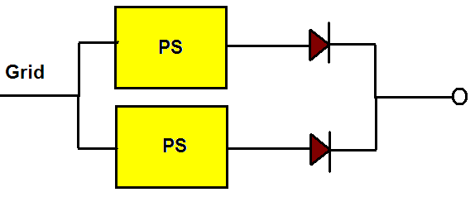
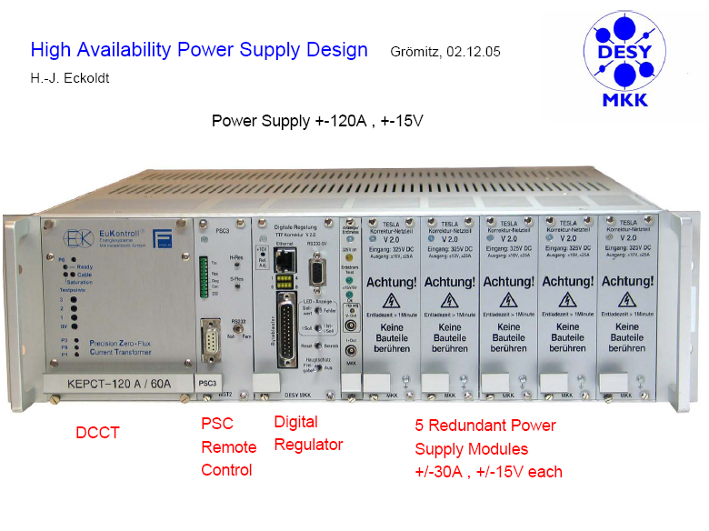
Build-in Redundancy and Hot Spares
Build in Redundancy
will increase reliability significantly
If failed modules are replaced continuously ➔ needs access!
➔ “Hot Swap” Capability helps
Example:
TESLA/XFEL
Switched Mode
PS with Hot
Spare Redundant
Power Modules

Slide 18
Examples of Accelerator Domain Specific

Slide 19
High Availability Operations
Operational Strategy to mitigate Impact of Failure
Scheduled Maintenance
  Opportunity for repair
  Preventive maintenance
Back-up programs to operate with limited performance
  Electron Cloud
  Machine studies
Management
  Cleary defined roles and accountabilities
  Escalation strategy
  Experts On-call

Slide 20
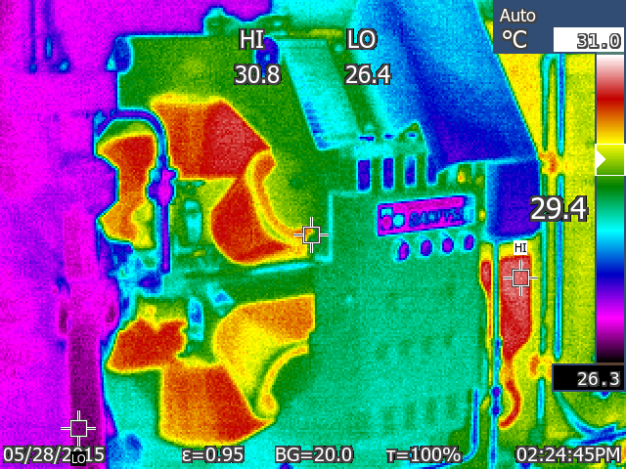
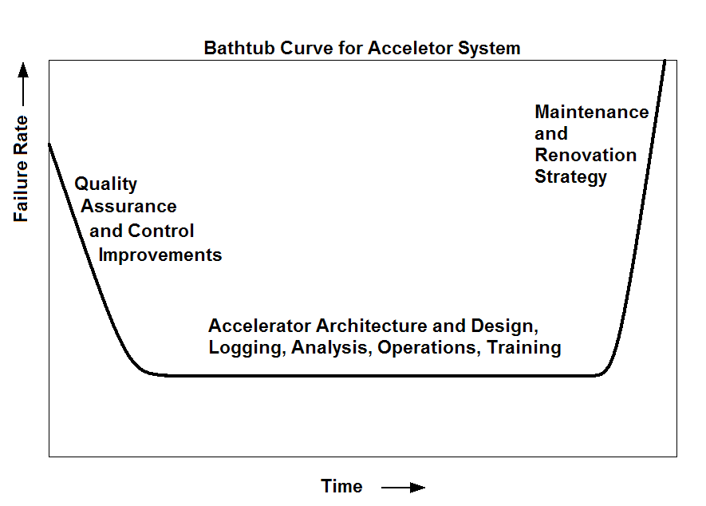
High Availability Operations
Predictive / Preventive Maintenance
The terms Preventive and Predictive maintenance are often interchanged, but drastically different. Knowing the difference can help save you time and money with your maintenance plan.
Predictive Maintenance (PdM) encompasses preventive maintenance, but does it in a way that minimizes costs by performing maintenance only when necessary.
Preventive Maintenance (PM) is the care and servicing of assets to keep equipment and facilities in satisfactory operating condition.

Slide 21
High Availability Operations
Speed Up Repair (Mean Time To Repair)
Transient Recording ➔ fast diagnose
Integration of Operational Data Base and Asset Management
Remote Access to Build-in Diagnostics
Logged Data Analysis Tools
Failure Scenario Data Base
Start-up Check List
…

Slide 22
How to Break Through?
In 10 Points

Slide 23
How to Break Through
The most obvious ones, these are known factors from industry…
1. Make reliable systems to make a reliable machine
Magnets
Powering
Protection
Interlocks
Instrumentation
…
2. Manage the timeline diagnostics + logistics + repair + restart
see A. Apollonio
3. Higher availability = Higher MTBF = Shorter MTTR
break through = look to preventive maintenance
What are the real High Energy Physics factors which we need to look at?

Slide 24
How to Break Through
clearly define the targets that should be optimised
What do you mean by “more reliable”
What figure of merit should change?
And by how much?
Patients treated?
Neutron fluence?
Experiments successful?
Integrated Luminosity?
time colliding physics beams
turnaround between successive physics beams
time to clear faults
physics performance during colliding beams
availability
machine understanding

Slide 25
How to Break Through
clearly define the metrics that are used
Identify the important factors
Everyone should use the same base definitions
They should be centrally managed
  Run Time and
  Scheduled Physics Time
Physics Efficiency:
  time with both beams present and stable beams, versus scheduled physics time
Machine Availability:
  time when machine is ready to accept and accelerate beam, versus run time

Slide 26
How to Break Through
Make analysis part of the core business
Build common working practices
Set a team of people who know the core business to work
Analyse systems before they are built
Analyse behavior during operation
For example, building models

Slide 27
How to Break Through
Make data collection robust
information capture should be easy and rigorous…
tracking and understanding faults must be consistent.
parallel / hidden / dependent faults should be built in…
analysis should be easy… built the correct tools
Simple & easy to use
Accelerator Fault Tracker
Project
Availability Working Group
feedback to correct availability data

Slide 28
How to Break Through
8. A driving force is needed that people can get behind
LHC Machine Protection is a good example – risk analysis forces everyone to look closely.

Slide 29
How to Break Through
9. Use the Data to make data driven improvements
maximise the machine understanding
track and analyse fault information to drive availability optimisation

Slide 30
How to Break Through
10. Aim for efficient operation
Clear line of command in operating and maintaining accelerator
Well defined roles and responsibilities
Distribution of information, operation briefings at shift change
Written, reviewed and approved instructions and procedures
Clearly defined line of command for routine/non-routine
Automation of operating procedures wherever safe and possible
Software Interlock System to prevent operator mistakes
Operator Training and Motivation
On-line Technical and Procedural Information
Ergonomic Operation Software
Functional alarm system (limit false alarms)
Management of access to accelerator controls
Management of access to accelerator equipment

Slide 31
The Real Conclusions…
Physicists
Operators
Breakthrough together
Technical Gurus
Reliability experts
In an existing organisation, the first step is to be able to measure improvements

Slide 32
Thank you!
2012 – Availability Working Group Established

