Slide 1
CSNS Running Management System
Yuliang Zhang
Institute of High Energy Physics
December 11, 2018
APEC 2018 Workshop

Slide 2
Outline
1
Brief introduction of CSNS
2
Accelerator operation requirements overview
3
RMS design and implementation
4
Summary

Slide 3
Brief introduction of CSNS
2000kM
CSNS

Slide 4
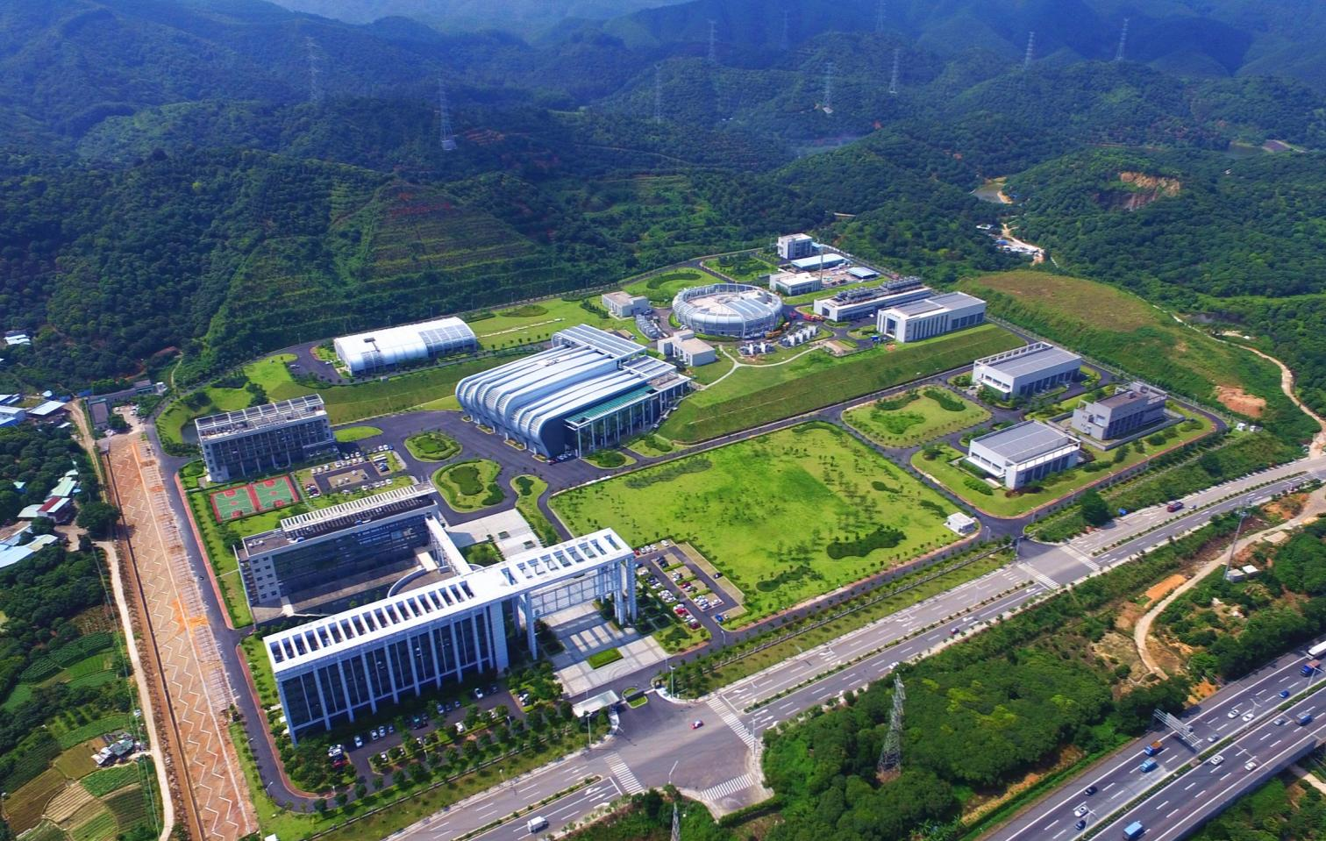
Brief introduction of CSNS
2017.8 CSNS Bird’s Eye View
Dalang, Dongguan, China
LINAC
RCS
Target

Slide 5
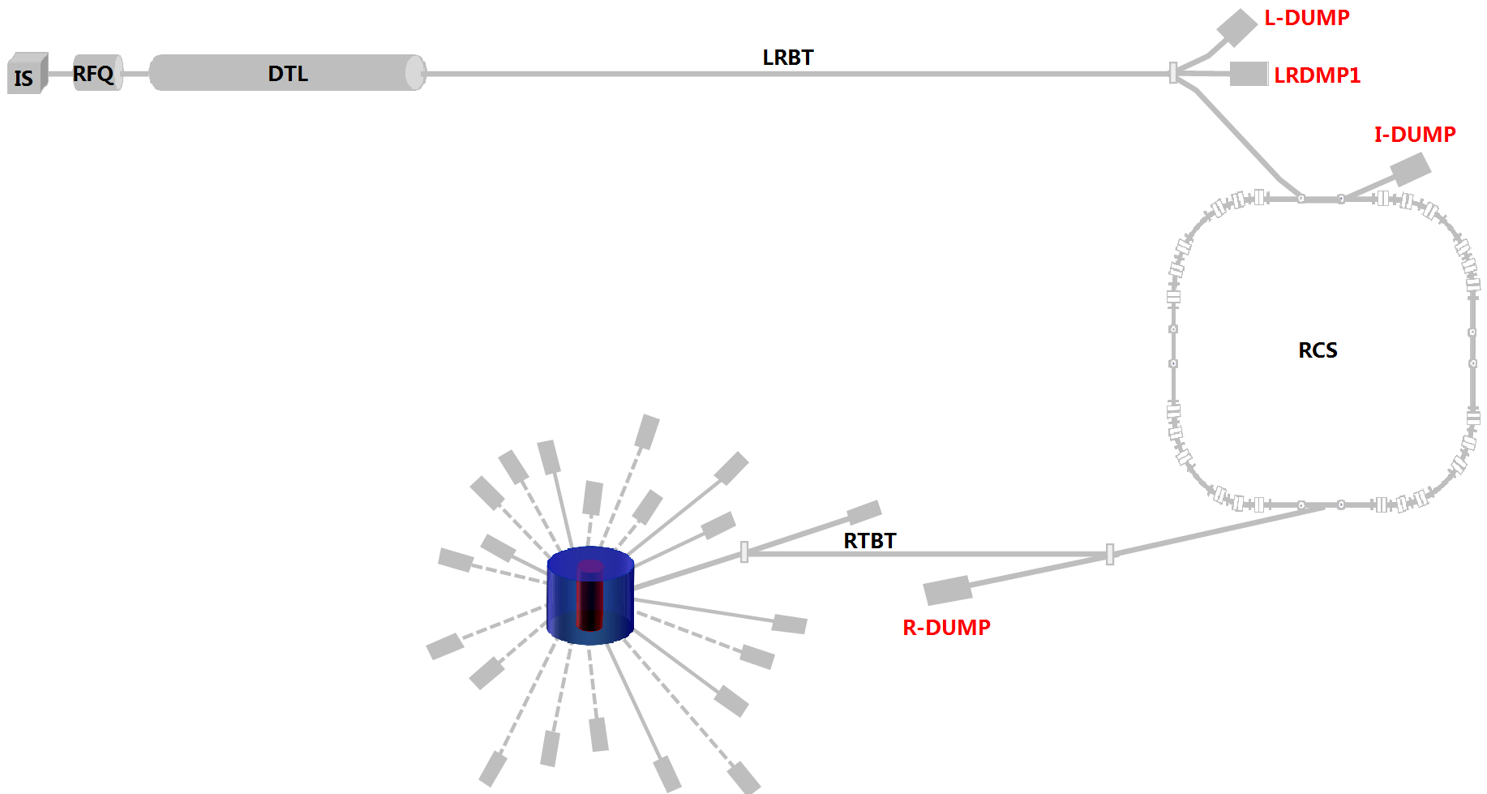
Accelerator operation requirements
Five beam destinations: L-DUMP, LRDMP1, I-DUMP, R-DUMP and Target

Slide 6
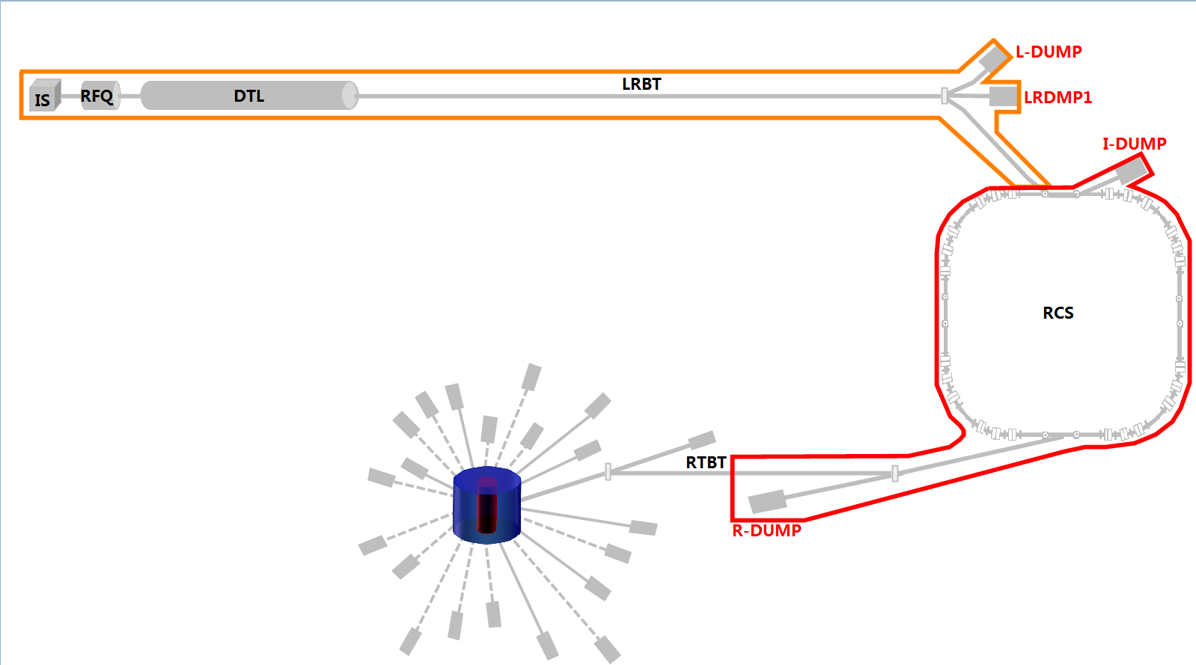
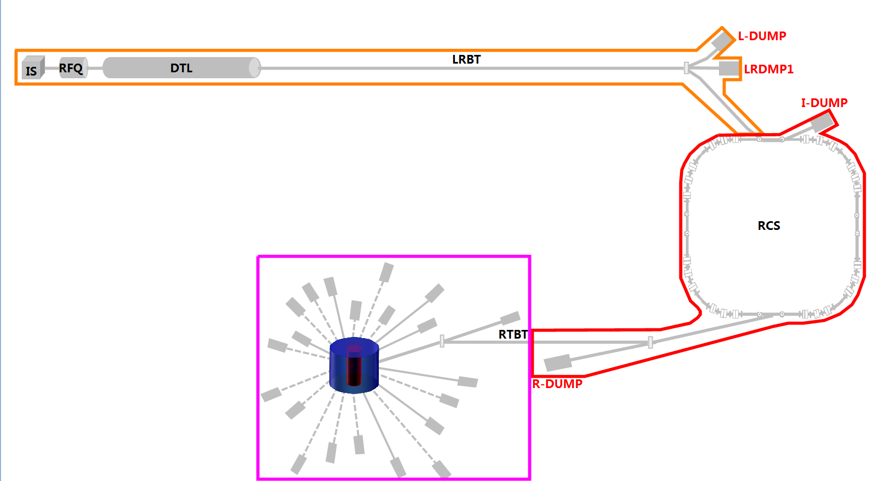
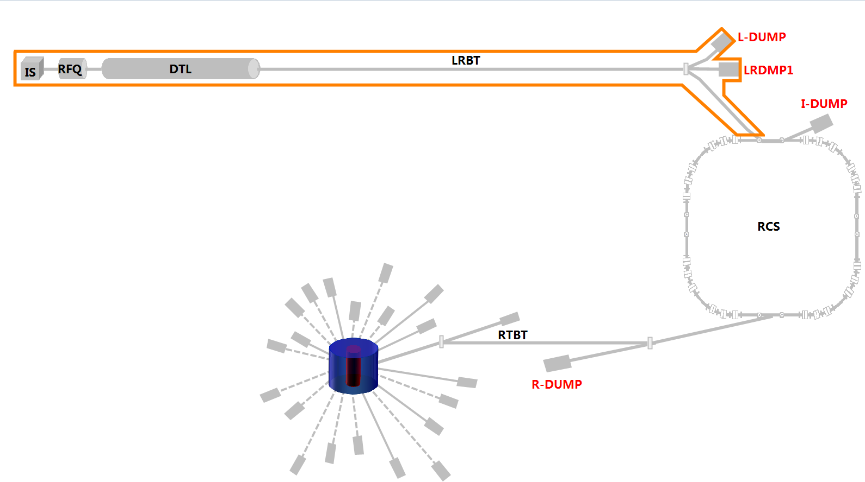
Accelerator operation requirements
Three independent PPS(Personnel Protection System) control areas: LINAC tunnel, RCS tunnel and target and spectrometer areas.
LINAC Control Area
LINAC Control Area
LINAC Control Area
RCS Control Area
RCS Control Area
Target
Control Area

Slide 7
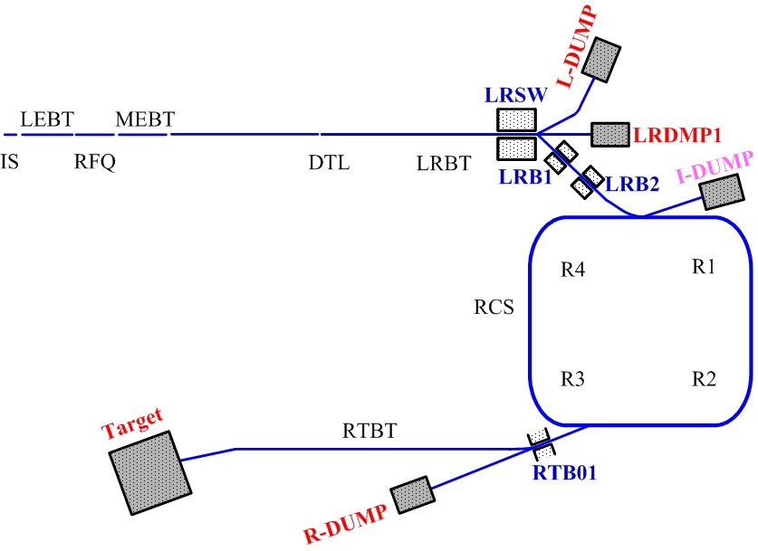
Accelerator operation requirements
MPS defines 10 interlock sub-areas, for each beam destination, the final interlock area is composed of several sub-areas. The status will be ignored for those sub-areas that are not in final interlock area.
1. IS
2 . LINAC
3. L-DUMP
4. LRDMP1
5. LRBT
6. I-DUMP
7. RCS
8. RTBT
9. R-DUMP
10. Target

Slide 8
Accelerator operation requirements
Access to Linac and RCS tunnel should be controlled independently, for example, when Linac is in operation, RCS tunnel can be opened and does not interrupt Linac, vice versa.
When accelerator is in RCS operation mode, beam destinations can be changed among Linac dumps and RCS dumps without powering off high power sources.
To ensure that beam should not be delivered to the unexpected beam destination in any cases.
To ensure that beam power should not exceed the power tolerance of selected beam destination.
To satisfy these requirements mentioned above, the run management system(RMS) was designed and implemented for CSNS.

Slide 9
RMS design and implementation
Run Management System(RMS) coordinates several related systems to guarantee the accelerator running safely and operating conveniently. RMS is the top level of the accelerator control systems.
Beam params control
Timing system
Control Network
Key Switches
cable
RMS
PLC
Touch Panel
Local
Net
cable
cable
IS control
MPS
PPS
PS control

Slide 10
RMS design and implementation
Tasks:
Set up and publish the machine mode and machine state.
Verify that all the relevant equipment is in right operating status for the selected machine mode.
Set up the max beam parameters allowed for the selected machine mode.
Provide an OPI to display the status of the facility.
Status Display
OPI
Beam Params
VME IOC
Software layer
Accelerator Control Network
Key Switch
Cable
PLC System
Touch Panel
Private
Net
Hardware layer
Diagram of the RMS architecture

Slide 11
RMS design and implementation
Machine mode definition:
Machine mode | Max beam power
Ion Source
Linac Dump | P_{L-DUMP} (4kW)
Linac Dump1 | P_{LRDMP1}(200W)
Injection Dump | P_{I-DUMP}(2kW)
Extraction Dump | P_{R-DUMP}(7.5kW)
Target | P_{Target}(100kW)

Slide 12
RMS design and implementation
Machine State definition:
Shutdown: No beam allowed, all tunnels can be entered in, machine mode can be changed.
Ready: No beam allowed, tunnel can not be entered in, locking the initial locked area based on the machine mode key position, and sending initial locked area signal to PPS.
Running: Beam is allowed, tunnel can not be entered in, machine mode can not be changed.
Beamoff: No beam allowed, tunnel can not be entered in, machine mode can be changed.

Slide 13
RMS design and implementation
Initial locked area:
When machine state transiting to Ready state, RMS will lock the position of the machine mode key and PPS uses this signal for determining the accelerator operating area. No matter the key position changed or not, this signal will keep its initial value in Running or Beamoff state. Only when machine state re-transiting to Ready state again, this position signal will be re-locked.
Current interlock area:
This signal represents the actual beam area based on the current position of machine mode key switch position. Current interlock area will be changed in Beamoff state, if the key switch position was changed.
Note: Current interlock area always smaller or equal than initial locked area.

Slide 14
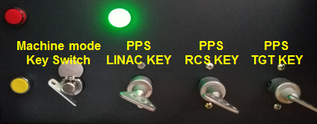
RMS design and implementation
RMS keys:
Machine Mode Key: 8 positions key, used for setting up machine mode.
LINAC Key: Linac tunnel access primary key, if this key is out position, Linac RF power source can not be powered up.
RCS Key: RCS tunnel access primary key, if this key is out position, RCS high power source can not be powered up.
Target Key: Target and instrument area access primary key.
Key position signals are read by PLC system and sent to PPS, MPS through cable. Meanwhile , RMS publishes machine mode in control network by EPICS PV.

Slide 15
RMS design and implementation
Initial Locked Area Combination with Tunnel Access Keys:
Initial Locked Area | Key must in Positon
Linac | Linac key
Linac+RCS | Linac/RCS key
Linac+RCS+Target | Linac/RCS/Target key

Slide 16
Accelerator operation requirements
When an exception occurs, the machine state will automatically back to Shutdown state.
MPS faulty inputs only switching state to Beam off.
Ready
MPS or Beam Off Btn
Run Btn
Beamoff
Running
Exception
Run Btn
Ready Btn
Shutdown Btn
Or Exception
Shutdown Btn
Or Exception
Shutdown
Accelerator state transition diagram

Slide 17
RMS design and implementation
Exceptions including:
Current interlock area exceeds the initial locked area(only check in Running state).
PPS within initial locked area sending faulty signal to RMS.
MPS itself is in abnormal status.
Any of tunnel access key for entering into the initial locked area is out position.
Changing machine mode when machine state is Ready or Running.
Machine mode key switch in position 0 or position 7.

Slide 18
RMS design and implementation
RMS Touch panel:
Used for setting up machine state, touch panel communicates with RMS PLC system by direct network cable.
RMS PLC distributes machine state to PPS/MPS through cable and publishes machine mode within control network by EPICS PV.
RMS touch panel

Slide 19
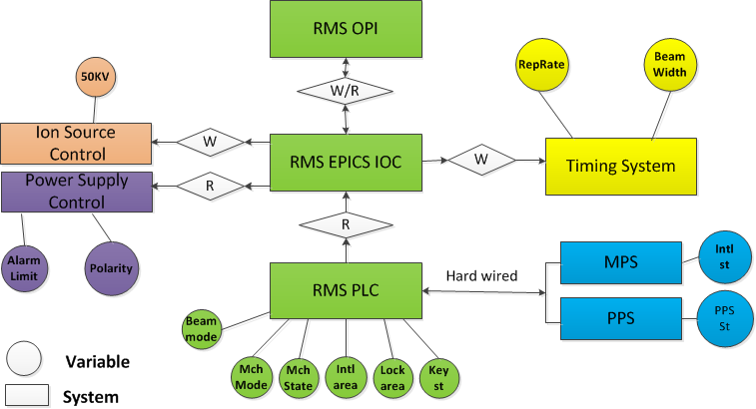
RMS design and implementation
Communication among all related systems:

Slide 20
RMS design and implementation
How to switch machine modes:
Switching machine mode must be done in Shutdown or Beamoff machine state.
If the related MPS interlock area with the to be selected machine mode does not exceedthe initial locked area, machine mode can be changed in Beamoff state.
If the initial locked area need to be enlarged, machine mode must be changed in Shutdown state.

Slide 21
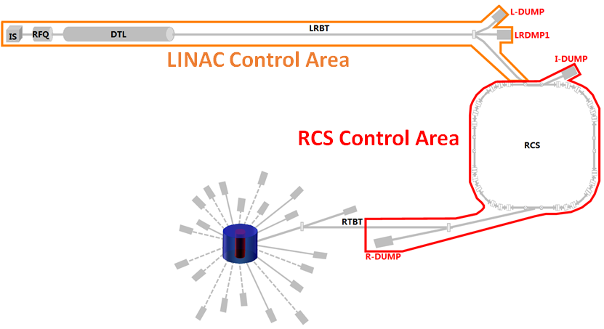
RMS design and implementation
PPS control area does not need to change:
Initial locked area(PPS control) area is Linac+RCS.
MPS interlock area
Beamoff
Beamoff
R-DUMP mode
L-DMP1 mode
R-DUMP mode

Slide 22
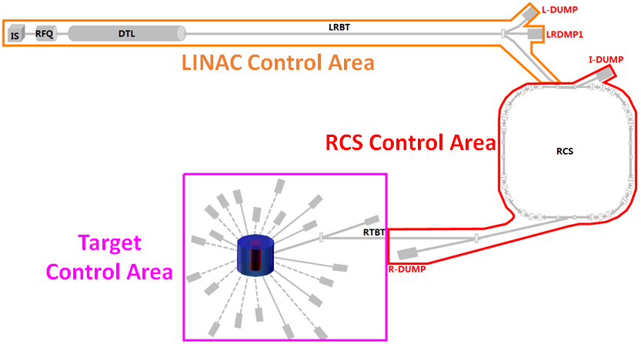
RMS design and implementation
PPS control area needs to be enlarged:
Initial locked area(PPS control area) is Linac+RCS.
The next mode will be entered is target mode.
Needs to change machine state to Shutdown and re-locks the PPS control area to Linac+RCS+Target.
Shutdown

Slide 23
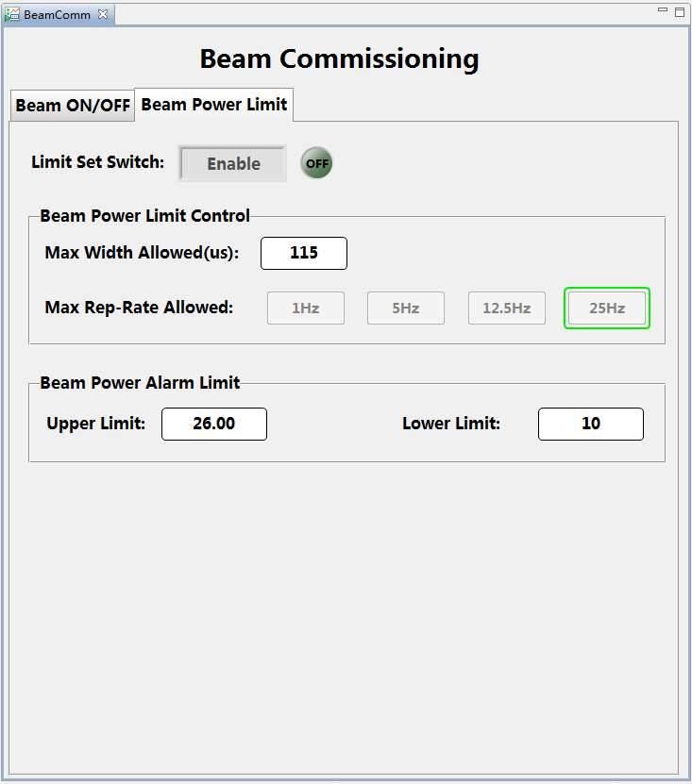
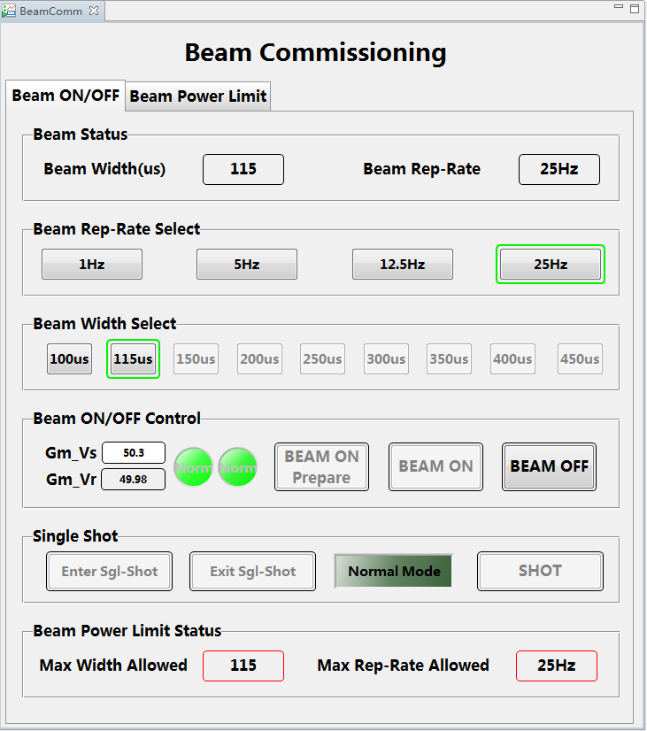
RMS design and implementation
Beam parameter setting OPI:

Slide 24
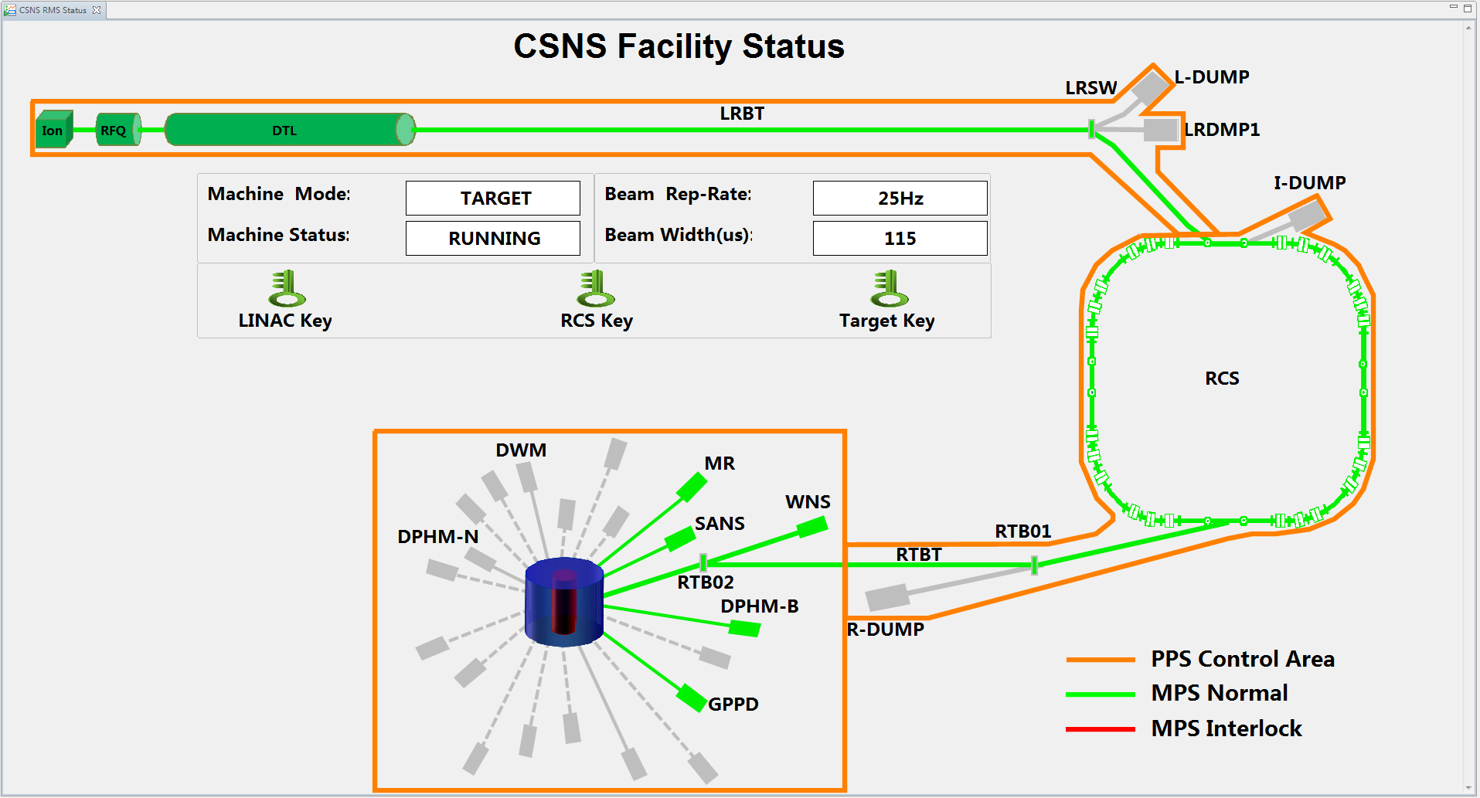
RMS design and implementation
RMS status display OPI(Running state):

Slide 25
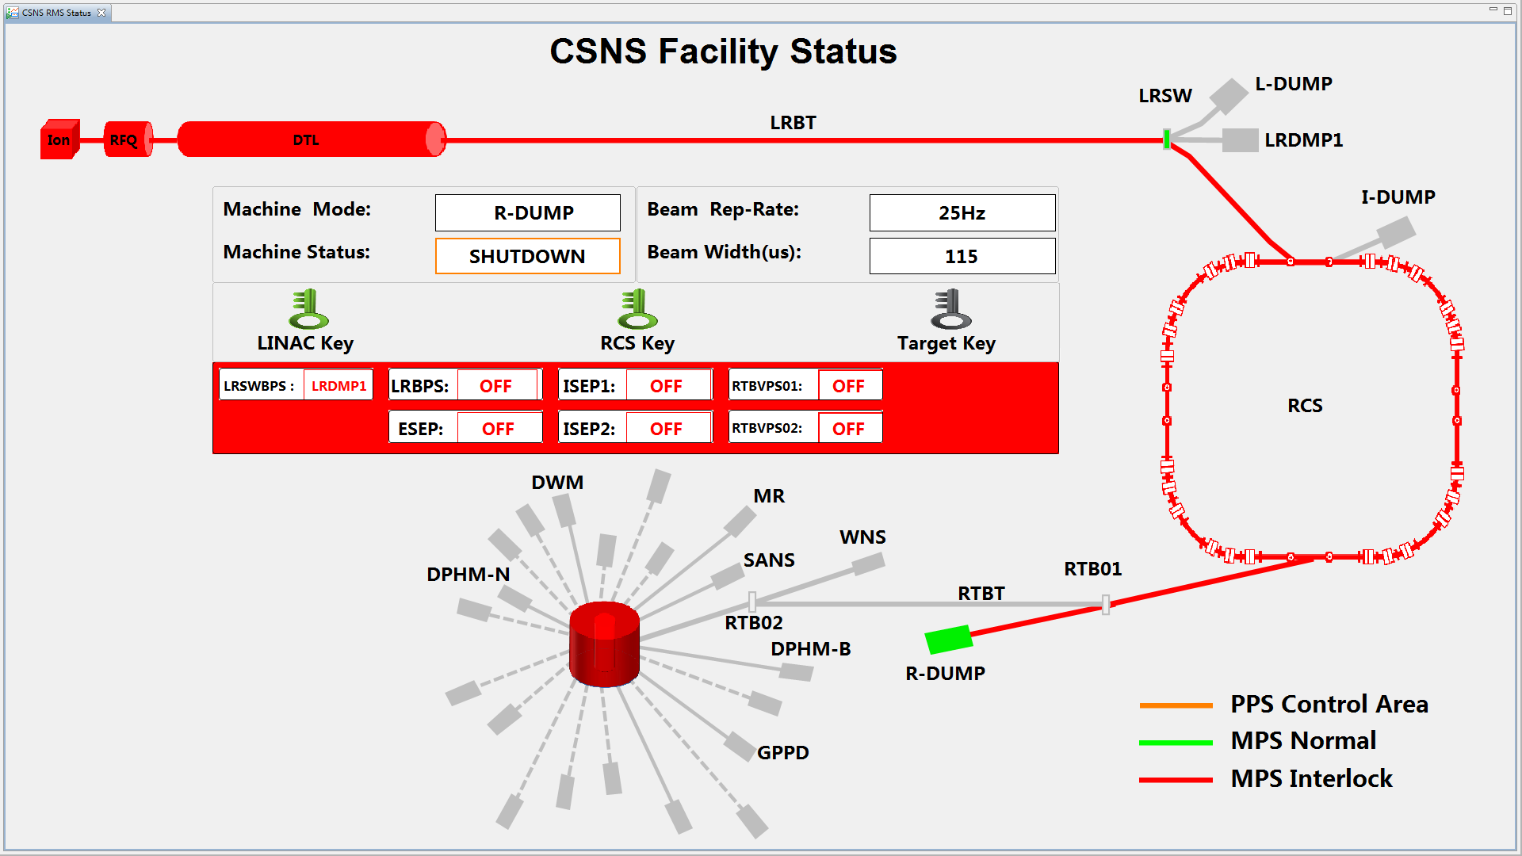
RMS design and implementation
RMS status display OPI(Shutdown):

Slide 26
RMS design and implementation
Relations among protection systems
PPS
Fault
Fault
Interlock
Interlock
MPS Main A
RMS
MPS Main B
Beam Off
/RST
Beam Off
/RST
RST
Interlock
Interlock
FPS
IS Timing
Stop Beam
RFQ LLRF
IS Control
Stop Beam

Slide 27
Summary
The run management system has designed and implemented for CSNS to help the facility operate safely and conveniently.
Strict and comprehensive joint test for RMS with PPS, MPS, FPS and other related systems have been done before RMS put into use, which ensures that the all the protection system of CSNS is reliable and stable.
Regular test program for RMS after every machine shutdown has been build, and automatic test program is under design to decrease the test time consumption.

Slide 28
Thanks for your attention!

