Slide 1
HEBT Magnets Batch2&3 Magnetic Measurements
07.11.2018
C. Mühle

Slide 2
Magnetic measurements at GSI
First results of magnetic measurement at GSI
1st pair of S100 steerers delivered in August 2018
Hall probe mapping done
Complete set-up with girder
Complete set-up with girder but ordinary steel bushes/screws between magnet and holders replaced by SS ones (S100v)
Magnet w/o girder as at BINP (S100h)
1st quadrupole 2 delivered November 5th 2018
Planned
Mapping with gradient hall probe
Rotating coil measurement
Axis measurements with alignment cylinder (hall probe)

Slide 3
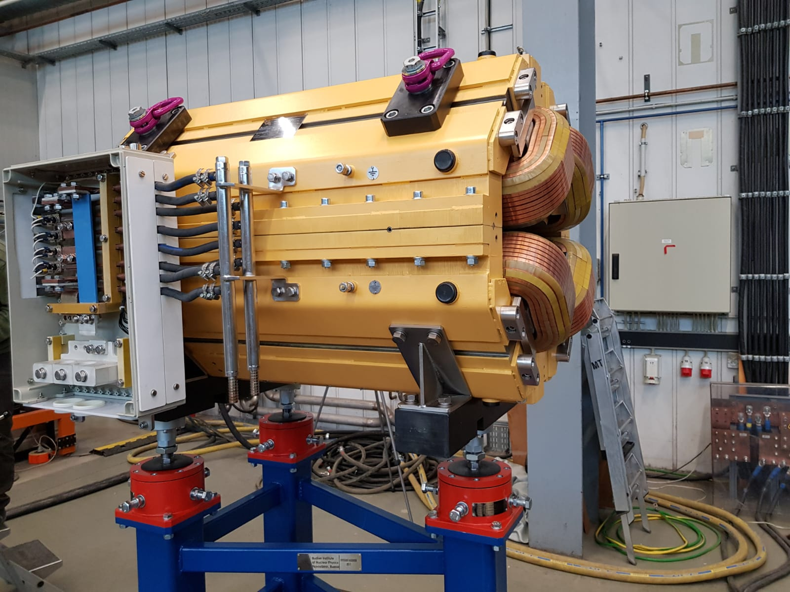
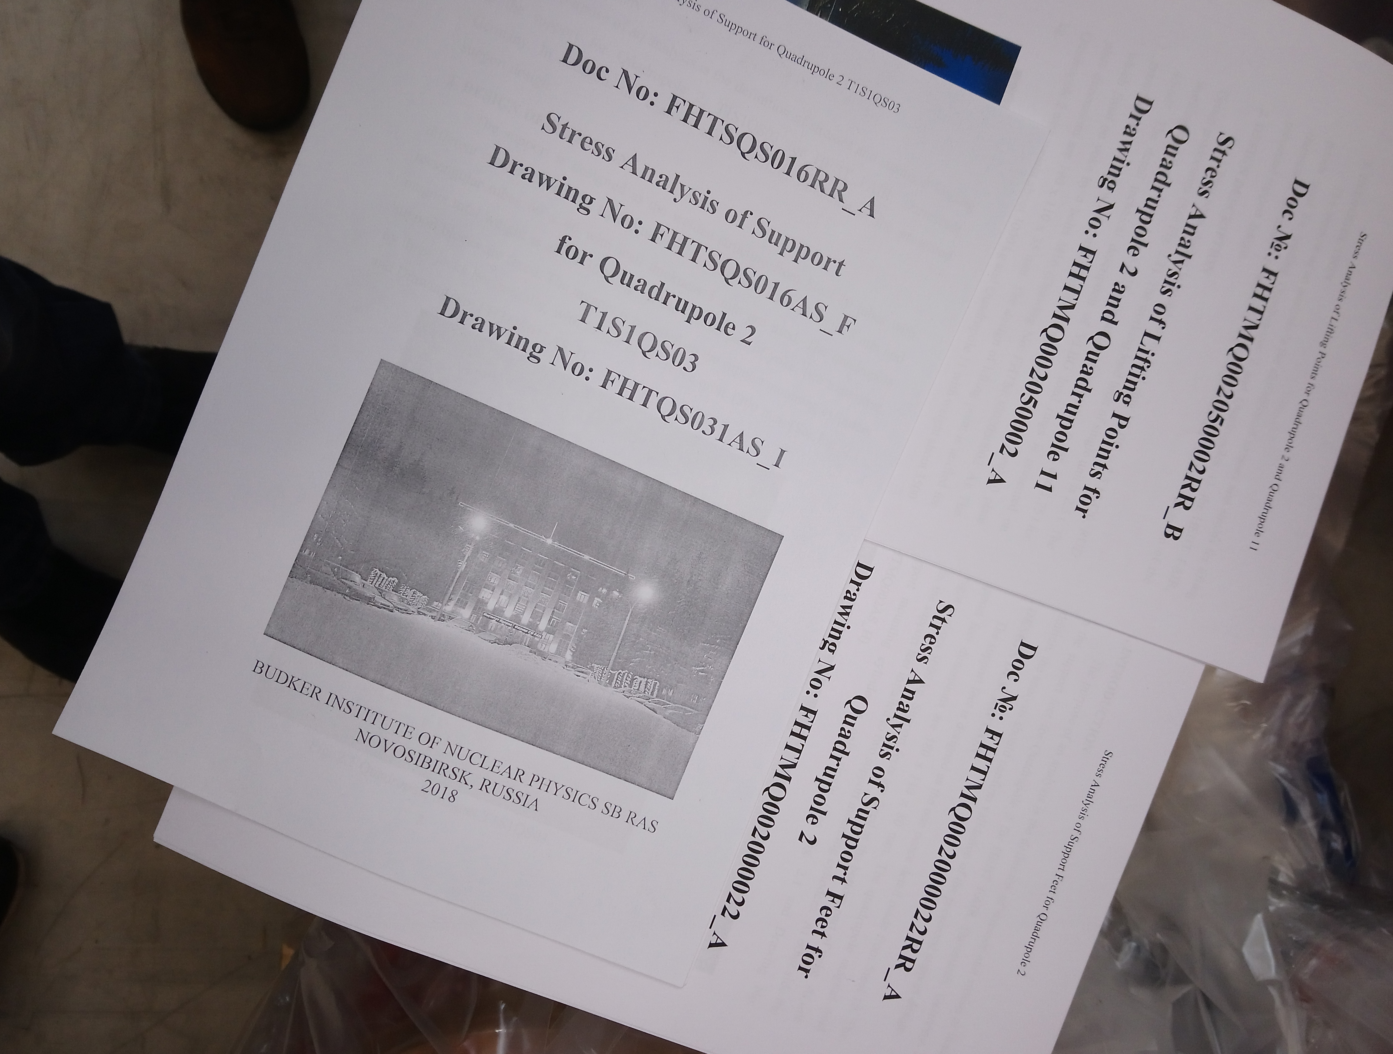
Prototype quadrupole 2
Delivered on November 5th 2018
No damages
Documentation not complete yet

Slide 4
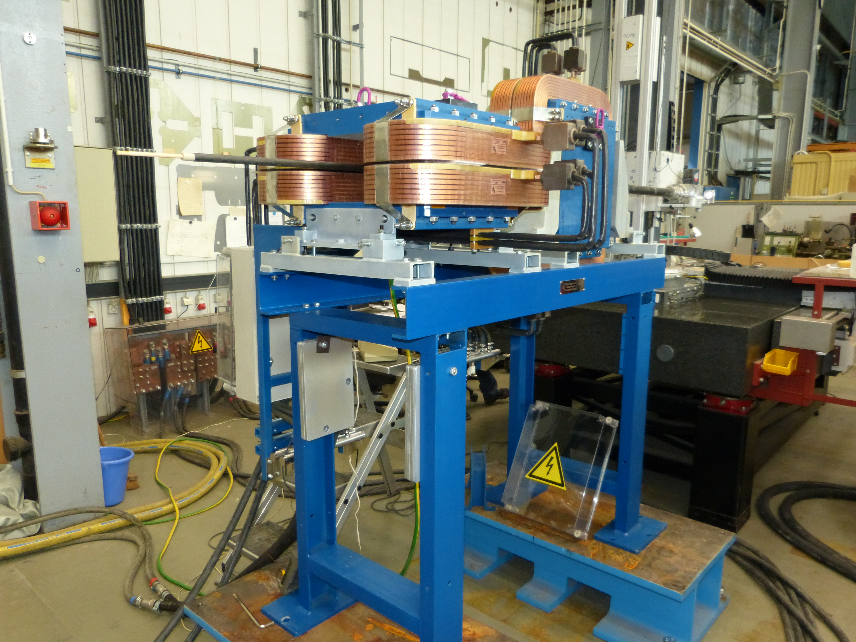
S100 steerer pair on girder

Slide 5
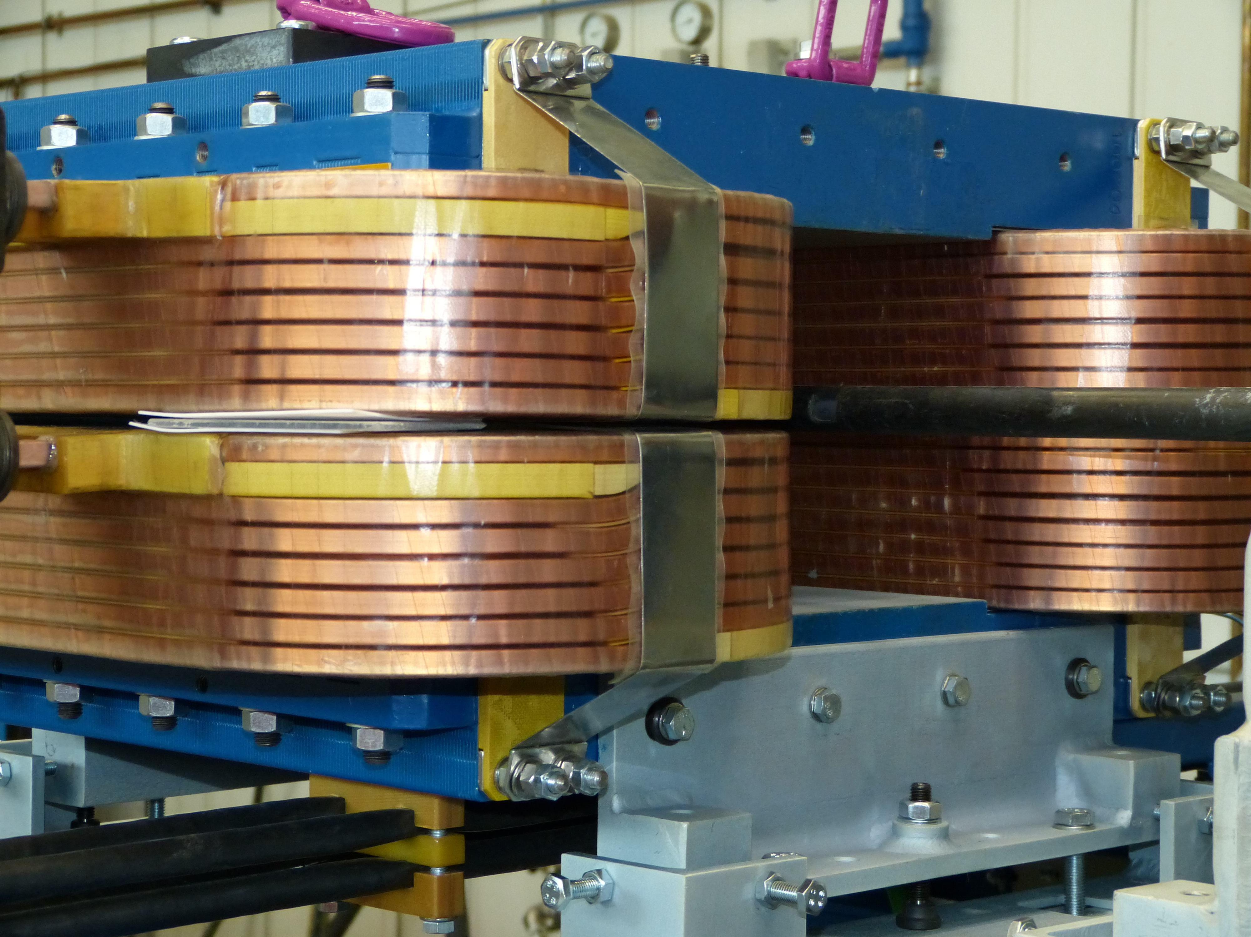
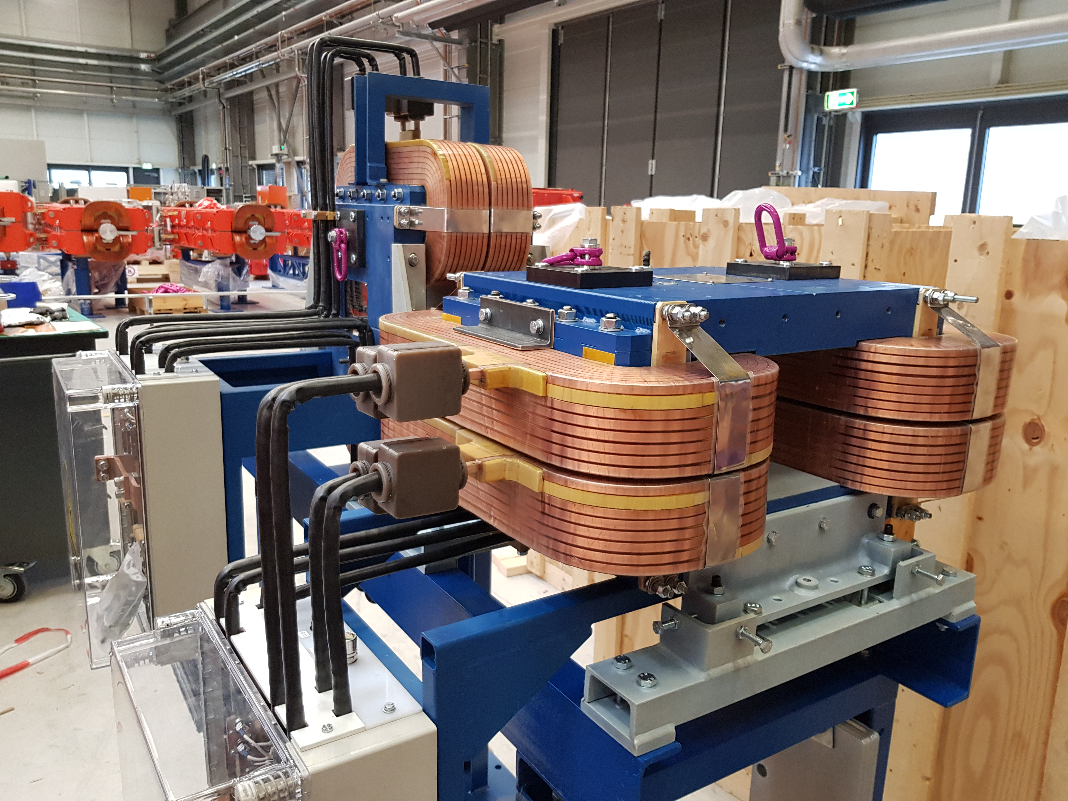
S100 steerer coil movement
Video
Temporary repair
Improved design (still ~0.5mm movement

Slide 6
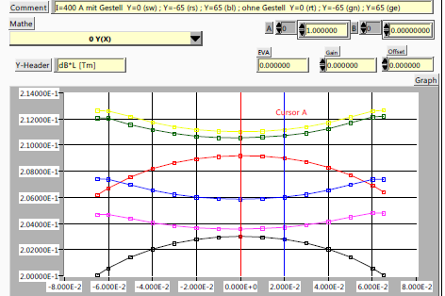
Comparison with and w/o girder 1
∫Bdl=f(x)
I=400A
With girder: black-y=0, pink-y=-65mm, blue-y=65mm
W/o girder: red-y=0, green-y=-65mm, yellow-y=65mm

Slide 7
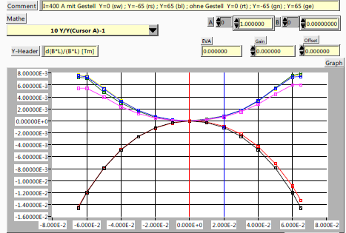
Comparison with and w/o girder 2
∫Bdl/∫Bdl(x=0)=f(x)
Not x=0, y=0.
I=400A
With girder: black-y=0, pink-y=-65mm, blue-y=65mm
W/o girder: red-y=0, green-y=-65mm, yellow-y=65mm

Slide 8
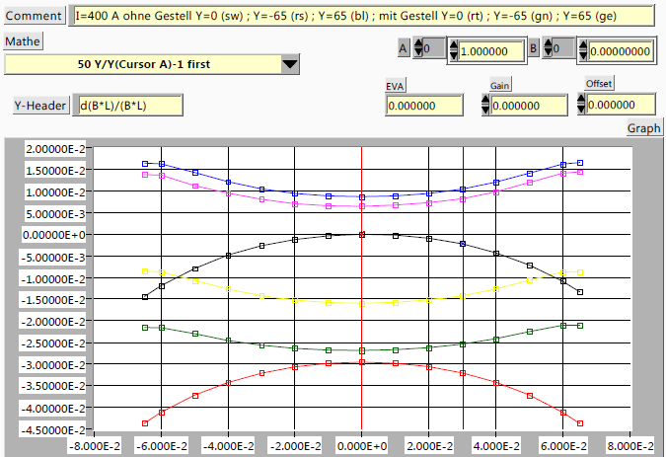
Comparison with and w/o girder 3
∫Bdl/∫Bdl(x=0)=f(x)
I=400A
W/o girder: black-y=0, pink-y=-65mm, blue-y=65mm
With girder: red-y=0, green-y=-65mm, yellow-y=65mm

Slide 9
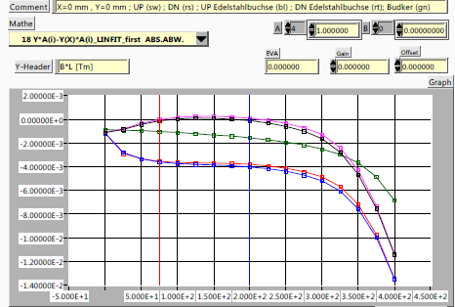
Comparison bushes/screws ordinary steel/stainless steel 1
∫Bdl=f(I)
x=0 y=0
Linear fit (black curve)
subtracted
GSI: Ordinary steel: black-up, pink-down
Stainless steel: blue-up, red-down
BINP: Ordinary steel: green

Slide 10
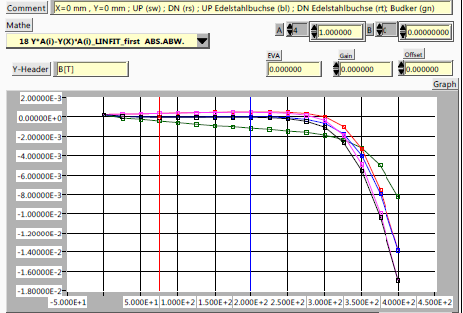
Comparison bushes/screws ordinary steel/stainless steel 2
B=f(I)
x=0 y=0
Linear fit (black curve)
subtracted
GSI: Ordinary steel: black-up, pink-down
Stainless steel: blue-up, red-down
BINP: Ordinary steel: green

Slide 11
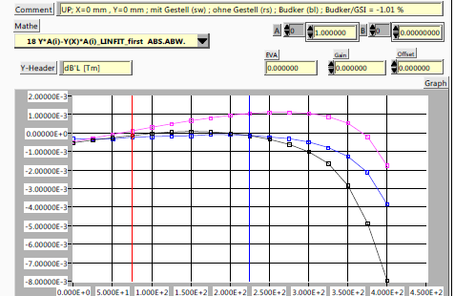
Comparison BINP/GSI 1
∫Bdl=f(I)
x=0 y=0
Linear fit (black curve)
subtracted
Gain between BINP and
GSI ~1.01%
BINP: blue-w/o girder
GSI: black–with girder , pink-w/o girder

Slide 12
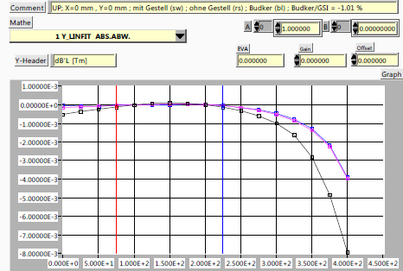
Comparison BINP/GSI 2
∫Bdl=f(I)
x=0, y=0
Linear fit (individual)
subtracted
Gain between BINP and
GSI subtracted
BINP: blue-w/o girder
GSI: black–with girder , pink-w/o girder

Slide 13
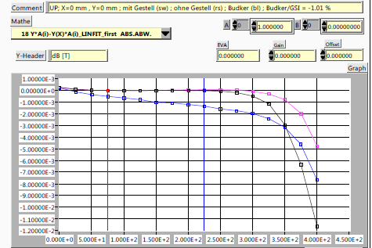
Comparison BINP/GSI 3
B(in center)=f(I)
x=0, y=0
Linear fit (black curve)
subtracted
Gain between BINP and
GSI ~1.01%
BINP: blue-w/o girder
GSI: black–with girder , pink-w/o girder

Slide 14
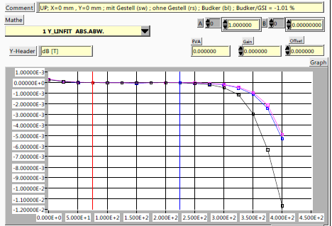
Comparison BINP/GSI 4
B(in center)=f(I)
x=0, y=0
Linear fit (individual)
subtracted
Gain between BINP and
GSI subtracted
BINP: blue-w/o girder
GSI: black–with girder , pink-w/o girder

Slide 15
Conclusions
Visual check during powering up and under power -> Will be part of FAT for prototypes in future
Magnetic measurement in completely assembled position mandatory
Improved coil fixation for S100
Improvements for girder of S100
Absolute magnetic field values to be checked

