Slide 1
GSI, December 7th, 2009
Status of the Pattern Recognition with
the STT system alone.
Gianluigi Boca

Slide 2
Parametrization of the Helix trajectory
x – x₀ = Rcos(Kz + ϕ₀)
y – y₀ = Rsin(Kz + ϕ₀)
Y
ϕ = Kz + ϕ₀
P(x ,y, z)
5 parameters :
R
x₀ ≡ abscissa of center of
cylinder
(x₀ ,y₀)
ϕ
y₀ ≡ ordinate of center of
cylinder
ϕ₀ ≡ azimuthal angle at z = 0
R ≡ radius of cylinder
Z
K ≡ rate of increase of ϕ
X

Slide 3
A 10 track event, in the XY projection , for the most difficult case,
with P = 0.3 GeV/c (P┴ < 0.3 GeV/c)
Y
green lines = MC
truth, notice that they
don’t go through the
hits exactly
X

Slide 4
ϕ
The ϕ z projection
2π
Y
cut here
P(x ,y, z)
ϕ = Kz + ϕ₀
R
(x₀ ,y₀)
ϕ
z
Z
X
Helix trajectory is a straight line
4
ϕ
4
MC true helix trajectory
skewed straw
intersections
z

Slide 5
Status at the Jülich meeting

Slide 6
Summary table of Track Finder performance in terms of CPU time
CPU used : AMD Athlon 65 bits, 3000+, 2GHz clock
Total P (Gev/c) | # generated tracks | Cputime/track (sec)
0.3 | 1 | 0.1
0.3 | 6 | 0.17
0.3 | 10 | 0.21
5.0 | 1 | 0.08
5.0 | 6 | 0.26
5.0 | 10 | 0.3
10.0 | 1 | 0.08
10.0 | 6 | 0.27
10.0 | 10 | 0.4

Slide 7
Summary table of Track Finder performance in terms of hits and tracks
Total P GeV/c | Generated tracks per event | Total # reaso-nable tracks gene-rated | % of recon-struct-ed tracks | Ghost tracks found (%) | Total genera-ted hits paral-lel straws | % of found hits paral-lel straws | Wrong paral-lel hits associ-ated (%) | Total genera-ted hits in skew straws | % of found hits in skew straws | Wrong skew hits associ-ated (%)
0.3 | 1 | 19 | 100 | 0 | 328 | 100 | 0.3 | 170 | 100 | 0
0.3 | 6 | 114 | 100 | 0 | 1910 | 98 | 8 | 1198 | 95 | 11.7
0.3 | 10 | 189 | 100 | 0 | 3205 | 96 | 14 | 2353 | 95 | 19.8
5.0 | 1 | 18 | 100 | 0 | 292 | 98.6 | 0 | 151 | 100 | 0
5.0 | 6 | 76 | 100 | 2.6 | 1244 | 98 | 9.8 | 816 | 98 | 40.6
5.0 | 10 | 142 | 100 | 2.8 | 2299 | 95 | 13 | 1503 | 99 | 37.9
10.0 | 1 | 19 | 100 | 0 | 318 | 98 | 0 | 149 | 100 | 3
10.0 | 6 | 87 | 100 | 5.7 | 1433 | 98.8 | 9.8 | 774 | 98.7 | 17
10.0 | 10 | 125 | 100 | 5.6 | 2031 | 93.7 | 12 | 1273 | 98 | 47
problem with spurious hits from skew straws

Slide 8
Progress since the Jülich meeting

Slide 9
1) Integration of the MILP minimizing program (GNU C library
GLPK ) in the Pandaroot framework.
In order to speed up the fitting procedure, I use the GNU C library
GLPK which was a stand alone pakage.
I modified some of the functions of the library so that the GLPK
minimizer can be called directly from the Pandaroot code.
That took a little longer than I hoped but now the GLPK library is an
external package of Pandaroot (thanks to Mohammed for putting it
in the svn and modify the makefiles necessary to compile the library).
So now everybody who needs to have a very fast minimizer for linear
problems and/or use integer variables together with continuous variables
can use GLPK in the Pandaroot code (talk to me for howto’s).

Slide 10
The typical case of usage is when one has a fit linear in the parameters
and is not interested in the final error matrix of the fitted parameters.
Then instead of the χ² one can minimize the sum of the absolute
values, here are 2 examples.
Straight line fit ( α , β are the parameters)
Σ_{i} | y_{i} – α x_{i} − β | / σ_{i}
Fit of a circle ( α , β , γ , are the parameters)
Σ_{i} | y_{i}² – x_{i}² – α x_{i} − β y_{i} – γ | / σ_{i}

Slide 11
2) Attacking the skew straws spurious problem

Slide 12
2) Attacking the skew straws spurious problem
Total P GeV/c | Generated tracks per event | Total # reaso-nable tracks gene-rated | % of recon-struct-ed tracks | Ghost tracks found (%) | Total genera-ted hits paral-lel straws | % of found hits paral-lel straws | Wrong paral-lel hits associ-ated (%) | Total genera-ted hits in skew straws | % of found hits in skew straws | Wrong skew hits associ-ated (%)
0.3 | 1 | 19 | 100 | 0 | 328 | 100 | 0.3 | 170 | 100 | 0
0.3 | 6 | 114 | 100 | 0 | 1910 | 98 | 8 | 1198 | 95 | 11.7
0.3 | 10 | 189 | 100 | 0 | 3205 | 96 | 14 | 2353 | 95 | 19.8
5.0 | 1 | 18 | 100 | 0 | 292 | 98.6 | 0 | 151 | 100 | 0
5.0 | 6 | 76 | 100 | 2.6 | 1244 | 98 | 9.8 | 816 | 98 | 40.6
5.0 | 10 | 142 | 100 | 2.8 | 2299 | 95 | 13 | 1503 | 99 | 37.9
10.0 | 1 | 19 | 100 | 0 | 318 | 98 | 0 | 149 | 100 | 3
10.0 | 6 | 87 | 100 | 5.7 | 1433 | 98.8 | 9.8 | 774 | 98.7 | 17
10.0 | 10 | 125 | 100 | 5.6 | 2031 | 93.7 | 12 | 1273 | 98 | 47

Slide 13
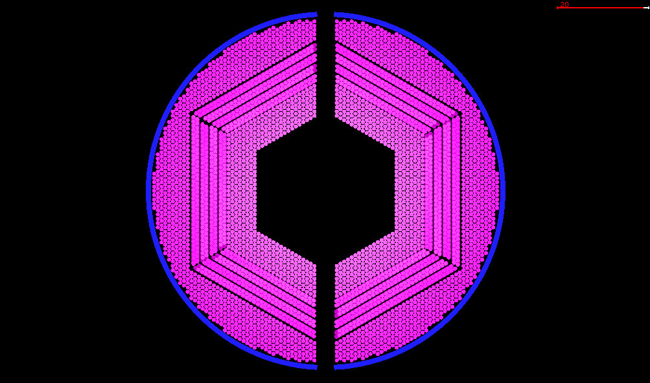
2) Attacking the skew straws spurious problem
Parallel straws layers
Skew straws layers
this is the track the fit
is working on
this track produces hits
in the skew straw layers
that are spurious for the
track the fit is working on

Slide 14
2) Attacking the skew straws spurious problem
Typical problematic case
ϕ
pattern recognition
found track
spurious hits that
confuse the fast fit
present in the pattern
recognition algorithm
MC truth track
z

Slide 15
2) Attacking the skew straws spurious problem
I am trying to use a Kalman fit to all hits ( parallel and skew ) in order
to obtain better Helix parameters and be able to exclude the spurious.
Unfortunately presently the Kalman in Genfit doesn’t have the
capability of excluding the hits that have a very bad χ² contribution.
Still working on this problem.

