Slide 1
Distribution of MC Information
| Tobias Stockmanns

Slide 2
Created Objects - MVD

Slide 3
Important Informations

Slide 4
Link Diagramm

Slide 5
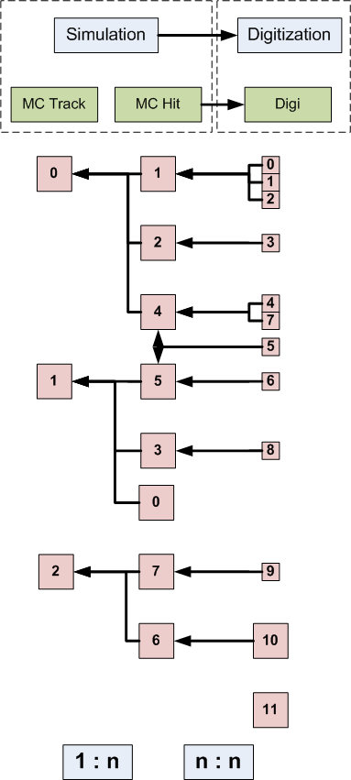
Link Diagramm

Slide 6
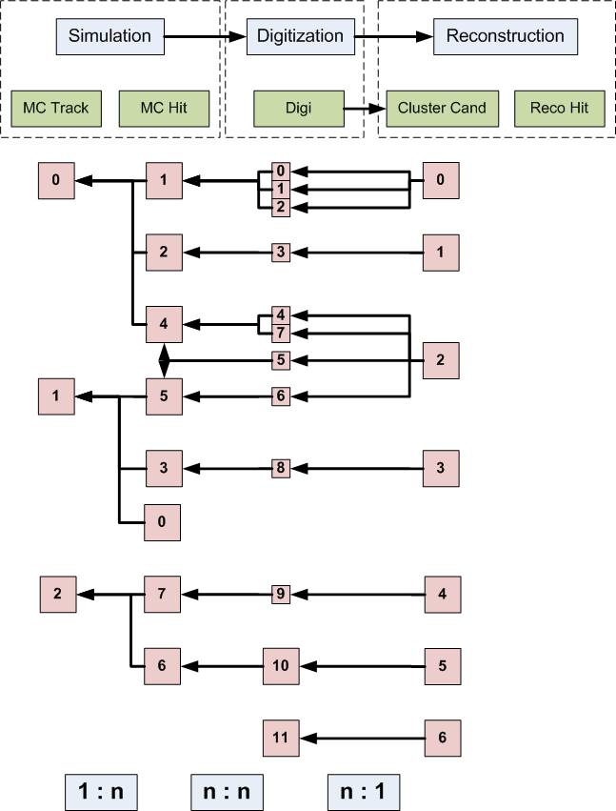
Link Diagramm

Slide 7
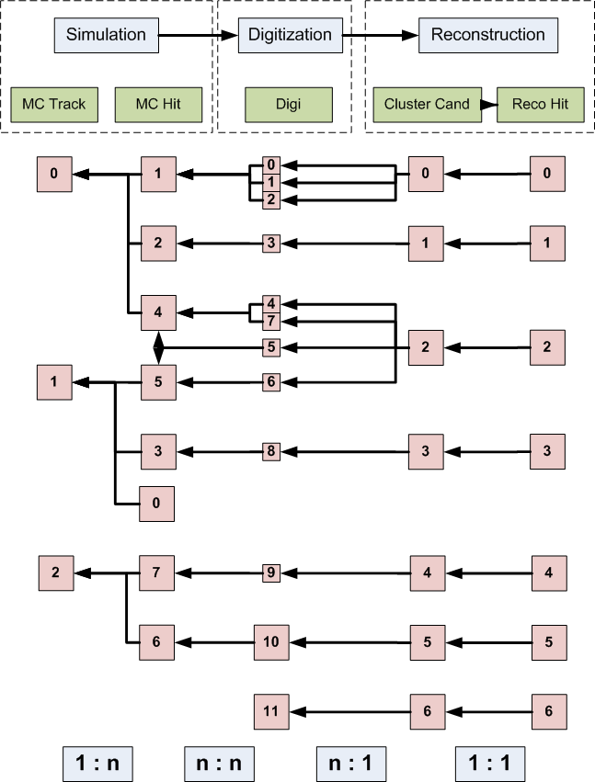
Link Diagramm

Slide 8
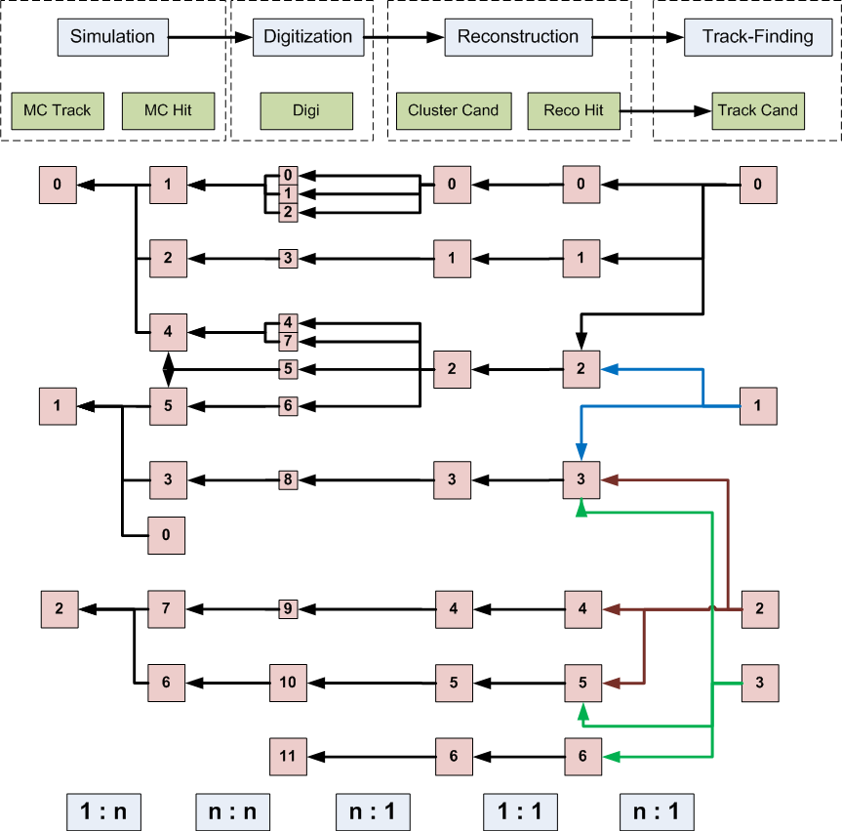
Link Diagramm

Slide 9
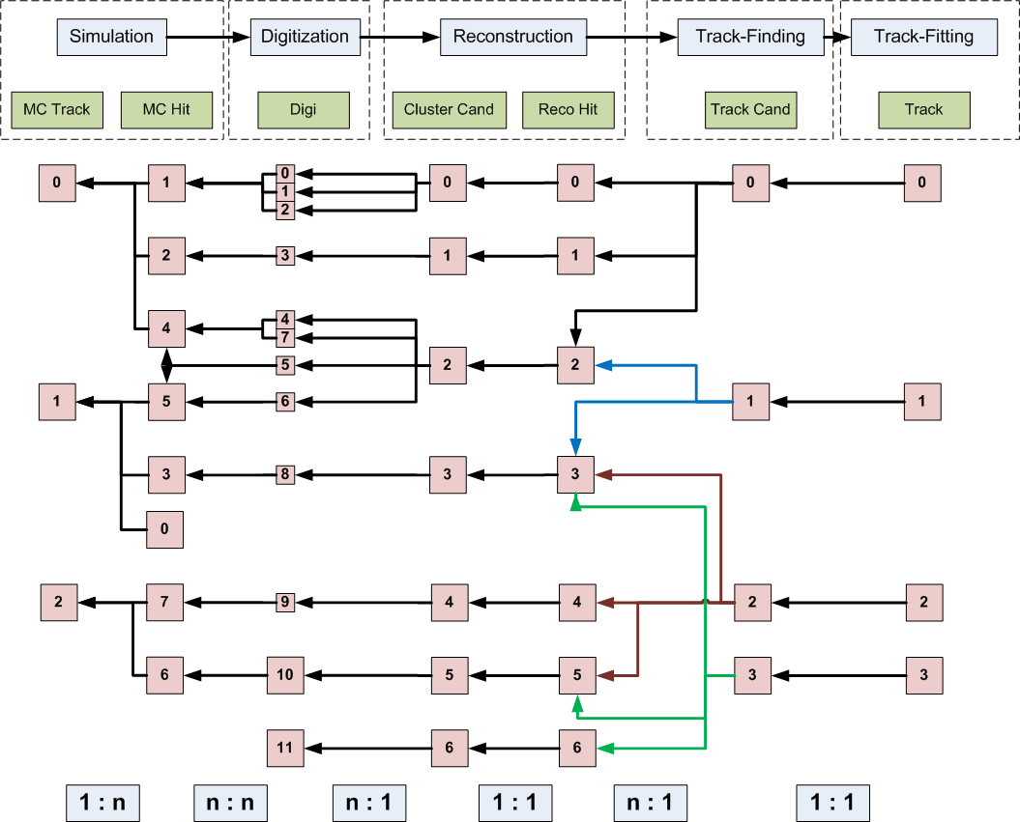
Link Diagramm

Slide 10
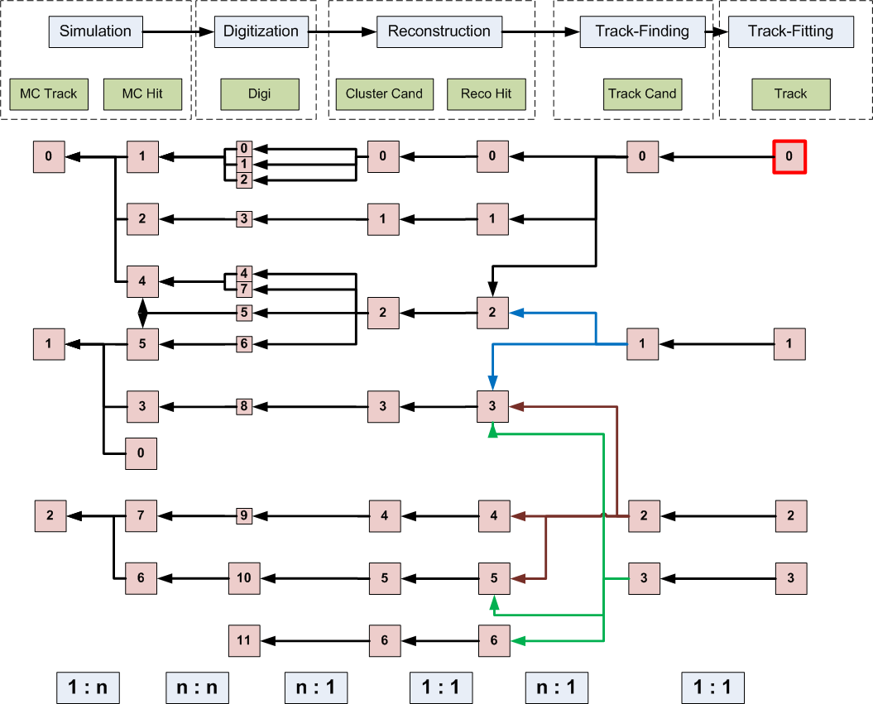
Track match for Track 0

Slide 11
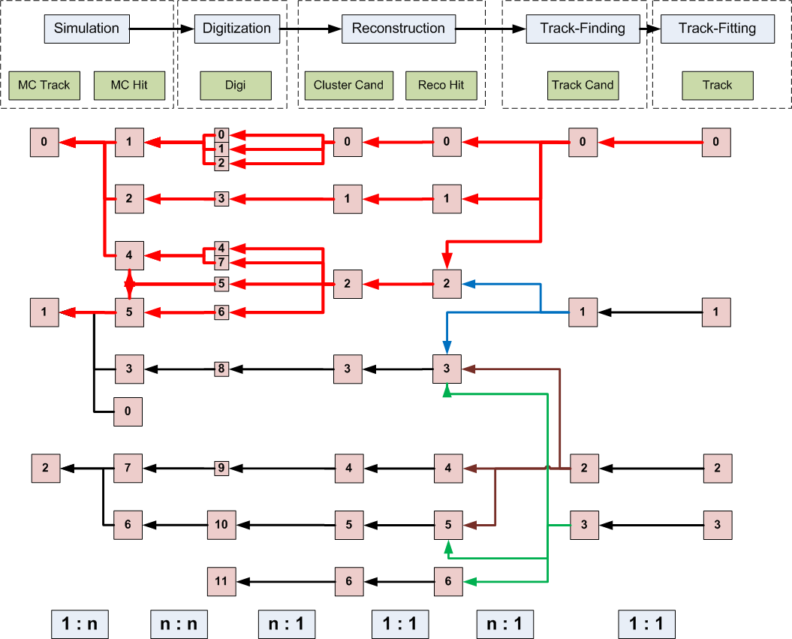
Track match for Track 0
7 ways to go to MC Track 0
2 ways to go to MC Track 1

Slide 12
Track match for Track 0
7 ways to go to MC Track 0
2 ways to go to MC Track 1
Better:
Information of matching hits:
MC Track 0 3 MC Hits
MC Track 1
1 MC Hit

Slide 13
How to translate this diagramm into C++
Each stage in the simulation process of each subdetector gets a unique ID ➔ extension of PndDetectorType
For each unique ID exists a list of data structures (vector<vector<Link> >)
Each data structure is a list of pairs consisting of a unique ID of the previous simulation stage and the „hitID“ within the previous list (→ see example)
A crawler runs through these lists and extracts the valid information:
which MC Track belongs to a PndTrack
which MC Hits are in a PndTrackCandidate
…

Slide 14
Basic concept
class PndMCStage
{
private :
PndDetectorType fStageId;
string fBranchName;
string fFileName;
vector<vector<pair<PndDetectorType, Int_t> > > fStage;
}
Parameter database to keep track of simulation steps?
class PndMCMatch
{
private :
map<PndDetectorType, PndMCStage> fMCInfo
}

Slide 15
Real Life Example
MC Info
Digitization
Clustering
Point Reco
1: --MCTrack:
5: --MVDStripDigis:
0: (4/3)
1: (4/3)
2: (4/6)
3: (4/6)
4: (4/6)
5: (4/7)
6: (4/7)
7: (4/7)
8: --MVDStripClusterCand:
0: (5/0)
1: (5/1)
2: (5/3) (5/2)
3: (5/4)
4: (5/6) (5/5)
5: (5/7)
9: --MVDHitsStrip:
0: (8/0)
1: (8/2)
2: (8/4)
4: --MVDPoint:
0: (1/1)
1: (1/1)
2: (1/1)
3: (1/1)
4: (1/0)
5: (1/0)
6: (1/0)
7: (1/0)
10: --MVDHitsPixel:
0: (7/0)
1: (7/1)
2: (7/2)
3: (7/3)
4: (7/4)
7: --MVDClusterCand:
0: (6/0) (6/1)
1: (6/2) (6/3)
2: (6/4) (6/5)
3: (6/6) (6/7) (6/8)
4: (6/9) (6/10)
6: --MVDPixelDigis:
0: (4/0)
1: (4/0)
2: (4/1)
3: (4/1)
4: (4/2)
5: (4/2)
6: (4/4)
7: (4/4)
8: (4/4)
9: (4/5)
10: (4/5)
Track Finder
18: --MVDRiemannTrackCand:
0: (0/0) (10/3) (10/4) (9/1) (9/2)
1: (0/0) (10/0) (10/1) (10/2) (9/0)
How good is the Track-Finder?
MC Link from: 18 to 1:
(1/0)
(1/1)

Slide 16
Data link
Abstract base class: PndLinkedData
Two derived classes:
PndSinleLinkedData for 1:1 relations
PndMultiLinkedData for 1:n relations
Set and Get methods identical for both classes, only the storage element is different to save some space on disk.
All data classes have to inherit from one of the two ...LinkedData classes.

Slide 17
Further Steps
Proof of principle done
Extend model to be more abstract → same code for all subdetectors:
Implement PndLinkedData class and inherit all data classes from PndLinkedData
Rewrite code to read in PndLinkedData
Each subdetector has to ensure that the links are stored correctly in their data classes. Important: Be careful if intermediate steps are not stored!
Extend data crawler to extract information in both directions
Introduce a weight at each step to introduce a quality factor for MC matching
Put branch and file information into data base

