Slide 1
Magnetic field calculations for PANDA magnets
G. Yang
Glasgow University

Slide 2
Contents
Coupling between the solenoid and dipole magnet.
Stray fields at the TOF and RICH regions.
Rotating patch analysis of the dipole and solenoid fields.
Considerations for magnetic field mapping.
Conclusions.

Slide 3
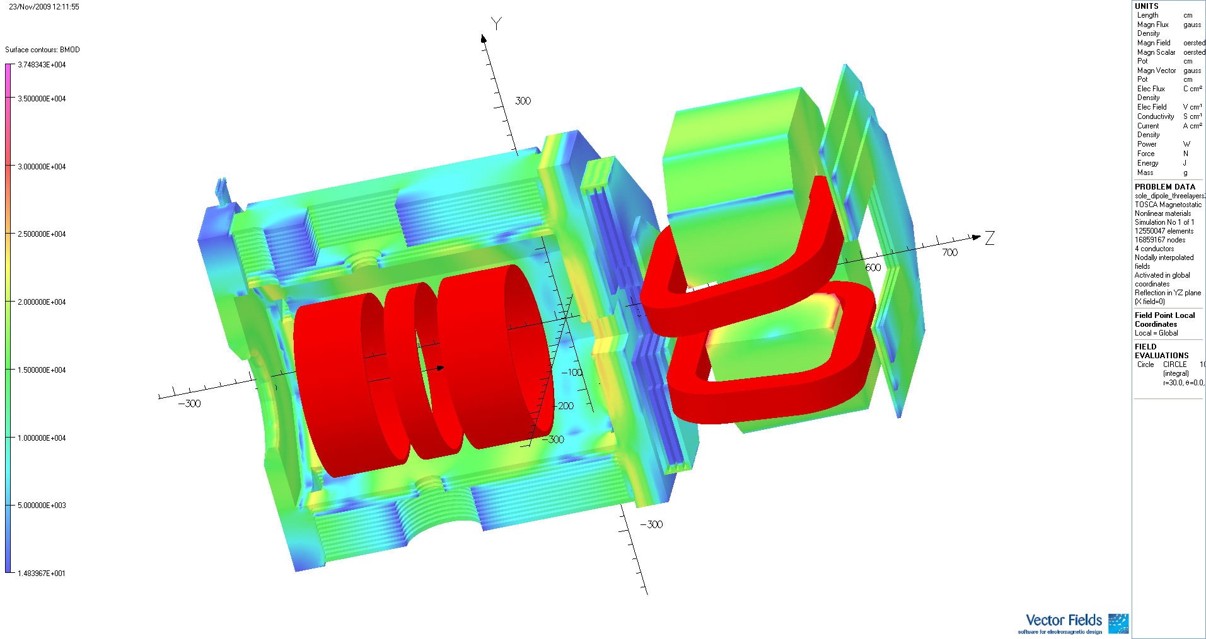
3D TOSCA model for solenoid and dipole magnets

Slide 4
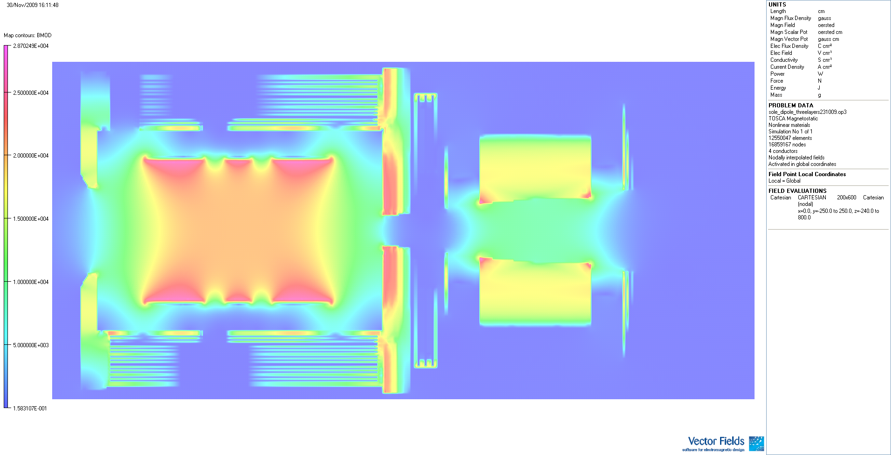
Field map in the vertical plane

Slide 5
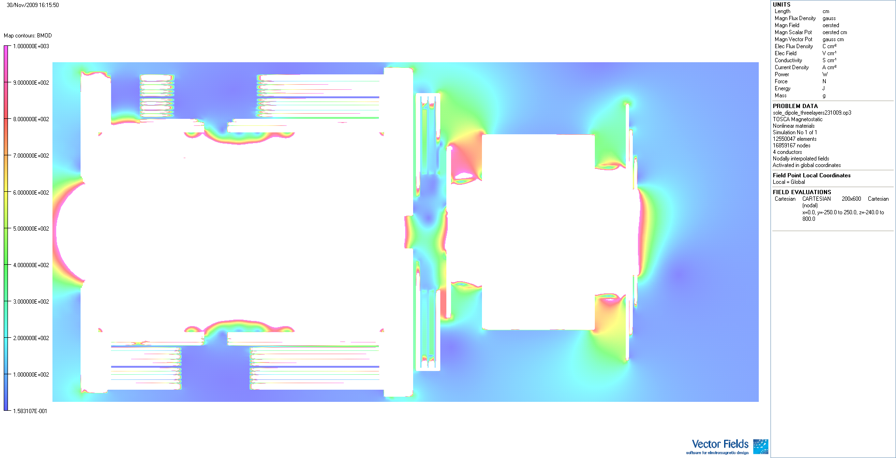
Field map in the vertical plane

Slide 6
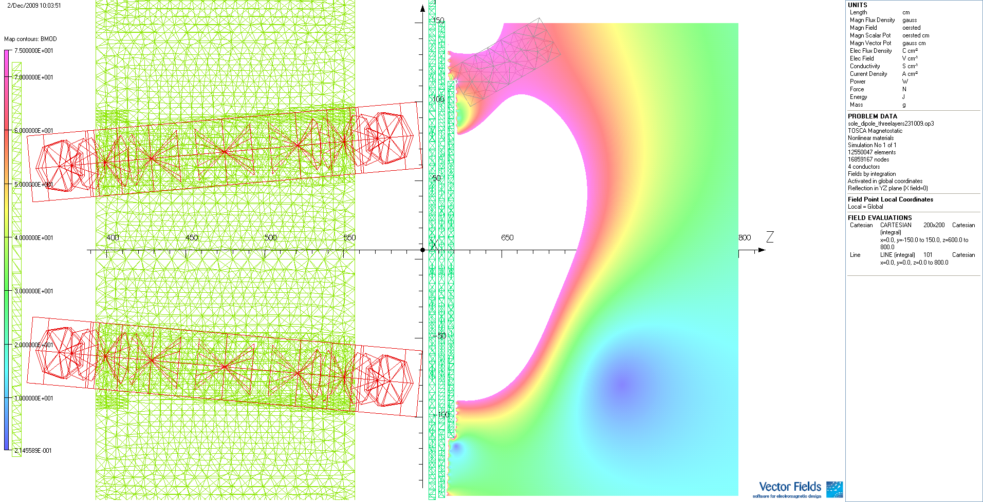
The effects of solenoid field on the stray fields at TOF and RICH regions

Slide 7
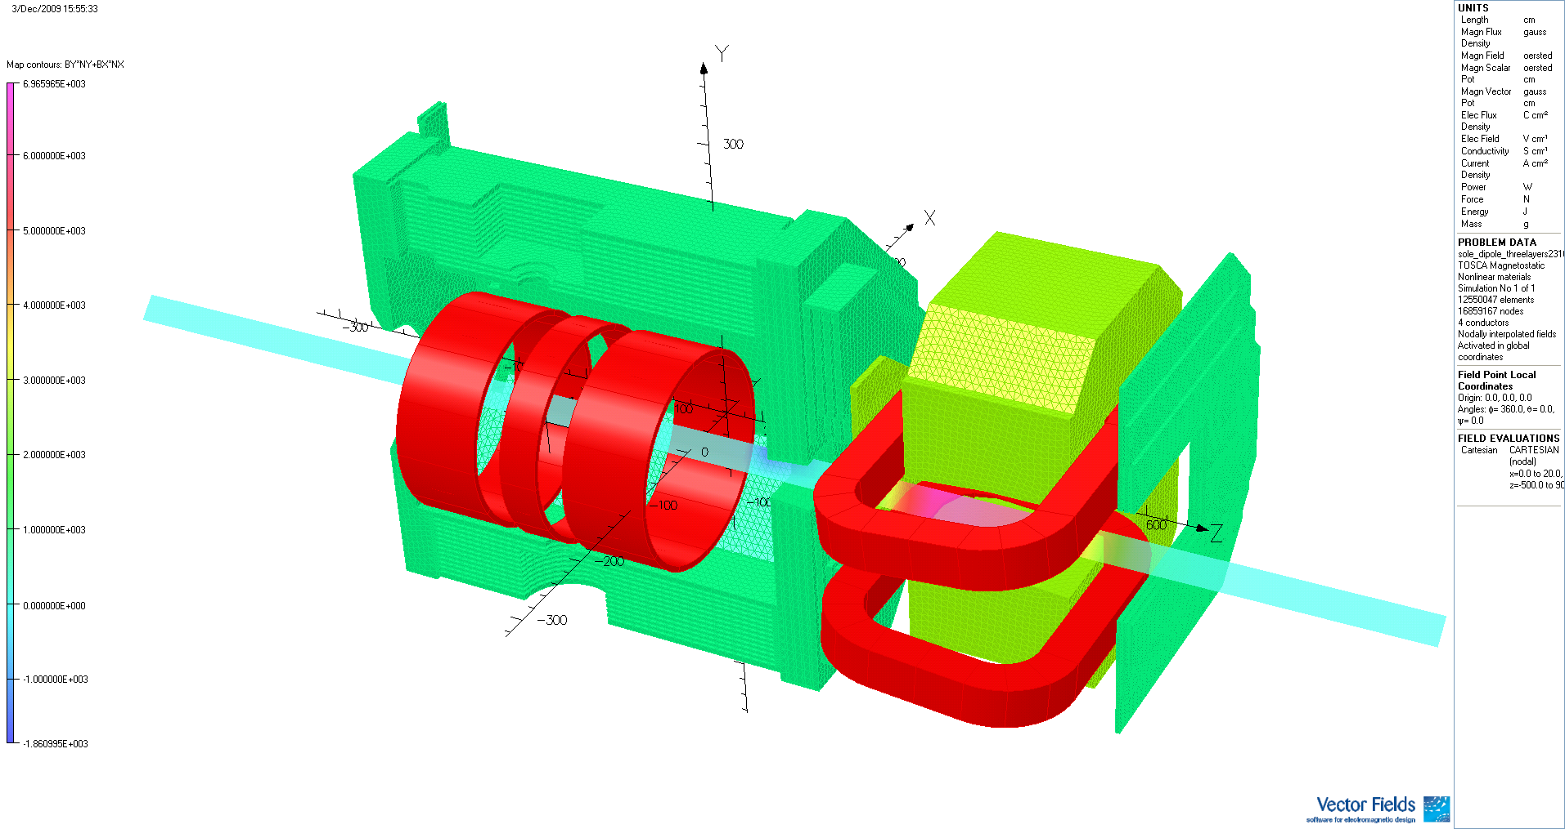
Rotating patch analysis of Solenoid and dipole magnets
Order | Sine term | Cosine term | Amplitude | Phase
n | A_n | B_n
0 | 0 | -3.11E-05 | 3.11E-05 | 179.999995
1 | 1.48E-05 | -6.29E+06 | 6.29E+06 | -179.999995
2 | 19132 | -1.98E-05 | 19132 | -89.99999755
3 | -2.22E-05 | 131.56 | 131.56 | 9.65E-06
4 | -25.86 | 2.20E-05 | 25.86 | 89.99994873
5 | -6.84E-06 | 0.314 | 0.314 | 1.25E-03
6 | -0.109 | -1.42E-05 | 0.109 | 90.00745288
7 | 3.96E-05 | 8.60E-04 | 8.61E-04 | -2.636216583
8 | 7.77E-04 | 4.68E-05 | 7.78E-04 | -86.55377715
9 | -2.63E-05 | -4.48E-04 | 4.48E-04 | 176.6395333
Table 1 Fourier coefficients for solenoid and dipole system

Slide 8
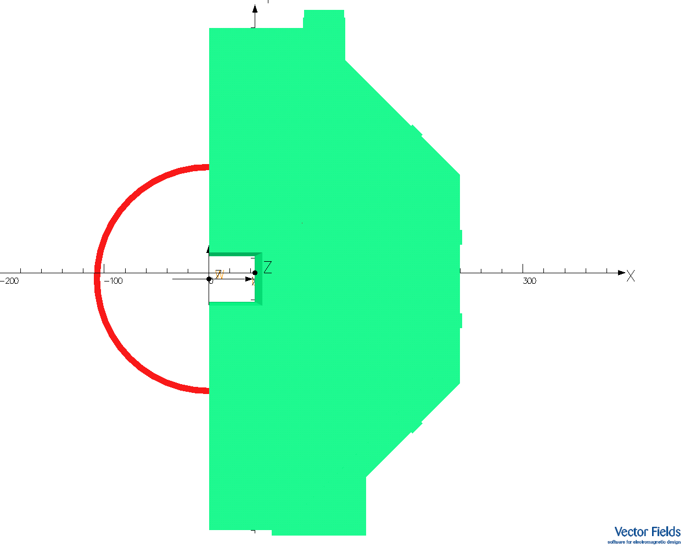
Solenoid with rectangular aperture
Order | Sine term | Cosinterm | Amplitude | Phase
n | A_n | B_n
0 | 0 | 0 | 0 | 0
1 | 0 | 1036.45 | 1036.45 | 0
2 | 18404 | 0 | 18404 | -90
3 | 0 | -7.79 | 7.79 | -180
4 | -22.08 | 0 | 22.08 | 90
5 | 0 | 0.057 | 0.057 | 0
6 | -0.077 | 0 | 0.077 | 90
7 | 0 | 2.01E-04 | 2.01E-04 | 0
8 | 4.67E-04 | 0 | 4.67E-04 | -90
9 | 0 | -1.33E-05 | 1.33E-05 | 180
Table 2 Fourier coefficients for solenoid with rectangular aperture

Slide 9
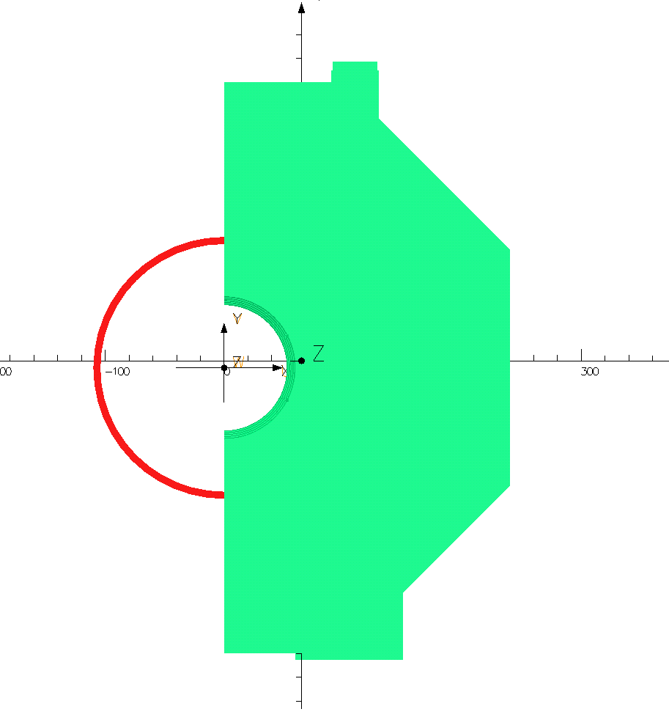
Solenoid with circular aperture
Order | Sine term | Cosine term | Amplitude | Phase
n | A_n | B_n
0 | 0 | 0 |  | 0
1 | 0 | 147.96 | 147.96 | 0
2 | 6.61 | 0 | 6.61 | -90
3 | 0 | -0.1999 | 0.1999 | -180
4 | 6.17E-04 | 0 | 6.17E-04 | 90
5 | 0 | -2.05E-03 | 2.05E-03 | 180
6 | -3.59E-04 | 0 | 3.59E-04 | 90
7 | 0 | -6.56E-07 | 6.56E-07 | -180
8 | 0 | 0 | 0 | 90
9 | 0 | -1.52E-08 | 1.52E-08 | 180
Table 3 Fourier coefficients for solenoid with circular aperture

Slide 10
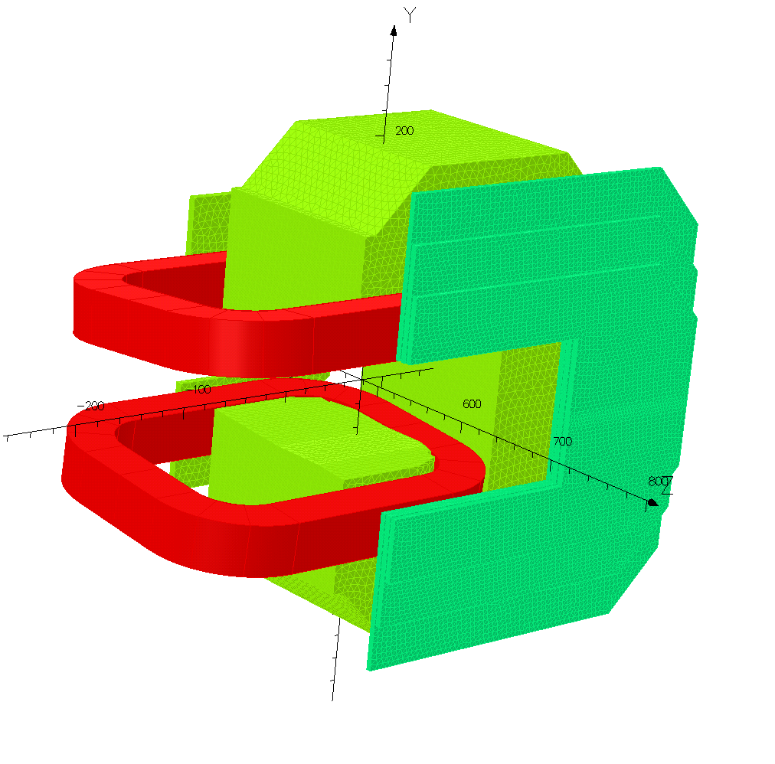
Dipole magnet
Order | Sine term | Cosine term | Amplitude | Phase
n | A_n | B_n
0 | 0 | -1.87E-05 | 1.87E-05 | 179.999995
1 | 0 | -6.21E+06 | 6.21E+06 | 179.999995
2 | -1.86 | -2.88E-06 | 1.86 | 90.00008586
3 | 1.56E-05 | 385.84 | 385.84 | -2.32E-06
4 | 0.015 | -3.50E-05 | 0.015 | -90.13257553
5 | 1.68E-05 | 0.145 | 0.145 | -6.61E-03
6 | -3.74E-05 | -5.12E-06 | 3.78E-05 | 97.79624719
7 | 1.02E-05 | 1.22E-04 | 1.22E-04 | -4.798012432
8 | 2.17E-05 | 1.88E-05 | 2.87E-05 | -49.20257092
9 | 8.24E-06 | 4.65E-05 | 4.72E-05 | -10.05719905
Table 4 Fourier coefficients for dipole magnet

Slide 11
Considerations for field mapping
The accuracy requirements for field mapping.
The reproducibility requirements for the magnet field.
With and without the downstream field clamps and the muon filter, the field distribution will be different. Can these be tolerated?

Slide 12
Conclusions
The interference between the solenoid magnet and the dipole magnet is small.
The stray fields at rich and TOF region were affected by the solenoid field.
Higher order field errors were calculated, a larger quadrupole term was found.
Considerations for field mapping were discussed.

Slide 13
Backup slides

Slide 14
HESR bending magnet

