Slide 1
GSI, December 7th, 2009
The interplay of GEM and STT
Gianluigi Boca

Slide 2
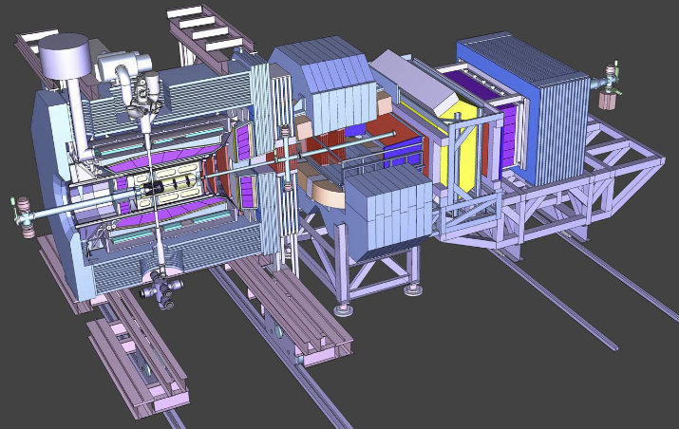
The track length of the straws in the central detector and
the number of GEM stations have to be optimized.

Slide 3
The GEM’s are a more precise detector, so in principle
one would like to have as many GEM planes as possible.

Slide 4
The GEM’s are a more precise detector, so in principle
one would like to have as many GEM planes as possible.
However one has to take into account also the amount
of passive material (for instance : cables, connectors,
etc.) of both the STT and the GEM’s and understand
what is the best combination of straw length−number
of GEM planes.

Slide 5
The GEM’s are a more precise detector, so in principle
one would like to have as many GEM planes as possible.
However one has to take into account also the amount
of passive material (for instance : cables, connectors,
etc.) of both the STT and the GEM’s and understand
what is the best combination of straw length−number
of GEM planes.
So the idea is to perform a set of simulations with different
configurations in order to assess that and have an answer
by March

Slide 6
A proposal of a roadmap to get an answer in 3-6 months

Slide 7
A proposal of a roadmap to get an answer in 3-6 months
The geometry of the STT and GEM in Geant must be modified
in order to take into account (reasonably) all the passive materials.
The 3º slant angle more or less fixed due to to construction
requirements.

Slide 8
A proposal of a roadmap to get an answer in 3-6 months
The geometry of the STT and GEM in Geant must be modified
in order to take into account (reasonably) all the passive materials.
The 3º slant angle more or less fixed due to to construction
requirements.
Simulation of uniformly generated tracks to asses the
geometrical coverage with different configurations.

Slide 9
A proposal of a roadmap to get an answer in 3-6 months
The geometry of the STT and GEM in Geant must be modified
in order to take into account (reasonably) all the passive materials.
The 3º slant angle more or less fixed due to to construction
requirements.
Simulation of uniformly generated tracks to asses the
geometrical coverage with different configurations.
Use the pattern recognition and track fitting to asses
reconstruction efficiency with different configurations.

Slide 10
A proposal of a roadmap to get an answer in 3-6 months
The geometry of the STT and GEM in Geant must be modified
in order to take into account (reasonably) all the passive materials.
The 3º slant angle more or less fixed due to to construction
requirements.
Simulation of uniformly generated tracks to asses the
geometrical coverage with different configurations.
Use the pattern recognition and track fitting to asses
reconstruction efficiency with different configurations.
Investigate efficiency with physical channels in different
configurations?

Slide 11
A proposal of a roadmap to get an answer in 3-6 months
The geometry of the STT and GEM in Geant must be modified
in order to take into account (reasonably) all the passive materials.
The 3º slant angle more or less fixed due to to construction
requirements.
Simulation of uniformly generated tracks to asses the
geometrical coverage with different configurations.
Use the pattern recognition and track fitting to asses
reconstruction efficiency with different configurations.
Investigate efficiency with physical channels in different
configurations?
Two people working on the project, hope to finish in 3-6 months.

