Slide 1
Barrel TOF LED Calibration
William NALTI, SMI Vienna
PANDA Collaboration Meeting, Stockholm, June 5th 2018

Slide 2
Idea is to use blue LED to monitor the detector performances, absolute & relative timing, aging and any other particular defects
Project is to implement 1 SMD LED on the board between the SiPMs on both sides of the Scintillator
Target is to reproduce as good as possible, in the first place, the amount of photons and time resolution of the detector (50ps)

Slide 3
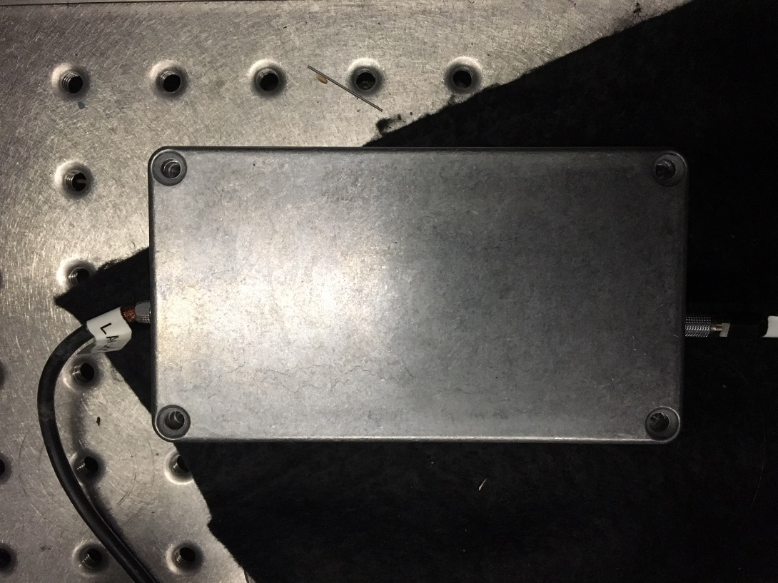
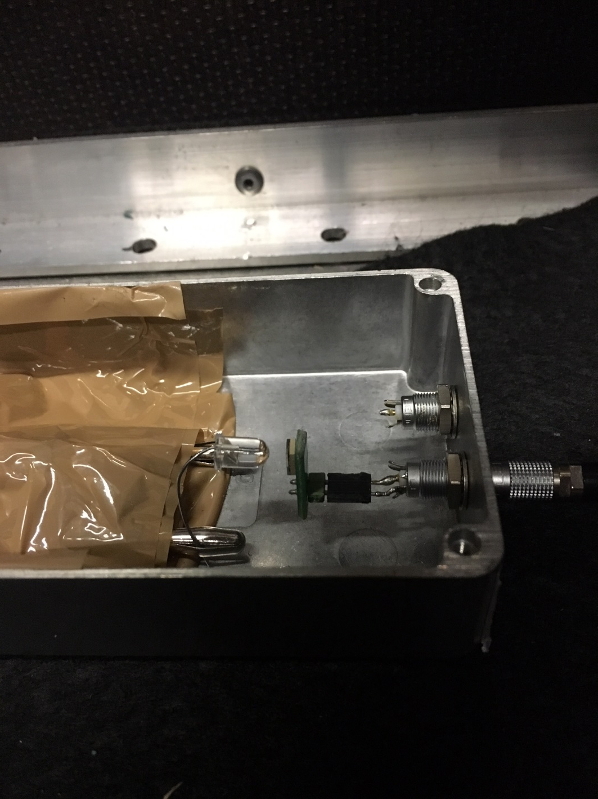
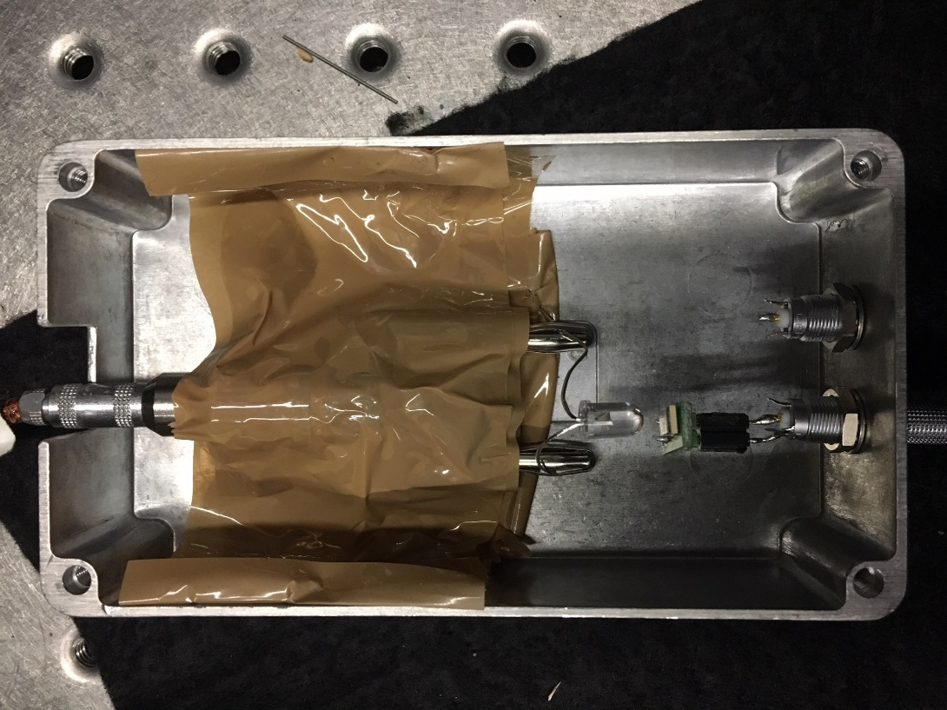

Slide 4
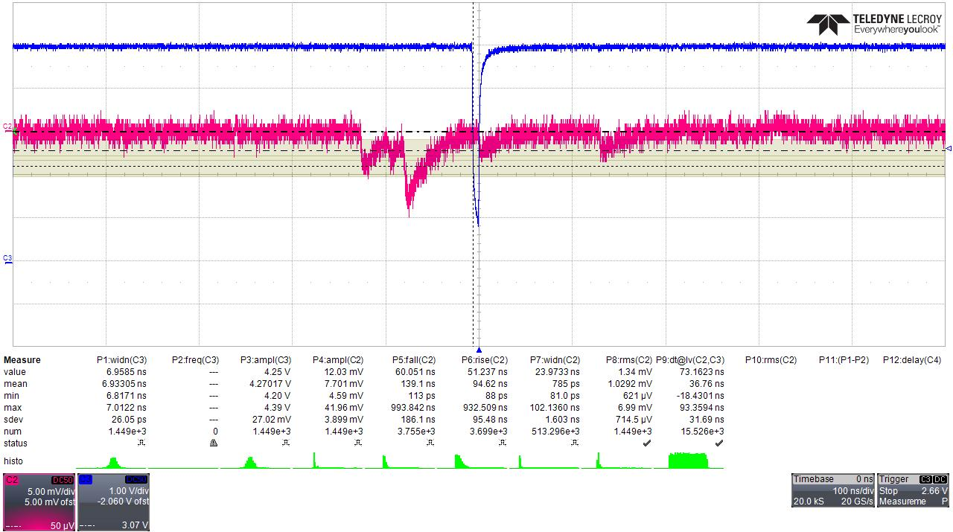
Single Photon and Noise rms
1.03mV rms
3mV Single Photon

Slide 5
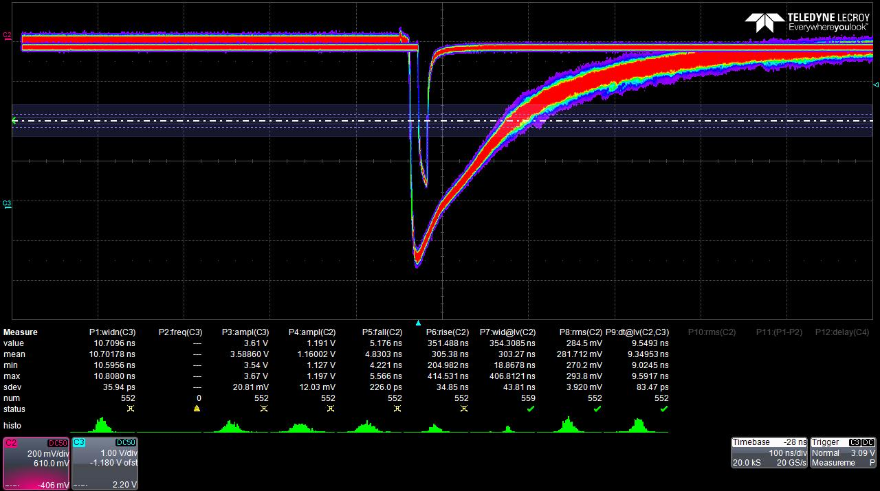

Slide 6
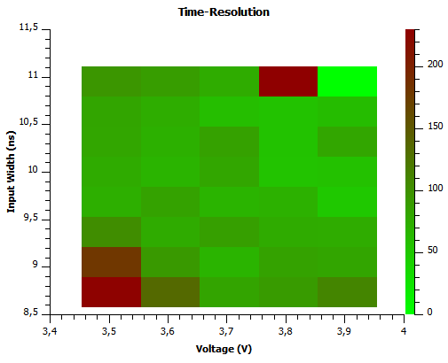
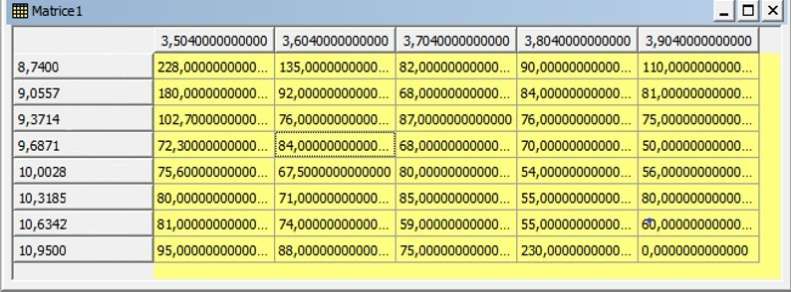
Time Resolution distribution

Slide 7
Time-resolution highly dependent on the 2 parameters
Addition of scintillator may give worst time-resolution.
Project to automatize the process and get finer mesh and resolution

Slide 8
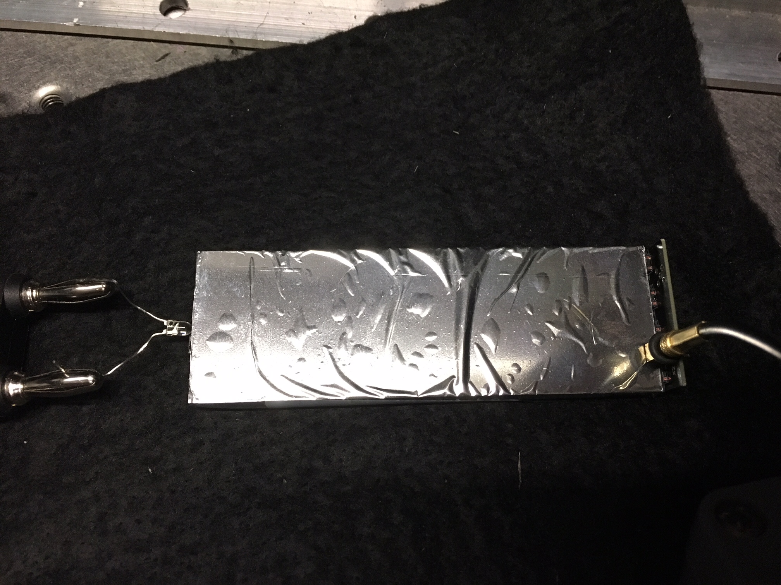
Measurements with Scintillator
Sensorboard glued on one side of Mylar wrapped Scintillator
LED on the other side
Else same setup

Slide 9
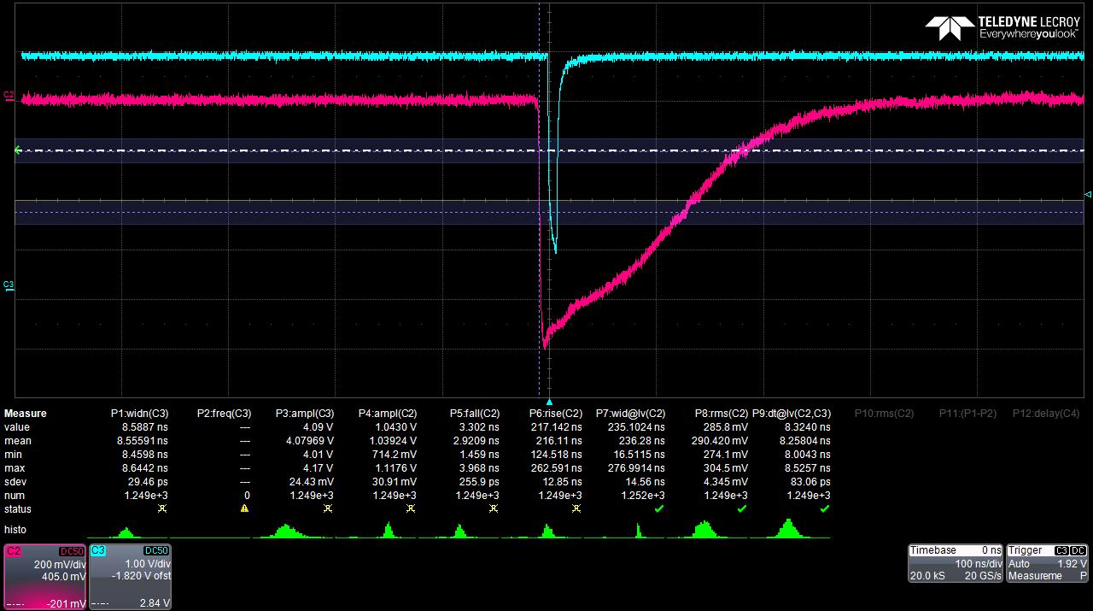

Slide 10
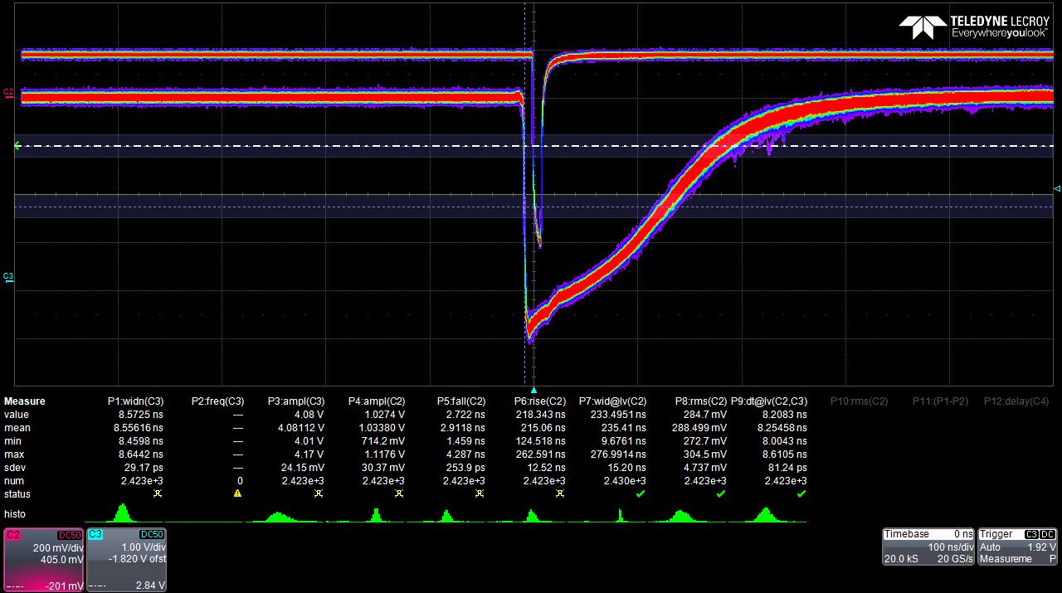

Slide 11
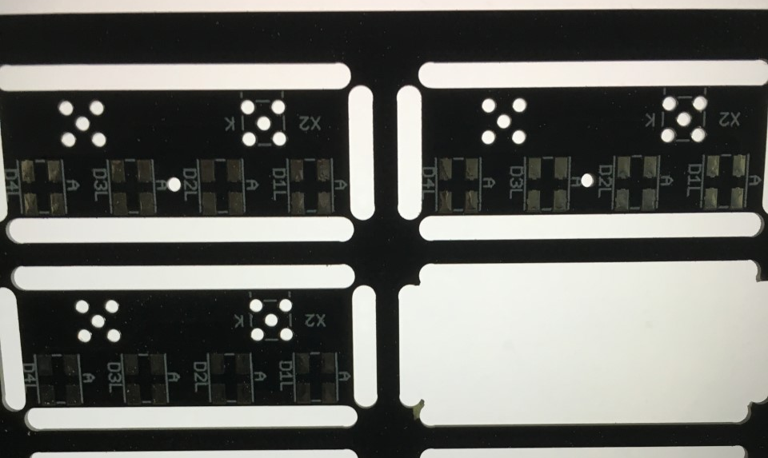
Measurement of reflection
LED on same side as Sensorboard, lightning through
1mm hole in the middle of sensorboard between SiPMs
Hamamatsu 50µm pitch SiPMs

Slide 12
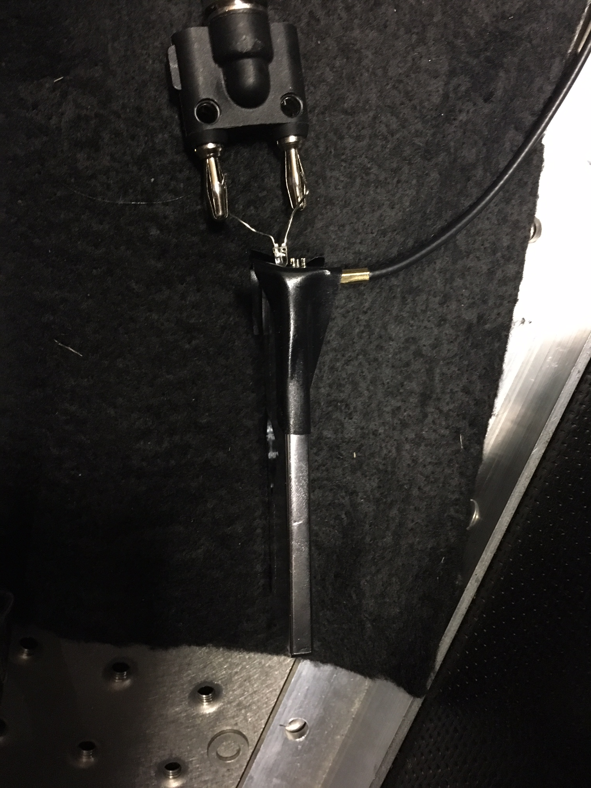
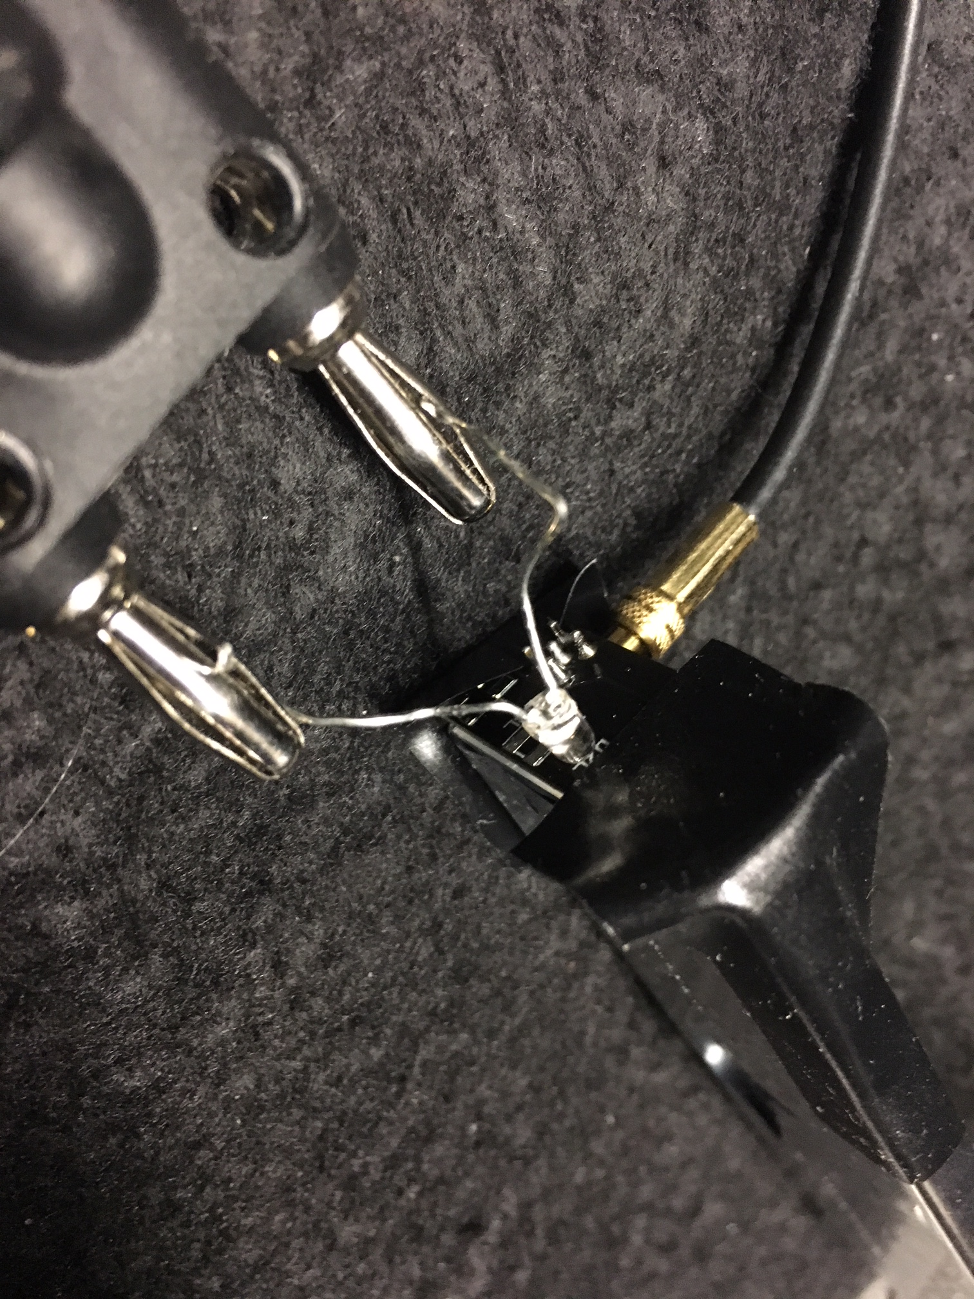
Setup

Slide 13
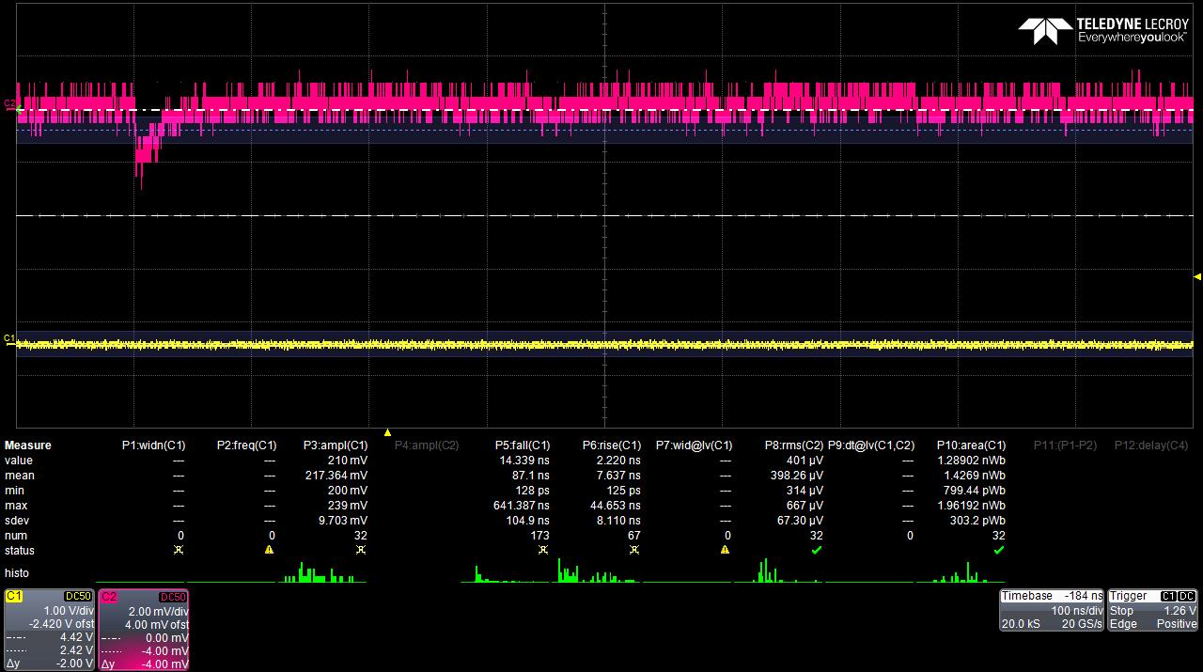
Single Photon & noise rms
Lower noise (400µV) than previously (1mV)
Single photon at 2mV

Slide 14
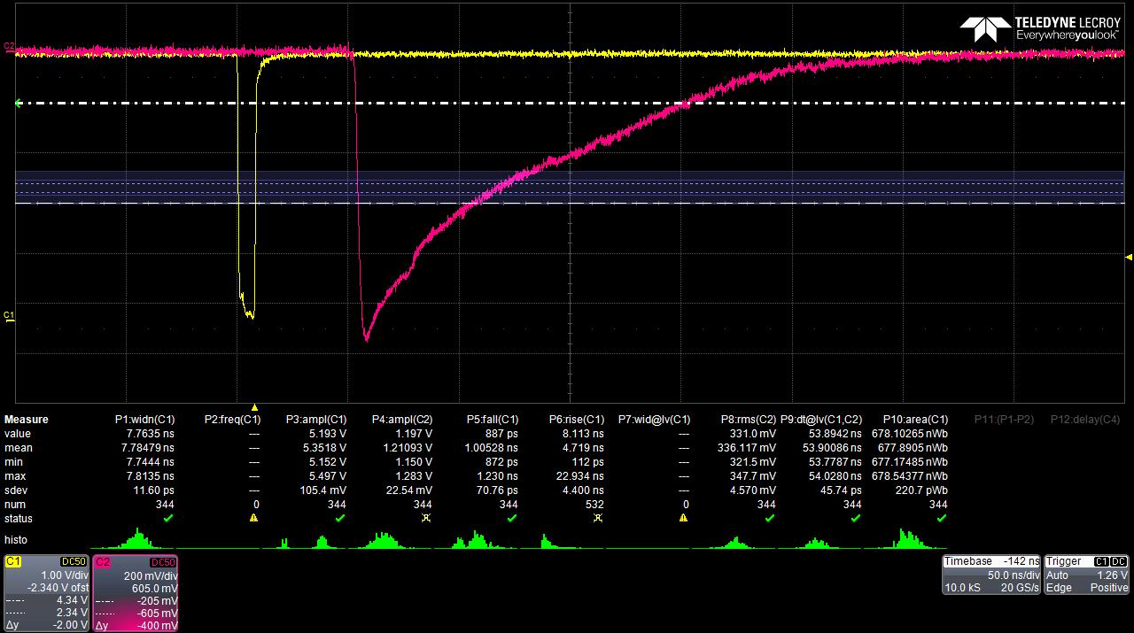
LED opposite to Sensorboard
Down to 45ps time resolution (Better than without Scintillator!)

Slide 15
LED through Hole
Too few photons detected
Need to increase signal width to get acceptable time-res (180ps)
Still unsure if these photons are reflections from other end of Scintillator, or are directly detected from the hole. Or if both, which is dominant
Signal much longer (800ns) = means reflections?

Slide 16
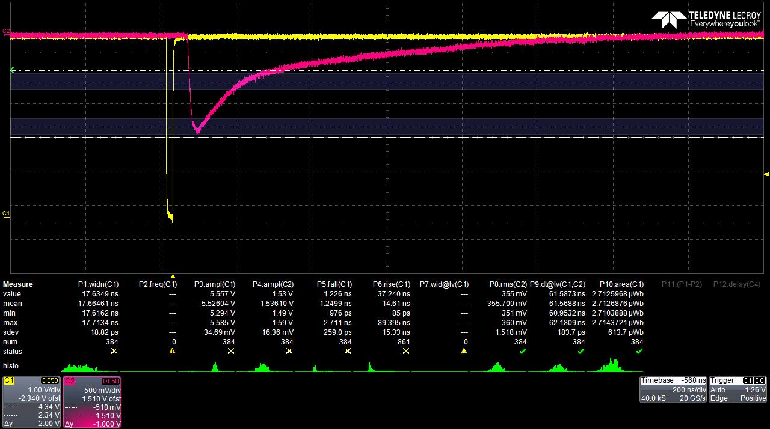
LED though Hole

Slide 17
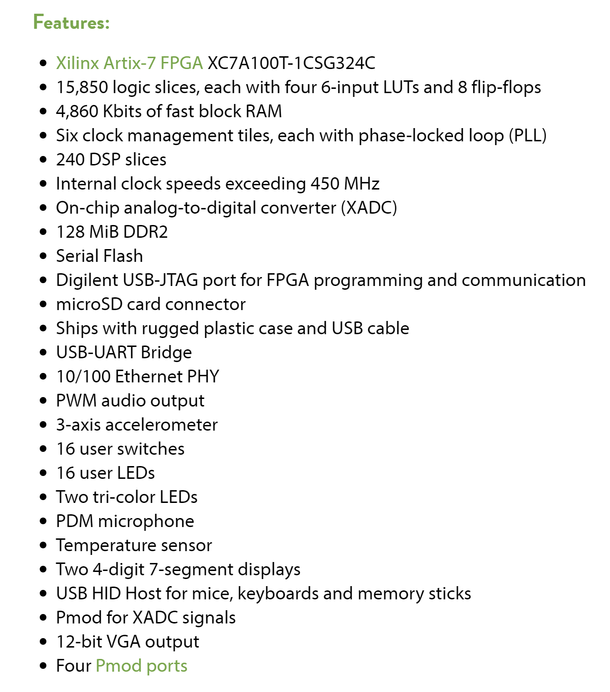
FPGA
Project is to use FPGA to drive the LEDs
Nexys 4 DDR Artix-7 Trainer Board FPGA
Still working on the programming
Interested in using Pmod ports

Slide 18
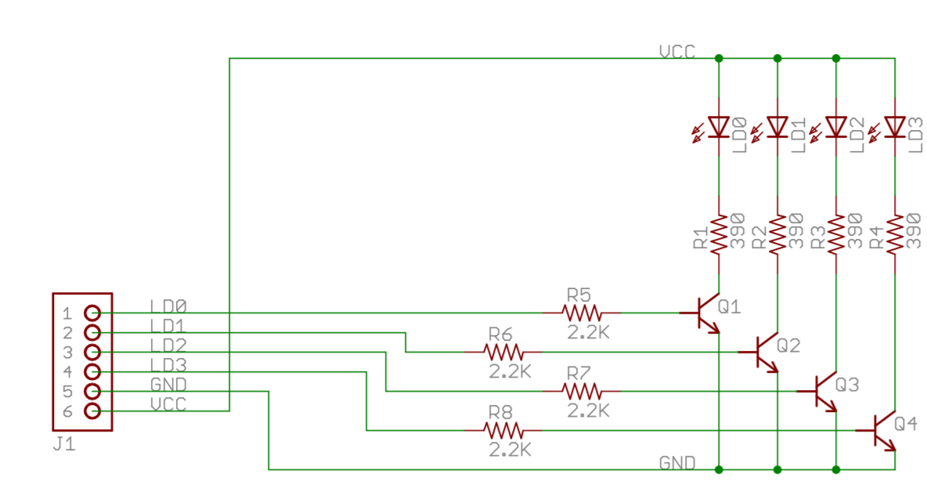
Pmod connection to LED
3V Power Pin (enough to get good time-resolution?)
24mA current (enough for our purpose)
Diligent offer 4-LED Pmod Module
    Circuit could be used for our purpose
    Will be tested once the programming get
    more advanced

Slide 19
Thank you for your attention!

