Slide 1
HADES
Detector Control System
Peter Zumbruch, GSI/EEL/EKS

Slide 2
HADES

Slide 3
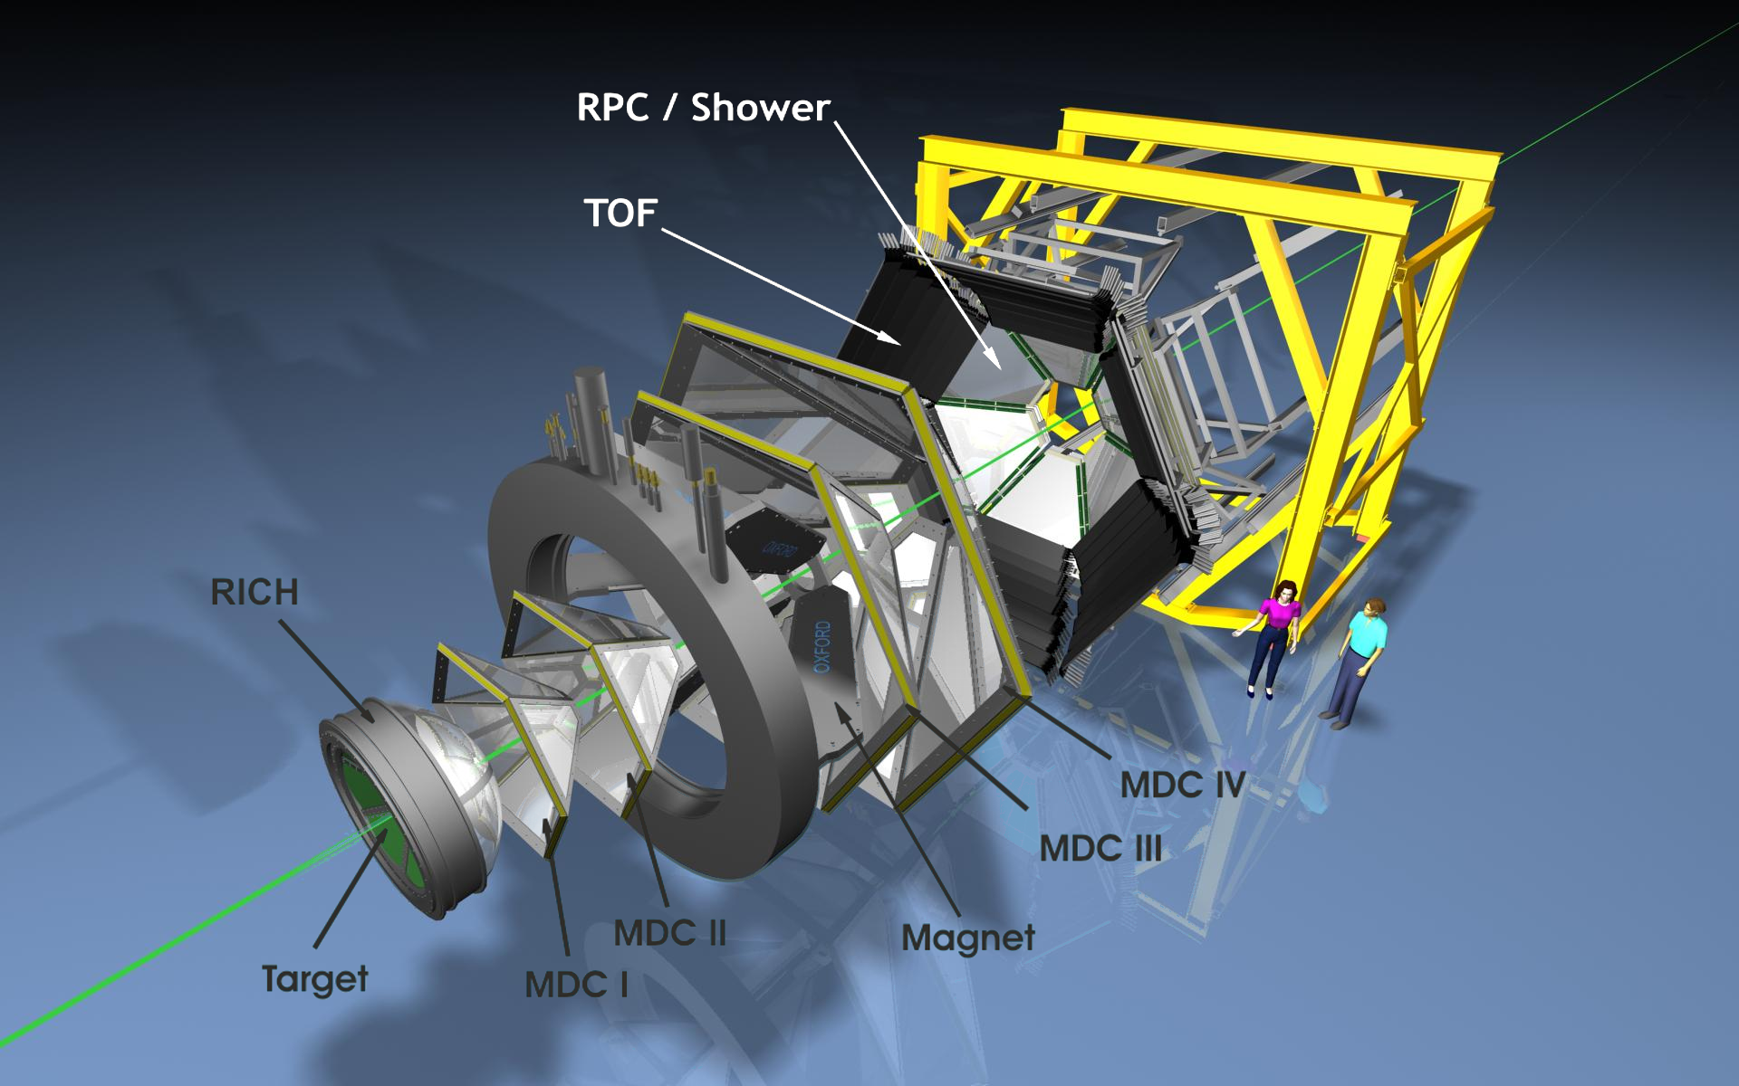
High Acceptance Dilepton Spectrometer
https://www-hades.gsi.de

Slide 4
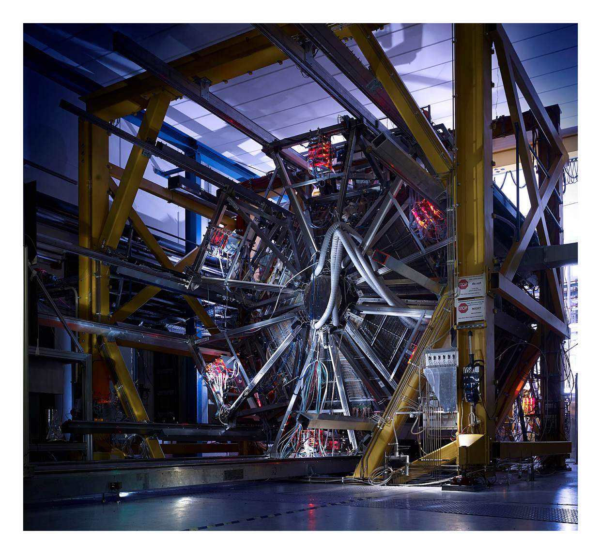
HADES
~ 80.000 channels
https://www-hades.gsi.de

Slide 5
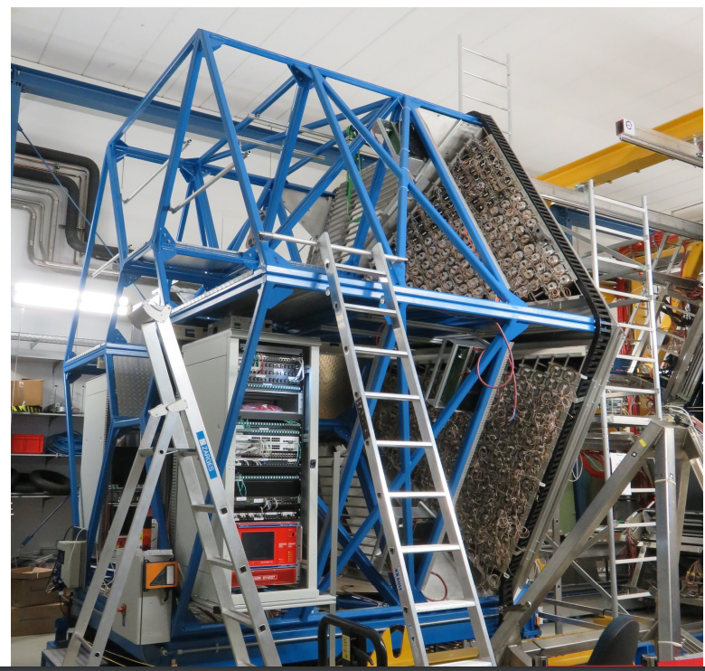
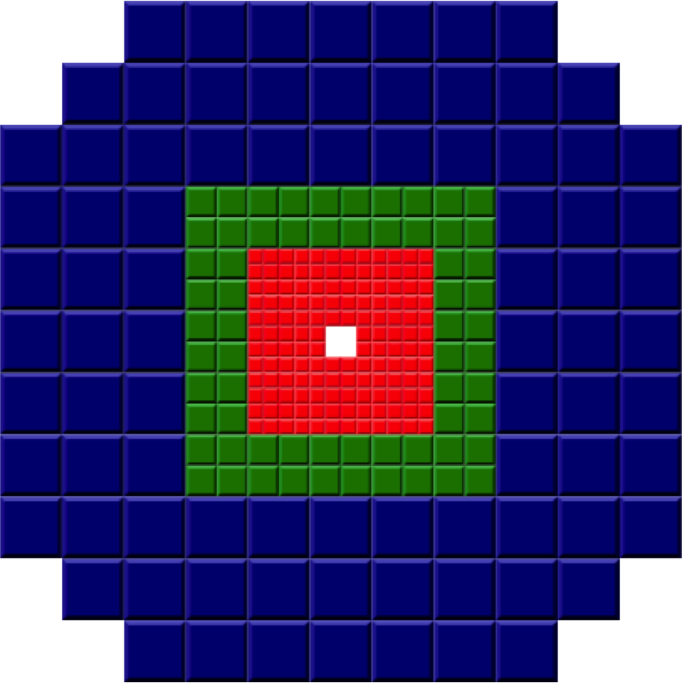
New ECAL
(not shown: additional) Forward wall
https://www-hades.gsi.de

Slide 6
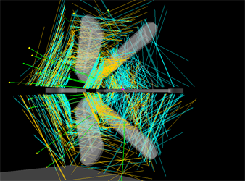
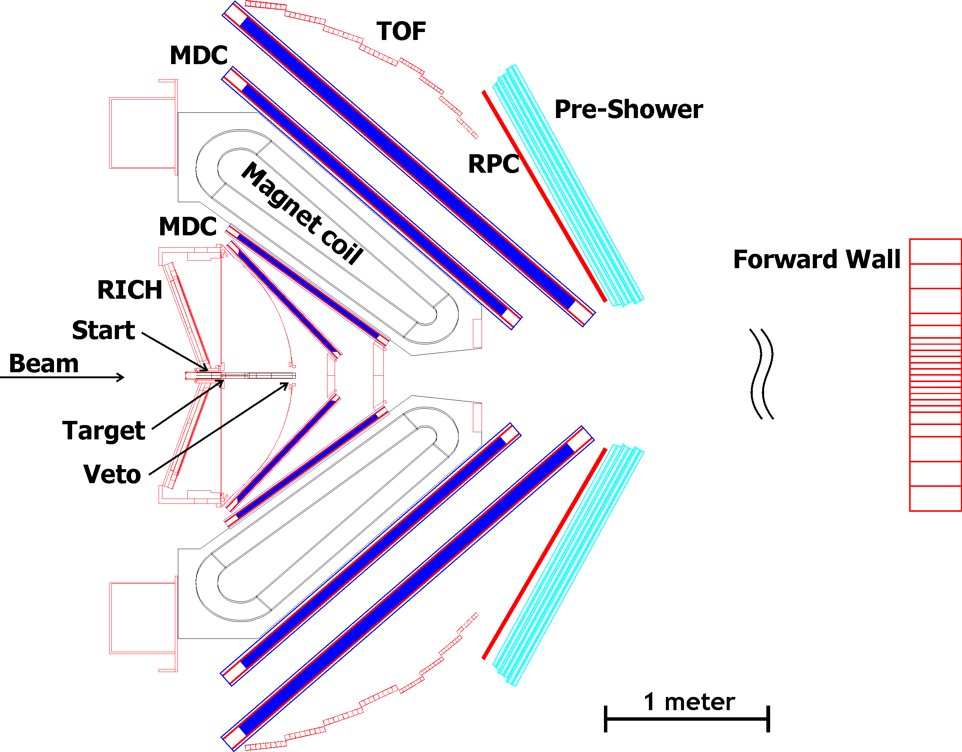
Components
A diamond START and VETO system
A Ring Imaging Cherenkov (RICH) gas radiator for electron identification with a position sensitive photon detector, covering the full azimuthal range.
Two sets of Multiwire Drift Chambers (MDC) before and after the magnetic field region form HADES tracking system.
A superconducting toroidal magnet with 6 coils in separate vacuum chambers.
A multiplicity/electron trigger array (formerly) consisting of granular Pre-shower detectors at forward angles (between 18° and 45°) and
two time of flight walls: a scintillator based time-of-flight wall (TOF) at angles above 45° and the RPC wall built from resistive plate chambers at angles below 45°.
https://www-hades.gsi.de
https://www-hades.gsi.de
https://hades-new.gsi.de/sites/default/files/web/media/documents/EPJA2009.pdf

Slide 7
Detector Control System

Slide 8
EPICS based

Slide 9
What is EPICS?
short answer: EPICS: Experimental Physics and Industrial Control System
a bit more elaborate:
EPICS is a set of Open Source software tools, libraries and applications developed collaboratively and used worldwide to create distributed soft real-time control systems for scientific instruments such as particle accelerators, telescopes and other large scientific experiments. (From the EPICS Home Page: http://www.aps.anl.gov/epics/)
striking - is three things at once:
  A collaboration of major scientific laboratories and industry ( > 100)
    A world wide collaboration that shares designs, software tools and expertise for implementing large-scale control systems
  An architecture for building scalable control systems
    A client/server model with an efficient communication protocol (Channel Access) for passing data
    The entire set of Process Variables establish a Distributed Real-time Database of machine status, information and control parameters
  A Software Toolkit of Open Source code and documentation
    A collection of software tools collaboratively developed which can be integrated to provide a comprehensive and scalable control system
8 - 10 September 2009
EPICS Overview - EPICS Tutorial - PANDA XXXth Collaboration Meeting, Jülich
Notes:
9

Slide 10
What is EPICS? (Getting Started with EPICS: Introductory Session I)
A Control System Architecture
  Network-based “client/server” model (hence the EPICS logo)
CA
CA
Client
Client
CA
CA
Server
Server
  For EPICS, client and server speak of their Channel Access role
    i.e. Channel Access Client & Channel Access Server
8 - 10 September 2009
EPICS Overview - EPICS Tutorial - PANDA XXXth Collaboration Meeting, Jülich

Slide 11
Why EPICS ?
scalable Control System Architecture
  rule of thumb: ~ 10 control channels per 1 data channel
    ~ 1-10 Million channels
runs on many OS architectures (Linux, Windows, Arm, RTOS)
used world-wide in huge applications, e.g. ITER, HADES
far reaching perspective, q.v. ITER
GUIs are (one sort of) clients, displaying/changing process variables which are provided by the server. They are not part of the server
support at GSI (P.Zumbruch)
support world-wide
  tech-talk
  use-case e.g.
    PANDA EMC Endcaps, Florian Feldbauer, Bochum
August 20, 2012
FAIR Controls - PANDA DCS

Slide 12







Supervisory Layer
Control Layer / EPICS
DCS Overview
EPICS IOC
HV
LV
Gas
HadCon2 alias
Sequencer
Ioc-stats
GUI („BOY/BOB“)
GSI LAN
RDB Archiver
Archiver
Configuration
Gateway
Data Browser
Process/Device Layer
Archiver
Storage
Supervisory Layer
Alarmhandler „BEAST“
CA
CA
LAN
LAN
JDBC
JDBC
LAN
HADES VLAN
LAN
CA
LAN
CA
miniPC
EPICS IOC
HV
Wiener
ISEG
LAN
CA
LAN
internal EPICS IOC
LAN
CA
Control Layer
LAN
miniPC
EPICS IOC
HADES I/O Box
32 up-to 16 bit ADC Channels for 0-5/10 or 4-20mA Inputs
ModBus
USB
PC
EPICS IOC
(RICH) Gas System
LV
TDK Lambda
USB
...
HadCon2 / CBM DSC (Prototype)
1-wire
HadCon2
1.1kV
x 74
48 V
...
analog
Ethercat
1-wire
trbnet
CAN
I2C
SPI
“TTL“
CAN
1-wire
I2C
SPI
“TTL“
LV Power Distributor Switches & Feedback ADCs
...
x 74
6 x 1-wire Temperature
TRB „Sensors“
T, DAQ, ...
RICH Gas Sensors & Actuators
Process Layer
Power /Concentrator Board
1.1 V, 1.2V, 2.5 V, 3.3 V
...
...
1..1 kV
x 74
0-5/10 V Signals
Power /Concentrator Board
1.1 V, 2.5 V, 3.3 V
1..1 kV
4-20mA Signals

Slide 13
Supervisory Layer
Control Layer / EPICS
DCS Overview
EPICS IOC
HV
LV
Gas
HadCon2 alias
Sequencer
Ioc-stats
GUI („BOY/BOB“)
GSI LAN
RDB Archiver
Archiver
Configuration
Gateway
Data Browser
Archiver
Storage
Supervisory Layer
Alarmhandler „BEAST“
CA
CA
LAN
LAN
JDBC
JDBC
LAN
HADES VLAN
LAN
CA
LAN
CA
miniPC
EPICS IOC
HV
Wiener
ISEG
LAN
CA
LAN
internal EPICS IOC
LAN
CA
Control Layer
LAN
miniPC
EPICS IOC
HADES I/O Box
32 up-to 16 bit ADC Channels for 0-5/10 or 4-20mA Inputs
ModBus
USB
PC
EPICS IOC
(RICH) Gas System
LV
TDK Lambda
USB
...
HadCon2 / CBM DSC (Prototype)
1-wire
HadCon2
1.1kV
x 74
48 V
...
analog
Ethercat
1-wire
trbnet
CAN
I2C
SPI
“TTL“
CAN
1-wire
I2C
SPI
“TTL“
LV Power Distributor Switches & Feedback ADCs
...
x 74
6 x 1-wire Temperature
TRB „Sensors“
T, DAQ, ...
RICH Gas Sensors & Actuators
Process Layer
Power /Concentrator Board
1.1 V, 1.2V, 2.5 V, 3.3 V
...
...
1..1 kV
x 74
0-5/10 V Signals
Power /Concentrator Board
1.1 V, 2.5 V, 3.3 V
1..1 kV
4-20mA Signals

Slide 14
Supervisory Layer
DCS Overview
EPICS IOC
HV
LV
Gas
HadCon2 alias
Sequencer
Ioc-stats
GUI („BOY/BOB“)
GSI LAN
RDB Archiver
Archiver
Configuration
Gateway
Data Browser
Process/Device Layer
Archiver
Storage
Supervisory Layer
Alarmhandler „BEAST“
CA
CA
LAN
LAN
JDBC
JDBC
LAN
HADES VLAN
LAN
CA
LAN
CA
miniPC
EPICS IOC
HV
Wiener
ISEG
LAN
CA
LAN
internal EPICS IOC
LAN
CA
Control Layer
LAN
miniPC
EPICS IOC
HADES I/O Box
32 up-to 16 bit ADC Channels for 0-5/10 or 4-20mA Inputs
ModBus
USB
PC
EPICS IOC
(RICH) Gas System
LV
TDK Lambda
USB
...
HadCon2 / CBM DSC (Prototype)
1-wire
HadCon2
1.1kV
x 74
48 V
...
analog
Ethercat
1-wire
trbnet
CAN
I2C
SPI
“TTL“
CAN
1-wire
I2C
SPI
“TTL“
LV Power Distributor Switches & Feedback ADCs
...
x 74
6 x 1-wire Temperature
TRB „Sensors“
T, DAQ, ...
RICH Gas Sensors & Actuators
Process Layer
Power /Concentrator Board
1.1 V, 1.2V, 2.5 V, 3.3 V
...
...
1..1 kV
x 74
0-5/10 V Signals
Power /Concentrator Board
1.1 V, 2.5 V, 3.3 V
1..1 kV
4-20mA Signals

Slide 15
Control Layer / EPICS
DCS Overview
EPICS IOC
HV
LV
Gas
HadCon2 alias
Sequencer
Ioc-stats
GUI („BOY/BOB“)
GSI LAN
RDB Archiver
Archiver
Configuration
Gateway
Data Browser
Process/Device Layer
Archiver
Storage
Supervisory Layer
Alarmhandler „BEAST“
CA
CA
LAN
LAN
JDBC
JDBC
LAN
HADES VLAN
LAN
CA
LAN
CA
miniPC
EPICS IOC
HV
Wiener
ISEG
LAN
CA
LAN
internal EPICS IOC
LAN
CA
Control Layer
LAN
miniPC
EPICS IOC
HADES I/O Box
32 up-to 16 bit ADC Channels for 0-5/10 or 4-20mA Inputs
ModBus
USB
PC
EPICS IOC
(RICH) Gas System
LV
TDK Lambda
USB
...
HadCon2 / CBM DSC (Prototype)
1-wire
HadCon2
1.1kV
x 74
48 V
...
analog
Ethercat
1-wire
trbnet
CAN
I2C
SPI
“TTL“
CAN
1-wire
I2C
SPI
“TTL“
LV Power Distributor Switches & Feedback ADCs
...
x 74
6 x 1-wire Temperature
TRB „Sensors“
T, DAQ, ...
RICH Gas Sensors & Actuators
Process Layer
Power /Concentrator Board
1.1 V, 1.2V, 2.5 V, 3.3 V
...
...
1..1 kV
x 74
0-5/10 V Signals
Power /Concentrator Board
1.1 V, 2.5 V, 3.3 V
1..1 kV
4-20mA Signals

Slide 16
DCS Overview
EPICS IOC
HV
LV
Gas
HadCon2 alias
Sequencer
Ioc-stats
GUI („BOY/BOB“)
GSI LAN
RDB Archiver
Archiver
Configuration
Gateway
Data Browser
Archiver
Storage
Supervisory Layer
Alarmhandler „BEAST“
CA
CA
LAN
LAN
JDBC
JDBC
LAN
HADES VLAN
LAN
CA
LAN
CA
miniPC
EPICS IOC
HV
Wiener
ISEG
LAN
CA
LAN
internal EPICS IOC
LAN
CA
Control Layer
LAN
miniPC
EPICS IOC
HADES I/O Box
32 up-to 16 bit ADC Channels for 0-5/10 or 4-20mA Inputs
ModBus
USB
PC
EPICS IOC
(RICH) Gas System
LV
TDK Lambda
USB
...
HadCon2 / CBM DSC (Prototype)
1-wire
HadCon2
1.1kV
x 74
48 V
...
analog
Ethercat
1-wire
trbnet
CAN
I2C
SPI
“TTL“
CAN
1-wire
I2C
SPI
“TTL“
LV Power Distributor Switches & Feedback ADCs
...
x 74
6 x 1-wire Temperature
TRB „Sensors“
T, DAQ, ...
RICH Gas Sensors & Actuators
Process Layer
Power /Concentrator Board
1.1 V, 1.2V, 2.5 V, 3.3 V
...
...
1..1 kV
x 74
0-5/10 V Signals
Power /Concentrator Board
1.1 V, 2.5 V, 3.3 V
1..1 kV
4-20mA Signals

Slide 17
Overview
HADES control system
  EPICS based client server system (main focus)
  ~ 25 compute nodes “IOCs“ (Input Output Controller
    5 central (linux-x86(_64))
      „Main IOC“, Gateway Hades Network – GSI Network, FSM Sequencer, HV and LV control
    1 RICH PC + embedded ISEG IOC
    1 CAEN 4527 EPICS IOC
    17++ smaller (linux-arm, etrax)
      HadCon1 (etrax FX)
      HadCon2 + dreamPlug/Raspberry PI
  ~ 163.000 Process Variables
    Temperature, HV, LV, Pressures, Scales, Switches, Gas Systems, ..
  Visualization / GUI client
    Still MEDM
    Old CSS 3.x (MDC, RPC, DCS beta)
    CSS 4.4
  Archiving
    CS-Studio based headless RDB Archiver
      connecting to
        local PostgreSQL database
        future: GSI PostgresQL Database Services
    archiving for ~7000 Process Variables at 0.1 to 10 Hz
  Involved institutes
    GSI, Gießen

Slide 18
Process Variables
PVs per type
in total
Main IOCs (5)
  133572 (121373 / 90.8%)
Dreamplug (4)
  2142 (1877 / 87%)
HadCon1 (11)
  7074 (6866 / 97%)
ISEG HV
  ~10.000
CAEN HV 4527
  ~10.000
~ 163,000 PVs (150,000 / 92%)

Slide 19
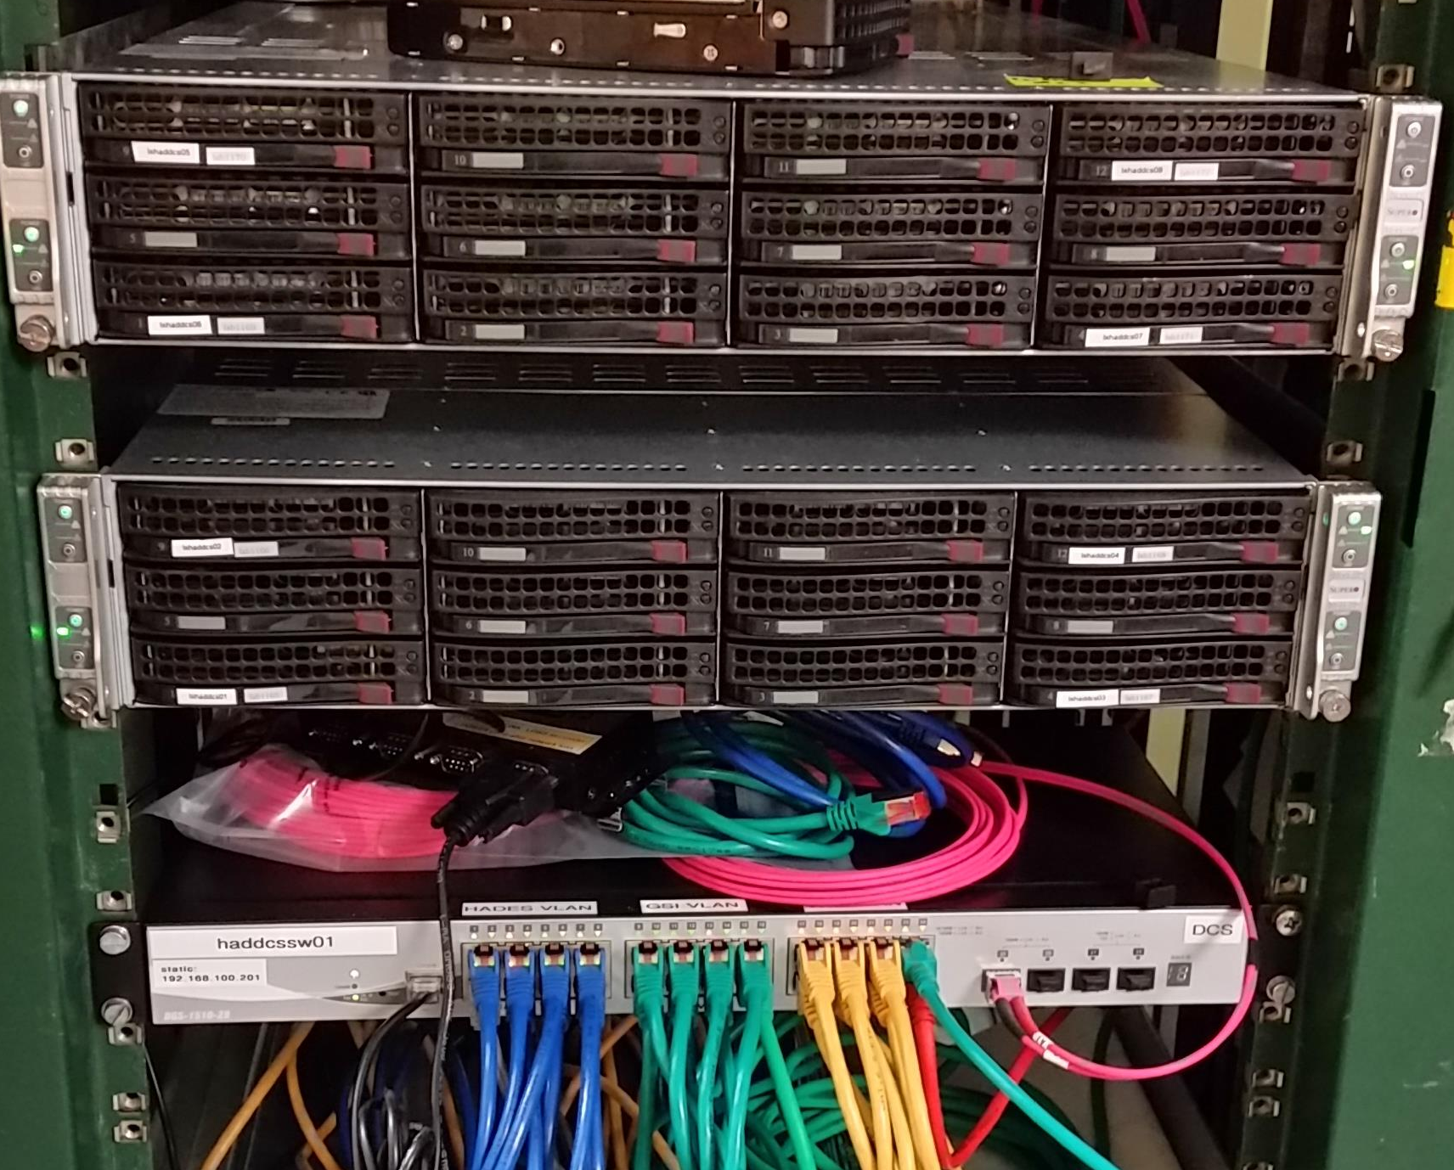
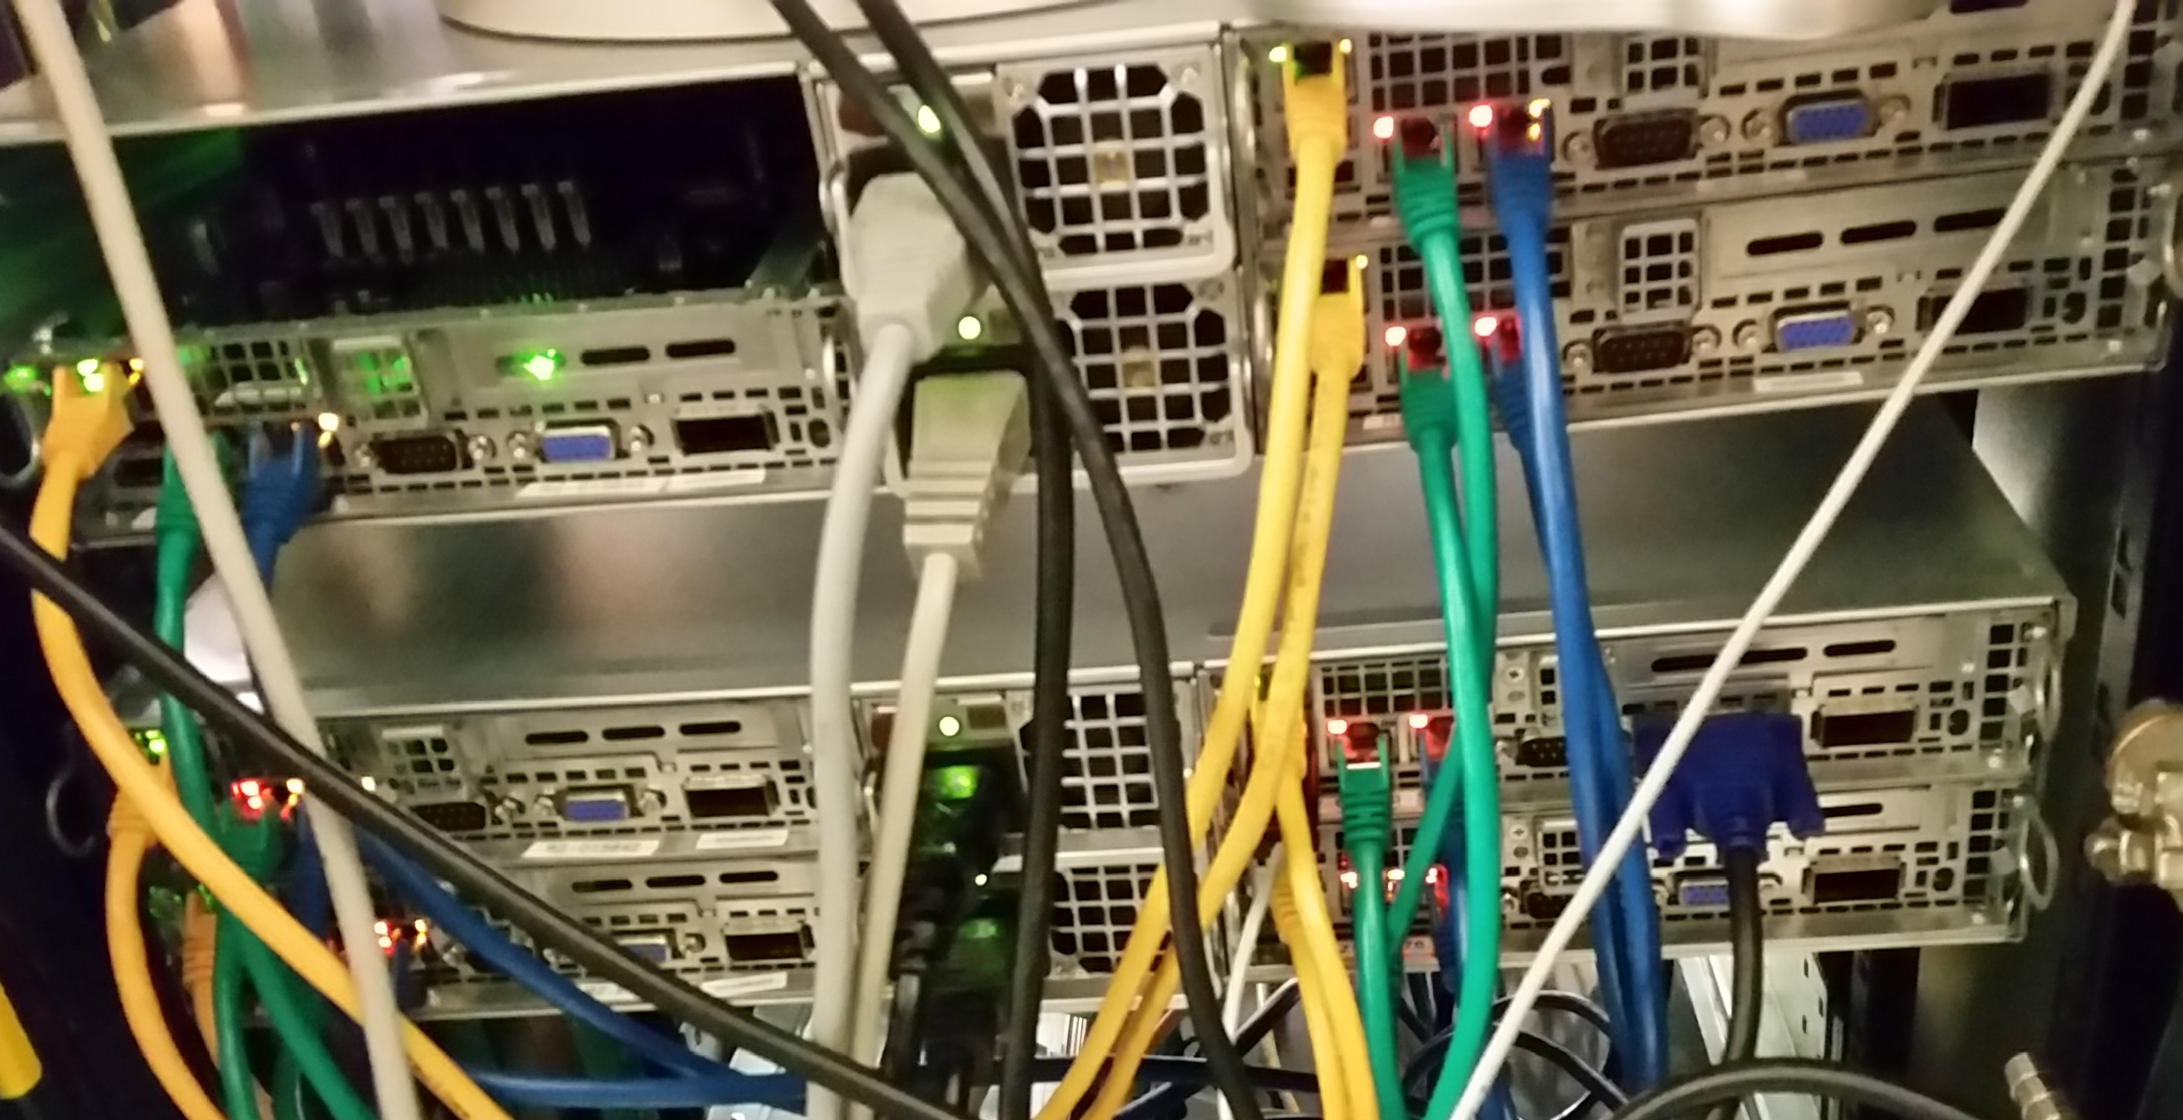
DCS Server
DCS got two segregated server units of GSI batch farm nodes from IT
Allows
  further modularization
  virtualization/container of servers and graphical clients.
  improved redundancy
  network (3 VLANs)
  IT department OS

Slide 20
Graphical user interfaces

Slide 21
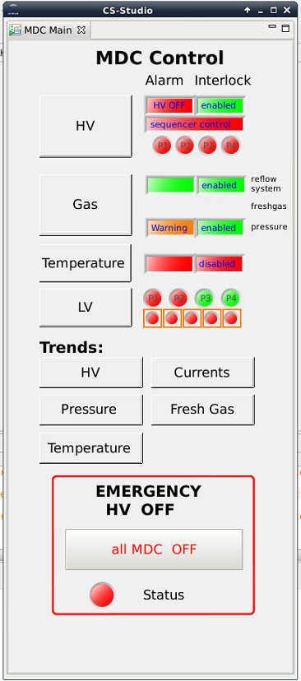
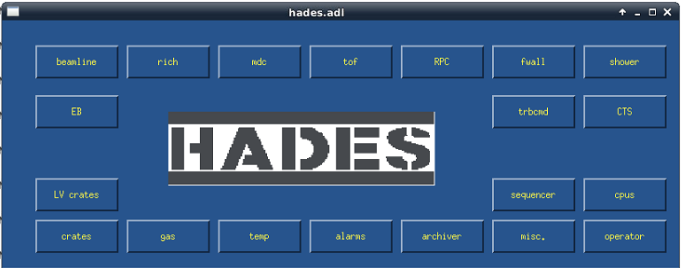
Current and Future Projects
GUI
CS-Studio - Replacement of MEDM displays
  automatic conversion tools do exist
NEEDS DETECTOR‘S INITIATIVE
FOR NEW DESIGN FEATURES
To get detector oriented DISPLAYs

Slide 22
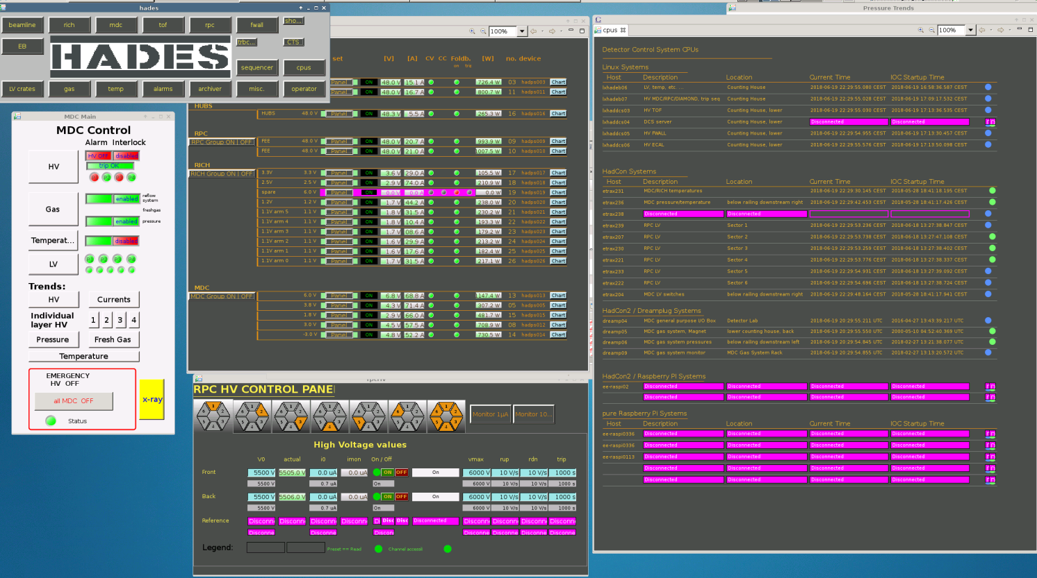
Controlsystemstudio.org

Slide 23
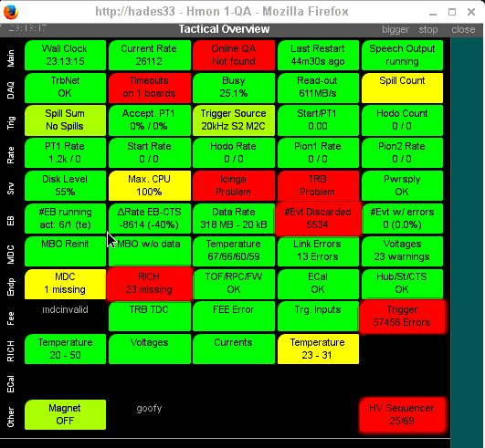
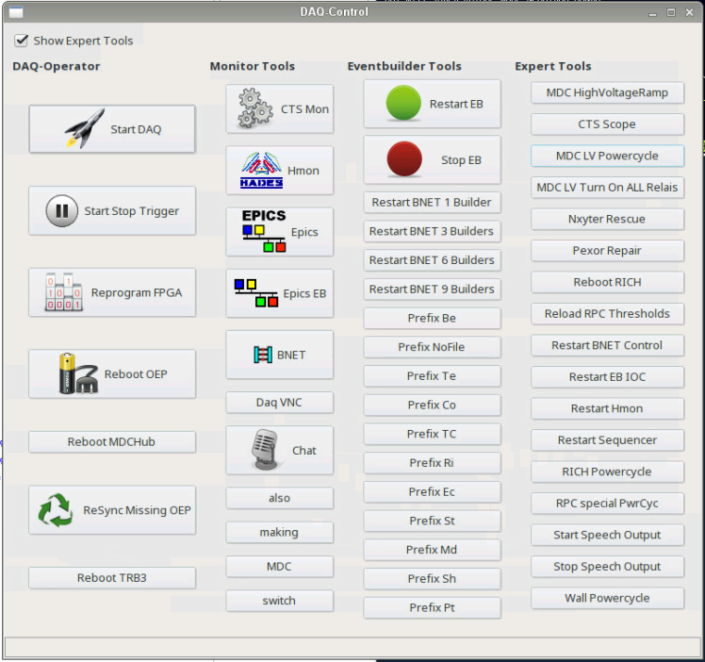
hmon: perl based ECS and DAQ controls
acting as an EPICS client

Slide 24
Organisational

Slide 25
Management (1)
People
1 core developer
1 detector (MDC) power user
1 advanced (RICH) user
~ 5-10 clients „I (would) need“
In general no real detector group DCS experts
1 impatient/unhappy group/user (DAQ)

Slide 26
Management (2)
System
Up to a few days ago:
  one main IOC
Now
  could be easily split up into 5 using $(hostname) based configuration files
    i.e. one type of executable configured for different setups
  git.gsi.de/HADES git repository growing use for all used IOC
  including automatic nightly update of resources for the main IOCs

Slide 27
Management (3)
Vital, unwritten Rules
PV naming scheme
Modularization and templates!
  No dump copy and paste
Configuration instead of coding.
Use of git or other type of CVS.
Restrictions: no
Hardware decisions, getting more involved by experienced users
Server Platforms:
  linux/unix (not EPICS driven)

Slide 28
Management
Coordination
(Core) IOCs
  Core Developer
GUIs, Clients
  User
NO
  user requirements
    no database
  processes
  list of responsible sub system detector people
  state machine

Slide 29
Summary

Slide 30
HADES DCS
HADES DCS System
  with approx. 130,000 PVs
  distributed over ~ 25 EPICS Server
  with about 20 client applications (GUIs, etc.)
is running
maintained by 1 core developer and coordinator
  gaining experience for bigger experiments
Modularization and Templates
Configuration instead of coding.

Slide 31
Thank You.

Slide 32
Backup slides

Slide 33
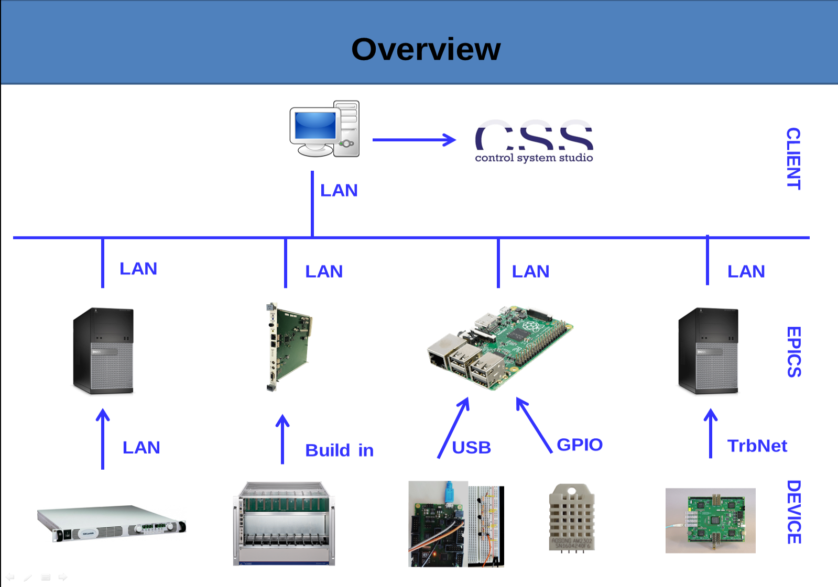
RICH Detector

Slide 34
