Slide 1


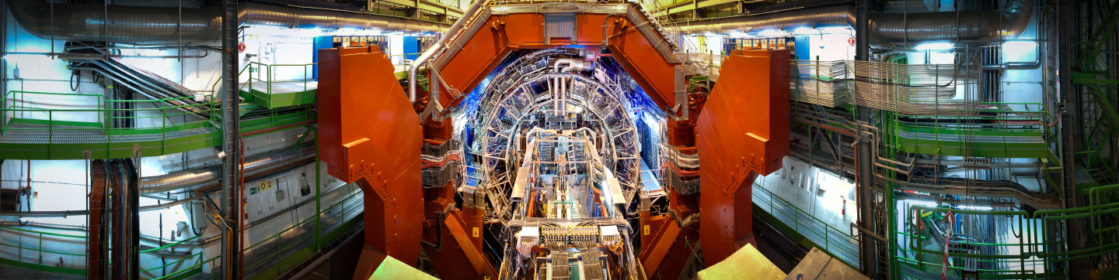
ALICE Detector Control System
Management and Organization
Peter Chochula, Mateusz Lechman
for ALICE Controls Coordination Team

Slide 2
Outline
The ALICE experiment at CERN
Organization of the controls activities
Design goals and strategy
DCS architecture
DCS operation
Infrastructure management
Summary & Open discussion

Slide 3
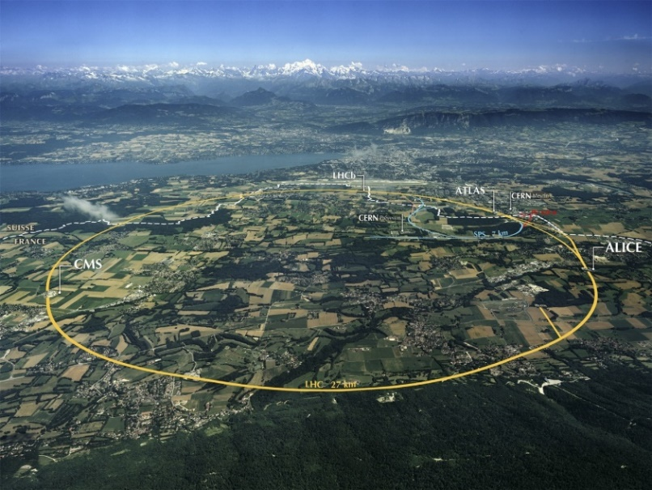
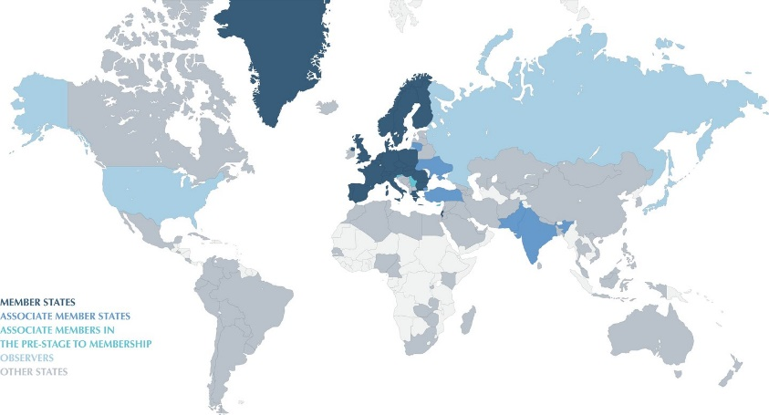
CERN & LHC
European Organization for Nuclear Research
  Conseil Européen pour la Recherche Nucléaire
Main function: to provide particle accelerators and other infrastructure needed for high-energy physics research
22 member states + wide cooperation: 105 nationalities
2500 employes + 12000 associated members of personnel
Main project: Large Hardron Collider

Slide 4
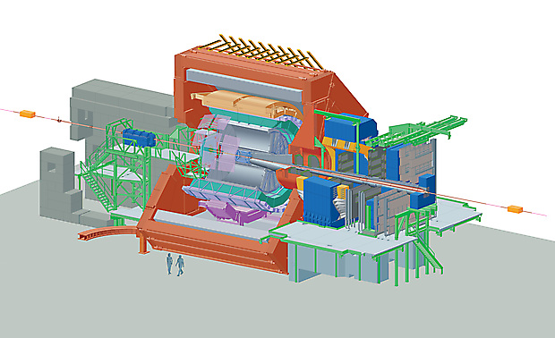
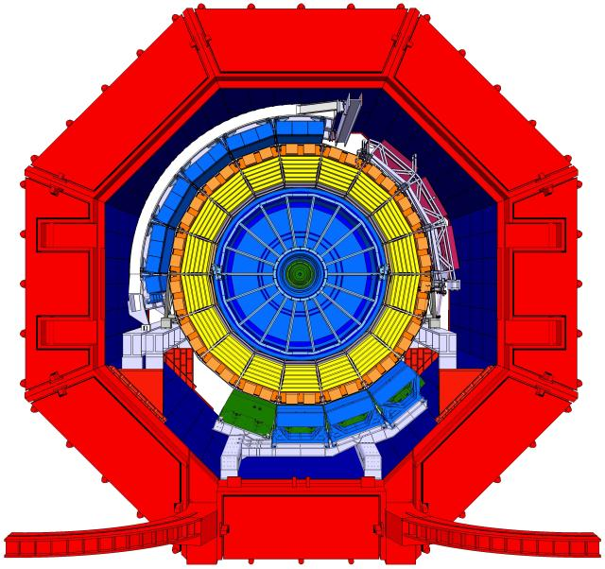
ALICE – A Large Ion Collider Experiment
Collaboration:
Members: 1500
Institutes: 154
Countries: 37
Detector:
Size: 16 x 16 x 26 m (some components installed >100m from interaction point)
Mass: 10,000 tons
Sub-detectors: 19
Magnets: 2

Slide 5
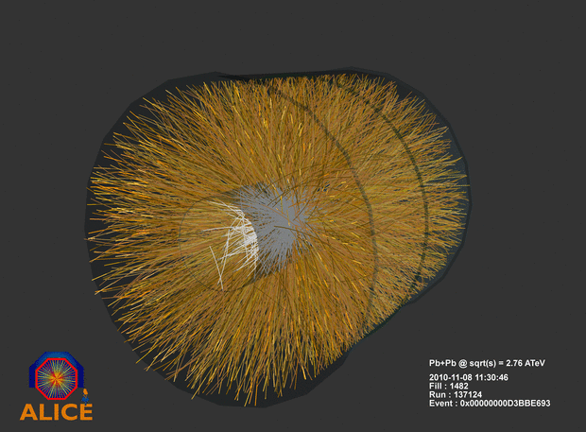
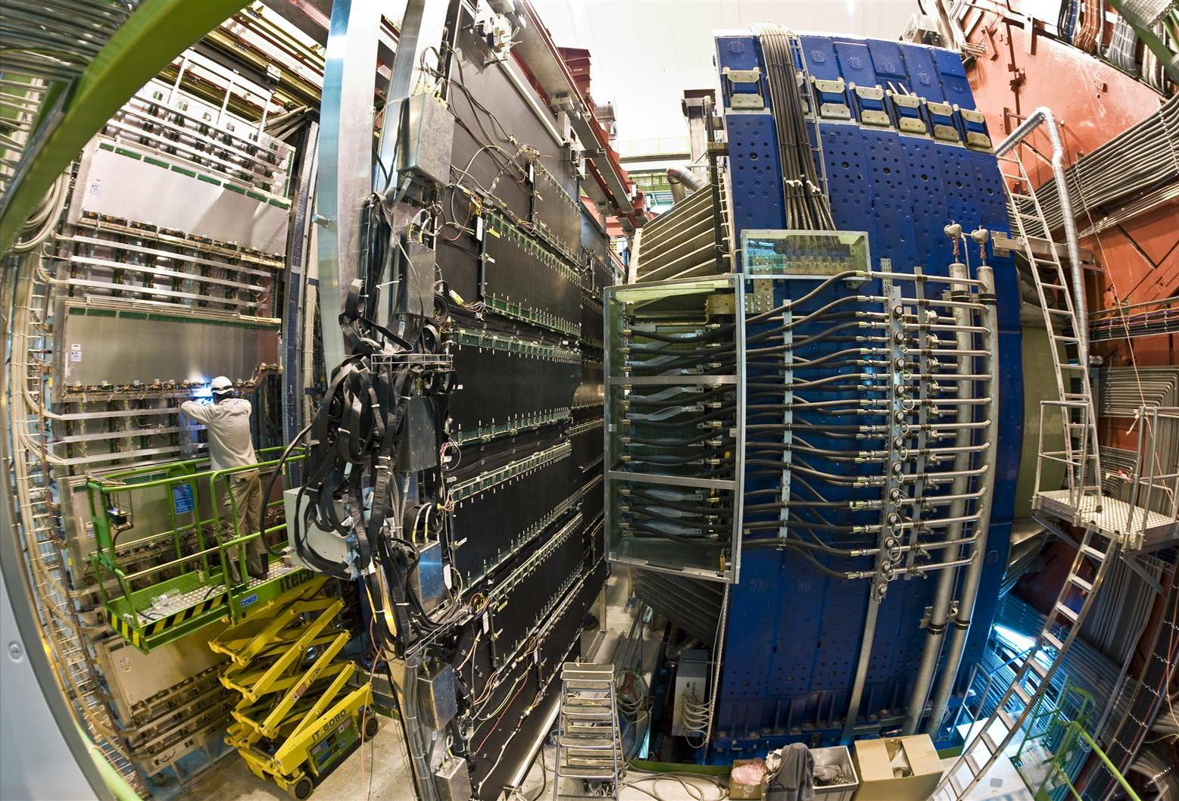
ALICE – A Large Ion Collider Experiment

Slide 6
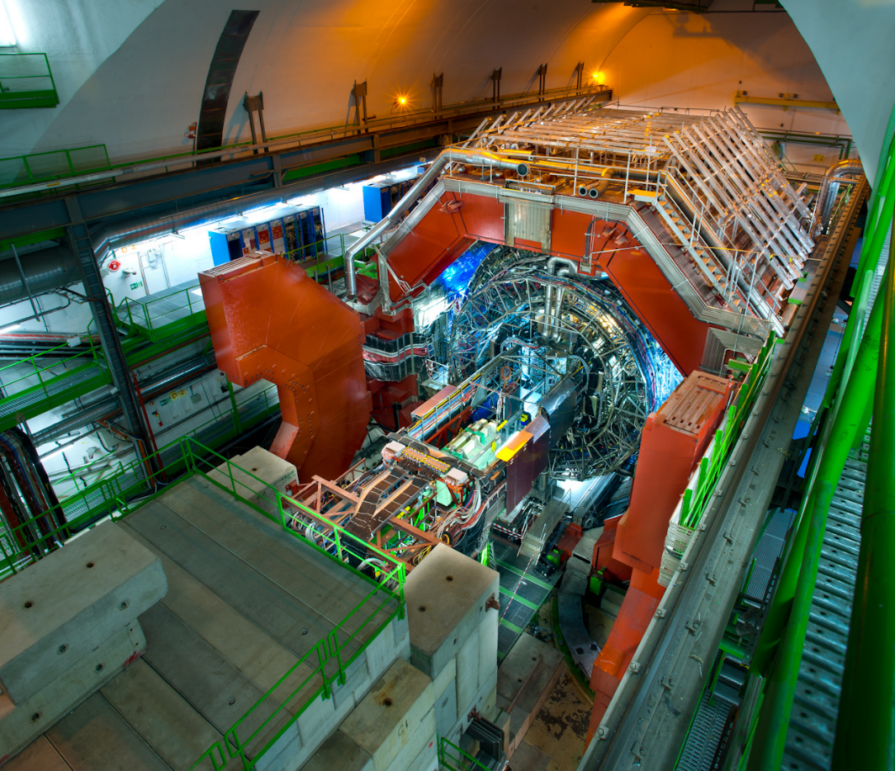
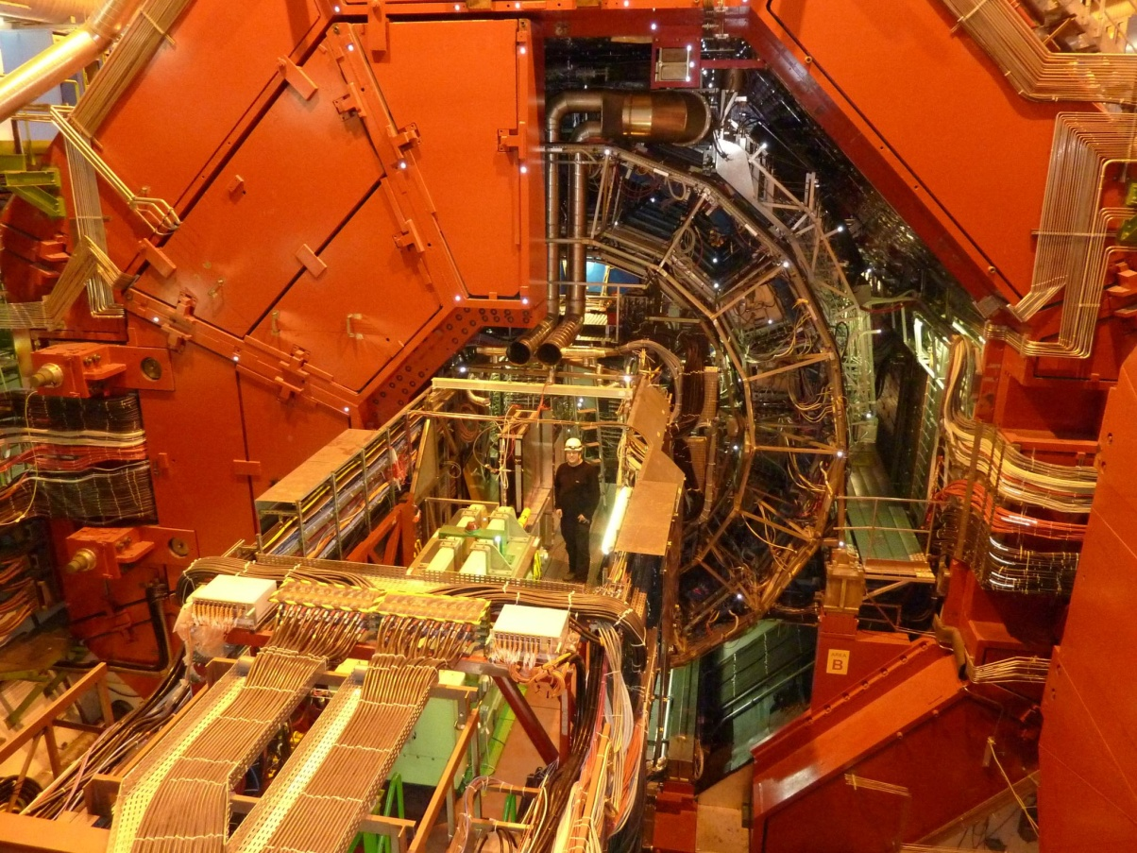
ALICE – A Large Ion Collider Experiment

Slide 7
Organization of controls activities

Slide 8
Decision making in ALICE
Collaboration Board
Management Board
Technical Board, Finance Board, Offline Board, Physics Board
Project level: ACC team, individual sub-detectors projects, DAQ, TRG, Offline groups,...
Technical Coordinator
Controls
Board
Project Leaders
Controls Coordinator
Mandate of ALICE Controls Coordination (ACC) team and definition of Detector Control System (DCS) project approved by Management Board (2001)
  Strong formal foundation for fulfilling duties

Slide 9
Organization structures
ALICE Control Coordination (ACC) is the functional unit mandated to co-ordinate the execution of the Detector Control System (DCS) project
Other parties involved in the DCS project:
  Sub-detector groups
  Groups providing the external services (IT, gas, electricity, cooling,...)
  DAQ, Trigger and Offline systems, LHC Machine
Controls Coordinator (leader of ACC) reports to Technical Coordinator and Technical Board
ALICE Controls Board
  ALICE Controls Coordinator + one representative per each sub-detector project and service activity
  The principal steering group for DCS project, reports to Technical Board

Slide 10
Controls activities
The sub-detector control systems are developed by the contributing institutes
  Over 100 developers from all around the world and from various backgrounds
  Many sub-detector teams had limited expertise in controls, especially in large scale experiments
ACC team (~7 persons) is based at CERN
  Provides infrastructure
  Guidelines and tools
  Consultancy
  Integration
  Cooperates with other CERN experiments/groups

Slide 11
Technical competencies in ACC
Safety aspects (member of ACC is deputy GLIMOS)
System architecture
Control system developement (SCADA, devices)
IT administration (Windows, Linux platforms, network, security)
Database development (administration done by the IT deparment)
Hardware interfaces (OPCS, CAN interfaces)
PLCs

Slide 12
ACC- relations
Electronics Pool
Vendors
ALICE Sub-detectors
IT – database service
ACC
IT – cyber security service
ALICE DAQ, TRG, Offline groups
IT – network service
Vendors
JCOP
ATLAS
CMS
LHCB
CERN (BE/ICS)
CERN infrastructure services: gas, cooling,ventilation
Common vendors

Slide 13

Cooperation
Joint COntrols Project (JCOP) is a collaboration between CERN and all LHC experiments to exploit communalities in the control systems
  Provides, supports and maintains a common framework of tools and a set of components
  Contributions expected from all the partners
  Organization: two types of regular meetings (around every 2 weeks):
    Coordination Board
      defining the strategy for JCOP
      steering its implementation
    Technical (working group)

Slide 14
JCOP Coordination Board - mandate
Defining and reviewing the architecture, the components, the interfaces, the choice of standard industrial products
  SCADA, field bus, PLC brands, etc
Setting the priorities for the availability of services and the production as well as the maintenance and upgrade of components
  in a way which is --as much as possible- compatible with the needs of all the experiments.
Finding the resources
  for the implementation of the program of work
Identifying and resolving issues
  which jeopardize the completion of the program as-agreed, in-time and with the available resources.
Promoting the technical discussions and the training
  to ensure the adhesion of all the protagonists to the agreed strategy

Slide 15
Design goals and strategy

Slide 16
Design goals
DCS shall ensure safe and efficient operation
  Intuitive, user friendly, automation
Many parallel and distributed developments
  Modular, still coherent and homogeneous
Changing environment – hardware and operation
  Expandable, flexible
Operational outside datataking, safeguard equipment
  Available, reliable
Large world-wide user community
  Efficient and secure remote access
Data collected by DCS shall be available for offline analysis of physics data

Slide 17
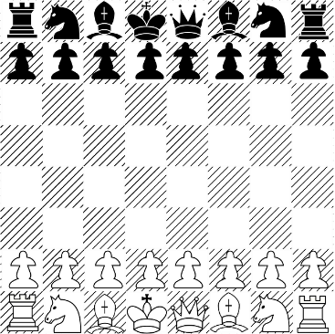
Strategy and methods
Common tools, components and solutions
  Strong coordination within experiment (ACC)
  Close collaboration with other experiments (JCOP)
  Use of services offered by other CERN units
Standardization: many similar subsystems in ALICE
  Identify communalities through:
    User Requirements Document (URD)
    Overview Drawings
    Meetings and workshops

Slide 18

User Requirement Document
Brief description of sub-detector goal and operation
Control system
  Description and requirement of sub-systems
    Functionality
    Devices / Equipment (including their location, link to documentation)
    Parameters used for monitoring/control
    Interlocks and Safety aspects
    Operational and Supervisory aspects
  Requirement on the control system
    Interlocks and Safety aspects
    Operational and Supervisory aspects
Timescale and planning (per subsystem)
  For each phase:
    Design, Production and purchasing, Installation, Commissioning , Tests and Test beam

Slide 19
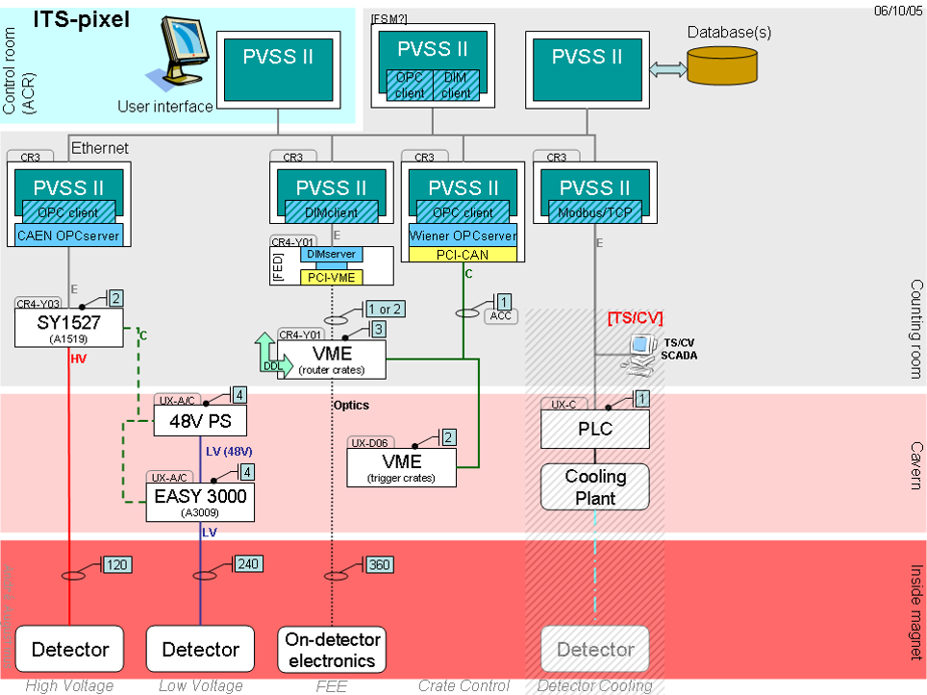
Overview Drawings

Slide 20

Prototype development
In order to study and evaluate possible options of ‘standard solutions’ to be used by the sub-detector groups it was necessary to gain "hands-on" experience and to develop prototype solutions
Prototype developments were identified after discussions in Controls Board and initiated by the ACC team in collaboration with selected detector groups
  Examples:
    Standard ways of measuring temperatures
    Control of HV systems
    Monitoring of LV power supplies
Prototype of complete end-to-end detector control slices including the necessary functions at each DCS layer
  from operator to electronics

Slide 21

ACC deliverables – design phase
DCS architecture layout definition
URD of systems, devices and parameters to be controlled and operated by DCS
Definition of ‘standard’ ALICE controls components and connection mechanisms
Prototype implementation of ‘standard solutions’
Prototype implementation of an end-to-end detector controls slice
Global project budget estimation
Planning and milestones

Slide 22
Coordination and evolution challenge
Initial stage, development
  Establish communication with all the involved parties
  To overcome cultural differences: Start coordinating early, strict guidelines
During operation, maintenance
  HEP environment: original developers tend to drift away
    (apart from a few exceptions) very difficult to ensure continuity for the control systems in the projects
  In many small detector projects, controls is done only part-time by a single person
The DCS has to
  follow the evolution of the experiment equipment and software
  follow the evolution of the use of the system
  follow the evolution of the users

Slide 23
DCS Architecture

Slide 24
The Detector Control System
Responsible for safe and reliable operation of the experiment
  Designed to operate autonomously
  Wherever possible, based on industrial standards and components
  Built in collaboration with ALICE institutes and CERN JCOP
  Operated by a single operator

Slide 25
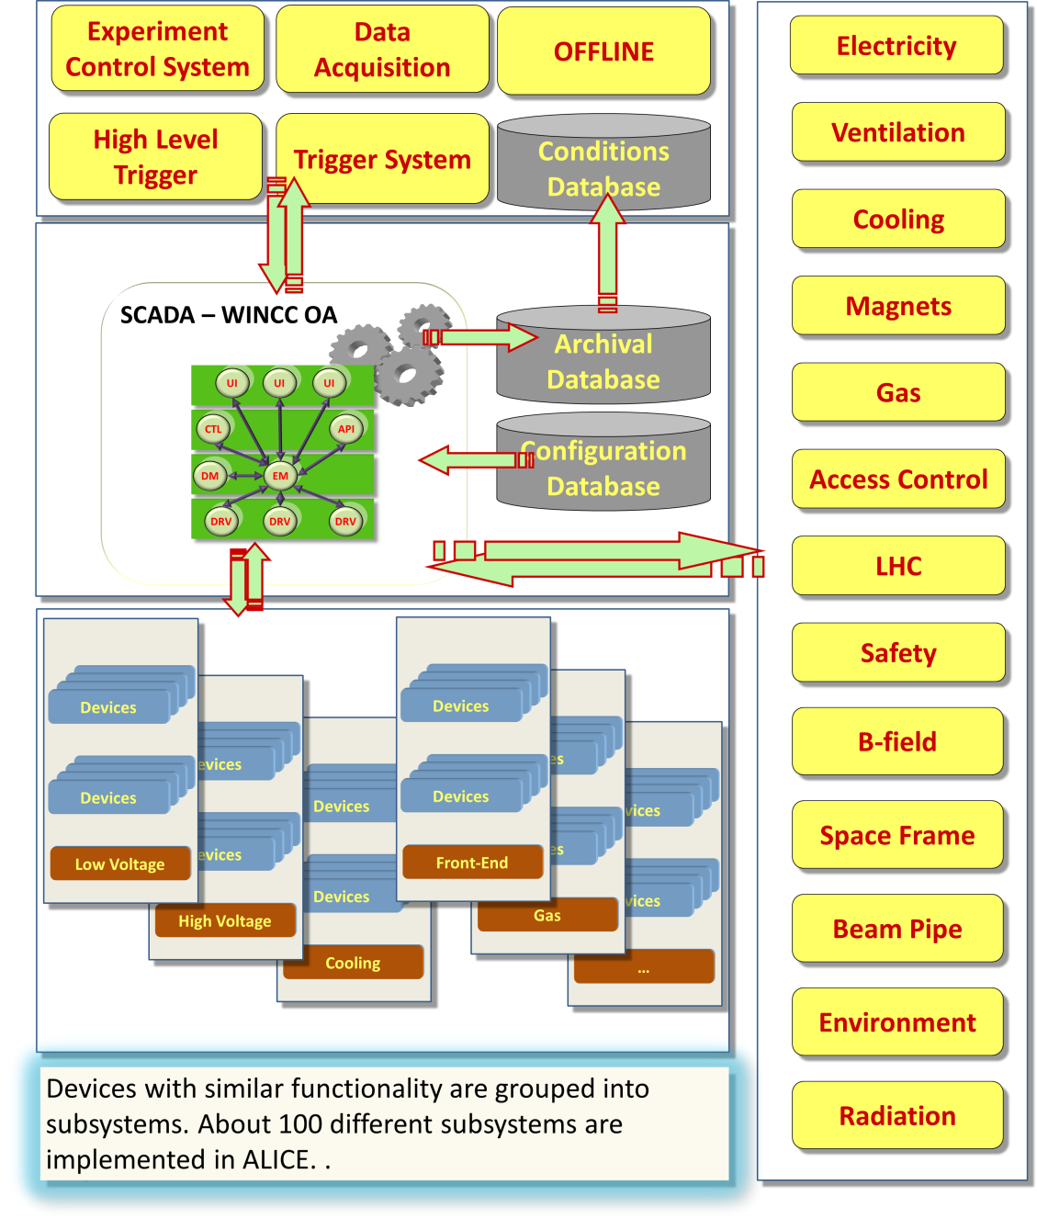
The DCS context and scale
19 autonomous detector systems
1200 network attached devices
100 WINCC OA systems
>700 embedded computers
>100 subsystems
170 control computers
270 crates
200 000 OPC items
1 000 000 supervised parameters
100 000 frontend services

Slide 26
The DCS data flow

Slide 27
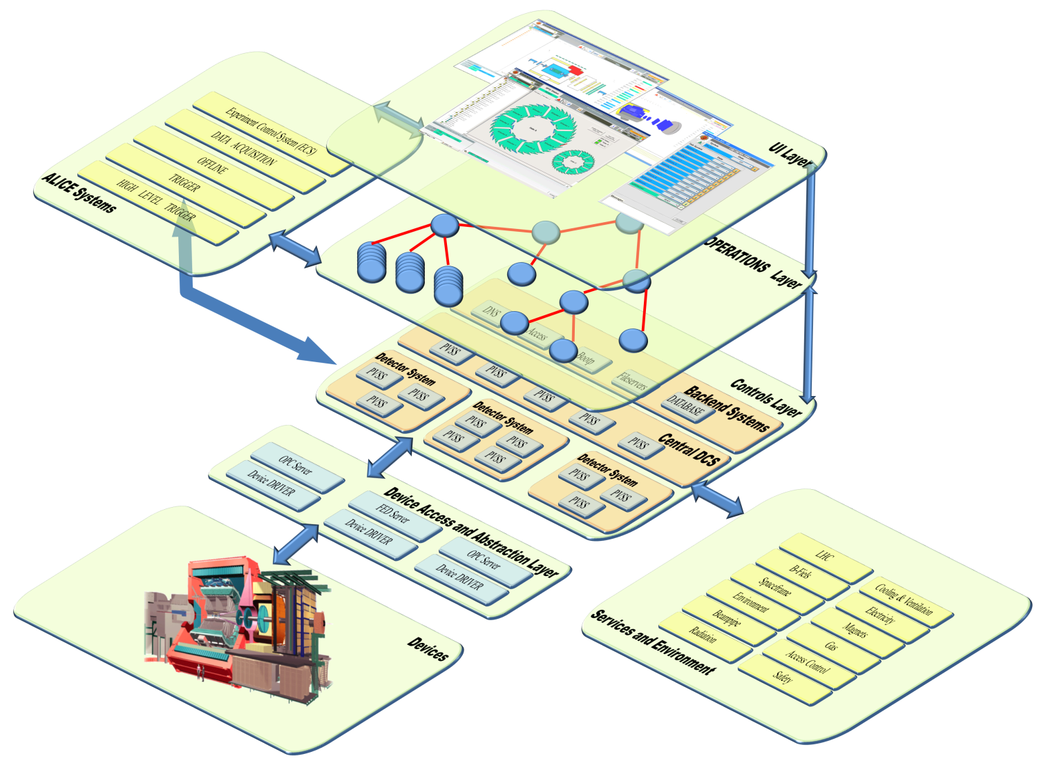
DCS Architecture
User Interface Layer
Intuitive human interface
User Interface Layer
Operations Layer
Hierarchy and partitioning by FSM
Controls Layer
Core SCADA based on WINCC OA
Operations Layer
Device abstraction Layer
OPC and FED servers
Field Layer
DCS devices
Controls Layer
Device abstraction Layer
Field Layer

Slide 28
DCS Architecture
The DCS Controls Layer

Slide 29
UI
UI
Control
API
Data
Event
Driver
Driver
Core of the Control Layer runs on WINCC OA SCADA system
Single WINCC OA system is composed of managers
Several WINCC OA systems can be connected into one distributed system
DIST
DIST
UI
UI
Control
API
100 WINCC OA systems
2700 managers
Data
Event
Driver
Driver

Slide 30
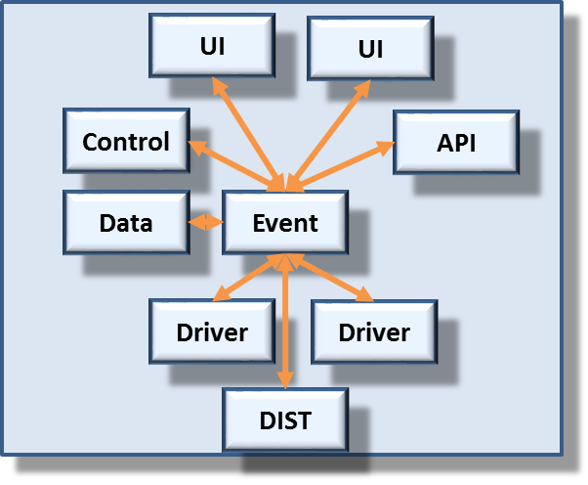
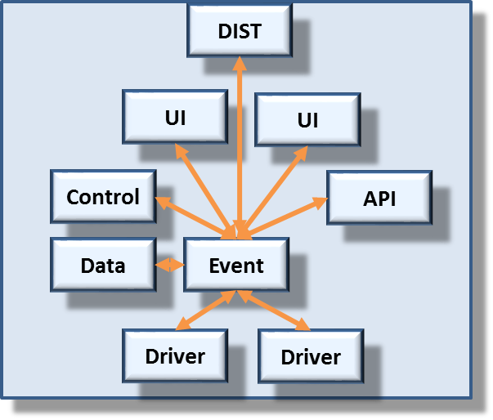
An autonomous distributed system is created for each detector

Slide 31
Central systems connect to all detector systems
ALICE controls layer is built as a distributed system consisting of autonomous distributed systems

Slide 32
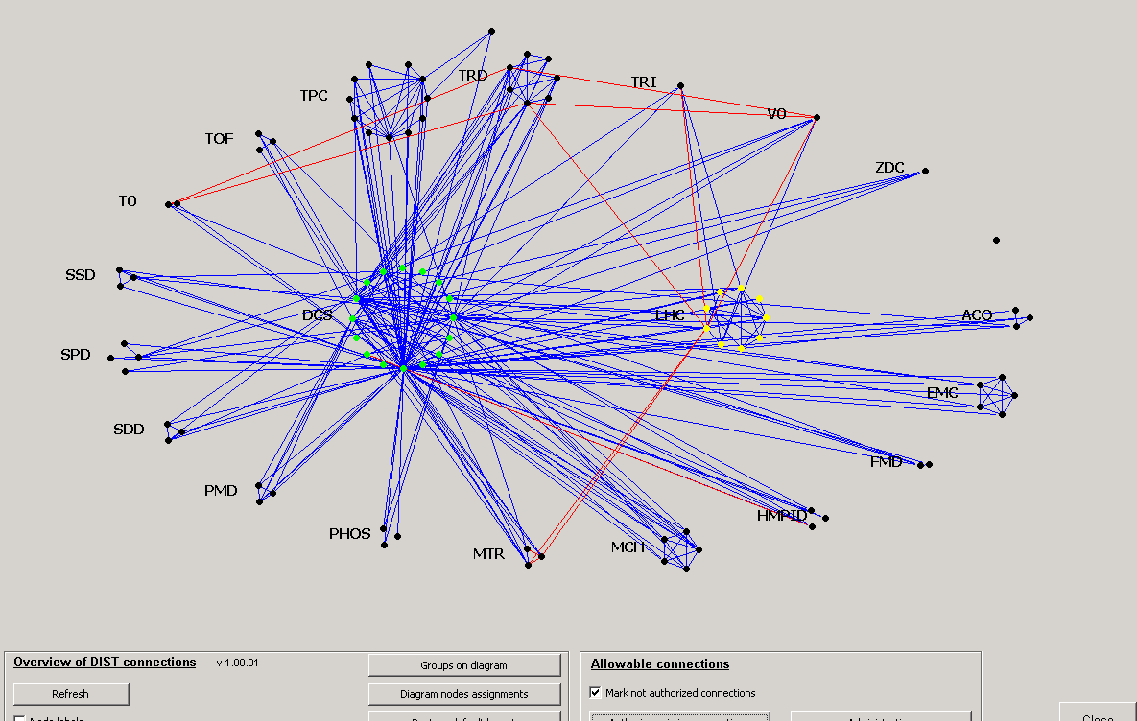
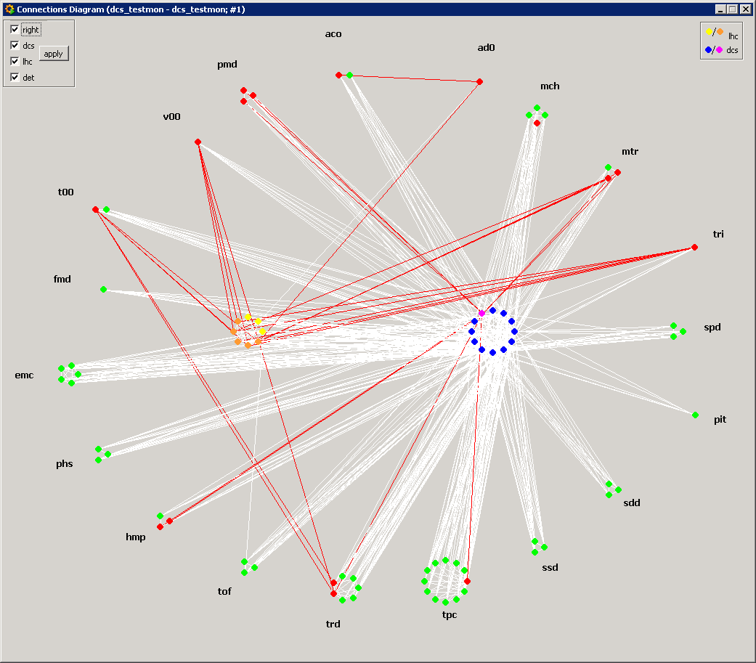
‘illegal’ connection
To avoid inter-system dependencies, connections between detectors are not permitted
Central systems collect required information and re-distribute them to other systems
  New parameters added on request
System cross connections are monitored and anomalies are addressed

Slide 33
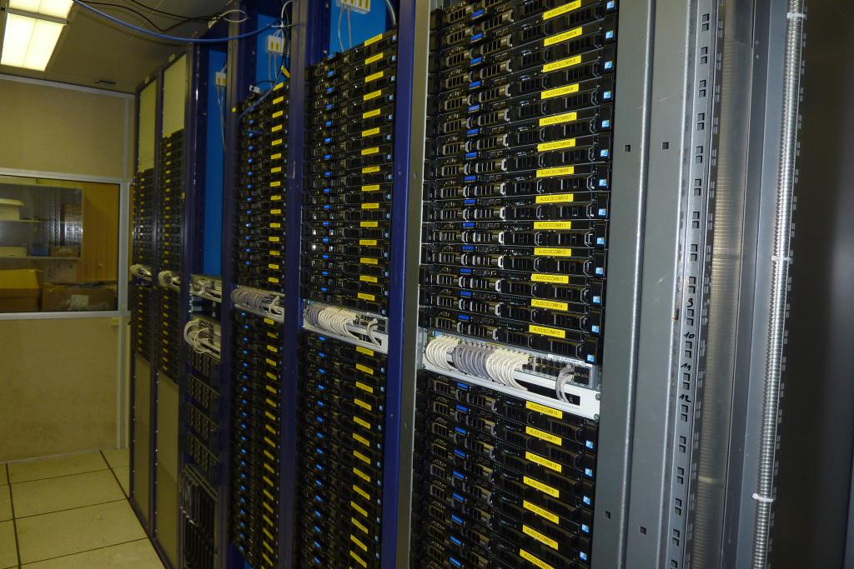
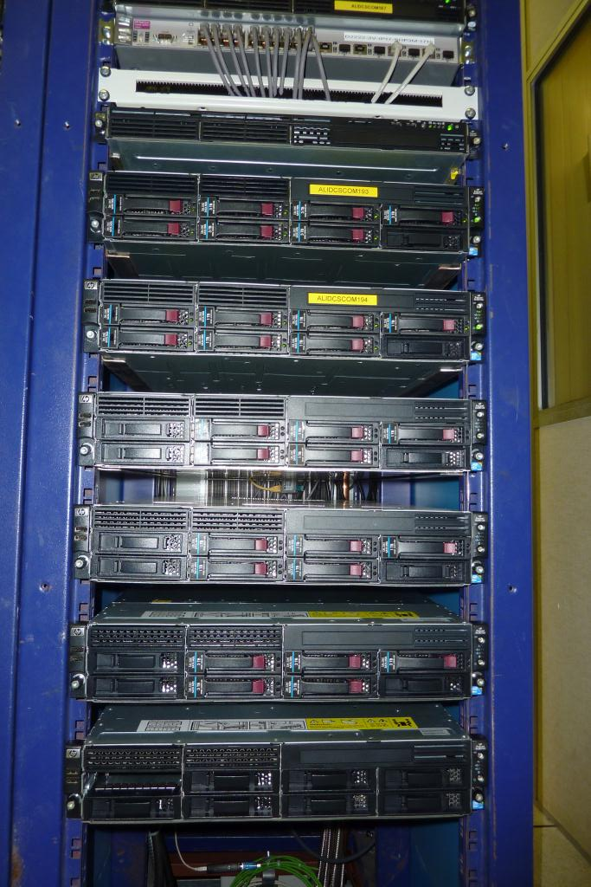
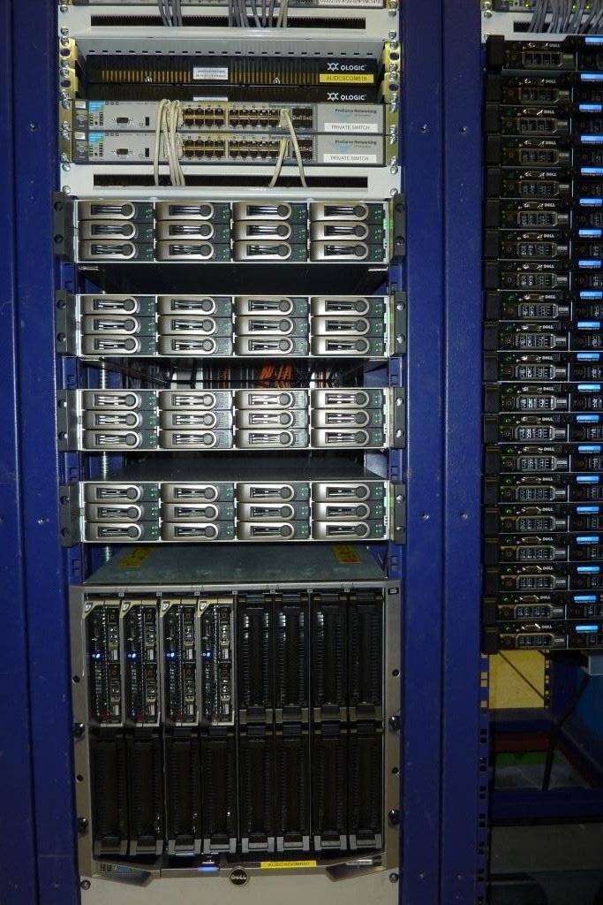
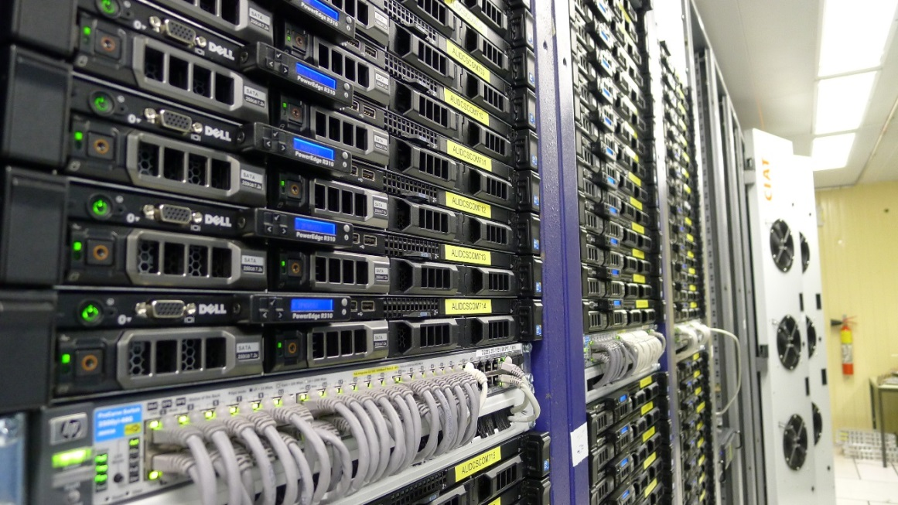
DB servers
ORACLE size:
5.4 TB
Worker nodes
Fileservers
Central DCS cluster consists of ~170 servers
  Managed by central team
  Worker nodes for WINCC OA and Frontend services
  ORACLE database
  Storage
  IT infrastructure

Slide 34
DCS Architecture
Field Layer
The power of standardization

Slide 35
DCS Architecture
User Interface Layer
Intuitive human interface
User Interface Layer
Operations Layer
Hierarchy and partitioning by FSM
Controls Layer
Core SCADA based on WINCC OA
Operations Layer
Device abstraction Layer
OPC and FED servers
Field Layer
DCS devices
Controls Layer
Device abstraction Layer
Field Layer

Slide 36
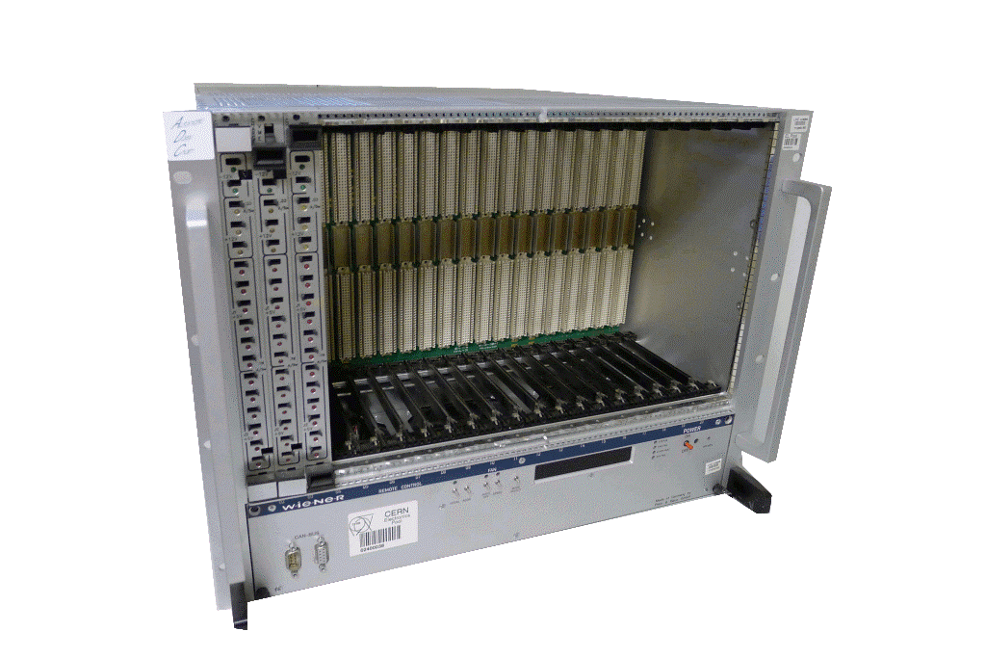
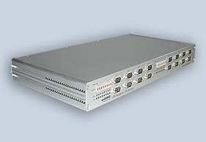
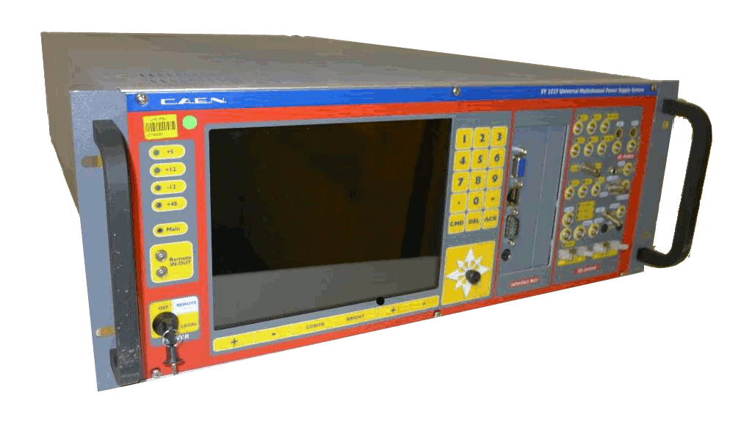
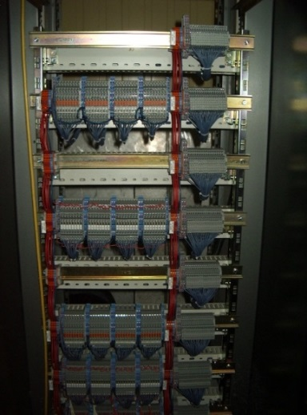
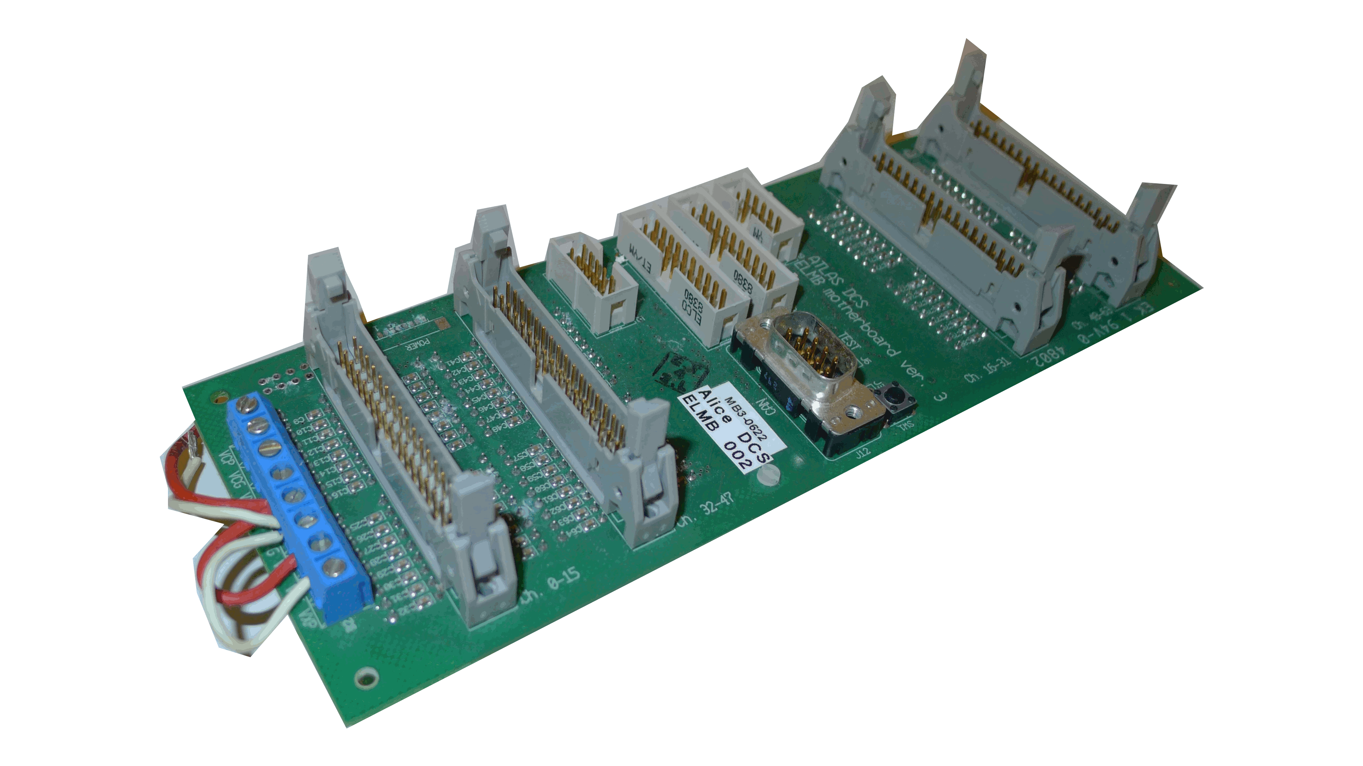
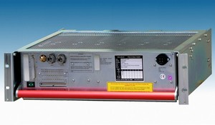
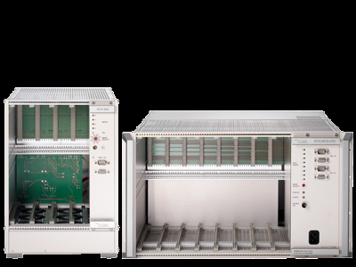
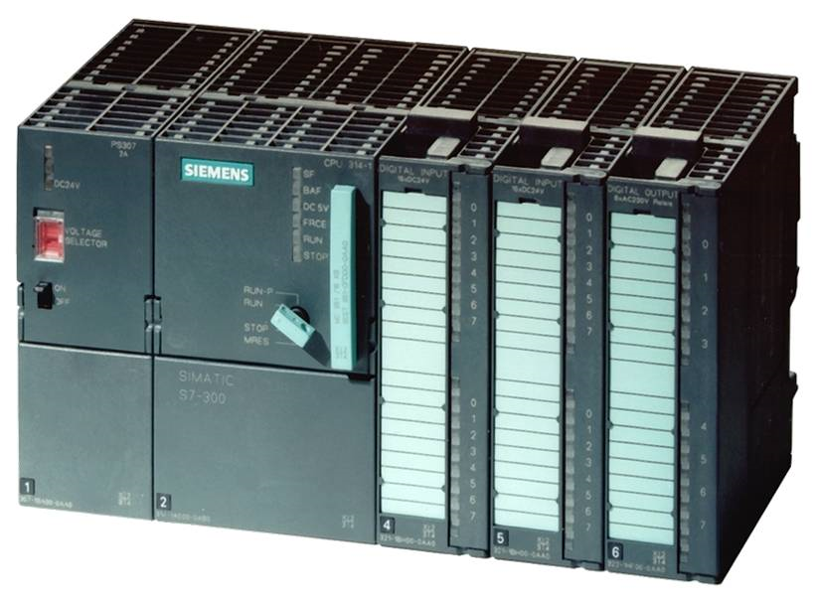
Wherever possible, standardized components are used
  Commercial products
  CERN-made devices

Slide 37
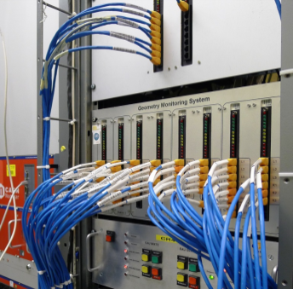
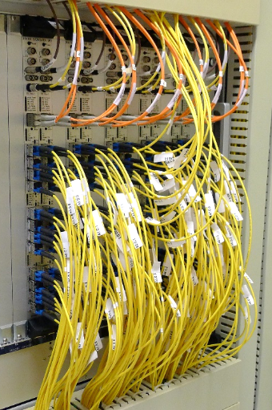
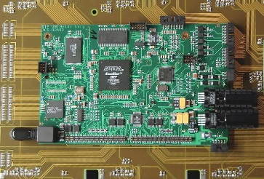
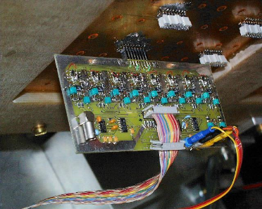
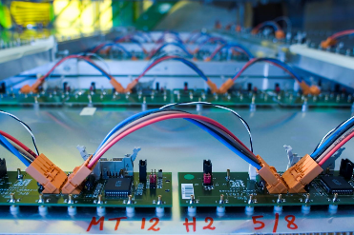
Frontend electronics
  Unique for each detector
  Large diversity, multiple buses and communication channels
    Several technologies used within the same detector
CAN
ETHERNET
EASYNET
VME
JTAG
RS 232
PROFIBUS
Custom links…

Slide 38
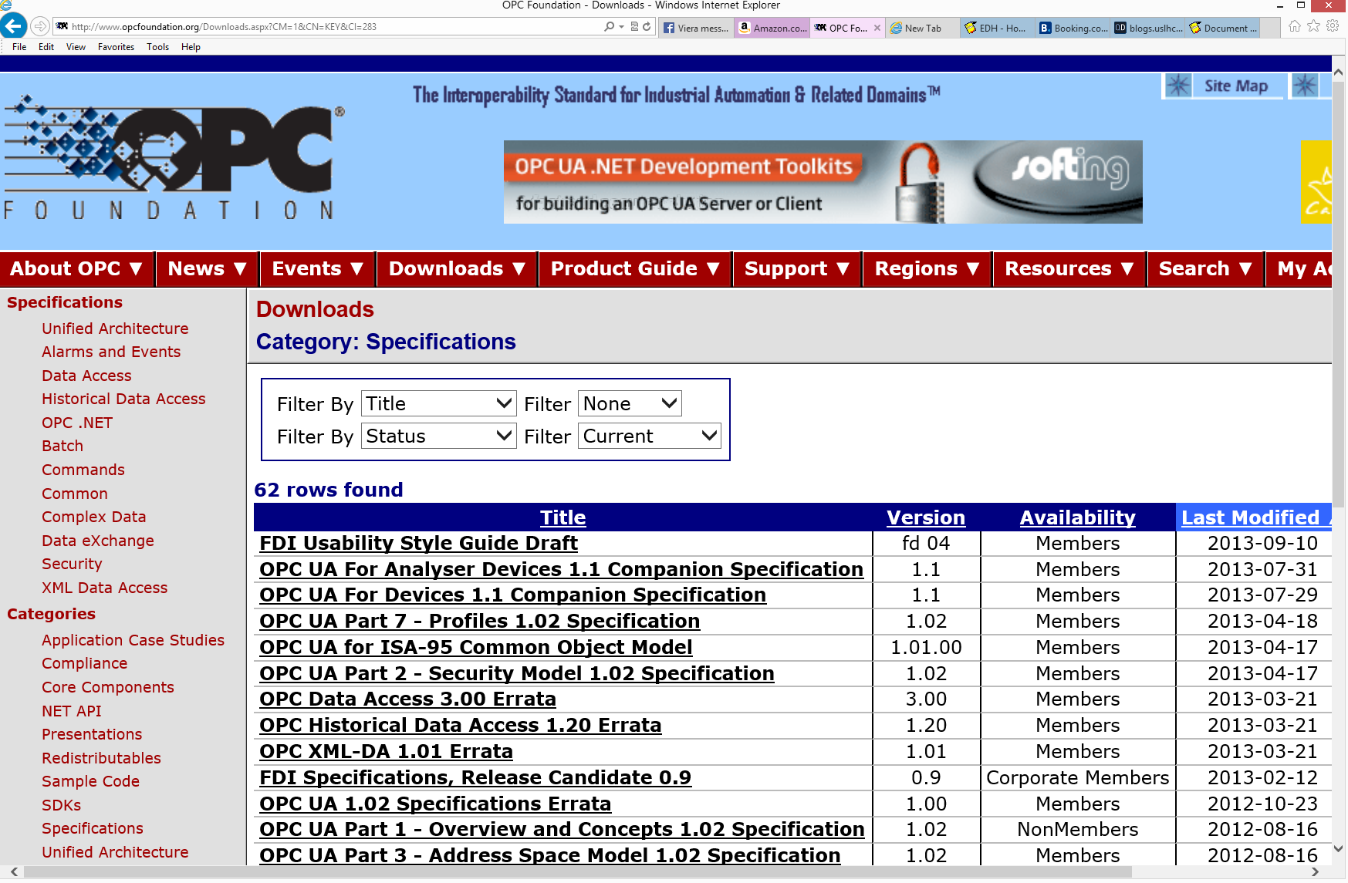
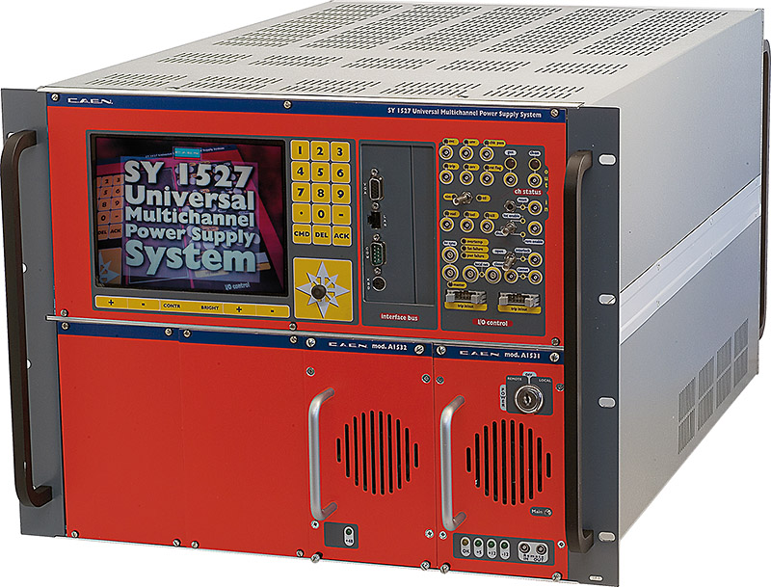
OPC used as a communication standard wherever possible
  Native client embedded in WINCC OA
WINCC OA
WINCC OA OPC Client
DCOM
Commands
Status
200 000 OPC items
in ALICE
OPC Server
Device Driver
Standardized interface
Standardized Device

Slide 39
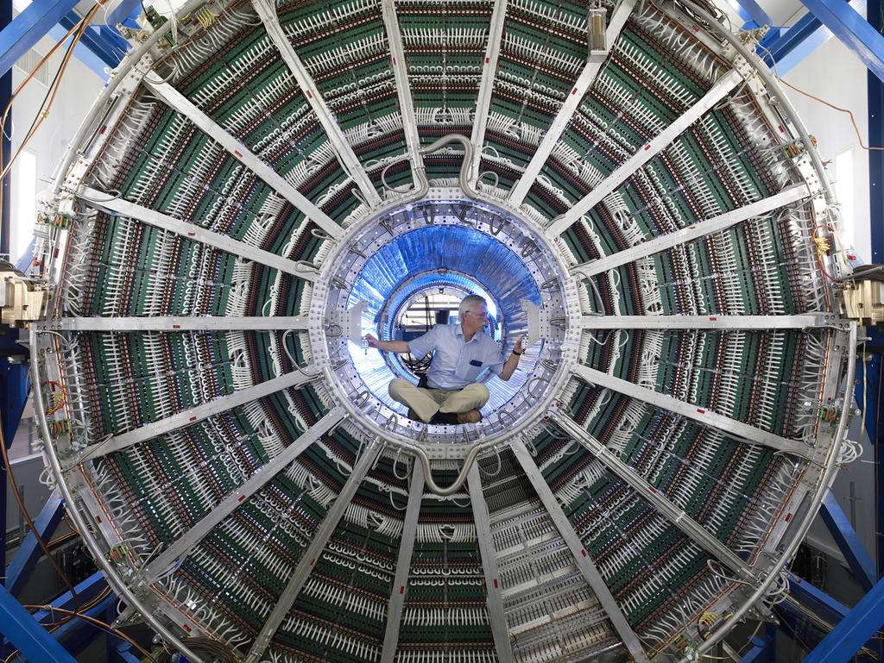
Missing standard for custom devices
  OPC too heavy to be developed and maintained by institutes
  Frontend drivers often scattered across hundreds of embedded computers (Arm Linux)
WINCC OA
???
???
Commands
Status
????
Device Driver
(Custom) interface
Custom Device

Slide 40
Filling the gap
PVSS
PVSS
???
FED (DIM) CLIENT
???
Commands
Status
DIM
Commands
Status
????
FED (DIM) SERVER
Device Driver
Device Driver
(Custom) interface
(Custom) interface
Custom Device
Custom Device

Slide 41
Generic FED architecture
Generic client implemented as PVSS manager
DIM Client
Commands
Data
Sync
FED Server
Communication interface with standardized commands and services
DIM Server
Custom logic
Device/specific layer providing high-level functionality (i.e. Configure, reset...)
Low-level device interface (i.e. JTAG driver and commands)
Low Level Device Driver

Slide 42
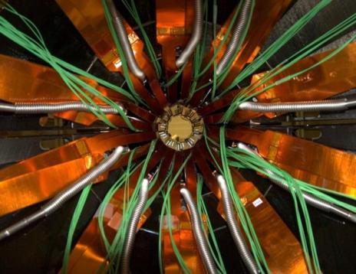
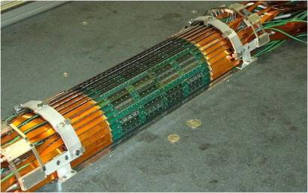
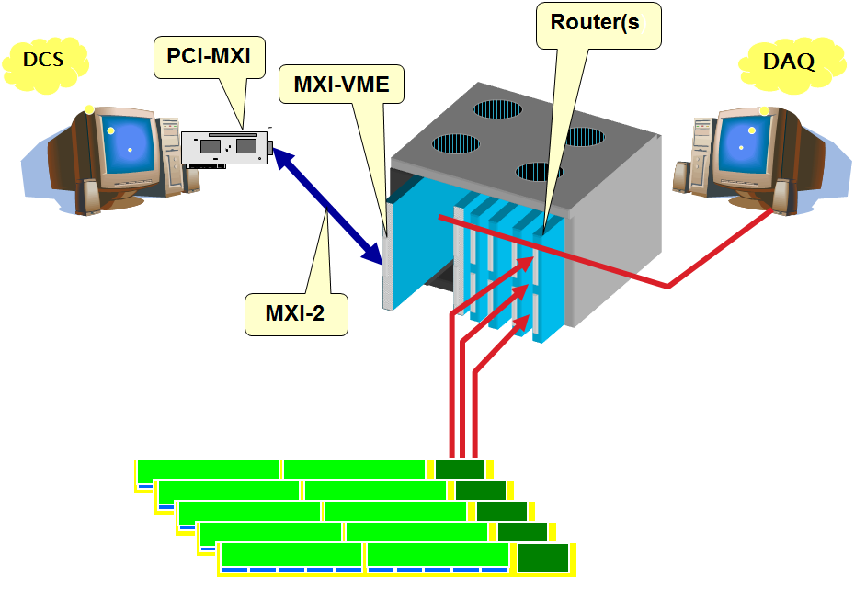
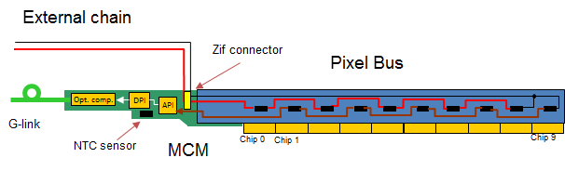
SPD FED Implementation
Commands
Data
Sync
FED Server
DIM Server
Custom logic
NI-VISA
MXI
VME-JTAG

Slide 43
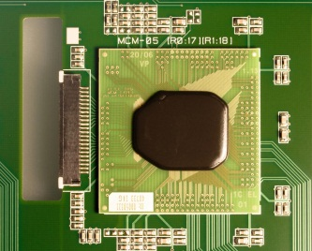
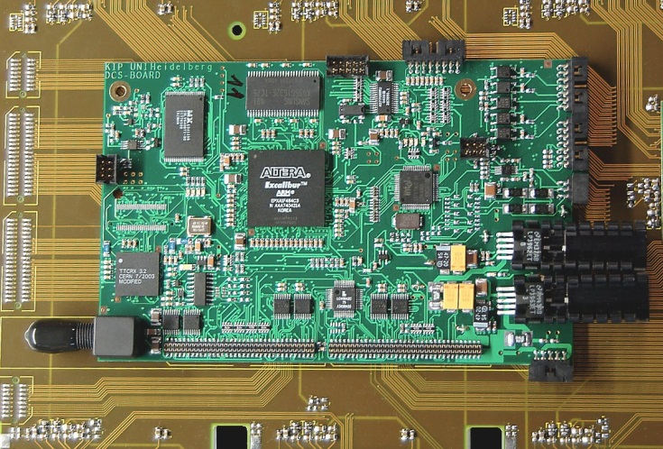
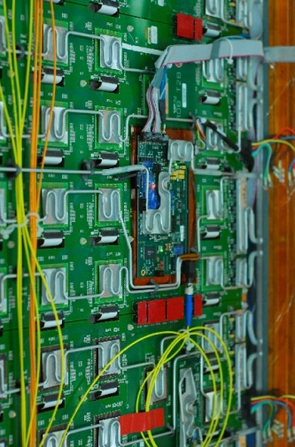
TRD FED Implementation
Commands
Data
Sync
500 FEE servers
FED Server
2 FED servers
DIM Server
Custom logic
(Intercom)
DCS control board (~750 used in ALICE)
DIM
FEE Client
FEE Server
Custom logic

Slide 44
DCS Architecture
Operation Layer

Slide 45
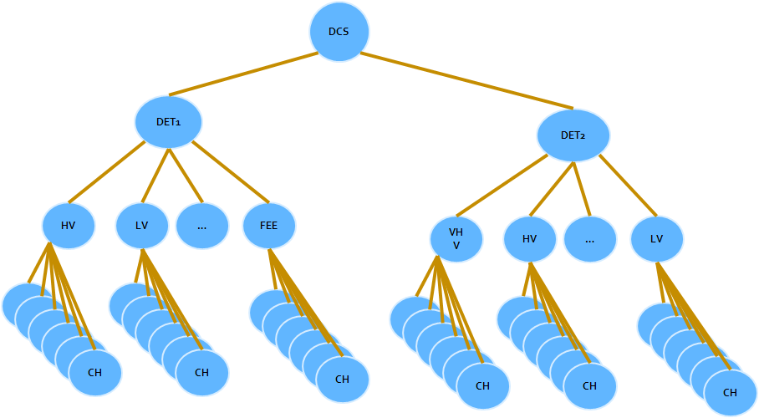
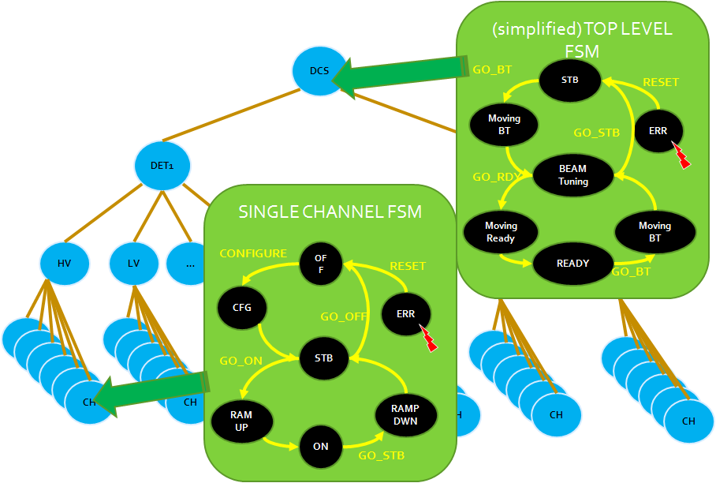
Hierarchical approach
Central control
Based on CERN toolkit (SMI++)
Detector
Each node modelled as FSM
Subsystem
Integrated with WINCC OA
Device

Slide 46
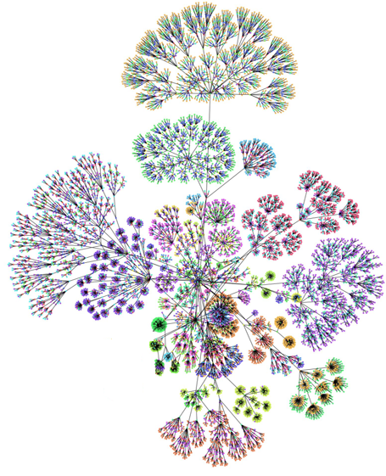
ALICE central FSM hierarchy
1 top DCS node
19 detector nodes
100 subsystems
5000 logical devices
10000 leaves

Slide 47
READY for Physics
READY
Compatible with beam operations
Beam Tuning
Configuration loaded
Standby
Configured
Devices powered ON
Standby
Everything OFF
OFF

Slide 48
OFF
GO_ON
ON
Atomic actions sometimes require complex logic:
Some detectors require cooling before they turn on the low voltage
But
Frontend will freeze if cooling is present without low voltage
Unconfigured chips might burn (high current) if powered
But
The chips can be configured only once powered
Do magic
OFF
GO_ON
GO_ON
ON

Slide 49
OFF
GO_ON
ON
Originally simple operation become complex in real experiment environment
Cross-system dependencies are introduced.
Am I authorized?
Is Cooling OK?
Is LHC OK
Are magnets OK?
Is run in progress?
Are counting rates OK?
OFF
GO_ON
GO_ON
ON

Slide 50
Each detector has specific needs
Operational sequences and dependencies are too complex to be mastered by operators
Operational details are handled by FSM prepared by experts and continuously tuned

Slide 51
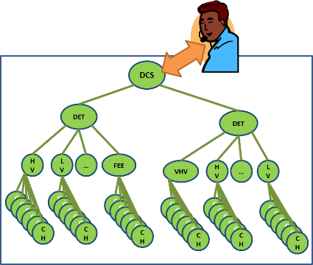
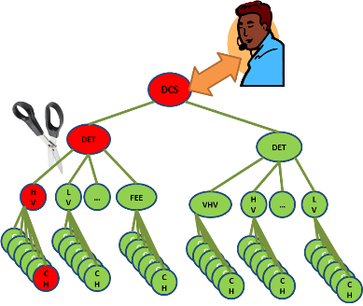
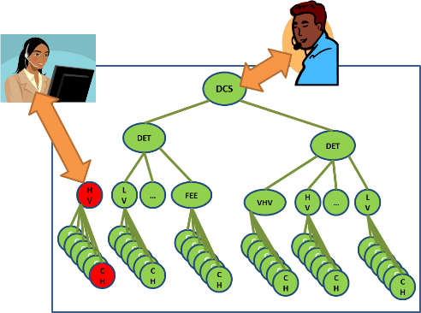
Partitioning
Single operator controls ALICE
Failing part is removed from hierarchy
Remote expert operates excluded part
ALICE is primary interested in ion physics
During the LHC operation with protons, there is small room for developments and improvements
Partitioning is used by experts to allow for parallel operation

Slide 52





Certain LHC operations might be potentially dangerous for detectors
Detectors can be protected by modified settings (lower HV…)
But……
Excluded parts do not receive the command!
DCS
DET
DET
HV
LV
…
FEE
VHV
HV
…
LV
CH
CH
CH
CH
CH
CH
CH
CH
CH
CH
CH
CH
CH
CH
CH
CH
CH
CH
CH
CH
CH
CH
CH
CH
CH
CH
CH
CH
CH
CH
CH
CH
CH
CH
CH
CH

Slide 53
For potentially dangerous situations a set of procedure independent on FSM is available
Automatic scripts check all critical parameters directly also for excluded parts
Operator can bypass FSM and force protective actions to all components

Slide 54






Slide 55
DCS Architecture
User interface layer

Slide 56
DCS Architecture
User Interface Layer
Intuitive human interface
User Interface Layer
Operations Layer
Hierarchy and partitioning by FSM
Controls Layer
Core SCADA based on WINCC OA
Operations Layer
Device abstraction Layer
OPC and FED servers
Field Layer
DCS devices
Controls Layer
Device abstraction Layer
Field Layer

Slide 57

The original simple FSM layout got complex with time
Potential risk of human errors in operation
A set of intuitive panels and embedded procedures replaced the direct FSM operation

Slide 58









Slide 59
DCS Operation

Slide 60
Organization
Central operator is responsible for all subdetectors
  24/7 shift coverage during ALICE operation periods
  High turnaround of operators – specific to HEP collaborations
  Shifters training and on-call service provided by the central team
  Requires clear, extensive documentation understandable for non-expert, and easily accessible
Sub-detector systems are maintained by experts from the collaborating institutes
  Oncall expert reachable during operation with beams
    Remote access for interventions
  In critical periods, detector shifts might be manned by detector shifters
    Very rare and punctual activity e.g. few hours when heavy ion period starts – the system has grow mature

Slide 61
Emergency handling
Sub-detectors developers prepare alerts and related instructions for their subsystems
  These experts very ofter become on-call experts
  Automatic or semi-automatic recovery procedures
3 classes of alerts:
Fatal | high priority - imminent danger, immediate reaction required
Error | middle priority - severe condition which does not represent imminent danger but shall be treated without delay
Warning | low priority - early warning about possible problem, does not represent any imminent danger

Slide 62

Alert handling
Reaction to DCS alerts (classes fatal and error) is one of the main DCS operator tasks
Warnings:
  Under responsibility of subsystems shifters/experts
  No reaction expected from central operator
Dedicated screen displays alerts (F,E) arriving from all connected DCS systems as well as from remote systems and services

Slide 63


Alert instructions
Available directly from the alerts screen

Slide 64
Alert handling procedure
Alert triggered
If sub-detector crew present - delegate
Check Instructions
(right click on AES)
Instructions missing – call expert
Follow instructions
Instructions not clear or do not help – call expert
Acknowledge
Make logbook entry

Slide 65
Infrastructure Management

Slide 66

DCS Network
The controls network is a separate, well protected network
  Without direct access from outside the experimental area
  With remote access only through application gateways
  With all equipment on secure power

Slide 67
Computing Rules for DCS Network
Document prepared by ACC and approved on the Technical Board level
Based on
  CERN Operational Circular Nr. 5 (baseline security document, mandatorily signed by all users having a CERN computing account)
  Security Policy prepared by CERN Computing and Network Infrastructure (CNIC)
  Recommendations of CNIC
Describes services offered by ACC related to computing infrastructure

Slide 68

Scope of Computing Rules
Categories of network attached devices
Computing hardware (HW) purchases and installation
  Standard HW -> by ACC
  Rules for accepting non-standard HW
Computer and device naming conventions
DCS software installations
  Rules for accepting non-standard components
Remote access policies for DCS network
  Access control and user privileges
    2 levels: operators and experts
  Files import and export rules
Software backup policies
Reminder that any other attempt to access the DCS network is considered as unauthorized and in direct conflict with CERN rules and subjected to sanctions

Slide 69


Managing Assets
DCS services require numerous software and hardware assets (Configuration Items)
Essential to ensure that reliable and accurate information about all these components along with the relationship between them is properly stored and controlled
CIs are recorded in different configuration databases at CERN
Configuration Management System - integrated view on all the data
Repository for software

Slide 70

Hierarchy of Configuration Items
Based on IT Infrastructure Library (ITIL) recommendations

Slide 71

Managing dependencies
Generation of diagrams showing dependencies between CIs for impact analysis

Slide 72


Knowledge Management
Implemented via:
  MS SharePoint - documents management and collaboration system
    before TWiki & custom ACC webpages were in use
  JIRA – issues tracking
  Scope – all deliverables from ACC
  Technical documentation for experts
  Operational procedures
  Training materials
  DCS Computing Rules
  Known Errors register
  Operation reports
  Publications
  ...

Slide 73
Summary
Standarization is the key to success
Experiment environment evolves rapidly
  Scalability and flexibility play important role in DCS design
  Stable central team contributing to the conservation of expertise
Central operation
  Cope with large number of operators
  Adequate and flexible operation tools, automation
  Easily accessible, explicit procedures
Experiment world is dynamic, volatile
  Requires a major coordination effort
ALICE DCS provided excellent and uninterrupted service since 2007

Slide 74
Summary
Operational experiences gained during the operation are continuously implemented into the system in form of procedures and tools
  Relatively quiet on-call shifts for ACC members
    Number of calls decreased significantly over time (from ~1 per day at the start to ~1 per week now)
      More automation
      Better training and documentation
      Better procedures
      Better UIs that make operation more intuitive (hiding complexity)

Slide 75

THANK YOU FOR YOUR ATTENTION

