Slide 1
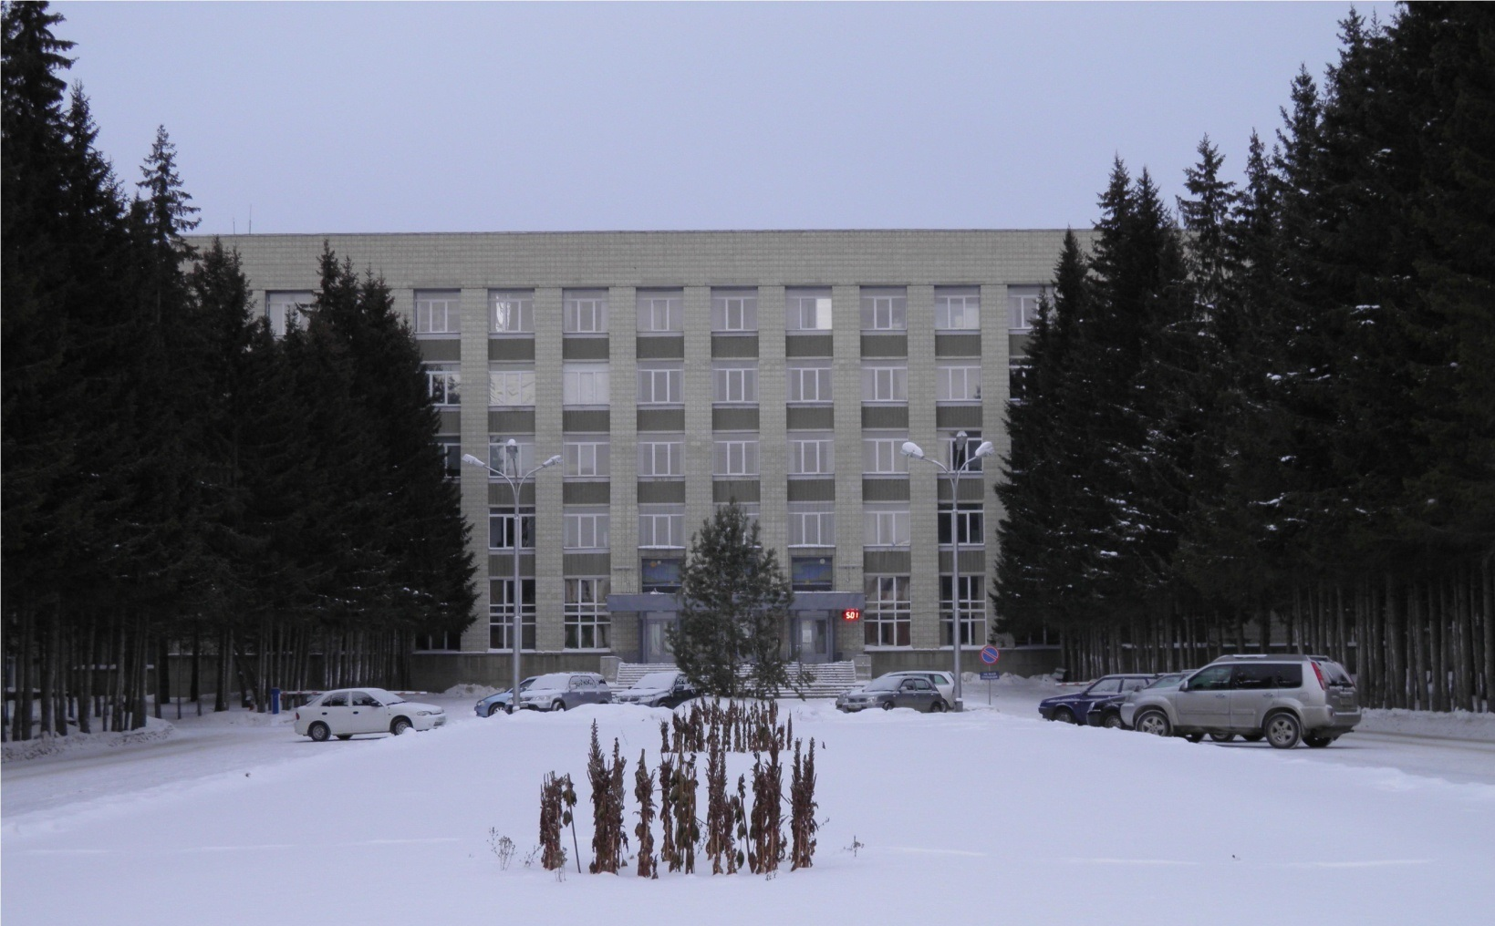
The conceptual design of control
Dewar for PANDA solenoid magnet

Slide 2
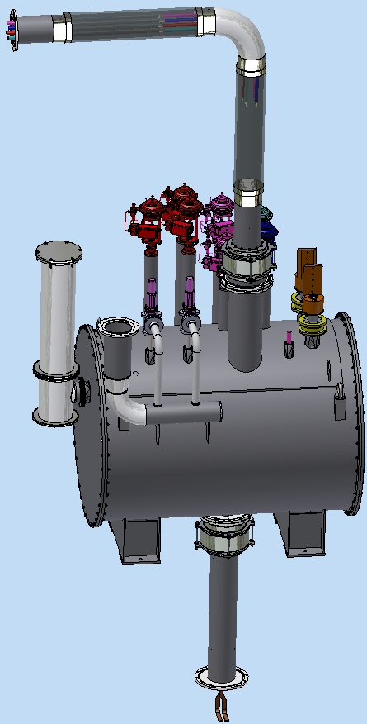
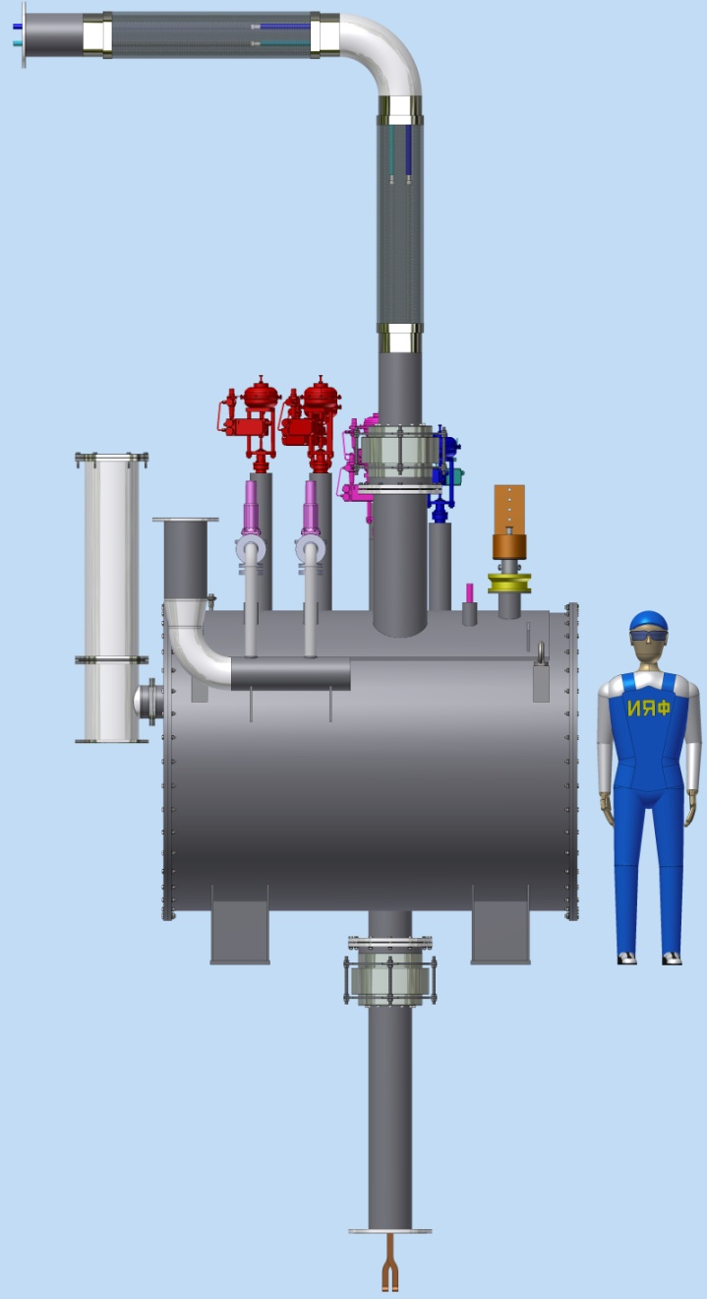
PANDA control Dewar
The PANDA control Dewar is designed to ensure helium delivery to the user in accordance with the flow scheme.
TL
The
Man
- transfer lines (TL) connecting refrigerator and control Dewar
- transfer line (Chimney) connecting the vacuum vessels of cryostat and control Dewar
D1600
2080
Chimney
Control Dewar
Figure 1. General view of the control Dewar.

Slide 3
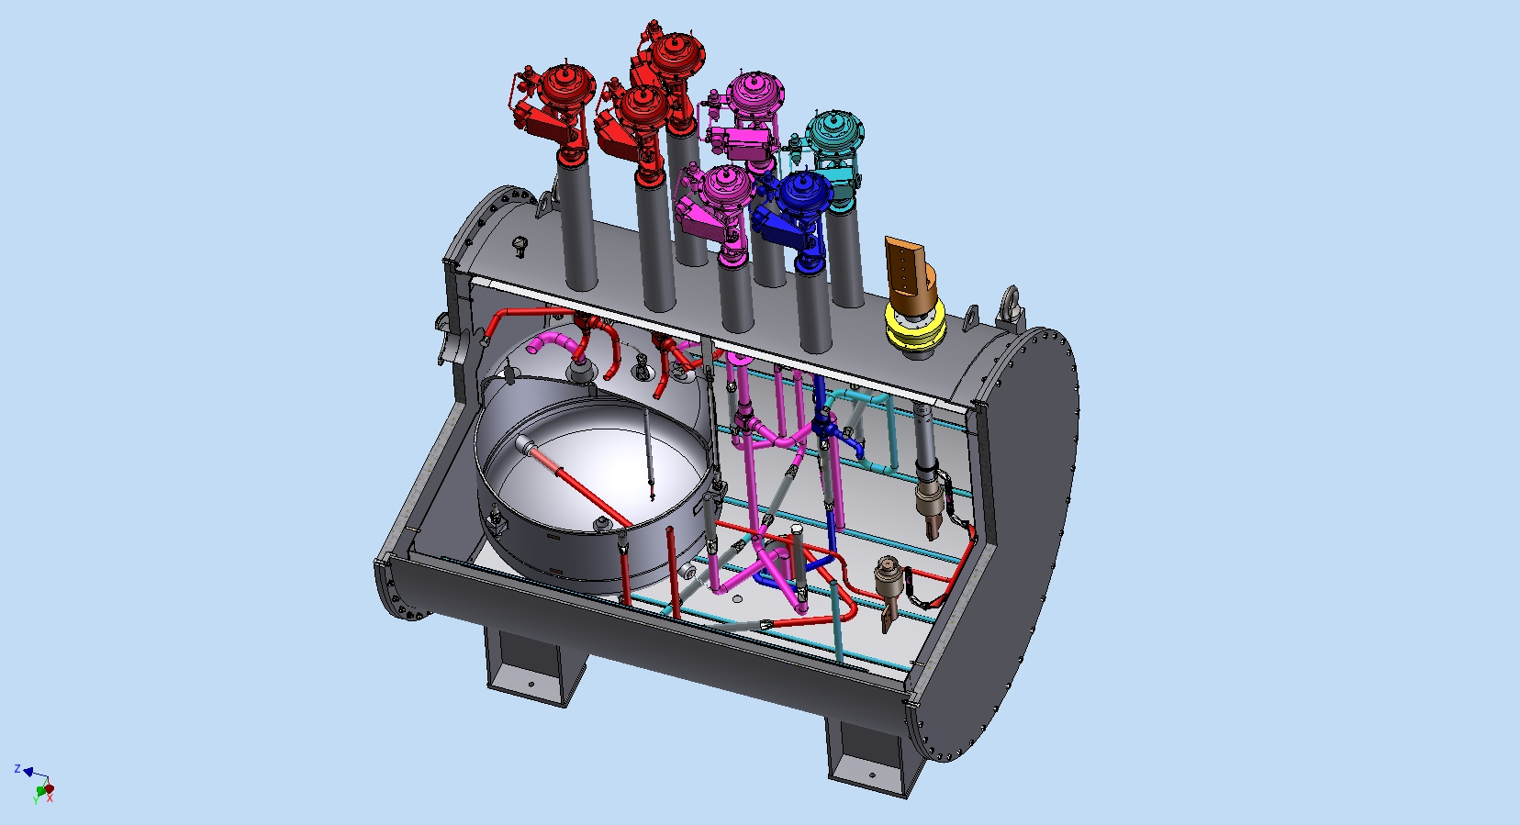
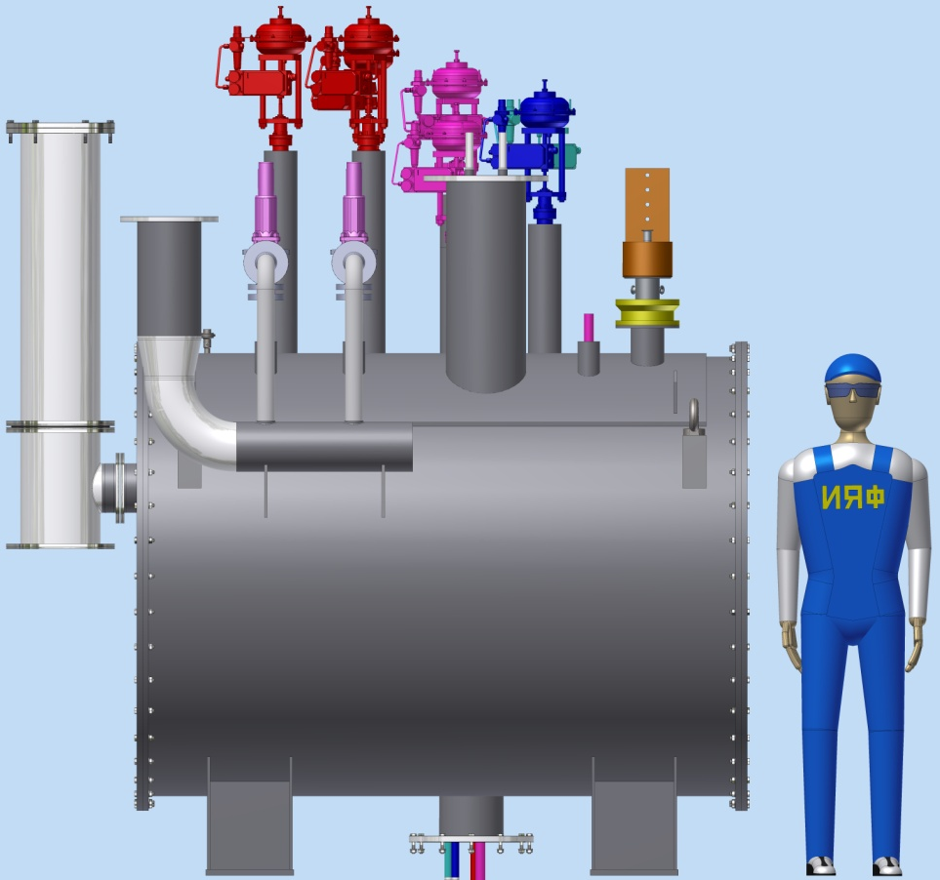
Control Dewar consists of:
• a vessel for liquid helium (~480L);
• current leads;
• thermal shields cooled by gaseous helium;
• valves, gauges;
• vacuum shell.
4
2
1
5
3
Figure 2. The main components of the control Dewar.

Slide 4
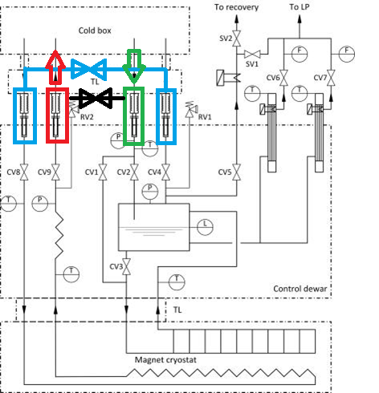
PANDA solenoid 2017, Flowscheme with comments of GSI
Figure 3. Process Flow Diagram of the PANDA cryogenic system.
Comments to the cryogenic flow scheme and the proposed operation (flowscheme__20170720)
The additional valves, as suggested in 2016, are missing in the flow scheme.
Flowscheme of the PANDA solenoid was approved.

Slide 5
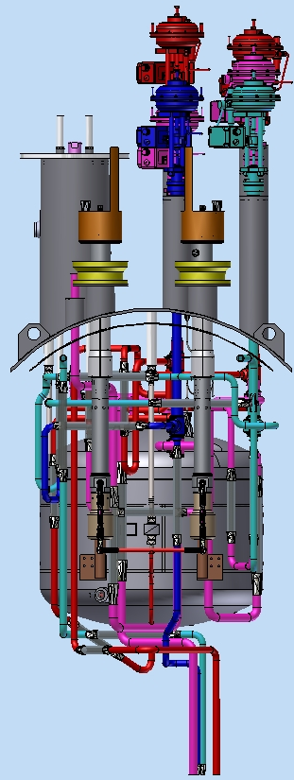
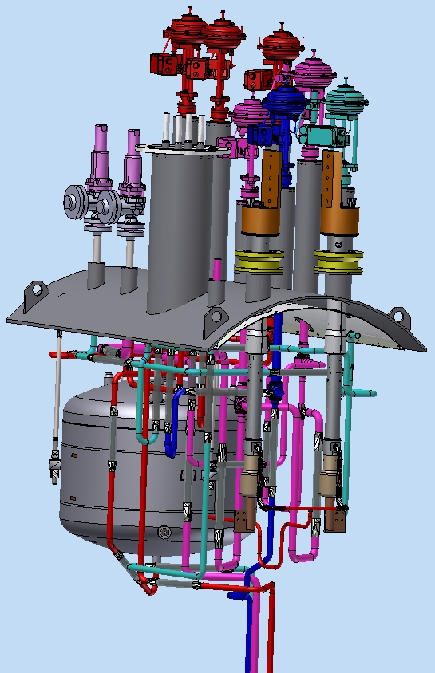
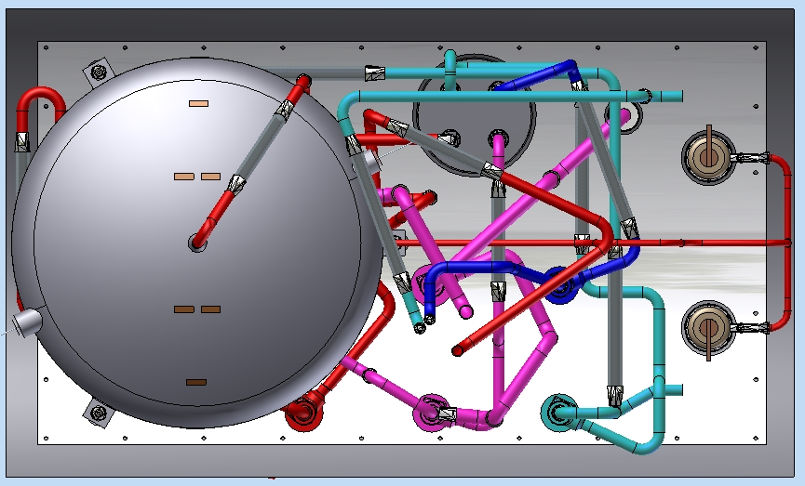
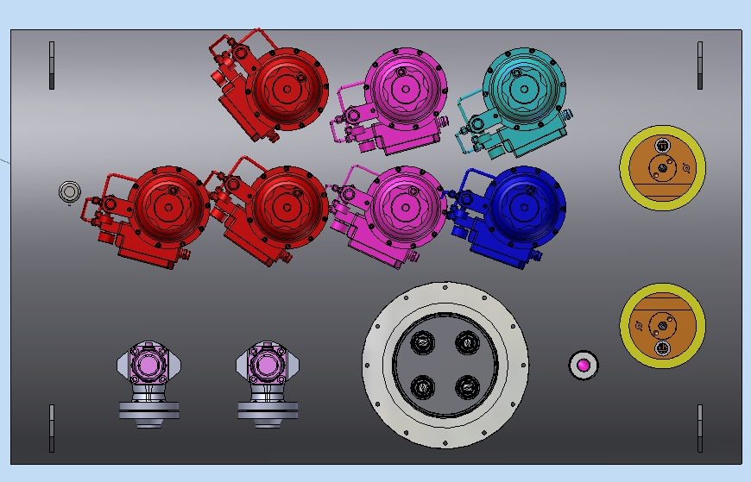
The stages of Assembly of the PANDA control Dewar:
1. Installation of pipelines on the lid of the control Dewar
Current
leads
4,2K
5K
40K
He vessel
80K
Figure 4. The stage 1.

Slide 6
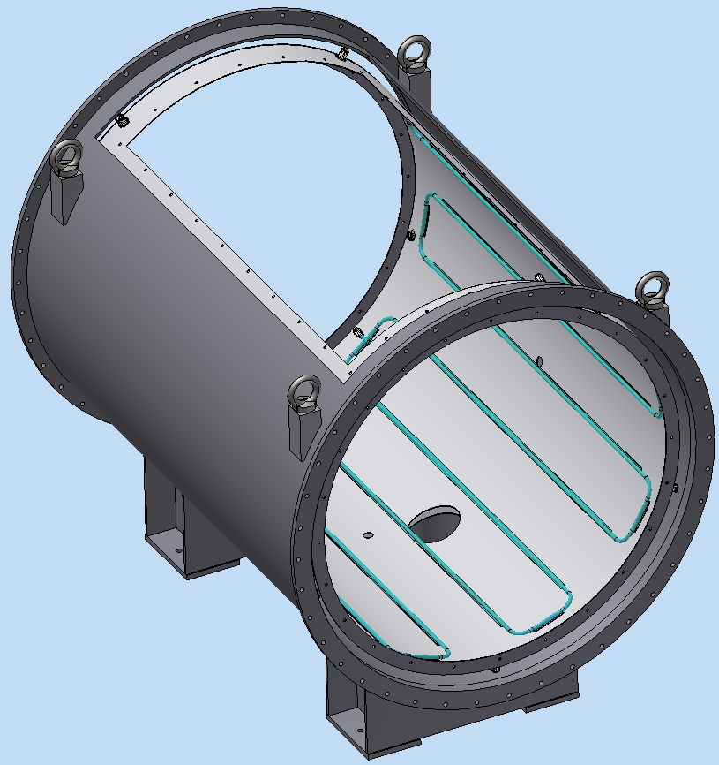
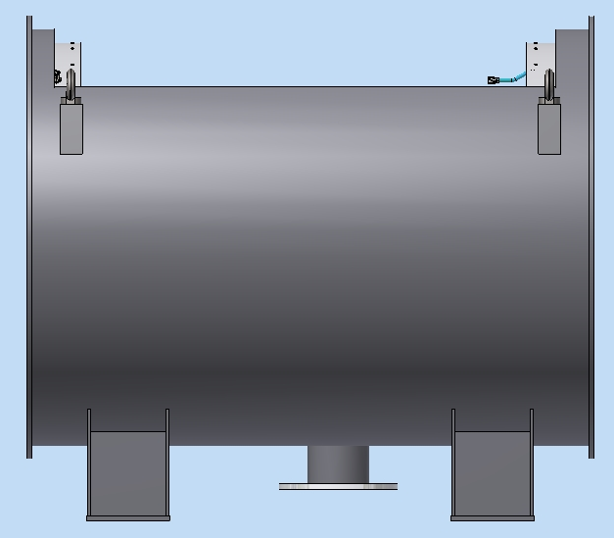
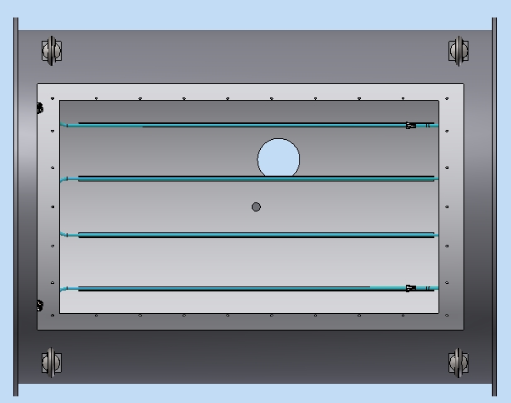
The stages of Assembly of the PANDA control Dewar:
2. Installation of the thermal shields in a vacuum shell
Thermal
shield
Vacuum
shell
80K
Figure 5. The stage 2.

Slide 7
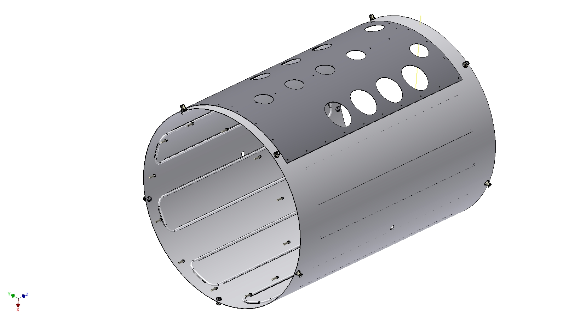
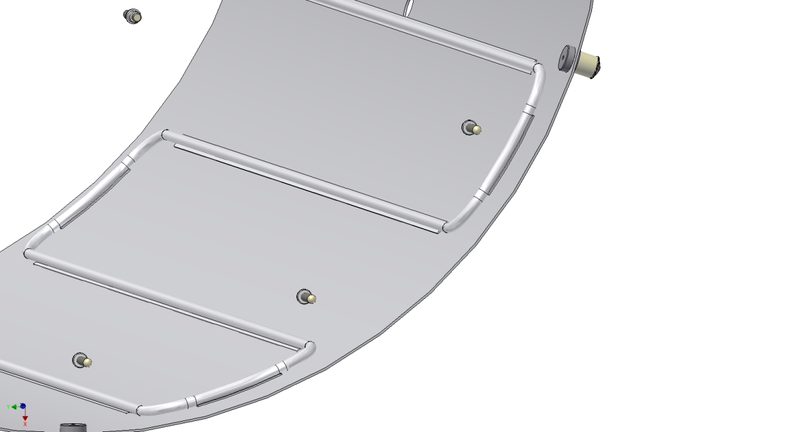
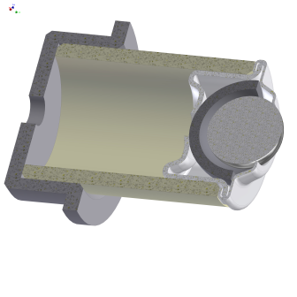
Design of the thermal shields
Al sheet S=3mm
Al profile Ø14 Ʊ-type
Ball support
Figure 6. thermal shield.

Slide 8
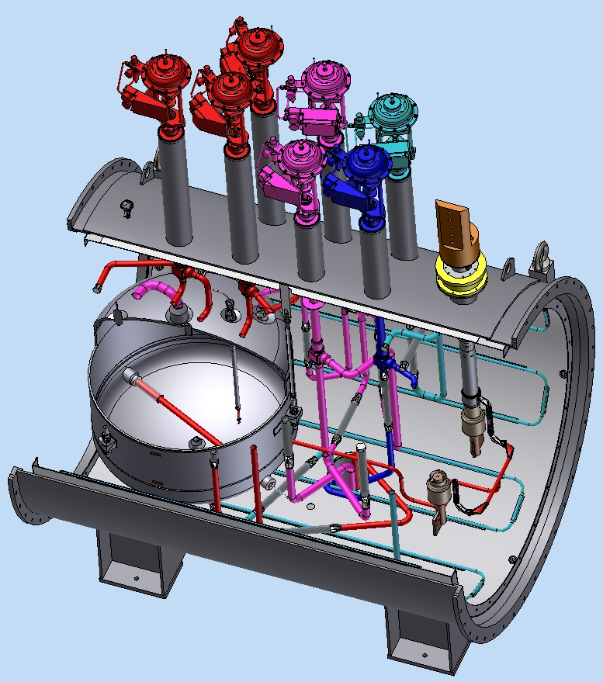
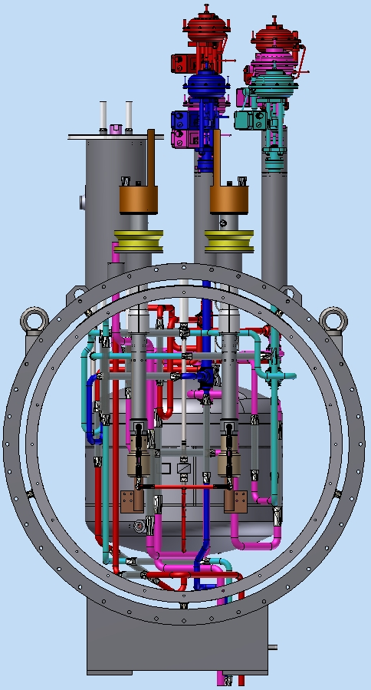
The stages of Assembly of the PANDA control Dewar:
3. Installation pipelines on the lid to the thermal shields in a vacuum shell
Figure 7. The stage 3.

Slide 9
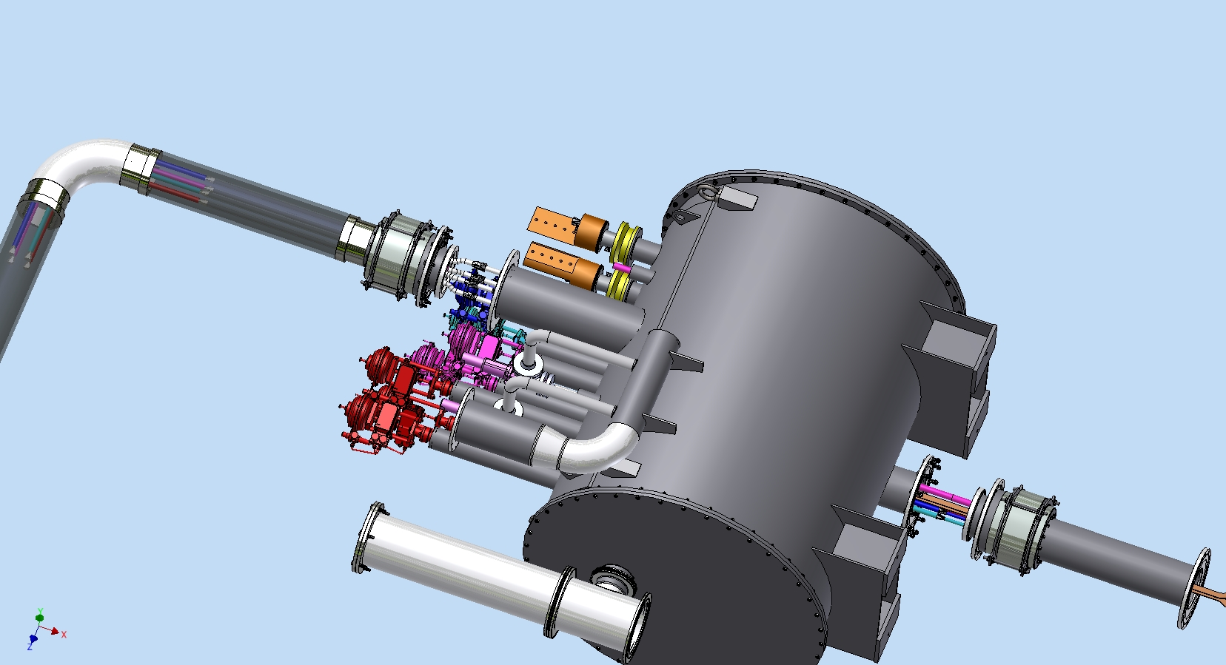

The interface of the PANDA control Dewar:
Vacuum barrier
TL
Shift the bellows unit
Combine the pipies in
accordance with the
flow scheme
-Carry out the connection of
the superconductor
-Carry out pipes connection
by welding
Install super insulation
Install the bellows unit in place
Shift the bellows unit
Combine the pipies in
accordance with the
flow scheme
-Carry out pipes connection
type Swagelok
Install super insulation
Install the bellows unit in place
Control Dewar
Chimney

Slide 10
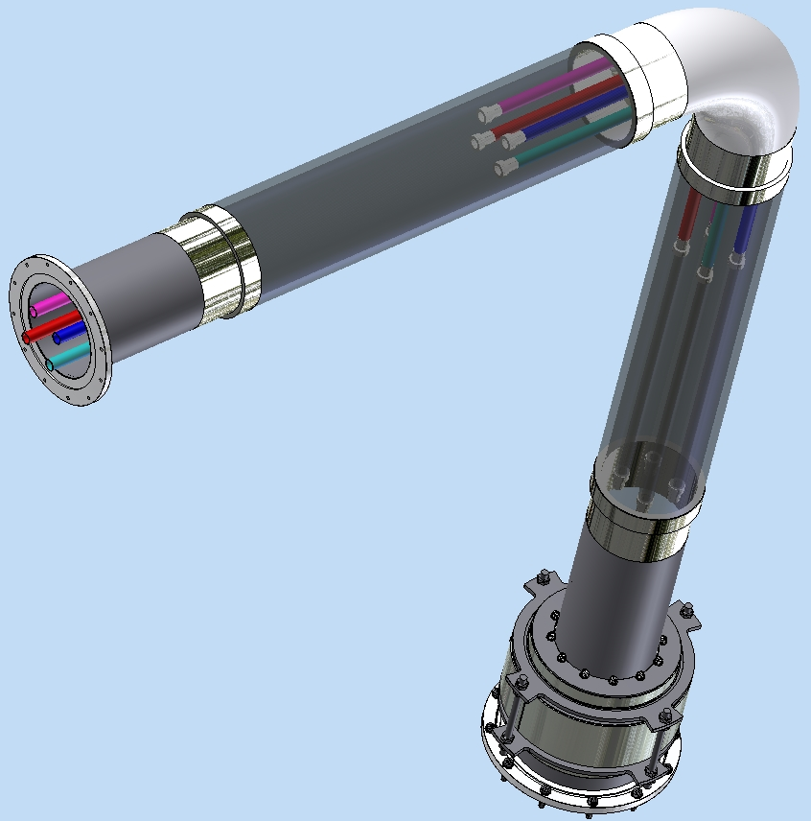
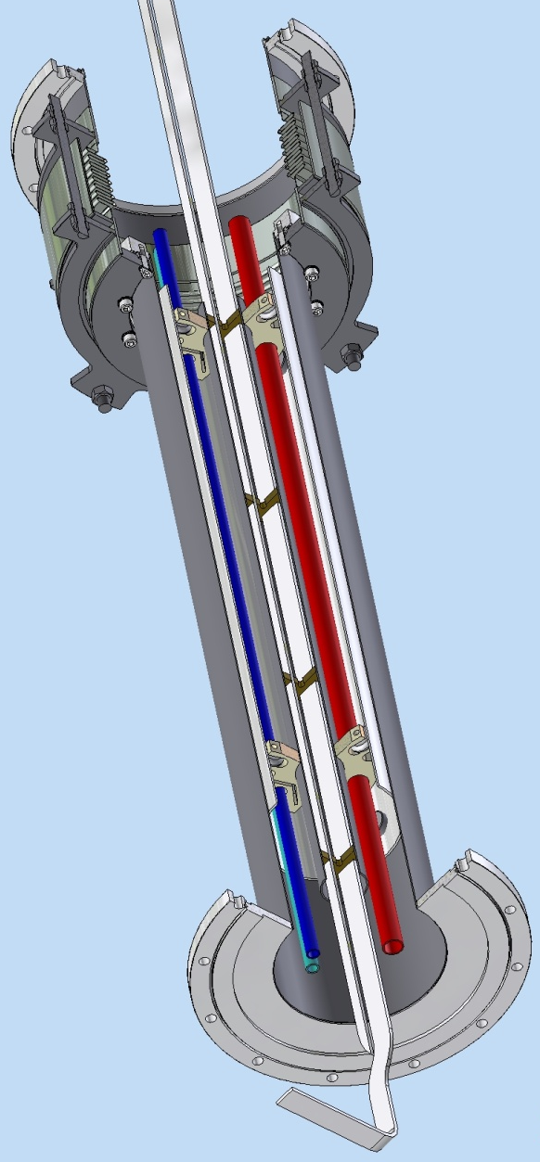
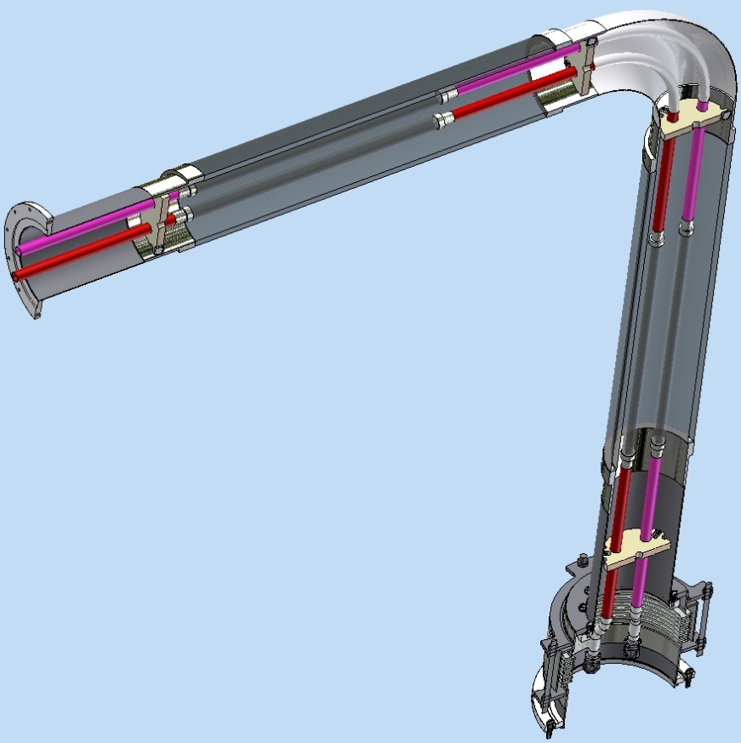
The interface of the PANDA control Dewar:
Flange ISO320RBR
Chimney
TL
Flange ISO250BF
Bellows unit
Metal
Hoses DN200
Thermal shield
Pipelines
Metal
Hoses DN20
Spacer
Flange ISO320RBR
Bellows
unit
The end of the supplying TL has the ability to 3D move ±300mm
Superconductor
Flange ISO320RBR

Slide 11
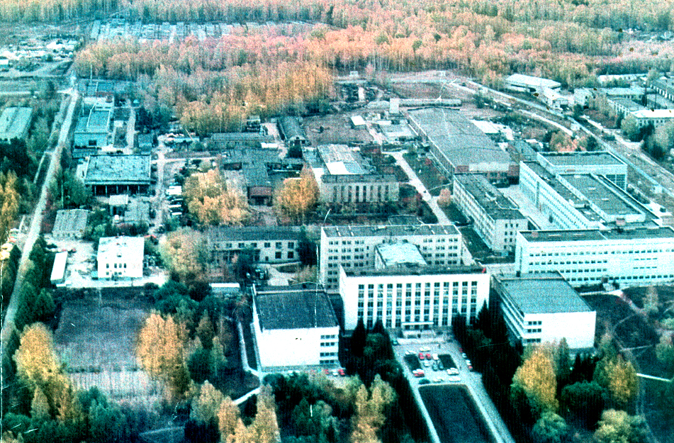

Thank you for your attention

