Slide 1
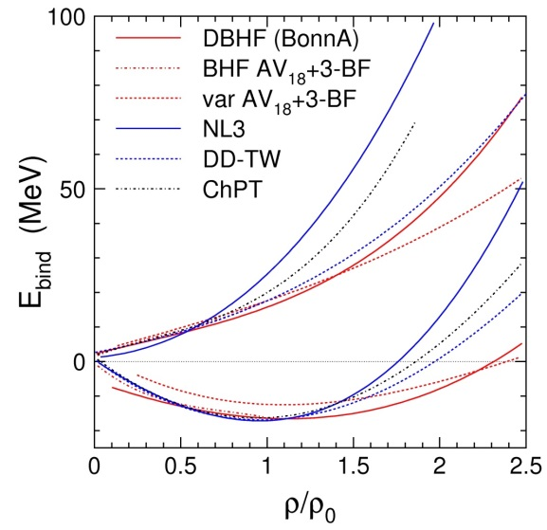
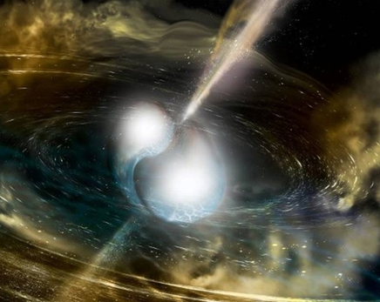
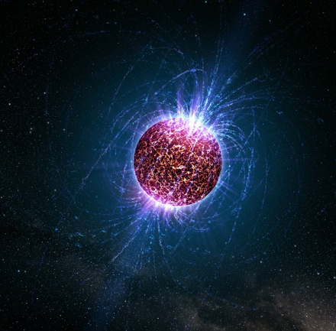
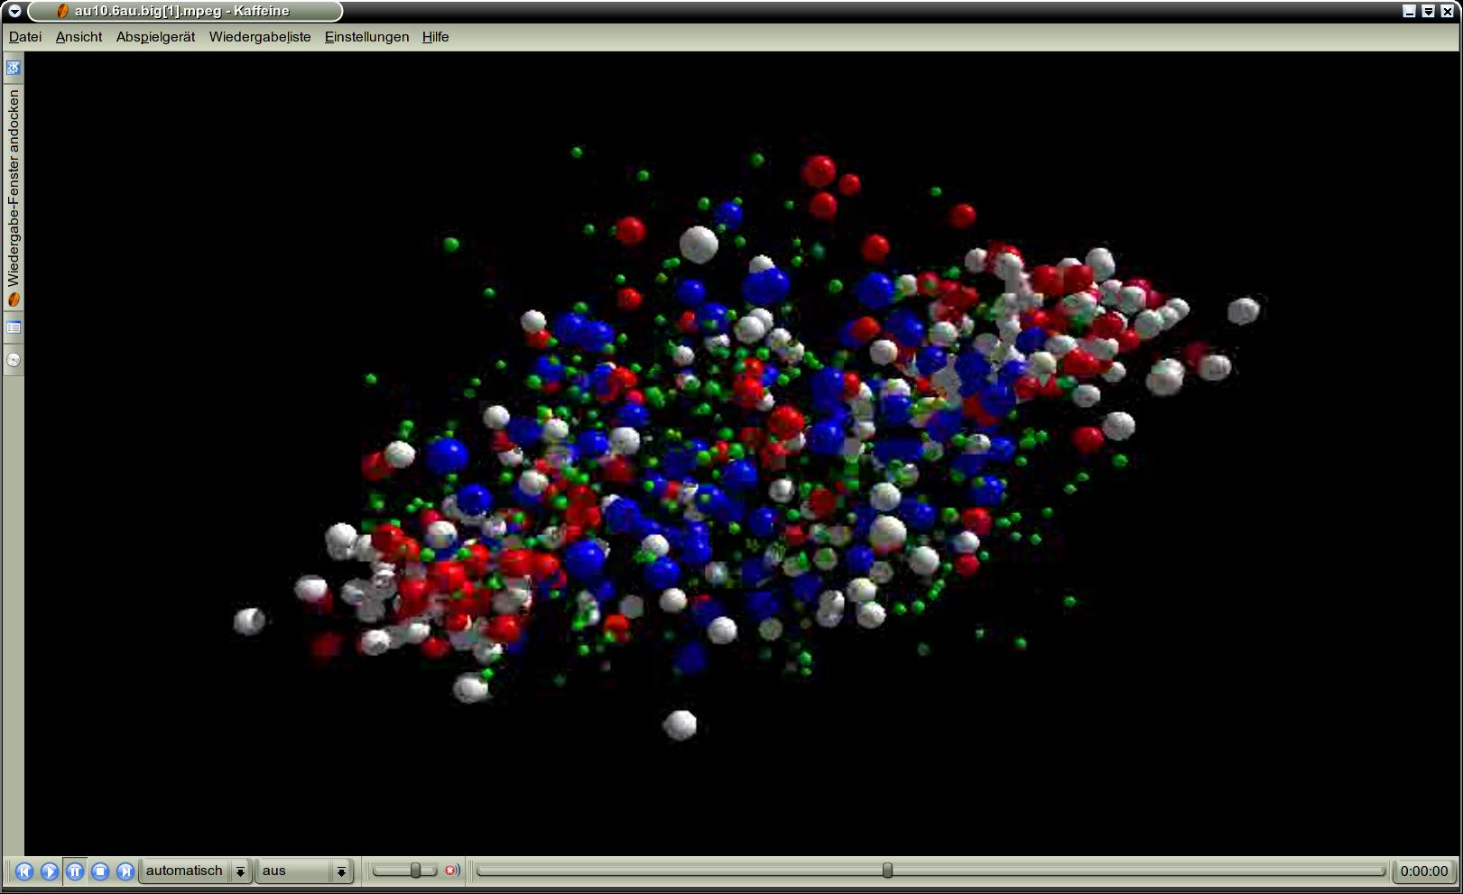
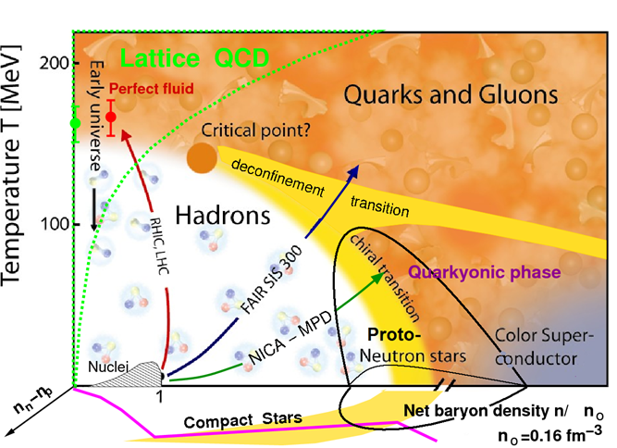
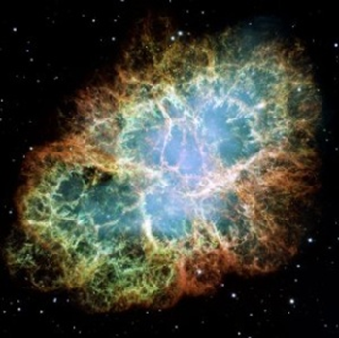
The high-density Equation of State
from Laboratory Experiments
Peter Senger, GSI
neutron
matter
symmetric
matter

Slide 2
Neutron star mergers and heavy-ion collisions
density
temperature
M. Hanauske et al.,
J. Phys.: Conf. Ser.
878 012031
n-star merger
EOS
Au +Au
1.5A GeV

Slide 3
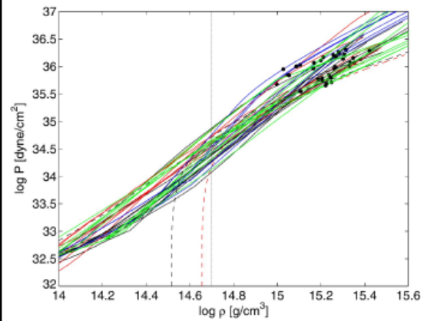
High-density equation-of-state
Tolman-Oppenheimer-Volkoff (TOV) equations
Mass-radius relation of neutron stars
Andreas Bauswein

Slide 4

The equation-of-state of nuclear matter
The nuclear matter equation of state (EOS) describes the relation between density, pressure, temperature, energy, and isospin asymmetry
P = δE/δV⏐_{T=const}
V = A/ρ
δV/ δρ = - A/ρ²
P = ρ² δ(E/A)/δρ⏐_{T=const}
Fuchs and Wolter, EPJA 30 (2006)
Neutron matter
E_{A}(ρ,δ) = E_{A}(ρ,0) + E_{sym}(ρ)·δ² + O(δ⁴)
with asymmetry parameter δ= (ρ_{n}–ρ_{p})/ρ
δ = 1
Finite nuclei:
E_{sym}
Symmetric matter
δ = 0
Bethe-Weizsäcker mass formula

Slide 5
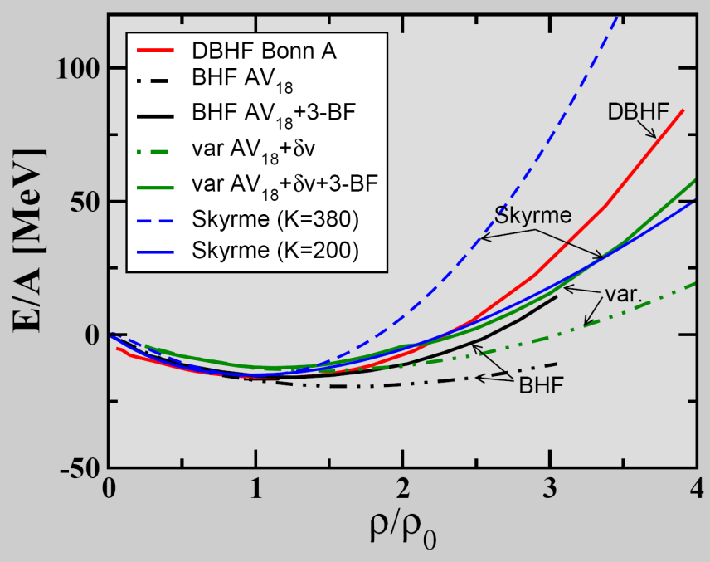
The equation-of-state of (symmetric) nuclear matter
E_{A}(ρ,δ) = E_{A}(ρ,0) + E_{sym}(ρ)·δ² + O(δ⁴)
C. Fuchs, Prog. Part. Nucl. Phys. 56 (2006) 1
T=0: E/A = 1/ρ ∫ U (ρ)dρ
Effective NN-potential:
U(ρ)=αρ+βρ^{γ}
➢ E/A(ρ_{o}) = -16 MeV
¬ δ(E/A)(ρ_{o})/δρ = 0
K_{nm} = 9ρ² δ²(E/A)/δρ²
(nuclear incompressibility)
K_{nm} = 200 MeV: "soft" EOS
K_{nm} = 380 MeV: "stiff" EOS

Slide 6
The symmetry energy
E_{A}(ρ,δ) = E_{A}(ρ,0) + E_{sym}(ρ)·δ² + O(δ⁴)
with asymmetry parameter δ= (ρ_{n}–ρ_{p})/ρ

Slide 7
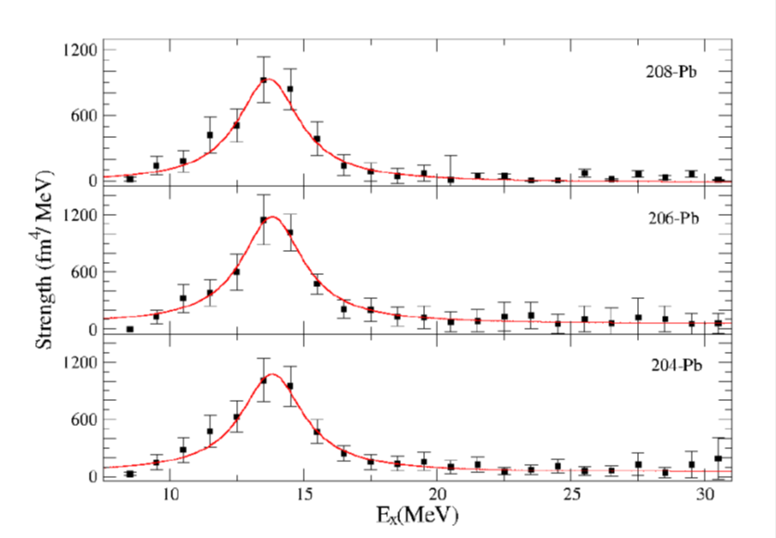
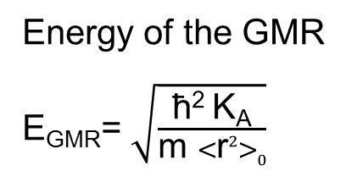
Nuclear Incompressibility from
Giant Monopole Resonances (ρ≤ρ₀)
inelastic scattering 400 MeV α + Pb
at very forward angles
GMR
Energy of the GMR
E_{GMR}= $\sqrt{\frac{\text{ħ}\text{2} \text{K}\text{A}}{\text{m} <\text{r}2>0}}$
K_{A}: incompressibility of the nucleus
U. Garg, Progress of Theoretical Physics Supplement
No. 196, 2012

Slide 8
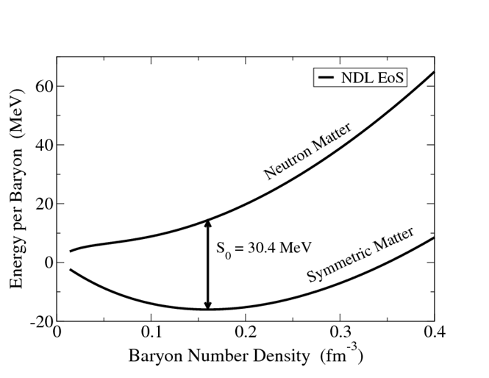
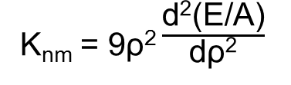
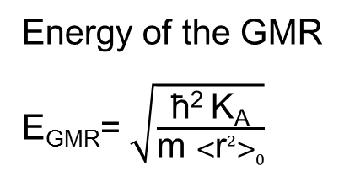
Nuclear Incompressibility from
Giant Monopole Resonances (ρ≤ρ₀)
Nuclear incompressibility:
K_{nm} = 9ρ² $\frac{\text{d}\text{2}\text{(}\text{E}\text{/}\text{A}\text{)}}{\text{d}\text{ρ}\text{2}}$
at ρ=ρ₀
Energy of the GMR
E_{GMR}= $\sqrt{\frac{\text{ħ}\text{2} \text{K}\text{A}}{\text{m} <\text{r}2>0}}$
K_{A}: inkompressibility of the nucleus
K_{A} = K_{vol} + K_{surf} A^{-1/3} + K_{sym}(N-Z)²/A² + K_{Coul} Z²/A^{4/3} + ... (liquid drop model)
K_{nm} = lim K_{A} = K_{vol}
A→∞
400 MeV α + ²⁰⁶Pb:
400 MeV α + ¹¹²⁻¹²⁴Sn:
K_{nm} = 220 – 240 MeV
K_{sym} = 400 – 600 MeV
J.P. Blaisot et al., Nuclear Physics A 591 (1995) 435-457

Slide 9
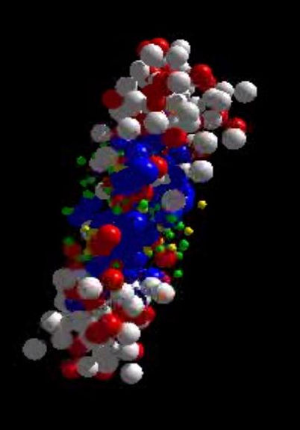
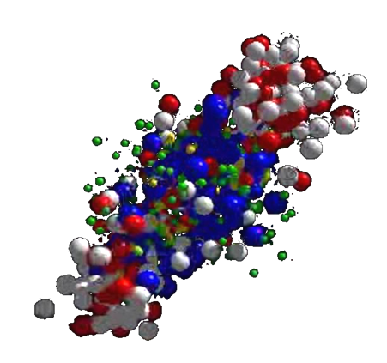
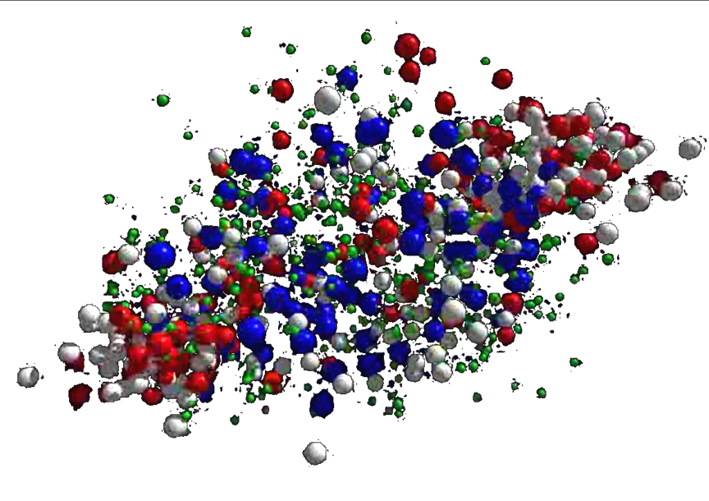
The EOS of nuclear matter at ρ > ρ₀
Production of dense nuclear matter in
high-energy heavy-ion collisions
Volume about 1000 fm³, lifetime 10⁻²² s
Finite size, finite lifetime effects?
Observables:
Collective flow
Subthreshold particle production

Slide 10
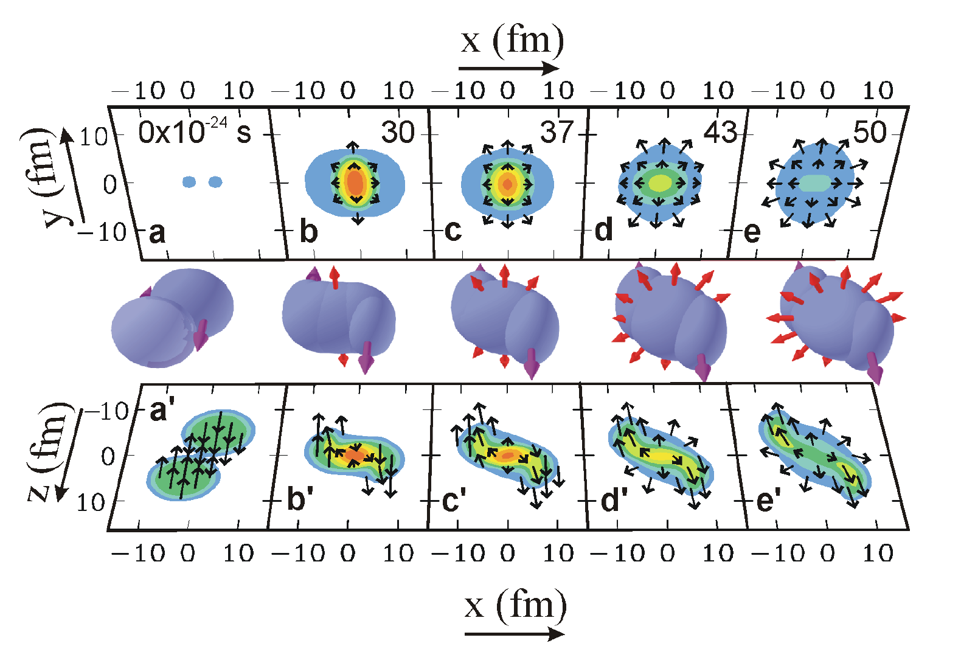
Dynamics of a semi-central Au+Au collision at 2 AGeV
Collective flow of nucleons: driven by pressure gradient
P. Danielewicz, R. Lacey, W.G. Lynch, Science 298 (2002) 1592

Slide 11
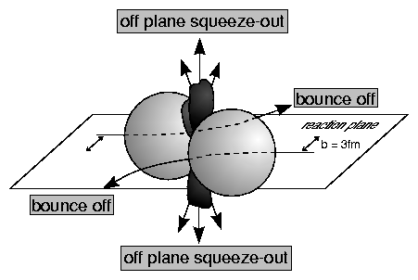
Azimuthal angular distribution of protons in Au+Au collisions at 1.15 - 8 AGeV
AGeV
C.Pinkenburg et al., (E895),
Phys. Rev. Lett. 83 (1999) 1295
Azimuthal angle distribution:
dN/dΦ ∝ (1 + 2v₁ cosΦ + 2v₂ cos2Φ)
Rapidity: y⁽⁰⁾ = y-y_{m}
with y = 0.5 ln [(E+p_{z})/(E-p_{z})]

Slide 12
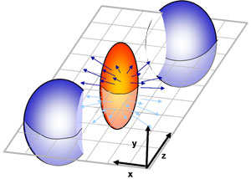
Azimuthal angular distribution of protons measured
in Au+Au collisions at 1.15, 2, 4, 6, 8 AGeV
AGeV
C.Pinkenburg et al., (E895),
Phys. Rev. Lett. 83 (1999) 1295
Azimuthal angle distribution:
dN/dΦ ∝ (1 + 2v₁ cosΦ + 2v₂ cos2Φ)
Rapidity: y⁽⁰⁾ = y-y_{m}
with y = 0.5 ln [(E+p_{z})/(E-p_{z})]

Slide 13
Azimuthal angular distribution of protons measured
in Au+Au collisions at 1.15, 2, 4, 6, 8 AGeV
AGeV
C.Pinkenburg et al., (E895),
Phys. Rev. Lett. 83 (1999) 1295
Azimuthal angle distribution:
dN/dΦ ∝ (1 + 2v₁ cosΦ + 2v₂ cos2Φ)
Rapidity: y⁽⁰⁾ = y-y_{m}
with y = 0.5 ln [(E+p_{z})/(E-p_{z})]

Slide 14
EOS of symmetric matter from elliptic flow of fragments in Au+Au collisions at SIS18 energies (ρ < 3ρ₀)
A. Le Fevre , Y Leifels, W. Reisdorf, J. Aichelin, Ch. Hartnack, arXiv:1501.02546
HM
SM

Slide 15
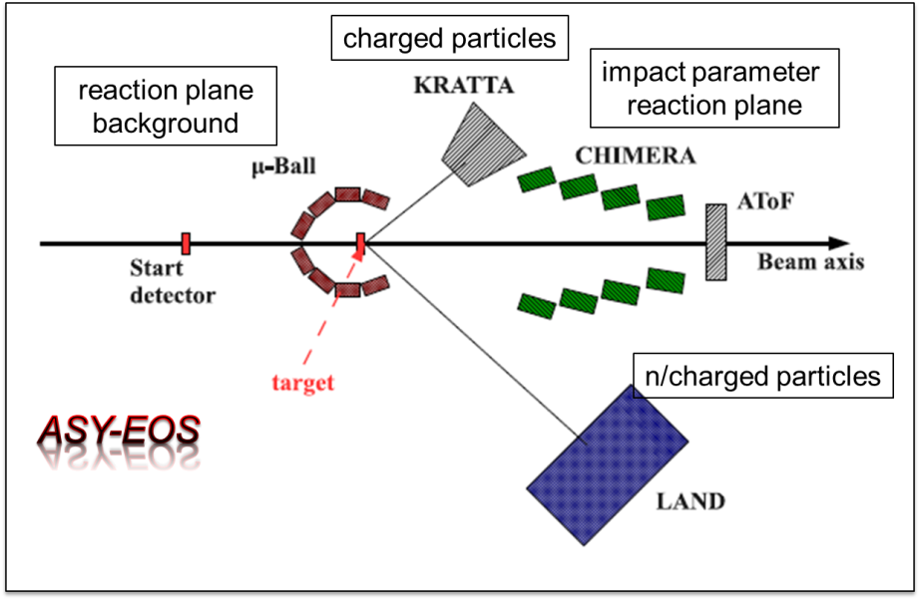
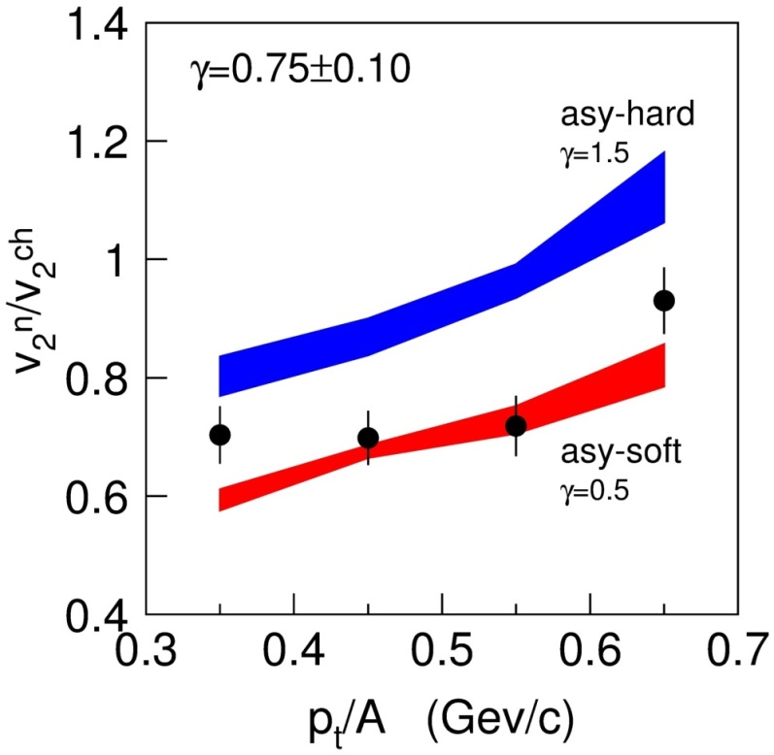
The ASY-EOS experiment at GSI:
The symmetry energy up to densities of 2ρ₀
P. Russotto et al.,
Phys. Rev. C 94, 034608 (2016)
Measuring the elliptic flow of
charged particles and neutrons
in Au+Au collisions at 400A MeV

Slide 16
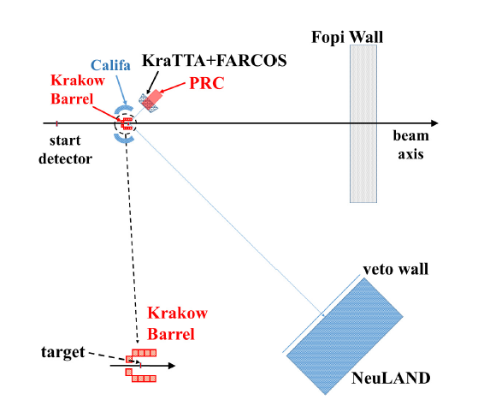
Proposal to measure E_{sym} at 2 – 3 ρ₀
ASY – EOS II experiment at SIS18 (P. Rusotto, Y. Leifels et al.):
Measurement of n/p-elliptic flow in Au+Au collisions up to 1A GeV

Slide 17
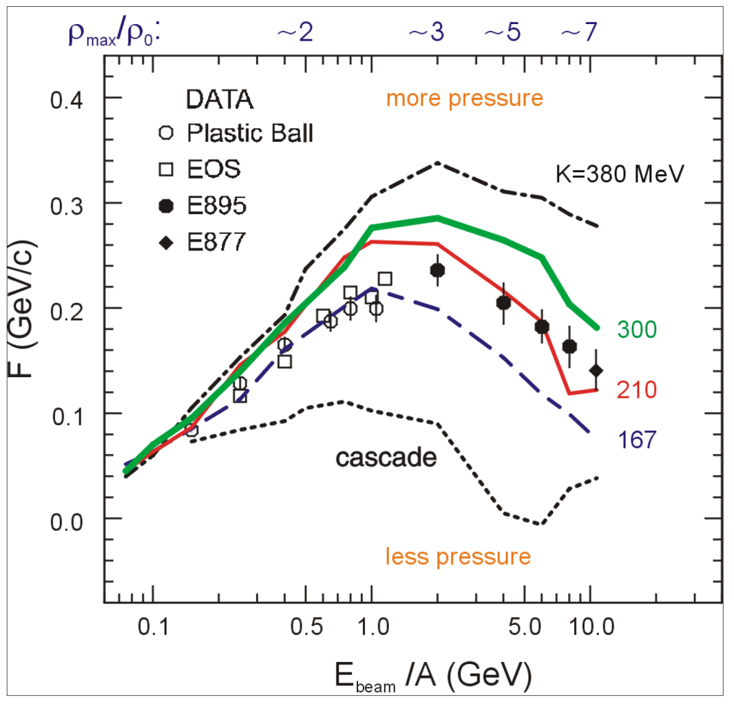
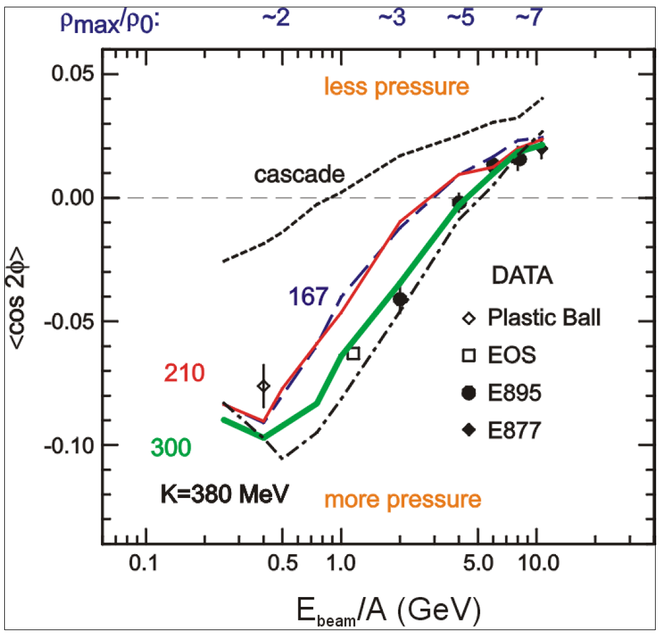

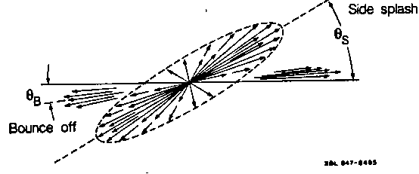
Nuclear incompressibility from collective proton flow
P. Danielewicz, R. Lacey, W.G. Lynch, Science 298 (2002) 1592
Transverse in-plane flow:
Elliptic flow:
F = d(p_{x}/A)/d(y/y_{cm})
dN/dΦ ∝ (1 + 2v₁ cosΦ + 2v₂ cos2Φ)

Slide 18
Nuclear equation-of-state from collective proton flow
P. Danielewicz, R. Lacey, W.G. Lynch, Science 298 (2002) 1592

Slide 19
Collective flow in Au+Au collisions
and the nuclear matter EOS
Beam energy AGeV | central density | flow observable | incompressibility K
0.4 – 1.5 | ρ = 1 – 3 ρ₀ | v₂ of p, d, t, 3He | ≈ 200 MeV
2 – 10 | ρ = 3 – 7 ρ₀ | v₁ of p, | ≈ 200 MeV
2 – 10 | ρ = 3 – 7 ρ₀ | v₂ of p, | ≈ 300 MeV
Within microscopic transport models the collective flow is sensitive to:
➢ The nuclear matter equation of state
➢ In-medium nucleon-nucleon cross sections
➢ Momentum dependent interactions
Independent observables? particle production

Slide 20
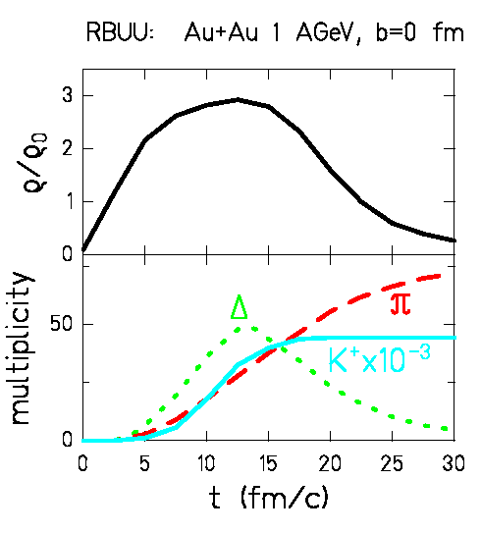
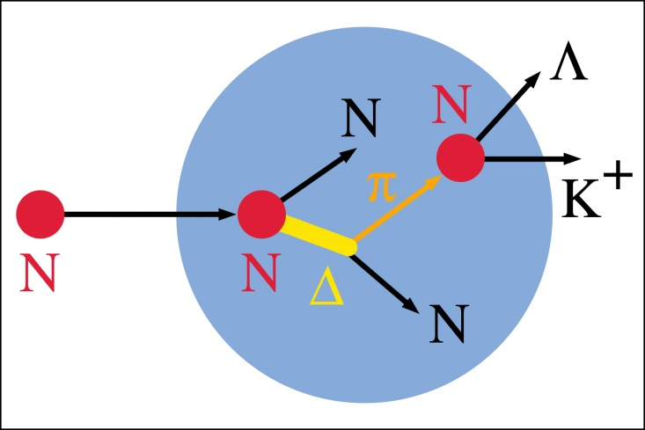
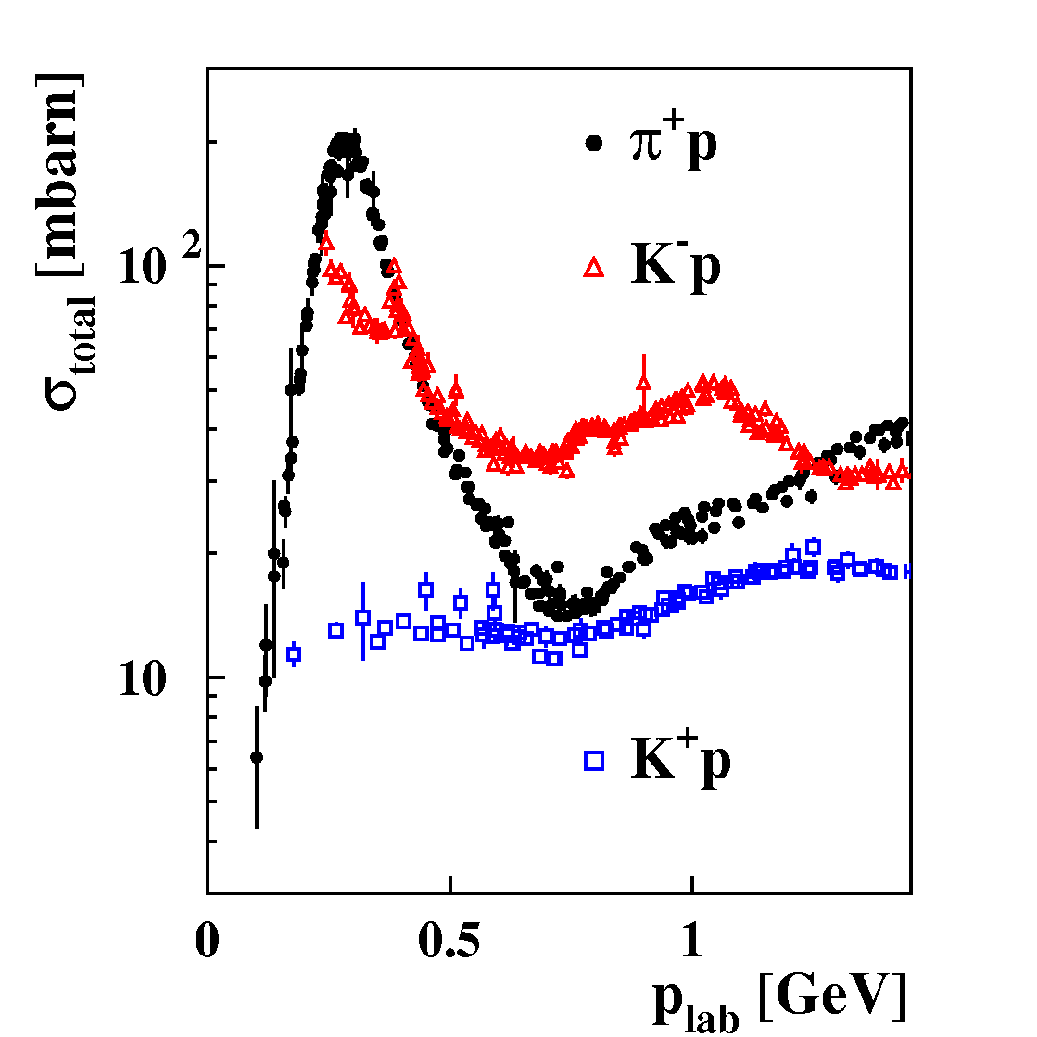
Probing the nuclear equation-of-state (ρ = 1 – 3 ρ₀)
by K⁺ meson subthreshold production in HI collisions
pp → K⁺Λp (E_{thres}= 1.6 GeV)
K⁺ mesons probe high densities
K⁺ mesons scatter elastically only

Slide 21
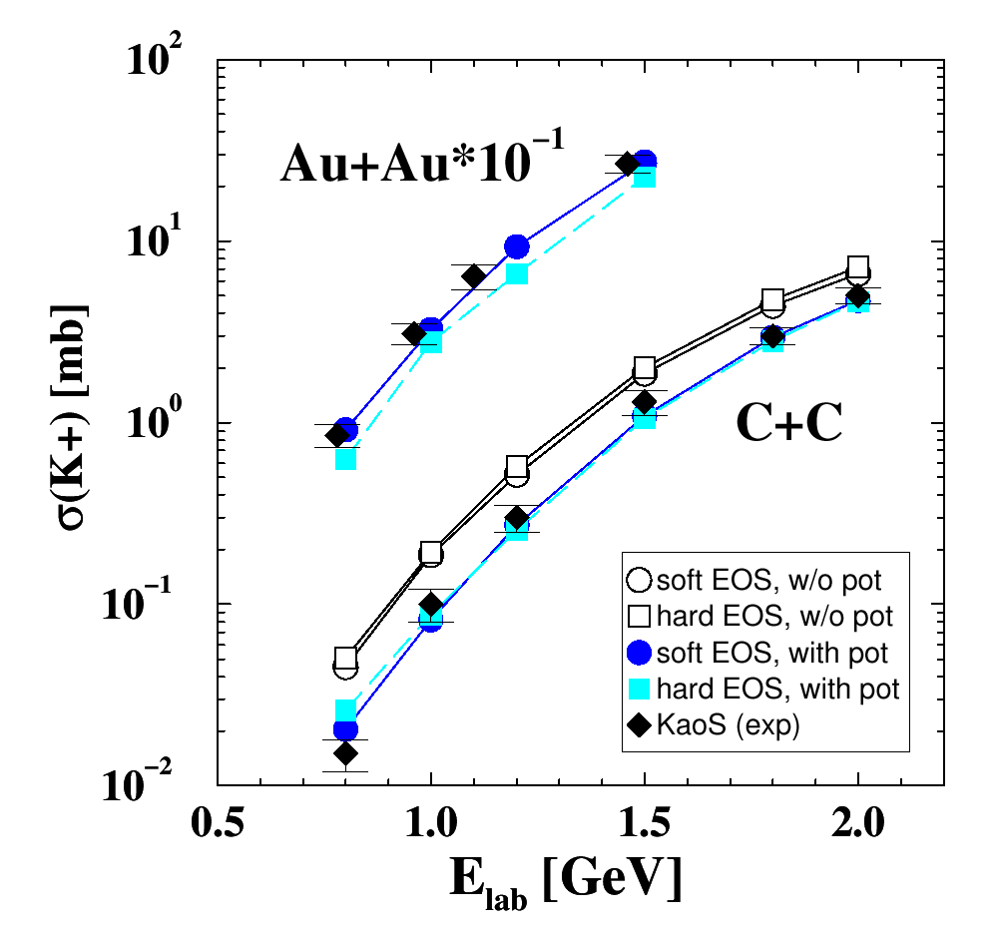
Probing the nuclear equation-of-state (ρ = 1 – 3 ρ₀)
by K⁺ meson production in C+C and Au+Au collisions
Idea: K⁺ yield ∝ baryon density ∝ compressibility
Transport model (RBUU)
Au+Au at 1 AGeV:
κ = 200 MeV ⇨ ρ_{max}≈ 2.9 ρ₀ ⇨ K⁺
κ = 380 MeV ⇨ ρ_{max}≈ 2.4 ρ₀ ⇨ K⁺
Reference system C+C:
K⁺ yield not sensitive to EOS
Experiment:
C. Sturm et al., (KaoS Collaboration),
Phys. Rev. Lett. 86 (2001) 39
Theory:
Ch. Fuchs et al.,
Phys. Rev. Lett. 86 (2001) 1974

Slide 22
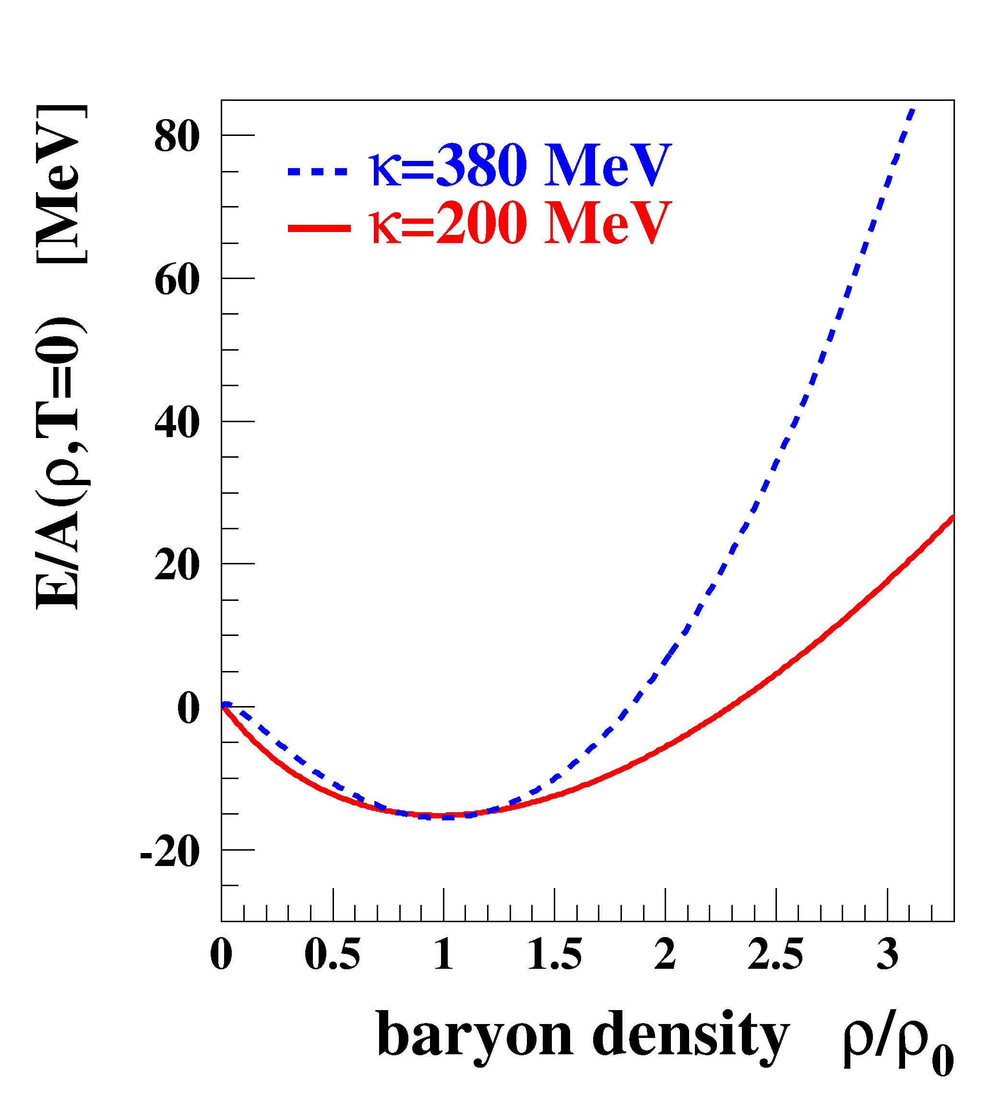
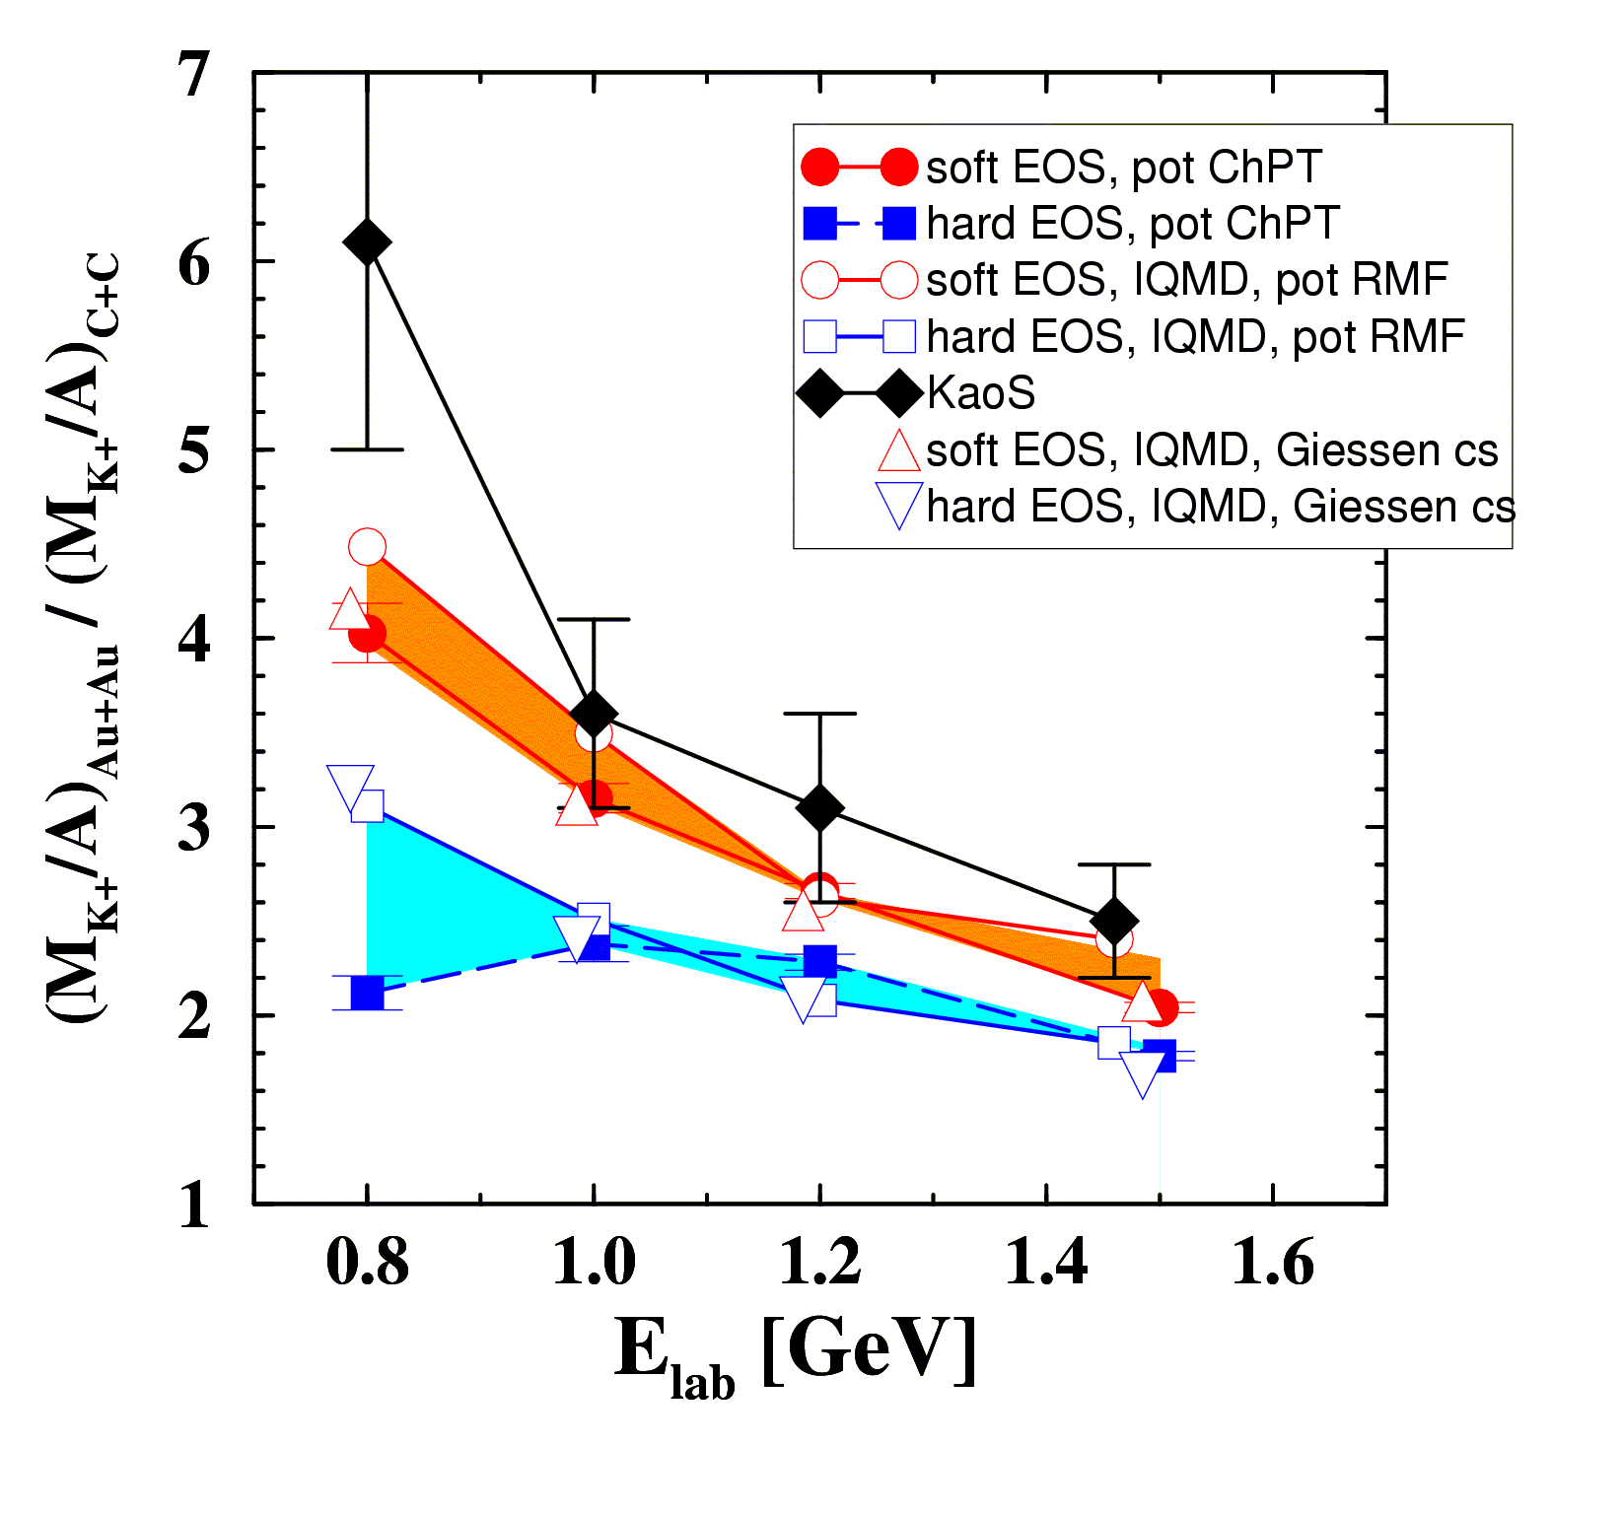
The compressibility of (symmetric) nuclear matter
Experiment: C. Sturm et al., (KaoS Collaboration) Phys. Rev. Lett. 86 (2001) 39
Theory: QMD Ch. Fuchs et al., Phys. Rev. Lett. 86 (2001) 1974
IQMD Ch. Hartnack, J. Aichelin, J. Phys. G 28 (2002) 1649
Au/C ratio: cancellation of systematic errors both in experiment and theory

Slide 23
The compressibility of (symmetric) nuclear matter
Experiment: C. Sturm et al., (KaoS Collaboration) Phys. Rev. Lett. 86 (2001) 39
Theory: QMD Ch. Fuchs et al., Phys. Rev. Lett. 86 (2001) 1974
IQMD Ch. Hartnack, J. Aichelin, J. Phys. G 28 (2002) 1649
Soft equation-of-state: κ ≤ 200 MeV
Confirmation of flow measurements

Slide 24
Estimating the EOS of neutron matter
Neutron matter
E_{sym}= 50-70 MeV
(ASY-EOS)
E_{sym}=30MeV
(GMR)
Symmetric matter

Slide 25
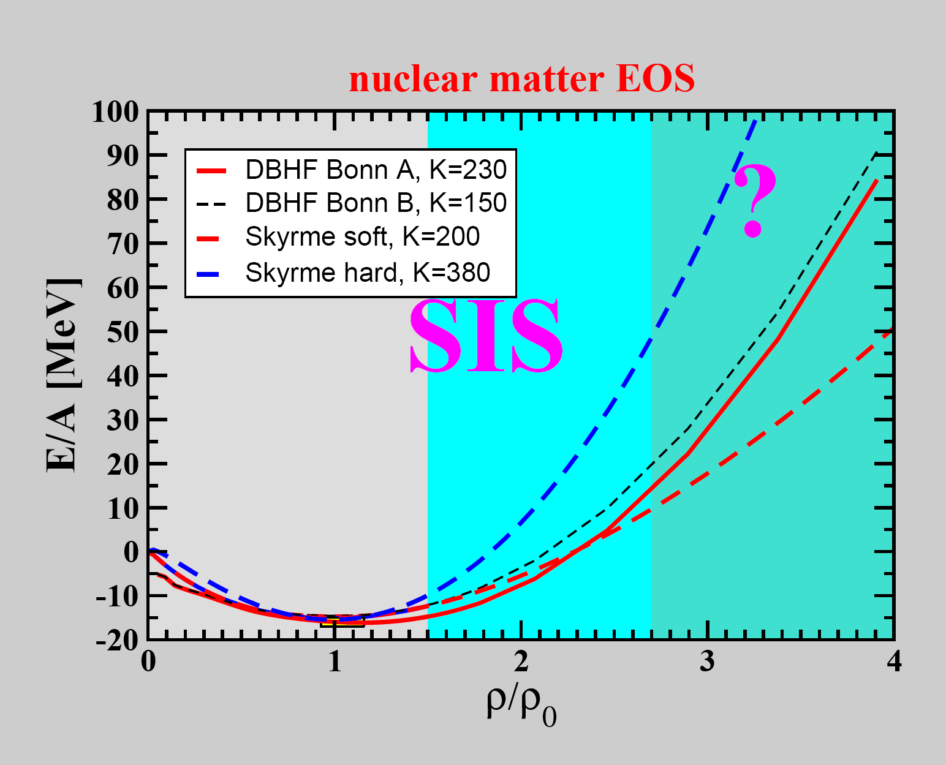
K⁺ production,
Fragment flow

Slide 26
?
K⁺ production,
Fragment flow

Slide 27


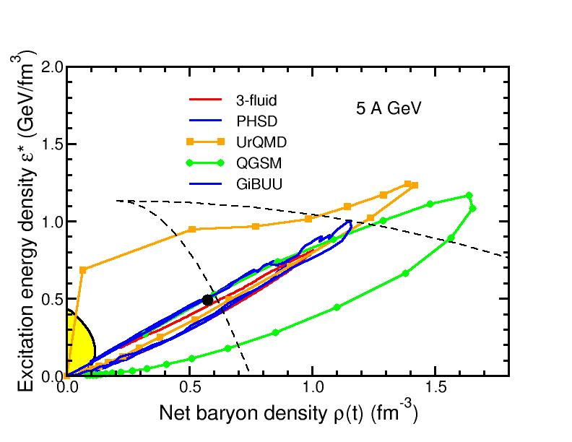
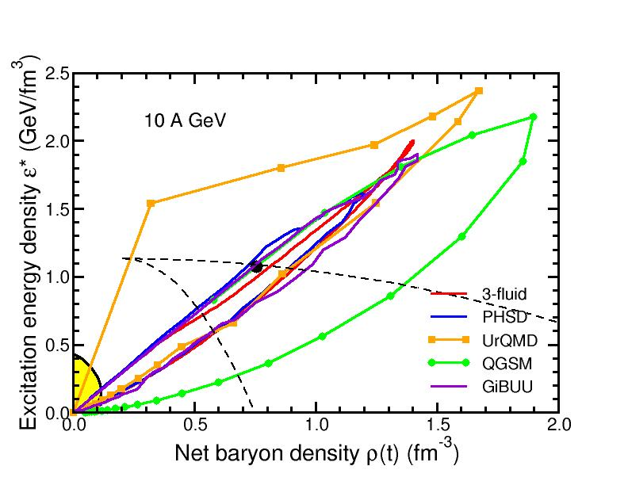
Baryon densities in central Au+Au collisions
I.C. Arsene et al., Phys. Rev. C 75, 24902 (2007)
5 A GeV
10 A GeV
8 ρ₀
5 ρ₀
phase
coexistence
phase
coexistence

Slide 28
Exploring the high-density equation-of-state
of symmetric nuclear matter (3 – 6 ρ₀)
Observable: multistrange hyperon production at (sub)threshold energies
Direct multi-strange hyperon production:
pp → Ξ⁻ K⁺K⁺p (E_{thr} = 3.7 GeV)
pp → Ω⁻ K⁺K⁺K⁰p (E_{thr} = 7.0 GeV)
pp → Λ⁰Λ⁰ pp (E_{thr} = 7.1 GeV)
pp → Ξ⁺ Ξ⁻ pp (E_{thr} = 9.0 GeV)
pp → Ω⁺ Ω⁻ pp (E_{thr} = 12.7 GeV
p
p
p
Hyperon production via multiple
strangeness exchange reactions:
Hyperons (s quarks):
pp → K⁺Λ⁰p, pp → K⁺K⁻pp,
pΛ⁰→ K⁺ Ξ⁻ p, πΛ⁰→ K⁺ Ξ⁻ π,
3. Λ⁰Λ⁰→ Ξ⁻ p, Λ⁰K⁻ → Ξ⁻ π⁰
4. Λ⁰ Ξ⁻ → Ω⁻ n, Ξ⁻K⁻ → Ω⁻ π⁻
Antihyperons (anti-s quarks):
1. Λ⁰ K⁺ → Ξ⁺π⁰ ,
2. Ξ⁺ K⁺ → Ω⁺ π⁺.
p
Λ⁰
(uds)
p
K⁺
p
Λ⁰
Ξ⁻
(uds)
(dss)
Ω⁻
p
K⁺
p
p
Λ⁰
(uds)
K⁺
p
n

Slide 29
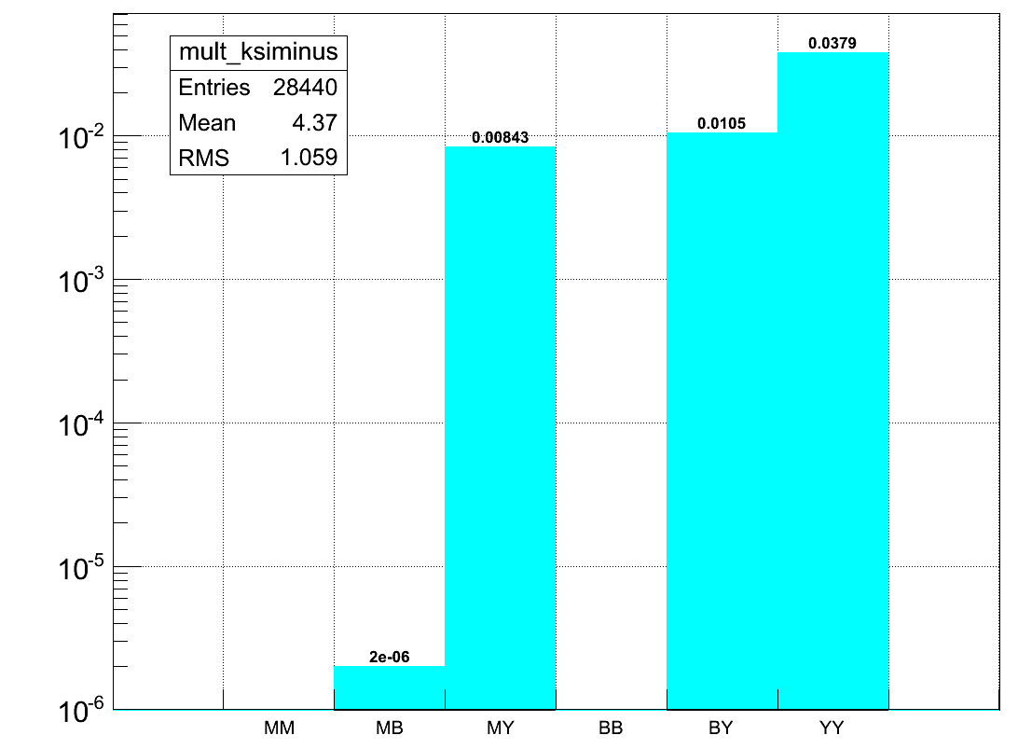
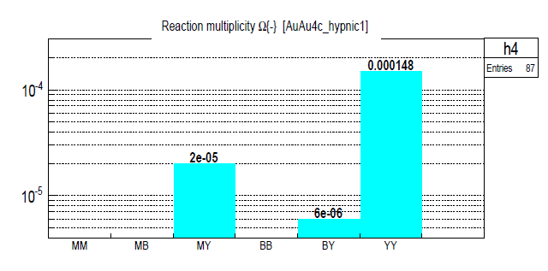
Exploring the high-density equation-of-state
of symmetric nuclear matter (3 – 6 ρ₀)
Observable: multistrange hyperon production at (sub)threshold energies
HYPQGSM calculations for 4 A GeV Au+Au
Ξ⁻ → Λπ⁻
Ω⁻ →ΛK⁻
MB MY BB BY YY
HYPQGSM calculations

Slide 30
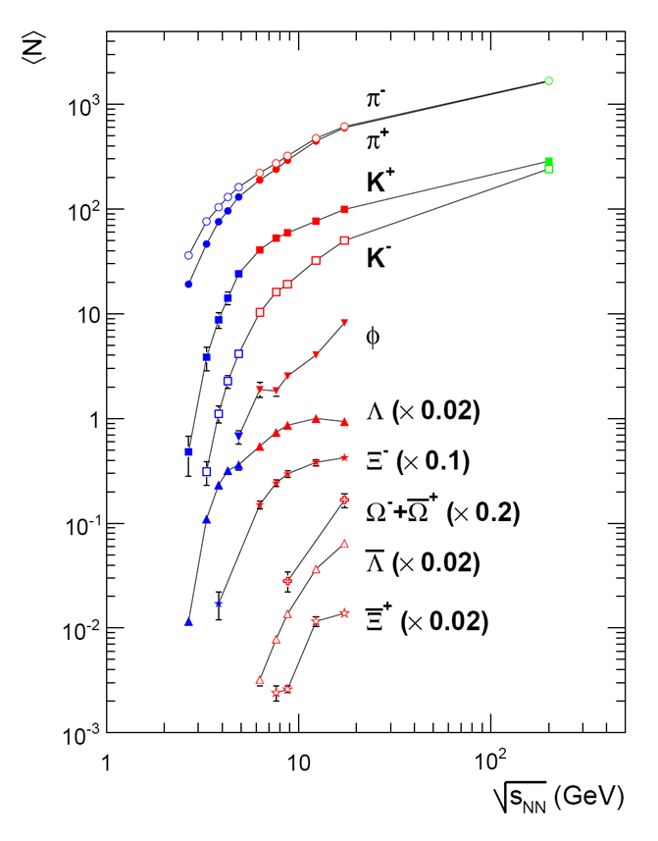
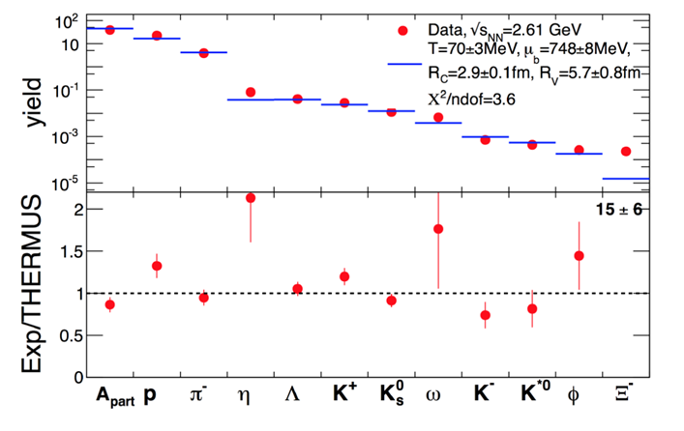
Strangeness
Data situation
Pb+Pb, Au+Au (central)
HADES: Ar + KCl 1.76 A GeV
G. Agakishiev et al., arXiv:1512.07070
FAIR

Slide 31
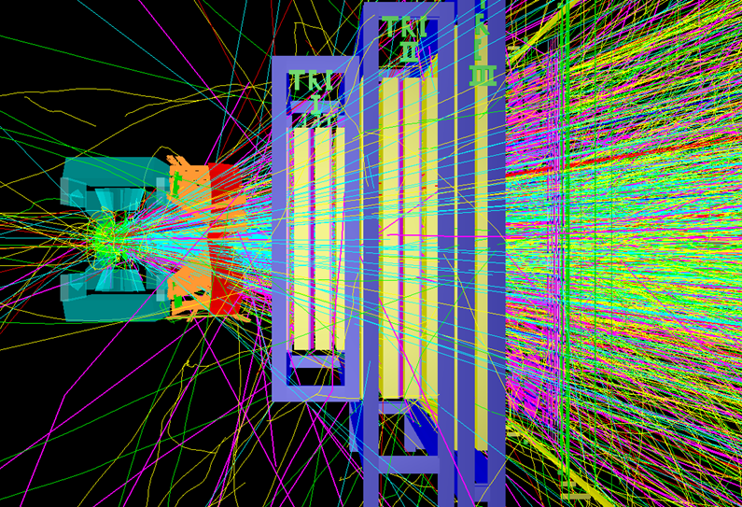
Hyperon yields at CBM
4A GeV min. bias Au+Au collisions,
multiplicities from statistical model, reaction rate 10⁶/s
Particle | E_{thr}NN GeV | Multiplicity min.bias | ε % | Yield/week min. bias
Ξ⁻ | 3.7 | 2.5⋅10⁻² | 3 | 4.5⋅10⁸
Ω⁻ | 6.9 | 5⋅10⁻⁴ | 3 | 9⋅10⁶
Anti-Λ | 7.1 | 5⋅10⁻⁵ | 15 | 9⋅10⁵
Ξ⁺ | 9.0 | 1.5⋅10⁻⁵ | 3 | 2.7⋅10⁵
Ω⁺ | 12.7 | 2.5⋅10⁻⁶ | 3 | 4.5⋅10⁴

Slide 32
Nuclear EOS and the QCD phase diagram
m_{NS}>2m
m_{NS}>2m
δP/δε=c_{s}²
δP/δε=c_{s}²
supported
by lab. expts.!
Toru Kojo (CCNU), arXiv:1712.06255v1

Slide 33
Consequences for the QCD phase diagram:
Continuous transition from hadrons to quarks
Toru Kojo (CCNU), arXiv:1712.06255v1

Slide 34
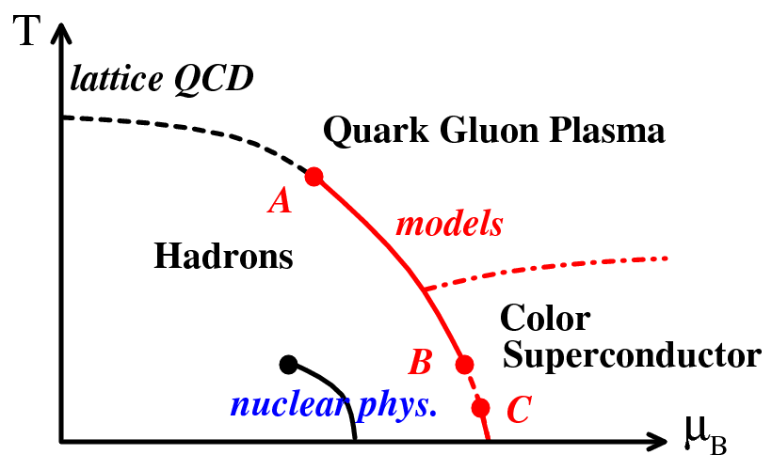
Consequences for the QCD phase diagram:
Cross over at high density and low temperature
heavy-ion collisions

Slide 35
Consequences for the QCD phase diagram:
Cross over at high density and low temperature
?

Slide 36
Consequences for the QCD phase diagram:
Cross over at high density and low temperature
?

Slide 37
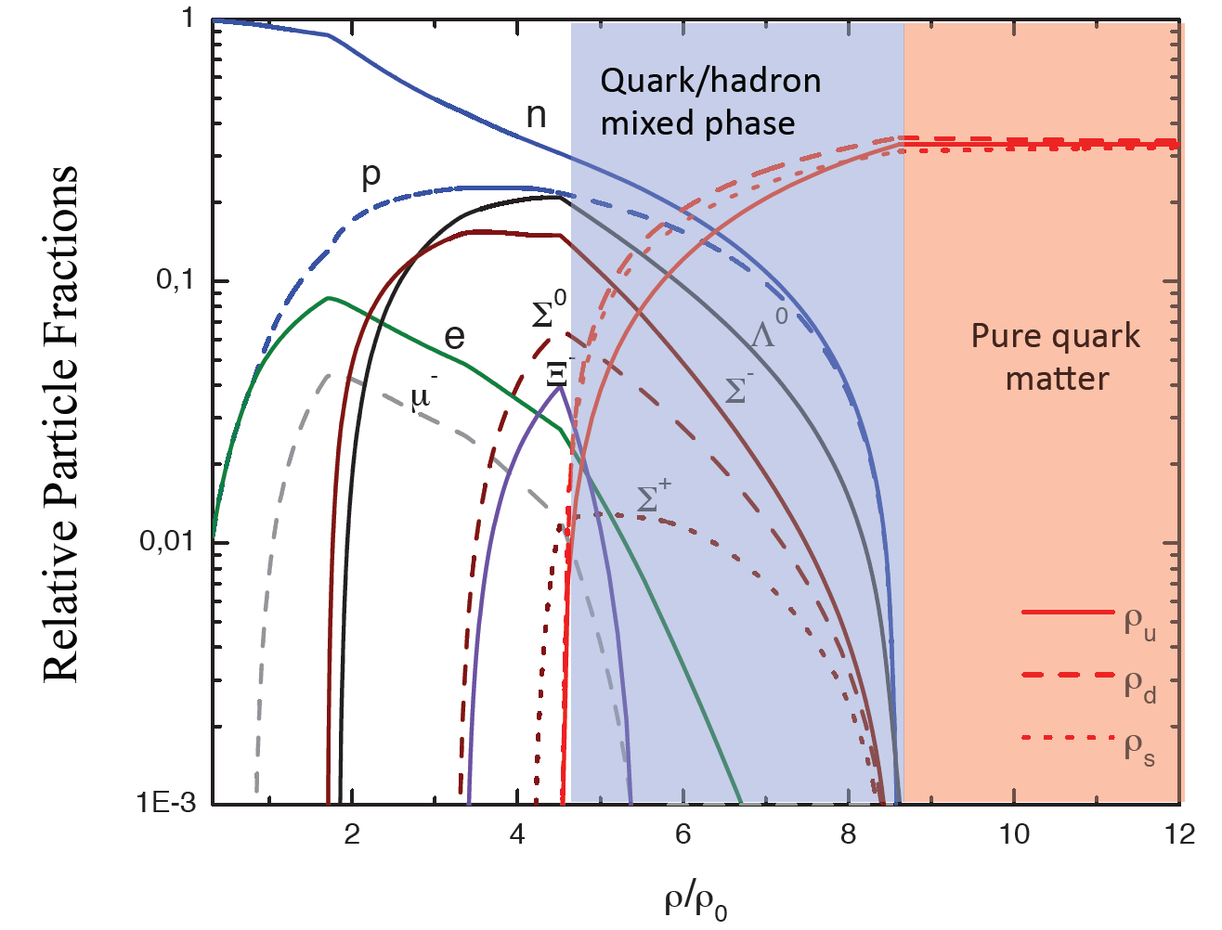
Degrees of freedom in massive neutron stars?
Equation-of-state: Non-local SU(3) NJL with vector coupling
M. Orsaria, H. Rodrigues, F. Weber, G.A. Contrera, arXiv:1308.1657
Hyperon puzzle
in neutron stars
N-Λ, Λ-Λ interaction ?

Slide 38

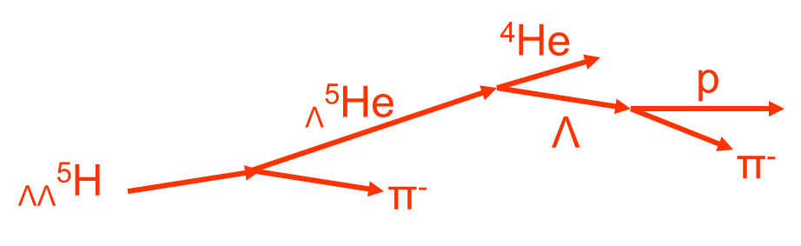

Hyperon production in A+A collisions
N-Λ, Λ-Λ interaction ➢ (double-) lambda hypernuclei
Double lambda hypernuclei production
in central Au+Au collisions at 10 A GeV:
 | Multiplicity | Yield in 1 week
_{ΛΛ}⁵H | 5 ⋅ 10⁻⁶ | 3000
_{ΛΛ}⁶He | 1 ⋅ 10⁻⁷ | 60
Assumption for yield calculation:
Reaction Rate 1 MHz
BR 10% (2 sequential weak decays)
Efficiency 1%
N-Λ, Λ-Λ interaction at high densities:
collective flow of _{Λ}³H and _{ΛΛ}⁵H ?
SIS100
A. Andronic et al., Phys. Lett. B697 (2011) 203

Slide 39
Summary
Nuclear density | Inkompressibility K_{nm} | Symmetry energy E_{sym}
≤ ρ₀ | 220 – 240 MeV | ≈ 30 MeV
∼ 2 ρ₀ | 180 – 250 MeV | 50 – 70 MeV
EOS beyond twice ρ₀:
➢ Proton flow data inconclusive
➢ Future: Precision measurements of excitation functions of
the collective flow of identified particles (SIS100) and neutrons (SIS18, SIS100?) → E_{sym}
multi-strange hyperon production (SIS100)
→ needed: reliable description of observables sensitive to the EOS by transport codes up to beam energies of 10A GeV
Hyperon puzzle in neutron stars:
Study ΛΛ and ΛN interactions by measuring yields, livetime, binding energy and collective flow of (double) Λ hypernuclei

