Slide 1
The Silicon Tracking System of the CBM Experiment at FAIR
Group Report

Slide 2
Outline of the presentation
Introduction
STS silicon sensors
Detector modules
System integration
COSY and mCBM campaigns
Conclusions

Slide 3
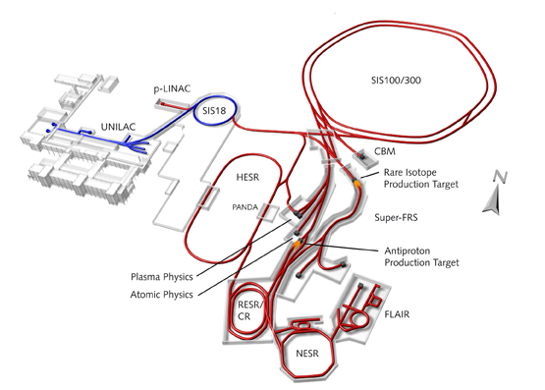
Future Facility for Antiproton and Ion Research (FAIR)
FAIR is an international research facility located based in GSI
Ion beams from proton to uranium will be provided
CBM is one of 4 major experimental pillars
Expected start of operation 2024
A conceptual view of the future FAIR facility

Slide 4
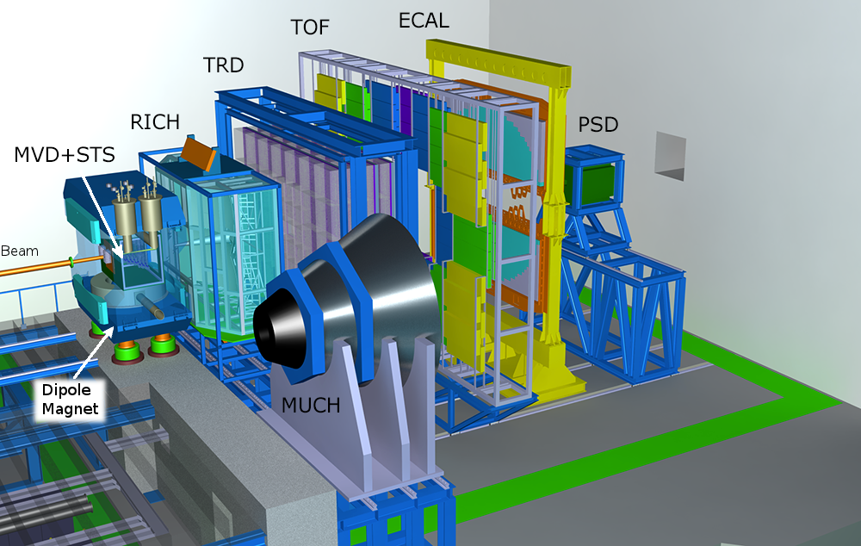
Compressed Baryonic Matter (CBM) experiment
10 MHz interaction rate allows high statistics for rare and exotic probe detection
Caveat: no hardware trigger on complex particle decays is possible
Challenging solution: free-streaming read-out electronics with real-time software triggers
Physics analysis is done on high performance computing farms
The CBM experimental setup including, from left to right, Dipole Magnet, MVD, STS, RICH, MUCH, TRD, TOF, ECAL and PSD detector systems

Slide 5
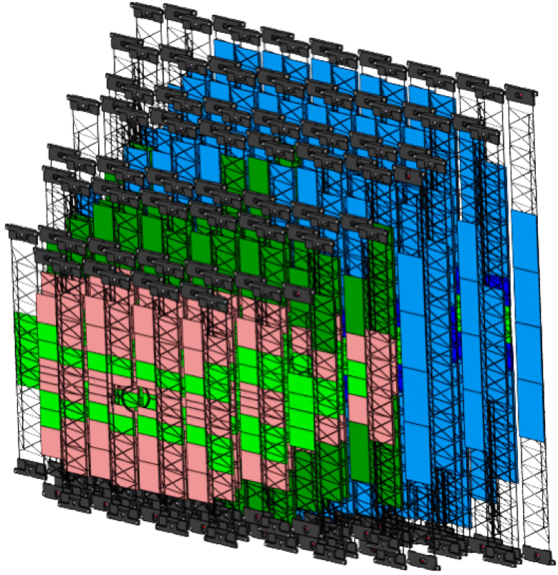
Silicon Tracking System (STS) Detector
Key detector to reconstruct particle tracks and resolve their momentum with Δp/p ≈ 1-2%
Built out of ~900 silicon microstrip sensors forming 8 tracking stations
Fast electronics produce up to 40 kW of thermal power in the close vicinity of the sensors
Very limited overall volume (~2m³) requires very efficient cooling
View of the STS detector without thermal enclosure and services

Slide 6
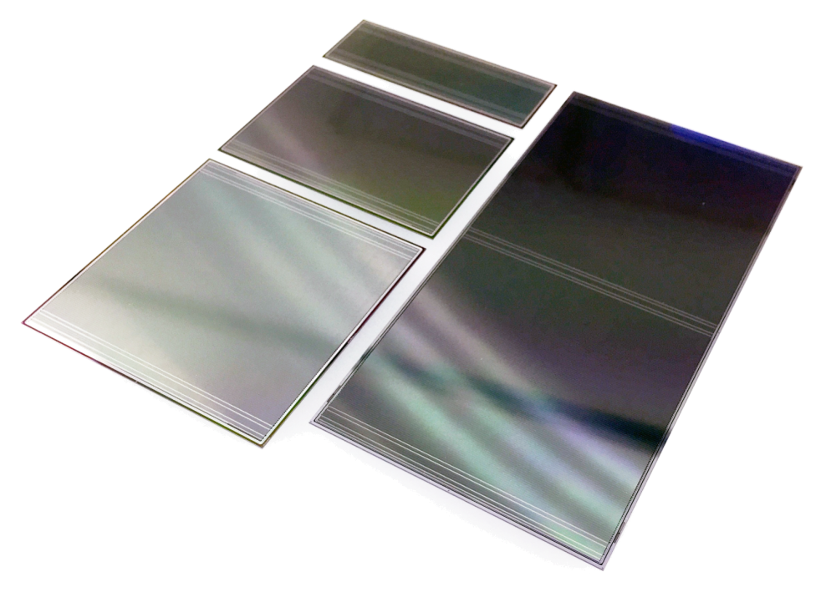
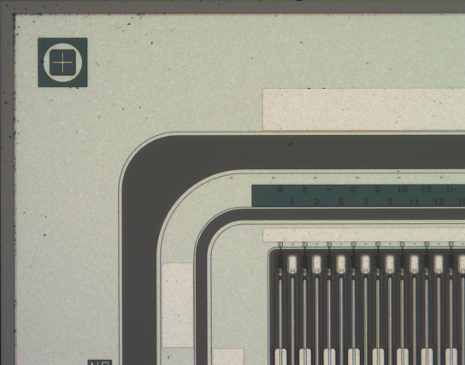
Silicon microstrip sensors
State of the art microstrip technology
Provide spatial hit resolution of about 25 μm
Come in 4 different sizes, 2 manufacturers
Rich microscopic structure is prone to manufacturing errors and defects
A photograph of prototype silicon sensors. 4 different sensor sizes are shown.
A feature rich corner region of the STS sensor

Slide 7
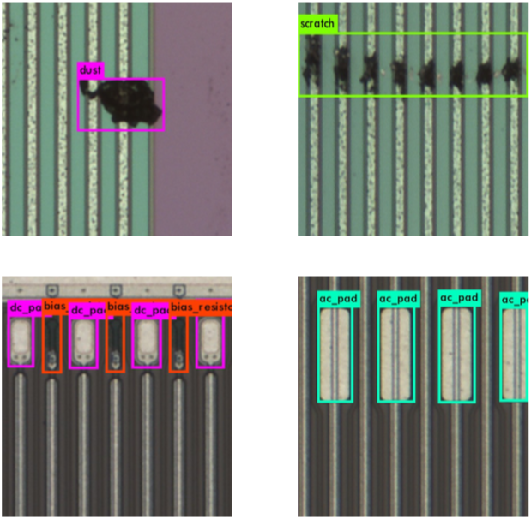
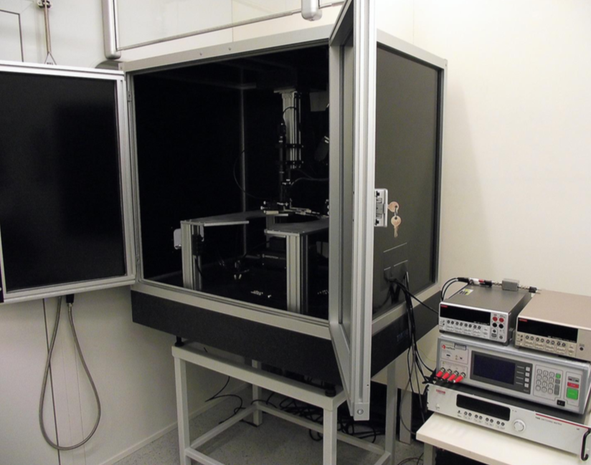
Quality assurance of the sensors
Detection of surface defects and electrical elements
Optical (all) and electrica (fraction)l QA of the sensors is required
Optical:
  allows to identify surface defects, such as scratches, strip and implant defects, control electrical element integrity, etc.
  Based on a machine vision and machine learning algorithms for recognition
Electrical:
  Allows to perform the global and per-strip measurements of a sensor, e.g. IV, CV dependencies, etc.
  Employs a custom build probe station
  Exhaustive QA procedures allow to identify pinholes, strip breaks and shorts, leaky strips, breakdown behavior, etc.

Slide 8
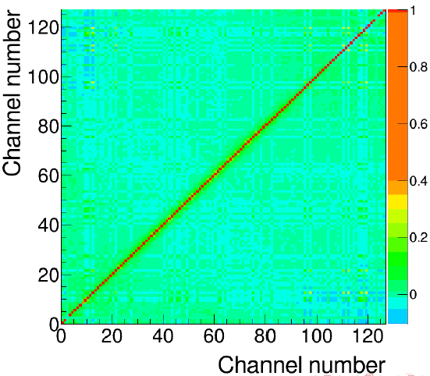
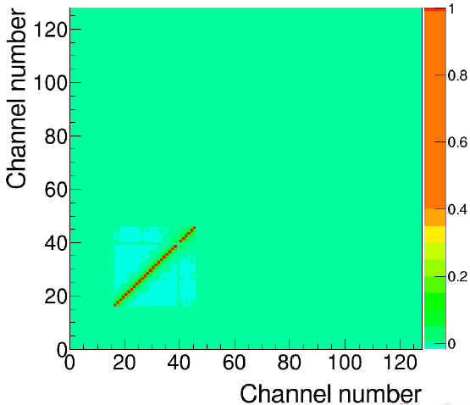
Sensor cross-talk for second metal layer
Since we use the DSDM sensors, there is a possibility for cros-talk between read-out strips and second metal layer strips
Cross-talk through second metal layer was studied with prototype modules with NXYTER chip (H. Malygina, M. Teklishyn )
CIS sensor shows correlation between neighbors - charge sharing and cross-talk through IS capacitance
HPK: no significant difference between single-metal and double-metal sensors
Channel signal correlation map for CIS (top) and HPK (bottom) sensors

Slide 9
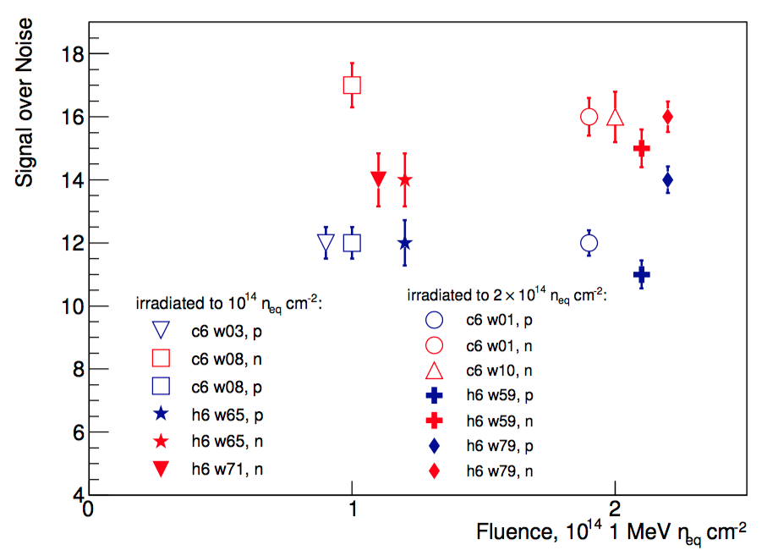
Radiation hardness studies with protons
The STS sensors were subjected to the NI irradiation doses of up to 2x lifetime
Irradiation was done with E_{kin} = 22.9 MeV protons at KIT cyclotron
Aim was to control the CCE, S/N ratio, IV and CV measurements
S/N ratio of the sensors vs fluence
SIS100 lifetime - no big decrease of CCE
SIS300 lifetime - 85-95 % CCE
2x SIS300 - drops to 75-90 %

Slide 10
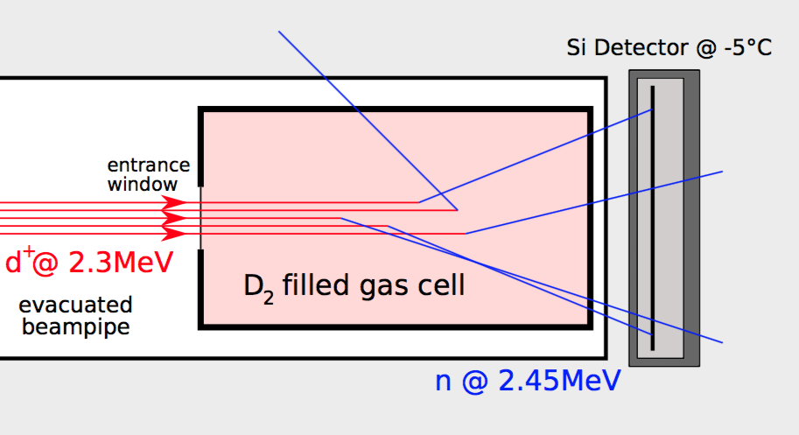
Radiation hardness studies with neutrons
The STS sensors will be exposed for a total non-ionizing dose of up to 10¹⁴ n_{eq}/cm² over 6 years of operation
This project aims to study the long-term slow radiation damage to the sensors, monitor their electrical characteristics.
A d-d fusion reaction is used to produce the neutrons to irradiate the silicon sensors
A big irradiation campaign have taken place in the end of 2017
Analysis ongoing
Neutron generation scheme to irradiate the sensors.
See talk of Eduard Friske shortly after

Slide 11
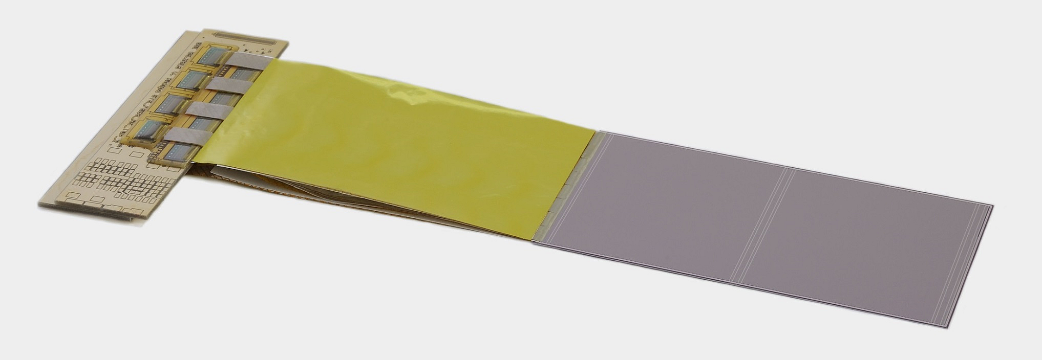
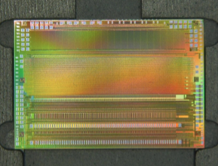
Detector modules
Modules consist of a sensor, a bundle of microcables and ASICs placed on the Front-End-Board
Each sensor side is tab bonded to 8 micrcables, which in turn are bonded to 8 STS-XYTER ACICS
Module assembly workflow was developed and established (GSI Detector Lab, C. Simons)
Assembly tools were designed, manufactured and supplied to the production sites (GSI, JINR)
Prototype detector module assembled in GSI
STS-XYTER chip developed in AGH, Krakow

Slide 12
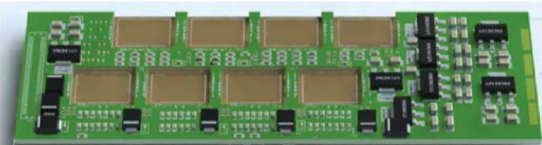
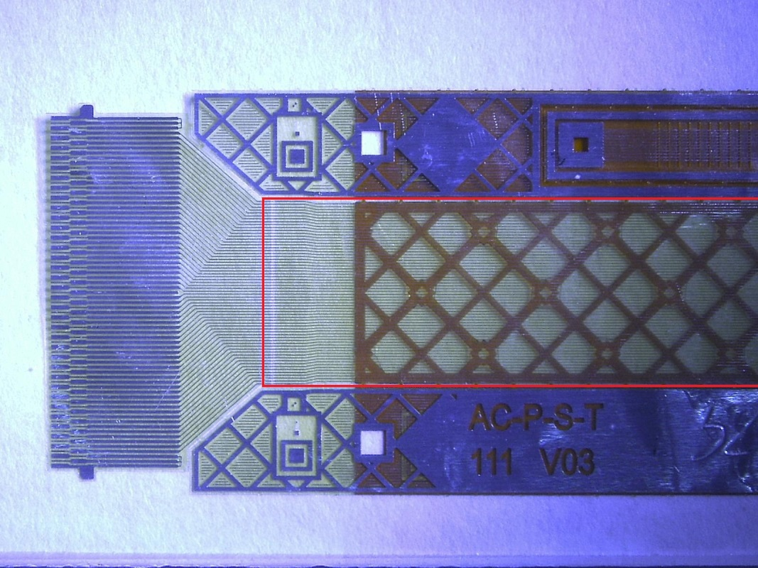
Detector modules (continued)
Modules consist of a sensor, a bundle of microcables and ASICs placed on the Front-End-Board
Each sensor side is tab bonded to 8 micrcables, which in turn are bonded to 8 STS-XYTER ACICS
Module assembly workflow was developed and established (C. Simons)
Assembly tools were designed, manufactured and supplied to the production sites (GSI, JINR)
FEB PCB
L. Mik, W. Kucewicz (AGH), V. Kleipa (GSI)
Microphotograph of the Alu-microcable before cutting
Produced at LTU, Kharkov

Slide 13
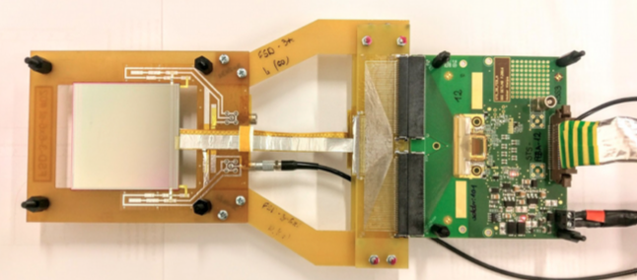
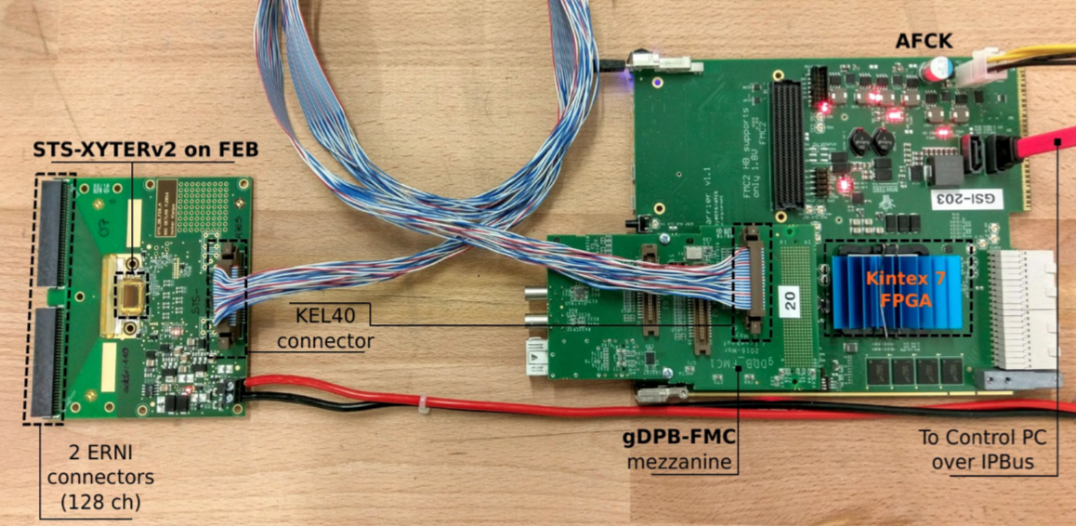
Detector read-out chain
The prototype read-out chaing for silicon sensors with STS-XYTER chip was developed in GSI (J. Lehnert, A. Rodriguez-Rodriguez)
Provides means for ADC calibration processes
Allows the noise estimation with real silicon sensors
Detector read-out chain with a sensor connected to a STS-XYTER chip on a FEB-B (top) and the FEB-B to data processing board with an uplink to the control PC

Slide 14
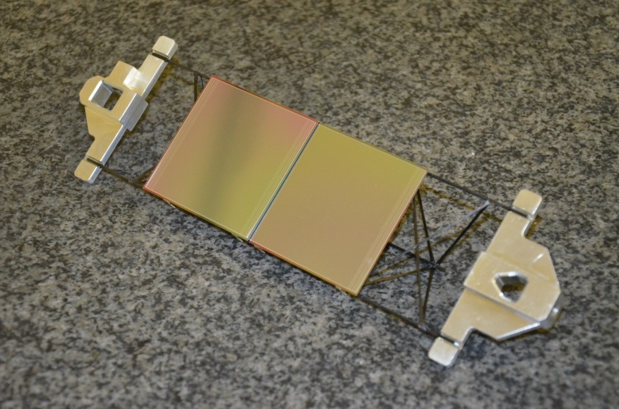
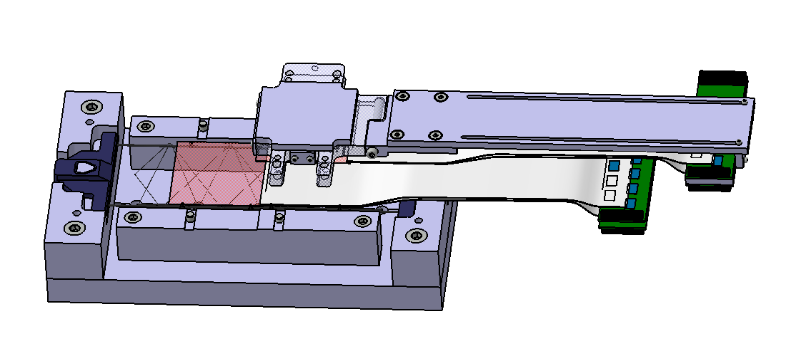
Sensor Ladders
The carbon fiber ladders will provide the means to arrange the sensors in units and stations
The sensors are mounted to the ladders with special fixtures – fiber-glass L-Legs
The assembly fixtures were developed (O. Vasylyev) allowing for high mechanical placement precision

Slide 15
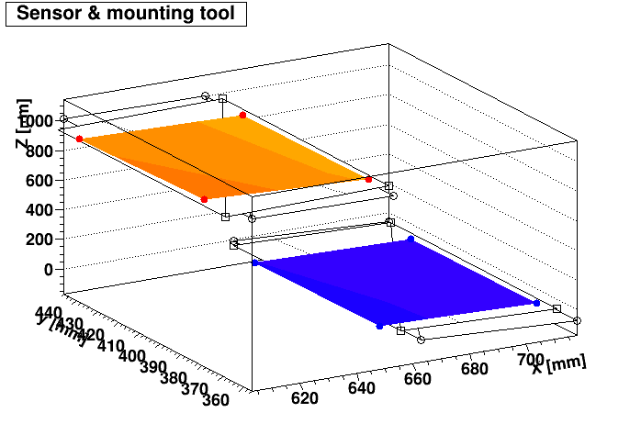
Sensor Ladder Inspection
The sensors placed on the ladder are inspected for their placement precision by the means of optical survey
The coordinates of the sensors are measured in 3D contactless by the autofocusing measurements
The placement precision w.r.t. base plane is measured by reconstructing the spatial configuration of the sensors
Output of the ladder survey.
Spatial configuration of the sensors
is reconstucted.
By E. Lavrik, U. Frankenfeld, S. Mehta

Slide 16
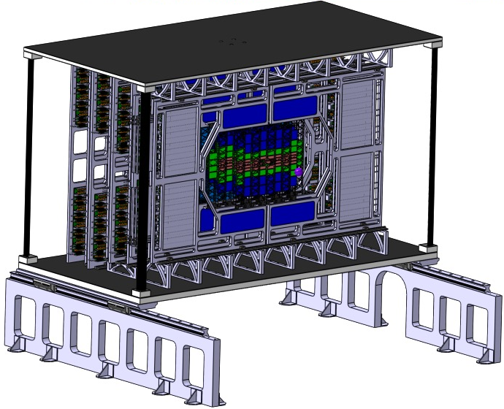
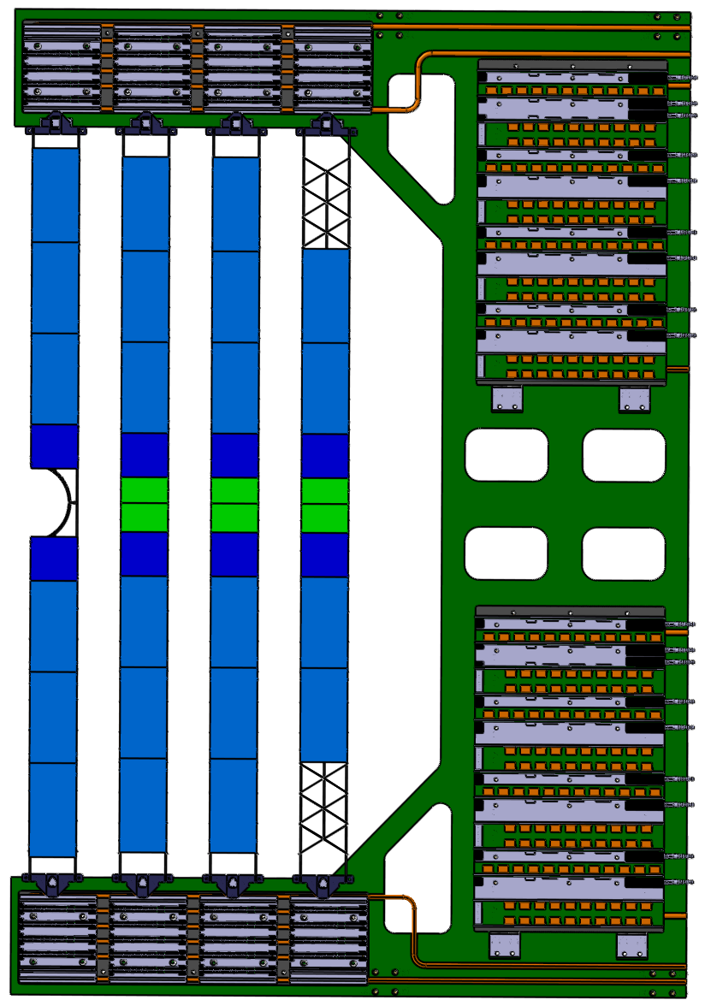
System Integration & Cooling
STS is a compact detector with high degree of component density
The conceptual engineering design (by O. Vasylyev, see pictire) is highly developed
Activities towards prototype station assembly
Thermally insulated and air tight to prevent condensation
Thermal management is carried out by K. Agarwal (see upcoming talk)
Use of evaporative bi-phase CO₂ cooling due to space constraints

Slide 17
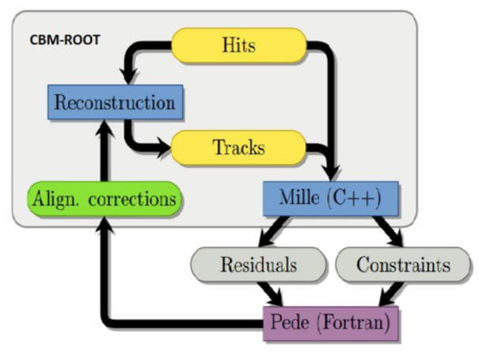
Track-Based Detector Alignment
Limited mechanical precision of ~100µm requires advanced techniques for precise alignment
Approach is based on minimisation of track hit residuals
The data from ladder optical survey might be used as an initial input for the alignment
Input parameters for alignment algoritms
Workflow diagram of the track-
based alignment, see talk of S.Das

Slide 18
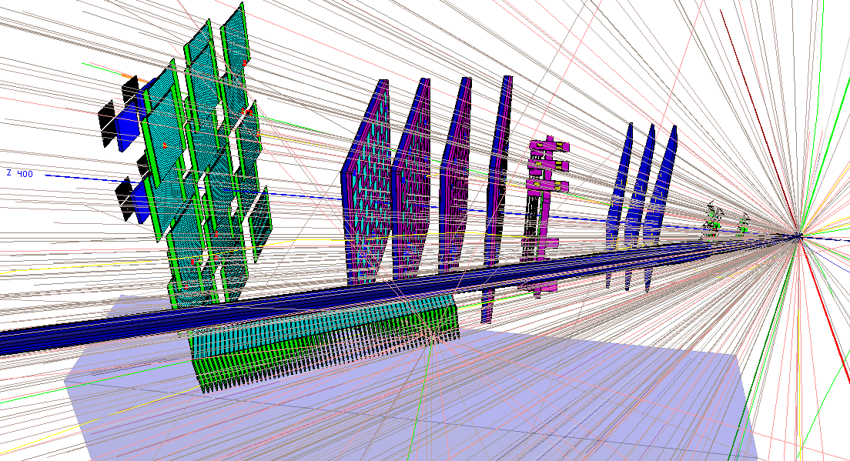
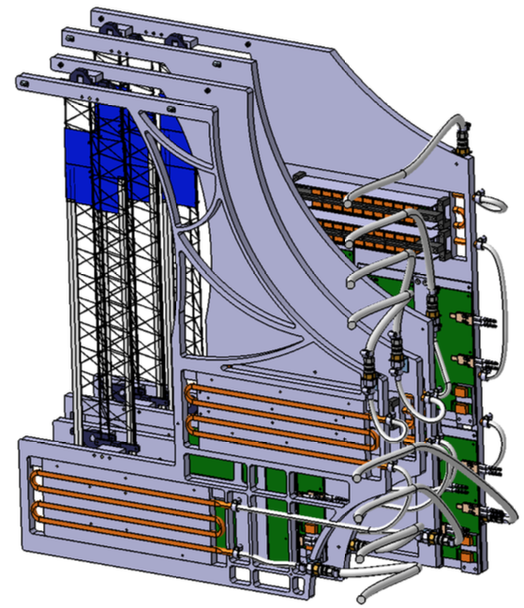
mSTS in the mCBM@SIS18 campaign
mCBM is a piloting project employing the mini-versions of all detector systems of CBM experiment, joint effort of all groups involved
mSTS will consist of 2 stations - (4 units)
Hence minimalistic design, all components from the final version of the STS detector will be used
Integration concept of mSTS
by O. Vasylyev

Slide 19
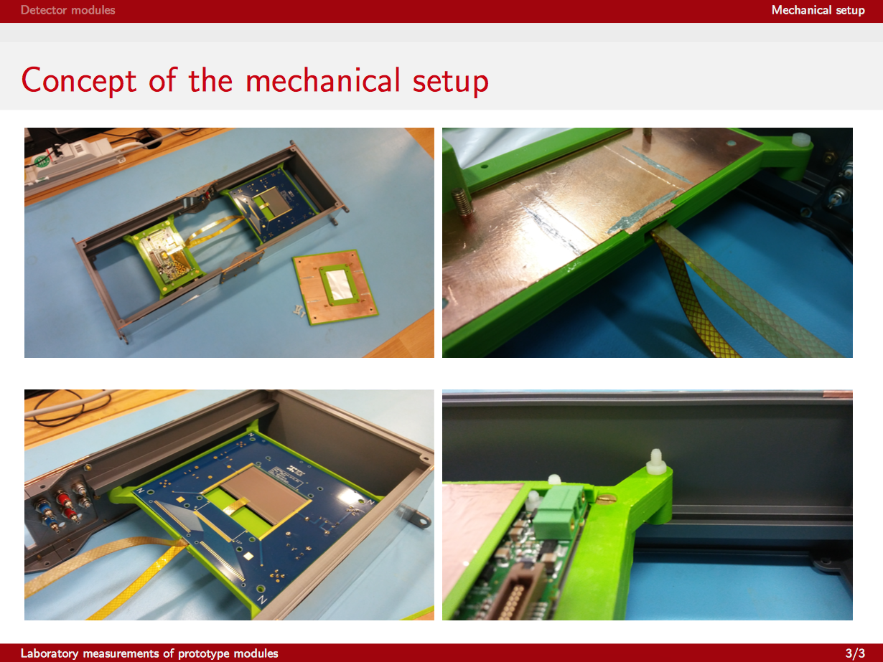
Beamtime at COSY
This week the beamtime campaign at COSY is ongoing
Aim is to test the prototype sensors, sensor modules and readout chain in realistic irradiation conditions
Additionally the noise performance of the assembled modules is studied
Prototype STS sensor module for beamtime. A. Lymanets, E. Momot, M. Teklyshyn, A. Rodriguez²

Slide 20
Key project institutes
  GSI-FAIR, Darmstadt, Germany; JINR, Dubna, Russia;
  Univ. Tübingen, Germany; KIT, Karlsruhe, Germany;
  AGH, Cracow, Poland; JU, Cracow, Poland;
  WUT, Warsaw, Poland.
  Assembly Centers: GSI-FAIR, JINR -VBLHEP
Project Timeline:
  2013 – Technical Design Report
  2017-2018 – Production Readiness
  (Sensors, Electronics, System Integration)
  Detector construction until 2022
  Commissioning until 2023

Slide 21
Conclusions and outlook
The sensor development is to be concluded with mass ordering
QA procedures were developed and ready to assess quality of the manufactured sensors
Irradiation studies show adequate sensor performance at the 1x and 2x lifetime of a sensor in terms of radiation exposure
Module and ladder assembly procedures were developed and to be applied on batches of sensors
Mechanical design of the STS detector box and services is developed and to be tested on prototype assemblies
Cooling and thermal management of the detector is assesed
Track based alignment development is ongoing and to be concluded in 2018
mSTS project is a nice opportunity to integrate all the individual projects and test the performance of the detector
              Big thanks to the whole STS team!

Slide 22
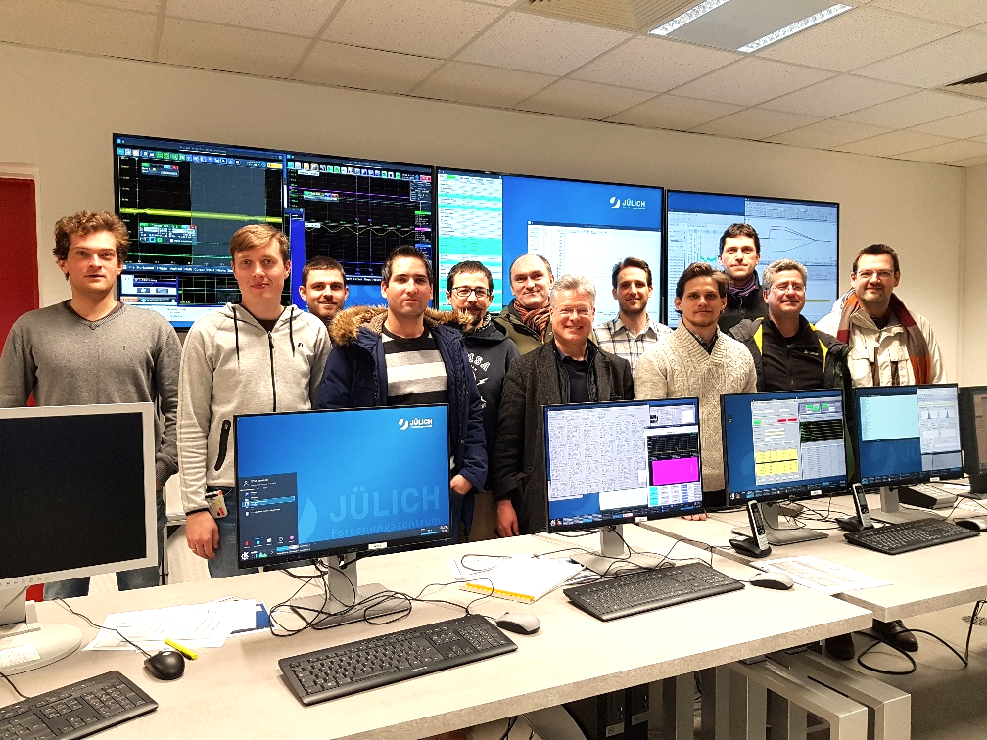
Greetings from COSY

Slide 23
Backup

Slide 24
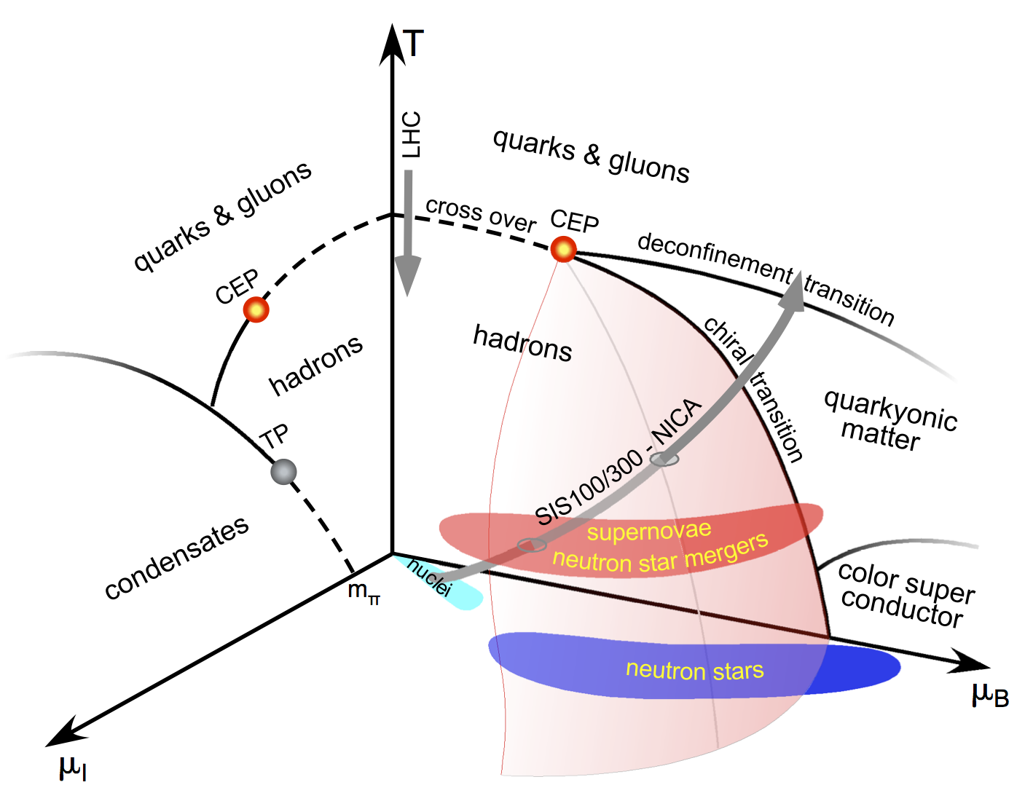
Introduction
Modern physics aims to investigate the phases of the QCD matter
RHIC and LHC identify a cross over transition at vanishing µ_{B} and high T
Deconfinement and partially restored chiral symmetry phases are expected at high µ_{B} (⪞5 𝜌₀)
Dense matter similar to that in the cores of neutron stars and neutron star mergers can be probed in the CBM
3-dimensional representation of the QCD phase diagram at high net-baryonic μ_{B} and moderate isospin μ_{I} chemical potentials.

Slide 25
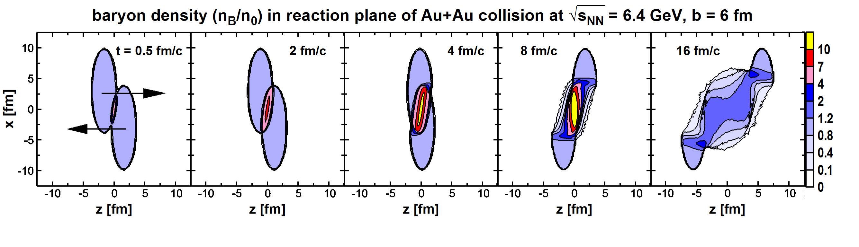
Using Hydrodynamical event generator in CBM
Based on THESEUS 3-fluid hydrodynamical model
Supports different EOS
Provides events for CBM energies at various impact parameters
Particles are transported through the CBM detector setup
Aim is to obtain the corresponding physics performance plots and compare them to UrQMD and PHSD generated events
Presented at poster session by E. Volkova at Thursday

Slide 26
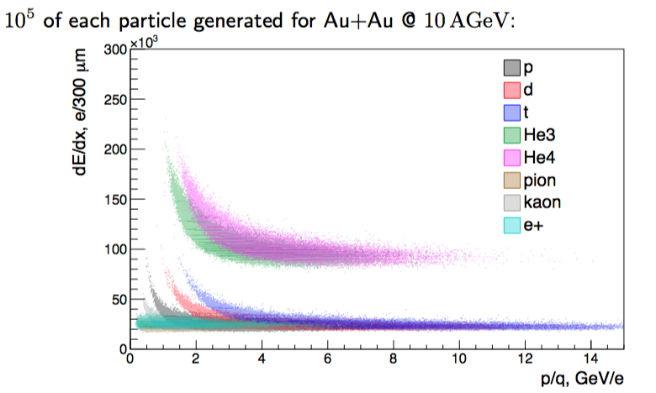
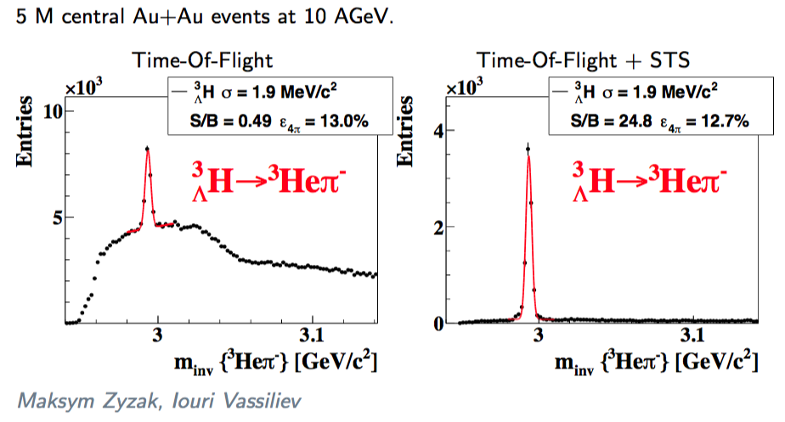
dE/dx Particle identification in STS
STS is promising tool for PID of single- and double charged particles: perfect separation for the whole momentum range
STS involving into global PID increase S/B for 3ΛH in 50 times(!) in comparison with TOF only
Joint effort of H. Malygina, M. Teklyshin from STS and PWG Hadrons

