Slide 1






Towards an EPICS based Detector Control System for the CBM Micro Vertex Detector
Philipp Klaus & Ole Artz for the CBM-MVD Collaboration
26 February 2018, DPG-Verhandlungen 2018 in Bochum

Slide 2
Tasks of Control Systems
Intro
Monitoring
Visualization
Archiving
Tracing (protocolling access)
Control (manual or automatic)
Alarming / Alerting
Be it in an industrial setting like a production plant or…
a large physics experiment
EPICS: Experimental Physics and Industrial Control System
→ our system, covered in this talk
Notes:
It should aggregate information from all sub systems for a wholistic view of the system status.

Slide 3
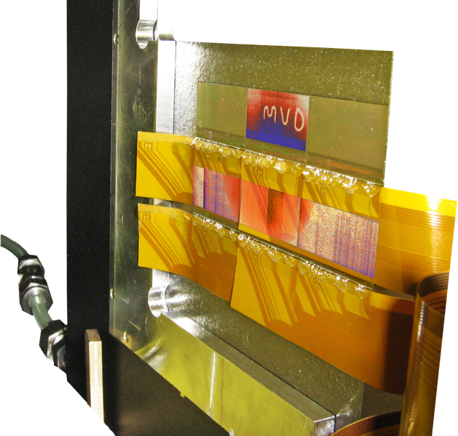

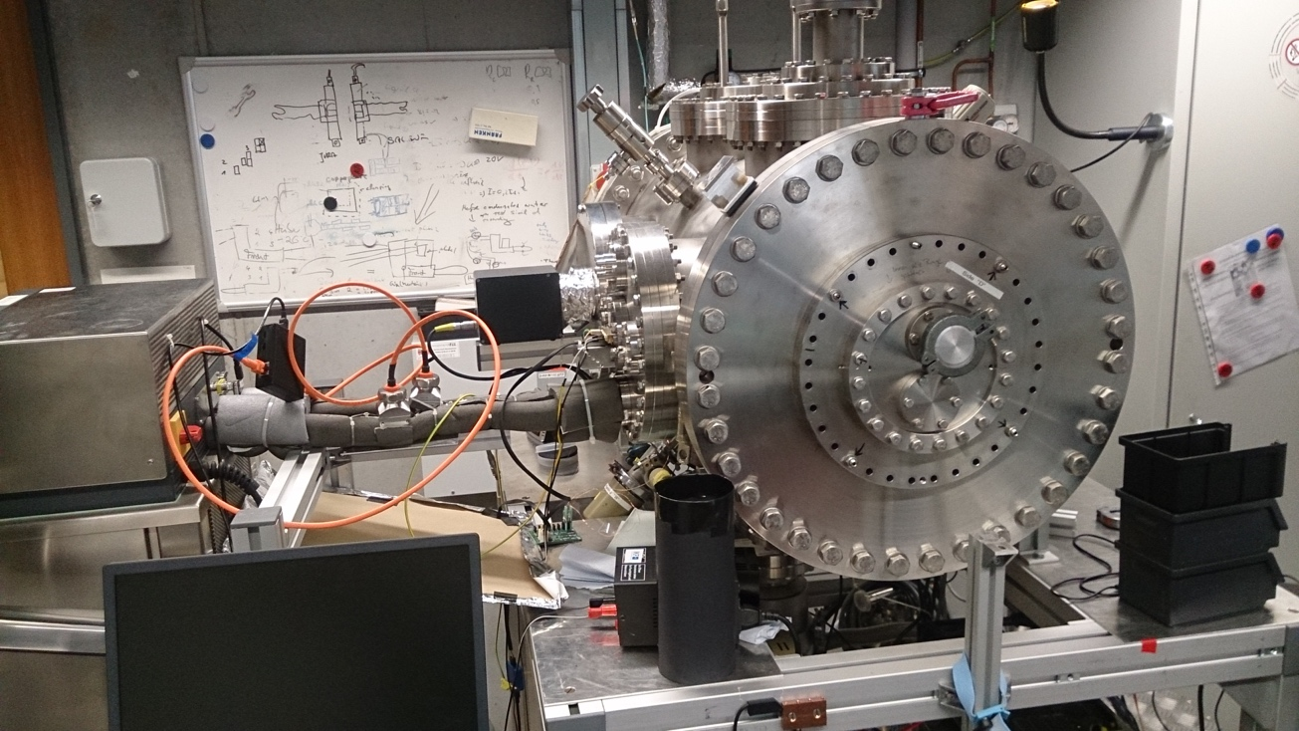
EPICS for the CBM-MVD (PRESTO)
Intro
Vacuum
⁵⁵F
What is PRESTO? → The most sophisticated prototype of the Micro Vertex Detector we have:
  Mimosa-26 based (= legacy read-out)
  15 sensors integrated one one quadrant made from TPG
  Realistic heat dissipation (>= heat dissipation of final sensor MIMOSIS)
  Successfully tested (=operated) in vacuum chamber
Goal: Confidently run the system 24/7 in the laboratory to identify potential problems and to test the control system.
PRESTO
PRESTO: Prototype of the MVD-station #2 quadrant

Slide 4
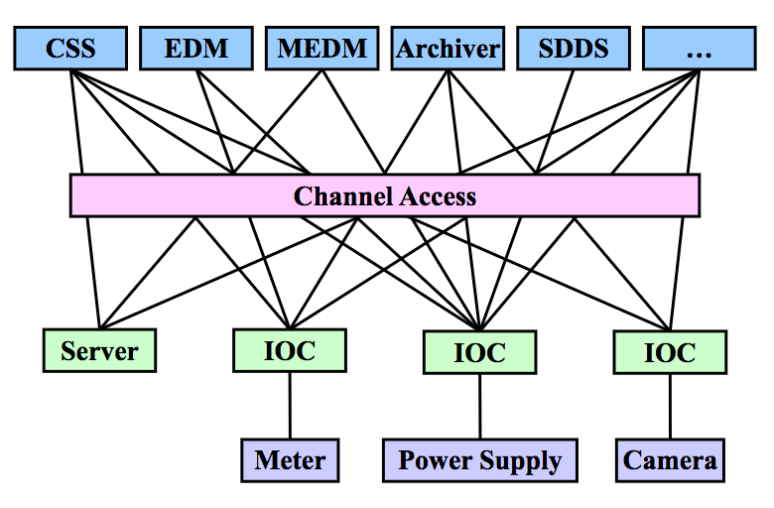
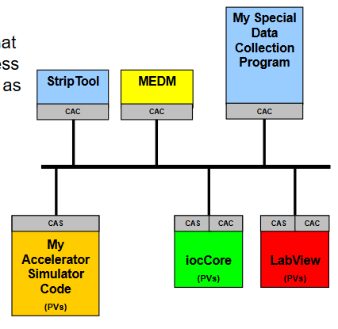
The Protocol Behind EPICS: Channel Access
Intro
The basic verbs for a channel access client:
  caget
  caput
  camonitor
Highly scalable for large real-time systems:
upon connecting to the IOCs, (long) PV names are mapped to numerical channel IDs
→ improves latency and throughput
Request status of a control variable
Update value of a control variable
Subscribe to changes of a control variable
The “backbone” of EPICS
http://www.aps.anl.gov/epics/docs/APS2014/05-CA-Concepts.pdf

Slide 5
EPICS Terminology
Intro
Channel Access (CA)
The communication protocol used by EPICS
Process Variable (PV)
A named endpoint of readable or writable information in channel access
Channel Access Server (CAS)
Server software to provide PVs via CA on the network
Channel Access Client (CAC)
A consumer of / controller for the offered data
I/O Controller (IOC)
A channel access server with many modules to realize device communication, setting limits, alarms, and more.

Slide 6
Timeline Detector Control System (DCS) for the CBM-MVD
Intro
Implementation of
many Devices (IOCs)
(2017-04 - current)
Div. tools emerged
to ease usage & development
(ongoing)
Alarm
Handling
PRESTO to
run 24/7
with DCS
CSS Archiver
deployed w/
PostgreSQL
(2017-07)
MVD
at CBM
Current
Situation
Sequences
/ FSMs
MVD Prototypes
(mMVD / mCBM)?

Slide 7
Areas of Control
Intro
Environmental
Vacuum
Control
  Lab temperature
  humidity
  Pressure Gauges
  Valves
  Steering
  Automation
Powering
Cooling
Safety
  Low voltage power supplies
  voltmeters
  Cooling Plant
    Setpoint
    Circulation
  Sensor Temperature
  Hardware interlocks,
  Latch-up protection
  Emergency Shutdown
→
Not all aspects can be covered by EPICS, employing a DCS is rather wholistic, means more than just deploying one piece of software.

Slide 8


Device Overview
Device Support
Category | Vendor & Product | Type of Interface | Support
Bench Power Supply | Hameg (now R&S) HMP 4030 / 4040 | USB (FTDI) | ✓
Bench Power Supply | Hameg (now R&S) HMC 8043 | USBTMC / VXI-11 | ✓
Cooling System | Huber CC-405 | RS-232 | ✓
Vacuum Gauge Controller | Vacom MVC-3 | RS-232 | ✓
Vacuum Gauge Controller | Balzers PKG 020 | Analog Vout | ✓
General Purpose ADC | ADCuC Board (IKF development) | USB Serial | ✓
Cooling: Flow Meter | Kobold DPM (ATmega 32u4 uC) | USB Serial | ✓
Temperature Sensors | Pt100 IKF 8ch board (ATmega 328p) | USB Serial | ✓
Humidity Sensor | Lufft OPUS 20 | TCP/IP | ✓
6½ Digit Multimeter | Agilent 34411A | VXI-11 | ✓
DAQ bridge | TRB3 / trbnet registers | trbnet | 🚧
Meta: Alarm Handling | Soft IOCs | - | 🚧
Via reverse-
engineering
with 3-way
RS232 cable
with
PCASpy
✓ implemented / finished
🚧 currently being implemented / planned
Notes:
CC-405: ✓ extended support
Pt100: 🚧 extended support

Slide 9
Device Overview: Outlook
Device Support
Via reverse-engineering
with Wireshark
Category | Vendor & Product | Type of Interface | Support
Probe Station | Suess PA200 (Semi-automatic) | TCP/IP | 🚧
Heating/Drying Oven | Memmert UNE 400 | RS-232 | 🚧
Via reverse-engineering
with 3-way RS232 cable
🚧 currently being implemented / planned

Slide 10
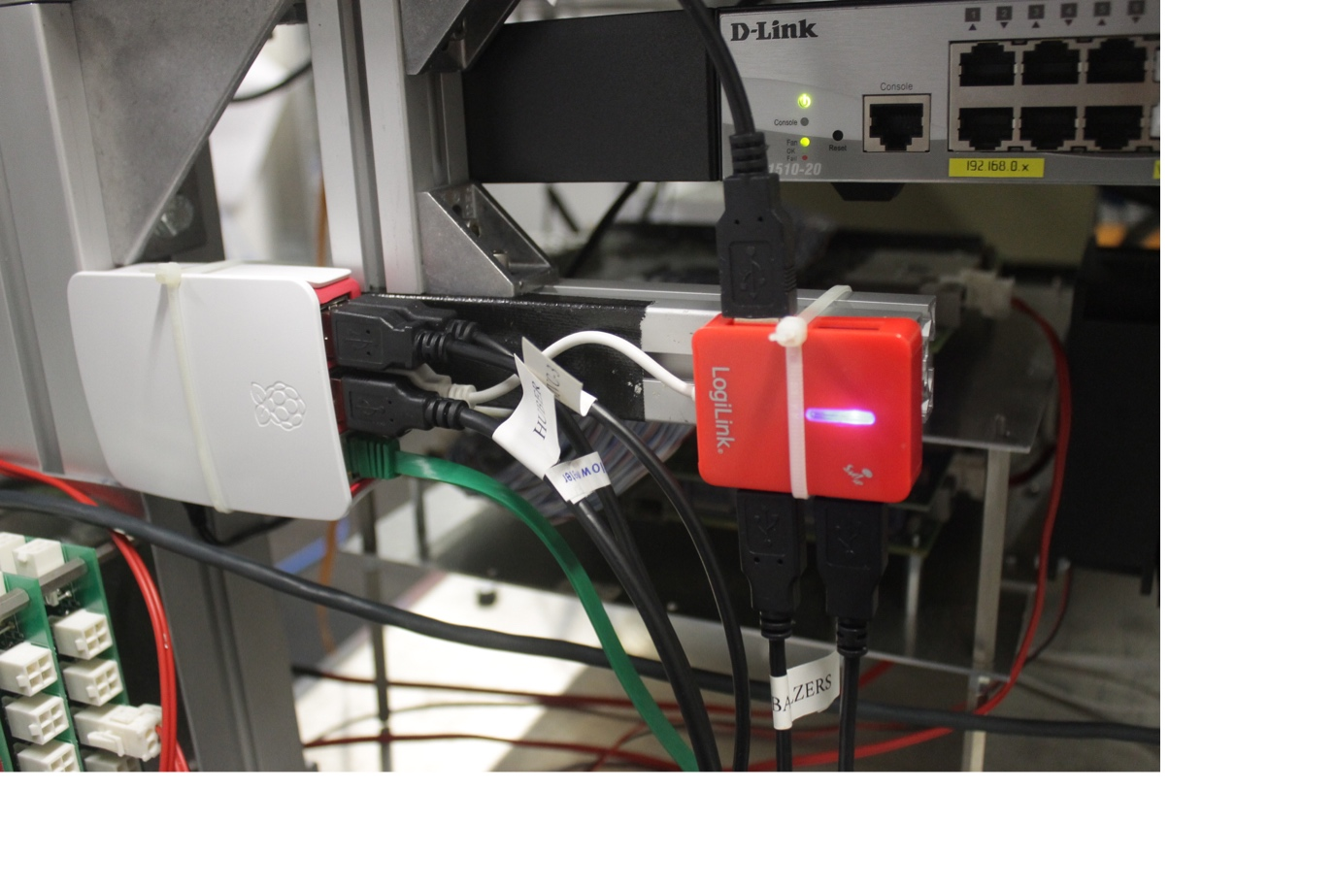
Input Output Controller (IOC) Deployment
Device Support
IOC: The backend controlling EPICS process variables
Currently our IOCs are mostly deployed on a Raspberry Pi 3 single board computer (SBC).
The system is rather “fail-safe”. It runs on a uninterruptible power supply (UPS); hardware interlocks are forseen
All our IOCs are available in a Docker container for fast deployment

Slide 11
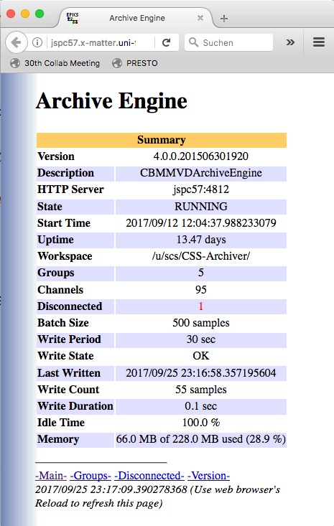
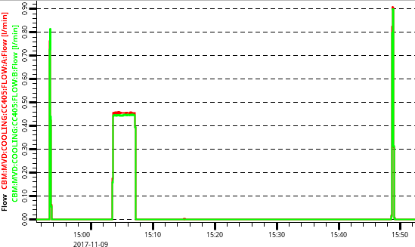
Deployment of the CS-Studio Archiver
Archiver
Database Engine used: PostgreSQL
  “Partitioning” is an important feature helping with:
    fast queries,
    periodic backups,
    scalability.
  We set up partitioning to cover one week per partition.

Slide 12
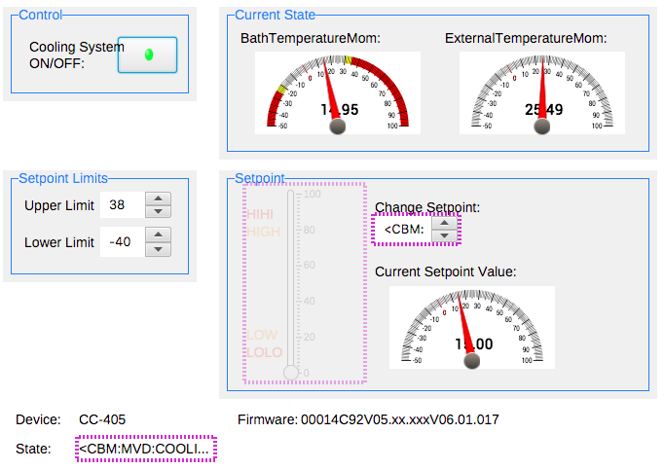
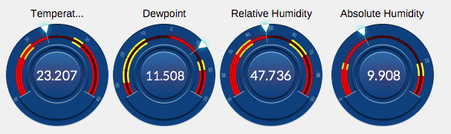
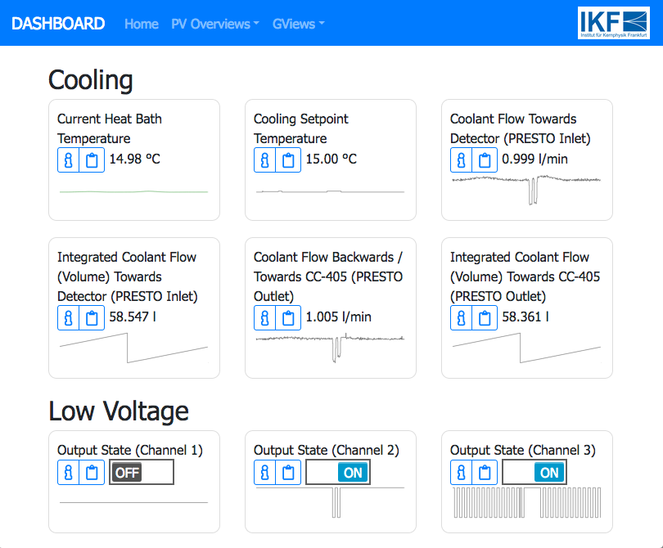
Implemented User Interfaces
User Interfaces
CS-Studio
  For full-fledged system control
  Locally accessible (read/write access)
Web GUI
  Dashboard-like
  For quick status information
  Remotely accessible (read-only!)
  “Mobile First” Approach
**Check it out for yourself**
https://presto.site

Slide 13






Website with Live-Data from EPICS CA
Web Dashboard
**Check it out for yourself**
https://presto.site
Based on the following technology:
Python (main programming language)
PyEPICS (EPICS/CA bindings for Python)
Bottle (micro web-framework)
Furthermore:
  Bootstrap (Responsive, mobile-first layout)
  Jinja2 (template engine)
  d3 (JS visualization toolkit)
PyEPICS
Bootstrap
d3.js

Slide 14
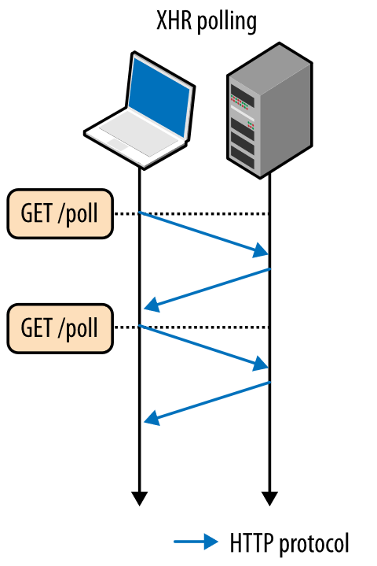
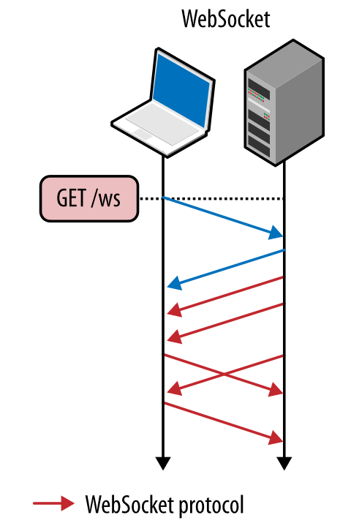
Real-Time Information on Web Interfaces
Web Dashboard
(Obvious) Technology Choice: HTML/CSS/JS
For real-time applications there are multiple options:
  (HTML refresh meta tag)
  Polling (AJAX)
  Long-Polling (AJAX)
  Publish/Subscribe (WebSockets)

Slide 15
Real-Time Information on Web Interfaces
Web Dashboard
(HTML refresh meta tag)
Polling (AJAX)
Long-Polling (AJAX)
Publish/Subscribe (WebSockets)
“pv list”
Current implementation
“gview”
Considered for entire web dashboard

Slide 16
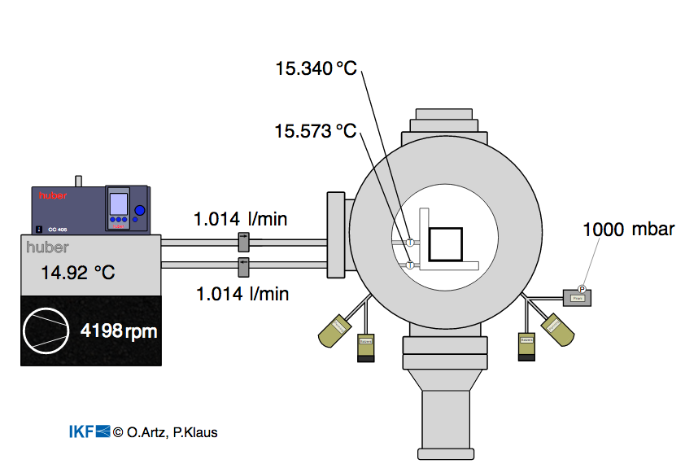
Bonus Feature in the Web Dashboard:
Graphical Views (“Gview”)
Web Dashboard
Heartbeat indicating live-status
Basis: SVG vector image (Inkscape)
PV values update
in real-time

Slide 17
CaRecPlay – Channel Access Recording & Playback
Tools
In the course of the recent EPICS DCS development, a new tool for EPICS/Channel Access was conceived and implemented by us: CaRecPlay
Consists of two Python scripts:
  carec.py Allows to monitor a given list of process variables via Channel Access
  → stores the received value updates in a persistance file (.pickle).
  caplay.py Mock-up IOC that can play-back recorded process variables (pretending it would be the device offering those PVs).
Why:
  Safe testing of new features without endangering expensive lab equipment.
  To demonstrate & develop the DCS in a country with filtered Internet.

Slide 18
Alarms using data from different devices (IOCs) = ”Meta”-Alarms
Alarms
Power Supply
for Sensors: ON
Cooling: Off
Data Taking: ON
DAQ Switch Port Counter: < 2Mbit/s
&&
&&
or:
Alarm: Potentially Hazardous Mode
Alarm:
Malfunctioning Readout
To be detailed.

Slide 19



Summary Of Our EPICS DCS Developments
Realized
Under Development
Upcoming
Device Coverage
Archiver Deployment
CS-Studio Interface
Web Dashboard
  SVG illustrations
  Tabular overview & sparklines
CaRecPlay
Bridge: EPICS CA → MQTT
DAQ / trbnet Support
Plotting Webserver
for archived values
Sequencing: self-contained state machine within IOC
Alarm Propagation /
Global Status
External Alarm Handling:
send email, send SMS,
flash alarm lights, etc.
Thank you for your attention!
Custom Tool
Standard EPICS (base)
CS-Studio
PyEPICS
PCASpy

