Slide 1






THERMAL MANAGEMENT (COOLING) OF THE CBM SILICON TRACKING SYSTEM
Kshitij Agarwal
Eberhard Karls Universität Tübingen, Tübingen, Germany
for the CBM Collaboration

Slide 2
OUTLINE
Introduction of the CBM Silicon Tracking System
Motivation & challenges for thermal management of CBM-STS
Optimisation of thermal interfaces
Optimisation of cooling plates
Feedthrough test setup
Conclusion and outlook

Slide 3
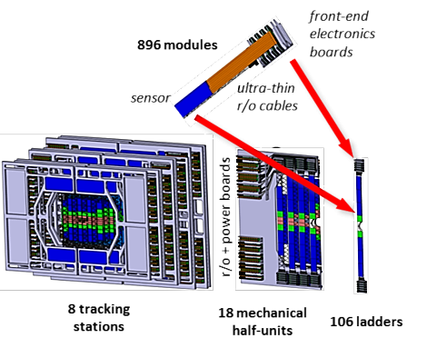

CBM SILICON TRACKING SYSTEM
CBM aims to explore regions of high-baryonic densities of QCD phase diagram
Requires detection of rare probes → 10⁵ – 10⁷ collisions/sec (Au-Au)
→ Momentum Resolution
→ High track reconstruction efficiency with pile-up free track point determination
↓
Silicon Tracking Station → Key to CBM Physics
8 Tracking Stations :- 896 double-sided micro-strip sensors
Low Material Budget :- 0.3% - 1% X₀ per station
Radiation tolerance: ≤ 10¹⁴ n_{eq} cm⁻² (1 MeV equivalent)
~ 1.8 million read-out channels
~ 16000 r/o ASICs “STS-XYTER”
STS Group Report
HK 61.1, 14:00, E. Lavrik
40kW Power Dissipation!!!

Slide 4

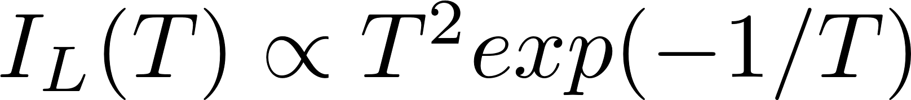
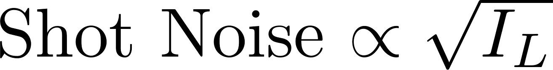
MOTIVATION & CHALLENGES FOR STS COOLING
Adverse effects of high-radiation
→ Leakage current increases with fluence & temperature
→ Reduces signal-to-noise ratio (STS req.: S/N > 10)
→ Thermal Runaway
→ Reverse annealing of depletion voltage
Sensor cooling could control these adverse effects
STS sensor temp. -10°C to -5°C at all times
STS Sensor Radiation Damage
HK 61.5, 15:15, E. Friske

Slide 5
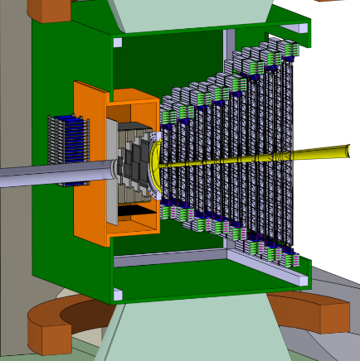
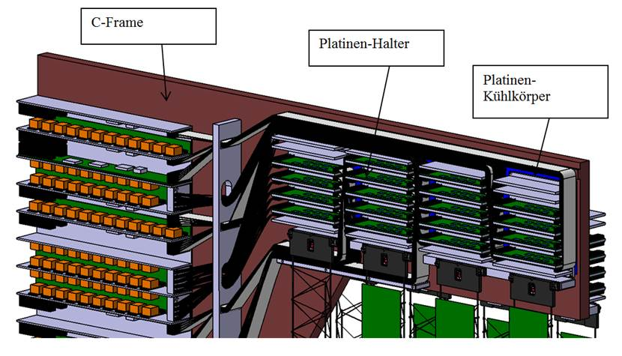
MOTIVATION & CHALLENGES FOR STS COOLING
Thermal
Insulation Box
FEE (40kW)
Cooling
Plate
No cooling pipes inside detector acceptance
Cooling of sensors (~ 1mW/cm²) → forced convection (N₂ cooling) + thermal enclosure
Cooling of front-end electronics (~ 40kW) → bi-phase CO₂ cooling
<-5°C
@sensors

Slide 6
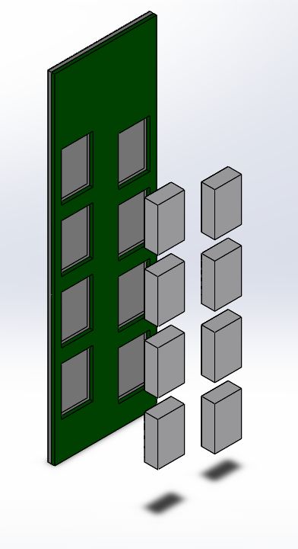
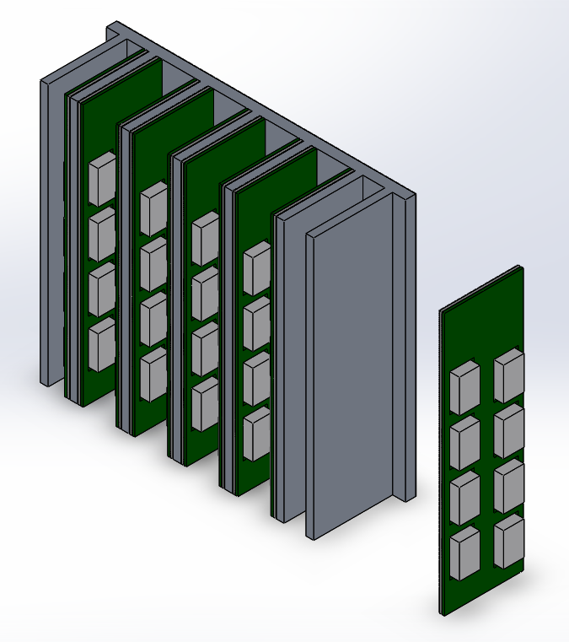
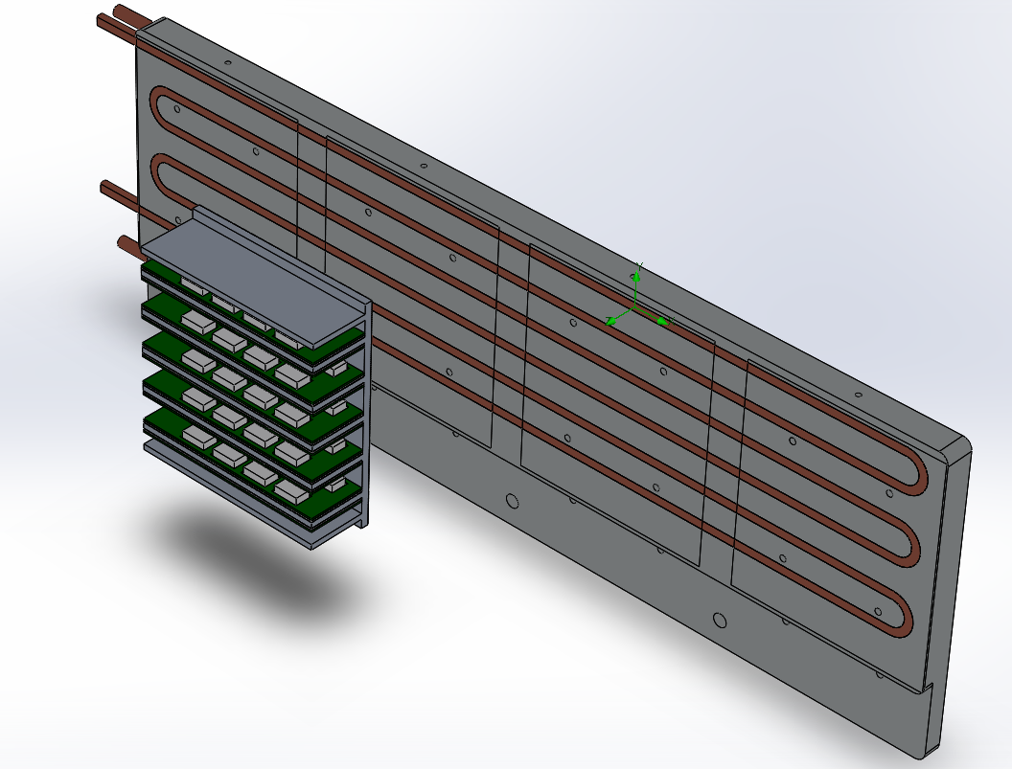
OPTIMISATION OF THERMAL INTERFACES
Thermal Interface Materials (TIMs) → increases area of contact at microscopic scale
→ increase overall thermal conductivity
(k_{air} = 0.026 W/(m∙K) )
Interface 1: (Fixed)
Aluminium Nitride – ASIC (Resistors)
Interface 2: (Removable)
Aluminium Nitride – Aluminium Fin
Interface 3: (Removable)
FEE box – Cooling Plate

Slide 7
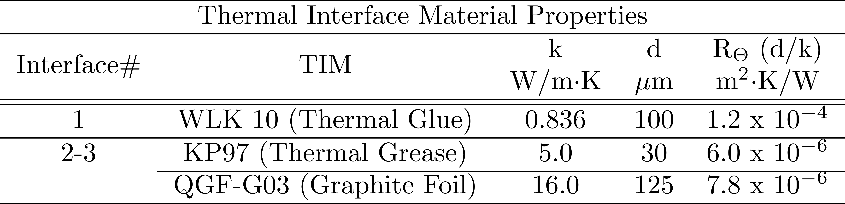
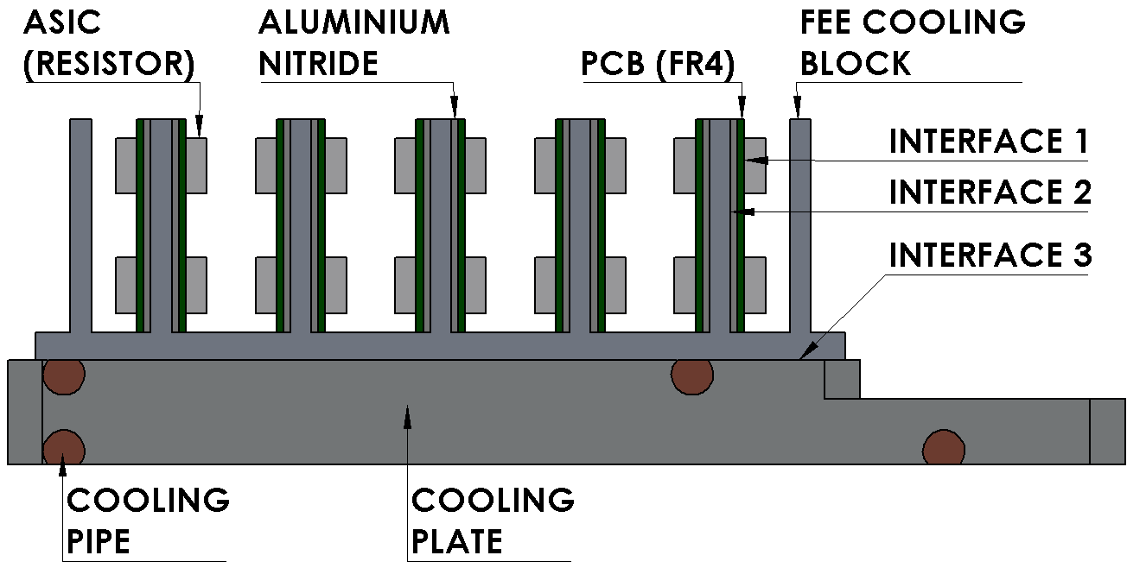
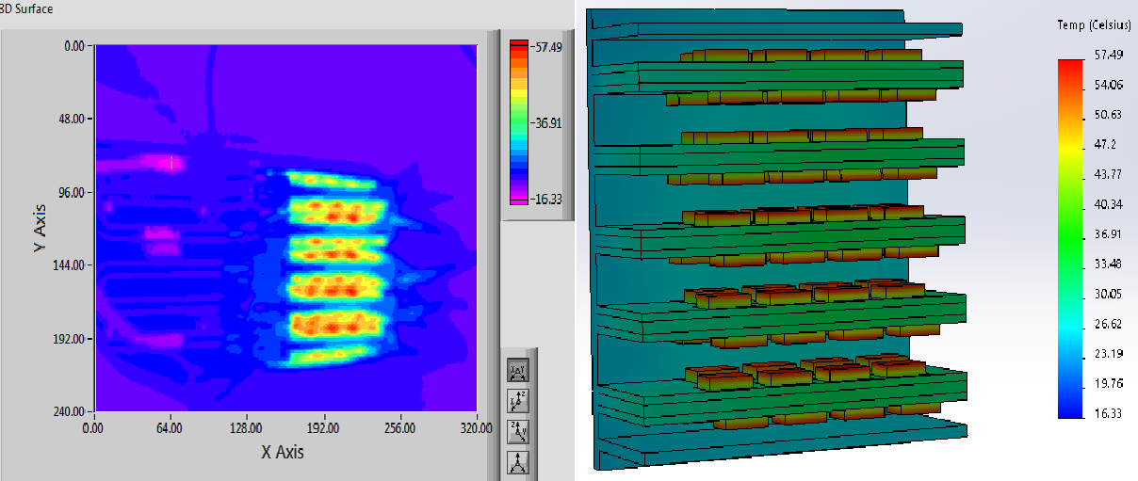
OPTIMISATION OF THERMAL INTERFACES
Power Dissipated: 160W
Exp. – IR Camera + PT100
FEA – Solidworks Thermal Sim.
H₂O inlet: 15°C @ 40lt/hr
HTC: 750 W/m²K
Air Convection: 10 W/m²K
Radiation included

Slide 8
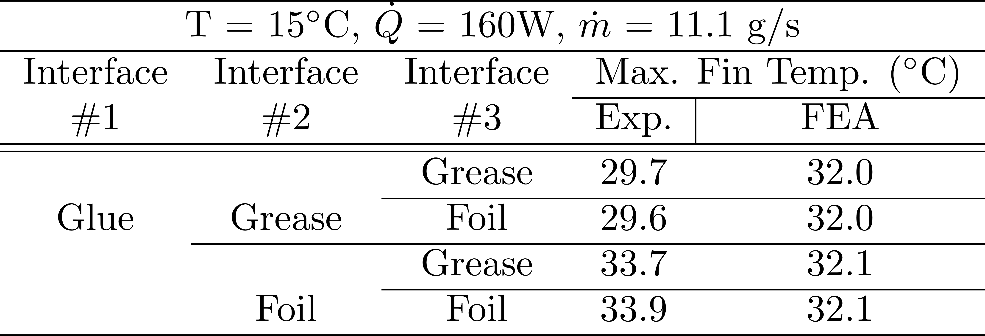
OPTIMISATION OF THERMAL INTERFACES
Power Dissipated: 160W
Key take-aways :
A more viscous TIM (grease) has a better thermal performance than a relatively rigid TIM (graphite foil, thermal pad)
Flattening the interfaces (~ 10µm) improves the results substantially
Good agreement (± 10%) between experiments & simulations
H₂O inlet: 15°C @ 40lt/hr
HTC: 750 W/m²K
Air Convection: 10 W/m²K
Radiation included

Slide 9
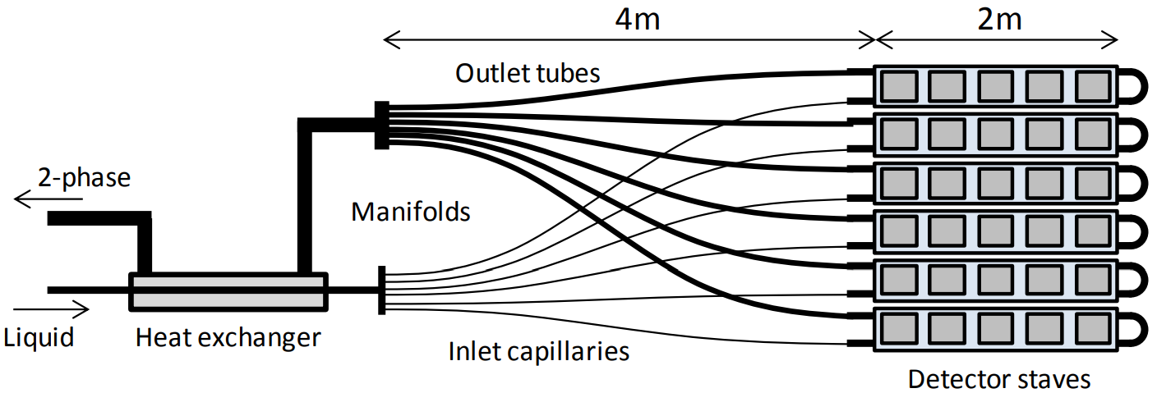
OPTIMISATION OF COOLING PLATE
Bi-Phase CO₂ cooling for STS-FEE (~ 40kW)
CO₂ heat transfer co-efficient depends on: → cooling plate's tube (diameter & length) (√)
  mass flow of the coolant (√)
  targeted amount of heat removal (√)
STS cooling plate's boundary conditions for this study: →
Coolant temp. T_{CO2} = -40°C
Targeted heat removal = 1300W (~ 8 FEBs)
Outlet Pressure - FIXED
Inlet Temperature - FIXED

Slide 10
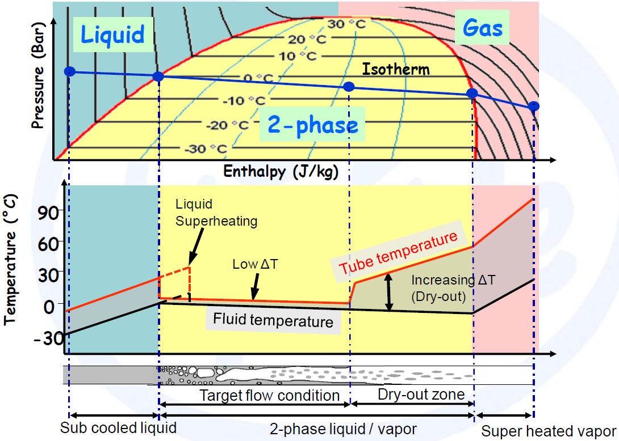
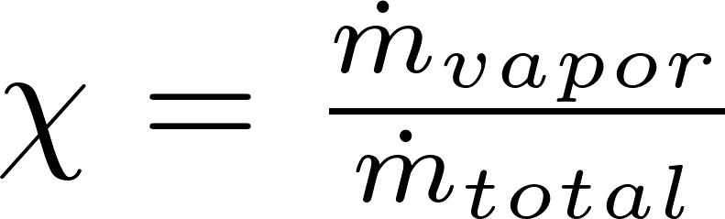
OPTIMISATION OF COOLING PLATE
Vapor Quality: (= 0: saturated liq.)
(= 1: saturated vap.)
Dry-out zone: Tube′s inner surface is no longer in contact with liquid coolant
↓
Much lower Heat Transfer Co-eff
↓
Higher tube wall temperature
↓
Higher ΔT (Local temp. diff. between fluid and tube wall in tube)
Outlet vapor quality SHOULD NOT reach dry-out!
Solution: Higher mass flows

Slide 11
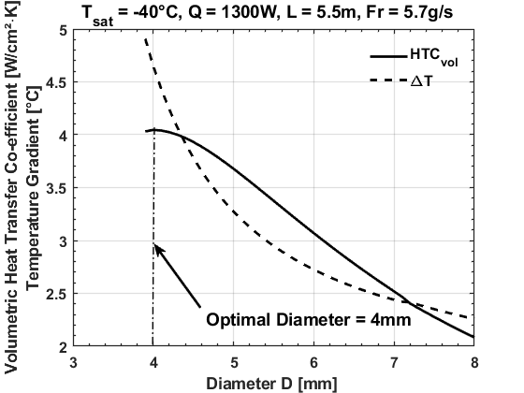
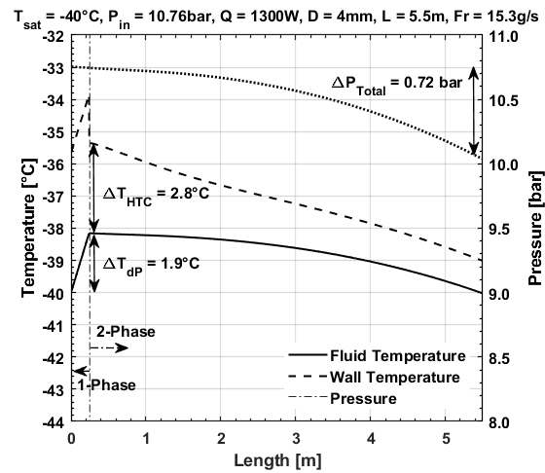

OPTIMISATION OF COOLING PLATE
Bi-Phase CO₂ Pressure/Temp. Distribution v/s Tube Length
Maximisation of:
Mass defined at 50% from dry-out quality

Slide 12
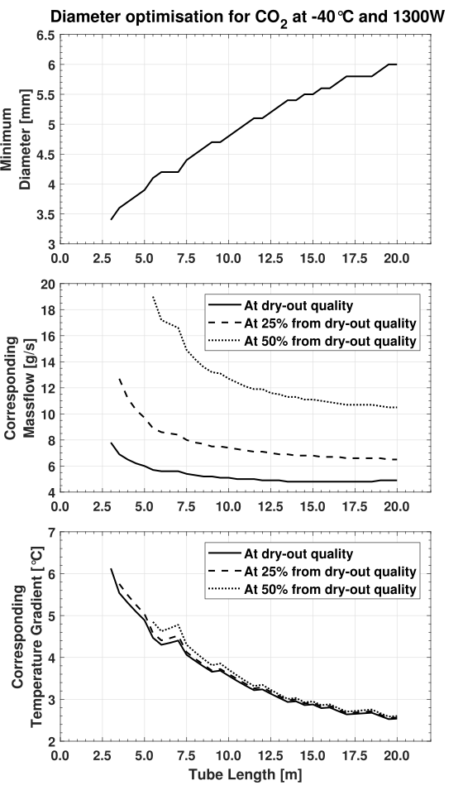
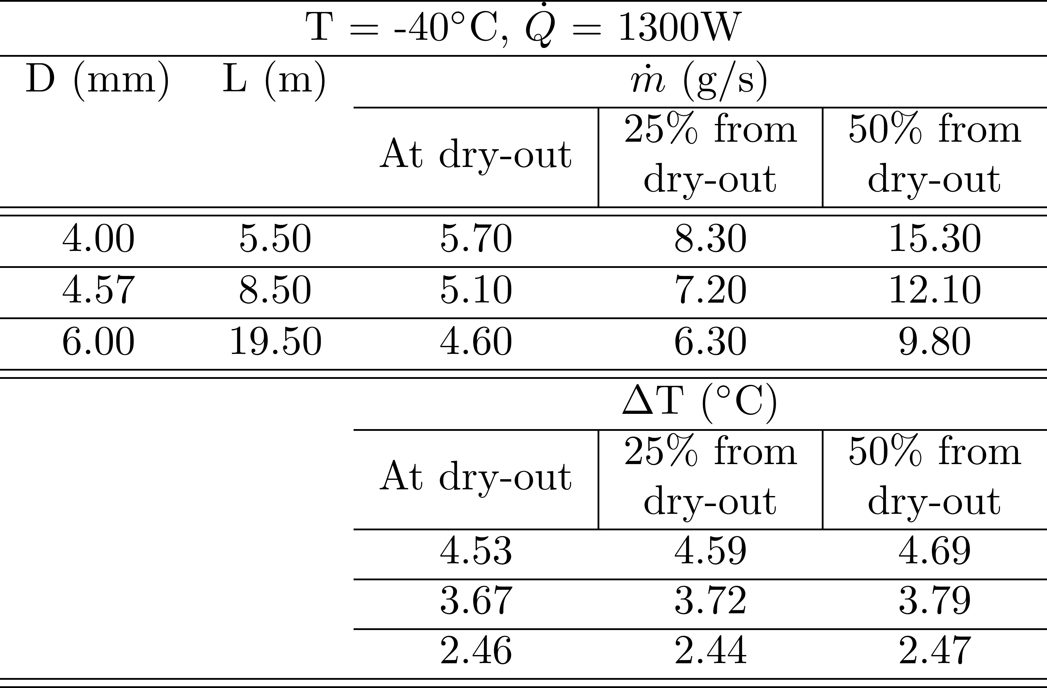
OPTIMISATION OF COOLING PLATE
Operational Parameters look-up table
(Diameters w.r.t. Swagelok VCR connections)
Calculations based on:
L. Cheng et al., Int. J. Heat Mass Transfer 51 (2006), p.111 & p.125
B. Verlaat et al., Proceedings of 10th IIR Gustav Lorentzen Conference on Natural Refrigerants (2012), GL-209
Z. Zhang, CERN-THESIS-2015-320 (2015)
11

Slide 13
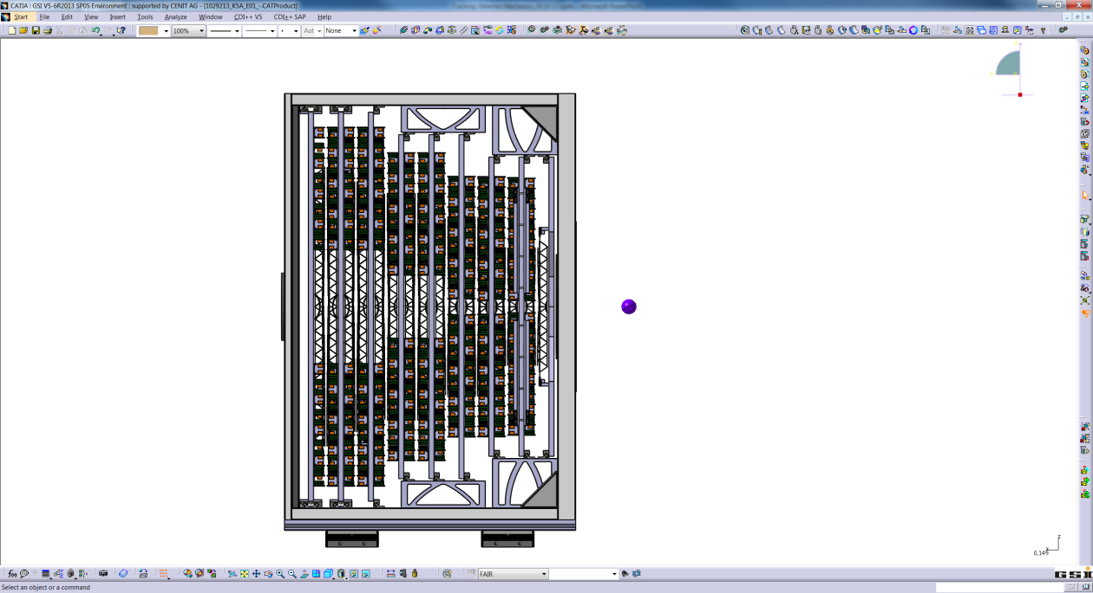
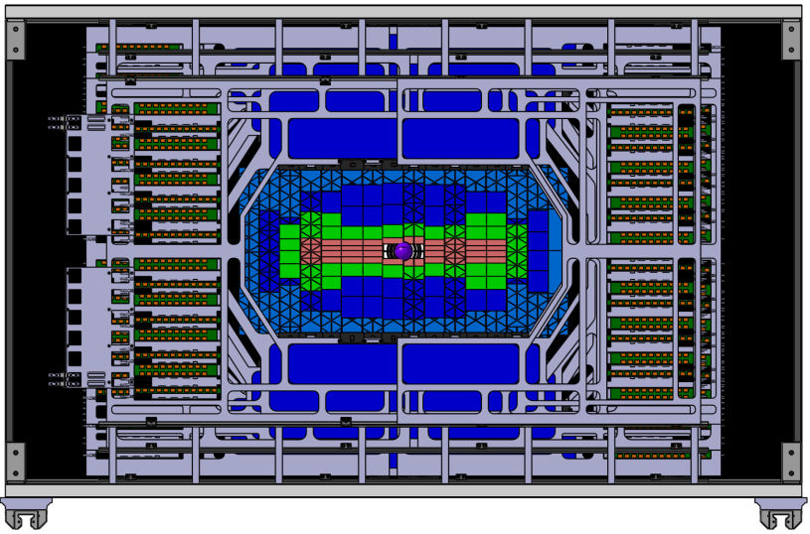
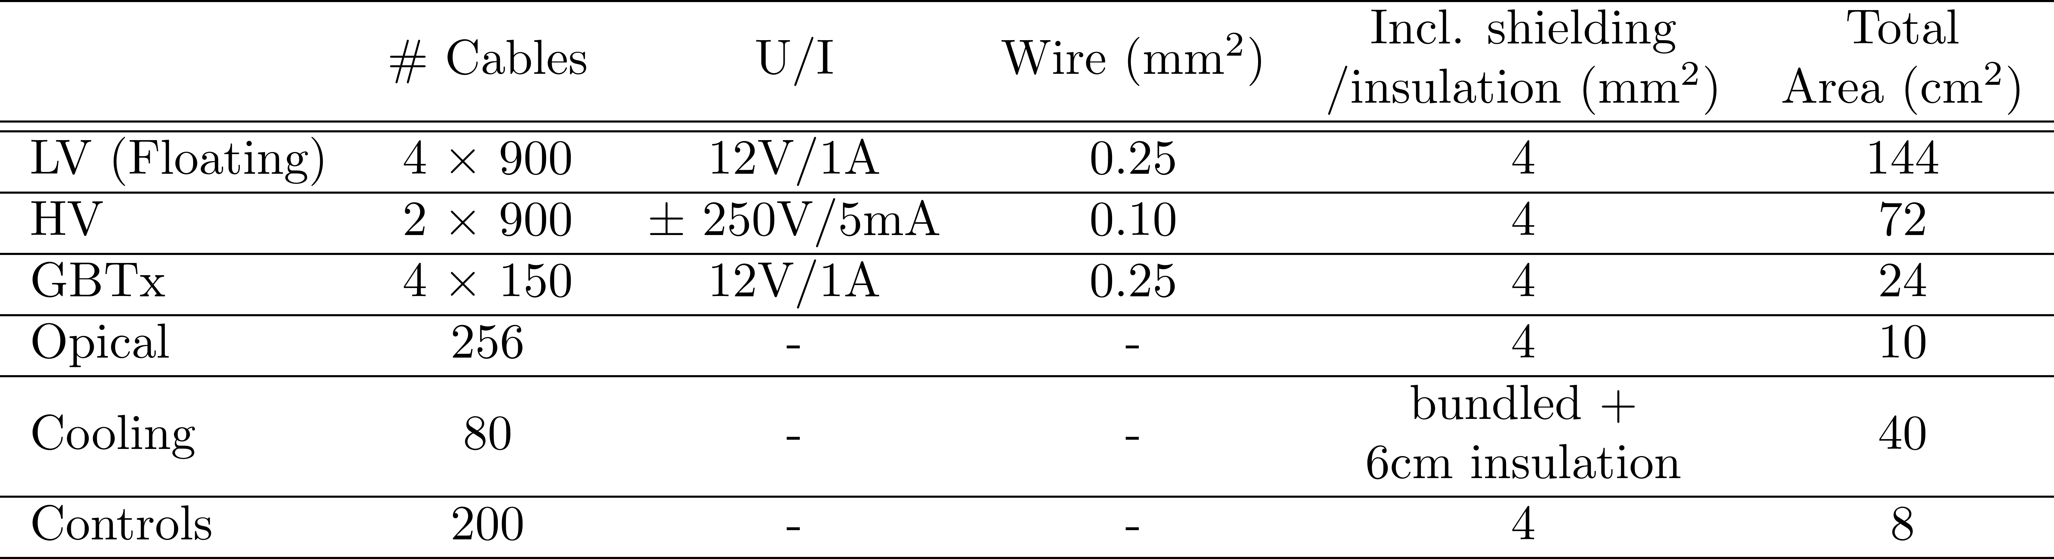
FEEDTHROUGH INTEGRATION & TESTS
2300
All services (HV, LV, data transmission, cooling etc) will be routed through STS front panel
Total available area = 1.5m²
Easy cabling & de-cabling
Maintainence of thermal environment inside STS
↓
1425
High-density thermally-insulating feedthroughs!
+ Micro Vertex Detector (MVD)
+ Beam Pipe
Total: 1.5m² (only)
12

Slide 14
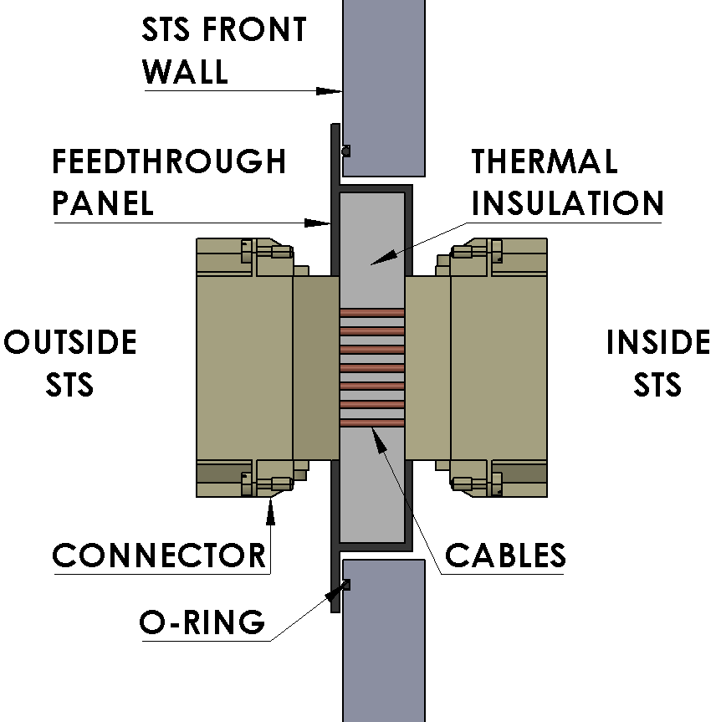
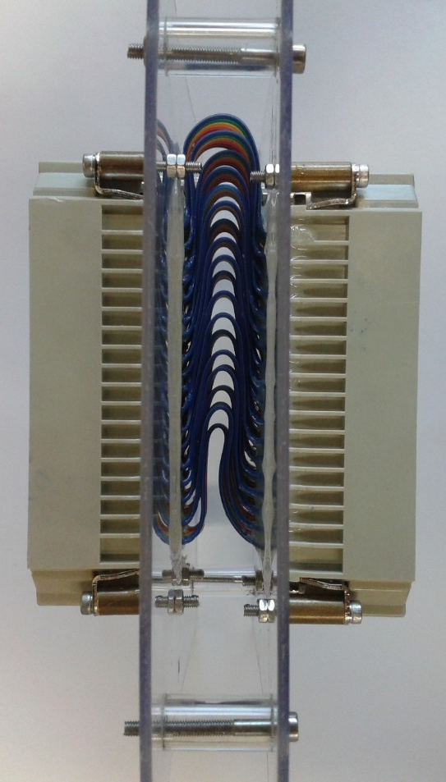
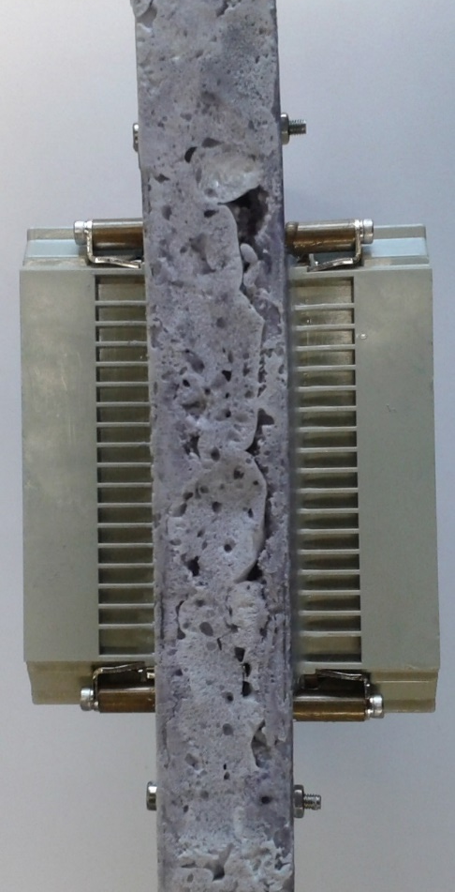
FEEDTHROUGH INTEGRATION & TESTS
25°C
50% RH
-10°C
1% RH
1st Dummy
108 cables squeezed in 2cm gap!
Sealed with silicone & filled with PUR foam
13

Slide 15
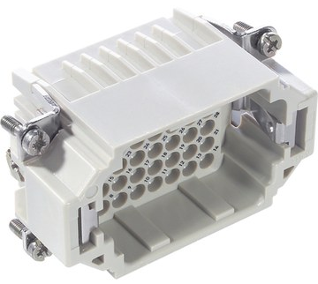
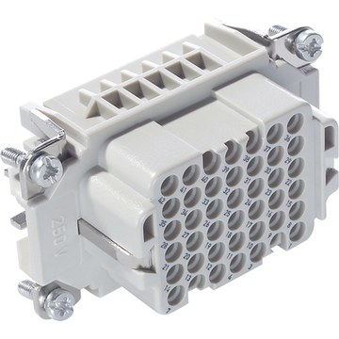
FEEDTHROUGH INTEGRATION & TESTS
Next Steps:
Panel with 9 x EPIC H-DD 42 connectors will be fabricated (area: 20cm x 20cm, #pins: 378)
Shielded flat-band cables
Thermal Insulation
Similar panels with different connectors & configurations will be thermally tested at Universität Tübingen & electrically tested at GSI-Darmstadt
Could be tested at mSTS
25°C
50% RH
-10°C
1% RH
14

Slide 16
SUMMARY AND OUTLOOK
Challenges of STS Thermal Management:
  STS sensors temp. < -5°C
  Removal of FEE power (40kW) by bi-phase CO₂ cooling
  Operation in thermal enclosure
  High-density thermally insulating feedthroughs for services
Progress towards construction of cooling demonstrator:
  Thermal interfaces are optimised: Viscous TIM (grease etc.) more efficient
  Optimised operational parameters for cooling plates available
  Feedthrough dummys are under construction
15

Slide 17
SUMMARY AND OUTLOOK
Sensor cooling: Heat-producing sensor dummies & N₂ cooling system
FEE cooling:
  Thermal FEA Simulations with different cooling plate designs + electronics
  Feasibility of cooling plate‘s industrial manufacturing
  Cooling plant commissioning (TRACI – XL)
Environment management: Thermal enclosure & feedthroughs
Integration: Aim towards start of production of parts by Sept 2018
16

Slide 18
SUMMARY AND OUTLOOK
Challenges of STS Thermal Management:
  STS sensors temp. < -5°C
  Removal of FEE power (40kW) by bi-phase CO₂ cooling
  Operation in thermal enclosure
  High-density thermally insulating feedthroughs for services
Progress towards construction of cooling demonstrator:
  Thermal interfaces are optimised: Viscous TIM (grease etc.) more efficient
  Optimised operational parameters for cooling plates available
  Feedthrough dummys are under construction
Sensor cooling: Heat-producing sensor dummies & N₂ cooling system
FEE cooling:
  Thermal FEA Simulations with different cooling plate designs + electronics
  Feasibility of cooling plate‘s industrial manufacturing
  Cooling plant commissioning
Environment management: Thermal enclosure & feedthroughs
Integration: Aim towards start of production of parts by Sept 2018
THANKS A LOT FOR YOUR ATTENTION!
17

Slide 19
BACKUP SLIDES

Slide 20
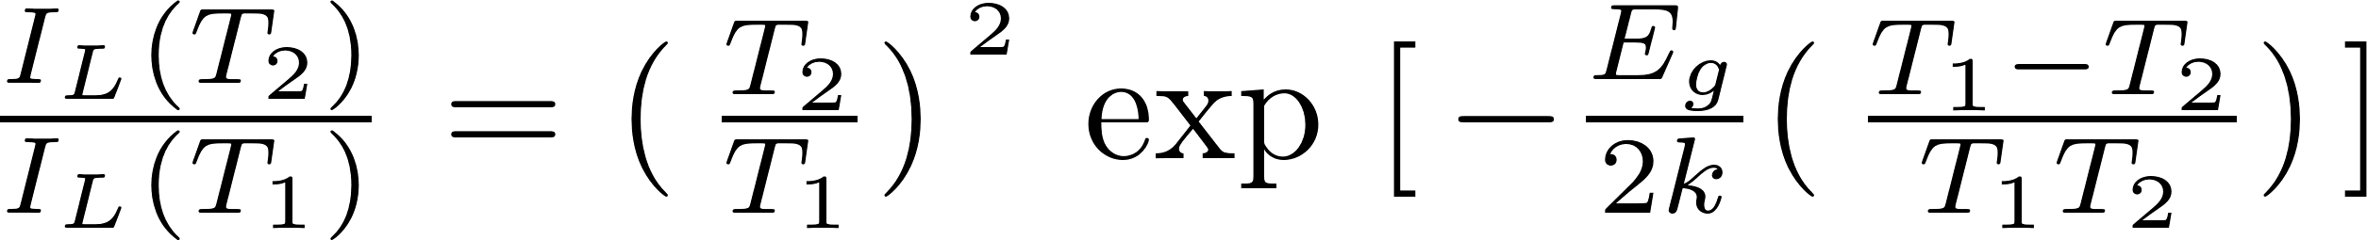
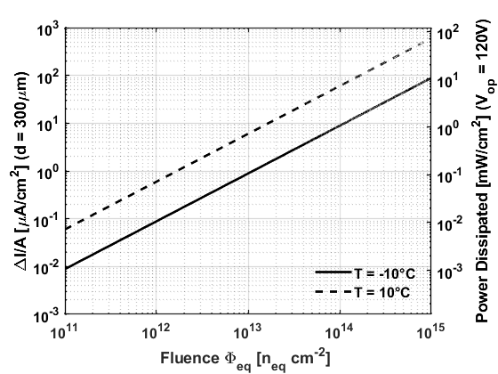
MOTIVATION & CHALLENGES FOR STS COOLING
Adverse effects of high-radiation → Leakage current increases with fluence & temperature
→ Reduces signal-to-noise ratio (STS req.: S/N > 10)

Slide 21
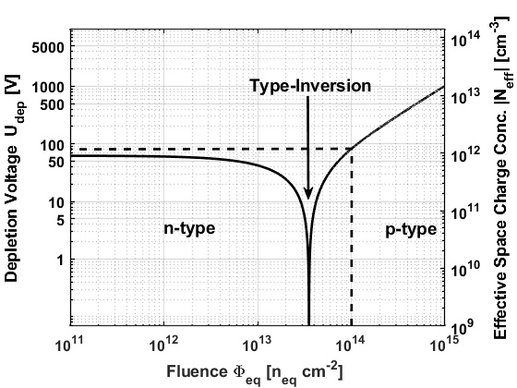
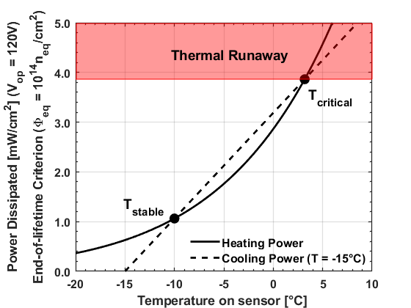
MOTIVATION & CHALLENGES FOR STS COOLING
Adverse effects of high-radiation → Leakage current increases with fluence & temperature
→ Reduces signal-to-noise ratio (STS req.: S/N > 10)
→ Thermal Runaway

Slide 22
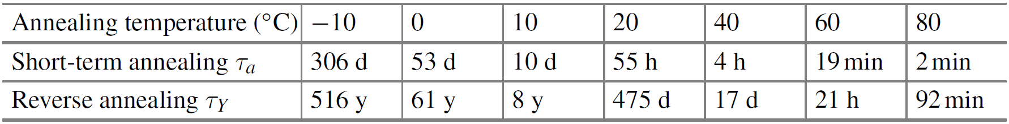
MOTIVATION & CHALLENGES FOR STS COOLING
Adverse effects of high-radiation → Leakage current increases with fluence & temperature
→ Reduces signal-to-noise ratio (STS req.: S/N > 10)
→ Thermal Runaway
→ Reverse annealing of depletion voltage
F. Hartmann, Evolution of Silicon Sensor Technology in Particle Physics,
Springer Tracts in Modern Physics 275, DOI 10.1007/978-3-319-64436-3_2

Slide 23
MOTIVATION & CHALLENGES FOR STS COOLING
Adverse effects of high-radiation → Leakage current increases with fluence & temperature
→ Reduces signal-to-noise ratio (STS req.: S/N > 10)
→ Thermal Runaway
→ Reverse annealing of depletion voltage
Sensor cooling could control these adverse effects → STS sensor temp. -10°C to -5°C at all times

Slide 24
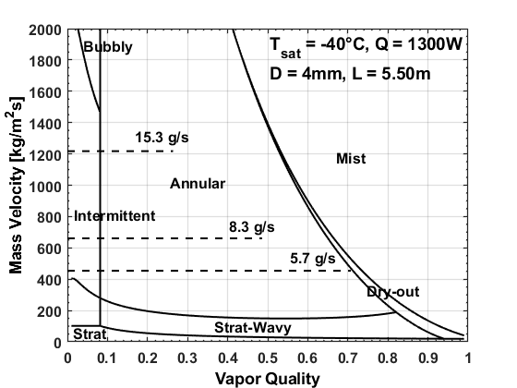
OPTIMISATION OF COOLING PLATE
Bi-Phase CO₂ Flow Pattern Map
50% from dry-out quality
25% from dry-out quality
At dry-out quality
Calculations based on:
L. Cheng et al., Int. J. Heat Mass Transfer 51 (2006), p.111 & p.125
B. Verlaat et al., Proceedings of 10th IIR Gustav Lorentzen Conference on Natural Refrigerants (2012), GL-209
Z. Zhang, CERN-THESIS-2015-320 (2015)

Slide 25
OPTIMISATION OF COOLING PLATE
Bi-Phase CO₂ Pressure/Temp. Distribution v/s Tube Length
Mass defined at 50% from dry-out quality
Calculations based on:
L. Cheng et al., Int. J. Heat Mass Transfer 51 (2006), p.111 & p.125
B. Verlaat et al., Proceedings of 10th IIR Gustav Lorentzen Conference on Natural Refrigerants (2012), GL-209
Z. Zhang, CERN-THESIS-2015-320 (2015)

