Slide 1


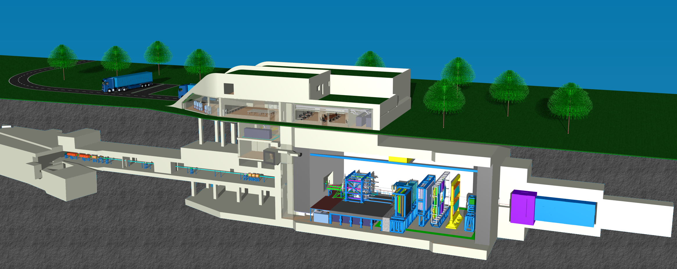

Status of the CBM experiment
Christian Sturm, GSI
for the CBM Collaboration
Outline
CBM physics program at day 1
Status of the experiment preparation
  The full system test-setup mCBM@SIS18

Slide 2
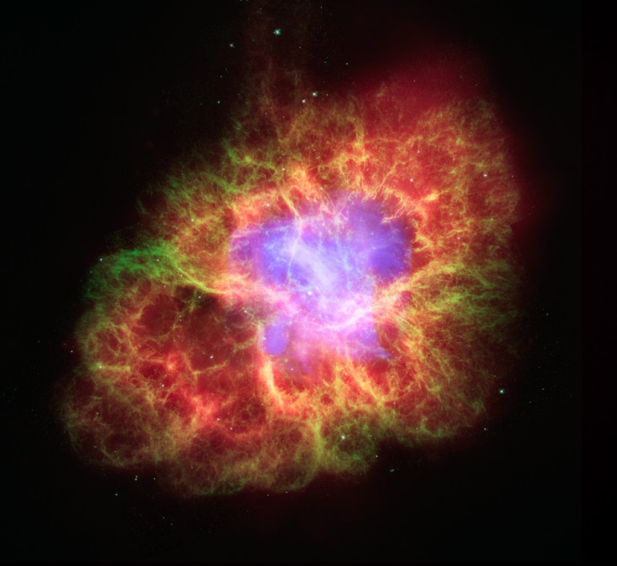
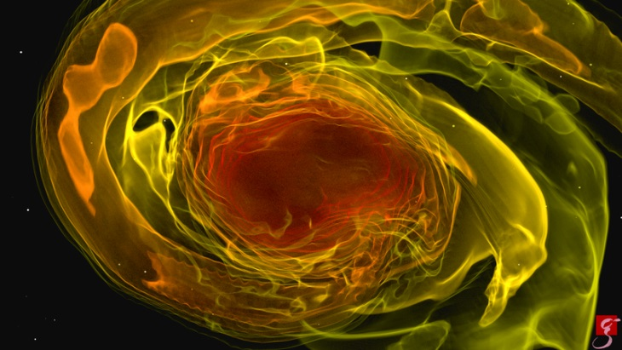
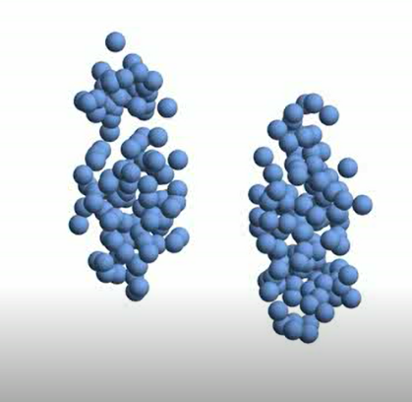
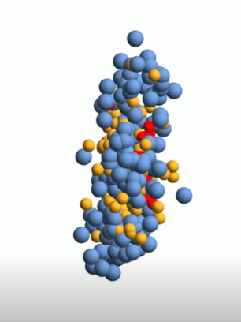
Compressed baryonic matter
Neutron stars
Temperature
T < 20 MeV
Core density
ρ < 10 ρ₀
Lifetime
Δt ~ infinity
Crab-Nebula
(Supernova 1054)
Neutron star merger
Temperature
T < 70 MeV
Density
ρ < 2 – 6 ρ₀
Reaction time
Δt ~ 10 ms
NASA pseudo-color image
numerical simulation, GW170817
T. Dietrich (Max Planck Institute for Gravitational Physics)
optical – Hubble
infrared – Spitzer x-ray – Chandra
Crab pulsar T = 33.4 ms, Mass ~ 1.5 M_{ʘ}
Relativistic nucleus-nucleus collisions at SIS100
Temperature
T < 120 MeV
Density
ρ < 8ρ₀
Reaction time
Δt ~ 10⁻²³ s

Slide 3
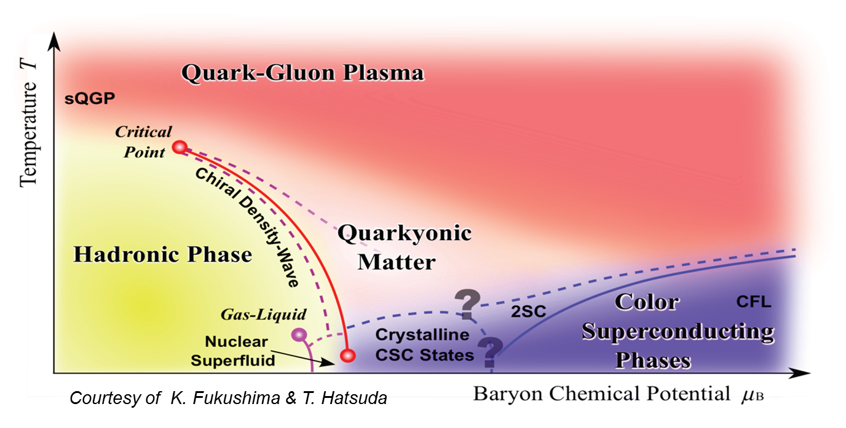
CBM – Goals
Mission:
    Systematically explore QCD matter at large baryon densities with high accuracy and rare probes.
Fundamental questions:
Equation-of-state of QCD matter at neutron star core densities
Phase structure of QCD matter
Chiral symmetry restoration at large densities
Bound states with strangeness
Field driven by experimental data !

Slide 4












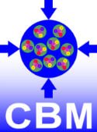


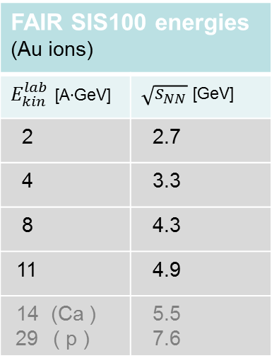
The Facility for Antiproton and Ion Research
FAIR SIS100 energies (Au ions)
$E_{kin}^{lab}$ [A∙GeV] | $\sqrt{s_{NN}}$[GeV]
2 | 2.7
4 | 3.3
8 | 4.3
11 | 4.9
14 (Ca ) 29 ( p ) | 5.5 7.6

Slide 5
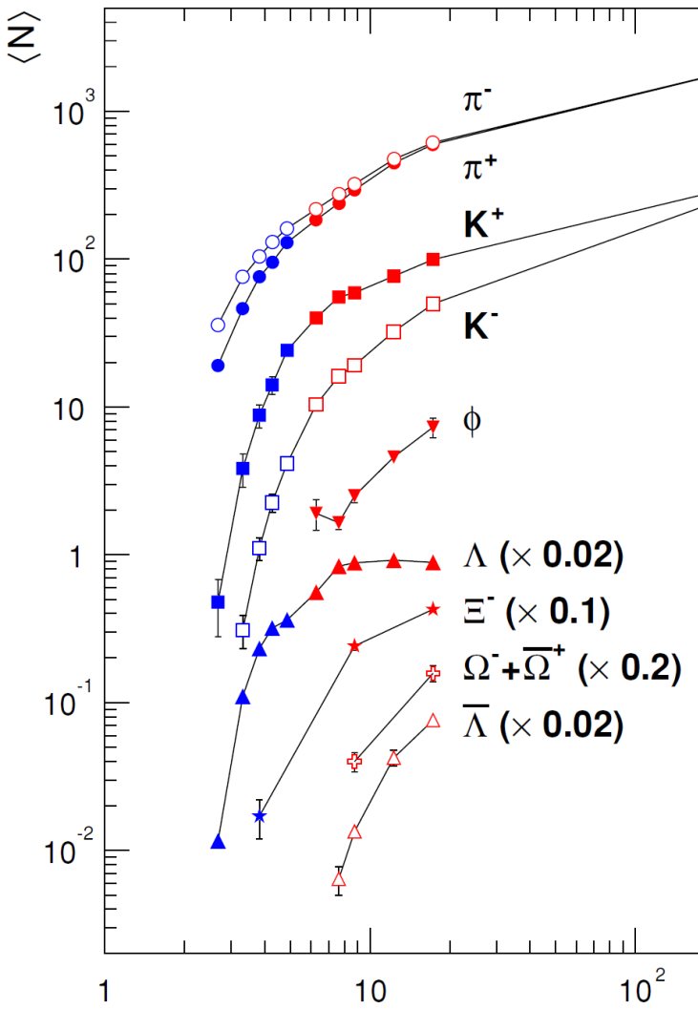
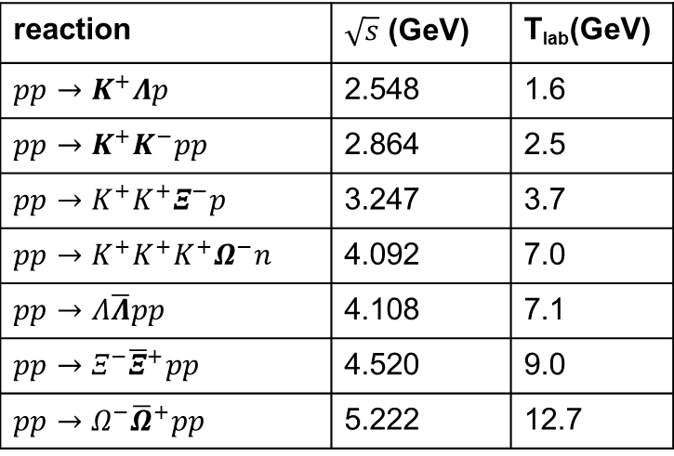

Strangeness at FAIR energies
Particle yields
from central Au + Au collisions
Particle production thresholds in pp - collisions
reaction | $\sqrt{s}$ (GeV) | T_{lab}(GeV)
$$pp→K^{+}Λp$$ | 2.548 | 1.6
$$pp→K^{+}K^{−}pp$$ | 2.864 | 2.5
$$pp→K^{+}K^{+}Ξ^{−}p$$ | 3.247 | 3.7
$$pp→K^{+}K^{+}K^{+}Ω^{−}n$$ | 4.092 | 7.0
$$pp→Λ\overline{Λ}pp$$ | 4.108 | 7.1
$$pp→Ξ^{−}{\overline{Ξ}}^{+}pp$$ | 4.520 | 9.0
$$pp→Ω^{−}{\overline{Ω}}^{+}pp$$ | 5.222 | 12.7
AGS
NA49/SPS
C.Blume, JP 31 (2005) S57
Little knowledge on multi-strange hyperons at energies T_{lab} < 10 AGeV
→ multi-stepproduction ?
→ production via strangeness exchange
channels ?
→ enhanced production in dense medium ?
SIS100
$$\sqrt{s_{NN}} (GeV)$$

Slide 6


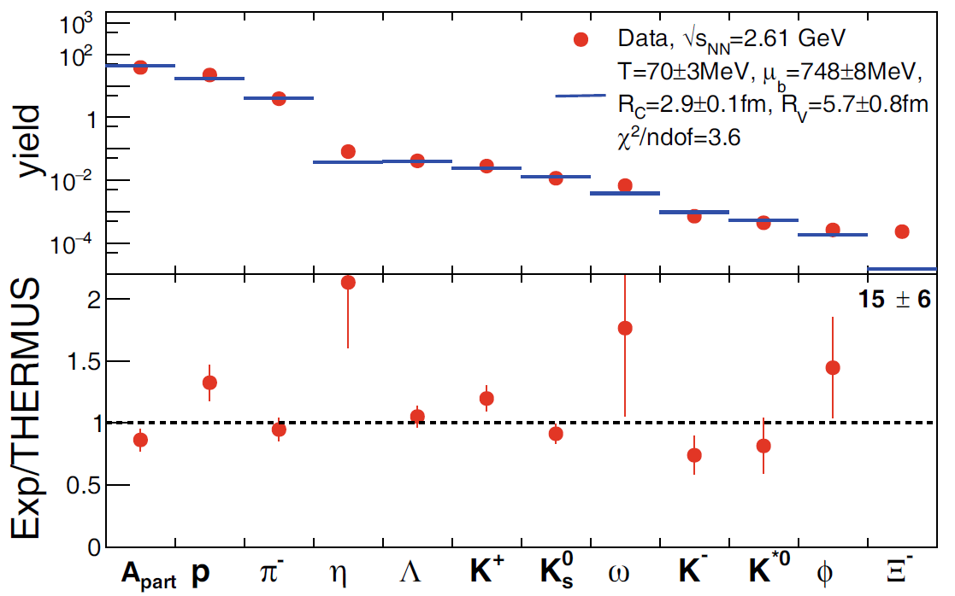
Multi-strange hyperons and hypernuclei at FAIR energies
HADES data
Ar + KCl 1.76 A GeV
Statistical hadronisation model:
production of light nuclei and hypernuclei
Phys. Rev. Lett. 103 (2009) 132301
Statistical model fit, THERMUS v3.0
Eur. Phys. J. A (2016) 52 178
SIS100
A. Andronic, P. Braun-Munzinger,
J. Stachel, H. Stöcker
Phys. Lett. B697 (2011) 203

Slide 7
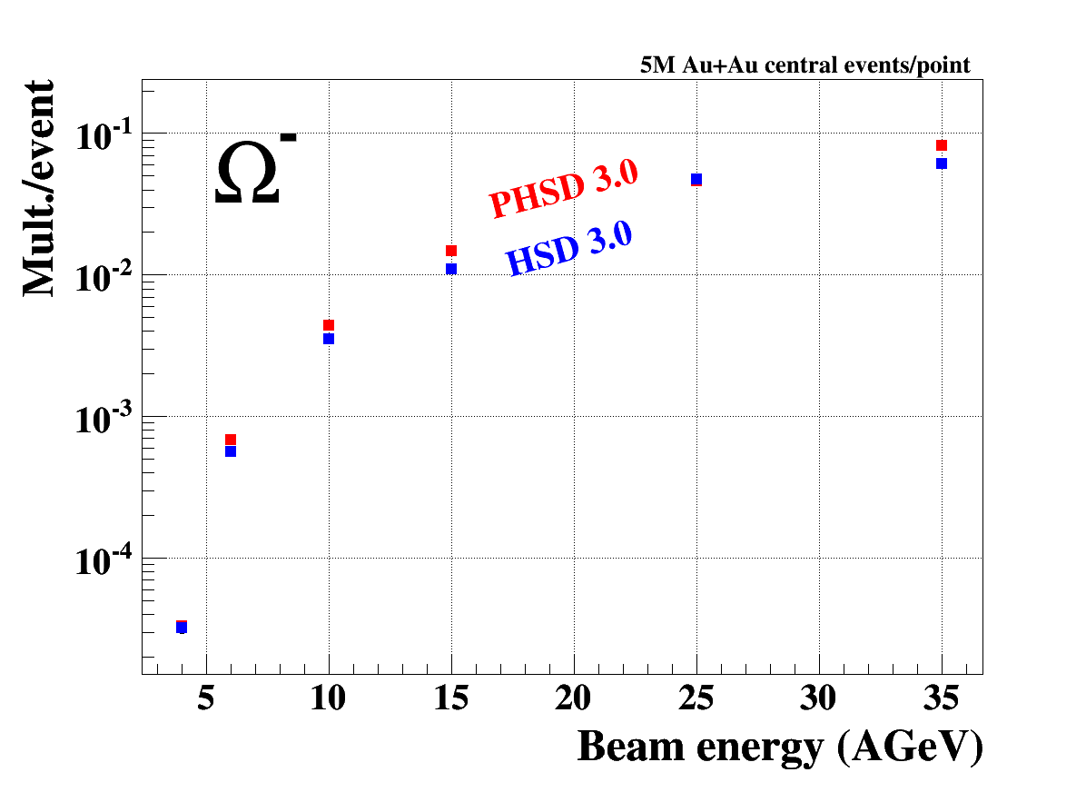
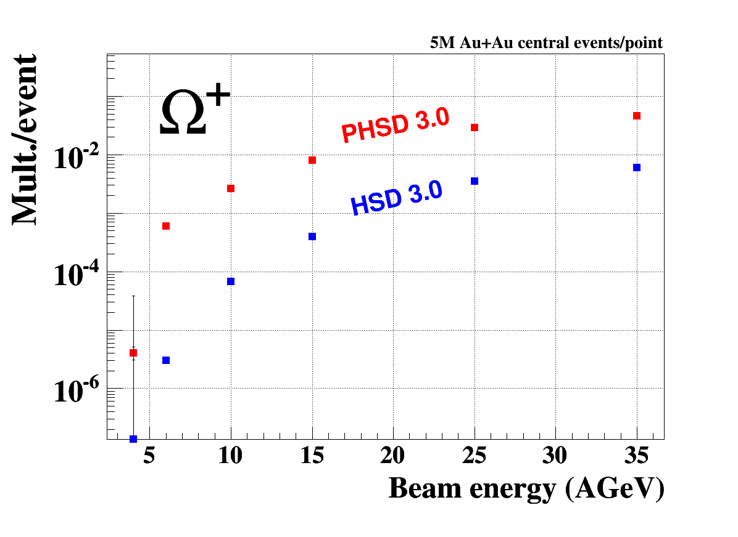
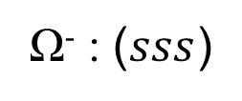
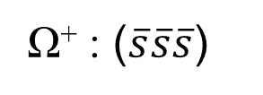
Strangeness
Multi-strange (anti-) hyperons at FAIR energies
PHSD: Transport code with partonic phase (ε > 1 GeV/fm³)
HSD: Hadronic transport code
Ω⁻ : ($sss$)
Ω⁺ : ($\overline{s}\overline{s}\overline{s}$)
I. Vassiliev, E. Bratkovskaya, preliminary results

Slide 8
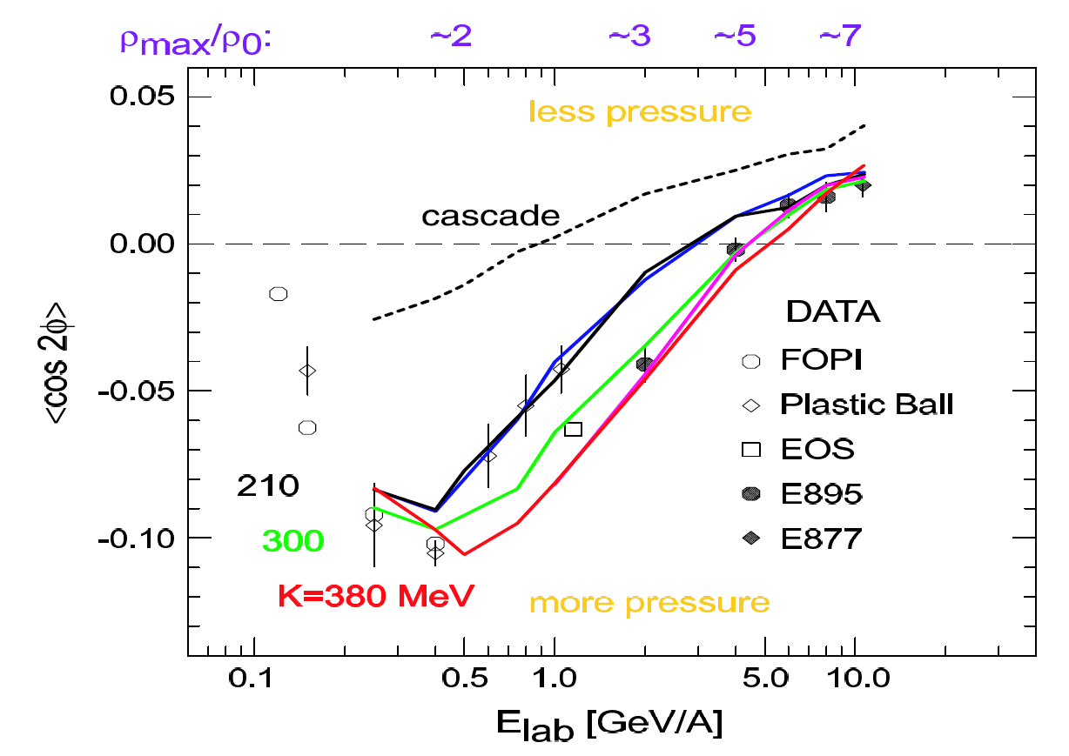
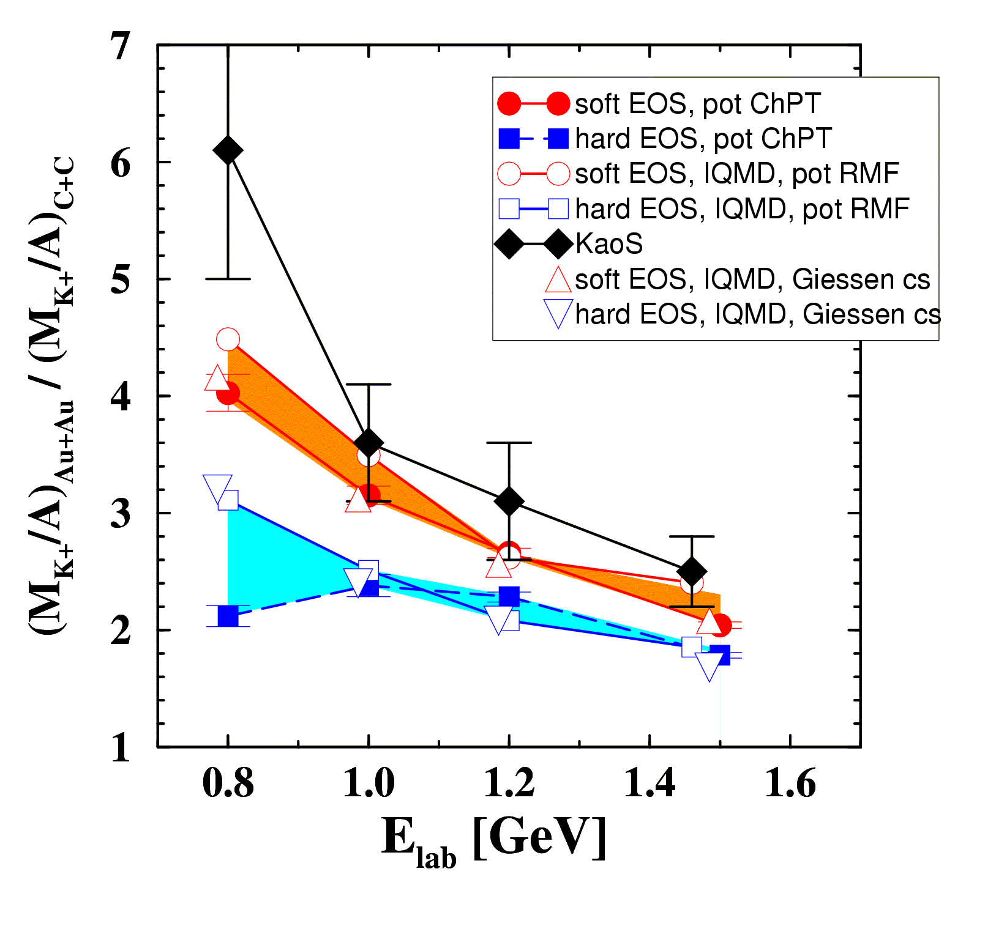
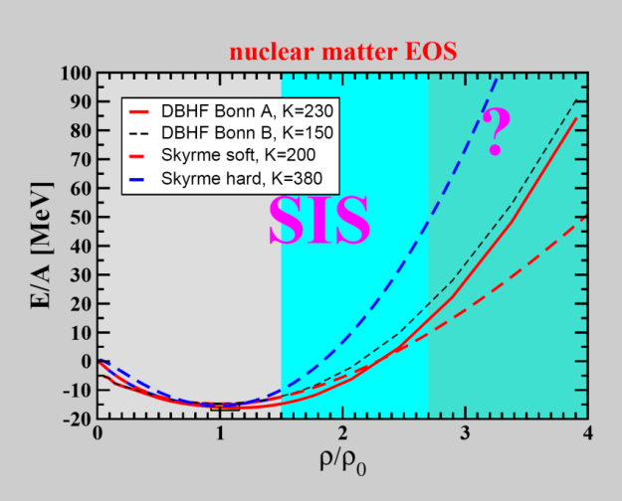
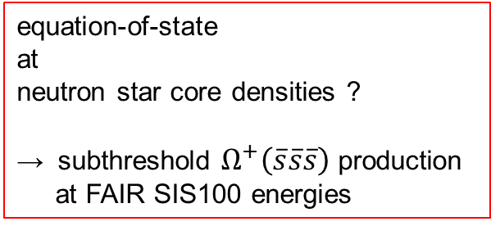
Nuclear equation-of-state at high net-baryon densities
Experiment: Phys. Rev. Lett. 86 (2001) 39
Theory: QMD C. Fuchs et al., Phys. Rev. Lett. 86 (2001) 1974
IQMD Ch. Hartnack, J. Aichelin, J. Phys. G 28 (2002) 1649
P. Danielewicz et al., Science 298 (2002) 1592
v₂
equation-of-state
at
neutron star core densities ?
→ subthreshold $Ω^{+}\left(\overline{s}\overline{s}\overline{s}\right)$ production
at FAIR SIS100 energies
DBHF: E. N. E. van Dalen, C. Fuchs, A. Faessler
EPJ. A 31,29 (2007)

Slide 9
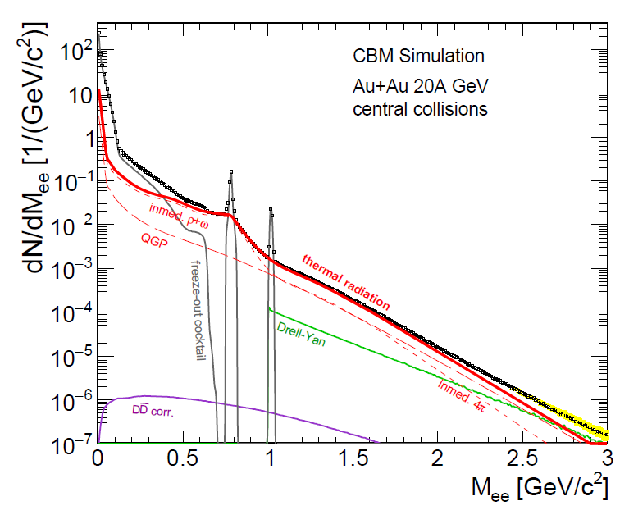
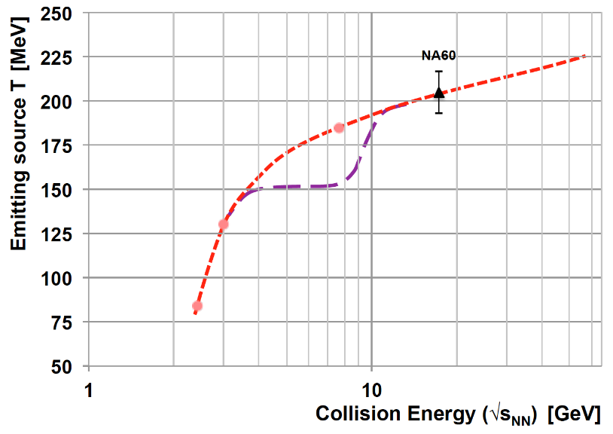
Dileptons
Electromagnetic radiation from the fireball
R. Rapp, H. v.Hees, PLB 753 (2016) 586
LMR (low mass region) :
ρ – chiral symmetry restoration
fireball space – time extension
IMR (intermediate mass region) :
access to fireball temperature
ρ-a₁ chiral mixing
LMR
IMR
Fig. by T.Galatyuk &
EPJA 52 (2016) 131
caloric curve ?
Measurement program:
e.g. excitation function of IMR–slope

Slide 10
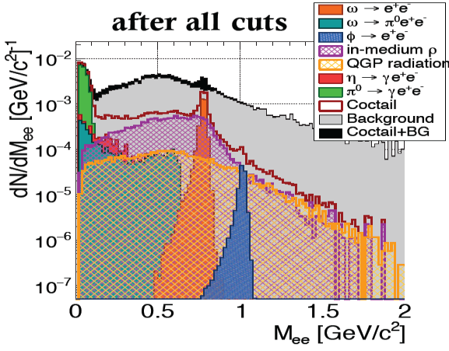
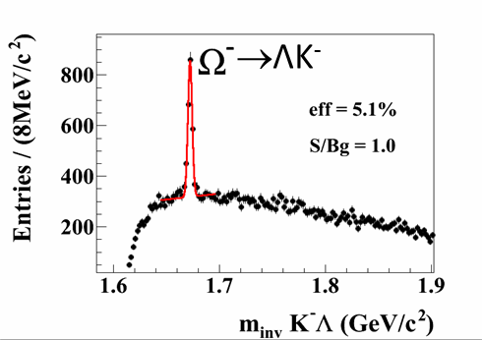
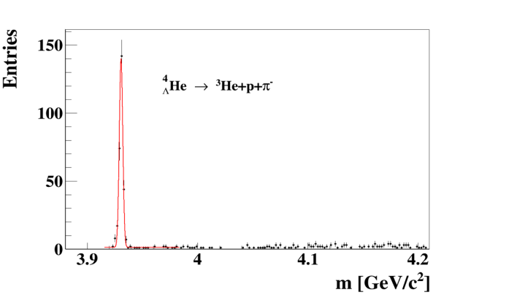

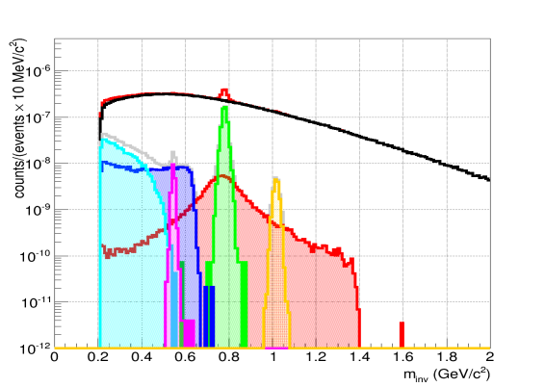
Summary: unique measurements with CBM at day 1
Au+Au, 8A GeV,
Di-electron measurement
Full performance,
(uses MVD, limited to 100 kHz)
Hyperon measurements, e.g. Au+Au at 10A GeV :
Hypernuclei measurement,
e.g. Au + Au at 10A GeV
Di-muon
LM measurement at 8A GeV
= complementary measurement to e⁺e⁻
with different systematic errors
µ⁺µ⁻
η
ω
φ
ρ

Slide 11
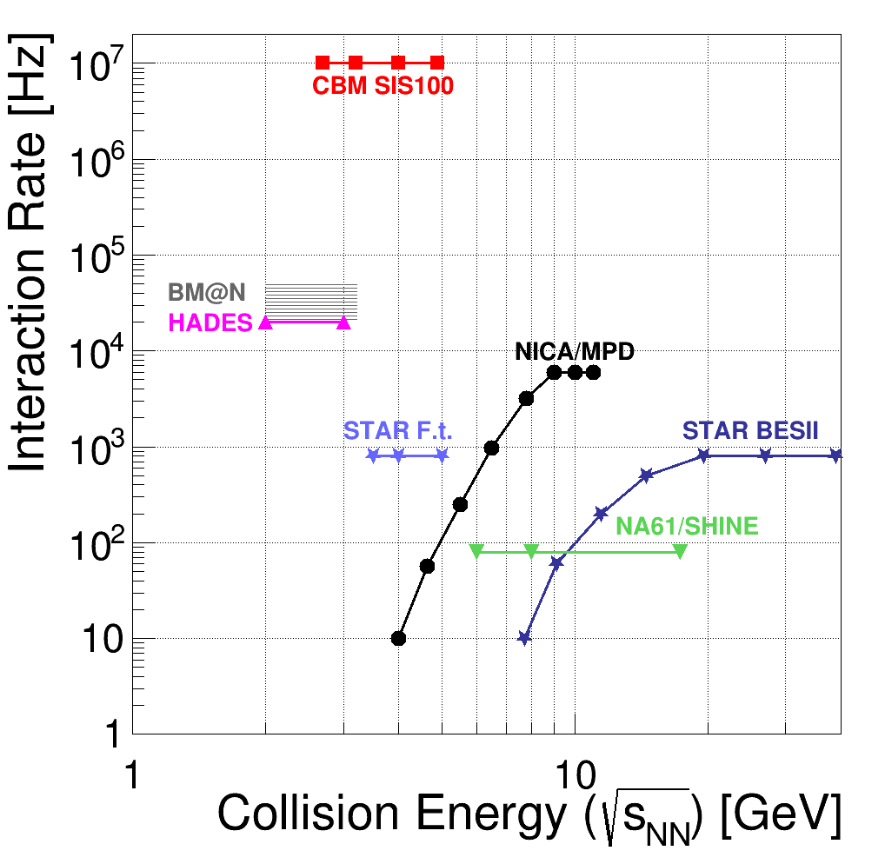
CBM strategy
Exploration of the QCD phase diagram
as international effort:
  NA61 @ SPS / CERN
  BM@N @ Nuclotron / JINR
  STAR (F.t.) @ RHIC / BNL
  MPD @ NICA / JINR
CBM‘s unique feature:
ultimate rate capability for
high statistics measurement of rare probes
→ fast and radiation tolerant detectors
→ free-streaming read-out electronics
→ high speed data acquisition and
high performance computer farm
for online event reconstruction and selection

Slide 12
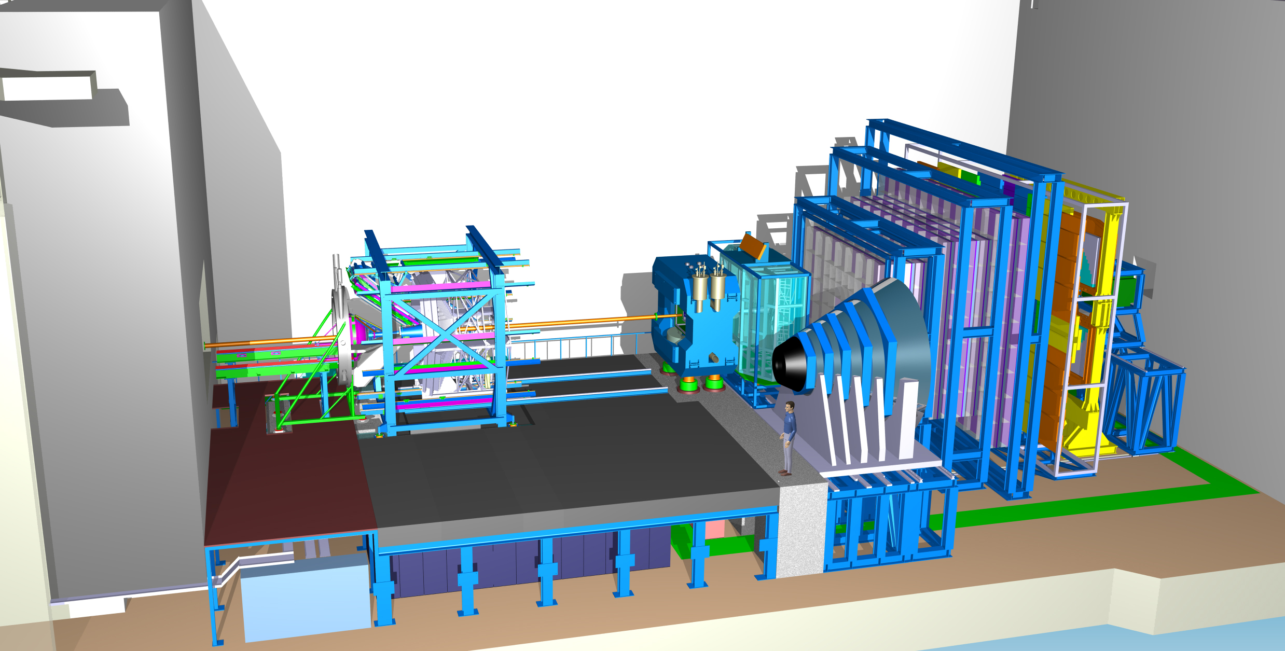
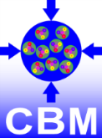
CBM
hadrons
HADES
p+p, p+A
A+A (low mult.)
large acceptance
low material budget
Time of Flight
Silicon
Tracking
System
s.c. Dipol
Magnet
data transport to a
DAQ/FLES HPC cluster
Projectile
Spectator
Detector
DPG Spring Meeting, Bochum, March 1st, 2018
C.Sturm, GSI
11

Slide 13
CBM
dileptons
Ring
Imaging
Cherenkov
Time of Flight
Silicon
Tracking
System
Transition
Radiation
Detector
(4/10)
s.c. Dipol
Magnet
Micro
Vertex
Detector
Muon
Detector
(SIS100 version)
Projectile
Spectator
Detector
data transport to
DAQ/FLES HPC cluster
DPG Spring Meeting, Bochum, March 1st , 2018
C.Sturm, GSI
12

Slide 14
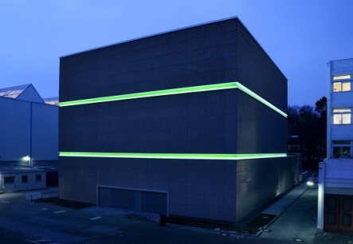
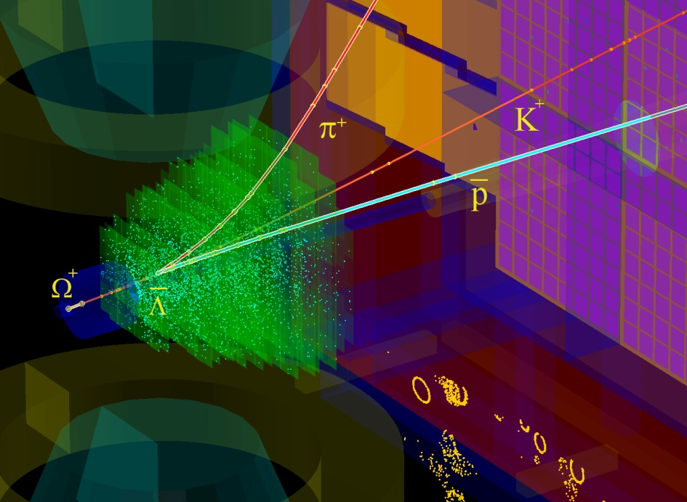
The high-performance free-streaming DAQ system of CBM
DAQ room:
data pre-processing
on FLES input cluster
Green IT Cube:
online
time slice building and event selection
data transport
μ-slices
data
tree
flow
1 TB/s
Green IT Cube
data
~ 800m
~80m
raw
Main features:
radiation tolerant detectors and front-end electronics
free-streaming DAQ system
  all detector hits with time stamps,
  software based event selection

Slide 15
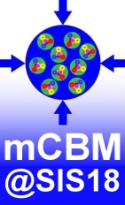
A CBM full-system test-setup at GSI/FAIR: mCBM@SIS18
concept:
a permanent test-setup at the host lab
detector prototypes at θ_{lab} ≈ 20°
collision rates up to 10 MHz
compact setup (< 5m)
no B-field → straight tracks
high resolution TOF (T₀ – TOF stop wall)
mPSD
target
beam
20°
mMVD, mSTS, mMUCH, mTRD, mTOF, mRICH, mECAL
T₀ diamond
Topics to be addressed
free streaming read-out and data transport to the mFLES
online reconstruction
offline data analysis
controls
detector tests of final detector prototypes

Slide 16
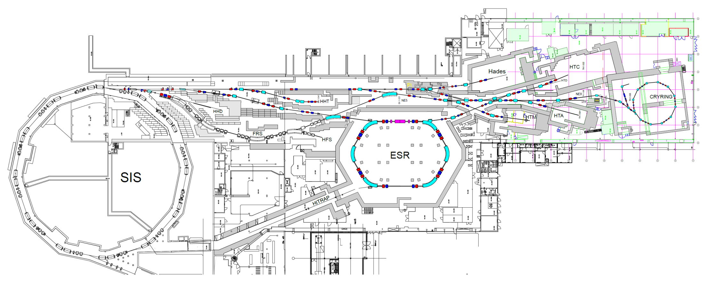
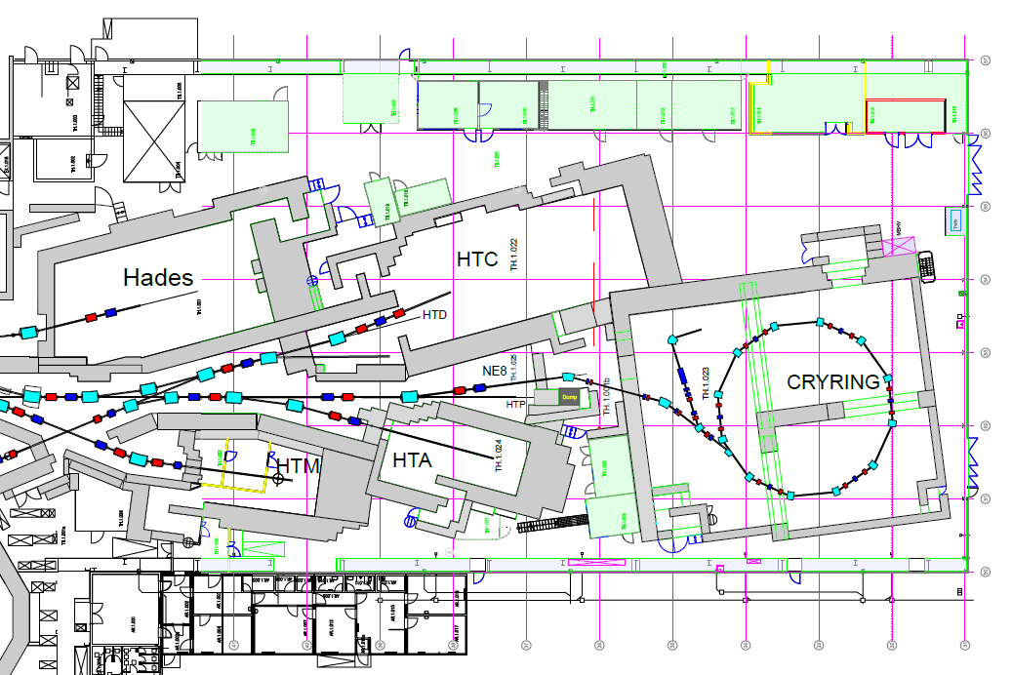
mCBM @ SIS18 facility

Slide 17
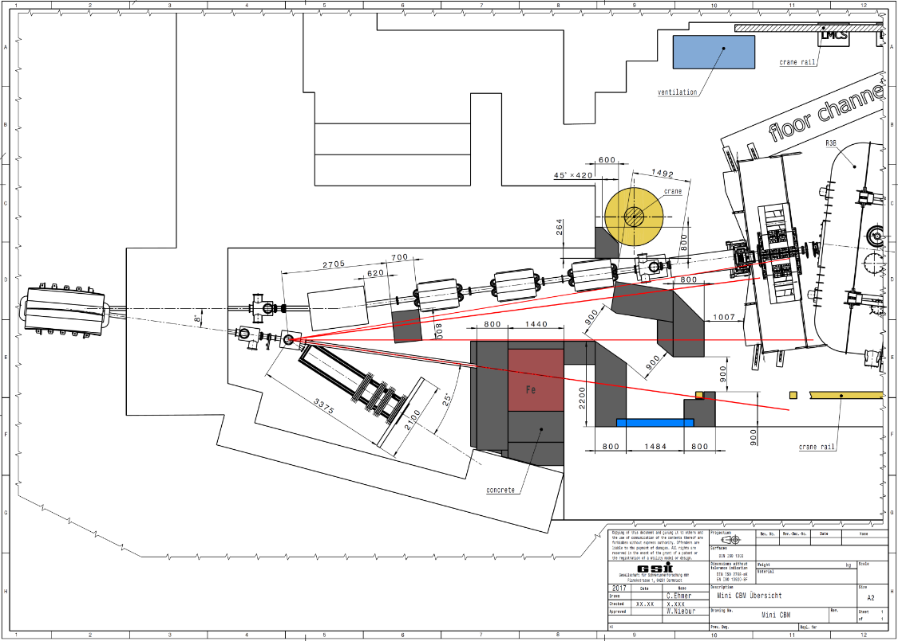
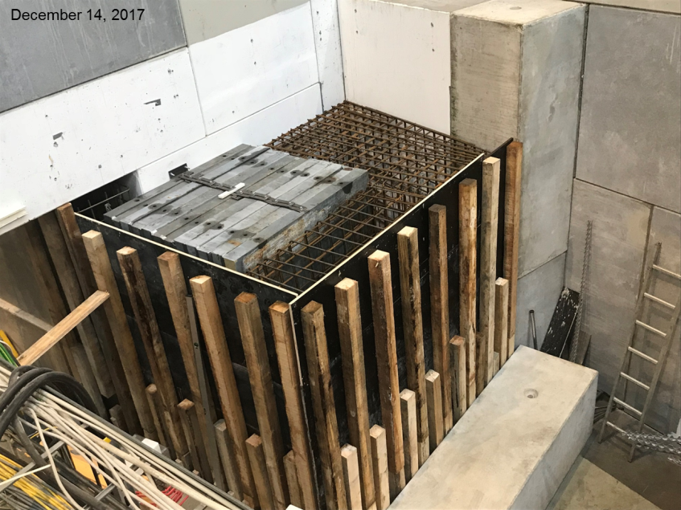

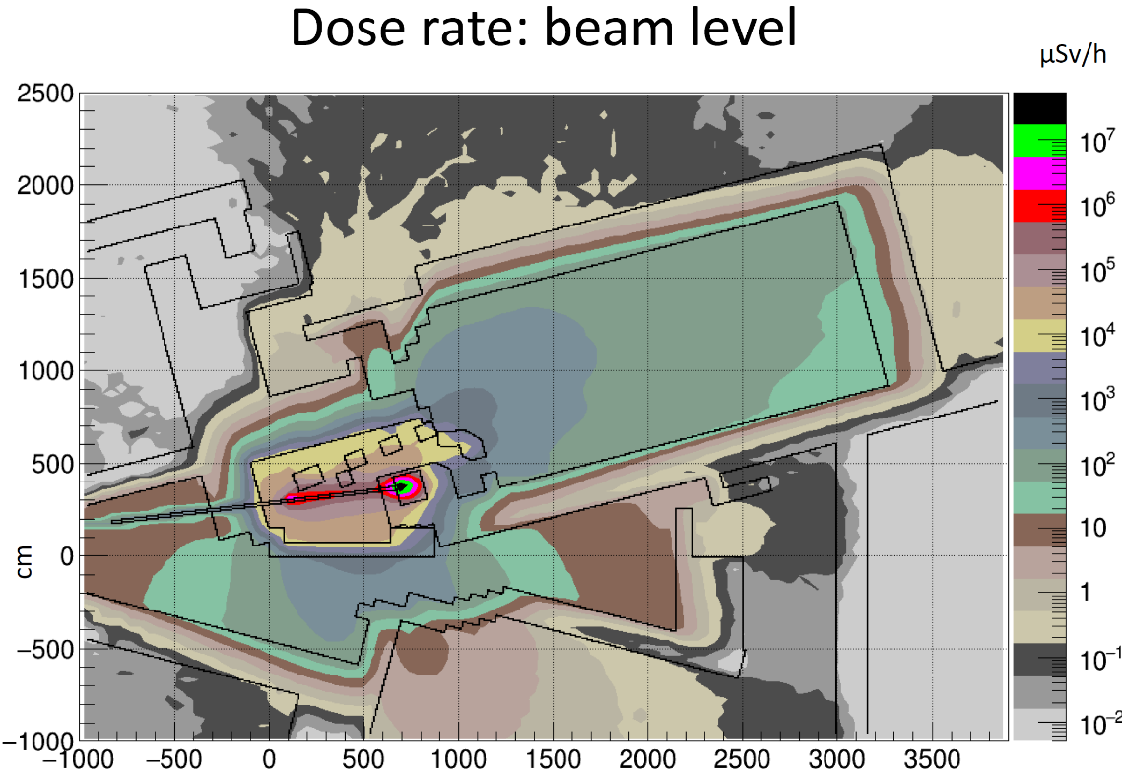

mCBM Cave (HTD @ SIS18 facility)
HTD MU1
dose rate
additional shielding
modified switching magnet (HTD MU1)
new beam dump
additional shielding
    FLUKA calculations (right fig.):
    10⁸ Au ions s⁻¹, 1.24 AGeV,
    2.5 mm Au target (P_{int} = 10%)
    vertical section: beam level
requirement: $\dot{D}≤ 0.5 μ$Sv/h

Slide 18
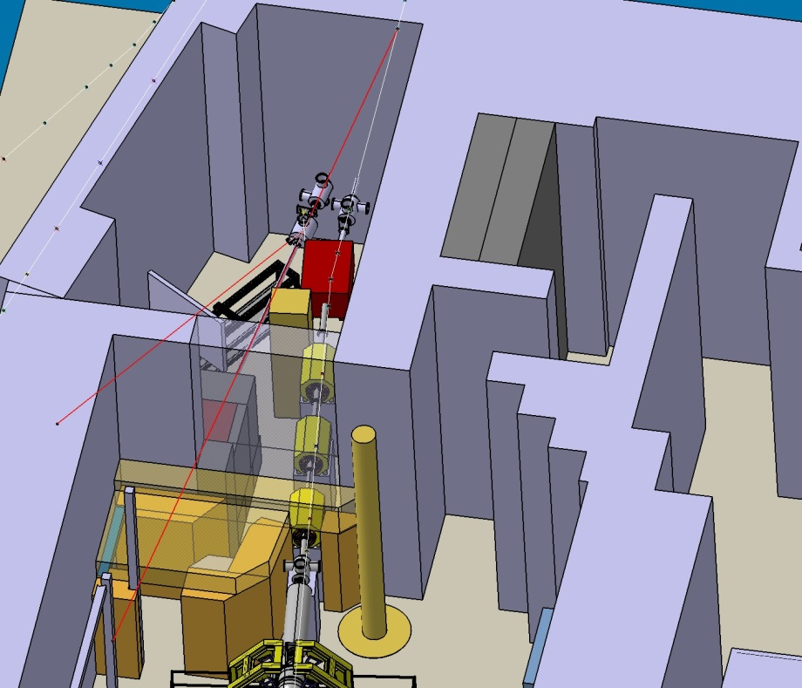
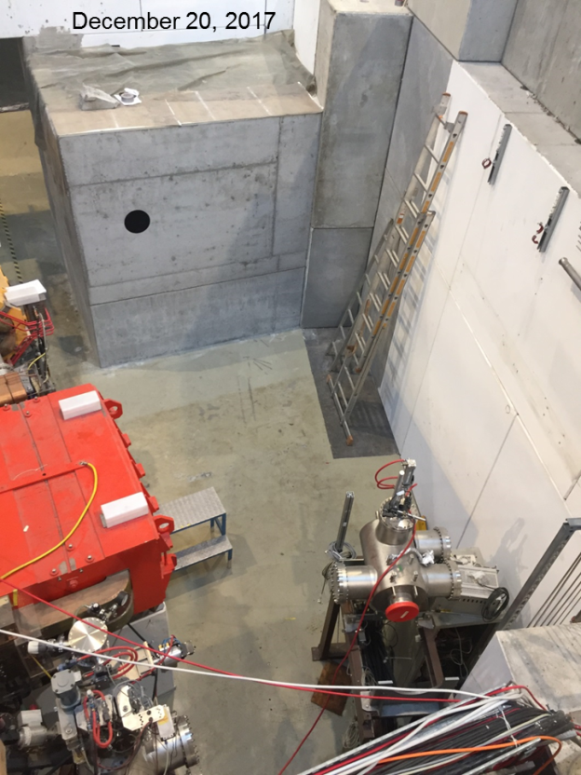
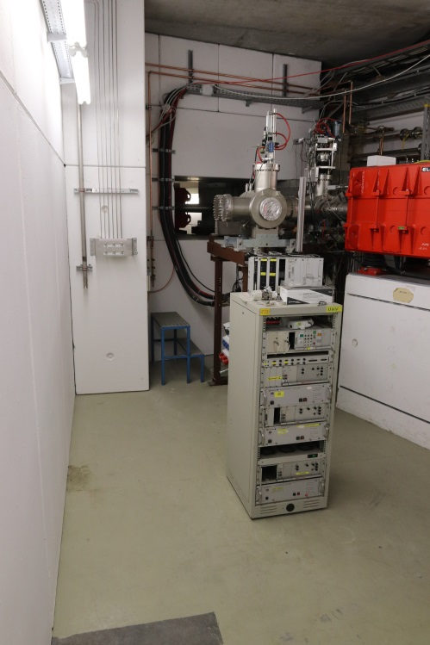
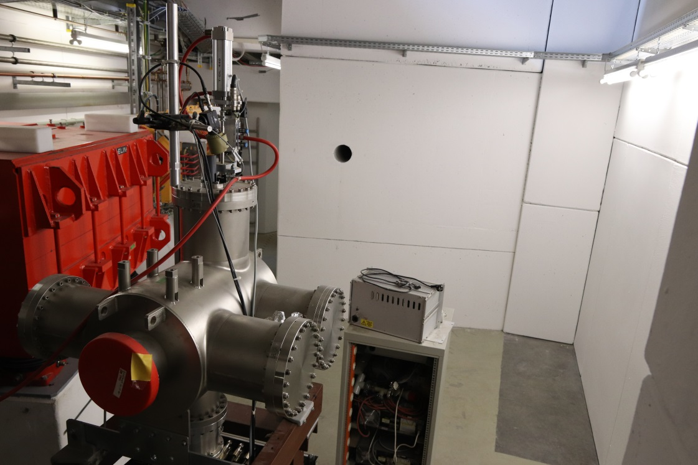
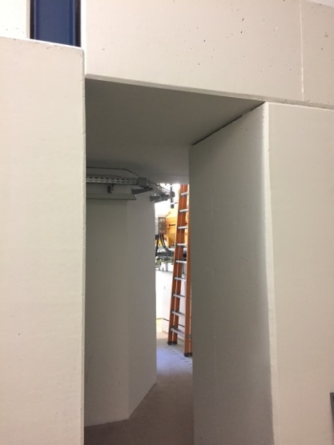
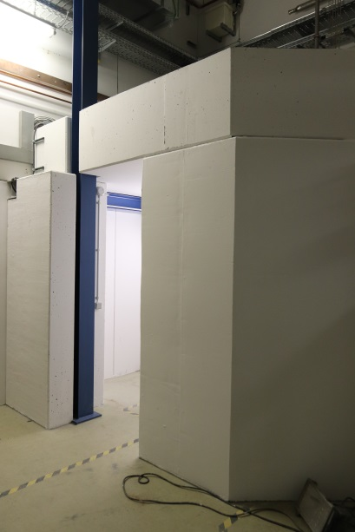
Status of the cave reconstruction

Slide 19
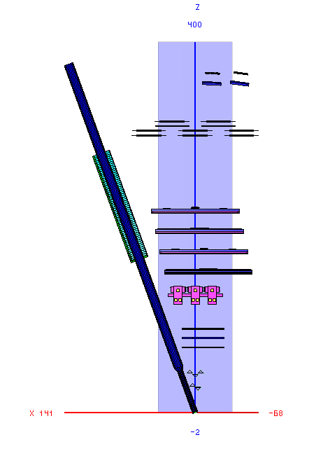
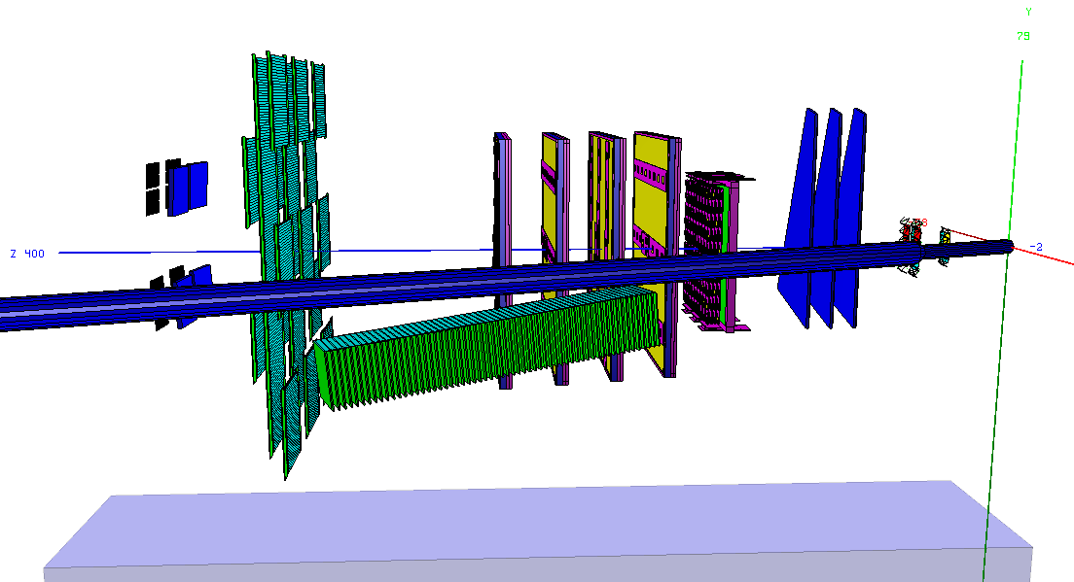
Design of the mCBM test-setup
top view
side view
mRICH
mTOF
mTRD
mPSD
mMUCH
support table
(with rail system)
support table
(with rail system)
mSTS
target
beam

Slide 20
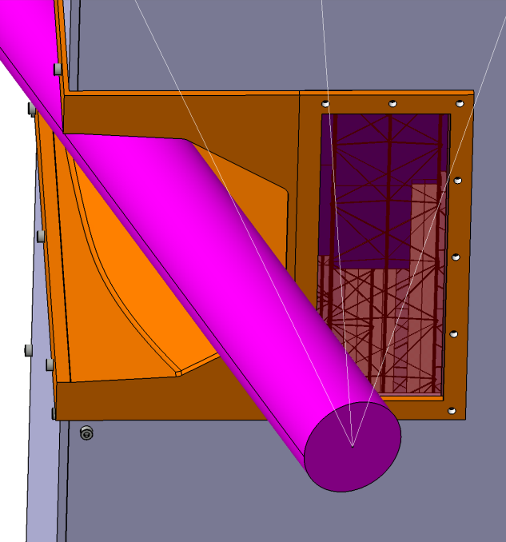
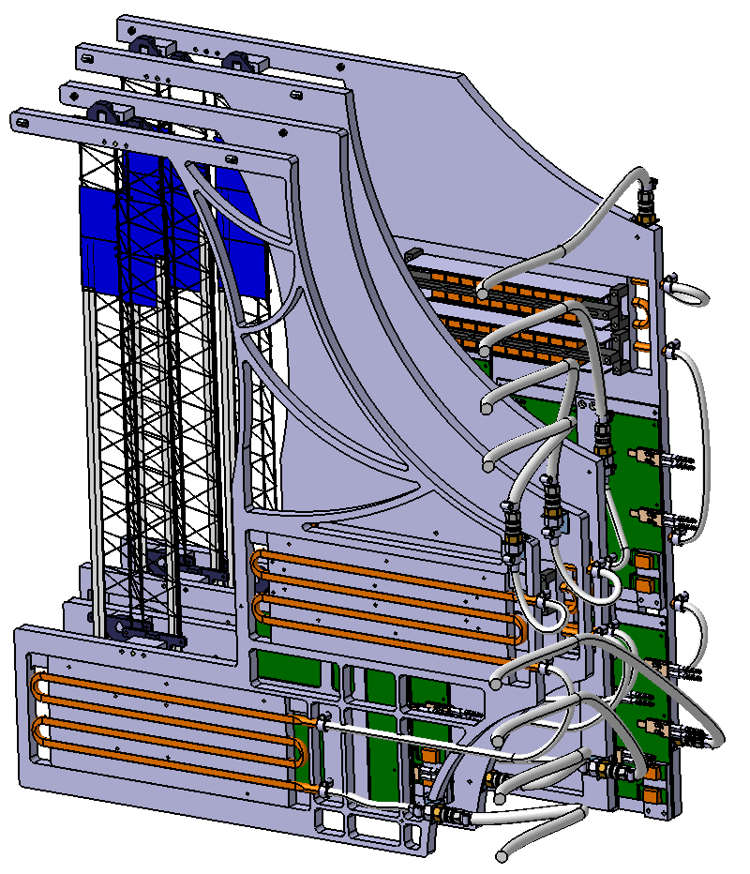

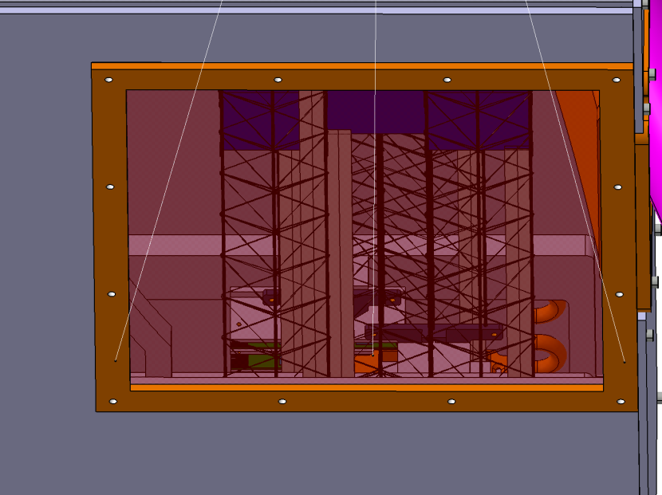
Example: mSTS integration
4 C-frames (“Units”)
holding the ladders with modules
holding the read-out and powering electronics
(FEB, C-ROB, POB) on cooling plates
beam pipe

Slide 21
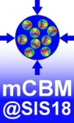
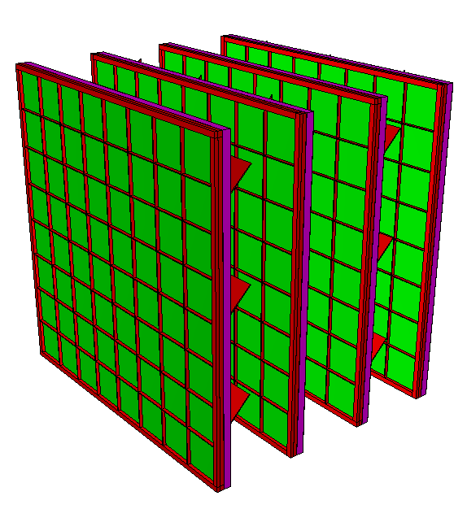
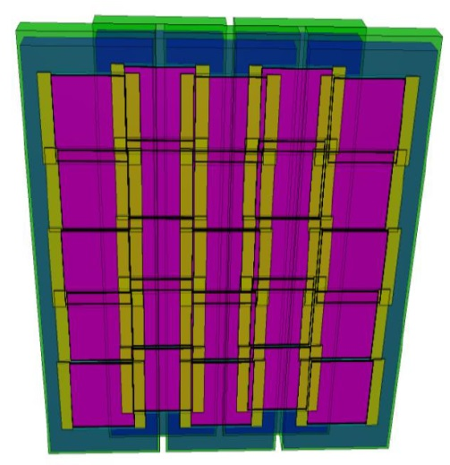




The mTRD and mTOF subsystems
mTRD setup
4 layers
TRD modules
from DESY/CERN tests 2017
mTOF setup
25 MRPC(3a) counters
(= 5x STAR modules)
150 x 120 cm² active area
1600 readout channels

Slide 22



Hit rates at mCBM (simulation)
mSTS, 1st station
max. (design) rate: 1.5 MHz/cm²
mTOF
max. (design) rate: 20 kHz/cm²
Input:
UrQMD, Au+Au 1.24 AGeV, mbias,
incl. δ-electrons

Slide 23








mCBM benchmark observable: Λ reconstruction
Simulation input: 10⁸ UrQMD events, min. bias
Acceptance
Efficiency
$$π^{−}$$
Ni+Ni 1.93AGeV
Au+Au 1.24AGeV
$$p$$
S/B = 8.4
S/B = 0.24
$$Λ→p+ π^{−}$$

Slide 24



Λ production at SIS18 energies – mCBM reference data
Ni + Ni 1.93 AGeV
Au + Au 1.23 AGeV
M. Merschmeyer et al. (FOPI), PRC 76, 024906 (2007)
H. Schuldes et al. (HADES)
EPJ Web of Conferences 171, 01001 (2018), SQM2017
midrapidity

Slide 25

mCBM data taking
2018 | development & commissioning data transport, data analysis, detector tests
2019 | approaching full performance subsystems completed, high-rate data transport / processing → online reconstruction
2020 | 1st benchmark run Λ reconstruction production runs benchmark coll. systems: Ni+Ni 1.93AGeV & Au+Au 1.24AGeV
2021 | 2nd benchmark run Λ reconstruction in Ni+Ni and Au+Au collisions at various projectile energies → Λ production excitation function
requested beamtime
was fully granted
by GSI/FAIR G-PAC
proposal to be submitted in 2019
Λ - slope parameter:
smaller than proton
not explained by transport models
reason unclear:
  rescattering cross section ?
  repulsive potential ?

Slide 26




Schedule of mCBM@SIS18 construction
Schedule
10/2017 | cave & beam line: reconstruction started, procurement started
12/2017 | mDAQ test stand @ Heidelberg operational
12/2017 | beam dump mounted
03/2018 | cave reconstruction completed
04/2018 | mFLES cluster @ Green IT Cube installed
05/2018 | beam line installed and commissioned
05/2018 | installation of detector stations
06/2018 | start commissioning w/o beam
08/2018 | start commissioning with beam
green IT cube

Slide 27






CBM – FAIR Phase 0 projects (2018 – 2022)
1. Install, commission and use 430 out of 1100
CBM RICH multi-anode photo-multipliers (MAPMT)
including FEE in HADES RICH photon detector
2. Install, commission and use
10% of the CBM TOF modules
including read-out chain
at STAR/RHIC (BES II 2019/2020)
3. Upgrade BM@N experiment
with 4 Silicon stations of CBM/STS design in the
BM@N experiment at the Nuclotron JINR/Dubna
(Au-beams in late 2020)
4. Install, commission and use the Project
Spectator Detector at the BM@N experiment
5. mCBM@SIS18:
demonstrator for full CBM data taking and analysis chain

Slide 28





Status of the experiment preparation
# | Project | TDR Status
1 | Magnet | approved
2 | STS | approved
3 | RICH | approved
4 | TOF | approved
5 | MuCh | approved
6 | HADES ECAL | approved
7 | PSD | approved
8 | MVD | submission in 2018
9 | DAQ/FLES | submission in 2018
10 | TRD | submission in 2018
11 | ECAL | submission in 2018
MVD
TRD
STS
RICH (readout)
TOF
DAQ/
FLES

Slide 29

CBM Collaboration: 55 institutions, 470 members
China:
CCNU Wuhan
Tsinghua Univ.
USTC Hefei
CTGU Yichang
Chongqing Univ.
Czech Republic:
CAS, Rez
Techn. Univ. Prague
France:
IPHC Strasbourg
Germany:
Darmstadt TU
FAIR
Frankfurt Univ. IKF
Frankfurt Univ. FIAS Frankfurt Univ. ICS
GSI Darmstadt
Giessen Univ.
Heidelberg Univ. P.I.
Heidelberg Univ. ZITI
HZ Dresden-Rossendorf
KIT Karlsruhe
Münster Univ.
Tübingen Univ.
Wuppertal Univ.
ZIB Berlin
Russia:
IHEP Protvino
INR Troitzk
ITEP Moscow
Kurchatov Inst., Moscow
VBLHEP, JINR Dubna
LIT, JINR Dubna
MEPHI Moscow
PNPI Gatchina
SINP MSU, Moscow
Ukraine:
T. Shevchenko Univ. Kiev
Kiev Inst. Nucl. Research
India:
Aligarh Muslim Univ.
Bose Inst. Kolkata
Panjab Univ.
Univ. of Jammu
Univ. of Kashmir
Univ. of Calcutta
B.H. Univ. Varanasi
VECC Kolkata
IOP Bhubaneswar
IIT Kharagpur
IIT Indore
Gauhati Univ.
Korea:
Pusan Nat. Univ.
Poland:
AGH Krakow
Jag. Univ. Krakow
Warsaw Univ.
Warsaw TU
Romania:
NIPNE Bucharest
Univ. Bucharest
Hungary:
KFKI Budapest
Eötvös Univ.
30th CBM Collaboration meeting in Wuhan
24-28 September 2017
CBM Scientists

