Slide 1




Evaluation of Innovative Cooling Concepts with High-Performance Carbon Materials for Vertex Detectors operated in Vacuum
DPG Frühjahrtagung in Bochum 2018
Daniela Mijatovic
IKF University Frankfurt
This work has been supported by BMBF (05P15RFFC1), GSI and HIC for FAIR

Slide 2
Outline
Motivation
Convective and Conductive Cooling
The Sensor Carrier
The Experimental Setup
Performance Measurement
Summary

Slide 3
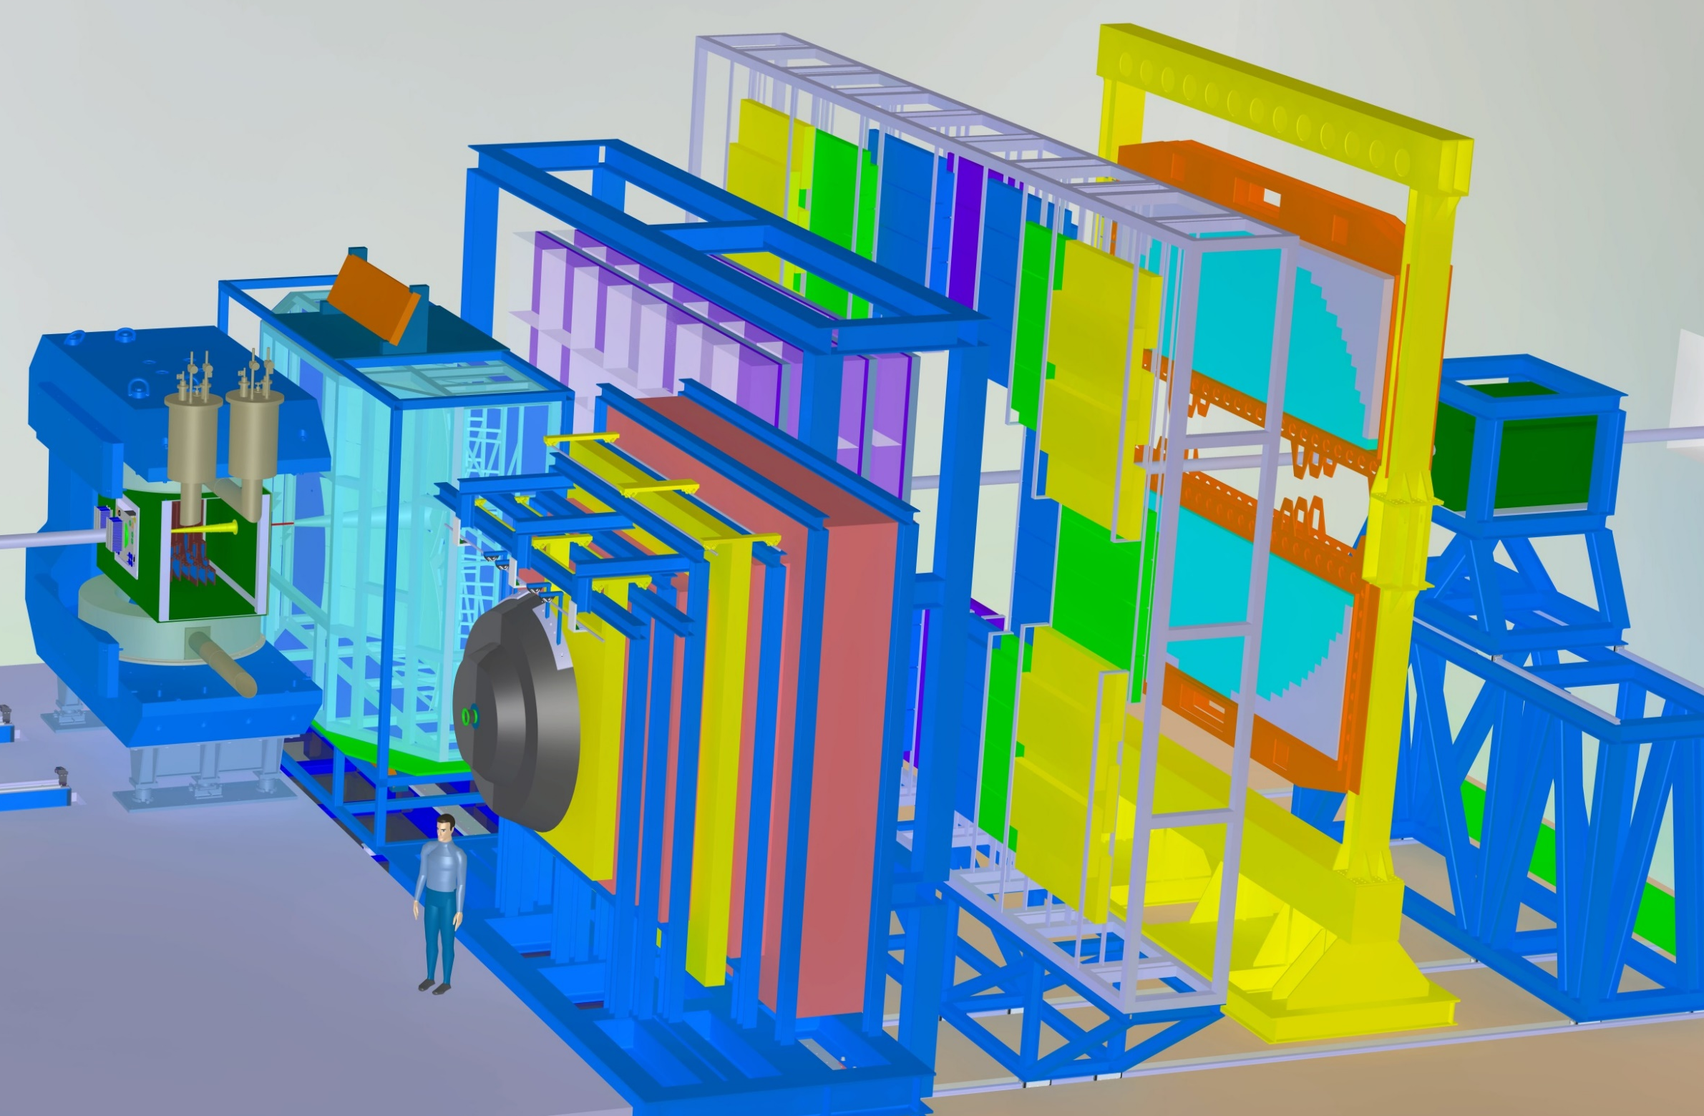
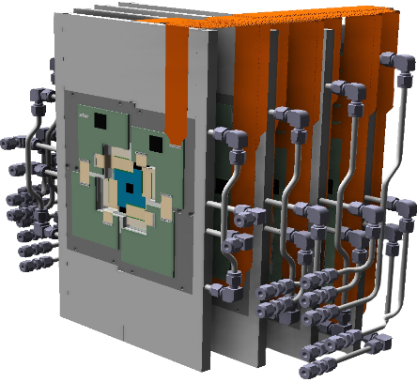
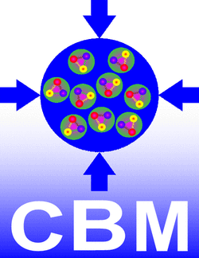
Motivation
The Micro Vertex Detector MVD

Slide 4

Motivation
The Micro Vertex Detector MVD
Tracking of charged particles in fixed target set-up
Precise determination of secondary decay vertices of short lived particles
(50 - 70 µm along beam axis)
Task
  Close to the target
  High radiation hardness
  Low material budget and vacuum operation
    Actively cooled sensors
Requirements
MVD
Inside the acceptance
Outside the acceptance
Efficient Cooling
Low Material Budget
Convective cooling with heat sink
Conductive cooling with high performance sensor carrier

Slide 5
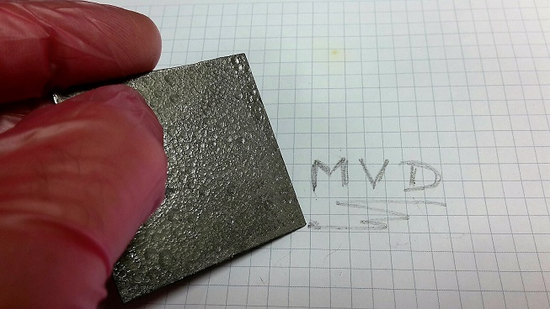
The Sensor Carrier
Thermal Pyrolithic Graphite TPG
CVD Diamond is used for St. 1 and 2
Thin
Excellent heat conductivity in-plane (1600 W/mK)
Mechanical Stable

Slide 6
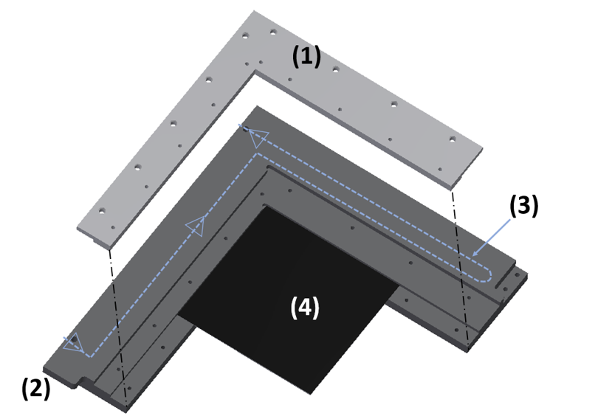
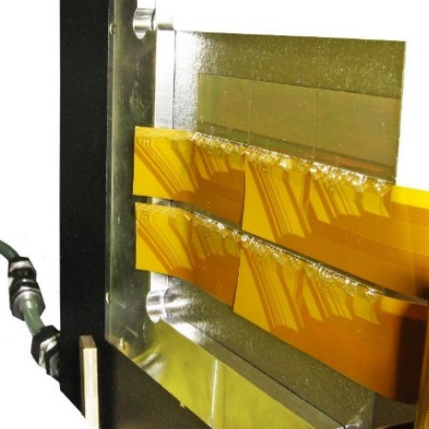
Convective and Conductive Cooling within one Quadrant
Heat-sink balcony
Conductive Cooling:
Sensor carrier clamped to the heat sink (TPG)
Convective Cooling:
Liquid cooled Al-heat sink
Acceptance

Slide 7
Convective and Conductive Cooling
The Quadrant
Sensor Carrier (TPG)
50µm thin sensor
prototypes
(test placing, bonding, gluing)
Micro Cables
Liquid cooled Al-heat sink

Slide 8

Convective and Conductive Cooling
Heat Flow
1. Sensors produce heat (200 – 500 mW/ ${cm}^{2}$)
2. Heat transferred by conduction over the sensor carrier
3. Sensor carrier is clamped to the Al- heat sink
4. Cooling liquid circulating inside the heat sink transfers the heat by convection

Slide 9
Convective and Conductive Cooling
Heat Flow
1. Sensors produce heat
Can be achieved by materials with a very high heat conductivity
2. Heat transferred by conduction over the sensor carrier
3. Sensor carrier is clamped to the Al- heat sink
4. Cooling liquid circulating inside the heat sink transfers the heat by convection

Slide 10
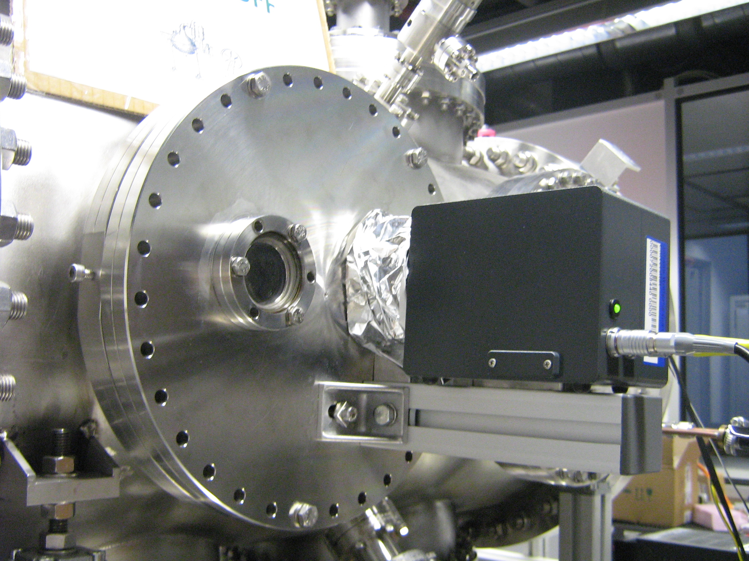
The Experimental Setup
Goal:
Measuring thermal performance with infrared (IR) thermography of sensor carriers in vacuum for quantitative evaluation
needs
A standardized test setup
IR advantages:
Contactless temperature measurement
High resolution spatial temperature profile
IR Camera:
VarioCAM head HiRes 640

Slide 11
The Experimental Setup
AIR
VACUUM
IR measuring point
Bolometer
array
Pt 100 sensors
2 cm
24 cm
X
X
Ge window (coated)
IR Camera + lens
Measured object

Slide 12
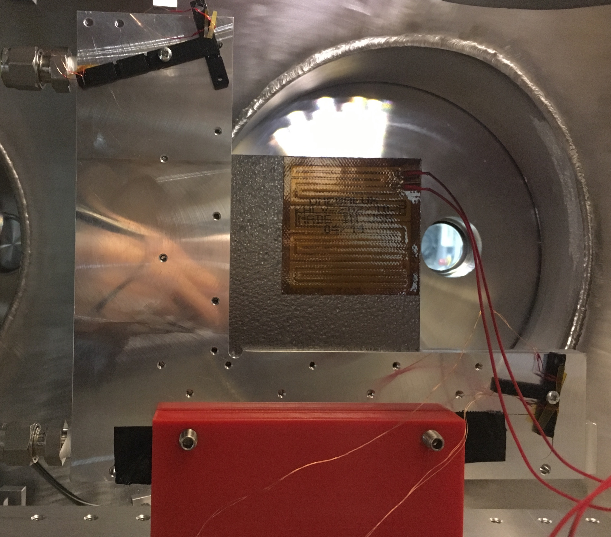
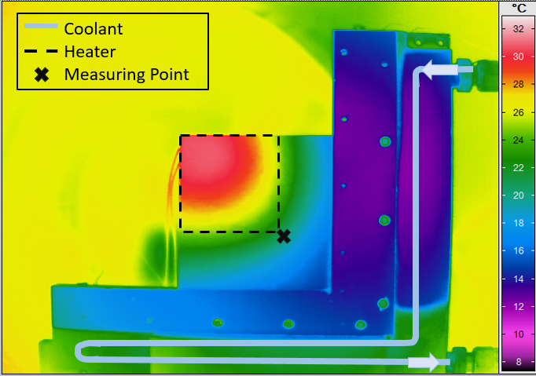
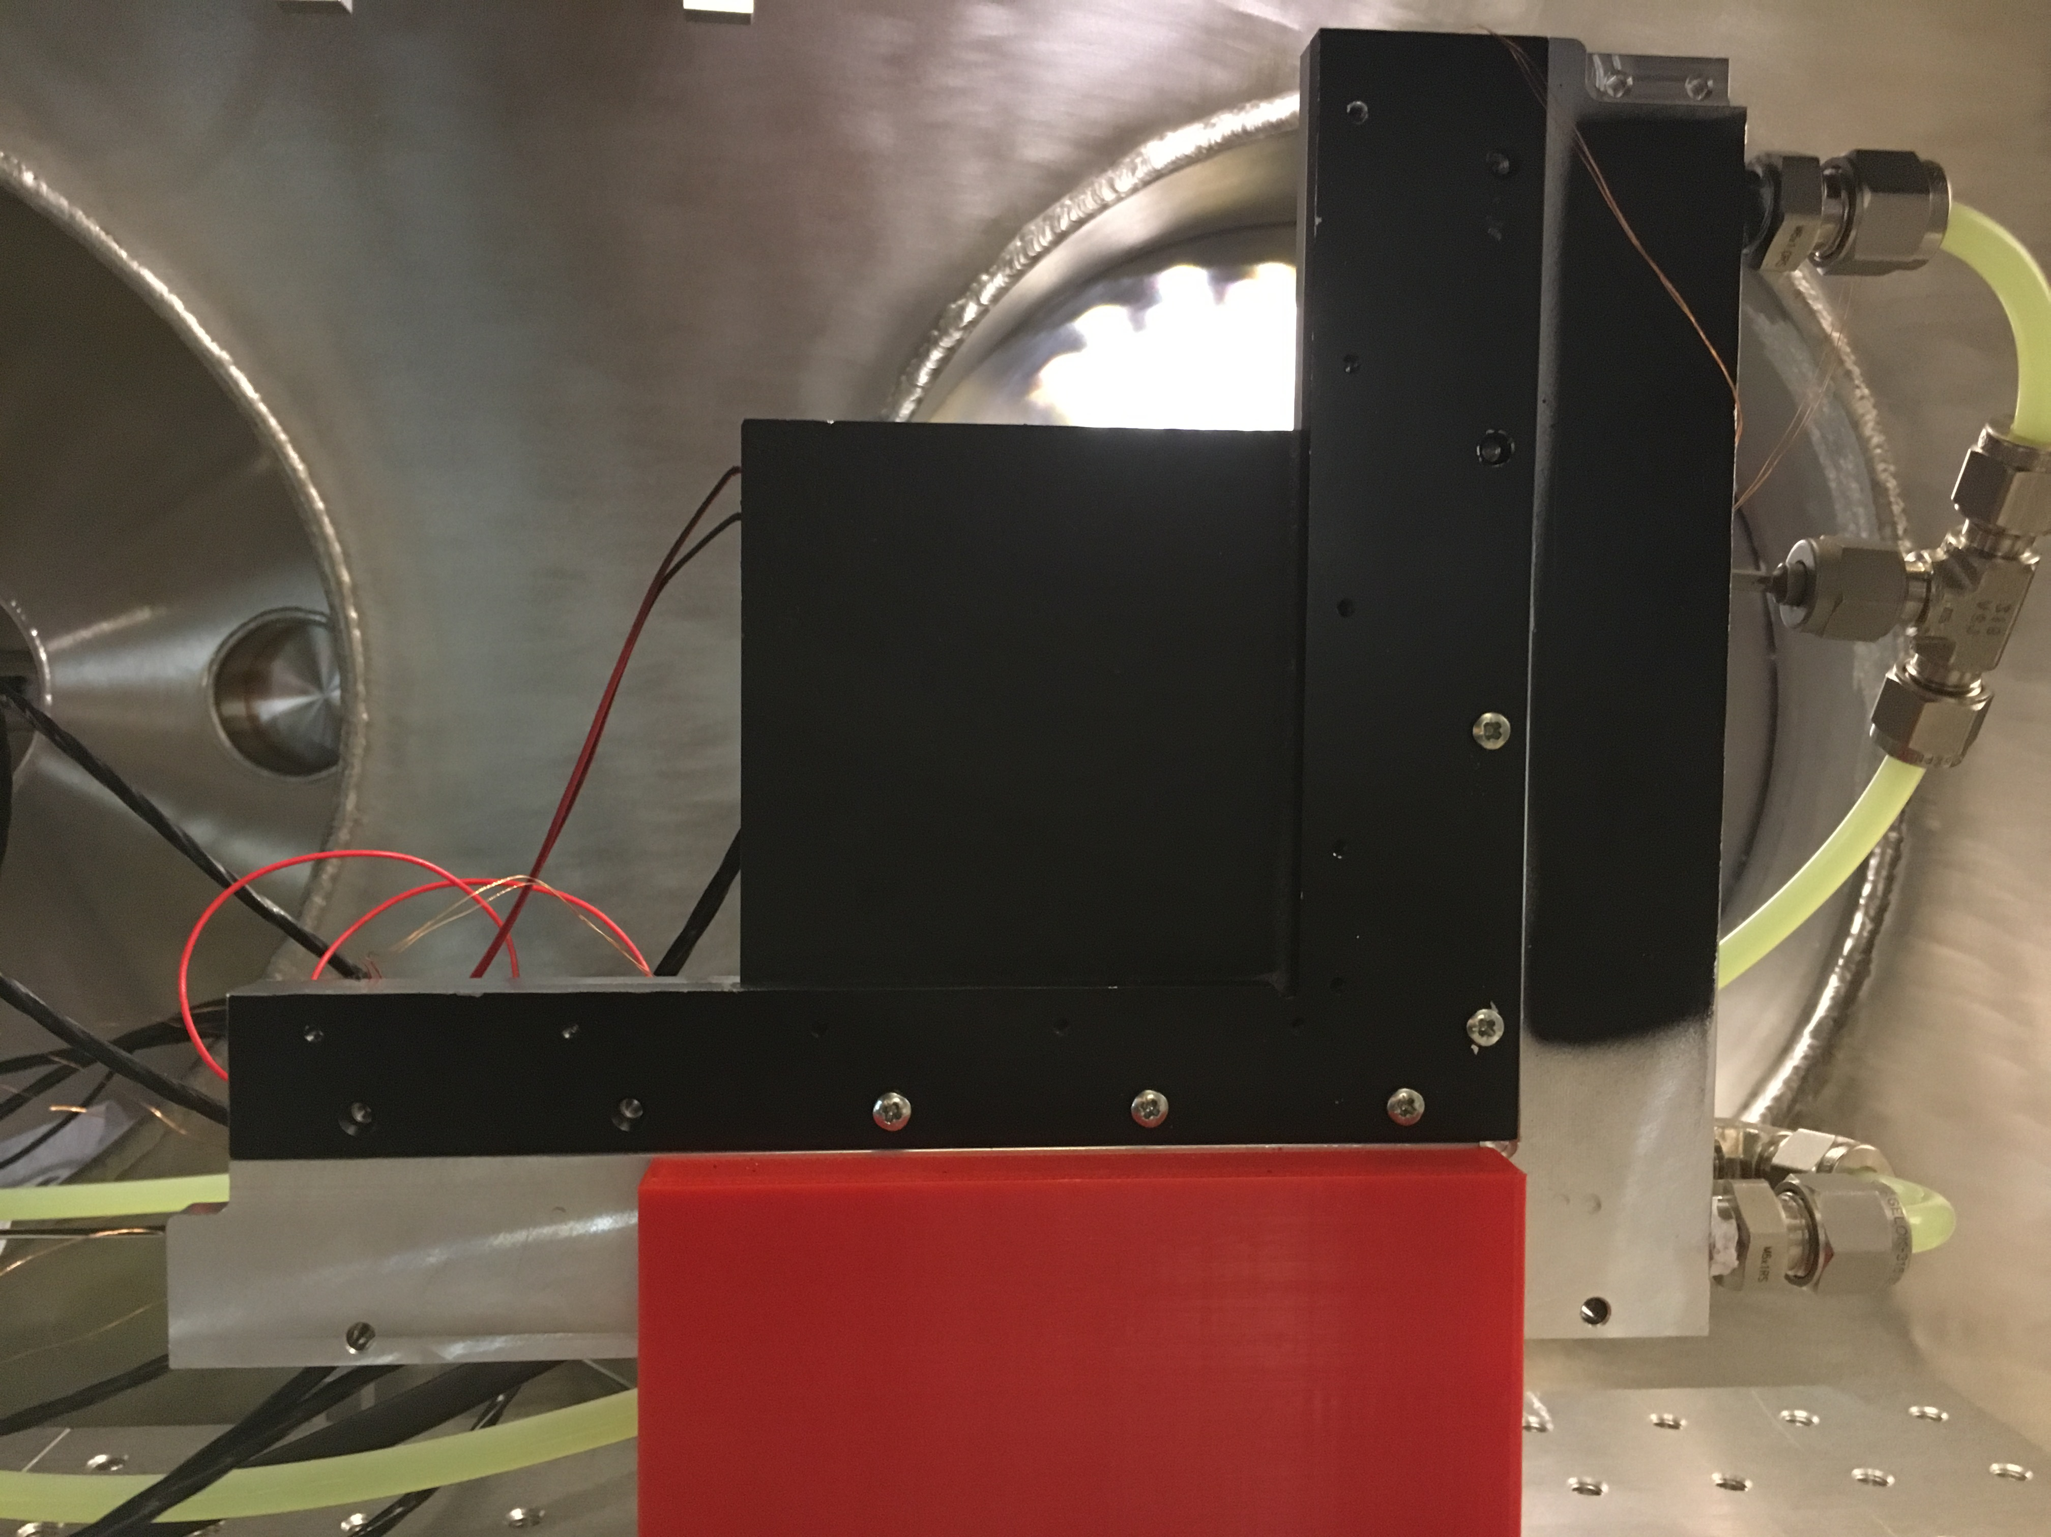
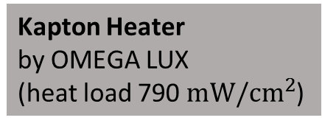
The Experimental Setup
AIR
VACUUM
Kapton Heater
by OMEGA LUX
(heat load 790 ${mW/cm}^{2}$)
Sensor carrier TPG
Al-heat sink
Measuring point
Bolometer
array
X
X
X
X
IR Camera + lens
Ge window coated
(Backside)
Measured object
IR Image

Slide 13
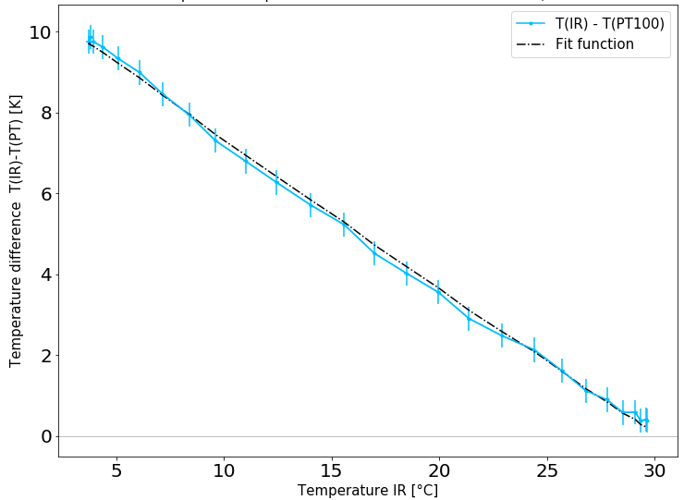
Experimental Setup
Calibration
Many parameters influences the measurements. That is why Pt100 sensors were used as reference measurement and calibration
The calibration is not universal
  A continuous re-calibration is necessary
Absolut temperature is not need to evaluate the thermal performance of a material

Slide 14
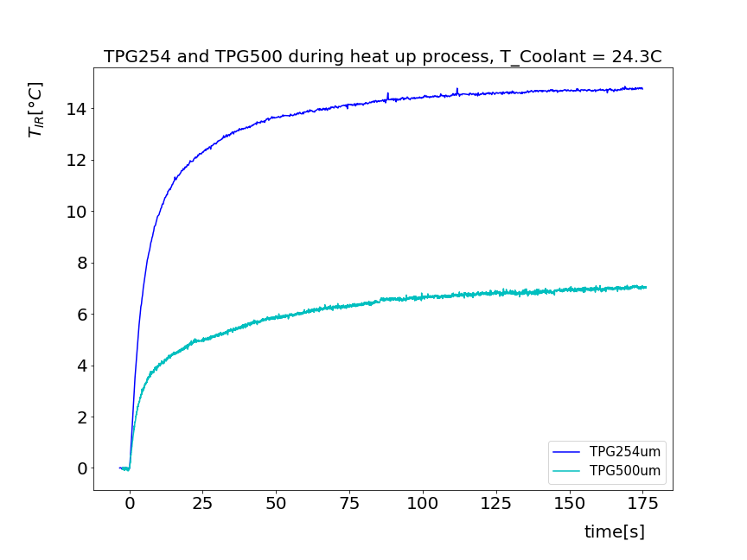
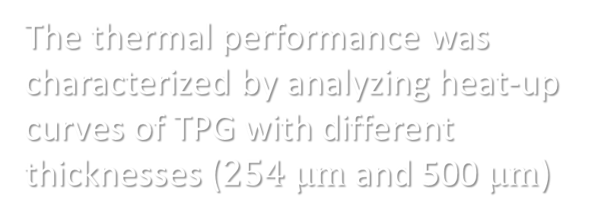


Thermal Performance Measurement
[K]
$$TPG 254 μm$$
The thermal performance was characterized by analyzing heat-up curves of TPG with different thicknesses ($254 μm$ and 500 $μm$)
1st Notice:
Thickness of the material effects strongly the end temperature and heat distribution
2nd Notice:
Curves can be described with an exponential function
$$TPG 500 μm$$

Slide 15
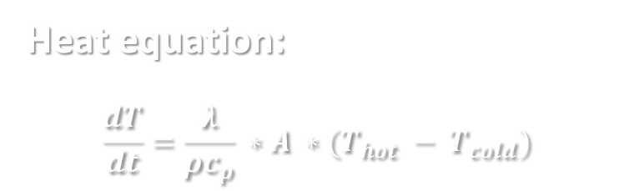
Thermal Performance Measurement
[K]
$$TPG 254 μm$$
The thermal performance was characterized by analyzing heat-up curves of TPG with different thicknesses ($254 μm$ and 500 $μm$)
2nd Notice:
Curves can be described with an exponential function
$$TPG 500 μm$$
Heat equation:
$$\frac{dT}{dt}=\frac{λ}{ρc_{p}} ∗A ∗(T_{hot} − T_{cold})$$

Slide 16
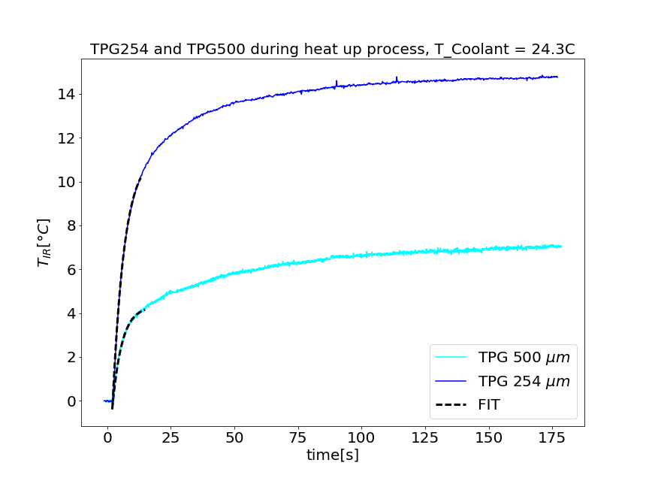

Thermal Performance Measurement
Single exp. Fit
[K]
Fitting the heat- up curves during the first 15 seconds with
T(t) = $T_{End}−{ T}_{carrier}∗ exp\left(−\frac{time}{τ_{carrier}} \right)$
t = 15s
Fit range

Slide 17
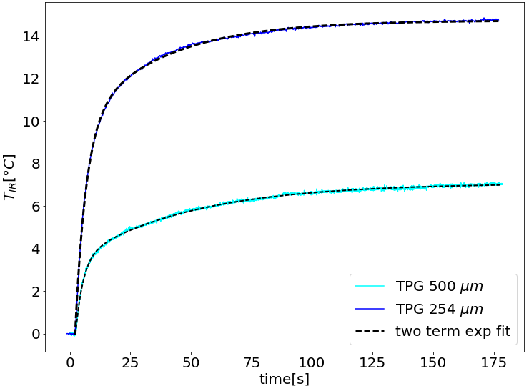
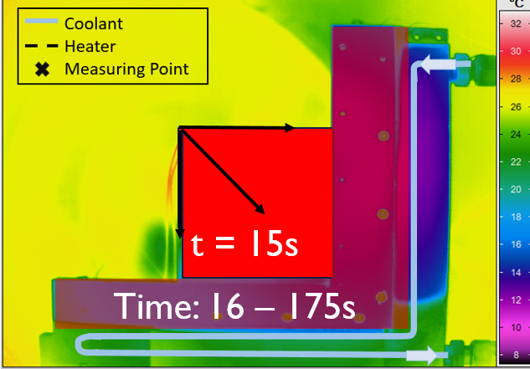
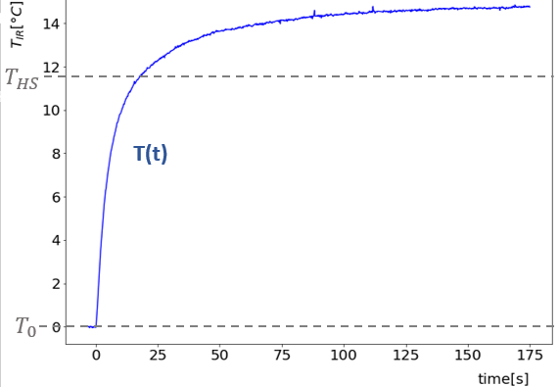

Thermal Performance Measurement
Two-Term exponential Curve Fit
Fitting the complete heat up curve with
a two-term exponential curve fit:
T(t) = $T_{End}−T_{carrier}∗\exp\left(−\frac{time}{τ_{carrier}}\right)$
$− { T}_{HS} ∗\exp\left(−\frac{time}{τ_{HS}} \right)$
[K]

Slide 18
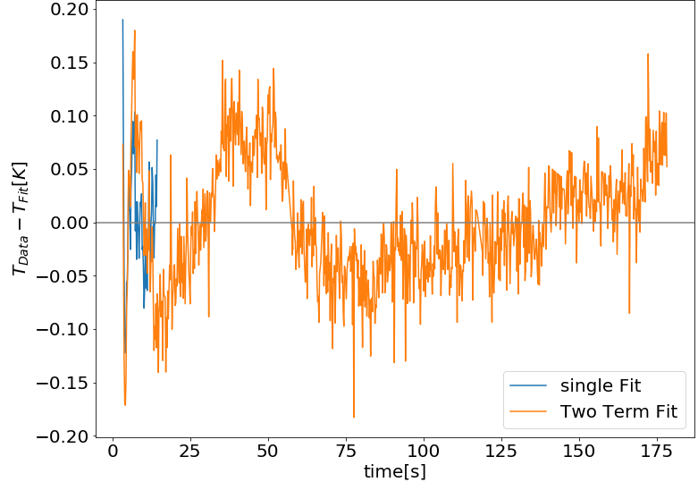
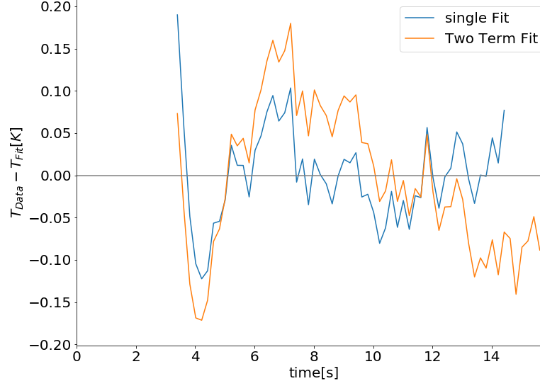
Thermal Performance Measurement
Single and Two-Term in Comparison

Slide 19
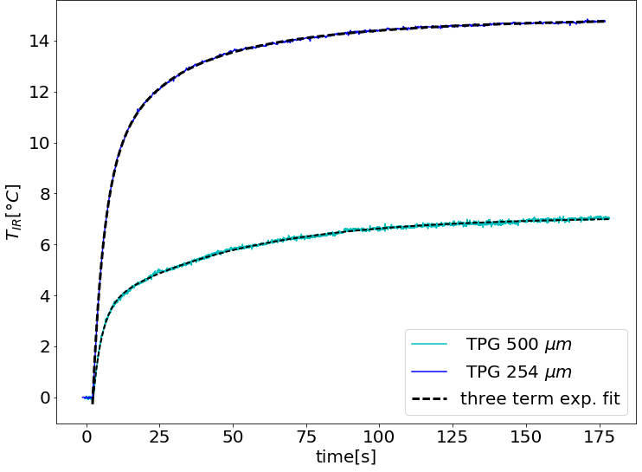

Thermal Performance Measurement
Three-Term exponential Curve Fit
Fitting the complete heat up curve with a three-term exponential curve fit:
T(t) = $T_{End}− T_{carrier} ∗exp\left(−\frac{time}{τ_{carrier}}\right) − T_{contact} ∗\exp\left(−\frac{time}{τ_{contact}}\right) −$ $T_{HS} ∗\exp\left(−\frac{time}{τ_{slow}}\right)$
[K]

Slide 20
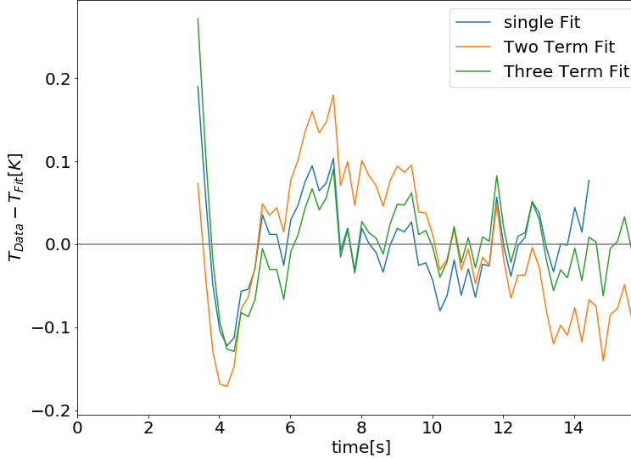
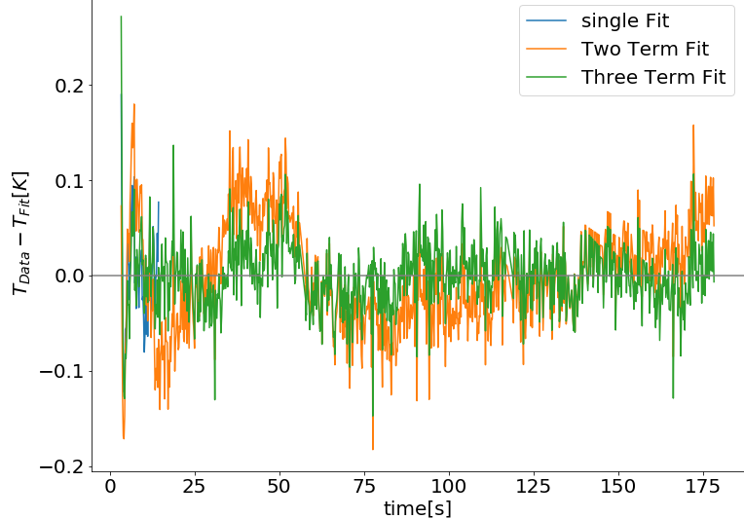
Thermal Performance Measurement
Fits in Comparison for TPG 254 µm

Slide 21
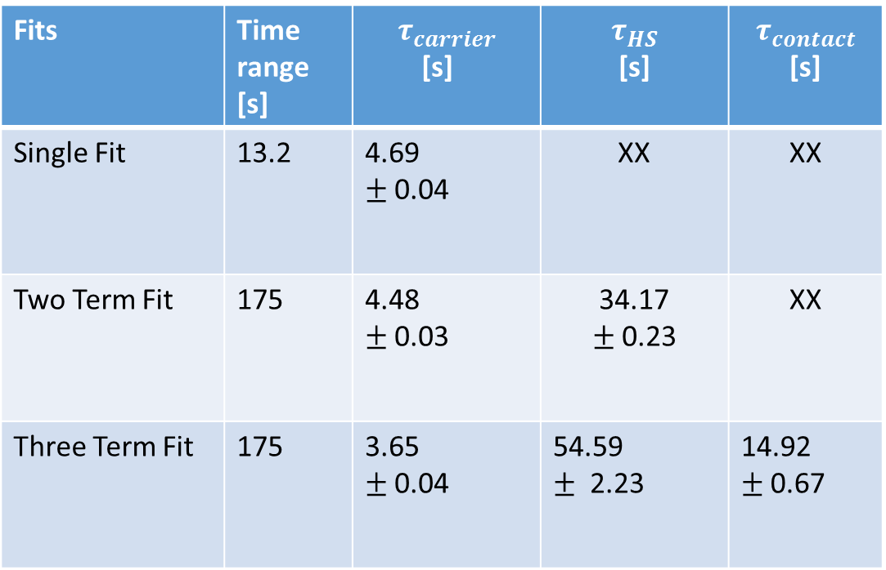




Thermal Performance Measurement
Fits in Comparison
$$τ=\frac{l^{2}ρc}{\text{λ}}$$
The relaxation time $τ$ is connected to the heat conductivity.
A short relaxation time is an indicator for a high heat conductivity.
$τ_{carrier }$ describes relaxation time of the sensor carrier (TPG)
$τ_{contact }$gives information about the contact between carrier and heat sink
$τ_{HS }$ gives information about thermal performance of the heat sink
Fits | Time range [s] | $$τ_{carrier}$$ [s] | $$τ_{HS}$$ [s] | $$τ_{contact}$$ [s]
Single Fit | 13.2 | 4.69 $±$0.04 | XX | XX
Two Term Fit | 175 | 4.48 $±$0.03 | 34.17 $±$0.23 | XX
Three Term Fit | 175 | 3.65 $±$0.04 | 54.59 $±$2.23 | 14.92 $±$0.67
[K]
$$τ_{Heat−sink }$$
$$τ_{contact }$$
$$τ_{carrier }$$

Slide 22
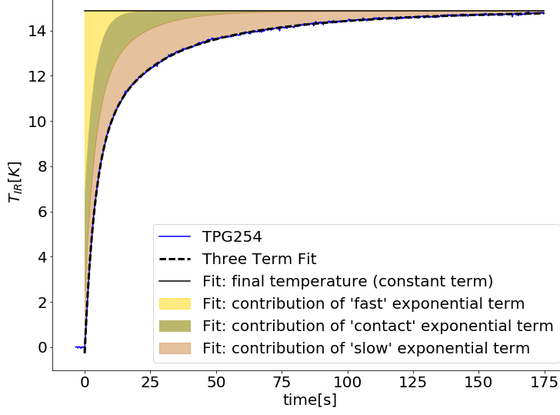


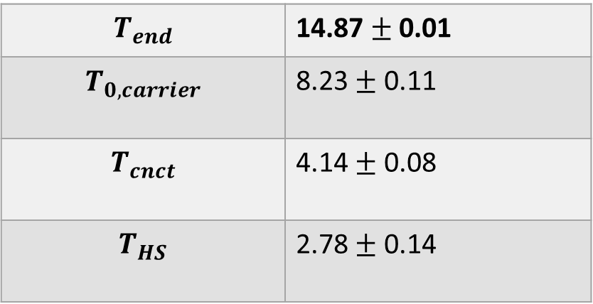



Thermal Performance Measurement
Fits in Comparison for TPG 254 µm
$$T_{end}$$
T(t) = $T_{End}$
$$− T_{carrier} ∗exp\left(−\frac{time}{τ_{carrier}}\right)$$
$$− T_{contact} ∗exp\left(−\frac{time}{τ_{contact}}\right)$$
$${−T}_{HS} ∗\exp\left(−\frac{time}{τ_{slow}}\right)$$
$$T_{0,carrier}$$
$$T_{end}$$ | 14.87 $±$ 0.01
$$T_{0,carrier}$$ | 8.23 $±$ 0.11
$$T_{cnct}$$ | 4.14 $±$ 0.08
$$T_{HS}$$ | 2.78 $±$ 0.14
$$T_{cnct}$$
$$T_{HS}$$

Slide 23
Summary
Established Experimental Setup with IR Thermography:
Setup too complex to achieve reliable absolute values without calibration.
Empiric calibration with a reference measurement (Pt100) is not universal.
Reliable results achievable with continuous recalibration.
Measurement of Thermal Performance with IR Thermography:
Thermal performance of TPG was evaluated.
An analytic function was used to fit our measurements.
  Single exponential Fit fits the best to the data but to understand the whole system a two / three term fit is necessary

Slide 24
Backup

Slide 25
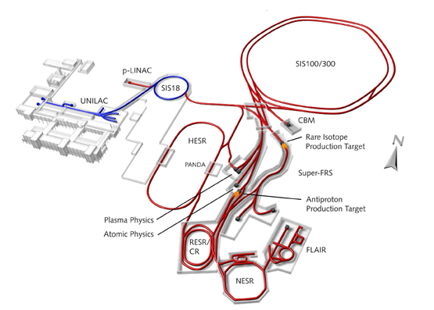
The
Compressed Baryonic Matter
Experiment
CBM
Fixed-target experiment
High energy: 11AGeV
Nucleus-Nucleus &
Proton-Nucleus collision:
very high interaction rate:
100kHz / 1MHz
Research goals:
  Open Charm
  Di-Leptons
  Multi-strange-particles

Slide 26
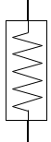
The Cooling Concept
The Quadrant
Sensor Carrier (TPG)
50µm thin sensor
prototypes
(test placing, bonding, gluing)
Micro Cables
Liquid cooled Al-heat sink
One Quadrant

Slide 27
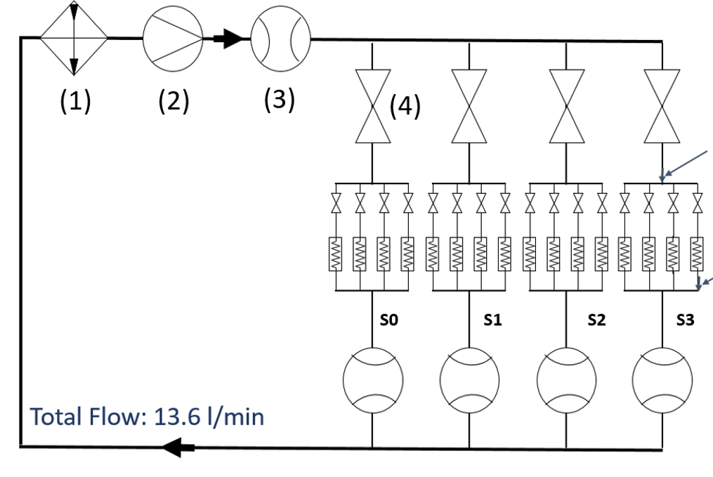
The Cooling Concept
Pump
Huber CC-405
Valves for Stations
Flow Meters
One Quadrant

Slide 28
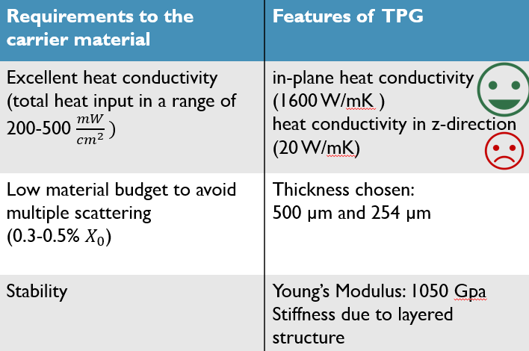
The Sensor Carrier
Thermal Pyrolithic Graphite TPG

Slide 29
Calibration
Aspects that could influence the measurement:
Window between vacuum chamber and camera
Temperature of the window
Ambient Light
Shiny Surfaces (reflections) with low emissivity
Software settings
  Emissivity
Reflection of the chamber

Slide 30
Thermal Performance Measurement
Single exp. Fit
[K]
Fitting the heat- up curves during the first 15 seconds with
T(t) = $T_{End}−{ T}_{carrier}∗ exp\left(−\frac{time}{τ_{carrier}} \right)$
t = 15s
Fit range

Slide 31
Thermal Performance Measurement
Single and Two-Term in Comparison

Slide 32
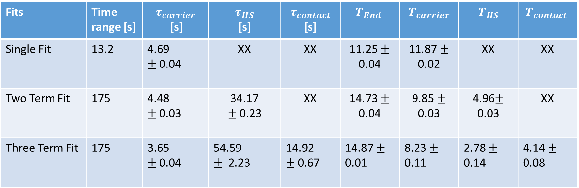
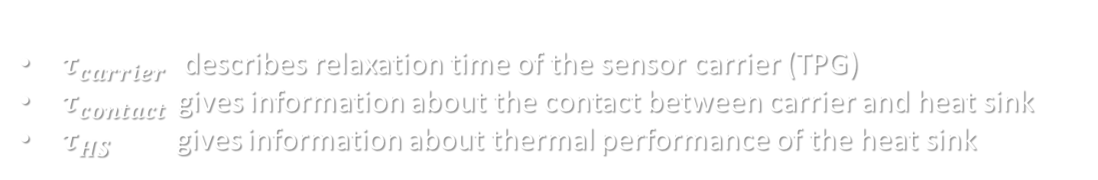
Thermal Performance Measurement
Fits in Comparison
Fits | Time range [s] | $$τ_{carrier}$$ [s] | $$τ_{HS}$$ [s] | $$τ_{contact}$$ [s] | $$T_{End}$$ | $$T_{carrier}$$ | $$T_{HS}$$ | $$T_{contact}$$
Single Fit | 13.2 | 4.69 $±$0.04 | XX | XX | 11.25 $±$ 0.04 | 11.87 $±$ 0.02 | XX | XX
Two Term Fit | 175 | 4.48 $±$0.03 | 34.17 $±$0.23 | XX | 14.73 $±$ 0.04 | 9.85 $±$ 0.03 | 4.96$±$ 0.03 | XX
Three Term Fit | 175 | 3.65 $±$0.04 | 54.59 $±$2.23 | 14.92 $±$0.67 | 14.87 $±$ 0.01 | 8.23 $±$ 0.11 | 2.78 $±$ 0.14 | 4.14 $±$ 0.08
$τ_{carrier }$ describes relaxation time of the sensor carrier (TPG)
$τ_{contact }$gives information about the contact between carrier and heat sink
$τ_{HS}$ gives information about thermal performance of the heat sink

Slide 33


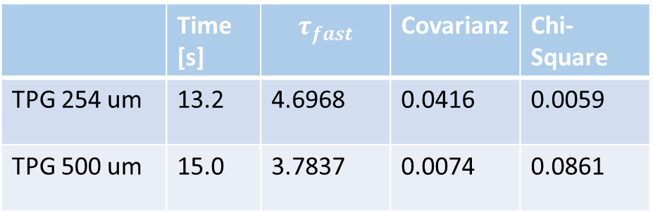
Thermal Performance Measurement
Single exponential Fit
Fitting the heat- up curves during the first 15 seconds with
$$t_{0}−{( p}_{fast}∗ exp\left(−\frac{time}{τ_{}}\right) )$$
 | Time [s] | $$τ_{fast}$$ | Covarianz | Chi-Square
TPG 254 um | 13.2 | 4.6968 | 0.0416 | 0.0059
TPG 500 um | 15.0 | 3.7837 | 0.0074 | 0.0861
t = 15s
$$τ=\frac{l^{2}ρc}{\text{λ}}$$
The short relaxation times describe the excellent thermal performance of TPG
(heat conductivity $\text{λ}$=1600 W/mK)
Fit range

Slide 35
The Experimental Setup
AIR
VACUUM
IR measuring point
Bolometer
array
Pt 100 sensors
2 cm
24 cm
X
X
Ge window coated
IR Camera + lens
Measured object

Slide 36
