Slide 1

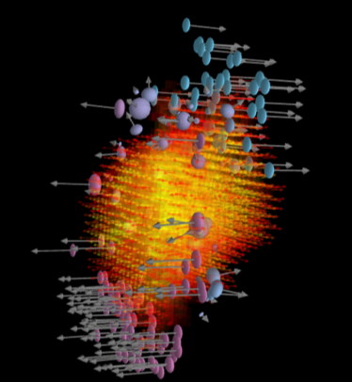







Slide 2
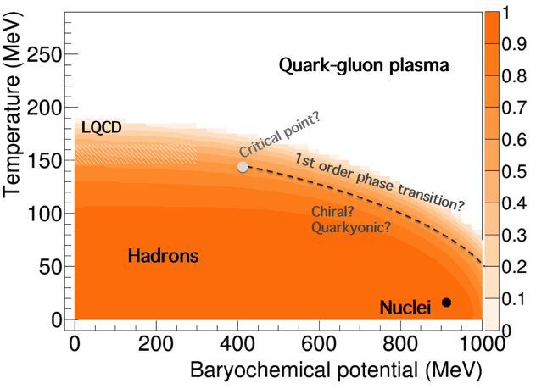
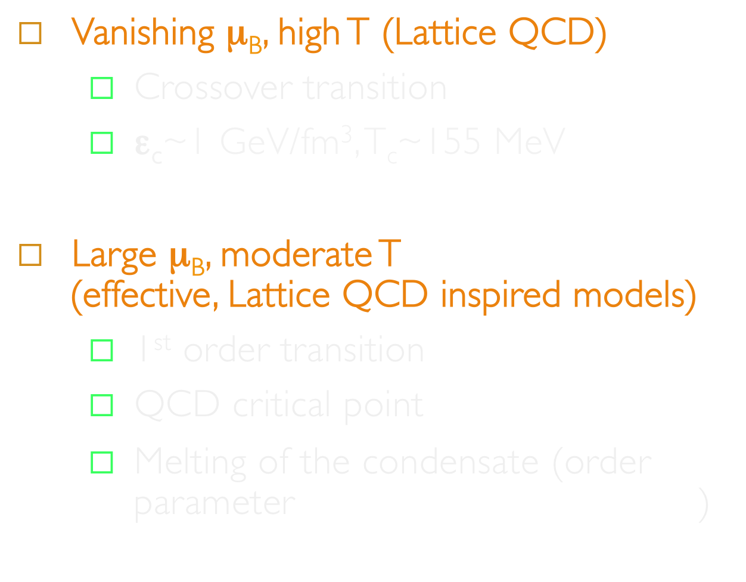


Slide 3
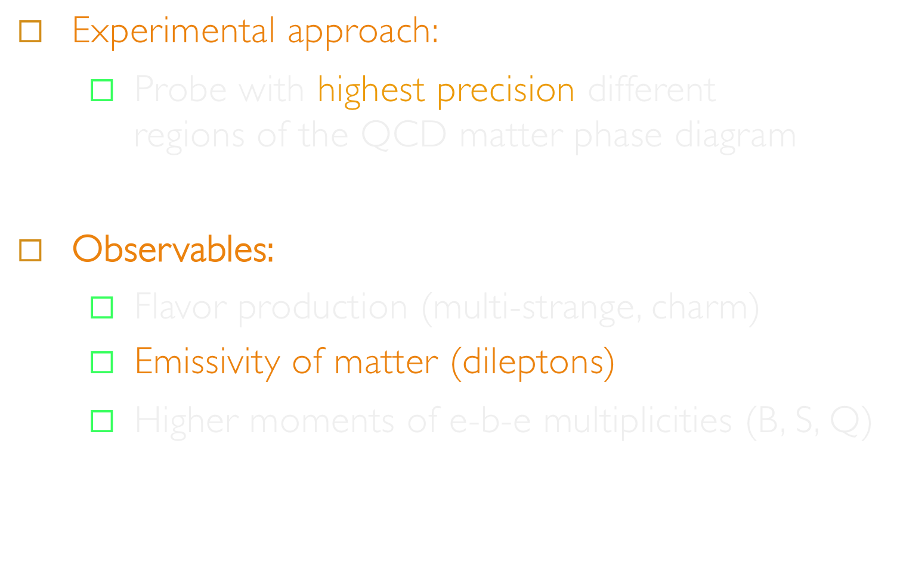

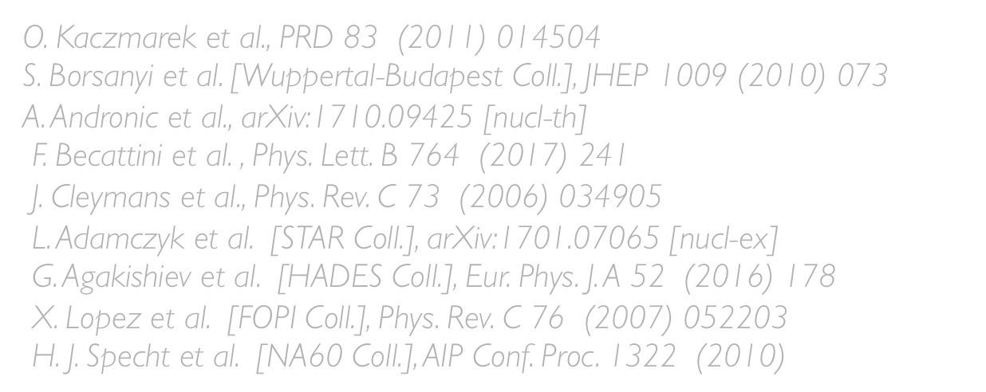



Slide 4
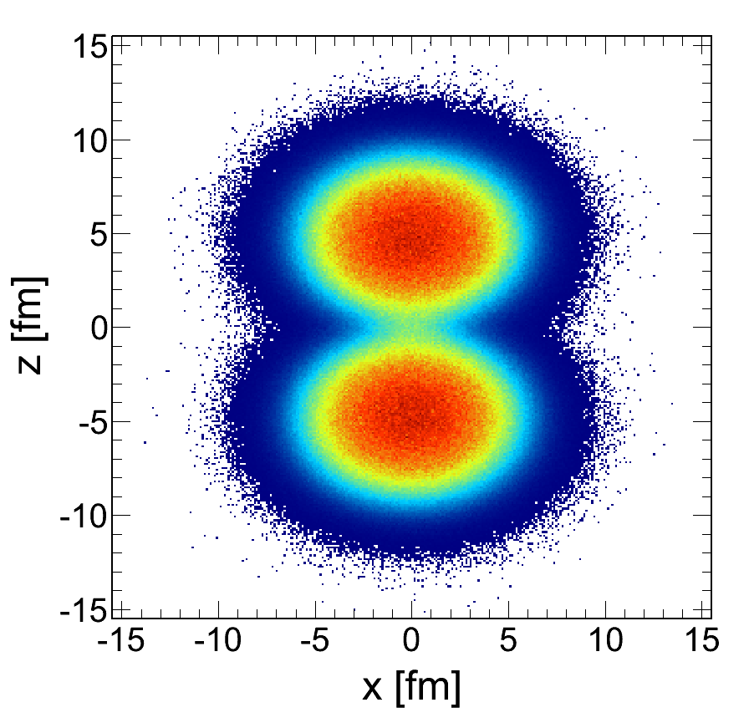

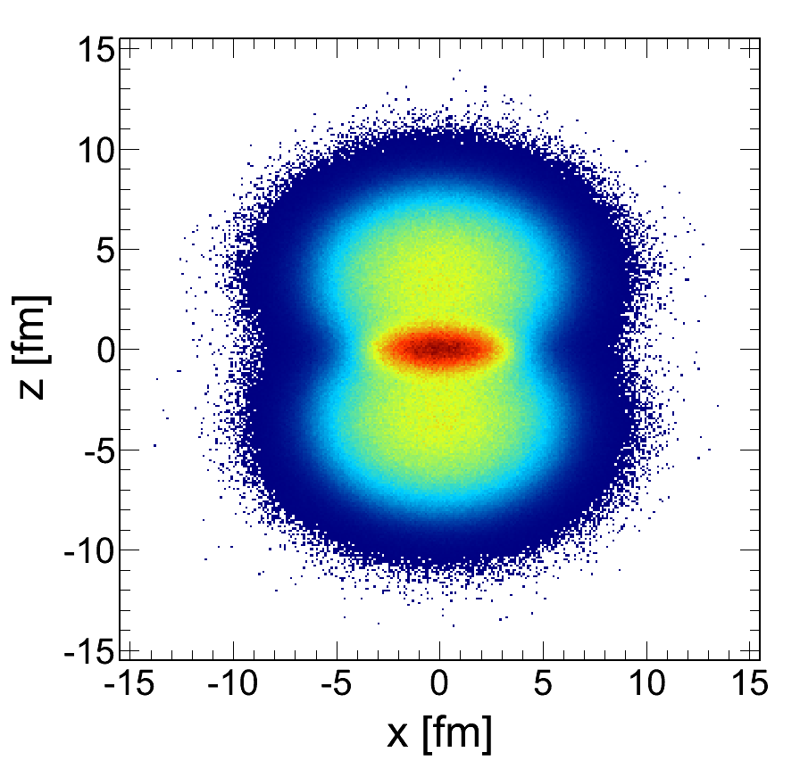
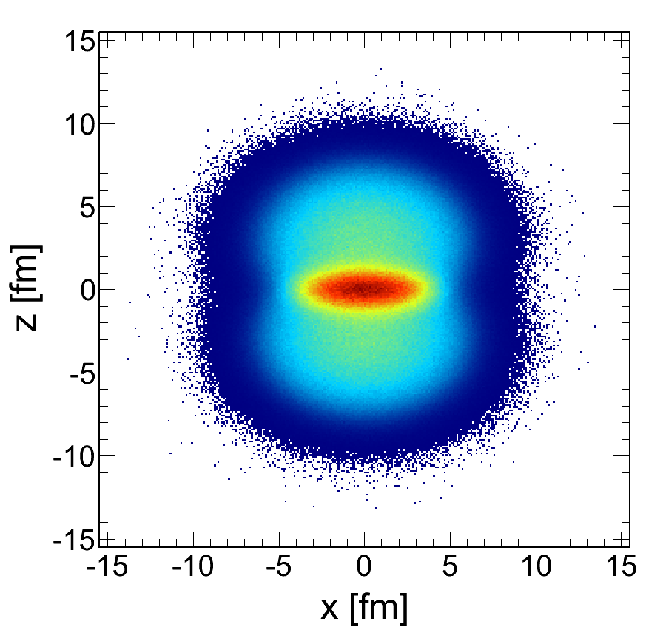
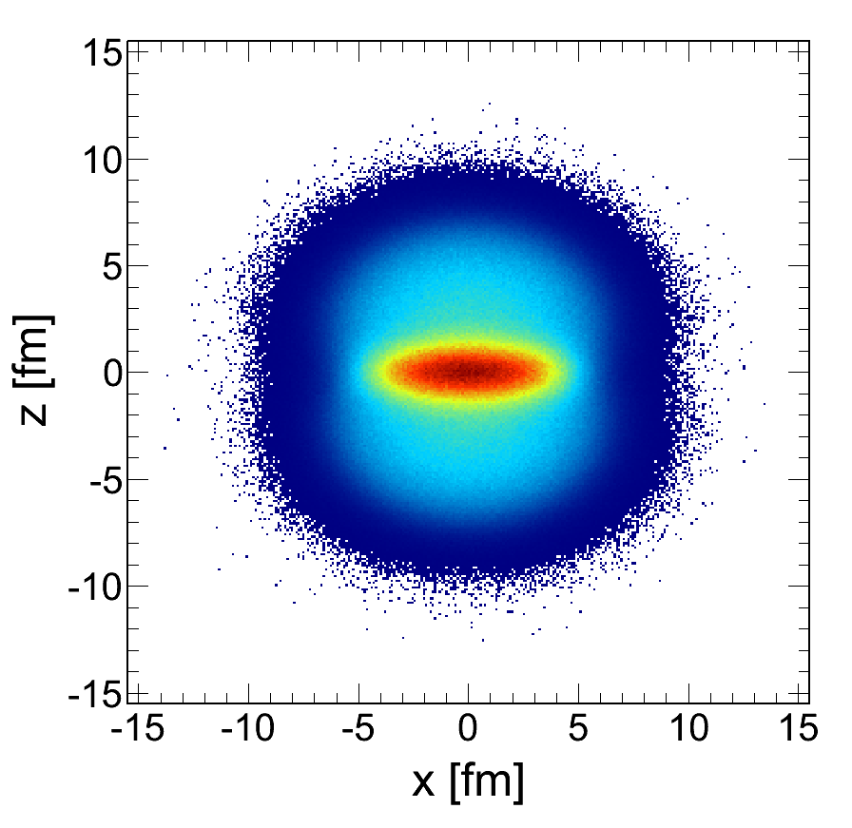
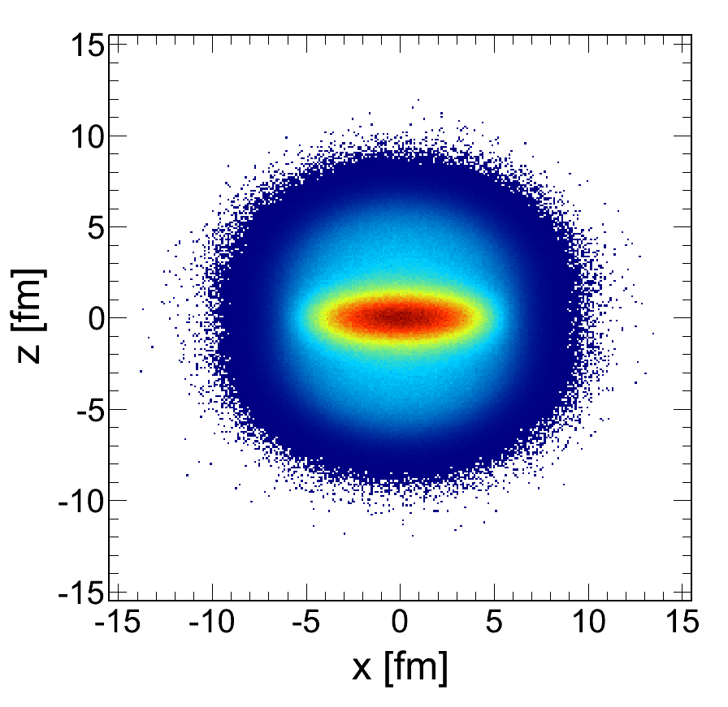
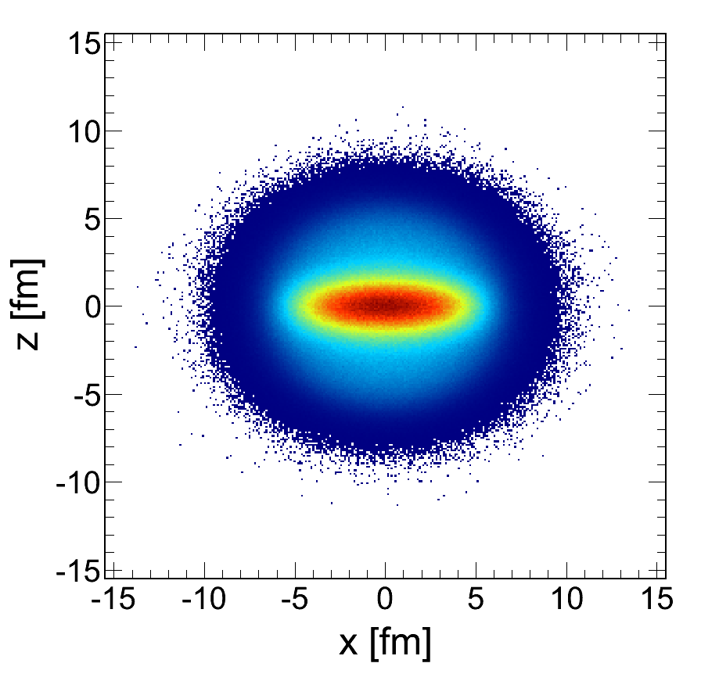
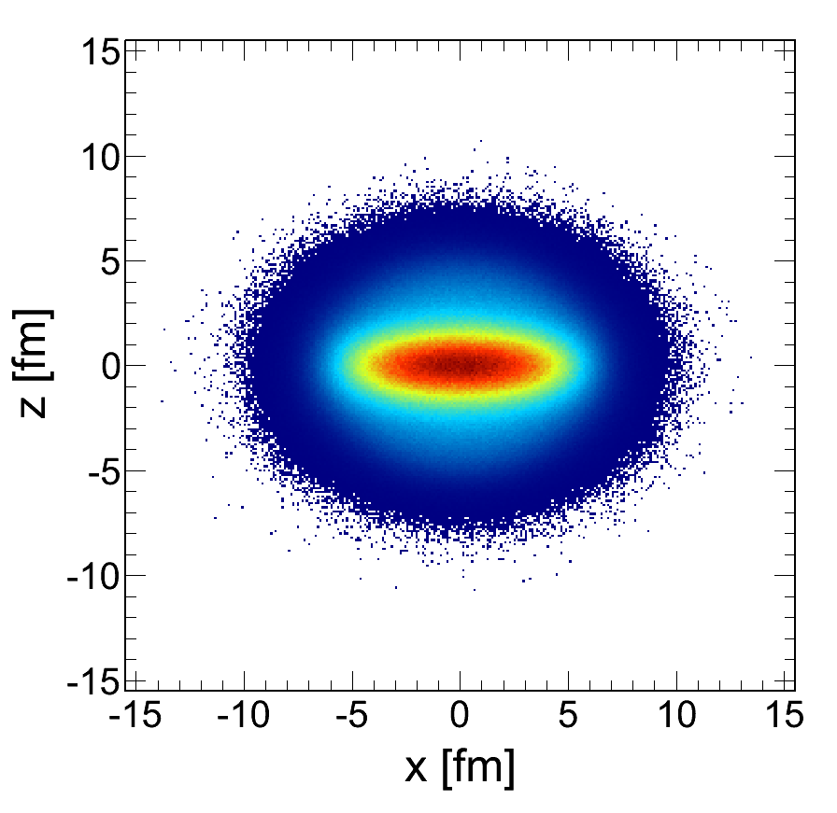
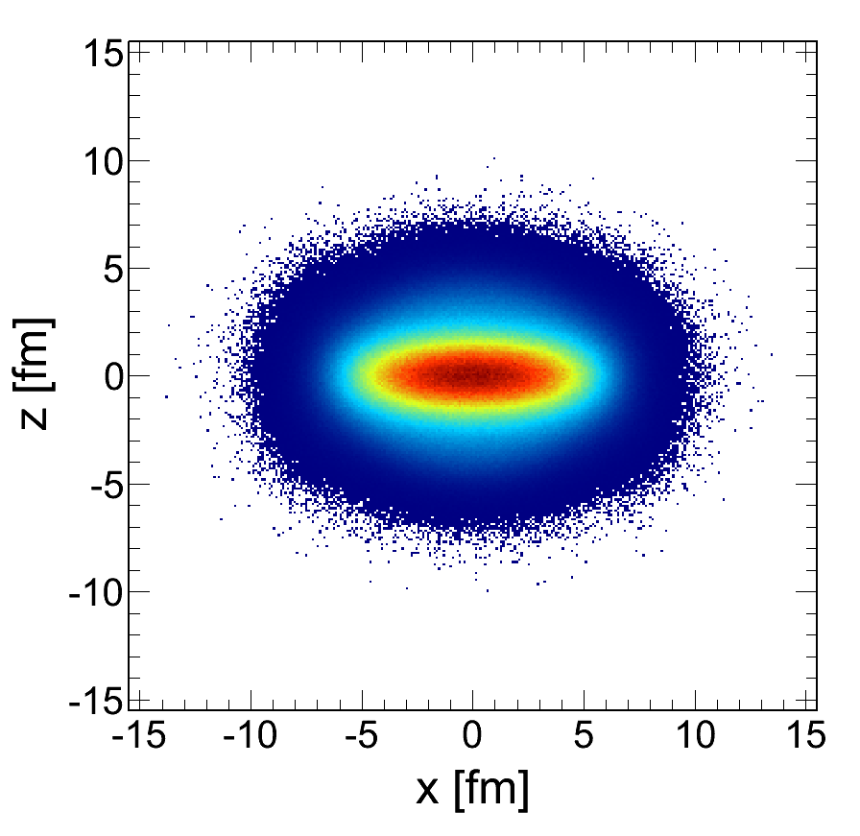
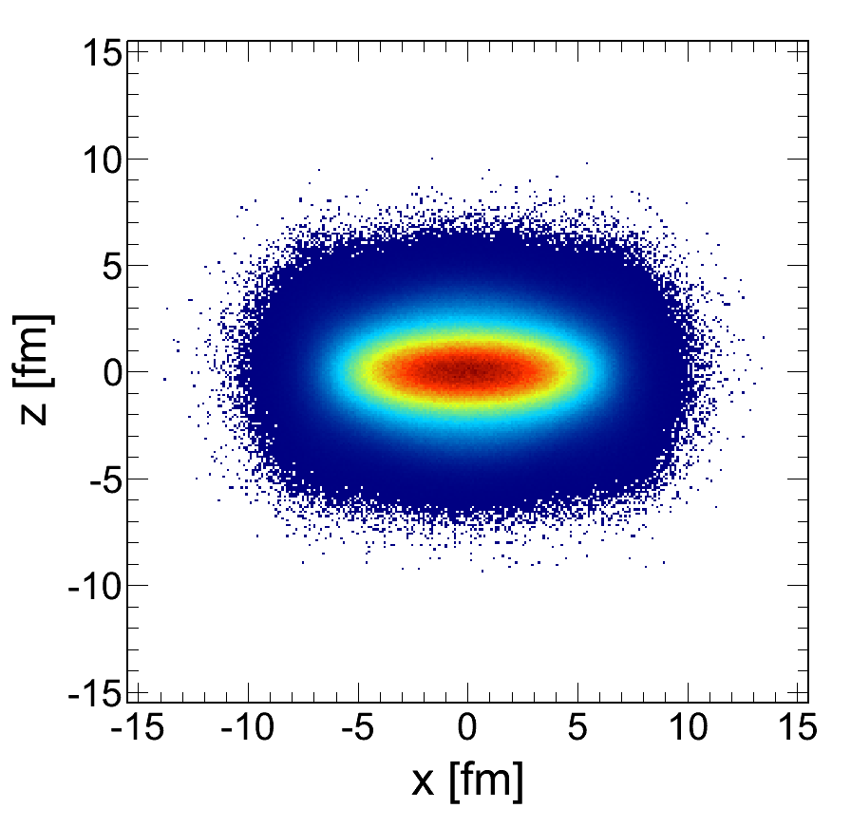
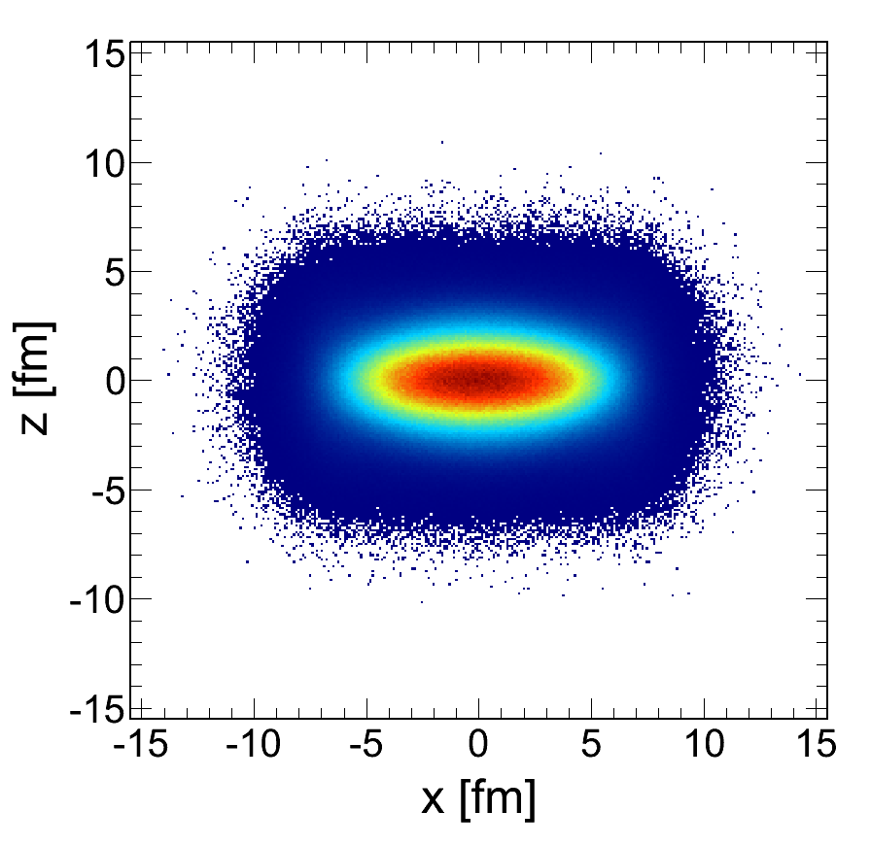

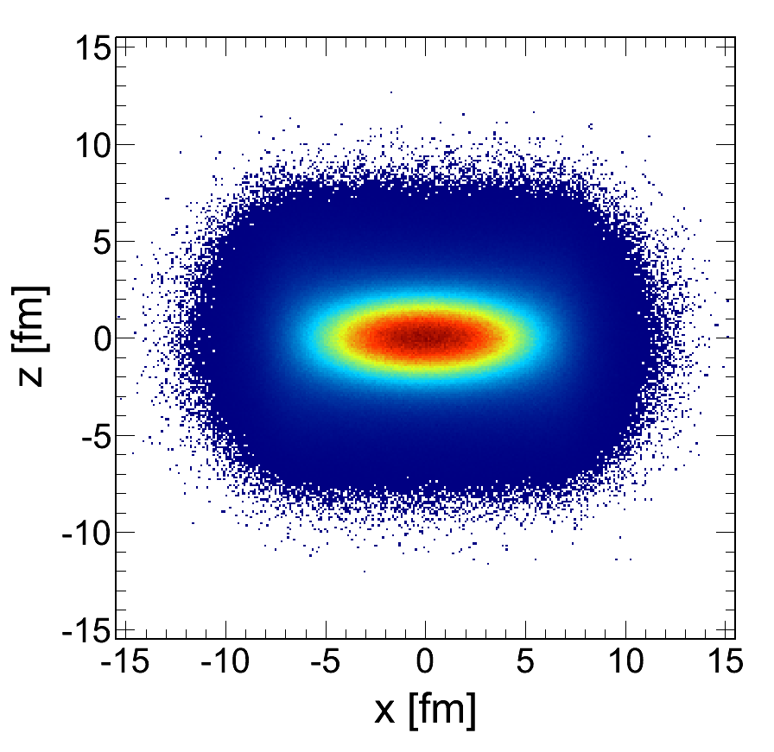
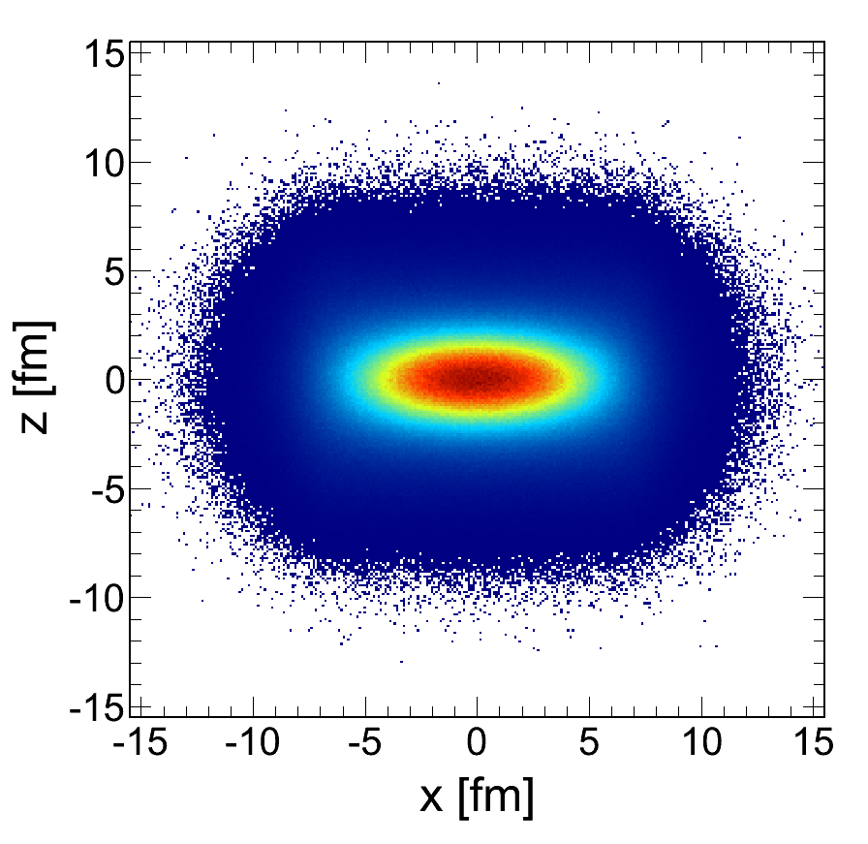
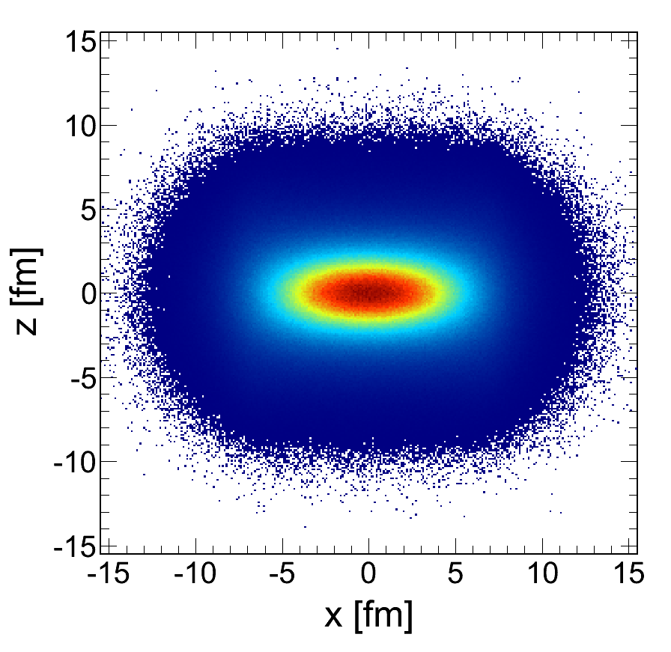
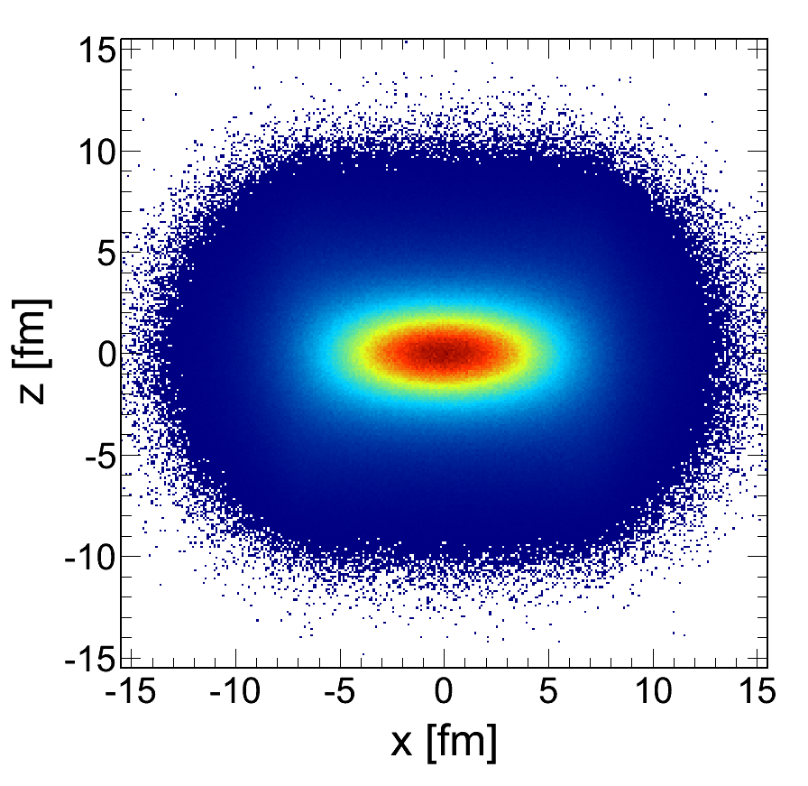
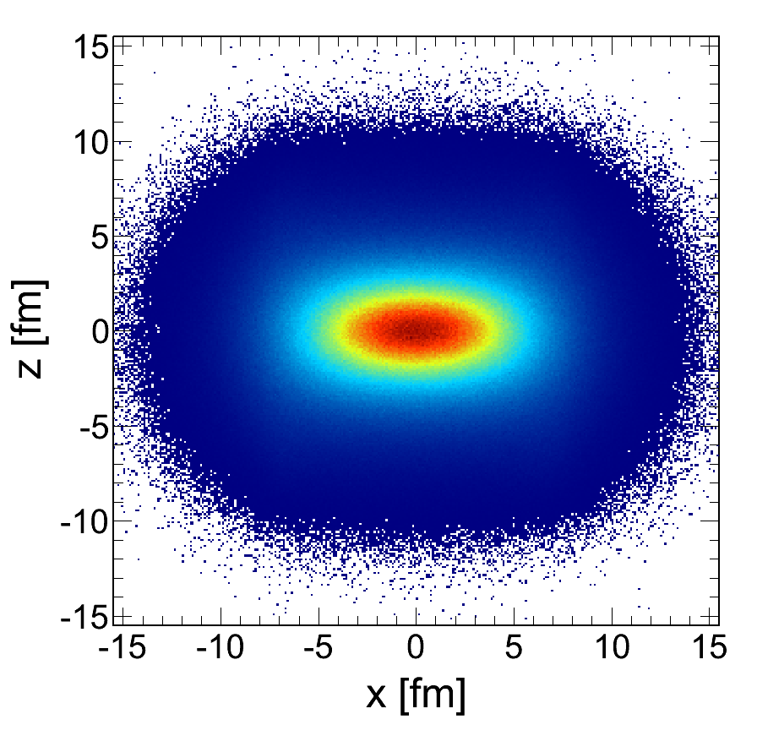
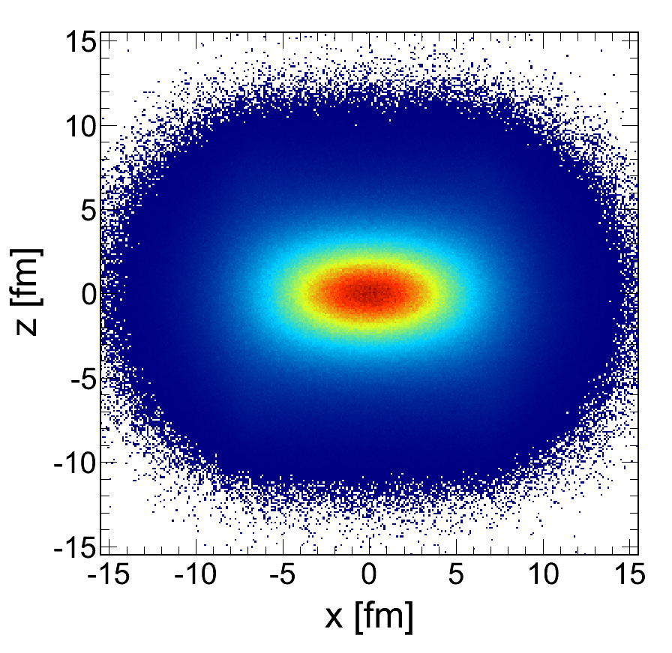
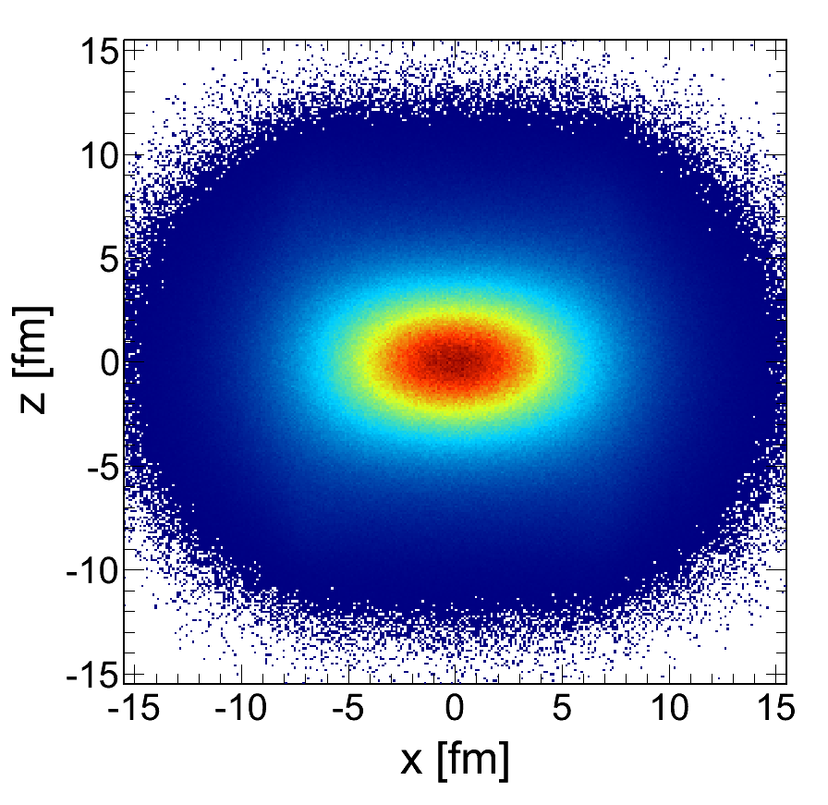
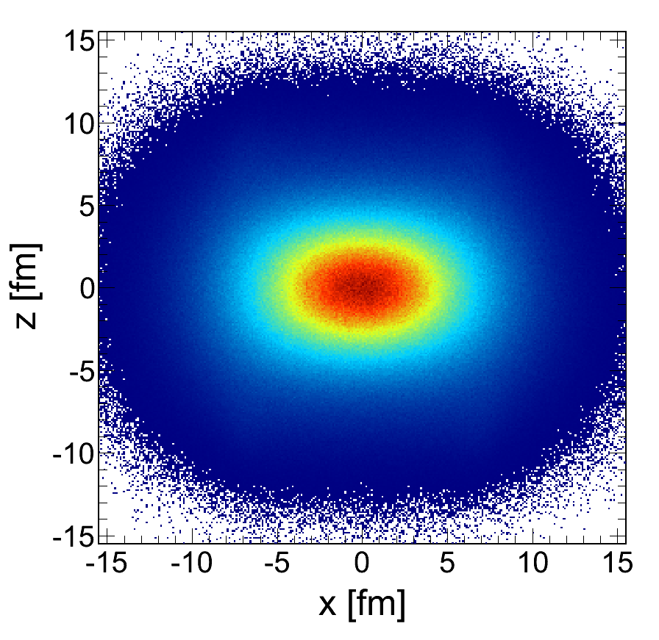
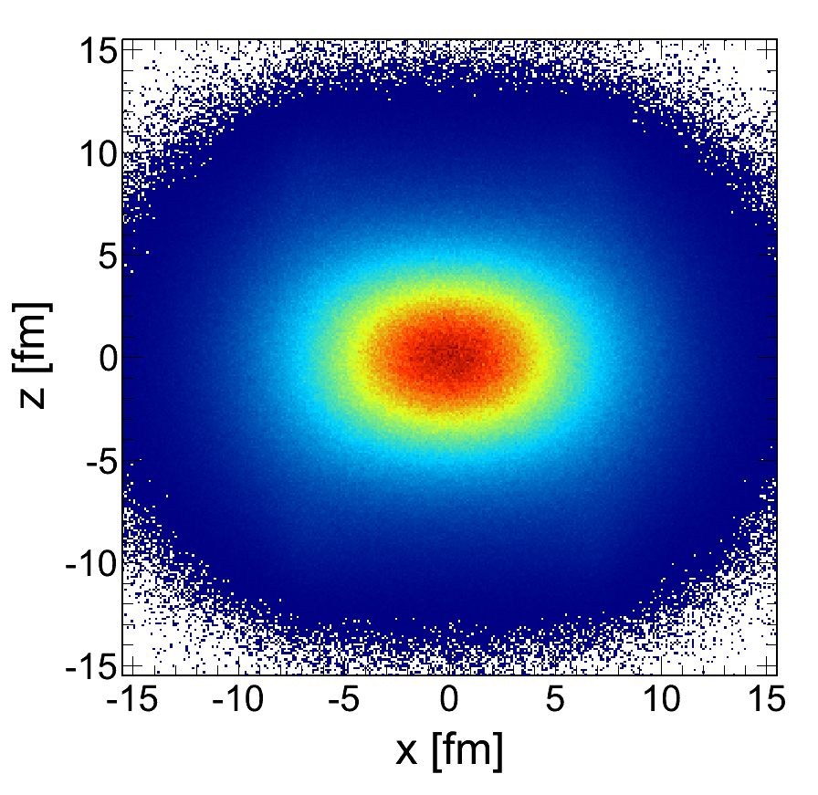
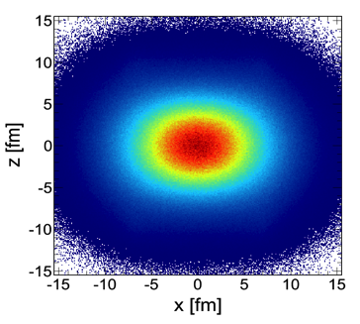
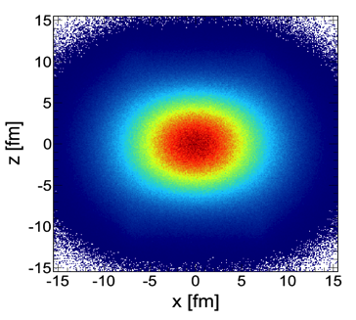
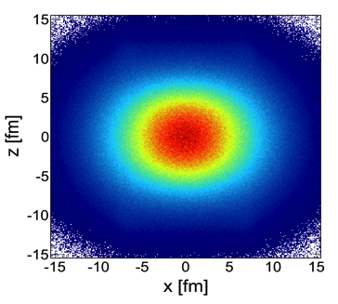
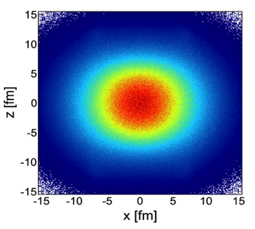
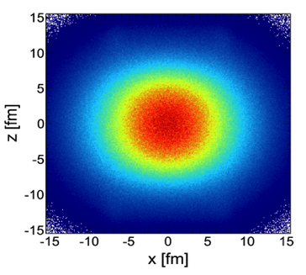
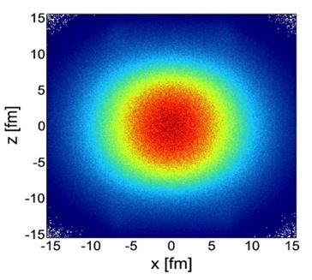
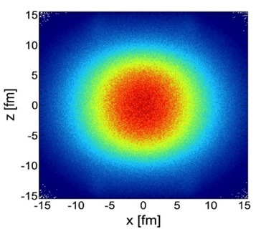
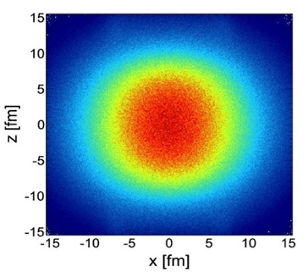
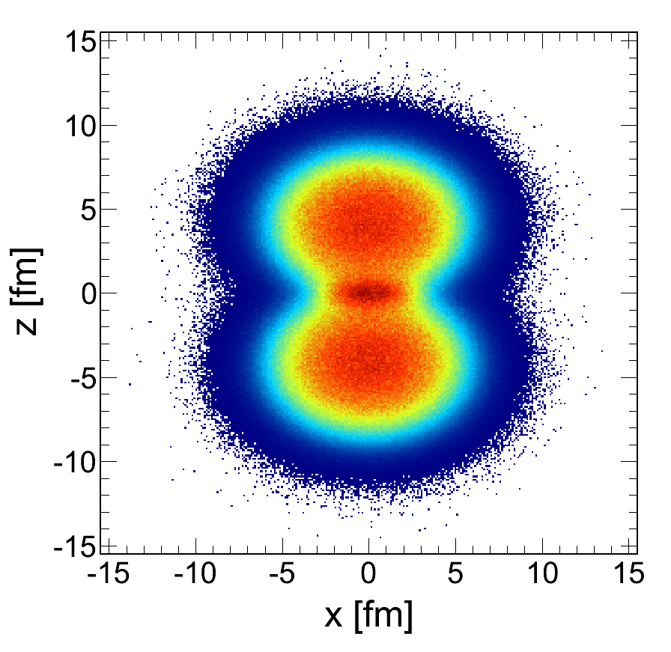
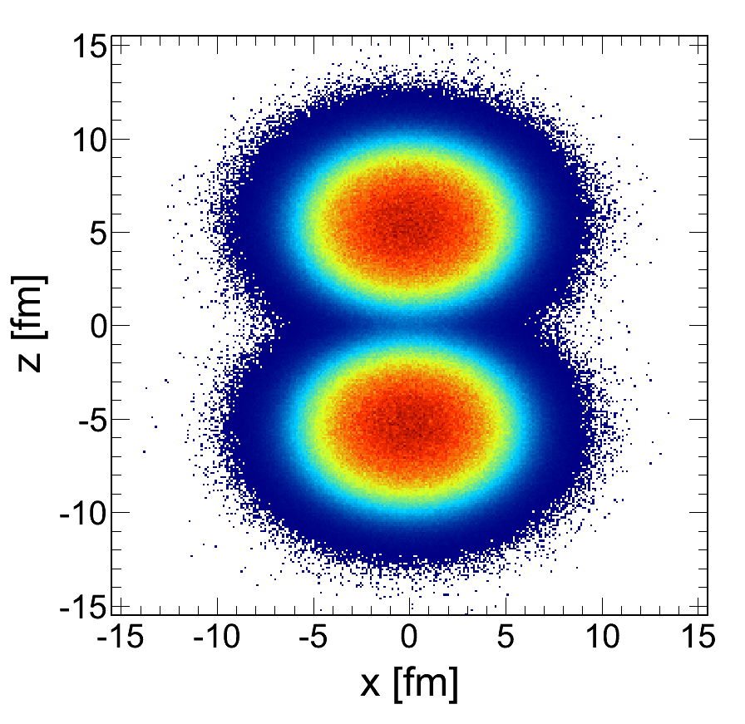



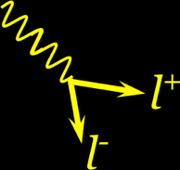

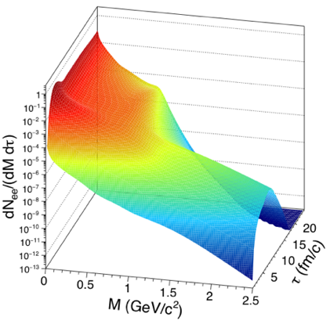



Slide 5

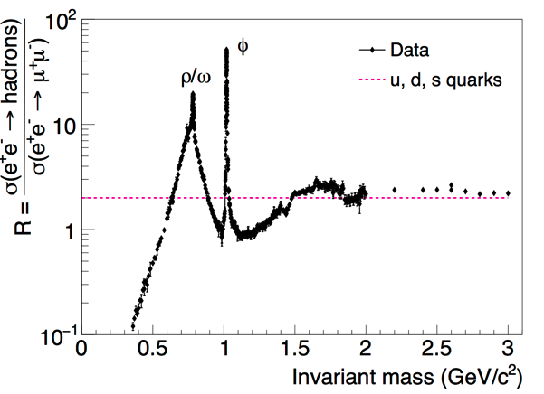









If thermal dilepton emission will follow a Bose distribution
Dileptons as thermometer

Slide 6

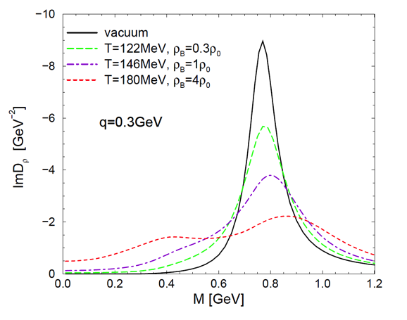



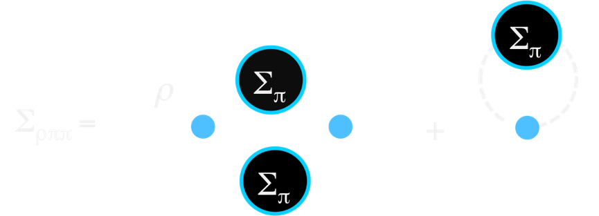






Slide 7
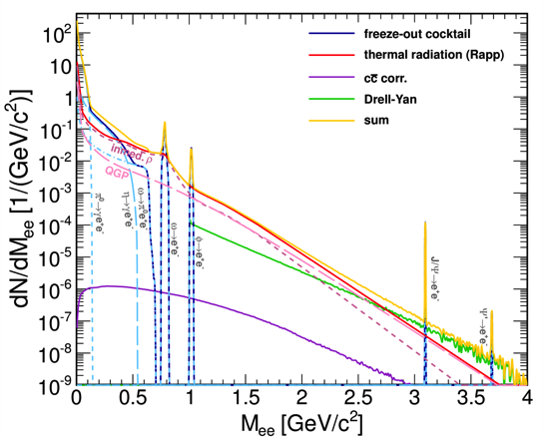
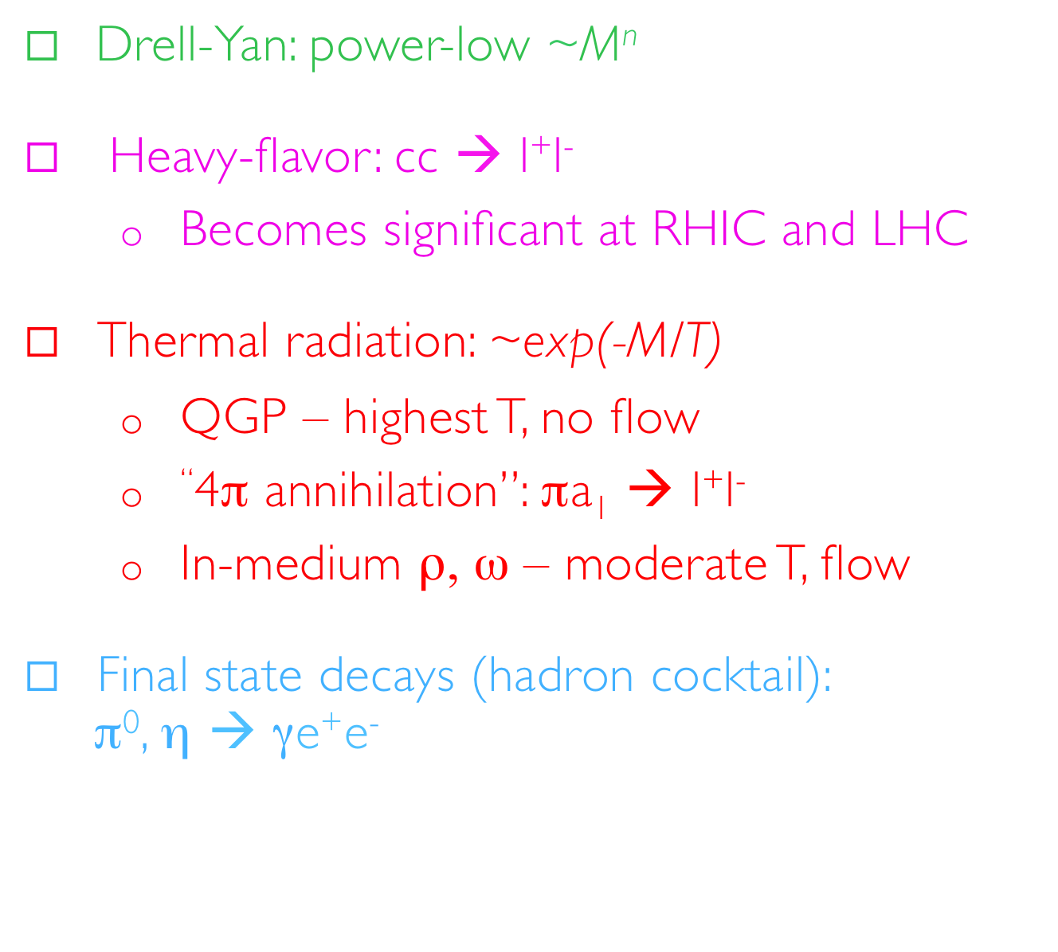


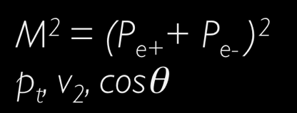


Slide 8
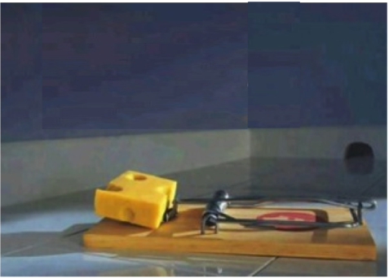
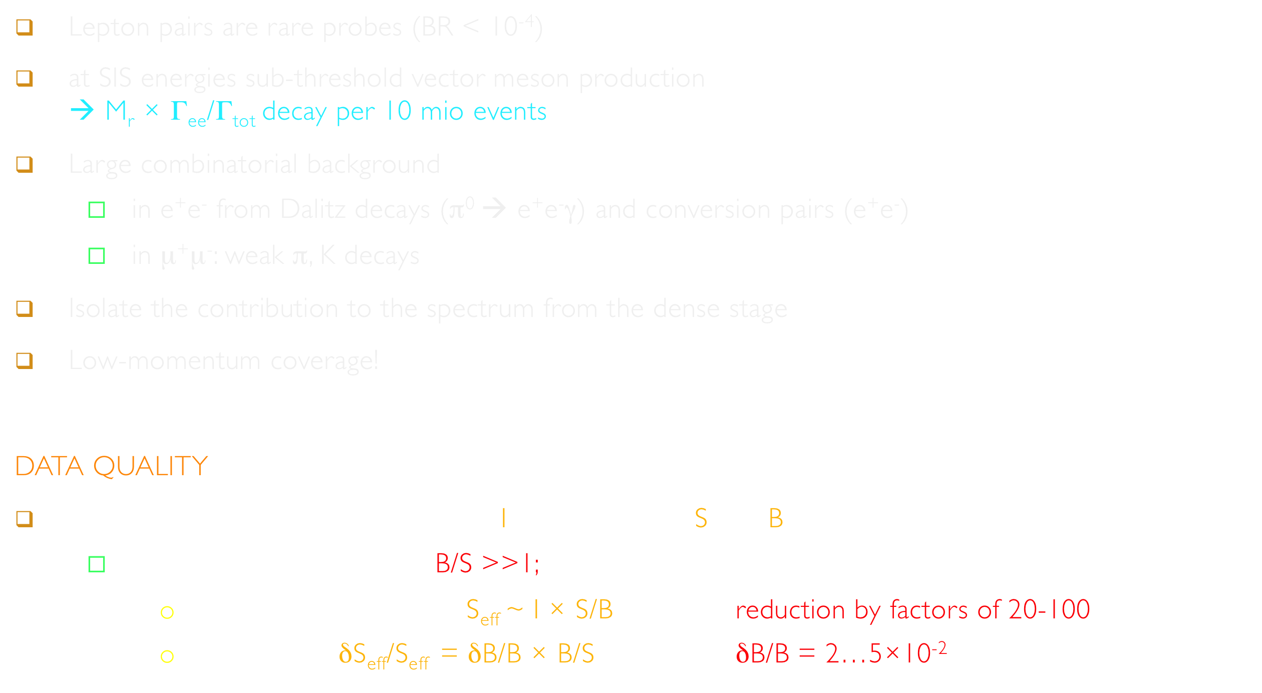


Lepton pairs are rare probes (BR < 10⁻⁴)
at SIS energies sub-threshold vector meson production
→ M_{r} × Γ_{ee}/Γ_{tot} decay per 10 mio events
Large combinatorial background
  in e⁺e⁻ from Dalitz decays (π⁰ → e⁺e⁻γ) and conversion pairs (e⁺e⁻)
  in μ⁺μ⁻: weak π, K decays
Isolate the contribution to the spectrum from the dense stage
Low-momentum coverage!
DATA QUALITY
The decisive parameters: Number of Interactions and Signal/Background
  Range of B/S: 20 - 100 → B/S >>1;
    Effective sample size: S_{eff} ~ I × S/B reduction by factors of 20-100
    Systematics: δS_{eff}/S_{eff} = δB/B × B/S δB/B = 2…5×10⁻²

Slide 9
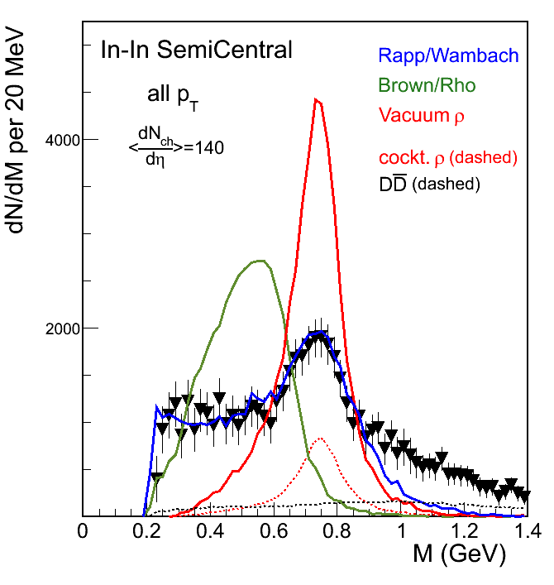



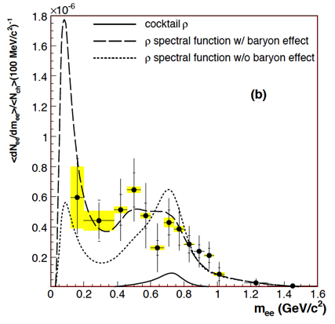
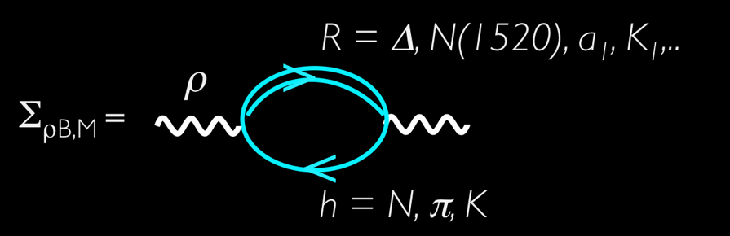


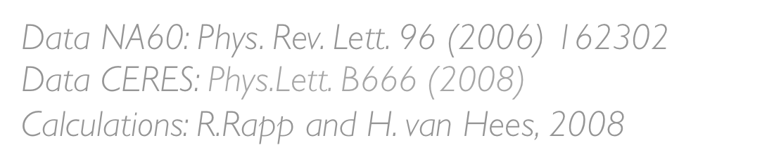


Slide 10





Slide 11

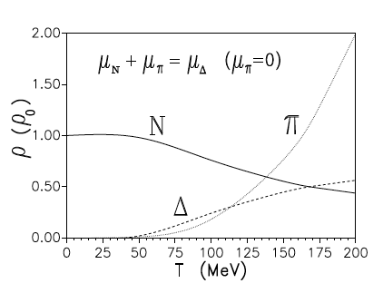
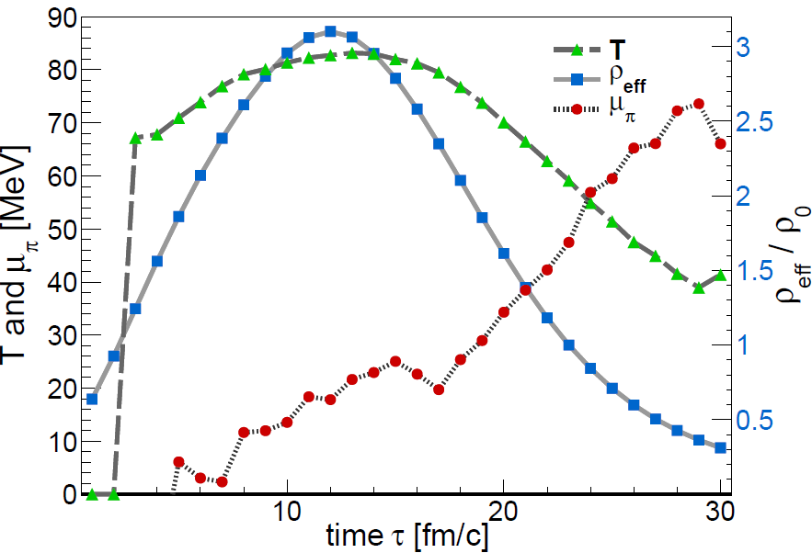






Slide 12











e⁺
e ⁻
Divide space-time evolution into 4-dimensional cells
21 x 21 x 21 space cells (1fm³), 30 time steps → ~ 280 k cells
Determine for each cell the bulk properties like T, μ_{B} , μ_{π},
collective velocity
Apply in-medium ρ & ω spectral functions to compute
EM emission rates
→ parameterization of RW in-medium spectral function
Sum up contributions of all cells

Slide 13








Robust understanding across QCD phase diagram

Slide 14













Slide 15












Slide 16










System size dependence of excess
“R-clock”
Preliminary
Rapid increase of relative yield reflect the number of ρ‘s / R’s regenerated in fireball

Slide 17









Slide 18







“M_{ll} is the only Lorenz-invariant thermometer of the field”

Slide 19







Slide 20





Slide 21





What are the possible signatures in dilepton radiation?

Slide 22






Slide 23





Slide 24





Slide 25



“You may say I’m a dreamer…
but I’m not the only one”
 |  | 2016 | 2017 | 2018 | 2019 | 2020 | 2021 | 2022 | 2023 |  | 2024 |  | 2025
HADES | SIS18 |  |  | 2.5 GeV + pA, pA
STAR BES | RHIC |  |  |  | 8 – 20 GeV |  |  | 200 GeV
MPD | NICA |  |  |  | 4 – 11 GeV
CBM | SIS100 |  |  |  |  |  |  |  |  |  |  | 2 – 5 GeV
ALICE* | LHC | 5.5 TeV |  |  |  |  | 5.5 TeV
 | J-PARC** |  |  | pA 8 GeV |  |  |  |  |  |  |  | 2 – 5 GeV
NA60+ | SPS |  | LOI |  |  |  |  |  | 6 – 17 GeV
PHENIX | RHIC | 200 GeV
STAR | RHIC | 200 GeV | pp(500)
sPHENIX |  |  |  |  |  |  |  | 200 GeV
BM@N | Nuclotron |  | 2 – 3 GeV
* - ITS, 50kHz, lower field
** - Proposal to J-PARC → If approved, construction of HI injector and detectors in 10 years ?

Slide 26









Slide 27





Résumé and prospects
Thank you
for your attention!

Slide 28


There is a power that can take away life,
but never the memory of friends

Slide 29


Slide 30















Slide 31




Slide 32




Slide 33






Slide 34










Chemical freeze-out from measured particle yields analyzed with SHM
  Trajectories extracted from inner cube of cells with coarse-grained UrQMD
Time-window of dilepton emission → access to hot and dense stage of the heavy-ion collision
T_{max} = 85 MeV, ρ_{max} = 3 ρ₀
Excitation of the vacuum
(melting of condensate)
matches spectral medium effects!

