Slide 1
CBM Dipole from Technical Design Report (TDR, JINR) to Conceptual Design Review (CDR, BINP)
Gebhard Moritz
CDR meeting
April 24-25 2018
GSI Darmstadt

Slide 2
History CBM Dipole
October 2013: TDR by JINR
October 2016: Contract with BINP for the
Design, production and delivery of the magnet including power converter, feed- and branchbox
Assembly and operation test onsite
Annex 3: Functional specification
Annex 1: Milestones
Conceptual Design Review (A) April 2017
recommendations
Conceptual Design Review (B) April 2018, based on an informal report of February 2018

Slide 3
CBM Dipole – main parameters
Opening angle: ±25° vertically, ± 30° horizontally from the target
Free aperture: 1.44 m vertically x 3.0 m horizontally
Distance target- magnet end: 1m (STS detector)
Field integral within STS detector (along straight lines): 1 Tm
Field integral variation over the whole opening angle along straight lines: ≤ 20% (± 10%)
Fringe field downstream < reasonable value of the order of 50 to 100 Gauss at the position of the first RICH box.
Operates at both polarities
100% duty cycle, 3 months/year, 20 years
1 hour up/down ramp

Slide 4
CBM dipole- general view
TDR
CDR
based on the design of the SAMURAI dipole at RIKEN

Slide 5
CBM dipole – conductor (highly stabilized by copper)
TDR
CDR
CMS- ‚wire- in- channel‘
Cu to SC: 9:1
Co-extrusion
Cu to SC: 7.4

Slide 6
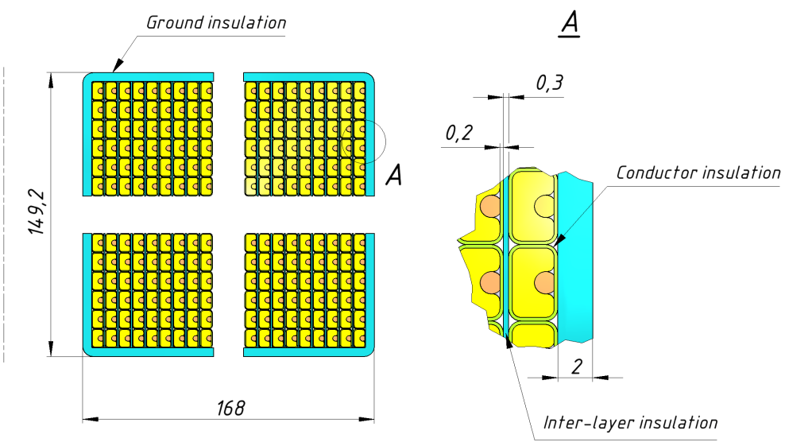
CBM dipole - coil
TDR
CDR
cross section ‚identical‘
no splice
one splice, unit length 5 km
number of layers: 53
number of turns per layer: 33
number of turns per pole: 1749

Slide 7
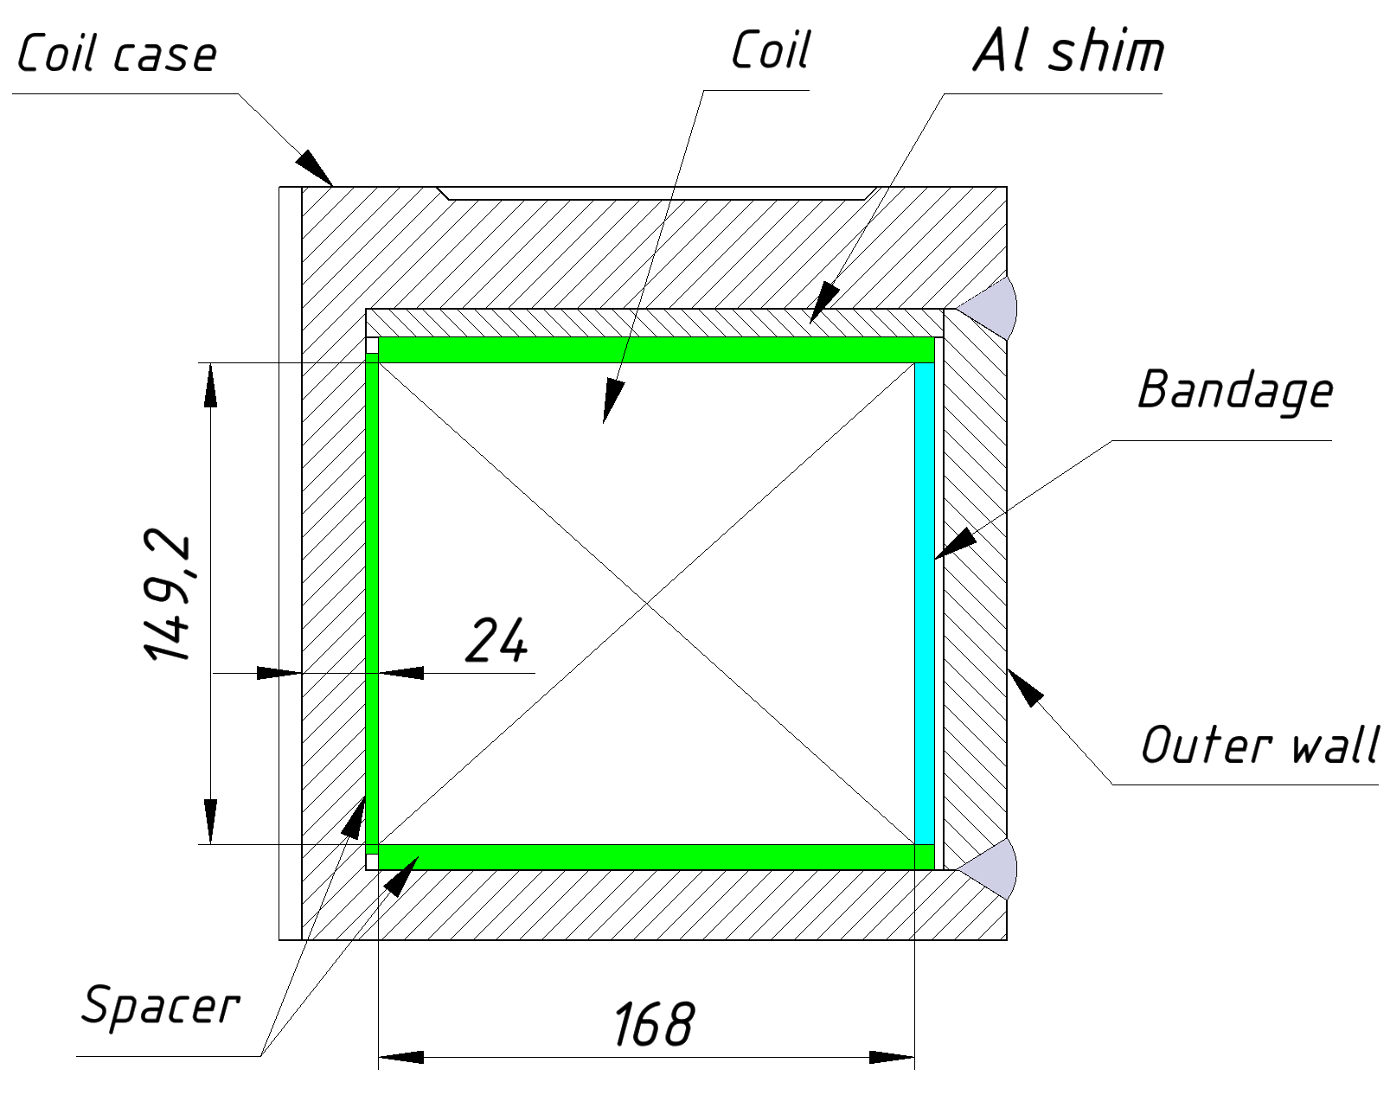
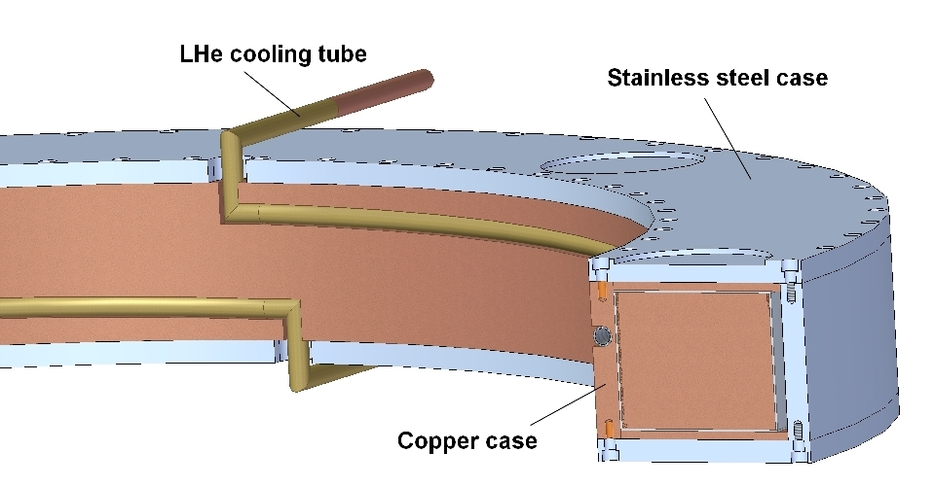
CBM dipole – coil-structure
TDR
CDR
Stainless steel mandrel
Stainless steel coil casing
direct cooling through channels
wet winding
prestress applied
Copper mandrel U profile
Stainless steel U profile
indirect cooling
vacuum impregnation (epoxy with filler)
no prestress applied
very different !!!

Slide 8
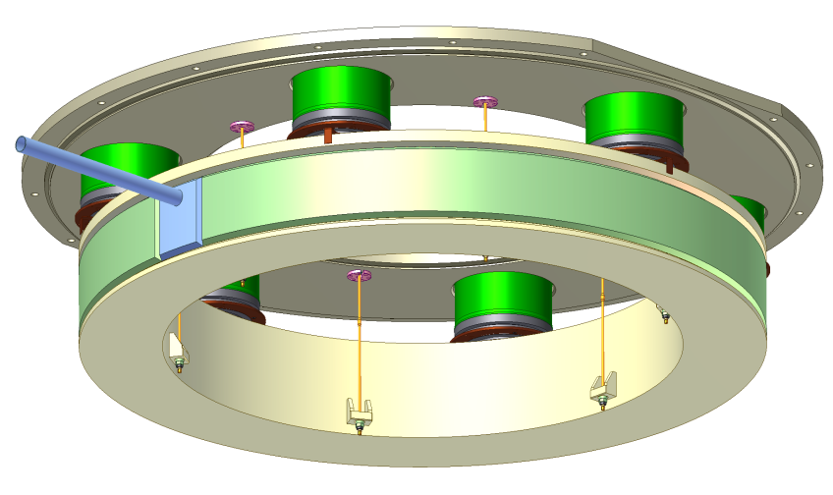
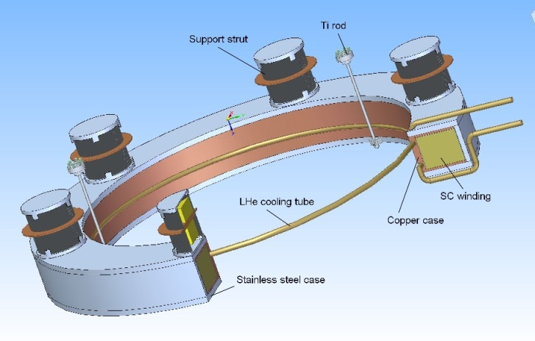
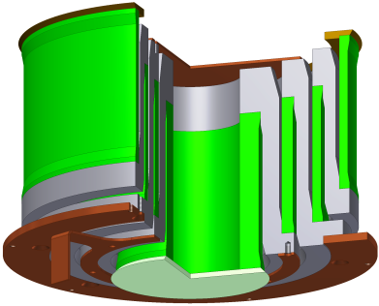
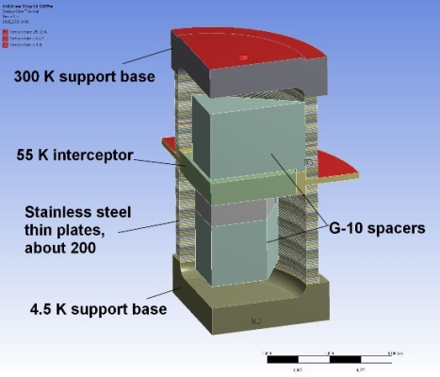
CBM dipole- coil cryostat
TDR
CDR
SAMURAI proven design

Slide 9
CBM dipole - cooling
TDR
CDR
bath cooling, direct
large helium volume
heat load (4.5K) per coil (preliminary): 5 W
two cryogenic circuits (one per coil)
thermosyphon, indirect
small helium volume
heat load (4.5K) per coil (preliminary): 4 W
eddy current loss in one copper U profile during the ramp: 4.5 W
one cryogenic circuit

Slide 10
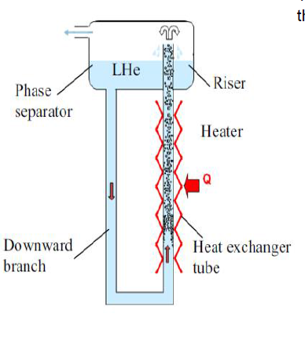
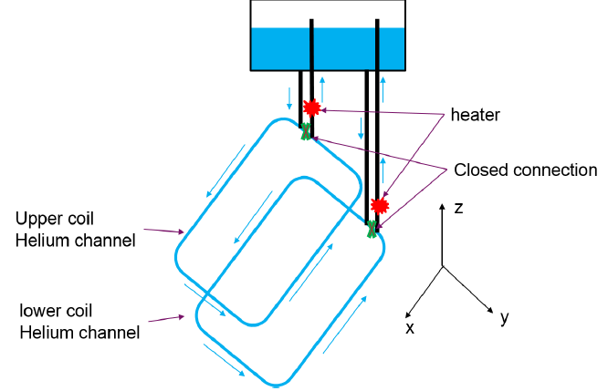
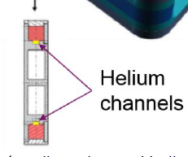
CBM dipole – thermosyphon cooling
refer to Super-FRS dipole cooling, by Hervé Allain et al., IRFU

Slide 11
CBM dipole - stability
Main sources of instability:
energy release by epoxy cracking
energy release by conductor movement (friction)
Consequences:
make MQE large: 7.9 mJ (calculated by BINP)
avoid even the smallest mechanical movement under magnetic forces < 10µm !!)
avoid cracking of organic materials (small epoxy volumes, no tensile stress)
avoid stick slip motion at interfaces
pre-load the winding so that it stays under compression at low temperatures
pay careful attention to the mechanical design of the supporting structure and differential thermal contraction
careful structural analysis

Slide 12
CBM dipole - quench
TDR
CDR
self- protecting magnet
3D calculations (CIEMAT, GSI)
Hot spot temperature < 160 K
Quench voltage Vq =1200 V
one protection system systems including quench detector, breaker and dump resistor.
self-protecting magnet with requested
Hot spot temperature <200 K
Quench voltage V_{q} <1200 V
relevant conductor/coil parameter identical to TDR -> same results
additional coupled circuit (copper case)
two fully independent protection systems including quench detector, breakers and dump resistors.

Slide 13
CBM dipole – leads, busbars
TDR
CDR
direct cooling
standard copper leads
indirect cooling
HTS leads (to be designed)
busbars (to be designed)

Slide 14
CBM dipole – recommendations after the first CDR 5/2017
Recommendation 3 (controversial)
A particular feature of this magnet is that the coil has to slide during the energization against the fixed supporting plate. This generates energy release possibly inducing unwanted quenches. Considering that a similar magnet (SAMURAI) is operating successfully with coils immerged in a helium bath we recommend the same principles for the CBM dipole (including highly conductive plates) in order to reduce the technical risk. Therefore we strongly recommend a helium bath cooling.
Recommendation 4 (controversial)
For the coils we recommend two independent cooling circuits in parallel.

Slide 15
CBM dipole -comments/questions/concerns
Stefania Farinon made 3D ANSYS calculations (refer to indico: material).
comments:
1. I strongly suggest including in the structural analysis the force distribution coming from the electromagnetic analysis. A uniform distribution leads to an underestimation of stresses and strains.
2. Despite the fact that, in a perfectly symmetric system, horizontal forces should be null, in real life horizontal forces will be present and there has to be a mechanical system able to withstand them. You should at least evaluate the effect of a non-perfect positioning of the coil.

Slide 16
CBM dipole -comments/questions/concerns
Comments by P. Fabbricatore, S. Farinon
Struts: all faulty scenarios have been considered leading to a possible tensile load??
coil delamination leading to reduced cooling and conductor movement? thermal contraction coefficient to be measured!
eddy currents in the copper profile (load on the ramp, forces in case of a quench)
coil cooling: heat load of the struts – to be measured!
heat loads generally too optimistic?
material properties ok?
“Samurai magnet cannot be longer considered a reference for CBM magnet design”.

Slide 17
CBM dipole -comments/questions/concerns
Comment by Alain Hervé
topic: Cu channel used as winding mandrel and also as cooling mandrel
the bonding as it is standing on the inner diameter is submitted to tensile stress when energizing the coil. The risk of delamination of mandrel and turns is maybe limited during energization because of the limited value of the applied stress. However, I see a big risk of delaminating this very important bond during cool-down as the cooling circuit has to be kept much cooler than the coil, generating a dangerous gradient.
cooling down from an internal mandrel is not really a recommended design

Slide 18
CBM dipole -comments/questions/concerns
Comment by Alain Hervé
topic: new strut (pillar) design:
difficult to understand its merits.
more information (load, radial rigidity) is needed
perfect symmetry is never guaranteed- deviations have to be accounted for (coil off-centered etc.)

Slide 19
CBM dipole -comments/questions/concerns
Comment by Alain Hervé
topic: Interface between the pillars and the coil structure
The possible sliding of the coil structure will appear between the Cu plate and the SS plate. Therefore
1) there is a risk of stick-slip movement during energizing that could be detrimental to stability because of heat generated by friction and un-controlled eddy currents.
2) there is a high risk of galling with a situation deteriorating with time and the number of cycles.
The introduction of a sliding surface on top of the pillars could mitigate this risk.

Slide 21
Training: what to do and what not to do
Do
use a composite conductor with as much copper as other design constraints allow
allow helium to permeate the winding in direct contact with the conductors
reinforce any resin or other organic material used with a low contraction material such as glass fibre
pre-load the winding so that it stays under compression at low temperatures
coat sliding interfaces with hard low friction materials and ensure they are well cooled
match thermal contractions as closely as possible
support the winding with a rigid structure that doesn't move much under magnetic loading
Don't
allow any possibility of any turn to move under field forces
use large volumes of clear resin or other organic material
use any more resin or other high contraction material than necessary
glue anything directly to the conductor
allow 'stick slip' motion at interfaces, eg where the winding presses against the supporting structure
allow the possibility of tensile or shear failure anywhere in the winding

