Slide 1

Review of SiPM readout circuitry
D. Gascon, S. Gomez (ICCUB)
R. Ballabriga, J. M. Fernandez (CERN)
ICASiPM
14/06/2018

Slide 2
Outlook
Introduction
SiPM electrical parameters
FE circuits stage
ASIC examples
Conclusions

Slide 3
I. Introduction
Many different ASICs
  Many possible classifications as well !
According the input impedance
  Current mode versus voltage mode
According the complexity / functionality
  Pure analogue front-end
    Section III
  Mixed-mode including digitization and readout
    Section IV
According the application
  Many applications: PET, LIDAR, vision, life-sciences, particle physics, astrophysics, etc
  Fast timing is a must in many of them

Slide 4
I. Introduction
Disclaimers: what this talk will not be
  A comprehensive review of SiPM read out chips
    We would need hours !
  How to measure SiPM electrical parameters
    Some references at the end
    Recommendation for model fine tuning and validation:
      Compare measurements to simulations including model of the electronics!
What we will talk about:
  Review SiPM electrical parameters impact on signal shape and readout
  Include effect of load (“amplifier”) input impedance and interconnect
  Review basic input stages and analog signal processing
  Present some examples of ASICs for different applications
    Projects in which I am involved: the ones we know better ☺

Slide 5
Outlook
Introduction
SiPM electrical parameters
FE circuits
ASIC examples
Conclusions

Slide 6
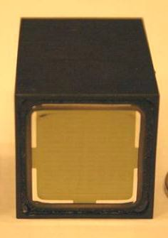
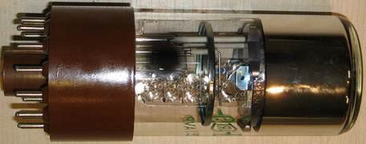
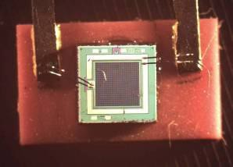

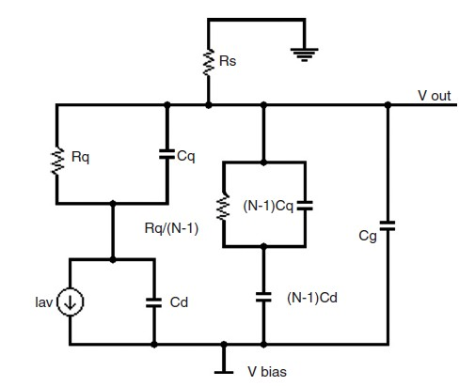
6
II. SiPM electrical model
Vacuum Photomultipliers
G = 10⁵ – 10⁷
Cd ~ 10 pF L ~ 10 nH
Silicon Photomultipliers
G = 10⁵ – 10⁷
C = 10 - 400 pF
L = 1 – 10 nH
L
I in
C d
R_{S}=50 Ω
C. De La Taille, Photodet conference, 2012

Slide 7
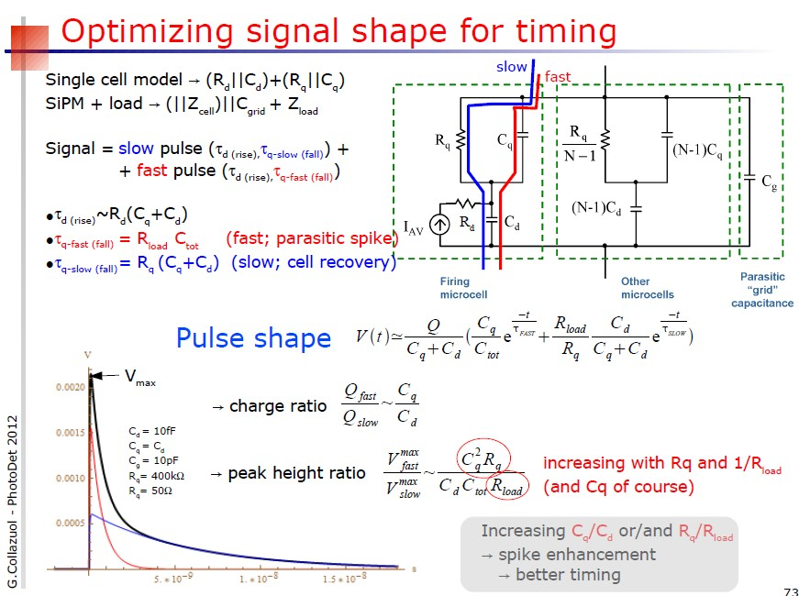
7
II. SiPM electrical model
Peak V/I signal goes with C⁻¹
2) Peak I signal goes with R⁻¹
3) Fast vs slow component

Slide 8
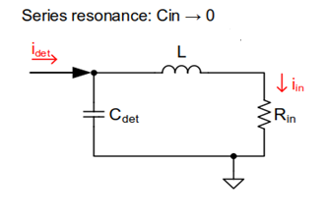
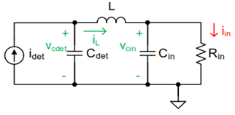
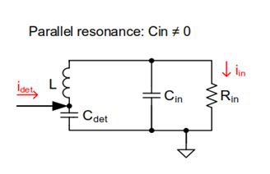
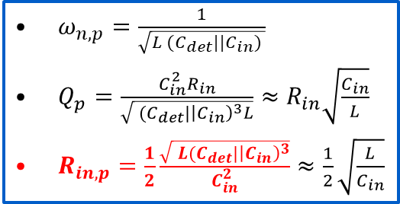
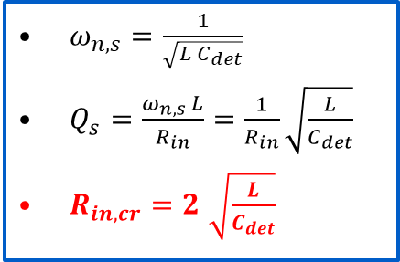
II: Equivalent input network: Series and parallel resonances
Current sensing
2nd order system
$ω_{n,s}=\frac{1}{\sqrt{L{ C}_{det}}}$
$Q_{s}=\frac{ω_{n,s} L}{R_{in}}=\frac{1}{R_{in}}\sqrt{\frac{L}{C_{det}}}$
$R_{in,cr}=2$ $\sqrt{\frac{L}{C_{det}}}$
3nd order system
$ω_{n,p}=\frac{1}{\sqrt{L{ (C}_{det}||C_{in}) }}$
$Q_{p}=\frac{C_{in}^{2}R_{in}}{\sqrt{{ (C}_{det}|{\left|C_{in}\right)}^{3}L}}≈R_{in}\sqrt{\frac{C_{in}}{L}}$
$R_{in,p}=\frac{1}{2}\frac{\sqrt{{ L(C}_{det}|{\left|C_{in}\right)}^{3}}}{C_{in}^{2}}$ $≈\frac{1}{2}\sqrt{\frac{L}{C_{in}}}$
Similar analyses in “Interfacing a SiPM to a Current-mode Front-End, F. Ciciriello et al.”, and “SiPM readout electronics overview, CNRS/IN2P3, C. de la Taille, 2012”
Notes:
The dynamics of the input current are dominated by the parasitic RLC network at the input of the channel.
A simple lumped equivalent model is derived, taking into account:
Detector capacitance.
Wirebond inductance plus inductance from the connections.
Input capacitance (i.e. PAD).
T.L effects not considered!
The goal of this exercise is to see how these parasitics impact the rising edge slope, thus time jitter.
From the results, one can come up with a criteria to select a target input impedance and bandwidth in the design.

Slide 9
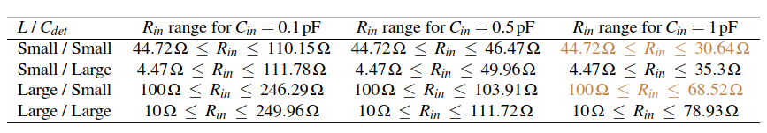
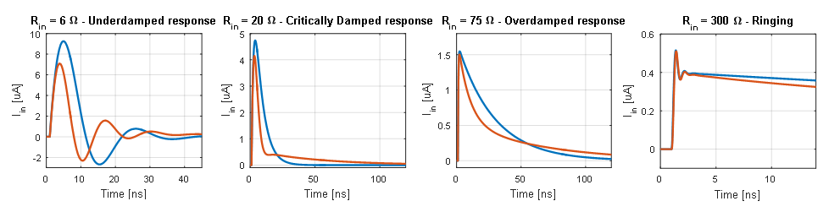
II: Dynamics of the input signal
For oscillation-free input current:
$R_{in,cr}≤R_{in}≤R_{in,p}→2\sqrt{\frac{L}{C_{det}}}≤R_{in}≤\frac{1}{2}\frac{\sqrt{{L(C}_{det}|{\left|C_{in}\right)}^{3}}}{C_{in}^{2}}$ && $C_{det}≥18.7 C_{in}$
Corners: L = 5 nH (Small) / 25 nH (Large), Cdet = 10 pF (Small) / 1 nF (Large)
Oscillatory response:
Below 5 Ω
Above 250 Ω
Example (Cdet = 380 pF, L = 25 nH, Cin = 0.5 pF)
Ipulse||Cdet
SiPM model
Condition for oscillation-free input current also valid for SiPM model!

Slide 10
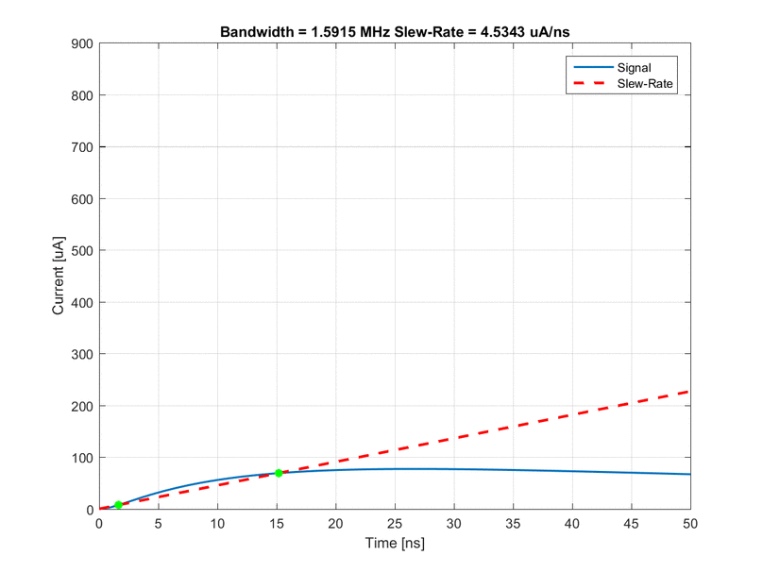
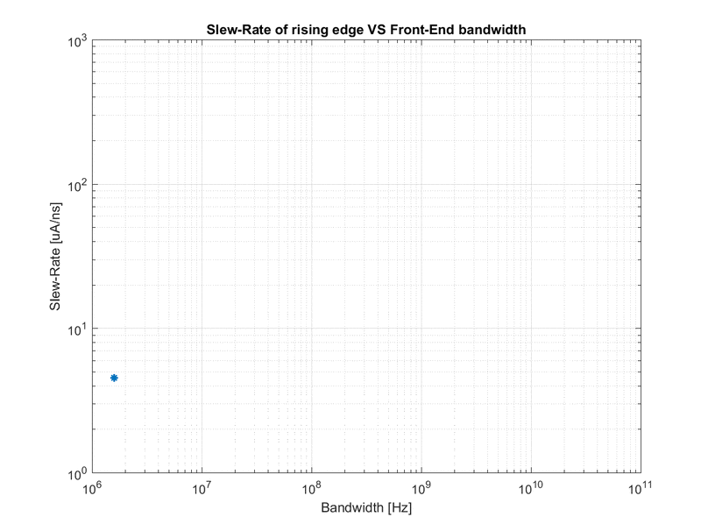
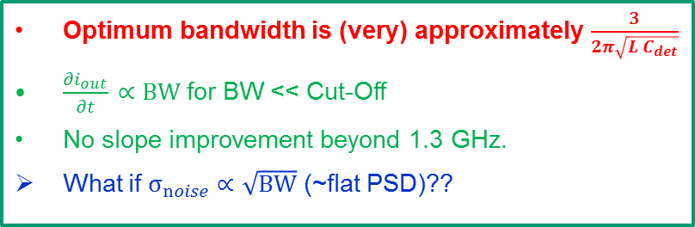



II. Slew-rate degradation with bandwidth in current sensing
Convolution between the input slope and the electronics bandwidth (time domain): $SR=\frac{\text{∂}i_{out}}{\text{∂}t}\text{∝}\left(\frac{\text{∂}i_{in}}{\text{∂}t}\right)∗\left({BW⋅e}^{−t⋅BW} \right)$
$$\frac{∂i_{in}}{∂t}$$
$$\frac{∂i_{out}}{∂t}$$
Optimum bandwidth for connecting inductances 5 nH – 25 nH and Cdet = 10 pF – 1 nF
Lwb / Cdet
5 nH / 10 pF | 5 nH / 1 nF | 25 nH / 10 pF | 25 nH / 1 nF
1.3 GHz | 270 MHz | 560 MHz | 81 MHz
$$\frac{∂i_{out}}{∂t}$$
Optimum bandwidth is (very) approximately $\frac{3}{2π\sqrt{L C_{det}}}$
$\frac{∂i_{out}}{∂t} \text{∝} BW$ for BW << Cut-Off
No slope improvement beyond 1.3 GHz.
What if $σ_{noise} \text{∝ }\sqrt{BW}$ (~flat PSD)??

Slide 11
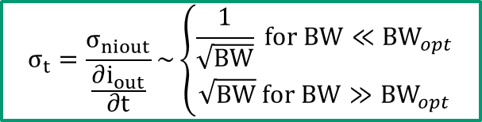
II. Example of Slew-rate versus bandwidth in current sensing (assuming leading edge discrimination)
BW_{opt} between 500 MHz - 1 GHz
BW_{opt} around 1 GHz
$$σ_{t}=\frac{σ_{niout}}{\frac{∂i_{out}}{∂t}}\sim \left\{\begin{aligned}\frac{1}{\sqrt{BW}} for BW≪{BW}_{opt} \\ \sqrt{BW} for BW≫{BW}_{opt}\end{aligned}\right.$$
BW_{opt} around 500 MHz
BW_{opt} around 100 MHz

Slide 12
II. SiPM electrical model
Front end electronics for SiPM is needed to:
  Preamplify for SNR optimization
    Even if “nominal” gain is in the order of 10⁶ only a fraction of the charge is used for fast read-out systems
    The “effective” gain for a fast system can be between 2 and 10 times lower than the nominal gain

Slide 13
Outlook
Introduction
SiPM electrical parameters
FE circuits
ASIC examples
Conclusions

Slide 14
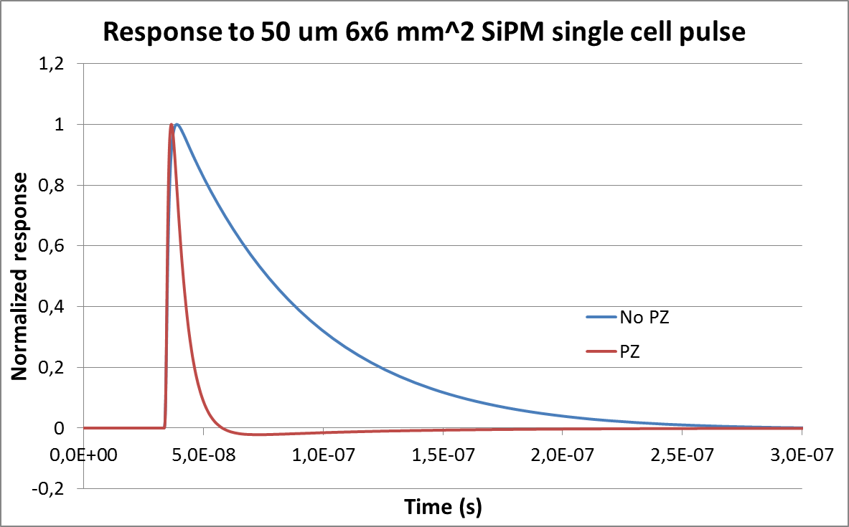
III. FE circuits: Pole-Zero cancellation
14
Pole-Zero (PZ) cancellation of the SiPM recovery long time constant (τ_{slow})
The PZ shaping has an effect in the signal to noise ratio (SNR)
  A SNR>5 is required for photopeak identification
  Can be seen in 2 different ways:
    Attenuation of slow frequency components of the signal
    Increase of the input referred noise (ENC=Equivalent Noise Charge)
Simulation with a model obtained from 3x3 mm device

Slide 15
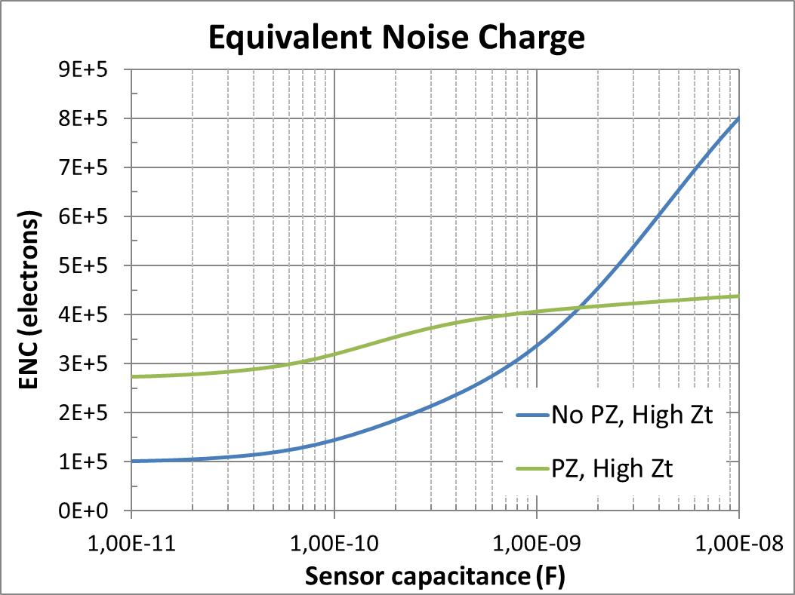
II FE circuits: effect of capacitance and shaping in noise
Front end electronics for SiPM is needed to:
  Low noise front end is required for large SiPMs
    SiPM capacitances range from 10s pF to more than several nF
  Series noise < 2 nV/sqrt(Hz)
  Parallel noise < 20 pA/sqrt(Hz)
ENC_{max} for SNR>5 @ 2*10⁶ nominal gain
ENC_{max} for SNR>5 @ 1*10⁶ nominal gain

Slide 16
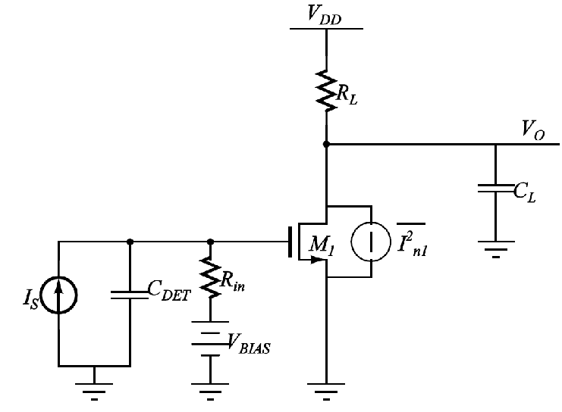
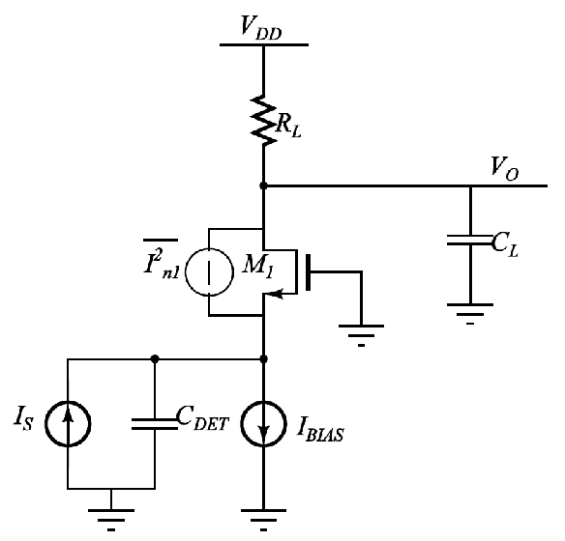
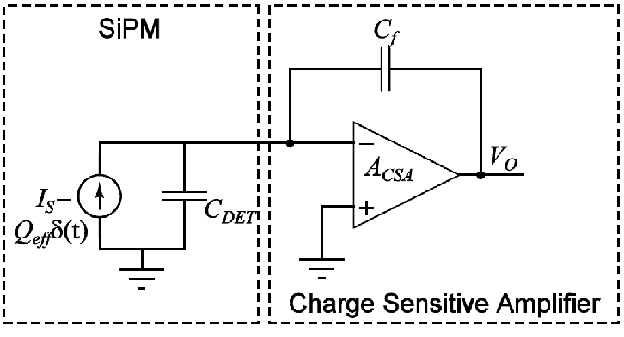
III. FE circuits: current versus voltage mode
Typical photo-sensor front end circuit configurations:
Charge preamplifier
Current preamplifier
Voltage preamplifier
Best noise performance
Best with short signals
  Long tails: pile-up!
  Need to discharge Cf
Best with small capacitance
  BW=Cf/Cdet*GBW, with Cf<<Cdet typically…
E.g. common-emitter/source configuration
Large Zin // Large Zout
Current conversion with Rin
High power budget for high speed systems
But can exploit RF technologies
E.g. (super) common-base/gate
Low Zin // Large Zout
Current conversion with Rin
Potential stability issues
Best for high rate applications
Good power/BW trade-offº
F. Ciciriello et alt., "Time performance of voltage-mode vs current-mode readouts for SiPM's," IWASI, 2015

Slide 17
III. FE circuits: MUSIC: Multipurpose SiPM RO chip
MUSIC: current mode, analog (binary) and designed for astroparticle (CTA) but multipurpose
  Amplification / impedance adaptation
  Pole zero cancellation
  Summation
  Discrimination

Slide 18
III. FE circuits: MUSIC: Multipurpose SiPM RO chip
Possible to disable each input reducing overvoltage to Va_off.
Double feedback loop
  Low input impedance
  Anode voltage control
High bandwith
  Series noise < 2 nV/sqrt(Hz)
  Parallel noise < 20 pA/sqrt(Hz)

Slide 19
III. FE circuits: MUSIC: Multipurpose SiPM RO chip
MUSIC 8 ch ASIC integrates all those functionalities
Individual channel amplification with adjustable pole-zero cancellation (analog)
Possible application: CTA SSTs

Slide 20
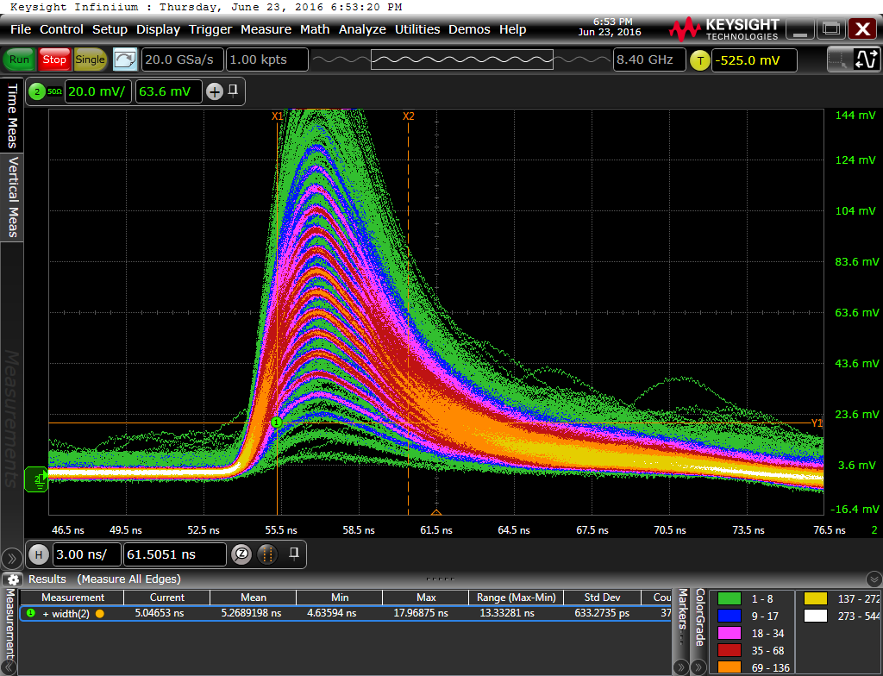
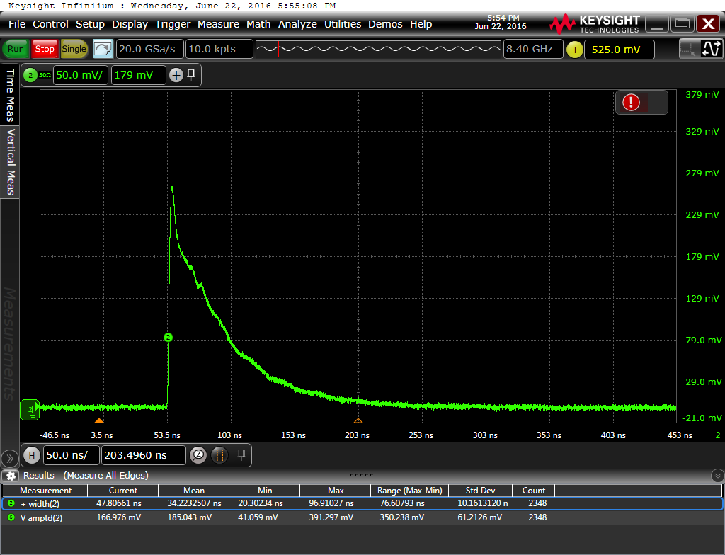
III. FE circuits: MUSIC: Multipurpose SiPM RO chip
20
Output for a LCT4 MPPC ( 3x3 mm²)
No Pole Zero FWHM = 100ns
Pole Zero FWHM ≈ 6ns

Slide 21
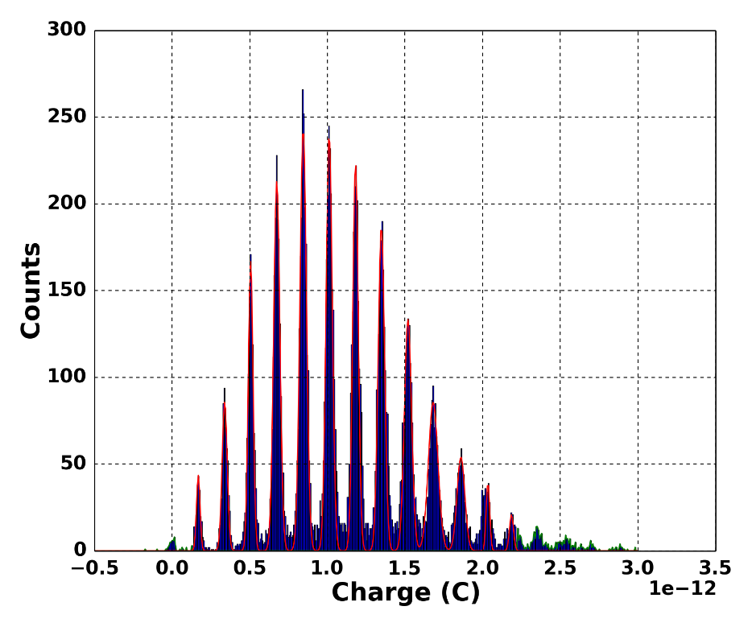
III. FE circuits: MUSIC: Multipurpose SiPM RO chip
21
Charge spectrum for a LCT4 MPPC ( 3x3 mm²)
Pole-zero cancellation
Excellent resolution with FWHM of 5 ns

Slide 22
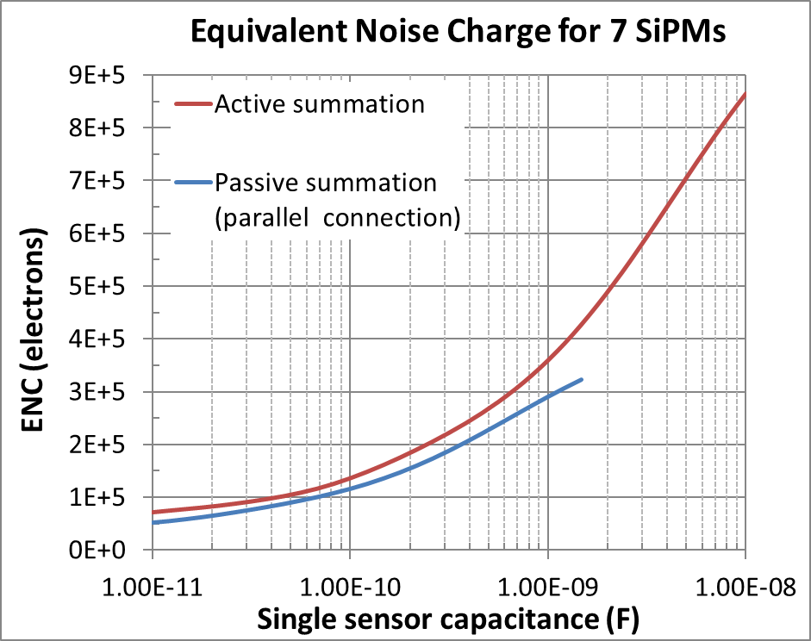

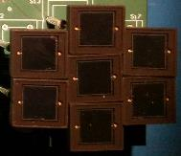

III. FE circuits: MUSIC: Multipurpose SiPM RO chip
Active summation to build large area detectors
Why active summation?
  Total noise for active and passive summation can be similar
    If series noise dominates…
  But signal (peak) is much higher !
    Provided high summation BW
  Series noise < 2 nV/sqrt(Hz)
  Parallel noise < 20 pA/sqrt(Hz)
7 x SIPM
6x6 mm² each
1 x PMT
18 mm diameter
$$≈$$
*7x7mm² and some custom larger SiPMs exist

Slide 23
III. FE circuits: MUSIC: Multipurpose SiPM RO chip
MUSIC 8 ch ASIC integrates all those functionalities
Summation of 1 to 8 channels with double gain (high dynamic range) and tunable pole-zero cancellation
Possible application: CTA LSTs and MSTs

Slide 24
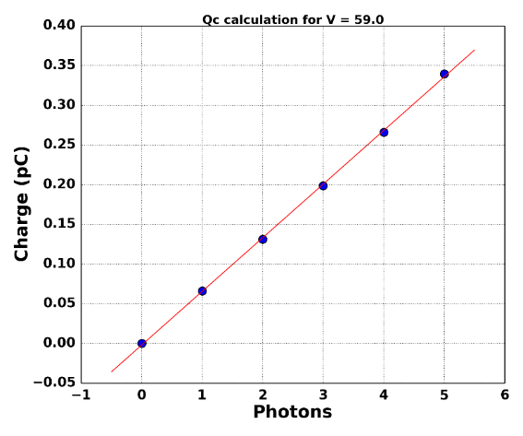
III. FE circuits: MUSIC: Multipurpose SiPM RO chip
24
MUSIC configuration: the adder takes only 1 channel
  Pole-zero cancellation: trade-off between resolution and speed
  High transimpedance gain (MUSIC)
S13360-6050 SiPM
6x6 mm², 50 um cell
1.2 nF capacitance
4 V overvoltage
S13360-6050 SiPM
6x6 mm², 50 um cell
1.2 nF capacitance
7 V overvoltage

Slide 25
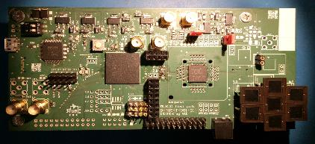
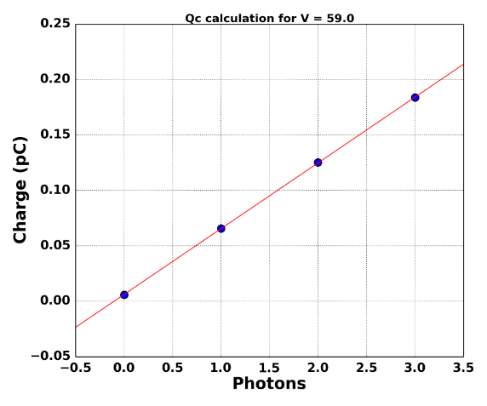

III. FE circuits: MUSIC: Multipurpose SiPM RO chip
25
MUSIC configuration: the adder takes 7 channels
  Noise is much higher (sqtr(7))
  But pe (cell) peaks can still be identified
  Channels have been equalized by MUSIC anode ctrl voltage
S13360-6050 SiPM
6x6 mm², 50 um cell
1.2 nF capacitance
4 V overvoltage
S13360-6050 SiPM
6x6 mm², 50 um cell
1.2 nF capacitance
7 V overvoltage
7 x SIPM
6x6 mm² each
$$≈$$
1 x PMT
18 mm diameter

Slide 26

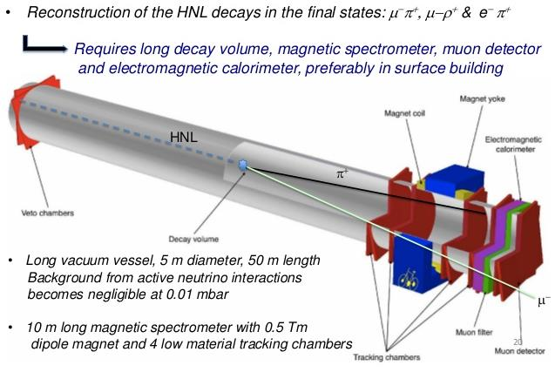
III. FE circuits: MUSIC: Multipurpose SiPM RO chip
SHIP experiment is a new general-purpose beam dump facility at the SPS (CERN) to search for hidden particles
  Predicted by a very large number of recently elaborated models of Hidden
  Dark matter, neutrino oscillations, and the origin of the full baryon asymmetry

Slide 27
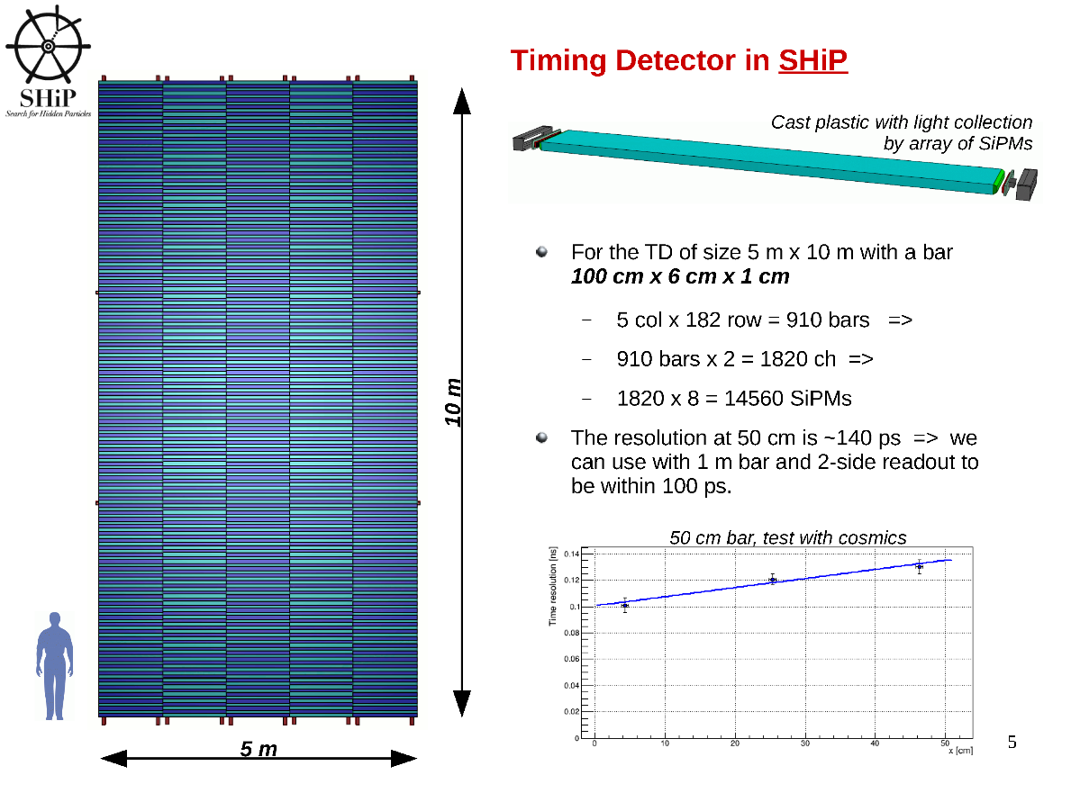
III. FE circuits: MUSIC: Multipurpose SiPM RO chip

Slide 28
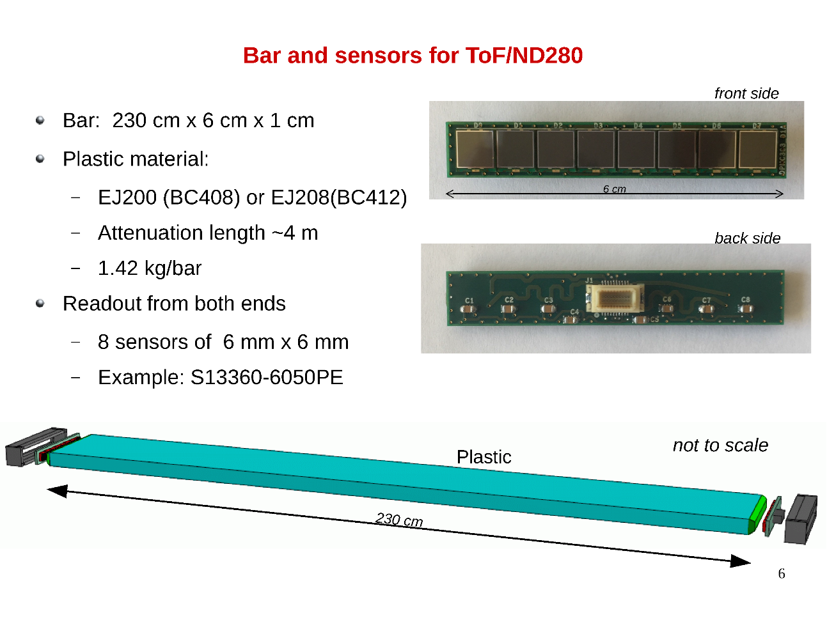
III. FE circuits: MUSIC: Multipurpose SiPM RO chip

Slide 29
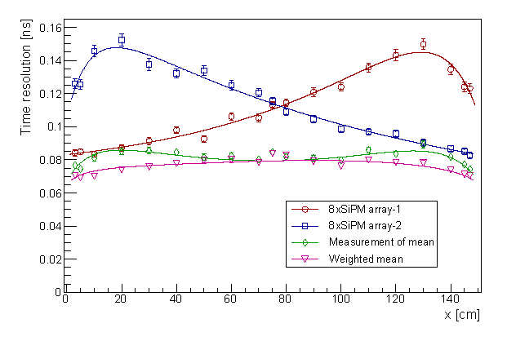
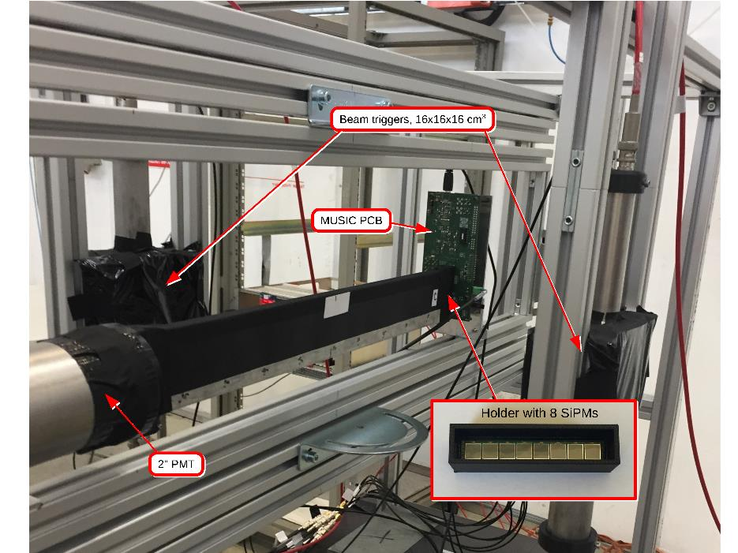
III. FE circuits: MUSIC: Multipurpose SiPM RO chip
Timing sub-detector test beam with MUSIC chip
  By Univ. Geneva & Univ. Zurich
  MUSIC in summation mode (8 6x6 mm^2 SiPMs)
    Bar read-out at both ends
  2.5 GeV/c muon beam at the CERN PS
  Readout with Wavecatcher
    Fast analog memory (LAL & IRFU/CEA)
Resolution < 100 ps
Measurements with the 150 cm x 6 cm x 1 cm bar.
Time resolution as measured by the SiPM arrays at both ends of the bar as a function of the interaction point along the bar.
© A. Kornezev (Univ. Geneva)

Slide 30
Outlook
Introduction
SiPM electrical parameters
FE circuits
ASIC examples
Conclusions

Slide 31

IV. ASICs for HEP: PACIFIC
31

Slide 32
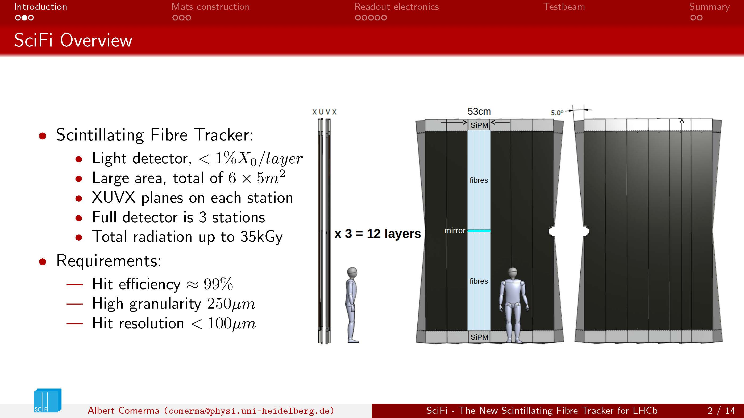
IV. ASICs for HEP: PACIFIC
32

Slide 33
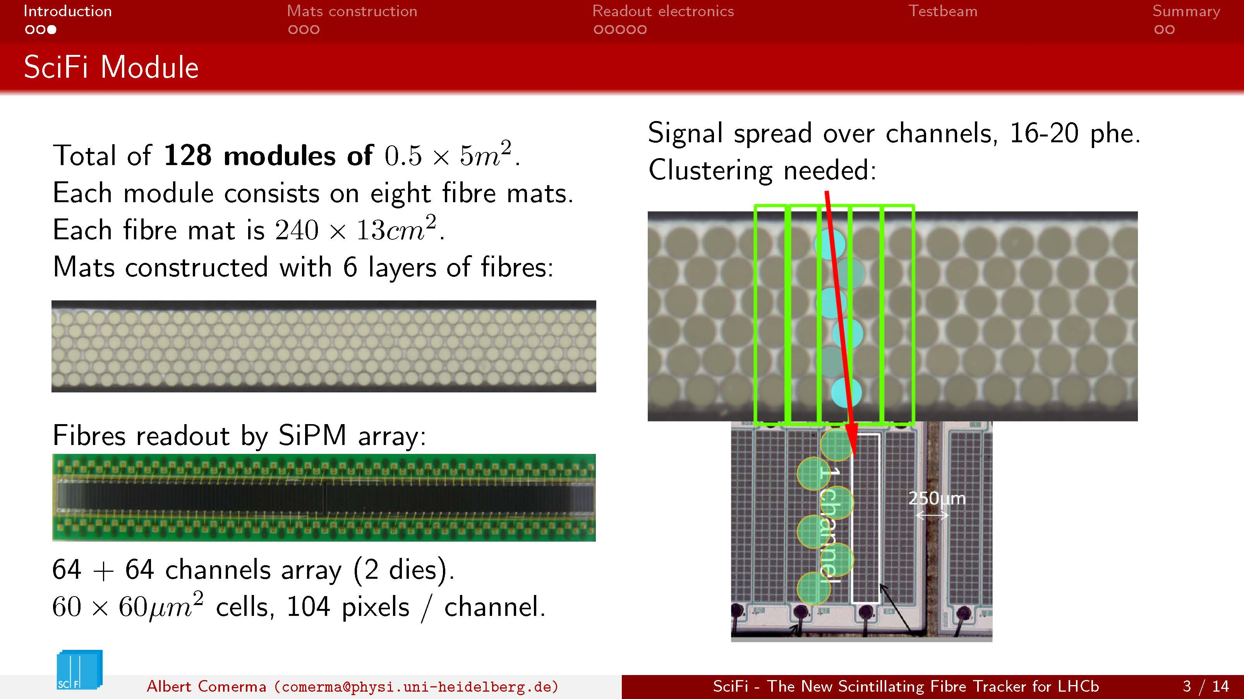
IV. ASICs for HEP: PACIFIC
33

Slide 34
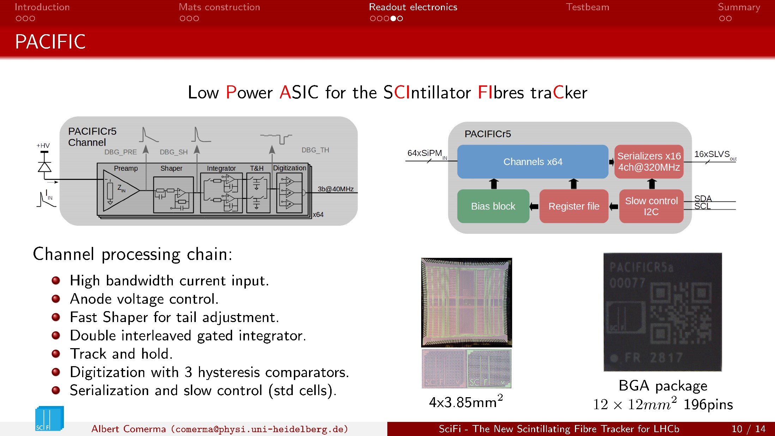
IV. ASICs for HEP: PACIFIC
Collaboration: Heidelberg, ICCUB , LPC-Clermont, IFIC-Valencia
34

Slide 35
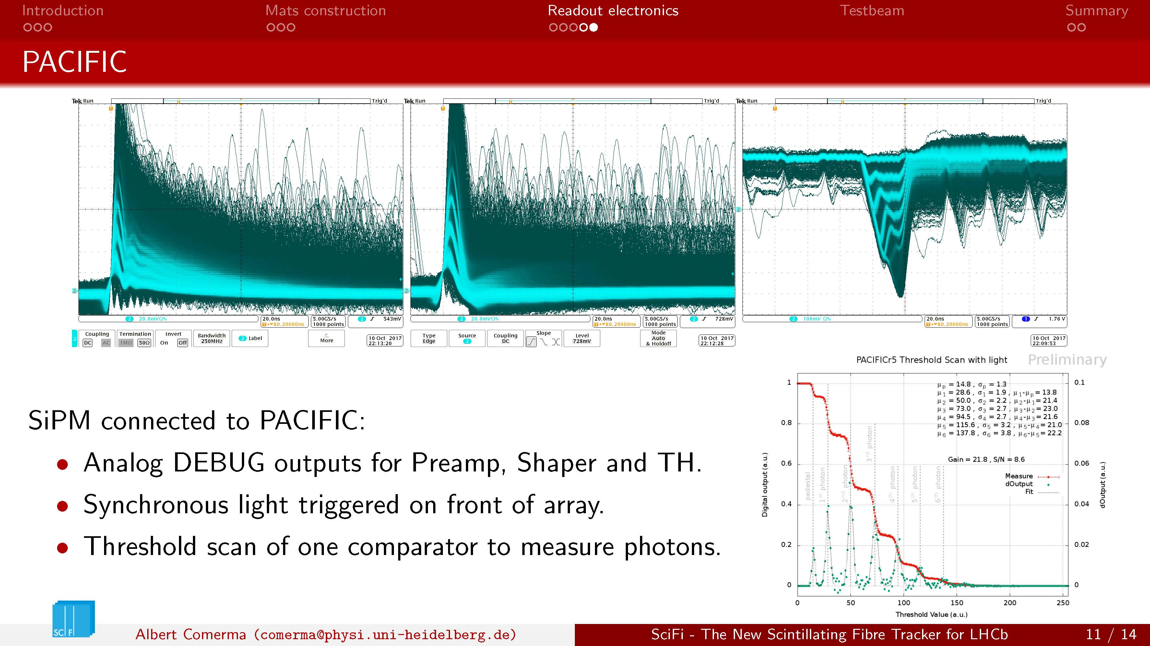
IV. ASICs for HEP: PACIFIC
Collaboration: Heidelberg, ICCUB , LPC-Clermont, IFIC-Valencia
Collaboration: Heidelberg, ICCUB , LPC-Clermont, IFIC-Valencia
35

Slide 36
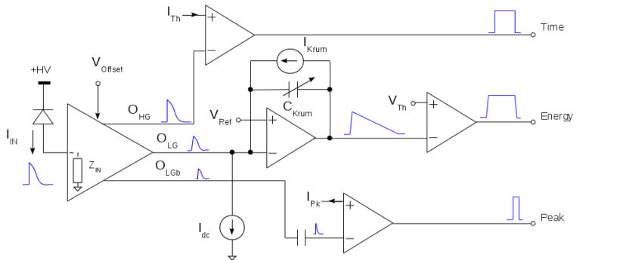
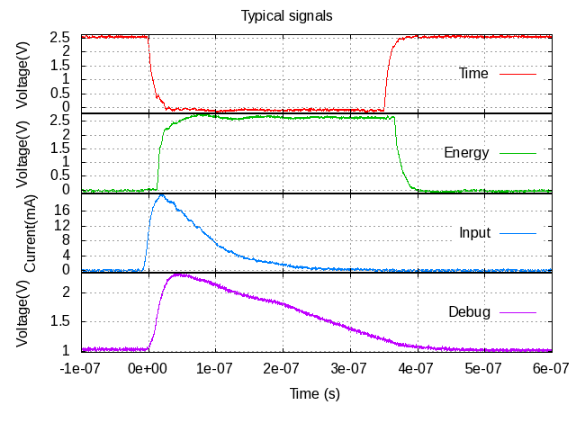

IV. ASICs for PET: FlexToT: linearized ToT RO chip
Collaboration: ICCUB and CIEMAT
A Flexible ASIC for SiPM RO (PET, SPECT, Compton)
  Novel current mode input stage
  Time resolution for ToF
  Time over Threshold RO
    No ADC
14 June 2018
Notes:
36
36

Slide 37
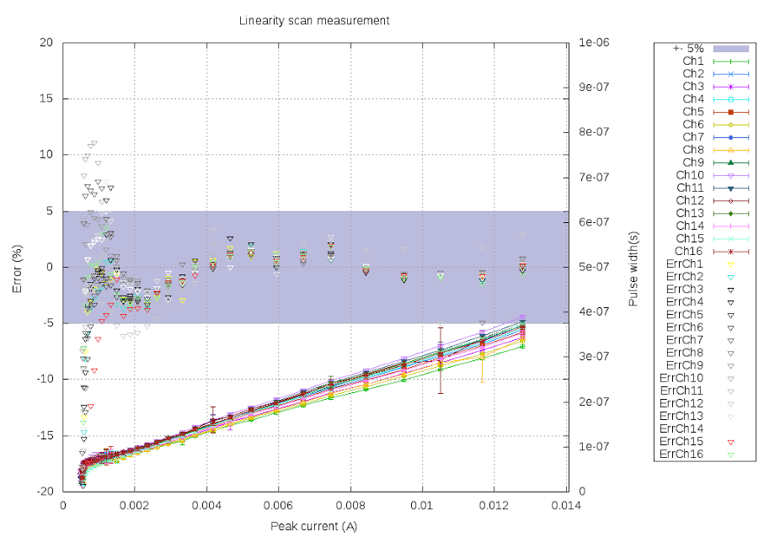
IV. ASICs for PET: FlexToT: linearized ToT RO chip
Good linearity and uniformity
  With only comparator threshold offset equalization
Different operating ranges can be covered
Notes:
37
37

Slide 38
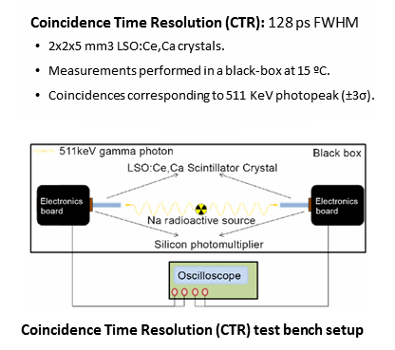
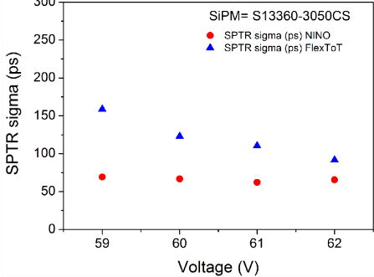
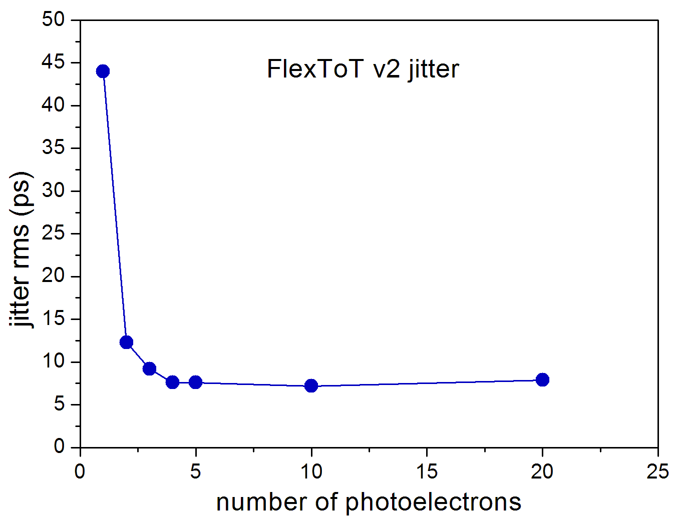
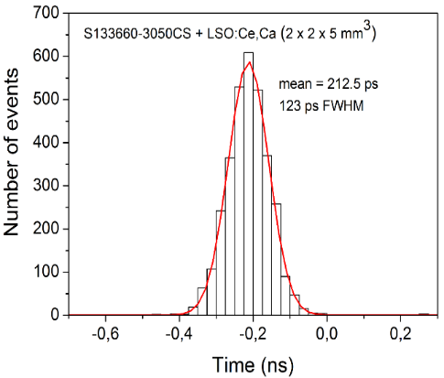

IV. ASICs for PET: FlexToT: linearized ToT RO chip
Measured @ CERN:
  Single Photon Time resolution (SPTR)
  Coincidence Time Resolution (CTR)
  Supported by FAST COST ACTION
    Many thanks to E. Auffray and S. Gundacker
  Similar results as for NINO but 3 times lower power consumption
CTR: 123 ps
SPTR=90ps
Jitter floor: 7 ps rms

Slide 39

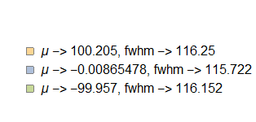
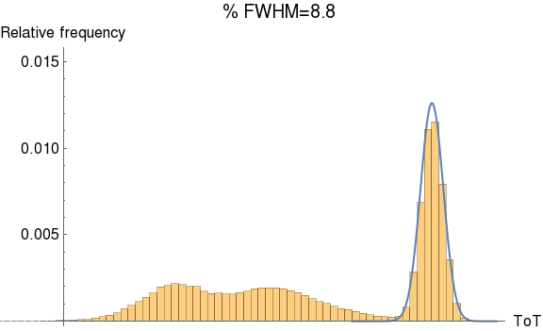
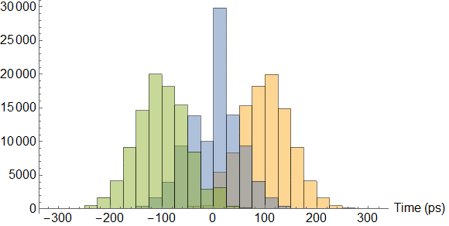
IV. ASICs for PET: FlexToT: linearized ToT RO chip
Pisa University has develpped a FPGA based TDC readout for FlexToT
  Based on Arria 10 FPGA
    TDC: 38 ps resolution
  System CTR: 116 ps FWHM !
  Energy resolution: 8 % FWHM @ 511 KeV
  Dead time < 5ns: event rate > 1 MHz !
P. Catra,
G. Sportelli
2 LYSO xtals 3x3x5 mm3
NUV-SiPM
CTR: 116 ps FWHM
Ge68 spectrum
8.8 % FWHM
Timing distributions for different source positions

Slide 40
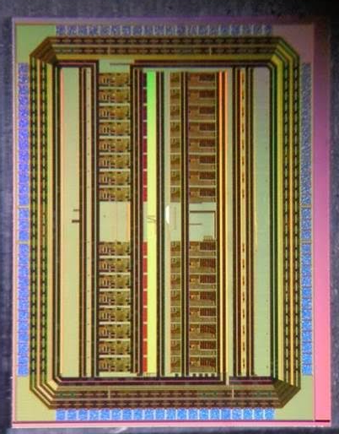
IV. ASICs for PET: HRFlexToT: linearized ToT RO chip
A new version of the FlexToT has been recently developed.
  A linear Time over Threshold with higher resolution (>8bits)
  Lower power consumption (about 3.5 mW/ch)
  Different trigger levels and cluster trigger for monolithic crystals.
  Different scintillator time constants.
HRFlexToT
180 nm CMOS
Notes:
40
40

Slide 41
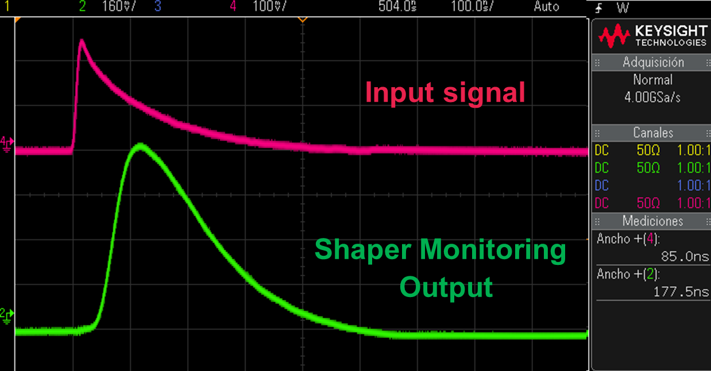
IV. ASICs for PET: HRFlexToT: linearized ToT RO chip
Based on shaper and peak detector circuits
Notes:
41
41

Slide 42

IV. ASICs for PET: HRFlexToT: linearized ToT RO chip
Linearity and dynamic range
Notes:
42
42

Slide 43

IV. ASICs for PET: HRFlexToT: linearized ToT RO chip
Preliminary results
  3x3 mm² HPKK device (50 um) cell, S13660.
  SPTR of about 60 ps rms (<150 ps FWHM) with 3.5 mW/ch
Best SPTR result for this SIPM to our knowledge:
  Other chips (TOFPET2, PETIROC2A, etc): 200 ps FWHM for S13360
  Comparable to transformer test (see C. Piemonte talk).
Notes:
43
43

Slide 44

IV. ASICs for fast timing: outlook
New ASIC FastIC in 65 nm being developed by ICCUB and CERN
  Very low power input stage, low input impedance, summation, < 10 ps TDC…
First step towards a Hybrid Single Photon Pixel Detector
Combined time by OR
Combined time, energy and trigger by analog summation

Slide 45
Outlook
Introduction
SiPM electrical parameters
FE circuits
ASIC examples
Conclusions

Slide 46

V. Conclusions
SiPM pulse shape depends on readout amplifier and parasitic component of inerconnects
In current sensing, R_{in} should be minimized for best timing (improved di/dt)
  But any value smaller than Rin,min = 5 Ω make the parasitic input network to resonate
In voltage sensing, R_{in} should be maximized for best timing (better dv/dt)
  This means large tails (PZ cancellation needed) and increasing series noise
Optimum bandwidth in the signal path, prior to discrimination BW_{opt} ~ $3\frac{1}{2π\sqrt{L C_{det}}}$
  → No point in designing faster circuits, since only increases noises !
  This limit can be below100 MHz for large SiPMs with high interconnect inductance.
  For an accurate design we need to consider SiPM, readout circuits and interconnects together
    Input impedance, electronics noise and shaping determine final performance: shape, effective gain, time resolution, energy resolution, etc
    In my “dream” LLL: sensor sensor and electronics are optimized together:
      3D integration and hybrid approaches: not purely analog nor purely digital

Slide 47
References on SiPM modelling and FE electronics
G. Collazoul,” The SiPM Physics and Technology”, Photodet 2012, https://indico.cern.ch/event/164917/contributions/1417121/attachments/198512/278663/PhotoDet12_-_collazuol_-_v3.pdf
S. Seifert, "Simulation of silicon photomultiplier signals", IEEE Trans. Nucl. Sci., vol. 56, no. 6, pp. 3726-3733, Dec. 2009.
F. Corsi et al., "Modelling a Silicon Photomultiplier (SiPM) as a Signal Source for Optimum Front-End Design", Nucl. Instr. and Meth. in Phys. Res., vol. A572, pp. 416-418, 2007
F. Ciciriello, F. Corsi, F. Licciulli, C. Marzocca, G. Matarrese et al., "Accurate Modeling of SiPM Detectors Coupled to FE Electronics for Timing Performance Analysis", Nucl. Instr. and Meth. in Phys. Res., vol. A 718, pp. 331-333.
F. Ciciriello, F. Corsi, F. Licciulli, C. Marzocca and G. Matarrese, “Design of Current Mode Front-End Amplifiers with Optimal Timing Performance for High-gain Photodetectors,” in European Conference on Circuit Theory and Design, 2015.
C. de la Taill, “SiPM readout electronics overview”, Photodet 2012, https://indico.cern.ch/event/164917/contributions/1417117/attachments/198508/278657/1-cdlt_Photodet2012.pdf

Slide 48

http://icc.ub.edu/congress/TechnoWeek2018

Slide 49
  Thanks a lot for your attention !!!
  Questions ?
  dgascon@fqa.ub.edu

Slide 50

II: Input stage optimization
In current sensing, R_{in} should be minimized for best timing (improved di/dt), but any value smaller than R_{in,min} = 5 Ω make the parasitic input network to resonate.
  Low R_{in} trade-offs with power consumption; it can be reduced by means of feedback schemes, at the cost of compromising stability.
  In practice, R_{in} in the range 15 Ω – 20 Ω are desirable in order to be compatible with detectors showing Cdet = 10 pF (PMTs/MCPs) – 1 nF (Large SiPMs).
In voltage sensing, R_{in} should be maximized for best timing (improved dv/dt). Signal dynamics are favourable since underdamped response is not possible under such a case.
  The parallel resonance can boost the slew-rate even more, but one should rely on parasitics…
  Large R_{in} results in degraded count-rate capabilities. PZ cancellation becomes compulsory.
Optimum bandwidth in the signal path, prior to discrimination BW_{opt} ~ $3\frac{1}{2π\sqrt{L C_{det}}}$
  The minimum LC_{det} product (5 nH short connection / 10 pF in PMT) already results in 1 GHz optimum bandwidth.
  → No point in designing current sensing circuits faster than 1 GHz, since only noise would be integrated, worsening σ_{t}!

Slide 51

I. Introduction: current IACTs cameras
Even some CTA telescopes will still be based on PMTs
C. Casella, “Application of photosensors”, ICCUB- Technoweek, 2016.

Slide 52

I. Introduction: current IACTs cameras
Even some CTA telescopes will still be based on PMTs
Amazing progress in last 10 years
  PMTs developped for CTA
Peak PDE > 35 %
Afterpulsing at 4 ph.e. Threshold << 0.02 %
22.04.2015 APPEC TF,
Razmik Mirzoyan:
Recent Progress on PMT and SiPM, where we are going to

Slide 53

I. Introduction: SiPM based IACTs cameras
SiPM principle
SST-1M
ASTRI
GCT
C. Casella, “Application of photosensors”, ICCUB- Technoweek, 2016.

Slide 54

I. Introduction: SiPM based IACTs cameras
What is crosstalk in a SiPM?
C. Casella, “Application of photosensors”, ICCUB- Technoweek, 2016.

Slide 55
I. Introduction: SiPM requirements for IACTs
High PDE > 40 %
  A higher PDE results in a higher reconstruction rate of Cherenkov photons and decreases the energy threshold
Low crosstalk
  Crosstalk degrades the single photon charge resolution
Trade-off between PDE and crosstalk
J. Biteau et alt. “Performance of Silicon Photomultipliers for the Dual-Mirror Medium-Sized Telescopes of the Cherenkov Telescope Array”, ICRC2015

Slide 56

I. Introduction: SiPM based IACTs cameras
SST-1M
ASTRI
GCT
C. Casella, “Application of photosensors”, ICCUB- Technoweek, 2016.

Slide 57

I. Introduction: SiPM based IACTs cameras
SST-1M
ASTRI
GCT
C. Casella, “Application of photosensors”, ICCUB- Technoweek, 2016.

Slide 58



Basic pulse shapes
Short pulse : Q=16 fC, Cd=100 pF, L=0-10 nH, RL=5-50 Ω
Smaller signals with SiPM (large Cd) ~ mV/p.e.
Sensitivity to parasitic inductance
Choice of RL : decay time, stability
Convolve with current shape… (here delta impulse)
L/R
RC
C=100 pF L=10 nH R=50 Ω
C=100 pF L=10 nH R=5 Ω
Q/Cd
C. De La Taille, Photodet conference, 2012

Slide 59


SiPM modelization
Modelization by Corsi et al [NIM A572 2007]
[F. Corsi et al. NIM A572]

Slide 60

15 jun 2012 CdLT Photodet conference
Collazuol 2008

Slide 61

15 jun 2012 CdLT Photodet conference
Collazuol 2010

Slide 62
15 jun 2012 CdLT Photodet conference
Collazuol 2012

Slide 63


II. Slew-rate in current and voltage sensing
Current sensing
SR improves with small R_{in}:
$$\frac{\text{∂}i_{in}}{\text{∂}t}\text{∝}\frac{Q_{det}}{L∙C_{det}}$$
Specially true when entering in underdamped region.
Underdamping can be problematic (multiple crossing in discrimination).
Independent of R_{in} deep in overdamping regime. Parallel resonance enhances the SR.
Voltage sensing
SR improves with large R_{in}:
$${\frac{\text{∂}v_{in}}{\text{∂}t}=R}_{in}⋅\frac{{\text{∂}i}_{in}}{\text{∂}t}\text{∝}\frac{Q_{det}⋅R_{in}}{L∙C_{det}}$$
Almost linear relationship between SR and R_{in}.
Parallel resonance can be exploited for peak enhancement.
Problem: reduced count-rate for large R_{in}.

Slide 64


III. FE circuits: NINO
NINO: current mode, binary and quite generic
Chip designed by CERN group for ALICE TOF RPCs but quite used for SiPM read-out
  8 channels amplifier and discriminator
  Common grid current conveyor, high speed differential discriminator
  High speed time measurement (10 ps),
  Pd = 25 mW/ch, Manufactured in IBM 0.25 um
  F. Anghinolfi, P. Jarron et al. NINO, NIM A, 2004, Vol. 533 page 183-187

Slide 65


III. FE circuits: NINO
NINO: current mode, binary and quite generic
Binary: usually connected to TDC for Time-Over-Threshold (ToT) energy
  Simple discriminator: ToT is not linear
Differential connection to the SiPM
  F. Anghinolfi, P. Jarron et al. NINO, NIM A, 2004, Vol. 533 page 183-187

Slide 66




III. FE circuits: NINO
Classical ToT is non-linear
It has an impact on energy resolution
  Calibration is possible
  But not perfect…
Orita, NIMA 648, S24-27, 2011
Non linear ToT
Linear ToT
Orita, NIMA 648, S24-27, 2011
Notes:
66
66

Slide 67

III. FE circuits: CITIROC
CITIROC: voltage mode, analogue and for CTA SSTs ASTRI camera
Part of Omega/Weeroc family: CITIROC, PETIROC, PETIROC2, TRIROC, etc
General ASIC
  32 channel, charge and trigger outting
  6.26mW/Ch. Power pulsed
Front-end
  Trigger
    Fast shaper connected to either low or high gain preamp
    Two discriminator : one for timing, one for event validation on energy
  Energy measurement
    2 voltage preamplifier (10x gain difference) followed by shaper
    Analogue memory : track and hold or peak detector
    Analogue multiplexer
    Peaking time between 12.5 and 100 ns
      Valid only for SSTs
  https://www.weeroc.com/fr/products/citiroc-1a

Slide 68

III. FE circuits: CITIROC
  https://www.weeroc.com/fr/products/citiroc-1a

Slide 69

III. FE circuits: CITIROC
  https://www.weeroc.com/fr/products/citiroc-1a

Slide 70
III. FE circuits: MUSIC: Multipurpose SiPM RO chip
MUSIC 8 ch ASIC integrates all those functionalities
Individual channel amplification with adjustable pole-zero cancellation (discriminated)

Slide 71


III. FE circuits: MUSIC: Multipurpose SiPM RO chip
Output for a LCT4 HPKK MPPC ( 3x3 mm²)
  Picosecond laser
  Pole-zero cancellation
  Single Photon Time Resolution about 100 ps (@ 5V OV)
1 photon
Laser trigger signal
600nm, 50 ps FWHM
2 photon
3 photon
Pulse width histogram
Jitter of the first photon (SPTR)

Slide 72



III. FE circuits: MUSIC: Multipurpose SiPM RO chip
Studying the possibility to develop a beam loss monitoring system based on scintillating fibers
  Collaboration with Alba synchrotron General idea:
  Fiber along the beam pipe or in selected regions
  Losses are detected by a rate increase
  With timing information, additional postion information
    Preliminary results: 20 cm resolution for a 2 m fiber of 1 mm diameter
20cm resolution
Thanks to C. Joram (CERN) for providing SciFibers

Slide 73


IV. ASICs for PET: PETIROC
PETIROC2:
  Voltage mode,
  Configurable: analogue, binary or digital
    S&H + Wilkinson ADC
  For medical imaging (PET)
  Versatile: analog or digital
  But shaping time > 10 ns
  Max ev. rate is 40 KHz in digital mode
  Power:
  https://www.weeroc.com/fr/products/petiroc-2a

Slide 74

IV. ASICs for PET: TOFPET
TOFPET2: current mode, digital (linear ToT) and for medical imaging (PET)
  Power: 8 mW/ch
  Max rate 200 KHz/ch
J. Varela, “New results with TOFPET2”, FAST, Ljubljana, Jan 2018

Slide 75

IV. ASICs for PET: STiC
STiC: current mode, digital (linear ToT) and for medical imaging (PET)
STiC — a mixed mode silicon photomultiplier readout ASIC for time-of-flight applications
T. Harion et alt., 2014 JINST 9 C02003

Slide 76

IV. ASICs for PET: FlexToT: linearized ToT RO chip
Joint project with CIEMAT to develop a time-over-threshold ASIC for SiPM based PET
  ICCUB: expertise on electronics and microelectronics design for detector FE
  CIEMAT: expertise on PET and medical imaging instrumentation
FlexToT
16 channel
SiGe BiCMOS 0.35um
Aaustriamicrosystem
10 mm²
3.3 V (10 mW/ch)
QFN 64
Notes:
76
76

Slide 77


IV. ASICs for PET: FlexToT: linearized ToT RO chip
Spectroscopy with linear ToT
Notes:
77
77

Slide 78
Outlook
Introduction
SiPM model
FE circuits
Digitization
System-On-Chip (SoC)
Emerging technologies

Slide 79



III. Digitization: basic options
“Classical” signal processing chain
  Requires complex analogue processing
  Not so flexible
  Optimal in power for specific app.
Digital signal processing
  Waveform sampling and digital signal processing
  Ideally one should sample at fs > 2 x signal BW (x5)
E. Delagnes, “Precise Pulse Timing based on Ultra-Fast Waveform Digitizers”, IEEE NSS 2011

Slide 80


III. Digitization: waveform sampling
Very demanding sampling specs for IACTs
  Dynamic range of about 12 bits (with several gains)
  Analog BW> 300 MHz requires 1-2 GS/s
    Power consumption and ADC cost !
    Alternative: FlashCAM digitizes at much lower speed and tries to extract signal parameters by signal processing
      But NSB will be there anyway, so energy threshold will be degraded…
Many projects have been using Switch Capacitor Arrays (SCAs) to perform analog sampling
E. Delagnes, “Precise Pulse Timing based on Ultra-Fast Waveform Digitizers”, IEEE NSS 2011

Slide 81

III. Digitization: waveform sampling
SCAs sample the signal which is digitized at a lower speed
S. Ritt

Slide 82

III. Digitization: waveform sampling
TARGET
CTA SCT and SST
NECTAr
CTA MST-NECTArCAM
DRS4
CTA LST
E. Delagnes, “Precise Pulse Timing based on Ultra-Fast Waveform Digitizers”, IEEE NSS 2011

Slide 83

III. Digitization: waveform sampling
SAMPIC Waveform TDC
D. Breton, 4th FAST WG3/4/5 Meeting, Ljubljana, January7/8 2018

Slide 84

III. Digitization: waveform sampling
SAMPIC Waveform TDC
D. Breton, 4th FAST WG3/4/5 Meeting, Ljubljana, January7/8 2018

Slide 85

III. Digitization: waveform sampling
CHEC camera is an interesting example of compact readout
Gary S. Varner, 2nd Adv SiPM Workshop, Geneva, 2014

Slide 86



III. Digitization: waveform sampling
Several iterations to have a functional chip: TARGET7
Gary S. Varner, 2nd Adv SiPM Workshop, Geneva, 2014

Slide 87
Outlook
Introduction
SiPM model
FE circuits
Digitization
System-On-Chip (SoC)
Emerging technologies

Slide 88

IV. ASICs for PET: PETA
PETA: current mode, charge (ADC) and time (TDC), for PET
  Choice between Differential FE (both polarities, MRT immune) and
  Single Ended FE (low Zin, DC bias adjustment, no external coupling parts)
  Readout rates >200 kHz per channel (in all channels)
  Power consumption ~30mW / channel
P. Fischer, Heidelberg University, The PETA Chip Family FAST Workshop, FBK 2016

Slide 89

IV. ASICs for PET: BASIC64
BASIC64: current mode, digital (peak detector + ADC) and for PET
  Power: 10 mW/ch
  Max rate: 75 KHz/ch
  No TDC for timing
C. Marzocca et alt., "BASIC64: A new mixed-signal front-end ASIC for SiPM detectors," NSS 2016

Slide 90

IV. ASICs for PET: FlexToT: linearized ToT RO chip
Why FlexToT is flexible?
  Different scintillator time constants
  Trading-off resolution versus rate
  Accurate analog processing directly connected to FPGA
    TDCs and signal processing are in FPGA: reconfigurable !
Notes:
90
90

Slide 91
IV. ASICs for PET: FlexToT: linearized ToT RO chip
No linear ToT may degrade resolution
Linear ToT is possible
  Used in Medipix, Timepix, Dosepix ASICs family
  Also proposed for PET
  Tuneable feedback current (IFB)
    Rate vs resolution
Non linear ToT
Linear ToT
Orita, NIMA 648, S24-27, 2011
I_{FB}
C_{FB}
Notes:
91
91

Slide 92

IV. ASICs for PET: HRFlexToT: linearized ToT RO chip
Preliminary results
Input signal
Shaper Output
Timing-OR
Ch Out: time
Notes:
92
92

Slide 93

IV. ASICs for PET: HRFlexToT: linearized ToT RO chip
Preliminary results
Input signal
Shaper Output
Timing-OR
Ch Out: energy
Notes:
93
93

Slide 94

IV. ASICs for PET: HRFlexToT: linearized ToT RO chip
Preliminary results
Input signal
Shaper Output
Timing-OR
Ch Out
Time + Energy
Notes:
94
94

Slide 95

IV. ASICs for PET: HRFlexToT: linearized ToT RO chip
Preliminary result
  3x3 mm² HPKK device (75 um) cell, 4 year old.
    Soon test with more recent devices
  SPTR of about 65 ps rms (150 ps FWHM)
Inverted logic: low code means high threshold
Notes:
95
95

Slide 96
IV. HRFlexToT: Linearity analysis: Channel Uniformity
Peak Detector mode and Max Gain (G=3, RL=3)
Maximum current limited by injection system with amplifiers.

Slide 97
IV. ASICs for fast timing: outlook
In order to improve CTR we need to progress in
  Crystals: prompt light emission
  Sensors: SPTR
    In the the limit, the single SPAD SPTR: 20 ps FWHM ?
A cost/power effective mixed-mode approach:
  Use small SiPMs
    Better SPTR
  Low power input stage
    Demonstrated with HRFlexToT chip
  Fast analog summation
    Demonstrated with MUSIC chip
  Multi threshold comparators
    Provides estimation of the time of arrival of several photons
  High performance TDCs and synchronization
    < 10 ps timing resolution demonstrated in 130 nm technology
Notes:
97
97

