Slide 1
1st Intl. Conference for Advancement of Silicon Photomultipliers
Schwetzingen, Germany
Hamamatsu’s SiPM (MPPC) Characteristics and Latest Developments
June 11, 2018
HAMAMATSU PHOTONICS K.K
Solid State Division
Ardavan Ghassemi
1
Notes:
I’m belong to project promotion group and I’m working for promote the MPPC and MPPC module.
We will introduce the latest MPPC and module information.
もう一回ゆっくり話してもらえませんか？
Would you say that again more slowly, please ?
図に書いてもらえませんか？
Would you write that on the white board ?
いつでも質問してください
Please do not hesitate to ask questions during my presentation.

Slide 2
Table of Contents
1. A Revision of MPPC Correlated Noise Parameters
2. Our Correlated Noise Measurement Method
3. New MPPC Developments for Physics Research
2

Slide 3
Part 1
1. A Revision of MPPC Correlated Noise Parameters
2. Our Correlated Noise Measurement Method
3. New MPPC Developments for Physics Research
3

Slide 4
Common questions from MPPC’s scientific users
How to distinguish delayed crosstalk from afterpulse?
How does Hamamatsu measure these noise parameters?
Why my measurements don’t match Hamamatsu’s?
What is a good method for comparing Hamamatsu’s MPPC with other manufacturers’ products?
Streamlined definitions of noise and other performance parameters can be helpful…
4

Slide 5
MPPC key performance parameters
Question : Which parameter is the toughest to define?
PDE=detected photon count
/incident photon count
No problem, definition is clear.
<Main MPPC Meas. Parameters>
・ Photon detection efficiency
・ Dark count
・ Gain
・ Crosstalk
・ Afterpulese
Pulse count rate exceeding a threshold of 0.5p.e under dark condition.
No problem, definition is clear.
Charge generated from one pixel when fired / Electron charge (1.602 x 10⁻¹⁹C).
No problem, definition is clear.
“Delayed” X-talk and afterpulse
are difficult parameters to fully distinguish…
5

Slide 6
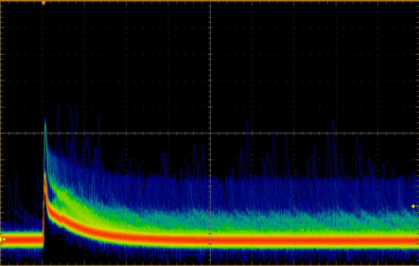
MPPC correlated noise parameters
User Question: How to distinguish delayed crosstalk from afterpulse?
Hamamatsu Question: Is it really necessary to tell them apart?
S13360-1350CS
Overvoltage = 3 V
Which one is afterpulse?
Which is delayed crosstalk?
50 ns
6

Slide 7
Revision of MPPC correlated noise parameters
No practical need to differentiate between delayed crosstalk and after-pulse!
Let’s redefine correlated noise parameters so that noise measurement becomes simpler and also more objective.
Correlated noise can be fully categorized into 2 parameters based on just one metric: time delay!
Hamamatsu’s proposal for new correlated noise parameters:
Prompt crosstalk & “Delayed pulses”
7

Slide 8

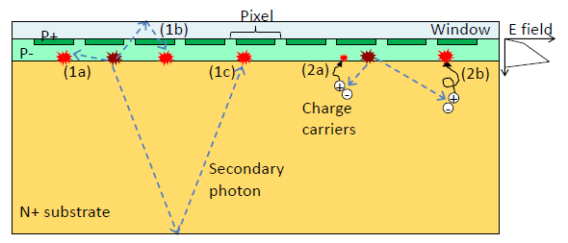
Definition of prompt crosstalk
1 : Prompt crosstalk
( secondary photons reaching a neighboring cell and triggering a secondary avalanche )
(1a) Direct X-talk
(1b) Front-surface reflected X-talk
(1c) Bottom-surface reflected X-talk
These 3 are
“Prompt X-talk”
※１Reference
8

Slide 9
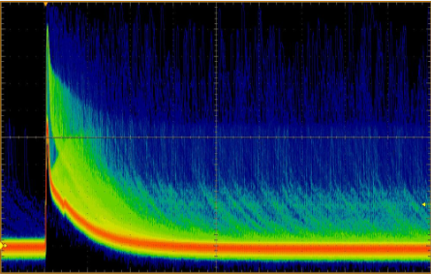
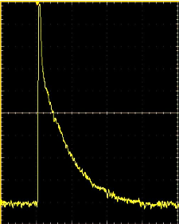
Waveform example – prompt crosstalk
Measured pulse
Shaped pulse
Overvoltage = 6 V
Prompt X-talk
2p.e.
Prompt X-talk
≧ 2p.e.
1p.e.
50 ns
9

Slide 10
Definition of delayed pulses
2 : Delayed pulses
( minority carriers generated in the substrate diffuse to the depletion region with time delay, triggering a secondary avalanche )
Diffuse to the primary cell, pulse height depends on cell’s recovery progress.
Diffuse to a neighboring cell,
pulse height is same level as 1p.e.
(2a) Afterpulses
(2b) Delayed X-talk
These 2 are
“Delayed pulses”
※１Reference
10

Slide 11
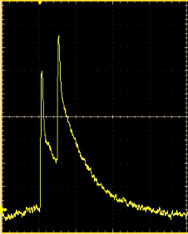
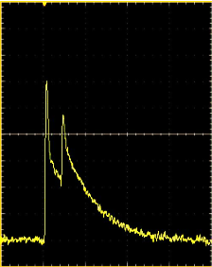
Waveform examples – delayed pulses
Measured pulses
Shaped pulses
Overvoltage = 6 V
Delayed X-talk
Delayed X-talk
Delayed pulses
Afterpulses
= 1p.e.
1p.e.
50 ns
Afterpulses
Note: Delayed X-talk and afterpulses are indistinguishable after full recovery of microcell voltage.
≦ 1p.e.
11

Slide 12
Part 2
1. A Revision of MPPC Correlated Noise Parameters
2. Our Correlated Noise Measurement Method
3. New MPPC Developments for Physics Research
12

Slide 13
Measuring MPPC characteristics
User questions from an earlier slide:
Why my measurements don’t match Hamamatsu’s?
How does Hamamatsu measure correlated noise?
What is the best method to compare Hamamatsu’s MPPC with other suppliers’ products?
Replicating the same measurement method reproduces the same result, so we share our method with you!
13

Slide 14
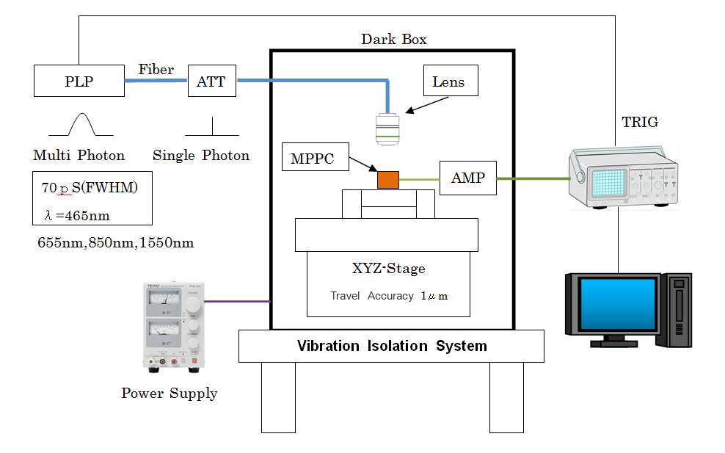
Correlated noise measurement
・ Configuration block
Focus on 1pixel

Slide 15
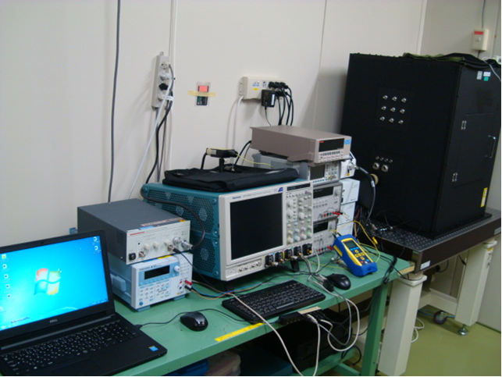
Correlated noise measurement
・ Instrumentation setup
PLP
Head
Black box
PLP
Controller
Oscilloscope
Bias supply
for MPPC
PC
Overall view

Slide 16
Correlated noise measurement
・ Biasing and readout scheme:
-HV
+12V
Capacitor
Inductor
Resistor
Resistor
Capacitor
MPPC
Output
Gp：20.5dB
fc：2.9GHz
Gp：20.5dB
fc：1.0GHz
Capacitor
Capacitor
Capacitor
Resistor
Amplifier
Amplifier

Slide 17
Pulse processing
Problem : Signal Pileup
In the waveform shown below, pulse height is affected by pileup.
Pileup
Fig.5
Amplifier output

Slide 18
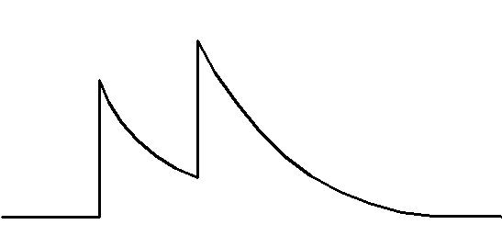
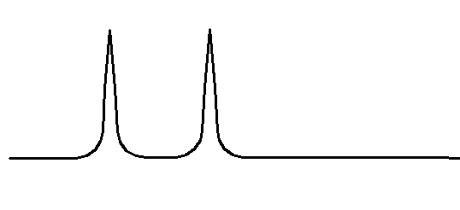
Pulse processing
How to alleviate pileup : software processing
The raw signal is passed through Deconvolution and
Wiener filters to obtain a processed output signal.
×
Filter
Pileup is removed.

Slide 19
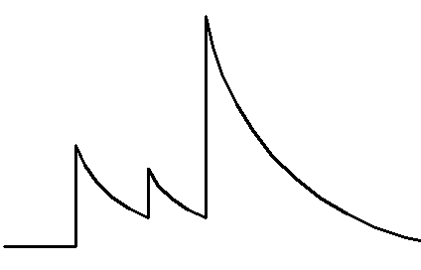
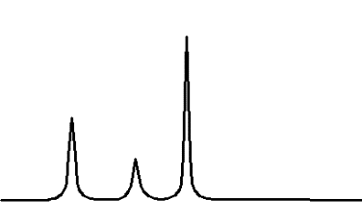
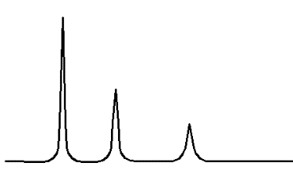
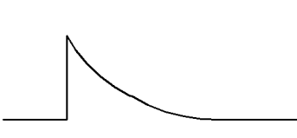
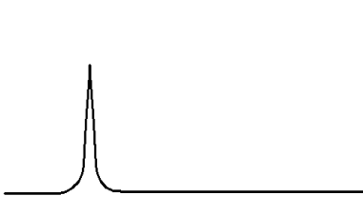
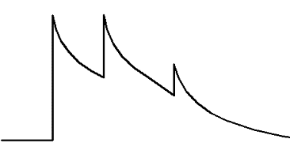
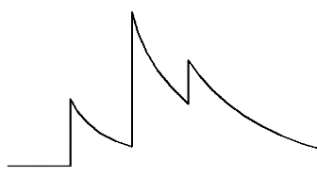
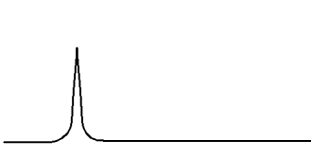
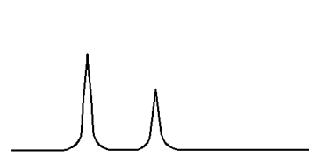
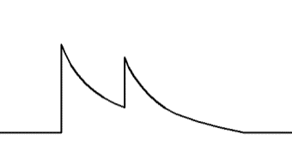


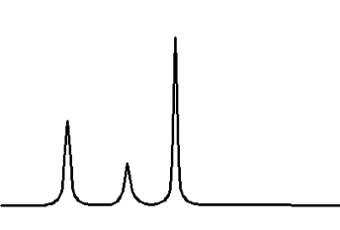
Correlated noise measurement
PLP
Oscilloscope
Computer
Filtering & Discrimination
MPPC
AMP(×100)
Normal
Prompt X-talk
Delayed Pulse
Data points: ~10,000 (exp.)
1
1
0
0
0
1
2
3

Slide 20
Correlated noise measurement
Waveform analysis ① : Prompt X-talk probability
It is defined by the following calculation:
Prompt X-talk(%)＝
(number of >1.5 p.e. pulses)
×100
(number of >0.5 p.e. pulses)
Signal
1.5pe
Delayed X-talk
0.5pe
After pulse

Slide 21
Correlated noise measurement
Waveform analysis ② : Delayed Pulse probability
It is defined by the following calculation:
Delayed Pulse(%)＝
(number of Delayed pulses)
×100
(number of >0.5 p.e. pulses)
After pulse
Delayed X-talk
Signal
Signal
0.5pe
0.5pe

Slide 22
Part 3
1. A Revision of MPPC Correlated Noise Parameters
2. Our Correlated Noise Measurement Method
3. New MPPC Developments for Physics Research
22

Slide 23
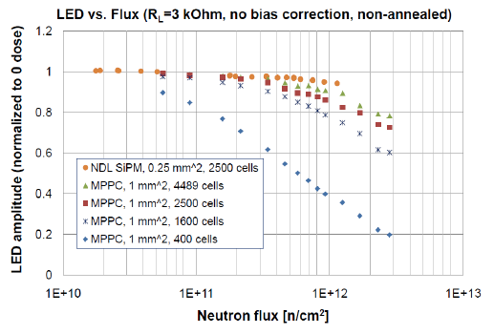
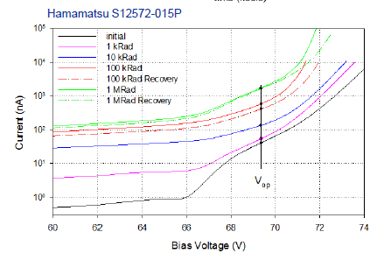
Improved irradiation lifetime
2 types of damage caused by radiation in MPPC:
Bulk damage: If sufficient particle energy is transferred to a Si atom, the atom can be displaced into an interstitial site, leaving a vacancy (defect) in the Si crystal lattice.
Surface damage: Energetic photons and electrons can cause surface damage near the Si-passivation (SiO2/Si3N4) boundary.
Both can result in increased dark output vs. accumulated irradiation.
Proposed Solution:
New MPPC with lower dark current
W/ high dynamic range (small microcells) for calorimetry
23

Slide 24
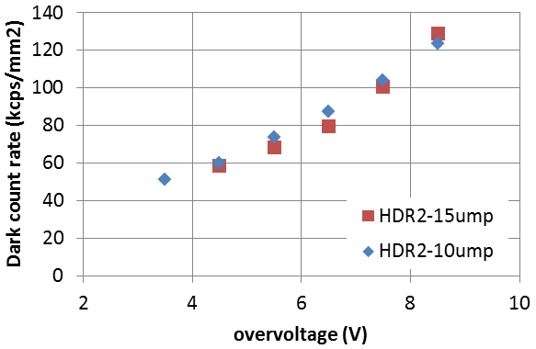
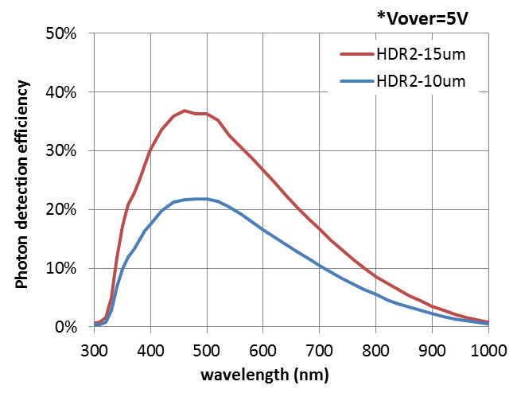
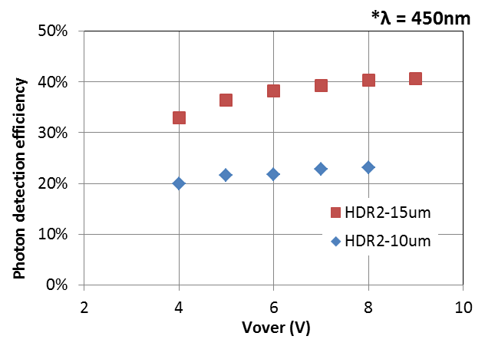
High DR w/ reduced dark output
Under Development
Small microcell with trench(HDR2)
  Low bias operation (~45V)
  High PDE
  Low Dark Current
24

Slide 25
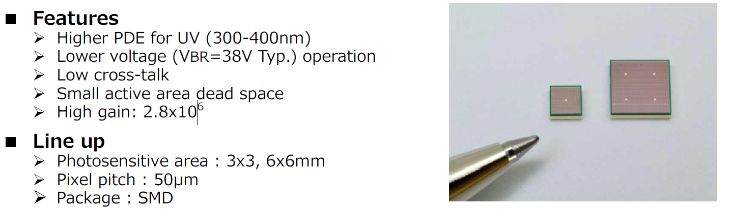
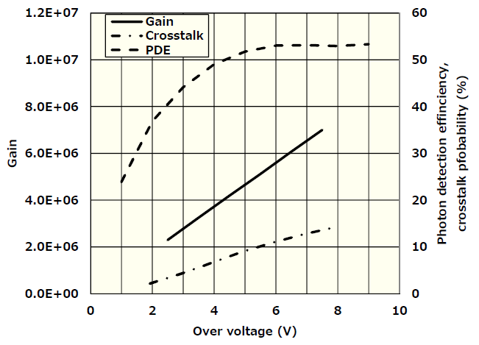
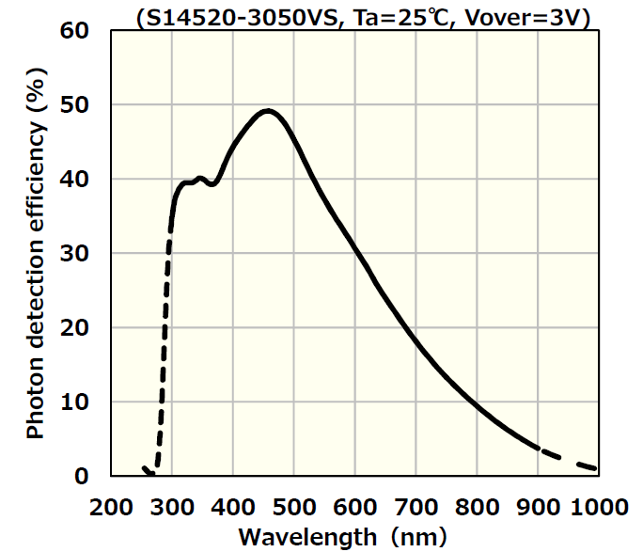
MPPC for Cherenkov detection
S14520* Series
*Mainly developed for CTA
25

Slide 26
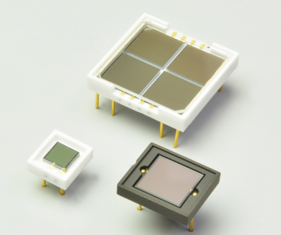
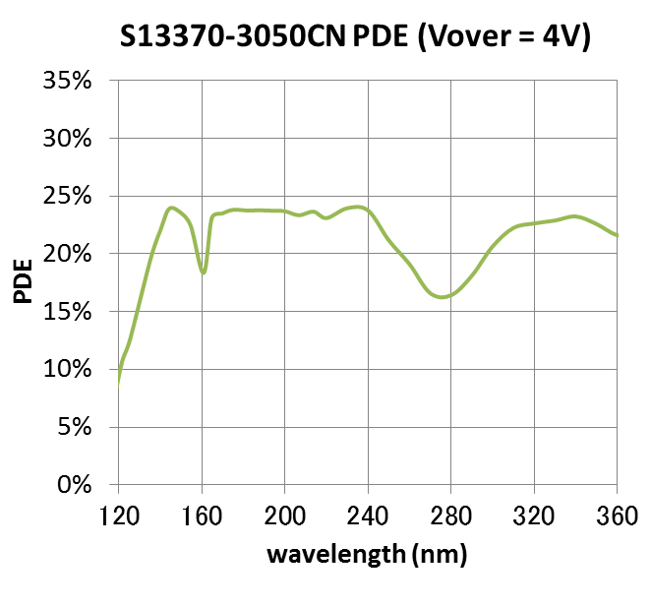
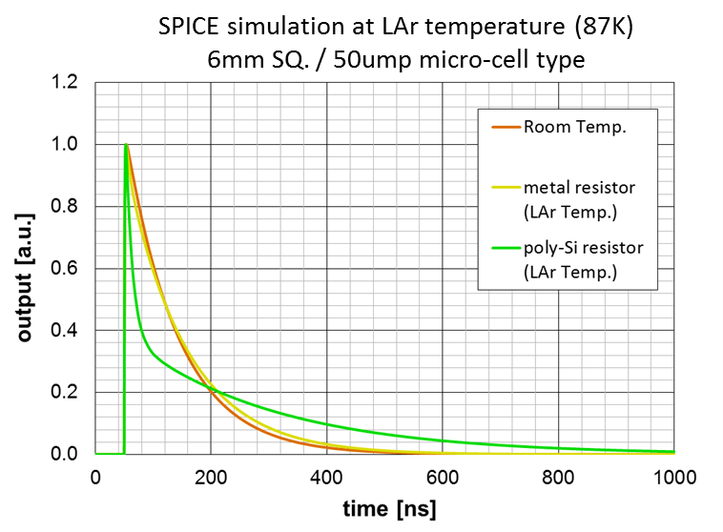
VUV-MPPC
S13370 series
High PDE in VUV wavelength range
Cryogenically reliable
Low optical crosstalk due to trenches
Fast recovery (stable Rq vs. temperature)
*Array type and low-RI pckg under development.
26

Slide 27
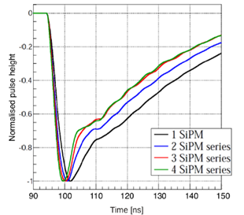
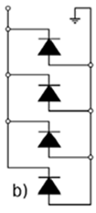
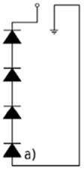
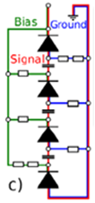
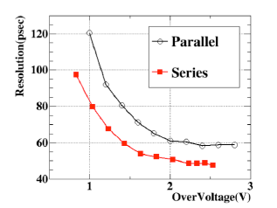
MPPC connection technique
3 connection methods are adopted in multichannel applications.
Series and hybrid connection suitable for cryogenic or high-count-rate applications, requiring reduced capacitance.
Technical note is being prepared...
Parallel
Series
Hybrid
Bias : parallel
Signal: series
(coupled with C)
Small bias voltage
Small capacitance
Small bias voltage
Large capacitance
(long waveform)
High bias voltage
(Vop x 4)
Small capacitance
(short waveform)
27

Slide 28
28

