Slide 1

Dynamic Range Characterization of SiPM with a Double Light Superposition (DLS) Method
Jian Liu, Lei Dai, Wenxuan Cheng, Yu Peng, Baozhou Zhang, Kun Liang, Ru Yang, Dejun Han
Novel Device Laboratory, Beijing Normal University
June 11-15, 2018 @ICASiPM, Schwetzingen, Germany

Slide 2
Contents
Motivation
Definitions and Concepts
Setup and Procedure of the DLS method
Results
Conclusions

Slide 3
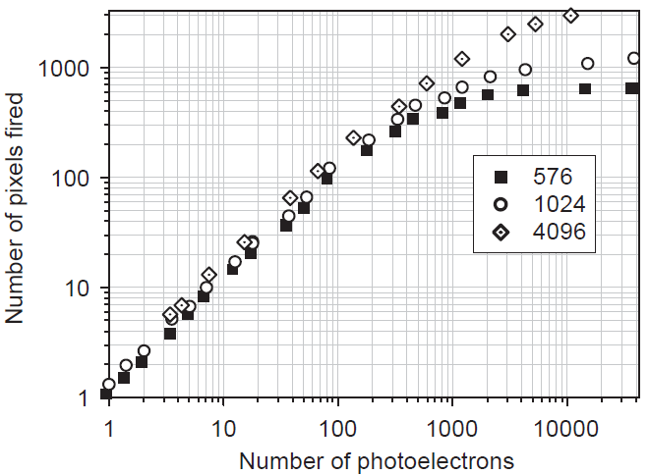
Motivation
Dynamic range - a key parameter for the SiPM
Determined by the total pixel number for low counting rate and short optical pulse
Determined by the recovery time for high counting rate and long optical pulse
A widely accepted technique for characterizing the DR has not been established
V. Andreev et al, NIM A, 540(2-3) (2005)

Slide 4
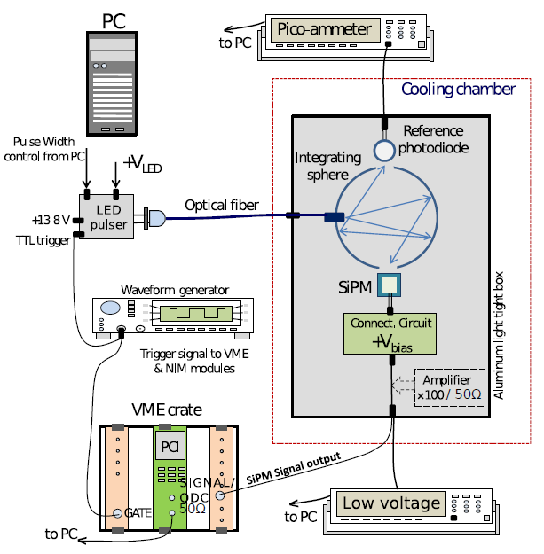
Motivation - Known Methods - Problems
Calibrated photodetector
Optical power attenuation
Complex setup
Optical attenuators
Complicated procedures
Measurement error
Scintillation detection
Dangerous and complicated
Calibration error
T. Bretz et al, J. INSTRUM, 11(03) (2016) P03009

Slide 5
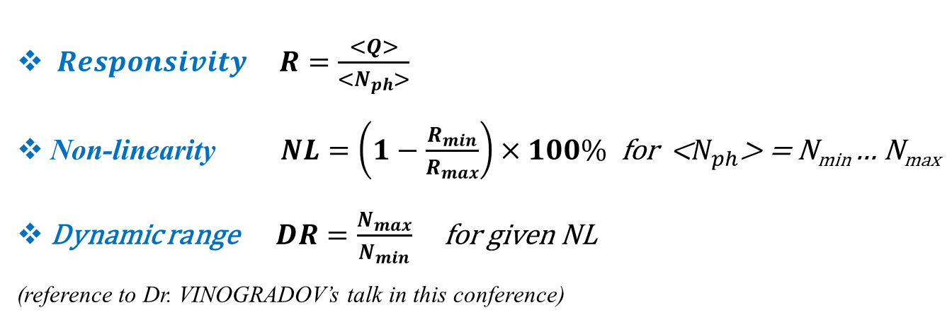
Definitions and Concepts
$Responsivity R=\frac{<Q>}{<N_{ph}>}$
Non-linearity $NL=\left(1−\frac{R_{min}}{R_{max}}\right)×100\%$ for <$N_{ph}$> = N_{min} … N_{max}
Dynamic range $DR=\frac{N_{max}}{N_{min}}$ for given NL
(reference to Dr. VINOGRADOV’s talk in this conference)

Slide 6
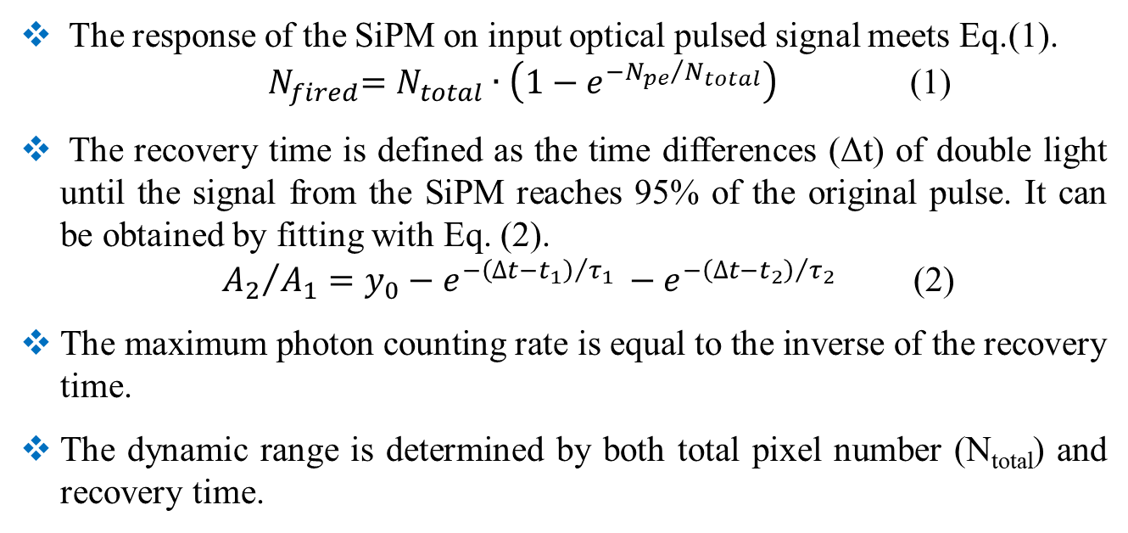
Definitions and Concepts
The response of the SiPM on input optical pulsed signal meets Eq.(1).
${ N}_{fired}=N_{total}∙\left(1−e^{{{−N}_{pe}}/{N_{total}}}\right)$ (1)
The recovery time is defined as the time differences (Δt) of double light until the signal from the SiPM reaches 95% of the original pulse. It can be obtained by fitting with Eq. (2).
${{ A}_{2}}/{A_{1}=y_{0}−{e^{−{\left(∆t−t_{1}\right)}/{τ_{1} }}−e}^{−{\left(∆t−t_{2}\right)}/{τ_{2} }}}$ (2)
The maximum photon counting rate is equal to the inverse of the recovery time.
The dynamic range is determined by both total pixel number (N_{total}) and recovery time.

Slide 7
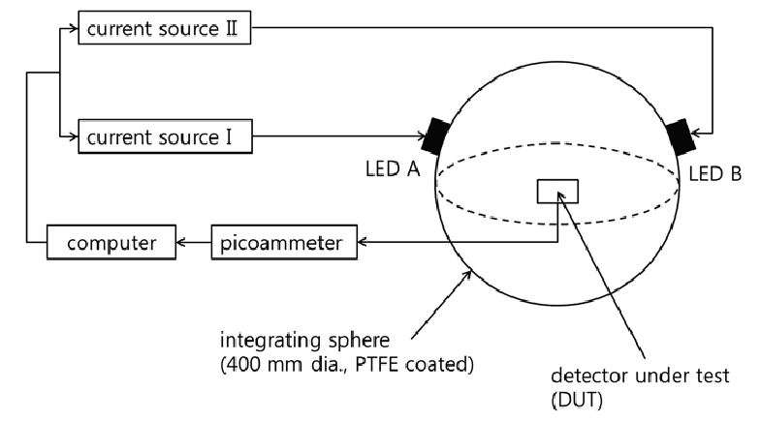
The DLS method
Features
Self-calibrated technique without external calibration
Obtain an adjustable pulsed light source with a large DR easily
Measure the intrinsic non-linearity of SiPM with a simple way
Compatible to characterize the recovery time
D. Shin et al, Metrologia, 51 (25-32) (2014)

Slide 8
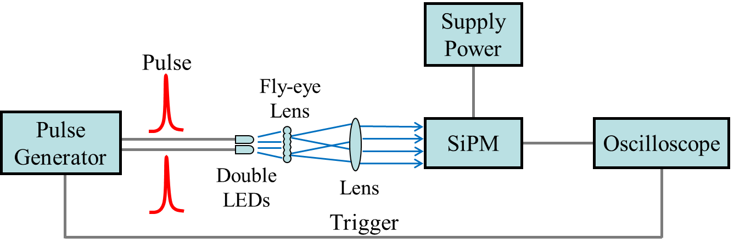
Setup of the DLS method

Slide 9
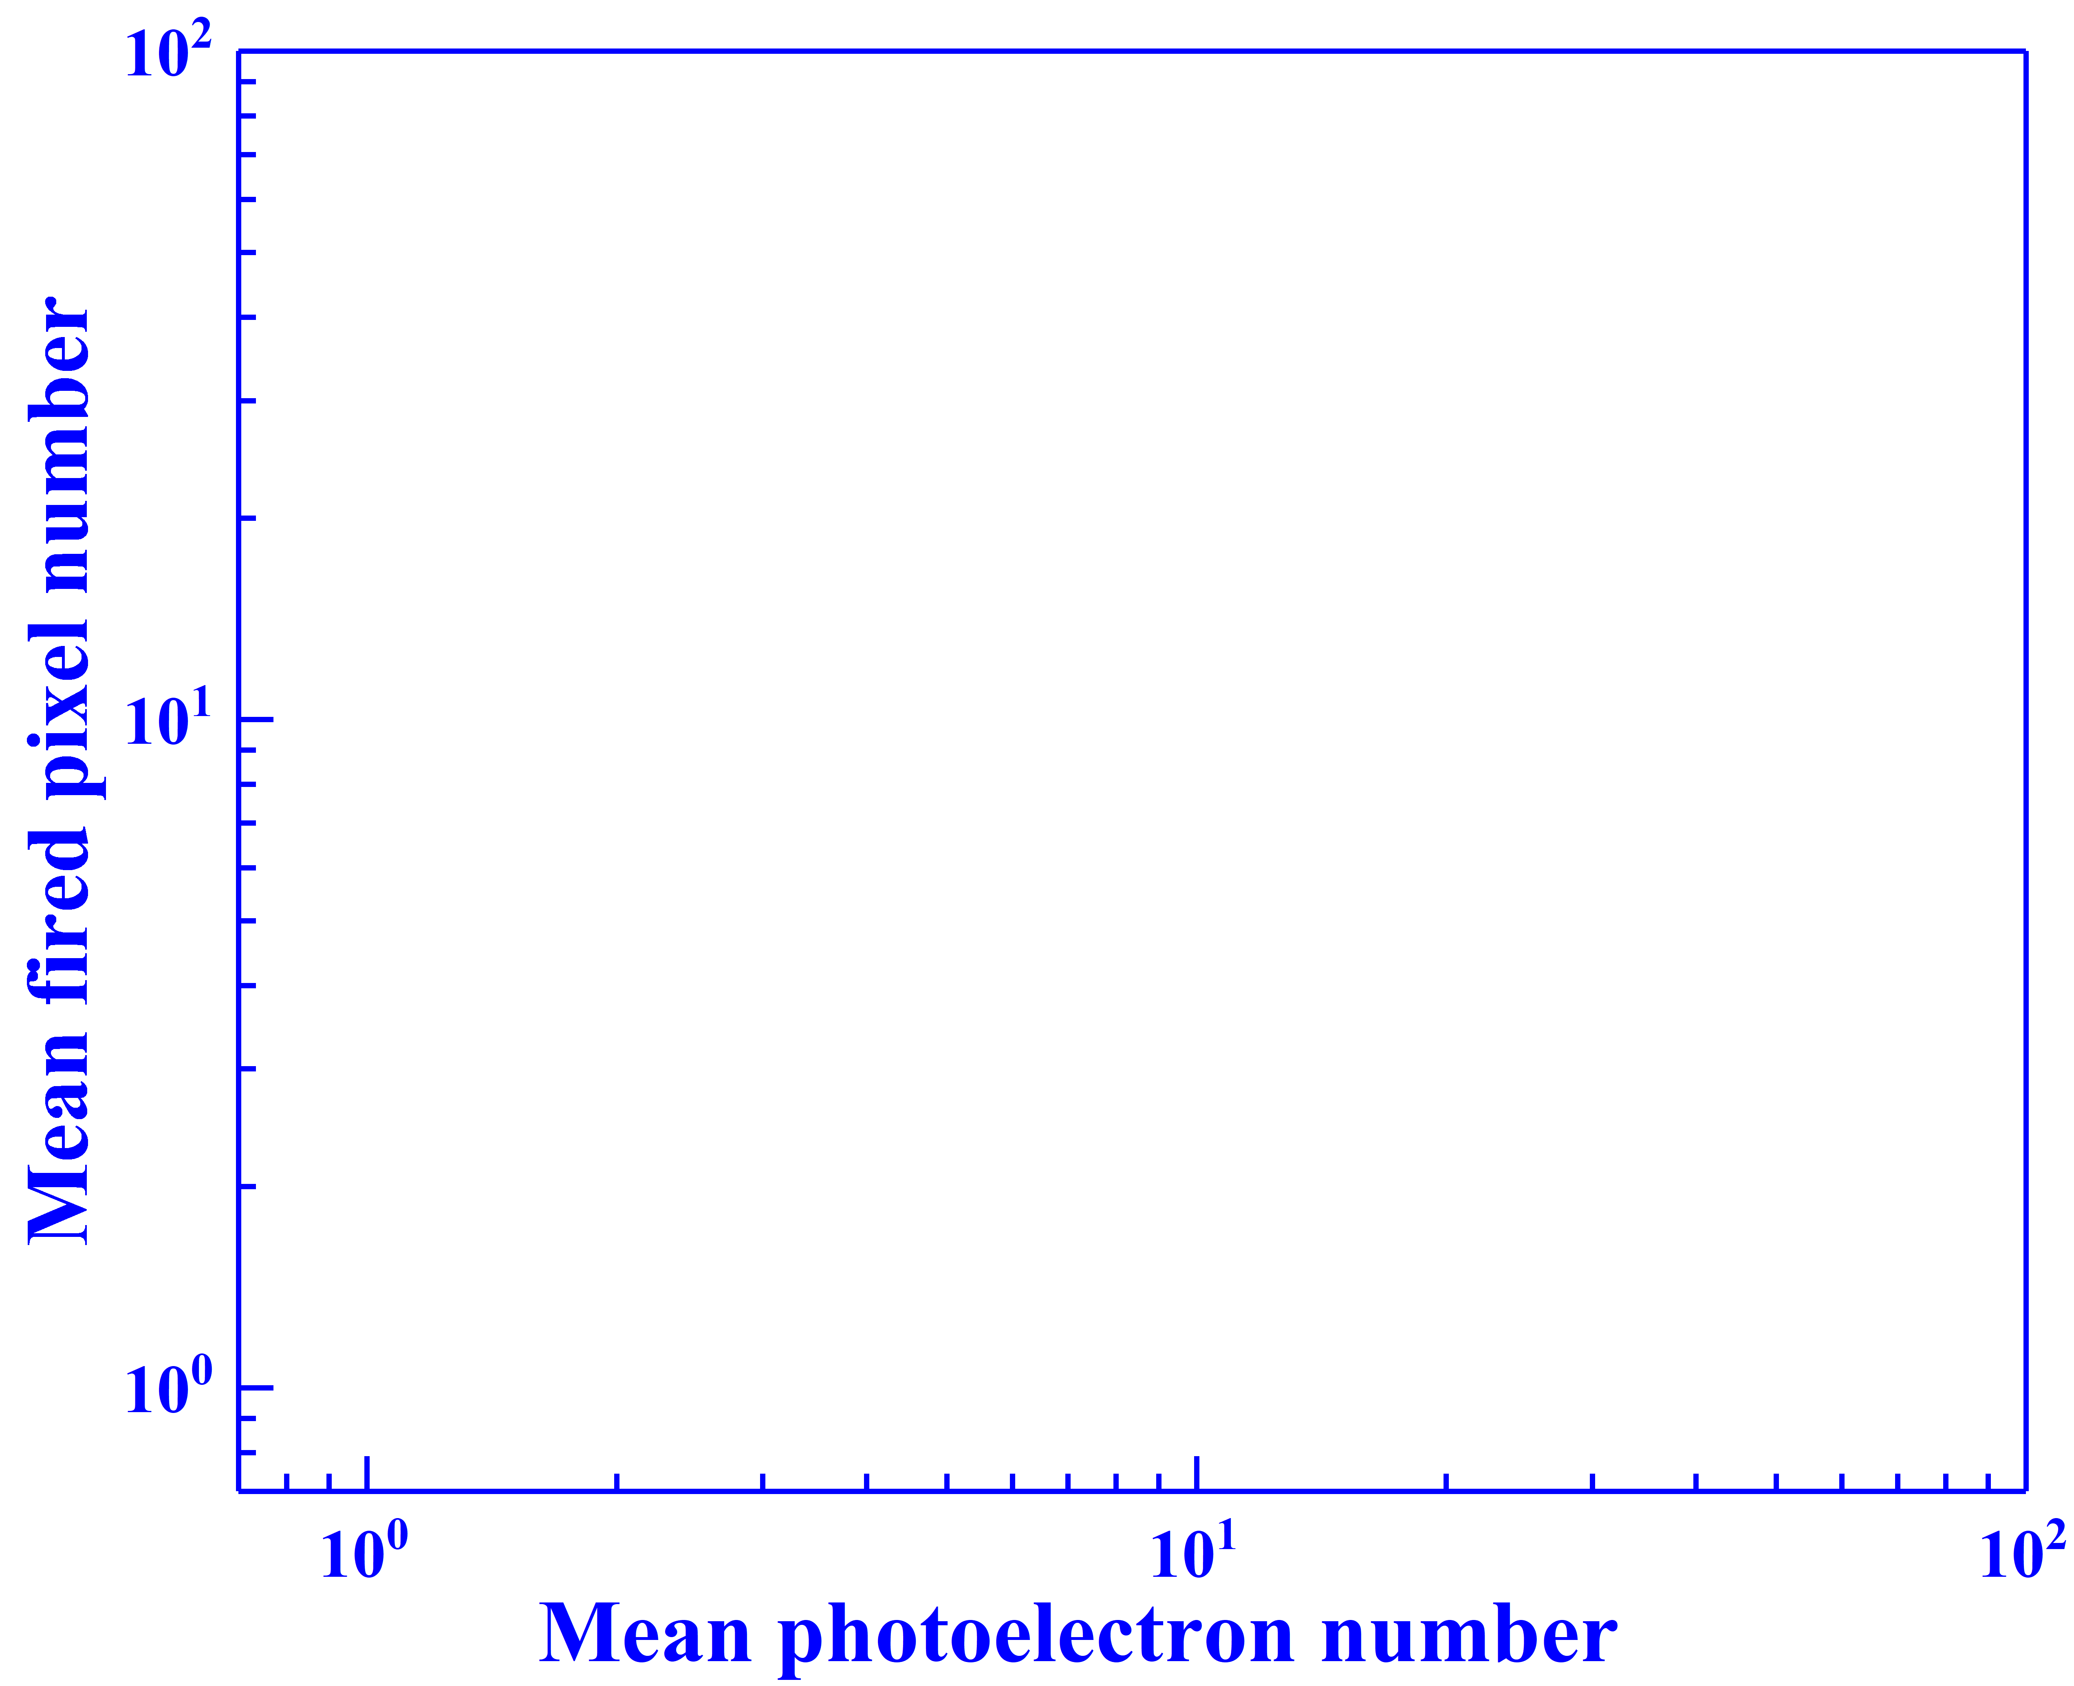
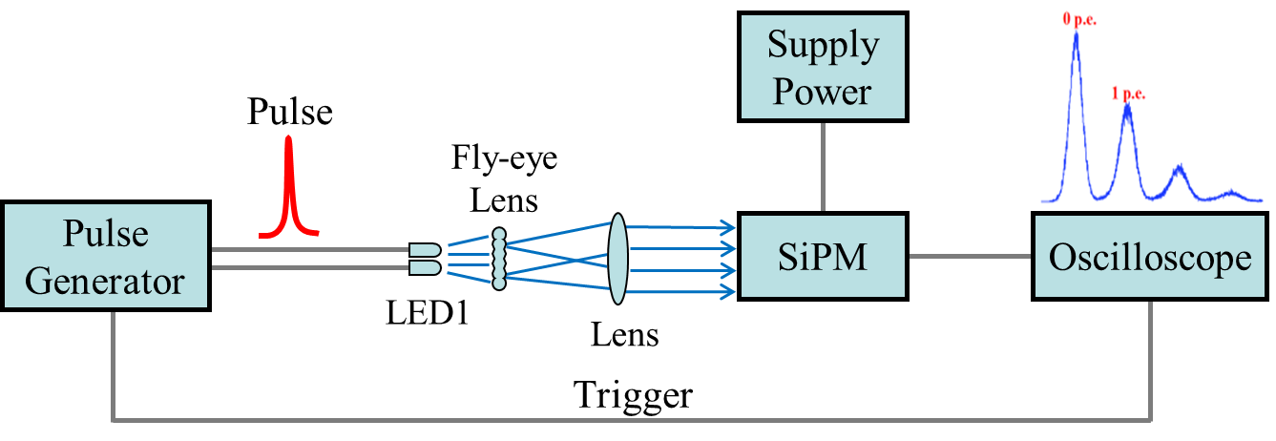
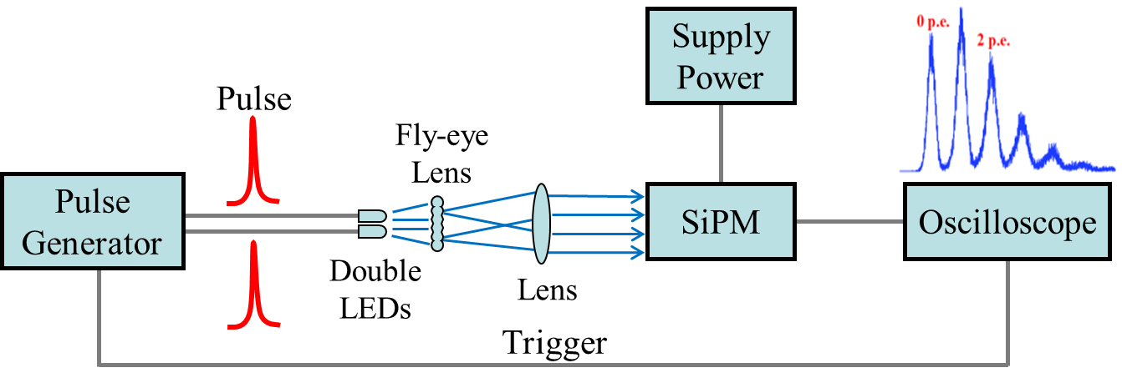
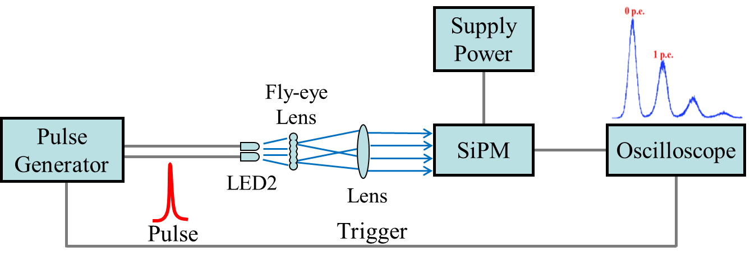
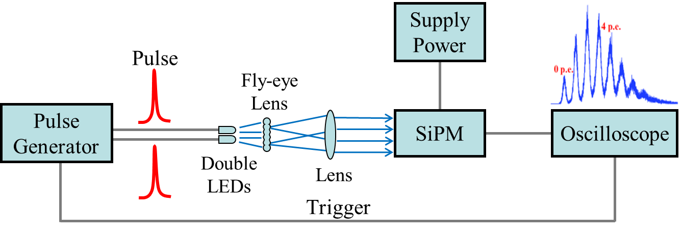

Procedures of the DLS method
.
.
$$MFPN=\frac{Q_{light}−Q_{dark}}{{∆Q}_{1p.e.}}$$
.
.
(16N_{init}, MFPN₅)
.
(8N_{init}, MFPN₄)
Step 5:
Increase the light intensity of each LED independently to achieve the same MFPN as the previous superposed one. Superpose the two light beams and re-measure the MFPN.
.
Step 2:
Calculate the mean photoelectron number N_{init} by zero peak statistics from the Poisson distribution (subtract the Poisson mean of dark counts). Record the mean fired pixel number.
(4N_{init}, MFPN₃)
Step 4:
Turn on the two LEDs. Superpose the two pulsed light and double the output . Re-measure the MFPN.
Step 1:
Turn on the LED1. Integrate the area of the signal from the SiPM, achieve about one pixel fired and obtain the pulse area distribution.
Step 3:
Turn off the LED1 and Turn on the LED2. Adjust the light intensity to make the same MFPN as the last output.
Step 6:
Follow this alternative and double increasing. The response curve can be obtained.
.
(2N_{init}, MFPN₂)
(N_{init}, MFPN₁)

Slide 10
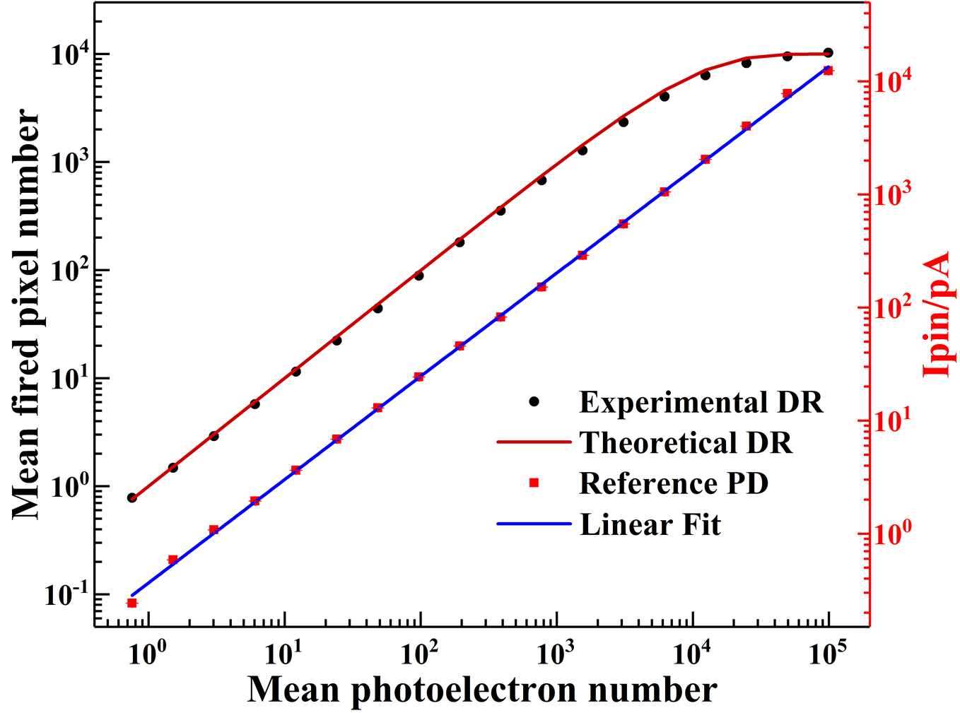

Experimental Results
NDL SiPM:
1 ×1 mm² pitch ~10μm ~10000 cells/mm²
Detect signal from single photoelectron to saturation about 10000 photoelectrons
Apply a reference p-i-n photodiode for external calibration and obtain the same exponential increase of the light intensity as the DLS method -- Same results as conventional DR measurement
$N_{fired}=N_{total}∙\left(1−e^{{{−N}_{pe}}/{N_{total}}}\right)$

Slide 11
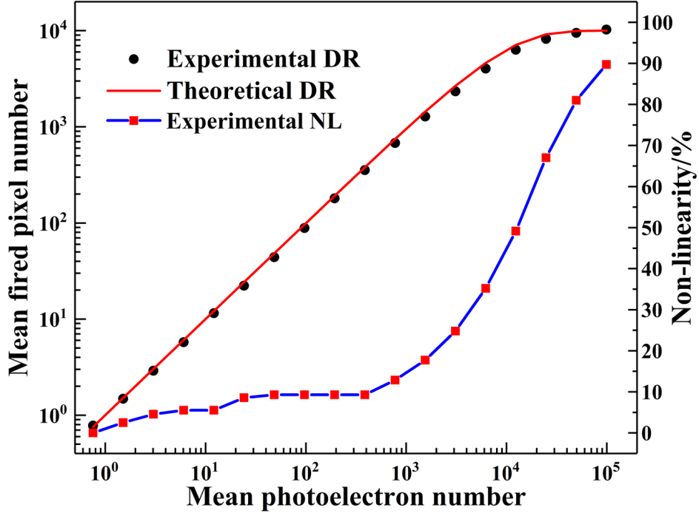
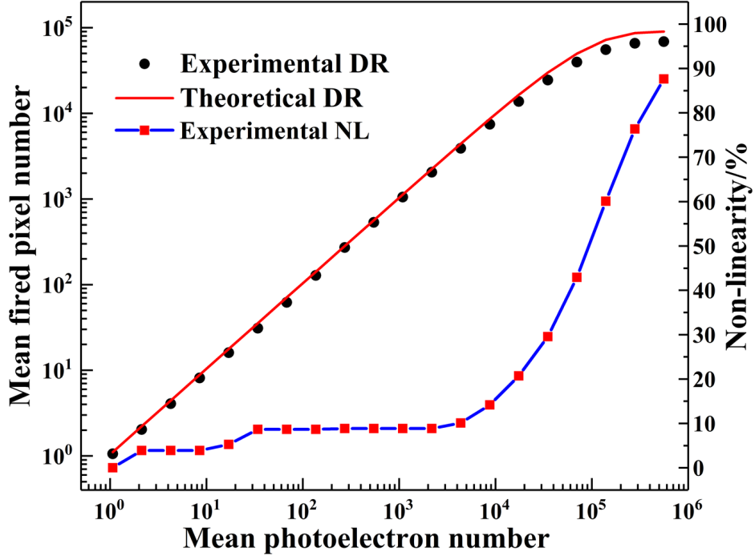

Experimental Results
1 × 1 mm² 10000 cells/mm²
3 × 3 mm² 10000 cells/mm²
$$NL= \left(1−\frac{R_{min}}{R_{max}}\right)×100\%$$
NL < 10%
~ 0.1N_{total}
~9000 p.e.

Slide 12
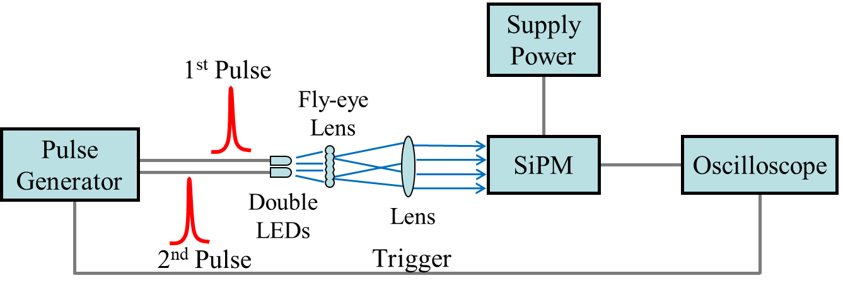
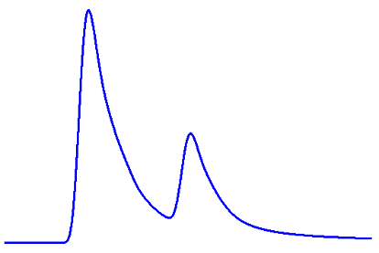
Recovery Time - Double Pulse Method
Fired pixels > 90%

Slide 13
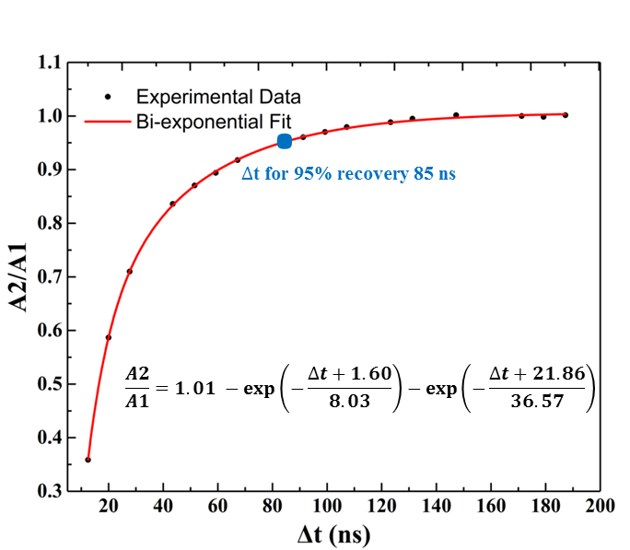
Recovery Time - Double Pulse Method
The recovery curve is fitted with bi-exponential function with two time constants.
The time differences of the two optical pulses for 95% recovery of the device are about 85 ns.
The maximum photon-counting rate is estimated ~12 MHz (1/85 ns） under the saturation response.

Slide 14
Conclusions
The DLS method can be a candidate of standard for DR measurement .
The linear response range (NL < 10%) of the device under test can be obtained from single photoelectron to ~ 0.1N_{total} photoelectrons.
The maximum photon-counting rate can be estimated by the recovery time under the saturation response.
Considering the linear response range and the maximum counting rate, the linear dynamic range of NDL SiPM (1 ×1 mm² pitch ~10μm ~10000 cells/mm²) can be estimated to be from 1 p.e. per pulse to 10¹⁰ p.e./s (~0.1N_{total} × 12 MHz).

Slide 15
Thank you for your attention!
NDL(Novel Device Laboratory, Beijing)
http://www.ndl-sipm.net

