Slide 1

Techniques for Characterizing Light Source Emission Statistics at Single-Photon Level
Paolo TRAINA
(In collaboration with Ivo P. Degiovanni)
ICASiPM 2018 - Schwetzingen

Slide 2
OUTLINE
Intro: g⁽²⁾(t) function
The Grangier parameter α
Generalization to n-th order
Working conditions
Applications
Conclusions
ICASiPM 2018 - Schwetzingen

Slide 3

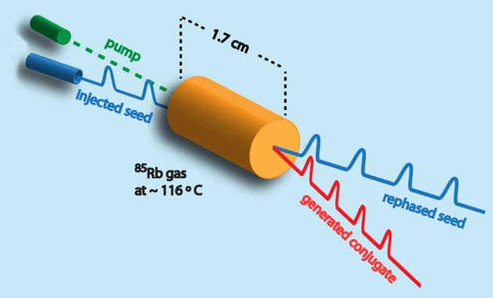
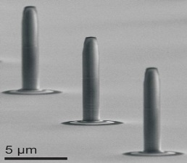
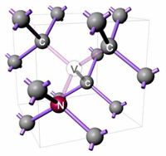
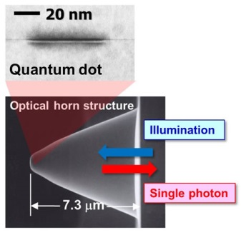
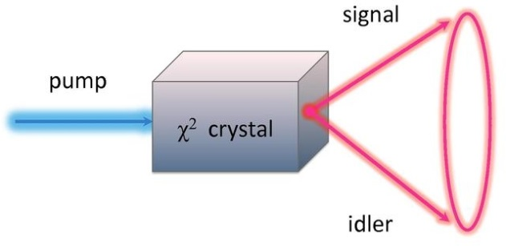
Single photon sources (SPS)
Ideal SPS:
Deterministic and on-demand: 100% photon emission probability at any time decided by the user (emission rate arbitrarily high);
Subsequent photons completely indistinguishable;
Two-photon emission probability: 0%.
Heralded sources
Real single photon emitters
FWM
NV
SPDC
Notes:
SPS necessaria per estendere la catena di riferibilità delle grandezze radiometriche (misura di p ottica per principio di sost elettrica con rad crio)
al regime di fotoconteggio tipico delle qtech. caratteristiche. Equivqale a stato di Fock, non classico e non presente in natura.

Slide 4


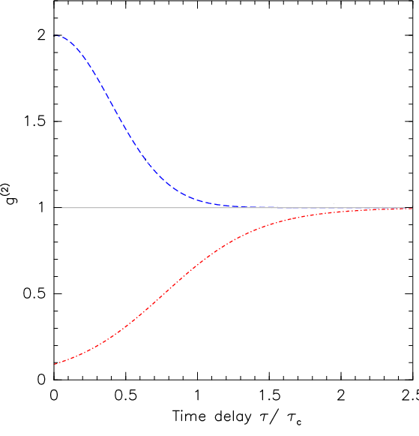
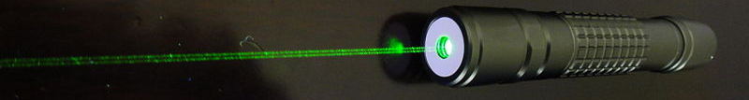

“g⁽²⁾”: Introduction
The second order intensity correlation function (or Glauber function) is defined as:
$$g^{\left(2\right)}\left(τ\right)=\frac{〈I(t)I(t+τ)〉}{〈I(t)〉〈I(t+τ)〉}$$
Chaotic source
(bunching, thermal)
Classical description is possible…
Single mode laser
(coherent, Poissonian)
SPS!
(Antibunching)
No classical description

Slide 5
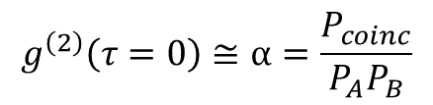
“g⁽²⁾” vs “α” parameter
Assuming low photon flux, g⁽²⁾(0) is equivalent to Grangier’s “α” parameter*:
$$g^{\left(2\right)}\left(τ=0\right)≅α=\frac{P_{coinc}}{P_{A}P_{B}}$$
Hanbury-Brown & Twiss
(HBT)
D_{A}
CC
D_{B}
The value of α is independent of:
the total efficiencies (η_{A}, η_{B}) of individual channels
Splitting ratio of the BS
*P. Grangier, G. Roger, and A. Aspect, Europhys. Lett. 11, 173-179 (1986).
ICASiPM 2018 - Schwetzingen

Slide 6

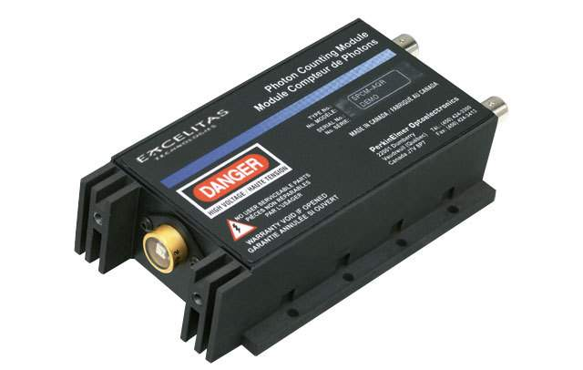
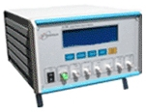
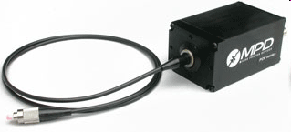
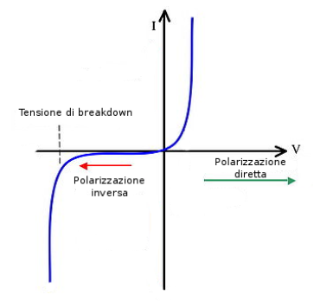


(Intermission)
On/Off Detectors:
Breakdown Voltage
“Geiger mode”
Forward Bias
Reverse Bias

Slide 7
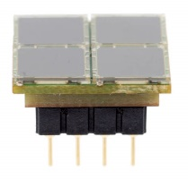

On/Off vs SiPM
PNR
Single-photon sensitivity
Cross-talk
ICASiPM 2018 - Schwetzingen

Slide 8

Manifold g-function...How to?
Detector tree configuration
BS
With four detectors in tree configuration, it is possible to measure up to the 4th-order Glauber’s self-correlation function:
BS
BS
Post-selection system:
Time-tagging instrumentation;
Post-selection software.
3 pigtailed 50%:50% beam splitters
4 On/Off detectors
(η = quantum efficiency)
ICASiPM 2018 - Schwetzingen

Slide 9
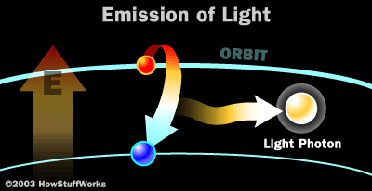

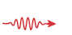
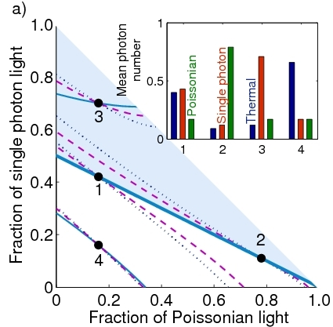
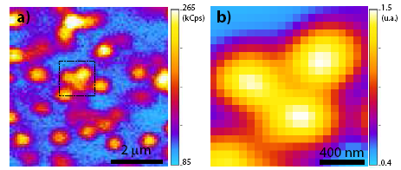
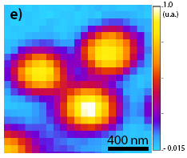
g^{(n)} as a resource
Proving non-classical emission (SPS)
Characterizing optical fields
Applications in Sensing (superresolution)

Slide 10
Working conditions(I)
P_{click}<0.1
1 thermal field
2 thermal fields
g⁽²⁾(0)
g⁽²⁾(0)
Log₁₀[thermal]
Log₁₀[thermal]
1 thermal +
1 Poissonian
For high photon flux, g⁽²⁾(0) collapses to «1» anyway!
g⁽²⁾(0)
Log₁₀[thermal]
ICASiPM 2018 - Schwetzingen

Slide 11
Working conditions(II)
P_{click}<0.1
…but SNR must be high!
1 «fixed»Thermal field
+ dark counts
g⁽²⁾(0)
For low SNR, the statistics is governed by DCR (Poissonian)
1 thermal +
1 Poissonian
x=Log₁₀[DCR]
ICASiPM 2018 - Schwetzingen

Slide 12
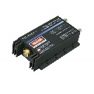
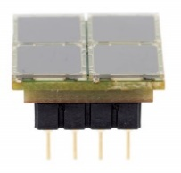
HBT vs SiPM
The architecture of SiPM in principle allows direct g^{(n)} measurement but…
…it requires pre-characterization of the device (efficiency, cross-talk, etc)
It is advisable to use SiPM like «overpowered» On/Off Detectors!
ICASiPM 2018 - Schwetzingen

Slide 13
Applications!
ICASiPM 2018 - Schwetzingen

Slide 14



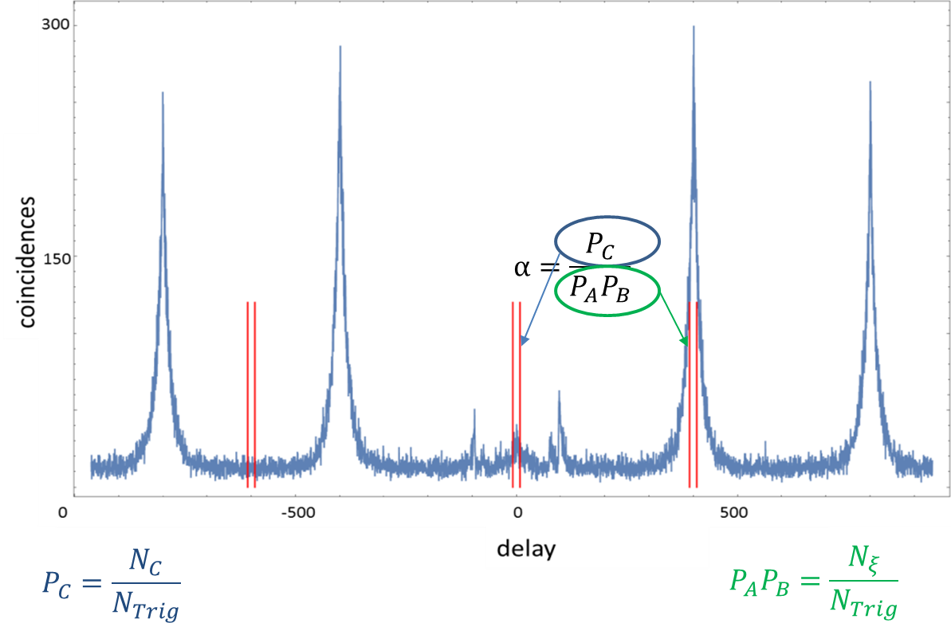
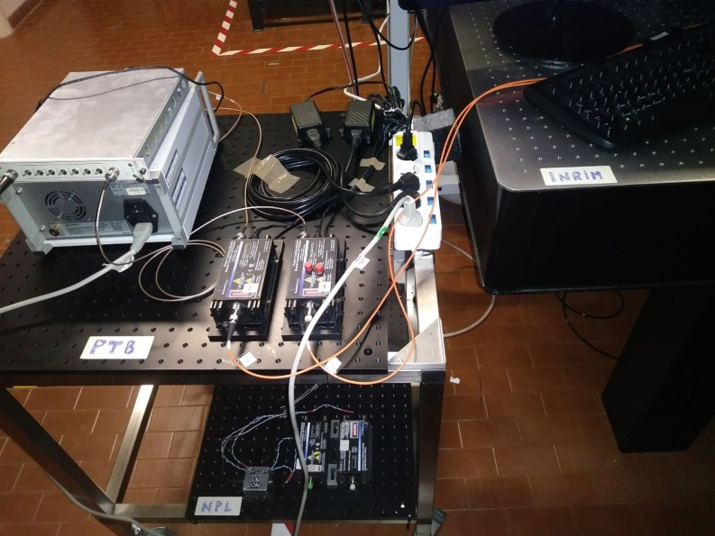
International comparison: g⁽²⁾(0) Measurement in the VISIBLE
(EMPIR 14IND05 MIQC2)
INRIM, Torino, October 16th - 29th 2017
To provide a snapshot of the measurement capabilities of European National Metrology Institutes (NMI) in the area of photon counting detection, a joint measurement of g⁽²⁾(0) among three NMIs been hosted at INRIM
Emitter: single NV center in diamond, pulsed excitation
Goal: To allow the participants and the scientific community to better understand the technical challenges and resources required to move from research projects to more standard measurement service
The Setup
Participants: INRIM (Host), NPL, PTB

Slide 15
International comparison: g⁽²⁾(0) Measurement in the VISIBLE
(EMPIR 14IND05 MIQC2)
INRIM, Torino, October 16th - 29th 2017
To provide a snapshot of the measurement capabilities of European National Metrology Institutes (NMI) in the area of photon counting detection, a joint measurement of g⁽²⁾(0) among three NMIs been hosted at INRIM
Emitter: single NV center in diamond, pulsed excitation
Goal: To allow the participants and the scientific community to better understand the technical challenges and resources required to move from research projects to more standard measurement service
The Setup
(In preparation)
Participants: INRIM (Host), NPL, PTB

Slide 16
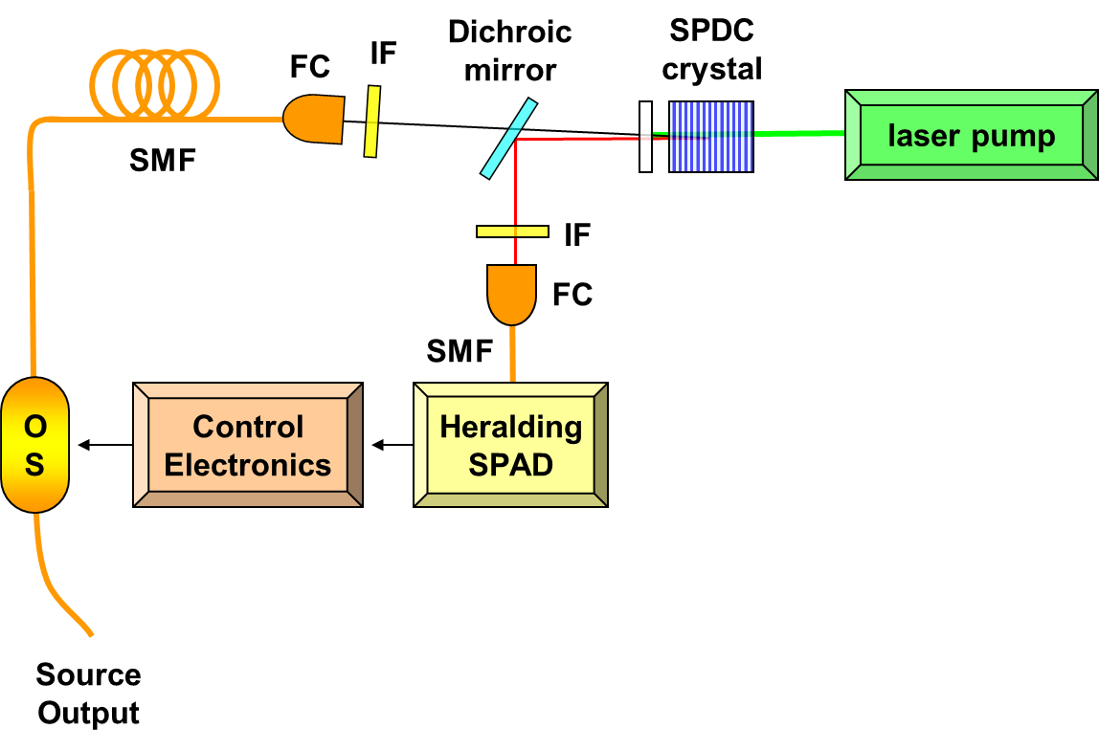
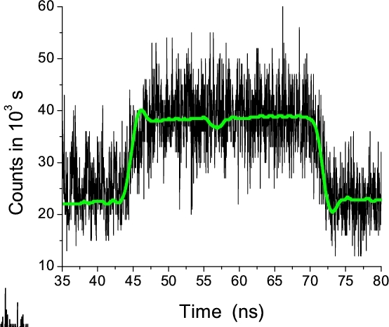
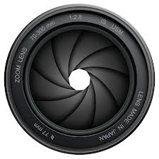

Joint measurement of the $g^{\left(2\right)}(0)$ of a “noiseless” heralded SPS @1550 nm
(In preparation)
t_{open}
The Optical Switch works as an electro-optical shutter, open for a short time (t_{open}) only when a heralded photon arrives, to suppress the “noise” photons: no need for post-selection!
The Control Electronics waits a custom $∆t$ (greater than the measuring device dead time) before accepting a second heralding: no dead-time effects affecting the measurements!
Noiseless Heralded SPS: APL 101 221112 (2012)

Slide 17
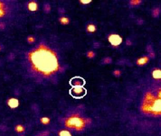
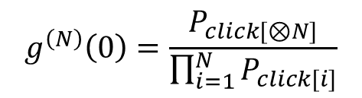
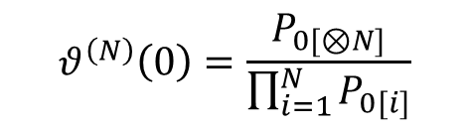
We experimentally demonstrated [1]for the first time a recently proposed criterion [2] which is capable of detecting nonclassical behavior in the fluorescence emission of ensembles of single-photon emitters.
1- poissonian noise off,
2- 10000 counts/s due to noise,
3- 25000 counts/s due to noise.
bins
Item 1
Item 2
-6 runs of 200 s
-excitation rate: 5 MHz.
-Red dot: stabilty test.
vs
More robust to poissonian noise!
[1] E. Moreva et al., Phys. Rev. B 96, 195209 (2017)
[2] L. Lachman et al., Scientific Reports 6, 19760 (2016).

Slide 18


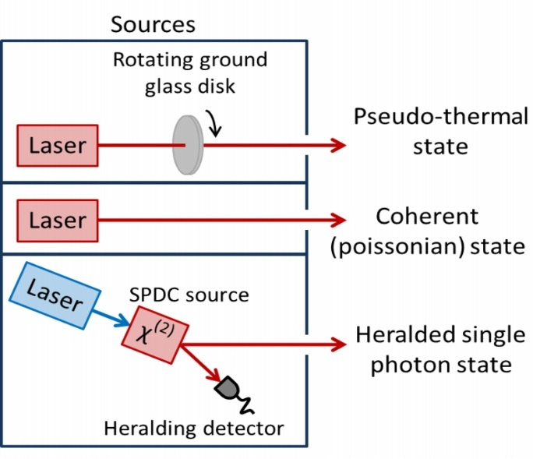


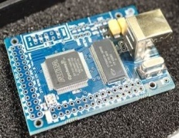
Mode reconstruction via multiphoton statistics
In collab. with:
Multi-mode states combination of poissonian, thermal and single-photon modes:
BS
BS
BS
Dotted blu lines: constant g⁽⁴⁾(0).
Dashed purple lines: constant g⁽³⁾(0).
Solid cyan lines: constant g⁽²⁾(0).
Light blue shaded area: nominally non-classical states (g⁽²⁾(0) < 1) region.
Even states 1, 2, and 4 (outside the shaded area) show a non-classical component!
Phys. Rev. A 88, 013822 (2013)
ICASiPM 2018 - Schwetzingen
nome, date e luogo della conferenza

Slide 19




Take-away
g⁽²⁾(t) function (and g^{(n)}) is a fundamental tool (not only!) for characterizing optical fields
It can be directly sampled by non-PNR detectors (HBT, Grangier’s α)
Trade-off between low flux and SNR
Direct measurement exploiting PNR features of SiPM requires pre-characterization of the detector. Use SiPM like On/Off detectors!
Funding:
Premiale Q-secGroundSpace
Thank you for your attention!
ICASiPM 2018 - Schwetzingen

Slide 20
BACKUP

Slide 21
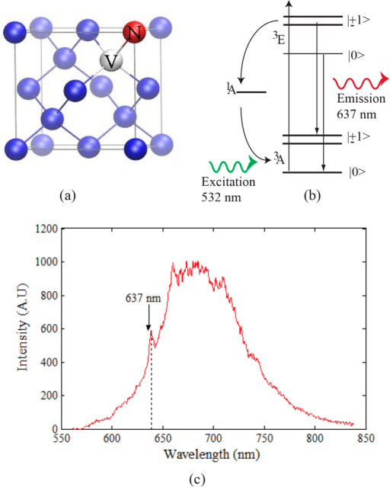

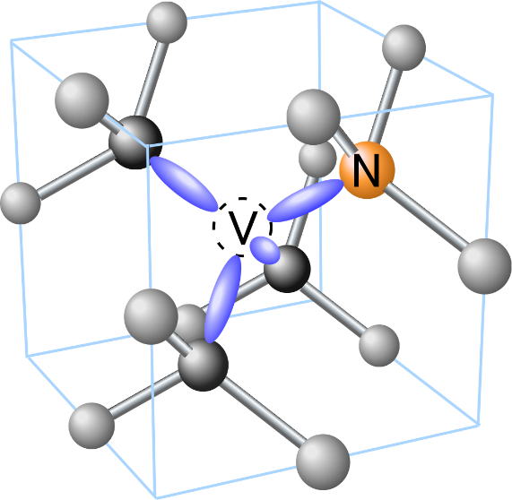
The source: NV center in ND
High photostability
Ambient temperature
Nanoscale magnetic sensor
Final Meeting: May 2018 - INRIM

Slide 22
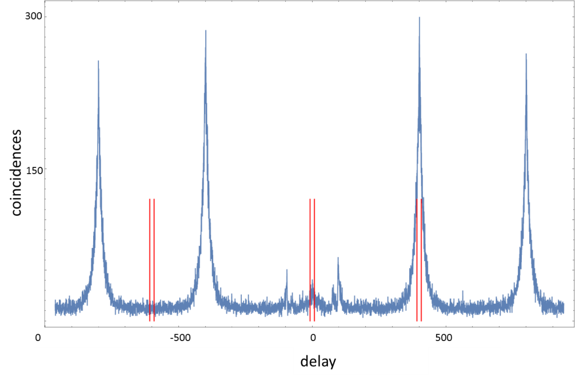
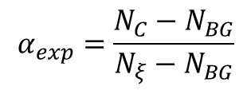


Model (II)
Including the effects of the background coincidences:
$$α_{exp}=\frac{N_{C}−N_{BG}}{N_{ξ}−N_{BG}}$$
We have developed a model accounting for the dead-time of the detectors effect and we observed that no significant events are lost.
Backflash peaks
$$P_{coinc}=\frac{N_{C}}{N_{Trig}}$$
$$P_{A}P_{B}=\frac{N_{ξ}}{N_{Trig}}$$
where:
Final Meeting: May 2018 - INRIM

Slide 23
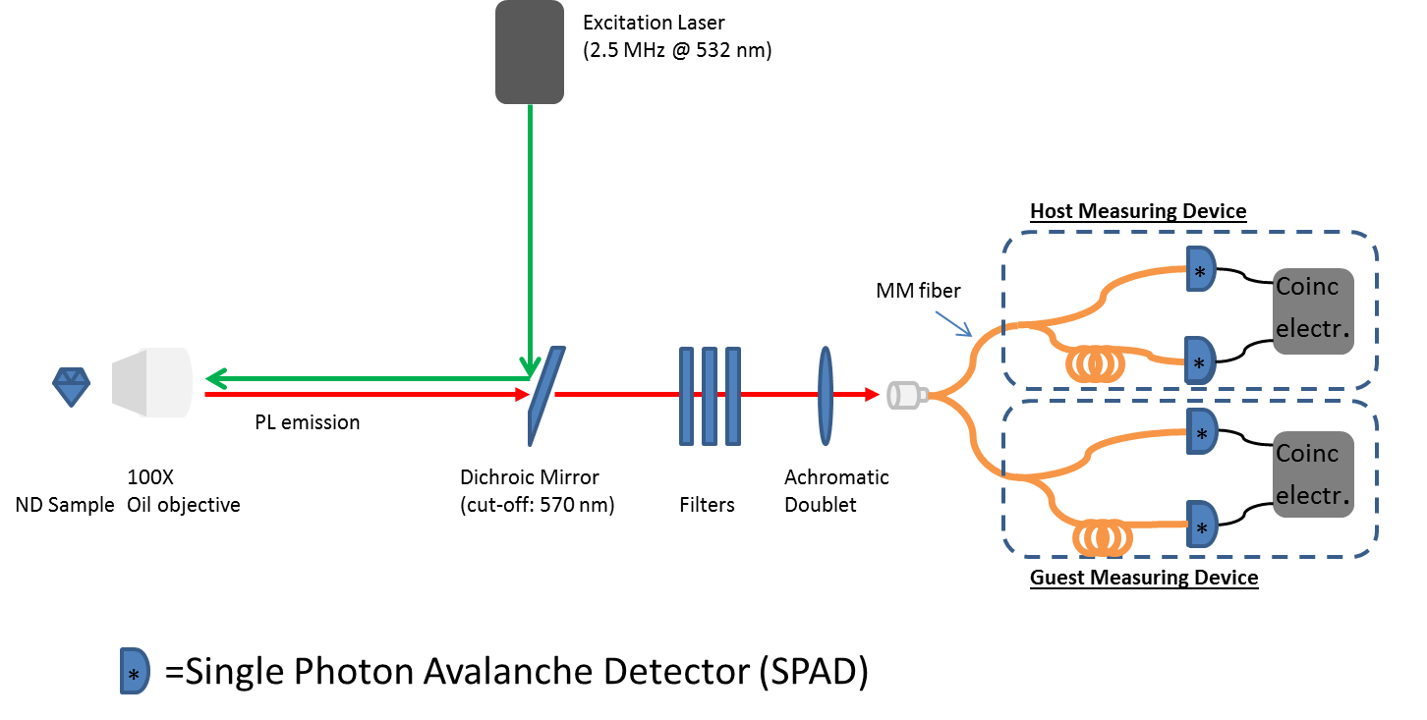
Experimental set-up
INRiM:
-fused 50:50 Beamsplitter;
-2 Excelitas SPCM-AQR SPADs;
-ID Quantuque “ID800” TDC.
NPL:
-fused 50:50 Beamsplitter;
-2 Excelitas SPCM-AQR SPADs;
PicoQuant “HydraHarp 400” TSPC module.
PTB:
-fused 50:50 Beamsplitter;
-2Excelitas SPCM-AQR SPADs;
-PicoQuant “HydraHarp 300” TSPC module.
Each measurement: 10 runs of 500 seconds Coincidence window: 16 ns
Coupling efficiency of system: η_{TOT} =1.76 ± 0.01%
Final Meeting: May 2018 - INRIM

Slide 24

1550 nm HSPS joint measurement setup
SMF
Dichroic
mirror
10x1x10 mm
PPLN
FC
IF
CW laser pump
λ/4
532 nm
IF
λ/2
1550 nm
FC
810 nm
λ/4
SMF
SPCM-AQR
MPD
InGaAs
MPD
InGaAs
Coinc
Coinc
O
S
Fast
Pulse
Generator
FPGA
FBS
FBS
MPD
InGaAs
MPD
InGaAs
CH B
CH A
INRiM
HBT
InGaAs
SPAD
Coinc
FBS
Guest
HBT
FBS
InGaAs
SPAD
Final Meeting: May 2018 - INRIM

Slide 25

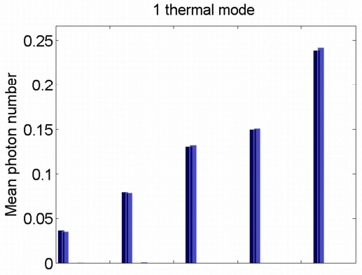
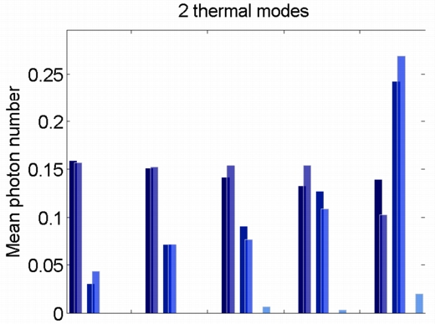
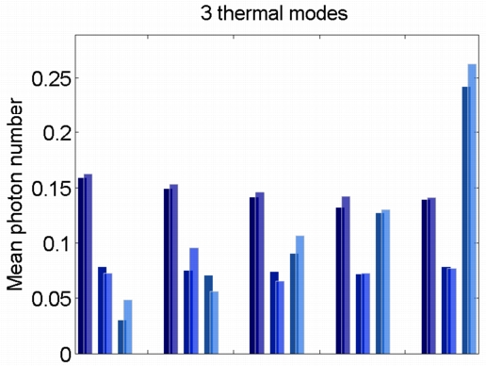
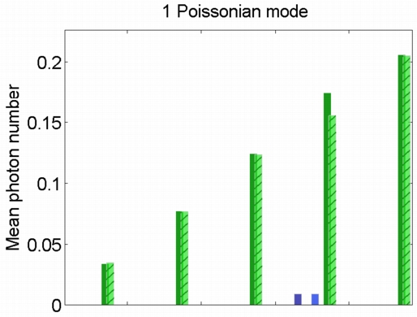
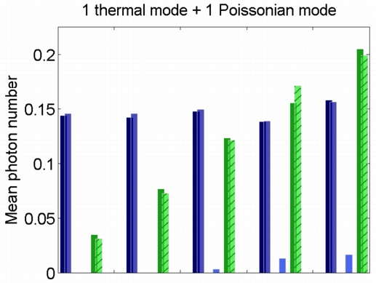
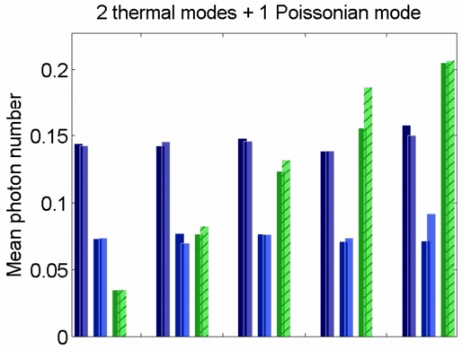
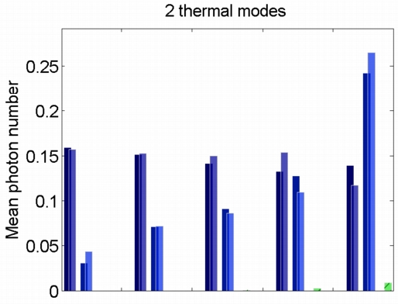
Experimental Results(I)
Pure thermal modes
Thermal + Poissonian modes
The algorithm is tuned in order to recover the mode structure of a field with just pseudo-thermal modes;
The fidelity of all the reconstructions shown is above 99%.
2 thermal + 1 «fake» poissonian mode

Slide 26
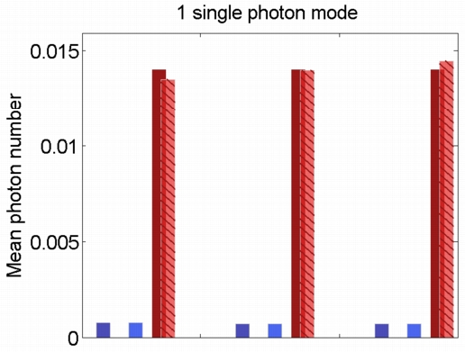
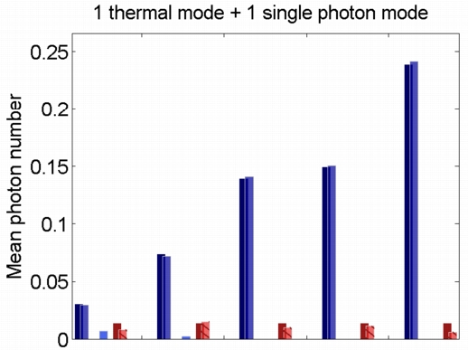
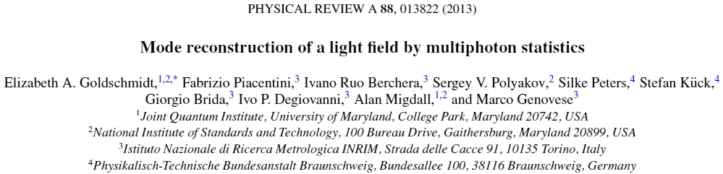
Towards D1.1.4 - Higher order g-function as a tool for the investigation of ...
Experimental Results(II)
Occupation modes of a single photon state heavily polluted by a thermal field
Reconstructed mode structure of the single photon state generated by our NHSPS (g⁽²⁾(0) < 0.05)
The mode structure of this state presents non-classical components, even if the state is nominally classical!
EXL02 – SIQUTE Interim Meeting 13 – 14 November, CEA, Grenoble

