Slide 1





Large scale characterization of SiPMs in the MEG II experiment
Y. Uchiyama (The University of Tokyo)
on behalf of MEG II collaboration
International Conference on the Advancement of Silicon Photomultipliers
12 Jun, 2018 @ Schwetzingen

Slide 2
Applications & usage of large number of SiPMs in MEG II
Not an R&D for future experiments
but in use in a real experiment
  Detectors have already been constructed and operated.
  Mass pro. by companies, their quality, pre-test & characterization, calibration during the experiment, etc.
2012
2015
2019
R&D
Construction/
commissioning
Run
SiPM production
in 2014–2015

Slide 3
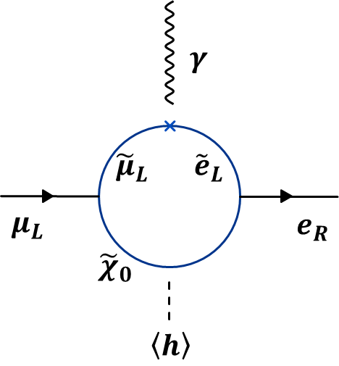
MEG II: in search of μ⁺ → e⁺γ
To get definitive evidence for BSM
An intensity frontier experiment
Upgraded from MEG experiment
    The upgrade largely relies on the application of SiPMs
MEG final result (2016)
B(μ⁺ → e⁺γ) < 4.2×10⁻¹³
(90% C.L.)
(while 5.3×10⁻¹³ expected)
×2 intensity muon beam
×2 resolution everywhere
×2 efficiency
μ⁺: World’s most intense DC muon beam @ PSI
γ : Detect with liquid xenon scintillation detector
e⁺: Detect with gradient B-field spectrometer
(drift chamber & timing counter inside)
Search for μ⁺ → e⁺γ down to
6×10⁻¹⁴
(90% C.L. sensitivity)

Slide 4
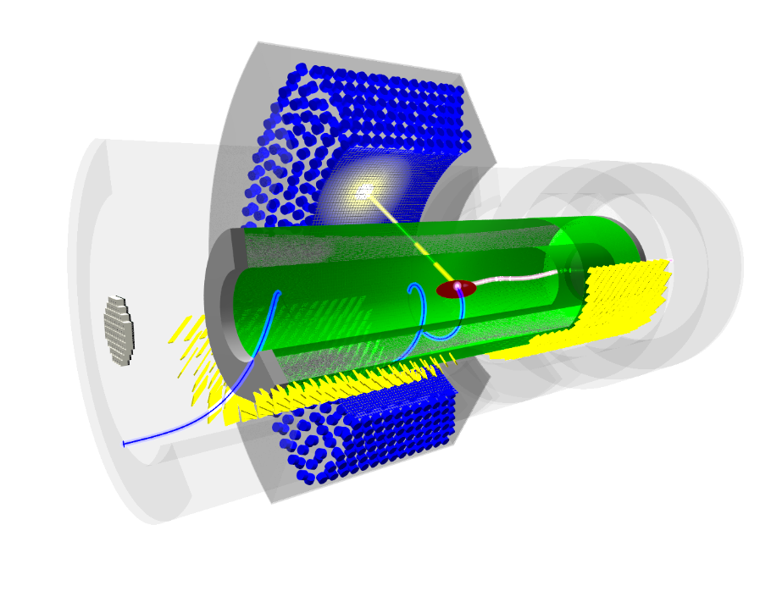
MEG II design (EPJ-C 78(2018)380)
Liquid xenon photon detector
(LXe)
COBRA
superconducting magnet
γ
μ⁺
e⁺
Pixelated timing counter
(pTC)
Muon stopping target
Cylindrical drift chamber
(CDCH)
Radiative decay counter
(RDC)
Scintillation detectors with SiPM

Slide 5
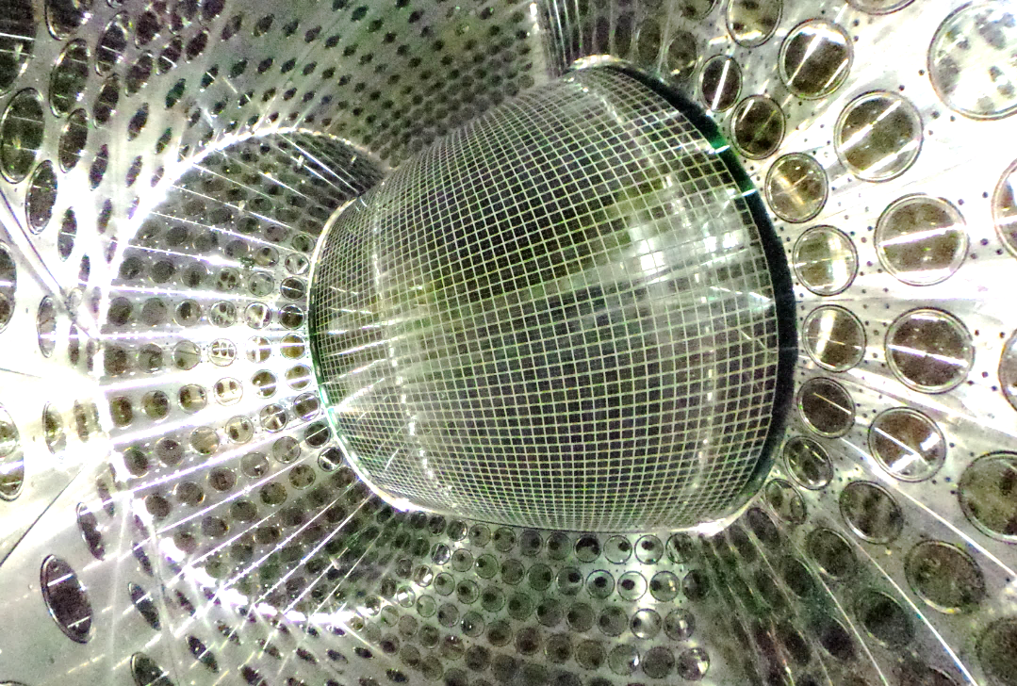
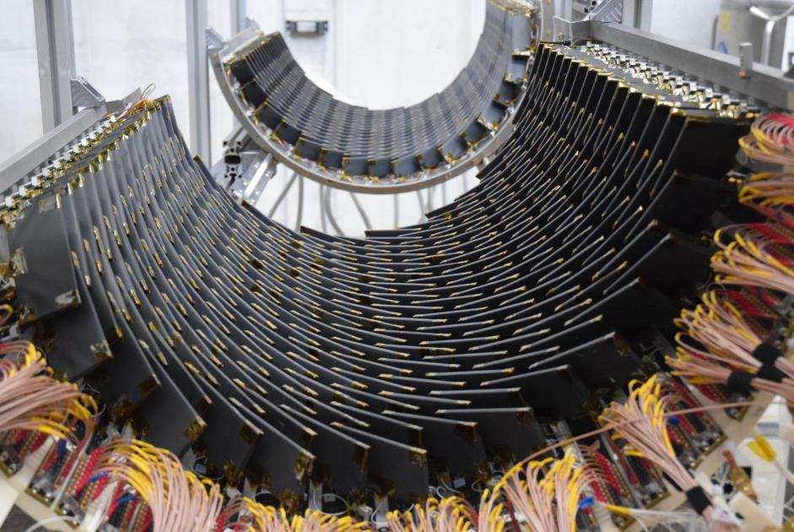
Two large-scale SiPM-based detectors
Liquid Xenon photon detector
Pixelated Timing Counter
For γ energy, timing & position measurement
SiPM for the readout of liquid xenon scint. light
Highly granular readout (4092 ch)
Total 4092×4=16368 SiPMs
  From Hamamatsu Photonics
  Large size (12×12 mm²) by 4 chips in a package (‘hybrid’ connection)
  VUV sensitive (λ=175 nm)
  Used at low temperature (-100℃)
For e⁺ timing measurement
SiPM for the readout of plastic scint. counters.
Highly segmented design (512 counters)
12 SiPMs/counter, 6 (series connection)×2 sides
Total 6144 SiPMs
  From AdvanSiD
  3×3 mm², 50 um pitch
See W. Ootani’s talk (on Fri.) for the device and detector

Slide 6
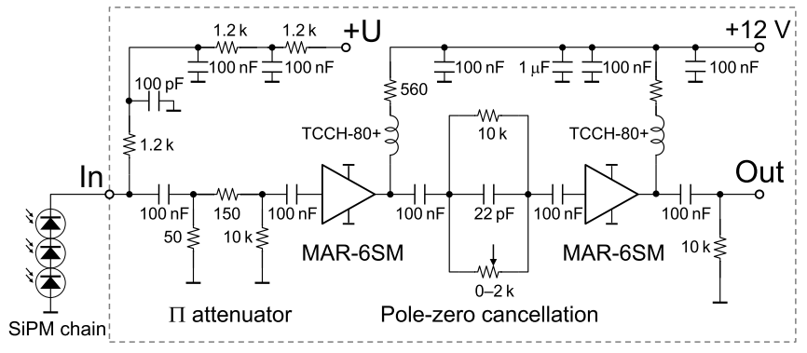
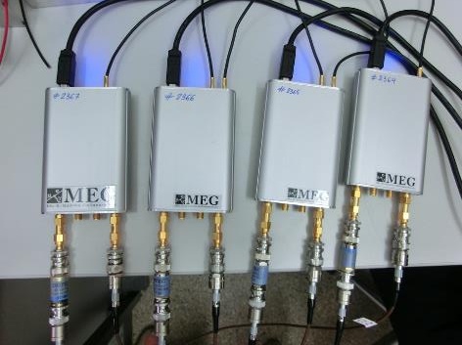
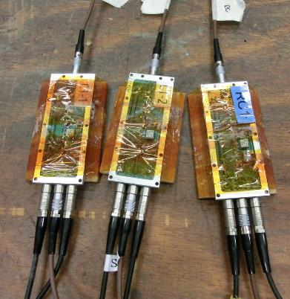
Readout electronics in pre-tests
During the R&D and mass test, we used standalone readout system.
KEITHLEY picoammeter
Amplifier developed at PSI (by U. Greuter)
DRS4 evaluation board (by S. Ritt)
  https://www.psi.ch/drs/evaluation-board
  4 ch waveform digitizer
  able to daisy-chain multiple boards
USB→PC

Slide 7
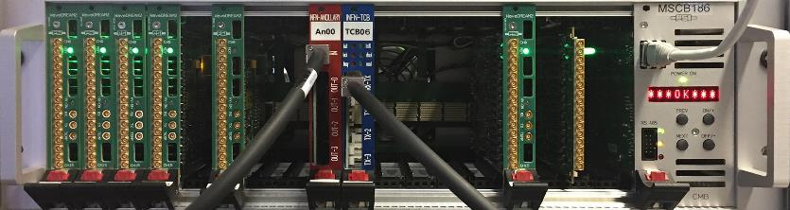
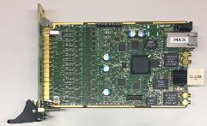
Readout electronics in the experiment
256 channels/crate
New DAQ/Trigger system being developed: WaveDAQ system
  Used for all MEG-II detectors in common
  Dense & compact system to cope with increased # of channels.
  Away from VME crates
  No pre-amplifier at detector side
  Custom multi-functional readout board: WaveDREAM
    Analog FE (programmable shaper & amplifier),
    SiPM bias-voltage supply, waveform sampling (DRS4),
    digitization, discriminator, FPGA-based trigger in one module
  Synchronization accuracy < 20 ps (over different crate modules)
16 channels/module

Slide 8
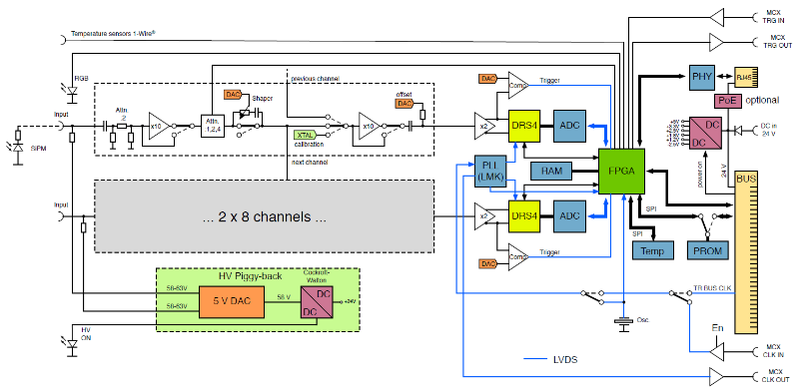
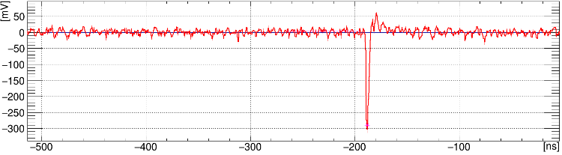
Readout electronics in the experiment
2-stage amplifier
Digitization
Trigger
Pole-zero cancellation
256 channels/crate
New DAQ/Trigger system being developed: WaveDAQ system
  Used for all MEG-II detectors in common
  Dense & compact system to cope with increased # of channels.
  Away from VME crates
  No pre-amplifier at detector side
  Custom multi-functional readout board: WaveDREAM
    Analog FE (programmable shaper & amplifier),
    SiPM bias-voltage supply, waveform sampling (DRS4),
    digitization, discriminator, FPGA-based trigger in one module
  Synchronization accuracy < 20 ps (over different crate modules)
Sync.
HV supply
SiPM signal waveform
digitized at 2.0 GSPS
baseline restoration by
the pole-zero cancellation
16 channels/module

Slide 9
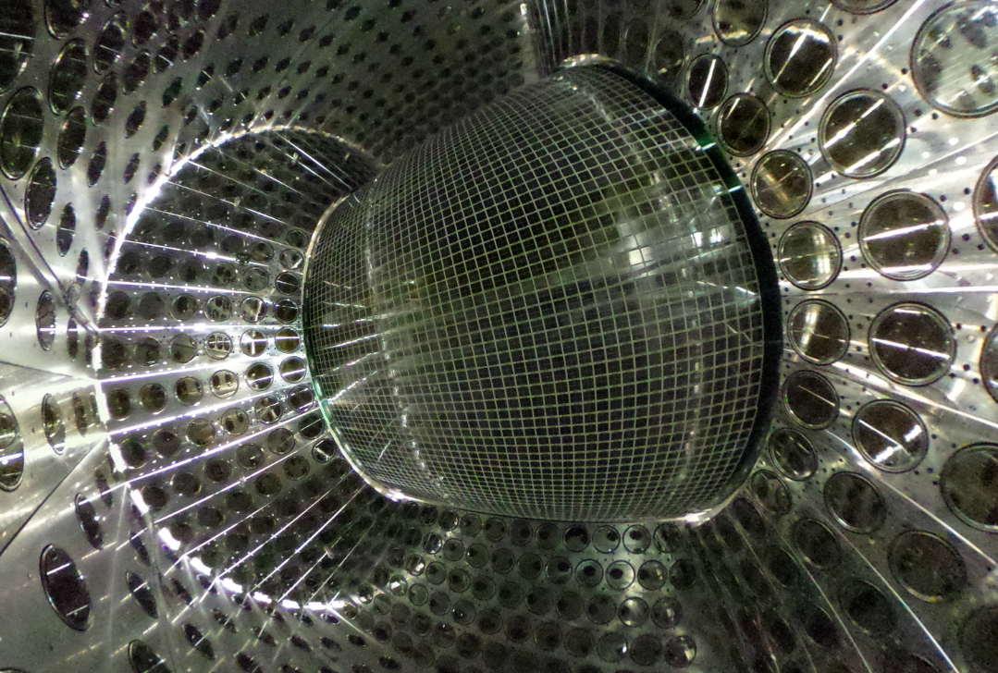
Liquid xenon
photon detector

Slide 10
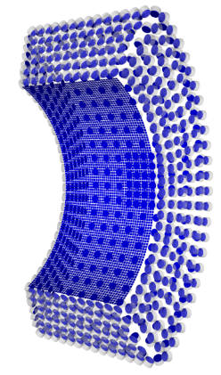
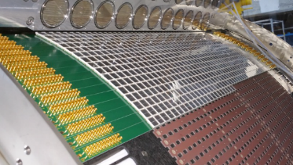
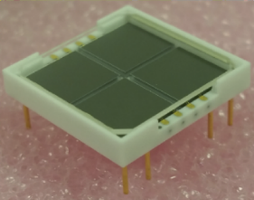
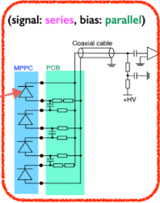
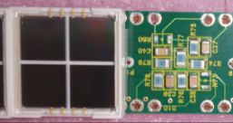
LXe-MPPC structure
An assembly PCB
An MPPC (S10943-4372)
A chip
~1 m²
6 mm
6 mm
A VUV-sensitive large-area MPPC consists of 4 independent SiPM chips
  Chips with similar V_{bd} are selected.
  Able to readout individually.
  We connect them on the assembly PCB
‘Hybrid’ connection
a chip

Slide 11
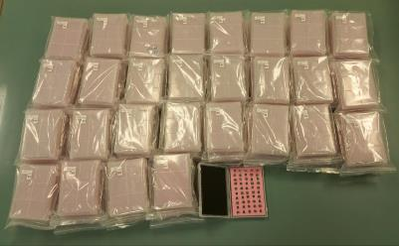
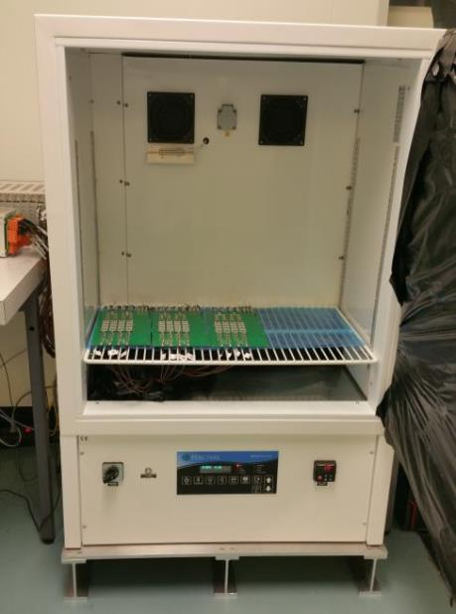
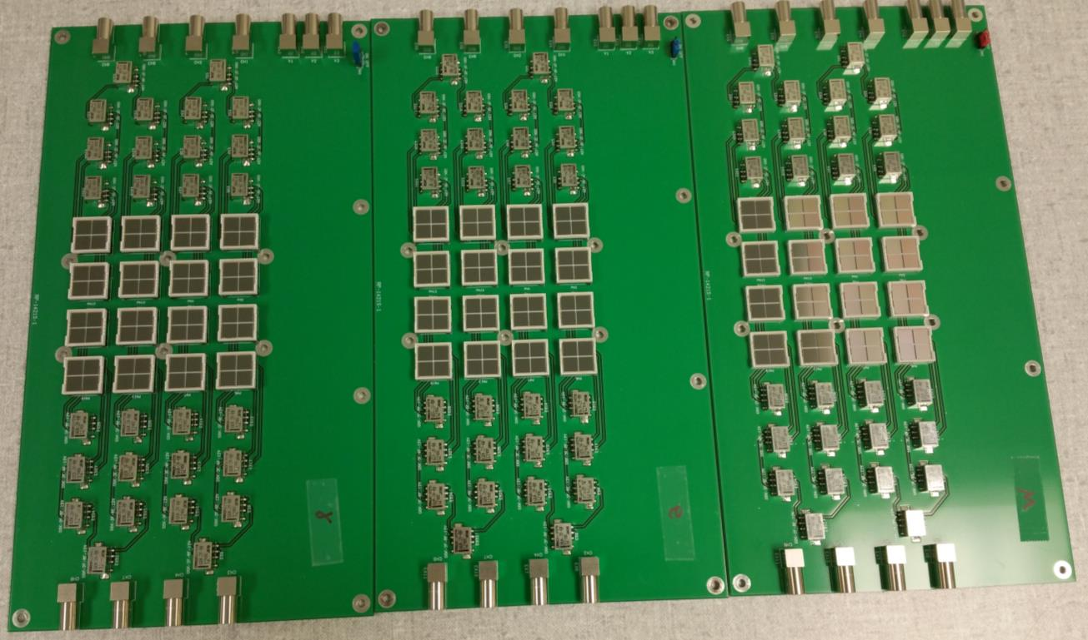
Mass test 1: individual chip test
To identify bad chips,
we measured I-V characteristics for all 4200×4 chips.
  Breakdown voltage (V_{bd})
  Leakage current @ V_{over} = 5.0 V (I_{meas})
  Shape of I-V curve
Setup for mass test 1
Multiplexing PCBs
~40 MPPCs (~160 chips) are measured at once.
Temperature:20℃
relays to change the readout
chips
~250 MPPCs / day

Slide 12
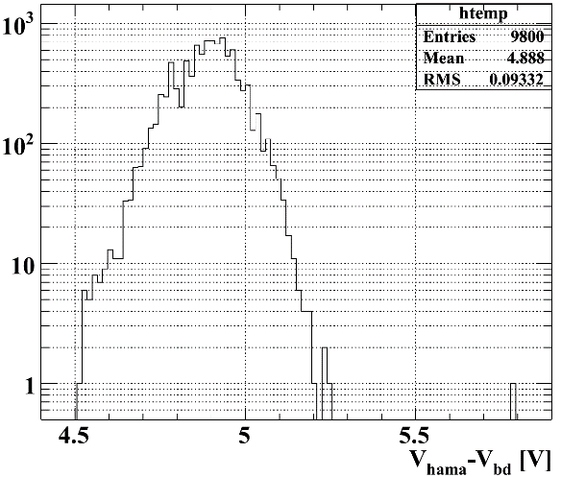
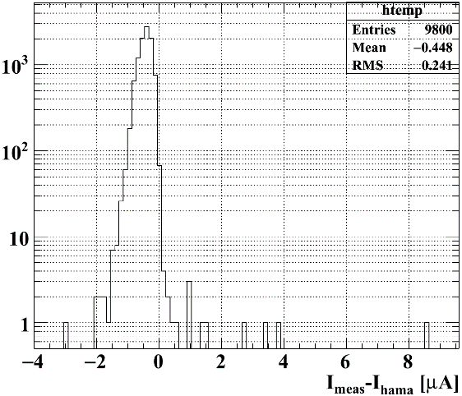

Mass test 1: individual chip test
To identify bad chips,
we measured I-V characteristics for all 4200×4 chips.
  Breakdown voltage (V_{bd})
  Leakage current @ V_{over} = 5.0 V (I_{meas})
  Shape of I-V curve
compare with the data sheet (V_{hama}, I_{hama})
Operation voltage
from data sheet
Measured breakdown voltage
Measured current at V = V_{bd}+5.0 V
Current at V_{hama} from data sheet
(gain=2.0x10⁶ @ 25$℃$)
V_{hama} – V_{bd}
I_{meas} – I_{hama}
large current chips
x ~10
one outlier
Fraction of outlier chips is very small.

Slide 13
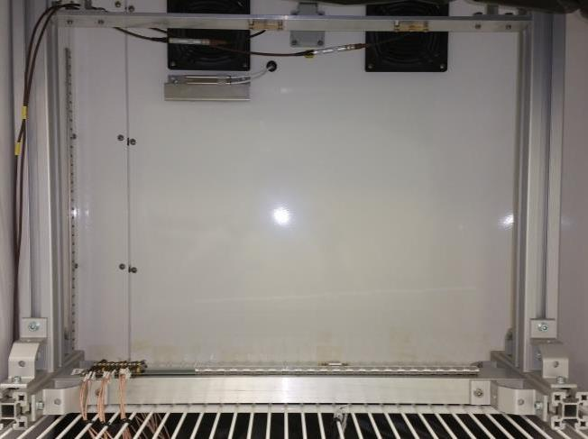
Mass test 2: MPPC test on PCB
To test MPPC signals
LED1
LED0
Waveform and charge were measured for all MPPCs on every PCB.
Temperature:20℃
reference MPPC
Data taking with strong LED light
V=V_{hama} (operation voltage from spec. sheet, V_{over}~5V)
MPPC mounting + test = ~15min/PCB
186 PCBs → ~47hours in total

Slide 14
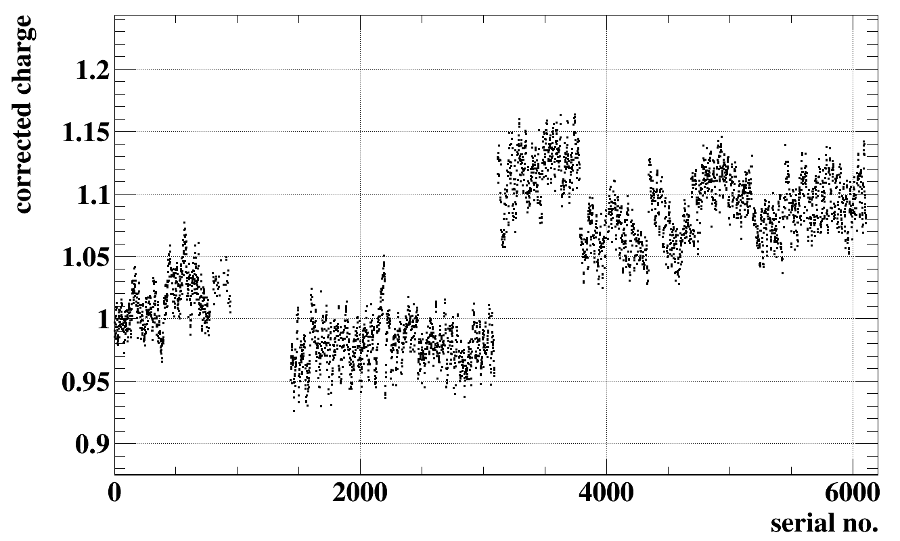
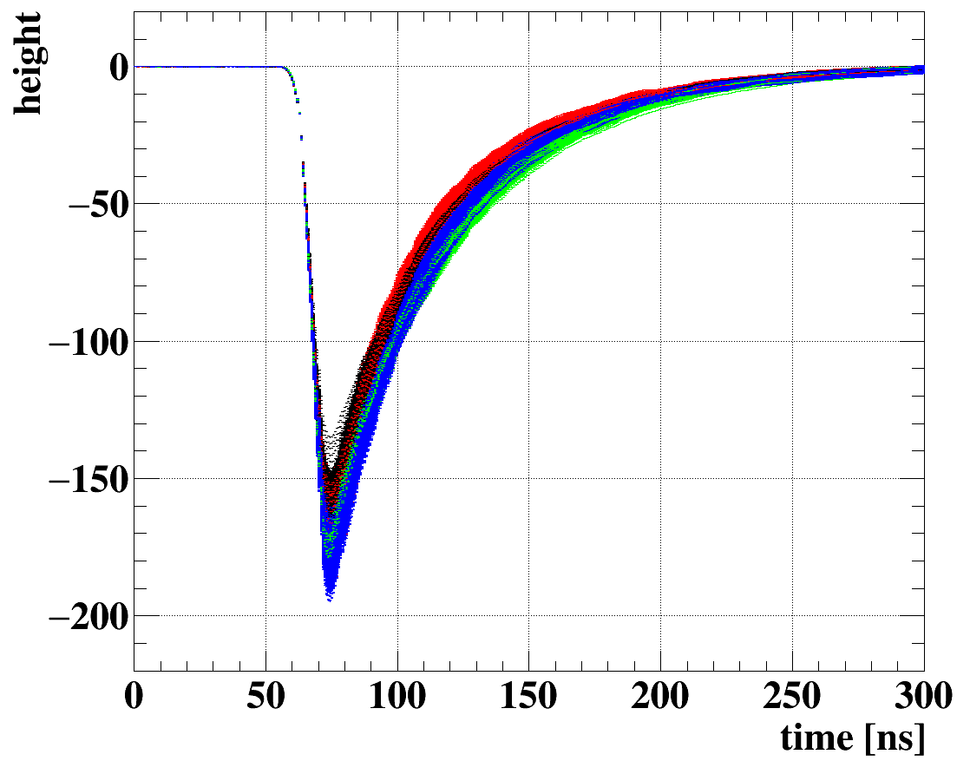
Mass test 2: MPPC test on PCB
Vertical axis is charge normalized by charge of a MPPC in batch A.
Waveform of 4092 MPPCs overlaid.
C
D
Batch A
B
Batch A
B
C
D
All channels are good.
Batch by batch difference is found, due to difference in afterpulse probability.

Slide 15
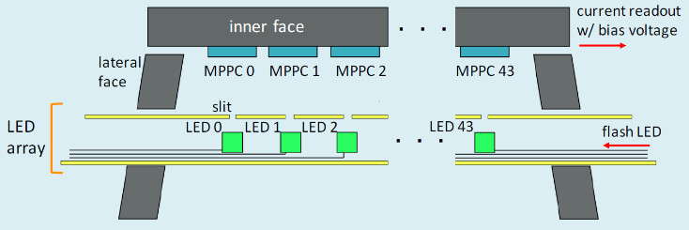
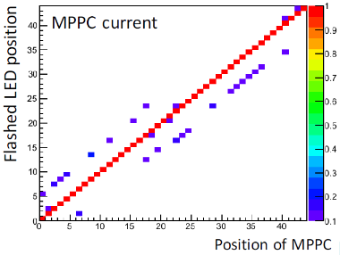
Signal check during construction
To check cabling and connection,
measure the MPPC currents with flashing LEDs in array one-by-one and check the correspondence.

Slide 16
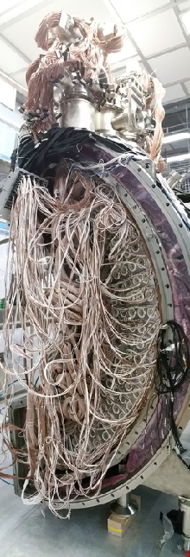
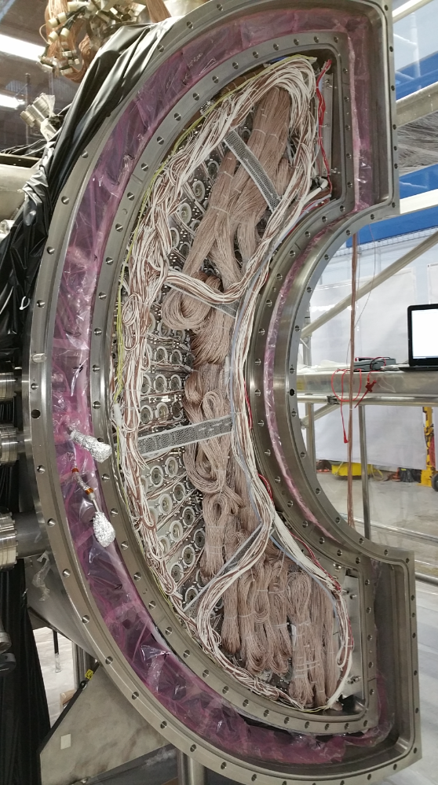
Signal check during construction
To check cabling and connection,
measure the MPPC currents with flashing LEDs in array one-by-one and check the correspondence.

Slide 17
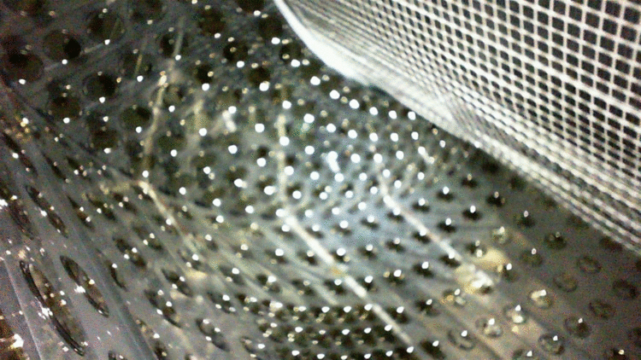
Close the detector & fill it with LXe
View from a USB camera installed inside the detector
LXe transfer

Slide 18
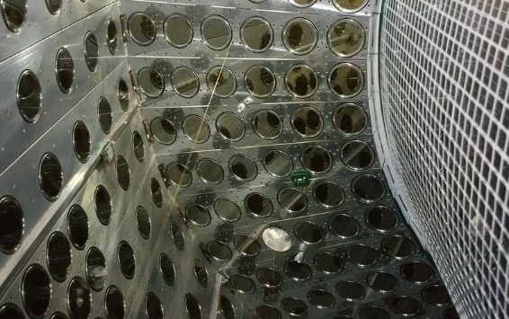
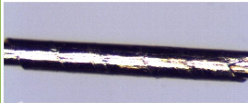
MPPC calibration during RUN
The detector is equipped with calibration sources:
  LEDs
  Alpha sources (²⁴¹Am) on wires
Gain
  Weak LED light^{(*)}
      Measure 1 p.e. charge, with amp ×100
  Strong LED to monitor relative G
  Other methods under development
      Photon statistics at various LED intensities
      Waveform fluctuation
Crosstalk/afterpulse
  Weak LED, deviation from Poisson
PDE @ 175 nm
  Alpha signal
Time offset
  LED
²⁴¹Am source
(*) DCR is too low at -100℃

Slide 19
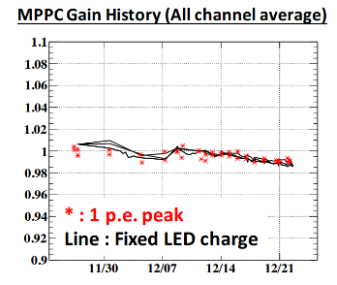
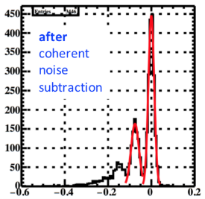
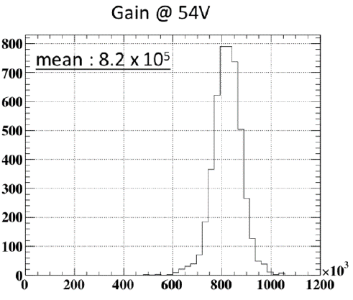
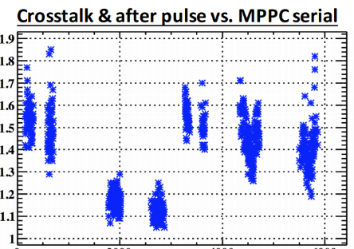
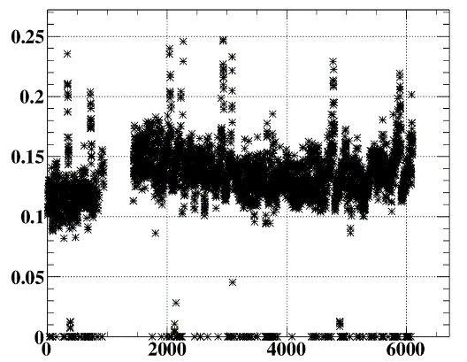
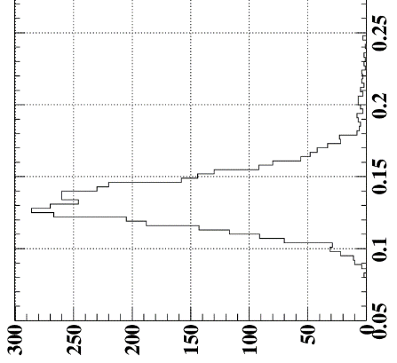
Charge distribution for weak LED light
0 p.e.
Gain change correlates with LXe temperature
1 p.e.
all MPPCs
Constantly
monitor
all MPPCs
PDE for LXe light (175 nm)
C
D
B
A
Serial No.
PDE estimated from α
Uncertainty on the absolute value
  Light yield
  Integration range
Serial No.

Slide 20
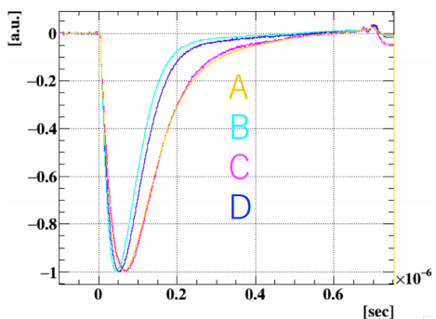
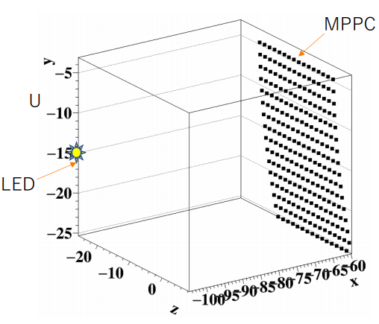
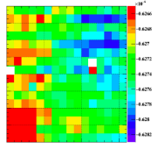
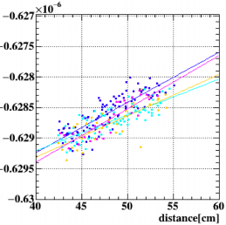
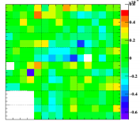
Large variation in afterpulse prob.
Batch dependence of afterpulse prob. was observed
Pulse shape difference,
especially at high V_{over}.
Calibration & analysis become complicated
V_{over} = 7 V
Time offset calibration with LED
Measured signal timing
Distance correction
Batch (PCB) dependence is visible
The correction depends on the pulse shape
Achieved calibration precision of ~60 ps

Slide 21
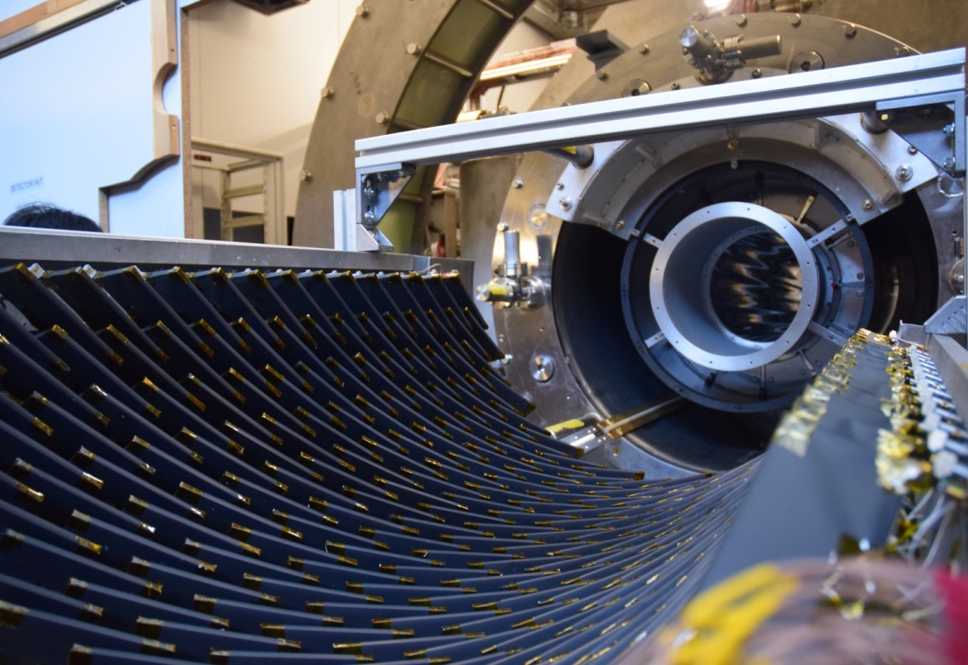
e⁺ pixelated
Timing Counter

Slide 22
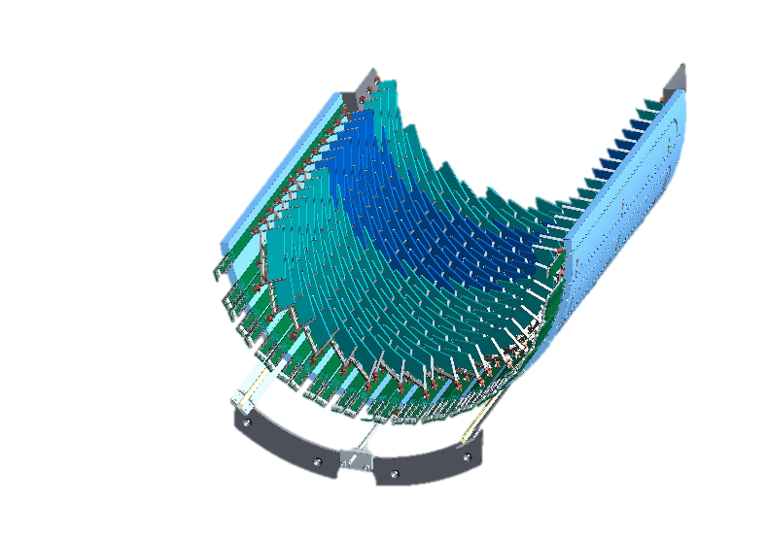
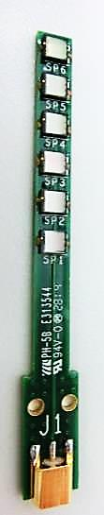
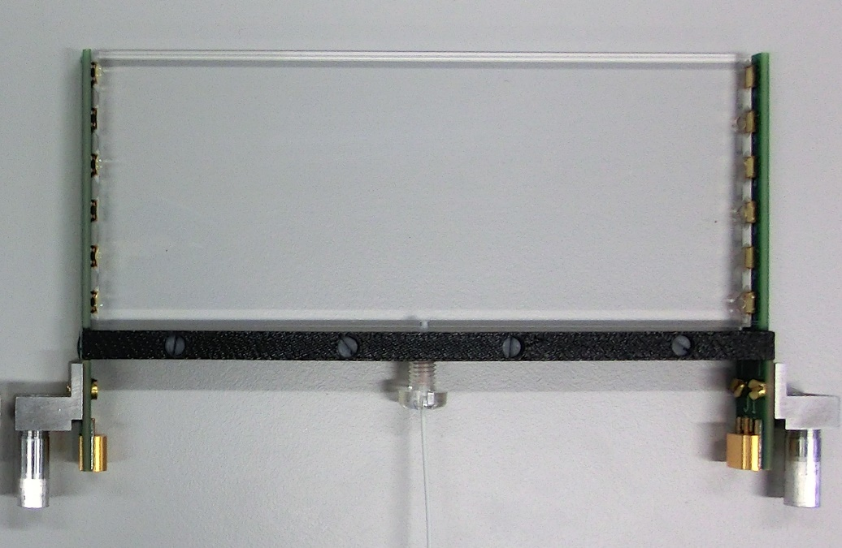
Counter structure
A SiPM-array
(a readout ch)
6 SiPMs
connected in series
120 mm
50 mm
BC-422
Optical fiber for laser calib.
SiPM: ASD-NUV3S-P High-Gain (MEG)
  3×3 mm², 50 μm pixel pitch
  Breakdown voltage: 24 V
  Operational range: V_{over}=2 – 3.5 V
  Peak sensitivity: 420 nm
  Temperature coeff. V_{BD}: 26 mV/℃
  Production in 2014

Slide 23
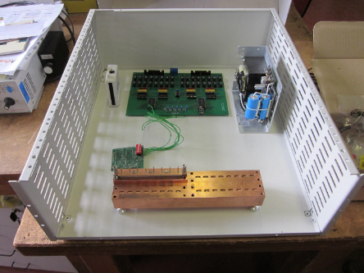
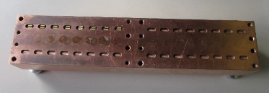
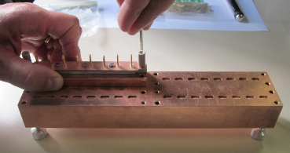
Mass test 1: individual SiPM test
To identify bad SiPMs and to group 6-SiPM sets,
we measured I-V characteristics for >7000 SiPMs.
  Breakdown voltage (V_{bd})
  Leakage current @ V_{over} = 3.0 V (I_{3V})
Group by the order of I_{3V}
32 pcs at once
Setup for mass test 1
SiPM’s electrodes (surface mount type)
Control board
Spring probe pins for the contact
Power suppply
Copper bench with electrical contact
to SiPMs sitting on it controlled at 30℃

Slide 24

Mass test 1: individual SiPM test
To identify bad SiPMs and to group 6-SiPM sets,
we measured I-V characteristics for >7000 SiPMs.
  Breakdown voltage (V_{bd})
  Leakage current @ V_{over} = 3.0 V (I_{3V})
Group by the order of I_{3V}
~7000 SiPMs
overlaid
Narrow distribution of V_{bd}
We observed 2 groups in I-V curves
Type1-2 shows quick blowup of current
  Due to larger crosstalk/afterpulse at high V_{over}
  Result in narrower operation range → lower PDE

Slide 25


Mass test 1: individual SiPM test
To identify bad SiPMs and to group 6-SiPM sets,
we measured I-V characteristics for >7000 SiPMs.
  Breakdown voltage (V_{bd})
  Leakage current @ V_{over} = 3.0 V (I_{3V})
Group by the order of I_{3V}
~7000 SiPMs
overlaid
Narrow distribution of V_{bd}
We observed 2 groups in I-V curves
Type1-2 shows quick blowup of current
  Due to larger crosstalk/afterpulse at high V_{over}
  Result in narrower operation range → lower PDE

Slide 26


Mass test 2: SiPM-array test
I-V measurement of 6-series SiPM array
Sensitivity to scintillation light (∝PDE)
Setup for mass test 2
(simplified measurement)
Setup for detail test
(time resolution measurement)
Use the same scintillator for all
@ room temperature
Exchange SiPM-array
(coupled with grease)
Measure signal
amplitude

Slide 27


Mass test 2: SiPM-array test
I-V measurement of 6-series SiPM array
Sensitivity to scintillation light (∝PDE)
Setup for mass test 2
(simplified measurement)
Setup for detail test
(time resolution measurement)
Large variation of PDE observed
15% standard deviation
Bad ones has <1/2 PDE of typical (mean) one
Clear correlation b/w signal amplitude (∝PDE)
and time resolution

Slide 28


Mass test 3: Counter test
Measure the time resolution of all the assembled counters
Find optimal operation point
Type 2 is a different batch (model)
produced in 2015
Suppressed afterpulsing widen the operational range
But time resolution is not necessarily better
Type 1-1
Type 1-2
Type 2
The variation includes scintillator quality
The difference b/w 40 & 50 mm counters
is due to the sensor coverage
The optimal points depend on the SiPM types
Time resolution gets worse when the dark current starts to blowup
Type 1-2 has narrow optimal region and worse resolution.

Slide 29

Sep. 2017
Assembled & installed.

Slide 30


Calibration during RUN
We are NOT interested in detailed parameters of SiPMs such as
  Gain, PDE, crosstalk/afterpulse prob.
But only in timing
  Timing & the time resolution
  Dark count rate (noise) ∝ dark current
The detector is equipped with
  Laser calibration system
  Temperature control & monitor system
  Continuous current monitor system
Laser light injected in a counter
(λ=401 nm, 60 ps FWHM)

Slide 31


Current monitor
Currents are continuously monitored during the experiment at precision of a few nA
  Easily identify problems on SiPMs.
  When necessary, we can take I-V curves for all channels at once
Gradual increase caused by
radiation damage
  →increase in the DCR
  Fluence is position dependent
  Need readjustment of operation voltage
  channel-by-channel time-to-time.
Beam ON
(μA)
5 days

Slide 32


Calibration & optimization with laser
Calibrate time offset of each counter with the synchronous laser pulse signal.
Monitor the timing (time offset) with the laser pulse over time.
  also the pulse amplitude (∝G×PDE)
Optimize the bias voltage for the best timing resolution.
  under a real noise condition.
RMS: 2.5 ps
Laser power
7.5
9

Slide 33
Conclusions
We established methods for mass test and calibration.
  Total inspection with a quick method is important before detector construction.
      reject bad sensors, optimize combinations/arrangement etc.
  Detailed characterization before experiment is important to understand the detector.
  Continuous monitoring of SiPM parameters is important during the experiment to maximize the performance.
      temperature change, radiation damage, etc.
Standardization makes little (no) sense once detector is built
  Necessity is different b/w detector R&D/designing and operation/calibration.
  We can/should only & all what we can do within the constraints of experiment.
Quality control in mass-production is important
  Not only to guarantee the high performance,
  but also to make the analysis & calibration easy.
  Hope manufacturers to improve this.

Slide 34



Slide 35


Methods for V_{bd}
@MPPC
mass test
@LXe
Linear + quadratic
2nd derivative of log(I)
@AdvanSiD SiPM
mass test
The proper way depends on the environment and setup.

Slide 36
PDE @175 nm
Charge distribution of α events
Dependent on LXe purity
Detailed simulation of photon tracking is necessary (reflection etc.)
T.Doke et al., NIM A 420 (1999), 62.
Notes:
(\text{PDE})&=(\text{Measured p.e.})/(\text{Expected photons})\\
(\text{Measured p.e.})&=\frac{(\text{Measured charge})}{(\text{Gain})*(\text{Expected value of CTAP})}\\
(\text{Expected photons})&=\frac{(\text{Energy of Alpha source})}{19.6(\pm 2.0) \mathrm{eV} }*(\text{Solid Angle})

Slide 37



Mass test in LXe
We did mass-test of ~600 pcs of prototype MPPCs in LXe
  Check the performance for LXe light
  →determine the final version
  Establish the procedure
In LXe
feed-through
α sources
²⁴¹Am
PCBs
(12+12)
LED
MPPC &
support structure
24MPPCs / PCB
Xe gas panel
feed-through

Slide 38

Radiation tolerance
Total fluence in MEG II
  ~1×10¹¹ e⁺/cm² in 3-year run.
  neutron flux is not severe
Impact on SiPM
  Dark current is expected to increase up to ~100 μA
  due to increased dark count rate.
  Tested impact on time resolution
    Using 37 MBq ⁹⁰Sr source
    e⁺ beam at Beam Test Facility @ LNF
  30% degradation in time resolution @ 100 μA @ 30℃
  5% degradation @ 10℃
Before irradiation
~2 μA
~53 μA
~97 μA
~126 μA
~156 μA

Slide 39


Slide 40



Series connection of SiPMs
SiPMs have high sensor capacitance
  Terminal capacitance ~300 pF for 3×3 mm² SiPM
This forms a slow RC time-constant
with amplifier input impedance
  3×3 mm² : 300pF × 50Ω = 15 ns
  3×9 mm² : 900pF × 50Ω = 45 ns !!
    → One of limitations for large area SiPMs
    or array of SiPMs with parallel connection
This large capacitance works as
capacitive coupling when connected in series
SPICE simulation
Single cell
3×3mm² MPPC
Measurement with 3 MPPCs
=
C
~$\frac{\text{c}}{\text{3}}$
I
C
R_{shunt}
C
e⁻
the other cells
+ stray capacitance
fired cells

