Slide 1

Metrological characterisation of single-photon avalanche diodes
Working group 4.54: Laser radiometry and quantum radiometry
Marco López
Robin Eßling
Beatrice Rodiek
Helmuth Hofer
Stefan Kück

Slide 2
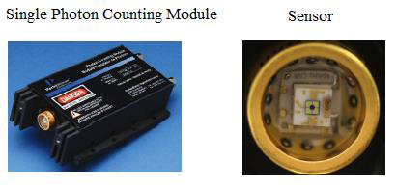
Motivation
Single-Photon Avalanche Diodes (Si or InGaAs SPADs) important for
  scientific research:
    experimental quantum optics
    quantum cryptography
    quantum computing
  medicine
  biology
  astrophysics
  ⇒ Wherever low photon fluxes need to be measured!

Slide 3
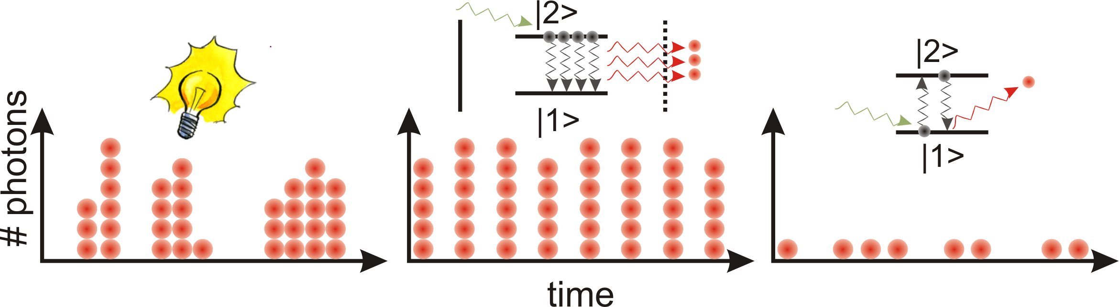
Motivation- Light
Classical light: Super-Poissonian-Distribution → bunching (thermal light)
Laser light: Poissonian Distribution
Non-classical light: Sub-Poissonian-Distribution → anti bunching
  semiconductor quantum dot, single atoms / molecules / ions,
single organic molecules, single defect centres in crystals

Slide 4
Motivation – Analog detector vs. Digital detector
Analogue detector
Digital detector
hν
hν
Si
I₁
SPAD
„Click“
I₁ < I₂
hν
hν
Si
I₂
SPAD
„Click“
Signal ∝ Number of photons
Only one “click” per time

Slide 5
Detector types
 | Si-SPAD | InGaAs-SPAD | TES | SNSPD
Detection efficiency | 80 % | 20 % | > 90 % | > 85 %
Dark counts | 5 cps | > 1 kHz < 50 Hz | - | < 10 cps
Jitter | ∼ 40 ps | ∼ 250 ps ∼ 100 ps | ∼ 100 ns | < 25 ps
Deadtime | ∼ 50 ns | > 1 µs | > µs | < 10 ns
Max. count rate | ∼ 20 MHz | ∼ 1 MHz | < 1 MHz | > 50 MHz
Photon number resolution | no | no | yes | (no)
After-pulsing | ∼ 0.5 % | ∼ 5 % | - | no
Spectral range | (350 – 1000) nm | (900 – 1700) nm | γ – mm | (< 0.5 – > 2.5) µm
Operation temperature | RT | RT | LT | LT

Slide 6
Detector types
 | Si-SPAD | InGaAs-SPAD | TES | SNSPD
Detection efficiency | 80 % | 20 % | > 90 % | > 85 %
Dark counts | 5 cps | > 1 kHz < 50 Hz | - | < 10 cps
Jitter | ∼ 40 ps | ∼ 250 ps ∼ 100 ps | ∼ 100 ns | < 25 ps
Deadtime | ∼ 50 ns | > 1 µs | > µs | < 10 ns
Max. count rate | ∼ 20 MHz | ∼ 1 MHz | < 1 MHz | > 50 MHz
Photon number resolution | no | no | yes | (no)
After-pulsing | ∼ 0.5 % | ∼ 5 % | - | no
Spectral range | (350 – 1000) nm | (900 – 1700) nm | γ – mm | (< 0.5 – > 2.5) µm
Operation temperature | RT | RT | LT | LT
 | Si-SPAD | InGaAs-SPAD
Detection efficiency | 80 % | 20 %

Slide 7
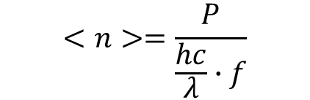

Detection efficiency, η
Photon detection probability (Detection efficiency, η): probability that a photon incident at the optical input will be detected within a detection gate.
$$η=−\frac{ln⁡(P_{i}−P_{d})}{<n>}$$
P_{i} : Photon detection probability at each illuminated gate
P_{d} : Dark count probability
<n>: Average photon number per emitted pulse (mean photon number)
Average optical power [W]
$$<n>=\frac{P}{\frac{hc}{λ}∙f}$$

Slide 8
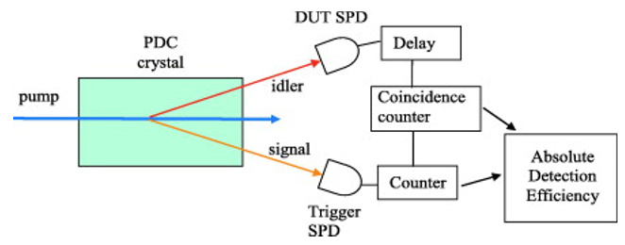
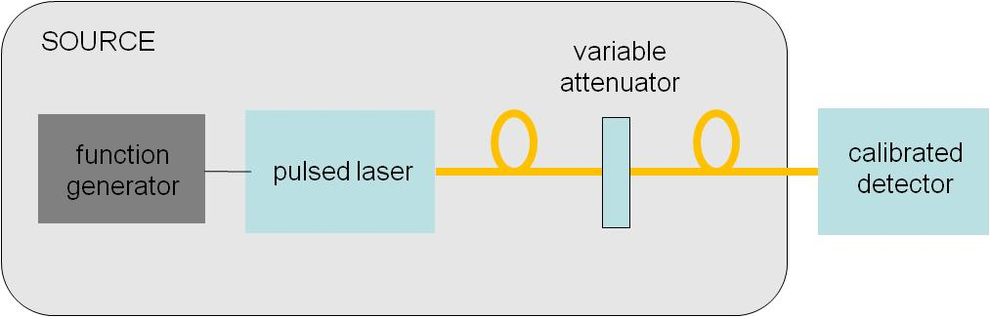




Measurement methods
Photon correlation technique (Reference detector not needed)
$$N_{DUT}=η_{DUT}N$$
$$N_{Coincidence}=η_{DUT}η_{Trigger}N$$
$$η_{DUT}=\frac{N_{DUT}}{N_{Trig}}$$
$$N_{Trigger}=η_{Trigger}N$$
Substitution method (Reference detector needed)
Calibrated
detector
$$η=\frac{Counts−DCR}{<n>}$$
SPAD

Slide 9
SPAD calibration using double attenuator technique – Step 1
Variable Filter
OD = 0.2 … 4
Microscope
objective
Filter 3
T = 1.6 × 10⁻⁴
Filter 2
T = 4.6 × 10⁻⁴
Beam
splitter
Laser
770 nm
Si-Diode
Si-SPAD
Monitor
detector
M. López, et. al, “Detection efﬁciency calibration of single-photon silicon avalanche photodiodes traceable using double attenuator technique, Journal of Modern Optics 62, S21 – S27 (2015)

Slide 10
SPAD calibration using double attenuator technique – Step 2
Variable Filter
OD = 0.2 … 4
Microscope
objective
Filter 3
T = 1.6 × 10⁻⁴
Filter 2
T = 4.6 × 10⁻⁴
Beam
splitter
Laser
770 nm
Si-Diode
Si-SPAD
Monitor
detector
M. López, et. al, “Detection efﬁciency calibration of single-photon silicon avalanche photodiodes traceable using double attenuator technique, Journal of Modern Optics 62, S21 – S27 (2015)

Slide 11
SPAD calibration using double attenuator technique – Step 3
Variable Filter
OD = 0.2 … 4
Microscope
objective
Filter 3
T = 1.6 × 10⁻⁴
Filter 2
T = 4.6 × 10⁻⁴
Beam
splitter
Laser
770 nm
Si-Diode
Si-SPAD
Monitor
detector
M. López, et. al, “Detection efﬁciency calibration of single-photon silicon avalanche photodiodes traceable using double attenuator technique, Journal of Modern Optics 62, S21 – S27 (2015)

Slide 12
SPAD calibration using double attenuator technique – Step 4
Microscope
objective
Variable Filter
OD = 0.2 … 4
Si-Diode
Filter 3
T = 1.6 × 10⁻⁴
Filter 2
T = 4.6 × 10⁻⁴
Beam
splitter
Laser
770 nm
Si-SPAD
Monitor
detector
M. López, et. al, “Detection efﬁciency calibration of single-photon silicon avalanche photodiodes traceable using double attenuator technique, Journal of Modern Optics 62, S21 – S27 (2015)

Slide 13
SPAD calibration using double attenuator technique – Step 5
Microscope
objective
Variable Filter
OD = 0.2 … 4
Si-Diode
Filter 3
T = 1.6 × 10⁻⁴
Filter 2
T = 4.6 × 10⁻⁴
Beam
splitter
Laser
770 nm
Si-SPAD
Monitor
detector
M. López, et. al, “Detection efﬁciency calibration of single-photon silicon avalanche photodiodes traceable using double attenuator technique, Journal of Modern Optics 62, S21 – S27 (2015)

Slide 14
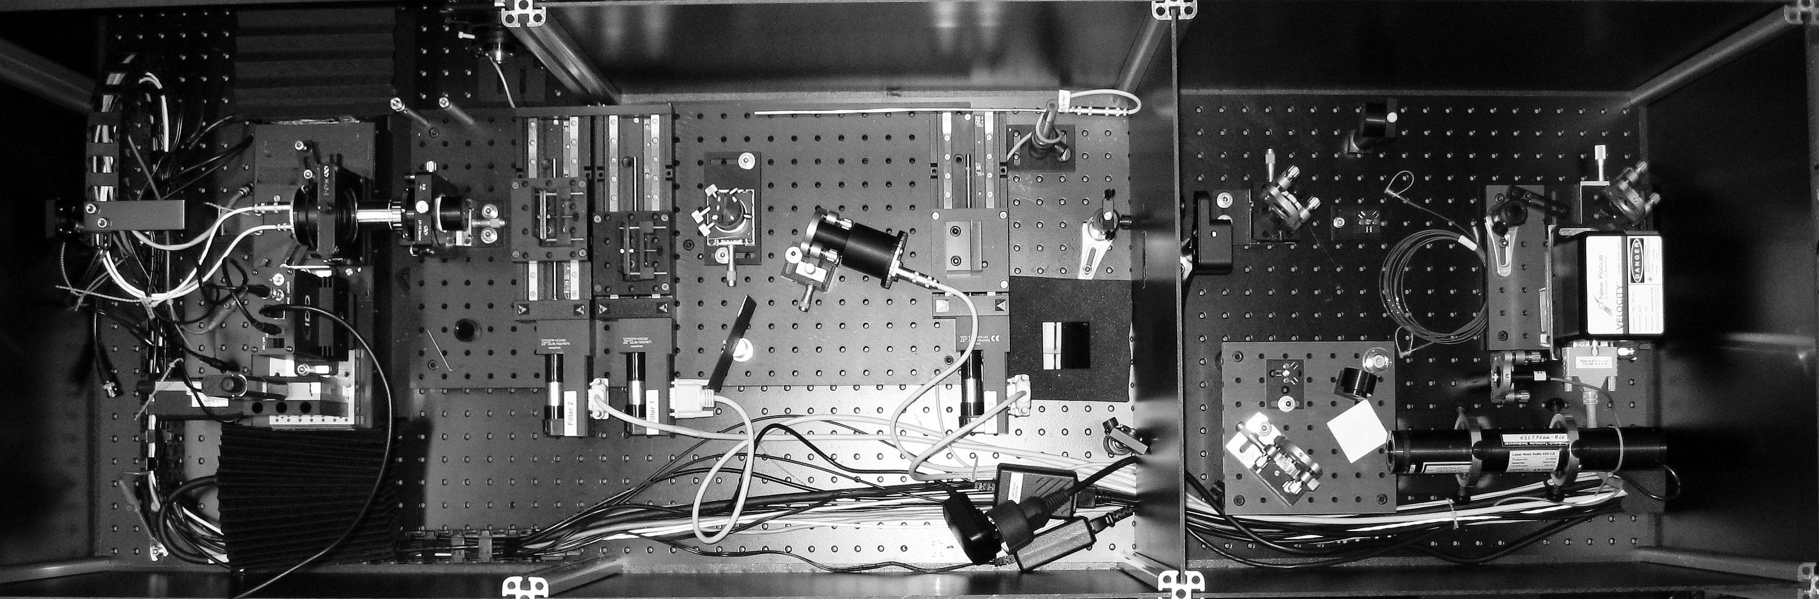
Si-SPAD calibration using double attenuator technique
F₃ F₂
Variable Filter
Variable Filter
OD = 0.2 … 4
Beam
splitter
Microscope
objective
Filter 3
T = 1.6 × 10⁻⁴
Filter 2
T = 4.6 × 10⁻⁴
Beam
splitter
Laser
770 nm
Si-Diode
Laser
Si-SPAD
Si-Diode
Monitor
Si-SPAD
Monitor
detector
M. López, et. al, “Detection efﬁciency calibration of single-photon silicon avalanche photodiodes traceable using double attenuator technique, Journal of Modern Optics 62, S21 – S27 (2015)

Slide 15
Measurement uncertainty budget – main components
η_{SPAD} = 0.6359 ± 0.0040 (k = 2)
η_{SPAD} = 0.6359 ± 0.63 % (k = 2)
Spectral responsivity of Si-diode: ∼ 40 %
  Caused by linearity measurements and its uncertainty
Filter transmission: ∼ 45 %
  Total filter transmission equals multiplication of two single filter transmissions?

Slide 16
Measurement setup – Improvements
Standard detector:
  Integrating sphere with Si-diode instead of Si-diode only
  (avoiding back-reflexion into the setup)
Automated alignment procedure:
  Better reproducibility in position

Slide 17
Detection efficiency – Results and Uncertainty
Uncertainty component | Uncertainty (%)
Planck constant, h | 2.52 x 10⁻⁷
Speed of light, c | 0.0
Wavelength, λ | 0.0075
Amplification factor, A₁ | 0.0021
Amplification factor, A₂ | 2.08 x 10⁻⁶
Amplification factor, A₃ | 2.08 x 10⁻⁶
Ratio V₁/V_{Mon1}, Q₁ | 0.004
Ratio V₂/V_{Mon2}, Q₂ | 0.015
Ratio V₃/V_{Mon3}, Q₃ | 0.05
Ratio CR/V_{MonSPAD}, Q₄ | 0.036
Spectral responsivity, s_{Si} | 0.15
Factor for the use of two filters, F_{filt} | 0.005
Combined uncertainty, u_{c} | 0.162
Main contribution:
Standard detector
u(η_{SPAD}) ≥ 0.16 %
(770 nm, 100 000 cps)
However, this is the ideal value. What will be achieved in day-to-day calibrations? 1 % seems reasonable!? Pilot study under way!!!

Slide 18
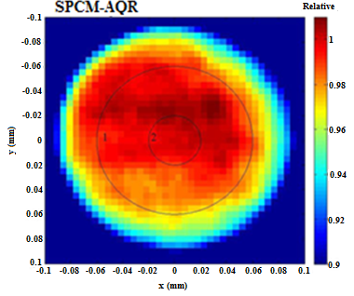
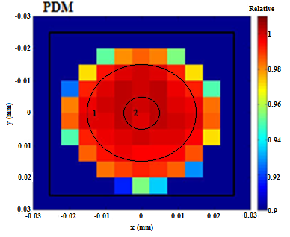
(In)Homogeneity
Relative spatial detection efficiency of the Si-SPAD detectors
Laser beam diameter ∅_{B} approx. 10 µm.
Relative values are within ± 1 % for the main active region of the detectors, at the border of the active regions the values drop.
Homegeneities
Region 1: ≤ 0.85 % (∅ = 120 µm) Region 1: ≤ 2.2 % (∅ = 40 µm)
Region 2: ≤ 0.3 % (∅ = 40 µm) Region 2: ≤ 0.13 % (∅ = 20 µm)

Slide 19
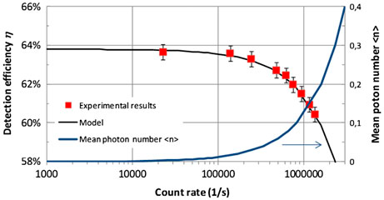
Detection efficiency – influence of photon statistics
M. López, et. al, “Detection efﬁciency calibration of single-photon silicon avalanche photodiodes traceable using double attenuator technique, Journal of Modern Optics 62, S21 – S27 (2015)

Slide 20
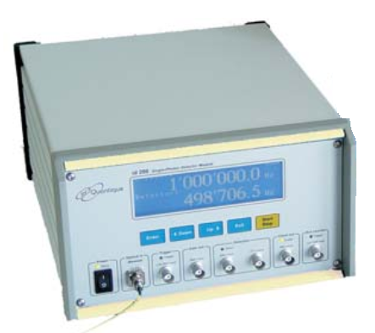
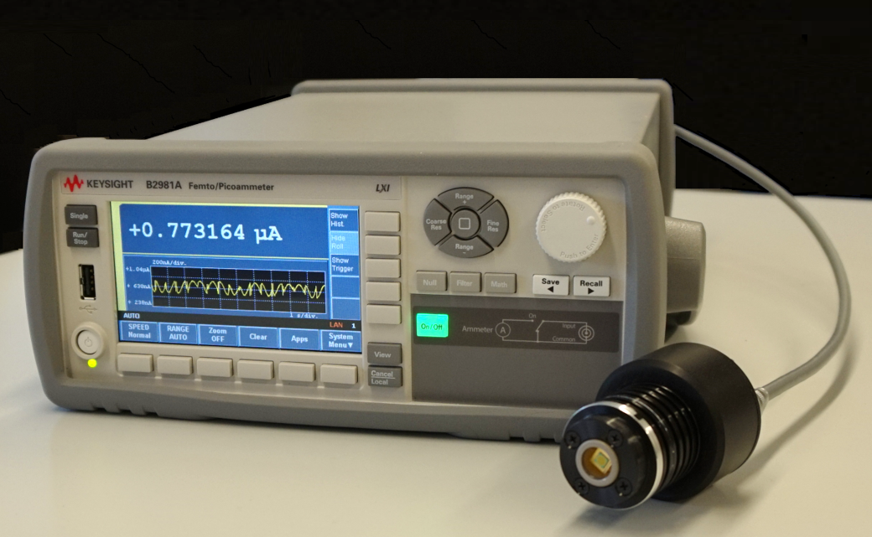
InGaAs calibration
Reference detector:
Low-noise InGaAs photodiode (Hamamatsu G8605-23), cooled at -20 °C, and a Femto/Pico-ammeter (Keysight B2981A)
  Dark current: I_{d} ~ 4 pA
  Linearity: < 0.25 % for I_{ph} = 10 µA – 10 pA

Slide 21
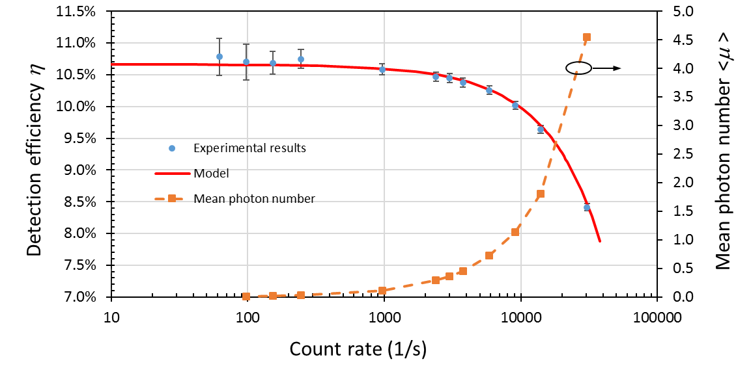
InGaAs calibration

Slide 22
InGaAs calibration
Source of uncertainty | Standard uncertainty (%)
Planck´s constant, h | 9.055×10⁻⁶
Wavelength, λ | 0.004
Speed of light, c | 0.000
Spectral Responsivity of InGaAs-diode, S_{InGaAs} | 0.300
InGaAs/InP SPAD counts, P_{count} | 0.720
InGaAs/InP SPAD dark counts, P_{dark} | 0.305
InGaAs/InP SPAD after pulsing, F_{Pafter} | 0.173
Photocurrent InGaAs diode, I_{ph} | 0.028
Attenuation factor, F_{Att} | 0.050
Linearity factor InGaAs photodiode, F_{Lin} | 0.050
Combined uncertainty, u_{c} | 0.857

Slide 23
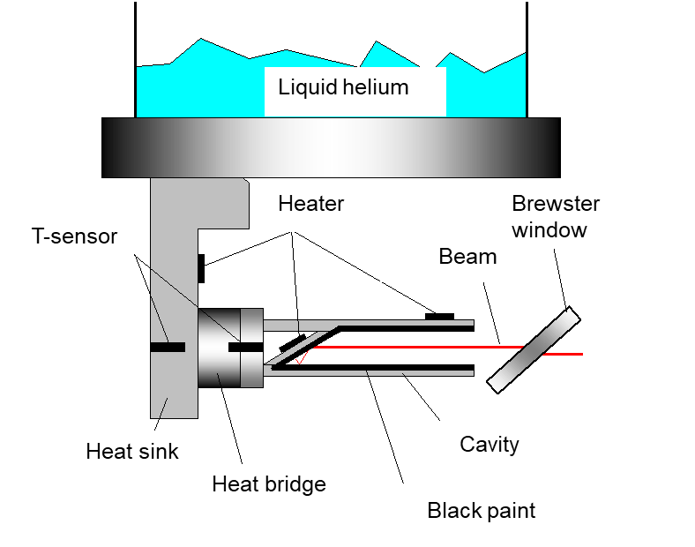
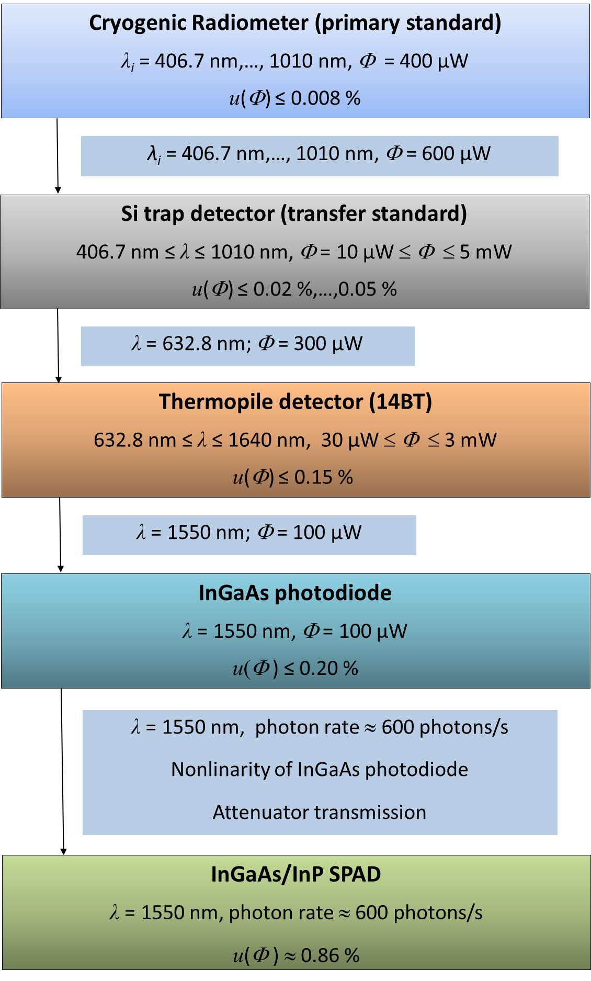
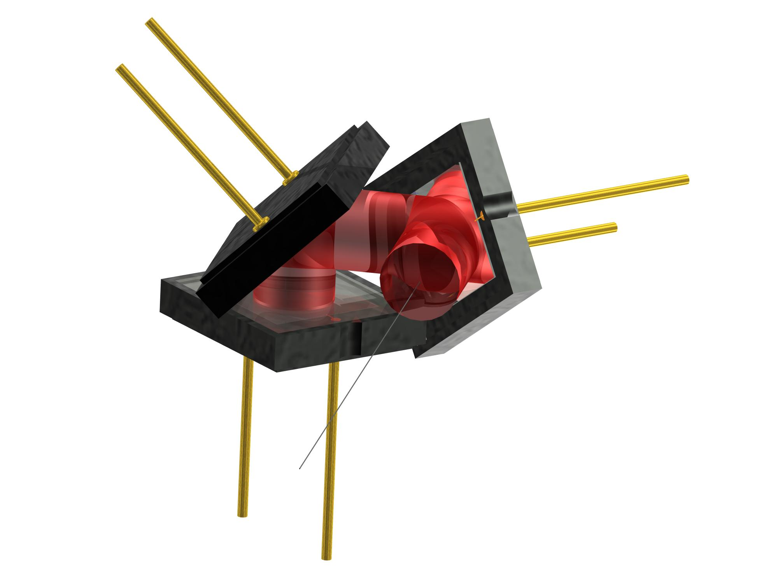
Traceability chart for cal. SPADs
Beam path:
1 – 2 – 3 – 2 – 1
α = 0.999879
τ = 0.99958
Sensitivity = 1.24 K/mW at 4.2 K
→ radiation nearly totally absorbed
Electrical Substitution Radiometer (ESR) operated at cryogenic low temperatures (∼4-7 K).
Optical power is traced back to electrical power (electric current I and electric potential difference V).

Slide 24
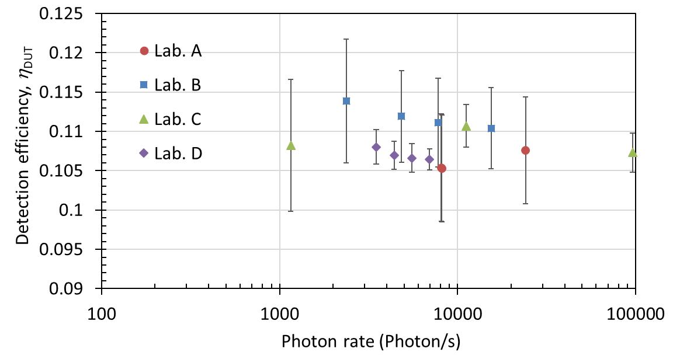
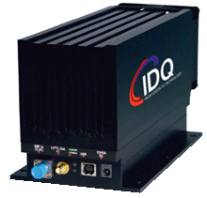






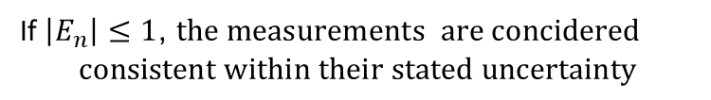

(First) European pilot comparison: DE (free-running InGaAs-SPAD)
Device Under Test (DUT):
Free-running InGaAs SPAD (ID Quantique, ID 220)
λ: 1550 nm
Trigger Freq.: 110 kHz
U(η)= 2 % - 6 % (⏐E_{n}⏐ ≤ 0.6)
SPIE Photonics, 22 - 26 April 2018, Strasbourg, France
$$E_{n,i}=\frac{η_{i}−\overline{η_{w}}}{\sqrt{U{\left(η_{i}\right)}^{2}+U{\left(η_{w}\right)}^{2}}}$$
If $\left|E_{n}\right|≤1$, $the measurements are concidered$
$$consistent within their stated uncertainty$$

Slide 25
Summary
Calibration setup and procedure (Si and InGaAs SPADs)
Measurement uncertainty budget
  Standard measurement uncertainty < 0.8 %
Improvements (free-beam):
  Filter transmission measurements
  Standard measurement uncertainty 0.16 % (@Si SPAD)
  Homogeneity
Comparisons: Consistent results
  Double attenuator technique vs. CMI-Standard
  First European comparison (@InGaAs, 1550 nm)

Slide 26


Acknowledgement
Thank you for your attention!

