Slide 1
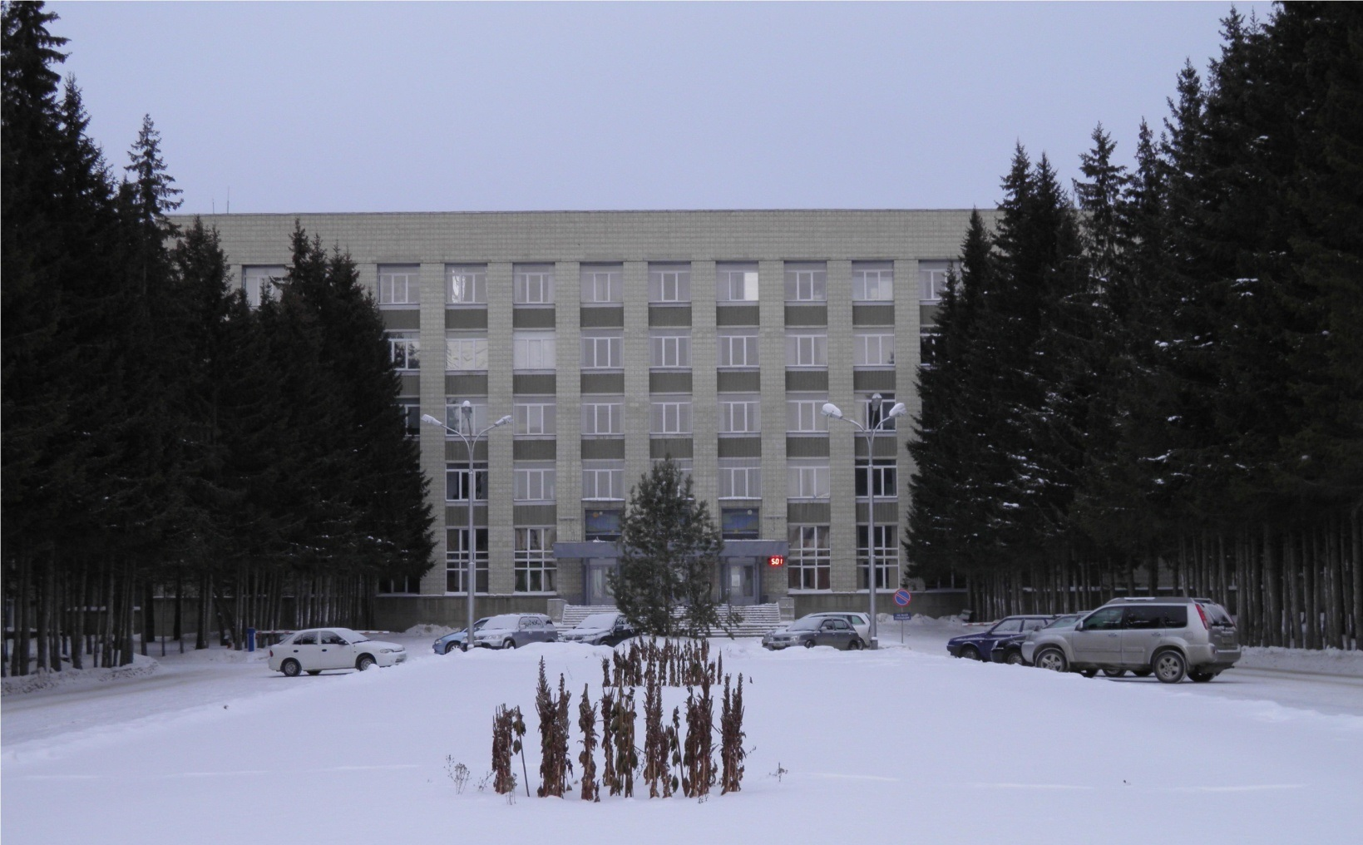
Status of the PANDA Solenoid Magnet Production in BINP

Slide 2
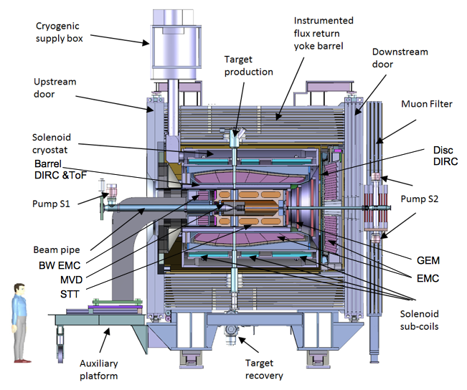
PANDA solenoid magnet
The PANDA solenoid is designed to provide a magnetic field of 2 T with a uniformity of ± 2% and radial magnetic field integral in the range 0 to 2 mm over the central tracking region. The magnet is characterized by a warm bore of 1.9 m diameter, a free length of 4 m and 22.4 MJ of stored energy.
Figure 1. Artistic cut side view of the solenoid magnet including contained detector systems.

Slide 3
The main milestones of production of the PANDA solenoid magnet
The scope of delivery includes:
Magnetic and engineering design of the magnet including tools and support;
Production and delivery of the magnet (consisting of yoke, cold mass and cryostat, alignment components, proximity cryogenics, support frame and platform beams) and all tools;
Power converter and quench protection and instrumentation.
Item | Date
Start contract | 03/2017
Control assembling of the Yoke of solenoid at the BINP site | 09/2019
Magnetic tests of the PANDA solenoid including safety system and electrical components at BINP (additional contract) | 07/2020 - 05/2021
Assembling and tests at the FAIR site
Assembling of the Yoke at Darmstadt | 11/2021
Acceptant tests at FAIR | 08/2022
Installation of the PANDA solenoid magnet at worked position and start final acceptance tests | 05/2023
Table 1. The main milestones.

Slide 4
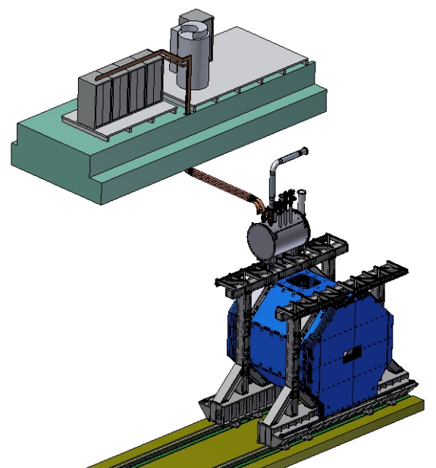
PANDA solenoid magnet, BINP responsibility
Power supply and energy extraction system
Control Dewar box
Cable channel
Solenoid and yoke
Frame of solenoid
Figure 2. Arrangement of the components of the PANDA solenoid.

Slide 5
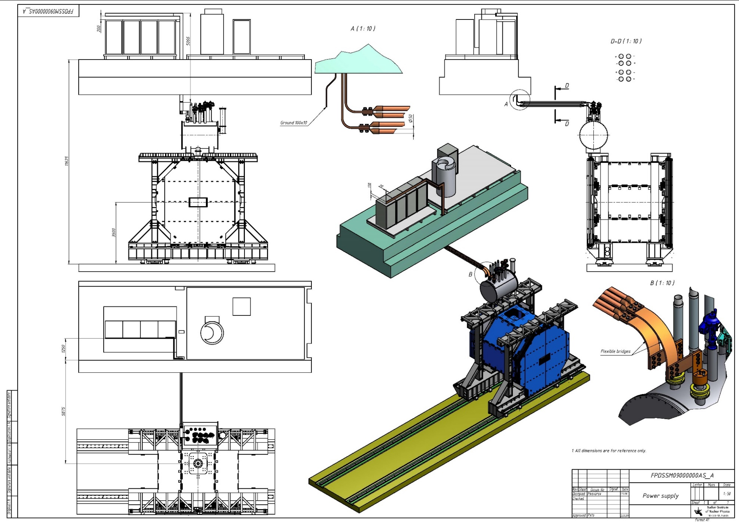
PANDA solenoid magnet, BINP responsibility
Figure 3. Arrangement of the components of the PANDA solenoid.

Slide 6
Development of the PANDA solenoid magnet
Name of item | Status of work
Yoke and frame | Design is ready, start production
Cryostat of solenoid | Design is ready, PDR 11th week 2018
Cold mass | Design is ready, PDR 11th week 2018
Control Dewar box | Design in progress
Cable channel | Start design
Power supply and energy extraction system | Design in progress, PDR 17th week 2018
Magnet safety system | Start discussing 11th week 2018
Table 2. Status of work of the PANDA solenoid production.

Slide 7
The main milestones of the yoke production
Name of milestone | Date 2017/10
Memorandum BINP/ plant SibElectroTherm (SET) | 05/2017
Presentation design of the yoke after technological work of drawings in FAIR | 20-25/07/2017
PDR of the yoke | 04-07/10/2017
FDR of the yoke | 20-25/11/2017
Contract with SibMash (SET), signed | 2/11/2017
Purchasing raw materials (1st batch, 60 t) | 26/12/2017
Start of production of the 1st octant | 01/2018
Status production
Manufacturing parts of tooling for assembly of octants | ready
Welding and machining tooling | In process
Cutting sheets of the 1st octant | In process
Start assembling of the 1st octant | 12th week 2018
Control of the 1st octant | 15th week 2018
Delivery raw material to SibMash (SET) | 04 - 08/2018
Table 3. The main milestones of the yoke production.

Slide 8
The main milestones of the yoke production
Name of milestone | Date 2017/10
Production of the all barrel octants | 12/2018
Production of the frame and beams | 11/2018
Production of the doors | 03/2019
Control assembling at SET | 04/2019
Finalization of the parts | 05/2019
Assembling of the Yoke at BINP | 09/2019
Table3. The main milestones of the yoke production.

Slide 9
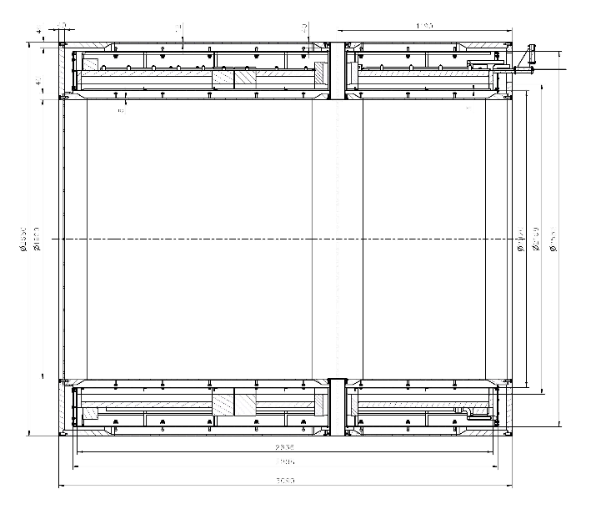
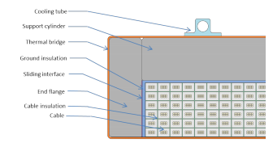
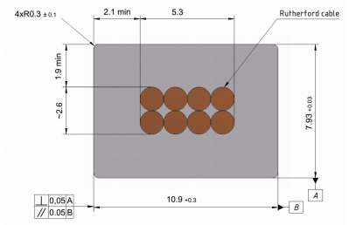
Main risks
Purchasing super conductive conductor - lack of a manufacturers
Rutherford cable, 8 strands, extruded in Al matrix
Thickness (after cold work) at 300 K | mm | 7.93 | ± 0.03
Width (after cold work) at 300 K | mm | 10.95 | ± 0.03
Critical current (at 4.2 K, 5 T) | A | > 14690
Critical current (at 4.5 K, 3 T) | A | > 16750
Overall Al/Cu/sc ratio |  | 10.5/1.0/1.0
Aluminum RRR (at 4.2 K, 0 T) |  | > 1000
Al 0.2% yield strength at 300 K | MPa | > 30
Table 4. Conductor mechanical and electrical parameters.
Figure 4. Longitudinal section of the cryostat with cold mass.
Figure 6. Drawing of the conductor.
Figure 5. Cold mass cross-section.

Slide 10
PANDA solenoid 2018, Conductor Cost ???
Conductor`s manufacturers
Furukawa, Japan - according to CERN specification, 1.5 year production time
But now absent possibility to produce extrusion of Rutherford cable to Al.
2. BINP, 1.1 year production time, if samples will produce according to CERN specification
A.A. BOCHVAR HIGH-TECHNOLOGY SCIENTIFIC RESEARCH INSTITUTE FOR INORGANIC MATERIALS (VNIINM), Russia – strands - according to CERN specification
VNIIKP - Rutherford cable, according to CERN specification
BINP, extrusion of Rutherford cable to Al, according to CERN specification

Slide 11
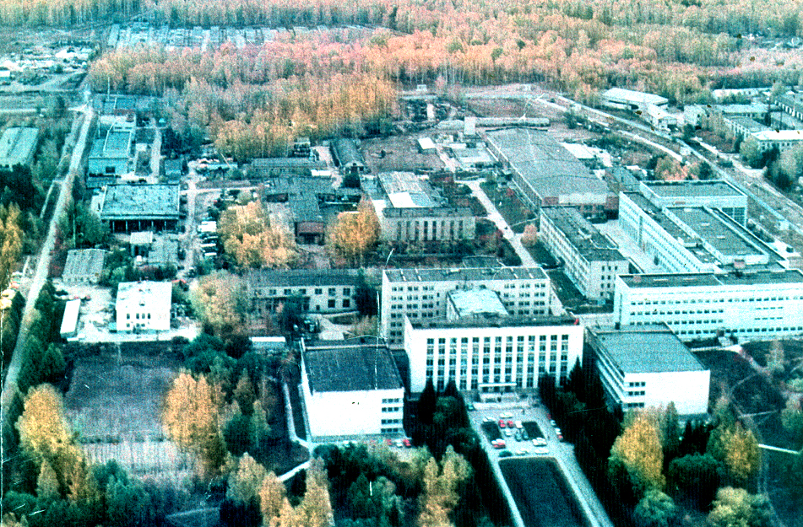
Thank you for your attention

