Slide 1
$Ξ^{∗}$ Resonances in $\overline{p}p→{\overline{Ξ}}^{+}Ξ^{−}π^{0}$
March 7, 2018 | Albrecht Gillitzer
PANDA Collaboration Meeting 1/18, GSI Darmstadt

Slide 2
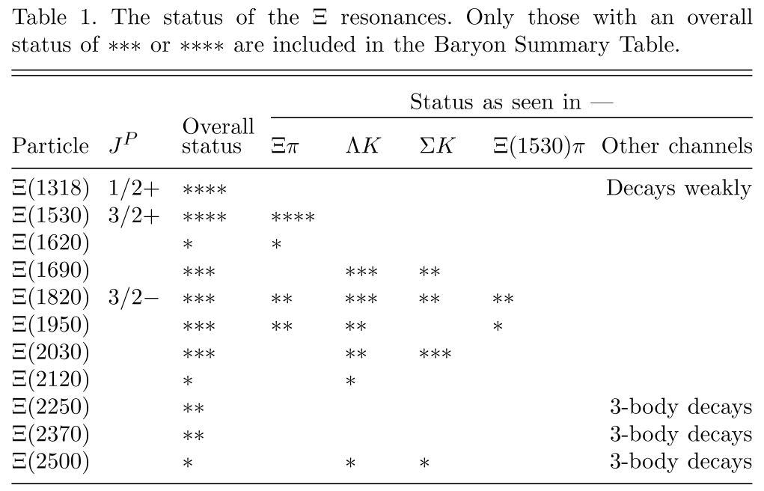
Status of $Ξ^{∗}$Resonances
Little known
Decay modes:
$Ξ^{∗}→Ξπ$
$Ξ^{∗}→Λ\overline{K}$
$Ξ^{∗}→Σ\overline{K}$
$Ξ^{∗}→Ξππ$
$Ξ^{∗}→Ξ^{∗′}π$
$Ξ^{∗}→Ξη$
$Ξ^{∗}→Ξηπ$
$Ξ^{∗}→Ξω$
?
?

Slide 3
Studied Event Samples
beam momentum p = 4.6 GeV/c
data set (1): 4 M events $\overline{p}p→{\overline{Ξ}}^{+}Ξ^{−}π^{0}$ (PHSP)
data set (2): 5 M events $\overline{p}p→{{\overline{Ξ}}^{+}Ξ^{∗−}→\overline{Ξ}}^{+}Ξ^{−}π^{0}$ & c.c. with $Ξ\left(1530\right), Ξ\left(1690\right), Ξ\left(1820\right)$ & c.c. & ${\overline{Ξ}}^{+}Ξ^{−}π^{0}$ cont., weight 1/7 each sub-channel
data set (3): 22 M events DPM
data set (4): 6.6 M events $\overline{p}p→\overline{p}pπ^{+}π^{+}π^{−}π^{−}π^{0}$ (PHSP)

Slide 4
Simulation & Analysis Parameters
same procedure for all data sets
standard detector, Geant4, ‚recoideal‘, ideal PID
PandaRoot trunk 30122 & 30127
no visible difference → both data sets added
define ${\overline{Ξ}}^{+}, Ξ^{−}$ as stable particles in EvtGen decay file
use modified decay of $\overline{Λ}, Λ$ in Geant4 → 98.6% signal events
both MC & reco info in one ntuple (quasi-complete)

Slide 5
Analysis Procedure
require all particles in the signal decay tree in the MC list
require all final particle candidates present with ‚hit tag‘ for charged particles: >3 hits in any central tracking detector
reconstruct $\overline{Λ}, Λ$ vertices (1.: vtx fit, 2.: mass constraint fit)
reconstruct $π^{0}$
reconstruct ${\overline{Ξ}}^{+}, Ξ^{−}$ vertices (1.: vtx fit, 2.: mass constraint fit)
reconstruct ${\overline{Ξ}}^{+}Ξ^{−}$ system (vtx fit)
reconstruct $\overline{p}p$ system $≡ {\overline{Ξ}}^{+}Ξ^{−}π^{0}$ system (4C fit)
control spectra for each step

Slide 6
MC Signal Efficiencies Data Set (1)
Sample | # Events | n / n_{gen} | n / n_{sig}
generated | 4 000 000 | 1.000
signal expected | 3 943 991 | 0.986 | 1.000
MC ${\overline{Ξ}}^{+}→\overline{Λ}π^{+}$ | 3 908 890 | 0.977
MC $Ξ^{−}→Λπ^{−}$ | 3 909 768 | 0.977
MC $\overline{Λ}→\overline{p}π^{+}$ | 3 834 971 | 0.959
MC $Λ→pπ^{−}$ | 3 838 090 | 0.960
MC $π^{0}→γγ$ | 3 952 955 | 0.988
MC Signal | 3 635 933 | 0.909 | 0.922
‚reco‘ tag (R1) | 1 014 129 |  | 0.257
‚XiXi‘ tag (R2) | 529 137 |  | 0.134
‚final‘ tag (R3) | 137 286 |  | 0.0348
MC losses due to:
interaction
missing hits of daughter particles

Slide 7
Resonstruction Efficiency Stable Particles
n-tuple only filled for fully ‚reconstructable‘ events
separate analysis
$$\overline{p}$$ | $$p$$ | $$π^{+}\left({\overline{Ξ}}^{+}\right)$$ | $$π^{+}\left(\overline{Λ}\right)$$ | $$π^{−}\left(Ξ^{−}\right)$$ | $$π^{−}\left(Λ\right)$$
0.837 | 0.867 | 0.757 | 0.709 | 0.753 | 0.706

Slide 8
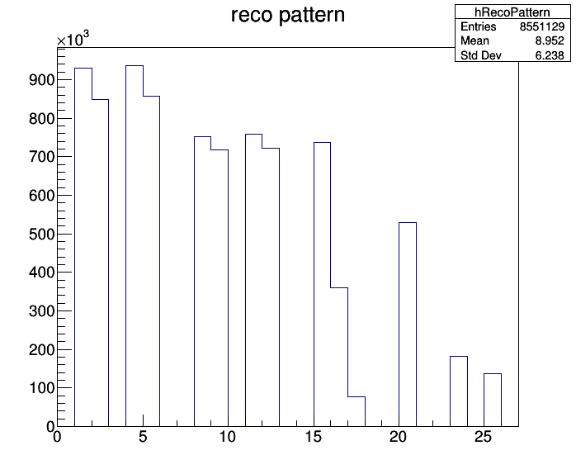
Reconstruction Efficiencies
reference:
reconstructable events
1: $Λ$ reco 0.916
2: $Λ$ reco true 0.838
4: $\overline{Λ}$ reco 0.924
5: $\overline{Λ}$ reco true 0.845
8: $Ξ^{−}$ reco 0.743
9: $Ξ^{−}$ reco true 0.708
11: ${\overline{Ξ}}^{+}$ reco 0.748
12: ${\overline{Ξ}}^{+}$ reco true 0.713
15: $π^{0}$ reco 0.728
16: $π^{0}$ reco true 0.355
17: $π^{0}$ reco conv. 0.076
$π^{0}$ true + conv. 0.431
20: ${\overline{Ξ}}^{+}Ξ^{−}$ reco 0.522
23: $\overline{p}p$ cand true 0.180
25: $\overline{p}p$ reco 0.136

Slide 9
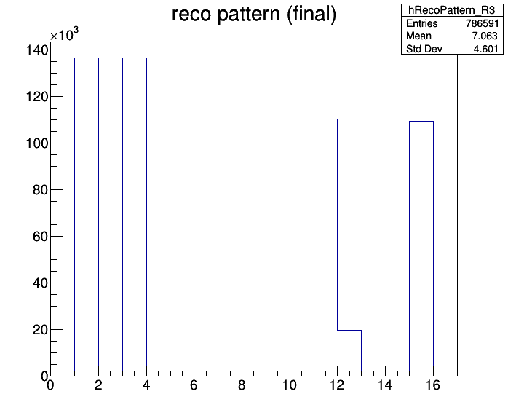
MC Truth Fraction Final ${\overline{Ξ}}^{+}Ξ^{−}π^{0}$ Sample
4C fit & mass cut
reference:
final sample
1: $Λ$ true 0.996
3: $\overline{Λ}$ true 0.996
6: $Ξ^{−}$ true 0.996
8: ${\overline{Ξ}}^{+}$ true 0.995
11: $π^{0}$ true 0.805
12: $π^{0}$ conv. 0.144
$π^{0}$ true + conv. 0.949
23: $\overline{p}p$ true* 0.798
* $γ$ conv. not included . incl. $γ$ conv.: 0.941

Slide 10
Histograms
~1000 histograms created → here: only few final plots !
MC spectra:
P_{x}, P_{y}, P_{z}, P, P_{t}, θ, P_{t} vs P_{z}, θ vs P for all particles: ${\overline{Ξ}}^{+},Ξ^{−},π^{0}, \overline{Λ}, Λ, {π^{+}}_{1},{π^{−}}_{1}, γ_{1}, γ_{2}, \overline{p}, p,{π^{+}}_{2},{π^{−}}_{2}$
decay positions of ${\overline{Ξ}}^{+},Ξ^{−}, \overline{Λ}, Λ$
${\overline{Ξ}}^{+}Ξ^{−}π^{0}$ 2-body mass spectra & Dalitz plot
4 analysis levels: ‚generated‘, ‚reco‘, ‚XiXi‘, ‚final‘
reco spectra:
${\overline{Ξ}}^{+},Ξ^{−}, \overline{Λ}, Λ$ vertex: position, reco-true, pulls
all fits (vtx, m.c.f., 4C; ${\overline{Ξ}}^{+},Ξ^{−}, \overline{Λ}, Λ,π^{0},{\overline{Ξ}}^{+}Ξ^{−},{\overline{Ξ}}^{+}Ξ^{−}π^{0}$): : $χ^{2}$ and prob.
mass spectra of composite particles at different stages
4-momenta of all particles before & after 4C fit
large number of control spectra

Slide 11
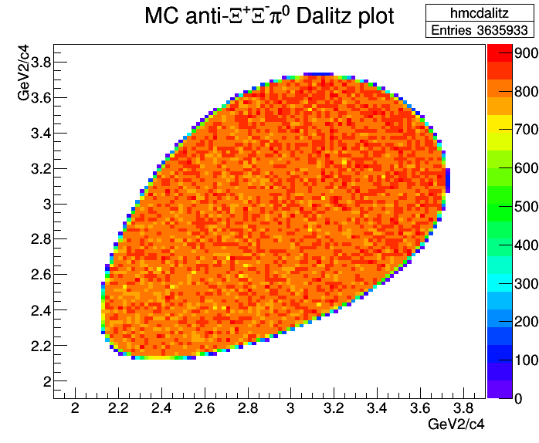
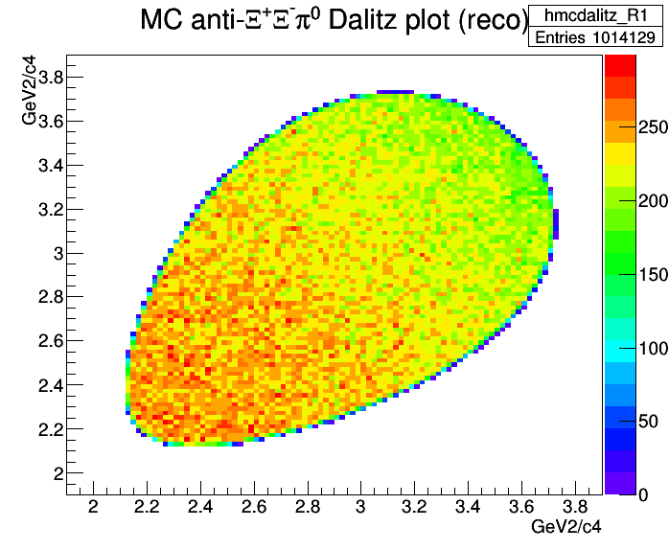
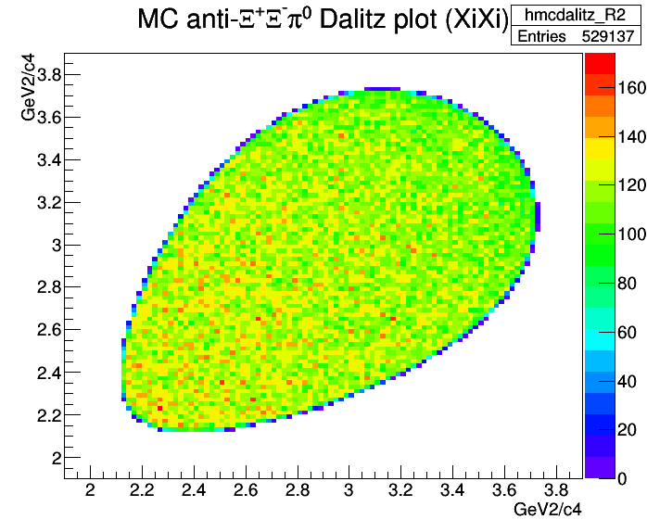
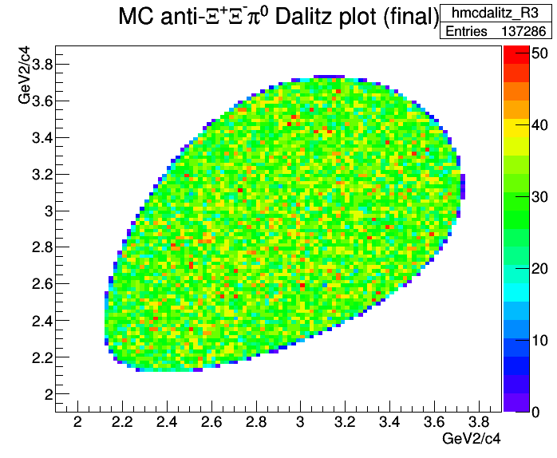
MC
generated
MC ‚reco‘
MC ‚XiXi‘
MC ‚final‘

Slide 12
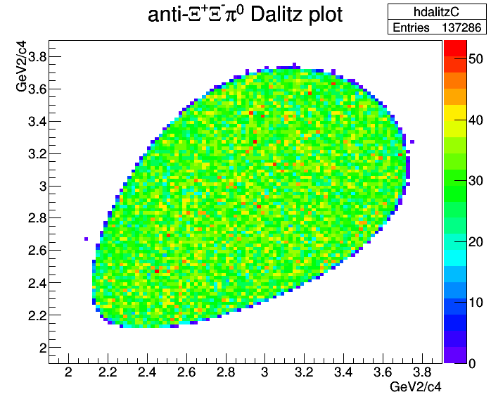
MC ‚final‘
Reconstructed
‚final‘

Slide 13
Signal Data Set (2): Include Ξ* Resonances
decay of the $\overline{p}p$ system to (b = 1/7 each):
${\overline{Ξ}}^{+}{Ξ\left(1530\right)}^{−}→{\overline{Ξ}}^{+}Ξ^{−}π^{0}$
${\overline{Ξ}}^{+}{Ξ\left(1690\right)}^{−}→{\overline{Ξ}}^{+}Ξ^{−}π^{0}$
${\overline{Ξ}}^{+}{Ξ\left(1820\right)}^{−}→{\overline{Ξ}}^{+}Ξ^{−}π^{0}$
${\overline{Ξ}\left(1530\right)}^{+}Ξ^{−}→{\overline{Ξ}}^{+}Ξ^{−}π^{0}$
${\overline{Ξ}\left(1530\right)}^{+}Ξ^{−}→{\overline{Ξ}}^{+}Ξ^{−}π^{0}$
${\overline{Ξ}\left(1530\right)}^{+}Ξ^{−}→{\overline{Ξ}}^{+}Ξ^{−}π^{0}$
${\overline{Ξ}}^{+}Ξ^{−}π^{0}$
5 M events
all reco efficiency values are same as for data set (1)

Slide 14
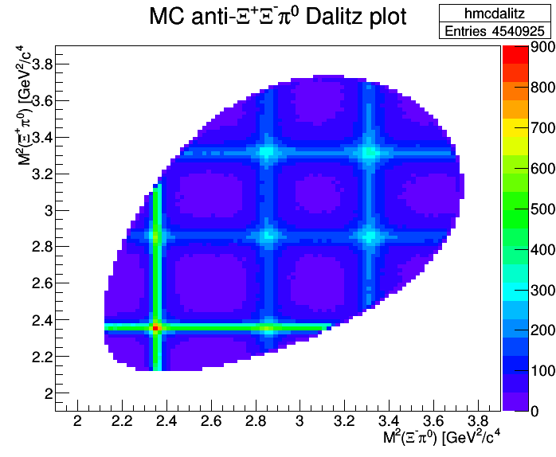
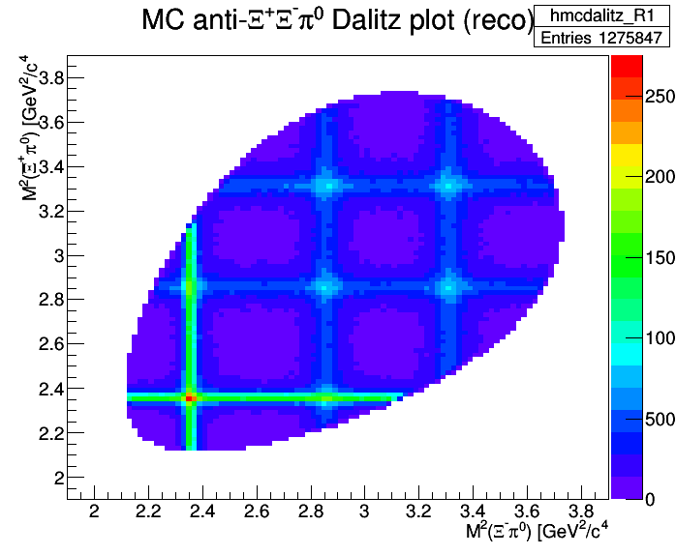
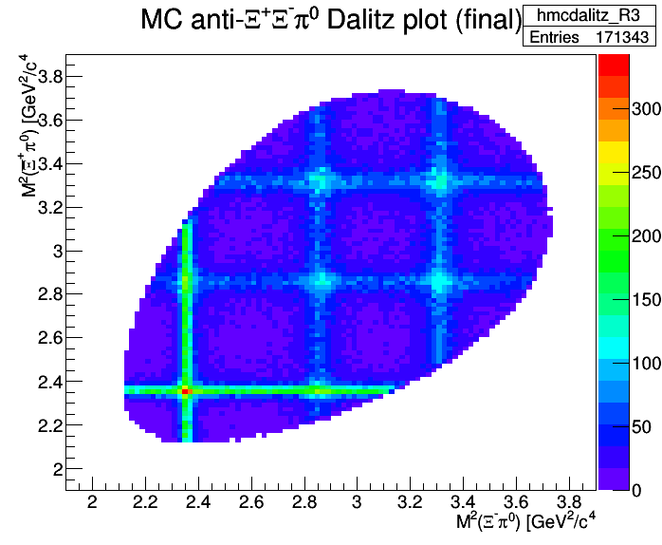
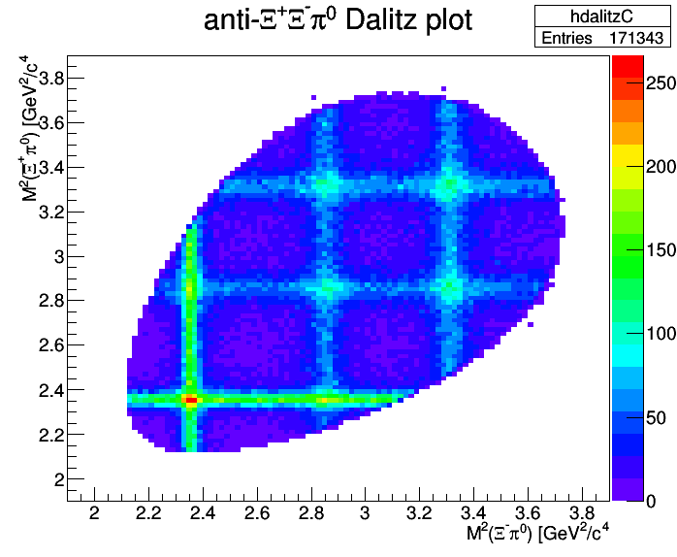
MC
generated
MC ‚reco‘
MC ‚final‘
Reconstructed
‚final‘

Slide 15
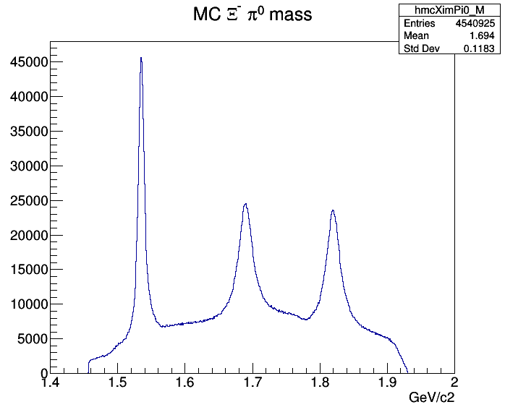
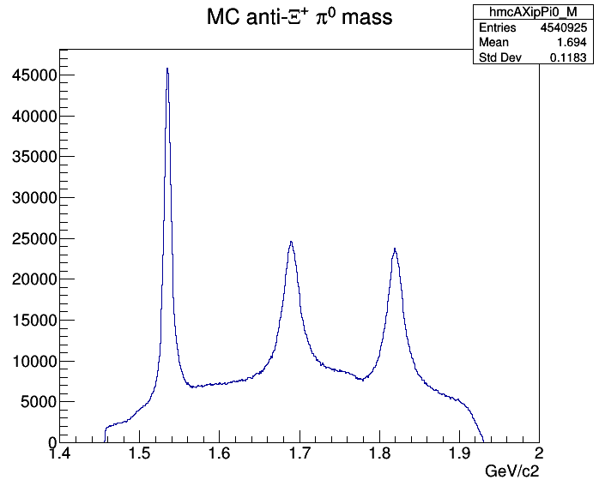
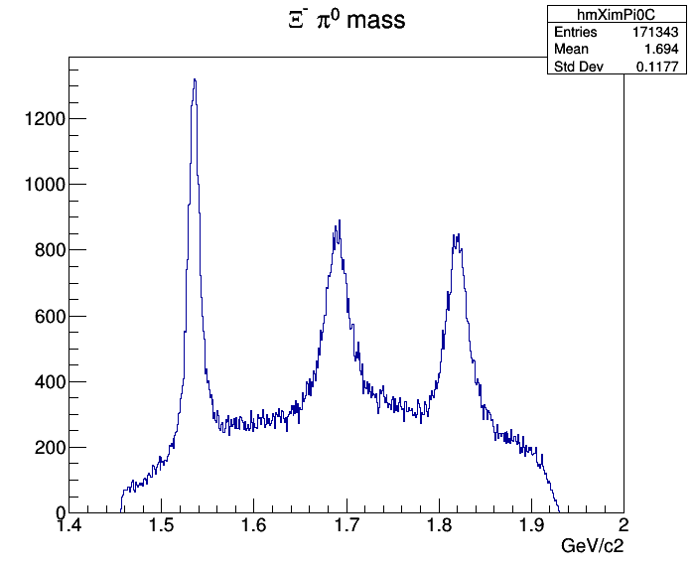
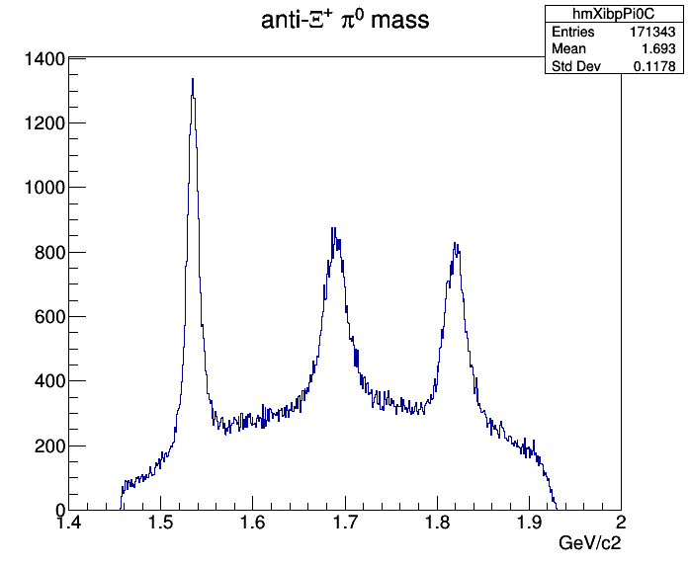
MC
generated
MC
generated
Reconstructed
‚final‘
Reconstructed
‚final‘

Slide 16
Data Set (3): DPM Background
identical analysis procedure
2 events out of 22 million survived all selection criteria
both events have prompt $Λ, \overline{Λ}, Ξ^{−},{\overline{Ξ}}^{+}$ decay vertices within 3 mm
requiring $3 mm<ct_{Λ,\overline{Λ}}<1 m$ and $d_{Ξ−\overline{Ξ}}>2 mm$ both events are eliminated
signal-to-background: $η_{S/B}>4.6$ (90% C.L.)
significance: $S_{signal}>349$ (90% C.L.)

Slide 17
Data Set (4): $\overline{p}p→\overline{p}pπ^{+}π^{+}π^{−}π^{−}π^{0}$
6.6 M events, $σ≅100 μb$ (extrapolated from data at higher $p_{\overline{p}}$)
674 events survived all selection criteria
most events have $Λ, \overline{Λ}, Ξ^{−},{\overline{Ξ}}^{+}$ decay vertices within few mm
after requiring $3 mm<ct_{Λ,\overline{Λ}}<1 m$ and $d_{Ξ−\overline{Ξ}}>2 mm$, 34 events survive
signal-to-background: $η_{S/B}=47$
significance: $S_{signal}=381$

Slide 18
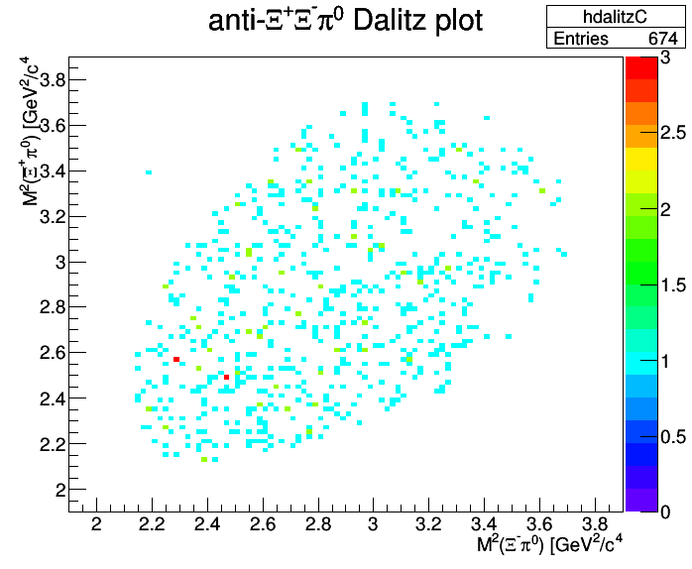
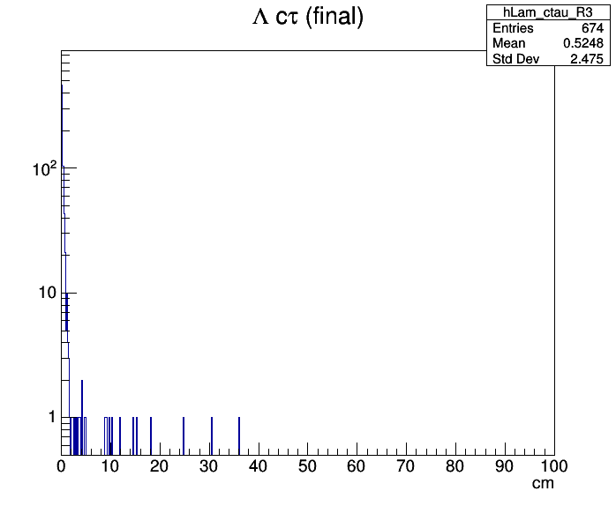
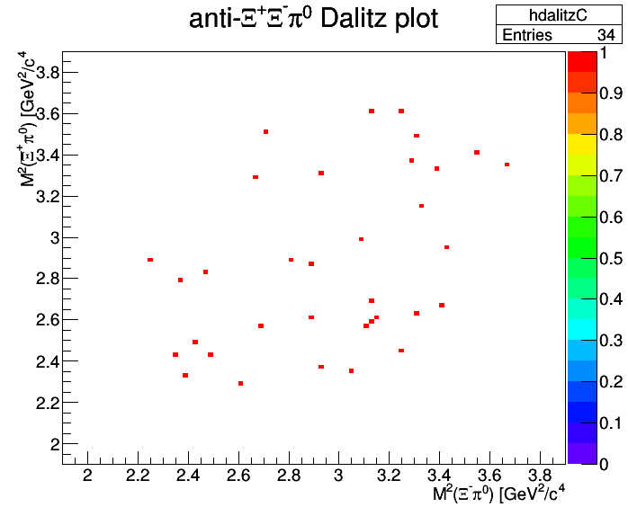
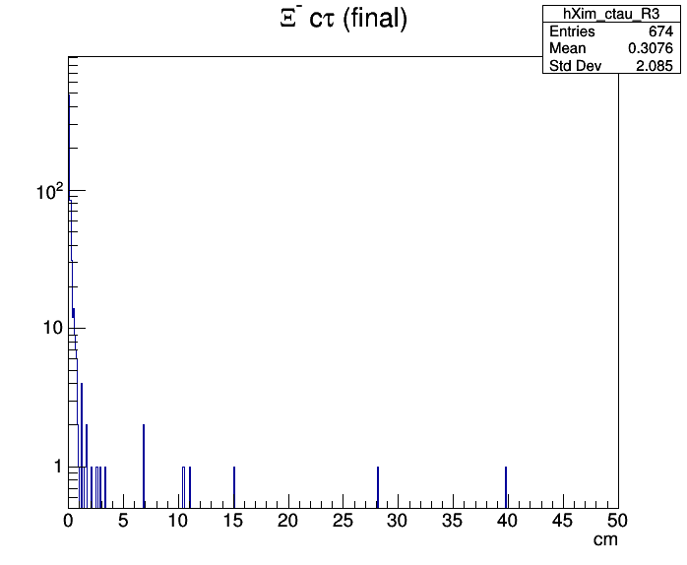
before vertex cut
after vertex cut

Slide 19
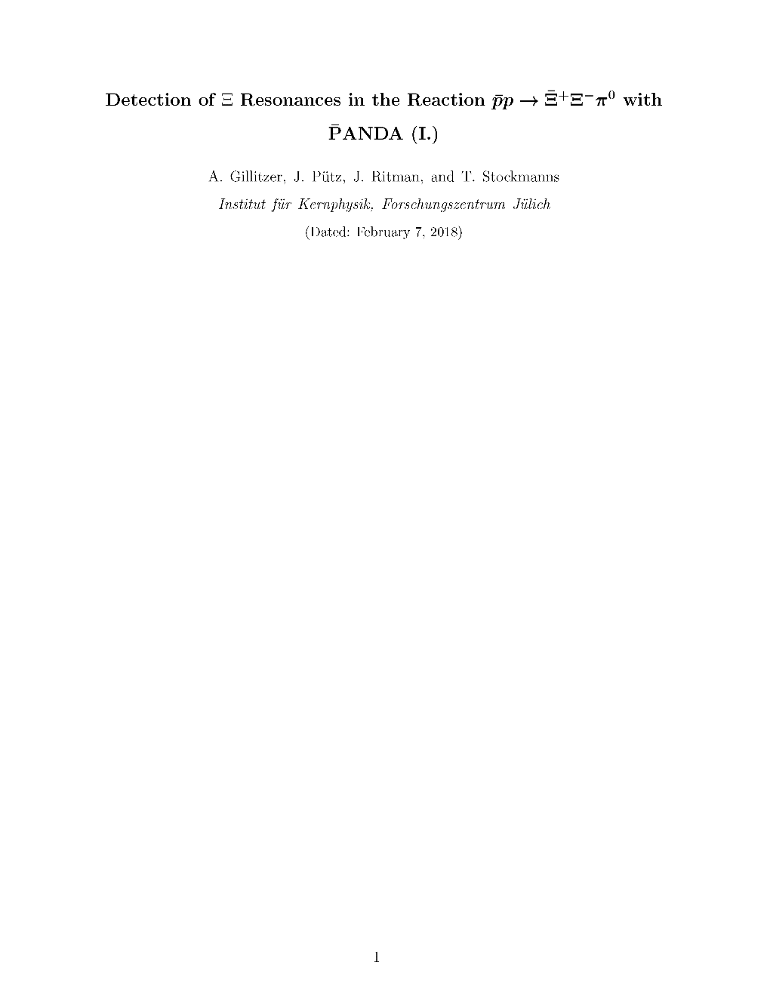
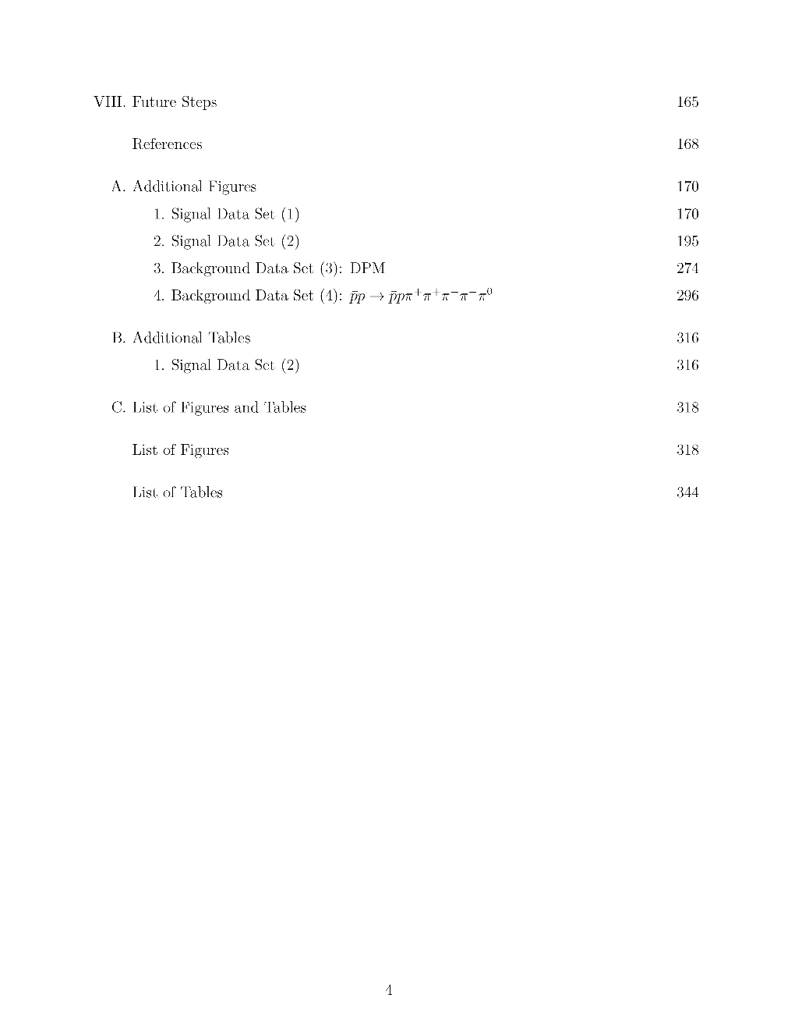
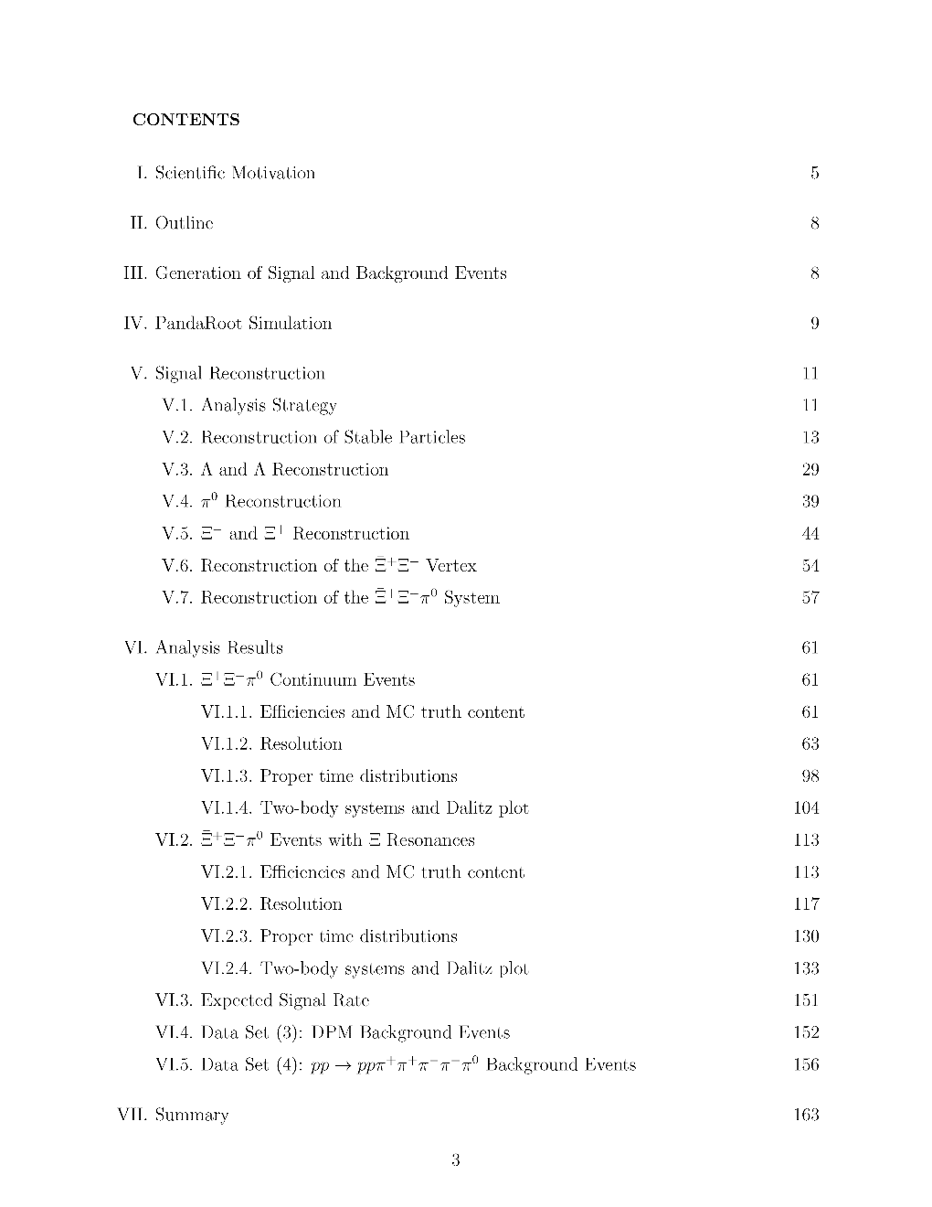
Release Note Ready

Slide 20
Summary
comprehensive analysis of 4.6 GeV/c $\overline{p}p→{\overline{Ξ}}^{+}Ξ^{−}π^{0}$ including background studies
over-all reconstruction efficiency: ~3.5 %
$π^{0}$ reconstruction significantly contributes to efficiency losses (~43%) and to ‚fake‘ combinations in the final data sample (~5%)
acceptance and reconstruction uniform across ${\overline{Ξ}}^{+}Ξ^{−}π^{0}$ phase space
22 M DPM background events → S/B > 4.6
6.6 M ${\overline{p}pπ}^{+}π^{+}π^{−}π^{−}π^{0}$ events → S/B = 47
release note ready for distribution to the collaboration

