Slide 1
PID for FTOF with Cellular Automaton tracking D. Veretennikov GSI, 07.03.2018

Slide 2
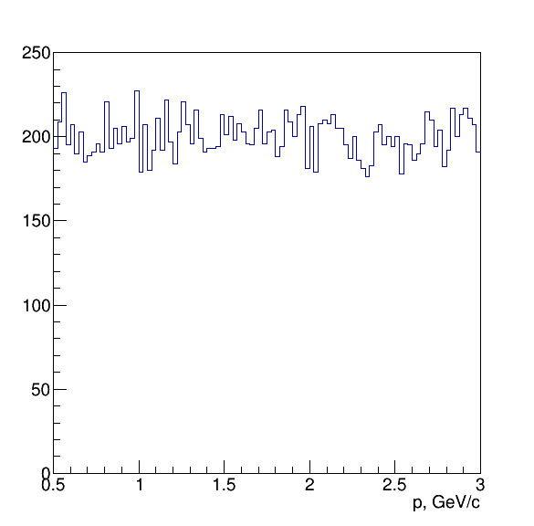
MC generators
Box generator in forward region
1° < theta < 5°
0° < phi < 360°
Momentum 0.5 < p < 3 GeV/c
9000 events
1 particle per events (π, K, p)
3000 events
3 particle per events (π, K, p)
FtsIdealTrack reconstruction
CAtrack reconstruction

Slide 3
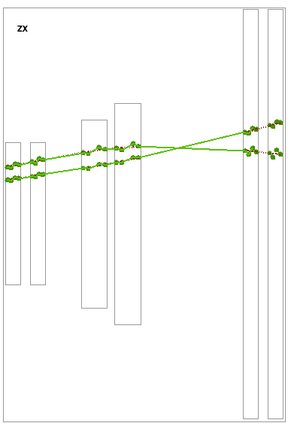
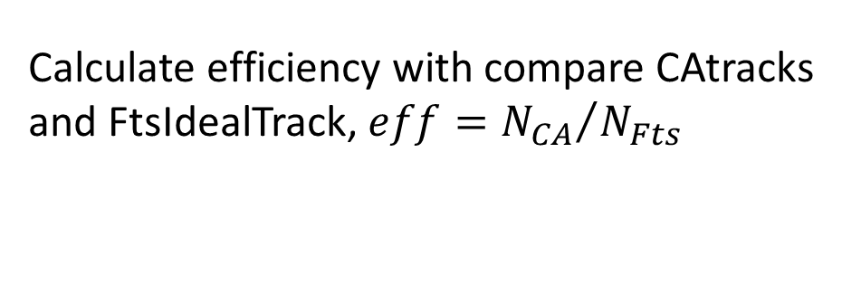
Reconstruction efficiency
1 particle per events eff = 98.7%
3 particle per events eff = 97.1%
Calculate efficiency with compare CAtracks and FtsIdealTrack, $eff={N_{CA}}/{N_{Fts}}$
Pictures from M. Pugach presentation

Slide 4
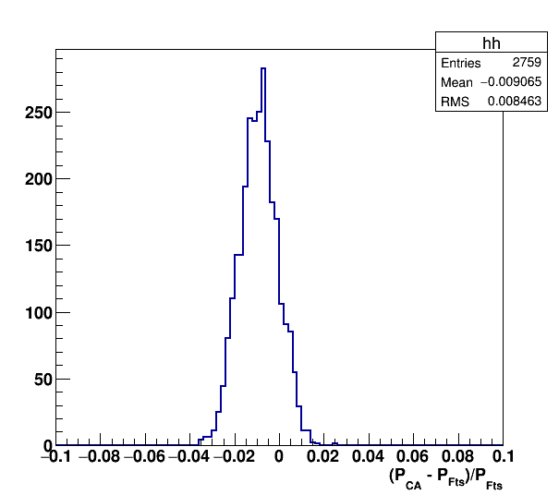
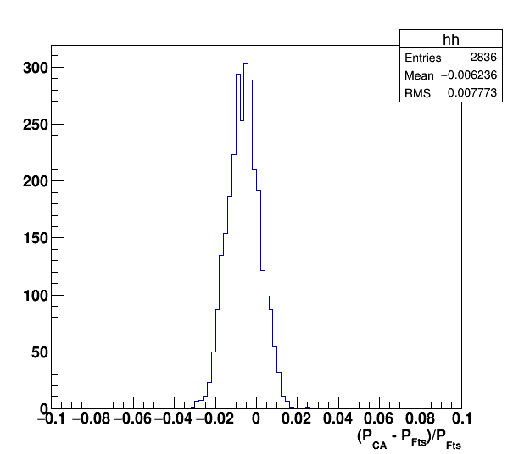
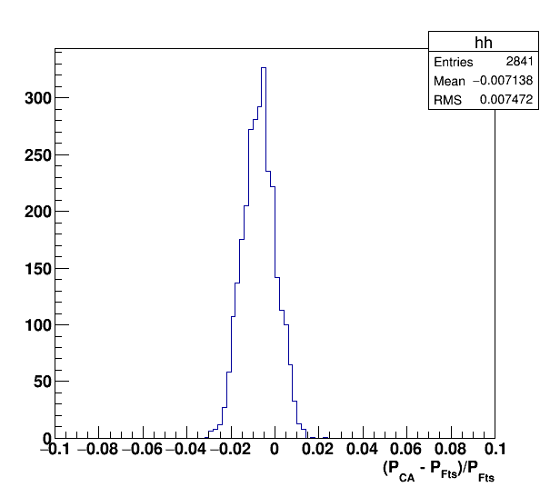
Momentum residuals
1 track per event
Mean value shifted, CAtrack momentum less then MC momentum
Pion
Kaon
Proton

Slide 5
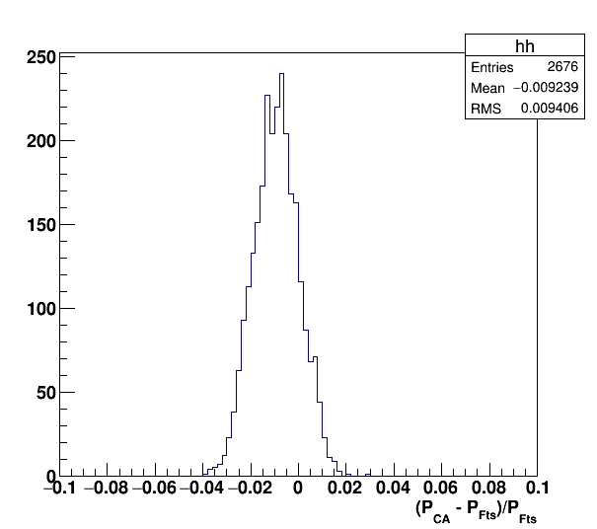
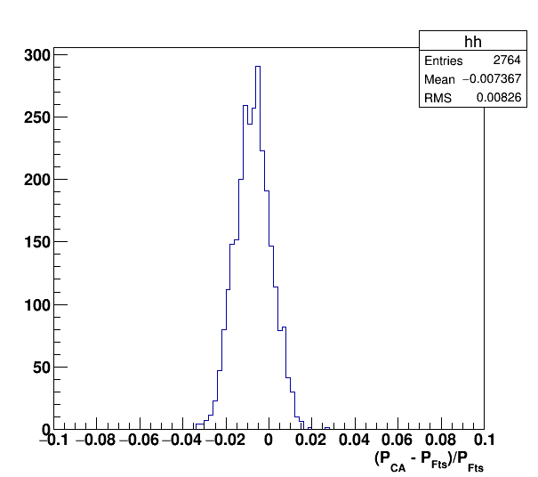
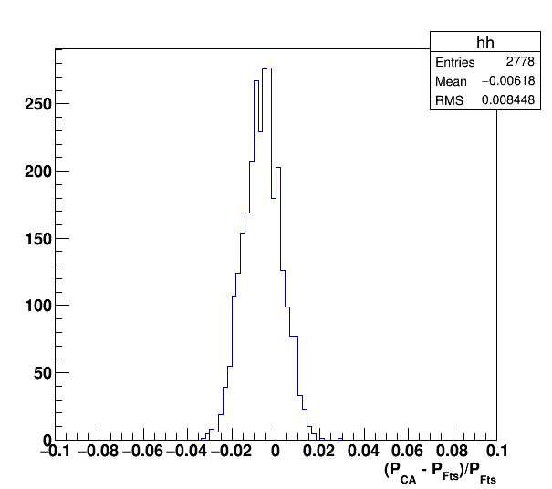
Momentum residuals
3 tracks per event
Mean value also shifted and sigma is higher then in 1 track case
Pion
Kaon
Proton

Slide 6
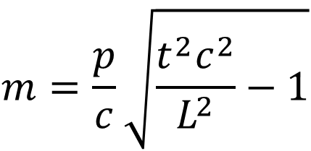
PID
$$m=\frac{p}{c}\sqrt{\frac{t^{2}c^{2}}{L^{2}}−1}$$
$t$ – reconstructed by FTOF time, event base simulation (T0 = 0)
$p$ – reconstructed by CAtrack momenta
$L$ - track length, taken from MC, later will be also taken from CAtrack

Slide 7
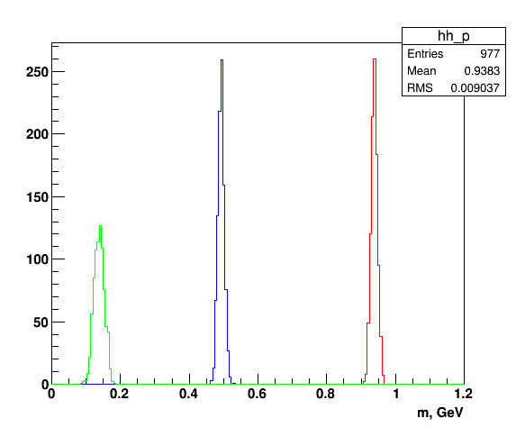
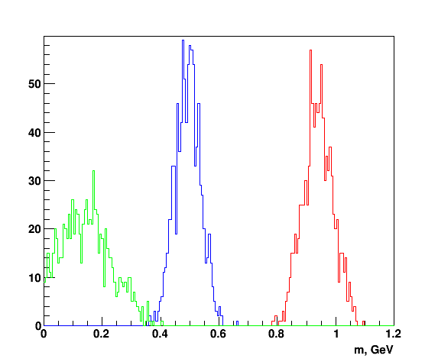
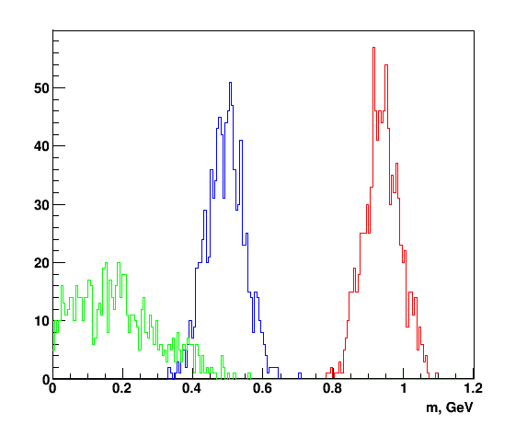
Reconstructed mass
1 track per event
0.5 GeV < p < 1 GeV
1 GeV < p < 2 GeV
2 GeV < p < 3 GeV
π, K, p
π, K, p
π, K, p

Slide 8
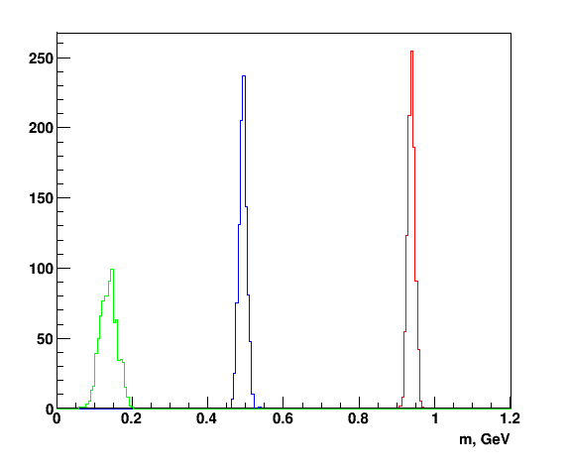
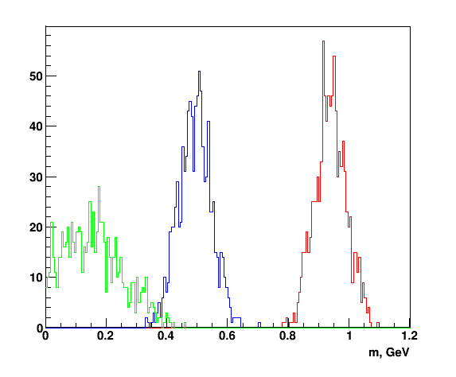
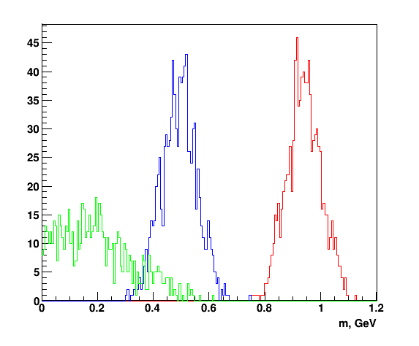
Reconstructed mass
3 tracks per event
0.5 GeV < p < 1 GeV
1 GeV < p < 2 GeV
2 GeV < p < 3 GeV
π, K, p
π, K, p
π, K, p

Slide 9
Separation power
1 track per event
3 tracks per event

Slide 10
Outlook
Use reconstructed track length for PID
Event mixing in timebase simulation
Looping PID algorithm in timebase simulation
Determination of T0 using track information

