Slide 1
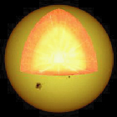
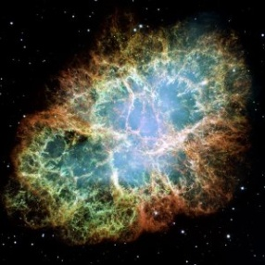
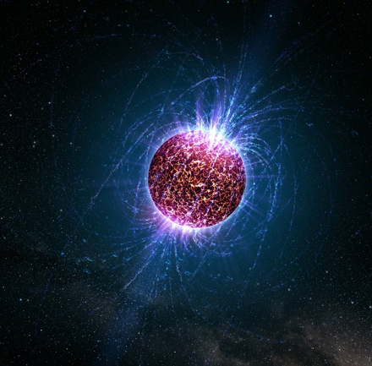
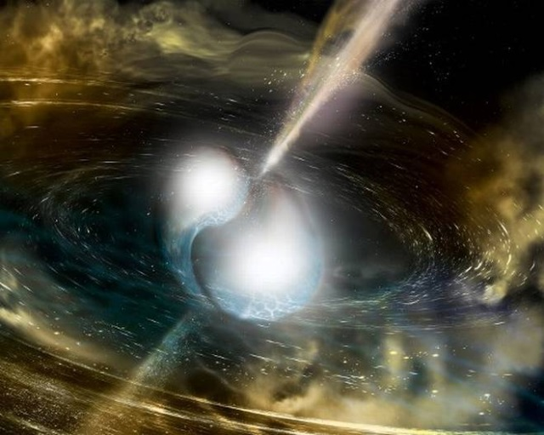














Cosmic matter in the laboratory –
Science at FAIR
Peter Senger
Outline:
GSI highlights
Cosmic matter
Research at FAIR
Eötvös University, 7th December 2017, Budapest, Hungary
Finland
France
Germany
India
Poland
Romania
Russia
Slovenia
Spain
Sweden
UK

Slide 2
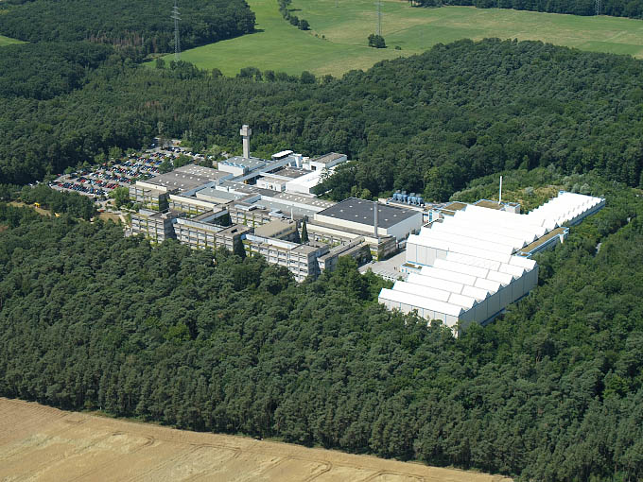
GSI Helmholtzzentrum für Schwerionenforschung
Employees: 1350
External scientists: 1000/year
Large scale accelerators and experiments

Slide 3
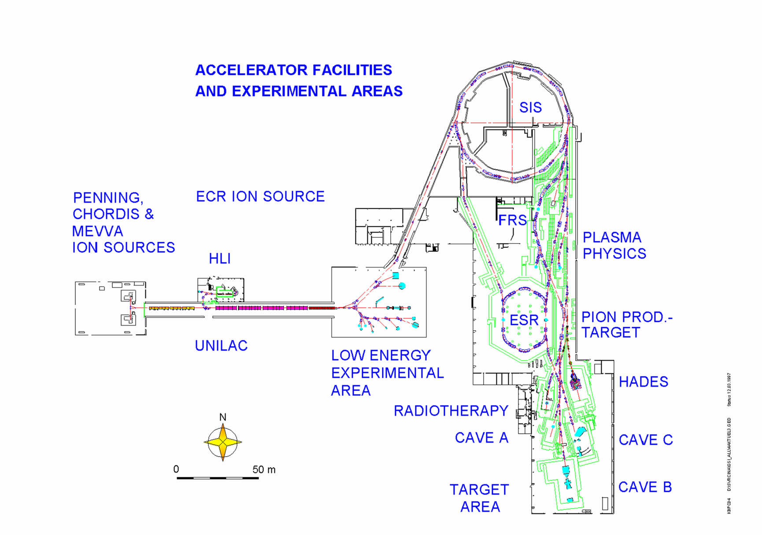


Slide 4
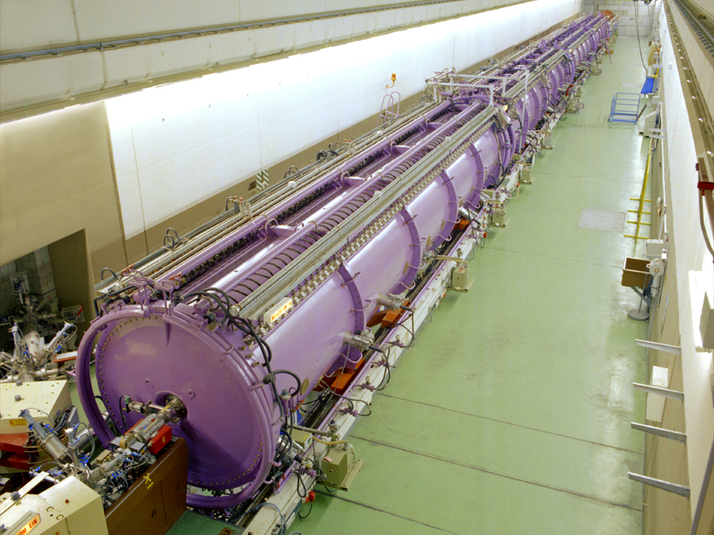

Slide 5
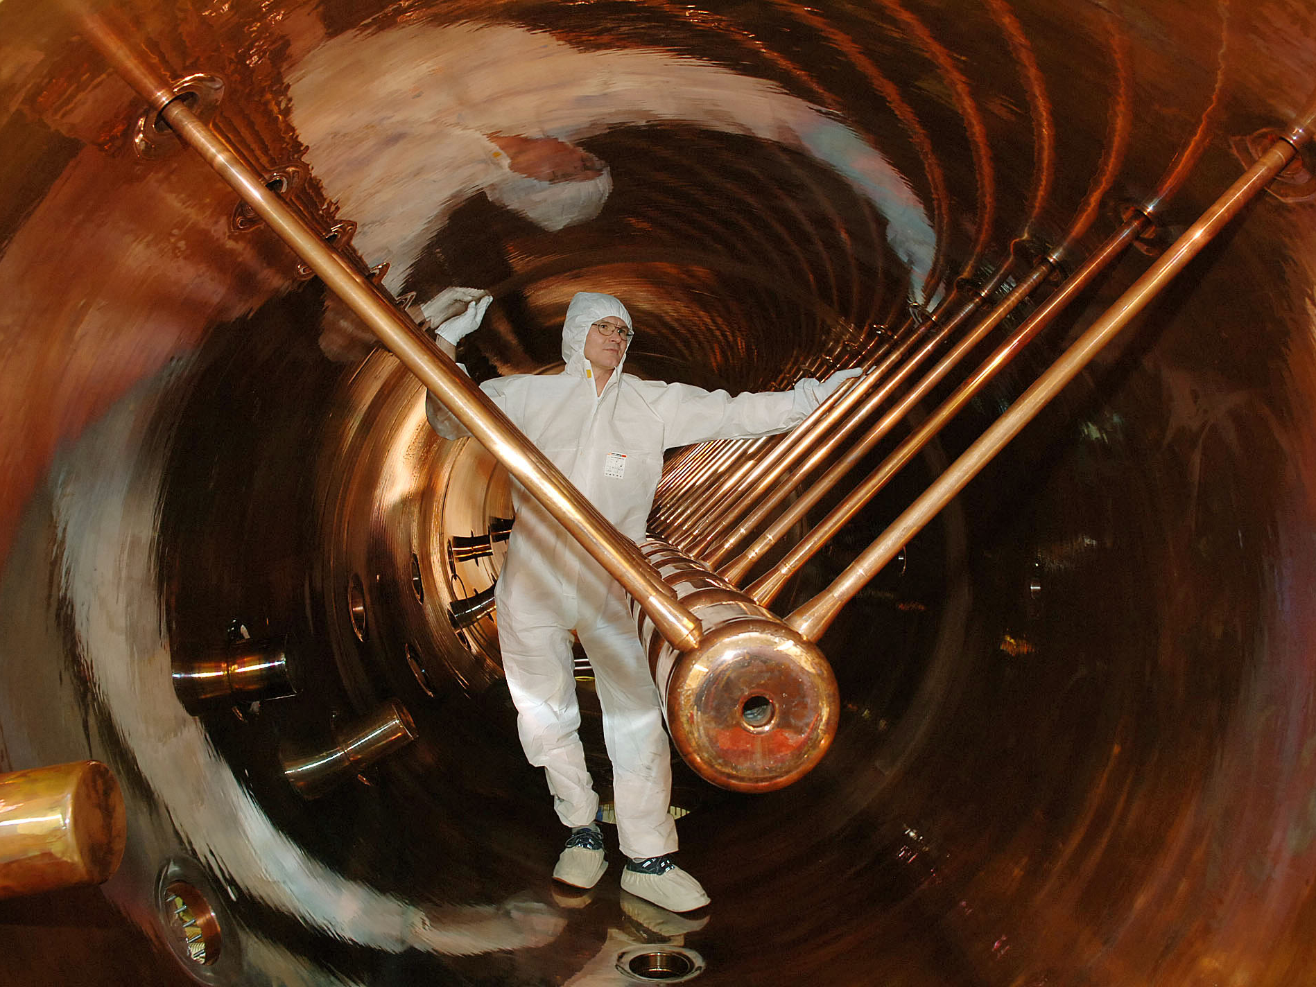
Rc 1505; 2f18

Slide 6
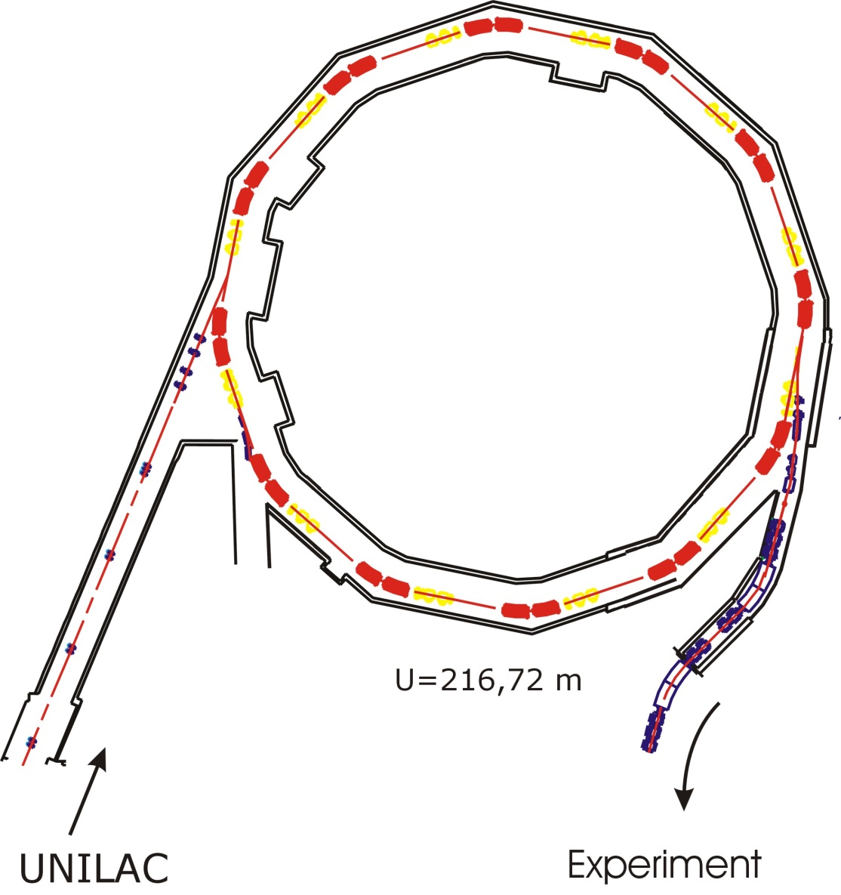
Heavy-ion synchrotron SIS18
Circumference: 216 m
Acceleration:
more than 100 000 turns per second
Magnets: up to 1.8 T
Acceleration cavity
Bending magnets
Focussing magnets
UNILAC
Experiment

Slide 7
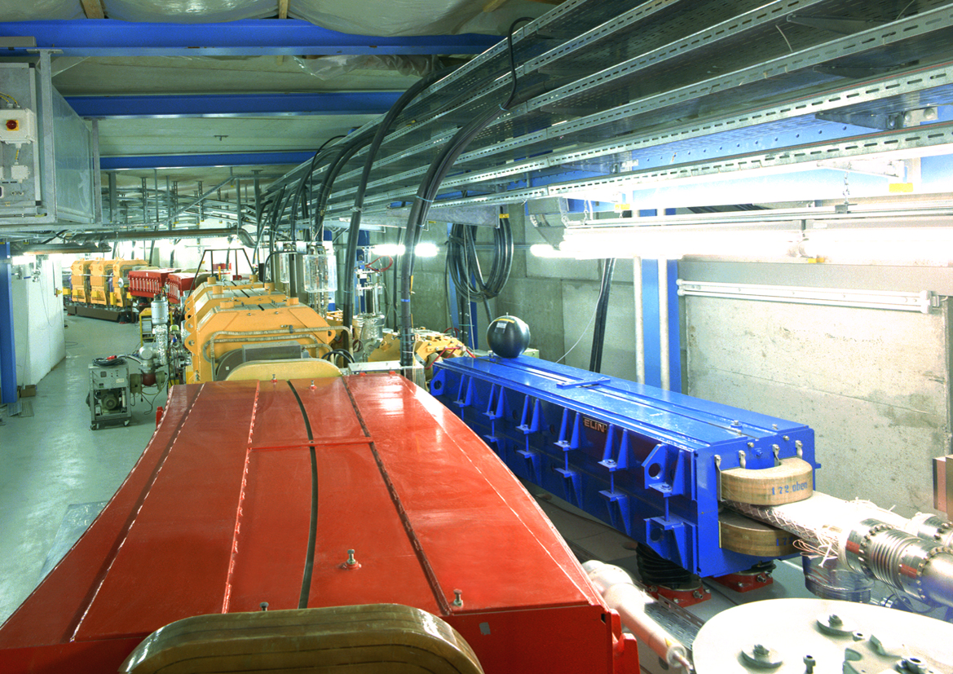

Slide 8
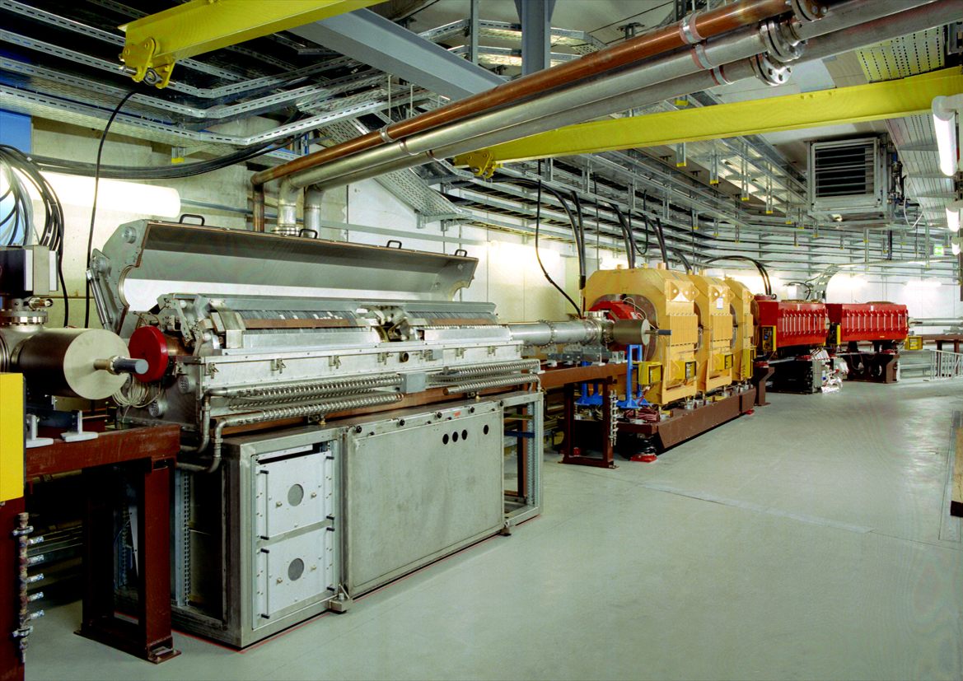

Slide 9
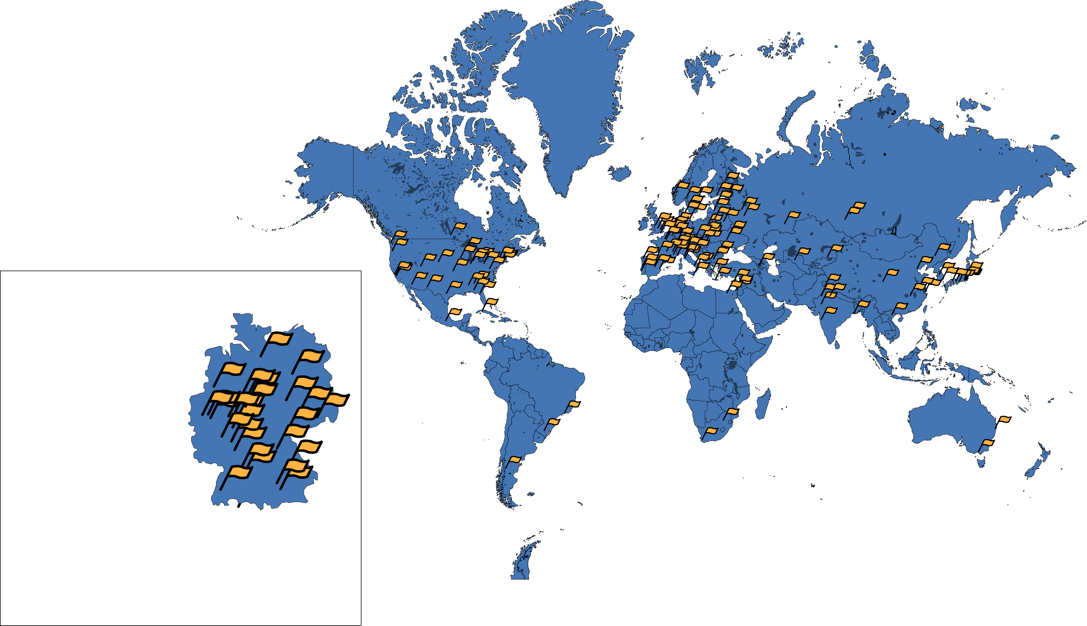
Worldwide Cooperations in more than 50 countries

Slide 10
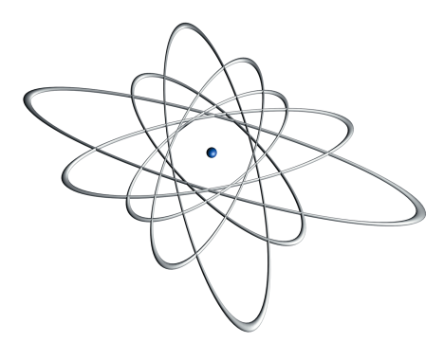
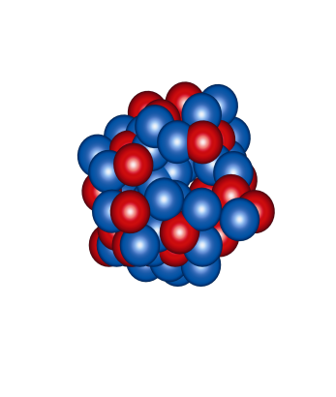
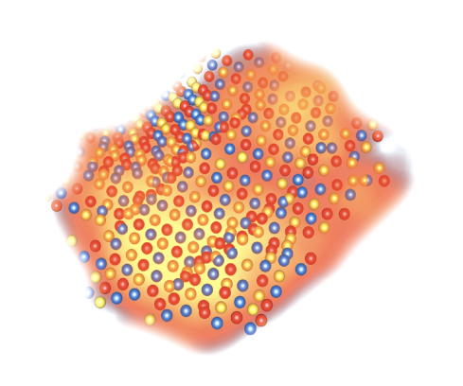
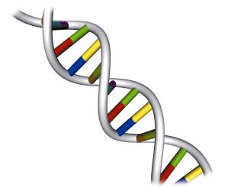
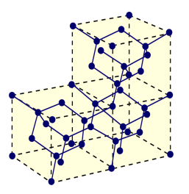
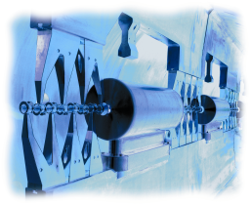
Research program
Nuclear physics (50%)
Nuclear reactions
hot and dense nuclear matter
Superheavy elements
Atomic physics (15%)
Atomic reactions
Precision spectroscopy of
highly charged ions
Biophysics and radiation physics (15%)
Radiobiological effects of ions
Tumor therapy twith ion beams
Plasma physics (5%)
Hot and dense plasmas
Ion-plasma interaction
Material research (5%)
Ion-material interaction
Structuring of materials
with ion beams
Accelerator technology (10%)
Linear accelerators
Synchrotrons und storage rings

Slide 11
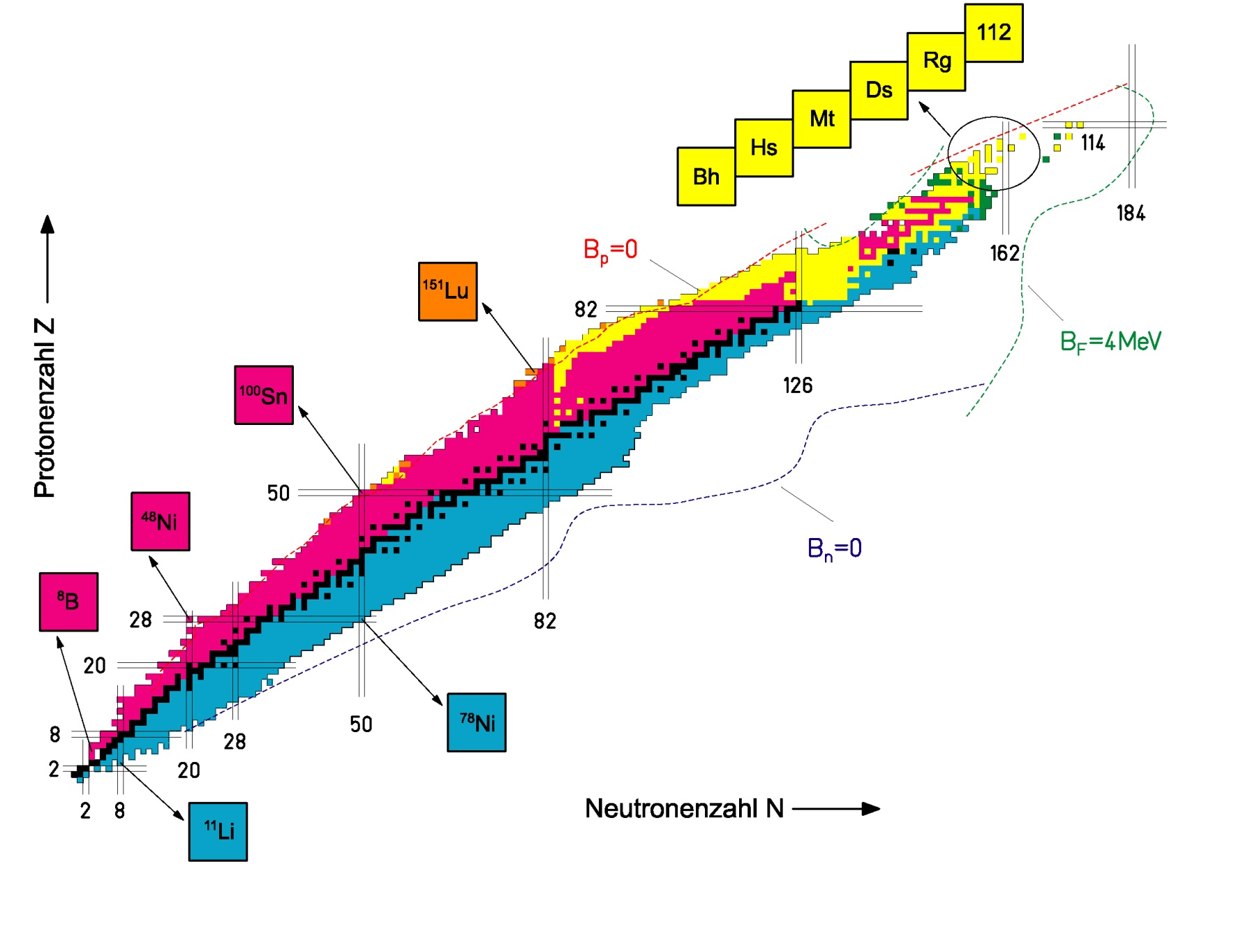
Superheavy elements

Slide 12
Superheavy elements
n
⁷⁰Zn
²⁰⁸Pb
²⁷⁷112
²⁷⁷112
²⁷⁷112
CN
²⁷³110
11.45 MeV
280 μs
²⁶⁹Hs
11.08 MeV
110 μ s
²⁶⁵Sg
9.23 MeV
19.7 s
²⁶¹Rf
4.60 MeV (escape)
7.4 s
known
SHIP: kinematic separation in flight
²⁵⁷No
8.52 MeV
4.7 s
identification
by α-α correlations
to known nuclides
Date: 09-Feb-1996
Time: 22:37 h
²⁵³Fm
8.34 MeV
15.0 s

Slide 13
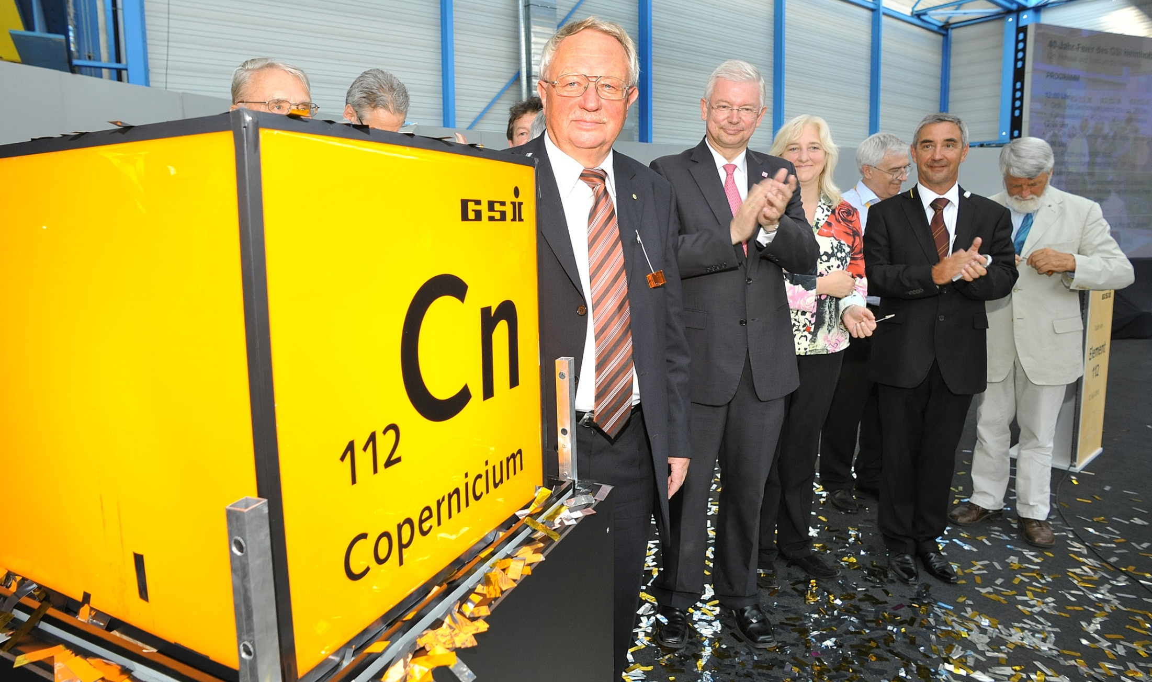
Superheavy elements

Slide 14
Periodic system of elements
I
VIII
H
II
III
IV
V
VI
VII
He
1
2
Li
Be
B
C
N
O
F
Ne
3
4
5
6
7
8
9
10
Na
Mg
Al
Si
P
S
Cl
Ar
11
12
13
14
15
16
17
18
K
Ca
Sc
Ti
V
Cr
Mn
Fe
Co
Ni
Cu
Zn
Ga
Ge
As
Se
Br
Kr
19
20
21
22
23
24
25
26
27
28
29
30
31
32
33
34
35
36
Rb
Sr
Y
Zr
Nb
Mo
Tc
Ru
Rh
Pd
Ag
Cd
In
Sn
Sb
Te
I
Xe
37
38
39
40
41
42
43
44
45
46
47
48
49
50
51
52
53
54
Cs
Ba
La
58-71
Hf
Ta
W
Re
Os
Ir
Pt
Au
Hg
Tl
Pb
Bi
Po
At
Rn
55
56
57
72
73
74
75
76
77
78
79
80
81
82
83
84
85
86
Fr
Ra
Ac
90-103
Rf
Db
Sg
Bh
Hs
Mt
Ds
Rg
Cn
113
Fl
115
Lv
117
118
87
88
89
104
105
106
107
108
109
110
111
112
113
114
115
116
117
118
Ce
Pr
Nd
Pm
Sm
Eu
Gd
Tb
Dy
Ho
Er
Tm
Yb
Lu
58
59
60
61
62
63
64
65
66
67
68
69
70
71
Th
Pa
U
Np
Pu
Am
Cm
Bk
Cf
Es
Fm
Md
No
Lr
90
91
92
93
94
95
96
97
98
99
100
101
102
103
natürlich,
stabil
natürlich,
instabil
künstlich,
instabil
bei GSI erzeugt,
instabil
nicht bestätigt

Slide 15
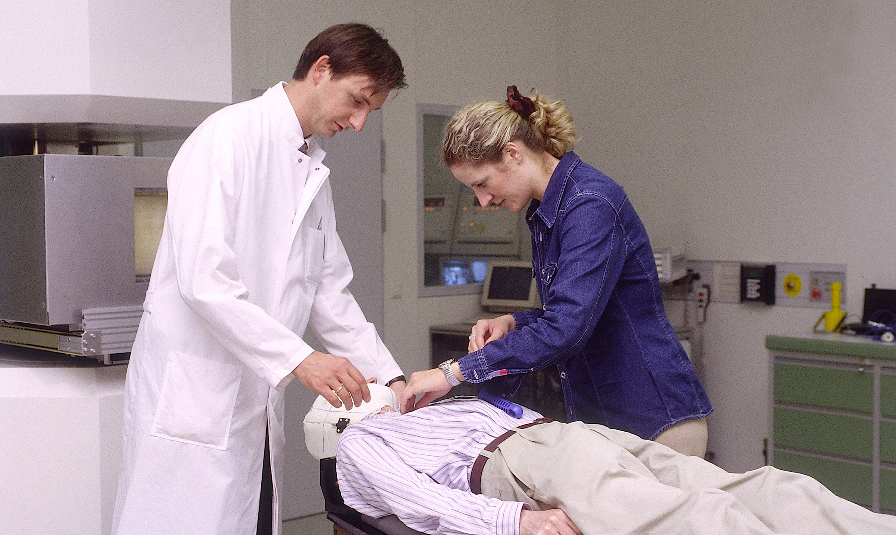
Tumor therapy with heavy ions

Slide 16
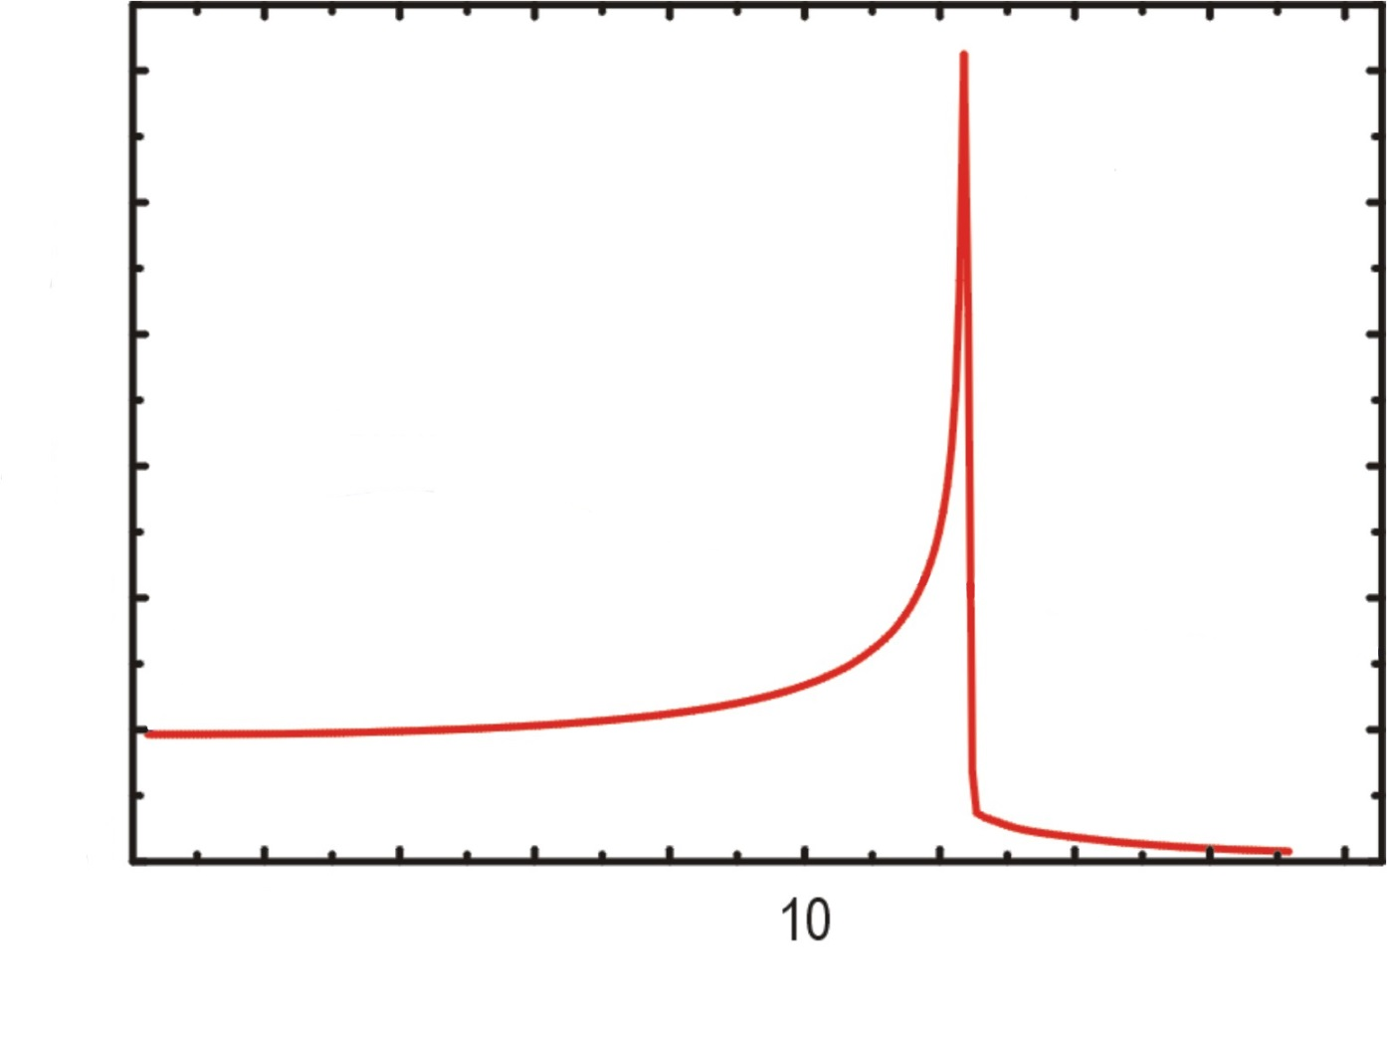
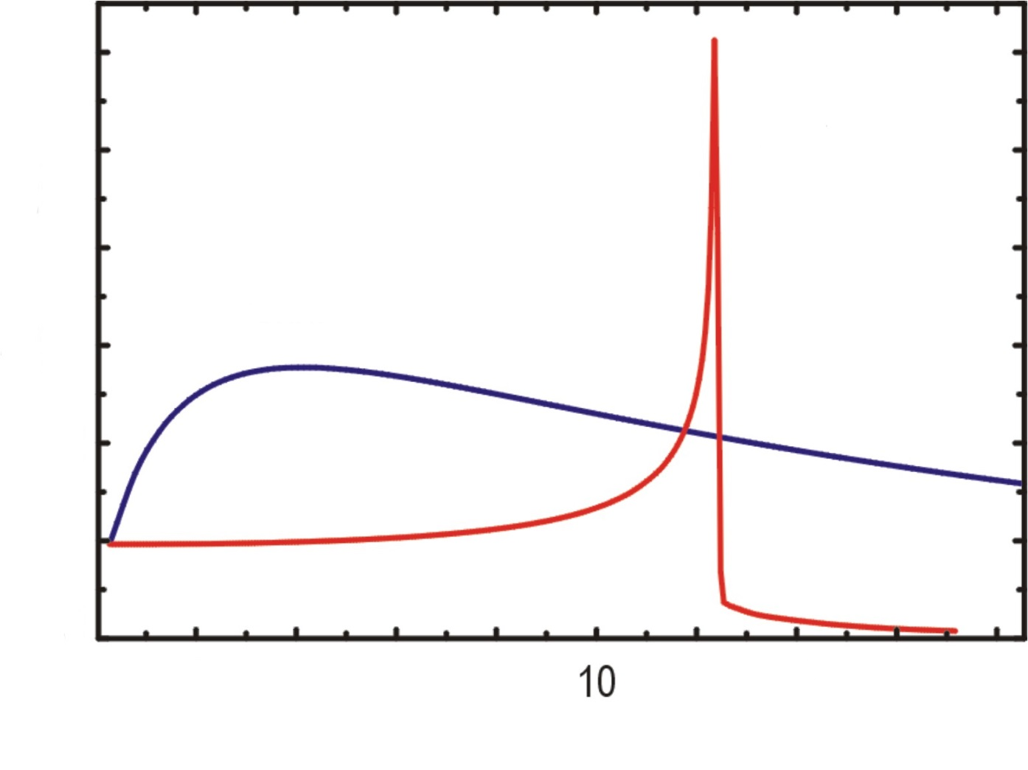
Radiation effects
Tumor
100 %
Ion beam
relative dose
hard x-rays
50 %
0 %
2
6
10
14
18
penetration depth [cm]

Slide 17
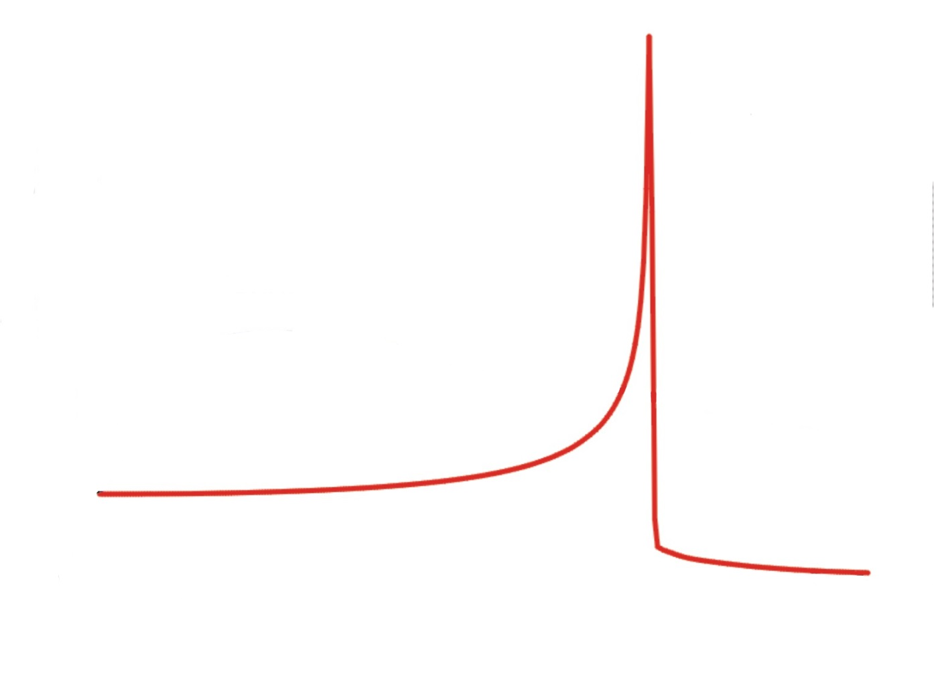
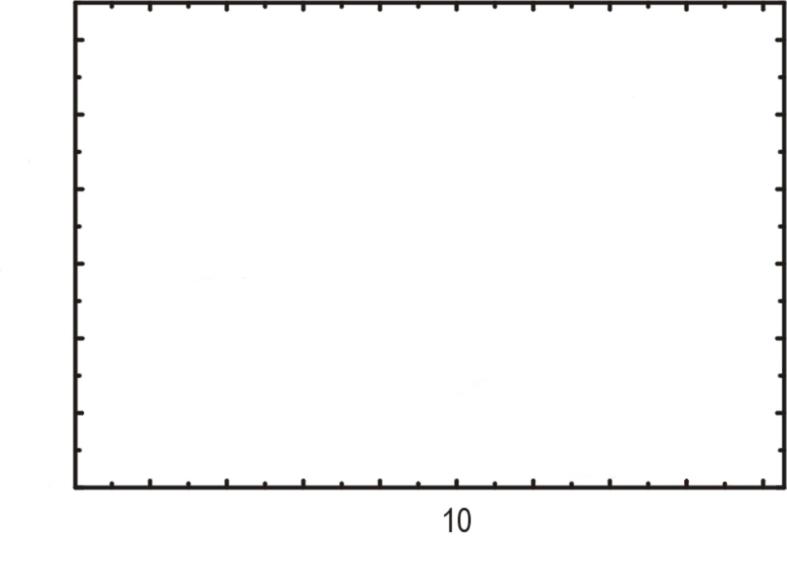
Radiation effects
Tumor
100 %
Ion beam
relative dose
50 %
0 %
2
6
10
14
18
penetration depth [cm]

Slide 18

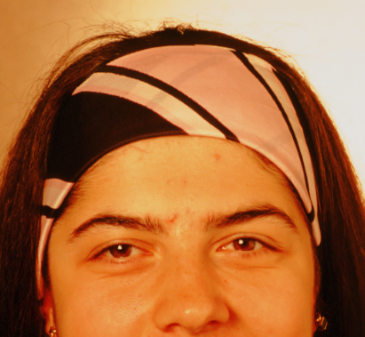
Course of desease
Prior to Carbon therapy
6 weeks after
Carbon therapy

Slide 19
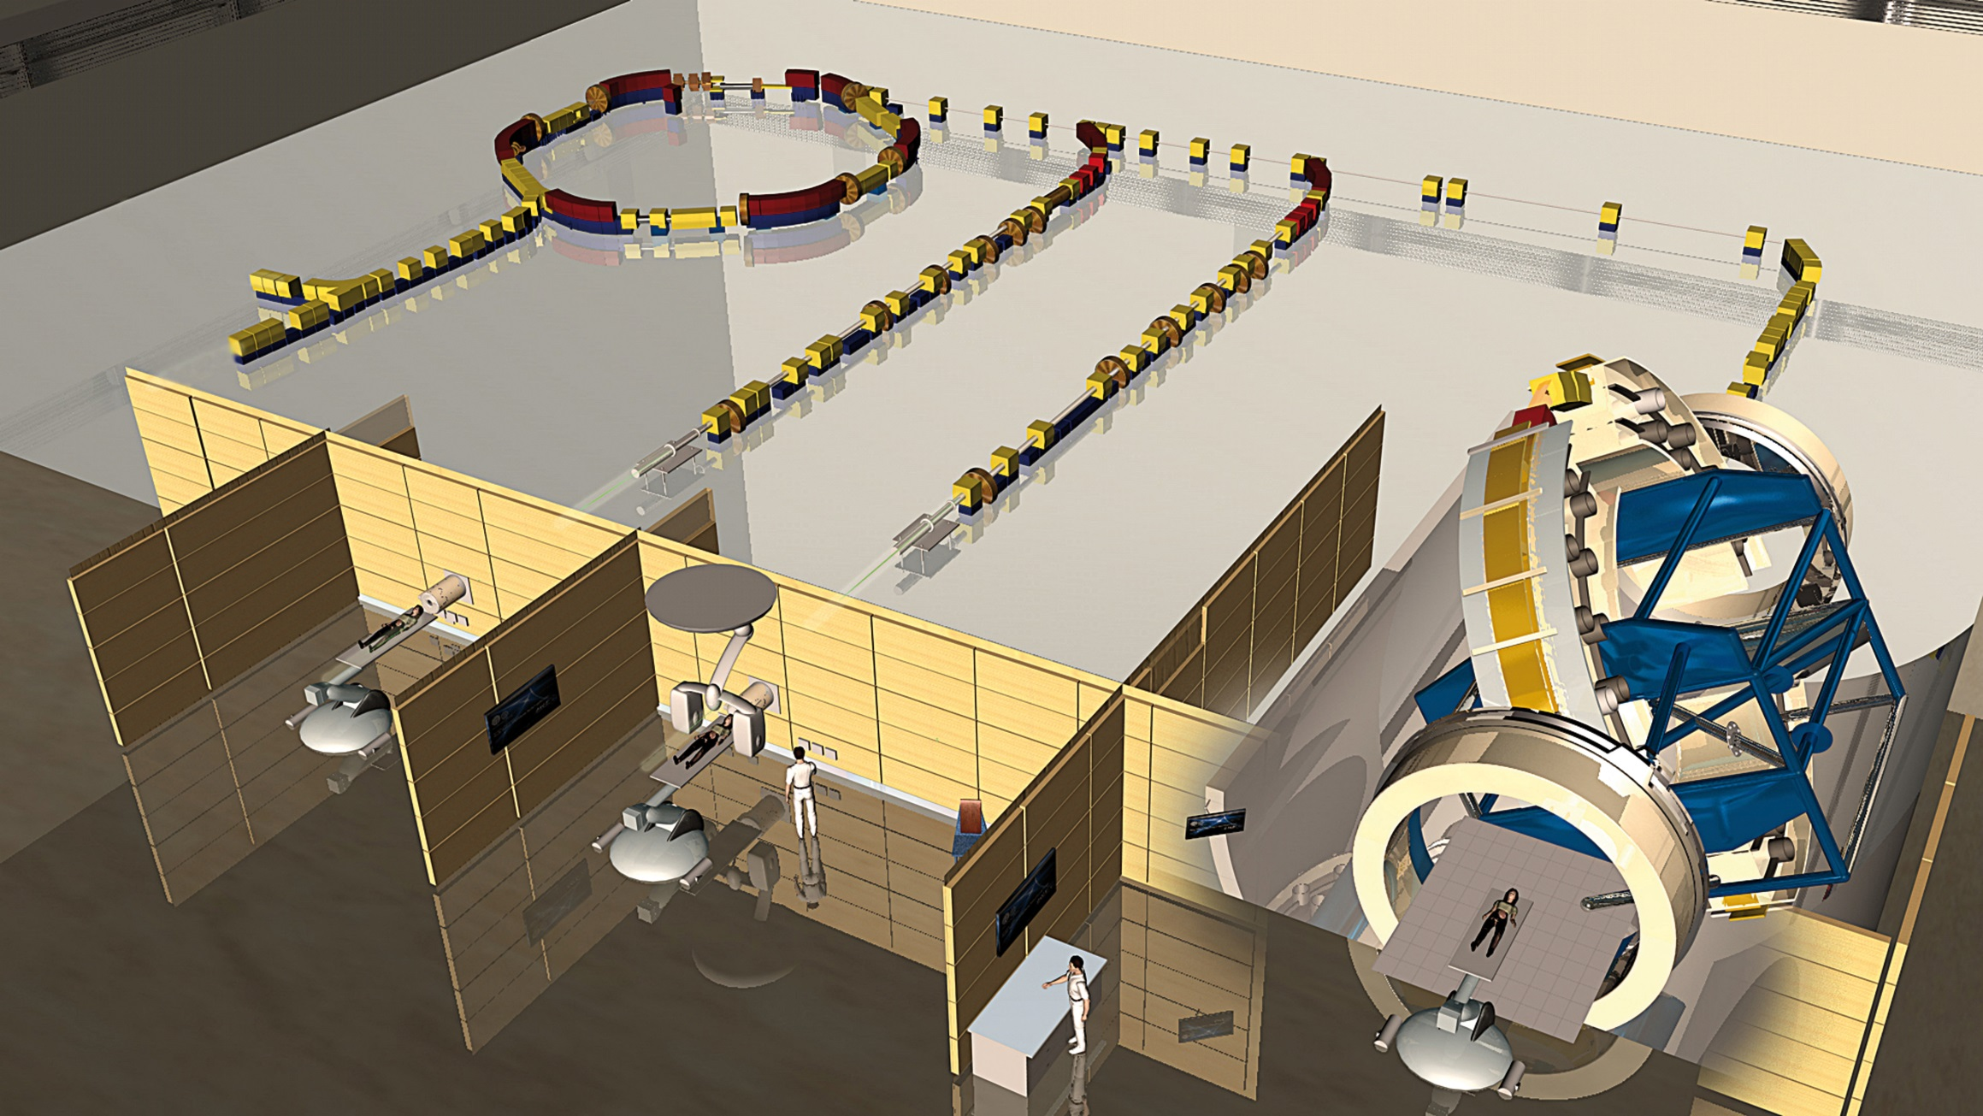
Heidelberger Ionenstrahl-Therapiezentrum (HIT)

Slide 20
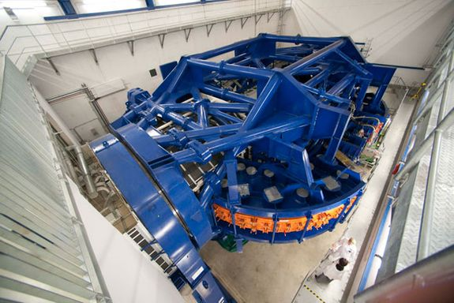
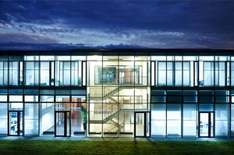
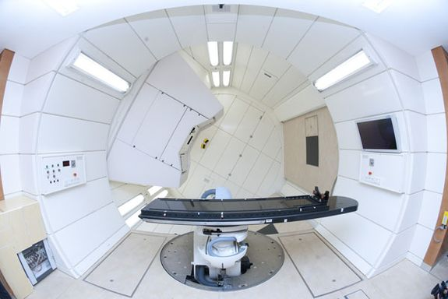
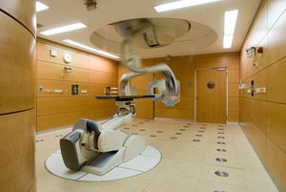
Heidelberger Ionenstrahl Therapiezentrum (HIT)
Inauguration Nov. 2, 2009
1000 patients per year

Slide 21
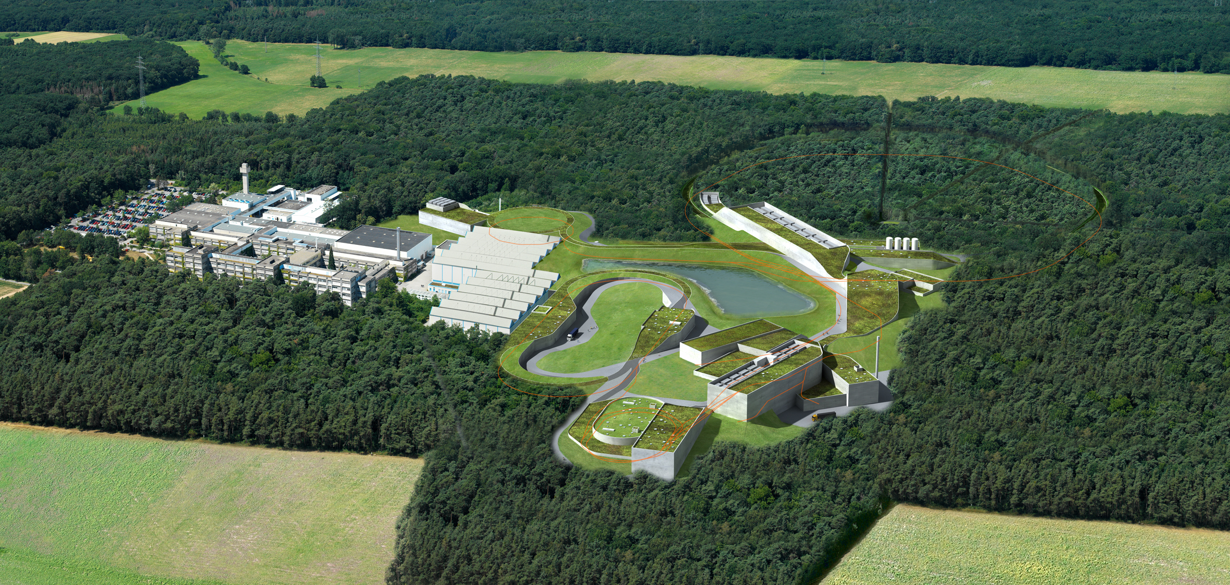
FAIR – Facility for Antiproton and Ion Research
Facility for Antiproton and Ion Research:
Cosmic matter in the laboratory
FAIR is worldwide the largest project in fundamental science.
Forefront research in nuclear, hadron, atom, plasma, antimatter, and applied physics.
Member states: Germany, Russia, India, Poland, Romania, France, Finland, Sweden, Slovenia,
Great Britain.
2500 – 3000 users per year.
Total costs ca. 1.7 Mrd. €, full completion in 2025.
Financing: Fed. Rep. Germany 60%, Hesse 10%,
partner countries 30%

Slide 22
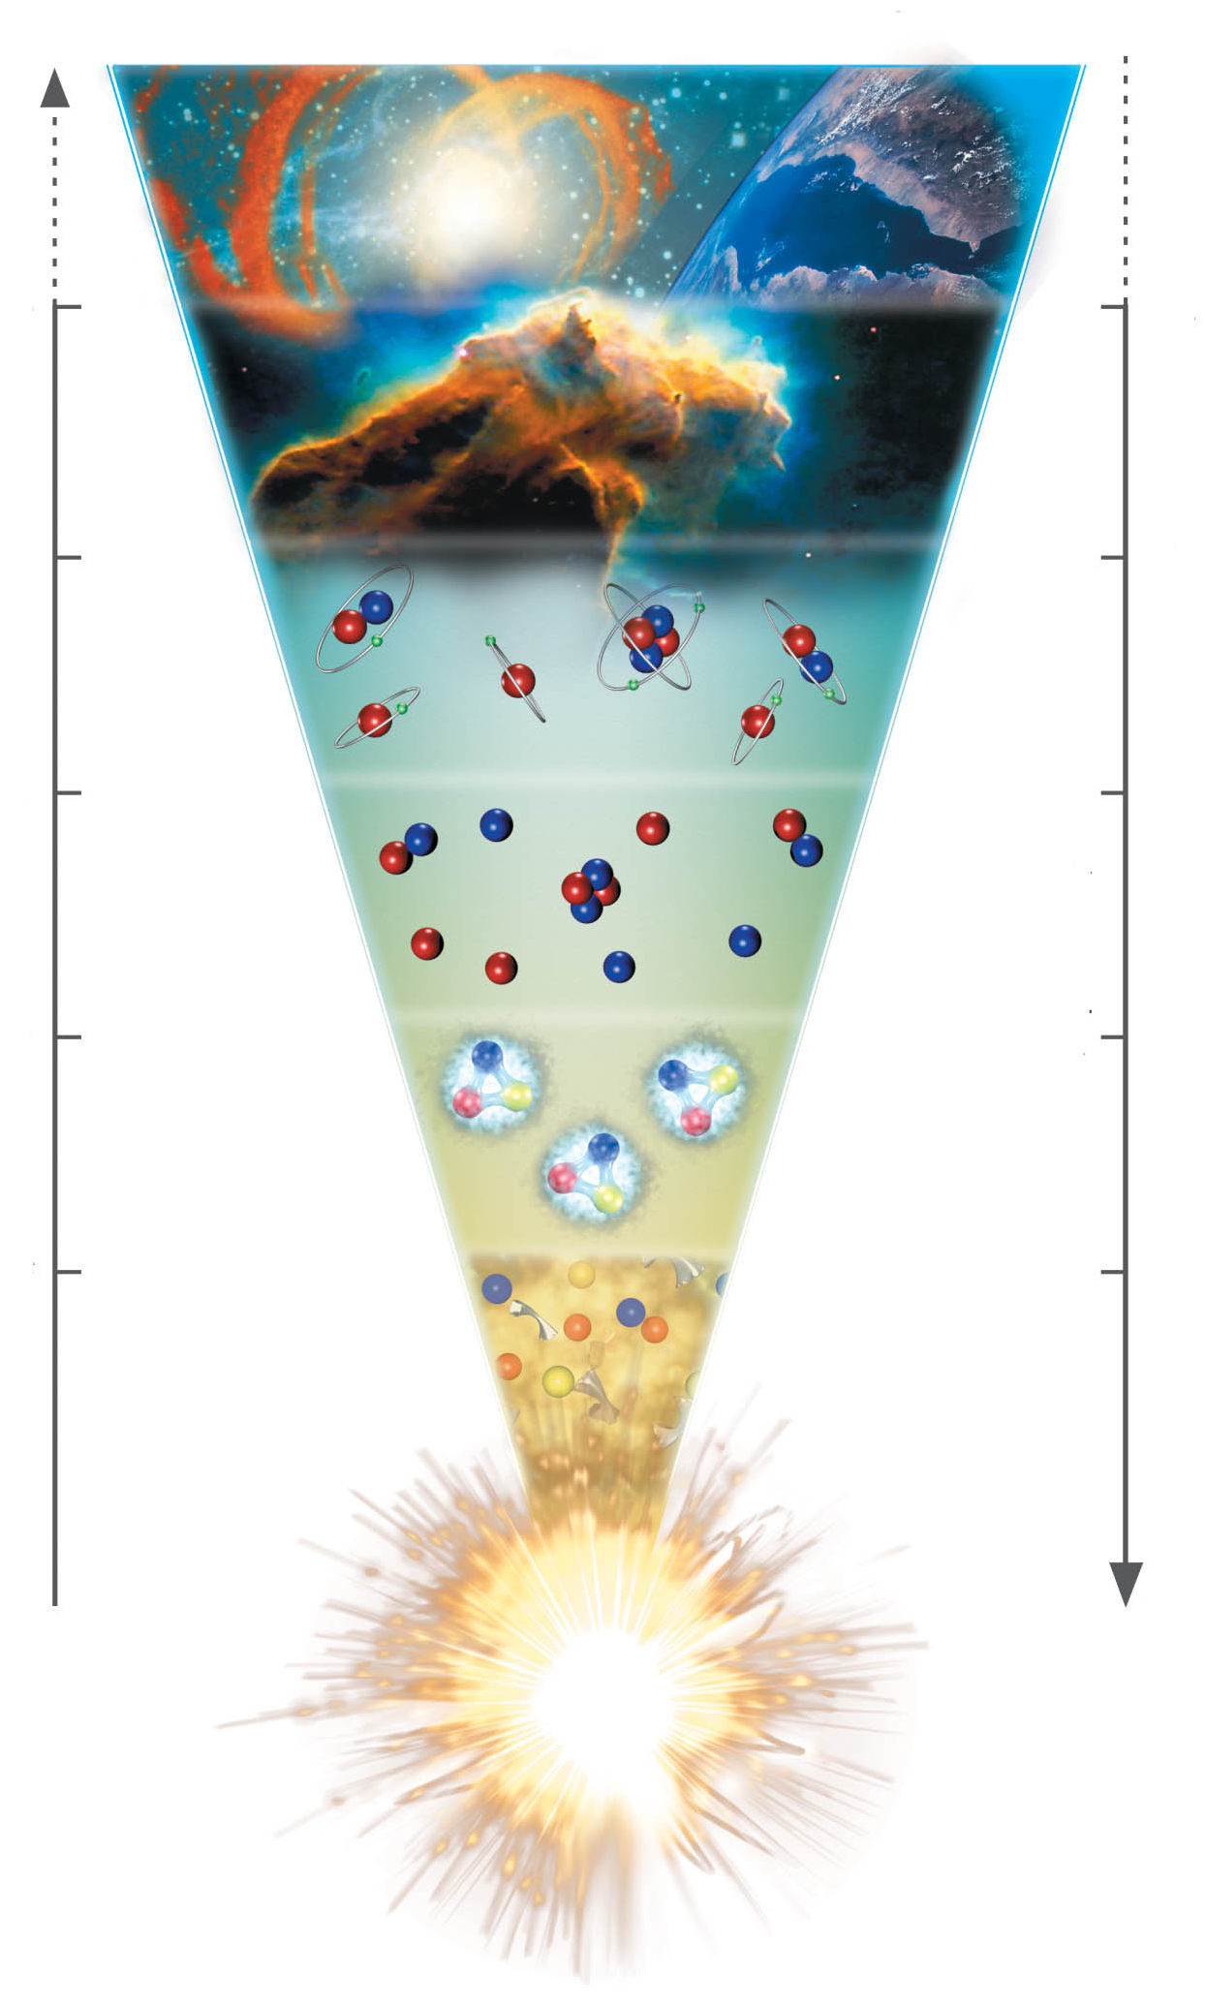
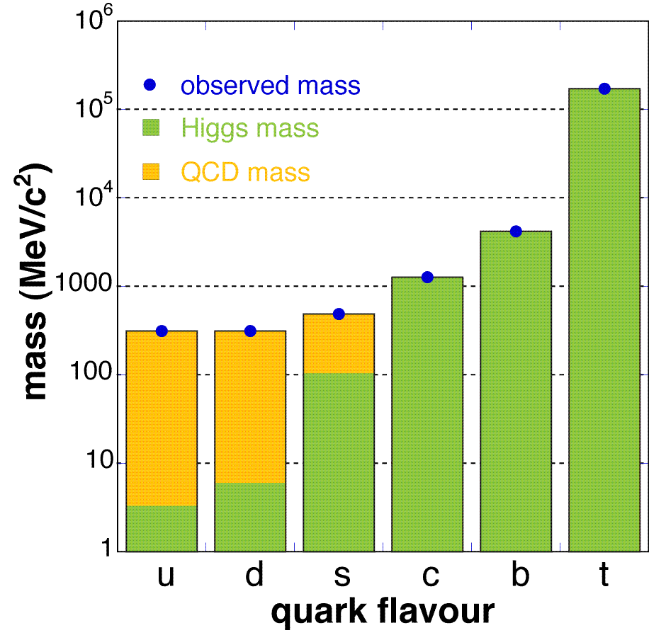
The evolution of matter in the universe
15 billion years
3 K
1 billion years
20 K
time
300.000 years
3000 K
temperature
3 minutes
10⁹ K
1 millisecond
10¹² K
1 microsecond
Explicit breaking
of Chiral Symmetry
(Higgs mechanism)
m_{u} ≈ 5 MeV,
m_{d} ≈ 10 MeV,
m_{s} ≈ 150 MeV
distance

Slide 23
The evolution of matter in the universe
15 billion years
3 K
1 billion years
20 K
time
300.000 years
3000 K
temperature
3 minutes
10⁹ K
1 millisecond
10¹² K
1 microsecond
The soup of the
first microsecond:
quarks, antiquarks,
electrons, positrons,
gluons, photons
distance

Slide 24
The evolution of matter in the universe
15 billion years
3 K
1 billion years
20 K
time
300.000 years
3000 K
temperature
3 minutes
10⁹ K
1 millisecond
10¹² K
1 microsecond
Spontaneous/dynamical
Chiral Symmetry breaking:
Hadrons acquire mass by
coupling to the virtual
quark-antiquark pairs
of the chiral condensate
distance

Slide 25
The evolution of matter in the universe
15 billion years
3 K
1 billion years
20 K
time
300.000 years
3000 K
temperature
3 minutes
10⁹ K
1 millisecond
10¹² K
1 microsecond
Annihilation of particles
and antiparticles, only
10⁻⁹ of particles survived
distance

Slide 26
The evolution of matter in the universe
15 billion years
3 K
1 billion years
20 K
time
300.000 years
3000 K
temperature
3 minutes
10⁹ K
Formation of d, He
1 millisecond
10¹² K
1 microsecond
distance

Slide 27
The evolution of matter in the universe
15 billion years
3 K
1 billion years
20 K
Evolution of stars
time
300.000 years
3000 K
temperature
3 minutes
10⁹ K
1 millisecond
10¹² K
1 microsecond
distance

Slide 28
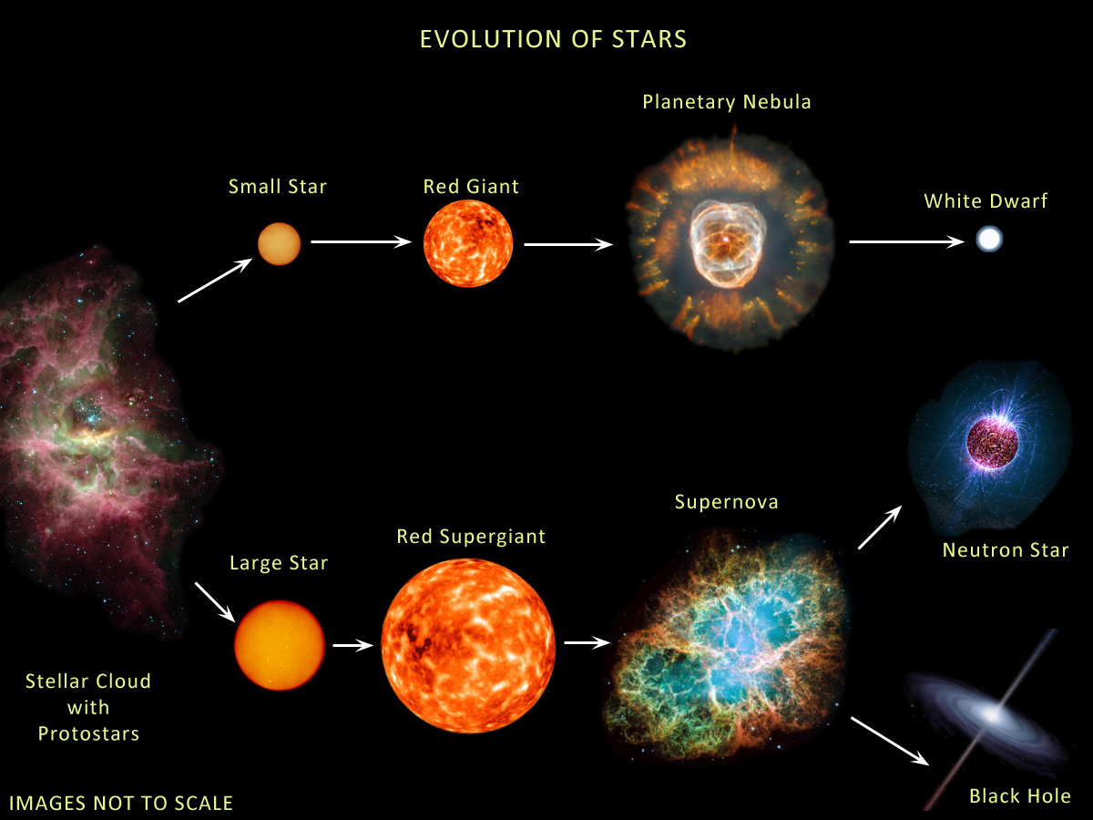
The evolution of stars
M < ≈ 8M → white dwarf
8M< M < 15M → neutron star: 1.4M< M_{core}< 2M
M >≈15M → black hole: M_{core} >≈ 2M
Courtesy of Anna Watts

Slide 29
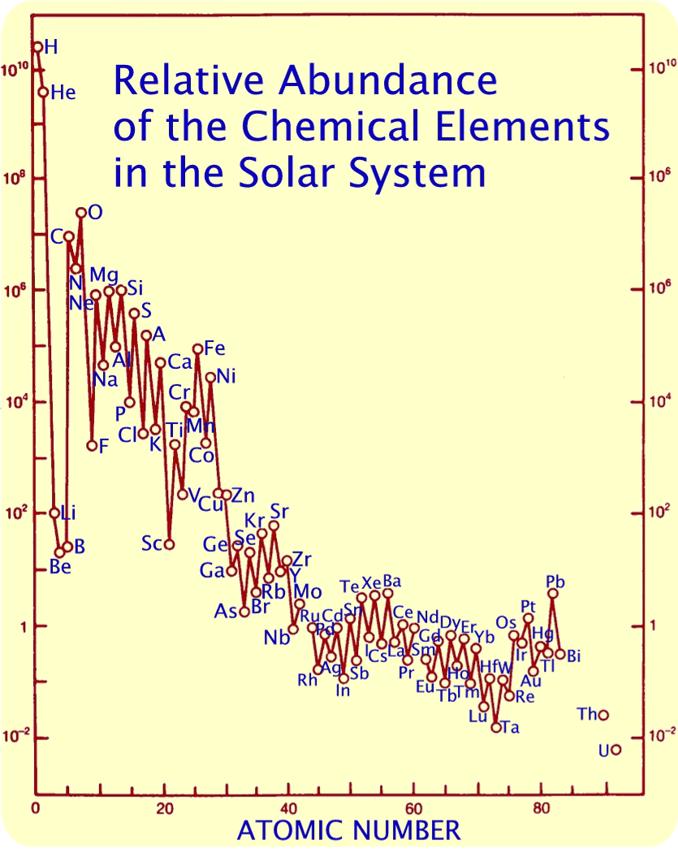
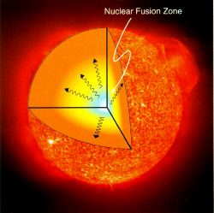

The Origin of Elements
Neutron capture
in Red Giants
(s-process) or in
supernovae or neutron star mergers (r-process)
Nukleosynthesis
after the Big Bang
Krebs Nebel
Nuclear fusion in stars

Slide 30
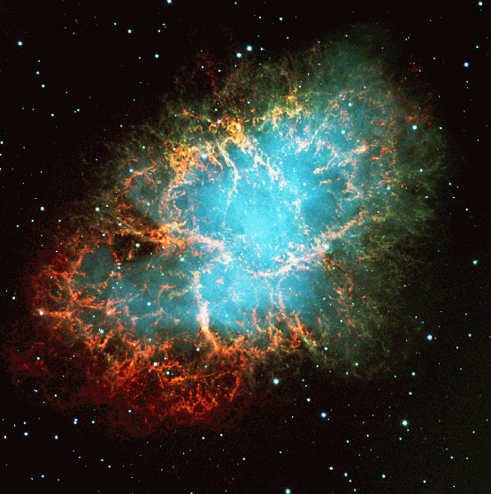
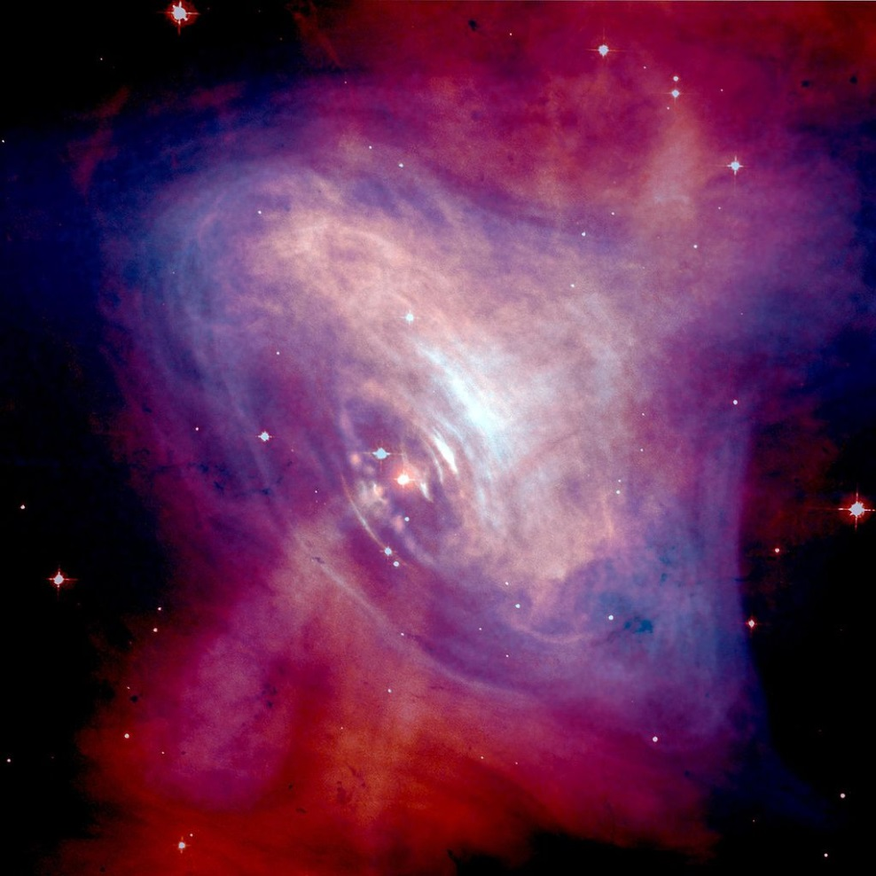
Discovery of the first pulsar in 1968
Crab nebula:
ashes of a core collapse supernova observed in 1054 by Chinese astronomers.
The “visiting star” was as bright as the Venus for more than 20 days.

Slide 31
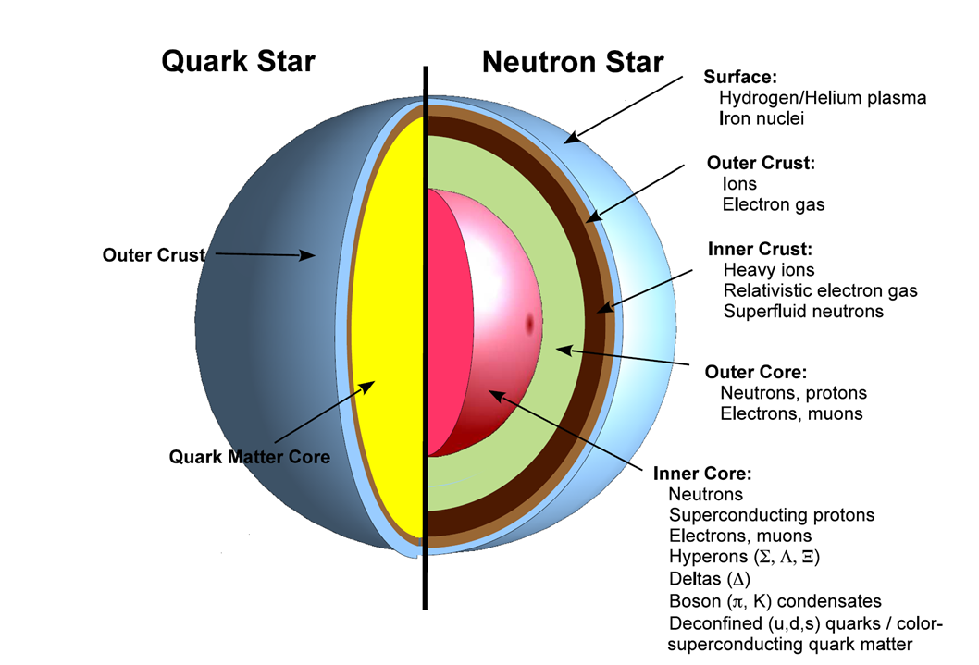
?

Slide 32
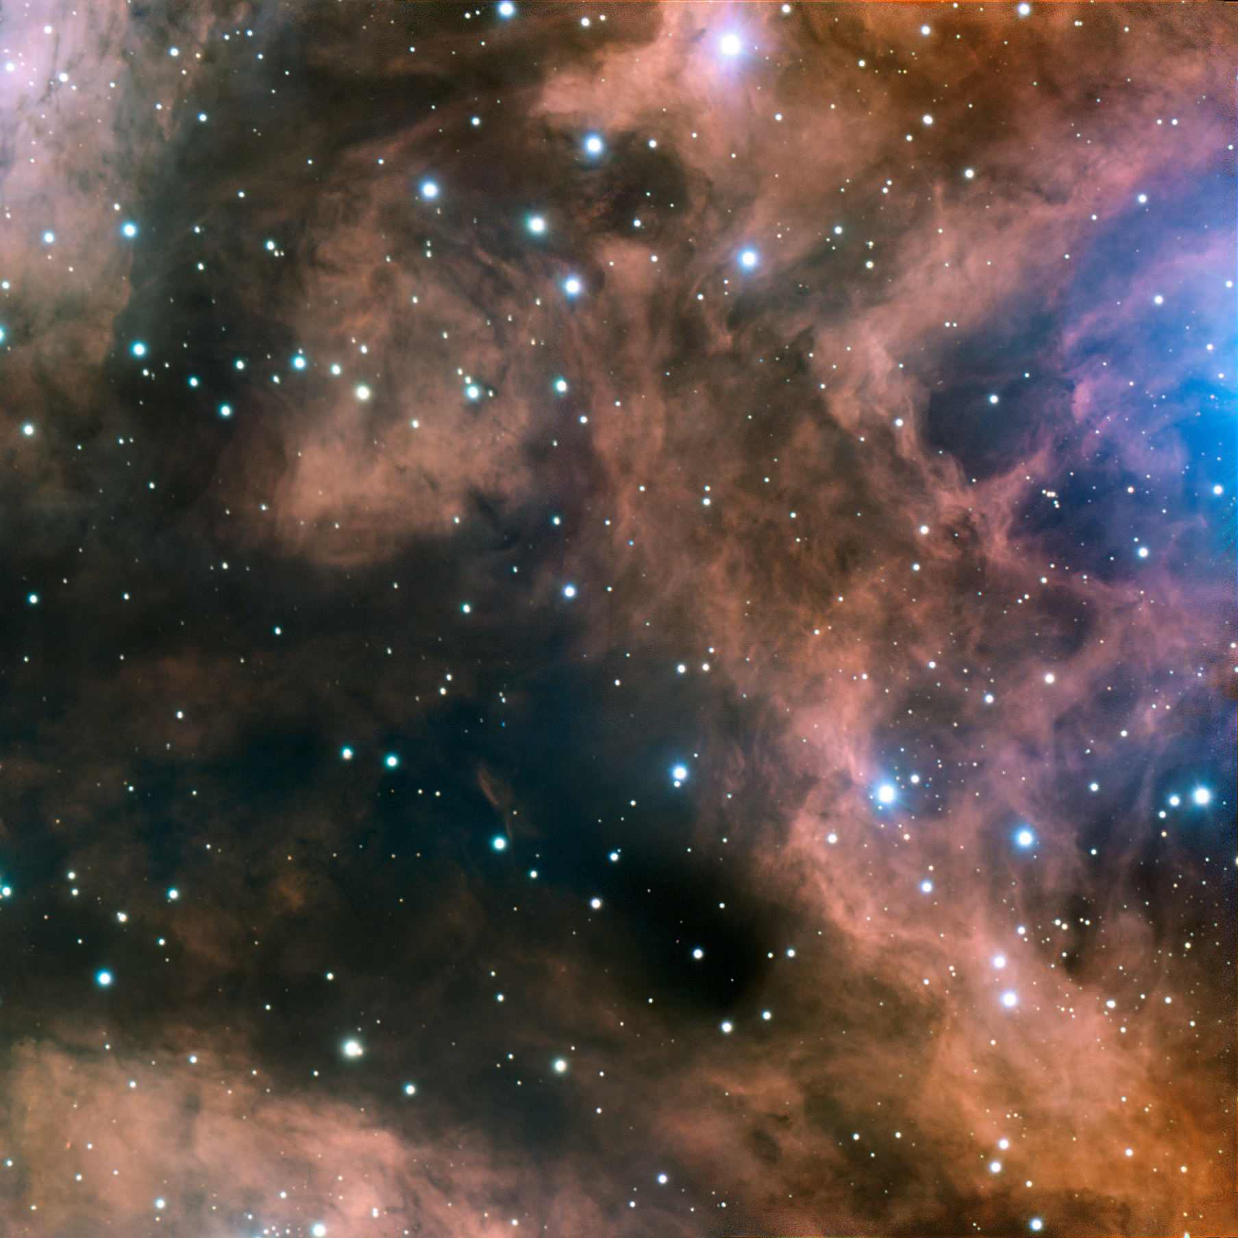
Fundamental questions
What is the origin of the mass of the universe?
What is the origin of the elements ?
What is the structure of neutron stars?
Can we ignite the solar fire on earth ?
Does matter differ from antimatter ?
Why do we not observe individual quarks ?
→ to be explored at the future international
Facility for Antiproton and Ion Research (FAIR)

Slide 33




Facility for Antiproton & Ion Research
SIS100/300
p-Linac
SIS18
Compressed Baryonic Matter
Primary Beams
10¹²/s; 1.5 GeV/u; ²³⁸U²⁸⁺
10¹⁰/s ²³⁸U⁹²⁺ up to 11 (35) GeV/u
3x10¹³/s 30 (90) GeV protons
Anti-Proton Physics
HESR
Super Fragment-Separator:
Nuclear Structure and Astrophysics
Secondary Beams
radioactive beams up to
1.5 - 2 GeV/u;
10¹¹ antiprotons 1.5 - 15 GeV/c
Technical Challenges
FAIR phase 1
FAIR phase 2
CR
rapid cycling superconducting magnets
dynamical vacuum
33
100 m

Slide 34
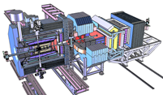
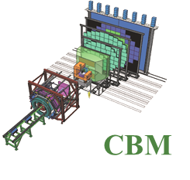
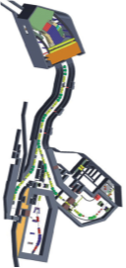
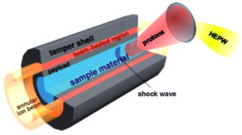
Facility for Antiproton & Ion Research
Experimental programs:
APPA: Atomic & Plasma Physics & Applications
➢ Highly charged atoms
➢ Plasma physics
➢ Radiobiology
➢ Material science
SIS18
SIS100/300
p-Linac
Compressed Baryonic Matter
HESR
CBM: Nucleus-nucleus collisions
➢ Nuclear matter at neutron
star core densities
➢ Phase transitions from
hadrons to quarks
Anti-Proton Physics
Super Fragment-Separator:
Nuclear Structure and Astrophysics
NUSTAR: Rare Isotope beams
➢ Nuclear structure far off stability
➢ Nucleosynthesis in stars and supernovae
CR
PANDA: Antiproton-proton collisions:
➢ Charmed hadrons (XYZ)
➢ Gluonic matter and hybrids
➢ Hadron structure
➢ Double Lambda hypernuclei
FAIR phase 1
FAIR phase 2
100 m
34

Slide 35
NUclear STructure Astrophysics and Reactions
How are complex nuclei built from their basic constituents?
– What is the effective nucleon-nucleon interaction and how does QCD constrain its parameters?
– How does the three-nucleon force modify the picture?
How does the effective nuclear force depend on varying proton-to-neutron ratios?
– What is the isospin dependence of the spin-orbit force?
– How does shell structure change far from stability?
– How does the role of N-N correlations in nuclei and nuclear matter change with isospin?
How to explain collective phenomena from individual motion?
– What are the phases, relevant degrees of freedom, and symmetries of the nuclear many-body system?
What are the limits of existence of nuclei?
– Where are the proton and neutron drip lines situated?
– What are the heaviest elements?
Which nuclei are relevant for astrophysical processes, what are their properties and what is their impact on nucleosynthesis modeling?
How does the equation of state of nuclear matter change with neutron-to-proton asymmetry?
– How large is the symmetry energy and its density dependence?
– What are the properties of neutron-rich matter?

Slide 36

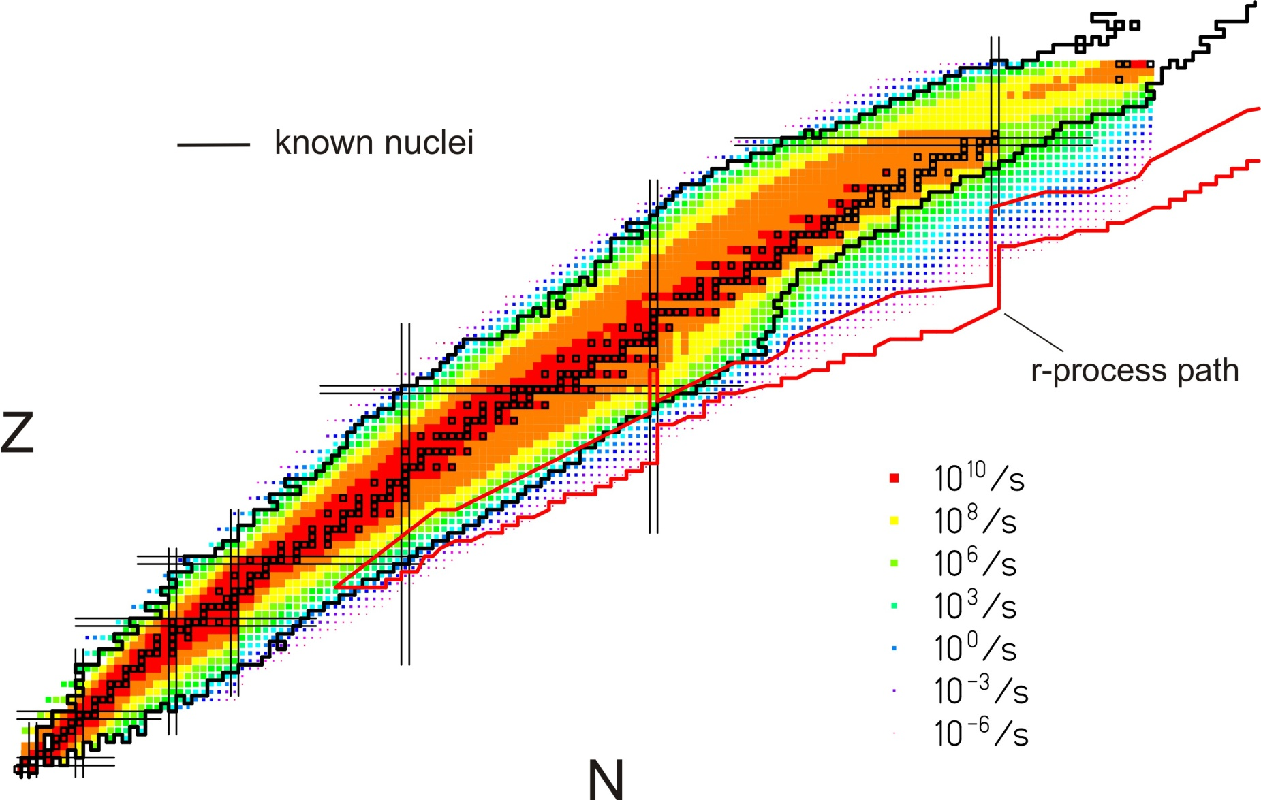
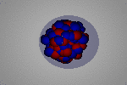
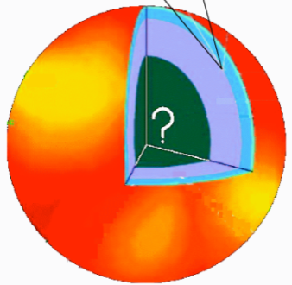
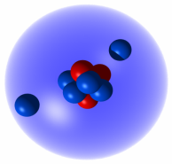
Nuclear structure research at FAIR
Limits of existence
Halos, Open Quantum Systems, Few Body Correlations
Skins, new collective modes, nuclear matter, neutron stars
Phases and symmetries of the nuclear many body system
Neutron Skins
Pygmy Resonance
Neutron stars
Halos
EOS
Notes:
36
36

Slide 37
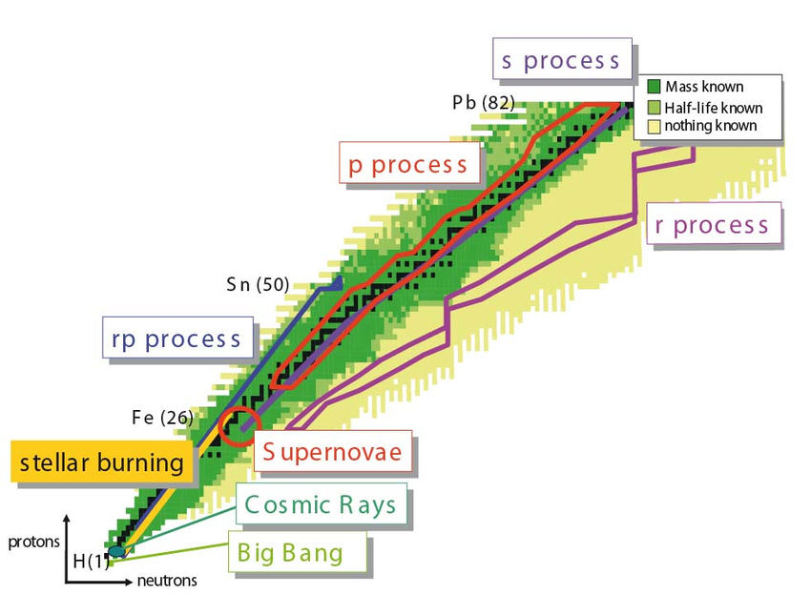


Nuclear Astrophysics at FAIR
rp-, p-process:
masses at & beyond the proton drip-line
X-ray binary
r-process:
masses, half-lives
b-delayed neutron emission
shell structure

Slide 38



Astrophysical site of heavy element production (r process) in the universe: Neutron star merger !
A. Bauswein
Neutron star merger
Metzer, Martinez-Pinedo, Arcones et al. (2010)
Astrophys. J. 848, L17 (2017)
Gravitational
Wave Signal
Electromagnetic “Kilonova” Signal
Copyright: Dana Berry, SkyWorks Digital, Inc
Electromagnetic “Kilonova” signal due to “r process” in neutron star merger theoretically predicted by GSI scientists in 2010.
Confirmation by recent astronomical observations after gravitational wave detection from GW170817 (September 2017).
Source of heavy elements including gold, platinum and uranium.
Sun

Slide 39


The NUSTAR experimental facilities at FAIR
Important beam parameters:
- all elements (H through U)
- intensity ~ 10¹² ions/sec.
- beam energies up to 1.5 GeV/u
- fast and slow (DC-type) extraction
phase 2
Four experimental areas:
- superconducting fragment separator
- high-energy branch with reaction setup
- storage-ring complex (CR, RESR, NESR, eA)
- low-energy branch with energy focusing and re-acceleration

Slide 40

Fragment-Separators at GSI and FAIR

Slide 41


Reactions with Relativistic Radioactive Beams R³B
✔
NeuLAND ✔
✔
R³B GLAD ✔
✔
Superconducting Dipole: Already installed at GSI
Construction by CEA Saclay

Slide 42

GLAD magnet at GSI

Slide 43





Hadron Physics with antiprotons at FAIR
Gluonic excitations:
Hybrids, glueballs
Charmonium states:
Precision
spectroscopy
Time-like form factors,
nucleon structure
In medium mass modifications:
Extension to the charm sector
Extension of nuclear chart:
Double hypernuclei
π⁻
25 MeV
π
π⁺
K⁺
K
100 MeV
K⁻
D
D⁻
50 MeV
D⁺

Slide 44



Antiproton-Proton-Annihilation in Darmstadt
Confinement and Charmonium spectroscopy
Coupling strength between two quarks

Slide 45

Antiproton-Proton-Annihilation in Darmstadt
Confinement and Charmonium spectroscopy
confinement potential

Slide 46

Antiproton-Proton-Annihilation in Darmstadt
Antiproton momenta up to 15 GeV/c

Slide 47

Antiproton-Proton-Annihilation in Darmstadt
The High Energy Storage Ring
Luminosity up to L~ 2x10³² cm⁻²s⁻¹
Stochastic & electron cooling
Resolution ~50 keV
Tune E_{CM} to scan resonance: precise mass and width

Slide 48

The PANDA spectrometer at FAIR
4π acceptance
High rate capability:
2x10⁷ s⁻¹ interactions
free-streaming data acquisition
Momentum resolution ~1%
Vertex info for D, K⁰_{s}, Y
(cτ = 317 μm for D±)
Good PID (γ, e, μ, π, K, p):
Cherenkov, ToF, dE/dx
γ-detection 1 MeV – 10 GeV
Crystal Calorimeter

Slide 49





Atomic Physics, Plasma and Applied Sciences
Atomic Physics
Plasma
Materials
Bio
SPARC
FLAIR
HEDgeHOB/WDM
MAT/BIOMAT
BIO/BIOMAT
strong field research
... probing of fundamental laws of physics
anti-matter
... matter / anti-matter asymmetry
planetary interiors
... states of matter common in astrophysical objects
extreme conditions
... radiation hardness and modification of materials
aerospace engineering
... radiation shielding of cosmic radiation
Highest Charge States: Extreme Static Fields
Relativistic Energies: Extreme Dynamical Fields and Ultrashort Pulses
High Intensities: Very High Energy Densities and Pressures
High Charge at Low Velocity: Large Energy Deposition
Low-Energy Anti-Protons: Antimatter Research

Slide 50

Atomic physics with stored and cooled ions
Stored and cooled highly charged ions and RIBs
Protons to Uranium in various charge states (U²⁸⁺ to U⁹²⁺)
Single to 10⁹ stored ions
From rest to relativistic (γ=6) energies
Cooling: The Key for Precision
From Single Ions to Highest Intensities
Electron Cooling
Stochastic Cooling
Laser Cooling
Notes:
statt „Ions“ → neue Überschrift
Farbrahmen + farbl. Schrifteb

Slide 51

Plasma physics with heavy ion beams
Neon beam at 300 A MeV penetrating an Ar cristal

Slide 52





Hot electromagnetic plasmas:
high-intensity ion beams + high-power laser
Temperature [eV]
Magnetic Fusion
Inertial
Cofinement
Fusion
Sun Core
PHELIX
SIS
100
Laser
Heating
Ideal plasmas
Strongly coupled
plasmas
Ion Beam
Heating
SIS 18
Jupiter
Sun Surface
solid state
density
Density [cm⁻³]

Slide 53



Radiobiology:
Radiation dose during long-term space missions ?
Cosmic radiation in space
Interaction cross section
Radiation dose during Mars mission only known within a factor of 10

Slide 54

Exploring the QCD phase diagram

Slide 55



Exploring the QCD phase diagram
Courtesy of K. Fukushima & T. Hatsuda
At very high temperature:
➢ N of baryons ≈ N of antibaryons
Situation similar to early universe
➢ L-QCD finds crossover transition between
hadronic matter and Quark-Gluon Plasma at T≈ 160 MeV
➢ Experiments: ALICE, ATLAS, CMS at LHC
STAR, PHENIX at RHIC

Slide 56


Exploring the QCD phase diagram
Courtesy of K. Fukushima & T. Hatsuda
At high baryon density:
➢ N of baryons >> N of antibaryons
Densities like in neutron star cores
➢ L-QCD not (yet) applicable
Models predict first order phase transition
with mixed or exotic phases
Experiments: BES at RHIC, NA61 at CERN SPS,
CBM at FAIR, NICA at JINR

Slide 57


Density estimates
Atomic nucleus:
Radius R = 1.2 fm A^{1/3} (σ_{reac} = π R²)
Volume V = 4/3 π R³ = 4/3 π 1.2³ A fm³
Nucleon density ρ₀ = A/V = 3/ (4 π 1.2³) fm⁻³ ≈ 0.14 fm⁻³
Mass of nucleon m = 1.67 ⋅ 10⁻²⁴ g
Mass density of cold nuclear matter ρ₀ ⋅ m ≈ 270 Mio t/cm³
Limits of nucleon density:
Au-nucleus: R ≈ 7 fm, V ≈ 1400 fm³
Nucleon: R ≈ 0.8 fm, V ≈ 2 fm³
200 Nucleons: V ≈ 400 fm³
At 3 – 4 ρ⁰: nucleons overlap, Fermi see of quarks?
Neutron star:
Radius R ≈ 10 km,
Volume V ≈ 4200 km³
Mass M ≈ 2 solar masses = 2 ⋅ 2 ⋅ 10³³ g
Average mass density ρ = M/V ≈ 1000 Mio t/cm³ ≈ 3.6 ρ⁰ ⋅ m
Core density 5 – 10 times nuclear density

Slide 58

Quark matter in massive neutron stars?
M. Orsaria, H. Rodrigues, F. Weber, G.A. Contrera, arXiv:1308.1657
Phys. Rev. C 89, 015806, 2014

Slide 59


Baryon densities in central Au+Au collisions
I.C. Arsene et al., Phys. Rev. C 75, 24902 (2007)
5 A GeV
10 A GeV
8 ρ₀
5 ρ₀
∼ 2 ρ₀
∼ 5 ρ₀
59
courtesy Toru Kojo (CCNU)

Slide 60



Messengers from the dense fireball:
UrQMD transport calculation Au+Au 10.7 A GeV
Ξ⁻, Ω⁻, φ
π, K, Λ, ...
p, Λ, Ξ⁺, Ω⁺, J/ψ
ρ → e⁺e⁻, μ⁺μ⁻
resonance decays
ρ → e⁺e⁻, μ⁺μ⁻
ρ → e⁺e⁻, μ⁺μ⁻

Slide 61

The Compressed Baryonic Matter (CBM) experiment
at FAIR: Physics case and observables
The QCD equation-of-state at neutron star core densities
➢ collective flow of identified particles (π,K,p,Λ,Ξ,Ω,...)
driven by the pressure gradient in the early fireball
➢ particle production at threshold energies via
multi-step processes (multi-strange hyperons, charm)
Phase transitions from hadronic matter to quarkyonic or partonic matter at high ρ_{B}, phase coexistence, critical point
excitation function of strangeness: Ξ⁻(dss),Ξ⁺(dss),Ω⁻(sss),Ω⁺(sss)
→ chemical equilibration at the phase boundary
excitation function (invariant mass) of lepton pairs:
Thermal radiation from fireball, “caloric curve”
anisotropic azimuthal angle distributions:
”spinodal decomposition”
event-by-event fluctuations of conserved quantities:
”critical opalescence”
61

Slide 62



The Compressed Baryonic Matter (CBM) experiment
at FAIR: Physics case and observables
Onset of chiral symmetry restoration at high ρ_{B}
➢ in-medium modifications of hadrons
(ρ,ω,φ →e⁺e⁻(μ⁺μ⁻))
➢ dileptons at intermediate invariant masses:
4 π → ρ-a₁ chiral mixing
Charm production at threshold energies
in cold and dense matter
➢ excitation function of charm production
in p+A and A+A (J/ψ, D⁰, D±)
N-Λ, Λ-Λ interaction,
strange matter
➢ (double-) lambda hypernuclei
➢ meta-stable objects
(e.g. strange dibaryons)
62

Slide 63

Experiments exploring dense QCD matter
high
net-baryon densities
The CBM Collaboration,
arXiv:1607.01487

Slide 64

The CBM experiment
Transition
Radiation
Detector
Time of Flight
Detector
Ring
Imaging
Cherenkov
SC Dipol
Magnet
Silicon
Tracking
System
HADES
p+p, p+A
A+A (low mult.)
Micro
Vertex
Detector
Muon
Detector
Projectile
Spectator
Detector
DAQ/FLES HPC cluster

Slide 65

The High Acceptance Di-electron Spectrometer (HADES)

Slide 66


CBM DAQ and online event selection
First-level Event Selector
GSI Green IT Cube
Novel readout system: no hardware trigger on events, detector hits with time stamps, full online 4-D track and event reconstruction.
66

Slide 67

FAIR Civil Construction
Synchrotrons: 1.1 km
HESR: 0.6 km
With beamlines: 3.2 km
Existing SIS 18
Total area > 200 000 m²
Area buildings ~ 98 000 m²
Usable area ~ 135 000 m²
Volume of buildings ~ 1 049 000 m³
Substructure: 1350 pillars, 60 m deep

Slide 68



Tunnel for SIS100/300

Slide 69

Civil construction (Status 2014)
The four most powerful drilling machines worldwide put down 1350 reinforced concrete pillars of 60 m depth and 1.2 m diameter.

Slide 70


FAIR Project Status 2017
Successful restart in 2015 and 2016
Comprehensive civil construction plan: completion of all buildings by 2022
Full integrated planning for construction and commissioning
of the entire project: Completion of the full FAIR facility by 2025.
Civil construction as well as procurement of accelerators and realization of experiments are progressing well ...
Ground breaking - 4 July 2017
Excavation SIS100 tunnel - Nov 2017

Slide 71






Construction of accelerator components
First of Series (FoS) of major components for SIS 100
FoS Dipole Magnet
FoS Cryo Catcher
FoS Cro-Bypass Line
FoS Dipole
Quadrupole Unit
FoS Bunch Compressor
FoS RF Cavity System

Slide 72




Construction of detector components
A
P
P
A
C
B
M
N
U
S
T
A
R
P
A
N
D
A
MUCH
TRD

Slide 73







FAIR International Collaborations
Atomic physics
NUSTAR
Bio physics
Plasma Physics
CBM
PANDA
Material research

Slide 74

Collaboration Members by Country
room for improvement

Slide 75




FAIR “Phase 0” - Detector commissioning
and science starting 2018 (examples)
R³B installation at GSI/Cave C:
Reactions at high beam energies up to 1-2 GeV/u
Identification capability even for the heaviest ions
Multiple neutron tracking capability
CBM detectors installed at
HADES (GSI) and STAR (LBL)
Photon detectors for HADES RICH
MRPC-TOF detectors as STAR endcap
Atomic physics at the CRYRING
installed being FRS-ESR at GSI
Precision collision spectroscopy of Be-like ions
Photoionization of C⁺ ions
Ground-state Lamb Shift in Hydrogen-like U91+
Swedish contribution to FAIR

Slide 76

  Instead of a summary ...
  Key Summary Recommendation of the NUPECC Long Range Plan 2017 presented in Brussels on Nov 27th :
  Complete urgently the construction of the ESFRI* flagship FAIR and develop and bring into operation the experimental program of its four scientific pillars APPA, CBM, NUSTAR and PANDA.
FAIR is a European flagship facility for the coming decades. Worldwide unique it will allow for a large variety of unprecedented fore-front research in physics and applied science. It focuses on the structure and evolution of matter. Its multi- faceted research opens a new era in our understanding of the fundamental building blocks of matter and the forces as well as of the evolution of our Universe: the new possibilities for research in Darmstadt are unique and are expected to produce ground breaking new insights for nuclear research.
*European Strategy Forum on Research Infrastructures

