Slide 1
PANDA Magnet

Slide 2
3D model of the Magnet.
Magnet with St. Steel Cryostat. The weight of magnet is ~14,5 t

Slide 3
Dimensions of the Magnet.
Inner diameter is 1900 mm, Outer diameter is 2680 mm, length is 3090 mm

Slide 4
Dimensions of the Coils (worked condition 4.5K).
Outer diameter of coils is 2200 mm, length: two coils - 887 mm, one – 400 mm.

Slide 5
Cross section of the Magnet.
In the radial direction the Cold mass is based into Cryostat with help suspensions and axis rods. The diameter of suspensions is 16 mm, diameter of axial rods is 12 mm. Material is Ti-5Al-2.5Sn

Slide 6
Cross section of the Magnet.

Slide 7
Longitudinal rod left side
In the axial direction the Cold mass is fixed with longitudinal rods.
The diameter of longitudinal rods is 20 mm, the length is 2010 mm (left side).
Material is Ti-5Al-2.5Sn

Slide 8
Longitudinal rod (Ti-5Al-2,5Sn) left side

Slide 9
Longitudinal rod right side
The diameter of longitudinal rods is 20 mm, the length is 1123 mm (right side).
Material is Ti-5Al-2.5Sn

Slide 10
Longitudinal rod (Ti-5Al-2,5Sn ) right side

Slide 11
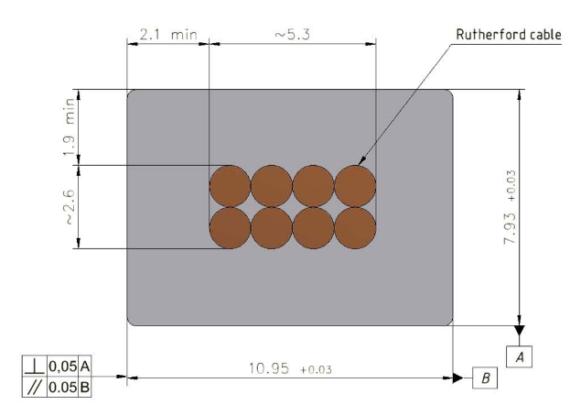
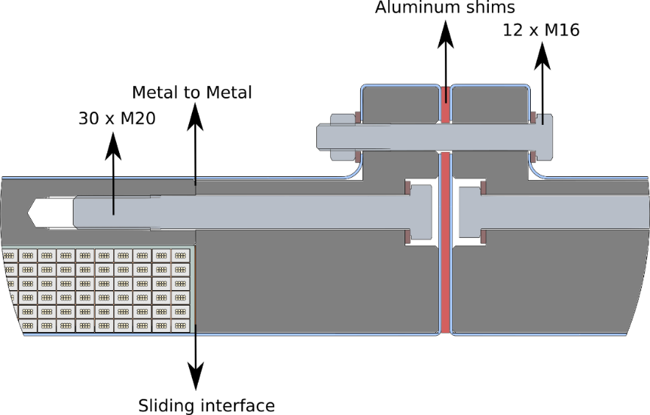
Cold mass. Coil (CERN design)
2x 6 layers - 78 turns
1x 6 layers - 35 turns
Magnetic field - 2 T
Current - 4.96 kA (3 T)
10,95 мм x 7.93 мм,
NbTi / Cu d=1.4 мм
The design of Cold mass is based on the design of Cold mass of CERN.

Slide 12
Cold mass.
The Cold mass is based in to Cryostat with help of suspension, axis rods and longitudinal rods. For thermal bridges is used the flexible copper.
The weight of cold mass is ~5.6 t

Slide 13
Cold mass (dimension for worked condition 4.5K)
Inner diameter is 2096 mm, Outer diameter is 2280 mm, length is 2826 mm

Slide 14
Collector of Cold mass.
For cooling of Coil is used the collector with special aluminum profile which is welded on the outer shell of Cold mass.

Slide 15
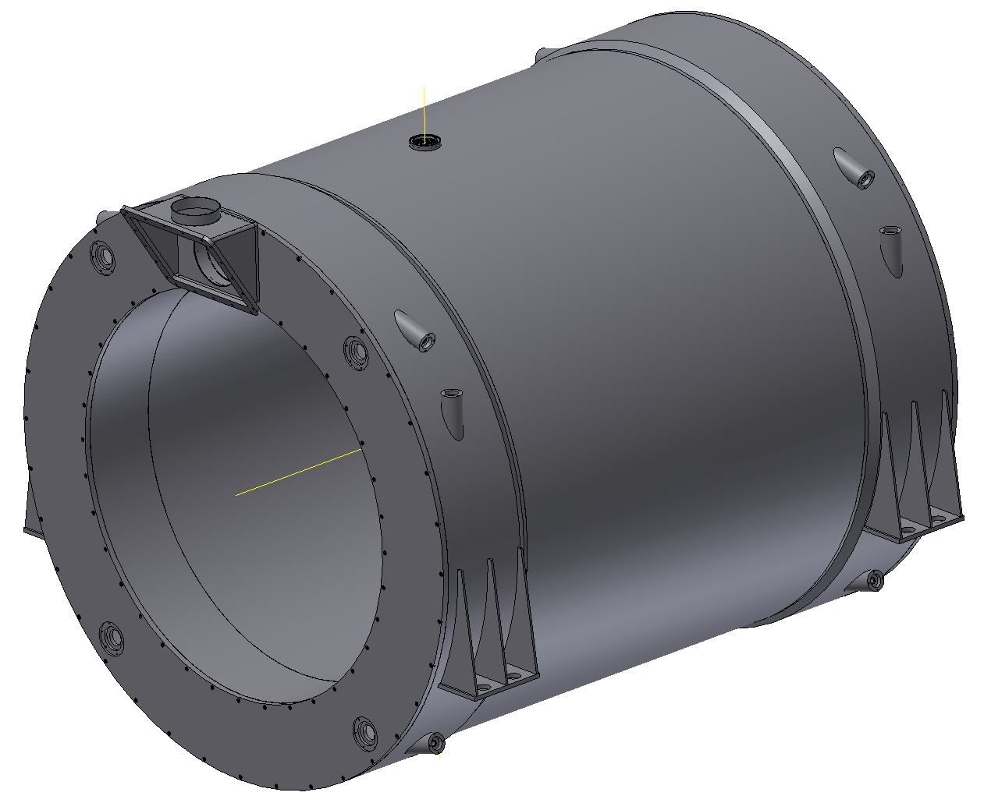
The Cryostat of Magnet.
Inner diameter is 1900 mm, Outer diameter is 2680 mm, length is 3090 mm Material is St.St. The weight is ~8 t

Slide 16
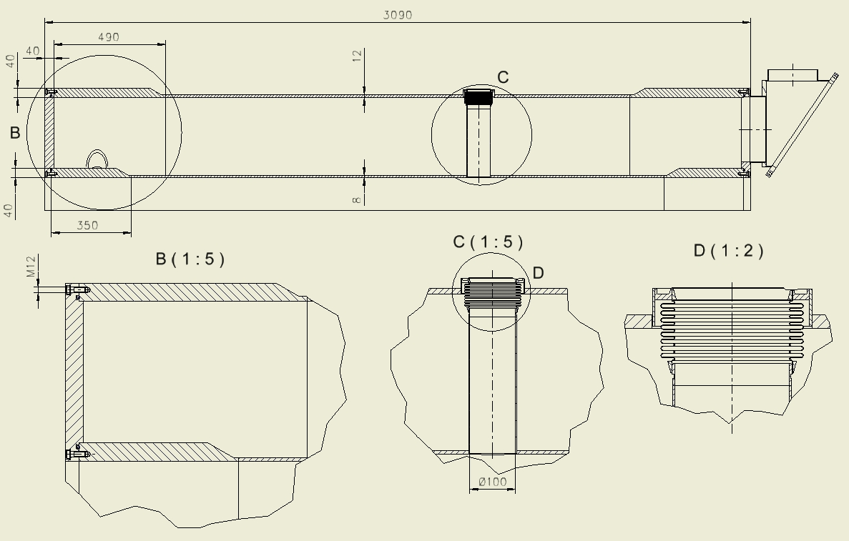
Configuration of the Cryostat
Thickness of the outer shell is 12 mm, Thickness of the inner shell is 8 mm , Thickness of the flanges is 40 mm, Thickness of the rings is 40 mm
The bolts – M12 – 2x36 ps. Sealing ring – d=8 mm

Slide 17
Results of calculation of Cryostat. Operation condition (p=0.1 MPa)

Slide 18
Results of calculation of Cryostat. Stress
The maximum equivalent stress is 43 MPa.

Slide 19
Results of calculation of Cryostat. Deformation
The maximum deformation is 0,1 mm.

Slide 20
Results of calculation of Cryostat. Operation condition (p=0.05 MPa)

Slide 21
Results of calculation of Cryostat. Stress
The maximum equivalent stress is 21.5 MPa.

Slide 22
Results of calculation of Cryostat. Deformation
The maximum deformation is 0,06 mm.

Slide 23
Shield of the magnet.
Outer diameter is 2552 mm, Inner diameter is 2020 mm, length is 2900 mm
Thickness is 3 mm, Material is Al. The weight is ~0,45 t

Slide 24
Gaps of the Shield .
The shield has 4 gaps isolated G10 bars. The shield is positioned into the cryostat with help Balls transfer units with G10 ring.

Slide 25
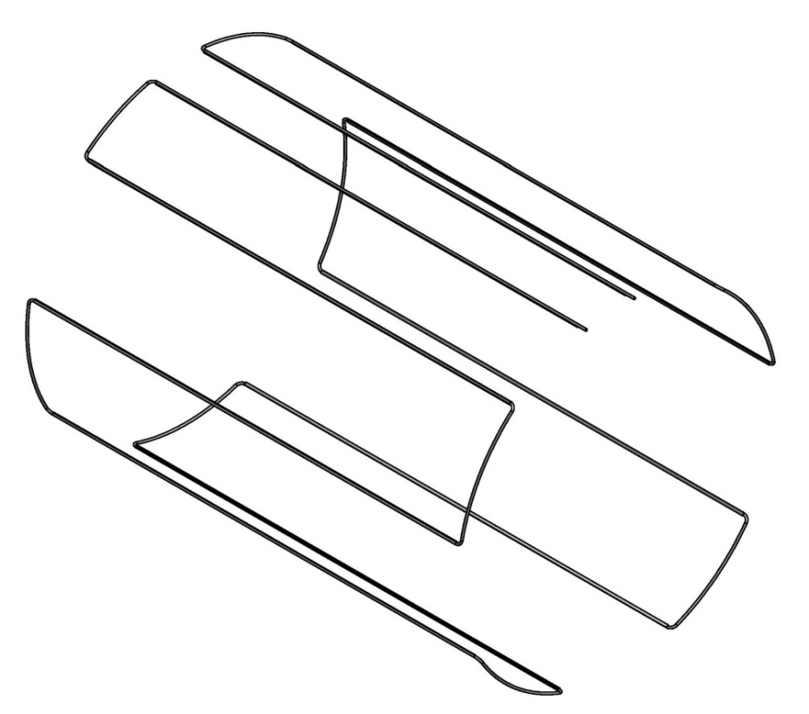
Pipe line of the inner Shield.
Inner shell of the shield with flanges, ribs and pipeline.
For cooling of Shield is used the pipeline with special aluminum profile which is welded on the shell.

Slide 26
Pipe line of the outer Shield.
Outer Shell of the shield with ribs, Balls transfer units and pipeline with special aluminum profile which is welded on the shell.

Slide 27
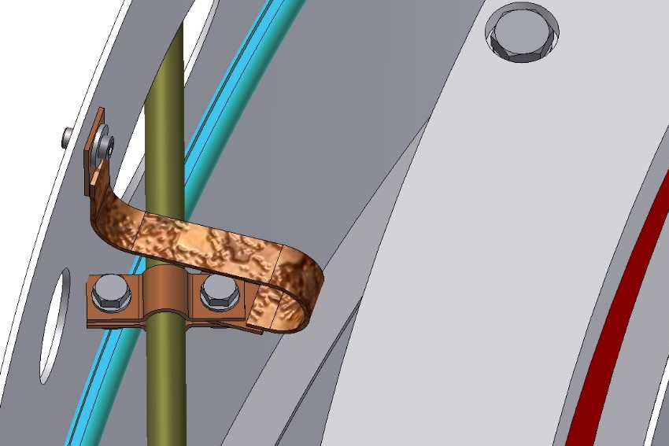
Shield into the magnet.
The Shield is based on the outer shells of the cryostat with help of Balls transfer units with G10 ring. Flanges of shield are fixed with help of thread rivets and bolts.
Thermal bridges is fixed on the shell of shield with help of thread rivets and bolts.

Slide 28
Fixation of the Shield into the Cryostat.
Position of bolts for fixing the shield into the cryostat. In the area of the target, the shield is fixed with help of bushes (G10) and bolts.

Slide 29
Diagram of position of the target`s axis in worked condition.
The length and position of fixation of the longitudinal rod, and position of the thermal bridges allow not to move the axis of the hole of the target.

Slide 30
Diagram of position of the Cold mass axis in worked condition.
The length and position of fixation of suspensions, and position of the thermal bridges allow to move the axis of the Cold mass for 0,25 mm.

Slide 31
3D model of the Magnet, Yoke, Platform and Frame.

Slide 32
Thank you for your attention!

