Slide 1
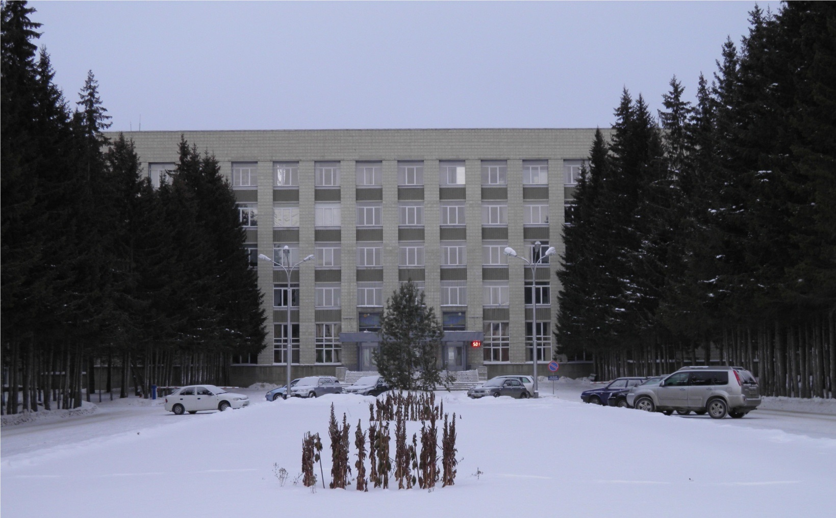
Status of the PANDA Solenoid Magnet Production in BINP

Slide 2
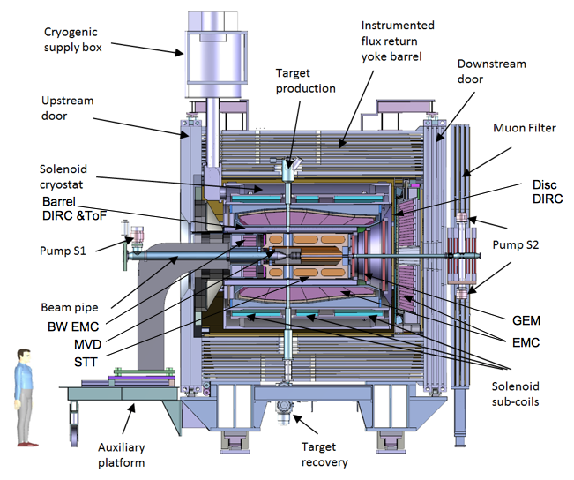
PANDA solenoid magnet
The PANDA solenoid is designed to provide a magnetic field of 2 T with a uniformity of ± 2% and radial magnetic field integral in the range 0 to 2 mm over the central tracking region. The magnet is characterized by a warm bore of 1.9 m diameter, a free length of 4 m and 22.4 MJ of stored energy.
Figure 1. Artistic cut side view of the solenoid magnet including contained detector systems.

Slide 3
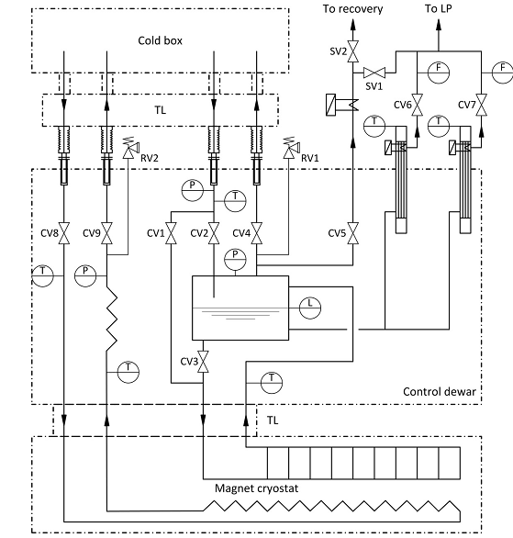
PANDA solenoid 2017, TDR Flowscheme
The Process Flow Diagram (PFD) of the PANDA cryogenic system proposed by Udo Wagner (CERN) is shown in Fig 2. The main components of the cryogenic system are:
1. the cryostat, which includes:
• the superconducting coil cooled indirectly via the thermal contact with the aluminum support cylinder;
• thermal shields cooled by gaseous helium;
• the vacuum vessel;
2. the control dewar, which includes:
• a vessel for liquid helium;
• current leads;
• thermal shields cooled by gaseous helium;
• valves, gauges;
• vacuum shell.
3. a transfer line (Chimney) connecting the vacuum vessels of cryostat and control dewar;
4. transfer lines (TL) connecting refrigerator and control dewar.
Figure 1. Process Flow Diagram of the PANDA cryogenic system.
Flowscheme of the PANDA solenoid was approved.

Slide 4
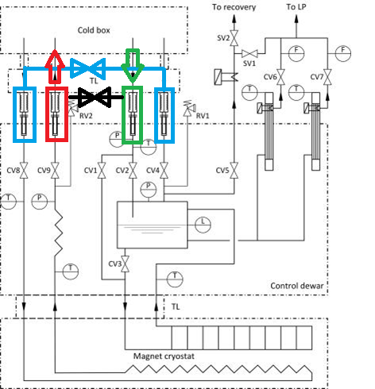
PANDA solenoid 2017, Flowscheme with comments of GSI
Figure 1. Process Flow Diagram of the PANDA cryogenic system.
Comments to the cryogenic flow scheme and the proposed operation (flowscheme__20170720)
The additional valves, as suggested in 2016, are missing in the flow scheme.
Flowscheme of the PANDA solenoid was approved.

Slide 5
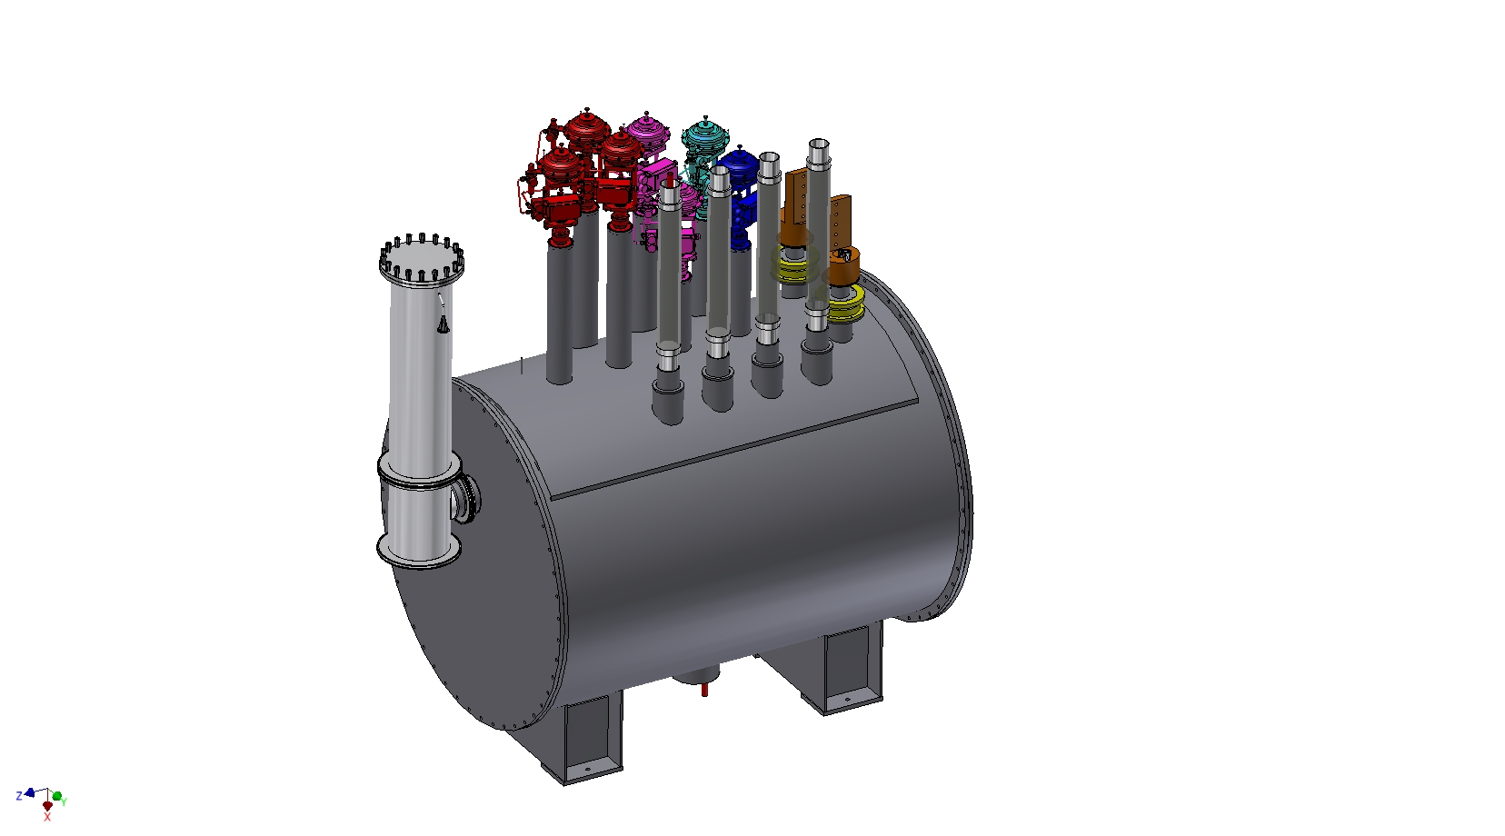

Slide 6
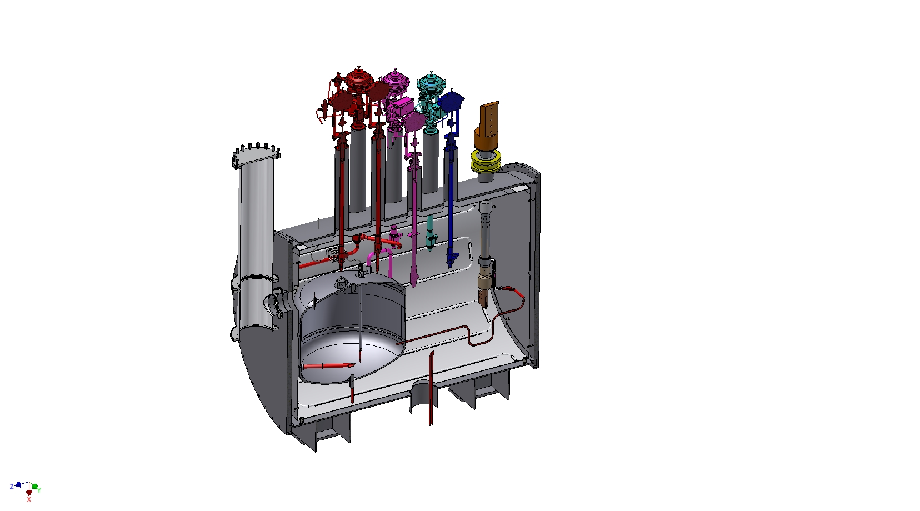

Slide 7
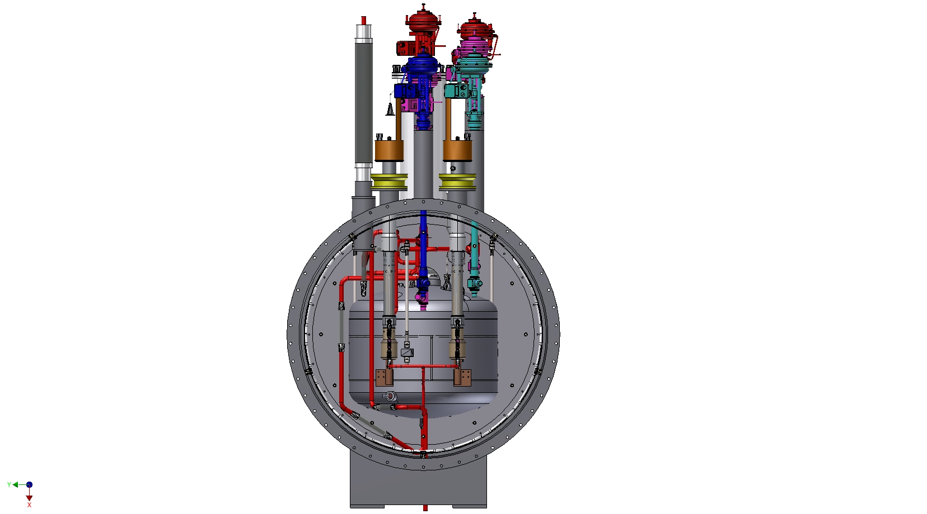

Slide 8
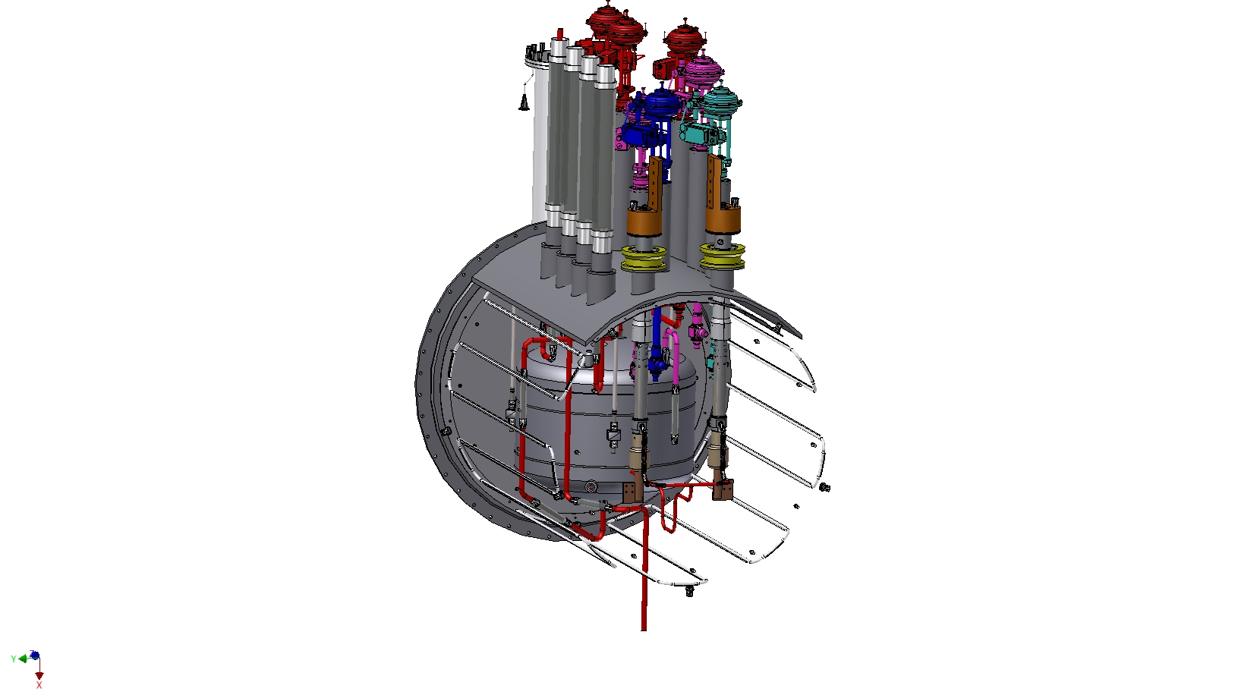

Slide 9
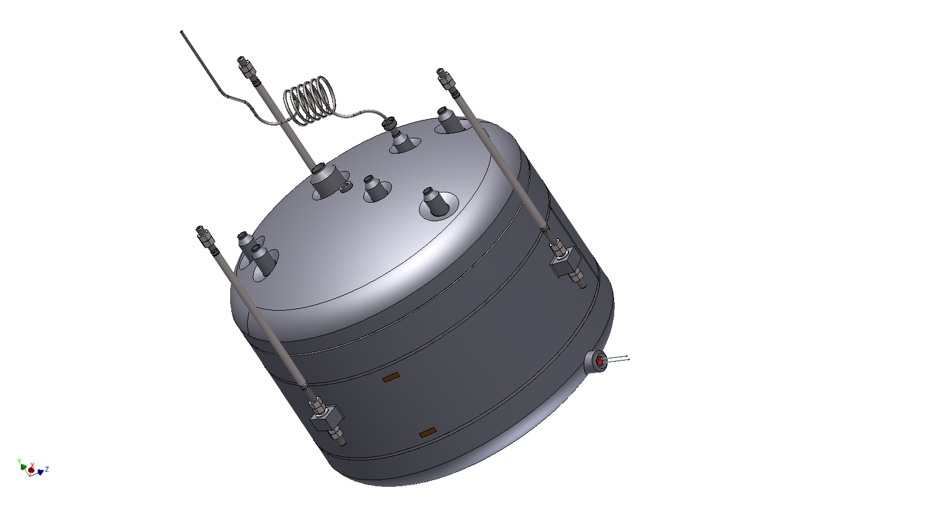

Slide 10
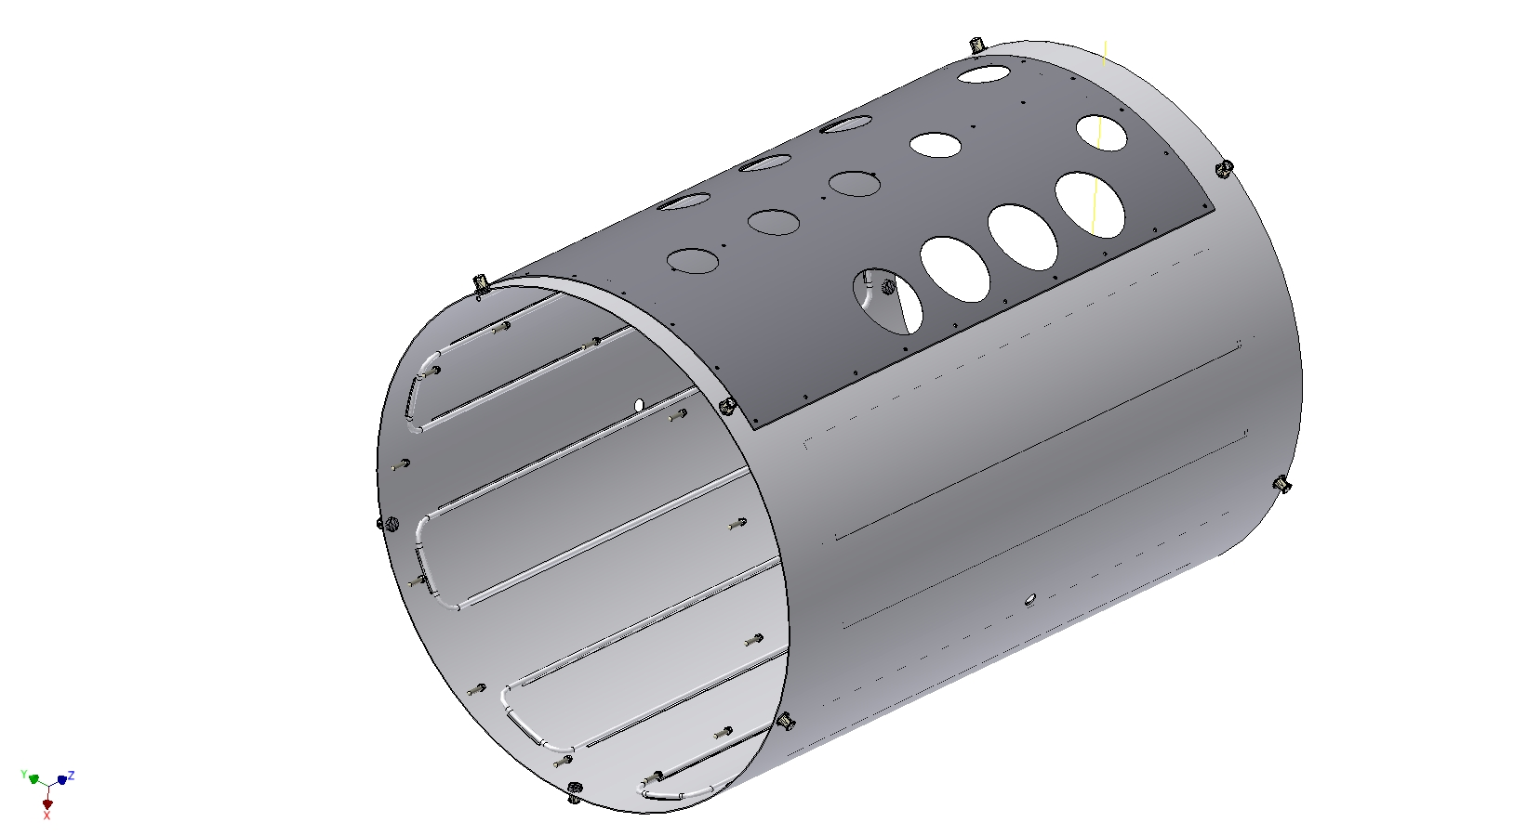
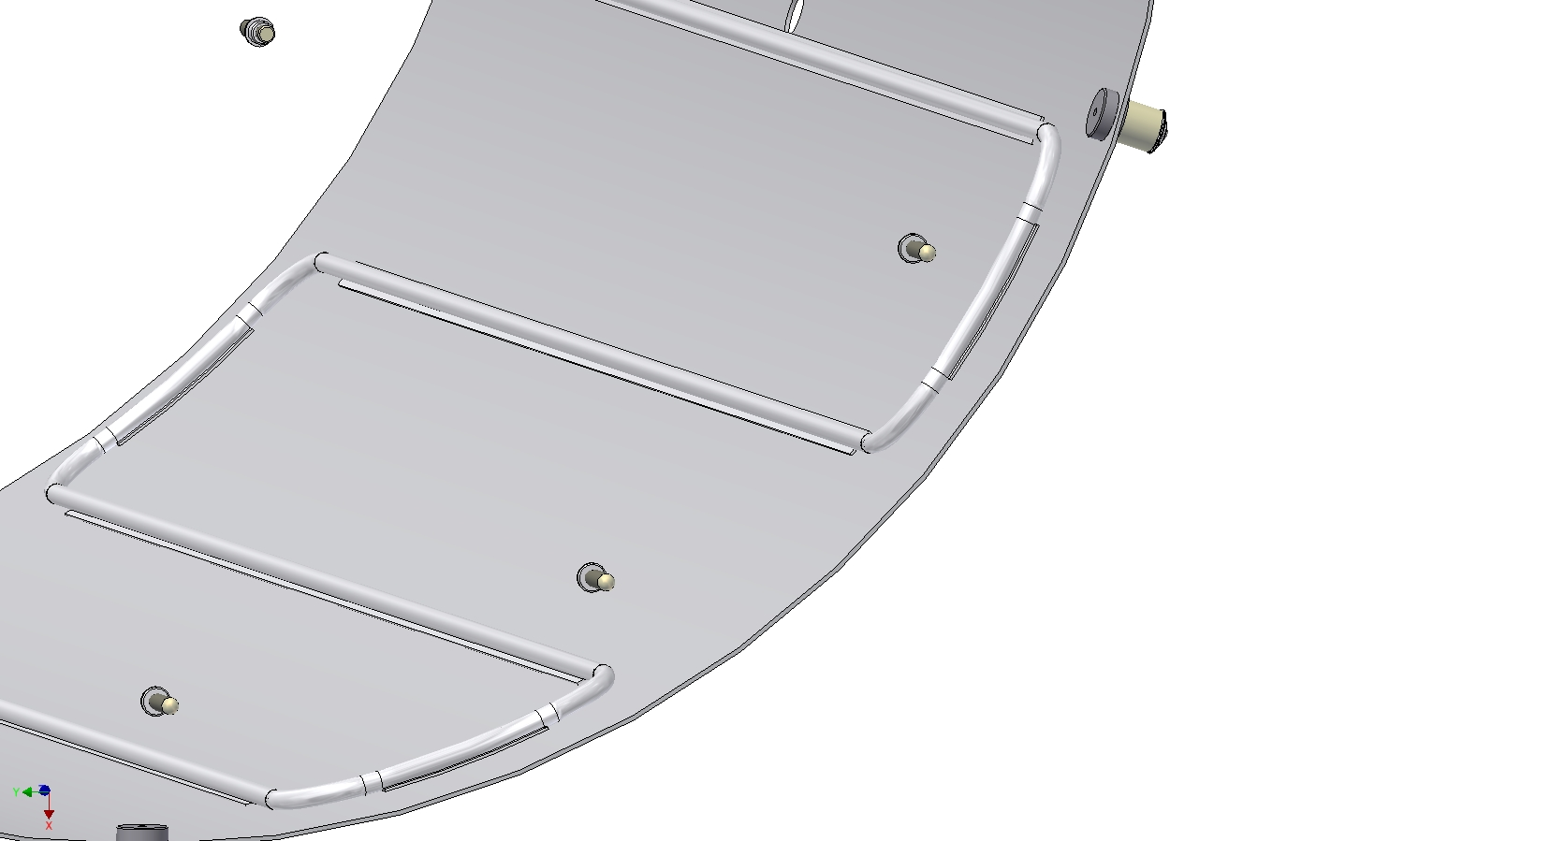

Slide 11


Thank you for your attention

