Slide 1
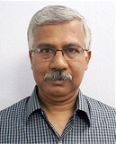



The CBM Group
University of North Bengal
Siliguri, Darjeeling, West Bengal, India 734013
Members
AA
(Research Scholar)
h Scholar)

Slide 2
COLLECTIVE FLOW AT FAIR
ENERGY
Soumya Sarkar
SILIGURI COLLEGE

Slide 3
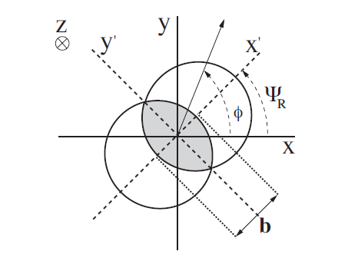



COLLECTIVE FLOW
Collective behaviour or flow of final state particles produced in high-energy heavy-ion collision is measured in terms of the nth Fourier coefficient (v_{n} ) of the azimuthal angles measured with respect to the reaction plane of individual collisions.
The 2nd coefficient v₂ characterises the elliptic flow of particles. Corresponding initial spatial anisotropy of the overlapping zone is quantified by the eccentricity ε:
References:
J.Y.Ollitrault, Phys. Rev. D 46, 229 (1992)
S. A. Voloshin et.al. arXiv:0809.2949 [nucl-ex]

Slide 4
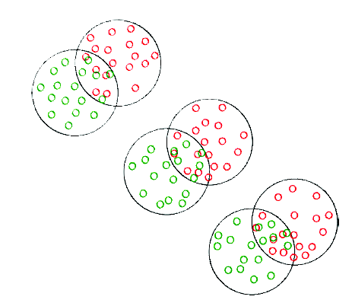
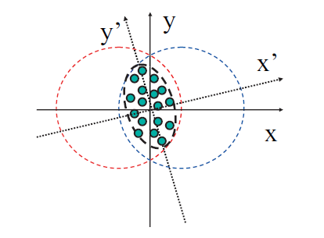

INTRODUCTION TO PARTICIPANT ECCENTRICITY
Two collisions are never
identical. In the figure we
show three collisions at
same impact parameter.
Fluctuations in the Initial
spatial asymmetry leads to
event by event fluctuation
in anisotropic flow
One should define the eccentricity of initial spatial anisotropy in a proper way to take care of the
event by event fluctuations.
Therefore, the eccentricity has to be redefined as:

Slide 5
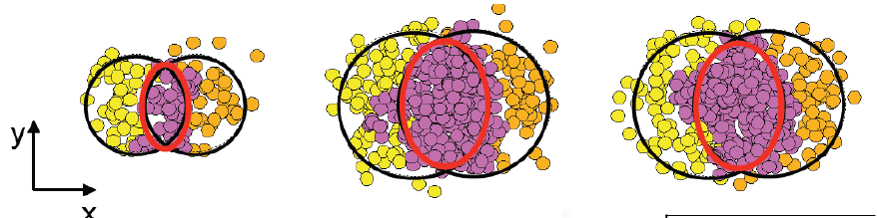
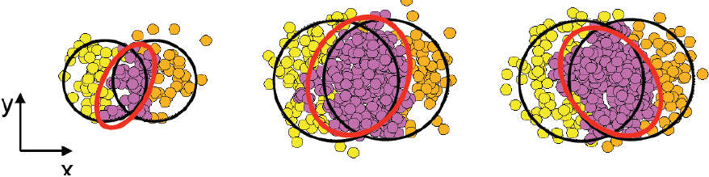
ECCENTRICITY (STANDARD)
ECCENTRICITY (PARTICIPANT)
Courtesy: PHOBOS Collaboration

Slide 6
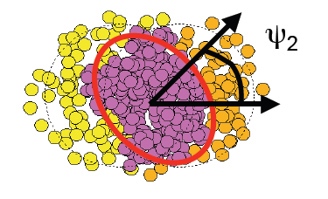
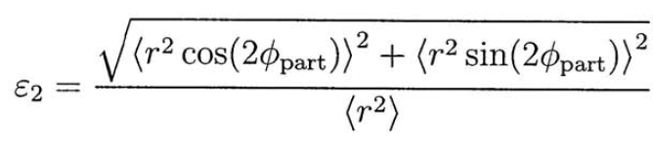
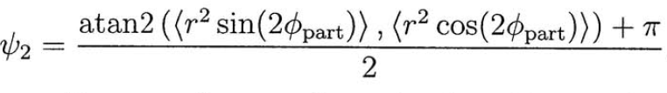
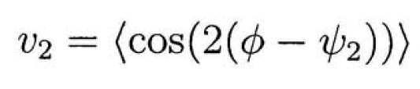
PARTICIPANT ECCENTRICITY AND ELLIPTIC FLOW
B. Alver et.al. Phys. Rev. C 81, 054905 (2010)

Slide 7
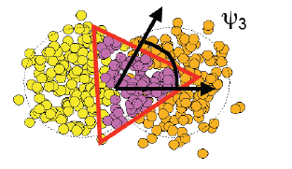
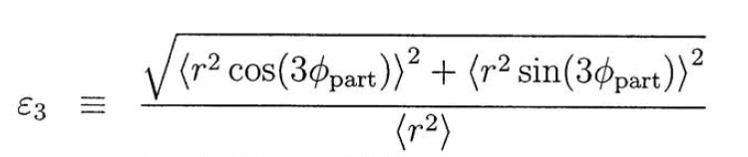
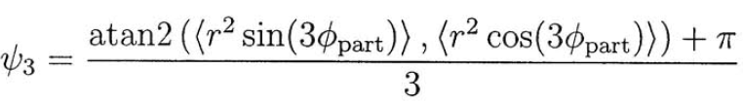

PARTICIPANT TRIANGULARITY AND TRIANGULAR FLOW
B. Alver et.al. Phys. Rev. C 81, 054905 (2010)

Slide 8
OUR ANALYSIS
SECTION I : System size dependence of elliptic
and triangular flow.
-> Model : AMPT (String Melting)
-> Systems :
(a) Au + Au ( 1 million events)
(b) In + In (2 million events)
(c) Ni + Ni (3 million events)
(d) Si + Si (7.5 million events)
->Energy : 30A GeV (E_lab)
SECTION II : Radial Flow
-> System : Au + Au (1 million events)
-> Energy : 10A GeV and 40A GeV (E_lab)

Slide 9
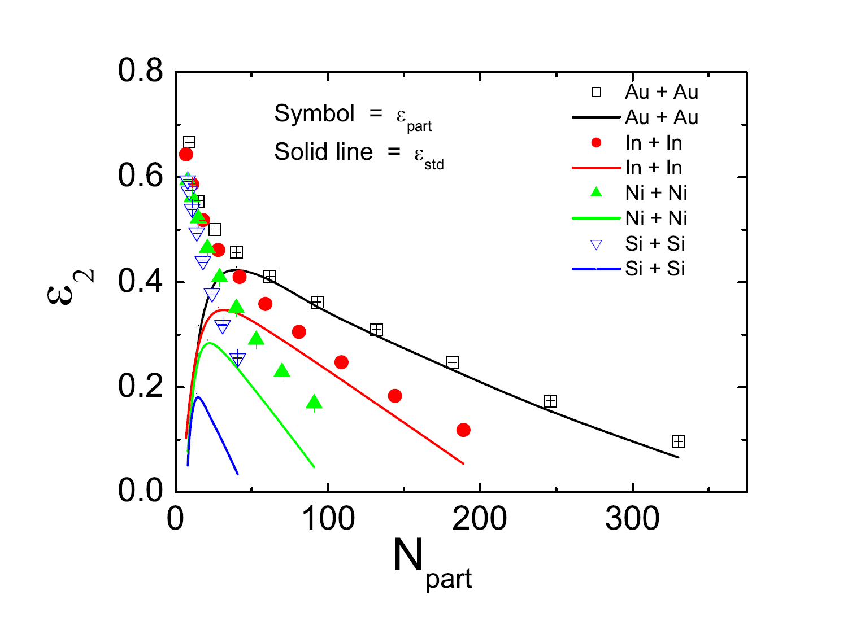
CENTRALITY DEPENDENCE OF ECCENTRICITY

Slide 10
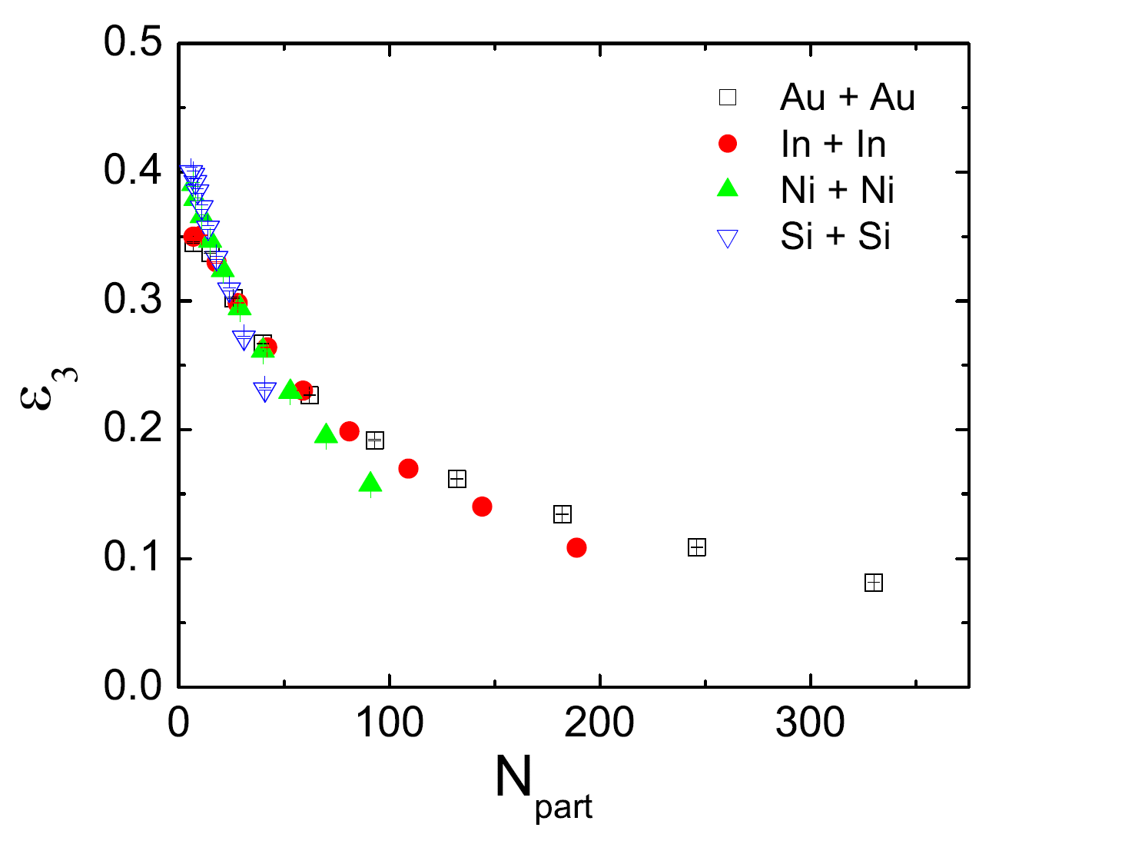
CENTRALITY DEPENDENCE OF TRIANGULARITY

Slide 11
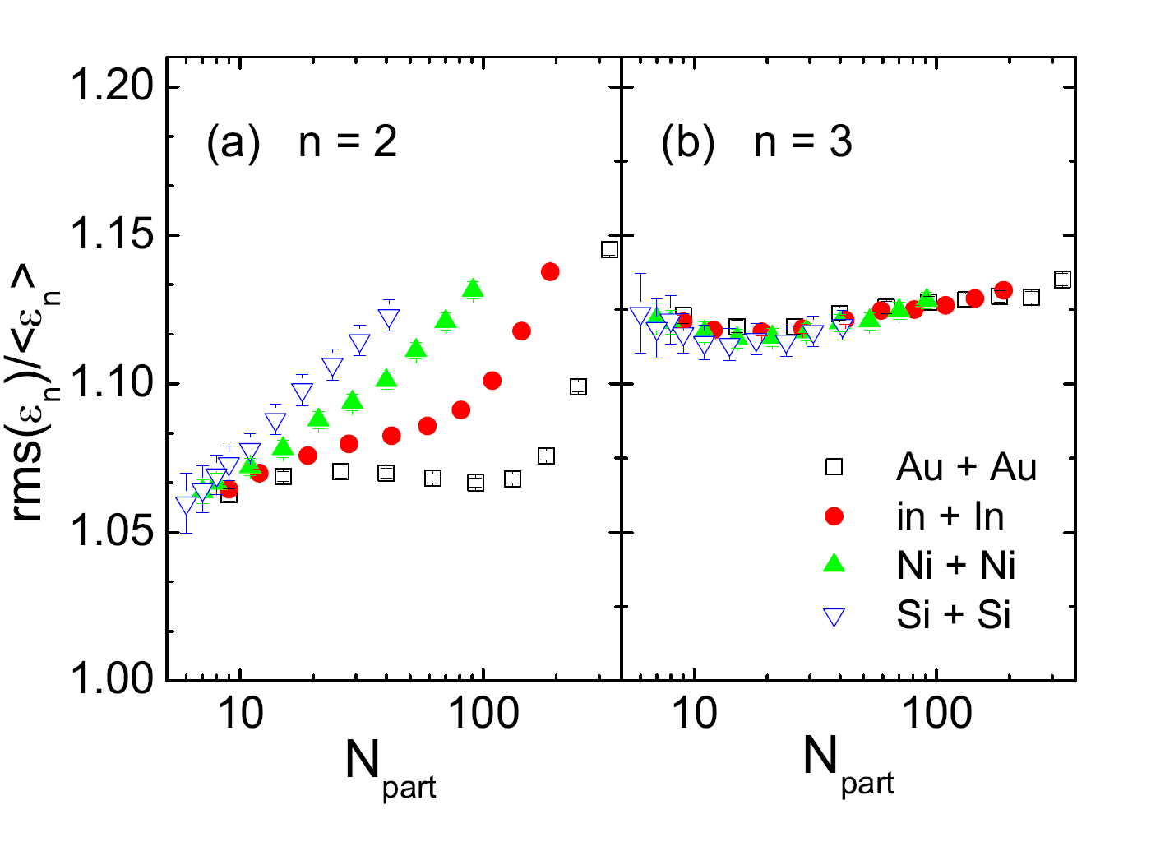
FLUCTUATIONS IN ECCENTRICITY AND TRIANGULARITY

Slide 12
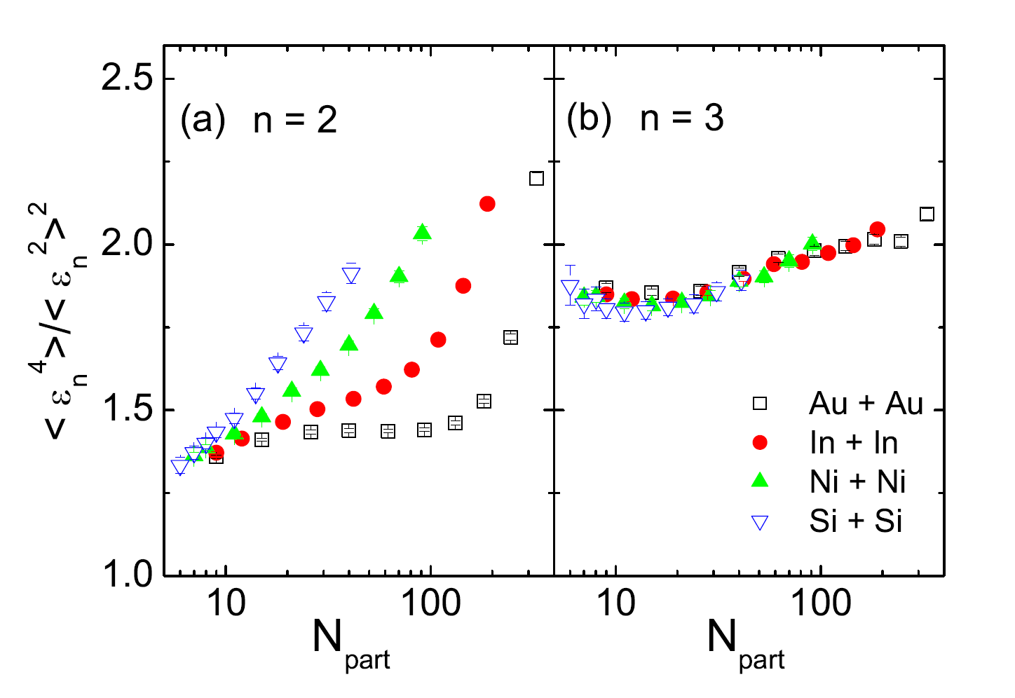
FLUCTUATIONS IN ECCENTRICITY AND TRIANGULARITY
R. S. Bhalerao et al. Phys. Rev. C 84, 054901, (2011)

Slide 13
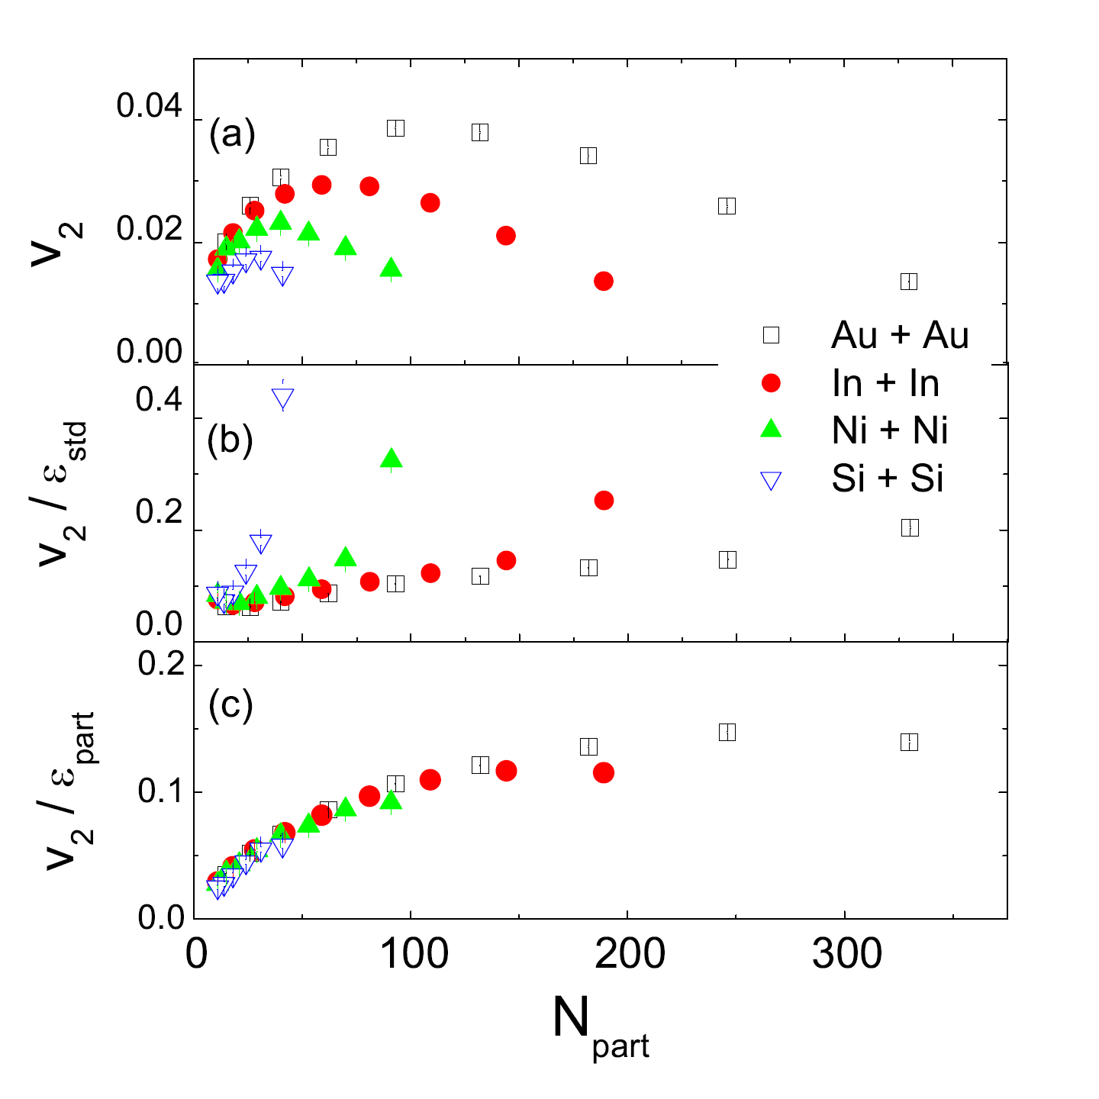
CENTRALITY DEPENDENCE OF ELLIPTIC FLOW
B. Alver et al. [PHOBOS Collaboration], Phys. Rev. Lett 98, 242302 (2007)

Slide 14
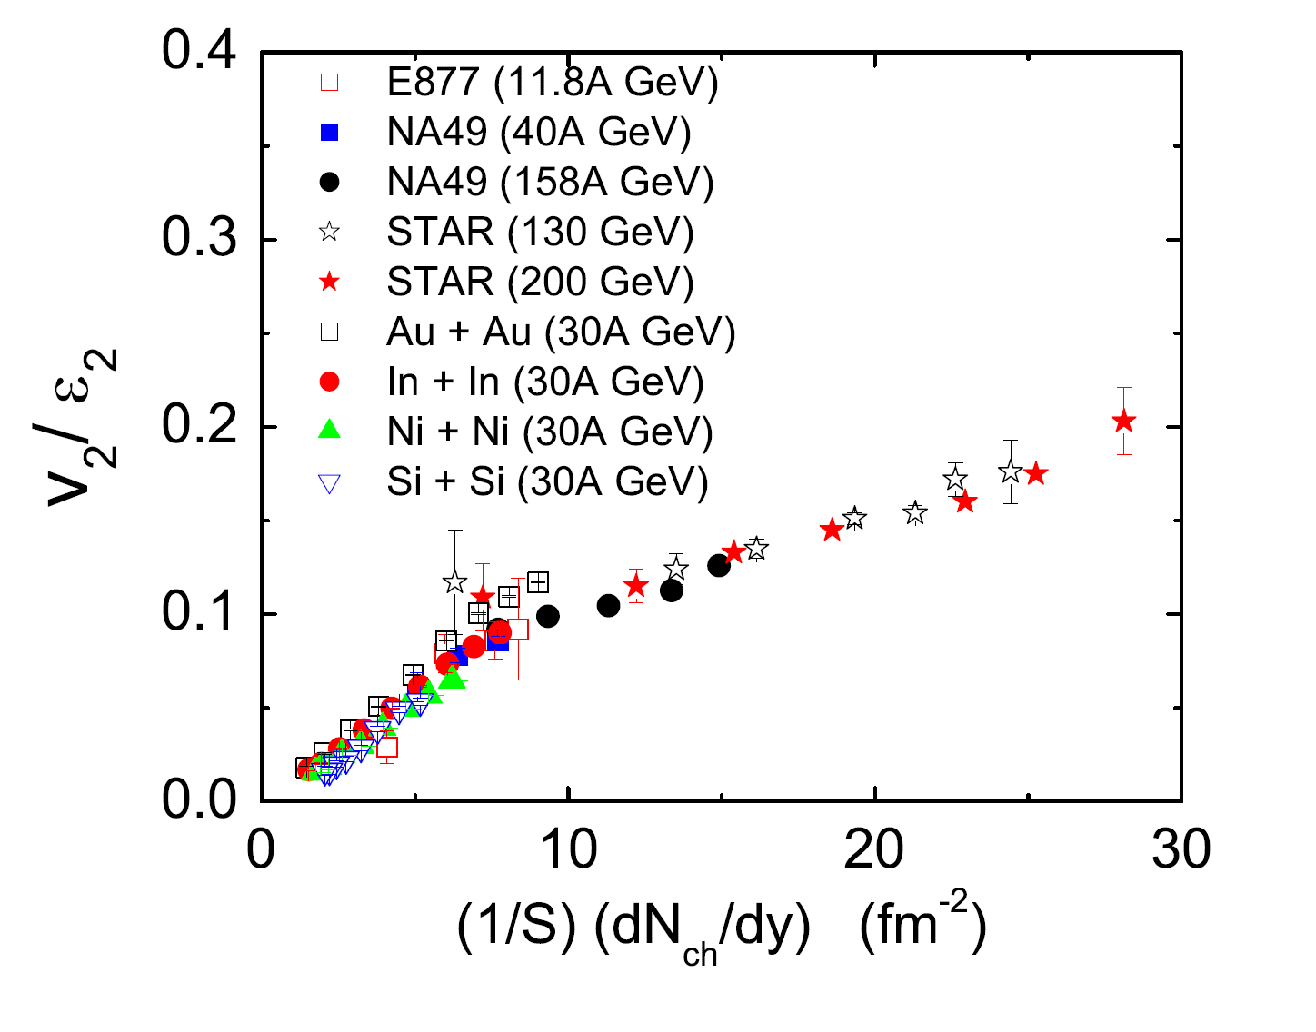
CENTRALITY DEPENDENCE OF ELLIPTIC FLOW
S. A. Voloshin and A. M. Poskanzer, Phys. Lett. B 474, 27 (2000)

Slide 15
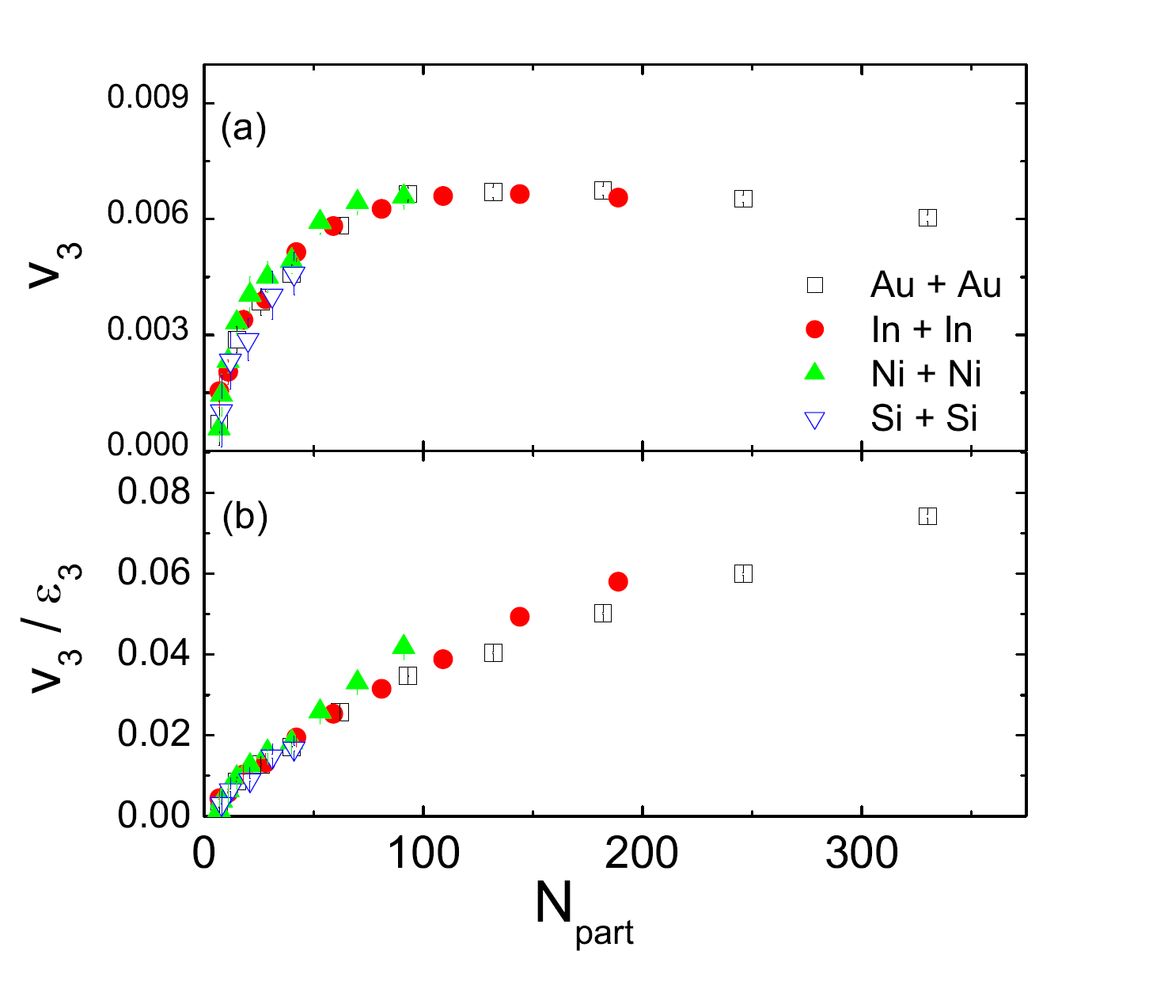
CENTRALITY DEPENDENCE OF TRIANGULAR FLOW

Slide 16
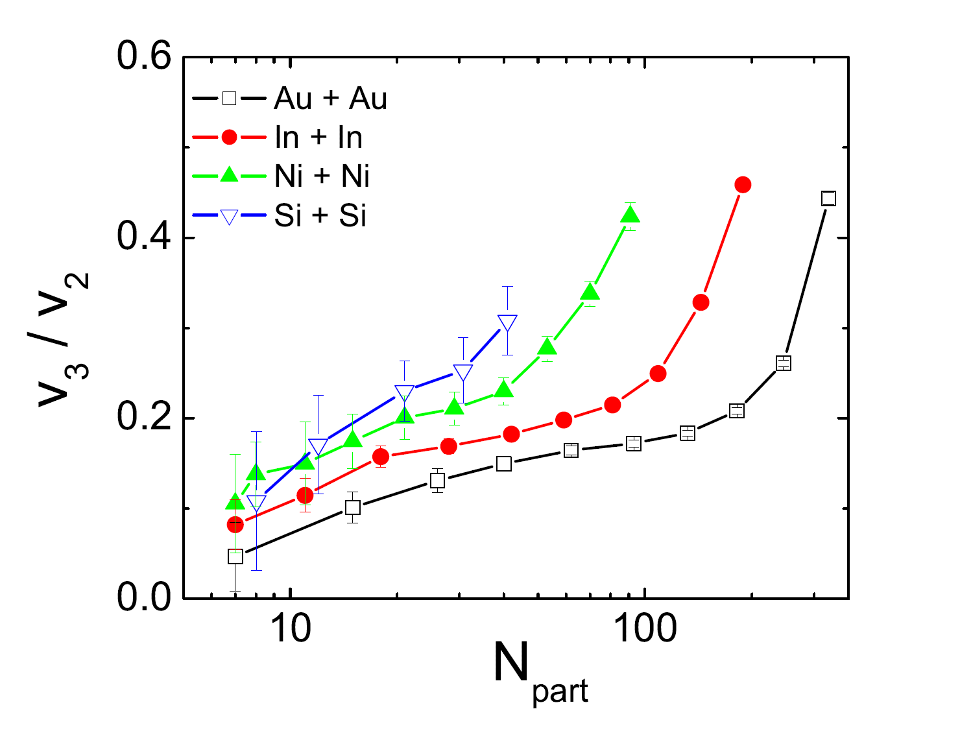
RELATIVE STRENGTH OF ELLIPTIC AND TRIANGULAR FLOW

Slide 17
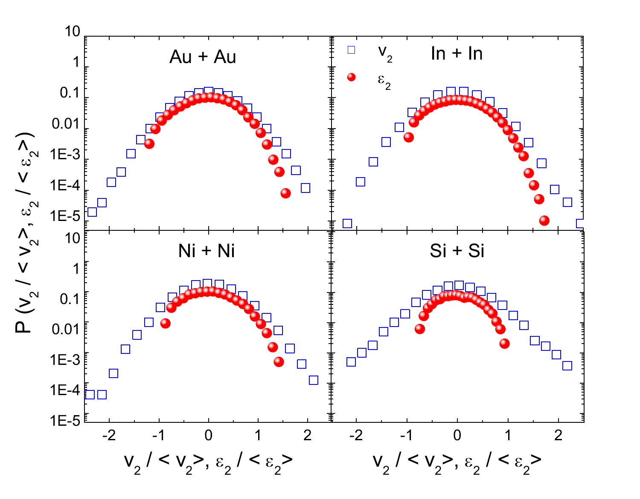
ELLIPTIC FLOW DISTRIBUTION
35 – 40
3
C. Gale et al. Phys. Rev. Lett. 110, 012302 (2013).
35 – 40 %

Slide 18
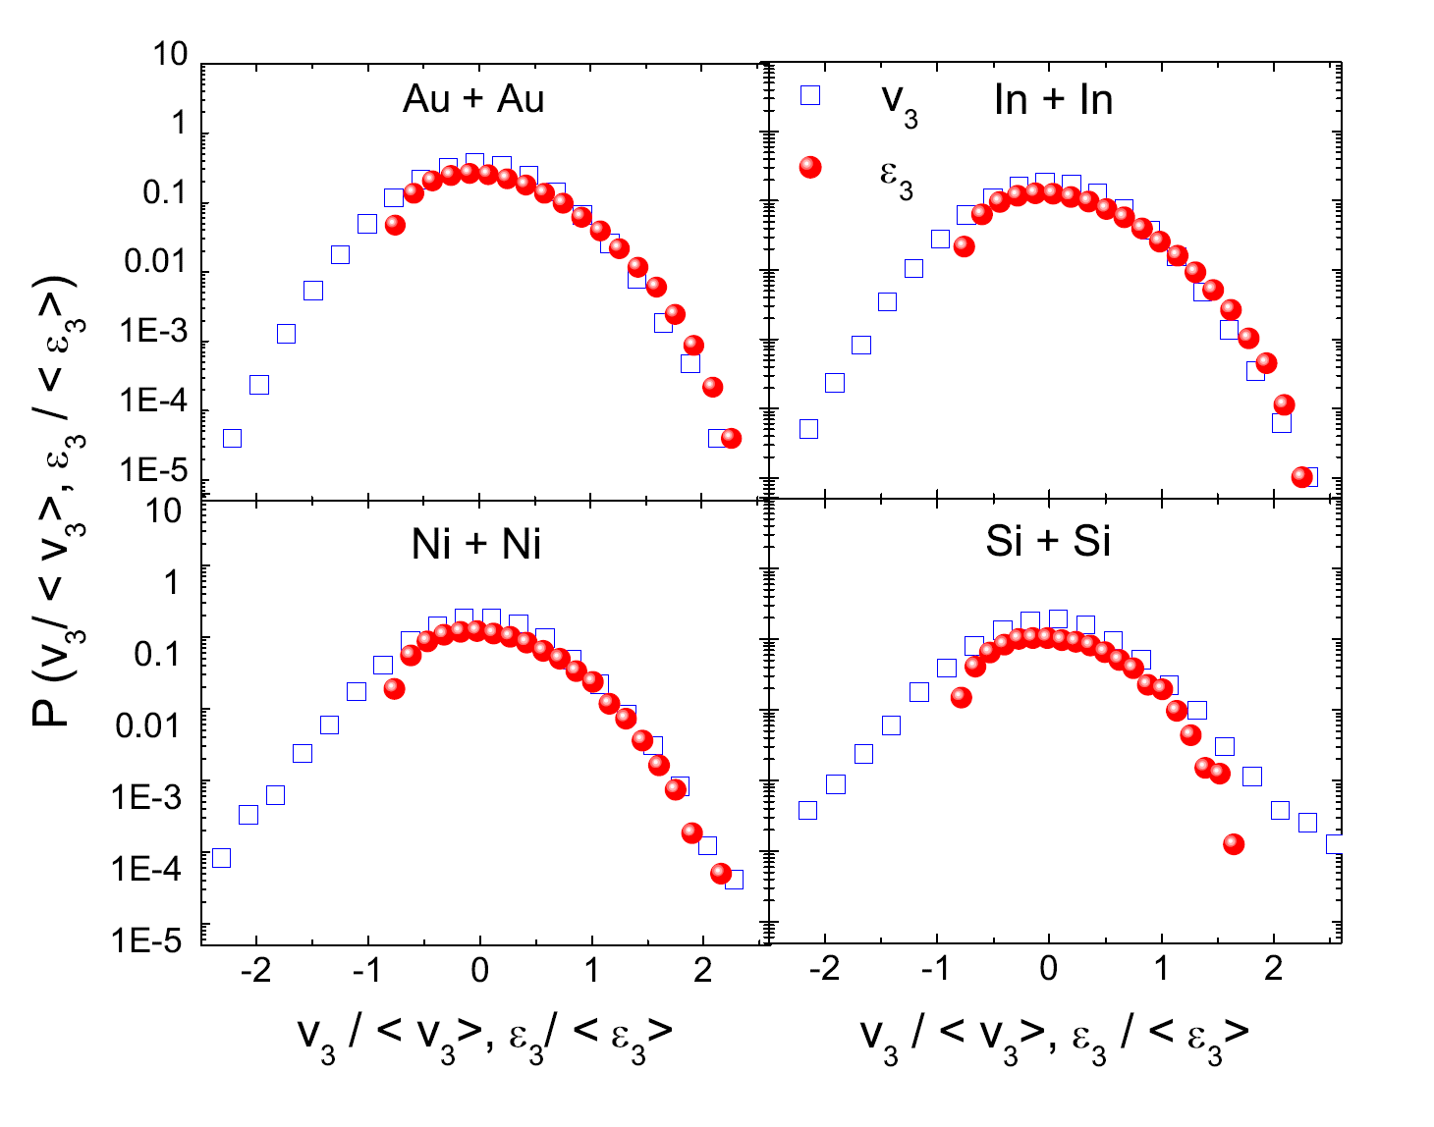
TRIANGULAR FLOW DISTRIBUTION
C. Gale et al. Phys. Rev. Lett. 110, 012302 (2013)
35 – 40 %

Slide 19
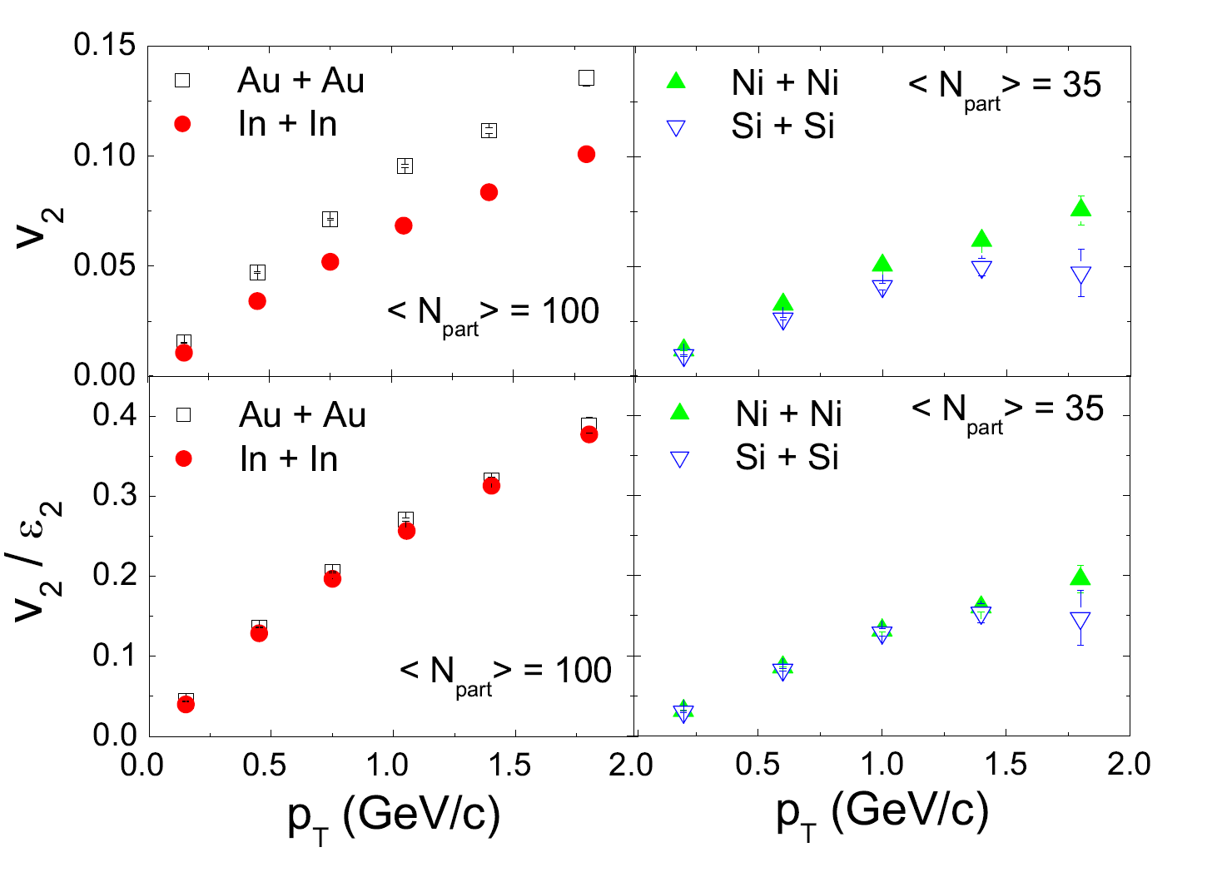
TRANSVERSE MOMENTUM DEPENDENCE OF ELLIPTIC FLOW

Slide 20
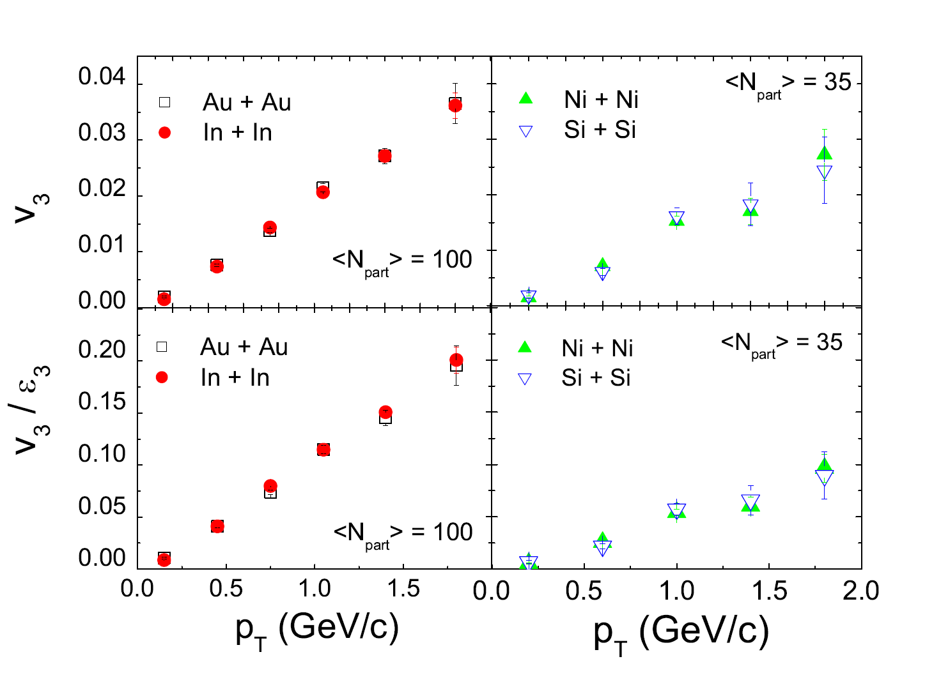
TRANSVERSE MOMENTUM DEPENDENCE OF TRIANGULAR FLOW

Slide 21
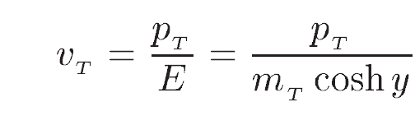
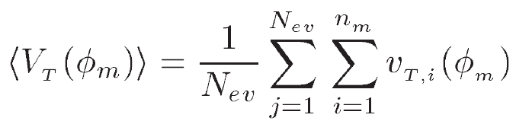
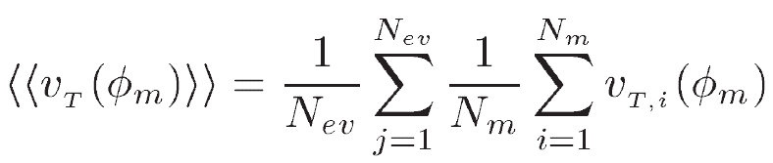
RADIAL FLOW
Transverse (radial) velocity :
Total radial velocity :
Mean transverse velocity : ( scaling out multiplicity effects)

Slide 22
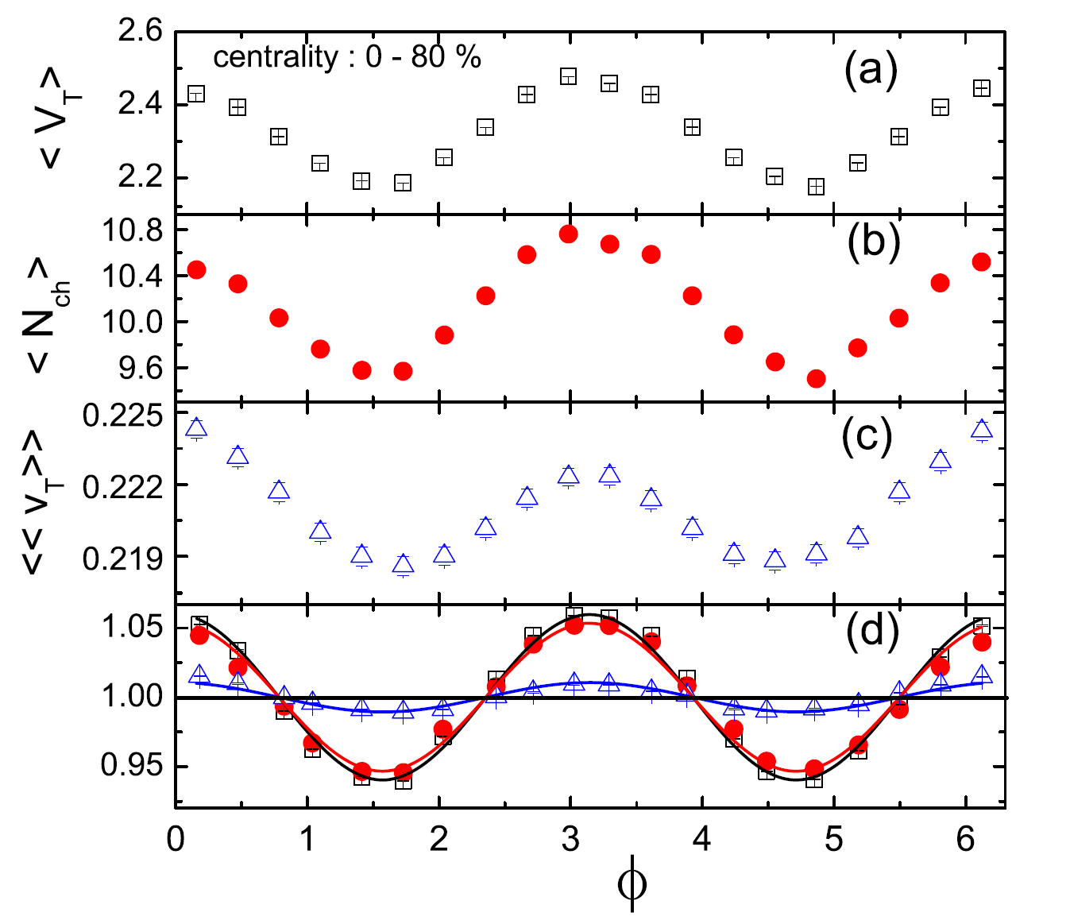
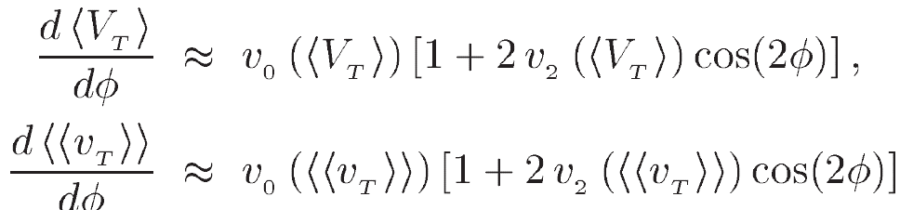
S. Sarkar, P. Mali and A. Mukhopadhyay, Phys. Rev. C 95,
014908 (2017)

Slide 23
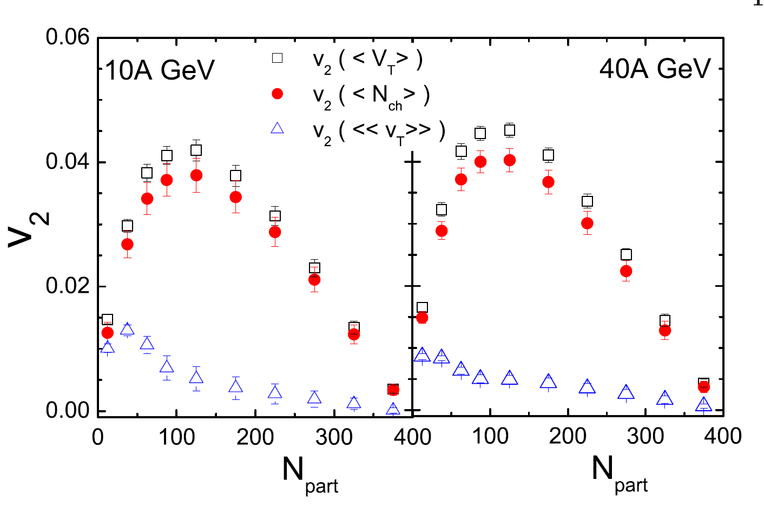
CENTRALITY DEPENDENCE OF ELLIPTIC FLOW PARAMETER

Slide 24
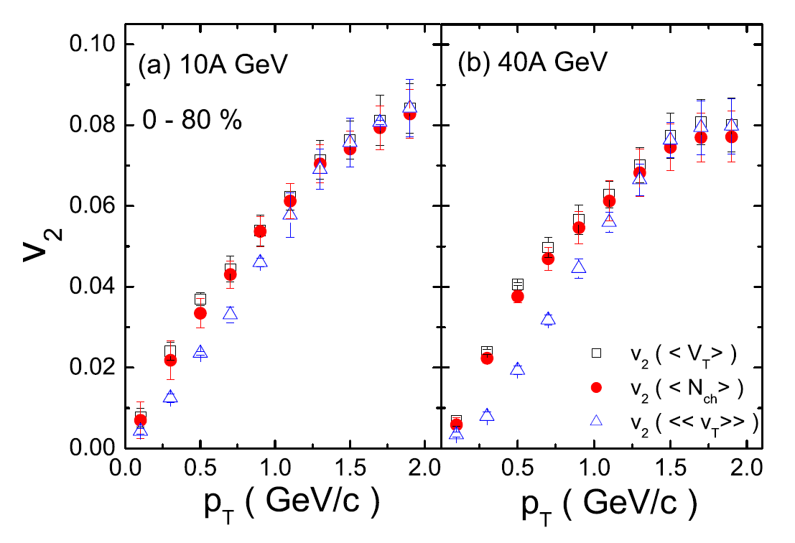
TRANSVERSE MOMENTUM DEPENDENCE OF ELLIPTIC FLOW PARAMETER

Slide 25
CONCLUSIONS
1. We have investigated the system size dependence of elliptic and triangular flow at E_{lab} = 30A GeV over a wide range from Si + Si to Au + Au systems and our results are found to be consistent with those from other experiments.
2. Eccentricity and its fluctuations plays an important role particularly in smaller systems like Si + Si and Ni + Ni.
3. Triangularity and triangular flow is nearly independent of the system size.
4. Investigations on radial flow show a small but finite anisotropy in transverse velocity even after scaling out the multiplicity effects.
5. Species-wise investigations of radial flow is on-going and would be reported soon.
6. We also intend to explore the collective effects in asymmetric heavy – ion collisions in our future analyses.
THANK YOU

Slide 26
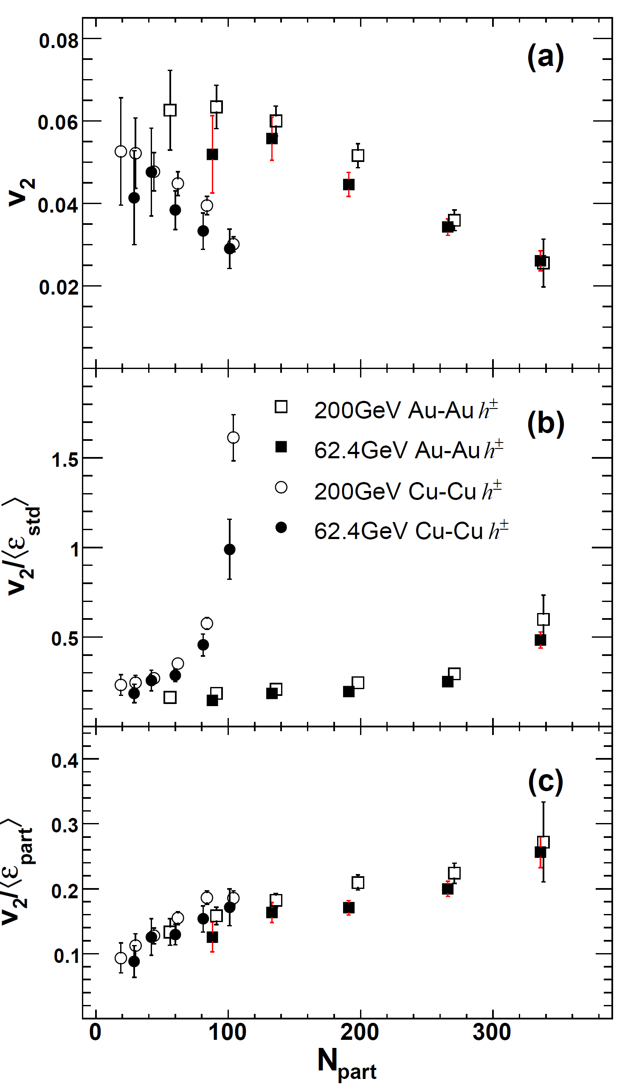
BACK UP SLIDES

Slide 27
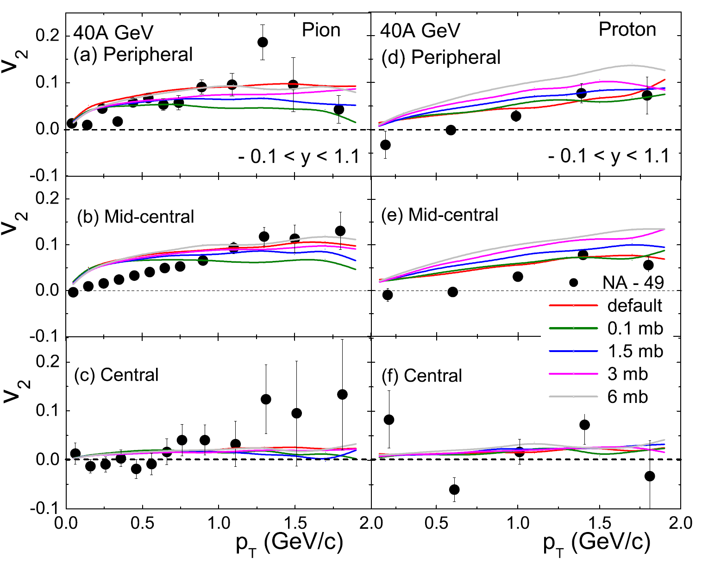
BACK UP SLIDES

Slide 28
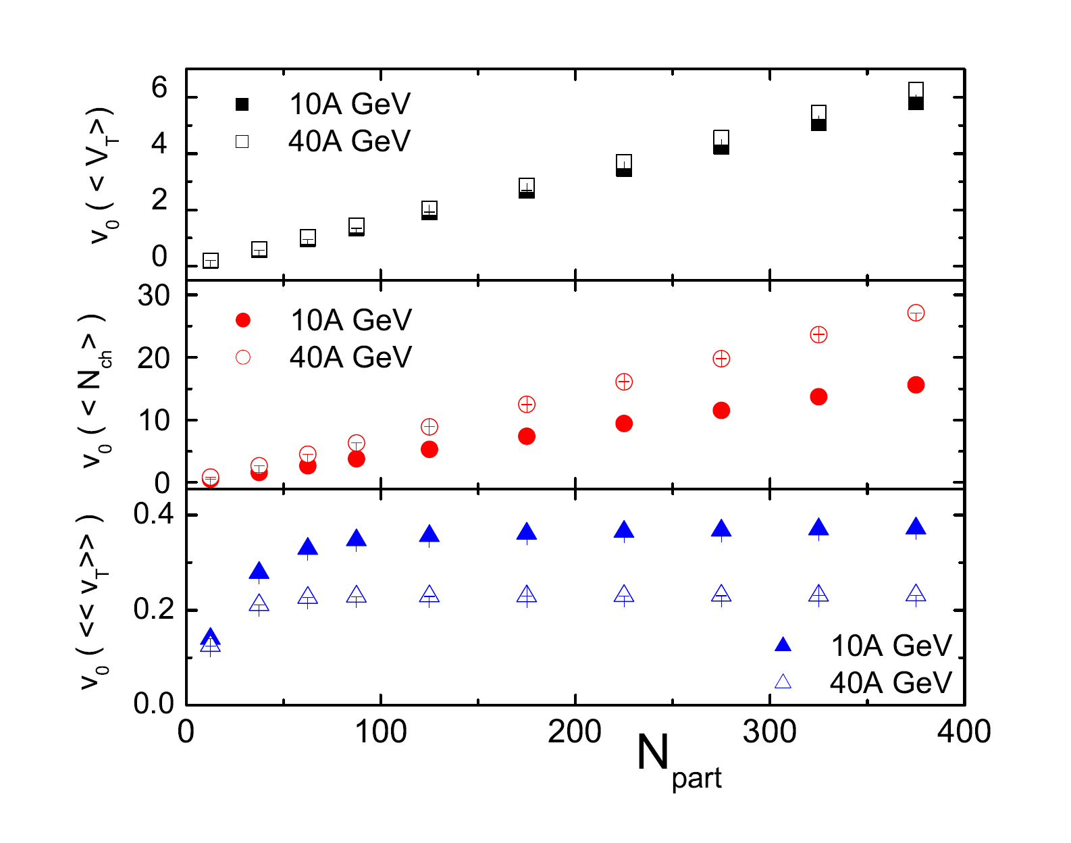
BACK UP SLIDES

Slide 29
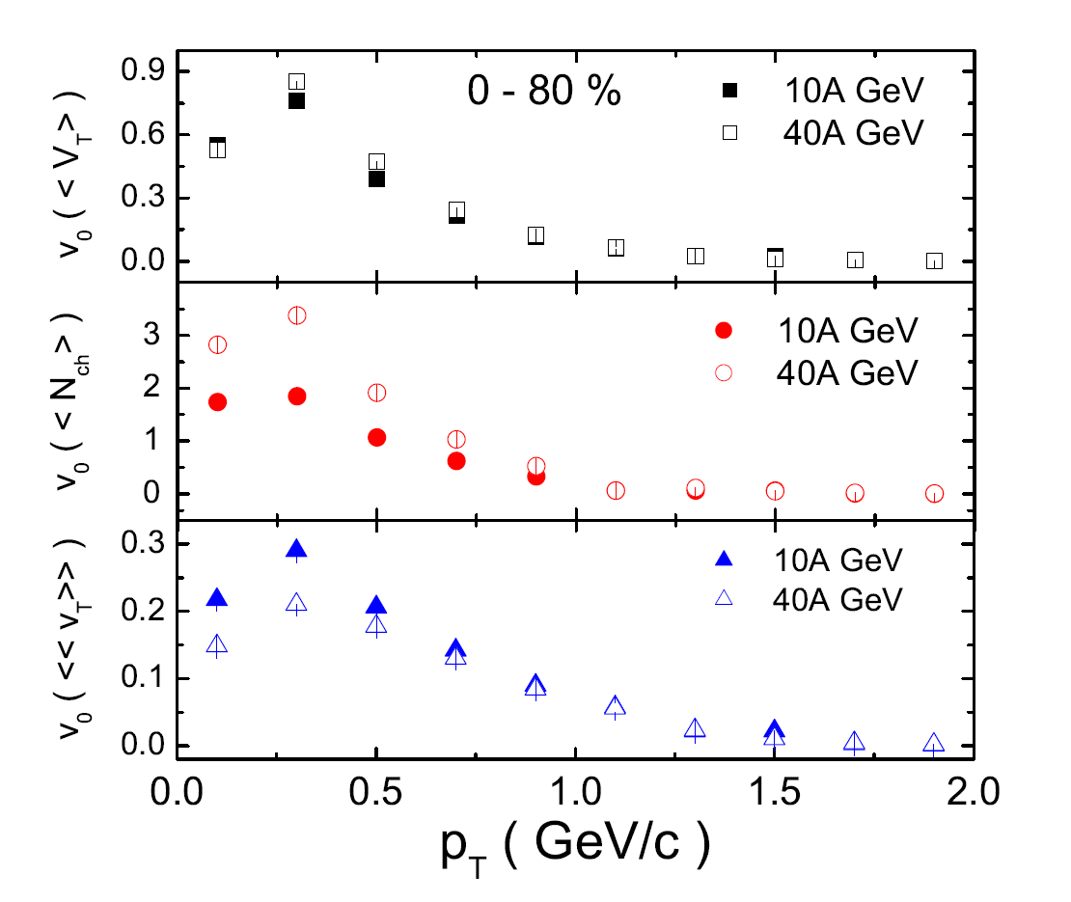
BACK UP SLIDES

