Slide 1
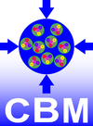
CBM Electronics
Christian J. Schmidt CBM-India Meeting
Feb. 15-17, 2018, Falta, India

Slide 2
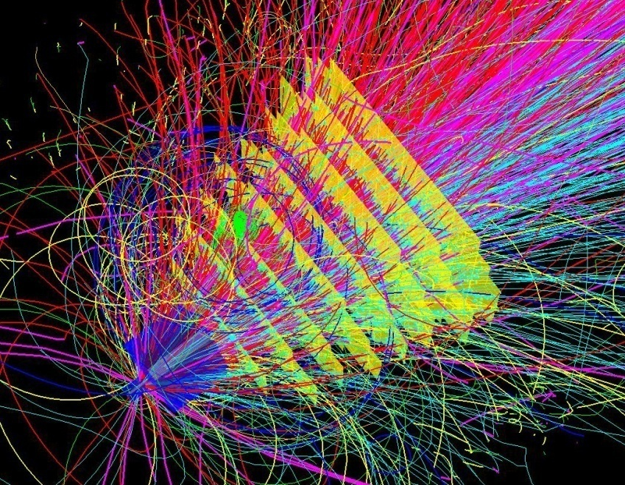
CBM technological challenges
fixed target configuration makes 10MHz Au+Au interaction rate feasible at FAIR
➢ determination of (displaced) vertices (σ ≈ 50 μm)
➢ identification of leptons and hadrons
➢ fast and radiation hard detectors
➢ free-streaming readout electronics
high speed data acquisition and high performance
computer farm for online event selection
➢ 4-D event reconstruction
Notes:
2
2
2

Slide 3
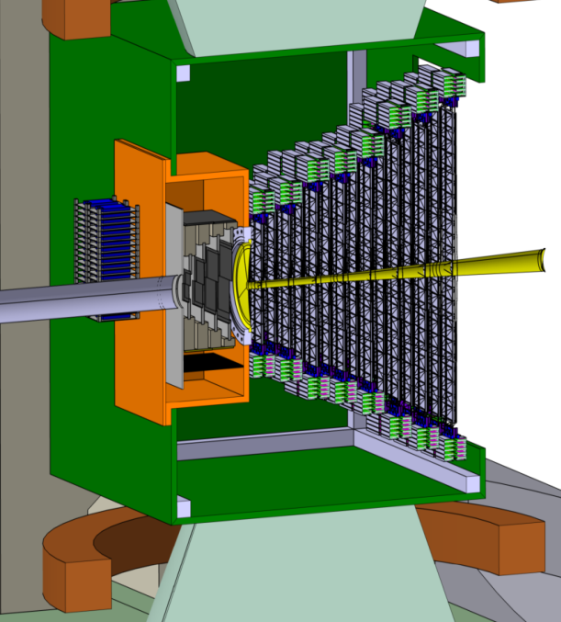
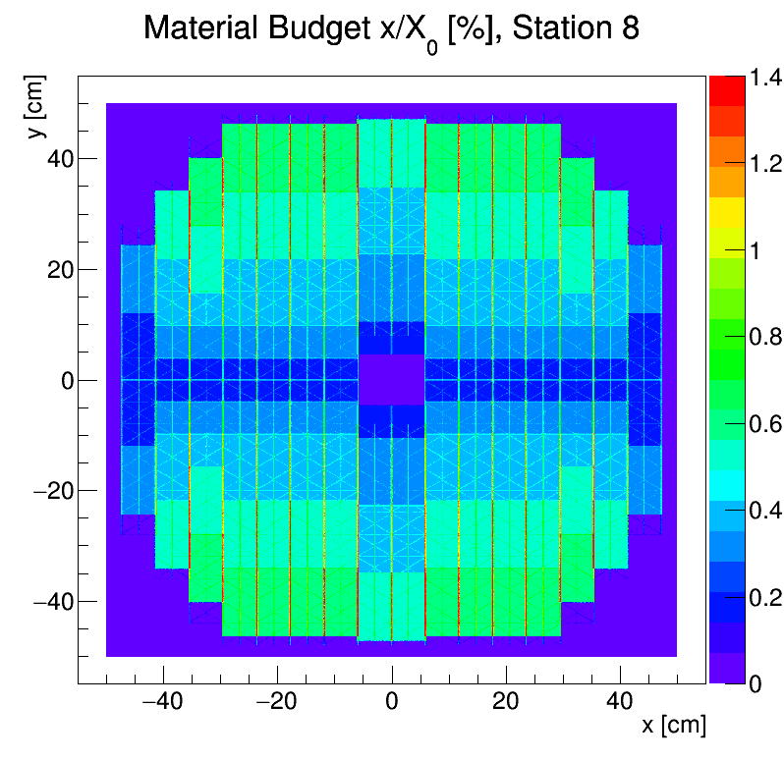
CBM-Silicon Tracking System
Low-mass micro cables from sensor to FEE
1.8 Mio channels, cooling power ~ 40 kW
selftriggering ASIC readout
STS
beam
2.5°
25°
x/X₀ [%]
target
material budget per station
~ 4 sqm active sensor area
double sided strips 7.5°, 58µm pitch
8 Stations,
106 ultra-light carbon ladders
896 Sensor modules

Slide 4
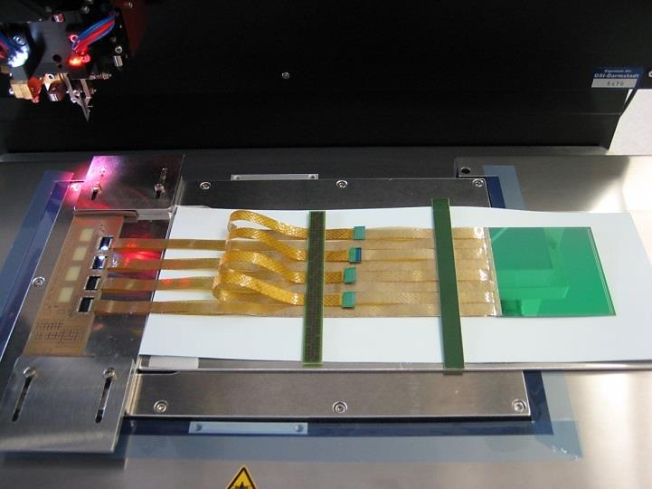
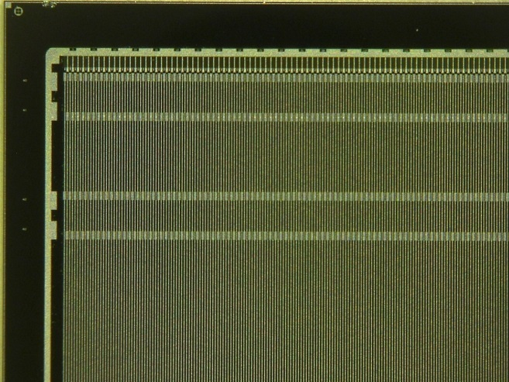
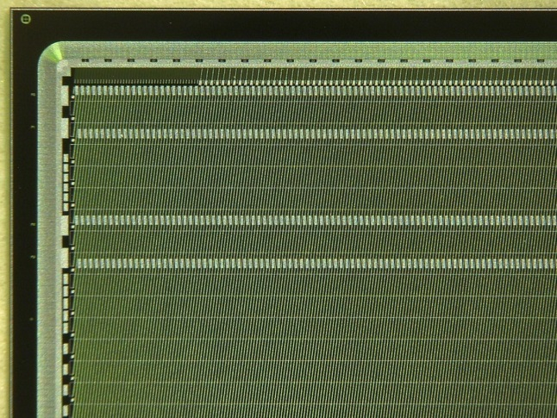
Assembly of double sided strip detector modules, a collaborative effort
prototyping ongoing
Topical workshop on radiation induced surface effects in silicon detectors, Oct. 2016 at KIT

Slide 5
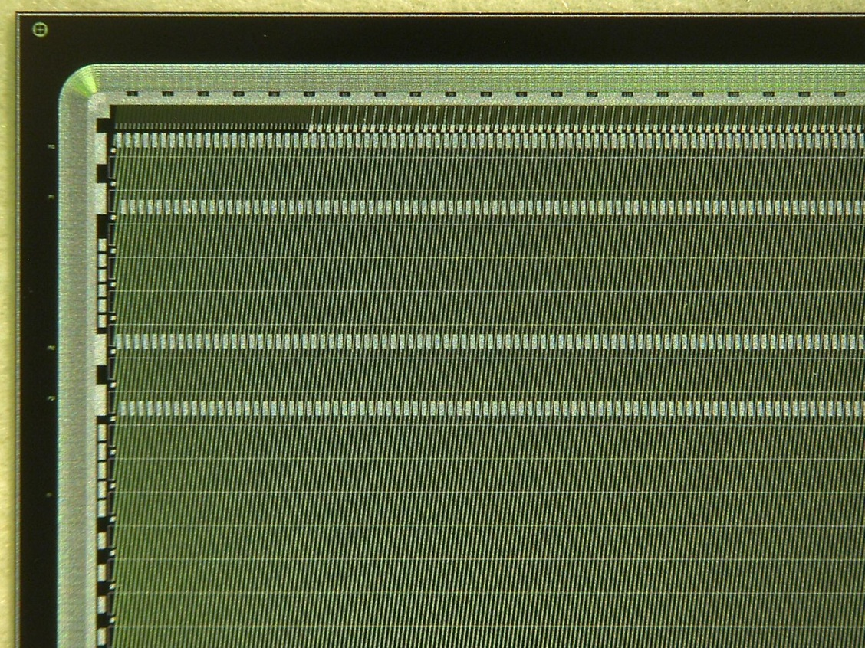
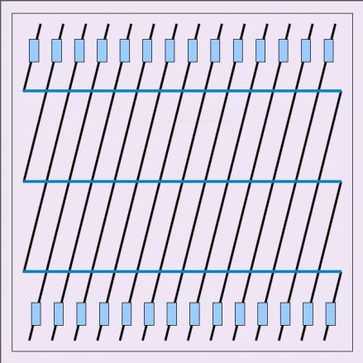
Silicon microstrip sensors
300 µm thick, n-type silicon
double-sided segmentation
2nd metal routing lines
1024 strips of 58 µm pitch
strip length 2/4/6/12 cm
angle front/back: 7.5/0 deg
read-out from top edge
rad. tol. up to 10¹⁴ n_{eq}/cm²
C.J. Schmidt, CBM-India Meeting 2018, Falta, India

Slide 6
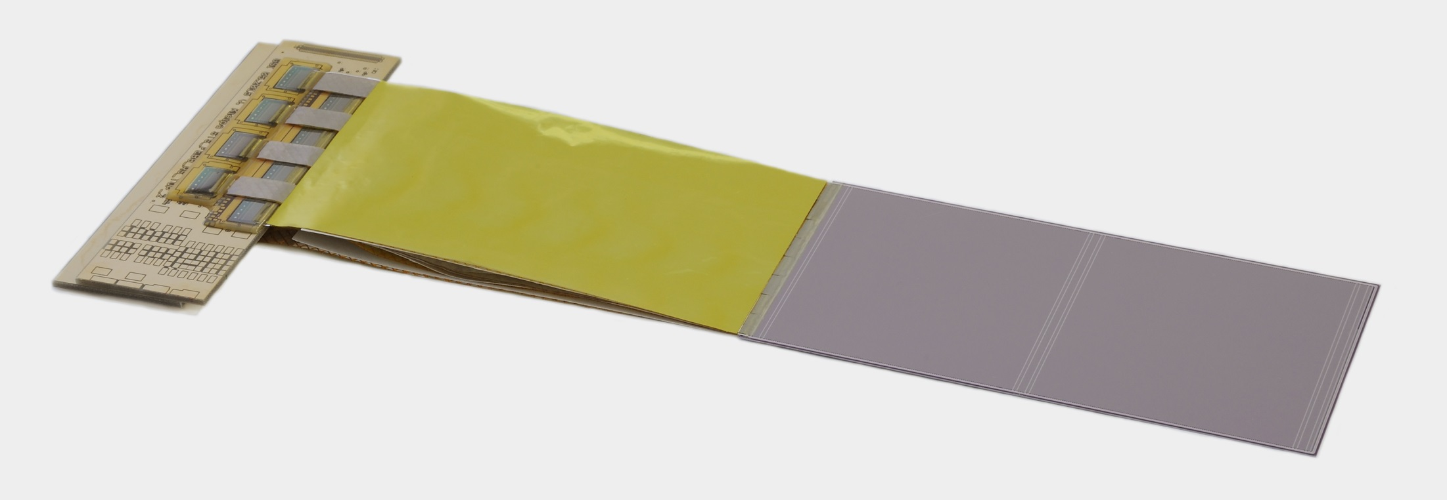
the Silicon-Sensor-Module
STS-module-components:
front-end-boards
signal transmission cable
double-sided silicon
microstrip sensor

Slide 7
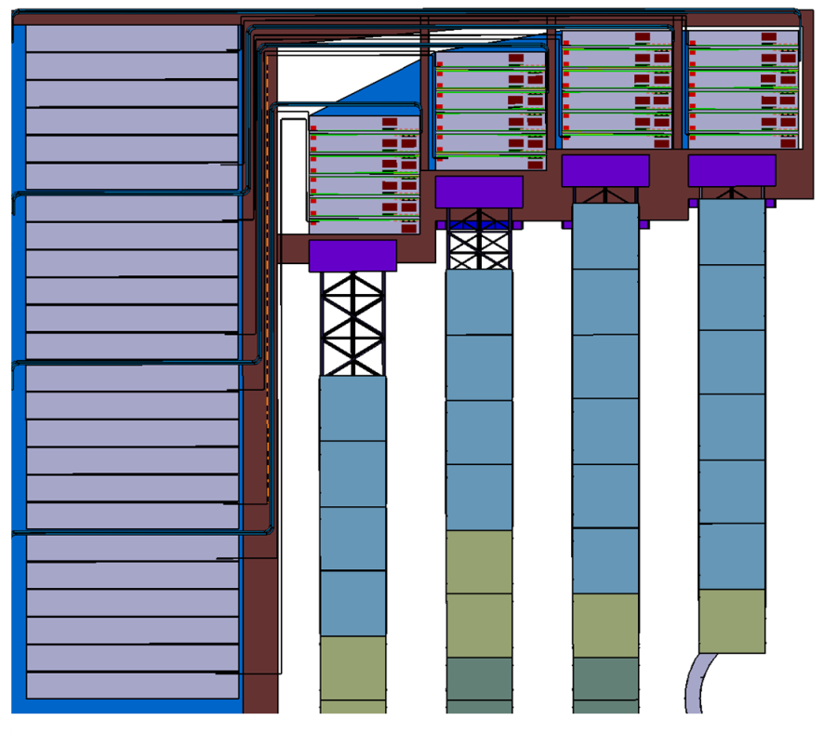
Module Electronics Allocated on Cooling Shelves
Cooling plate
Front-end Electronics Boards
Read-out Boards, Power Boards
bi-phase CO₂ cooling system
STS electronics total: 42 kW

Slide 8
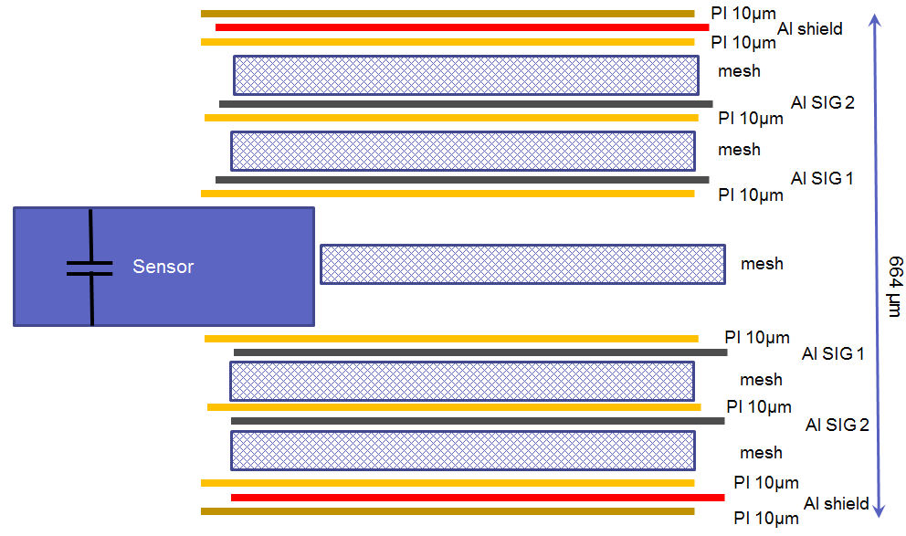
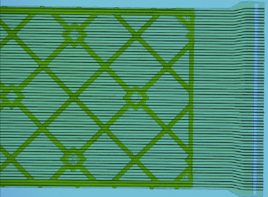
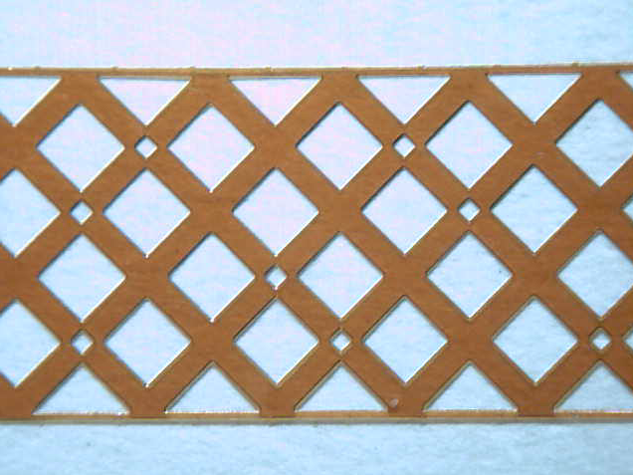
Read-out cables 32000 analogue cables of 64ch needed
cable stack: thickness 0.230 % X₀
spacer layer
64 traces per cable
signal layer: 64 Al lines of 116 µm pitch, 10 µm thick on 14 µm polyimide, lengths up to 55 cm
challenge: production yield of upto 50cm long cables → low yield = uncalculable project duration
Important: cable capacitance < 500fF per cm
C.J. Schmidt, CBM-India Meeting 2018, Falta, India

Slide 9
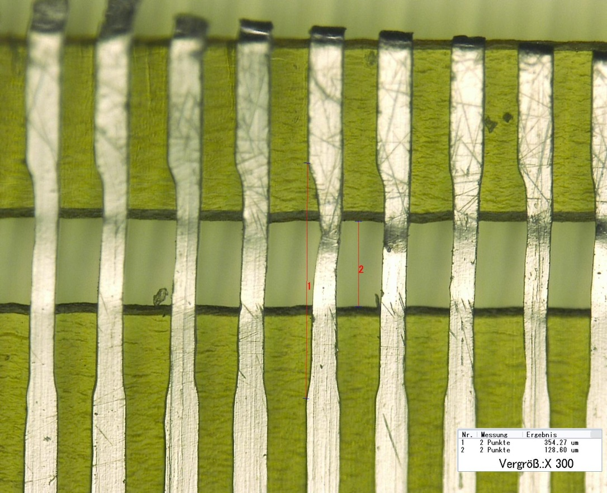
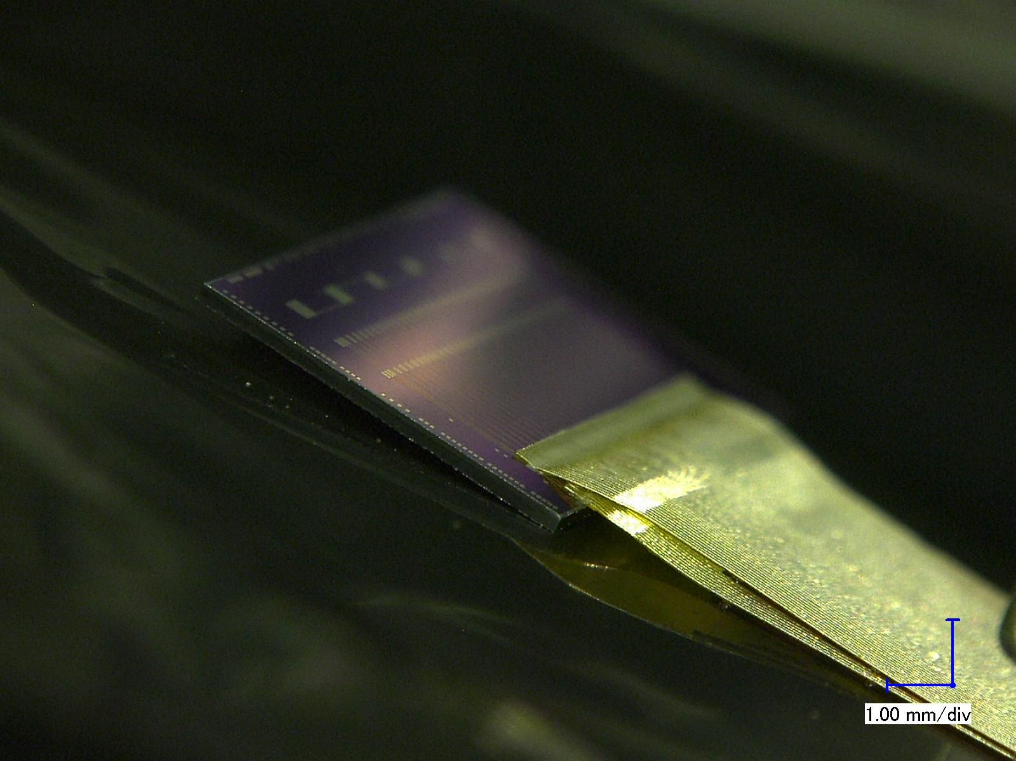
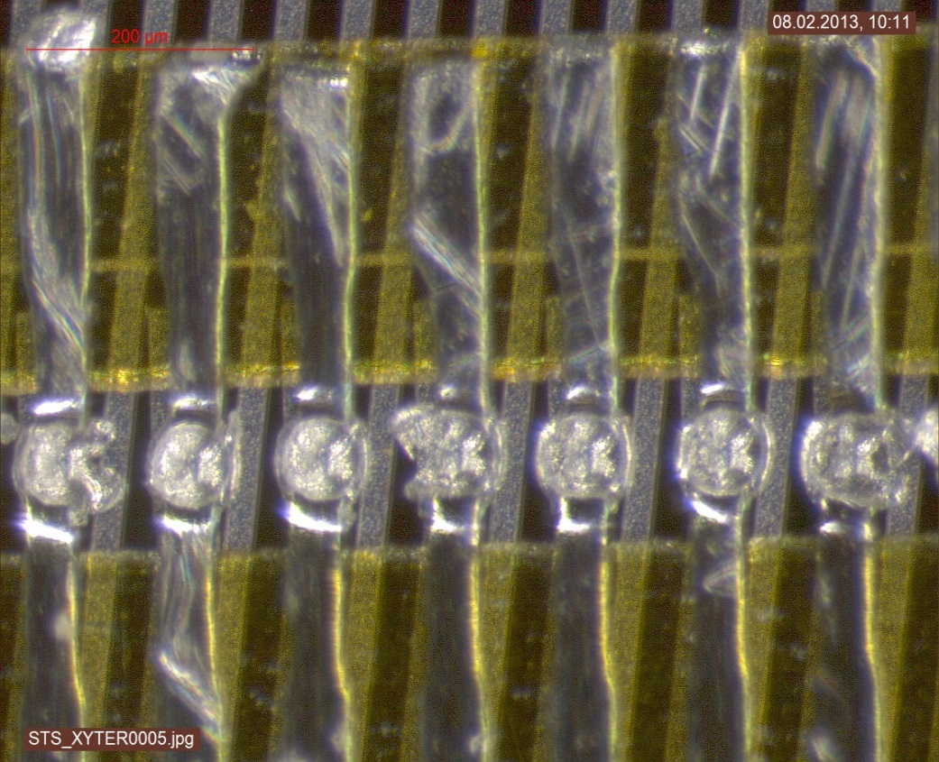
Micro Cable Technology with TAP-Bonding
double cable layer bonded onto chip

Slide 10
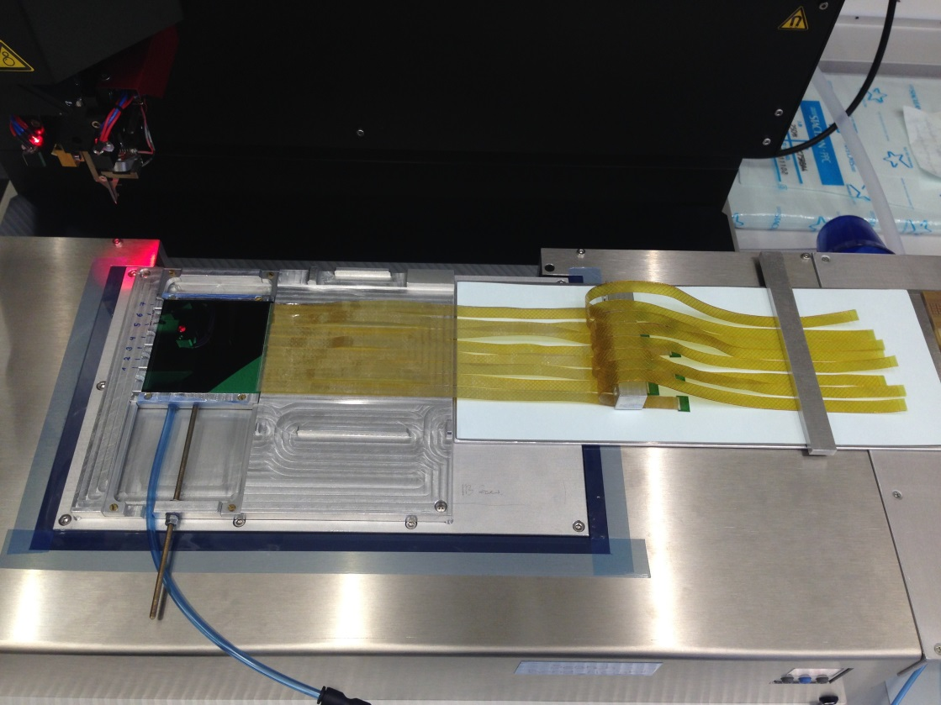
assembly-step 2: TAB-bonding of chip cables to the silicon sensor
fixing of the microcables with vacuum and alignment
TAB-bonding of 16 microcables to the sensor (two rows at 8 microcables)
protection of the TAB-bonds with Globtop after QA-measurements

Slide 11
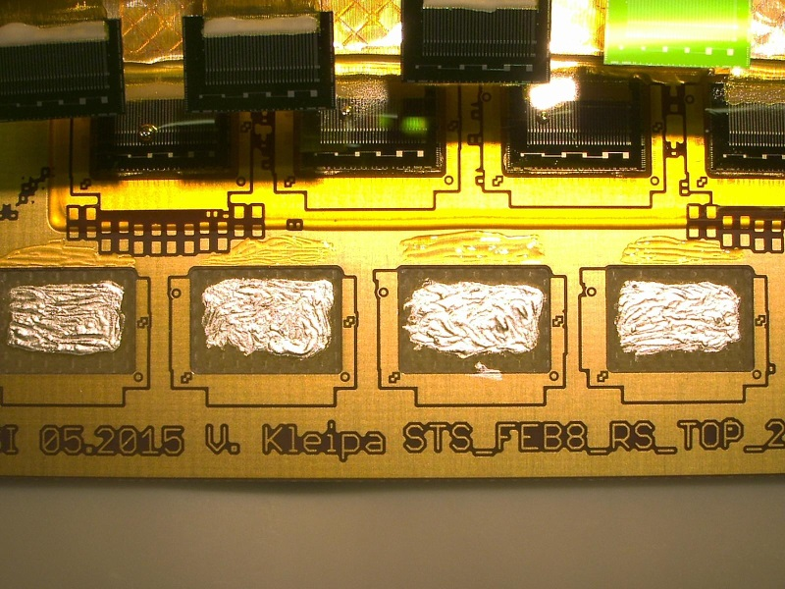
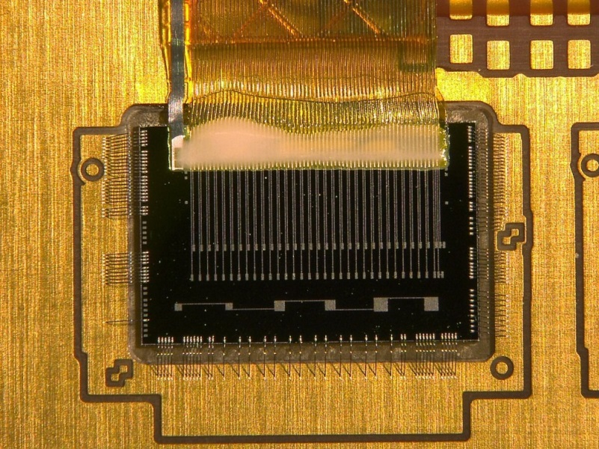
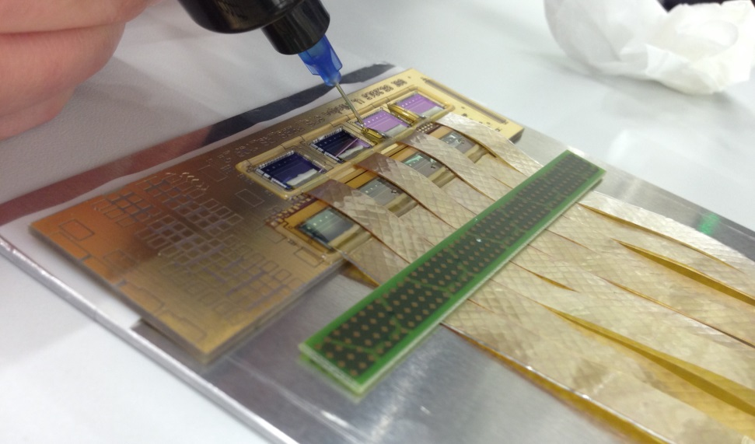
Die- and wirebonding of readout chips to the PCB-rows
wire-bonding of the STS-YTER-ASIC´s
die-bonding of four ASIC´s for the 2nd row
application of Globtop
after QA-measurements
wire-bonded STS-XYTER-ASIC

Slide 12
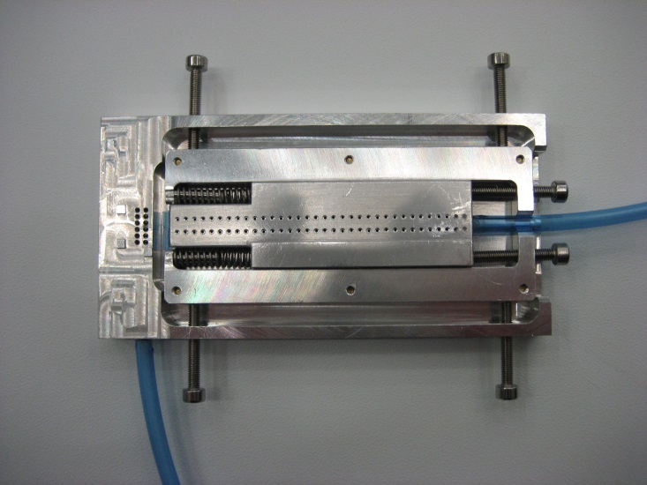
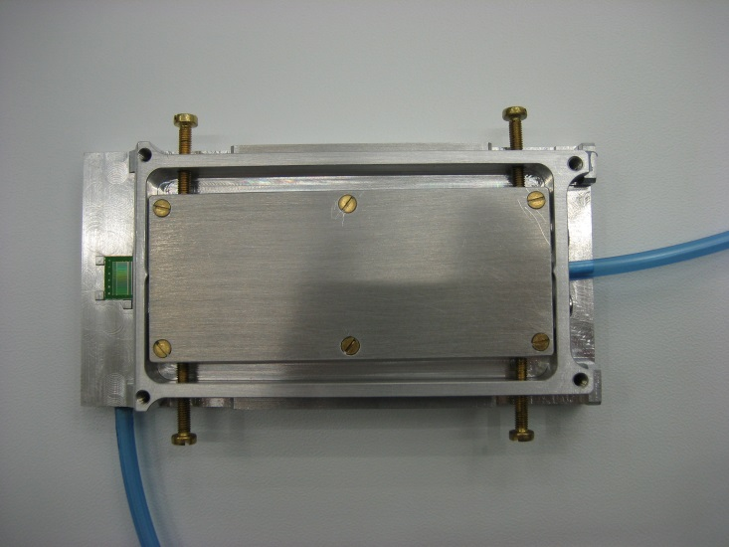
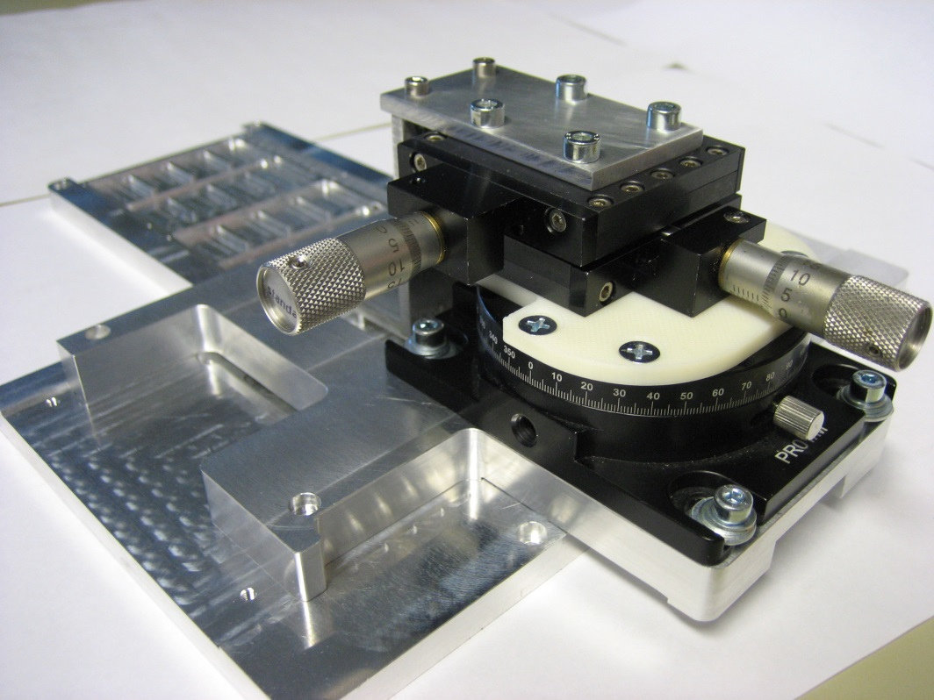
optimization of alignment jigs

Slide 13
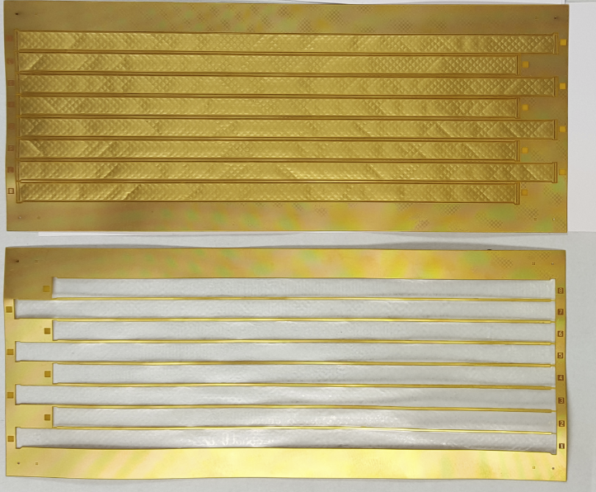
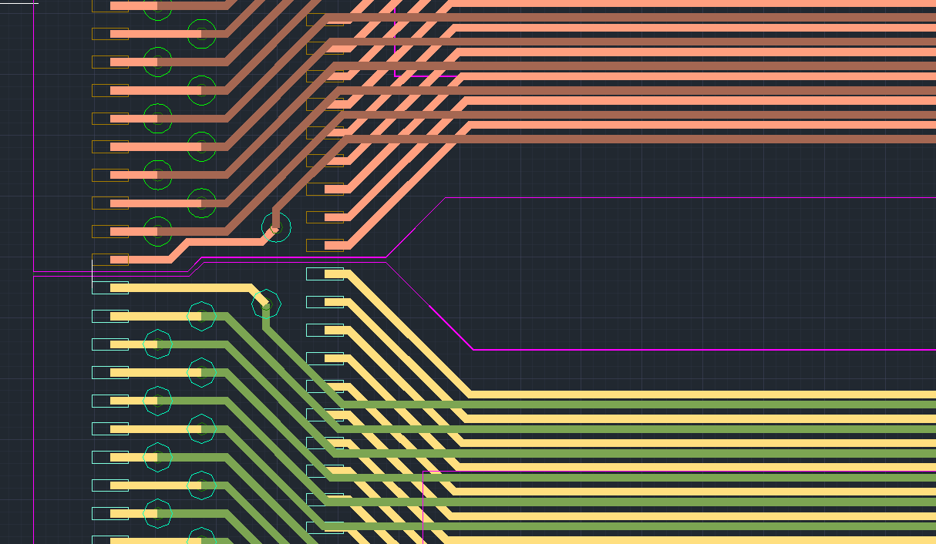
Signal Transmission Cable, Version 2
version 2: Copper-based microcables/
KIT-IPE (Dr. Thomas Blank & team)
As an alternative to the Aluminum-microcables a R&D-project has been
started that investigates Copper-based cables.
Benefits of Copper:
well known in PCB-Flexboard technology
offers interconnected multilayer solutions
one cable with two layers (bottom & top) and vias instead of two single Al-cables

Slide 14
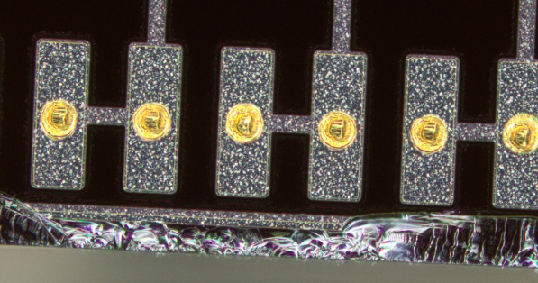
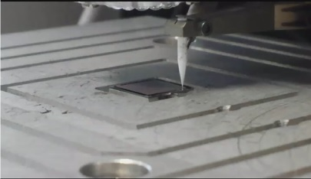
Interconnect of alternative signal cable
interconnection technology for version 2: Au-stud bumps + flip-chip
Au-Stud bumps on STSXter-Testchip
reliable and fast process
Ball-Wedge-Bonder

Slide 15
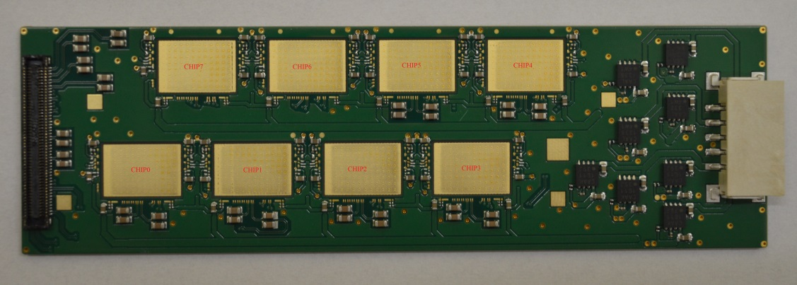
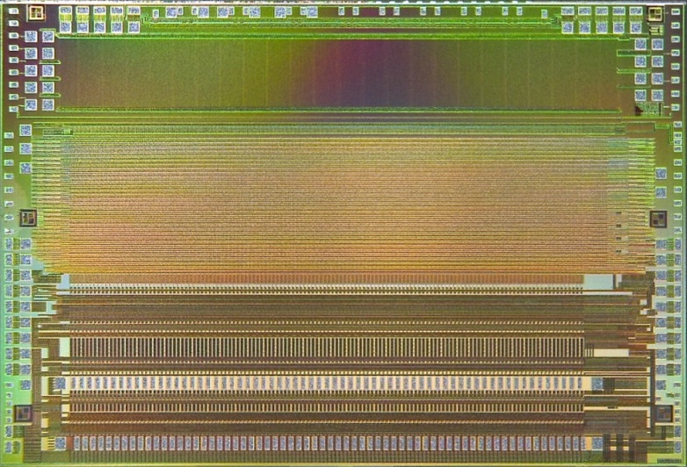
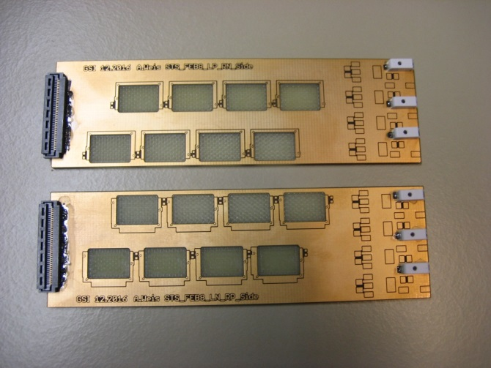
Module-Components: Front-End-Boards
STS-XYTER-ASIC
with 128 channels and pitch of 116 µm
(same as the sensor bond pad pitch)
8-STS-XYTER-board
(dummy-PCB with power and signal connectors)
MUCH will employ a similar FEB with 2 STS-XYTER Chips

Slide 16
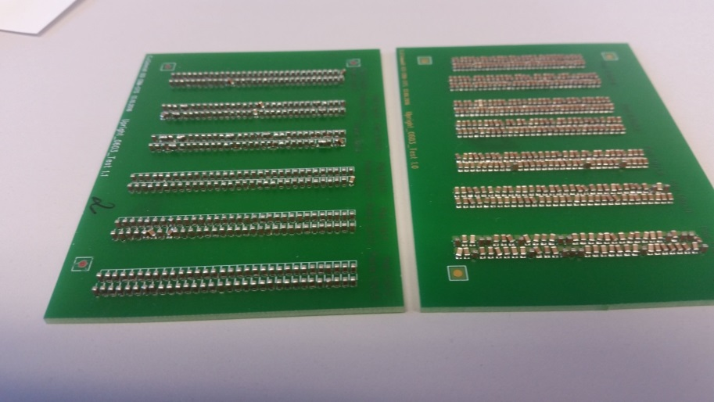
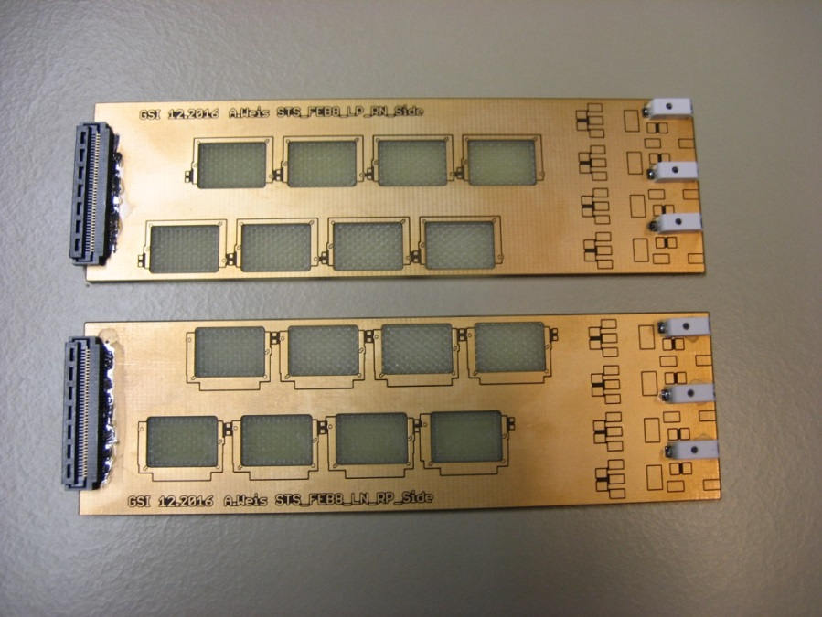
STS-Module Front-End Board
very dense (101 x 31mm²)
cooling challenges (~ 10W)
floating at biasing potential
upto 40 x 320Mbps data transfer
in-board chip LDOs
point of load skimming regulation
powered by CERN Feast-based DC/DC converters

Slide 17
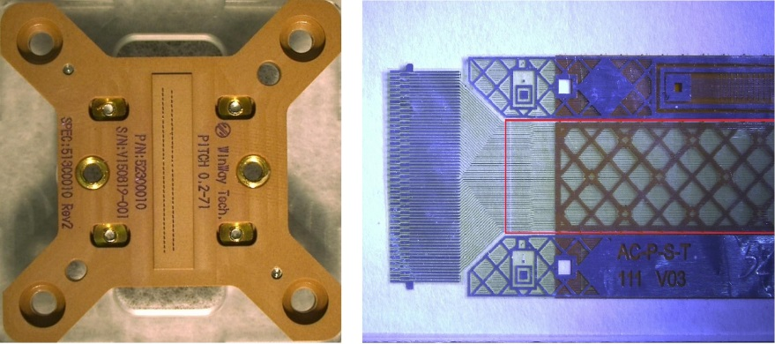
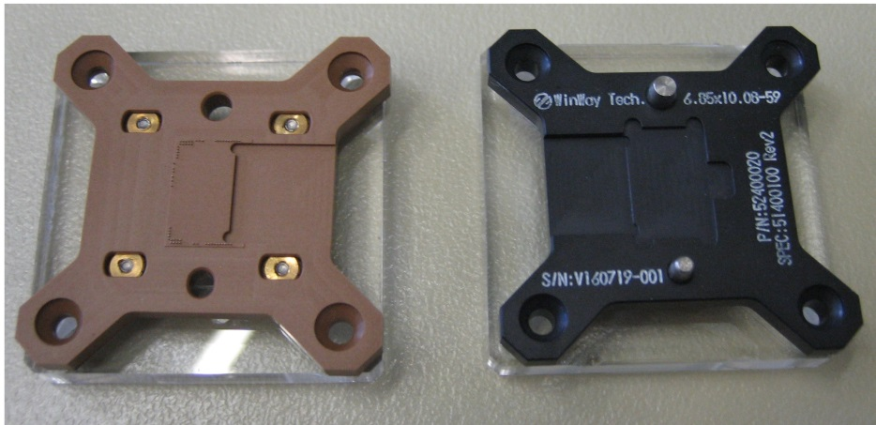
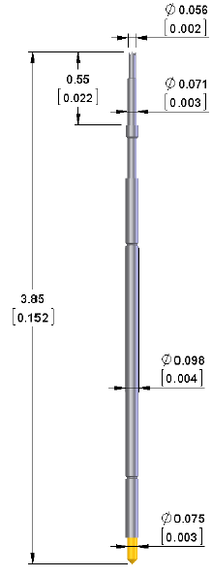
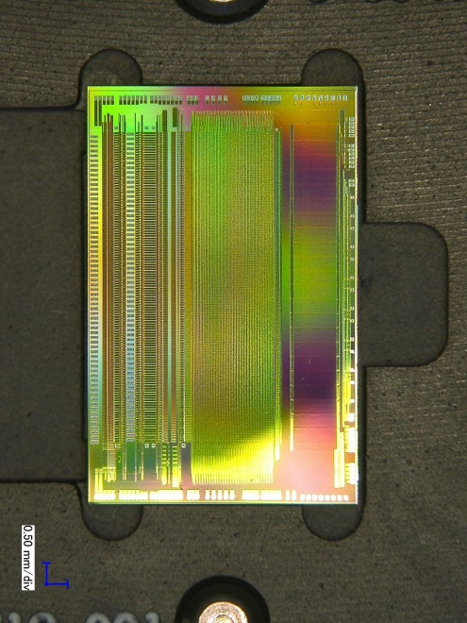
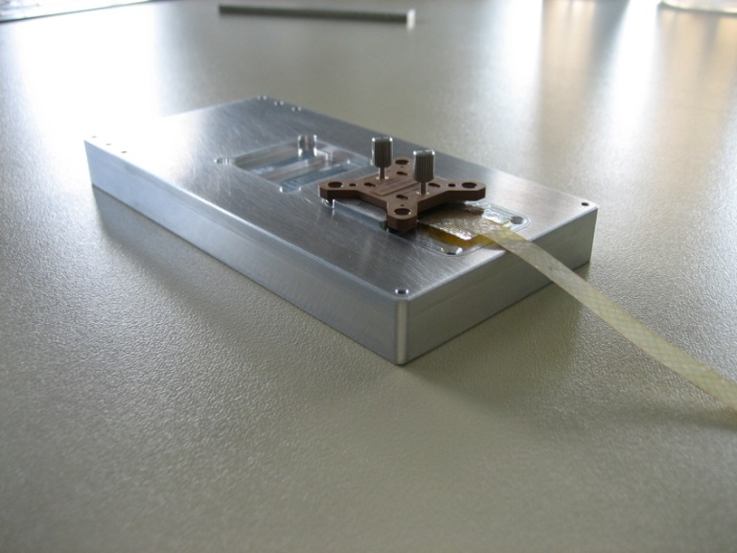
QA-measurement tools: Pogo-Pin Sockets
testsocket for the ASIC-TAB-bonds
testsocket for the sensor-TAB-bonds
Pogo-pin

Slide 18
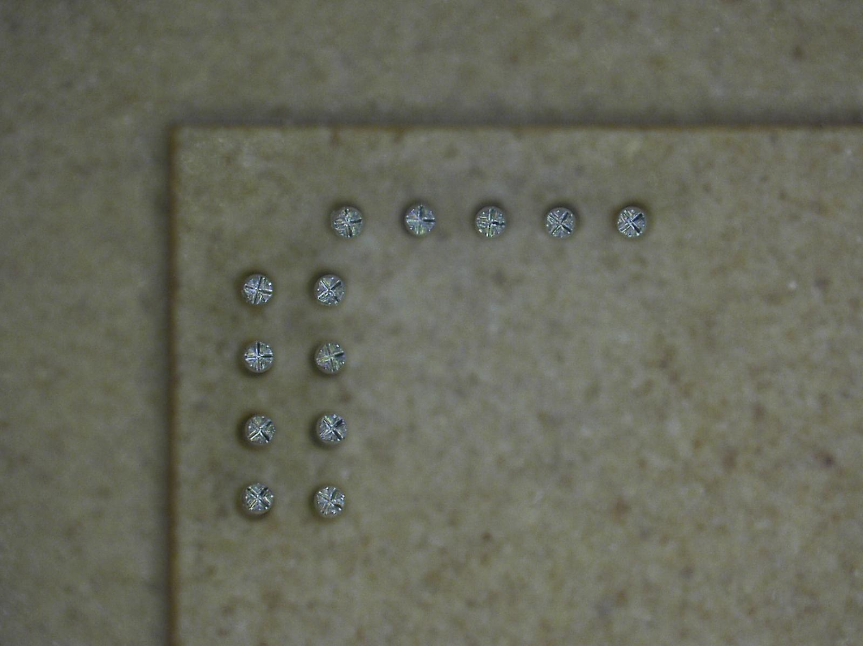
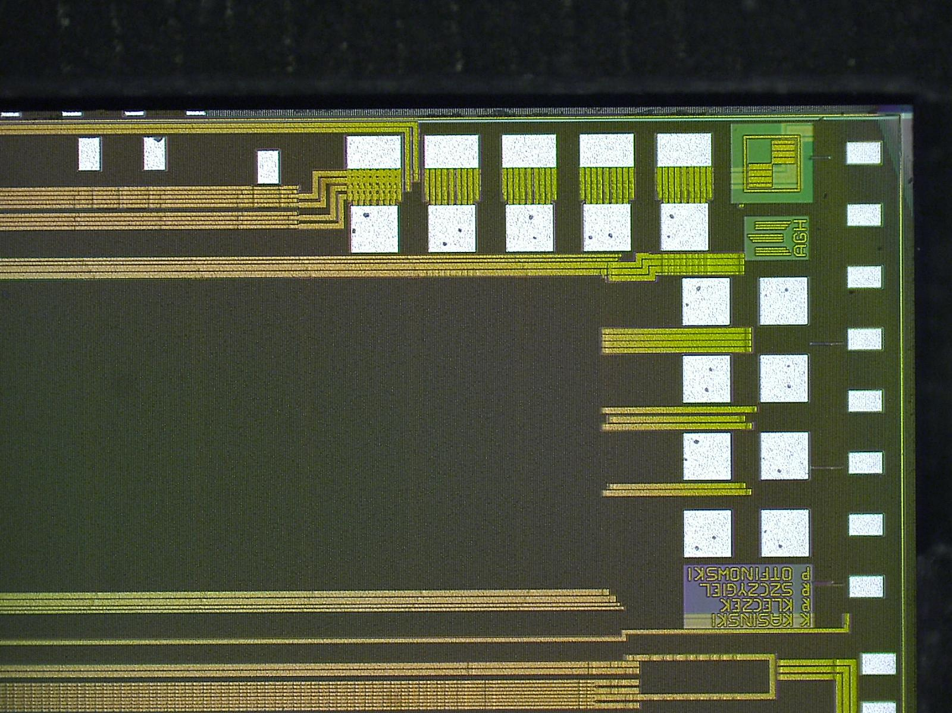
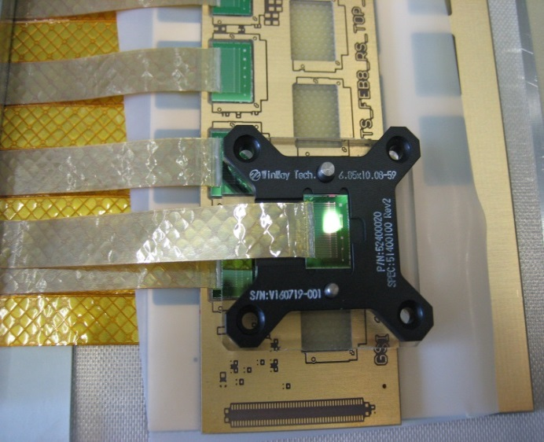
Dicing precision successful: 100µm Pogo-Pins match!

Slide 19
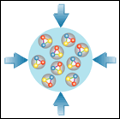
CBM-related Chip Developments and Options
PADI for Diamond
M. Ciobanu, ISS
CBM MuCH XYTER
E. Atkin et al, MEPhI
PADI for TOF
M. Ciobanu, ISS
Bucharest
CBM STS-XYTER/MuCH-XYTER
AGH Krakow, R. Szczygiel et al
GET-4 TDC (TOF)
H. Flemming, H. Deppe, GSI
SPADIC for TRD
ZiTi Heidelberg, P. Fischer et al
SPADIC 2.0 with e-link interface
CBM-GBTx
Chipset ordered from CERN
GBTx
FPGA emulation for
VECC and JINR
Rad tolerant LDOs
SCL Chandigarh, India

Slide 20
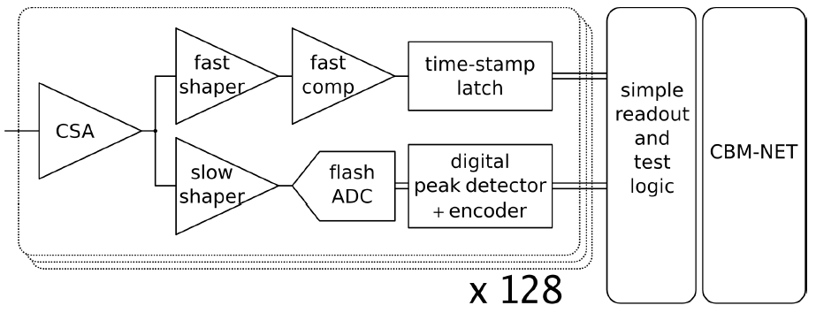
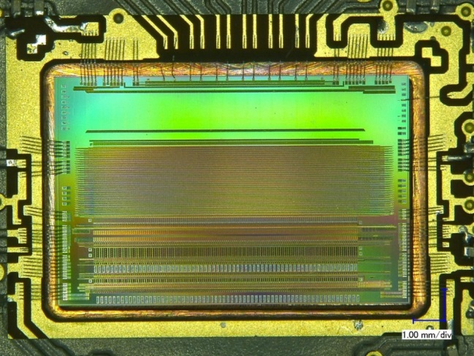
Fully digital Read-out ASIC “STS-XYTER”
purely data driven read-out
time-stamped data elements
250kHz per channel
for every channel:
fast branch: time-stamp
slow branch: signal height digitization (energy)
STS-XYTER ASIC
t_{s} = 30 ns
r/o logic
CBM-NET
(v1.0 )
GBT (V2.0)
UMC 180 nm CMOS
LSB veto
t_{s} = 80 ns
noise minimization in self-triggering system:
effective two-level discrimination
trigger to the timestamp latch vetoed if ADC-LSB generated no signal
channels | 128, polarity +/-
noise | < 1000 e⁻ under load
ADC range | 16 fC, 5 bit
clock | 160 MHz
power | < 10 mW/channel
timestamp | < 5 ns resolution
out interface | 5 × 320 Mbit/s LVDS
Design Team:
R. Szczygiel et al. at AGH Krakow/Poland

Slide 21
Analog Front End - overview
Switchable gain
(5x smaller for MUCH)
+ trimming 2 bit
Switchable
(90ns – 280ns)
in 4 steps

Slide 22
STS-XYTER R. Szczygiel et al. AGH Krakow
STS-XYTER turns into MuCH-XYTER via Gain Switch
Submission Review in Feb. 2015: Noise is an issue →
system issue, optimization with complete system perspective, extensive architectural studies → goal < 1000 ENC
Submission Review in Oct. 2015 → full go for submission
STS-XYTER 2.0: adaptation to GBTx-eLink-readout, STS-r/o protocol
→ all architectural elements included!
in 2018: STS-XYTER 2.1: fix of minor bugs prior to large scale production

Slide 23
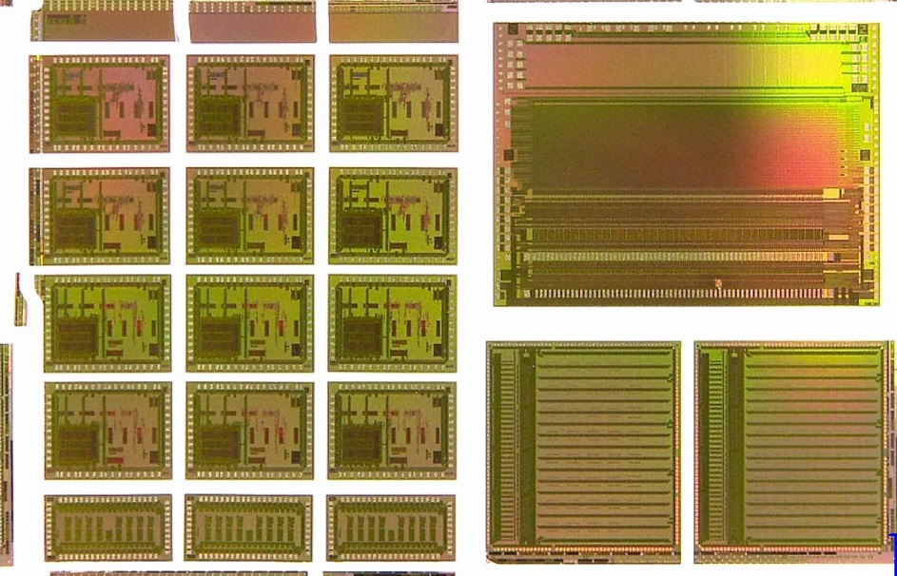
STS-XYTER 2.0 Submission Mai 2016
...evolved to a grand CBM-Joined 6-Chip Submission
STS-XYTER 2.0 → yield 930 chips for STS- and MUCH-prototyping
TOF readout ASICs, Volume production for operation at STAR
Get4-TDC in two versions:
Bug-fix version
Version for robust operation at 40MHz
PADI – fast 8-channel TOF pre-amp
SPADIC V2 → prototype run with CBM compatible e-link interface

Slide 24
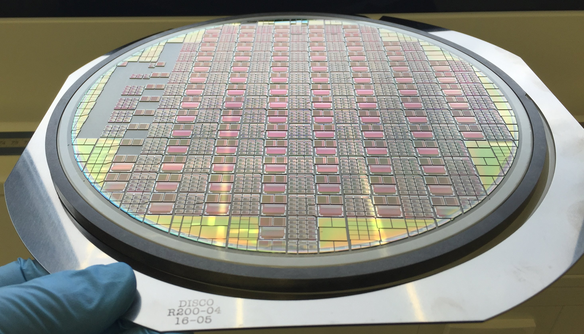
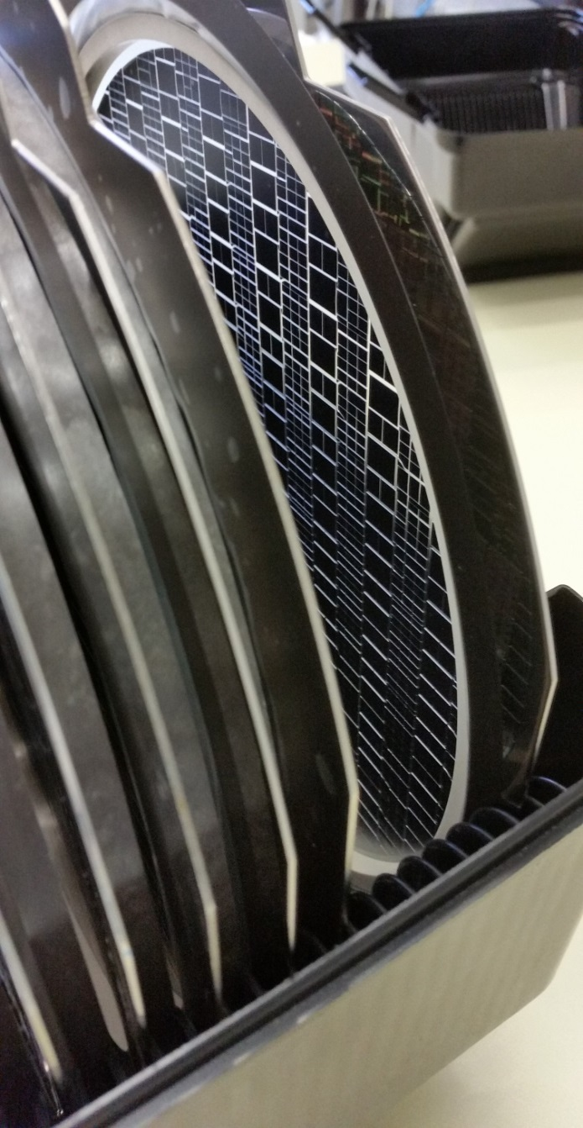
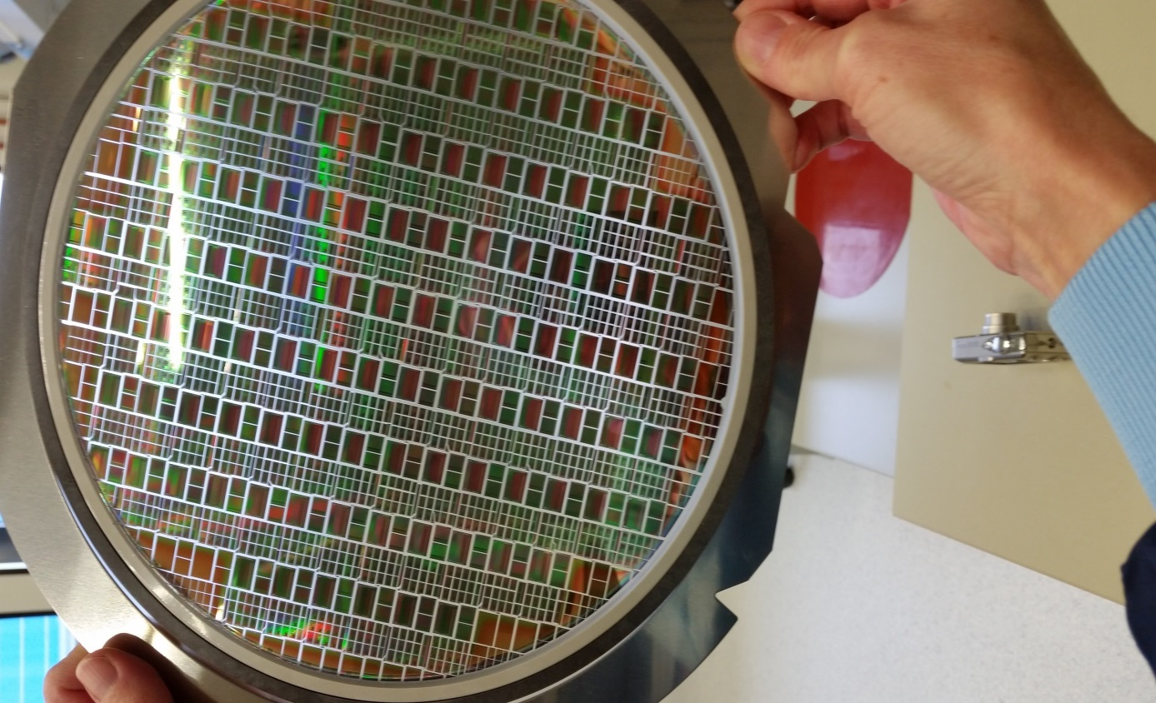
Unpacking was solemn like X-mas

Slide 25
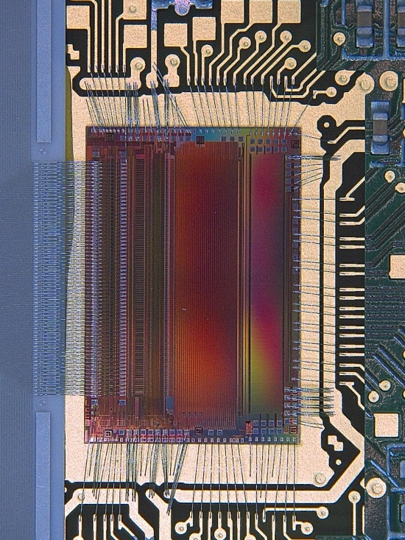
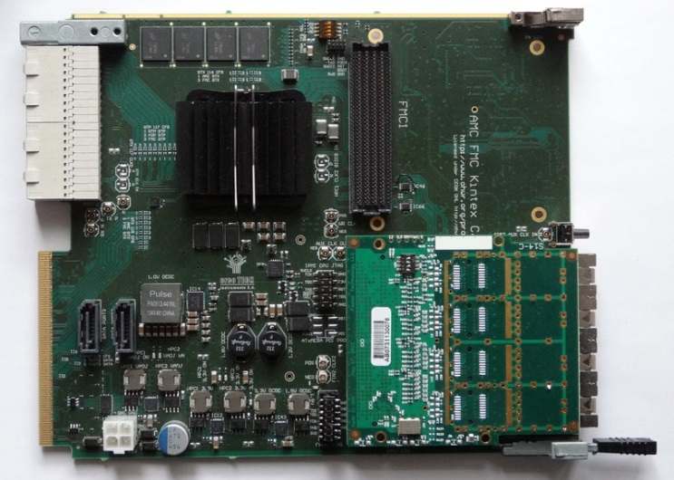
The Readout-ASIC STS-XYTER
Switchable gain
(5x smaller for MUCH)
+ trimming 2 bit
The moment of truth: Testing, a joined AGH, WUT, VECC and GSI effort → workshop on STS-XYTER testing Feb. 2017 in India
All results cumulate now in a final prototyping iteration: STS/MUCH-XYTER 2.1 submission 2018
Switchable
(90ns – 280ns)
in 4 steps

Slide 27
SCL realizes radiation tolerant LDOs for CBM
Sensitivity to Total Ionizing Dose evaluated by VECC Kolkata → OK for CBM
Sensitivity to Single Event Upset evaluated by GSI at COSY, FZJ → OK for CBM
STS-XYTER single ended cascode
very sensitive to supply noise
Semi–Conductor Laboratory
Department of Space, Government of India
180nm Tower Jazz Process

Slide 28
CBM-TRD: Spadic 2.0 in two versions being tested
32-channel signal digitizer 8bit at 16 MHz
self triggered
forced next neighbor trigger
e-link interface
Readout chip for CBM Transition Radiation Detector (allows to tell electrons from pions)

Slide 29
PADI, the one proven design, is available in large numbers now
Designer: Mircea Ciobanu

Slide 30
GET4 TDC σ~20ps
Designer: H. Flemming, H. Deppe GSI/EE

Slide 31
Summary
Big technological challenges tackled with CBM detectors and their signal rates
The STS- and MUCH-XYTER ASIC is a dedicated readout chip for the silicon tracker and the MUCH detector system alike
Careful full system design needed and done for adequate and dedicated customization of readout electronics
Outlook: We will be diving into our production phase

