Slide 1
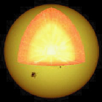
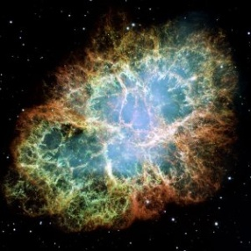
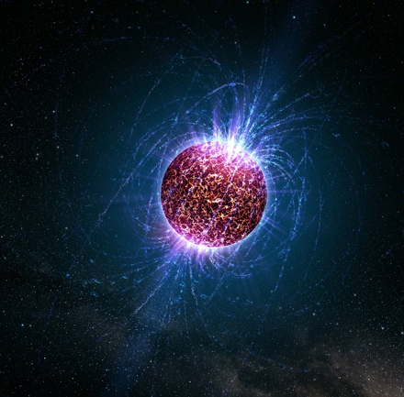
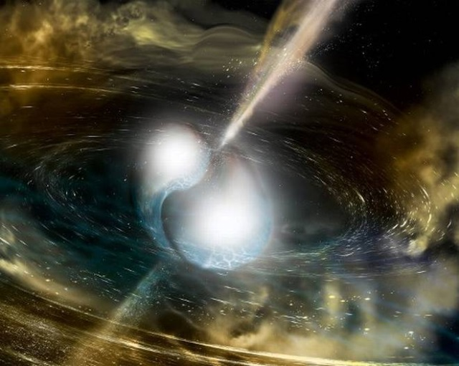














Cosmic matter in the laboratory –
Science at FAIR
Peter Senger
Outline:
Cosmic matter
Research at FAIR
Status of FAIR
CBM India Meeting, 15th – 17th February 2018, Falta, India
Finland
France
Germany
India
Poland
Romania
Russia
Slovenia
Spain
Sweden
UK

Slide 2
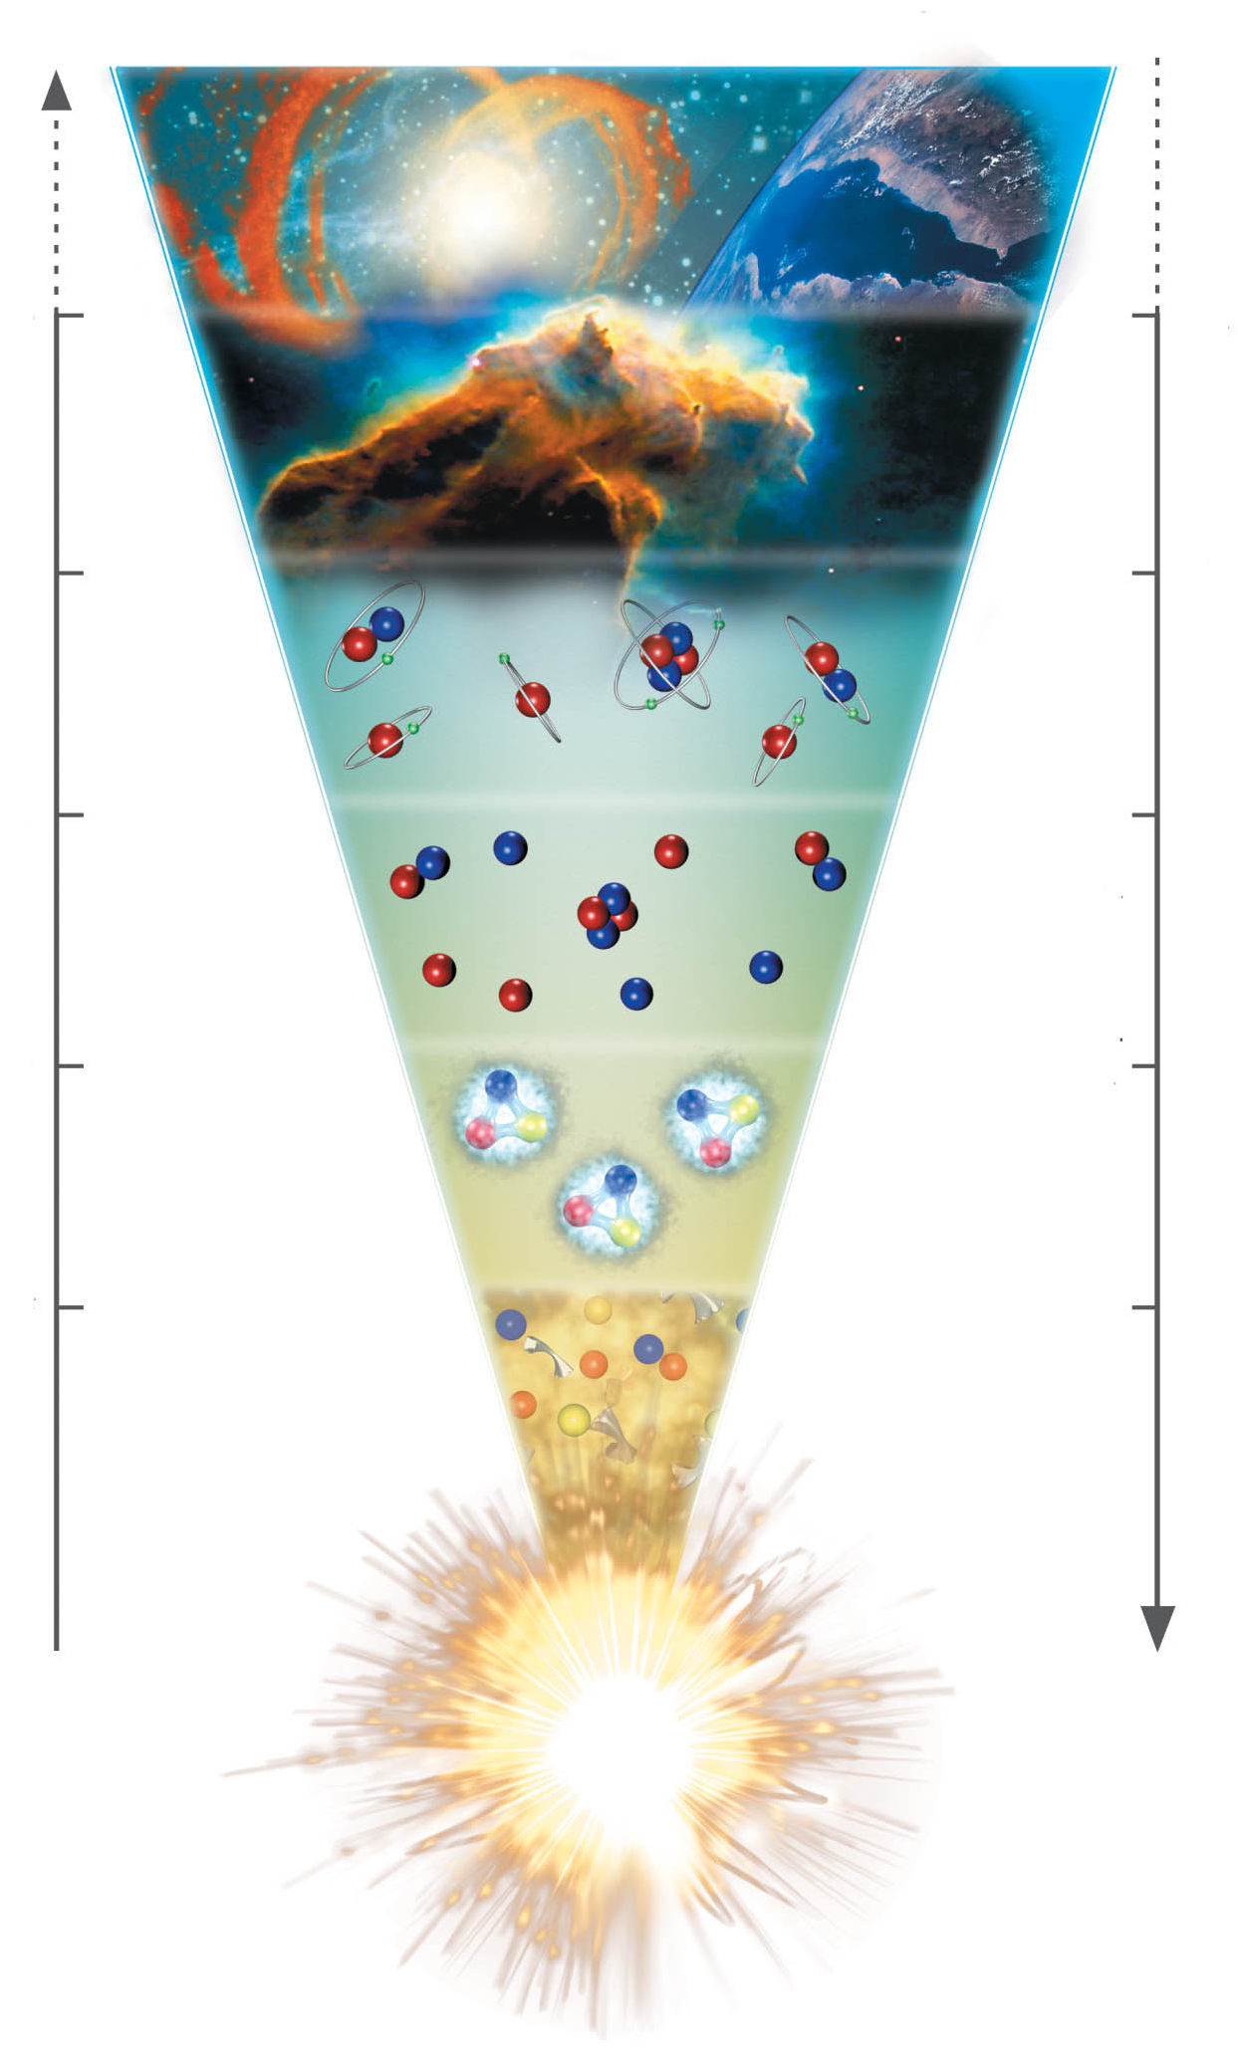
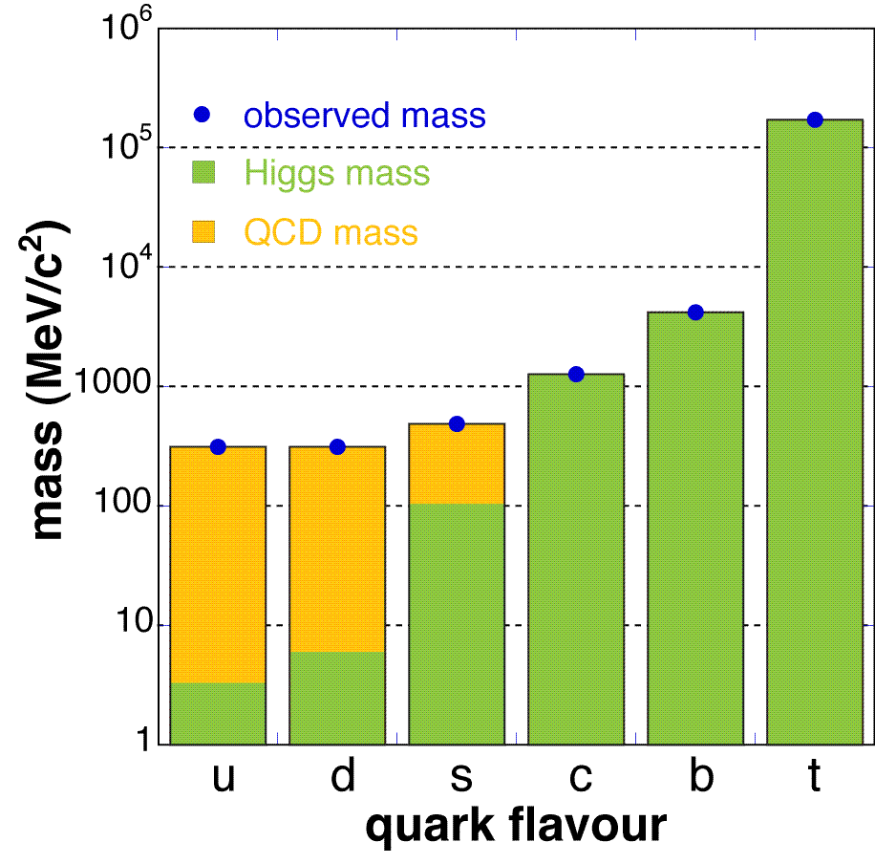
The evolution of matter in the universe
15 billion years
3 K
1 billion years
20 K
time
300.000 years
3000 K
temperature
3 minutes
10⁹ K
1 millisecond
10¹² K
1 microsecond
Explicit breaking
of Chiral Symmetry
(Higgs mechanism)
m_{u} ≈ 5 MeV,
m_{d} ≈ 10 MeV,
m_{s} ≈ 150 MeV
distance

Slide 3
The evolution of matter in the universe
15 billion years
3 K
1 billion years
20 K
time
300.000 years
3000 K
temperature
3 minutes
10⁹ K
1 millisecond
10¹² K
1 microsecond
The soup of the
first microsecond:
quarks, antiquarks,
electrons, positrons,
gluons, photons
distance

Slide 4
The evolution of matter in the universe
15 billion years
3 K
1 billion years
20 K
time
300.000 years
3000 K
temperature
3 minutes
10⁹ K
1 millisecond
10¹² K
1 microsecond
Spontaneous/dynamical
Chiral Symmetry breaking:
Hadrons acquire mass by
coupling to the virtual
quark-antiquark pairs
of the chiral condensate
distance

Slide 5
The evolution of matter in the universe
15 billion years
3 K
1 billion years
20 K
time
300.000 years
3000 K
temperature
3 minutes
10⁹ K
1 millisecond
10¹² K
1 microsecond
Annihilation of particles
and antiparticles, only
10⁻⁹ of particles survived
distance

Slide 6
The evolution of matter in the universe
15 billion years
3 K
1 billion years
20 K
time
300.000 years
3000 K
temperature
3 minutes
10⁹ K
Formation of d, He
1 millisecond
10¹² K
1 microsecond
distance

Slide 7
The evolution of matter in the universe
15 billion years
3 K
1 billion years
20 K
Evolution of stars
time
300.000 years
3000 K
temperature
3 minutes
10⁹ K
1 millisecond
10¹² K
1 microsecond
distance

Slide 8
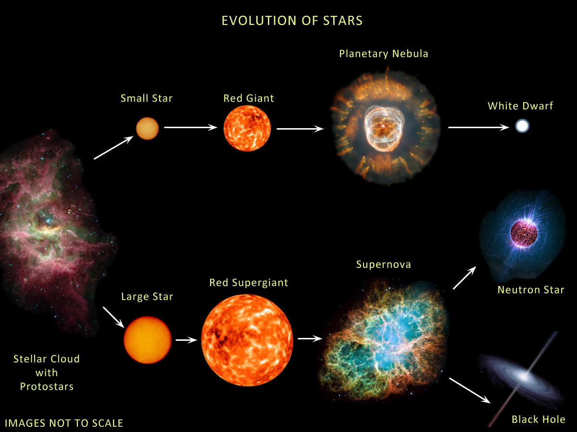
The evolution of stars
M < ≈ 8M → white dwarf
8M< M < 15M → neutron star: 1.4M< M_{core}< 2M
M >≈15M → black hole: M_{core} >≈ 2M
Courtesy of Anna Watts

Slide 9
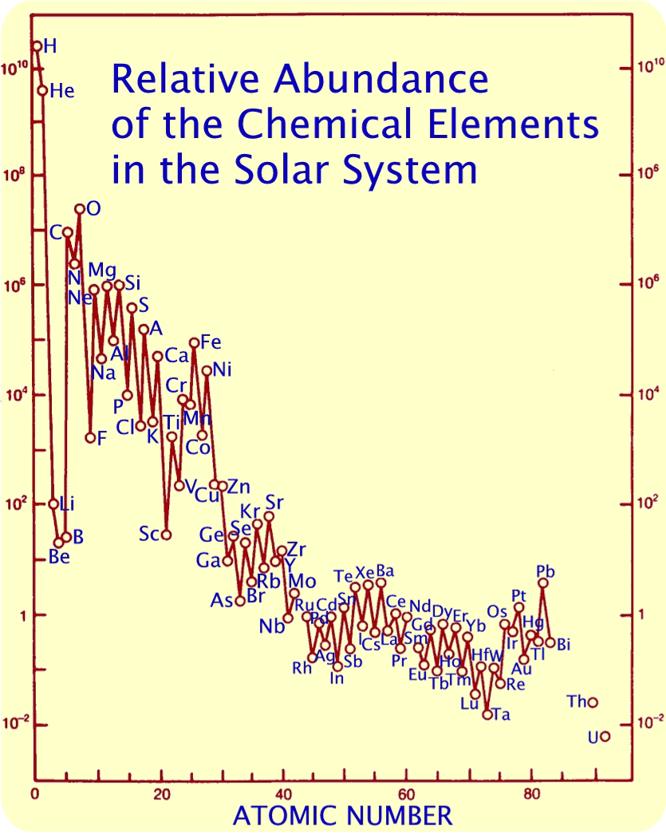
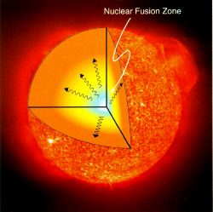

The Origin of Elements
Neutron capture
in Red Giants
(s-process) or in
supernovae or neutron star mergers (r-process)
Nukleosynthesis
after the Big Bang
Krebs Nebel
Nuclear fusion in stars

Slide 10
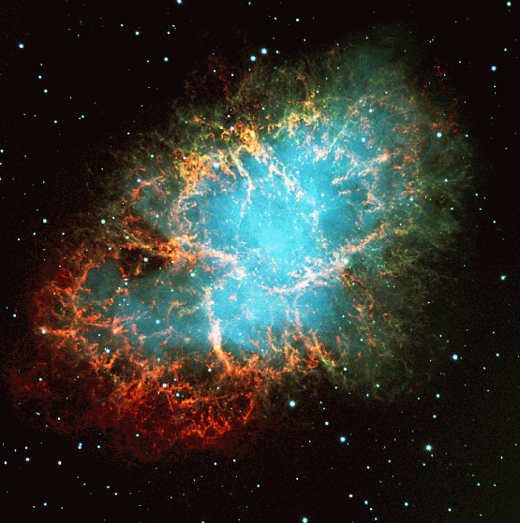
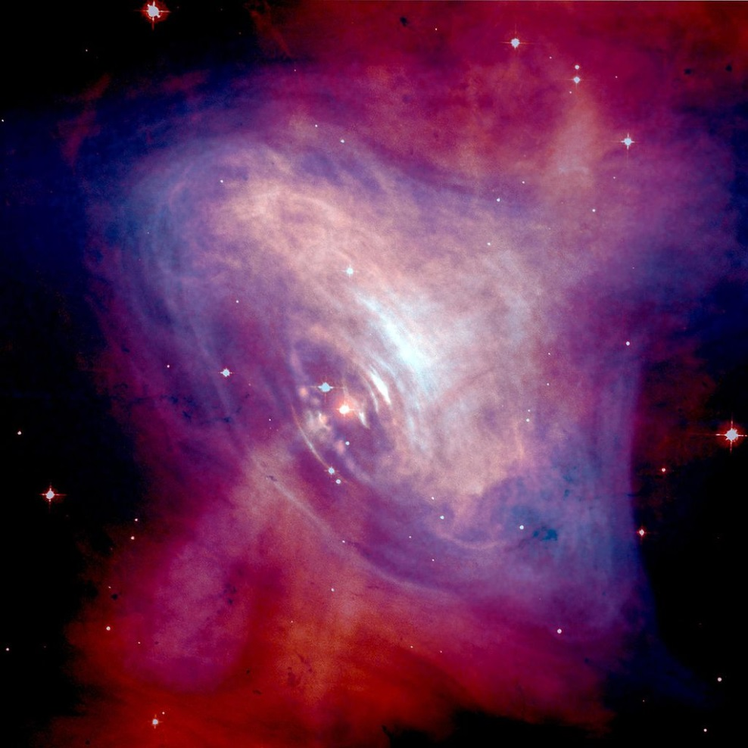
Discovery of the first pulsar in 1968
Crab nebula:
ashes of a core collapse supernova observed in 1054 by Chinese astronomers.
The “visiting star” was as bright as the Venus for more than 20 days.

Slide 11
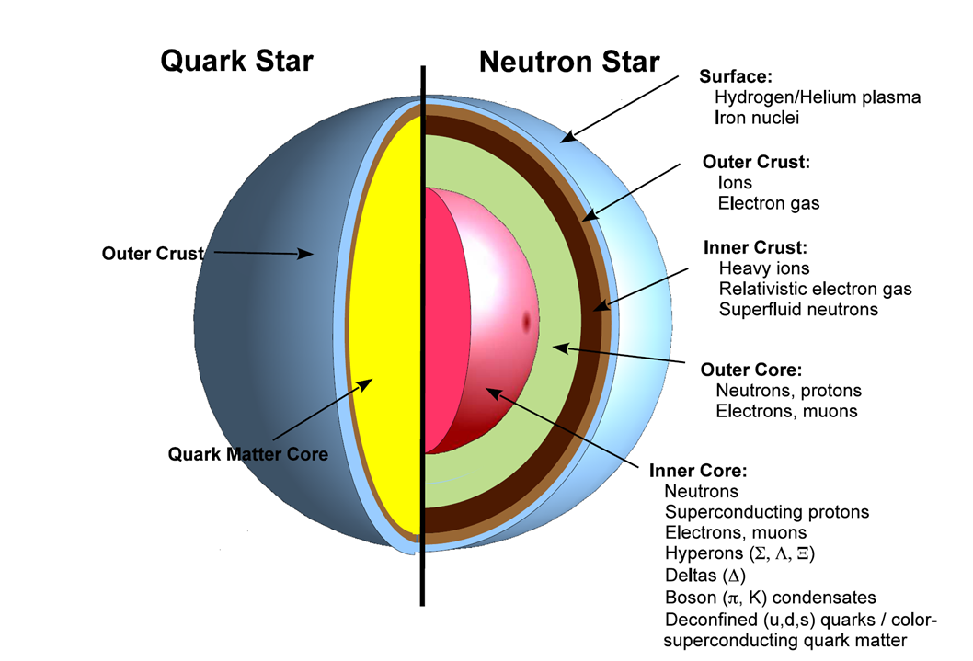
?

Slide 12
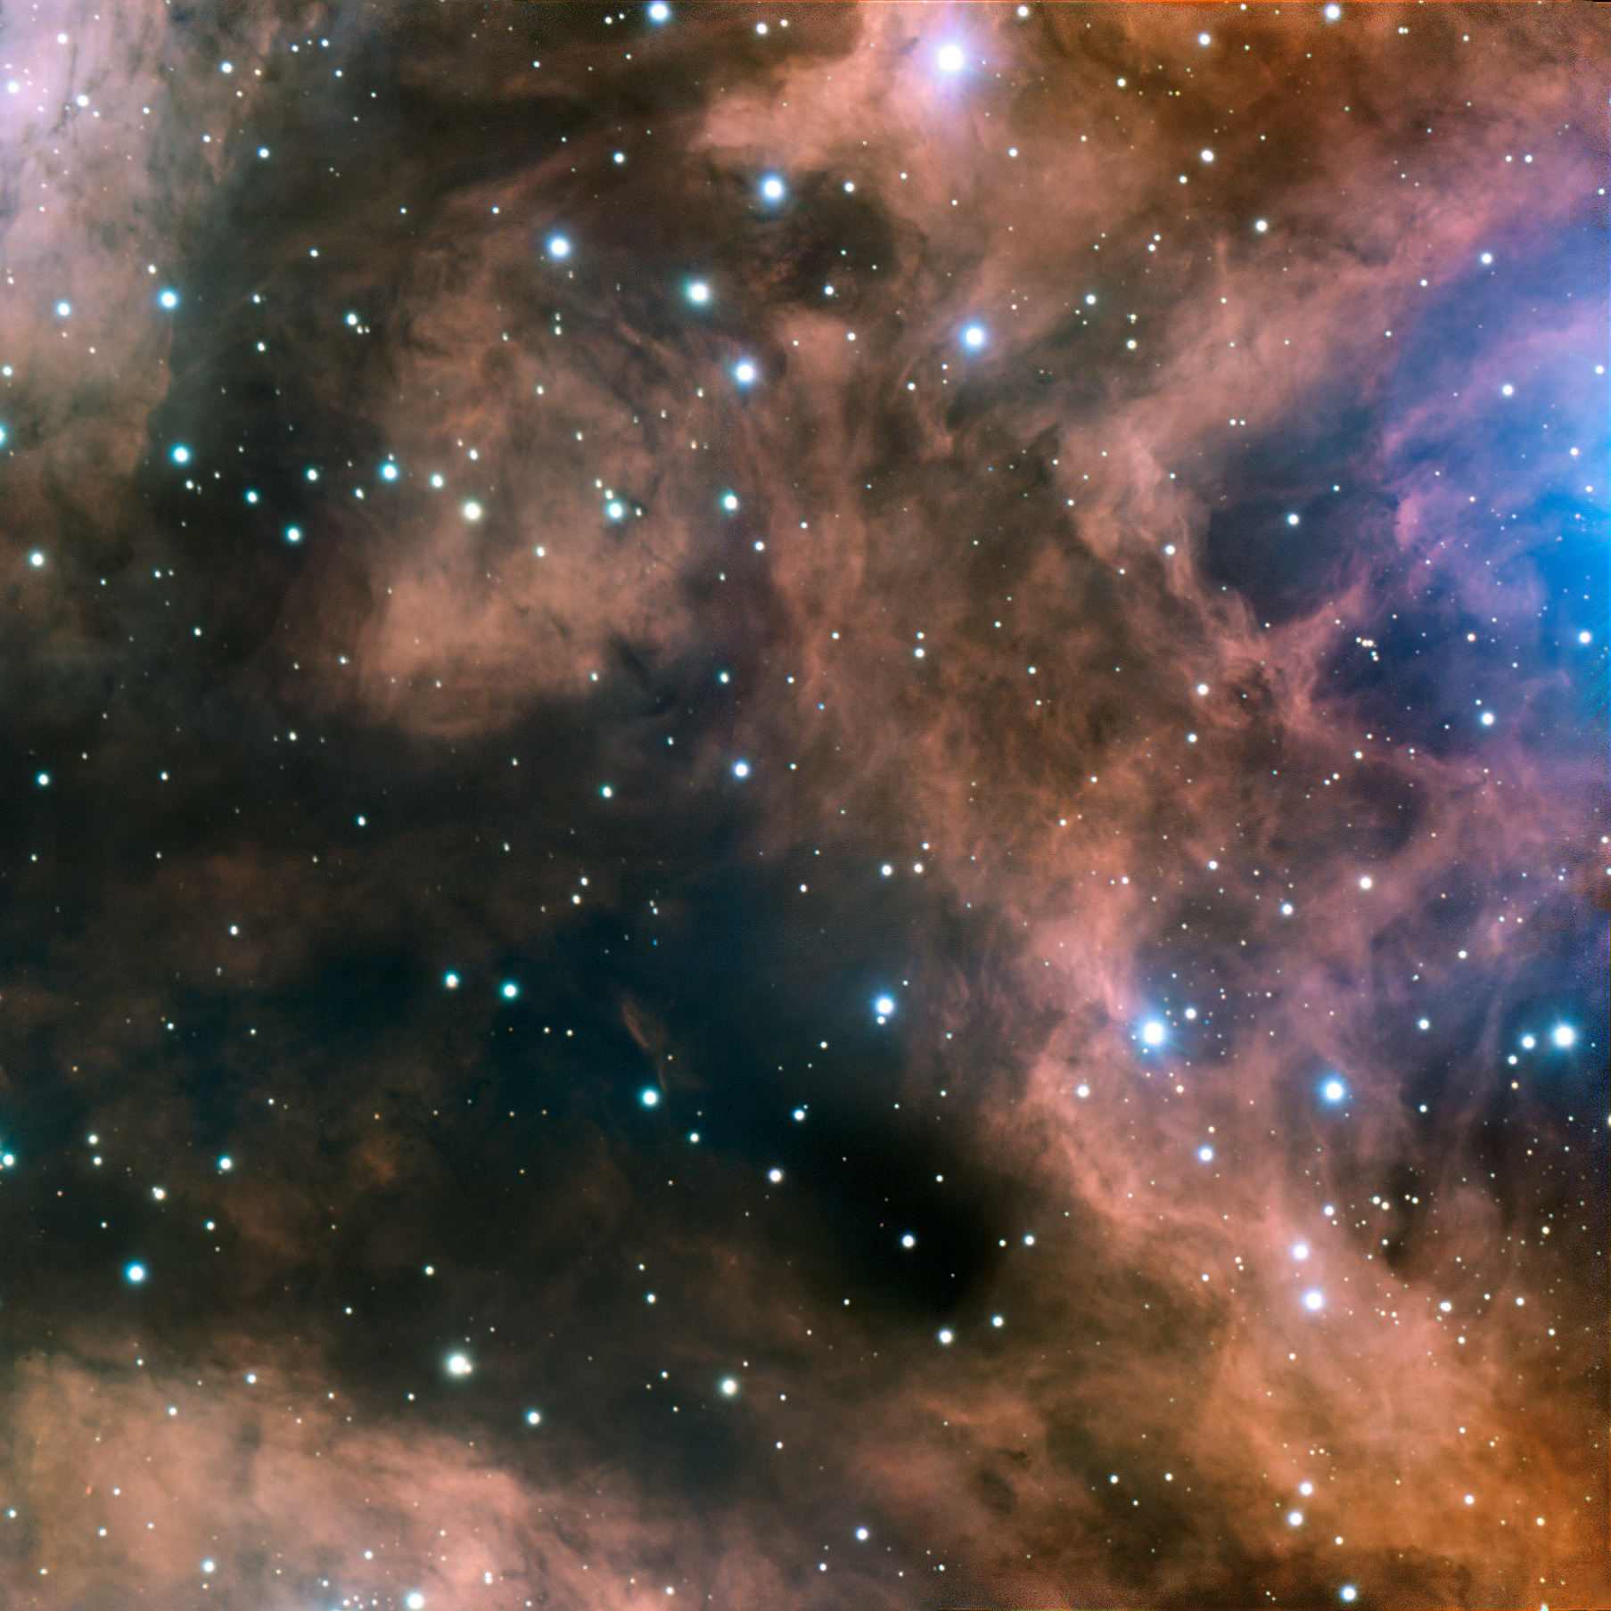
Fundamental questions
What is the origin of the mass of the universe?
What is the origin of the elements ?
What is the structure of neutron stars?
Can we ignite the solar fire on earth ?
Does matter differ from antimatter ?
Why do we not observe individual quarks ?
→ to be explored at the future international
Facility for Antiproton and Ion Research (FAIR)

Slide 13
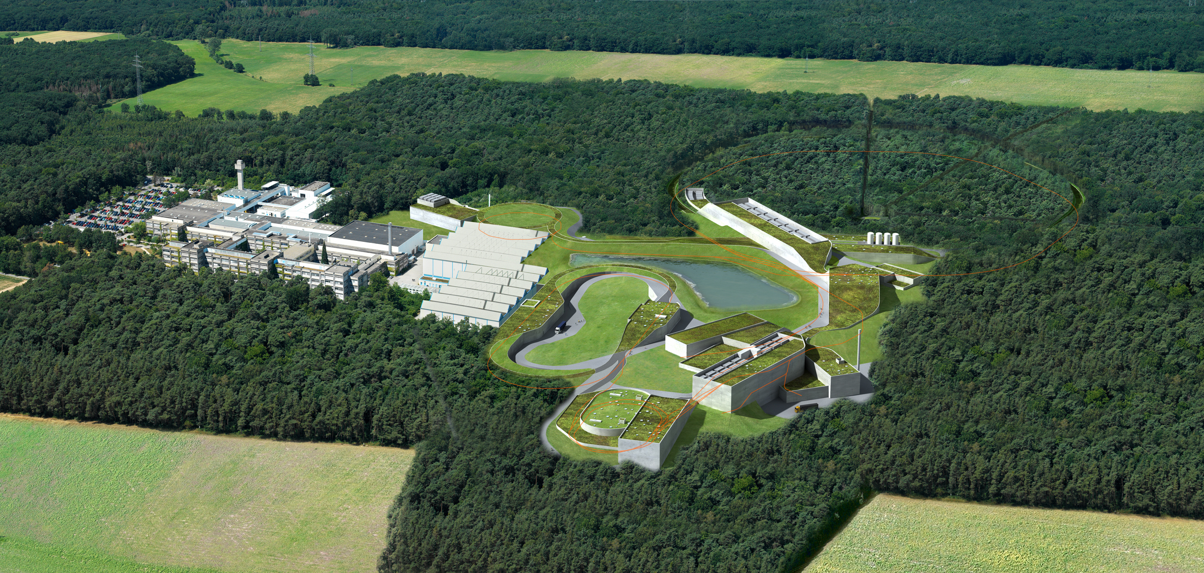
FAIR – Facility for Antiproton and Ion Research
Facility for Antiproton and Ion Research:
Cosmic matter in the laboratory
FAIR is worldwide the largest project in fundamental science.
Forefront research in nuclear, hadron, atom, plasma, antimatter, and applied physics.
Member states: Germany, Russia, India, Poland, Romania, France, Finland, Sweden, Slovenia,
Great Britain.
2500 – 3000 users per year.
Total costs ca. 1.7 Mrd. €, full completion in 2025.
Financing: Fed. Rep. Germany 60%, Hesse 10%,
partner countries 30%

Slide 14




Facility for Antiproton & Ion Research
SIS100/300
p-Linac
SIS18
Compressed Baryonic Matter
Primary Beams
10¹²/s; 1.5 GeV/u; ²³⁸U²⁸⁺
10¹⁰/s ²³⁸U⁹²⁺ up to 11 (35) GeV/u
3x10¹³/s 30 (90) GeV protons
Anti-Proton Physics
HESR
Super Fragment-Separator:
Nuclear Structure and Astrophysics
Secondary Beams
radioactive beams up to
1.5 - 2 GeV/u;
10¹¹ antiprotons 1.5 - 15 GeV/c
Technical Challenges
FAIR phase 1
FAIR phase 2
CR
rapid cycling superconducting magnets
dynamical vacuum
14
100 m

Slide 15
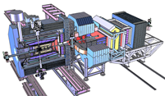
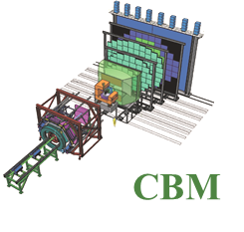
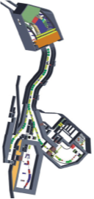
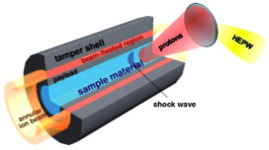
Facility for Antiproton & Ion Research
Experimental programs:
APPA: Atomic & Plasma Physics & Applications
➢ Highly charged atoms
➢ Plasma physics
➢ Radiobiology
➢ Material science
SIS18
SIS100/300
p-Linac
Compressed Baryonic Matter
HESR
CBM: Nucleus-nucleus collisions
➢ Nuclear matter at neutron
star core densities
➢ Phase transitions from
hadrons to quarks
Anti-Proton Physics
Super Fragment-Separator:
Nuclear Structure and Astrophysics
NUSTAR: Rare Isotope beams
➢ Nuclear structure far off stability
➢ Nucleosynthesis in stars and supernovae
CR
PANDA: Antiproton-proton collisions:
➢ Charmed hadrons (XYZ)
➢ Gluonic matter and hybrids
➢ Hadron structure
➢ Double Lambda hypernuclei
FAIR phase 1
FAIR phase 2
100 m
15

Slide 16
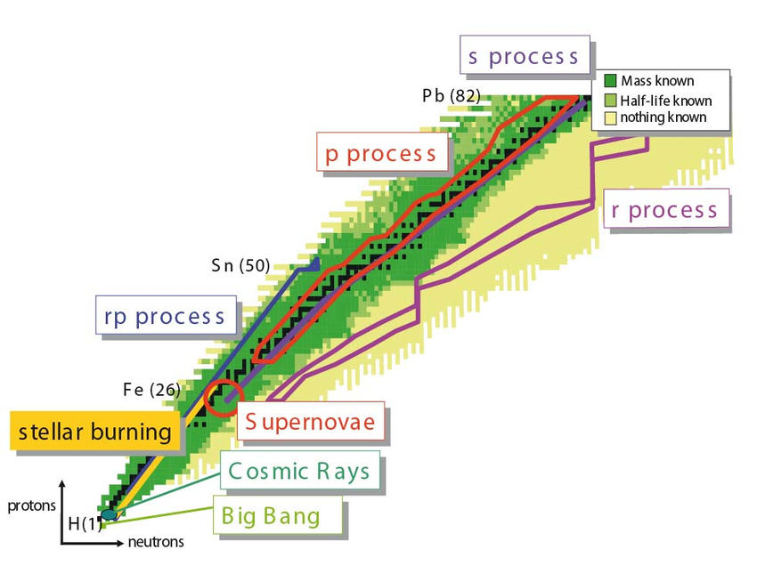

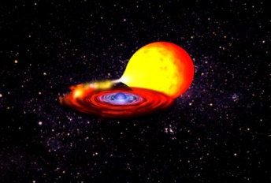
Nuclear Astrophysics at FAIR
rp-, p-process:
masses at & beyond the proton drip-line
X-ray binary
r-process:
masses, half-lives
b-delayed neutron emission
shell structure

Slide 17
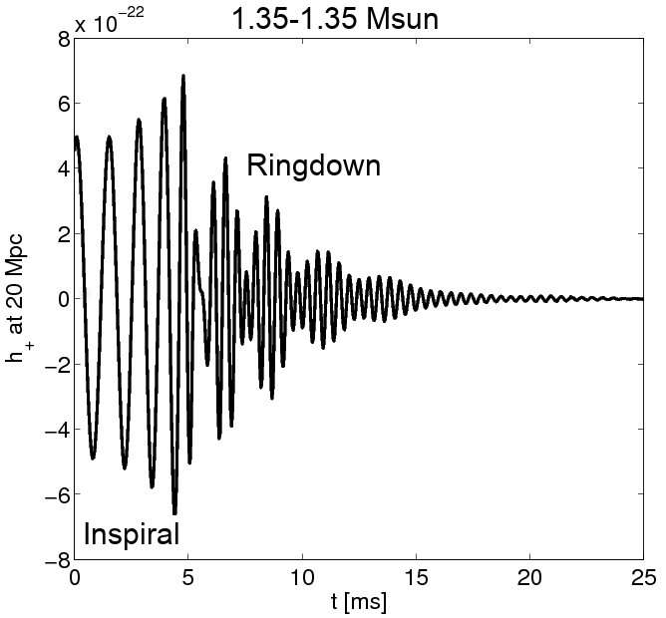
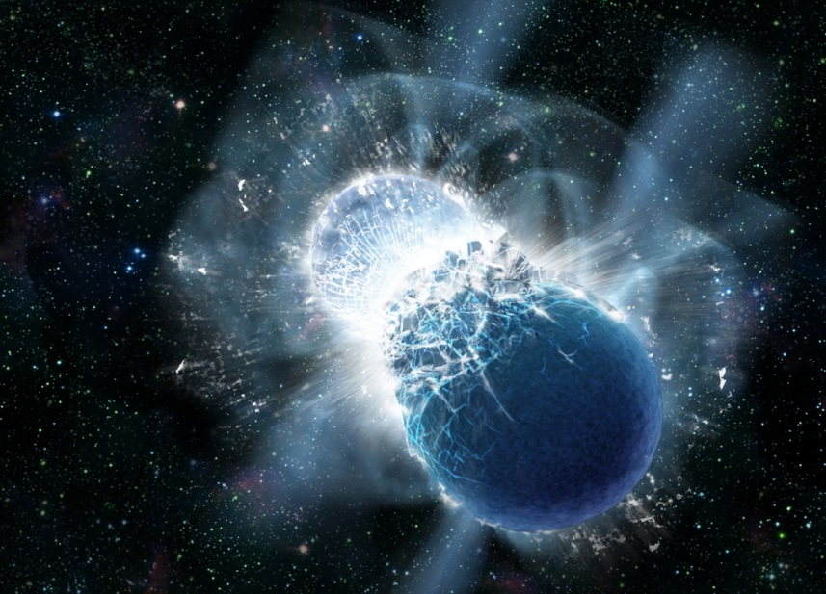
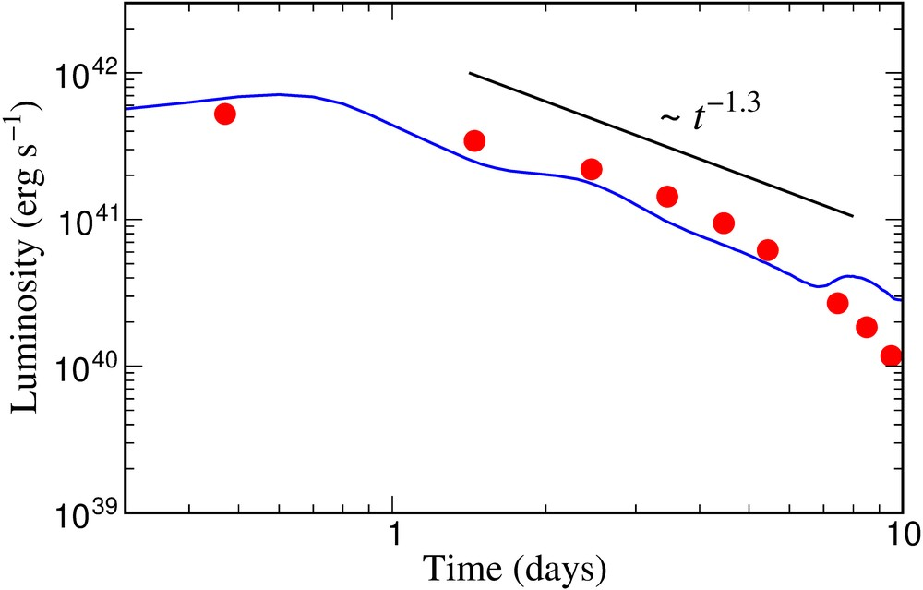
Astrophysical site of heavy element production (r process) in the universe: Neutron star merger !
A. Bauswein
Neutron star merger
Metzer, Martinez-Pinedo, Arcones et al. (2010)
Astrophys. J. 848, L17 (2017)
Gravitational
Wave Signal
Electromagnetic “Kilonova” Signal
Copyright: Dana Berry, SkyWorks Digital, Inc
Electromagnetic “Kilonova” signal due to “r process” in neutron star merger theoretically predicted by GSI scientists in 2010.
Confirmation by recent astronomical observations after gravitational wave detection from GW170817 (September 2017).
Source of heavy elements including gold, platinum and uranium.
Sun

Slide 18
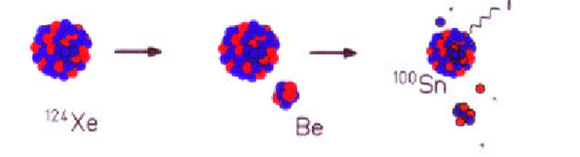
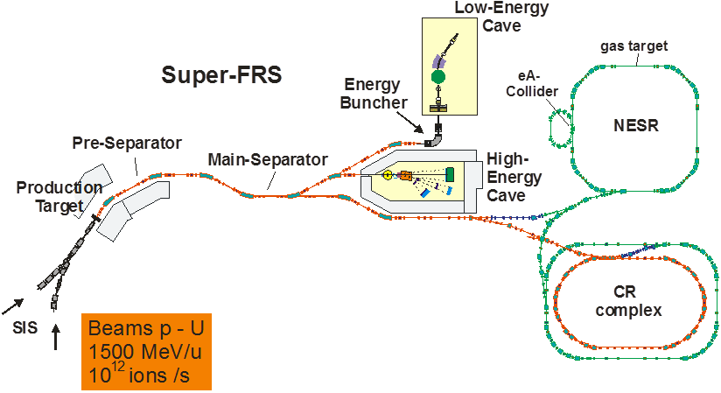
The NUSTAR experimental facilities at FAIR
Important beam parameters:
- all elements (H through U)
- intensity ~ 10¹² ions/sec.
- beam energies up to 1.5 GeV/u
- fast and slow (DC-type) extraction
phase 2
Four experimental areas:
- superconducting fragment separator
- high-energy branch with reaction setup
- storage-ring complex (CR, RESR, NESR, eA)
- low-energy branch with energy focusing and re-acceleration

Slide 19
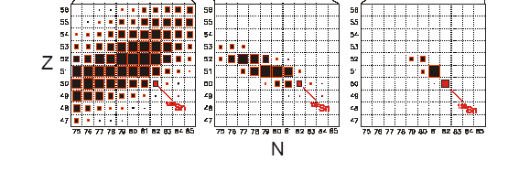
Fragment-Separators at GSI and FAIR

Slide 20
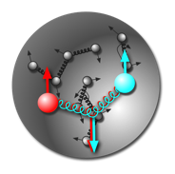
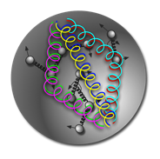
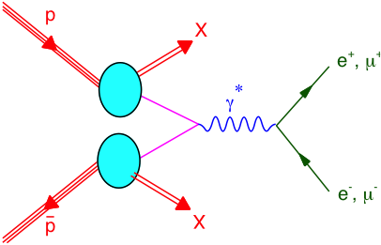
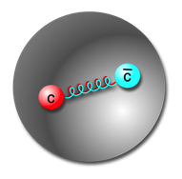
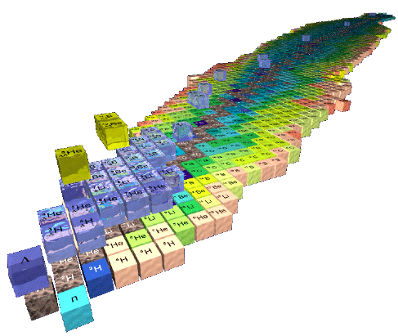
Hadron Physics with antiprotons at FAIR
Gluonic excitations:
Hybrids, glueballs
Charmonium states:
Precision
spectroscopy
Time-like form factors,
nucleon structure
In medium mass modifications:
Extension to the charm sector
Extension of nuclear chart:
Double hypernuclei
π⁻
25 MeV
π
π⁺
K⁺
K
100 MeV
K⁻
D
D⁻
50 MeV
D⁺

Slide 21

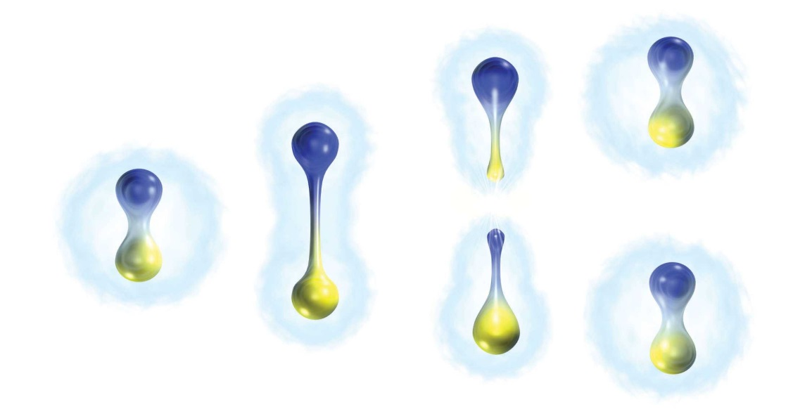
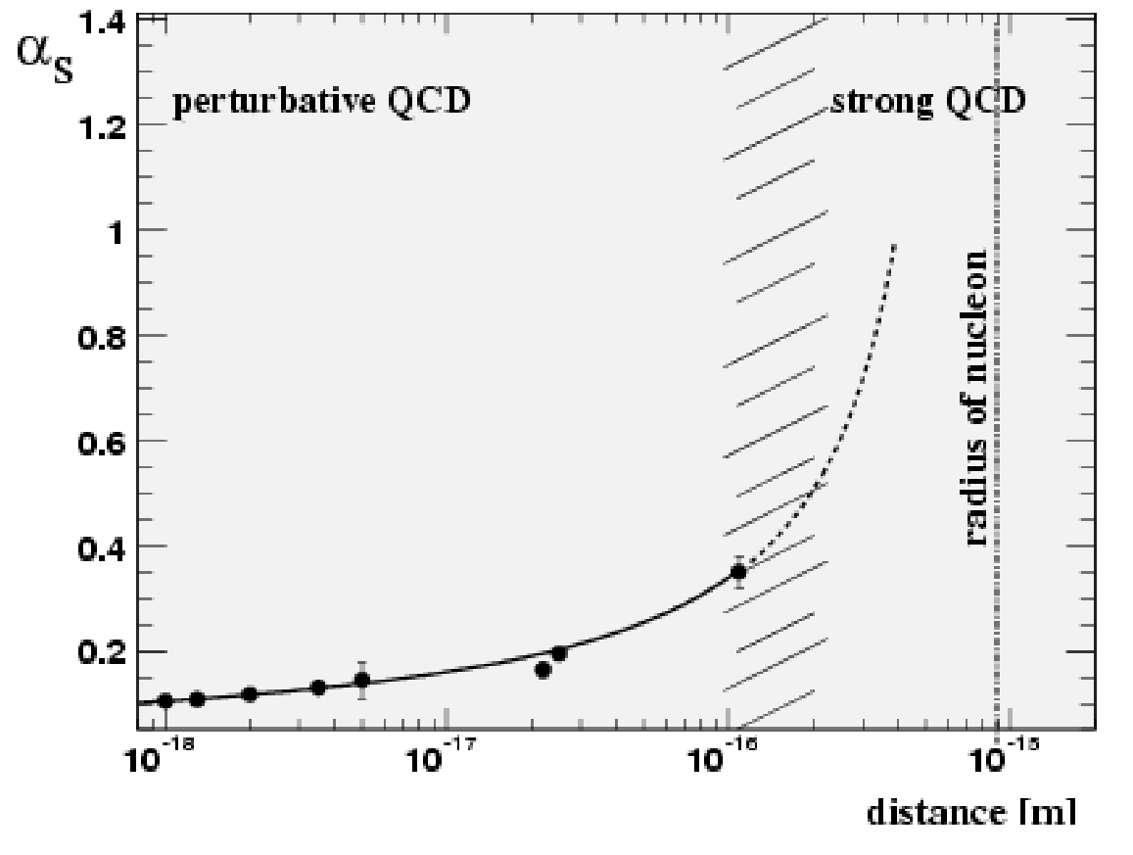
Antiproton-Proton-Annihilation in Darmstadt
Confinement and Charmonium spectroscopy
Coupling strength between two quarks

Slide 22
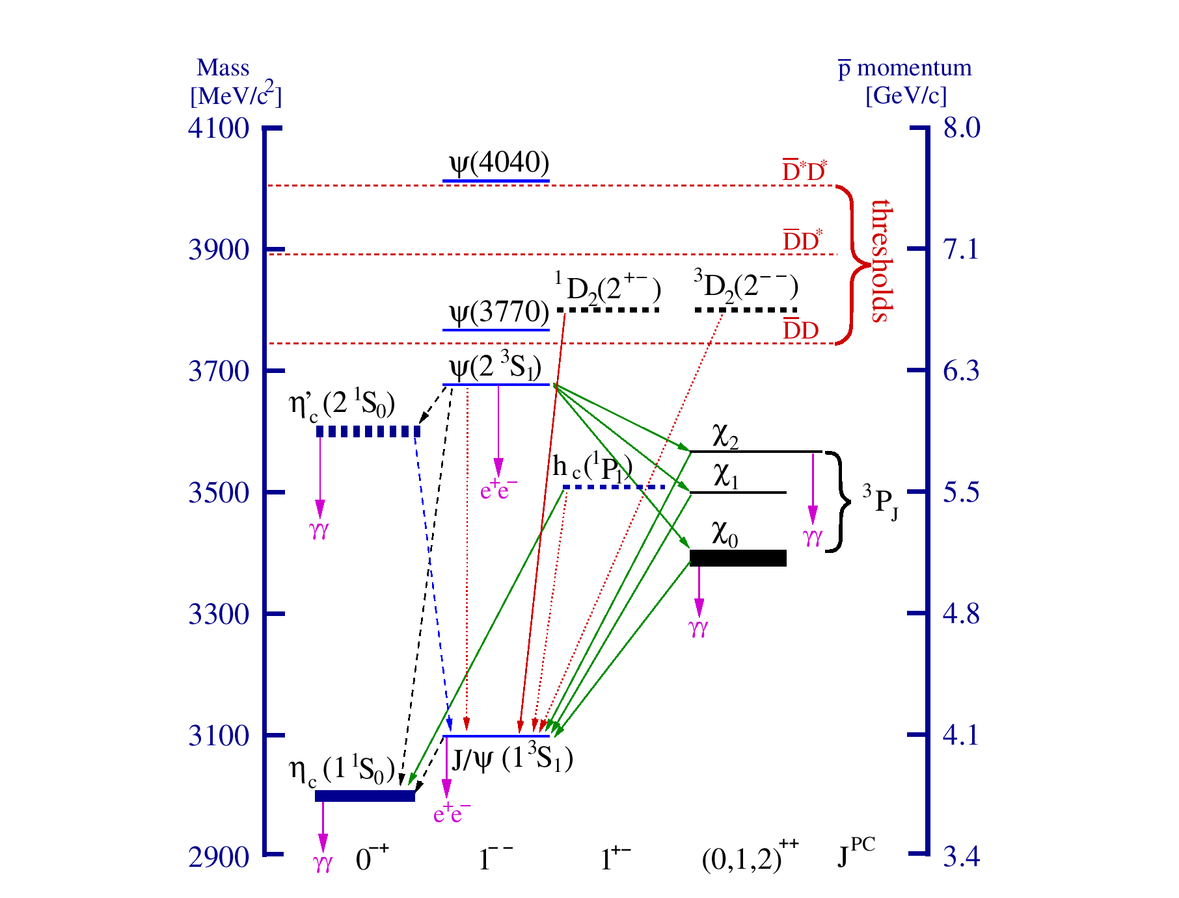
Antiproton-Proton-Annihilation in Darmstadt
Confinement and Charmonium spectroscopy
confinement potential

Slide 23
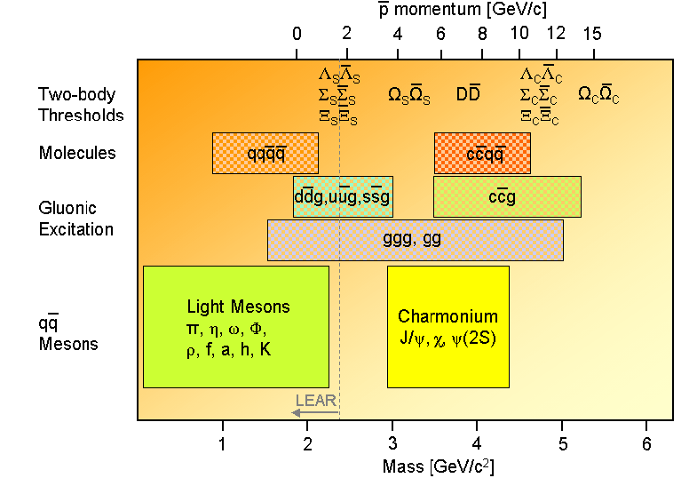
Antiproton-Proton-Annihilation in Darmstadt
Antiproton momenta up to 15 GeV/c

Slide 24
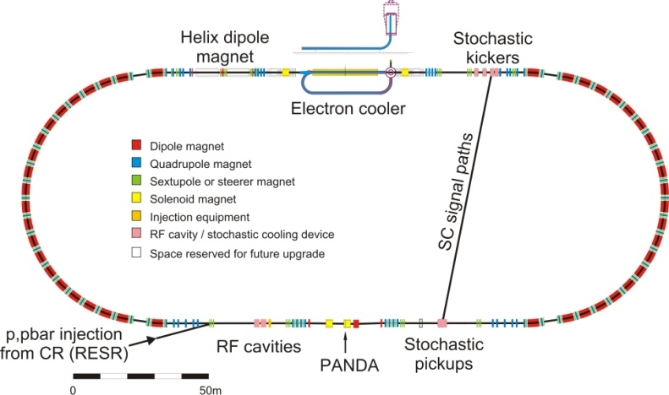
Antiproton-Proton-Annihilation in Darmstadt
The High Energy Storage Ring
Luminosity up to L~ 2x10³² cm⁻²s⁻¹
Stochastic & electron cooling
Resolution ~50 keV
Tune E_{CM} to scan resonance: precise mass and width

Slide 25
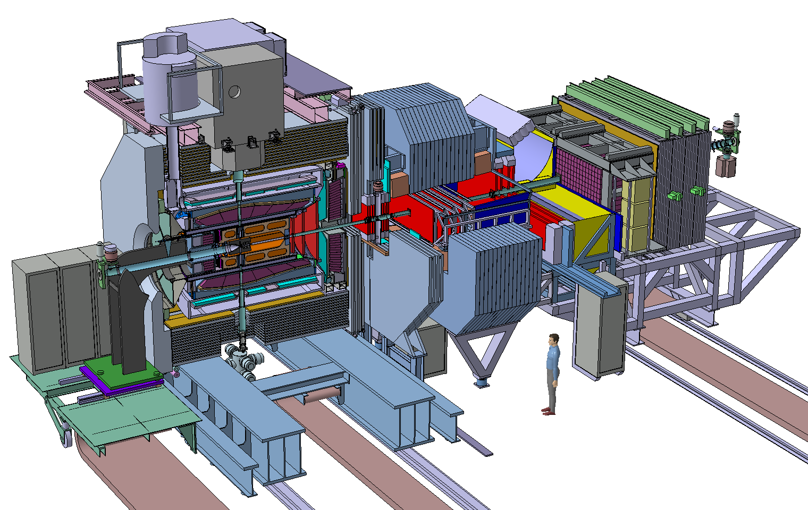
The PANDA spectrometer at FAIR
4π acceptance
High rate capability:
2x10⁷ s⁻¹ interactions
free-streaming data acquisition
Momentum resolution ~1%
Vertex info for D, K⁰_{s}, Y
(cτ = 317 μm for D±)
Good PID (γ, e, μ, π, K, p):
Cherenkov, ToF, dE/dx
γ-detection 1 MeV – 10 GeV
Crystal Calorimeter

Slide 26
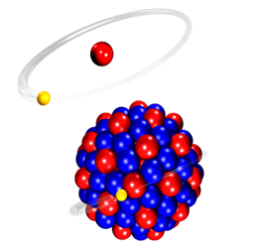
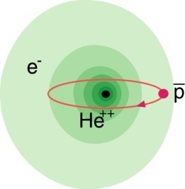
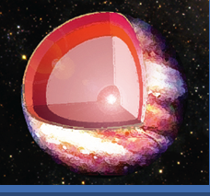
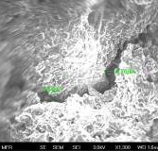
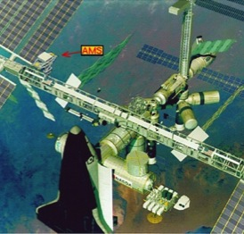
Atomic Physics, Plasma and Applied Sciences
Atomic Physics
Plasma
Materials
Bio
SPARC
FLAIR
HEDgeHOB/WDM
MAT/BIOMAT
BIO/BIOMAT
strong field research
... probing of fundamental laws of physics
anti-matter
... matter / anti-matter asymmetry
planetary interiors
... states of matter common in astrophysical objects
extreme conditions
... radiation hardness and modification of materials
aerospace engineering
... radiation shielding of cosmic radiation
Highest Charge States: Extreme Static Fields
Relativistic Energies: Extreme Dynamical Fields and Ultrashort Pulses
High Intensities: Very High Energy Densities and Pressures
High Charge at Low Velocity: Large Energy Deposition
Low-Energy Anti-Protons: Antimatter Research

Slide 27
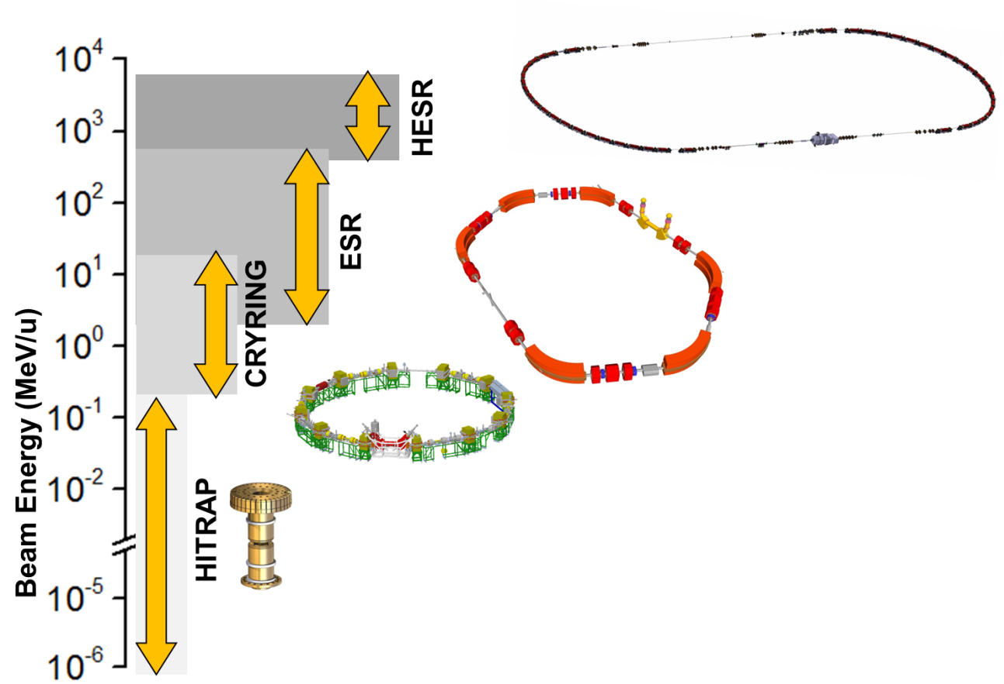
Atomic physics with stored and cooled ions
Stored and cooled highly charged ions and RIBs
Protons to Uranium in various charge states (U²⁸⁺ to U⁹²⁺)
Single to 10⁹ stored ions
From rest to relativistic (γ=6) energies
Cooling: The Key for Precision
From Single Ions to Highest Intensities
Electron Cooling
Stochastic Cooling
Laser Cooling
Notes:
statt „Ions“ → neue Überschrift
Farbrahmen + farbl. Schrifteb

Slide 28
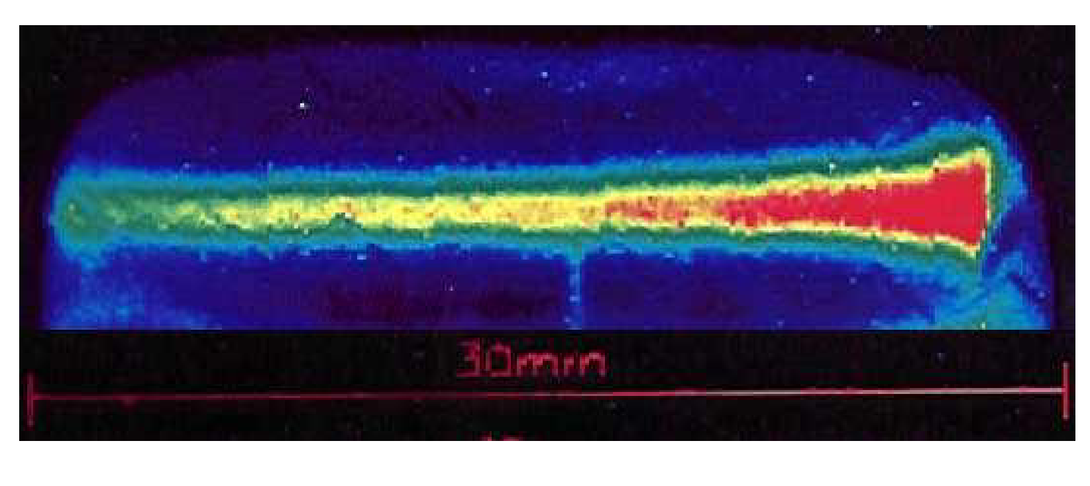
Plasma physics with heavy ion beams
Neon beam at 300 A MeV penetrating an Ar cristal

Slide 29
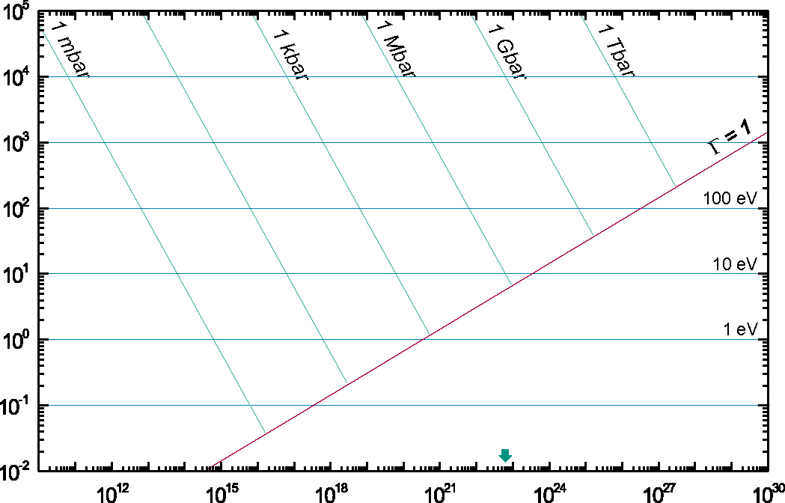
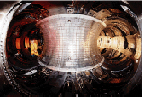
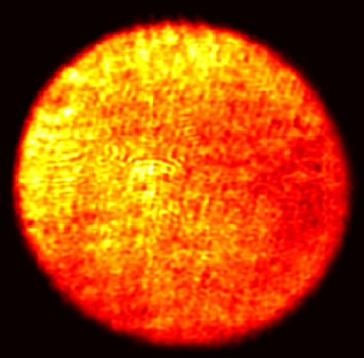
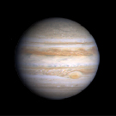
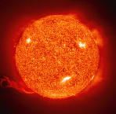
Hot electromagnetic plasmas:
high-intensity ion beams + high-power laser
Temperature [eV]
Magnetic Fusion
Inertial
Cofinement
Fusion
Sun Core
PHELIX
SIS
100
Laser
Heating
Ideal plasmas
Strongly coupled
plasmas
Ion Beam
Heating
SIS 18
Jupiter
Sun Surface
solid state
density
Density [cm⁻³]

Slide 30
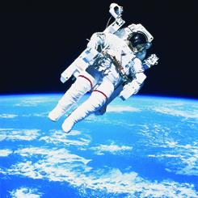


Radiobiology:
Radiation dose during long-term space missions ?
Cosmic radiation in space
Interaction cross section
Radiation dose during Mars mission only known within a factor of 10

Slide 31

Exploring the QCD phase diagram

Slide 32



Exploring the QCD phase diagram
Courtesy of K. Fukushima & T. Hatsuda
At very high temperature:
➢ N of baryons ≈ N of antibaryons
Situation similar to early universe
➢ L-QCD finds crossover transition between
hadronic matter and Quark-Gluon Plasma at T≈ 160 MeV
➢ Experiments: ALICE, ATLAS, CMS at LHC
STAR, PHENIX at RHIC

Slide 33


Exploring the QCD phase diagram
Courtesy of K. Fukushima & T. Hatsuda
At high baryon density:
➢ N of baryons >> N of antibaryons
Densities like in neutron star cores
➢ L-QCD not (yet) applicable
Models predict first order phase transition
with mixed or exotic phases
Experiments: BES at RHIC, NA61 at CERN SPS,
CBM at FAIR, NICA at JINR

Slide 34


Baryon densities in central Au+Au collisions
I.C. Arsene et al., Phys. Rev. C 75, 24902 (2007)
5 A GeV
10 A GeV
8 ρ₀
5 ρ₀
∼ 2 ρ₀
∼ 5 ρ₀
34
courtesy Toru Kojo (CCNU)

Slide 35

Quark matter in massive neutron stars?
M. Orsaria, H. Rodrigues, F. Weber, G.A. Contrera, arXiv:1308.1657
Phys. Rev. C 89, 015806, 2014

Slide 36



Messengers from the dense fireball:
UrQMD transport calculation Au+Au 10.7 A GeV
Ξ⁻, Ω⁻, φ
π, K, Λ, ...
p, Λ, Ξ⁺, Ω⁺, J/ψ
ρ → e⁺e⁻, μ⁺μ⁻
resonance decays
ρ → e⁺e⁻, μ⁺μ⁻
ρ → e⁺e⁻, μ⁺μ⁻

Slide 37

The Compressed Baryonic Matter (CBM) experiment
at FAIR: Physics case and observables
The QCD equation-of-state at neutron star core densities
➢ collective flow of identified particles (π,K,p,Λ,Ξ,Ω,...)
driven by the pressure gradient in the early fireball
➢ particle production at threshold energies via
multi-step processes (multi-strange hyperons, charm)
Phase transitions from hadronic matter to quarkyonic or partonic matter at high ρ_{B}, phase coexistence, critical point
excitation function of strangeness: Ξ⁻(dss),Ξ⁺(dss),Ω⁻(sss),Ω⁺(sss)
→ chemical equilibration at the phase boundary
excitation function (invariant mass) of lepton pairs:
Thermal radiation from fireball, “caloric curve”
anisotropic azimuthal angle distributions:
”spinodal decomposition”
event-by-event fluctuations of conserved quantities:
”critical opalescence”
37

Slide 38



The Compressed Baryonic Matter (CBM) experiment
at FAIR: Physics case and observables
Onset of chiral symmetry restoration at high ρ_{B}
➢ in-medium modifications of hadrons
(ρ,ω,φ →e⁺e⁻(μ⁺μ⁻))
➢ dileptons at intermediate invariant masses:
4 π → ρ-a₁ chiral mixing
Charm production at threshold energies
in cold and dense matter
➢ excitation function of charm production
in p+A and A+A (J/ψ, D⁰, D±)
N-Λ, Λ-Λ interaction,
strange matter
➢ (double-) lambda hypernuclei
➢ meta-stable objects
(e.g. strange dibaryons)
38

Slide 39

Experiments exploring dense QCD matter
high
net-baryon densities
The CBM Collaboration,
arXiv:1607.01487

Slide 40

FAIR Civil Construction
Synchrotrons: 1.1 km
HESR: 0.6 km
With beamlines: 3.2 km
Existing SIS 18
Total area > 200 000 m²
Area buildings ~ 98 000 m²
Usable area ~ 135 000 m²
Volume of buildings ~ 1 049 000 m³
Substructure: 1350 pillars, 60 m deep

Slide 41



Tunnel for SIS100/300

Slide 42

Civil construction (Status 2014)
The four most powerful drilling machines worldwide put down 1350 reinforced concrete pillars of 60 m depth and 1.2 m diameter.

Slide 43


FAIR Project Status 2018
Successful restart in 2015 and 2016
Start of excavation and trench sheeting in July 2017
Civil construction Area North, i.e. SIS-100 tunnel plus adjacent buildings including the CBM building, has been awarded on January 29th 2018.
Shell construction will start mid 2018.
Completion of all buildings by 2022
Full integrated planning for construction and commissioning
of the entire project: Completion of the full FAIR facility by 2025.
Ground breaking - 4 July 2017
Excavation SIS100 tunnel - Nov 2017

Slide 44

FAIR Project Status 2018
Excavation 1st section of SIS 100
January 2018

Slide 45

FAIR Project Status 2018
Excavation 1st section of SIS 100
January 2018

Slide 46

FAIR Project Status 2018
Excavation Transferbuilding
January 2018

Slide 47

FAIR Project Status 2018
  SIS 18 in direction of pLinac : Preparation of western transfer channel (WTK)
GAF project (GSI connection to FAIR)
December 2017

Slide 48






Construction of accelerator components
First of Series (FoS) of major components for SIS 100
FoS Dipole Magnet
FoS Cryo Catcher
FoS Cro-Bypass Line
FoS Dipole
Quadrupole Unit
FoS Bunch Compressor
FoS RF Cavity System

Slide 49




Construction of detector components
A
P
P
A
C
B
M
N
U
S
T
A
R
P
A
N
D
A
MUCH
TRD

Slide 50







FAIR International Collaborations
Atomic physics
NUSTAR
Bio physics
Plasma Physics
CBM
PANDA
Material research

Slide 51

Collaboration Members by Country

Slide 52




FAIR “Phase 0” - Detector commissioning
and science starting 2018 (examples)
R³B installation at GSI/Cave C:
Reactions at high beam energies up to 1-2 GeV/u
Identification capability even for the heaviest ions
Multiple neutron tracking capability
CBM detectors installed at
HADES (GSI) and STAR (LBL)
Photon detectors for HADES RICH
MRPC-TOF detectors as STAR endcap
Atomic physics at the CRYRING
installed being FRS-ESR at GSI
Precision collision spectroscopy of Be-like ions
Photoionization of C⁺ ions
Ground-state Lamb Shift in Hydrogen-like U91+
Swedish contribution to FAIR

Slide 53

  Instead of a summary ...
  Key Summary Recommendation of the NUPECC Long Range Plan 2017 presented in Brussels on Nov 27th :
  Complete urgently the construction of the ESFRI* flagship FAIR and develop and bring into operation the experimental program of its four scientific pillars APPA, CBM, NUSTAR and PANDA.
FAIR is a European flagship facility for the coming decades. Worldwide unique it will allow for a large variety of unprecedented fore-front research in physics and applied science. It focuses on the structure and evolution of matter. Its multi- faceted research opens a new era in our understanding of the fundamental building blocks of matter and the forces as well as of the evolution of our Universe: the new possibilities for research in Darmstadt are unique and are expected to produce ground breaking new insights for nuclear research.
*European Strategy Forum on Research Infrastructures

