Slide 1
CBM Computing Overview and Status V. Friese, GSI Darmstadt CBM-India Workshop, Falta, 15 Februar 2018

Slide 2
Computing in CBM
CBM Computing has to provide the software and related tools required to
operate the experiment
configuration, control, DAQ, online data processing, data storage
analyse data
reconstruction, PID, data access
simulate the detector setup
detectors, electronics, data acquisition
That‘s generic. So, what‘s particular for CBM?

Slide 3
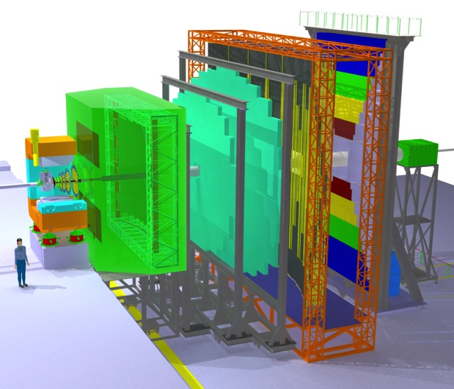
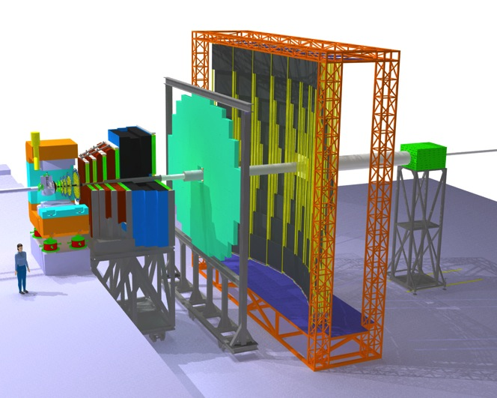
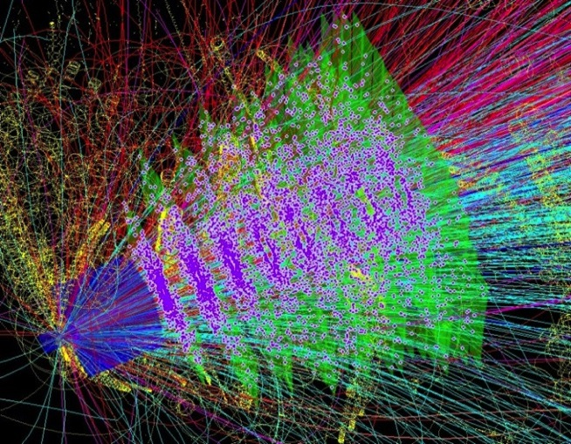
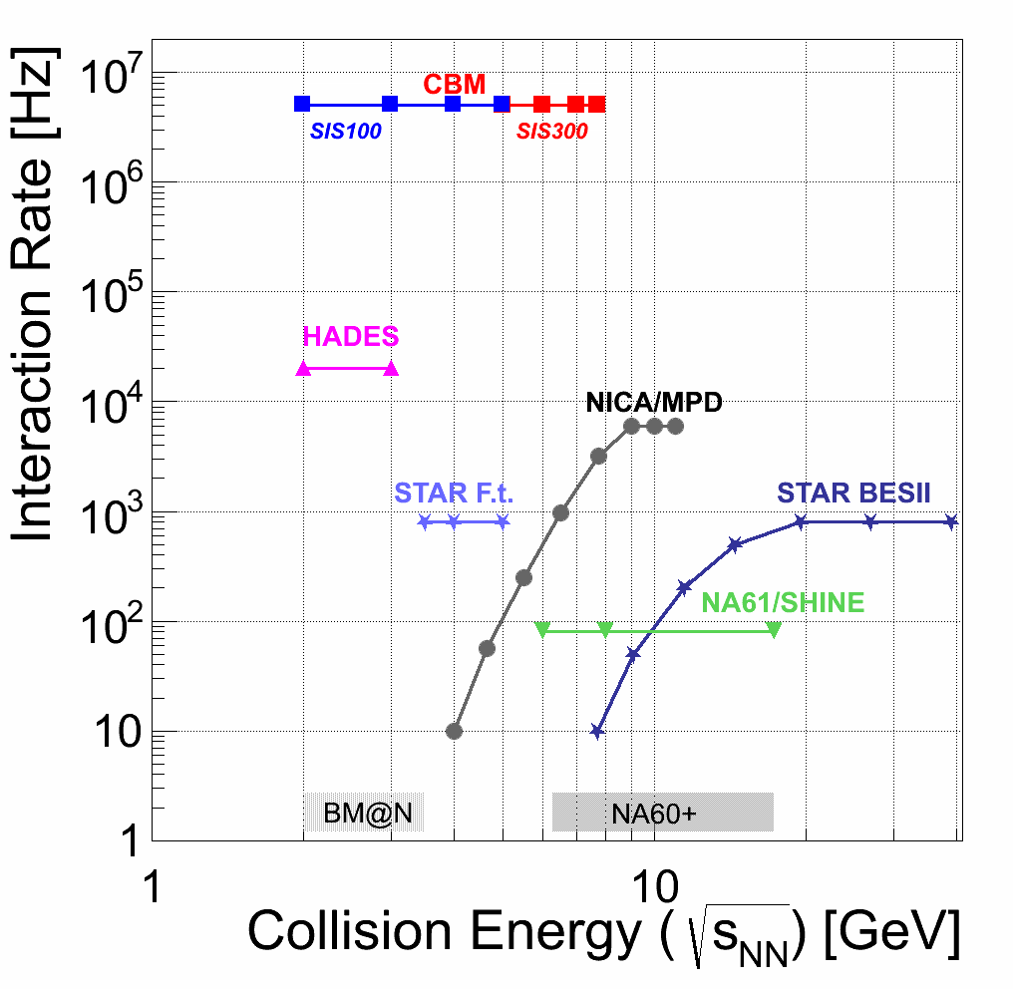
CBM Characteristics
Versatility: exchange or replace detector systems according to physics aim (e.g. electrons / muons) or conditions (beam energy)
Central Au+Au @ 10A GeV
electron + hadron setup
muon setup
Complexity: up to 600 charged tracks per collision in the acceptance
Capability: up to 10⁷ collisions per second
Software systems for CBM must cope with these specific requirements.

Slide 4
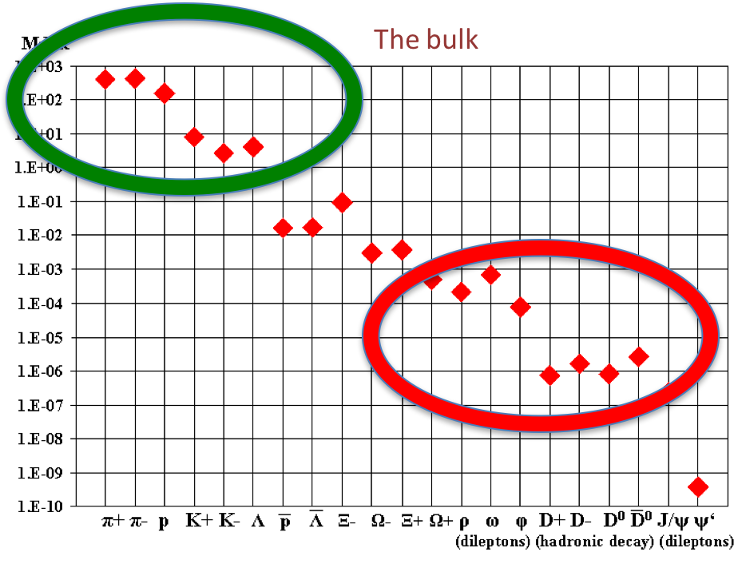
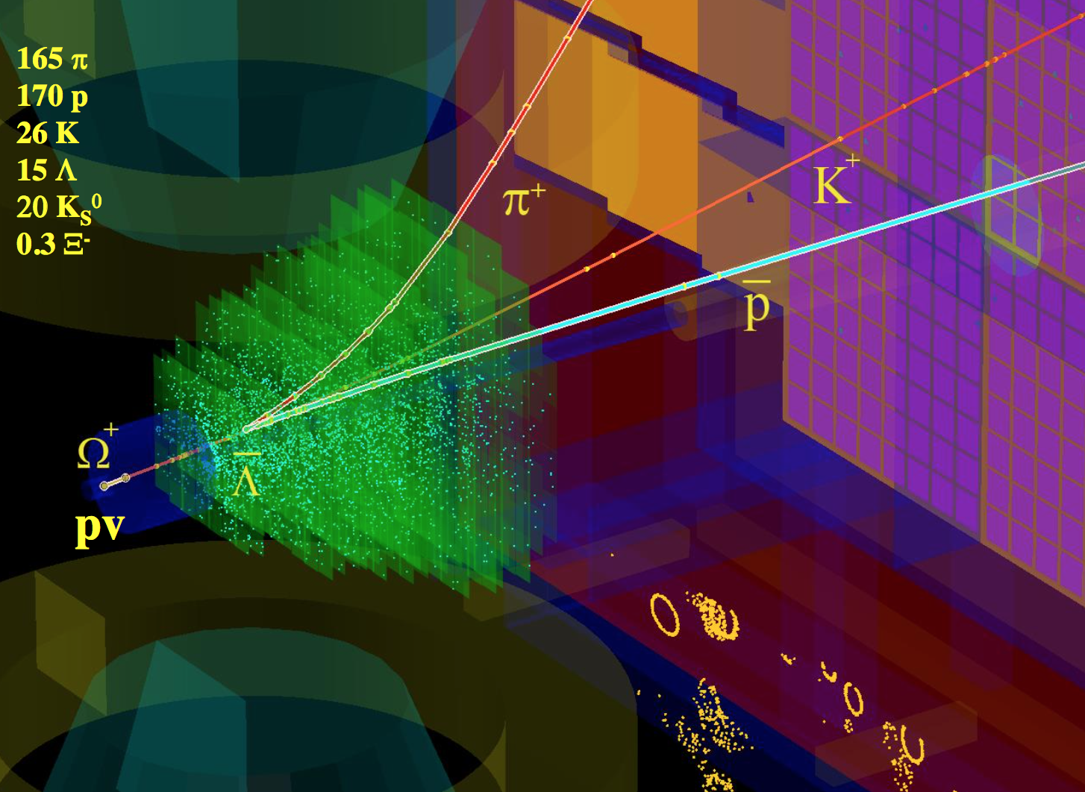
Needles in the Haystack
CBM targets at extremely rare probes, which necessitates very high interaction rates (design rate 10 MHz).
That entails a raw data rate of up to 1 TB/s.
To be reduced online to a storage rate of several GB/s.
Trigger signatures are mostly complex (e.g. weak cascade decays) and cannot be realized in hardware.
Readout concept:
No hardware trigger
Self-triggered front-end electronics deliver time-stamped data
Data-push architecture to online compute farm
Event reconstruction and –selection to be performed on CPU
Central Au+Au @ 10A GeV

Slide 5
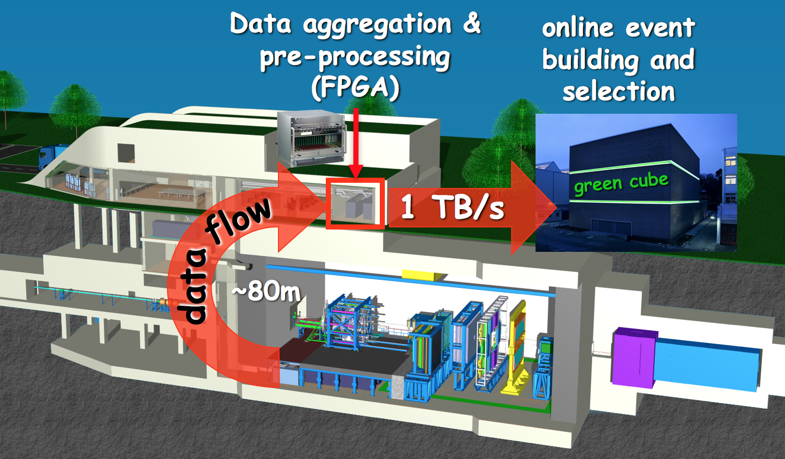
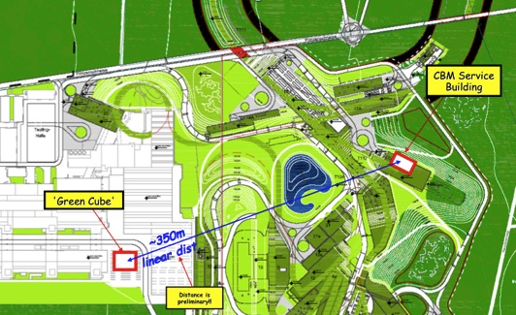
Online Data Flow
Data are aggregated and pre-processed in an FPGA layer near the experiment.
Time-slice building is performed on CPU (input nodes, in service building).
Event reconstruction and –selection is performed in real-time on CPU (compute nodes) in the GSI ”Green Cube” (already existing at GSI).

Slide 6
Data Rates
Raw data event size: 100 kB / min. bias event (Au+Au)
At 10 MHz event rate: raw data rate 1 TB/s
Archival rate:
technologically possible are rates of 100 GB/s and above
limiting factor are the storage costs
typical runtime scenario 2 effective months / year (5 x 10⁶ s)
At 1 GB/s: gives a storage volume of 5 PB/year
We aim at an data archival rate of a few GB/s, meaning that the raw data volume has to be suppressed online by factors 300 - 1000.

Slide 7
Consequences: Reconstruction
Reconstruction does not start from events (defined by hardware trigger) but from „time slices“ containing many events.
size of time slice adjusted to architecture of compute farm
typical value: 1 GB (10,000 Au+Au events @ 10A GeV)
one time slice delivered to one compute node; avoid intercommunication between compute nodes
the time coordinate becomes essential
events can overlap in time; no trivial event definition: ”4-D reconstruction”
All online algorithms have to be extremely fast
Trivial data-level parallelism for time slices (one time slice per node)
Use massive parallelisation also within one node (many-core CPU/GPU/...)
Processing time per time slice determines cost of online farm (for given physics sensitivity) or the physics output (at given budget)
Online reconstruction has to be precise enough to make decision
No conceptual difference between online and offline algorithms

Slide 8
Consequences: Framework
We want a common framework for online and offline, for simulation, reconstruction and analysis
No separate ”worlds” (HLT vs. offline: speed vs. precision)
Data ”containers” to be handled are: event and time-slice
Event: a collection of data (tracks) originating from the same primary vertex
Corresponds to one ion-ion collisions
Start point for simulation (from event generator)
Start point for analysis (from reconstruction)
Time slice: a collection of (raw) data measured in a given time interval
Contains data from many events
End point for simulation
Start point for reconstruction
The framework must allow to convert from events to time-slices and vice versa.
Goes beyond traditional, “triggered” frameworks

Slide 9
Events and Time Slices
Time
Slice
Experiment
Collision
Detector
Event Generator
Simulation
Event
Analysis
Reconstruction

Slide 10
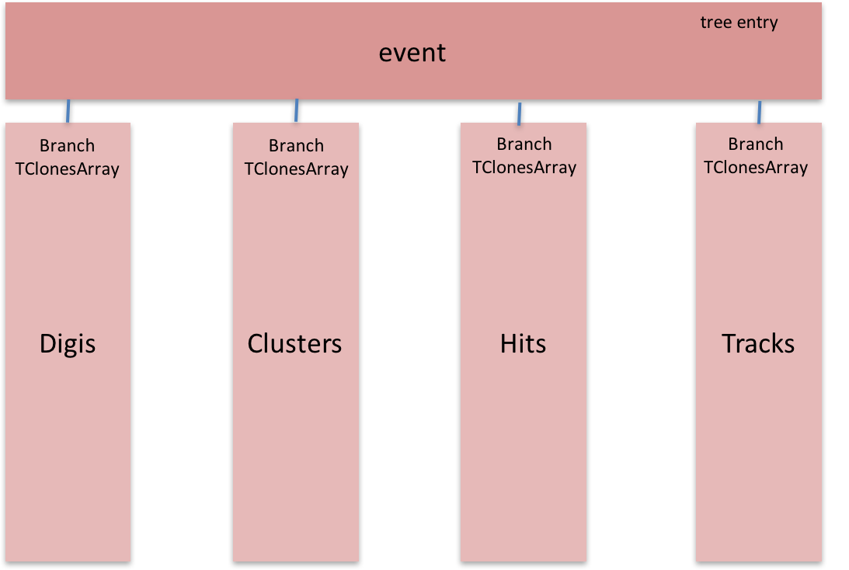
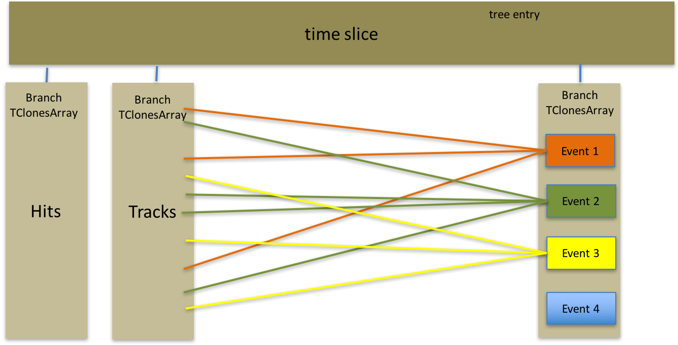
Data Model
No data copy when associating data to event
Small overhead (one pointer/index per data object)
Events can be defined based on any data level
Algorithms are flexible to run on entire time slice (4-d reco) or on defined events (analysis)
Ideal case (event-by-event) described in the same format (one event per time slice)

Slide 11
Where are we? Where do we go?
Starting in fall 2017, the CBM software development is being formulated in a project-like manner
Definition of work packages, milestones, time lines, manpower
Aim:
to ensure that all required components will be available in time
to coordinate the component development
to identify critical items and organise the manpower
Seven software projects were defined; working out the projects is close to being finished
Not included here are hardware-related issues:
DAQ hardware and firmware components
Installation and maintenance of the online compute facilities

Slide 12
Computing Projects
INF
Software Development Infrastructure
EDC
Experiment and Detector Control Systems
Computing
Board
SIM
Simulation Software
ODM
Online Data Management
OAA
Offline Analysis Environment
DPF
Data Processing Framework
ALG
Data Analysis Algorithms

Slide 13
Experiment and Detector Controls
Mission: Configure and monitor the different detector systems and the data acquisition
Status:
No coordinated activity until recently
Detector projects organised custom solutions for laboratory and in-beam tests
Design of a common system is to be worked out based on the requirements of detectors and DAQ
Existing solutions (running experiments) will be reviewed w.r.t. applicability for CBM
EDC
PL: P.-A. Loizeau, GSI

Slide 14
Online Data Management
ODM
PL: J. de Cuveland, FIAS
Mission:: receive data from the DAQ into the FLES input nodes; build time slices; distribute time slices to the FLES compute nodes
Status:
Prototype available
First experience in lab and in-beam tests (single node)
Tests on small clusters w/o detectors
Next milestone: operation of mCBM (all systems; many nodes)

Slide 15
Data Processing Framework
DPF
PL: F. Uhlig, GSI
Mission: to provide a flexible and efficient environment for data analysis (regulate data model, I/O, run configuration, execution of processing graph)
Status:
Since many years, CbmRoot is used as framework for simulation, reconstruction and analysis.
Builds up on the FairRoot software layer with ROOT as platform
Has been proven to be flexible and adaptable
But is not well suitable for real-time data processing (no concurrency model)
Will move to FairMQ (message-queue system developed by the GSI-SC group)
First deployment with the new system targeted for mCBM (fall 2018)

Slide 16
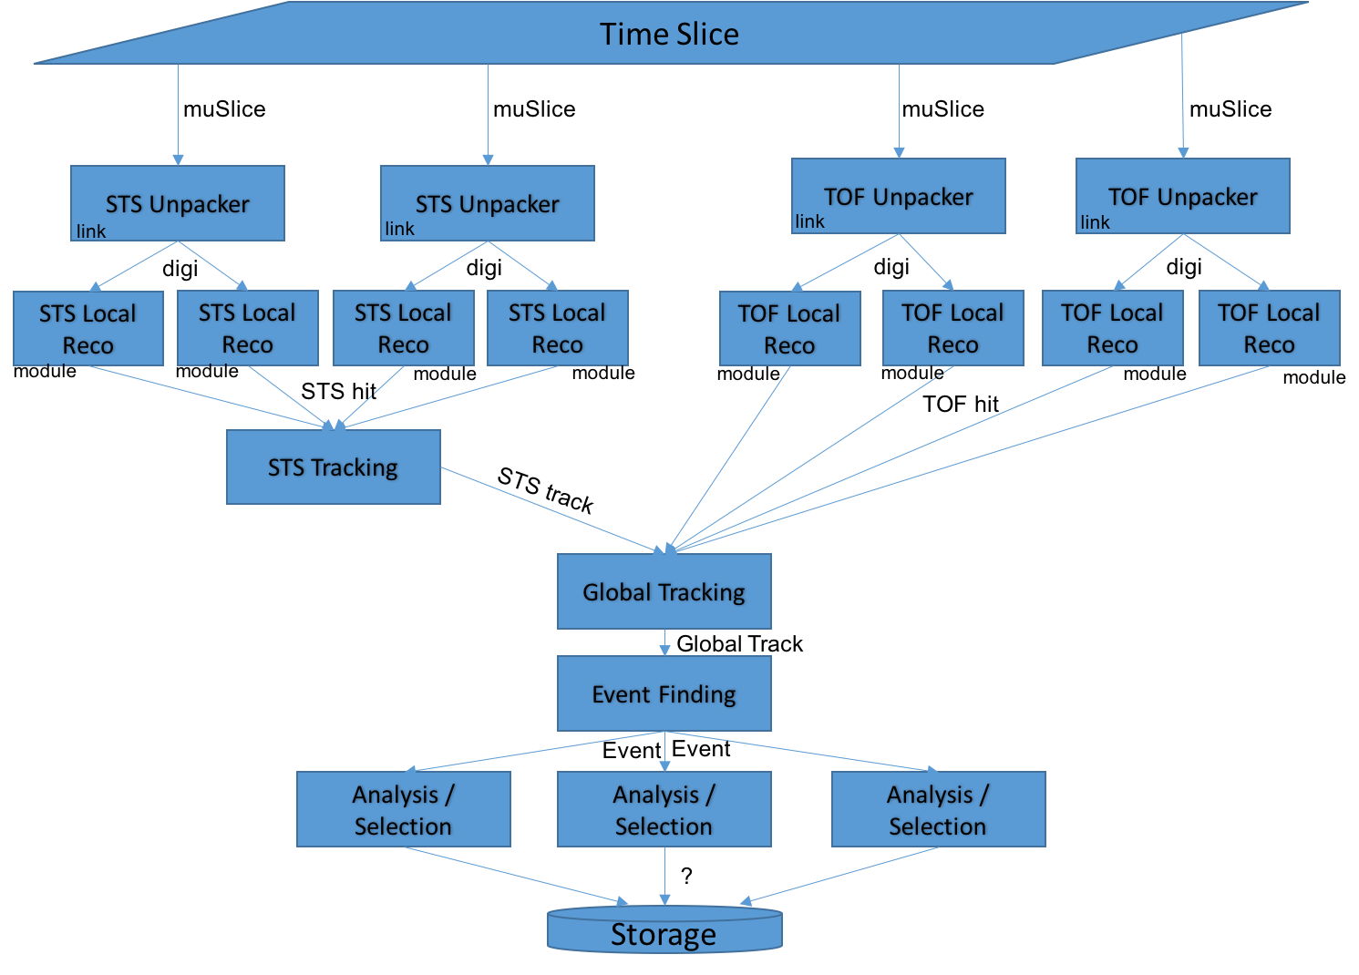
Example: Simple Process Graph (STS + TOF)

Slide 17
Data Analysis Algorithms
ALG
PL: M. Zyzak, GSI
Algorithms for event reconstruction are being developed since many years, with emphasis on fast algorithms suitable for online usage.
Developments started with the event-by-event case (proof of principle). Full reconstruction of simulated events is available.
Migration to reconstruction of free-streaming data done for the most compute-intensive tasks (track finding); in progress for others. Up to now, no show-stopper found.
Software for online event selection (KFParticle, KFParticleFinder) developed; is already in use by other experiments (STAR, ALICE)
Next milestones:
Demonstrator for full time-based reconstruction chain on simulated data
Application on real data for mCBM

Slide 18
Simulation Software
SIM
PL: V. Friese, GSI
Full description of detector geometries available
according to current technical planning
comprising all relevant contributors to the material budget
subject to continuous adjustments / improvements
Free-streaming response models available for all detectors (save PSD)
not all features yet included, e.g. noise
DAQ emulation available (time-slice building)
simplified scheme; not yet on raw-data format
Next milestones: Full system simulation on raw data level
Enables testing of reconstruction from the real data format

Slide 19
Software Development Infrastructure
INF
PL: N.N.
Software repository: subversion
Migration to git planned
Build system: CMake
Substantial change announced by FairRoot team
Regular test system: CDash
Checks software integrity on commit and nightly
Project platform: Redmine
Organisation and communication: repository browser, ticket system, code reviews, planning tools, news, forum
Also used by some hardware projects
Infrastructure tools have to be constantly maintained and, if needed, adapted. They are indispensable for efficient and controlled software development.

Slide 20
Offline Analysis Environment
OAA
P.L.: N.N.
Organise the offline analysis of experiment data on the scale of several PB per run campaign.
Status: no activities yet. Medium-scale data processing (simulated data, several 10 TB) on GSI cluster (some at FRRC cluster).
To be developed: offline data model (raw / reco / AOD), distribution of data to computer centres (TIER model), user access to data
Offline computing model has to be developed together with other FAIR experiments: FAIR computing model
Milestones: Data challenges with simulated data on 10% and 50% level.

Slide 21
Tentative Milestones
2018: operate mCBM; all data to disk; analyse data offline
2019/2020: run online data selection with mCBM
2020: TDR Online Event Selection
2021: simulation data challenge 10%
2023: simulation data challenge 50%
Experience with mCBM (starting fall 2018) will be decisive to test and adjust software concepts and for the further detailed planning towards CBM@SIS-100.

Slide 22
Manpower
A detailed resource demand is in preparation. Clear is already: the manpower assigned to software development in CBM is critically low.
The GSI/FAIR CBM department cannot provide a core software group with the same strength as usual at CERN or BNL.
We need CBM groups from outside GSI with long-term commitment to software projects and tasks (beyond the contributions from the detector groups, e.g., geometry and digitizer). Suitable candidates could be:
National / international labs (VECC, JINR, ...)
Technical universities, IT faculties

Slide 23
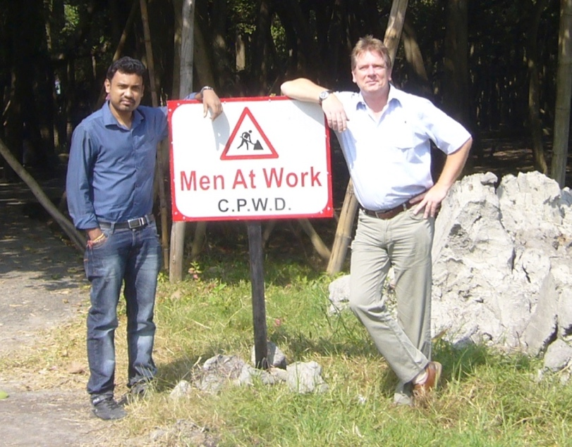
In Place of a Summary

