Slide 1
CBM-MUCH-RPC Electronics
J. Saini, VECC Kolkata

Slide 2
Readout Chain for the RPC detector
Beam Hall
Green Cube
RPC Detector
FEE Board
PADI Electronics
GET4 ASIC
PC/Computing
Node
ROB-3 (GBTx Board)
CRI Board

Slide 3
CSA (MUCH-XYTER) option as compared to Current sensitive PADI
Charge output of RPC ~ 1PC and above
CSA available in ASIC with CBM DAQ chain is STS/MUCH-XYTER
Dynamic range of MUCH-XYTER ~60FC
Attenuation required more then 50 times and general capacitive attenuator will introduce large noise as capacitor to ground will be 50 times large.
Active attenuation required where PADI itself can act as the attenuator.

Slide 4
COSY Test Beam preparation with PADI
PADI doesn't have pulse stretcher at the digital output stage hence LVDS to other logic conversion circuits were not responding to low level signals from RPC.
As timing ASIC GET4 was unavailable for the Beam time, we decided to make PADI specific discriminator to convert output LVDS to NIM pulse.

Slide 5
Present Lab setup of RPC-PADI
Sint1
Discriminator with NIM signal out
RPC Detector
PADI Electronics
Sint2
Coincidence
3 Fold
Coincidence
4 Fold
Sint3
Scaler

Slide 6
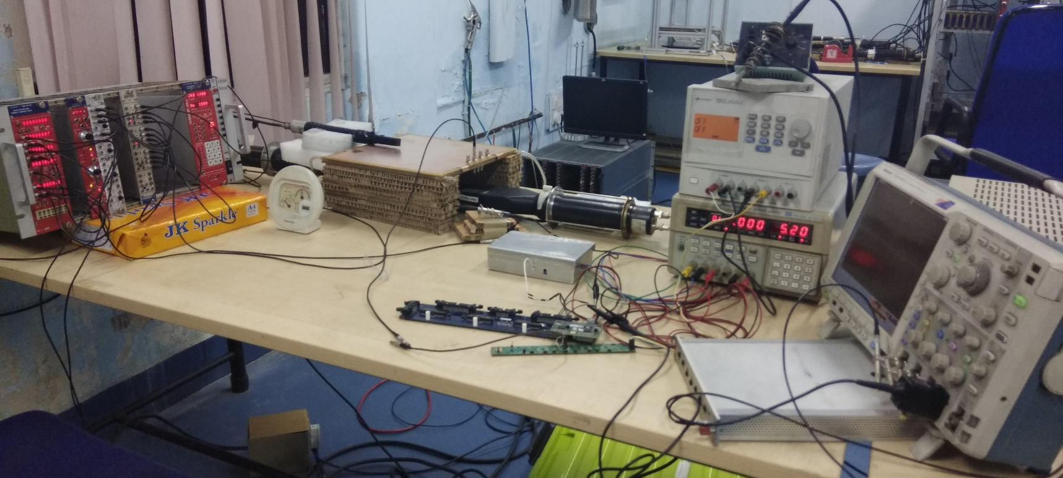
Picture of the setup
RPC Detector
Scintillators
Discriminator
Scaler and other
Conventional Electronics
PADI-Electronics
Used THS4520 from NINO
FEE board for spark protection

Slide 7
Results from the setup
We could get efficiency of ~ 94% at 10600 V from RPC-PADI combination.
These logic pulses can be inserted to STS-XYTER with some attenuation and series capacitance
Test beam setup is prepared without using GET4 and can be used for any other TEST-Beam using discriminator and STS/MUCH-XYTER chain.
With this results, we can say that PADI can be easy used along with RPC’s

Slide 8
Number of pad calculation
At 300cms of station-3, at 5.7 degree the radius of innermost pat is 29.35cms
Pad size per degree is 5.22mm
 | 1 degree | 2 degree | 5 degree
Size of first pad | 5.2mm | 10.4mm | 26.1mm
No of pads per plane | ~28,080 | Not calculated | ~1,500

Slide 9
Total number of channels for 1 degree and price estimate for RPC electronics
With 5 degree pads, total approx
Channels per layer = 28000
Channels per station = 84000
Channels in two stations = 1,68,000
Cost estimate
Cost per channel (with CRI) = 12Euro
Total cost =20,21,000Euro
Too much for pad….even PCB not possible

Slide 10
Total number of channels for 5 degree and price estimate for RPC electronics
With 5 degree pads, total approx
Channels per layer = 1500
Channels per station = 4500
Channels in two stations = 9000
Cost estimate
Cost per channel (with CRI) = 12Euro
Total cost =1,08,000Euro
PCB possible in 2-layer….Cost reasonable may be

Slide 11
Conclusion
PADI can be used along with RPC detector for station 3 & 4
STS/MUCH-XYTER based chain can also be used provided some active attenuator along with pulse stretcher is introduce in between

Slide 12
Thanks for attention…!!!

