Slide 1
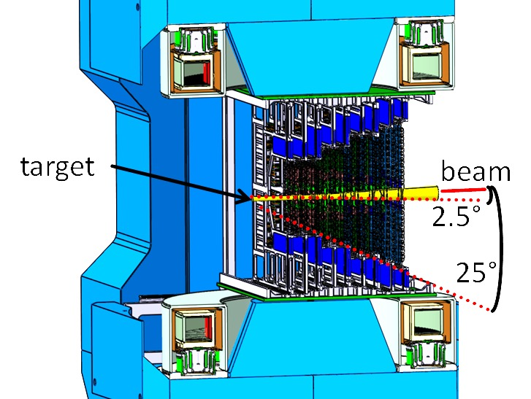
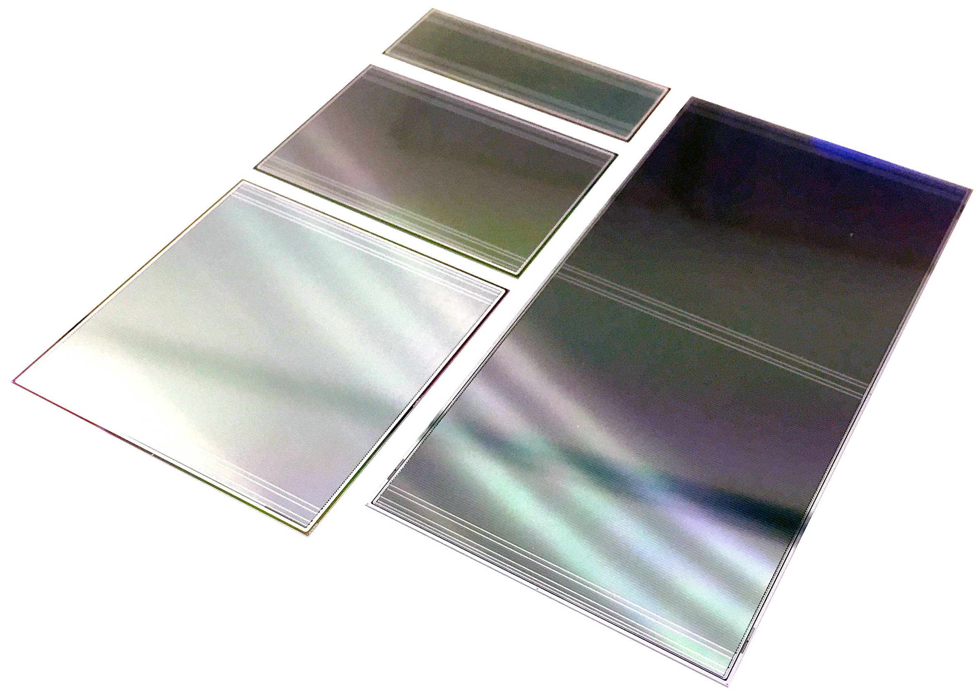
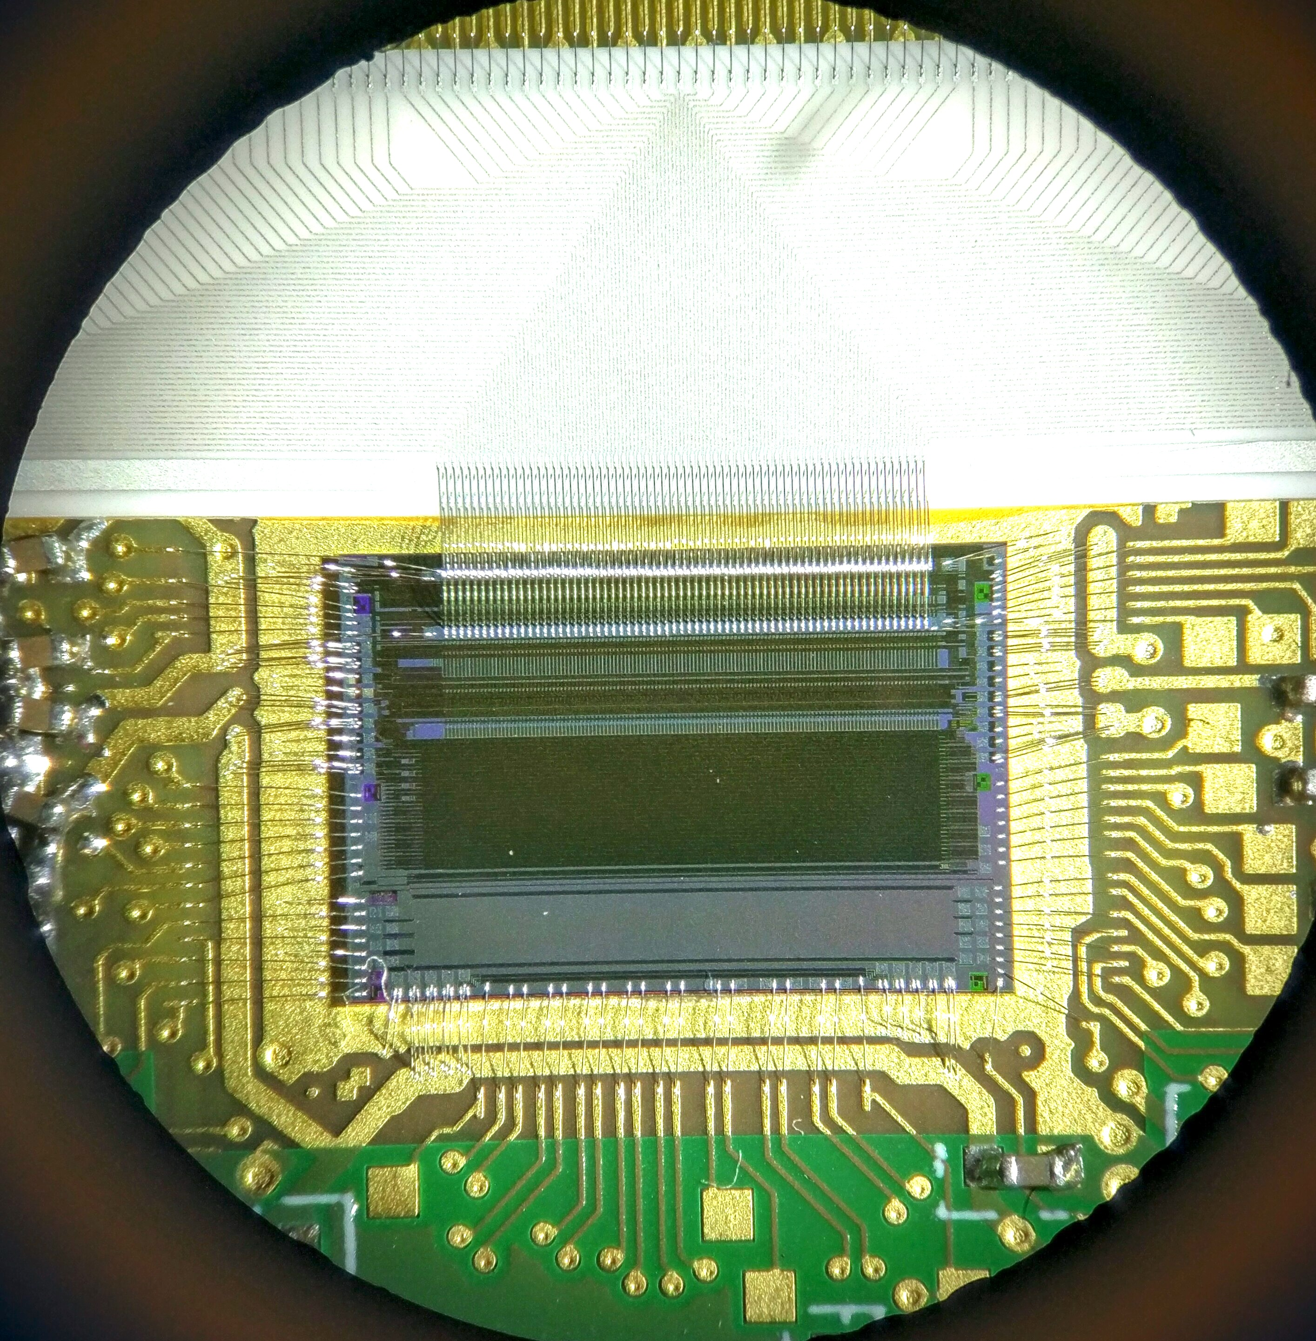
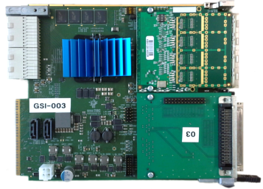
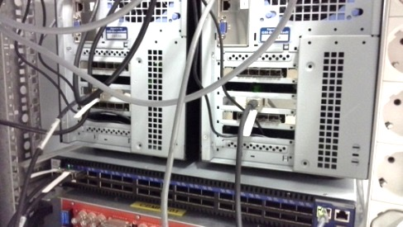
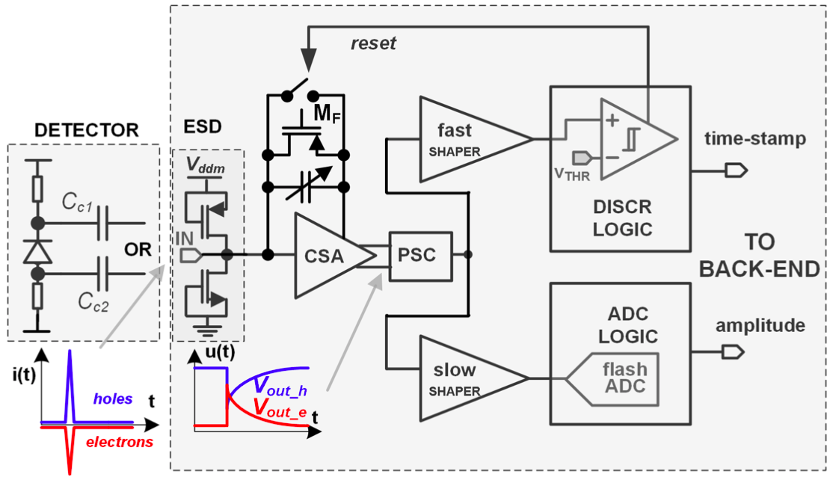
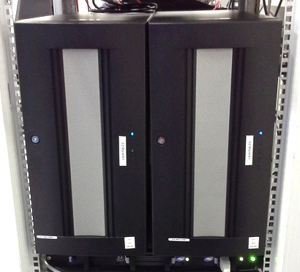
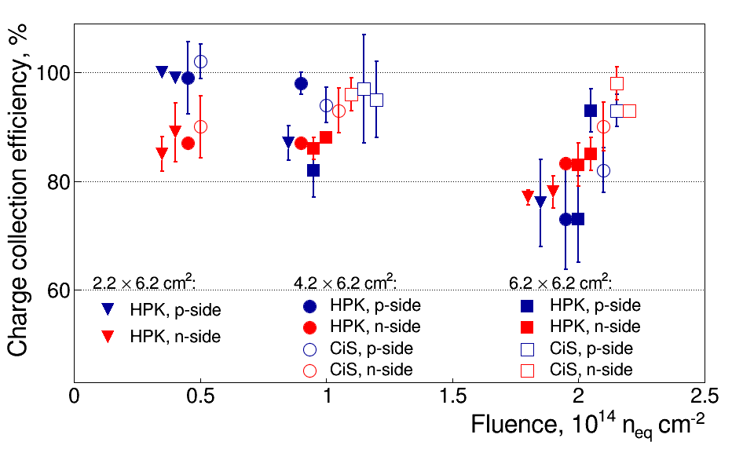
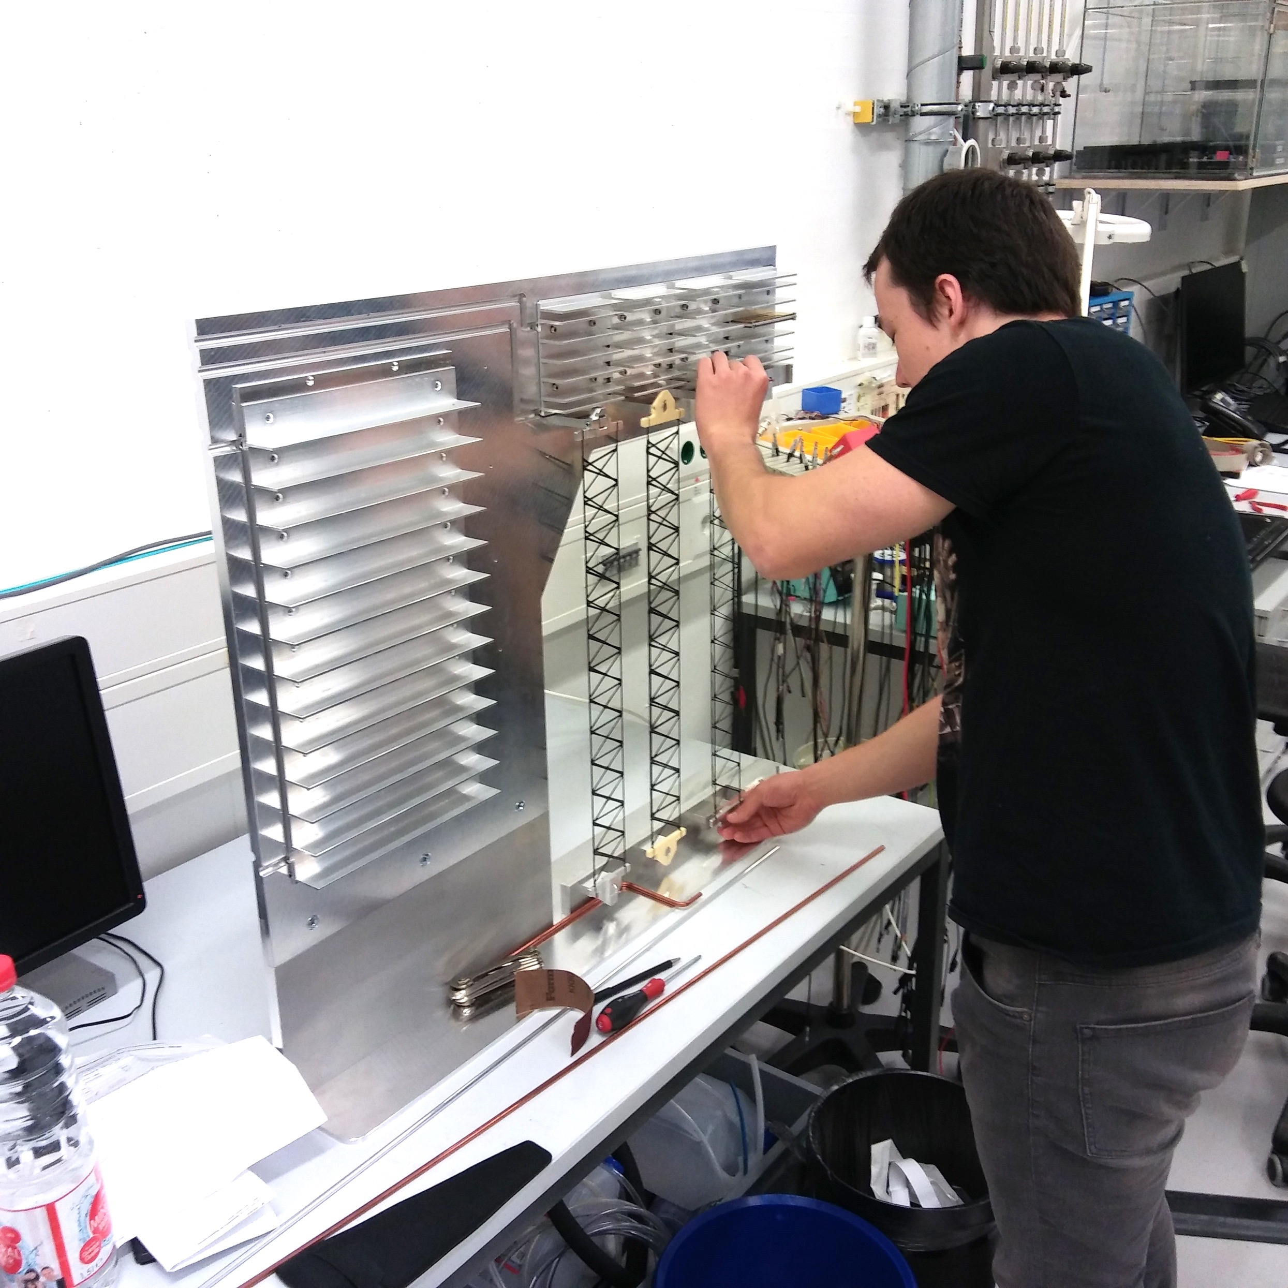
The Silicon Tracking System of CBM
The Silicon Tracking System
Project
pile-up free track point determination in high-rate collision environment: 10⁵ − 10⁷/s (A+A), up to 10⁹/s (p+A)
8 tracking stations
double-sided silicon microstrip sensors
self-triggering front-end electronics
time-stamp resolution ≈ 5 ns
material budget: ≈ 0.3% – 1% X₀ per station
momentum resolution: Δp/p ≈ 1.8% (p > 1 GeV/c, 1 Tm field)
Timeline:
Key Project Institutes:
2013 – Technical Design Report*
2017-2018 – Production Readiness (Sensors, Electronics, System Integration)
Detector construction until 2021 *GSI Report 2013-4 (Aug. 2013)
GSI-FAIR, Darmstadt, Germany;
JINR, Dubna, Russia;
Univ. Tübingen, Germany;
KIT, Karlsruhe, Germany;
AGH, Cracow, Poland;
JU, Cracow, Poland;
WUT, Warsaw, Poland.
Activities at GSI:
Assembly centers:
Component QA: sensors, microcables, readout electronics
Detector module assembly QA
Ladder assembly and QA
Mechanical integration
GSI-FAIR
JINR –VBLHEP
KIT
Longitudinal cut – Silicon Tracking System in Dipole Magnet
Low-mass module components
Read-out Electronics, Data Acquisition Chain
Full CBM06
sensor family
Self-triggering front-
end electronics
FPGA based hardware for free streaming data acquisition chain
High performance
compute nodes
Carbon fiber support structures
Custom STS-XYTER ASIC
Data processing board
Ultra-thin readout cables: 0.228 X0 per cable stack (equivalent to 213 µm Si)
System Integration
Current development activities
C-frame
front-end boards
Radiation hardness of sensors
Neutron-irradiated sensors tested in the laboratory and with proton beam. Sensors retain >70% charge collection efficiency after 2x lifetime fluence.
read-out + power boards
ultra-thin r/o cables
half-unit
ladder
sensor
8 stations
18 half-units
106 ladders
896 modules
Quarter-unit demonstrator
ladder mounting
mechanical stability
electronics cooling
cable routing
powering
connectivity
Module assembly: TAB-bonding of Al-polyimide cables between ASICs and sensor
Notes:
1

