Slide 1
Modular assembly of the barrel with the use of radial roller bearings, locating pins and brackets
December 2017
Giessen

Slide 2
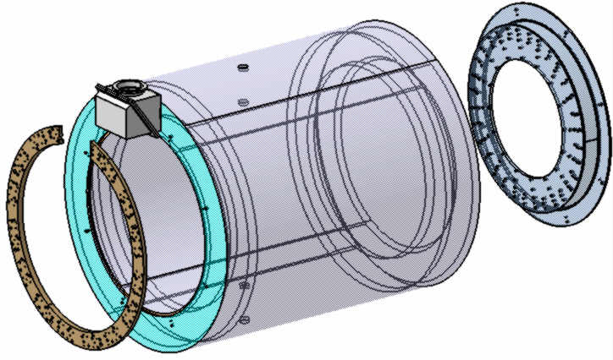
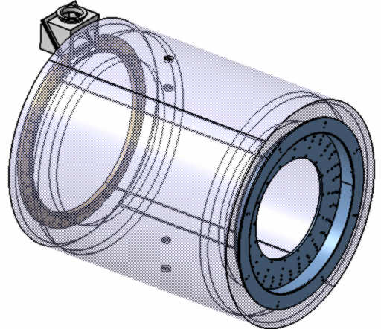
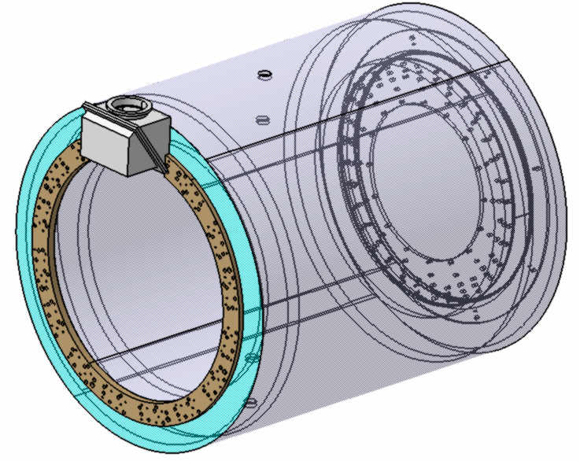
Step 1- Cryostat preparation (view without of a Magnet)
Procedures:
Mounting and fixation of 2 special Rings from both sides to the Cryostat Assembly;

Slide 3
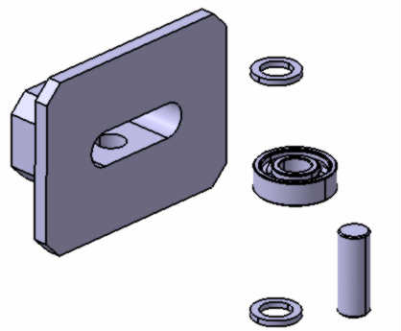
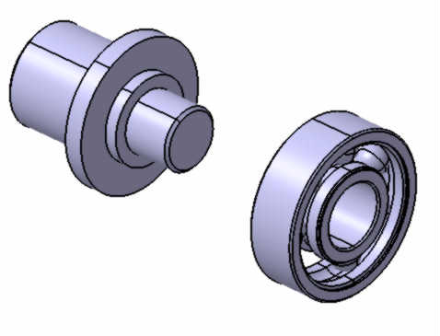
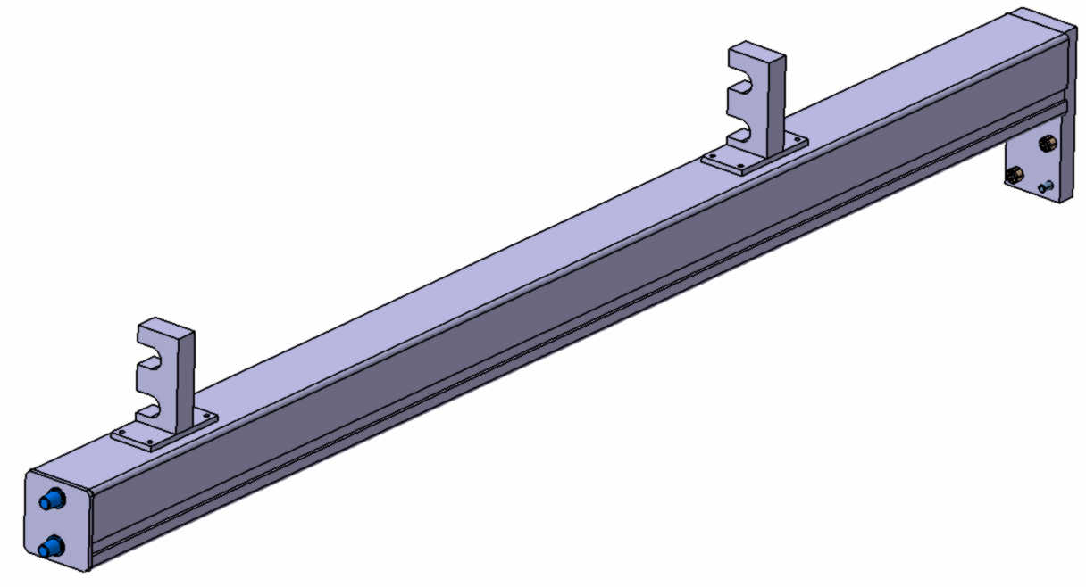
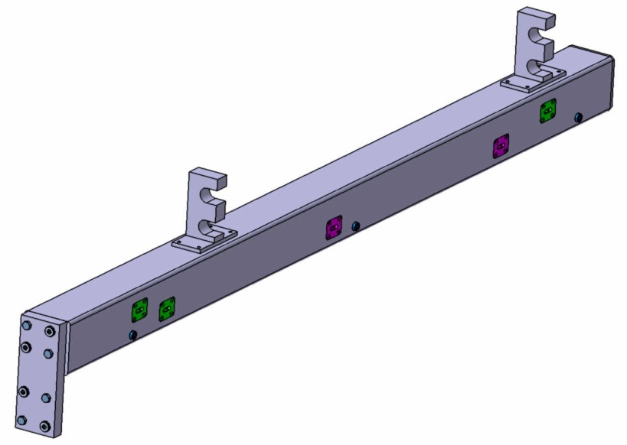
Step 2- Preparation of 2 special technological beams
Precise slot for bearings moving
Procedures:
Mounting and fixation of 2 centering pins and 5 bearings assembly on technological beam (square tube 160x160x12 mm);

Slide 4
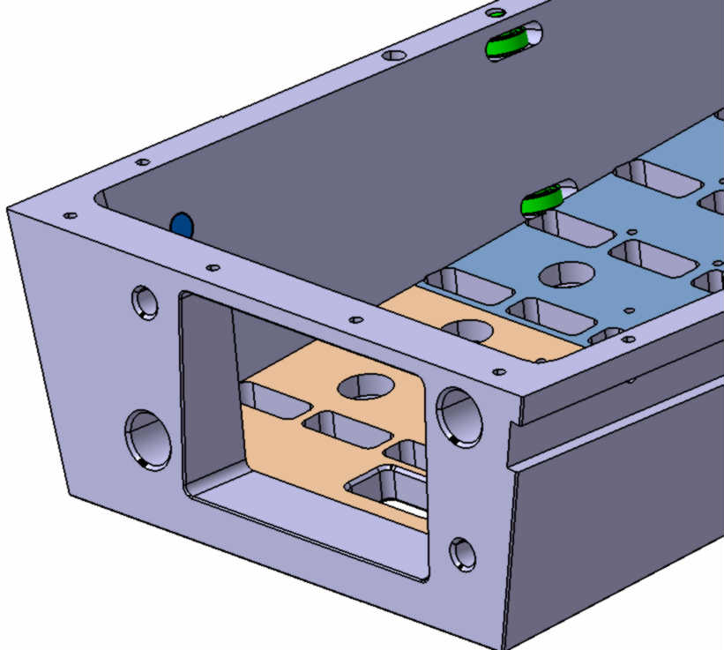
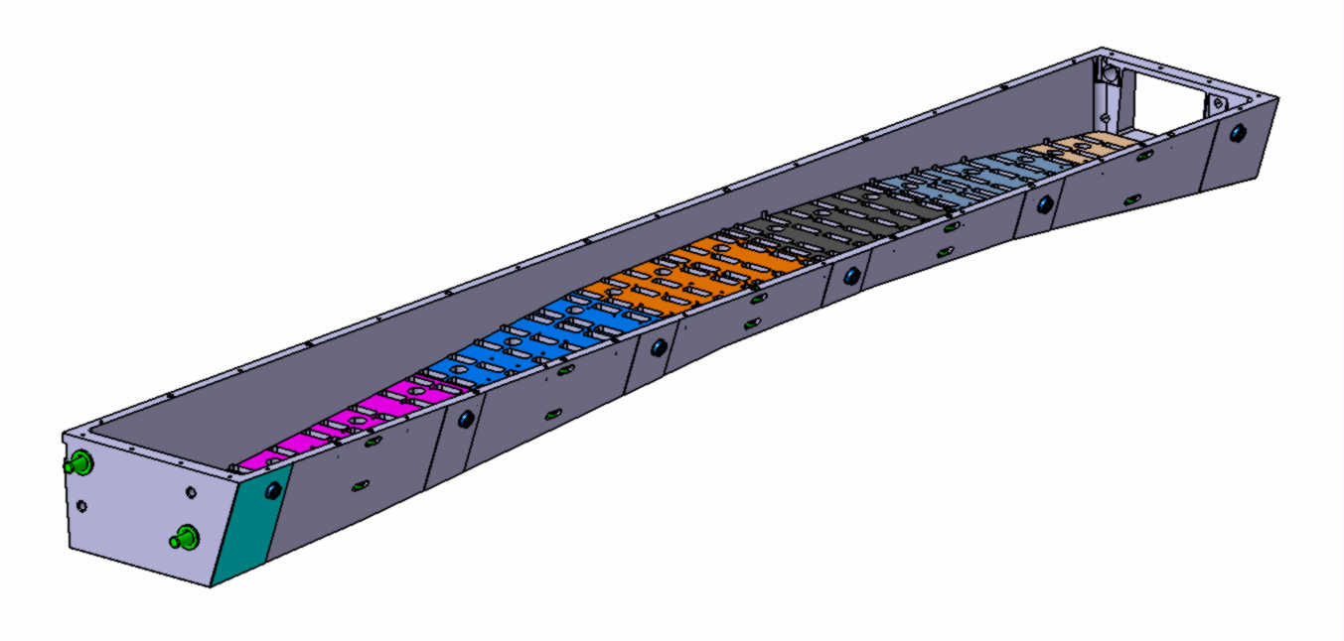
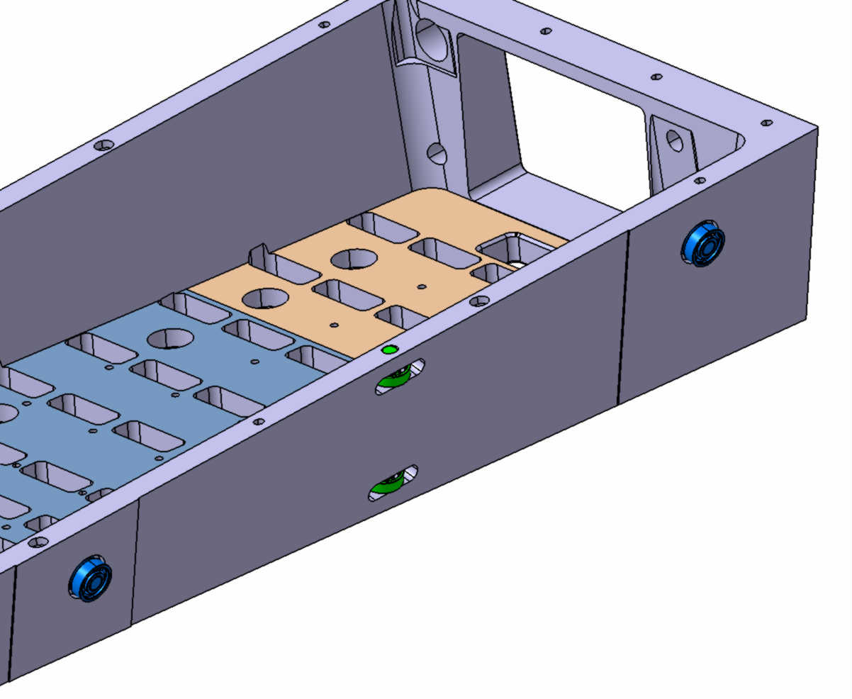
Step 3- Slice preparation (simplified image)
Procedures:
-Machining of special precise slot for bearing moving;
Mounting and fixation of 2 special Pins and 16 Bearings Assembly on technological beam

Slide 5
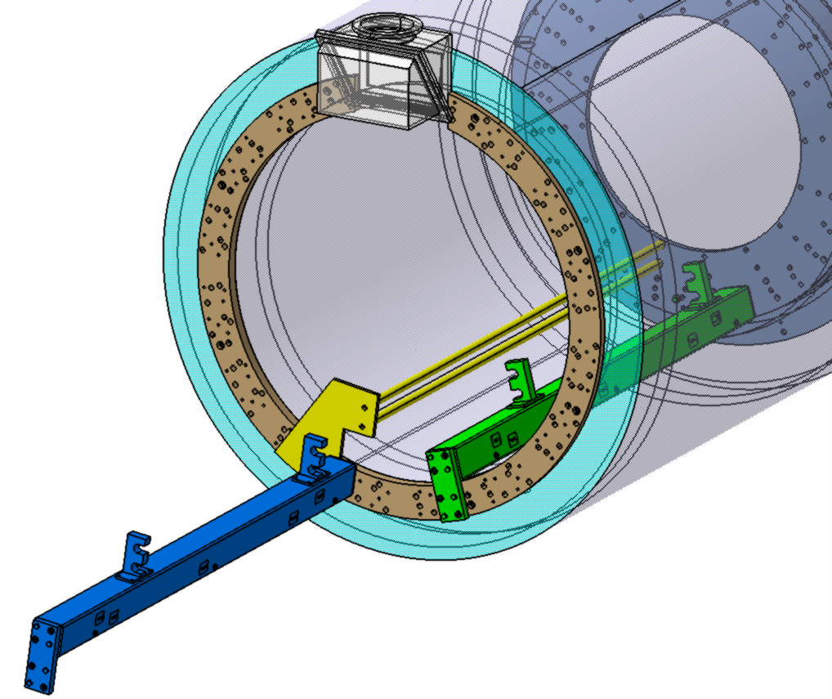
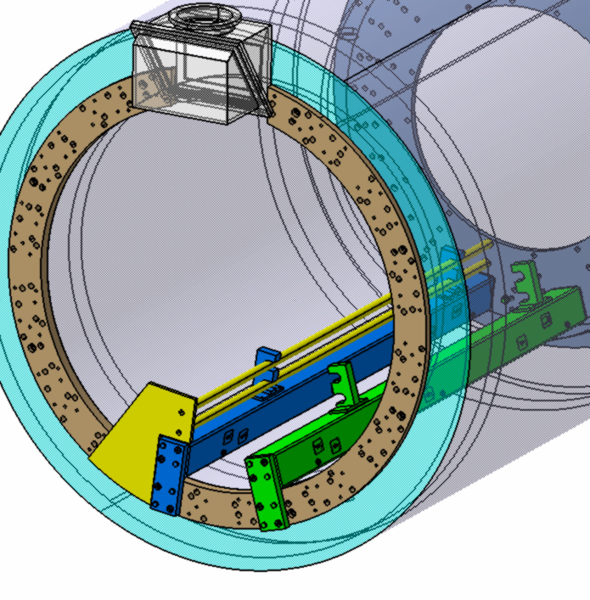
Step 4- Technological Beams installation
because of the high weight of the technological Beams (~180 kg) it is necessary to use
special Bracket for technological Beams installation
Procedures:
Mounting and fixation of supporting Bracket (yellow) ;
Pushing and sliding Technological Beam along the bracket;
Mounting and fixation of Technological Beam by means of 2 special Pins from downstream side and bolts and centering pins from upstream side;

Slide 6
Step 6- Installation of the tilting device (cantilever) in the preliminary position.
Installation and attachment of the slice to the cant.
Procedures:
The slice installation on the rotating platform of Technological device;
Adjusting of the slice and installation special guide rails to fix the slice

Slide 7
Step 7- Rotating and adjusting of the tilting
Procedures:
Rotating technological device by means of transfer worm;
Adjusting of the tilting I according to position of technological beams;
Push the slice till contact with rear flange. Centering pins have to be achieved to a holes.

Slide 8
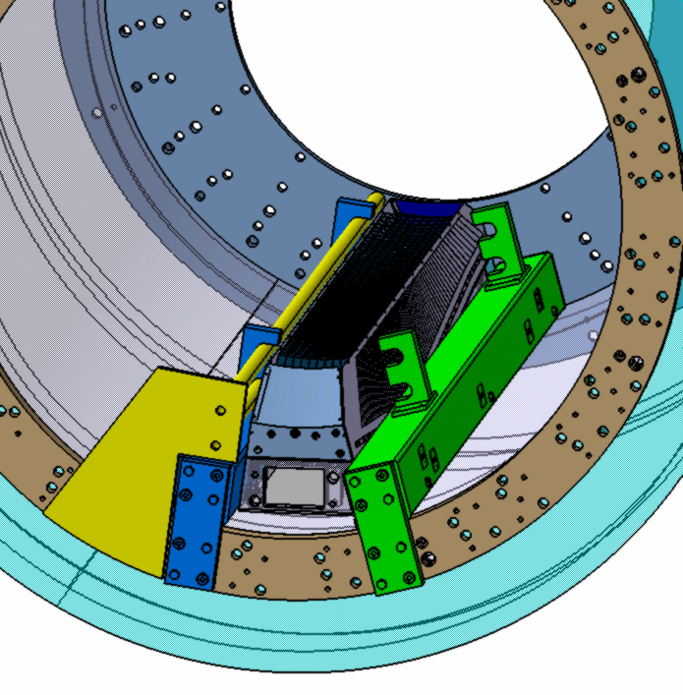
Procedures: -Slice is rolled up to the stop in the flange; -2 centering pins are installed in the holes
Step 8- Slice is at the working position

Slide 9
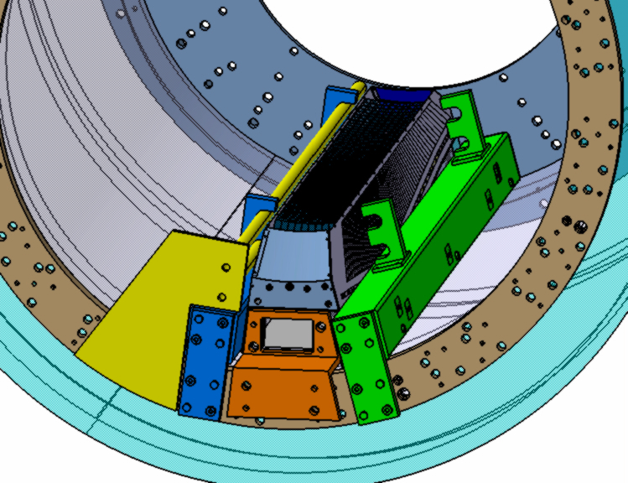
Step 9- Slice mounting at the working position
Procedures: -Slice to be fix to the upstream ring by the bracket;

Slide 10
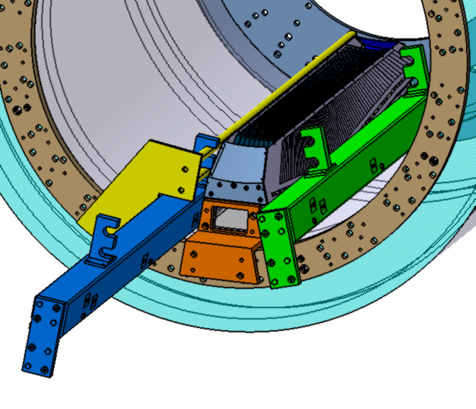
Step 10- Dismounting of the technological bracket
Procedures: - Removal of the technological beam (blue color) by sliding with the forks on the rails; - Removal of the bracket (Yellow color)

Slide 11
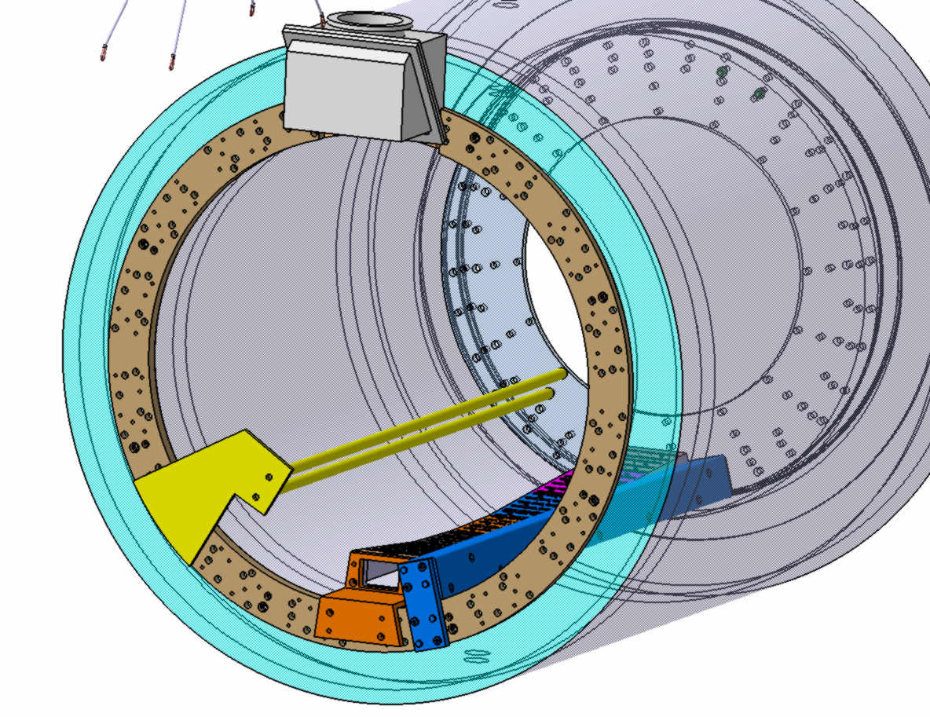
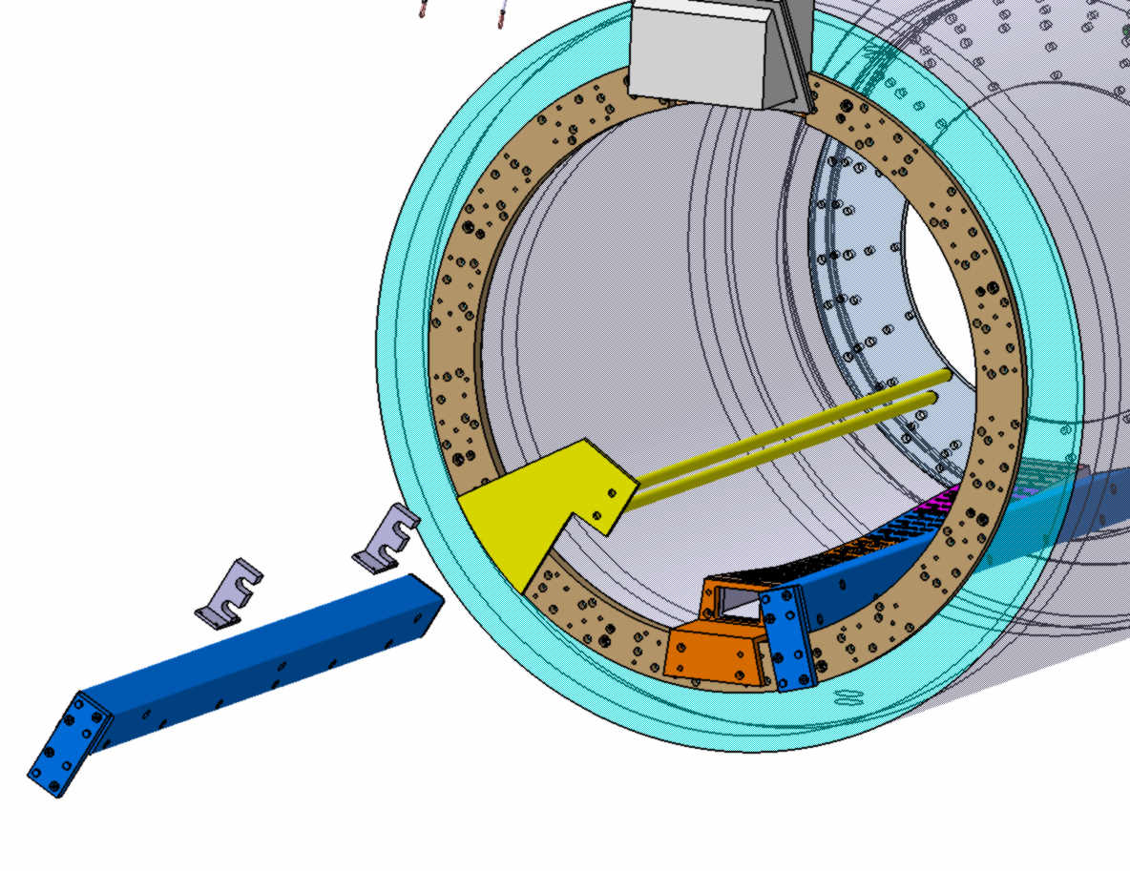
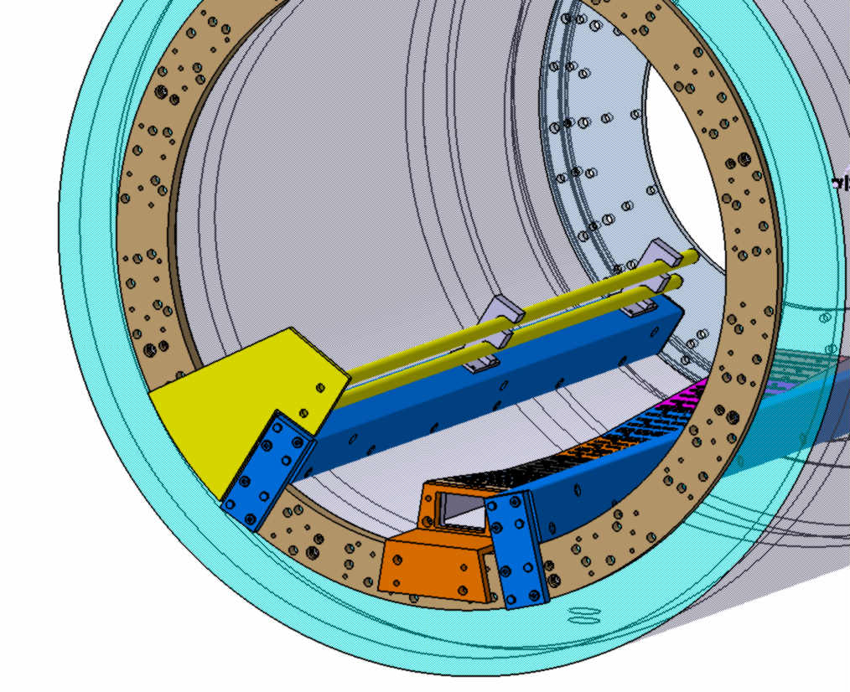
Step 11- Installation of the technological bracket in the next position
Procedures: - Installation of the bracket (yellow color);
- Installation of the technological beam in the new position

Slide 12
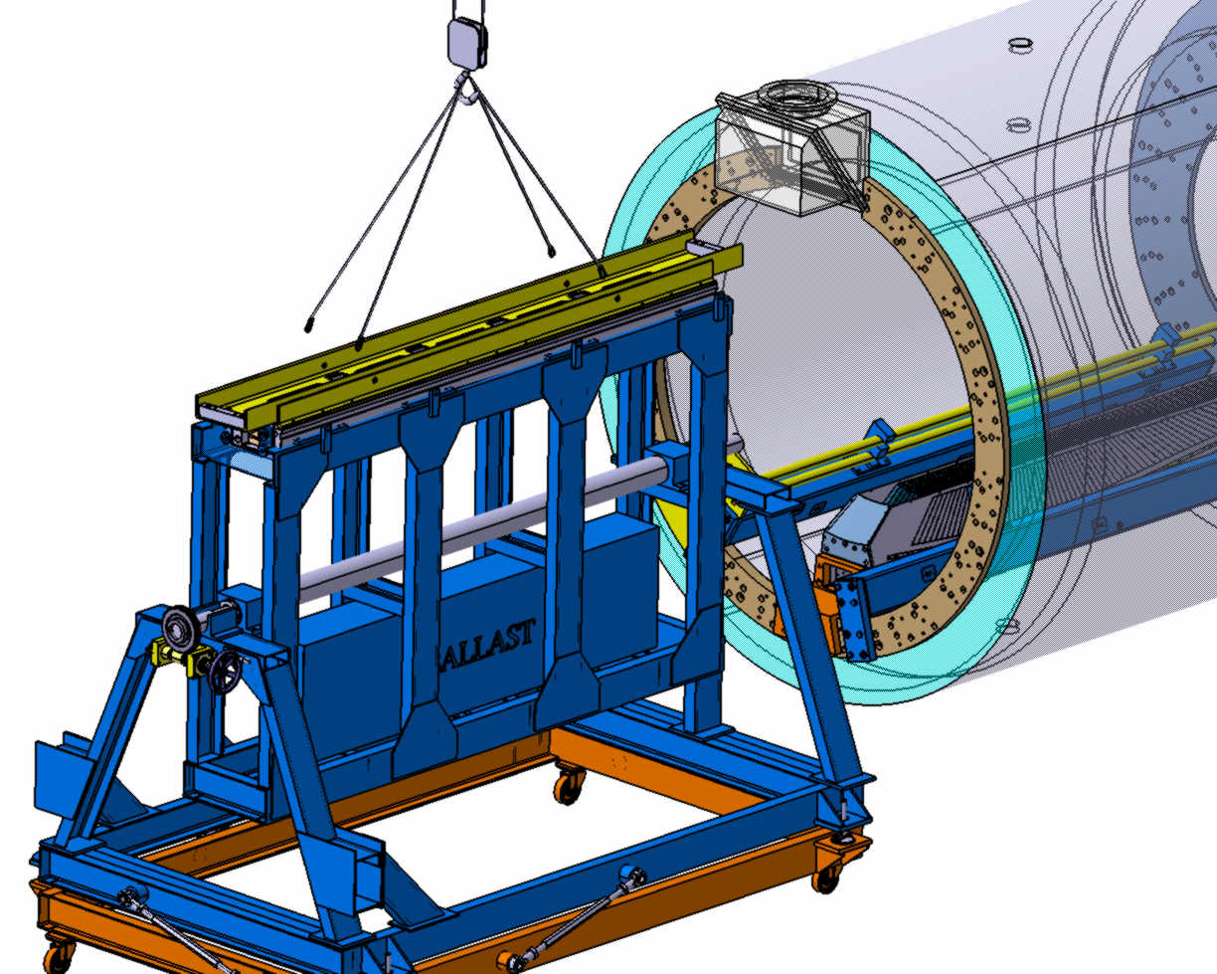
Step12- Installation of the tilting device (cantilever) in the preliminary position.
Installation and attachment of the slice to the cant.
Procedures:
The next slice to be install on the rotating platform of Technological device;
Adjusting of the slice and installation special guide rails to fix the slice

Slide 13
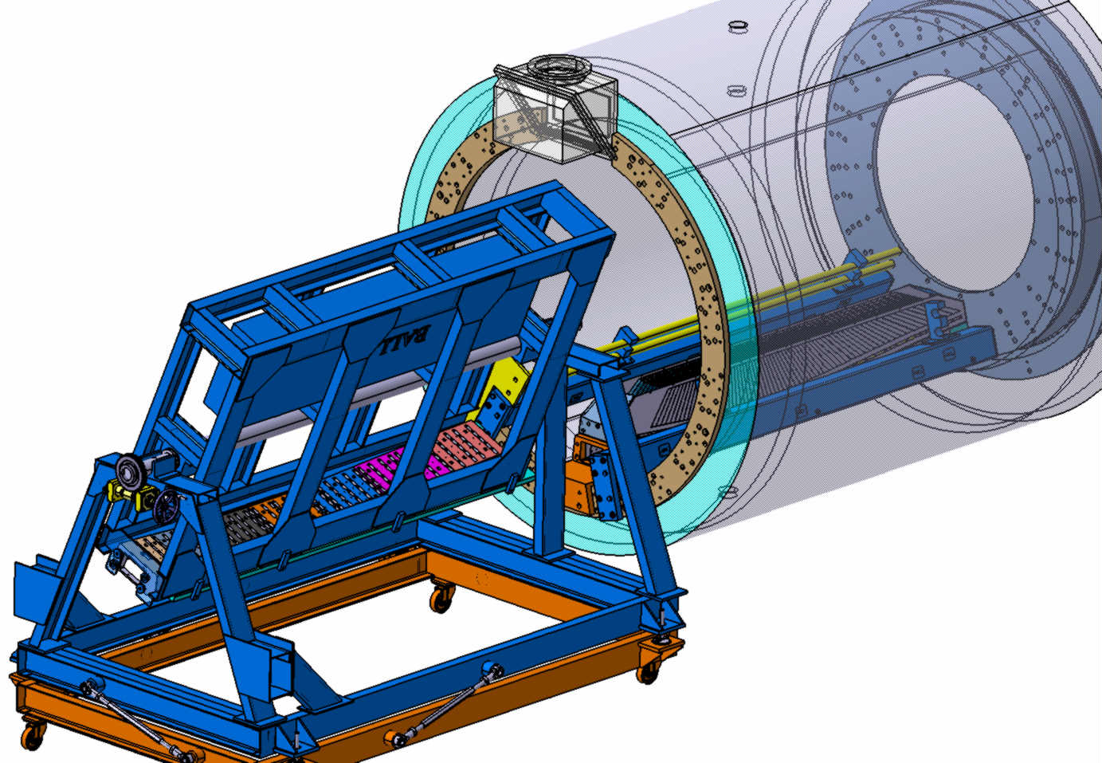
Step 13- Installation of the tilting device (cantilever) in the preliminary position.
Installation and attachment of the slice to the cant.
Procedures:
Rotating technological device by means of transfer worm;
Adjusting of the tilting I according to position of technological beams;
Push the slice till contact with rear flange. Centering pins have to be achieved to a holes.

Slide 14
Step 14- Installation of the technological bracket in the next position
Procedures: - Slice is rolled up to the stop in the rear flange; - 2 centering pins are installed in the holes

Slide 15
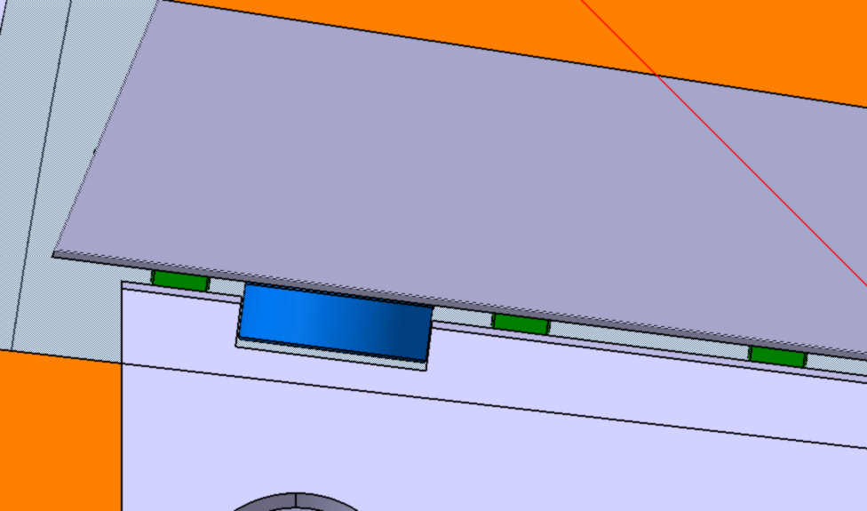
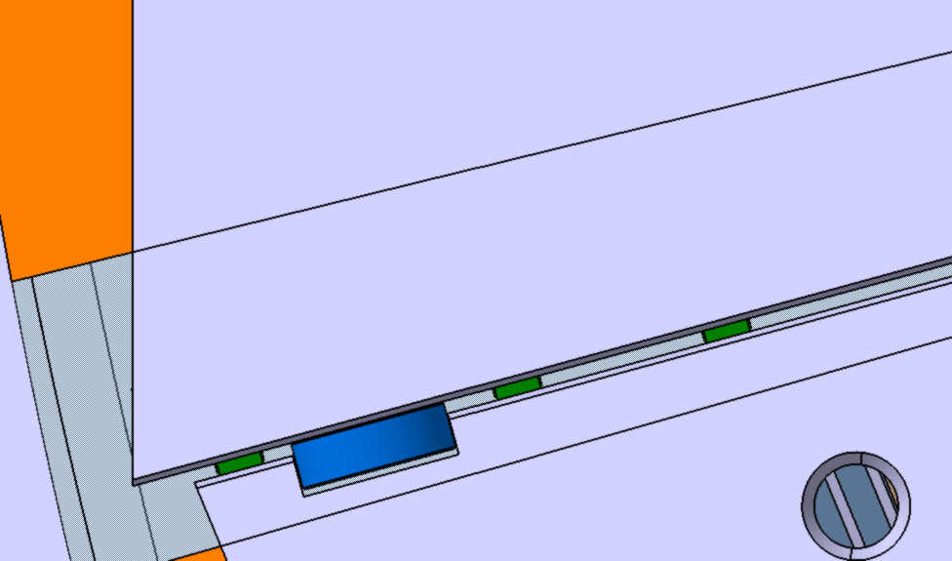
Поперечный разрез барреля. Подшипники закатные и позиционирующие
Step 15- Transversal section of the barrel Disposition of bearings

Slide 16
Step 16- Assembly continue
Procedures: - The same procedures as with the next slice

Slide 17
Step 17- Assembly continue
PROBLEM- The installation of the slice is impeded by the current lead

Slide 18
Step 18- Assembly continue
PROBLEM- The installation of the slice is impeded by the current lead
The technological beam and the bracket have to be refined

Slide 19
Step 19- Assembly continue
The same procedures for right side slices as with the left side slices

Slide 20
Step 20- Assembly continue
PROBLEMS- There is no place for fixing bracket, problem with cooling system (not shown here)

Slide 21
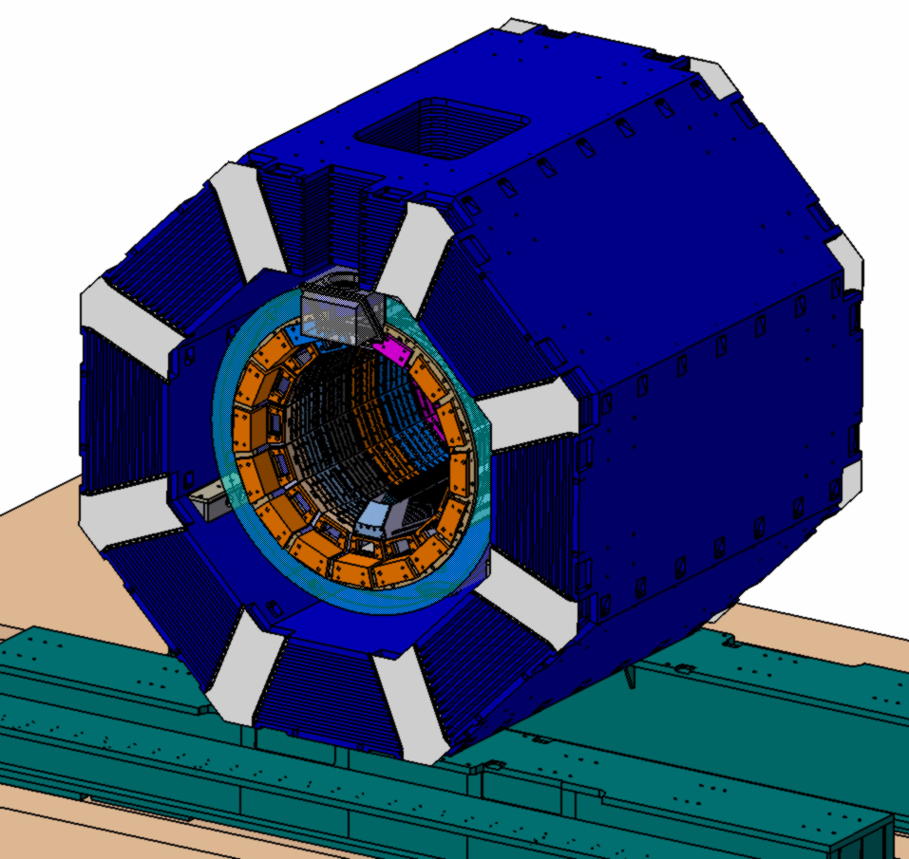
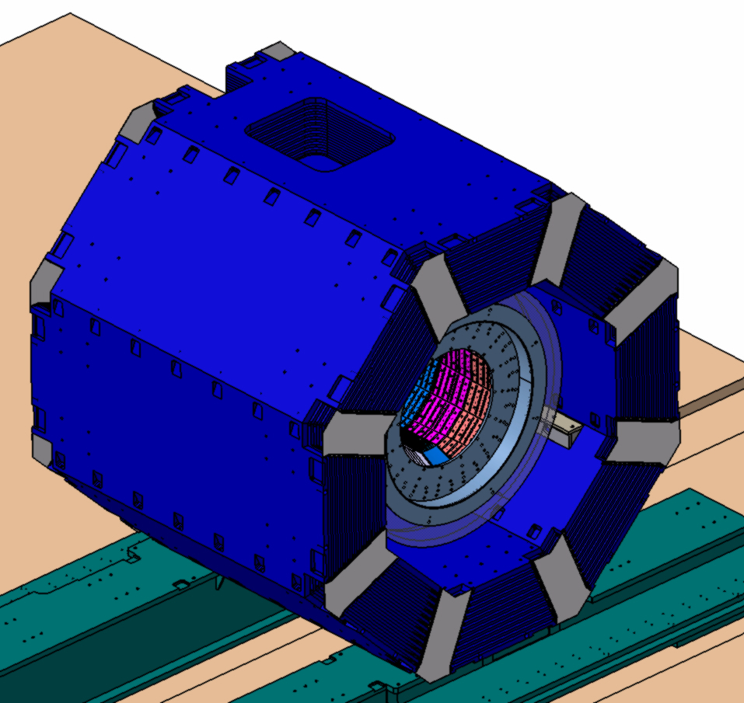
Completely view

Slide 22
ADVANTAGES AND DISADVANTAGES,
CONCLUSIONS
1. This version may be used with insufficient quantity of crystals for full calorimeter
2. In comparison with barrel version this version is more complicated.
3. Manufacturing of beam for slices must be more precisely because in case of
of barrel version we have spacers between of the slices so we may adjusting a gap.
In this version is NO adjusting. We may have some problem with insertion of next slice because some deformation may occurred.
4. Some problem with installation of last slice because of current lead.
5. To insert some additional slice you have to make dismounting some
part of calorimeter cooling system, monitoring system
6. To remove any slice and then move it once more in the same place may be
problematic because of deformation of upper slice (it loose its support).
That’s why we must make assembly procedure beginning from lower slice.

