Slide 1
Mechanics of the MVD
Daniela Calvo on behalf of the MVD group

Slide 2
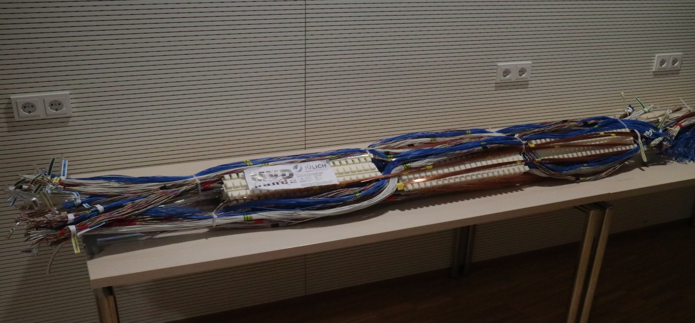
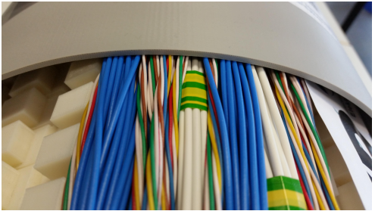
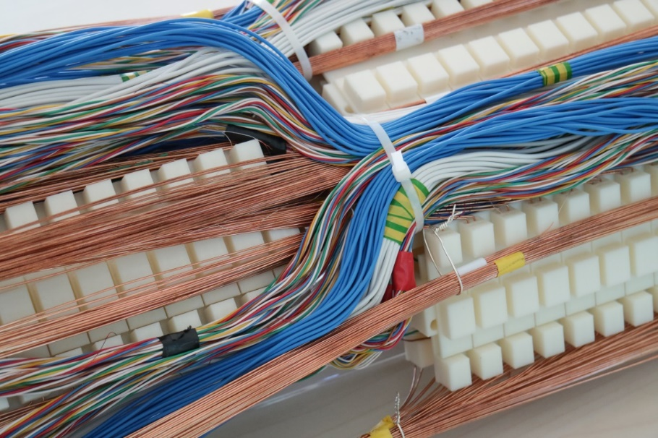
MVD services: mockup of DCDC part
340 diameter mock up

Slide 3
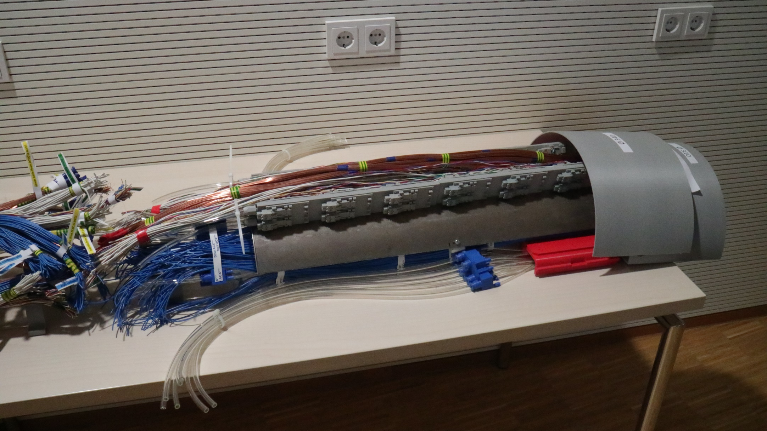
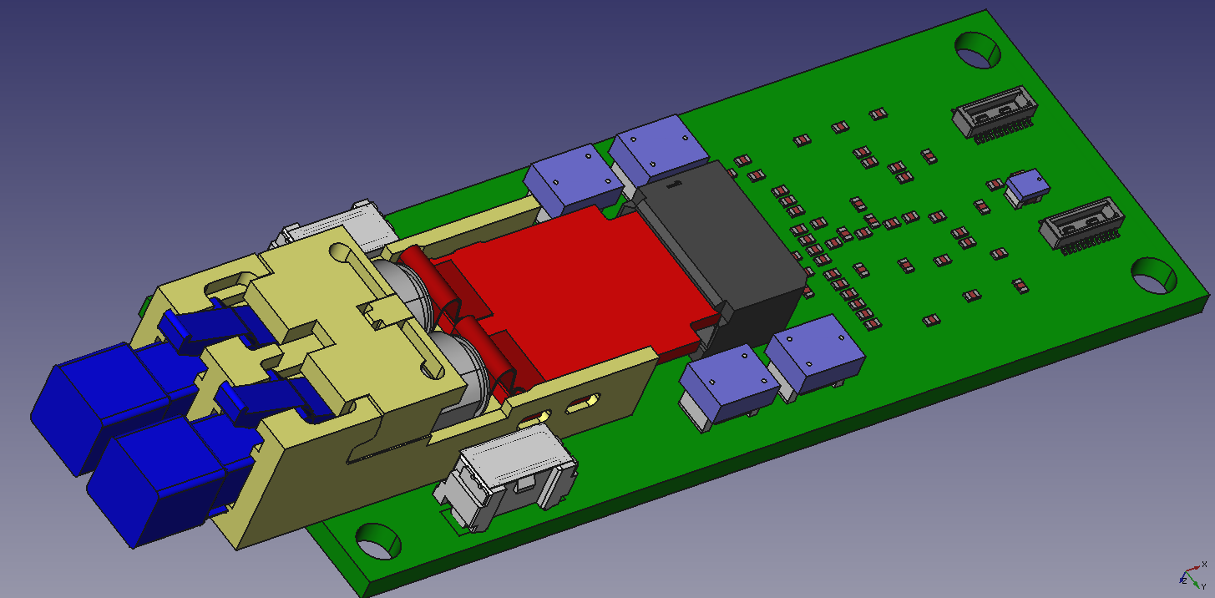
MVD services: mockup of the optoelectronic part
Power cables
Signal cables
86 mm
25.4 mm
Optical fibers

Slide 4
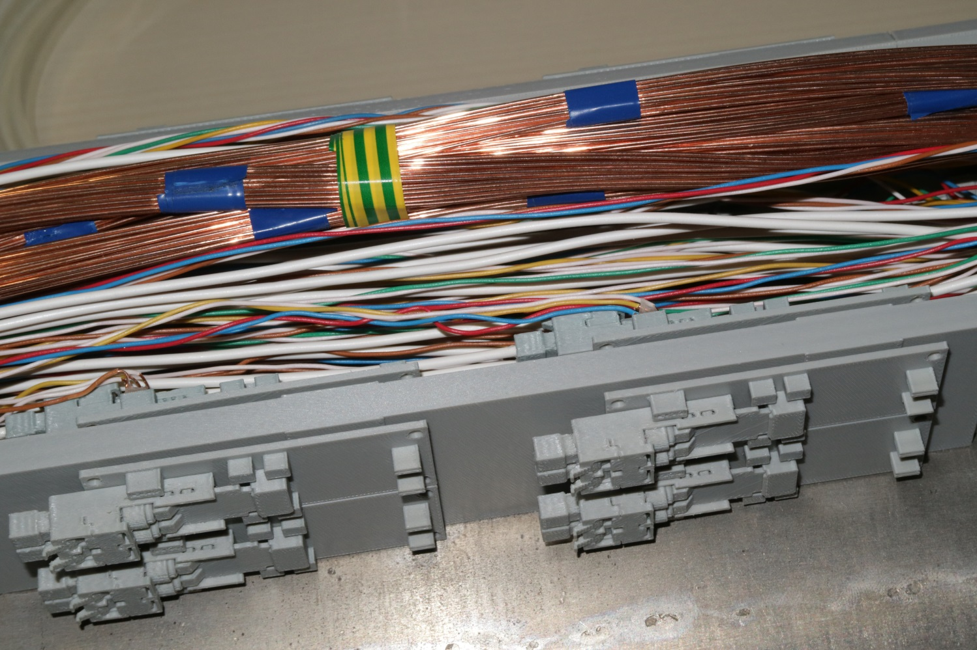
MVd services: Optoelectronic boards stave
Solution with two adjacent optoelectronic boards in the radius direction
Space for the GBT chipset and the thermal bridge to cool down this part

Slide 5
Story of the outer diameter
The outer diameter of 310 mm was not sufficient to accommodate all the services with cables and pipes;
Request to add 15 mm in radius (diameter: 340 mm) + a safety factor.
Mockups have been built to support this request: DCDC region and GBT region.
A diameter of 340 mm is just the limit of the cables.
1 cm more in radius is mandatory to allow a right arrangement of all the cables and the positioning of a shield
360 mm in diameter is the request for the MVD services space
+ the clearance between MVD and calorimeter

Slide 6
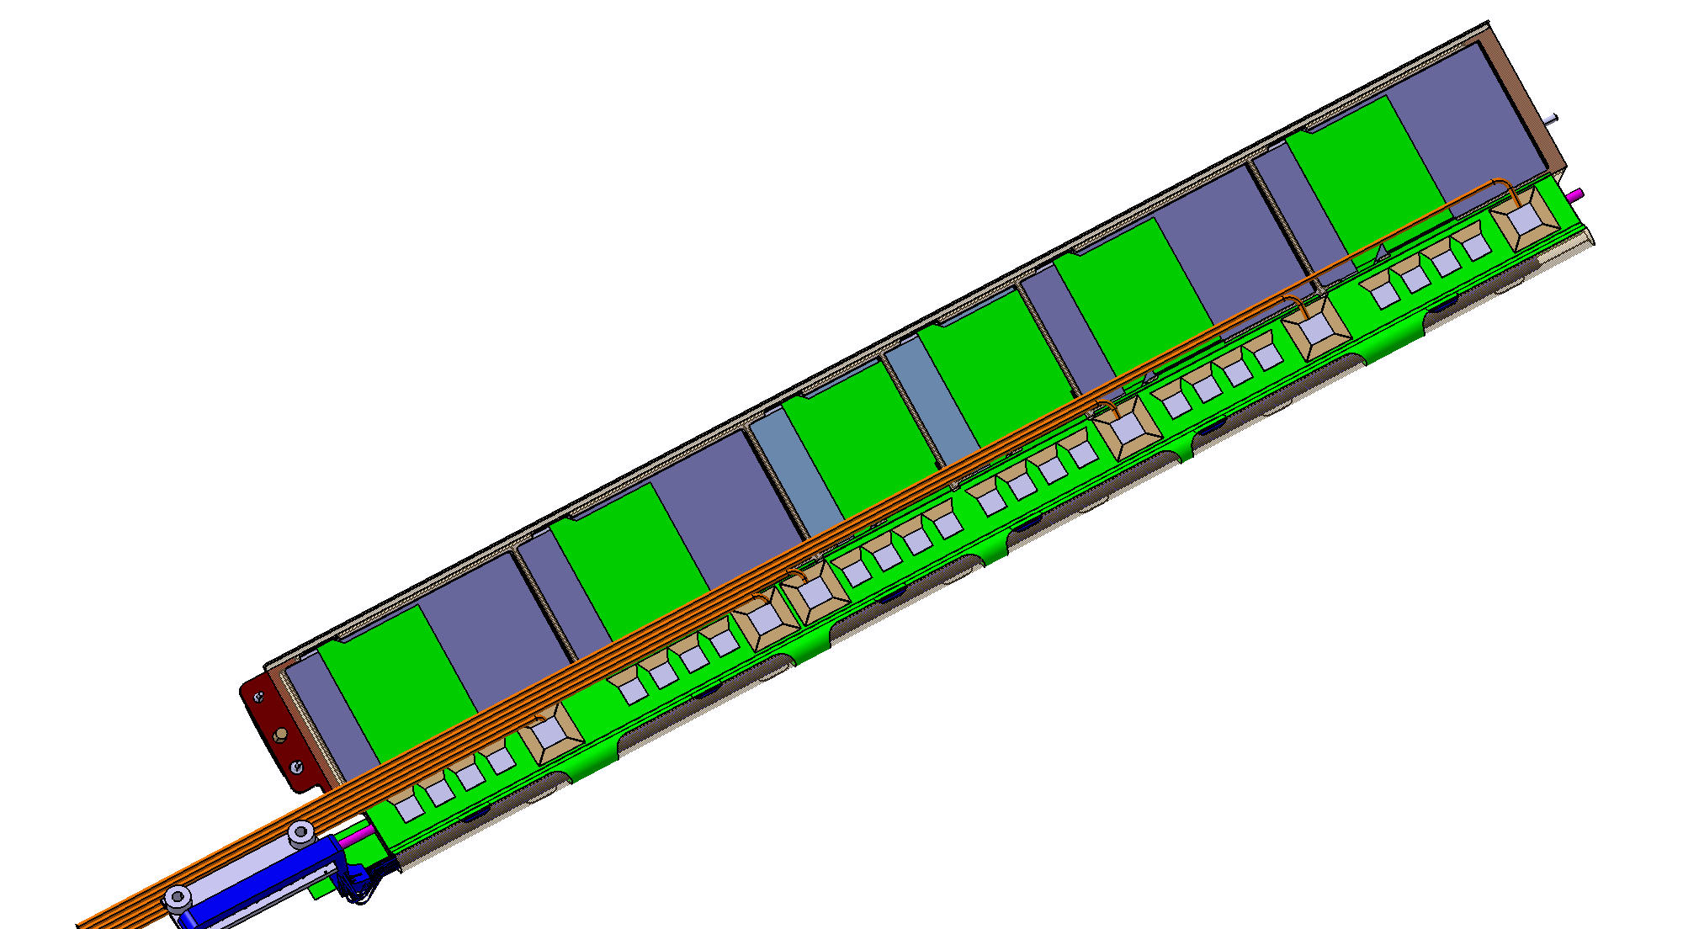
Barrel 4 stave
Work of R. Schmitz, E. Rosenthal, D. Grunwald (FZ Juelich) for the stave of the barrel 4
Flex PCB (1^ prototype) has to be designed and realized to perform gluing test and some other tests of wire bonding (in addition to the problem of to accommodate all the needed tracks)
The assembly process has to be studied deeply

Slide 7
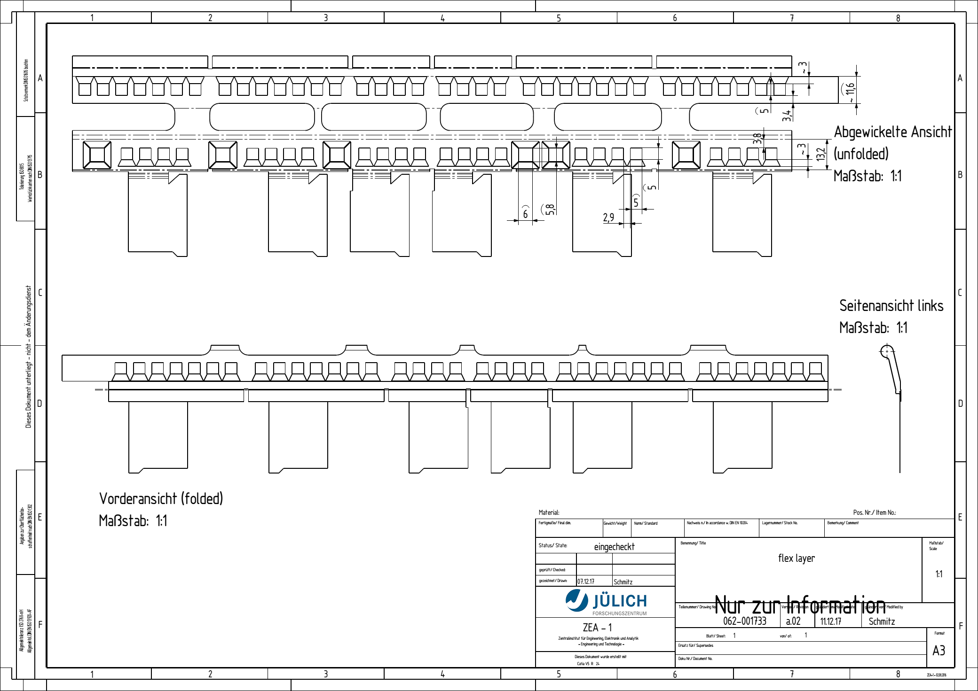
Flex pcb

Slide 8
Spares

Slide 9
MVd services

Slide 12
MVd services: Optoelectronic boards part

Slide 13
1 cooling rod (blue)(1 cooling pipe inside with input and output) equipped with 24
Optoelectronics board (yellow) arranged in 4 rows each with 6 boards.
The mockup demonstates that we need 15 mm in radius behyond the
present MVD limit with all the cables in a crowded arrangement and
without the delicated signal cables.
The additional request of 10 mm
presented in March
becomes very important
The total diameter
changes from 310 mm
to 360 mm.
The clearence must be maintened.
We gain space (green)
between the cooling rods
to route the LV cables (green part).
4 rods in the upper part
The same in the lower part.
8 rods instead of 12
Internal shield
and support
Scheme of the implemented solution

