Slide 1
INFN-LNF - SPAS
- SUMMARY -
NEWS FROM:
“CENTRAL SUPPORT FRAME” -
NEWS FROM
“STRAW-TUBES TRACKER” -
- “NEXT STEPS” -
Julich - September 2009 - D.Orecchini

Slide 2
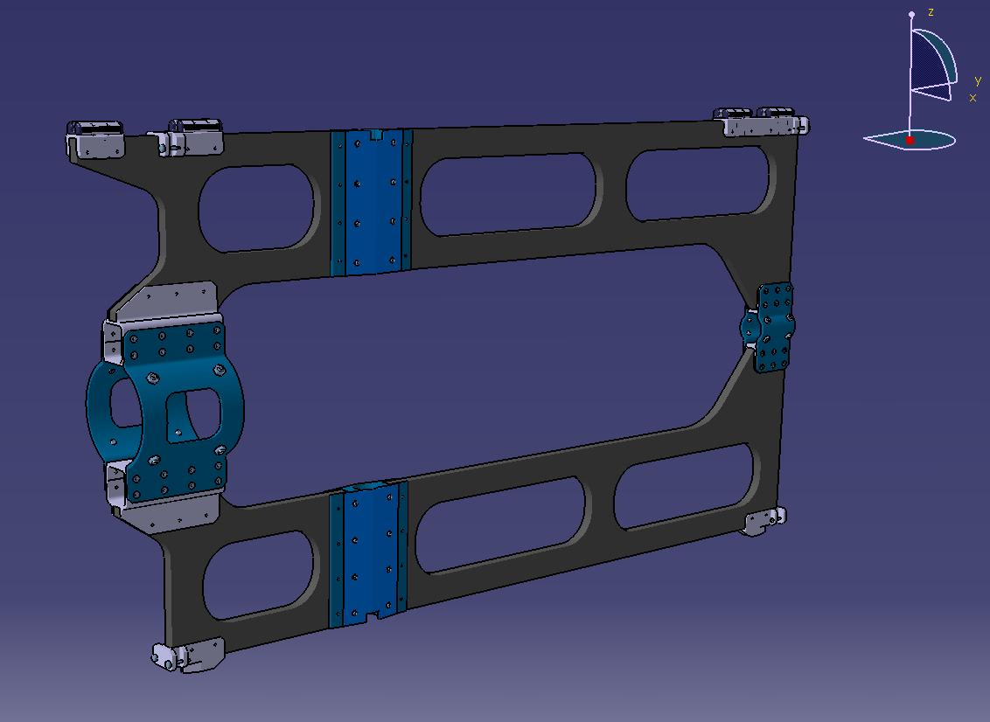
INFN-LNF - SPAS
- CENTRAL SUPPORT FRAME -
The “Central Support Frame” prototype is going to be realized in
INFN Turin workshop.
- The start of construction has been planned within september.
1
Julich - September 2009 - D.Orecchini

Slide 3
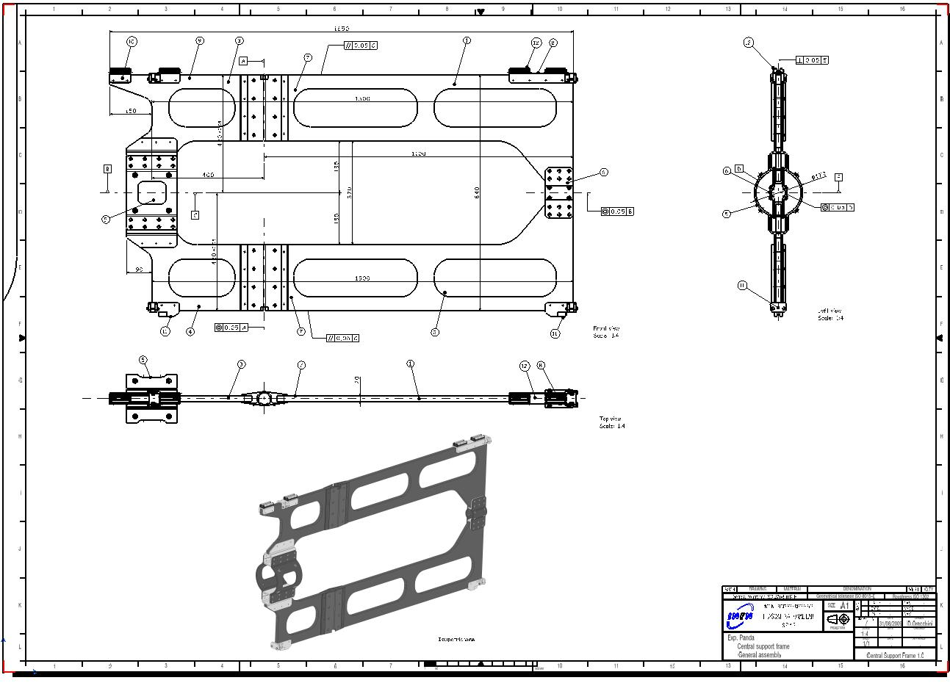
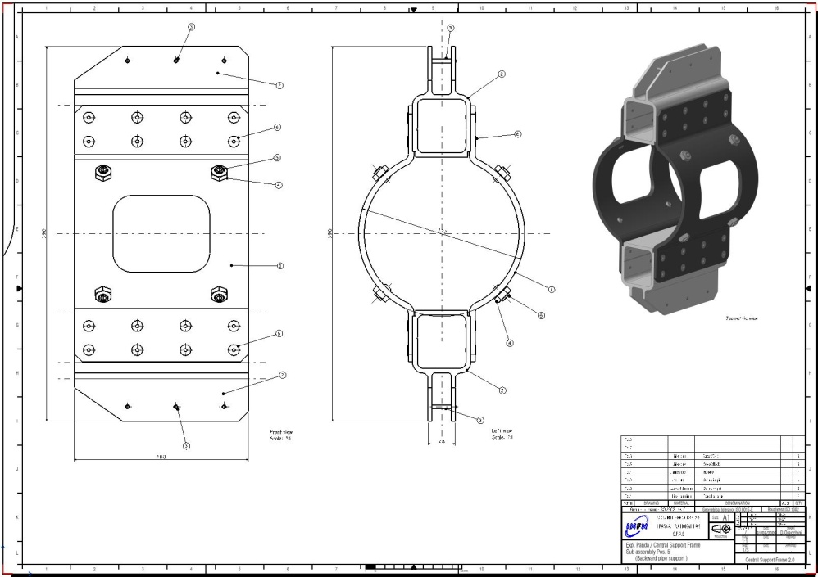
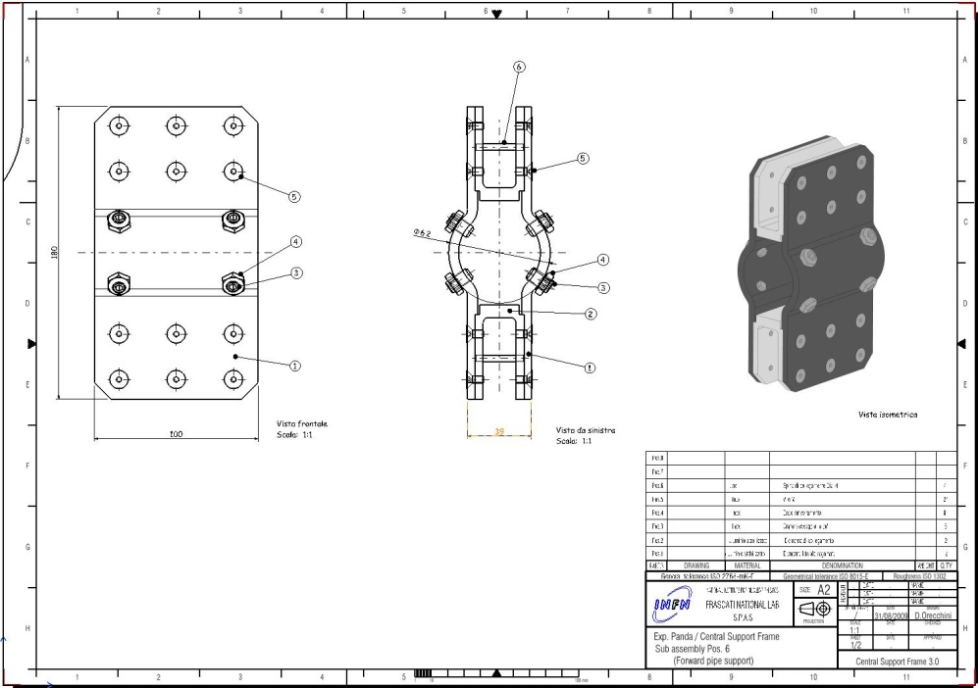
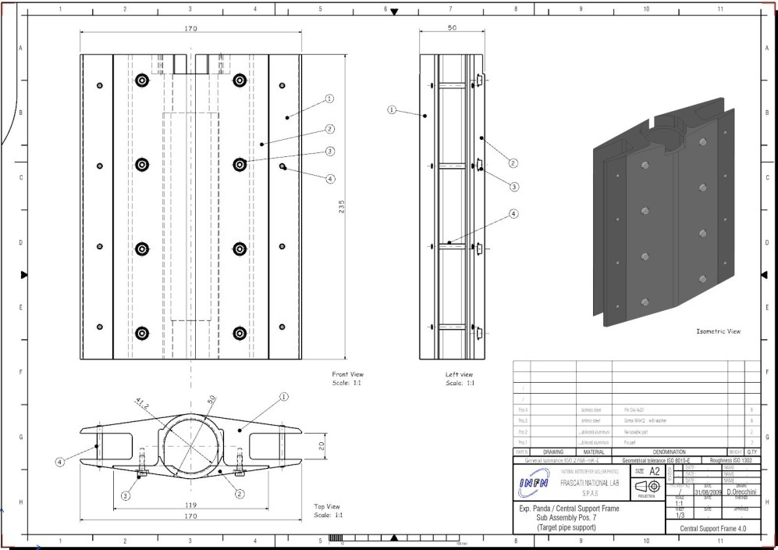
INFN-LNF - SPAS
- CENTRAL SUPPORT FRAME -
- THE CONSTRUCTION DRAWINGS HAS BEEN DEVELOPED IN FRASCATI -
Details:
- Backward pipe support-
- Assembly -
Details:
- Forward pipe support-
Details:
Target pipe support -
2
Julich - September 2009 - D.Orecchini

Slide 4
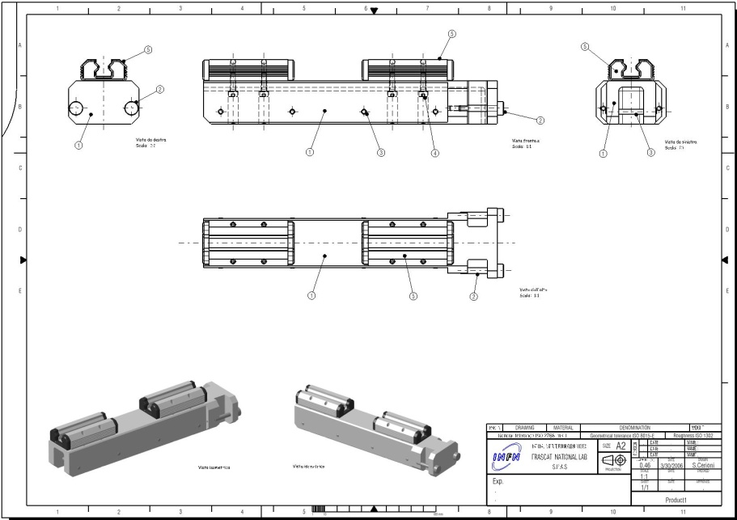
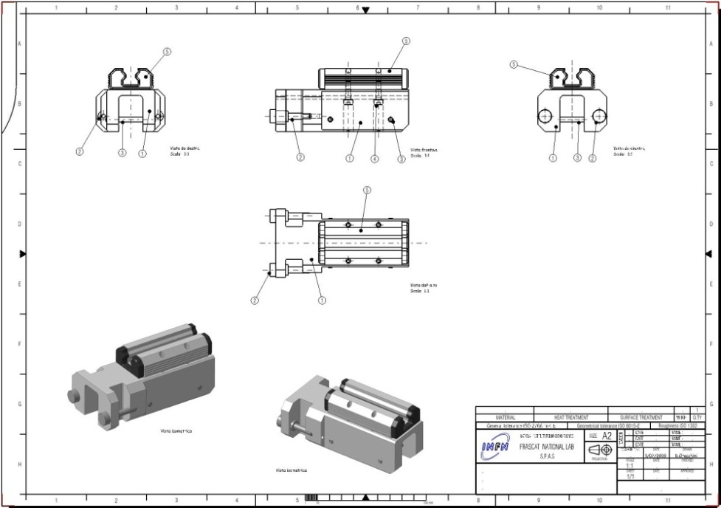
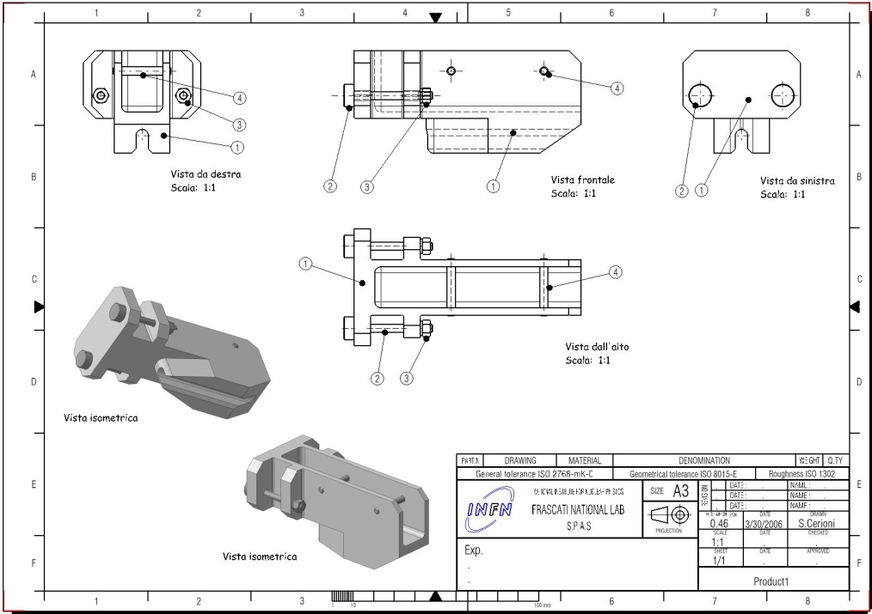
INFN-LNF - SPAS
- CENTRAL SUPPORT FRAME -
Details:
- Forward skate support-
Details:
- Backward skate support-
Details:
- Lower guide elements -
3
Julich - September 2009 - D.Orecchini

Slide 5
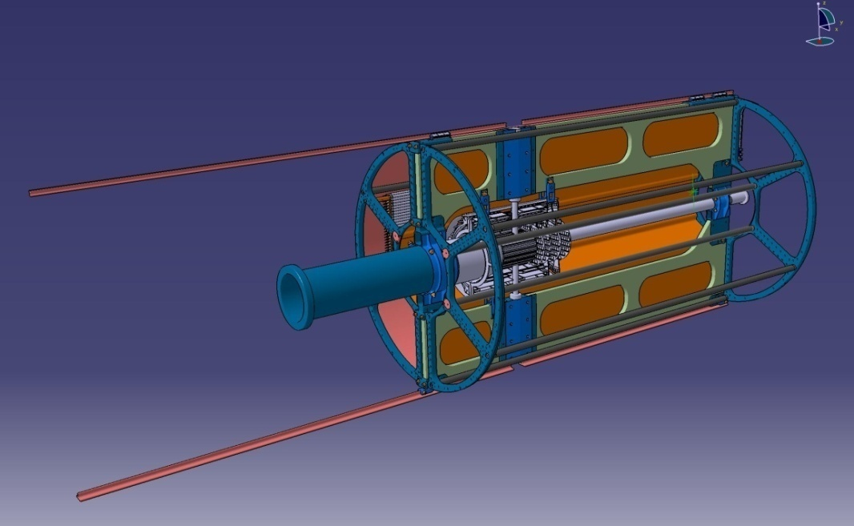
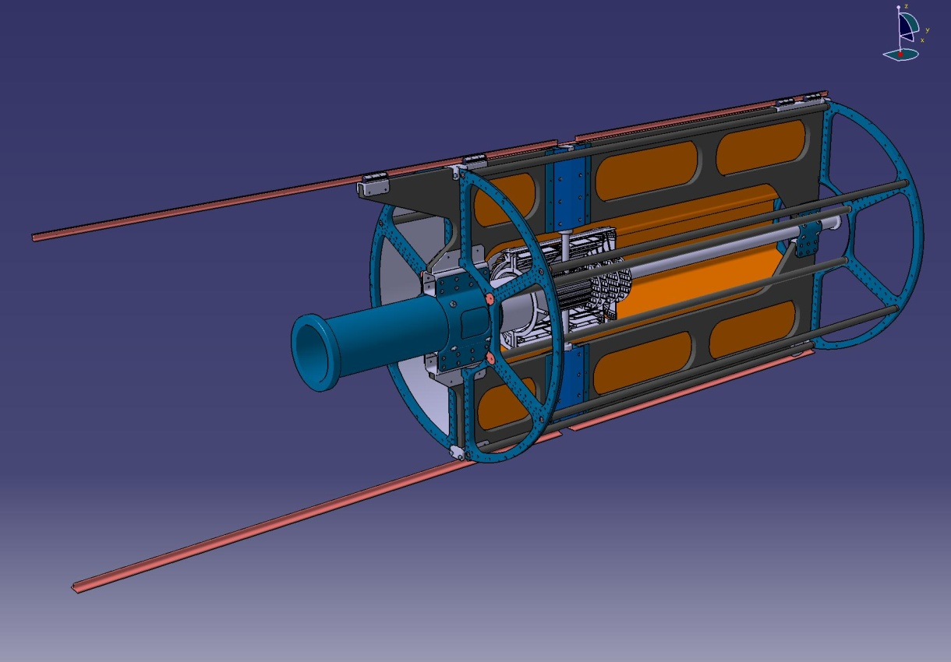
INFN-LNF - SPAS
- CENTRAL SUPPORT FRAME -
- CENTRAL SUPPORT FRAME GEOMETRY -
An update , probably , will be done to the Frame geometry.
- New geometry -
- Old geometry -
A sort of “nose” will be realized on the backward upper side.
4
Julich - September 2009 - D.Orecchini

Slide 6
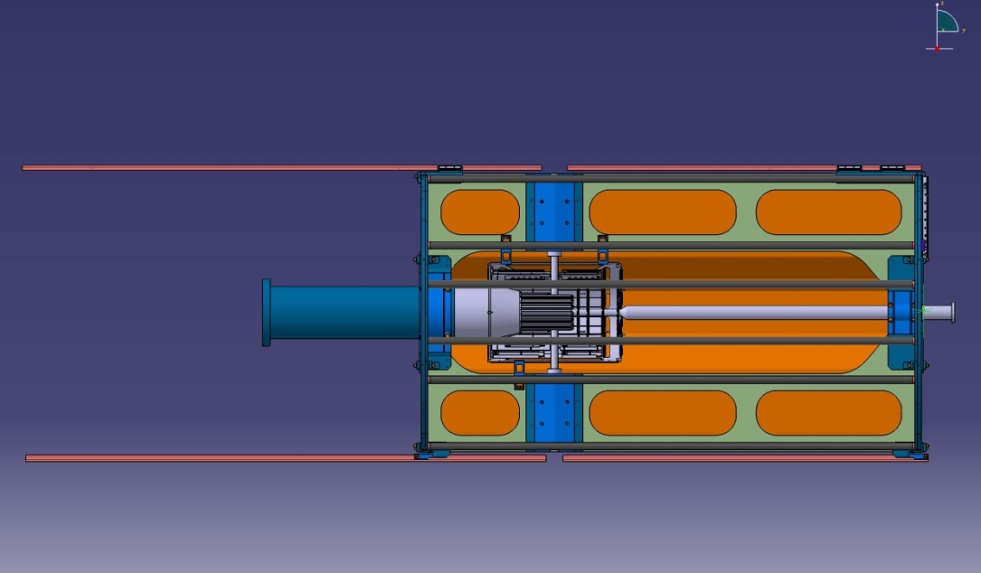
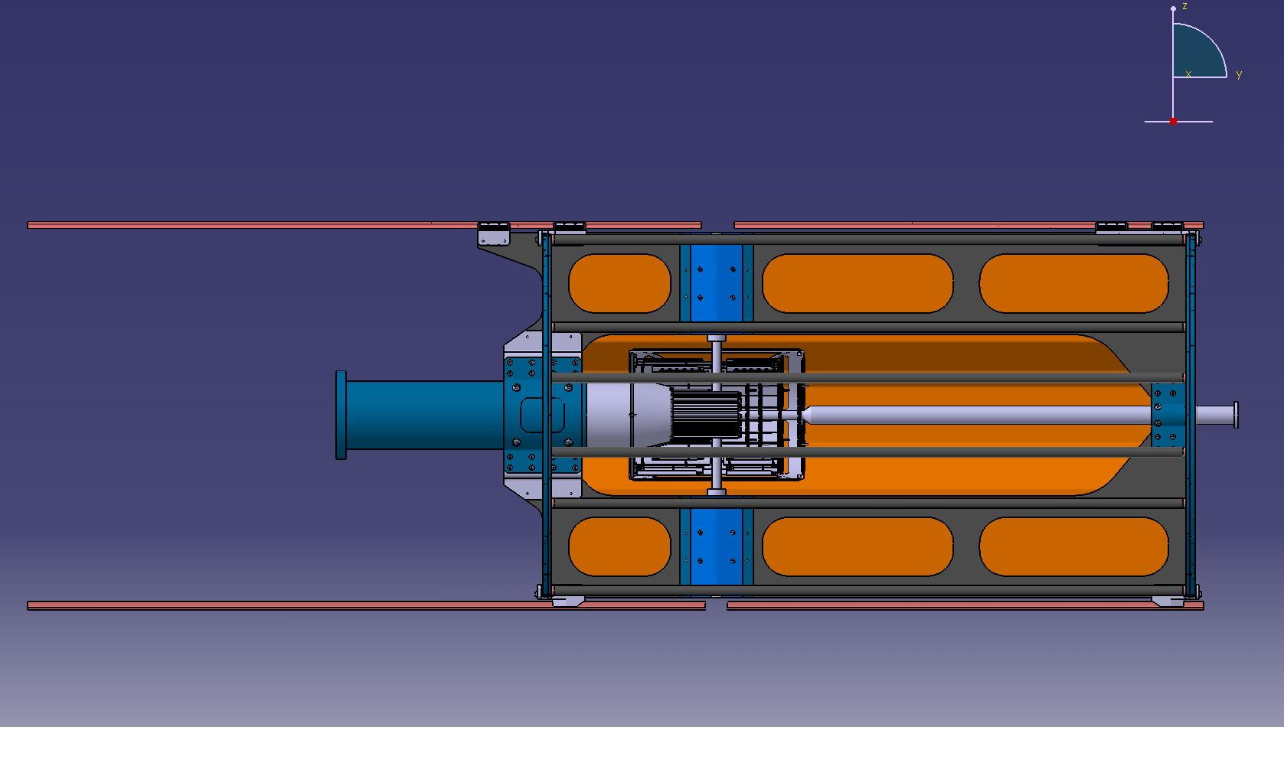
INFN-LNF - SPAS
- CENTRAL SUPPORT FRAME -
THE REASON IS:
TO PREVENT THE ROTATION OF THE FRAME, DUE TO THE EXTERNAL LOAD OF THE “PIPE FLANGE PLUS THE VACUUM PUMP” -
- New geometry -
- Old geometry -
?
Flange plus Vacuum Pump load.
?
5
Julich - September 2009 - D.Orecchini

Slide 7
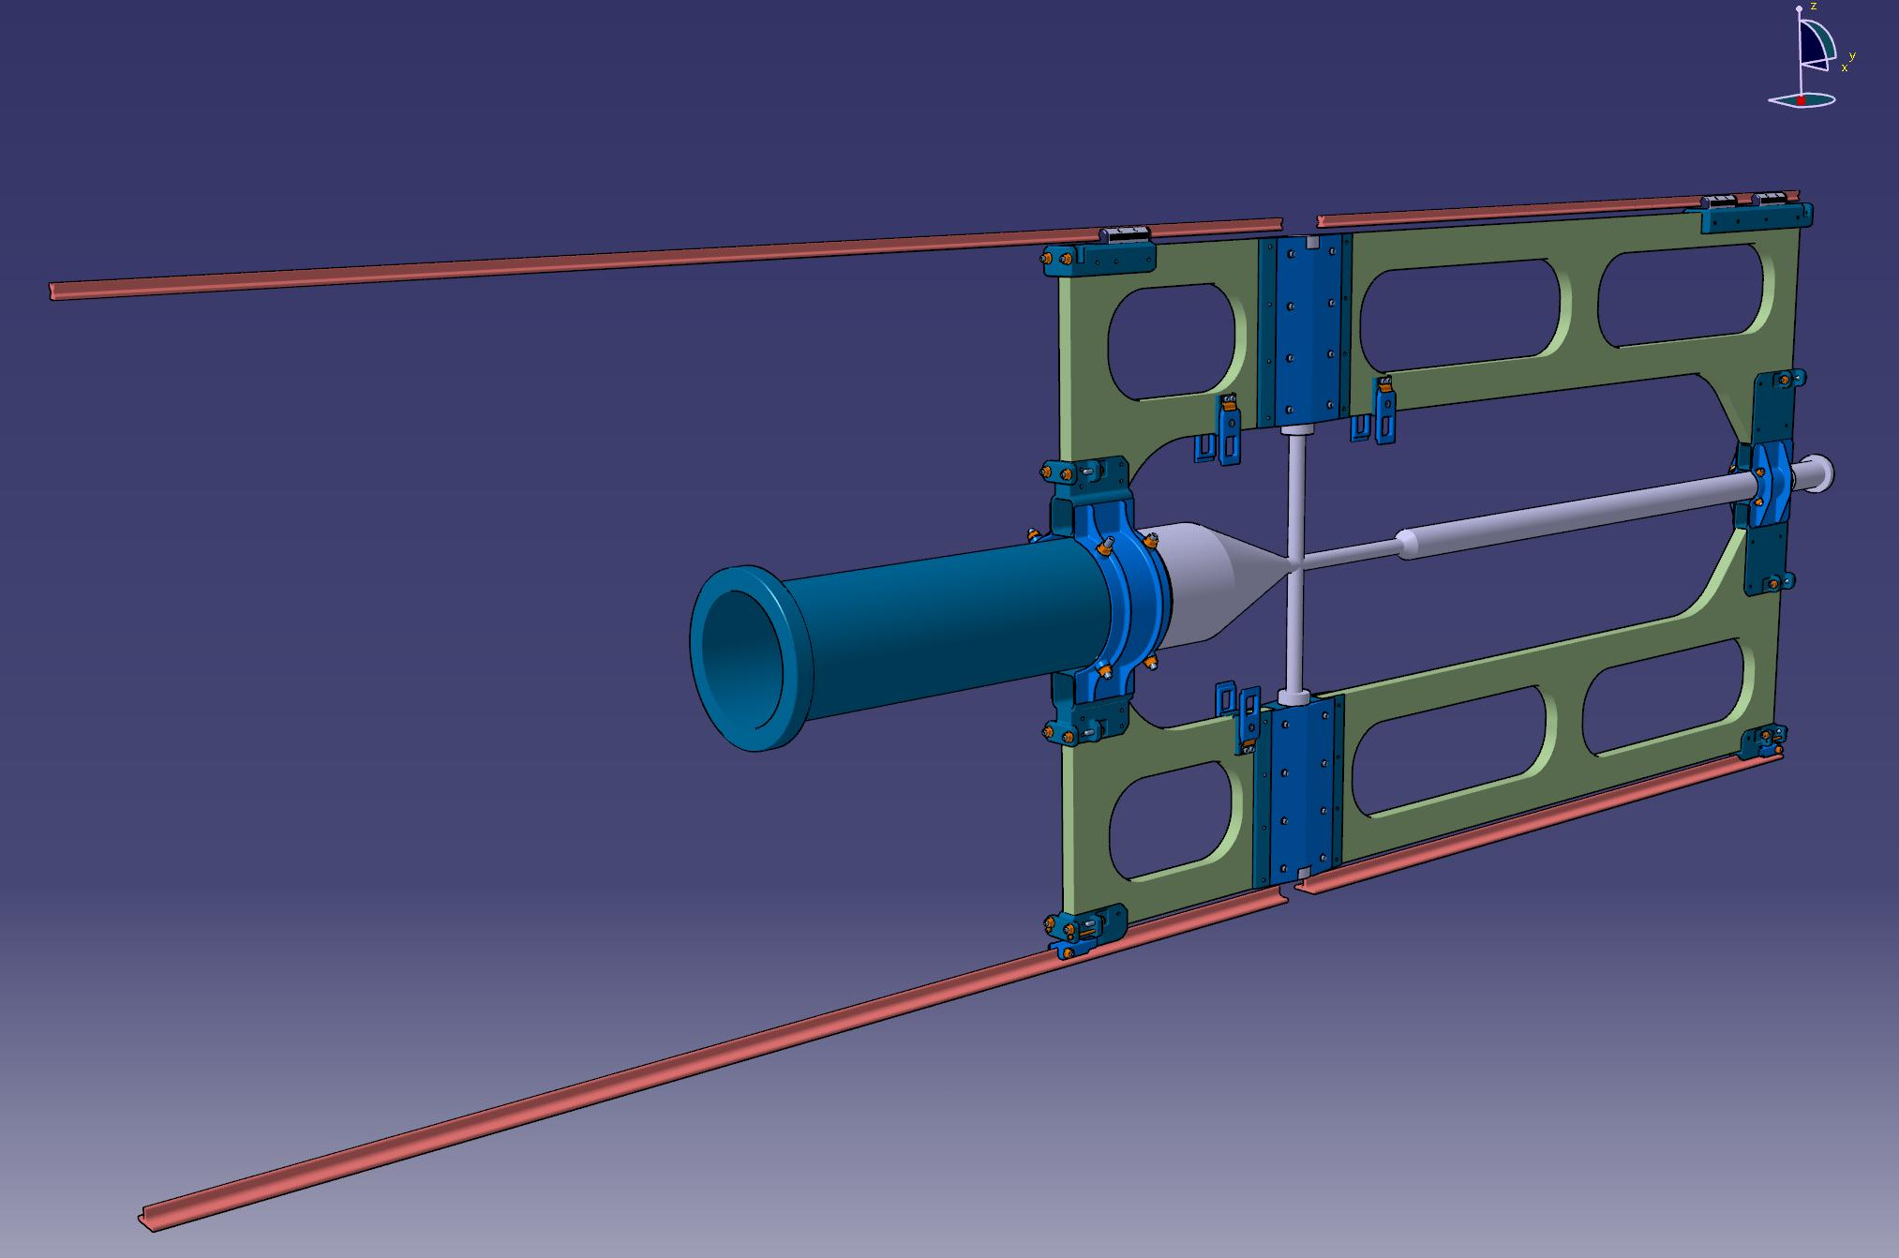
INFN-LNF - SPAS
- CENTRAL SUPPORT FRAME -
NB: The items that must be better to develop before the construction of the
frame prototype (in agreement with the involved peaple ) are:
- the connection points with the target pipe and the beam pipe and the
related functional and structural verifications.
6
Julich - September 2009 - D.Orecchini

Slide 8
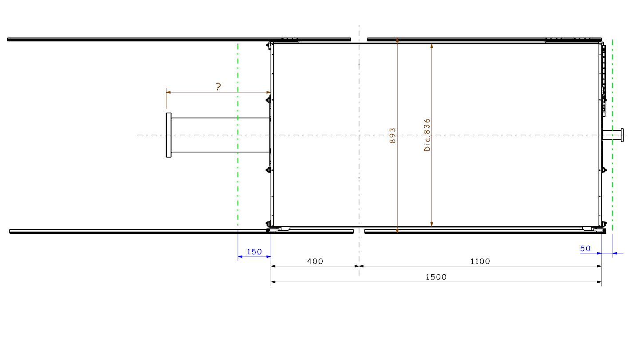
INFN-LNF - SPAS
- S_TUBES TRACKER MAIN DIMENSIONS -
- JUST TO REMEMBER -
-”Up and Down Rails” outer encumbrance: 893mm.
(Inserting System)
- S_TUBES TRACKER: main dimensions inside the target spectrometer.
-ST_Tracker: diam. 836mm.
-Electronics system encumbrance: 150mm.
-Gas system encumbrance: 50-60mm.
7
Julich - September 2009 - D.Orecchini

Slide 9
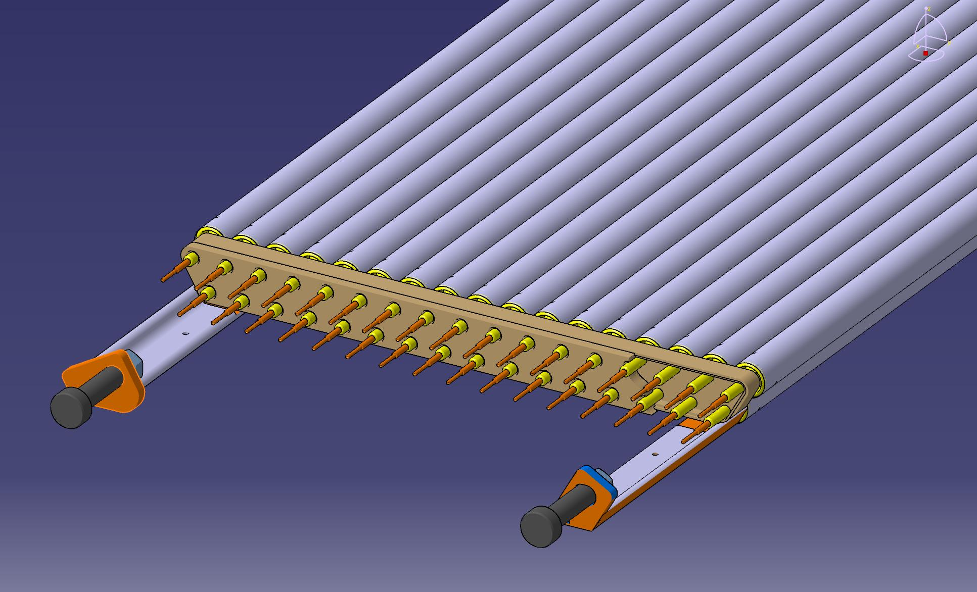
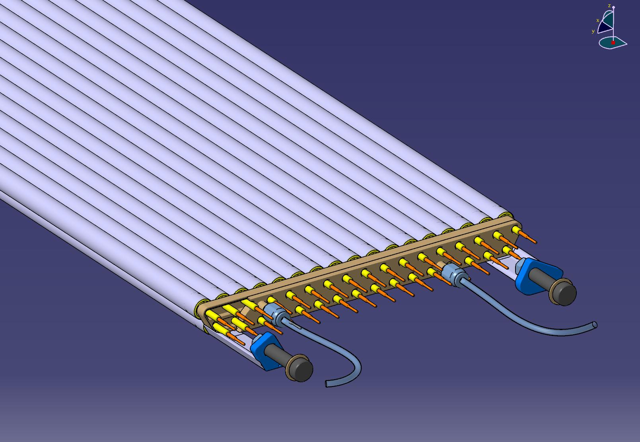
INFN-LNF - SPAS
- S_TUBES TRACKER DEVELOPMENTS -
Has been developed a completely new system for what concern:
- the straws end-plug;
- the connecting “straws modules” elements;
- the “straws gas supply system “;
- the mechanical connection on the support structure.
- New “straws gas-supply” -
9
Julich - September 2009 - D.Orecchini

Slide 10
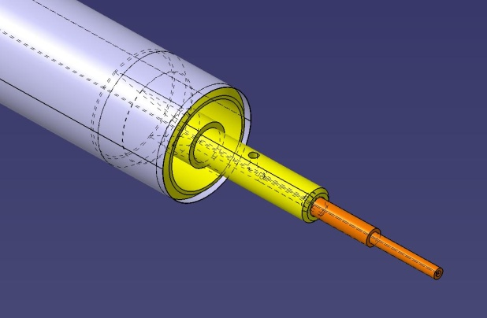
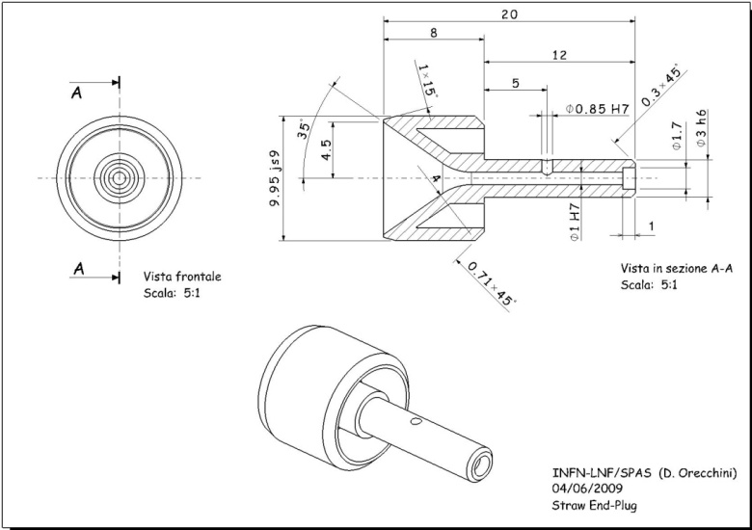
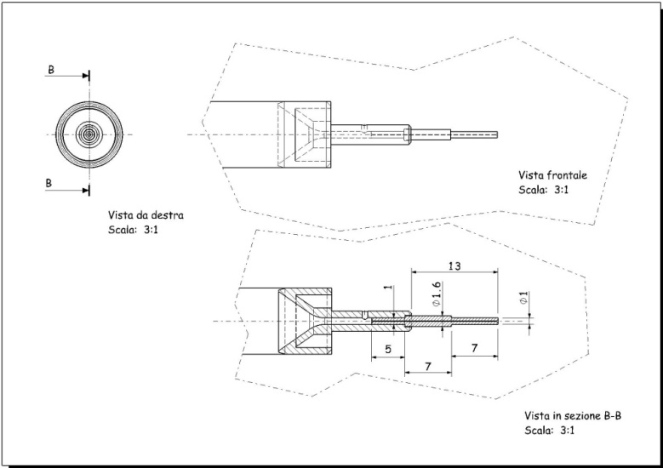
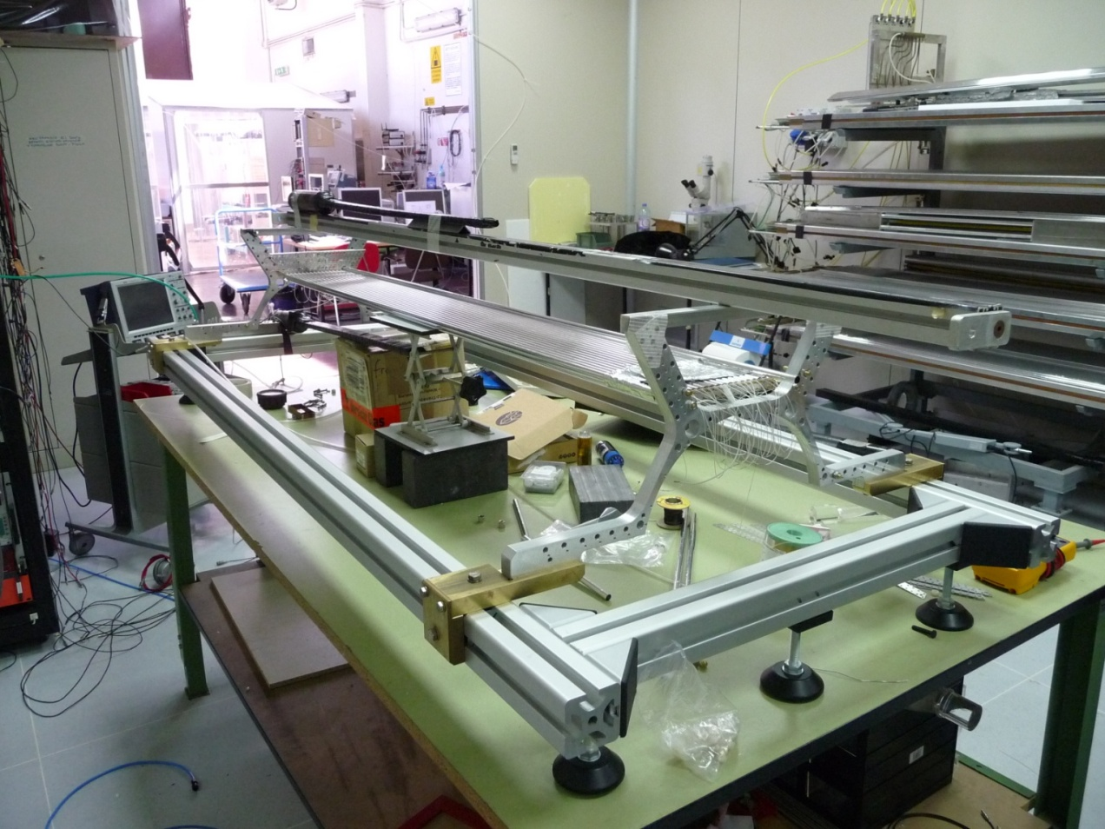
INFN-LNF - SPAS
- S_TUBES TRACKER DEVELOPMENTS -
- New “straw end-plug” -
The new components are under construction or under
development.
In the next months are planned a series of tests.
10
Julich - September 2009 - D.Orecchini

Slide 11
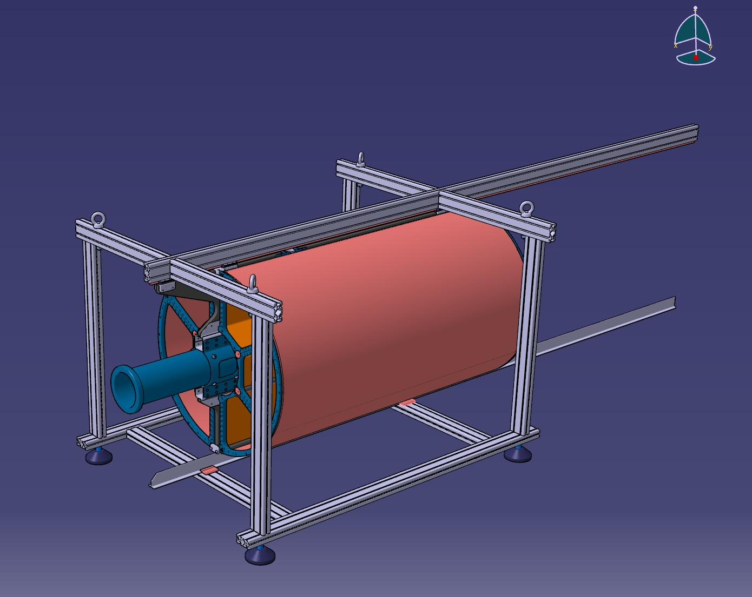
INFN-LNF - SPAS
- NEXT STEPS -
- CENTRAL TRACKER AUXILIARY SUPPORT STRUCTURE -
The “Central Tracker auxiliary Support Structure” prototype is going
to be realized in LNF workshop.
- The start of construction has been planned within october.
11
Julich - September 2009 - D.Orecchini

