Slide 1

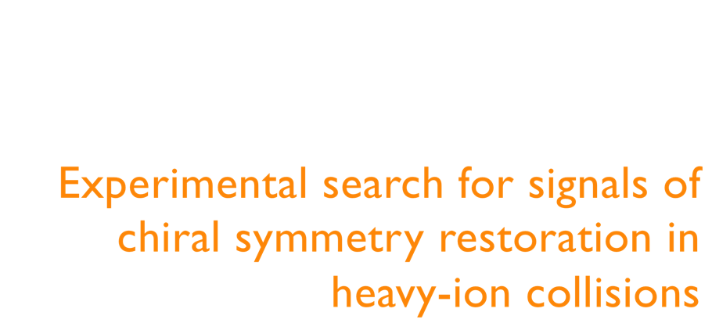
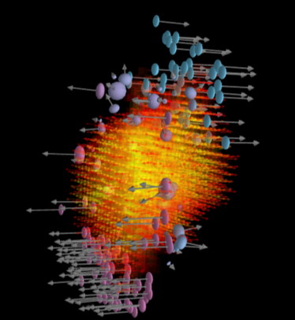
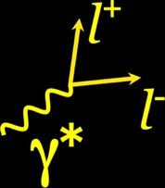


Slide 2

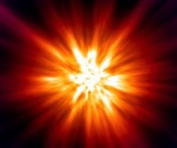


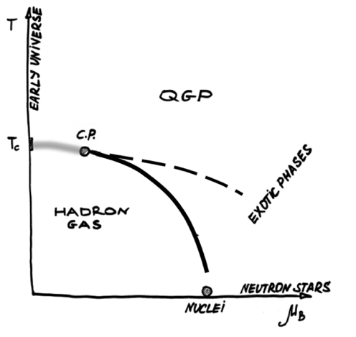


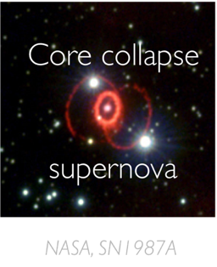
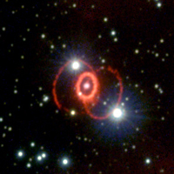
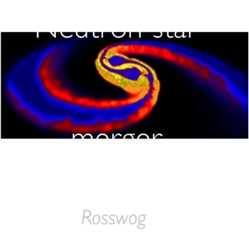
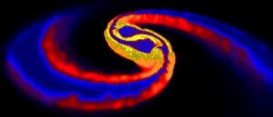

Early
Universe
Neutron star
merger
Core collapse
supernova
Rosswog
NASA, SN1987A

Slide 3
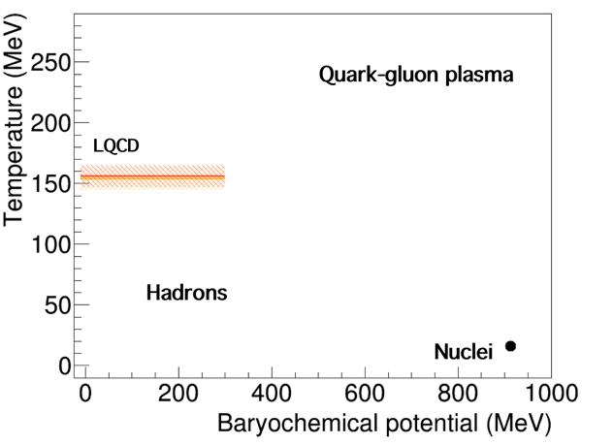



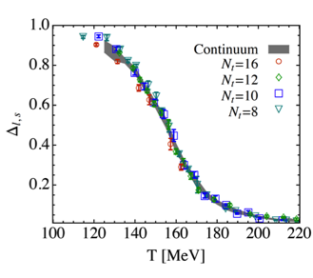
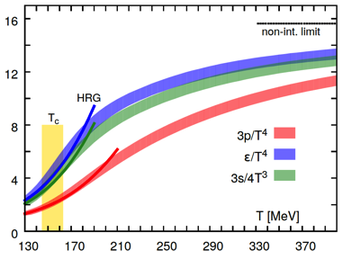




Slide 4
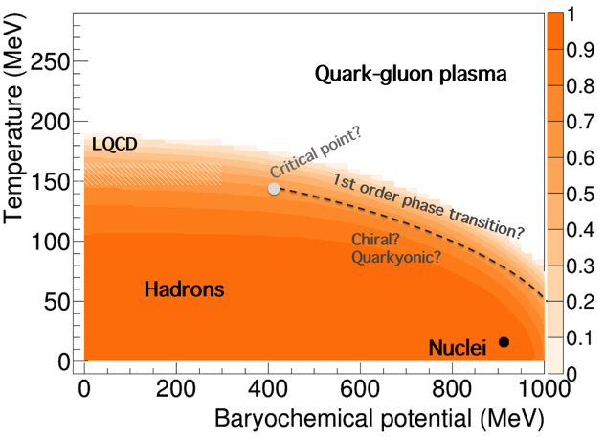
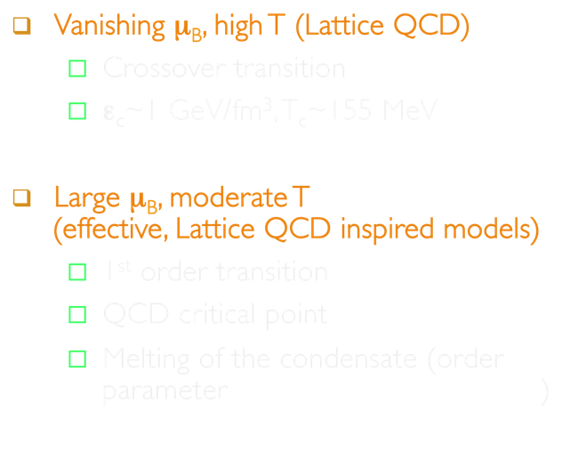


Slide 5
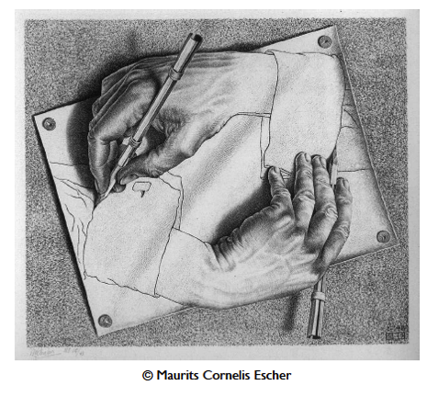



Slide 6
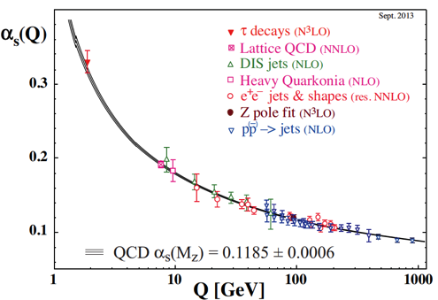


Invariance under
isospin and “handedness”

Slide 7

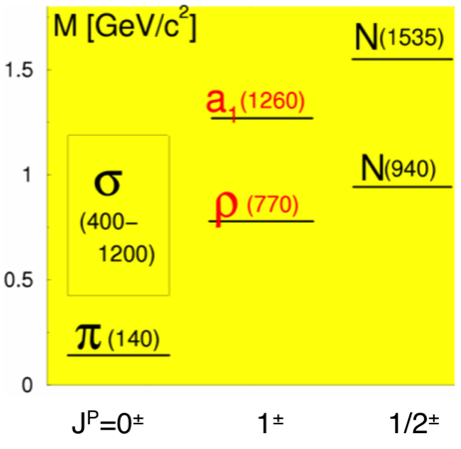



Slide 8






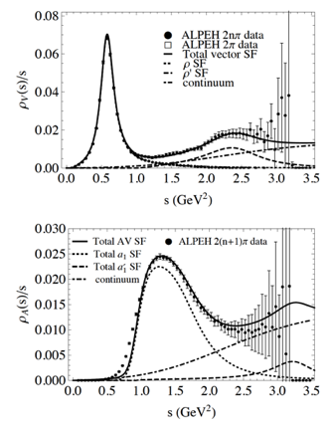


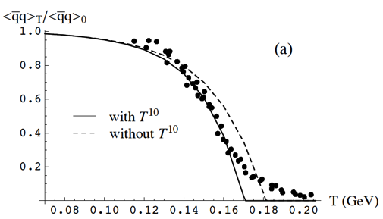
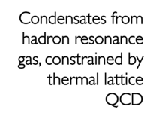





Slide 9
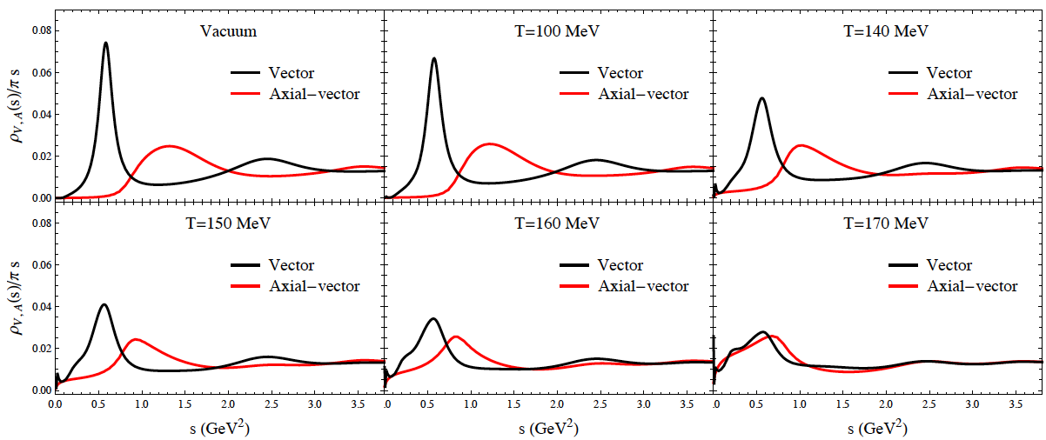
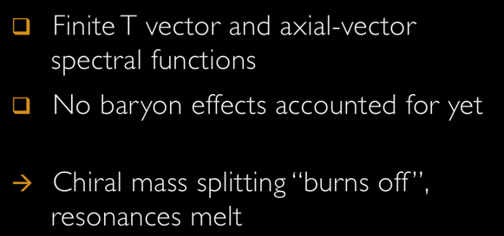

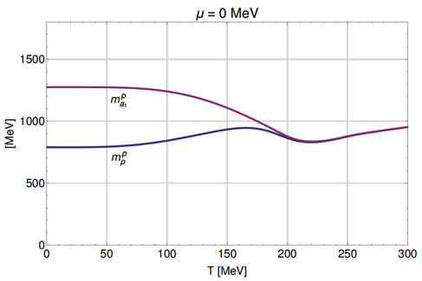



Slide 10










Slide 11
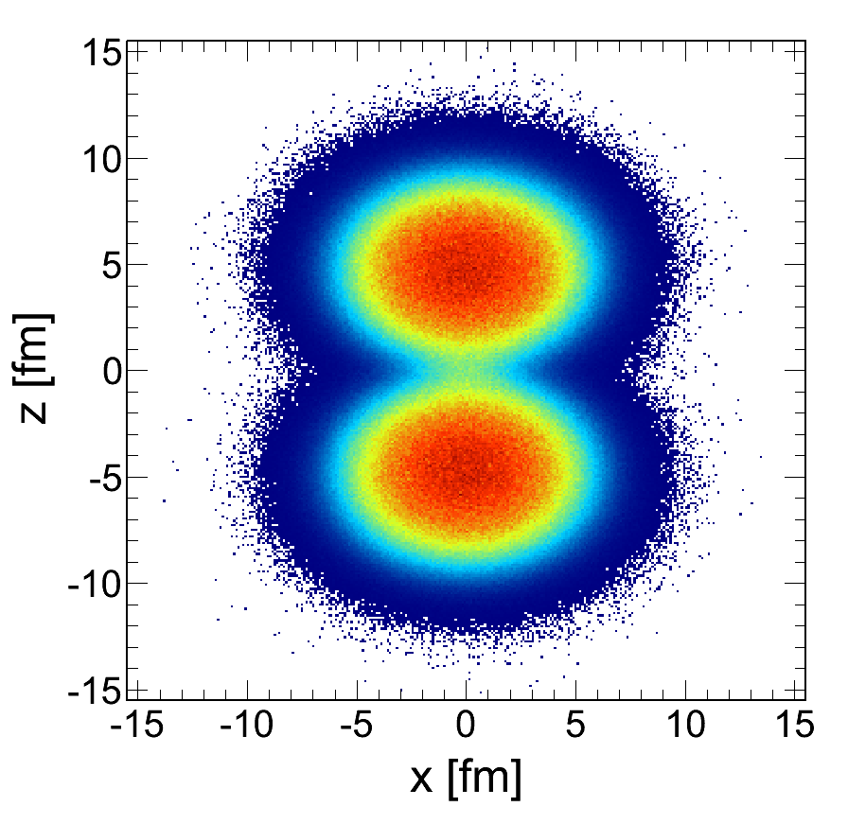

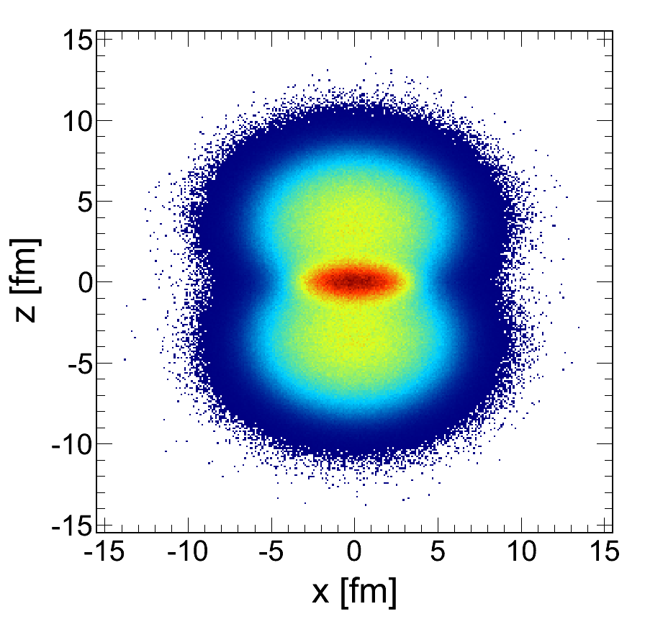
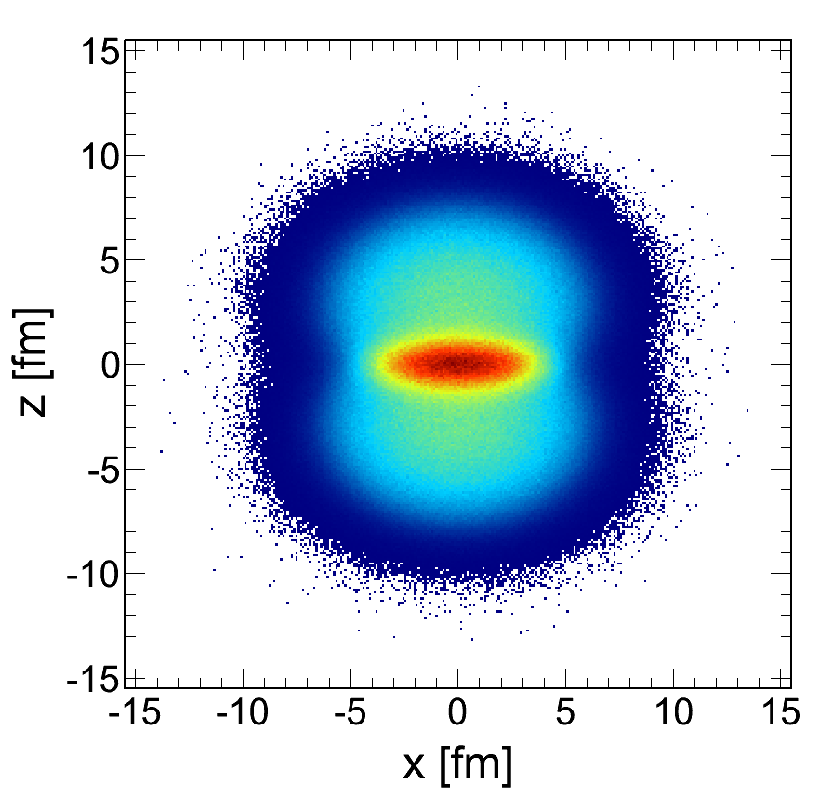
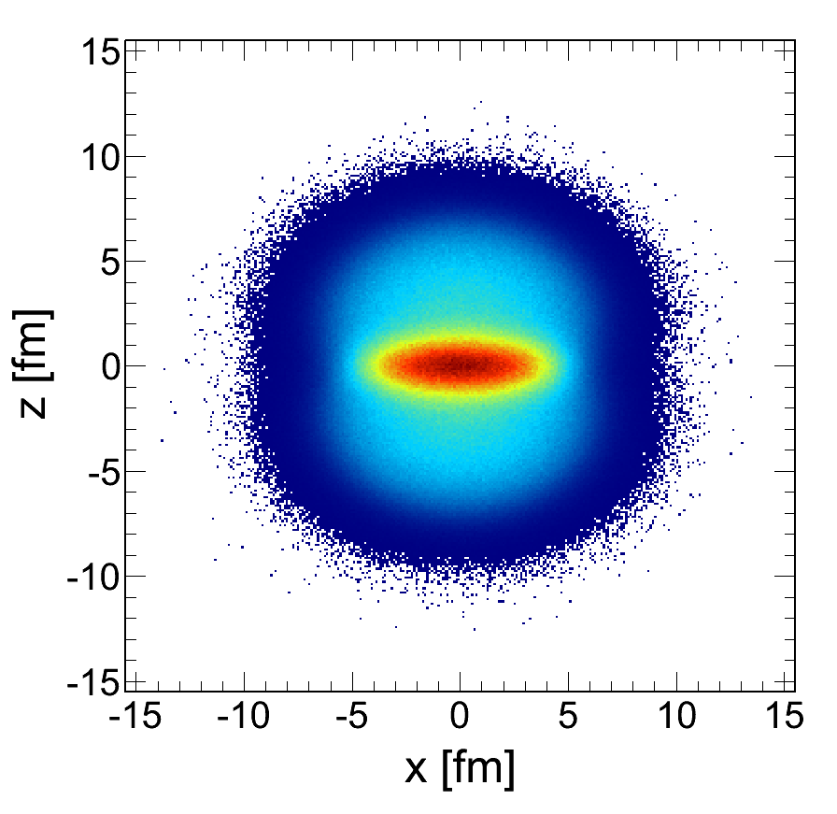
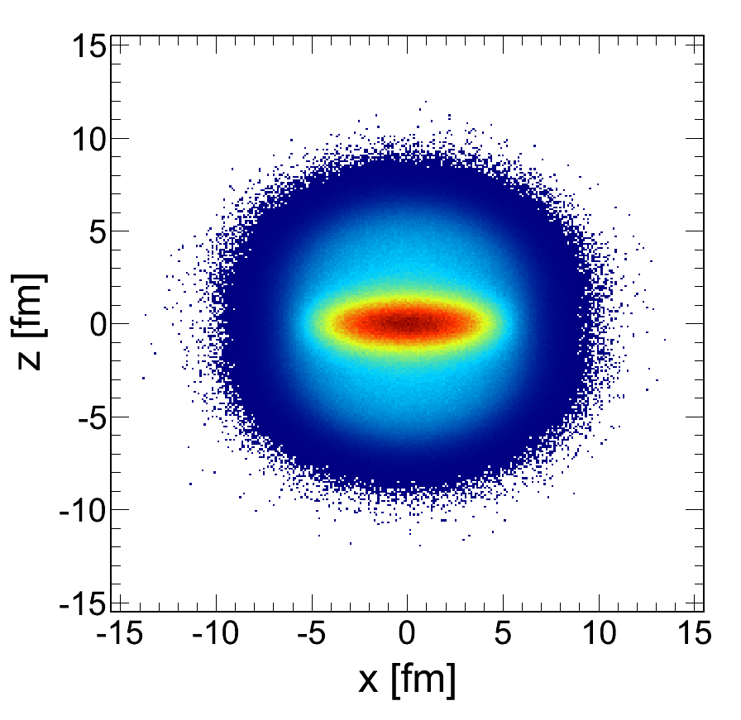
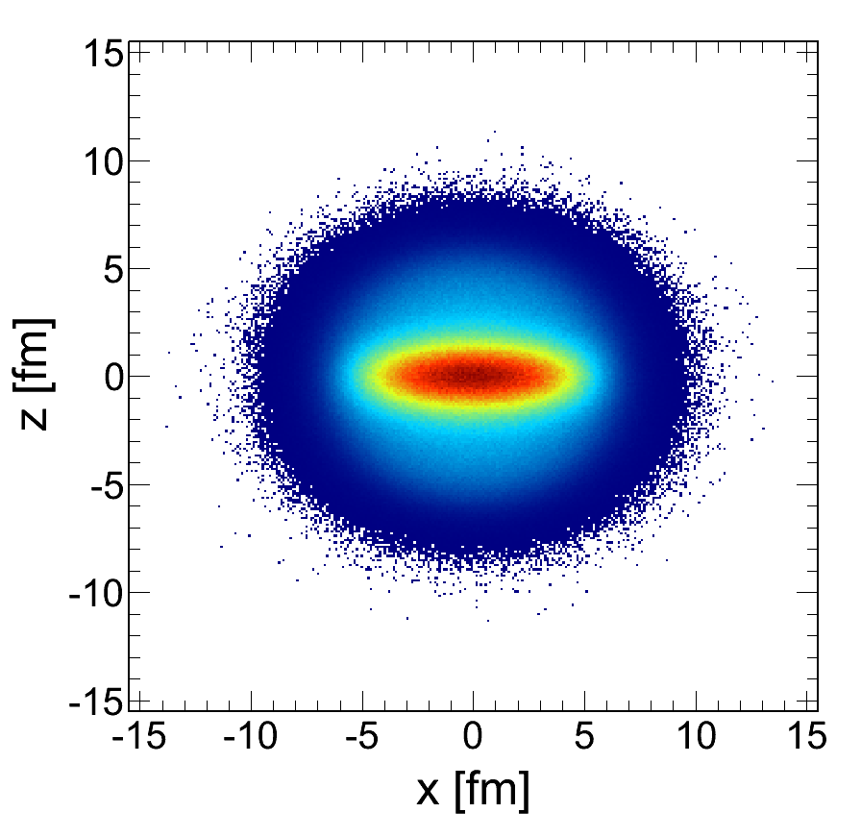
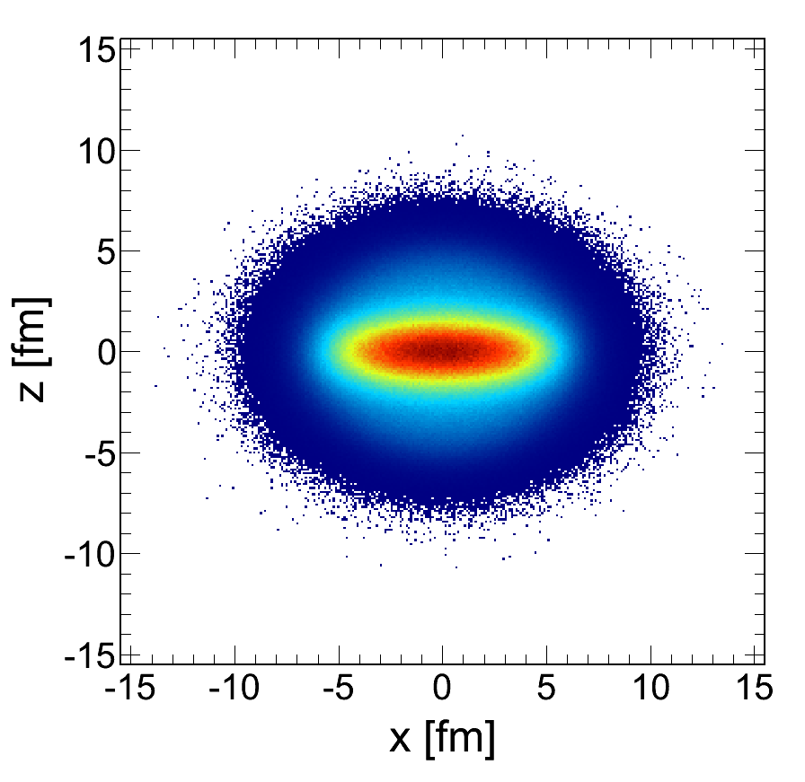
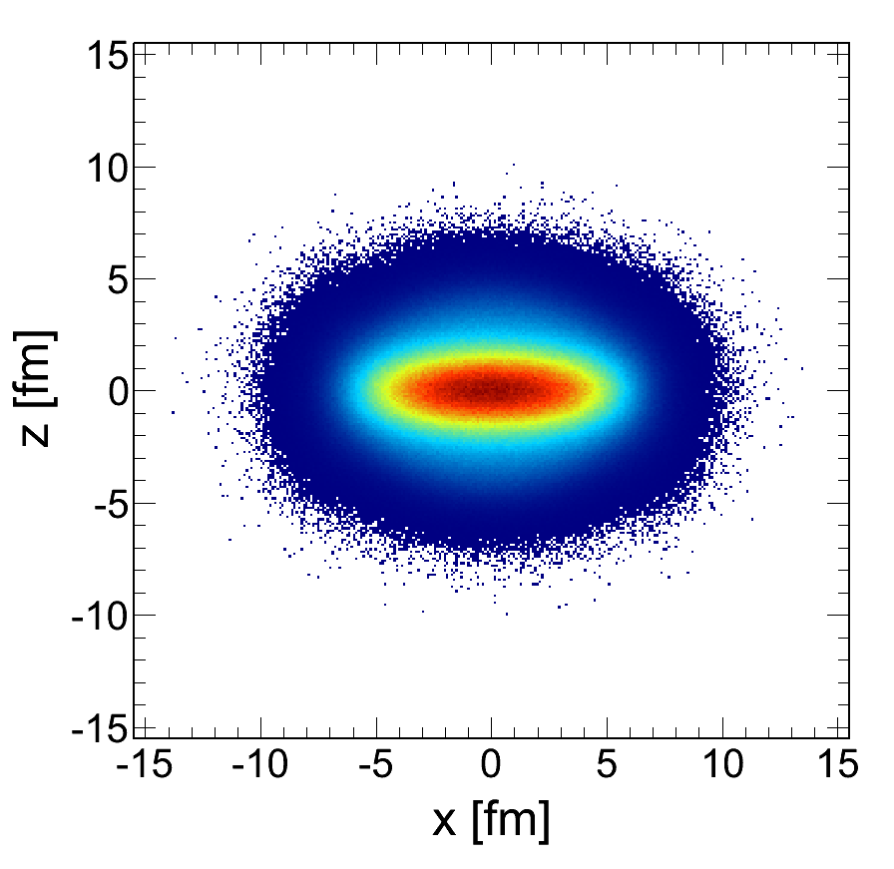
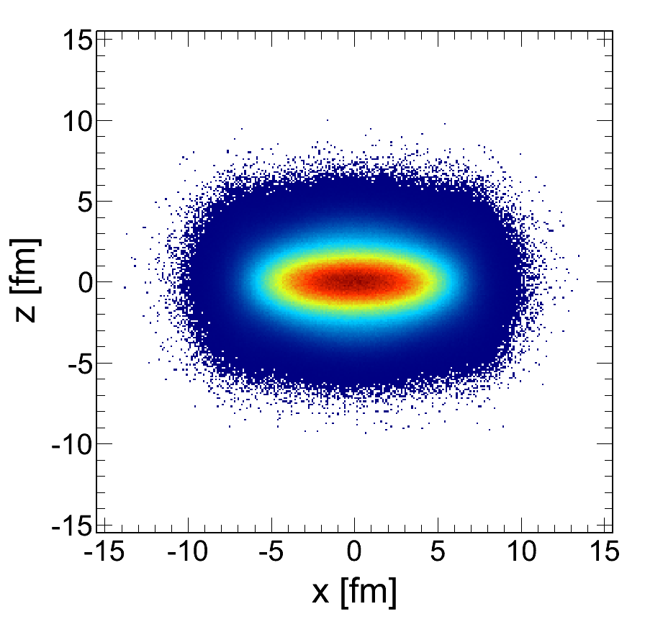
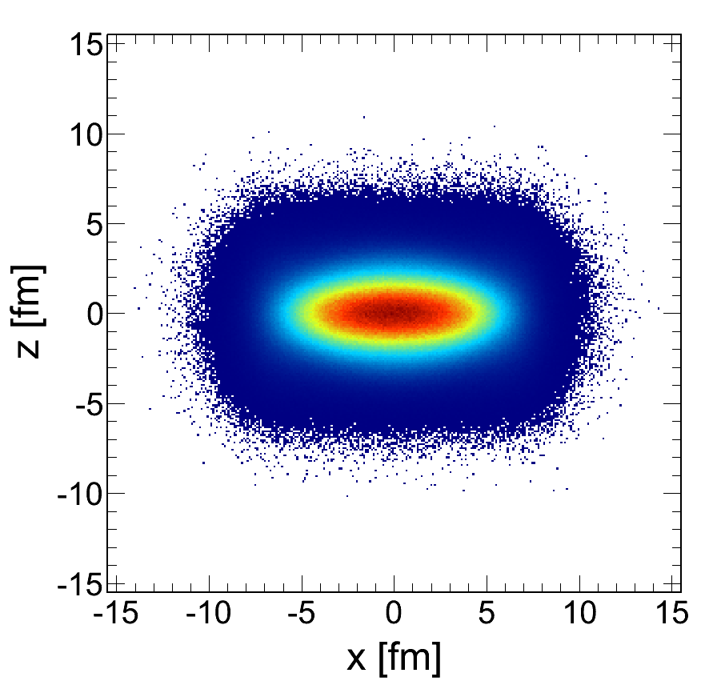

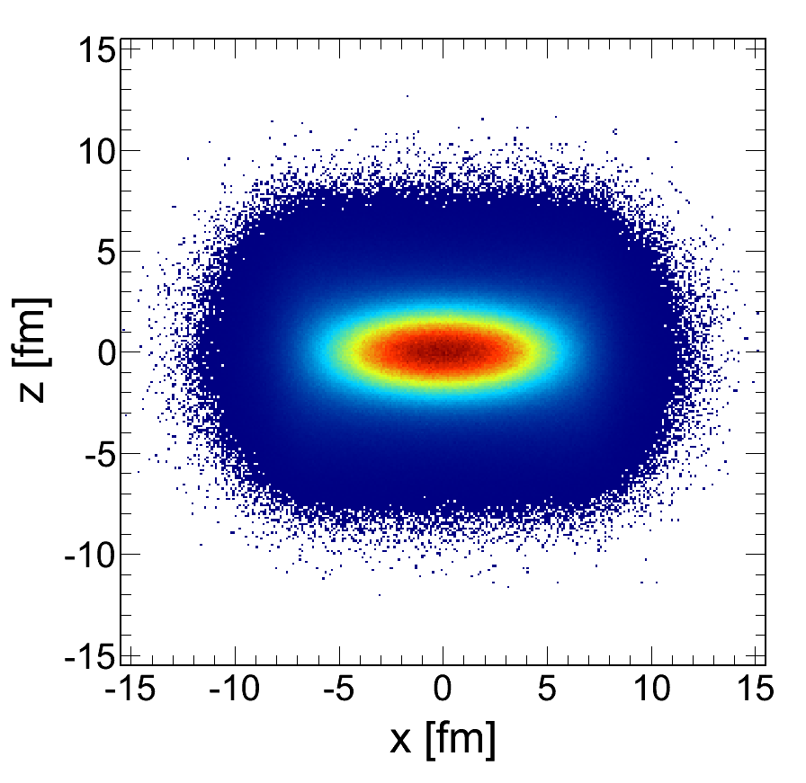
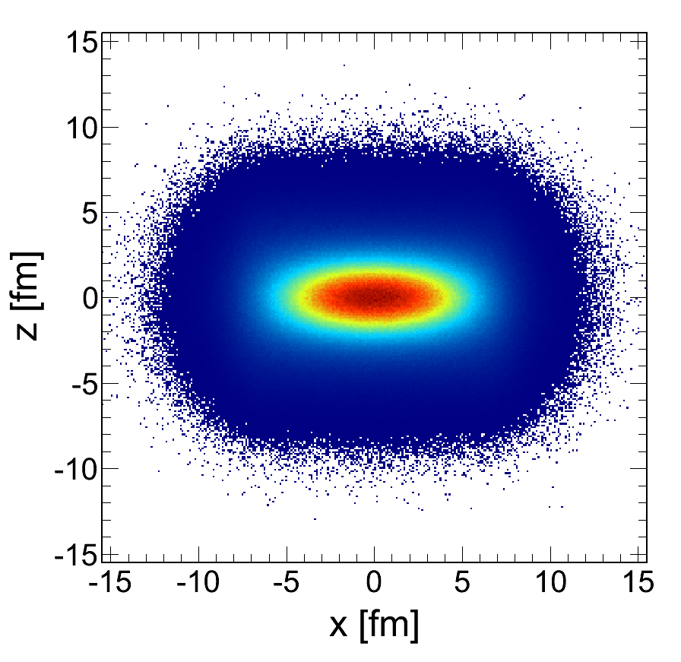
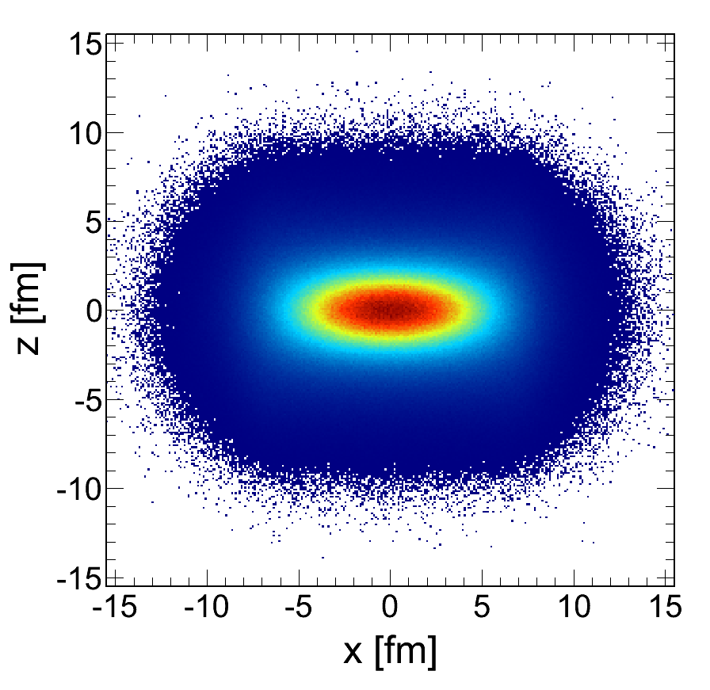
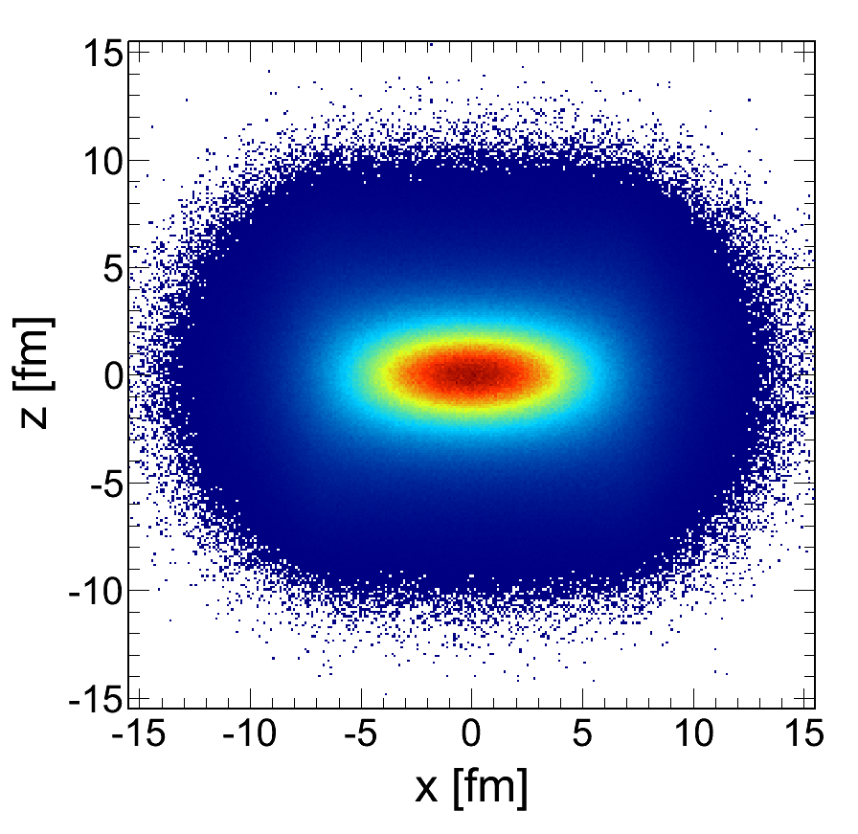
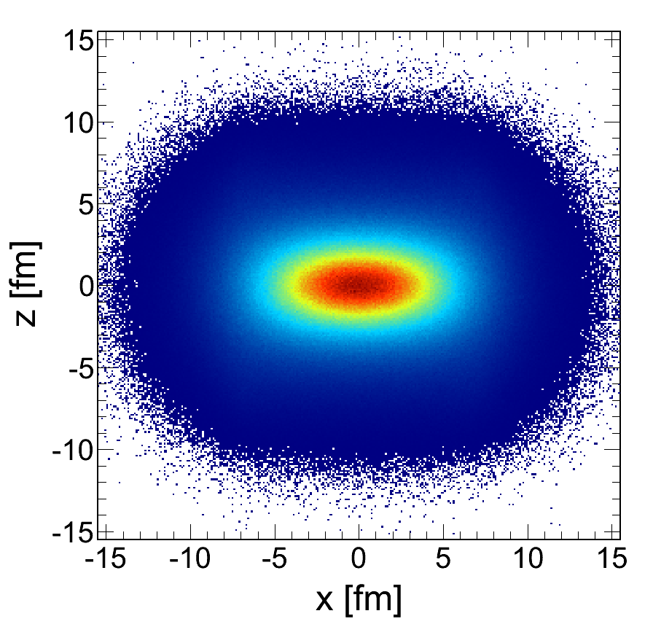
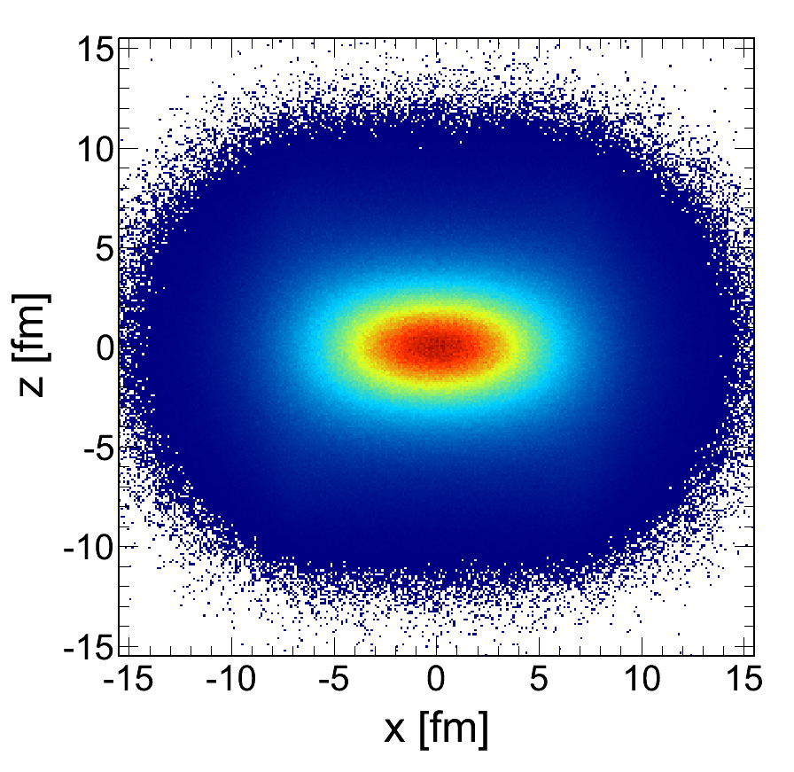
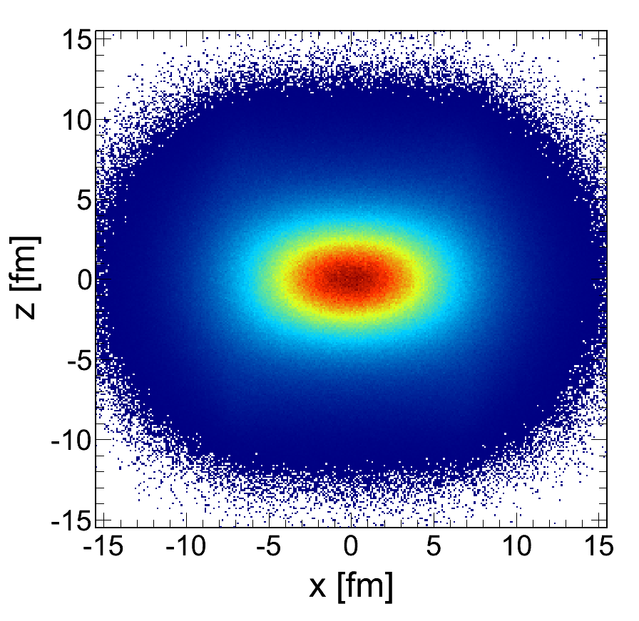
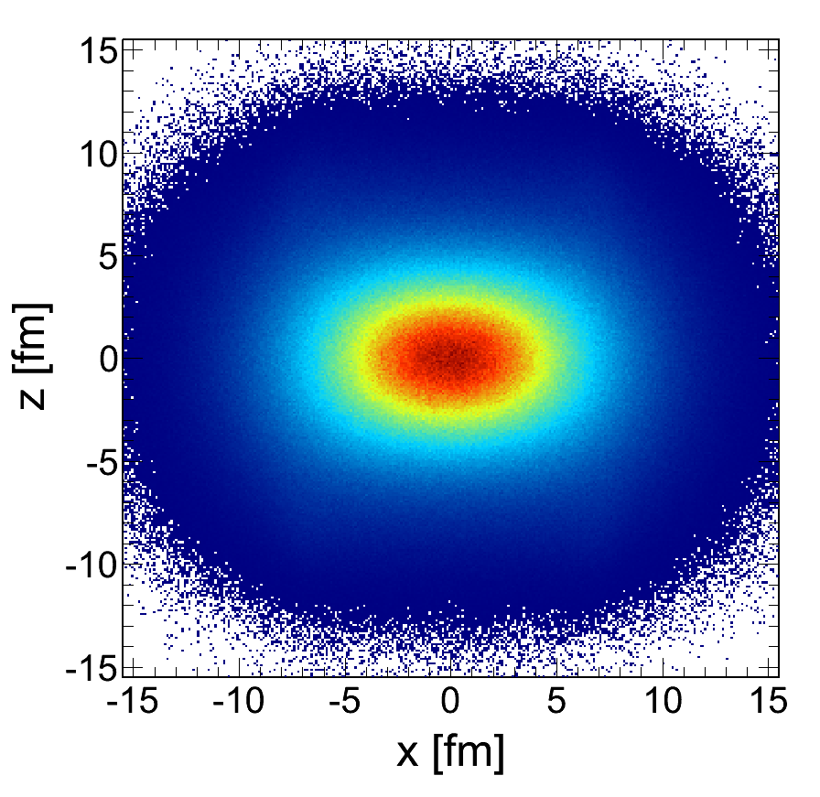
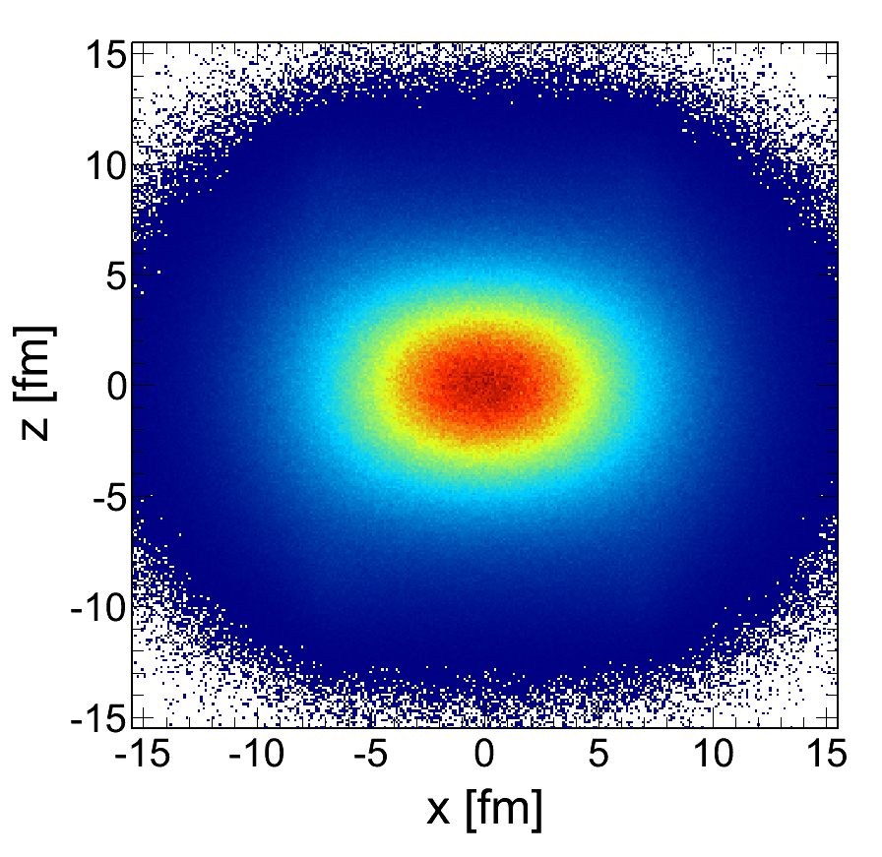
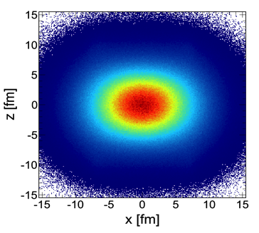
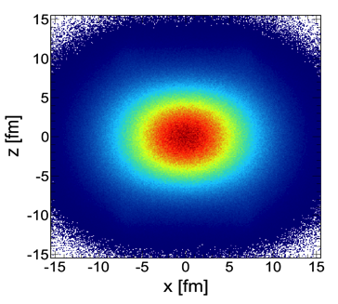
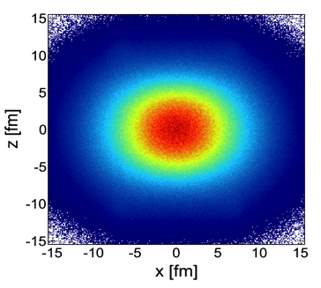
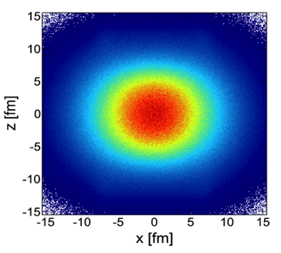
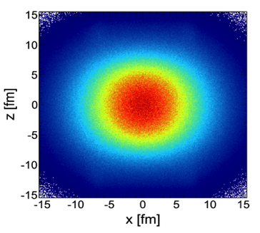
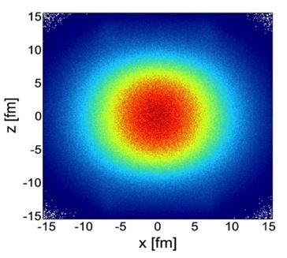
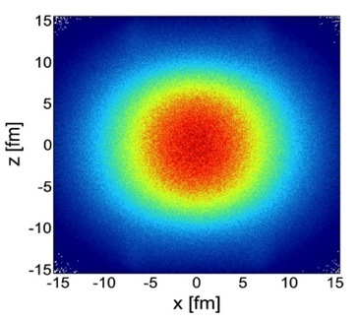
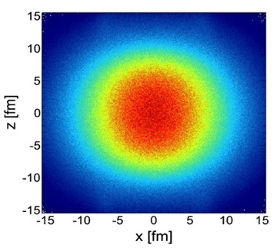











Slide 12










If thermal dilepton emission will follow a Bose distribution
Intermediate mass range as thermometer

Slide 13










Slide 14






Slide 15





Slide 16





Lepton pairs are rare probes (BR < 10⁻⁴)
at SIS energies sub-threshold vector meson production
→ M_{r} × Γ_{ee}/Γ_{tot} decay per 10 mio events
Large combinatorial background
  in e⁺e⁻ from Dalitz decays (π⁰ → e⁺e⁻γ) and conversion pairs (e⁺e⁻)
  in μ⁺μ⁻: weak π, K decays
Isolate the contribution to the spectrum from the dense stage
Low-momentum coverage!
DATA QUALITY
The decisive parameters: Number of Interactions and Signal/Background
  Range of B/S: 20 - 100 → B/S >>1;
    Effective sample size: S_{eff} ~ I × S/B reduction by factors of 20-100
    Systematics: δS_{eff}/S_{eff} = δB/B × B/S δB/B = 2…5×10⁻²
Fotolia.de

Slide 17









… but after 2 days, he found it !
… he has gone through periods of doubt
and serious discouragement

Slide 18















Slide 19

























Slide 20

















γ*
e⁺
Tracking
Electron identification
π⁰ and γ conversion rejection
Pairing
e⁻
Subtraction of background
(like-sign or event mixing)
Efficiency correction
γ*
→ →
e⁺
e⁻
γ*
Isolation of excess radiation
e⁺
→
→
e⁻
Acceptance correction

Slide 21


Slide 22









Slide 23






Open charm contribution
becomes significant

Slide 24




Slide 25






Slide 26









Slide 27










e⁺
e ⁻
Divide space-time evolution into 4-dimensional cells
21 x 21 x 21 space cells (1fm³), 30 time steps → ~ 280 k cells
Determine for each cell the bulk properties like T, μ_{B} , μ_{π},
collective velocity
Apply in-medium ρ & ω spectral functions to compute
EM emission rates
→ parameterization of RW in-medium spectral function
Sum up contributions of all cells

Slide 28






Robust understanding across QCD phase diagram

Slide 29


Slide 30









System size dependence of excess
“R-clock”
Preliminary
Rapid increase of relative yield reflect the number of ρ‘s / R’s regenerated in fireball

Slide 31





Slide 32






Slide 33





M is the only Lorenz-invariant thermometer of the field

Slide 34







Slide 35




Slide 36




Slide 37










Chemical freeze-out from measured particle yields analyzed with SHM
  Trajectories extracted from inner cube of cells with coarse-grained UrQMD
Time-window of dilepton emission → access to hot and dense stage of the heavy-ion collision
T_{max} = 85 MeV, ρ_{max} = 3 ρ₀
Excitation of the vacuum
(melting of condensate)
matches spectral medium effects!

Slide 38






What are the possible signatures in dilepton radiation?

Slide 39





Slide 40





Slide 41


“You may say I’m a dreamer…
but I’m not the only one”
 |  | 2016 | 2017 | 2018 | 2019 | 2020 | 2021 | 2022 | 2023 |  | 2024 |  | 2025
HADES | SIS18 |  |  | 2.5 GeV + pA, pA
STAR BES | RHIC |  |  |  | 8 – 20 GeV |  |  | 200 GeV
MPD | NICA |  |  |  | 4 – 11 GeV
CBM | SIS100 |  |  |  |  |  |  |  |  |  | 2 – 5 GeV
ALICE* | LHC | 5.5 TeV |  |  |  |  | 5.5 TeV
 | J-PARC** |  |  | pA 8 GeV |  |  |  |  |  |  |  | 2 – 5 GeV
NA60+ | SPS |  | LOI |  |  |  |  |  | 6 – 17 GeV
PHENIX | RHIC | 200 GeV
STAR | RHIC | 200 GeV | pp(500)
sPHENIX |  |  |  |  |  |  |  | 200 GeV
BM@N | Nuclotron |  | 2 – 3 GeV
* - ITS, 50kHz, lower field
** - Proposal to J-PARC → If approved, construction of HI injector and detectors in 10 years ?

Slide 42









Slide 43






Slide 44






Slide 45






Slide 46








Slide 47





Slide 48













Slide 49





Résumé and prospects
Thank you
for your attention!

Slide 50


Slide 51











e⁻
π⁺
γ∗
ρ
J^{P} = 1⁻ for both γ* and Vector Meson
e⁺
π⁻
Strong coupling of γ* to Vector Meson
→ Vector Meson Dominance model
Observable: vector mesons (ρ, ω, φ)

Slide 52




Slide 53


























Slide 54























Slide 55













q
q
q
q
q
q
q
q
q
q
q
q
q
q
q
q
q
q
q
q
q
q
q
q

Slide 56


Slide 57







Phys. Rev. Lett. 100 (2008) 022302
Eur. Phys. J. C 59 (2009) 607
m_{T} spectra exponential for
m_{T}-M > 0.1 GeV; <0.1 GeV ??
Fit with 1/m_{T} dN/m_{T} ~ exp(-m_{T}/T_{eff})
Extract T_{eff} aa a function of mass
IMR
LMR

Slide 58




What can we learn from m_{T} spectra?
Radial Flow
Origin of dileptons

Slide 59






T - dependence of thermal distribution of “mother” hadrons/partons
m - dependent collective radial flow (v_{T}) of “mother” hadrons/partons
(p_{T} - dependence of spectral function; dispersion relation)
→ Handle on emission region,
i.e. nature of emitting source

Slide 60




Dominance of partons for M>1GeV/c²: support from theory:
  Hadronic sources alone (2π+4π+a1π) cannot produce a discontinuity
  Continuous rise of T_{eff} with mass

Slide 61





