Slide 1
Accelerators for Nuclear Physics
FAIR and other upcomming facilities
1) FAIR key facts
2) In-flight facilities: RIKEN, FRIB
3) Heavy-ion colliders: NICA
4) Multi-purpose HI facilities: HIAF
5) Summary

Slide 3
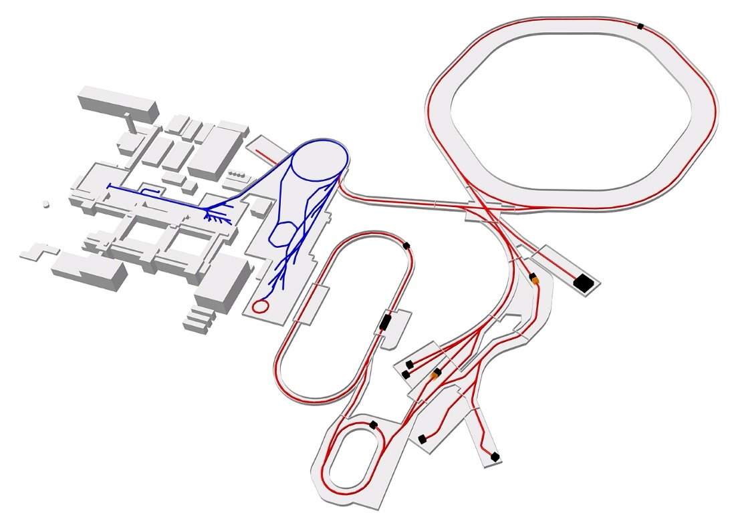
FAIR key facts
Primary ions: p-U
Max. energy: 100 Tm
Max. beam intensity on target: 10¹¹/s (15 kW)
Beam intensity/quality limitations:
Sources, injection (Liouville), cycle times
space charge / resonances
lifetime
activation
Unique features:
Parallel operation (serves 4 areas)
Intense and high-energy HI beams
Slow extraction, bunch compression (beam quality)
Storage rings and beam cooling (beam quality)
Start/end commissioning (day-1): 2024/2025
Design intensities: ?
 | SIS-100
Reference primary ion | U²⁸⁺
Reference energy | 1.5 GeV/u
Ions per cycle | 3E11
Bunch length | 60 ns
Cycle rate | 0.5 Hz
Beam power | 15 kW

Slide 4
FAIR phase 0: key facts
 | SIS-18
Reference primary ion | U⁷³⁺
Reference energy | 1 GeV/u
Ions per cycle | 1E10
Bunch length | 50 ns
Cycle rate | 1 Hz
Beam power | 1 kW
Primary ions: p-U
Max. energy: 18 Tm
Max. beam intensity on target: 10¹⁰/s (1 kW)
Beam intensity/quality limitations:
Sources, Injection, cycle times
space charge / resonances
Unique features:
Parallel operation (3 areas)
Intense and medium-energy beams
Slow extraction and bunch compression
Storage rings and beam cooling
Start/end commissioning: 2018/2019
Design intensities: ?

Slide 5
Word map of in-flight RIB facilties
T.Kubo, NIMA 2016

Slide 6
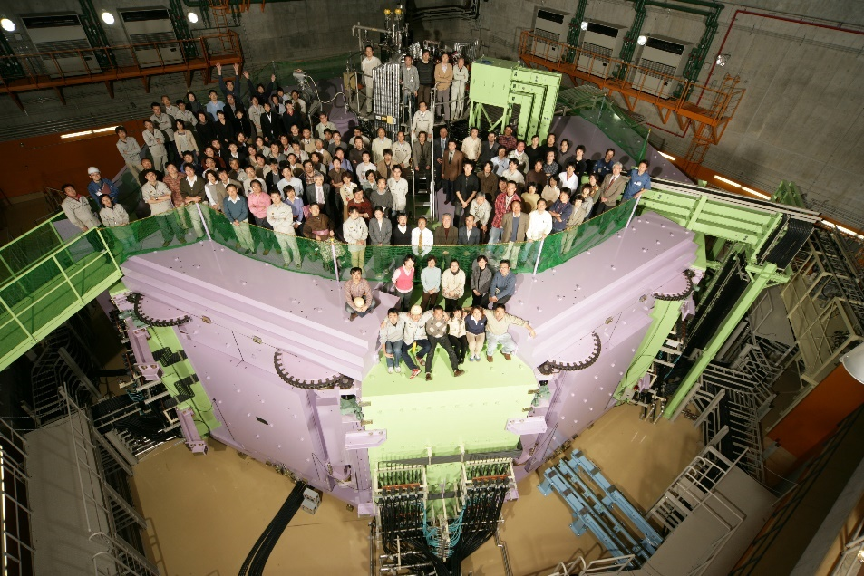
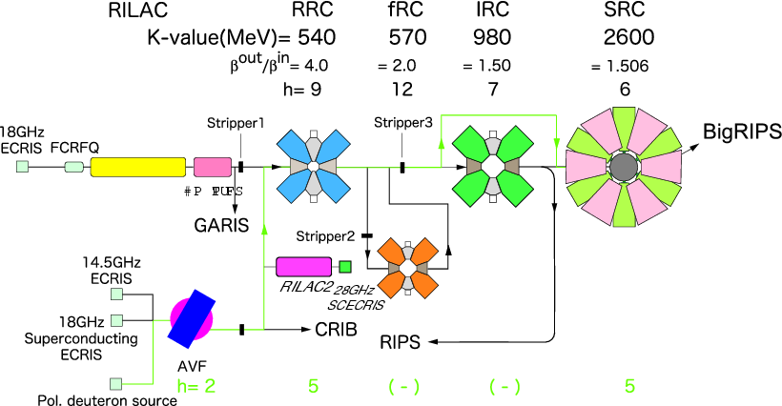
In-Flight: RIKEN (in operation since 2007)
 | SRC cyclotron
Ions | d-U
Energy for U | 345 MeV/u (9 Tm)
U/s | 6E12
Beam power (U) | 80 kW
RIKEN Superconducting Ring Cyclotron (SRC)
Unique features:
- High power HI beam
- High resolution separation
Comment: Operating cost !
Notes:
Cyclotron: no storage rings !

Slide 7
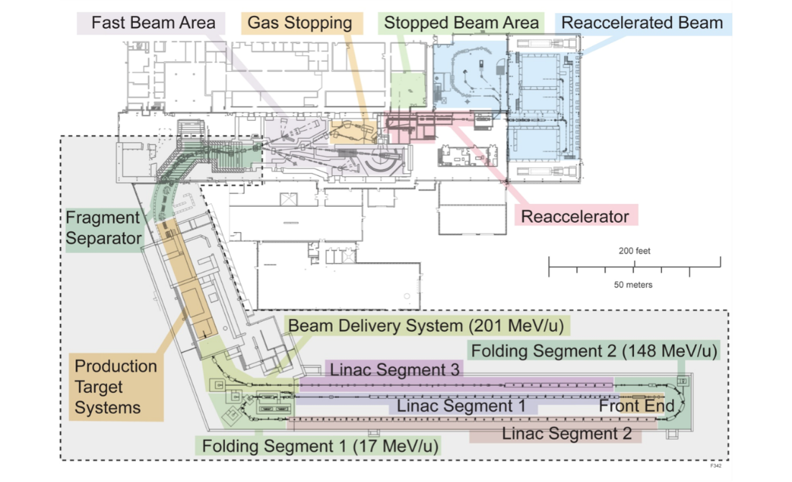
In-flight: FRIB@MSU
 | FRIB Linac
Reference ion | U
Reference energy | 200 MeV/u
Ions/s | 5E13
Beam power | 400 kW
Yamazaki, IPAC 2016
Technology:
- Low/medium beta SC cavities
- Advanced sources/strippers
Five charge state
beam on target
Beam dynamics:
- Multi charge state acceleration
- Low loss (< 1 W/m)
Completion: 2021/2022
Notes:
cw SC linac: Medium energy and no storage rings

Slide 8
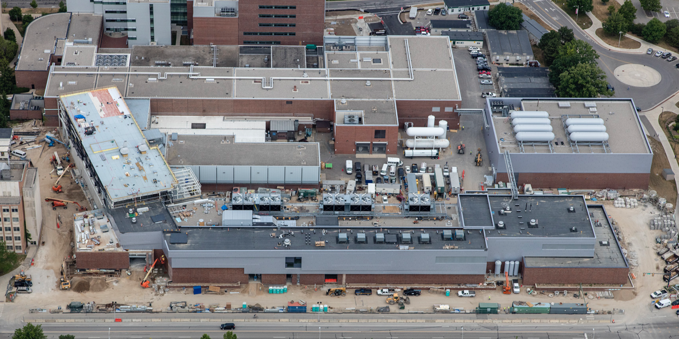
FRIB key facts
Primary ions: p-U
Max. energy: 200 MeV/u
Max. beam intensity on target:
5x10¹³/s (400 kW)
Beam intensity limitations:
Multi-charge state acceptance
Charge strippers
Activation
Unique features:
High power, medium energy HI beam
Fast, stopped and reaccelerated beams
Start/end commissioning: 2016/2022
Design intensities: ?

Slide 9
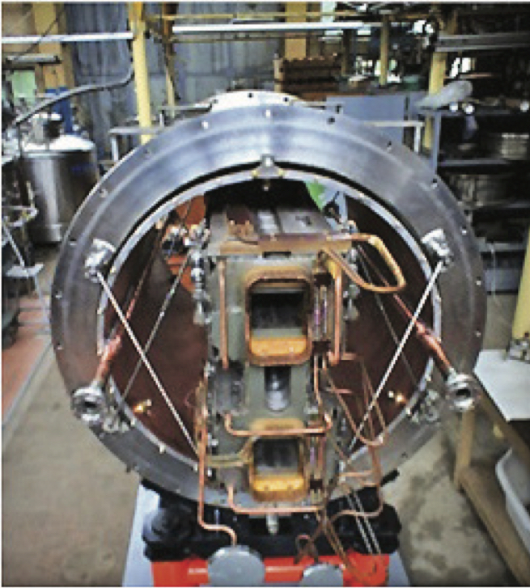
NICA (Nuclotron based Ion Collider fAcility)
-> CBM@FAIR
Ions: p-U
Max. energy: 45 Tm
Avg. Luminosity (Au+Au): 10²⁷ cm⁻²s⁻¹
Intensity limitations:
Injector/Injection, Cooling
Unique features:
Medium energy HI collider
with beam cooling
Start/end commissioning: 2020/2021
Design Luminosity: ?

Slide 10
HIAF (High Intensity Heavy Ion Facility)
-> APPA, NUSTAR.
Ions: p-U
Max. energy: 34 Tm
Max. beam intensity on target (U): 1.5x10¹¹/cycle
Intensity/quality limitations:
Injection (Liouville)
Space charge / resonances
Lifetime
….
Unique features:
Multipurpose
Intense and energetic heavy ion beams
Bunch compression
Storage ring and beam cooling
Start/end commissioning: 2022/2023

Slide 11
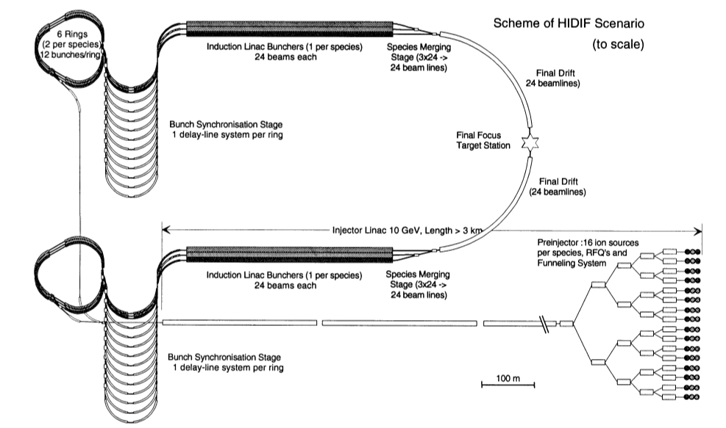
“Historic remark”: The HIDIF study (1998)
I. Hofmann et al. (1998)
Ring design similar to HIAF

Slide 12
Summary
Some of the unique features of FAIR:
Flexibility, Intense and high energy HI beams, Beam quality, Storage rings / cooling,
Antiprotons, upgrades, ...
FAIR
Phase 0
NICA
FAIR day-1
RIKEN
FRIB
HIAF
Now
2018
2020
2021
2023
2025
beyond 2025:
approaching FAIR design intensities
FAIR upgrades (SISXXX, Space charge compensation, Novel cooling schemes,….)
even beyond:
- EURISOL
Laser ion accelerators
...

Slide 13
Backup

Slide 14
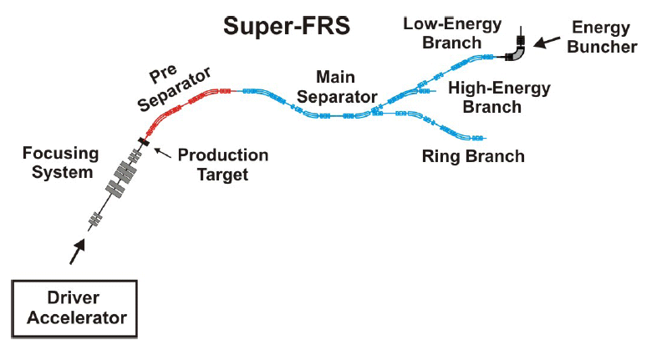
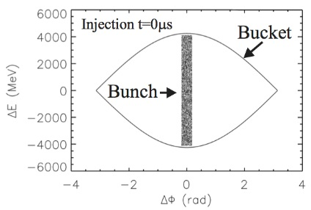
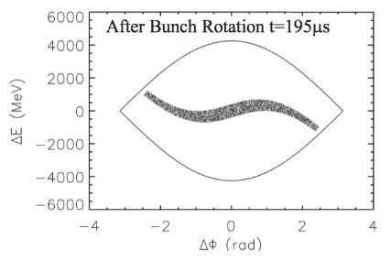
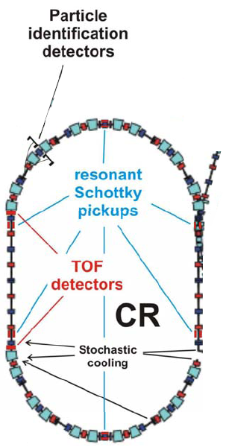
Super FRagment Separator and Collector Ring
High energy branch:
Reactions with Relativistic Radioactive
Primary Beams
15 kW beam power
30 kJ total energy
Bunch rotation in the CR
Secondary Beams
CR storage ring experiments
with RIBs:
Masses and half-lives for short-lived ions
 | SIS-100
Reference primary ion | U²⁸⁺
Reference energy | 1.5 GeV/u
Ions per cycle | 3E11
Bunch length | 60 ns
Cycle rate | 0.5 Hz
Beam power | 15 kW
SIS 100
FAIR: Optimized for RI production
at high energies and precision
storage ring experiments !

Slide 15
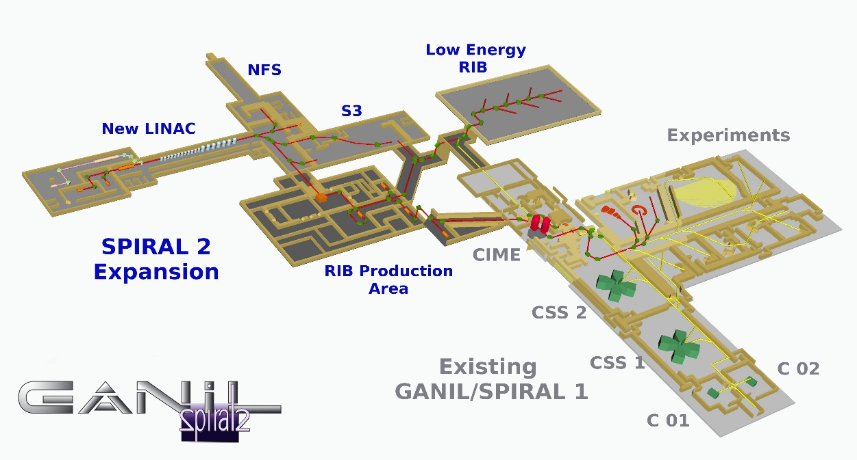
ISOL: Spiral 2 / GANIL
Spiral 2: Upgrade for research with stable and RI beams.
 | New linac
Reference ion | Deuterons
Reference energy | 20 MeV/u
Current | 5 mA
Beam power | 200 kW
Technology:
- SC linac for protons/heavy-ions
- Low/high beta sc cavities (QWR)
- Radiation safety requirements
Lagniel, HIAT 2015
Commissioning in progress.

Slide 16
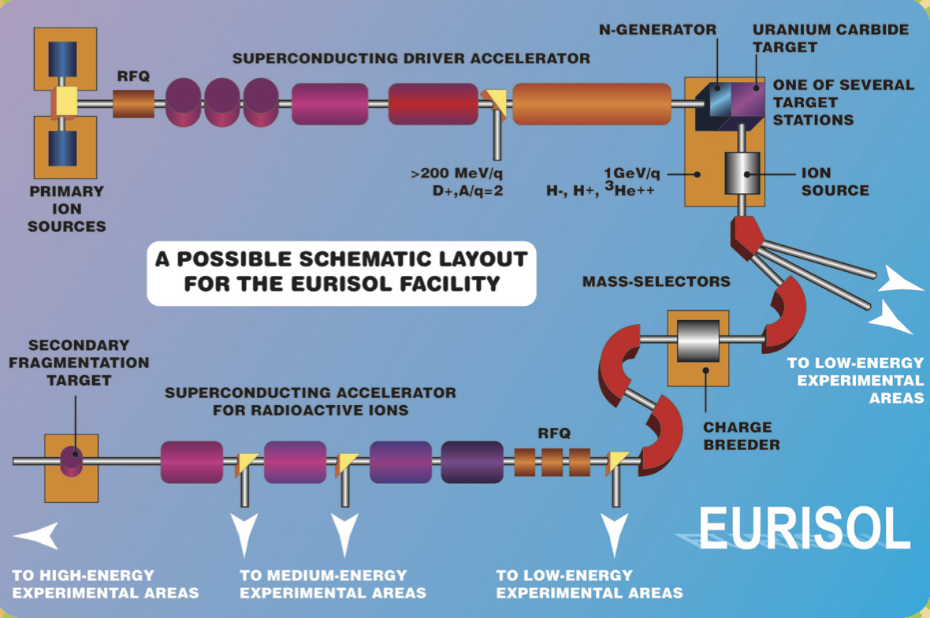
ISOL: EURISOL as a future perspective ?
5 MW, 1 GeV protons (and light ions)
+ MYRRAH ?
from the EURISOL broschure (2007)
nuclear physics
+ nuclear waste transmutation ?
Multi-purpose facility > 2030 ?
EURISOL Distributed Facility (DF)
as an intermediate step.

Slide 17
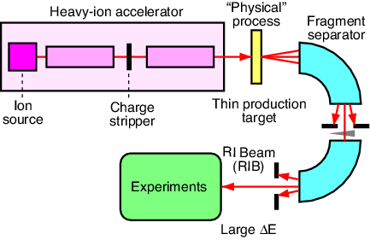
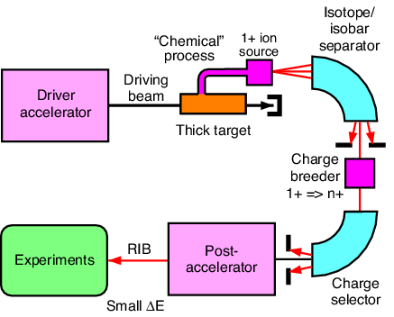
Radioactive Beam (RI) beam production
In-flight facilities:
RIKEN, Japan
GSI/FAIR, Germany
MSU/FRIB, USA
….
Some Pro/Cons:
+ High energy RI beams
+ Broad range of RI
- RI beam quality
- Large separators needed
Fragmentation
or In-Flight
production
ISOL facilities:
REX-ISOLDE, CERN
SPIRAL 2, France
EURISOL
….
Some Pro/Cons:
+ Better beam quality
+ Post-acceleration
- Target chemistry
- Finite diffusion time
ISotope OnLine (ISOL)

Slide 18
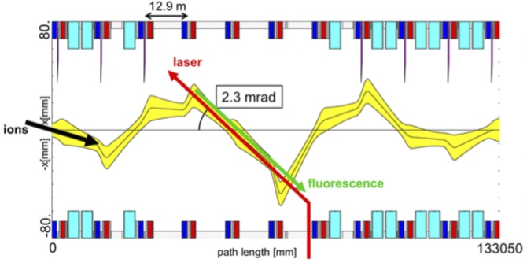
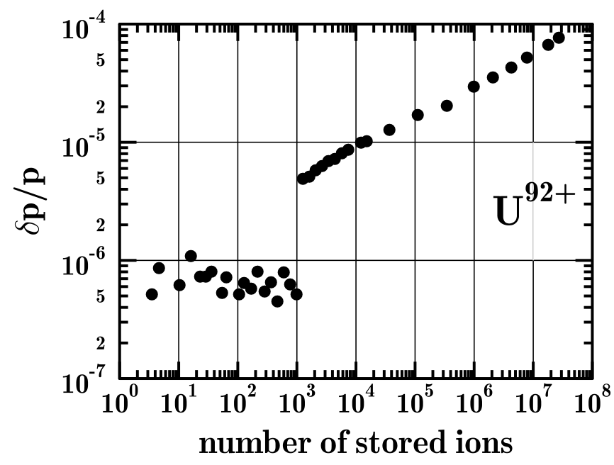
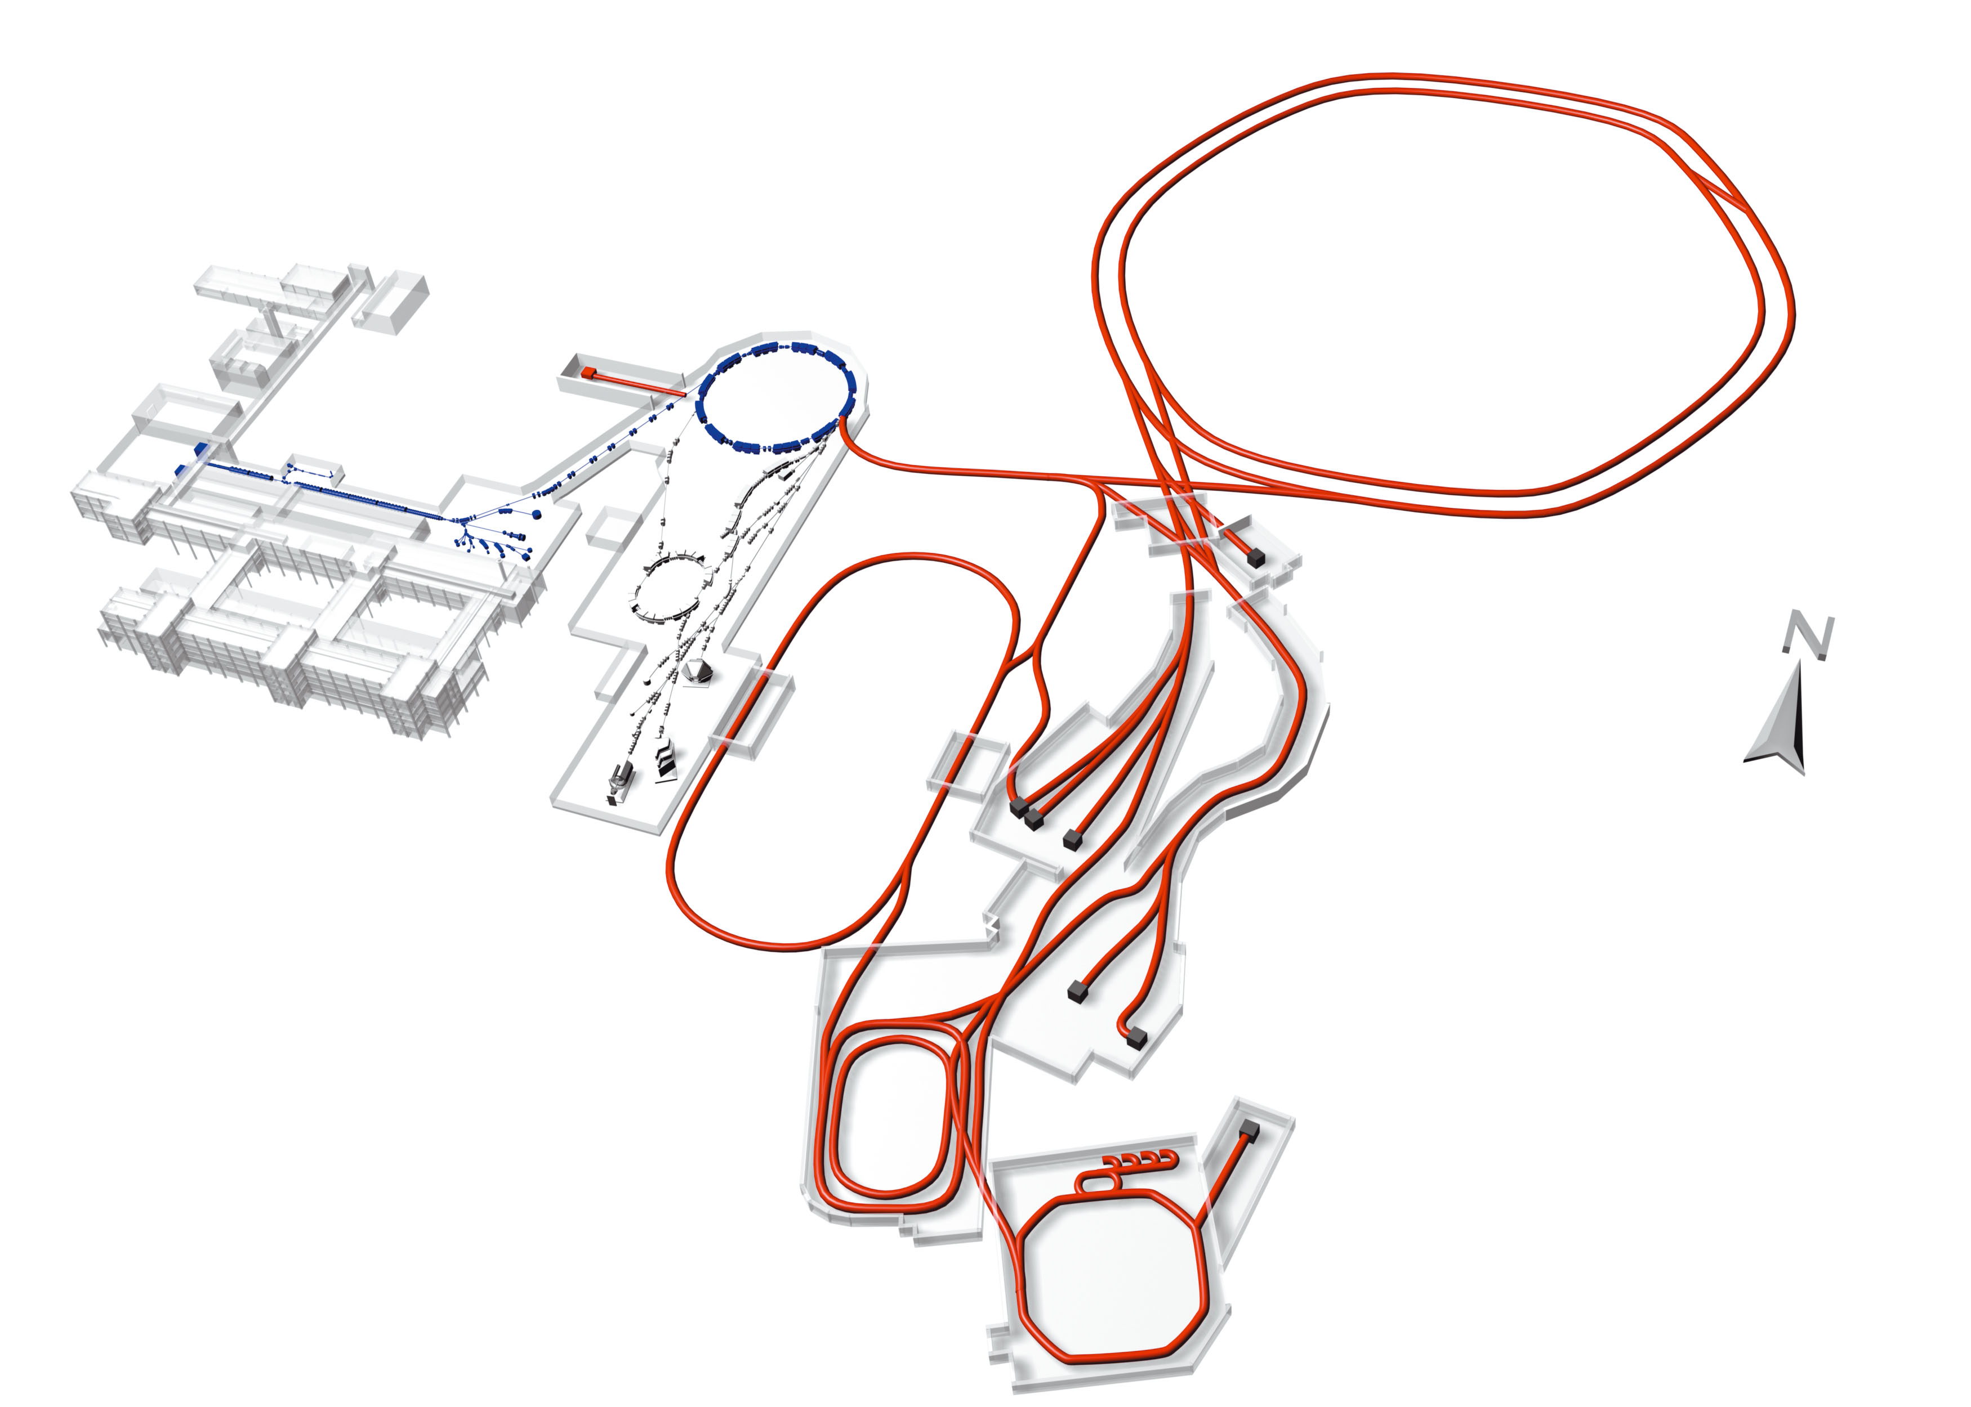

Beam cooling of ion beams in storage rings
Essential for precision experiments with in-flight produced RI (and internal targets)
Other applications: Cooling at high energy, ultra-cold beams, atomic physics
1D crystalline beams in the ESR
relativistic
Li-like ions
26 m overlap
laser cooling
Cooling schemes:
Stochastic (rf)
Electron beam
Laser beam
Coherent electron ?
…..
SIS100
Experiment: M. Steck et al., Phys. Rev. Lett. 1996
Theory: R. Hasse, Phys. Rev. Lett. 1999, 2001, 2003

Slide 19
Charge Stripper:
Critical component in heavy-ions accelerators
Thin stripper foils used at the GSI UNILAC
Liquid Lithium Stripper for FRIB
Marti, HIAT 2015
Yamazaki, IPAC 2016
Pulsed gas jet at GSI UNILAC
Alternative: Gas stripper with plasma window
FRIB/RIKEN
Plasma window,
A. Hershcovitch, PoP 1998
Barth, Scharrer, et al. PRAB 2015

Slide 20
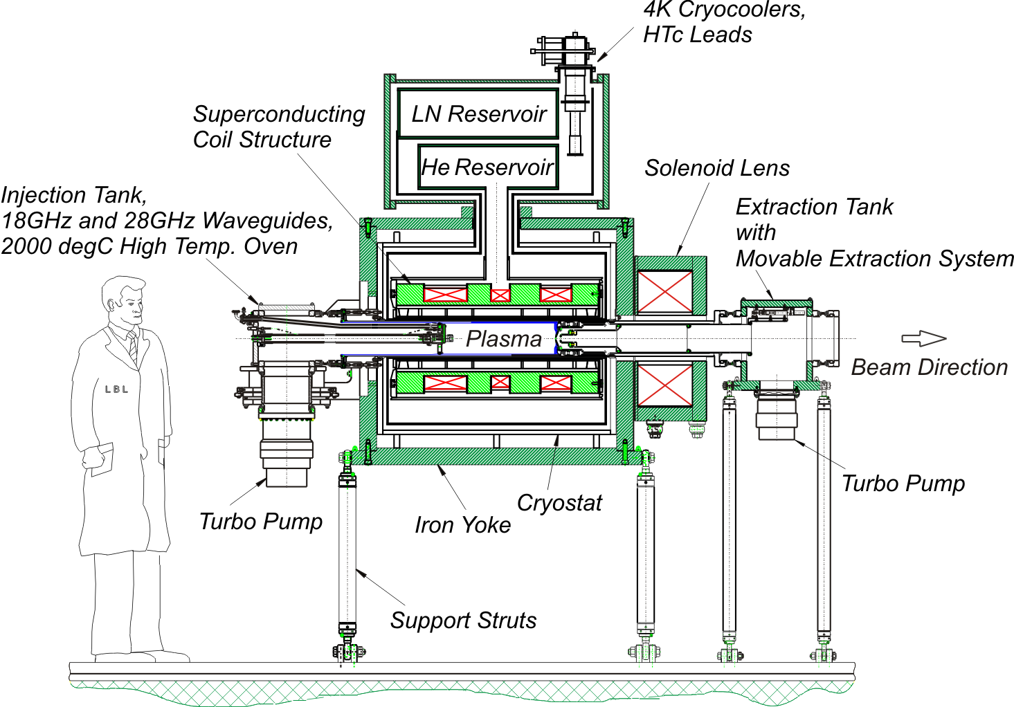
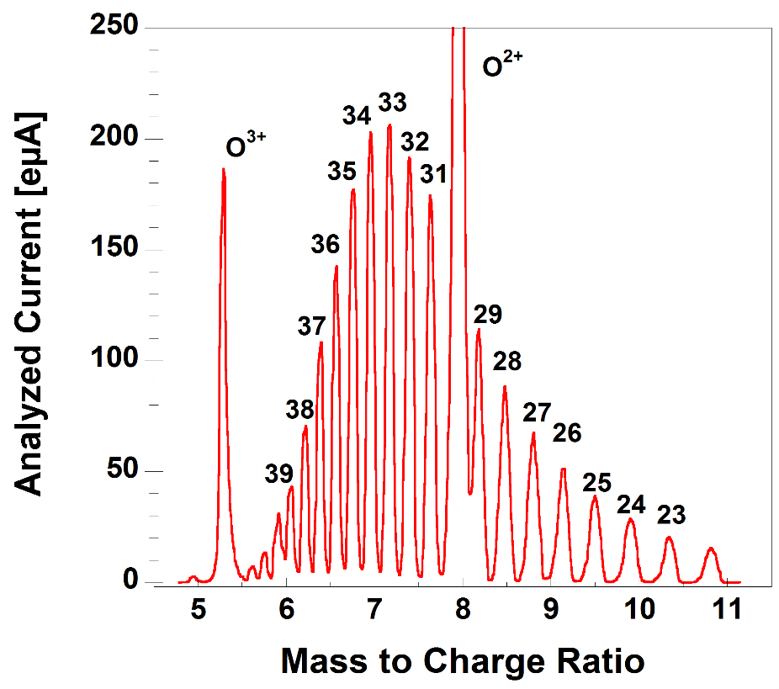
Sources for heavy ions: Electron Cyclotron Resonance Ion Sources (ECRIS)
Used at FRIB and RIKEN
LBL VENUS 28 GHz SC ECRIS
Spectrum of uranium charge states
D. Leitner et al., 2009
ECRIS: Higher magnetic field and microwave frequency -> higher extracted intensities
Challenge: Sources for different ions and charge states

Slide 21
Conclusion: Perspectives 10-20 years
Major new facilities/upgrades will come available in 2018-2025 !
Examples: Spiral 2 / France, FRIB / USA , FAIR / Germany
The next 10-20 years: Commissioning, Optimization for high-intensity, Exploitation
Key or critical components (with ongoing R&D efforts):
- Compact rf cavities (low/medium beta): post-acceleration
- Ion sources: ECR, Lasers ?, …
- Strippers: Gas, Plasma or „advanced materials“
- Beam cooling at medium/high-energies: stochastic, electron, laser, „advanced“
- Accelerator physics, „advanced“ full-scale simulation codes, optimization schemes
Afterwards:
- Eurisol (MW proton driver) ? Compact high rep. rate laser ion accerators ?
Always:
- New ideas are welcome: Multi-charge state acceleration and FFAG, ….

