Slide 1

Welcome
Secretariat:
Isabel De Caluwe
Organisation:
Angela Bräuning-Demian
Jürgen Gerl
Lars Schmitt
Oliver Boine-Frankenheim
Peter Spiller
Walter Müller
Technical support:
Thilo Egenolf
FAIR Detectors and Accelerators
WLAN: GSI
Passwd: FAIR2017
Webpage:
https://indico.gsi.de/event/6475
Workshop sponsors:

Slide 2
Brief summary of the previous workhops
O. Boine-Frankenheim
4th FAIR Detectors and Accelerators Workshop

Slide 3
Scope of the workshops
The main objective of the workshop have been:
To identify and discuss the physical and technical limits of both, FAIR detectors and accelerators related to the beam parameters.
Identification of the match / deviation of the performance / beam parameters of the accelerator to the requirements of the detectors
To determine the required adjustment and optimization of the FAIR accelerator's performance to serve the needs of the experimental set-ups.
To summarize the results in a report.

Slide 4
Hamburg 28-31 July 2015
Hamburg, Wasserturm
Workshop jointly organized by H4F EGs 3+4.
65 Participants (from GSI/FAIR, FZJ and universities)
Scope of the workshop:
Identify and discuss the physical and technical limits of both, FAIR detectors and accelerators related to the beam parameters.
Identification of the match / deviation of the performance / beam parameters of the accelerator to the requirements of the detectors.
Determine the required adjustment and optimization of the FAIR accelerator's performance to serve the needs of the experimental set-ups.
Summarize the results in a report
Selected results (see report):
Discussion and definition of reference beams and cycles.
Slow extraction: Dominant mode of operation (CBM, NUSTAR). Need for spill smoothing.
SIS18: Application of high rep. rate (> 1 Hz) for the production of very exotic ions.
Targets, Strippers, Dumps, Responsibilities,....

Slide 5
NUSTAR: Beam requirements (ring physics)
(Y. Litvinov)
SOURCE DEVELOPMENTS – Be, Tl and Th
FAST EXTRACTION – 50 ns / ~1 us
BEAM EMITTANCE – to assure the best transmission through the Super-FRS
REPETITION CYCLE – 0.1 Hz – 1 Hz
!!! NuSTAR PHYSICS REQUIRES HIGHEST INTENSITIES FOR ALL BEAMS!!

Slide 6

1th Report
Introduction
Ion source development
Synchrotron extraction
SIS18 2.7 Hz operation
Accelerator and detector protection
True parallel operation
Miscellaneous
https://indico.gsi.de/event/6475/material/0/

Slide 7
Follow-up workshop:
February 2016 Darmstadt
26 Februar 2016 (Darmstadtium)
70 Participants
https://indico.gsi.de/event/4570
Slow extraction
HEST
Ion sources
UNILAC upgrade
Beam dumps
Charge strippers

Slide 8

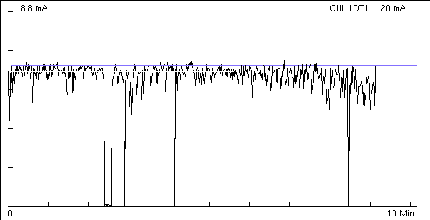

MEWA ion source: 2.7 Hz uranium operation
Bad factors:
High flux of neutrals from the surface
Shifting of the spectrum to the lower charge states
Problems with arc ignition
Sparking in the extraction system
3 Hz / 0.5 ms
Possible solutions:
Reducing the thermal load of the cathode
- short pulse operation
Improve the physical properties of the cathode material
- composite materials: U-W(10%)
Movable single cathode system
Ralph Hollinger
HIC4FAIR Workshop
26 / 38

Slide 9
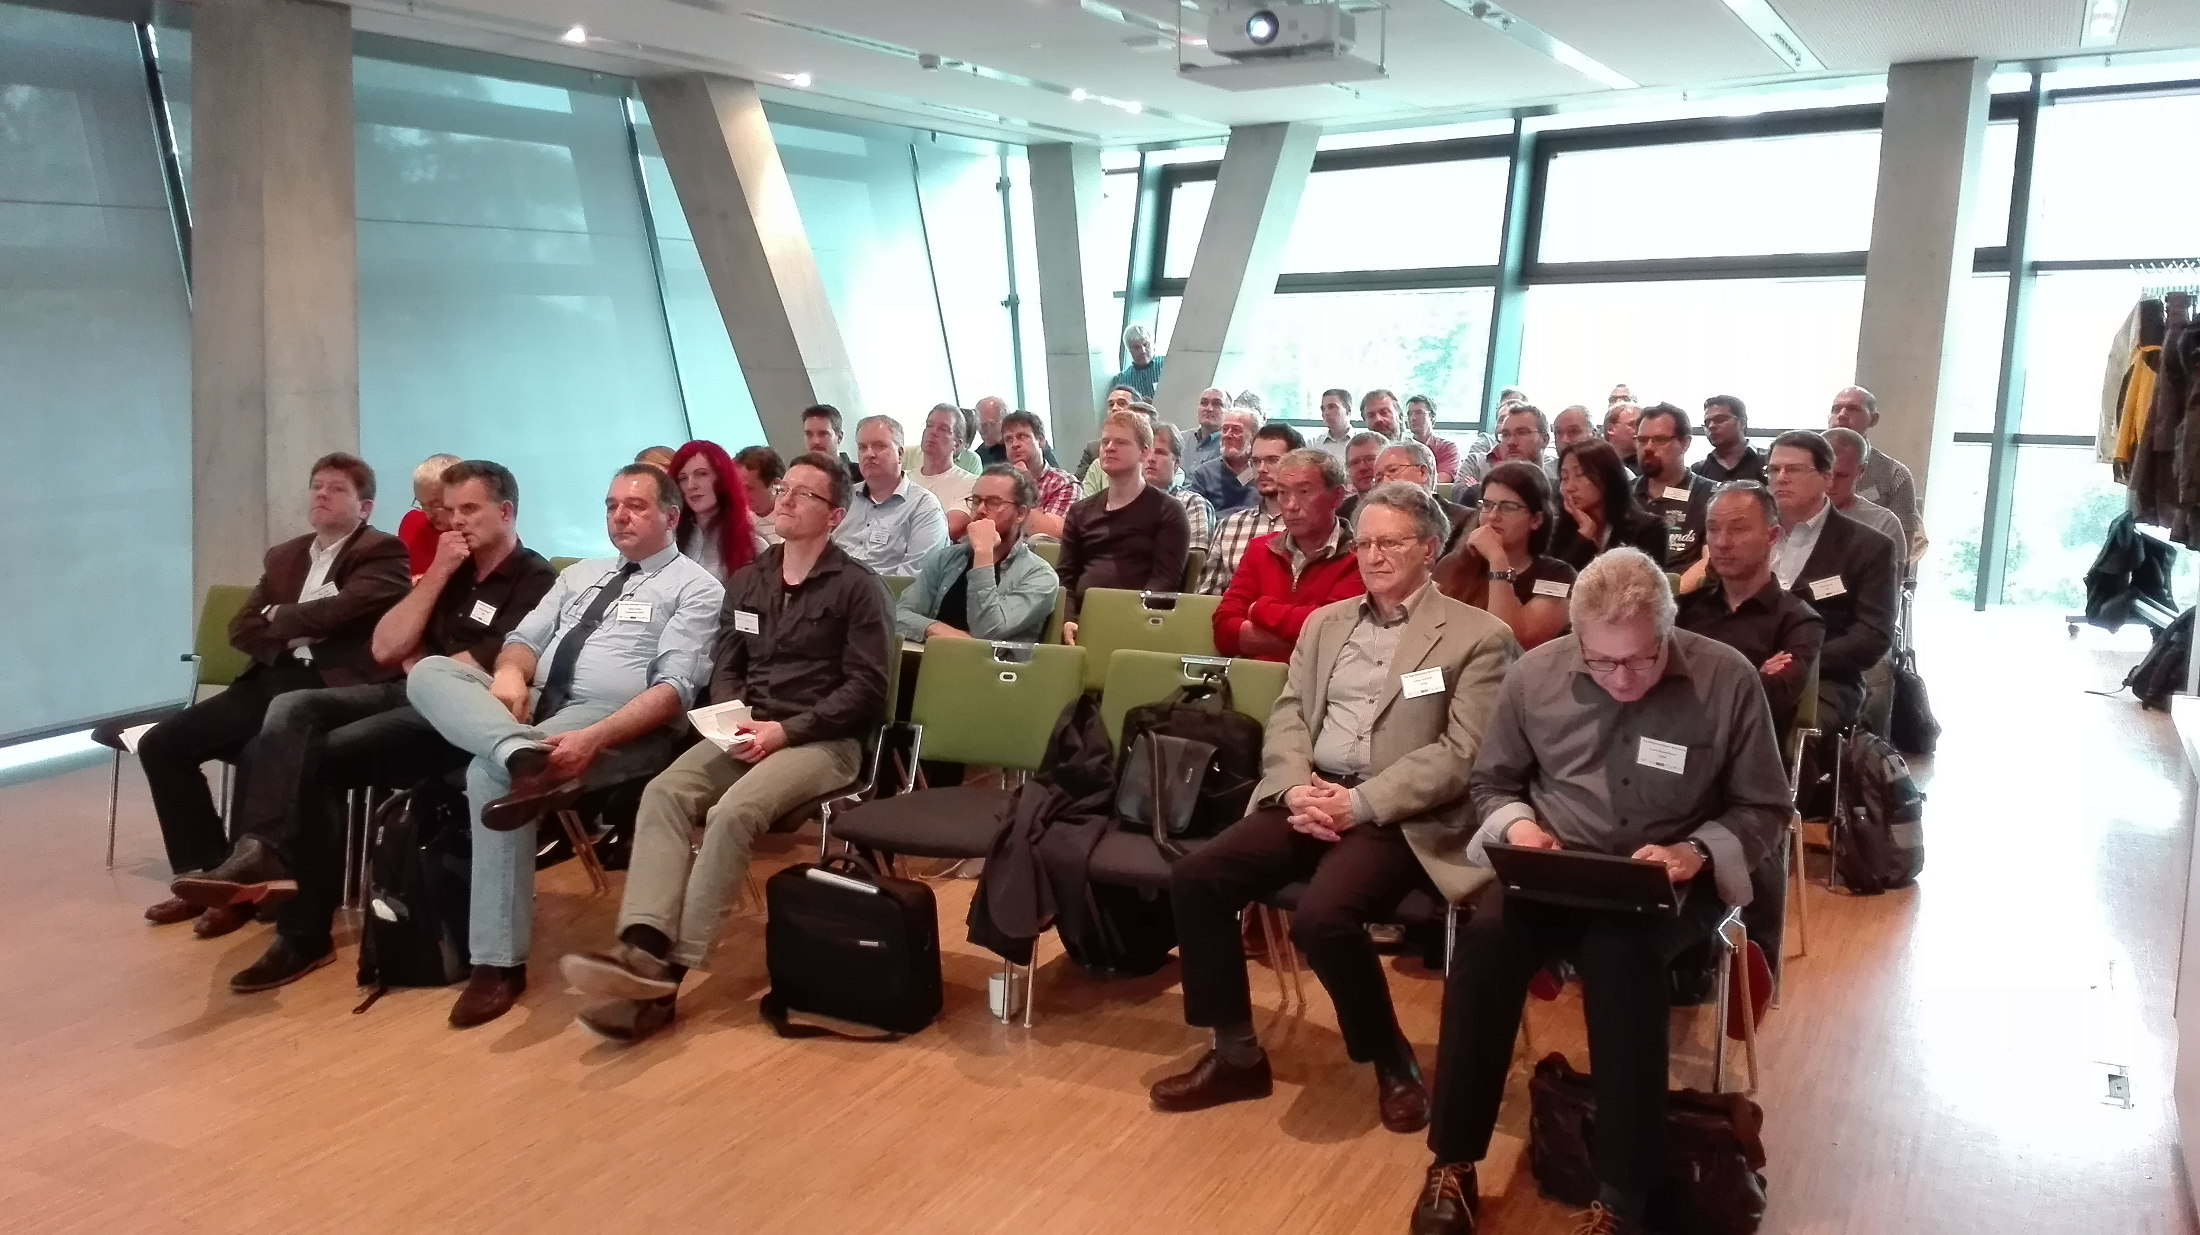
Slow extraction workshop (June 1-3, 2016)
Participants (total 50):
Austria: 2 (MedAustron, TU Wien)
Germany:37 (FZJ, Jena, Frankfurt, GSI, HIT, TUD, Bonn)
Italy: 2 (U. Bologna, CNAO)
Japan: 2 (NIRS, KEK)
Russia: 1 (IHEP)
Switzerland: 7 (CERN)
USA: 2 (BNL, FNAL)
Agenda:
Experience and issues from GSI/FAIR
Experience from USA
Experience from Japan
Experience from Russia
CERN and FZJ experience
Medical facilities
Electrons and crystals
Simulations
https://indico.gsi.de/event/4496/

Slide 10
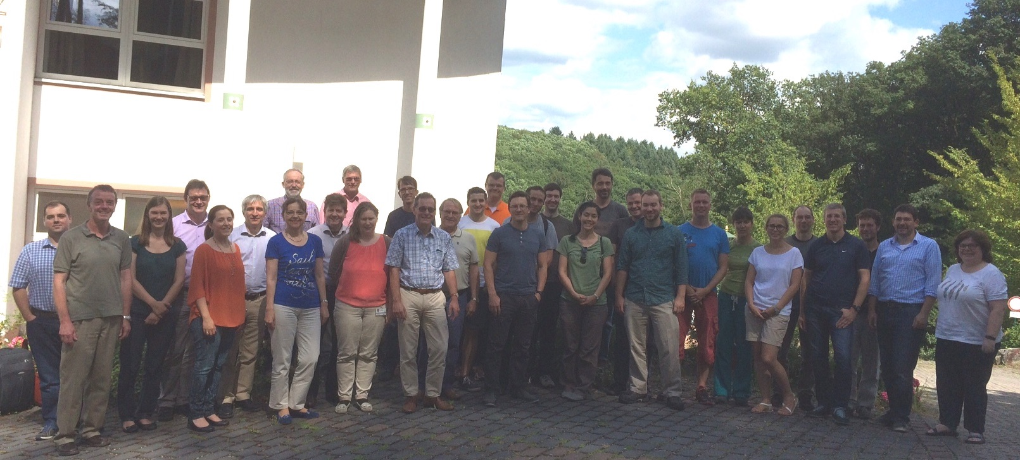
Rheingau, June 26-29 2016
26-29 Juni 2016 (Waldhotel Rheingau)
50 Participants
https://indico.gsi.de/event/4625
FAIR Phase 0
Controls
Report of beam time 2016
Slow extraction
UNILAC upgrade
Follow up

Slide 12
Today’s workshop
https://indico.gsi.de/event/6475/
Previous workshops (brief review)
Status slow extraction and spill structure control/smoothing
Beam parameter: New edition of the booklet
FAIR Injectors (developments, timeline, performance predictions): pLinac, UNILAC and SIS18
FAIR and other facilities: accelerators and experiments
FAIR commissioning and day-1 performance/experiments.
Next workshop (Discussion)

Slide 13
Recommendation: 17th MAC
Determine, in consultation with the user community, the initial beam parameters
(species, energy, and intensity) for each of the four experimental programs of FAIR that
can be expected to be available at the completion of the FAIR facility construction
and after a minimum amount of commissioning.
Actions:
Discussion of pilot beam parameters with experiment coordinators -> Distribution of pilot beam parameter list for reference cycles.
Upcoming workshop: FAIR Experiments and Accelerators (Dec 15)
Reference beam parameters: Discussion of new brochure (Dec 15).

