Slide 1
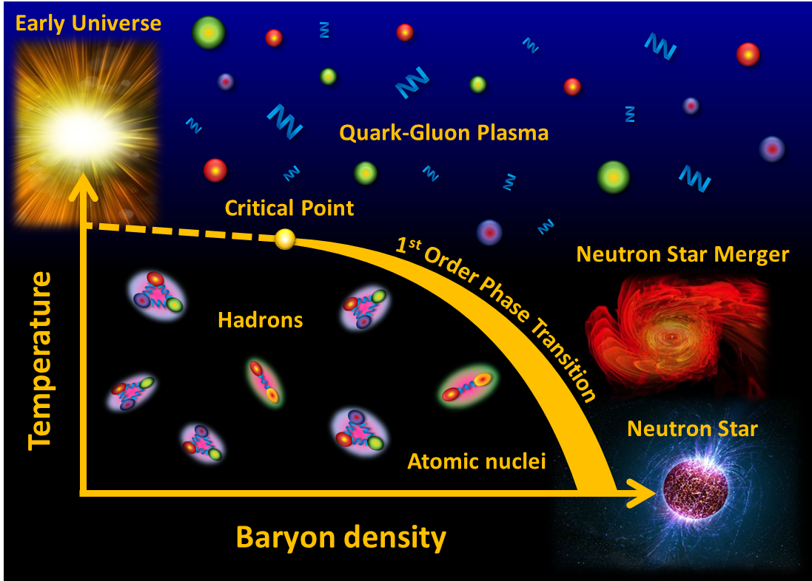
Cosmic Matter in the Laboratory –
The Compressed Baryonic Matter experiment at FAIR
Peter Senger GSI and Univ. Frankfurt
Outline:
➢ Cosmic matter
The Facility of Antiproton and Ion Research
The Compressed Baryonic Matter experiment
1
XXXVII Physics In Collision (PIC 2017), September 4- 8, 2017, Prague, Czech Republic

Slide 2
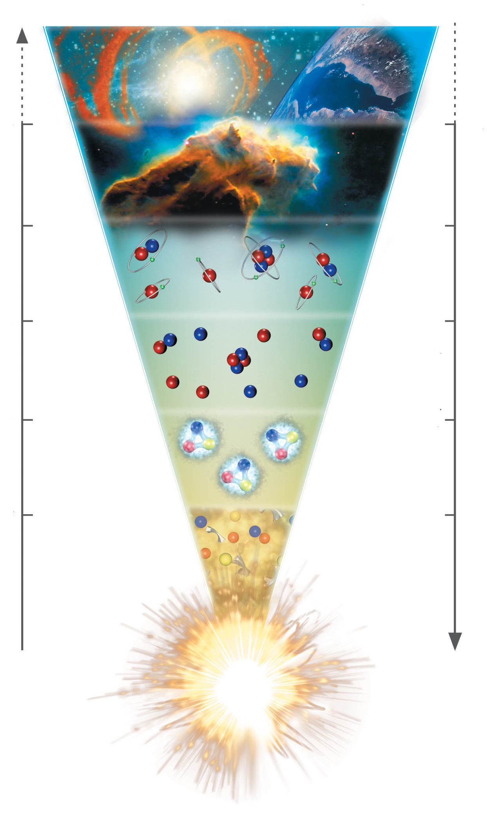
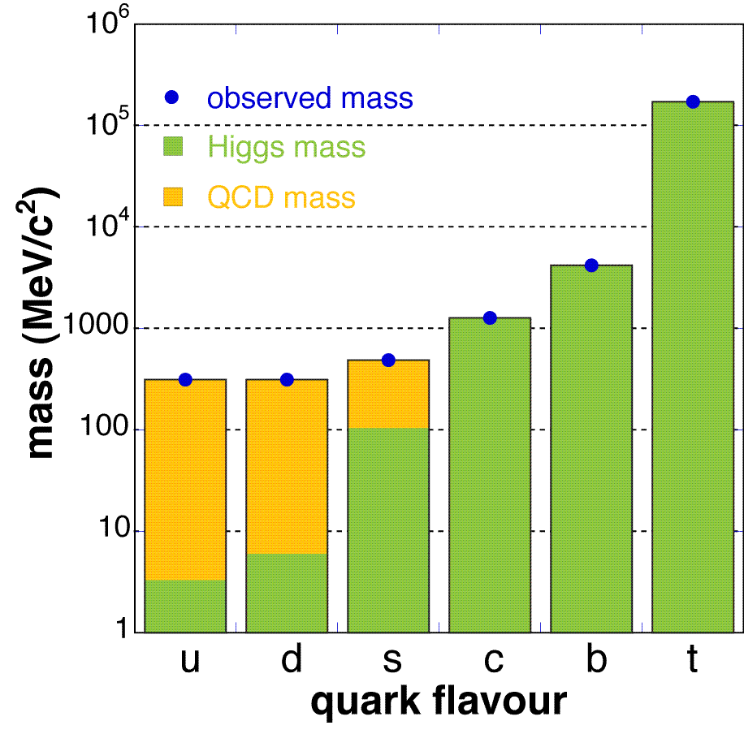
The evolution of matter in the universe
15 billion years
3 K
1 billion years
20 K
time
300.000 years
3000 K
temperature
3 minutes
10⁹ K
1 millisecond
10¹² K
1 microsecond
Explicit breaking
of Chiral Symmetry
(Higgs mechanism)
m_{u} ≈ 5 MeV,
m_{d} ≈ 10 MeV,
m_{s} ≈ 150 MeV
distance

Slide 3
The evolution of matter in the universe
15 billion years
3 K
1 billion years
20 K
time
300.000 years
3000 K
temperature
3 minutes
10⁹ K
1 millisecond
10¹² K
1 microsecond
The soup of the
first microsecond:
quarks, antiquarks,
electrons, positrons,
gluons, photons
distance

Slide 4
The evolution of matter in the universe
15 billion years
3 K
1 billion years
20 K
time
300.000 years
3000 K
temperature
3 minutes
10⁹ K
1 millisecond
10¹² K
1 microsecond
Spontaneous/dynamical
Chiral Symmetry breaking:
Hadrons acquire mass by
coupling to the virtual
quark-antiquark pairs
of the chiral condensate
distance

Slide 5
The evolution of matter in the universe
15 billion years
3 K
1 billion years
20 K
time
300.000 years
3000 K
temperature
3 minutes
10⁹ K
1 millisecond
10¹² K
1 microsecond
Annihilation of particles
and antiparticles, only
10⁻⁹ of particles survived
distance

Slide 6
The evolution of matter in the universe
15 billion years
3 K
Evolution of stars
1 billion years
20 K
time
300.000 years
3000 K
temperature
3 minutes
10⁹ K
1 millisecond
10¹² K
1 microsecond
distance

Slide 7
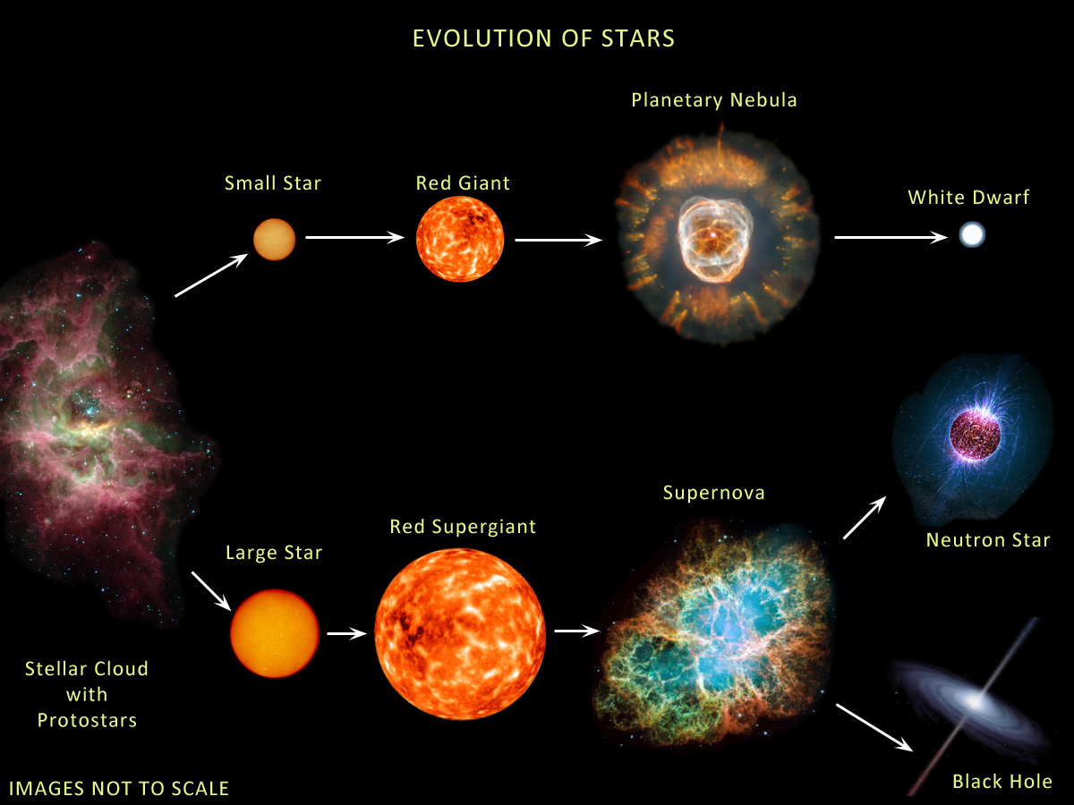
The evolution of stars
M < ≈ 8M → white dwarf
8M< M < 15M → neutron star: 1.4M< M_{core}< 2M
M >≈15M → black hole: M_{core} >≈ 2M
Courtesy of Anna Watts

Slide 8
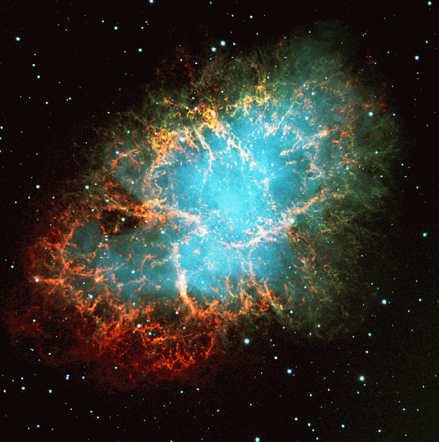
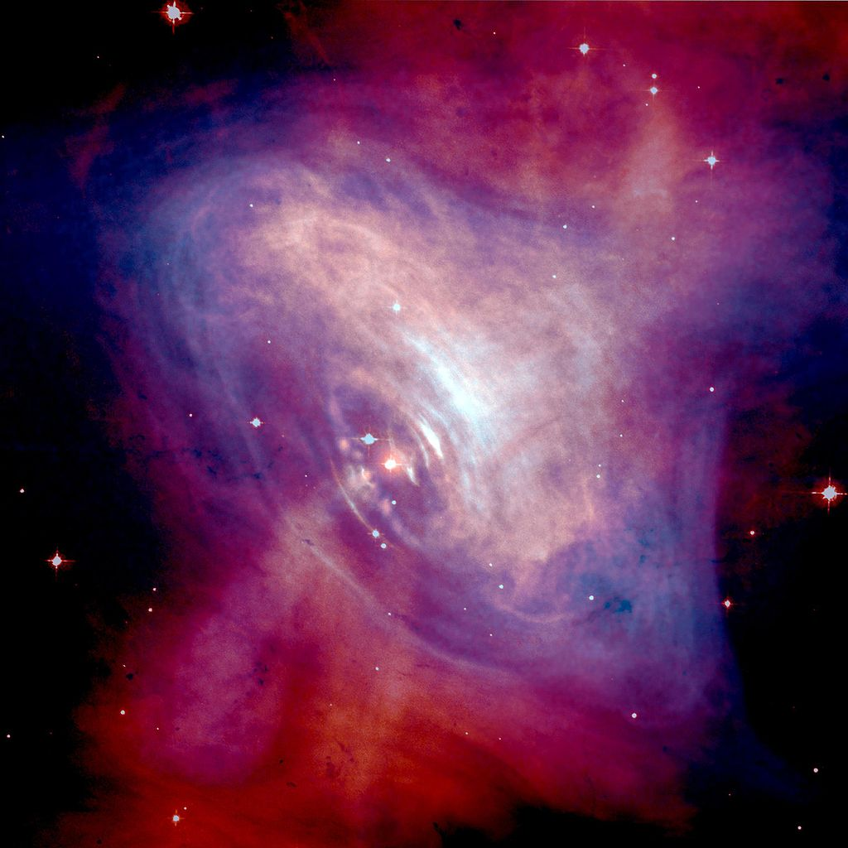
Discovery of the first pulsar in 1968
Crab nebula:
ashes of a core collapse supernova observed in 1054 by Chinese astronomers.
The “visiting star” was as bright as the Venus for more than 20 days.

Slide 9
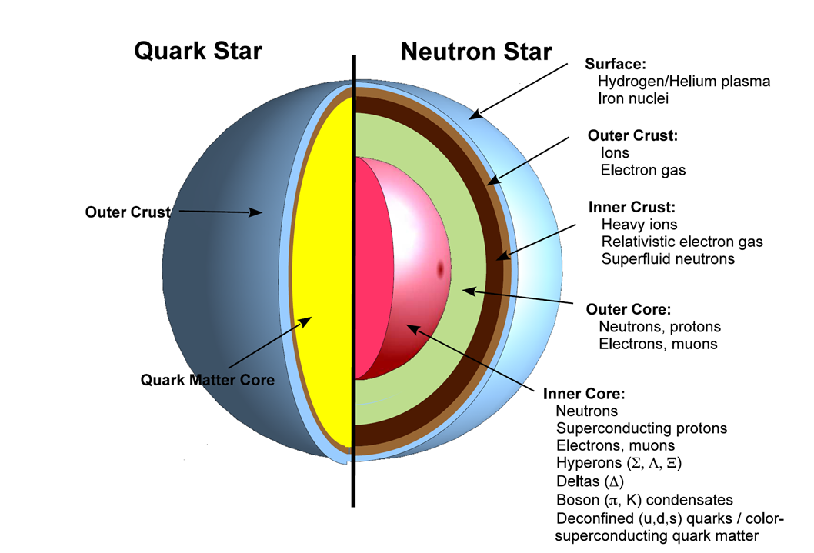
?

Slide 10
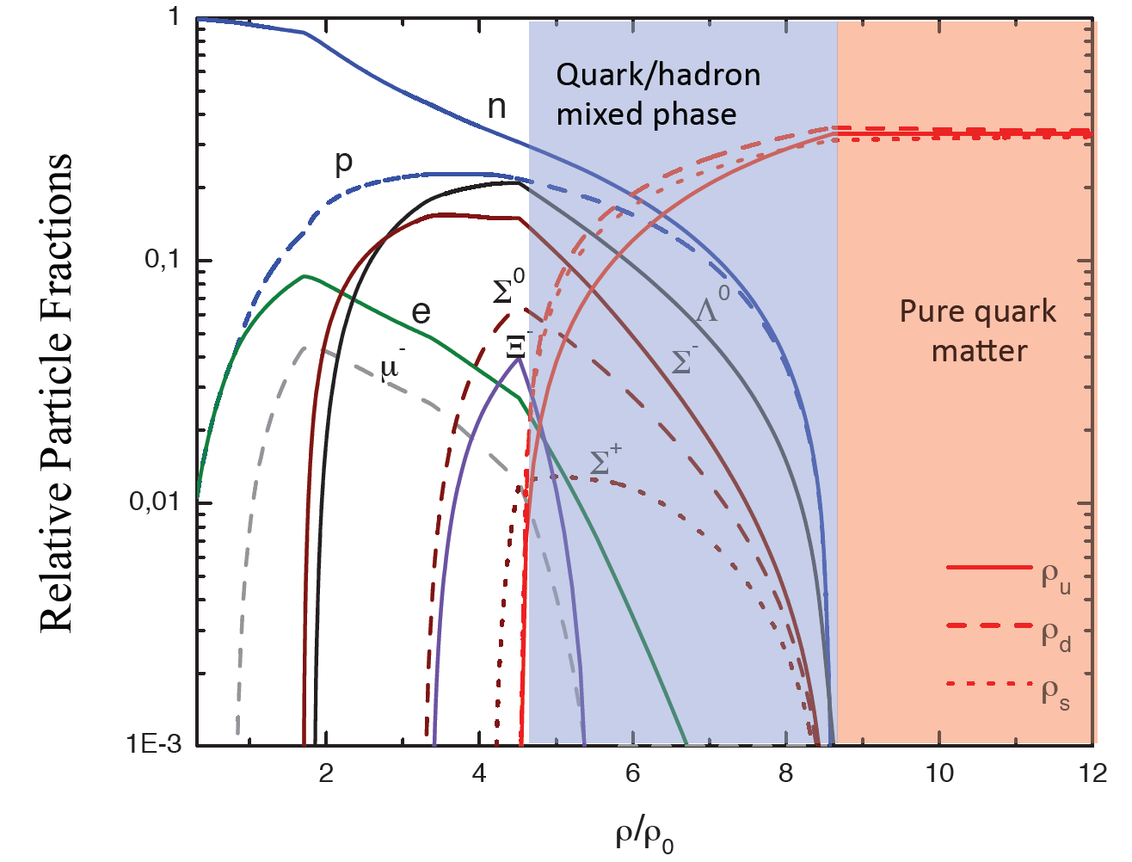
Quark matter in massive neutron stars?
M. Orsaria, H. Rodrigues, F. Weber, G.A. Contrera, arXiv:1308.1657
Phys. Rev. C 89, 015806, 2014

Slide 11
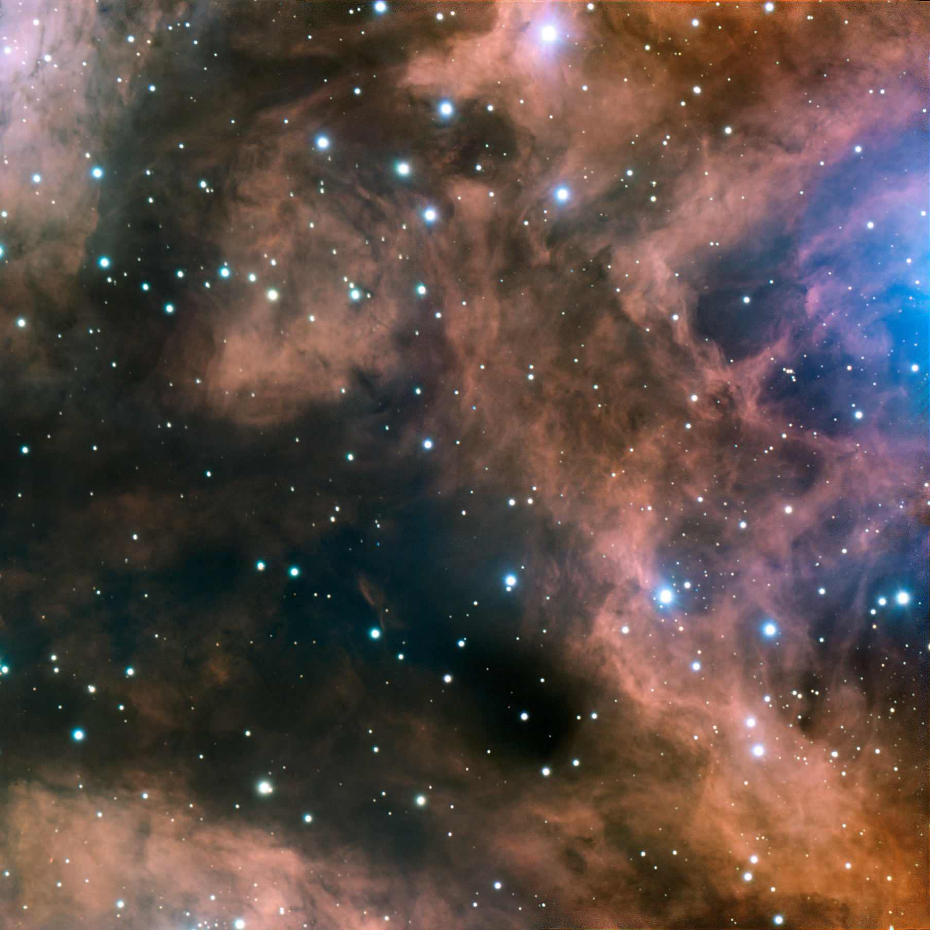
Fundamental questions
What is the origin of the mass of the universe?
What is the origin of the elements ?
What is the structure of neutron stars?
Can we ignite the solar fire on earth ?
Does matter differ from antimatter ?
Why do we not observe individual quarks ?
→ to be explored at the future international
Facility for Antiproton and Ion Research (FAIR)

Slide 12











Facility for Antiproton & Ion Research
SIS100/300
p-Linac
SIS18
Compressed Baryonic Matter
Primary Beams
10¹²/s; 1.5 GeV/u; ²³⁸U²⁸⁺
10¹⁰/s ²³⁸U⁹²⁺ up to 11 (35) GeV/u
3x10¹³/s 30 (90) GeV protons
Anti-Proton Physics
HESR
Super Fragment-Separator:
Nuclear Structure and Astrophysics
Secondary Beams
radioactive beams up to
1.5 - 2 GeV/u;
10¹¹ antiprotons 1.5 - 15 GeV/c
Technical Challenges
FAIR phase 1
FAIR phase 2
CR
rapid cycling superconducting magnets
dynamical vacuum
12
100 m

Slide 13
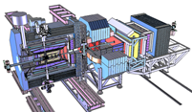
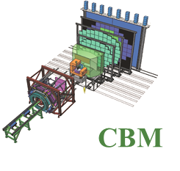
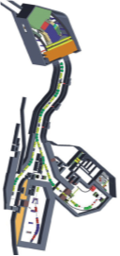
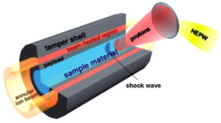
Facility for Antiproton & Ion Research
Experimental programs:
APPA: Atomic & Plasma Physics & Applications
➢ Highly charged atoms
➢ Plasma physics
➢ Radiobiology
➢ Material science
SIS18
SIS100/300
p-Linac
Compressed Baryonic Matter
HESR
CBM: Nucleus-nucleus collisions
➢ Nuclear matter at neutron
star core densities
➢ Phase transitions from
hadrons to quarks
Anti-Proton Physics
Super Fragment-Separator:
Nuclear Structure and Astrophysics
NUSTAR: Rare Isotope beams
➢ Nuclear structure far off stability
➢ Nucleosynthesis in stars and supernovae
CR
PANDA: Antiproton-proton collisions:
➢ Charmed hadrons (XYZ)
➢ Gluonic matter and hybrids
➢ Hadron structure
➢ Double Lambda hypernuclei
FAIR phase 1
FAIR phase 2
100 m
13

Slide 14
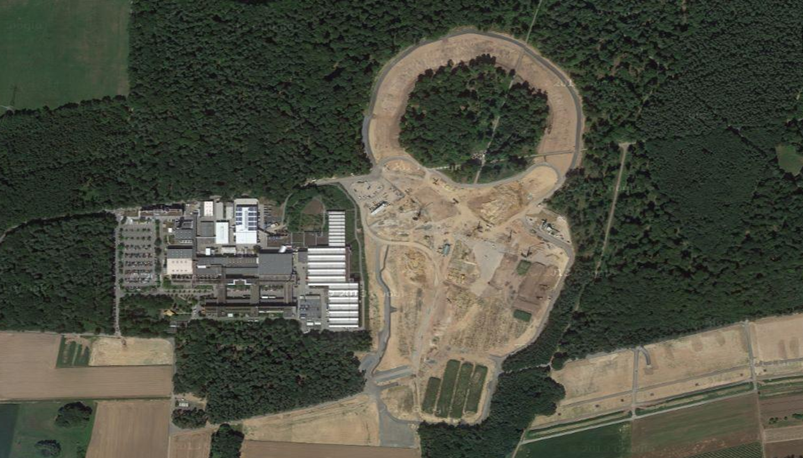
Facility for Antiproton & Ion Research
Experimental programs:
APPA: Atomic & Plasma Physics & Applications
➢ Highly charged atoms
➢ Plasma physics
➢ Radiobiology
➢ Material science
SIS18
SIS100/300
p-Linac
Compressed Baryonic Matter
HESR
CBM: Nucleus-nucleus collisions
➢ Nuclear matter at neutron
star core densities
➢ Phase transitions from
hadrons to quarks
Anti-Proton Physics
Super Fragment-Separator:
Nuclear Structure and Astrophysics
NUSTAR: Rare Isotope beams
➢ Nuclear structure far off stability
➢ Nucleosynthesis in stars and supernovae
CR
PANDA: Antiproton-proton collisions:
➢ Charmed hadrons (XYZ)
➢ Gluonic matter and hybrids
➢ Hadron structure
➢ Double Lambda hypernuclei
FAIR phase 1
FAIR phase 2
100 m
14

Slide 15
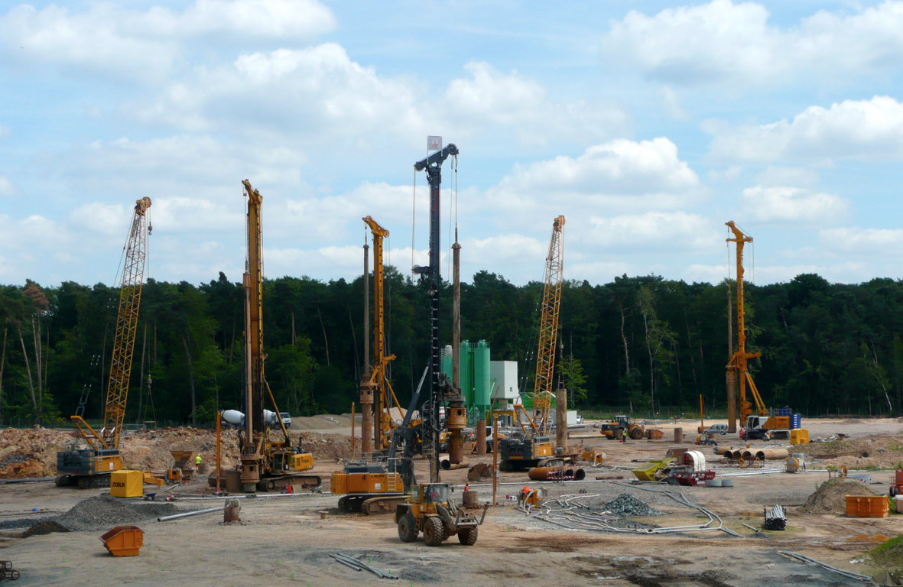
In 2014: Four worldwide largest drilling machines put down 1350 reinforced concrete pillars of 60 m depth and 1.2 m diameter.

Slide 16
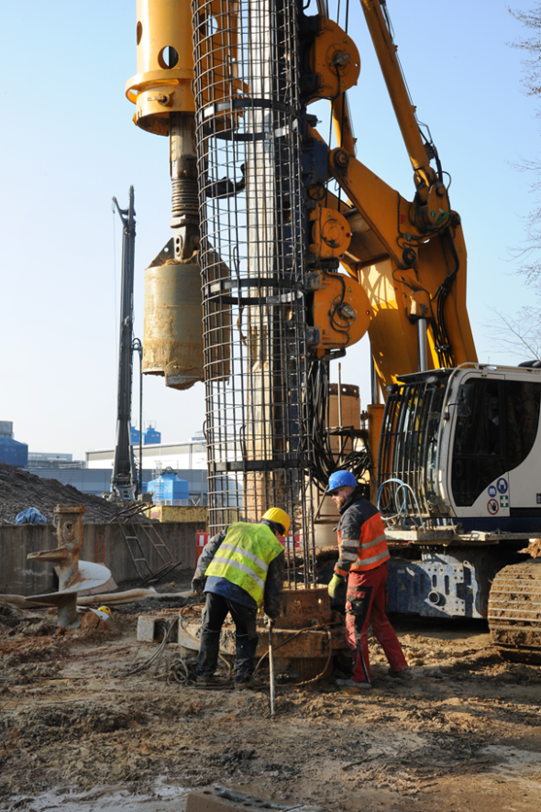
Status of FAIR
Construction started July 2017
Installation incl. commissioning of
the experiments is planned during 2021-2024
Full completion of FAIR by 2025
16

Slide 17
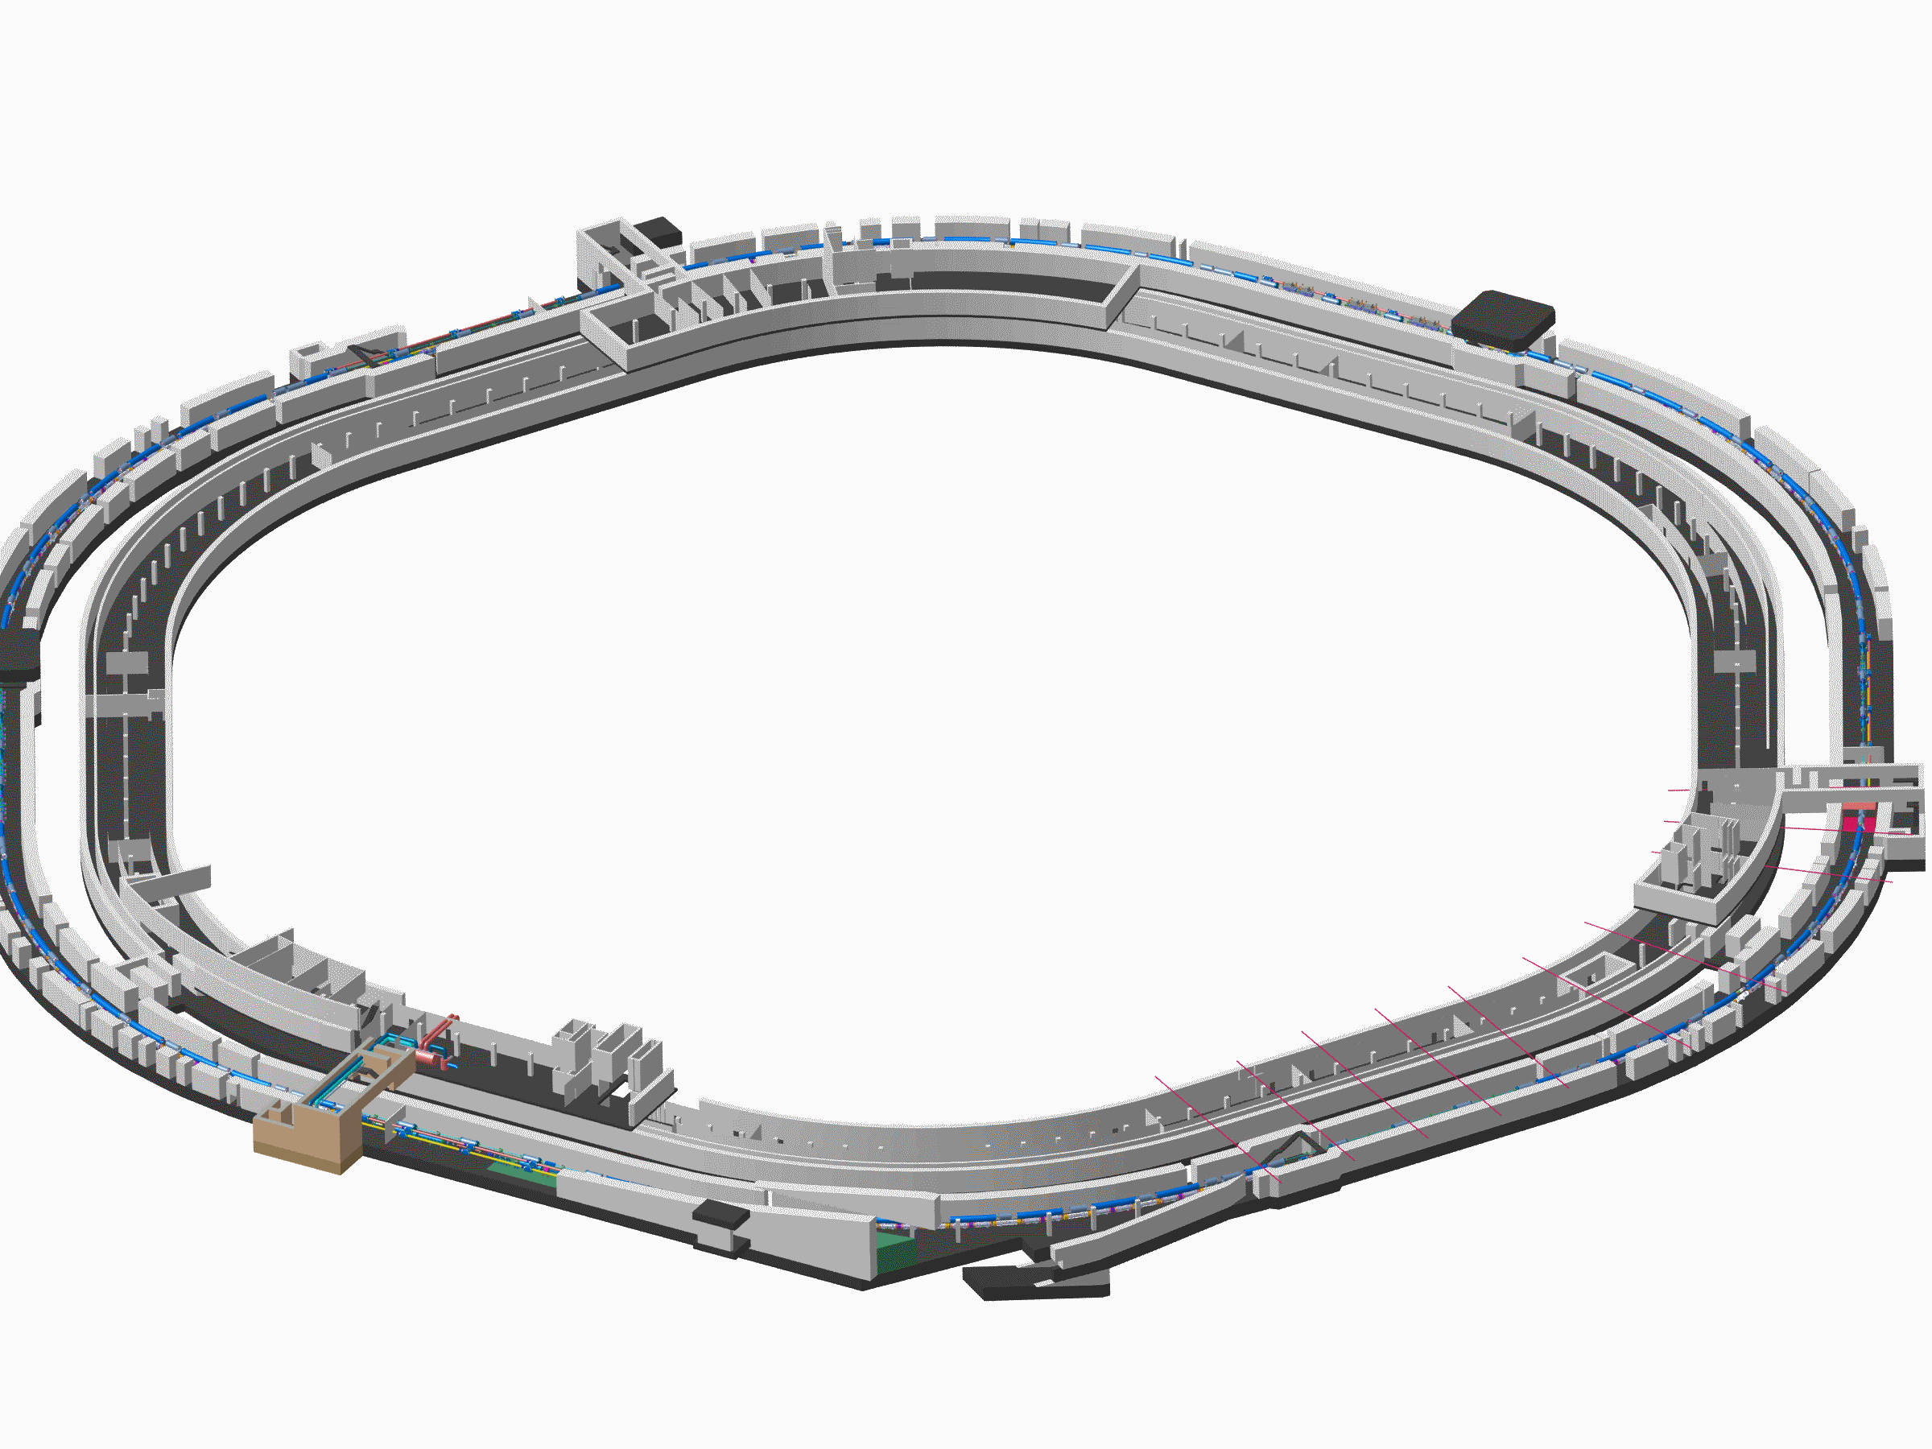
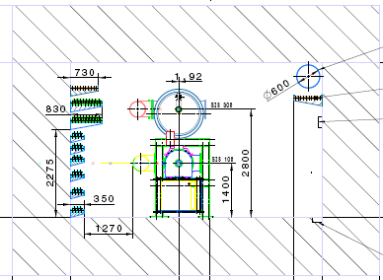
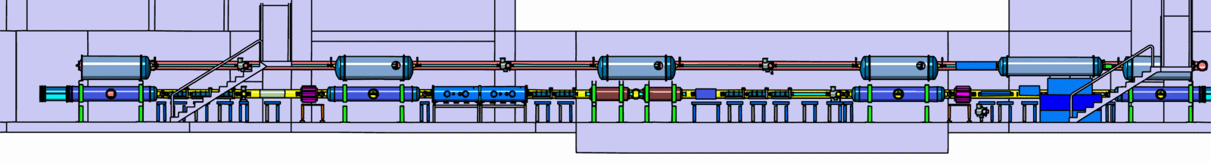
Tunnel for SIS100/300
17

Slide 18
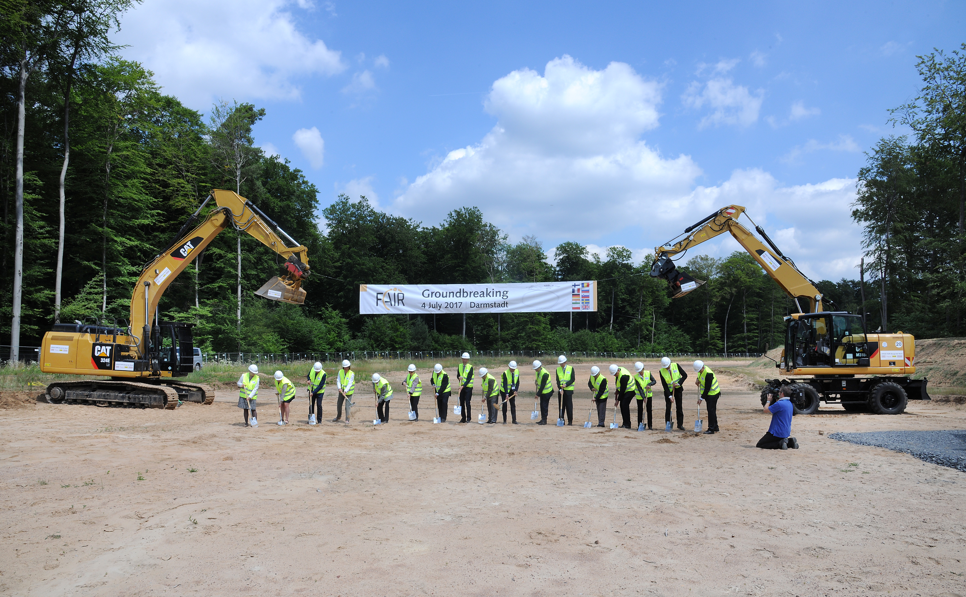

Slide 19
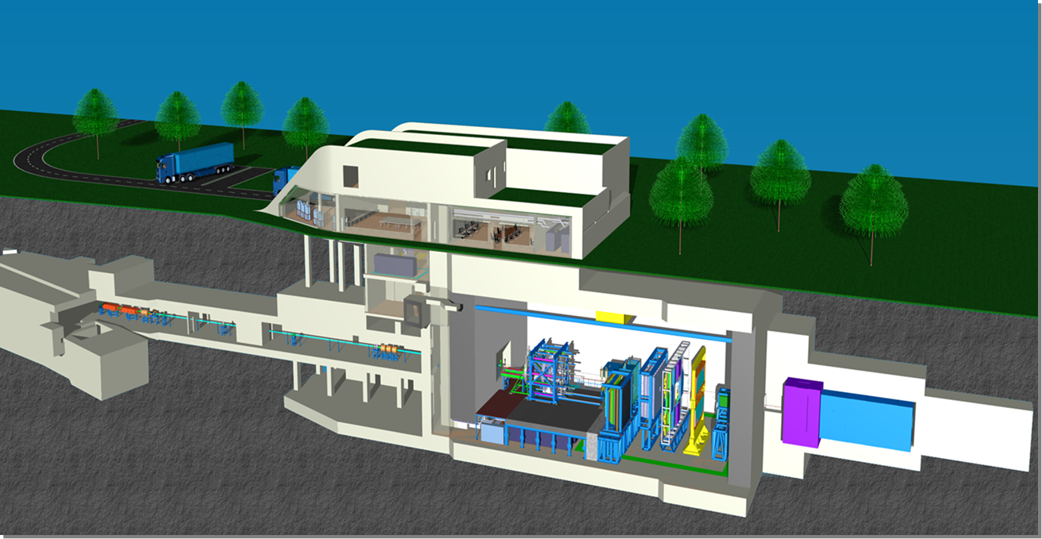
The Compressed Baryonic Matter (CBM)
experiment
19

Slide 20
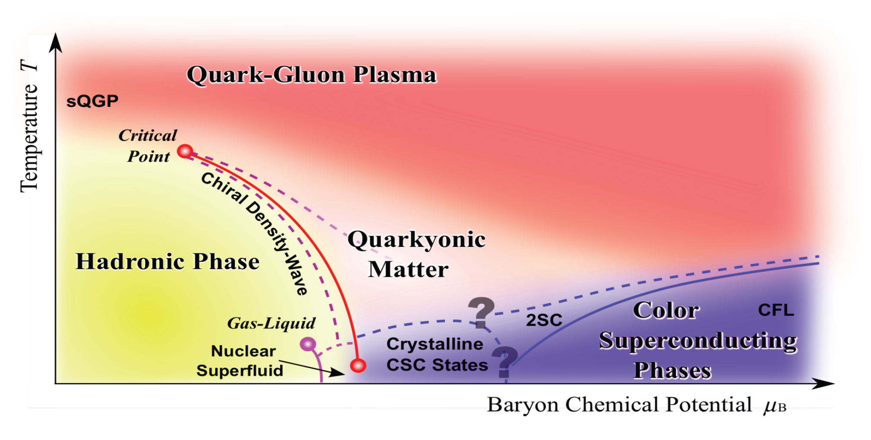
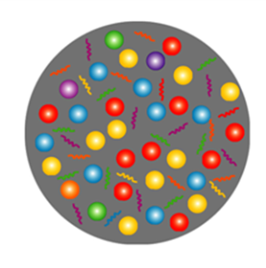
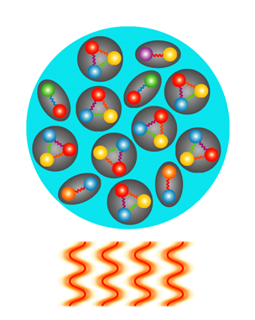
Exploring the QCD phase diagram
Courtesy of K. Fukushima & T. Hatsuda
At very high temperature:
➢ N of baryons ≈ N of antibaryons
Situation similar to early universe
➢ L-QCD finds crossover transition between
hadronic matter and Quark-Gluon Plasma
➢ Experiments: ALICE, ATLAS, CMS at LHC
STAR, PHENIX at RHIC

Slide 21
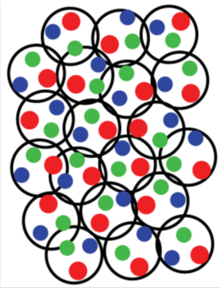
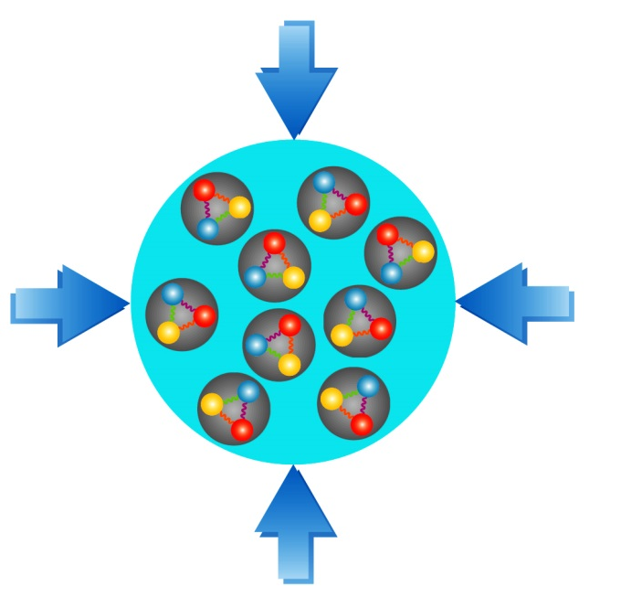
Exploring the QCD phase diagram
Courtesy of K. Fukushima & T. Hatsuda
At high baryon density:
➢ N of baryons >> N of antibaryons
Densities like in neutron star cores
➢ L-QCD not (yet) applicable
Models predict first order phase transition
with mixed or exotic phases
Experiments: BES at RHIC, NA61 at CERN SPS,
CBM at FAIR, NICA at JINR, J-PARC

Slide 22


Baryon densities in central Au+Au collisions
I.C. Arsene et al., Phys. Rev. C 75, 24902 (2007)
5 A GeV
10 A GeV
8 ρ₀
5 ρ₀
∼ 2 ρ₀
∼ 5 ρ₀
22
courtesy Toru Kojo (CCNU)

Slide 23
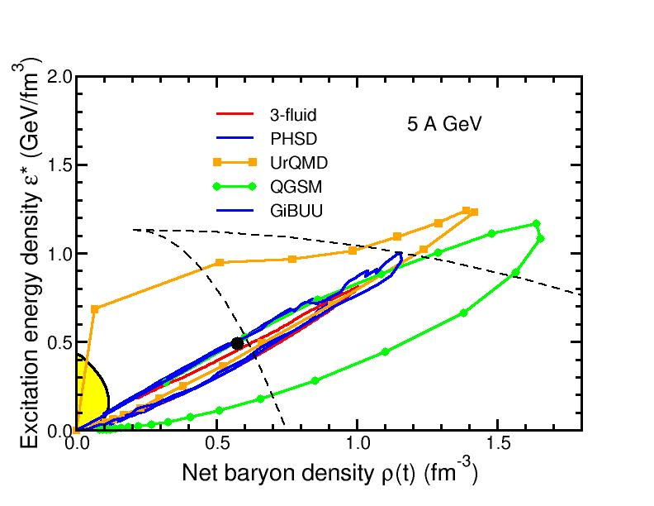
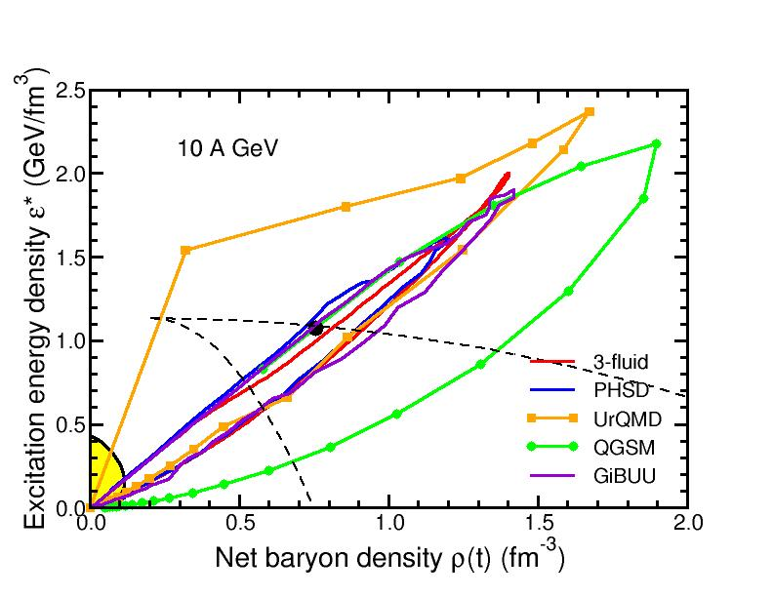
Baryon densities in central Au+Au collisions
I.C. Arsene et al., Phys. Rev. C 75, 24902 (2007)
5 A GeV
10 A GeV
8 ρ₀
5 ρ₀
phase
coexistence
phase
coexistence
23

Slide 24
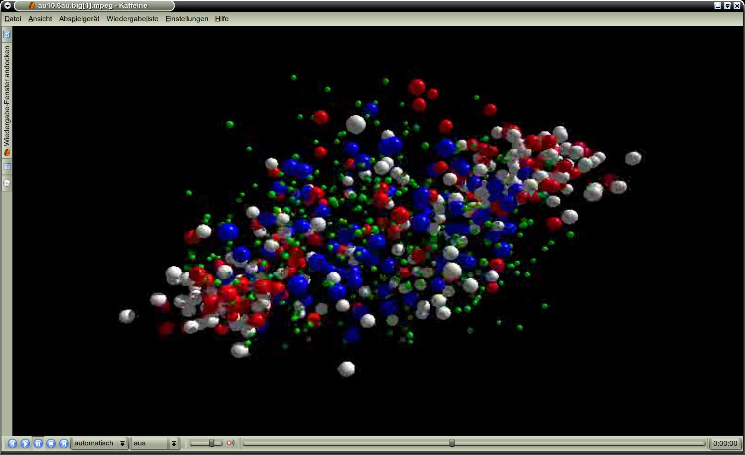
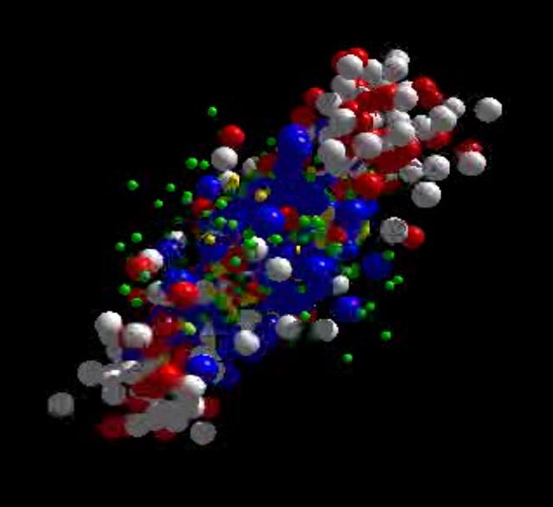
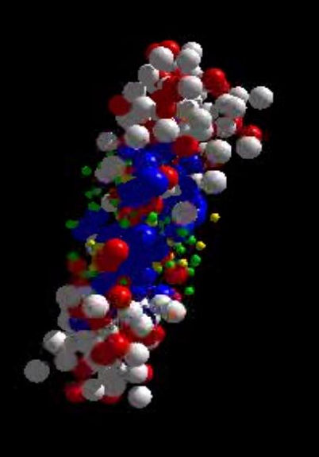
Messengers from the dense fireball:
CBM at FAIR
UrQMD transport calculation Au+Au 10.7 A GeV
Ξ⁻, Ω⁻, φ
π, K, Λ, ...
p, Λ, Ξ⁺, Ω⁺, J/ψ
ρ → e⁺e⁻, μ⁺μ⁻
resonance decays
ρ → e⁺e⁻, μ⁺μ⁻
ρ → e⁺e⁻, μ⁺μ⁻

Slide 25

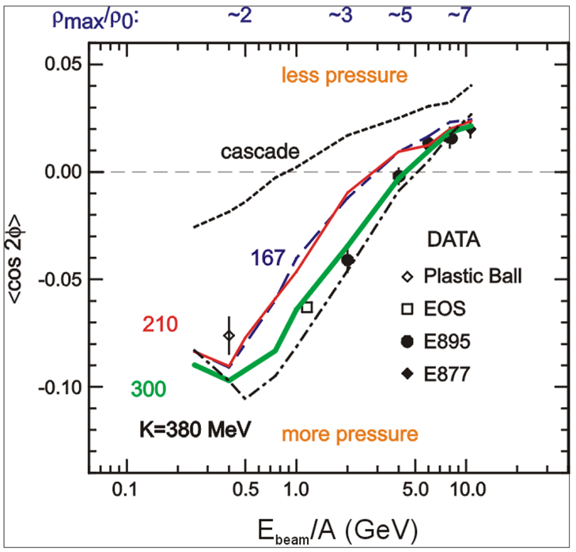
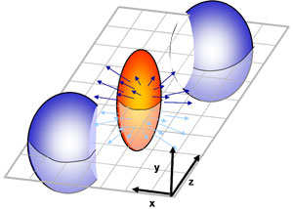
CBM physics case and observables
The QCD matter equation-of-state at neutron star core densities
➢ collective flow of identified particles (π,K,p,Λ,Ξ,Ω,...)
driven by the pressure gradient in the early fireball
AGS: proton flow in Au+Au collisions
Azimuthal angle distribution:
dN/dφ = C (1 + v₁ cos(φ) + v₂ cos(2φ) + ...)
P. Danielewicz, R. Lacey, W.G. Lynch, Science 298 (2002) 1592

Slide 26
CBM physics case and observables
The QCD matter equation-of-state at neutron star core densities
➢ collective flow of identified particles (π,K,p,Λ,Ξ,Ω,...)
driven by the pressure gradient in the early fireball
➢ particle production at (sub)threshold energies via
multi-step processes (multi-strange hyperons, charm)
Direct multi-strange hyperon production:
pp → Ξ⁻ K⁺K⁺p (E_{thr} = 3.7 GeV)
pp → Ω⁻ K⁺K⁺K⁰p (E_{thr} = 7.0 GeV)
pp → Λ⁰Λ⁰ pp (E_{thr} = 7.1 GeV)
pp → Ξ⁺ Ξ⁻ pp (E_{thr} = 9.0 GeV)
pp → Ω⁺ Ω⁻ pp (E_{thr} = 12.7 GeV
p
p
p
p
Λ⁰
(uds)
Hyperon production via multiple collisions
pp → K⁺Λ⁰p, pp → K⁺K⁻pp,
pΛ⁰→ K⁺ Ξ⁻ p, πΛ⁰→ K⁺ Ξ⁻ π,
Λ⁰Λ⁰→ Ξ⁻ p, Λ⁰K⁻ → Ξ⁻ π⁰
3 . Λ⁰ Ξ⁻ → Ω⁻ n, Ξ⁻K⁻ → Ω⁻ π⁻
Antihyperons
1. Λ⁰ K⁺ → Ξ⁺π⁰ ,
2. Ξ⁺ K⁺ → Ω⁺ π⁺.
p
K⁺
p
Λ⁰
Ξ⁻
(uds)
(dss)
Ω⁻
p
K⁺
p
(sss)
p
Λ⁰
(uds)
K⁺
p
n

Slide 27
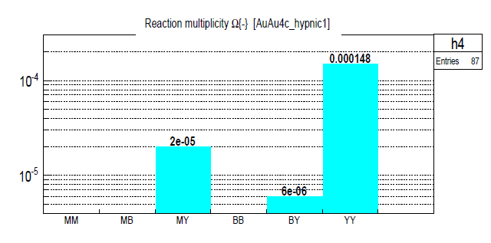
CBM physics case and observables
The QCD matter equation-of-state at neutron star core densities
➢ collective flow of identified particles (π,K,p,Λ,Ξ,Ω,...)
driven by the pressure gradient in the early fireball
➢ particle production at (sub)threshold energies via
multi-step processes (multi-strange hyperons, charm)
Direct multi-strange hyperon production:
pp → Ξ⁻ K⁺K⁺p (E_{thr} = 3.7 GeV)
pp → Ω⁻ K⁺K⁺K⁰p (E_{thr} = 7.0 GeV)
pp → Λ⁰Λ⁰ pp (E_{thr} = 7.1 GeV)
pp → Ξ⁺ Ξ⁻ pp (E_{thr} = 9.0 GeV)
pp → Ω⁺ Ω⁻ pp (E_{thr} = 12.7 GeV
Ω⁻ production in 4 A GeV Au+Au
Hyperon production via multiple collisions
pp → K⁺Λ⁰p, pp → K⁺K⁻pp,
pΛ⁰→ K⁺ Ξ⁻ p, πΛ⁰→ K⁺ Ξ⁻ π,
Λ⁰Λ⁰→ Ξ⁻ p, Λ⁰K⁻ → Ξ⁻ π⁰
3 . Λ⁰ Ξ⁻ → Ω⁻ n, Ξ⁻K⁻ → Ω⁻ π⁻
Antihyperons
1. Λ⁰ K⁺ → Ξ⁺π⁰ ,
2. Ξ⁺ K⁺ → Ω⁺ π⁺.
HYPQGSM calculations , K. Gudima et al.

Slide 28
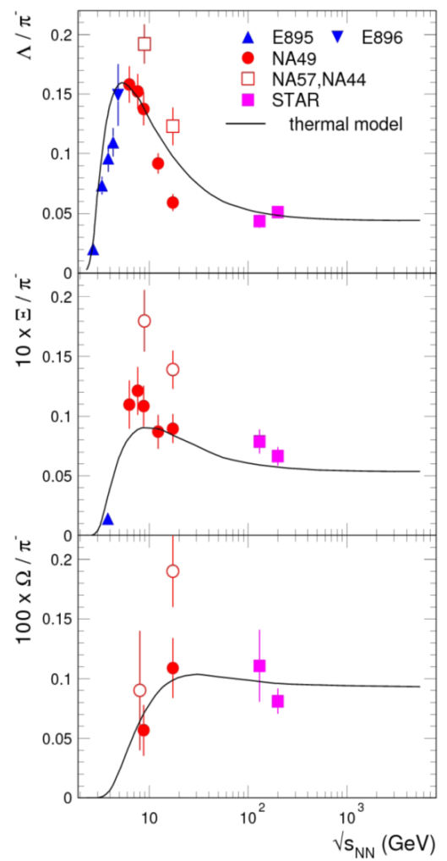
CBM physics case and observables
The QCD matter equation-of-state at neutron star core densities
➢ collective flow of identified particles (π,K,p,Λ,Ξ,Ω,...)
driven by the pressure gradient in the early fireball
➢ particle production at (sub)threshold energies via
multi-step processes (multi-strange hyperons, charm)
Direct multi-strange hyperon production:
pp → Ξ⁻ K⁺K⁺p (E_{thr} = 3.7 GeV)
pp → Ω⁻ K⁺K⁺K⁰p (E_{thr} = 7.0 GeV)
pp → Λ⁰Λ⁰ pp (E_{thr} = 7.1 GeV)
pp → Ξ⁺ Ξ⁻ pp (E_{thr} = 9.0 GeV)
pp → Ω⁺ Ω⁻ pp (E_{thr} = 12.7 GeV
Hyperon production via multiple collisions
pp → K⁺Λ⁰p, pp → K⁺K⁻pp,
pΛ⁰→ K⁺ Ξ⁻ p, πΛ⁰→ K⁺ Ξ⁻ π,
Λ⁰Λ⁰→ Ξ⁻ p, Λ⁰K⁻ → Ξ⁻ π⁰
3 . Λ⁰ Ξ⁻ → Ω⁻ n, Ξ⁻K⁻ → Ω⁻ π⁻
Antihyperons
1. Λ⁰ K⁺ → Ξ⁺π⁰ ,
2. Ξ⁺ K⁺ → Ω⁺ π⁺.
Very few data
at FAIR energies

Slide 29
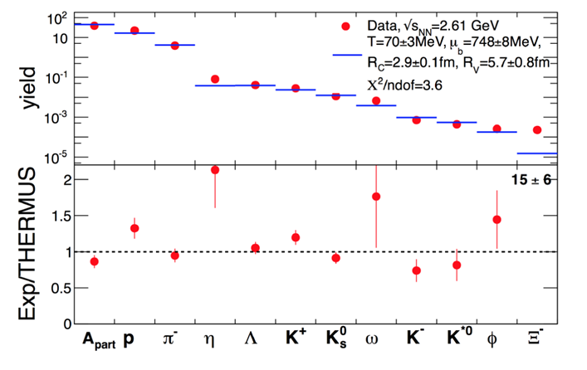
CBM physics case and observables
Phase transitions from partonic to hadronic matter
excitation function of strangeness: Ξ⁻(dss),Ξ⁺(dss),Ω⁻(sss),Ω⁺(sss)
→ chemical equilibration at the phase boundary
Particle yields and thermal model fits
Very few data
at FAIR energies
A. Andronic et al., Jour. Phys. G38 (2011)
HADES: Ar + KCl 1.76 A GeV
G. Agakishiev et al., arXiv:1512.07070

Slide 30
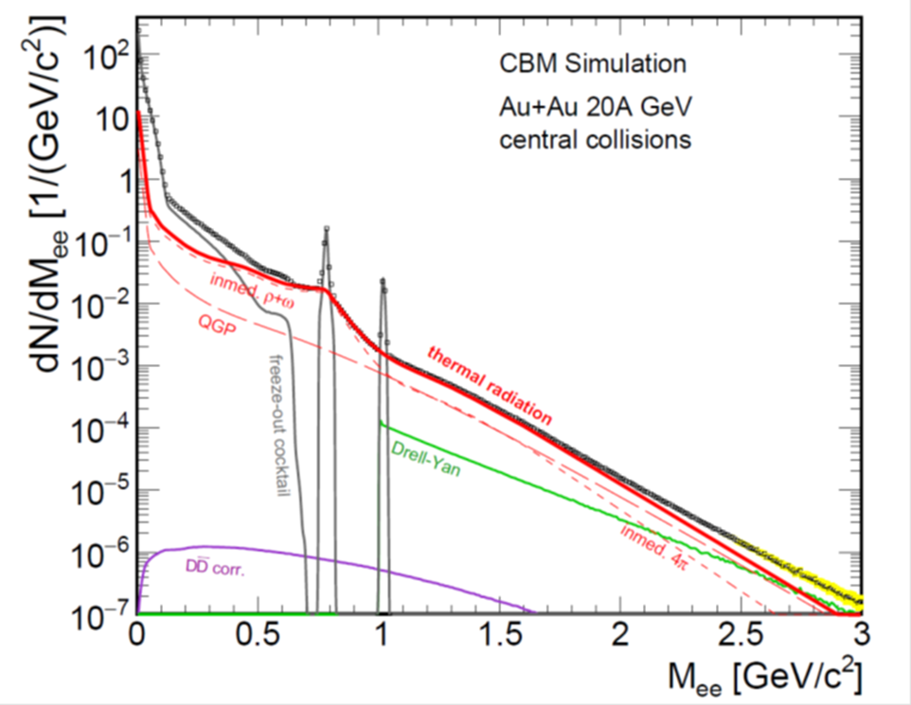
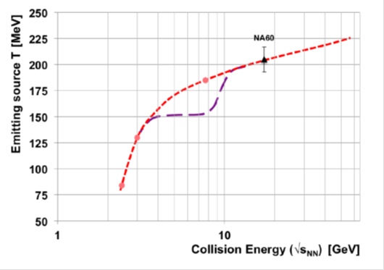
CBM physics case and observables
Phase transitions from partonic to hadronic matter
➢ excitation function of strangeness: Ξ⁻(dss),Ξ⁺(dss),Ω⁻(sss),Ω⁺(sss)
→ chemical equilibration at the phase boundary
Phase coexistence
excitation function (invariant mass) of lepton pairs:
thermal radiation from QGP, caloric curve
Invariant mass distribution of lepton pairs
Slope of dilepton invariant mass spectrum
1 GeV/c² < M_{inv} < 2.5 GeV/c²
No data
at FAIR energies
The CBM Collaboration, arXiv:1607.01487

Slide 31
CBM physics case and observables
Phase transitions from partonic to hadronic matter
➢ excitation function of strangeness: Ξ⁻(dss),Ξ⁺(dss),Ω⁻(sss),Ω⁺(sss)
→ chemical equilibration at the phase boundary
Phase coexistence
excitation function (invariant mass) of lepton pairs:
thermal radiation from QGP, caloric curve
➢ anisotropic azimuthal angle distributions: “spinodal decomposition”
Spinodal decomposition of the mixed phase: net baryon number density fluctuations
C. Herold, M. Nahrgang, I. Mishustin, M.Bleicher
Nuclear Physics A 925 (2014) 14
Jan Steinheimer, Jorgen Randrup
Phys. Rev. C 87, 054903 (2013)
Eur. Phys. J. A (2016) 52: 239

Slide 32
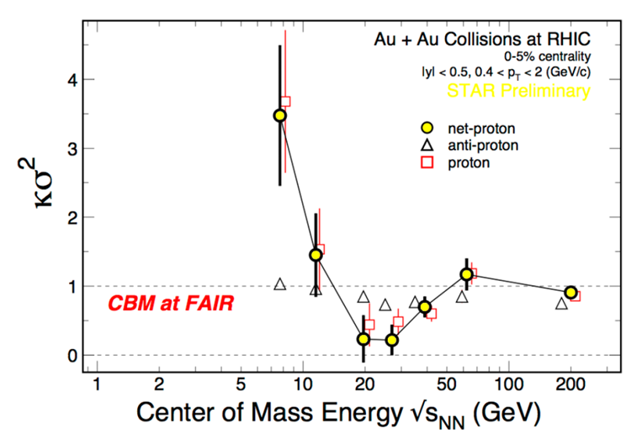
CBM physics case and observables
Phase transitions from partonic to hadronic matter
➢ excitation function of strangeness: Ξ⁻(dss),Ξ⁺(dss),Ω⁻(sss),Ω⁺(sss)
→ chemical equilibration at the phase boundary
Phase coexistence
excitation function (invariant mass) of lepton pairs:
thermal radiation from QGP, caloric curve
anisotropic azimuthal angle distributions: “spinodal decomposition”
Critical point
event-by-event fluctuations of conserved quantities (B,S,Q)
“critical opalescence”
4th moment of net-proton
multiplicity distribution:
critical fluctuations
STAR preliminary
No data
at FAIR energies

Slide 33
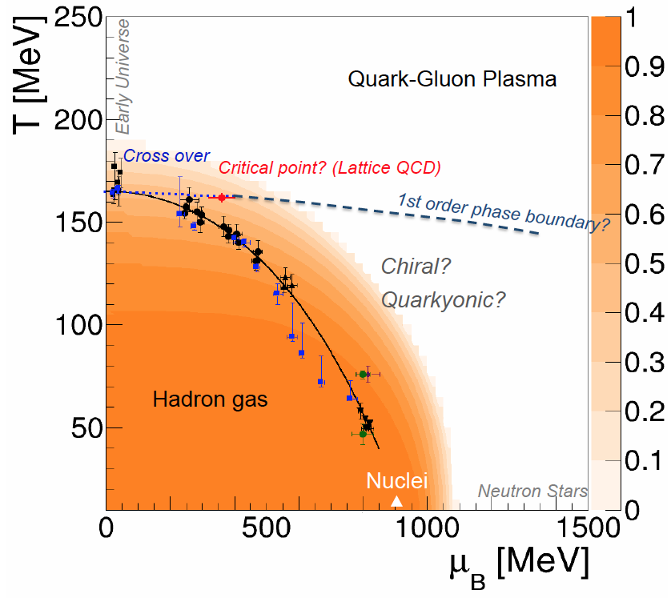
CBM physics case and observables
Onset of chiral symmetry restoration at high ρ_{B}
➢ in-medium modifications of hadrons: ρ,ω,φ →e⁺e⁻(μ⁺μ⁻)
➢ dileptons at intermediate invariant masses: 4 π → ρ-a₁ chiral mixing
Origin of quark masses
Orange region: Chiral condensate

Slide 34

CBM physics case and observables
Onset of chiral symmetry restoration at high ρ_{B}
➢ in-medium modifications of hadrons: ρ,ω,φ →e⁺e⁻(μ⁺μ⁻)
➢ dileptons at intermediate invariant masses: 4 π → ρ-a₁ chiral mixing
No data
at FAIR energies

Slide 35

CBM physics case and observables
N-Λ, Λ-Λ interaction, strange matter?
➢ (double-) lambda hypernuclei
➢ meta-stable objects (e.g. strange dibaryons)
No data
at FAIR energies
Double lambda hypernuclei production
in central Au+Au collisions at 10 A GeV:
 | Multiplicity | Yield in 1 week
⁵_{ΛΛ}H | 5 ⋅ 10⁻⁶ | 3000
⁶_{ΛΛ}He | 1 ⋅ 10⁻⁷ | 60
Assumption for yield calculation:
Reaction Rate 1 MHz
BR 10% (2 sequential weak decays)
Efficiency 1%
SIS100
A. Andronic et al., Phys. Lett. B697 (2011) 203

Slide 36
CBM physics case and observables
Charm production at threshold energies in cold and dense matter
➢ excitation function of charm production in p+A and A+A (J/ψ, D⁰, D±)
UrQMD calculation including subthreshold charm production via
N* → Λ_{c} + D and N* → N +J/ψ
No data
at FAIR energies
36
J. Steinheimer, A. Botvina, M. Bleicher, Phys. Rev. C 95, 014911 (2017), arXiv:1605.03439v1

Slide 37
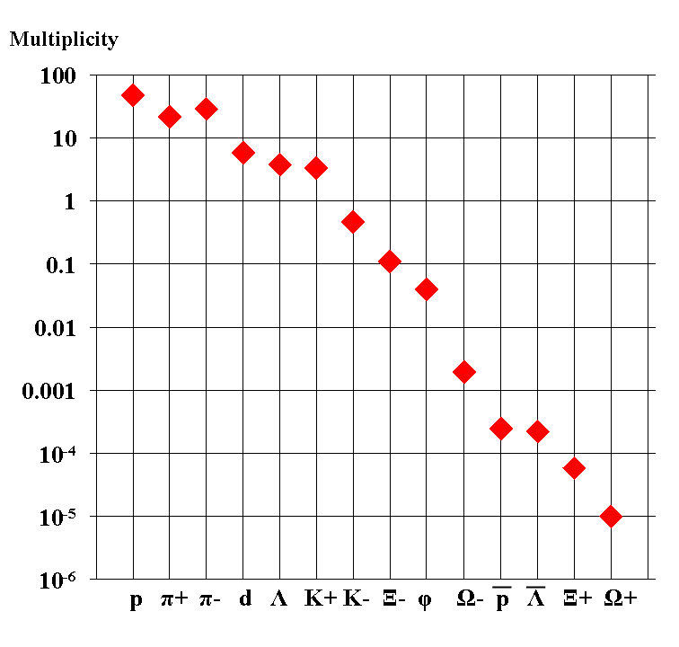
Experimental challenges
Particle yields in central Au+Au 4 A GeV
Statistical model, A. Andronic, priv. com.
AGS
extremely high
interaction rates
required !
e⁺e⁻
μ⁺μ⁻

Slide 38
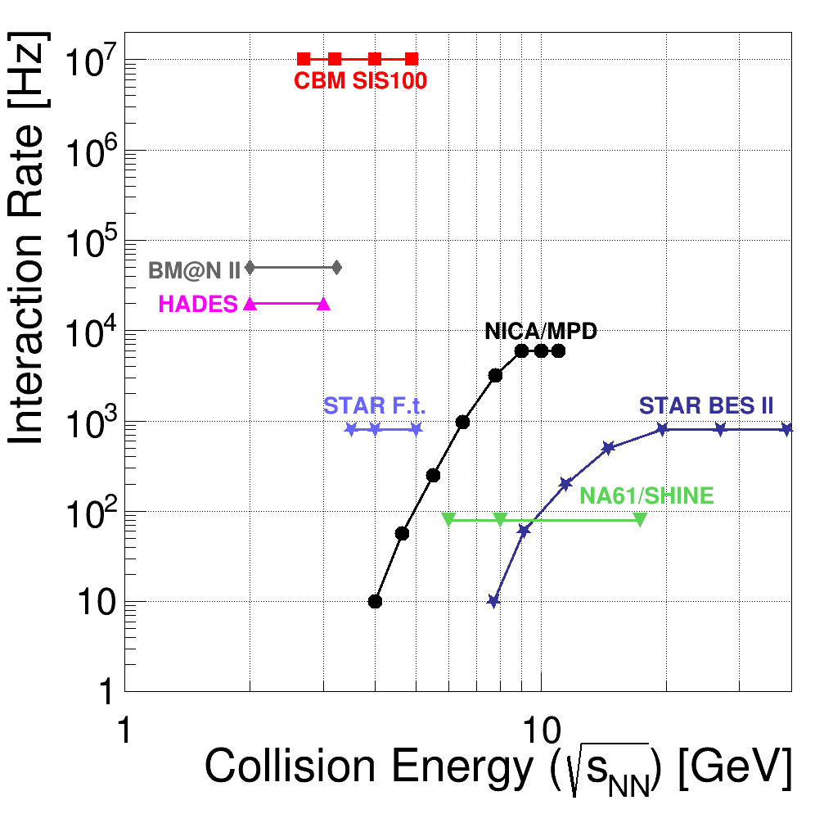
Experiments exploring dense QCD matter
high
net-baryon densities
The CBM Collaboration,
arXiv:1607.01487

Slide 39
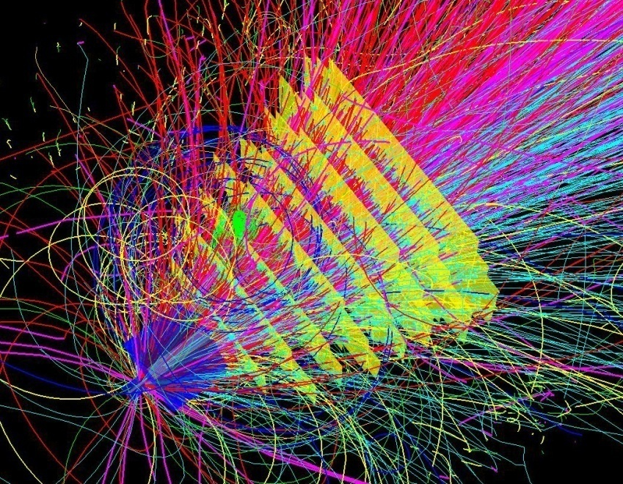
Experimental requirements
10⁵ - 10⁷ Au+Au reactions/sec
determination of displaced vertices (σ ≈ 50 μm)
identification of leptons and hadrons
fast and radiation hard detectors and FEE
free-streaming readout electronics
high speed data acquisition and high performance
computer farm for online event selection
4-D event reconstruction
39
Notes:
39
39
39

Slide 40
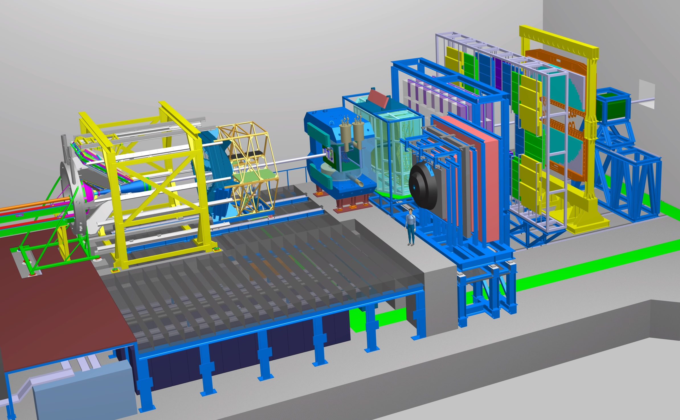
Experimental requirements
Transition
Radiation
Detector
Time of Flight
Detector
Ring
Imaging
Cherenkov
SC Dipol
Magnet
Silicon
Tracking
System
HADES
p+p, p+A
A+A (low mult.)
Micro
Vertex
Detector
Muon
Detector
Projectile
Spectator
Detector
DAQ/FLES HPC cluster

Slide 41
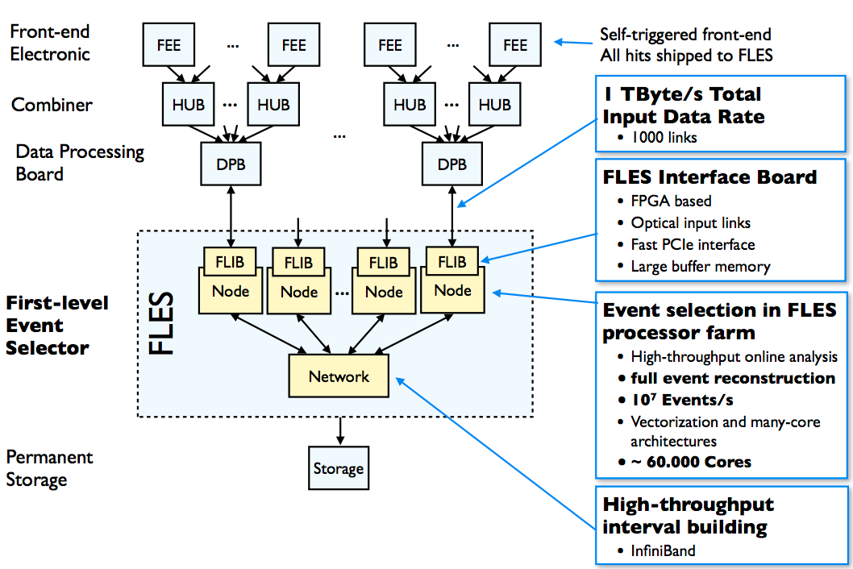
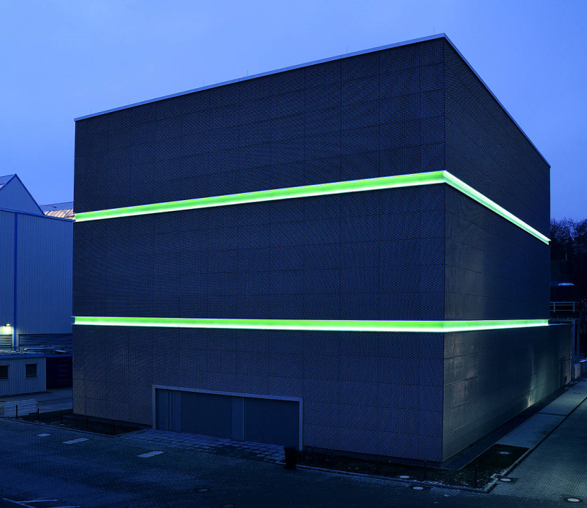
CBM DAQ and online event selection
First-level Event Selector
GSI Green IT Cube
Novel readout system: no hardware trigger on events, detector hits with time stamps, full online 4-D track and event reconstruction.
41

Slide 42
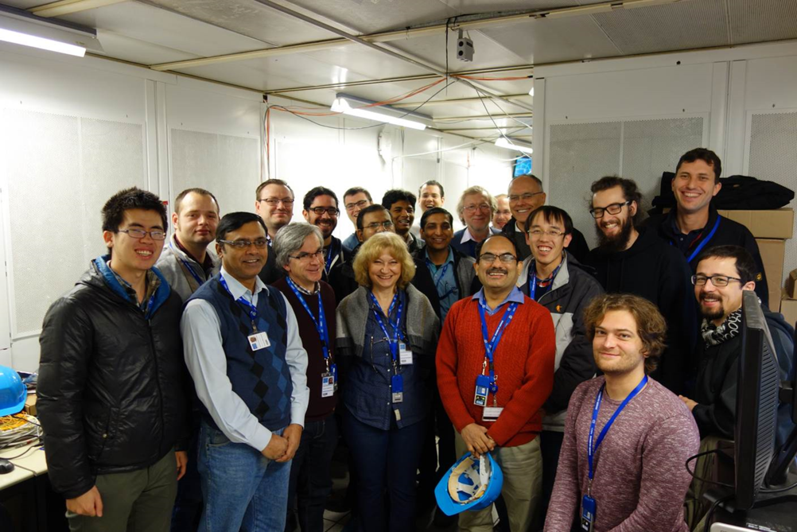
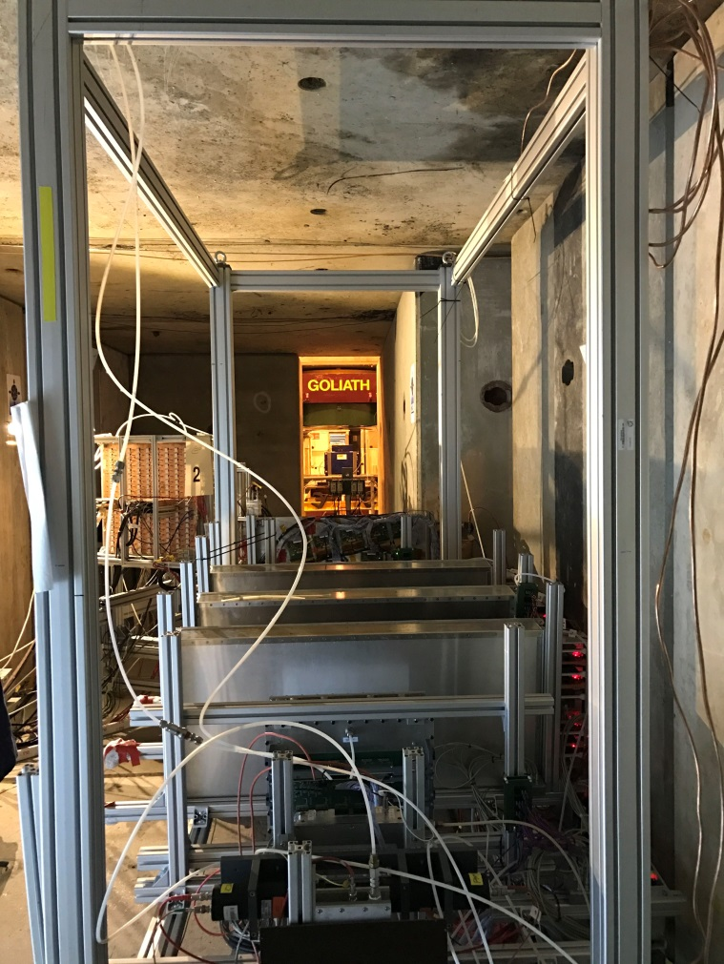
Test beams at CERN
Prototype TOF, GEM, TRD and diamond detectors with common free-streaming readout system and DAQ successfully tested.
Pb+Pb collisions with energies of 13, 30 and 160 A GeV.
Teams from China, Germany, India, Romania

Slide 43
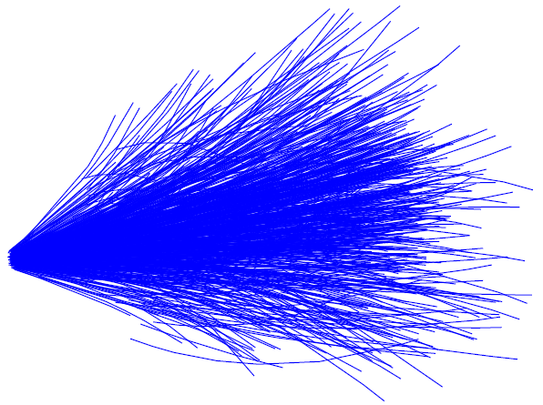
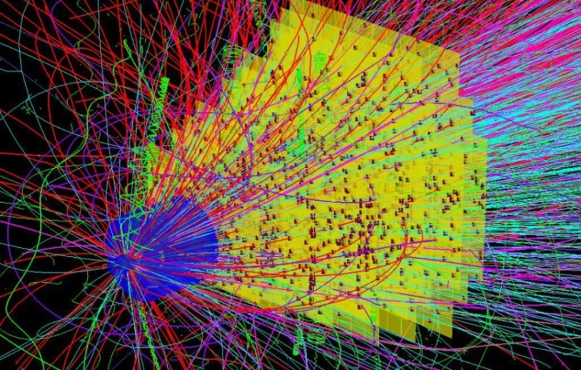

Simulation and reconstruction
Event generators UrQMD 3.3
Transport code GEANT3, FLUKA
Realistic detector geometries, material budget and detector response
reconstruction
Track reconstruction efficiency
min. bias Au+Au 25 A GeV
Notes:
43
43
43

Slide 44

Online particle identification in CBM:
The KF Particle Finder
successfully used online in the STAR experiment

Slide 45








Simulations: central Au+Au collisions at 8A GeV and 10A GeV
Hyperons at 10 A GeV
Dileptons 8A GeV
D mesons 30 GeV p+Au
e⁺e⁻
µ⁺µ⁻
η
ω
φ
ρ
Hypernuclei at 10 A GeV
D mesons Ni+Ni 15A GeV
Charmonium at 10 A GeV
45

Slide 46

Simulation and reconstruction
Hypernuclei in central Au+Au 10 AGeV

Slide 47
Simulation and reconstruction
Hyperons in
Au+Au 10 AGeV
(dds)
missing mass analysis
(uus)
(uus)

Slide 48


For further reading ...
“Challenges in QCD Matter Physics – the scientific programme of the Compressed Baryonic Matter Experiment at FAIR”
135 contributions, 220 pages
ISBN 978-3-9815227-4-7.
https://repository.gsi.de/record/186952/
files/CBM-PR-2015%20[pdf].pdf
Ablyazimov, T. et al. Eur. Phys. J. A (2017) 53: 60. doi:10.1140/epja/i2017-12248-y

Slide 49





FAIR phase 0 experiments on dense QCD matter
1. Install, commission and use 430 out of 1100
CBM RICH multi-anode photo-multipliers (MAPMT)
in HADES RICH photon detector
2. Install, commission and use
10% of the CBM TOF modules
including read-out chain
at STAR/RHIC (BES II 2019/2020)
3. Install, commission and use 4 Silicon Tracking
Stations and the Project Spectator Detector
in the BM@N experiment at the Nuclotron in
JINR/Dubna (start 2019 with Au-beams up to 4.5 A GeV)
4. Build miniCBM at GSI/SIS18
for a full system test with
high-rate nucleus-nucleus
collisions from 2018 - 2021
49

Slide 50


The CBM Collaboration: 55 institutions, 460 members
China:
CCNU Wuhan
Tsinghua Univ.
USTC Hefei
CTGU Yichang
Czech Republic:
CAS, Rez
Techn. Univ. Prague
France:
IPHC Strasbourg
Hungary:
KFKI Budapest
Eötvös Univ.
Germany:
Darmstadt TU
FAIR
Frankfurt Univ. IKF
Frankfurt Univ. FIAS Frankfurt Univ. ICS
GSI Darmstadt
Giessen Univ.
Heidelberg Univ. P.I.
Heidelberg Univ. ZITI
HZ Dresden-Rossendorf
KIT Karlsruhe
Münster Univ.
Tübingen Univ.
Wuppertal Univ.
ZIB Berlin
Russia:
IHEP Protvino
INR Troitzk
ITEP Moscow
Kurchatov Inst., Moscow
VBLHEP, JINR Dubna
LIT, JINR Dubna
MEPHI Moscow
PNPI Gatchina
SINP MSU, Moscow
Ukraine:
T. Shevchenko Univ. Kiev
Kiev Inst. Nucl. Research
India:
Aligarh Muslim Univ.
Bose Inst. Kolkata
Panjab Univ.
Rajasthan Univ.
Univ. of Jammu
Univ. of Kashmir
Univ. of Calcutta
B.H. Univ. Varanasi
VECC Kolkata
IOP Bhubaneswar
IIT Kharagpur
IIT Indore
Gauhati Univ.
Korea:
Pusan Nat. Univ.
Poland:
AGH Krakow
Jag. Univ. Krakow
Warsaw Univ.
Warsaw TU
Romania:
NIPNE Bucharest
Univ. Bucharest
CBM Scientists
29th CBM Collaboration meeting at GSI
20-24 March 2017
50

Slide 51

Summary
FAIR: Forefront research in nuclear, hadron, atomic, plasma and applied physics. Construction started, full operational in 2025. Installation/commissioning of experiments planned 2021-2024.
CBM scientific program at SIS100: Exploration of the QCD
phase diagram in the region of neutron star core densities
→ large discovery potential.
CBM concept: High-rate detectors combined with free streaming
data readout and online event selection enable high-precision
multi-differential measurements of hadrons incl. multistrange
hyperons, hypernuclei and dileptons for different beam energies
and collision systems → terra incognita.
Status of experiment preparation: Prototype detectors fulfill
CBM requirements. Mass production starts in 2018
FAIR Phase 0: HADES experiments with CBM RICH photon detector, use CBM detectors at STAR/BNL and BM@N/JINR,
and miniCBM at GSI
51

