Slide 1

PANDA Yoke of the Magnet
Preliminary Design Report
Sergey Pivovarov, BINP, 03.10.2017

Slide 2
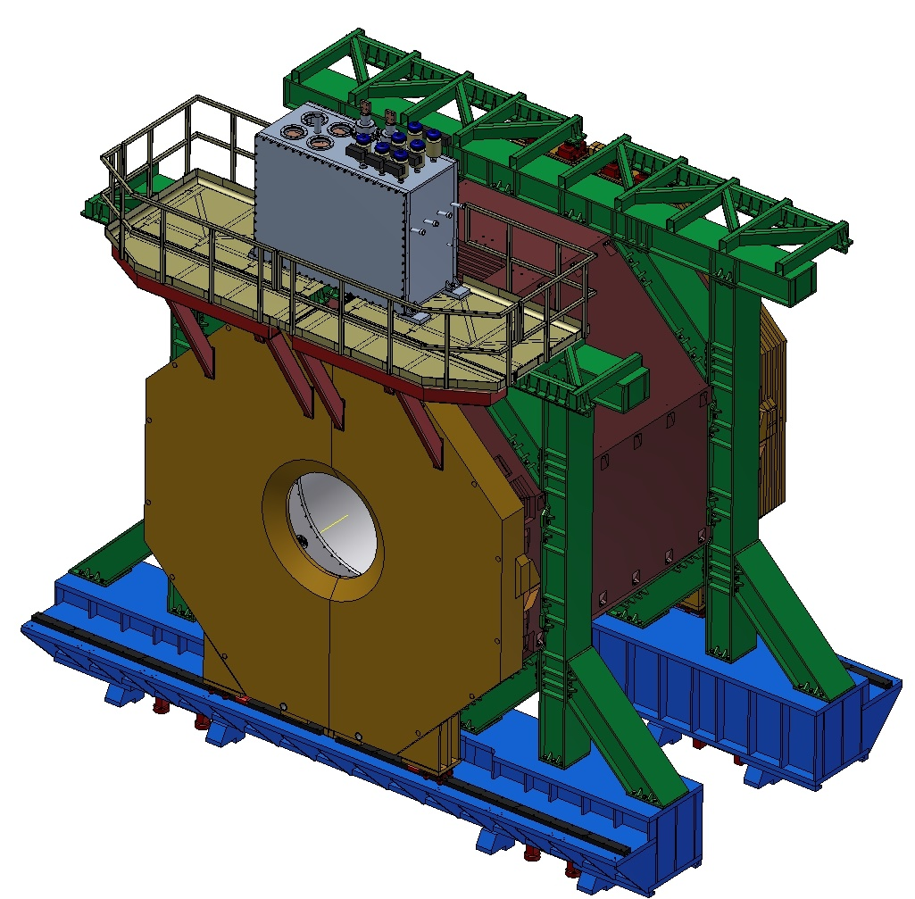
3D model of the Magnet, Yoke, Platform and Frame.
The main parts of the detector PANDA for production at BINP

Slide 3
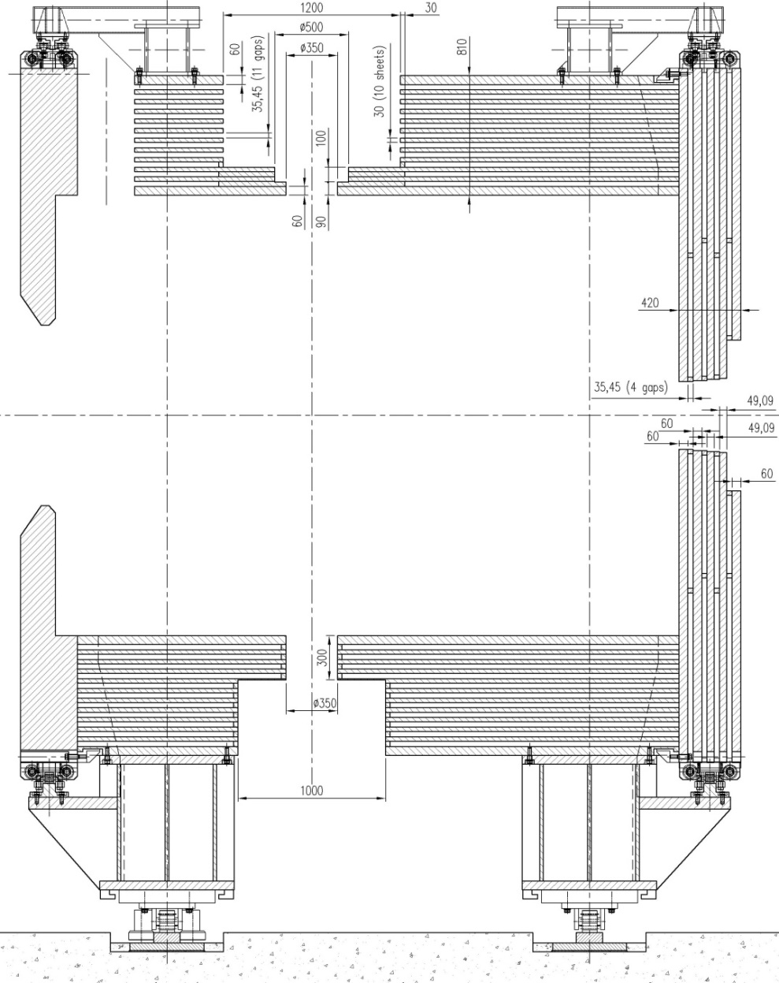
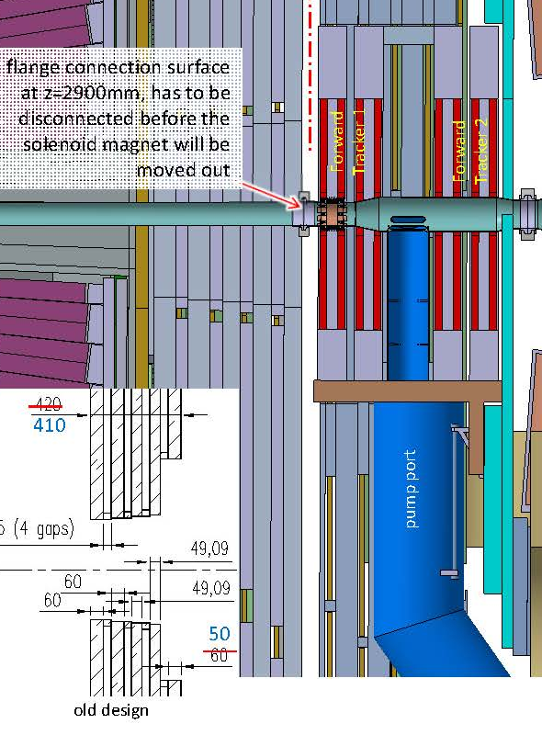
Configuration 12th layers of Yoke
At the request of the GSI, the thickness of the inner plate of the downstream door was changed from 60 to 50 mm. The total thickness of the downstream door is 410 mm.

Slide 4
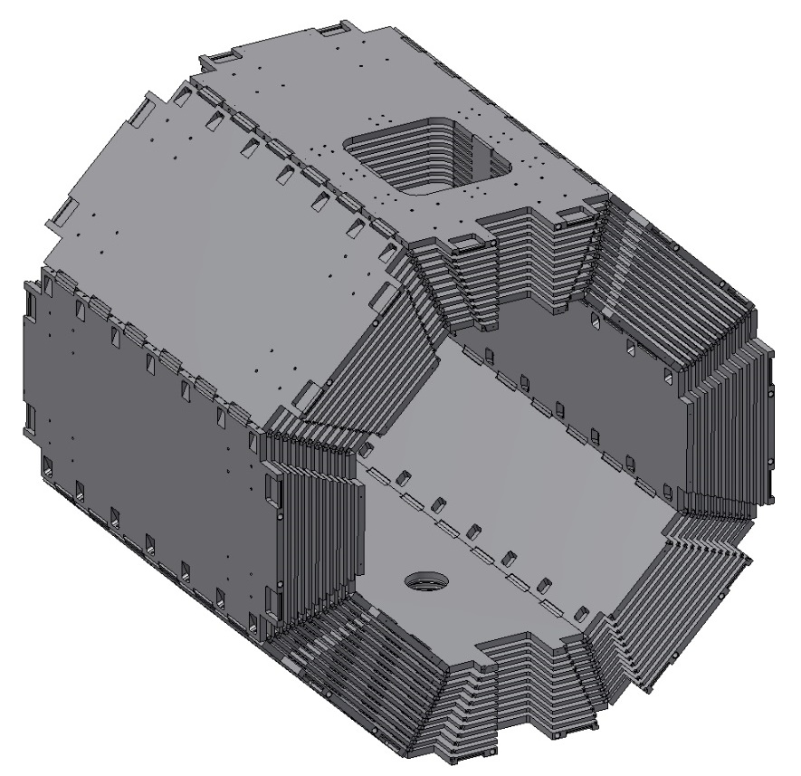
New Barrel part of the Yoke of the PANDA Detector
After contact with the plant it was proposed to change the design of the octants of the yoke.

Slide 5
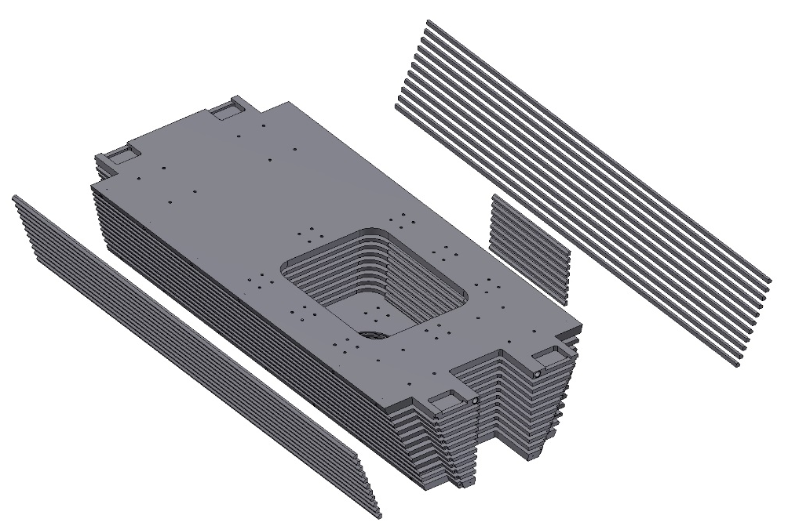
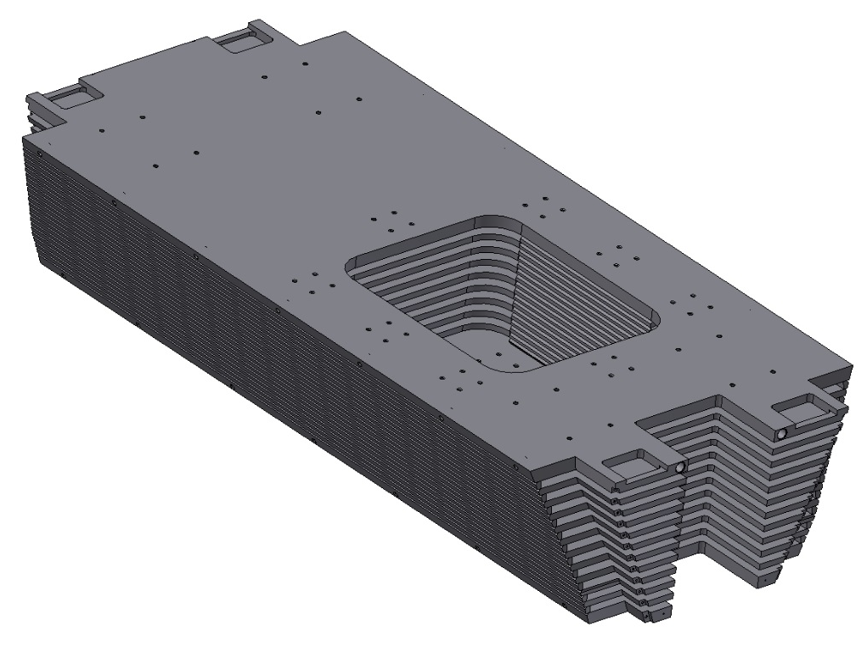
The old design of the octant of the Yoke
The Octant consists of the plates and bars. The bars connect the plates of the octant by welding. Disadvantage of such design:
1. A lot of welds.
2. Final machining on the surface of welded joints. It's very bad for a tools.
3. Octant construction is not so rigid.

Slide 6
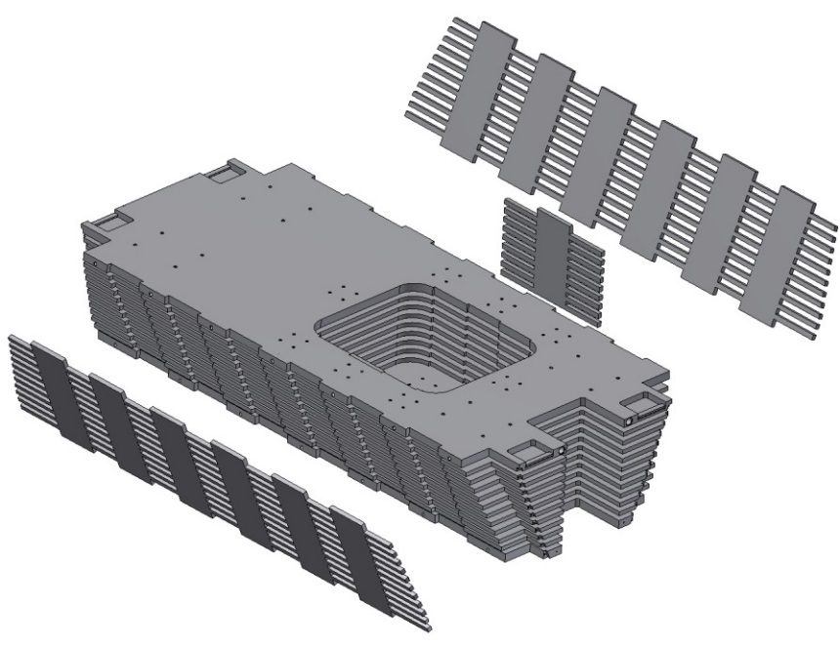
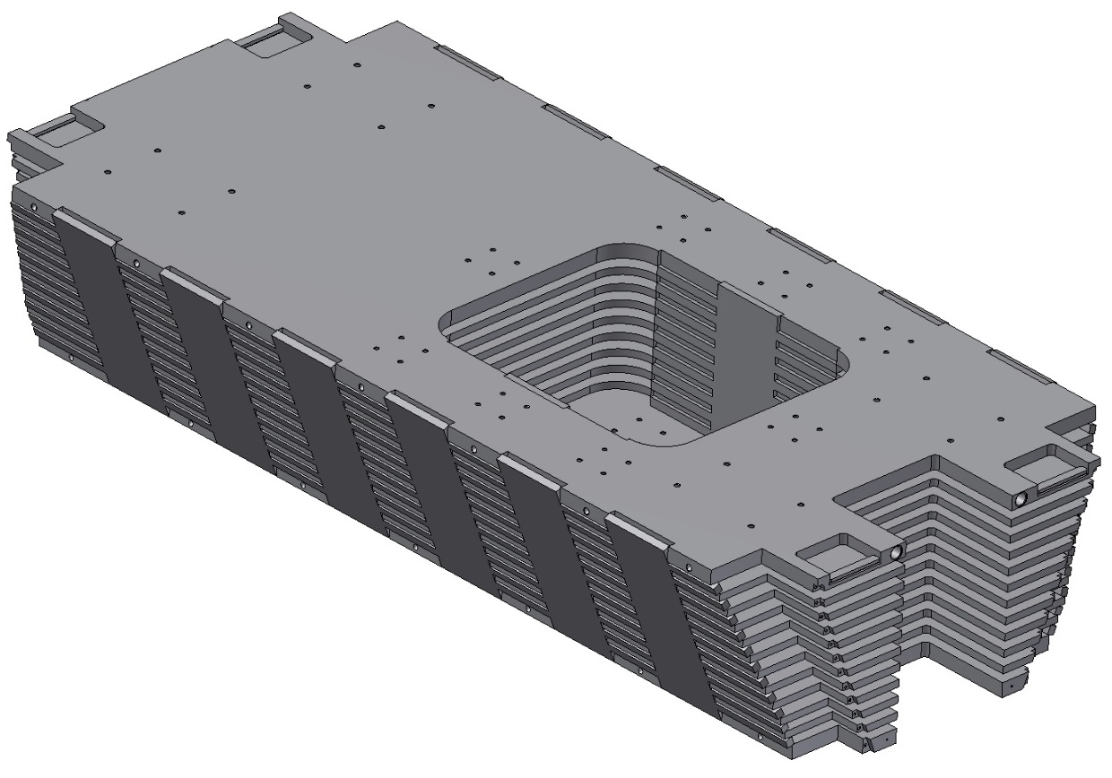
The modified octant of the Yoke
The bars was replaced by a side plates. The side plates are manufactured using water cutting machine. Advantage of such design:
The number of welds is reduced.
Final machining on the surface of the side plates (not welded joints).
3. Octant construction is more rigid.

Slide 7
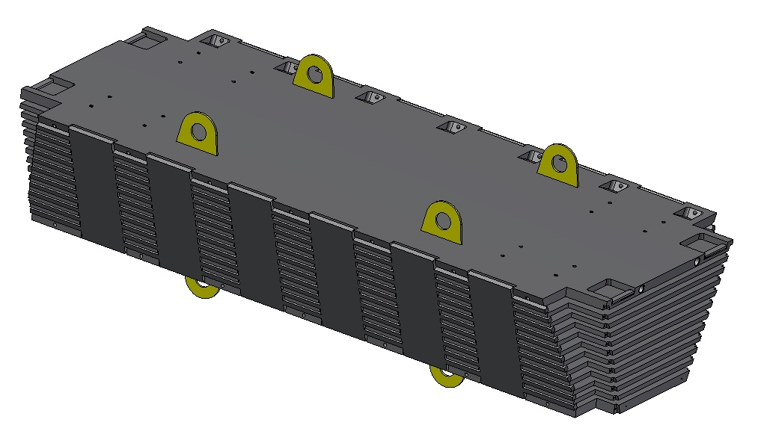
The Octant of the Yoke of the PANDA Detector
For moving, rotation, assembling to be used the ears which will be removed after final assembly

Slide 8
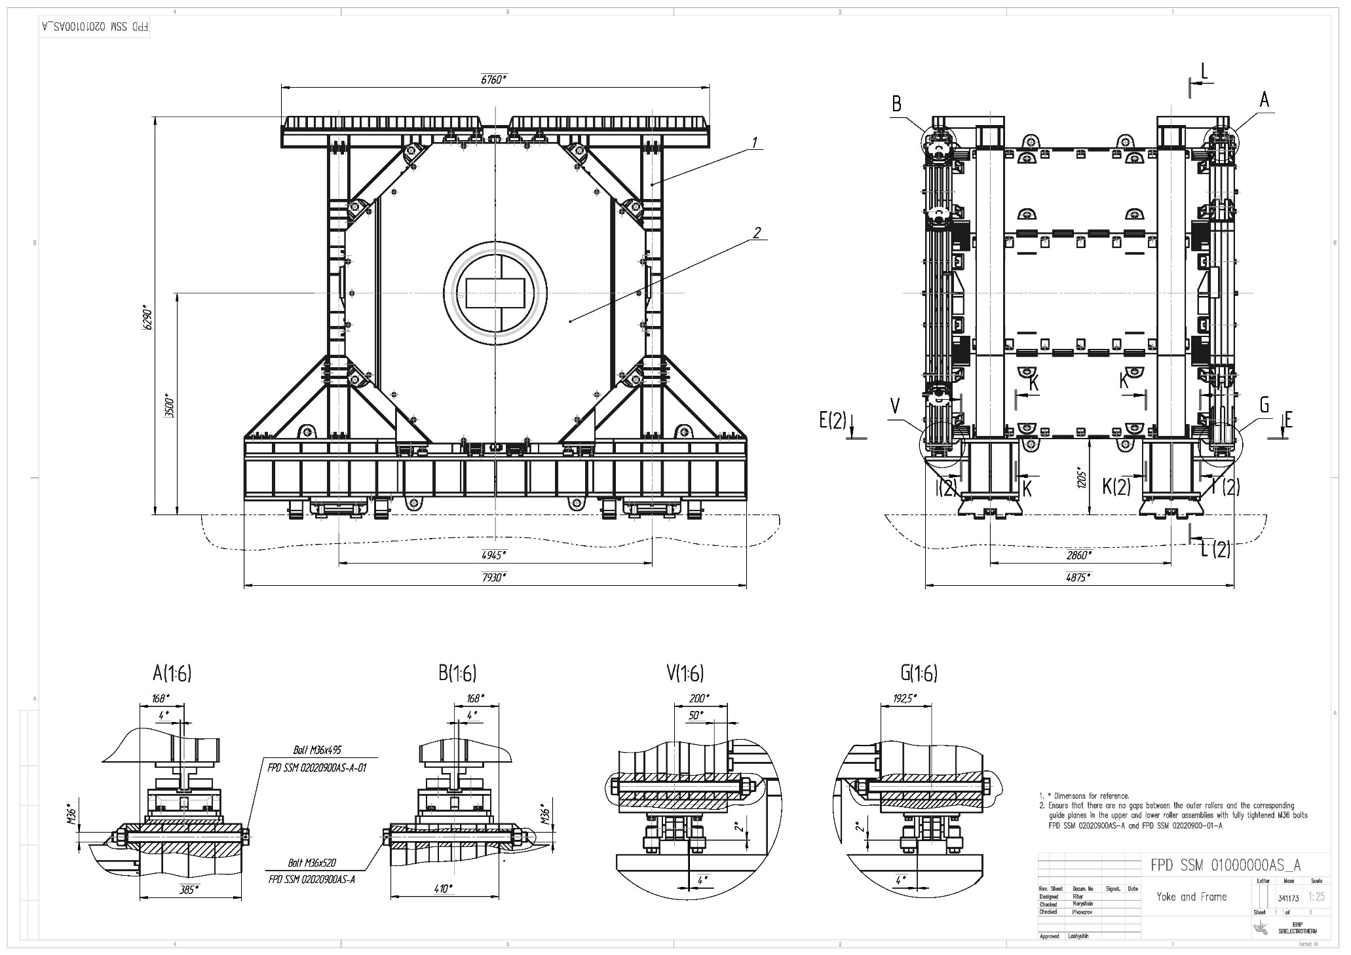
Drawing of the Yoke, Platform and Frame.

Slide 9
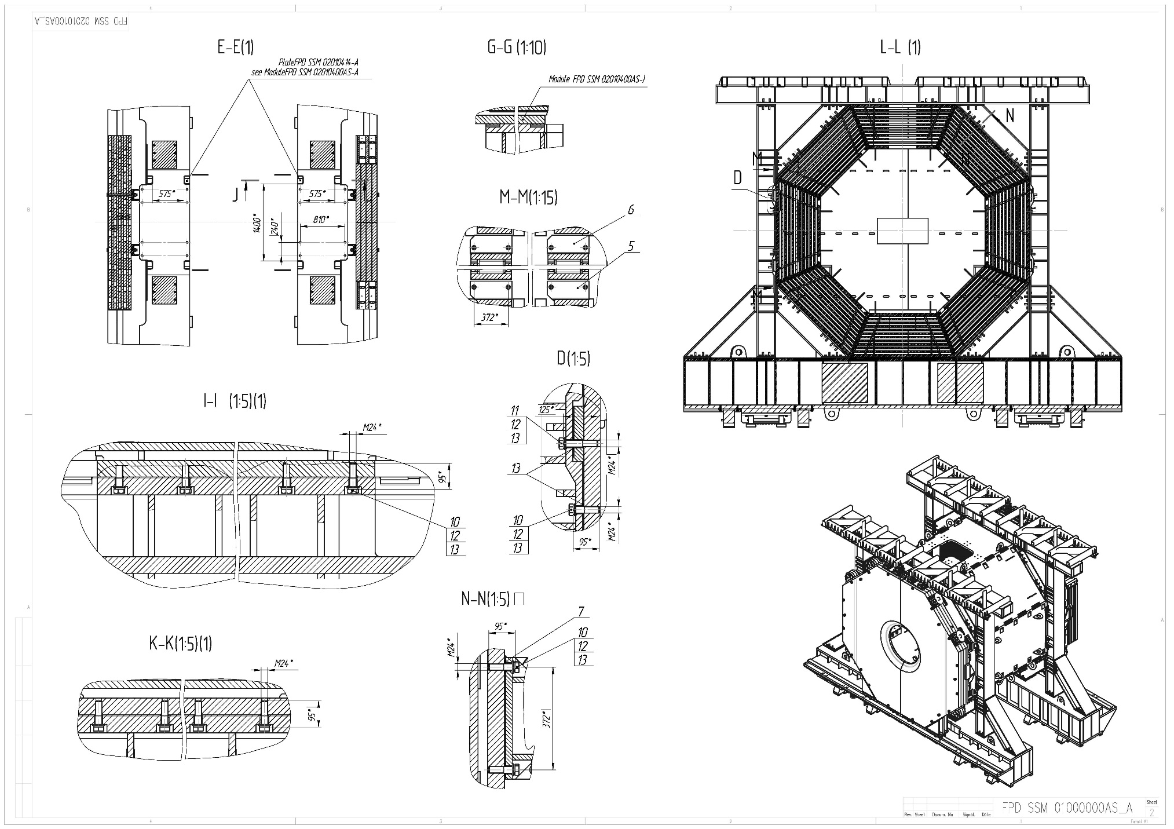
Drawing of the Yoke, Platform and Frame.

Slide 10
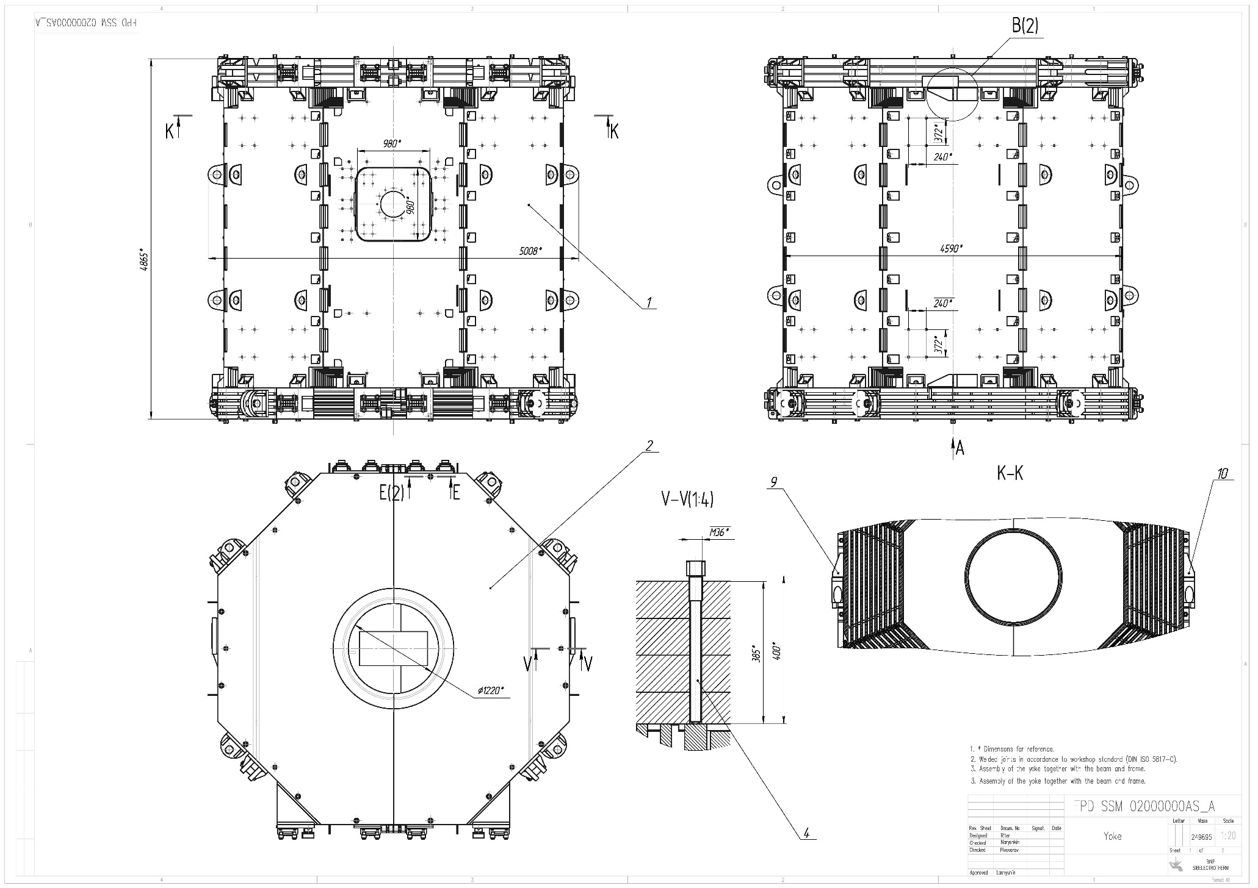
Drawing of the Yoke.

Slide 11
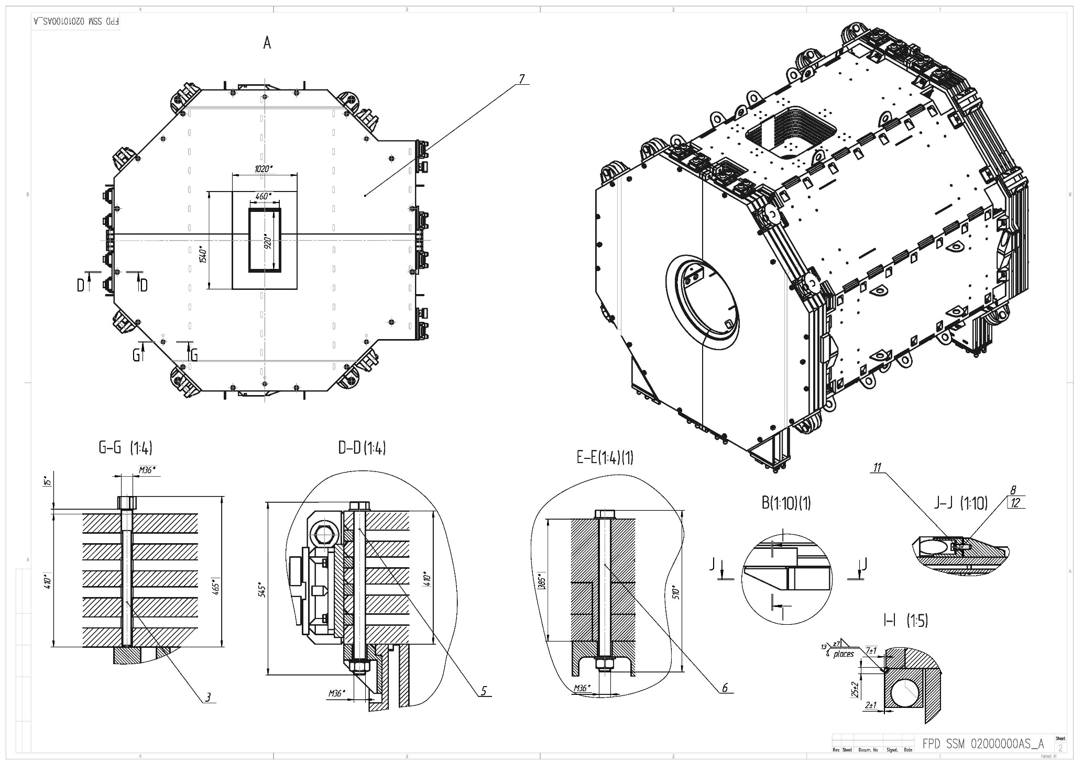
Drawing of the Yoke.

Slide 12
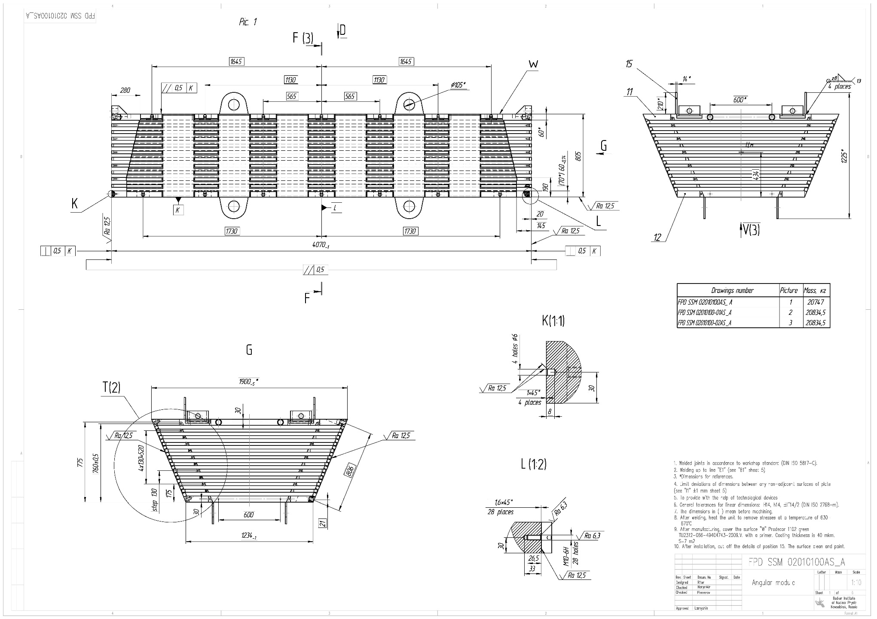
Drawing of the Octant.

Slide 13
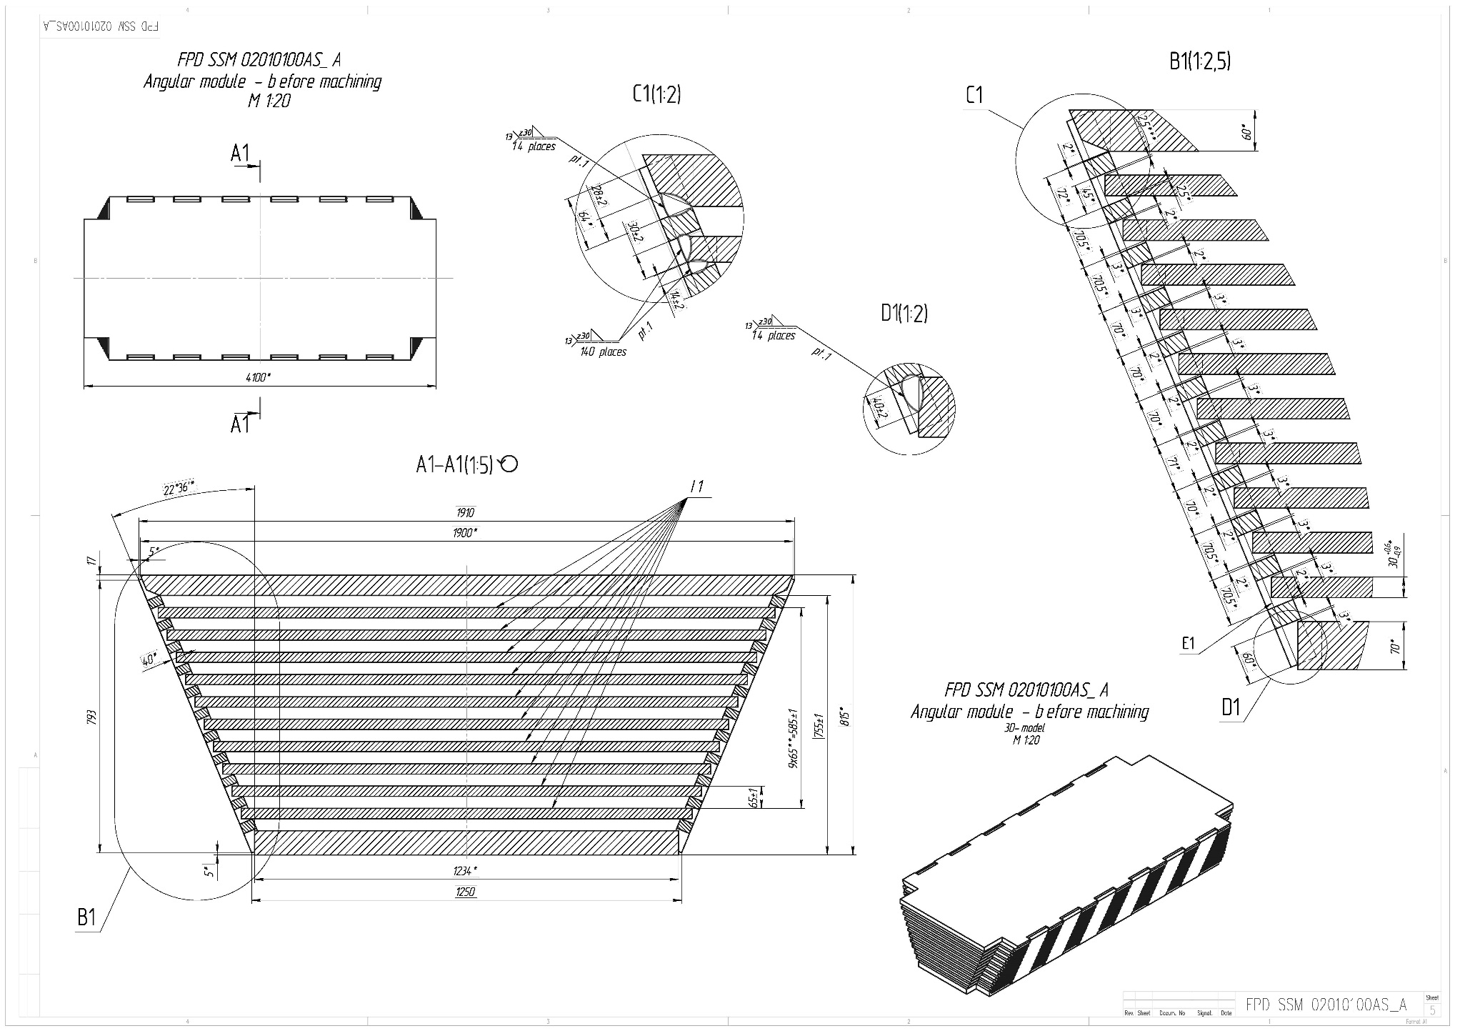
Drawing of the Octant.

Slide 14
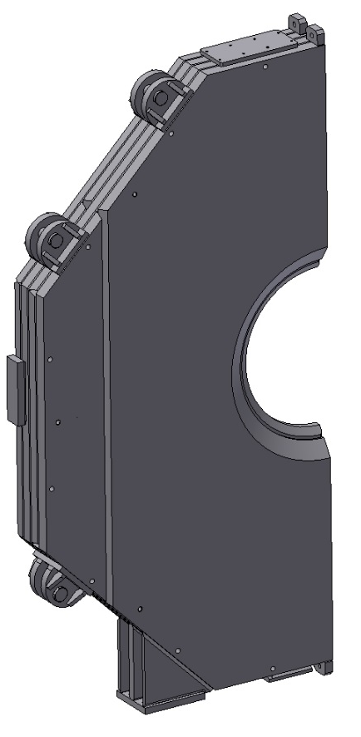
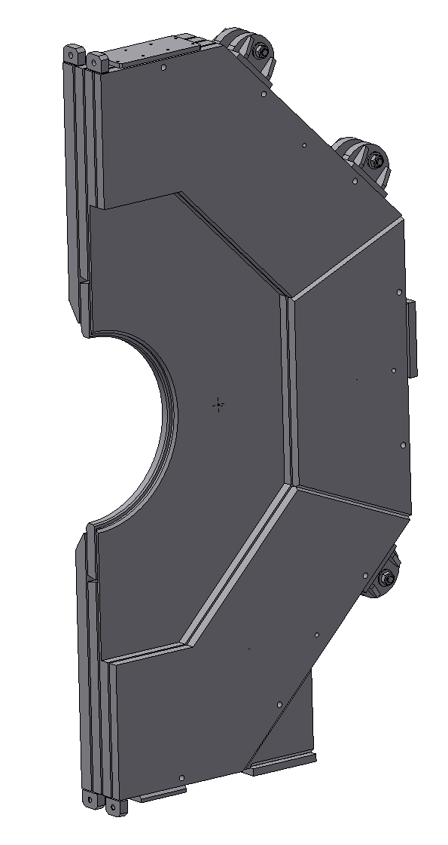
3D-Model of the Upstream Door of Yoke.
The door is made of 100 mm thick plates by welding.
For moving, rotation and assembling the doors to be used the ears which will be removed after final Assembly.

Slide 15
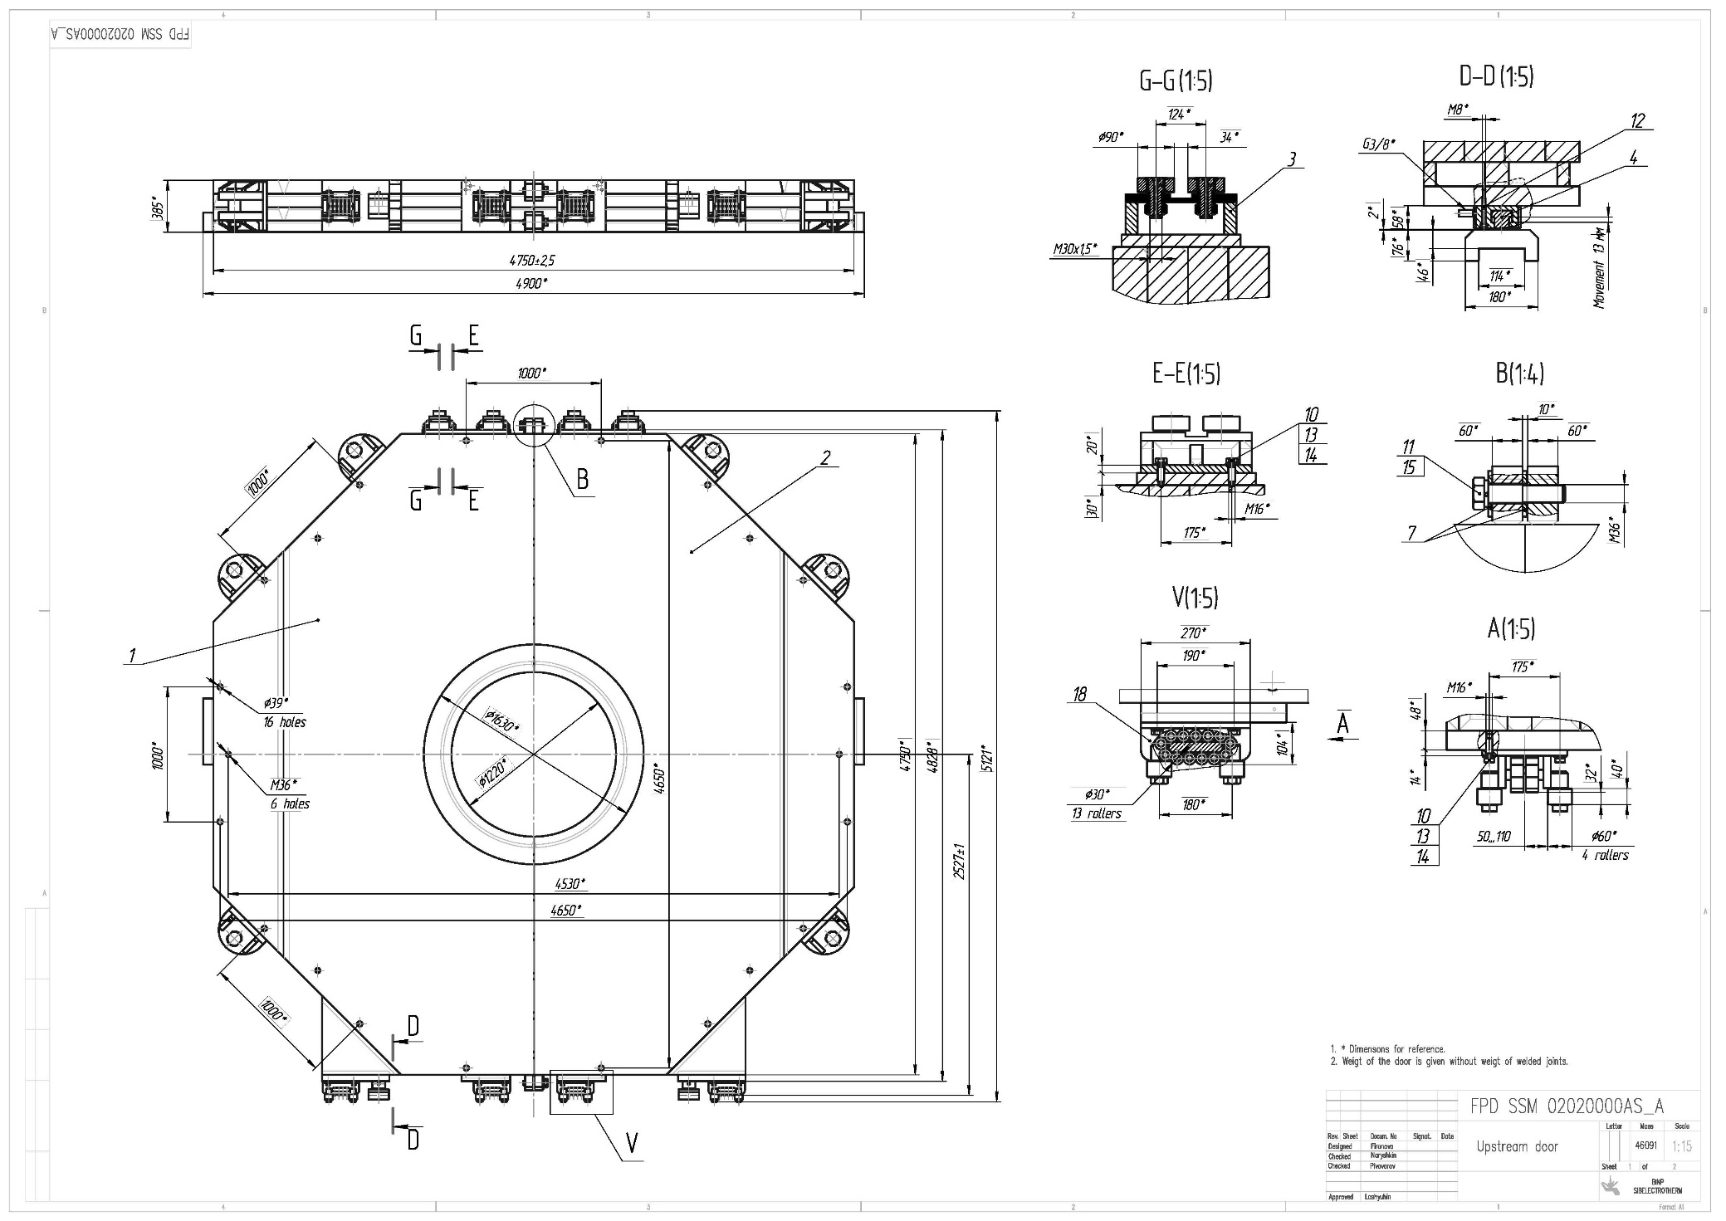
Drawing of the Upstream Door.

Slide 16
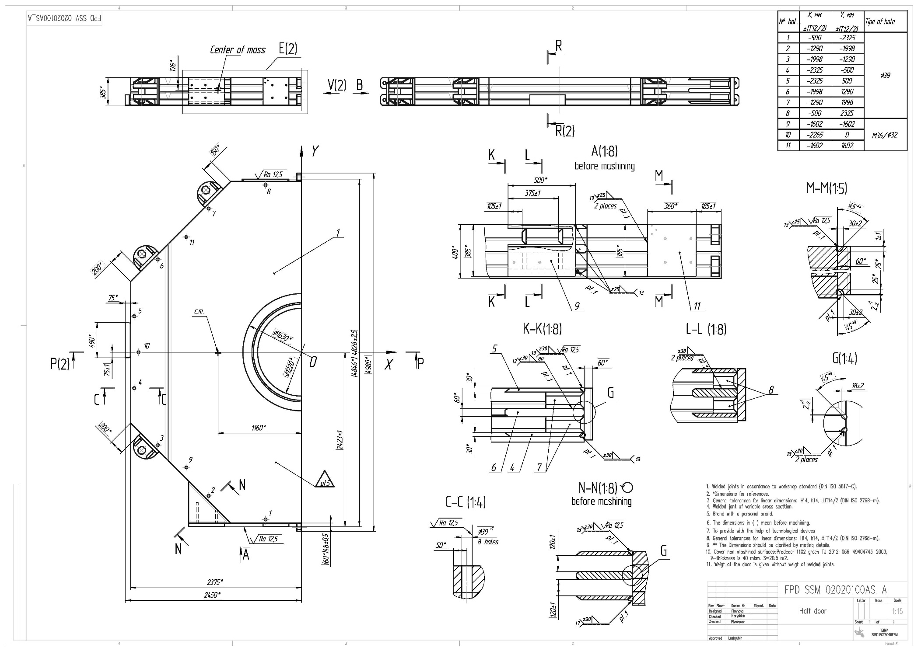
Drawing of the half of Upstream Door.

Slide 17
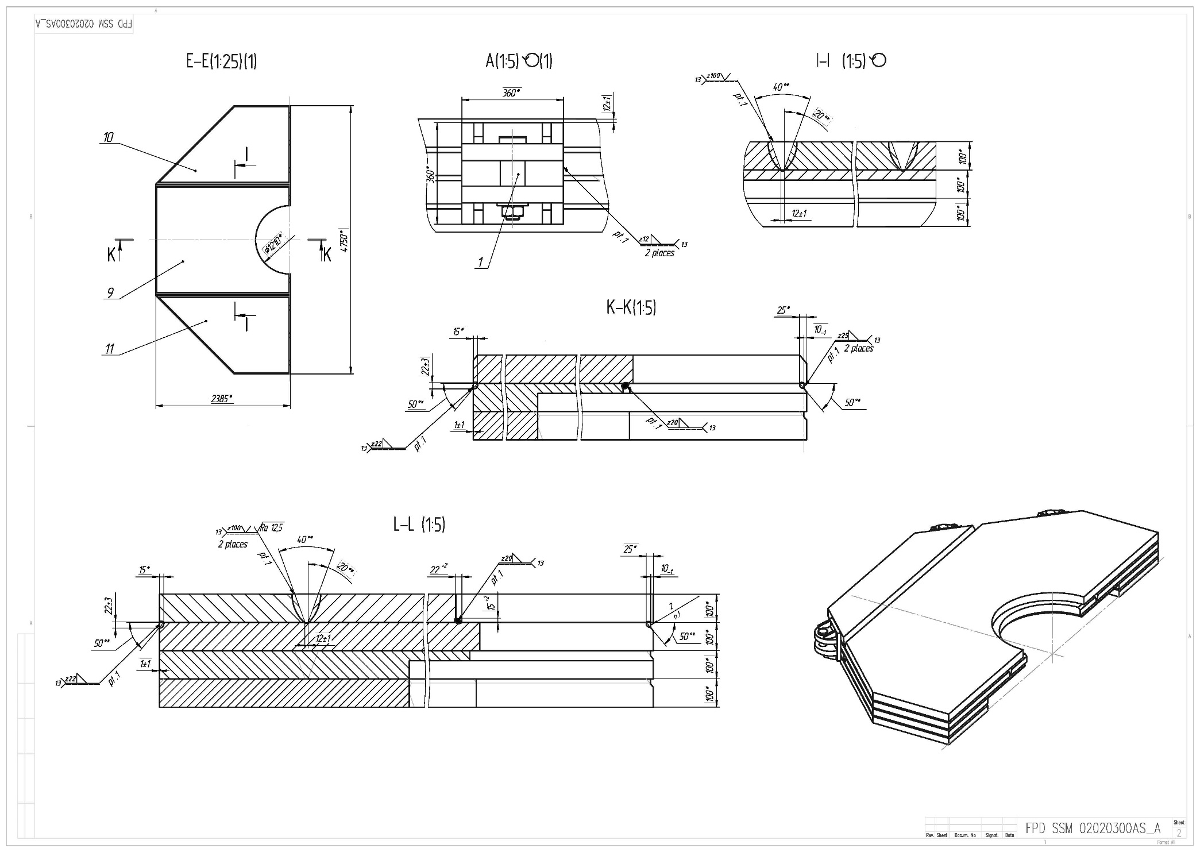
Drawing of the half of Upstream Door.

Slide 18
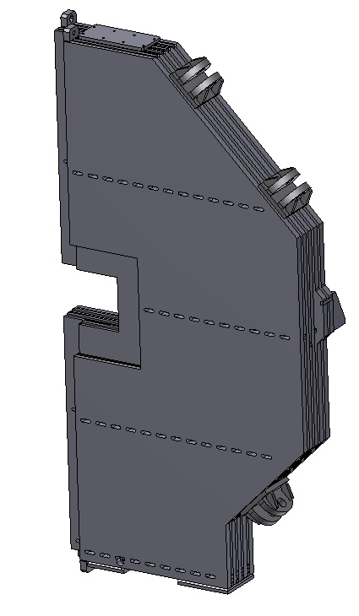
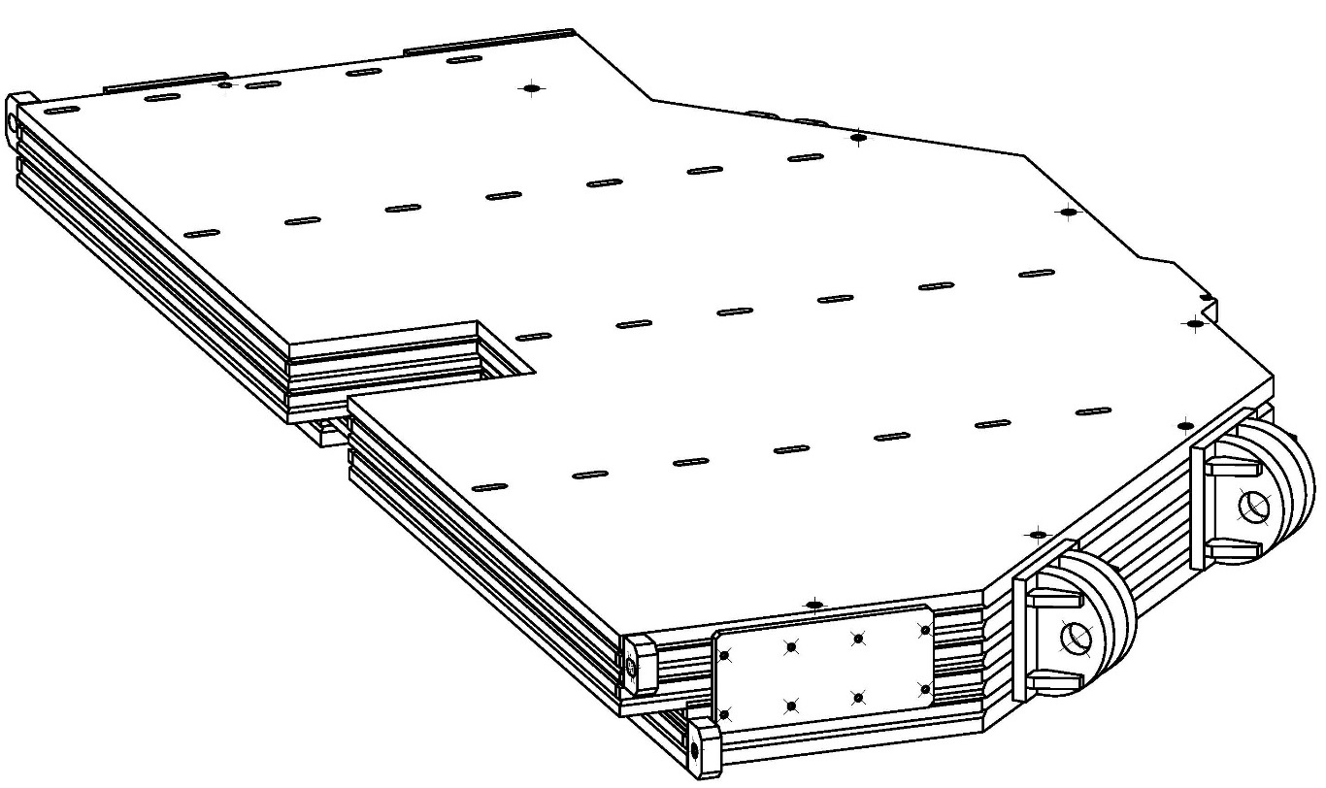
3D-Model of the Downstream Door of Yoke.
For moving, rotation and assembling the doors to be used the ears which will be removed after final Assembly.

Slide 19
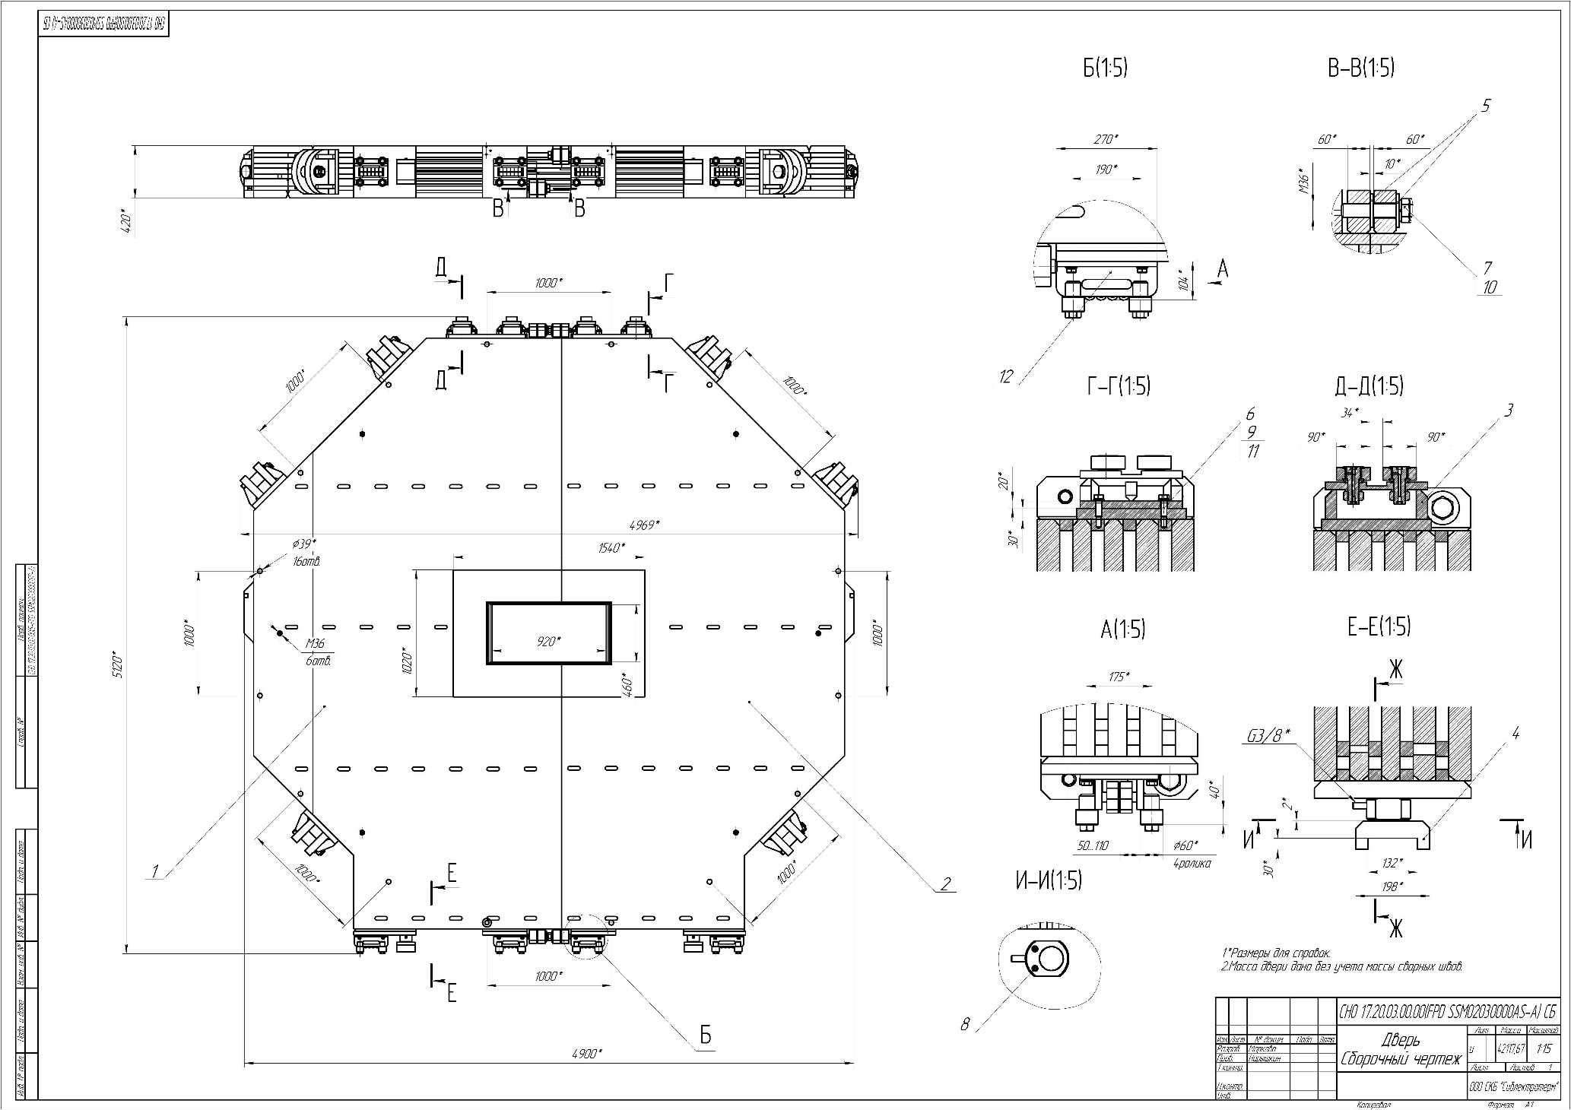
Drawing of the Downstream Door.

Slide 20
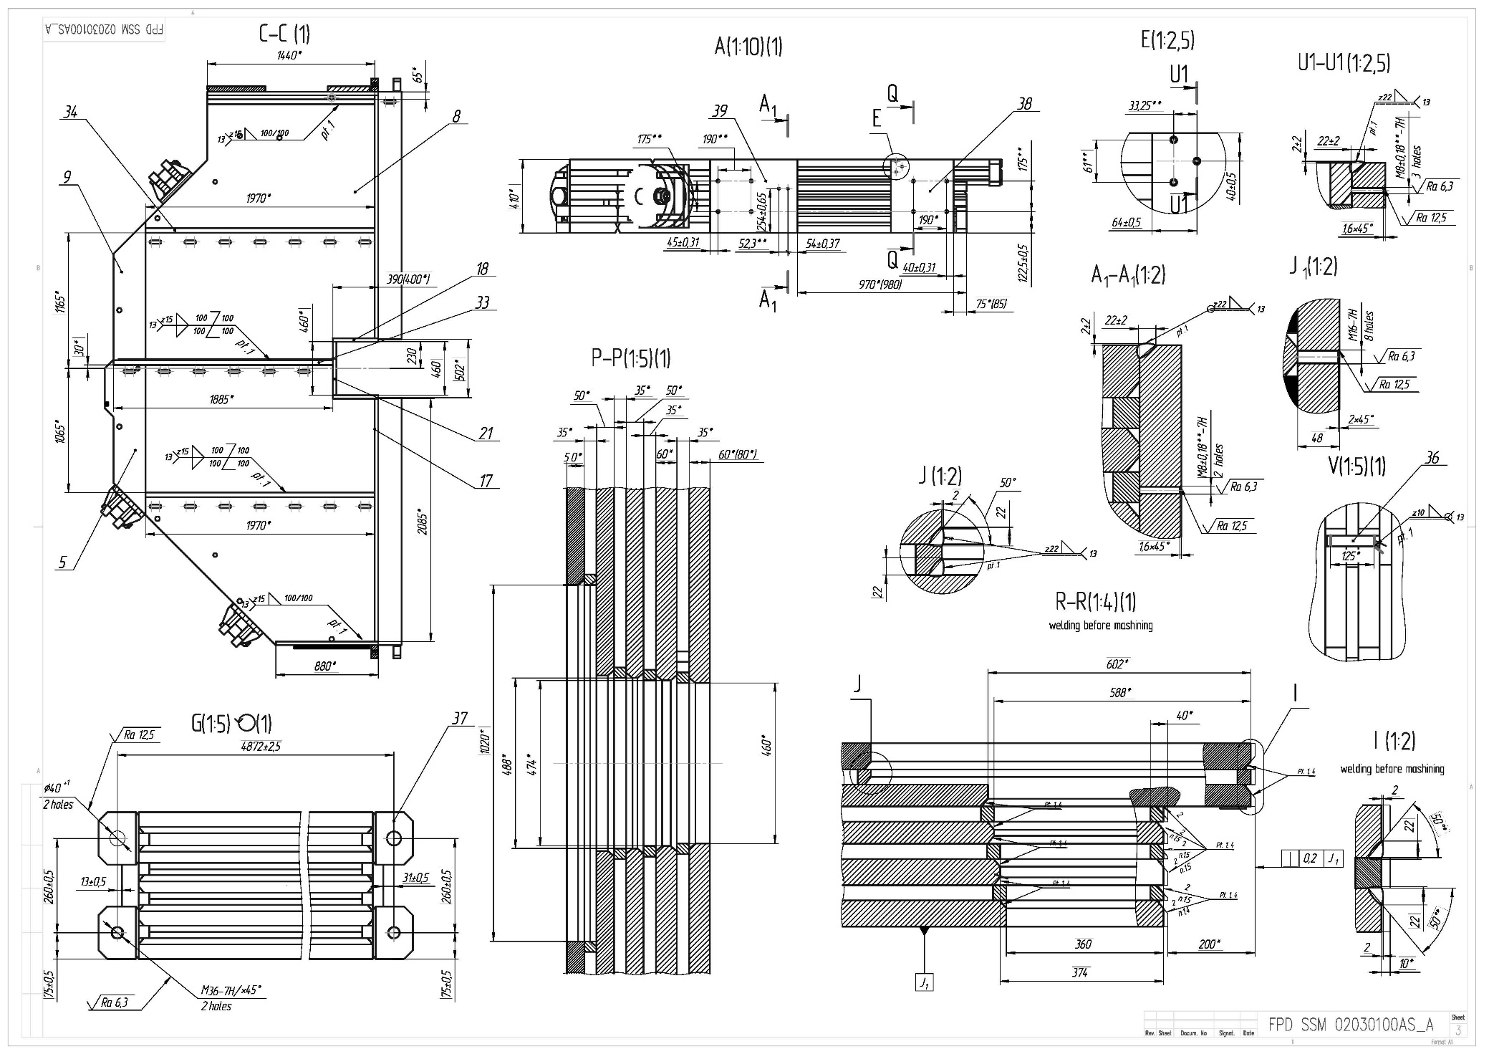
Drawing of the Downstream Door.

Slide 21
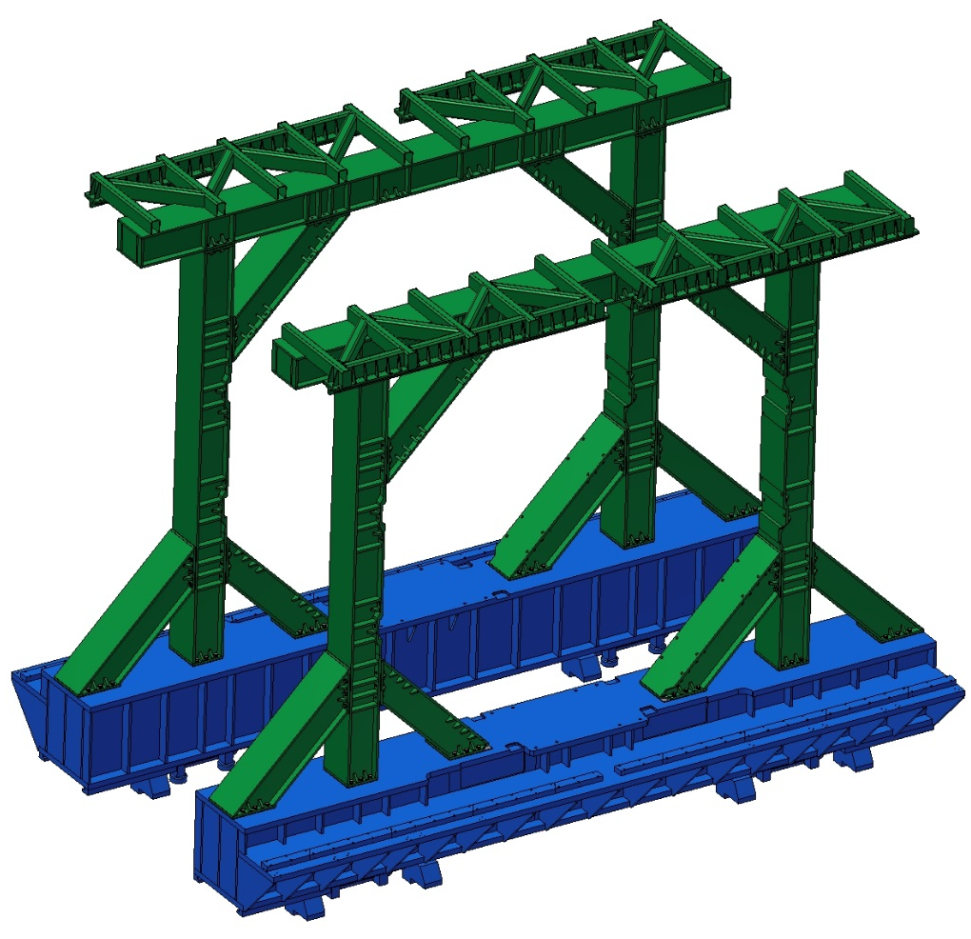
3D model of the Platform and Frame.
The weight of assembling is c~60 t

Slide 22
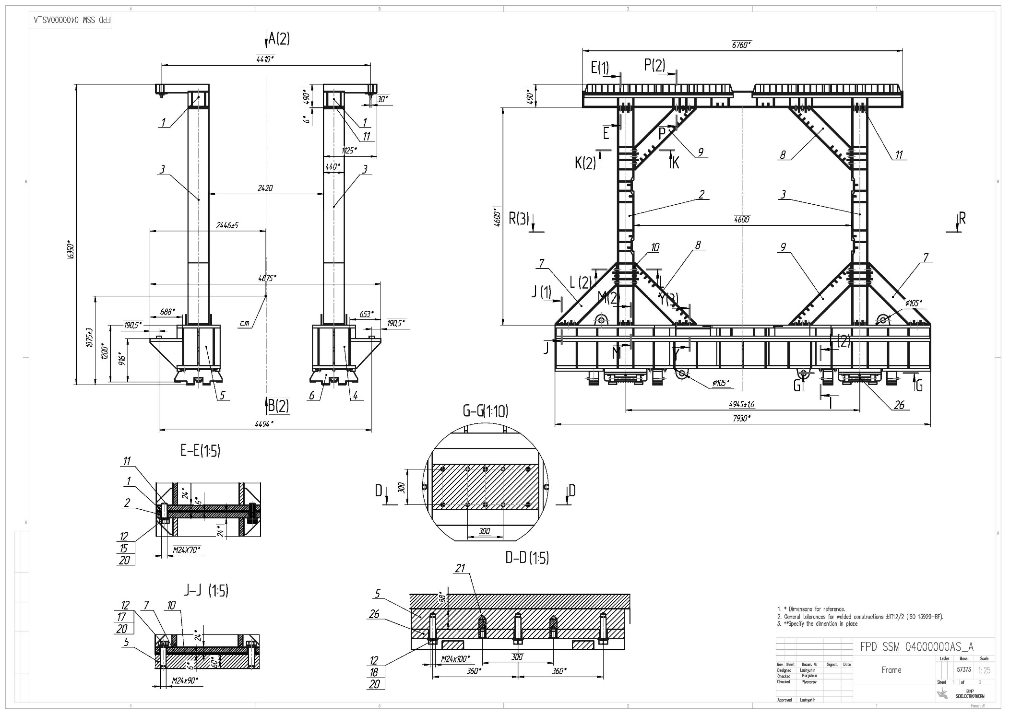
Drawing of the Platform and Frame.

Slide 23
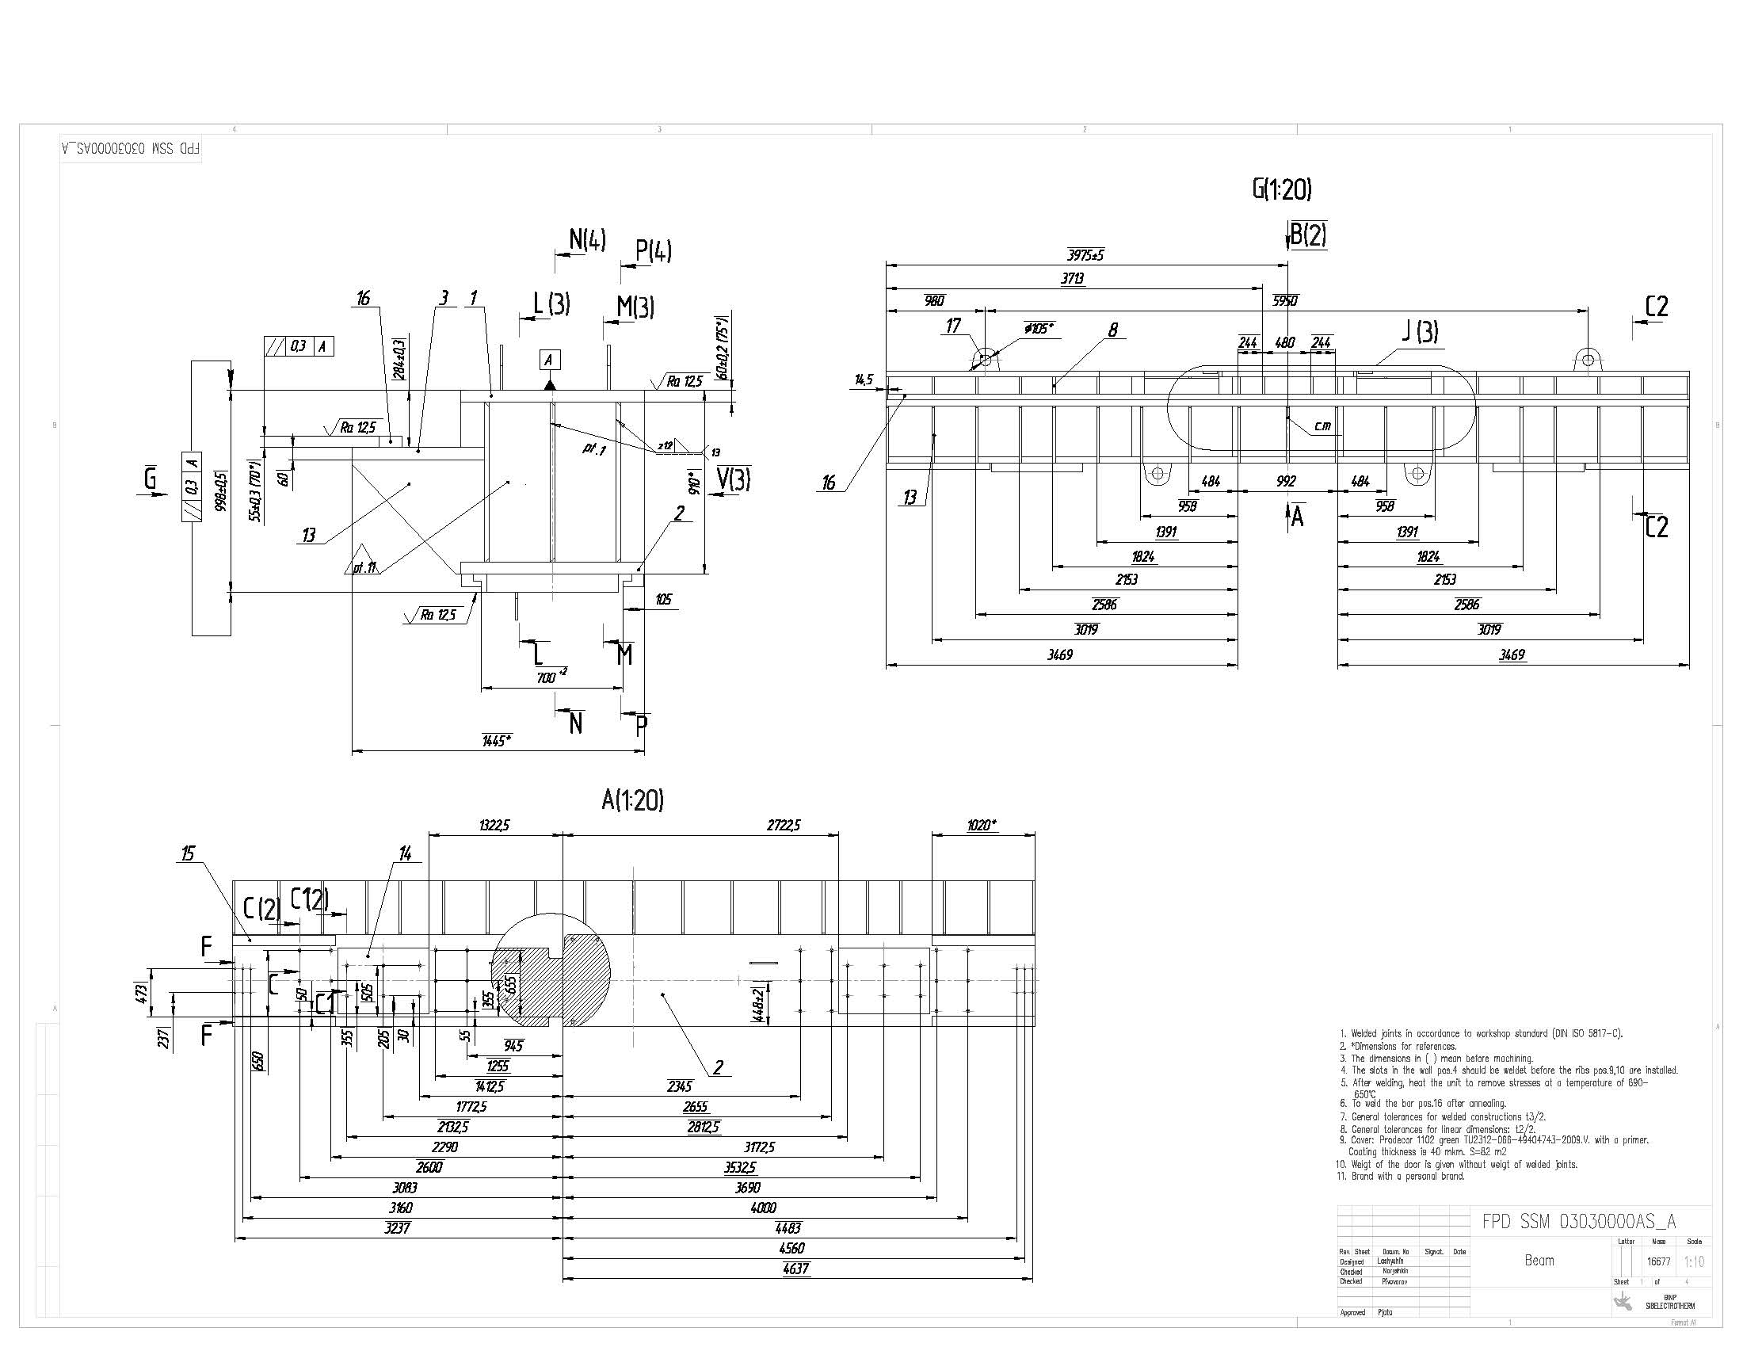
Drawing of the Beam of Frame.

Slide 24
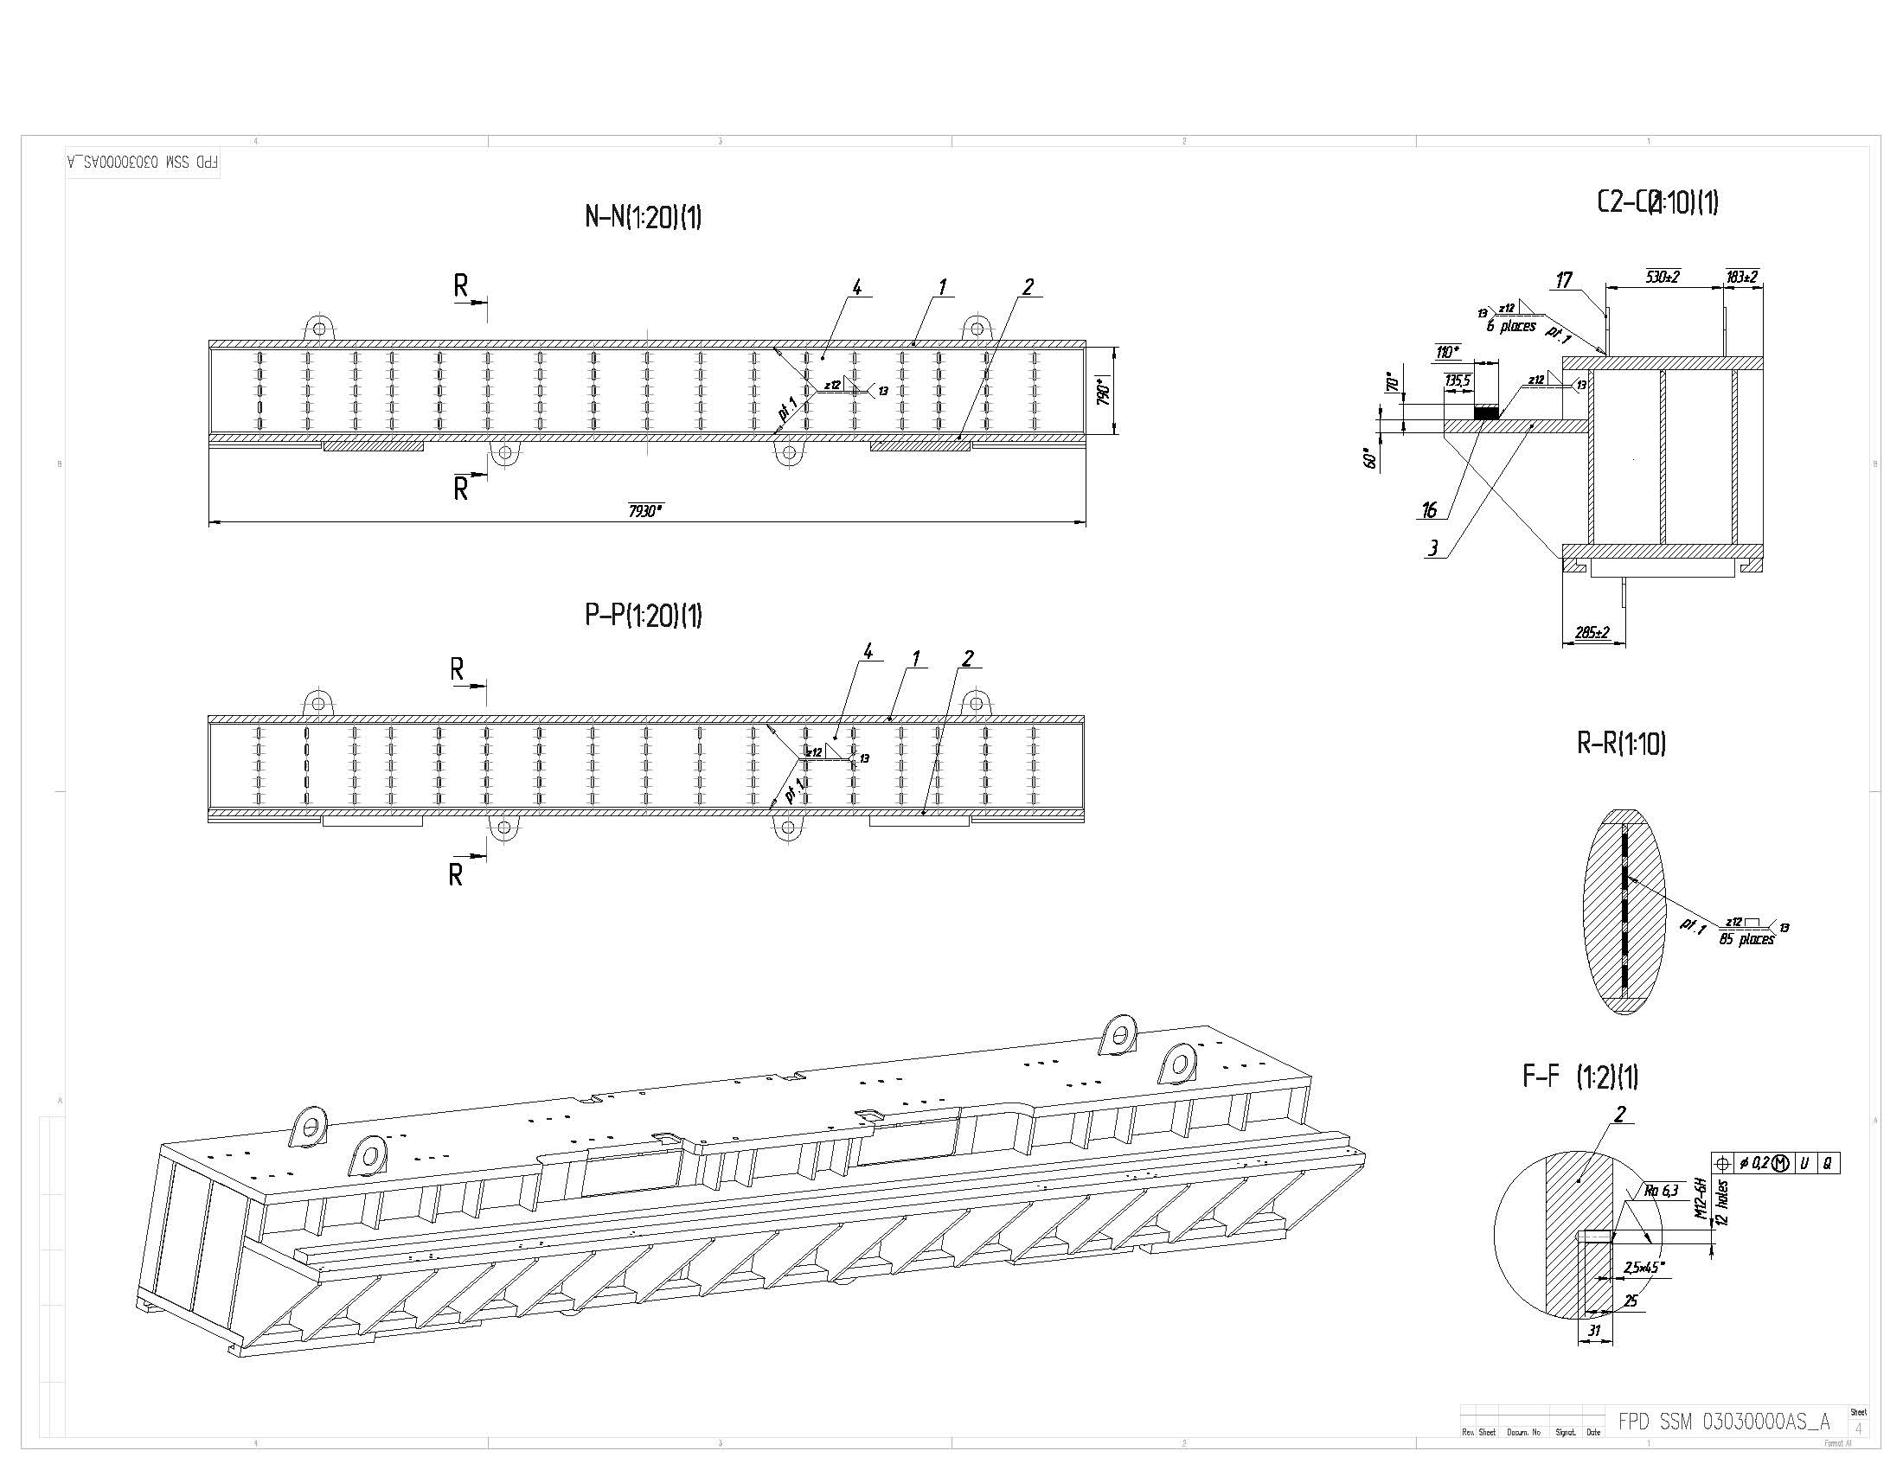
Drawing of the Beam of Frame.

Slide 25
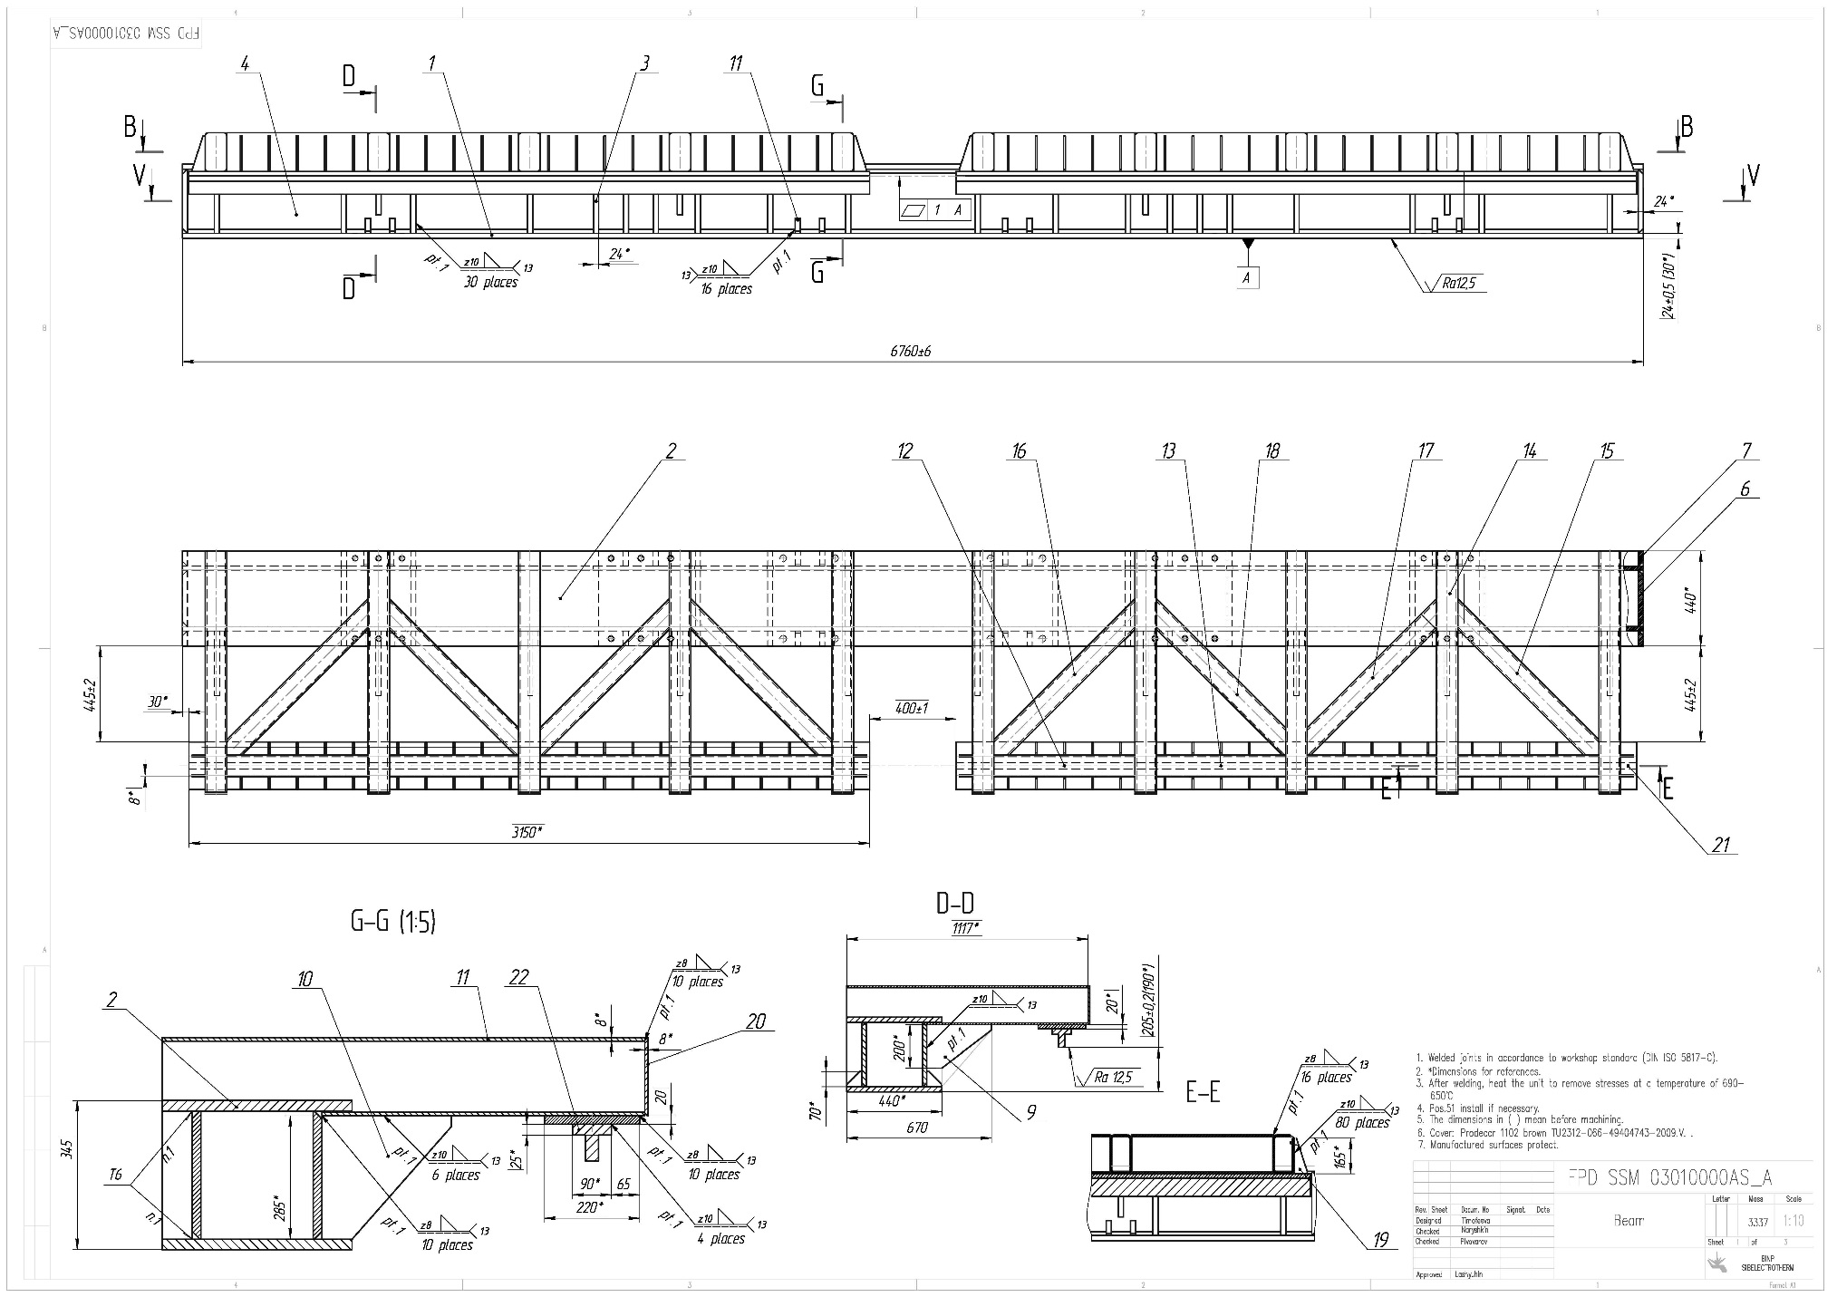
Drawing of the Top Beam of Frame.

Slide 26
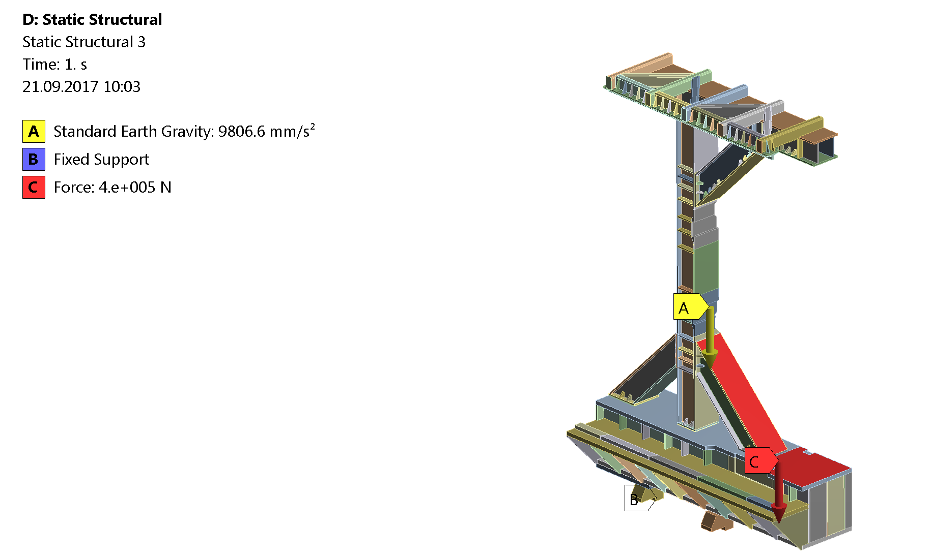
Calculatuonl of the Platform and Frame.

Slide 27
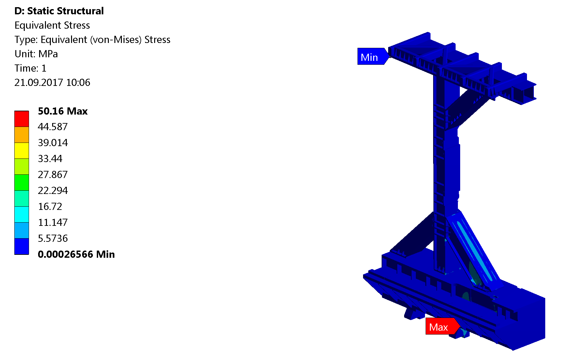
Results of calculation of the Platform and Frame. Stress
The maximum equivalent stress is 50 MPa.

Slide 28
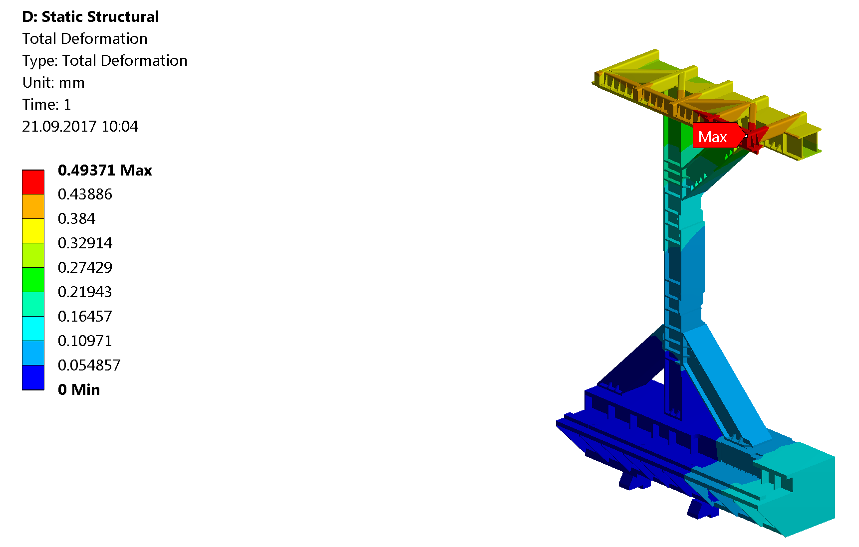
Results of calculation of the Platform and Frame. Deformation
The maximum deformation is 0.5 mm.

Slide 29
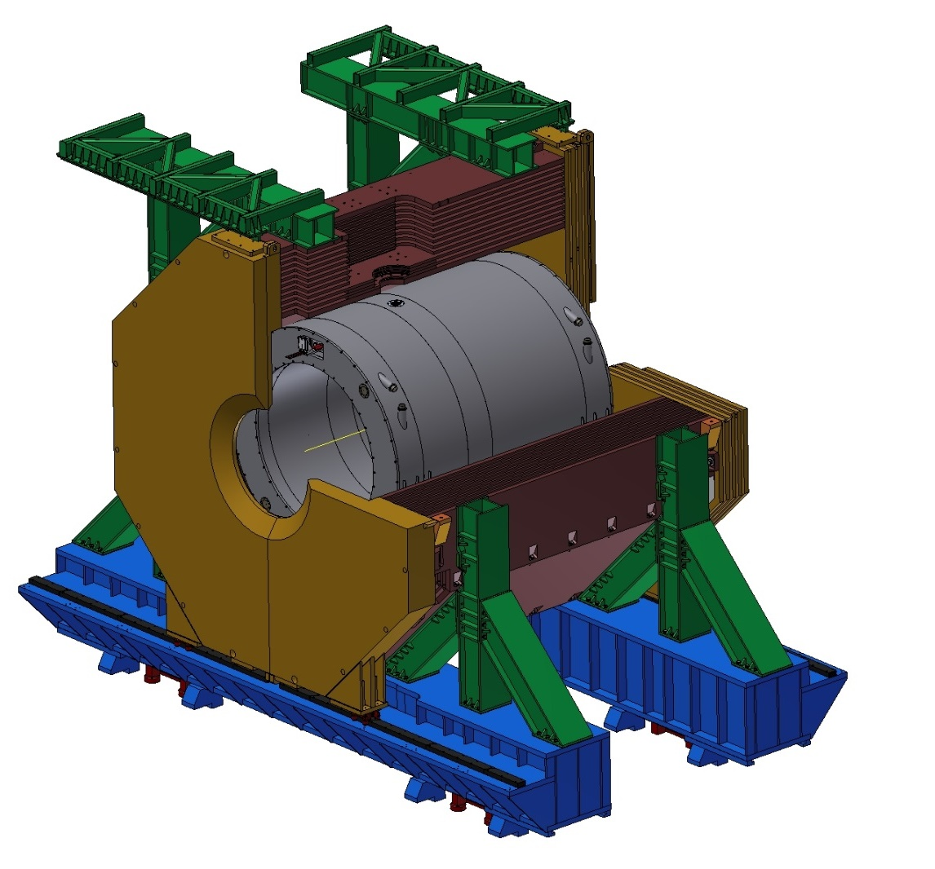
3D model of the Magnet, Yoke, Platform and Frame.

Slide 30
Thank you for your attention!

