Slide 1


Resonances in Nuclei:
From SATURNE to HADES@GSI
B. Ramstein*, IPN Orsay
Workshop: « WASA at GSI/FAIR 28 November 2017
* with great help from T. Hennino

Slide 2


Outline
Introduction: Δ in nuclei, π branch.
Saturne charge exchange experiments: (1981-1997)
  SPES4: inclusive
  DIOGENE: exclusive (Diogene)
  SPES4π : coherent pions
Disclaimer : - excavation work
- would need more time to present these results in
a modern perspective
A few words about HADES experiments ( > 2001)
Conclusion

Slide 3
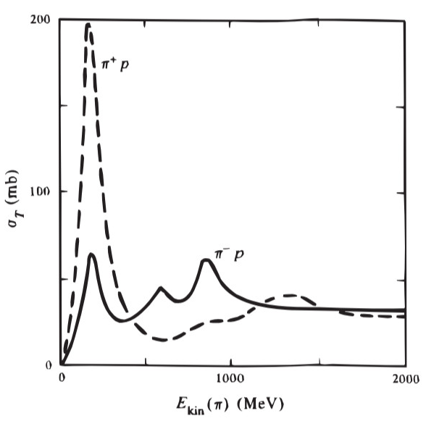
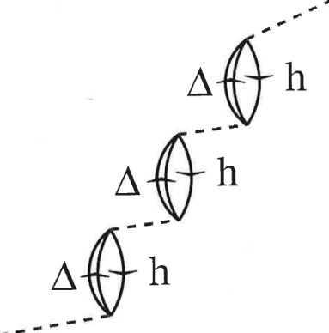
pions and Δs in nuclei
Pion mean free path in nuclei is very small < 1 fm around 100-250 MeV
Strong excitation of the Δ(1232) resonance
Δ : S=3/2 I=3/2 M=1232 MeV Γ=115 MeV
N→Δ ΔS=1, ΔT=1
Δ
Free Δ
Pions excite Δ-hole states in nuclei at lower energies
than the free Δ: pionic branch
Can be probed by charge exchange reactions ω<q
π branch

Slide 4
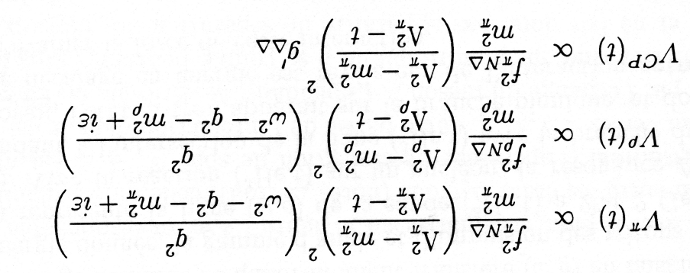

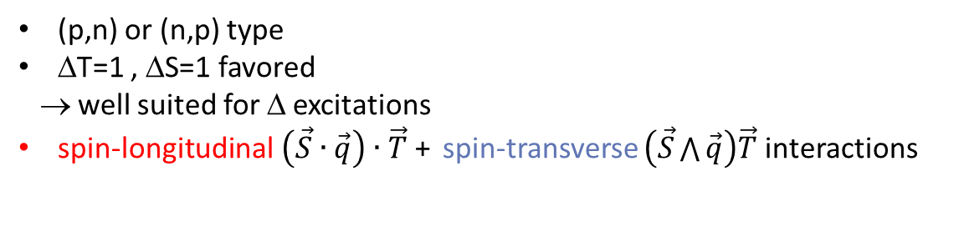
Charge-exchange reactions
------ T
L
(p,n) or (n,p) type
ΔT=1 , ΔS=1 favored
→ well suited for Δ excitations
spin-longitudinal$\left(\vec{S}∙\vec{q}\right)∙\vec{T}$+ spin-transverse $\left(\vec{S}\bigwedge{\vec{q}}\right)\vec{T}$interactions
strongly modified
only slightly modified in medium
G. Chanfray and M. Ericson , Phys. Lett. 141B (1984)163
Δ-hole interaction:
Spin-longitudinal
Spin-transverse
Short-range
Free parameter: compensates attraction of pion exchange
Despite their peripheral character, charge-exchange reactions are ideal to probe these effects

Slide 5
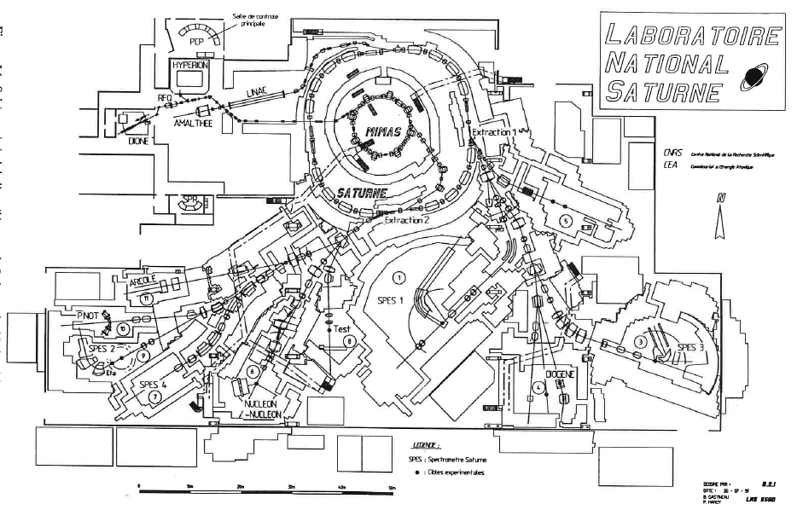
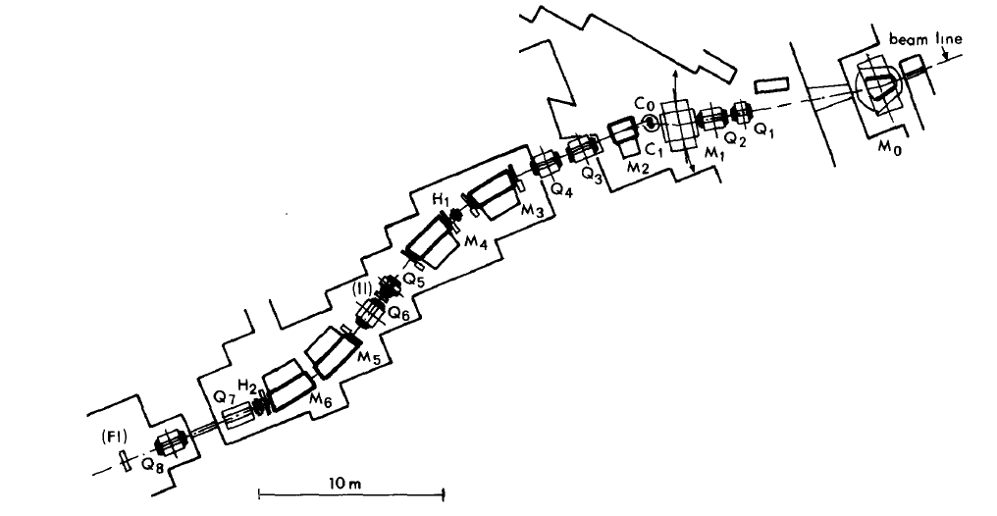
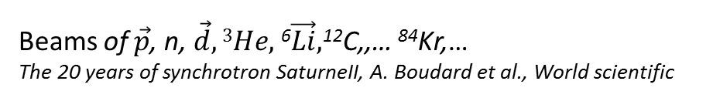
SATURNE-II
Charge-exchange program
initiated by C. Gaarde (NBI)
and P. Radvanyi (LNS) in the 80’s
(³He,t) , (d,2p), (¹²C,¹²N)
(²⁰Ne,²⁰F),(²⁰Ne,²⁰Na),
(¹⁴N, ¹⁴C), (¹⁴N, ¹⁴O), (⁴⁰Ar, ⁴⁰K)
(⁴⁰Ar, ⁴⁰Cl)
SPES4:33m, 5 dipoles,
6 Qpoles and 2 sextupoles
1977-1997
Beams of $\vec{p}$, n, $\vec{d}, 3He,$⁶$\vec{Li},$¹²C,,… ⁸⁴Kr,…
The 20 years of synchrotron SaturneII, A. Boudard et al., World scientific
M. Bedjidian et al., NIM A257 (1987) 132

Slide 6
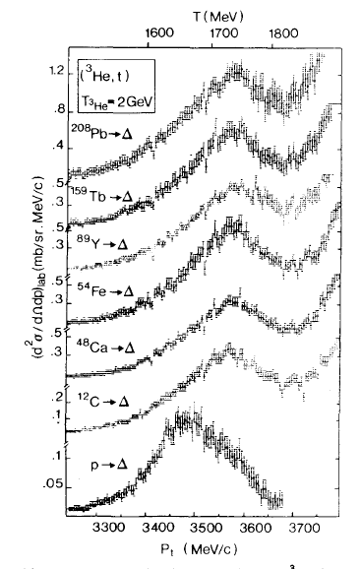
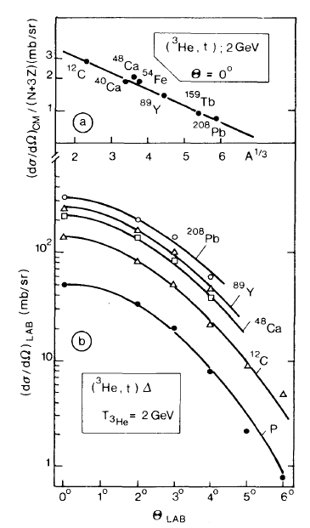
Inclusive (³He,t) reaction
LNS (Saclay)-IPNO (Orsay)-IPN(Lyon)-
NBI (Copenhagen)-Lund uni.
D. Bachelier, J.L. Boyard, T. Hennino,
J.C. Jourdain, M. Roy-Stephan, P. Radvanyi, B. R.
Prominent Δ excitation
70 MeV downward shift observed
between nucleon and nuclei response
C. Ellegaard, Phys.Lett. 154B (1985) 110-114
D. Contardo et al. (1986) Phys. Lett. 168B, 331
B. Ramstein et al. (1999) EPJA6, 225.
∼40 MeV
Mean-field + broadening (Fermi momentum + ΔN→NN) convoluted with FF
~ 30 MeV
Attractive Δ- hole interaction
Notes:
Figure inclusif (3He,t), + ions lourds

Slide 7
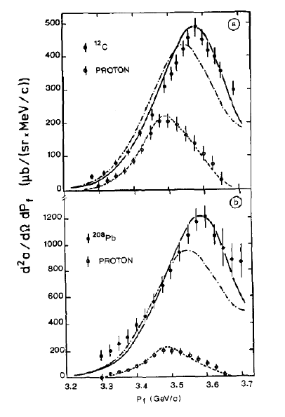
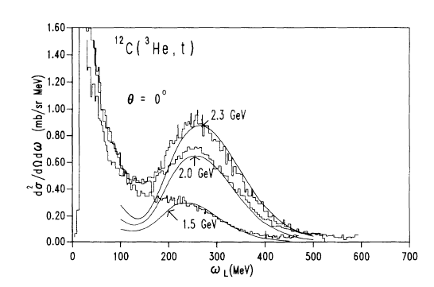
Delta-hole model
Role of Δ-hole correlations.
J. Delorme and P. Guichon, Phys. Lett. B 263 (1991) 168
g’_{Δ} ∼0.5
g’_{Δ} ∼0.33
T. Udagawa et al. PRC 49 (1994)3162.
Importance of projectile excitation
E. Oset et al. Phys. Lett. B 224 (1989) 252..

Slide 8
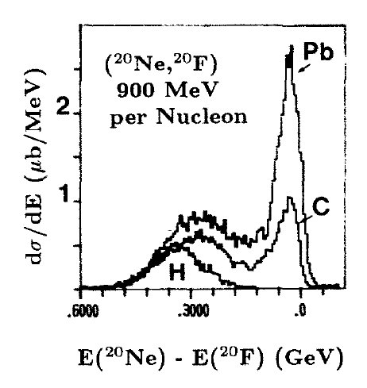
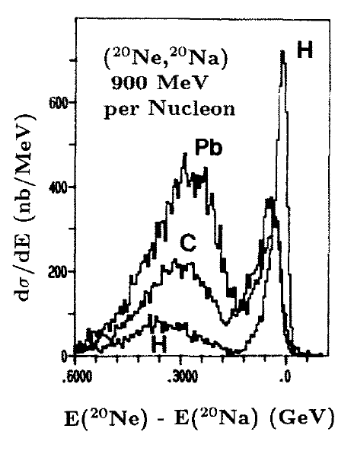
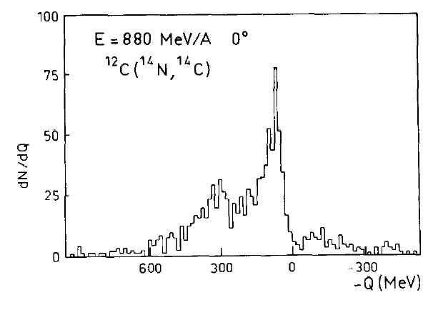
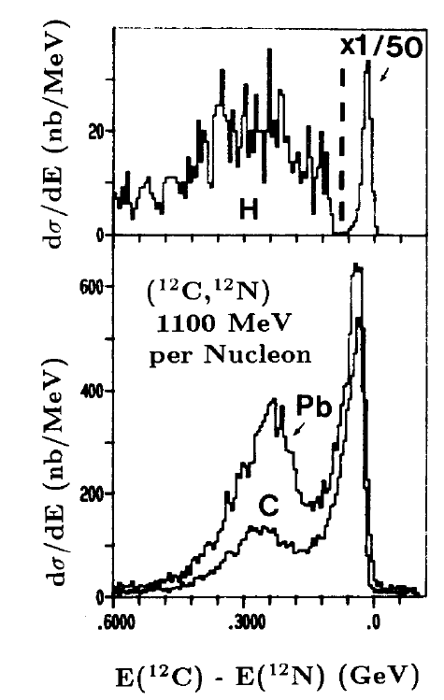
Heavy-ion charge exchange reactions
Fragmentation of
heavy beam impurities
M. Roy-Stephan et al. NPA 488 (1988) 178.
Shift observed: consistent with Δ-hole correlations
Dependent on target mass in (n,p) type transitions
Strong dependence on the projectile, ejectile structure
Calculations for (¹²C,¹²N) :
C. Guet, M. Soyeur et al., NPA494 (1989) 558

Slide 9
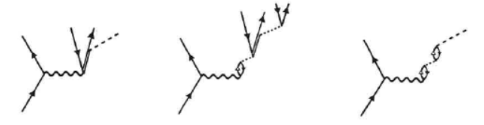
Δ Decay modes
Quasi-free process
Δ→πN
ΔN→NN
absorption
Coherent pion production
A_{Δ}→πA

Slide 10
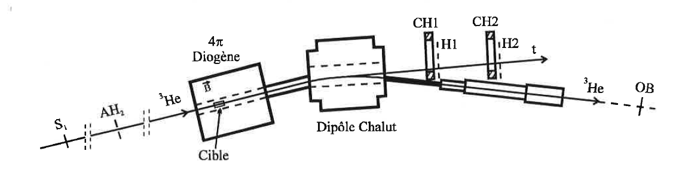
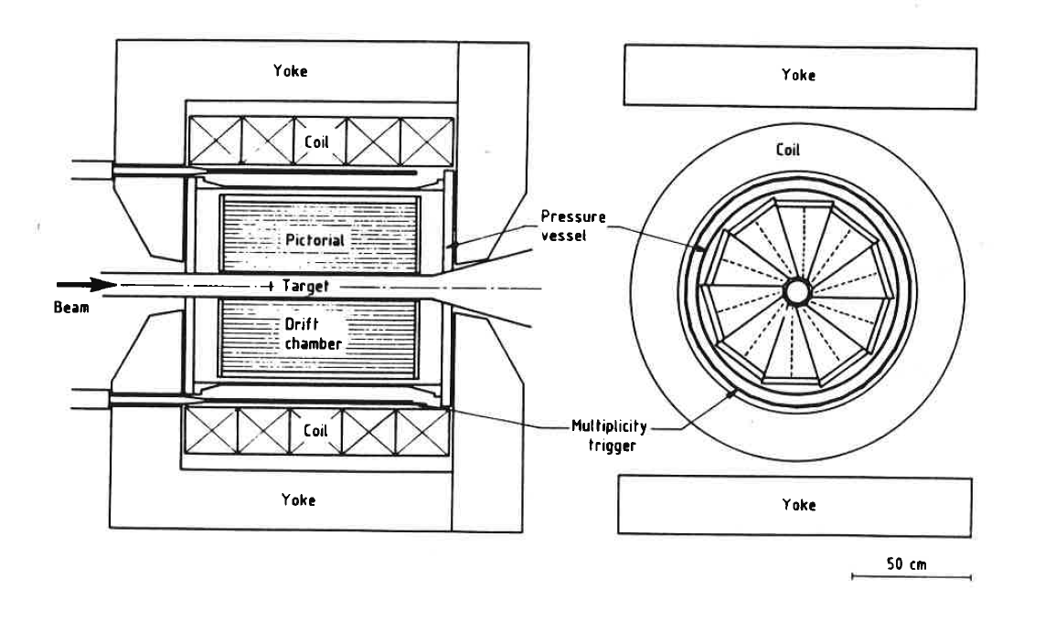
Exclusive experiments at Saturne
Collaboration: Orsay, LNS, Copenhague, Lund, Varsovie et DAPNIA/SPN
CHALUT: t detection
Hardware deuton
rejection (hodoscope)
0° < θ_{lab} < 4°
1.450 GeV < E_{t} < 2 GeV
ΔE_{t}~30-40 MeV
Δθ_{t}∼ 1.5-3 mrad
(³He,t) E=2 GeV
DIOGENE
CHALUT
DIOGENE: π,p detection
10 drift chambers
20°< θ_{lab}<132°
15 < E_{π}< 300 MeV
30 < E_{p}< 450 MeV
Δp/p ~ 10% for pions
Δp/p ~ 18% for ptotons
Δθ ∼ Δφ ~ 2-3°

Slide 11
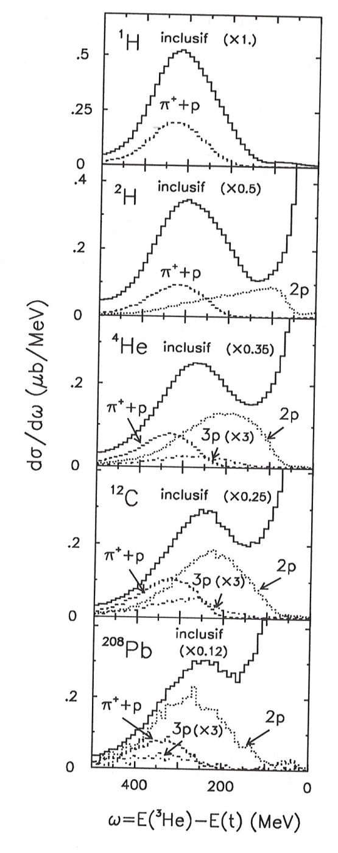
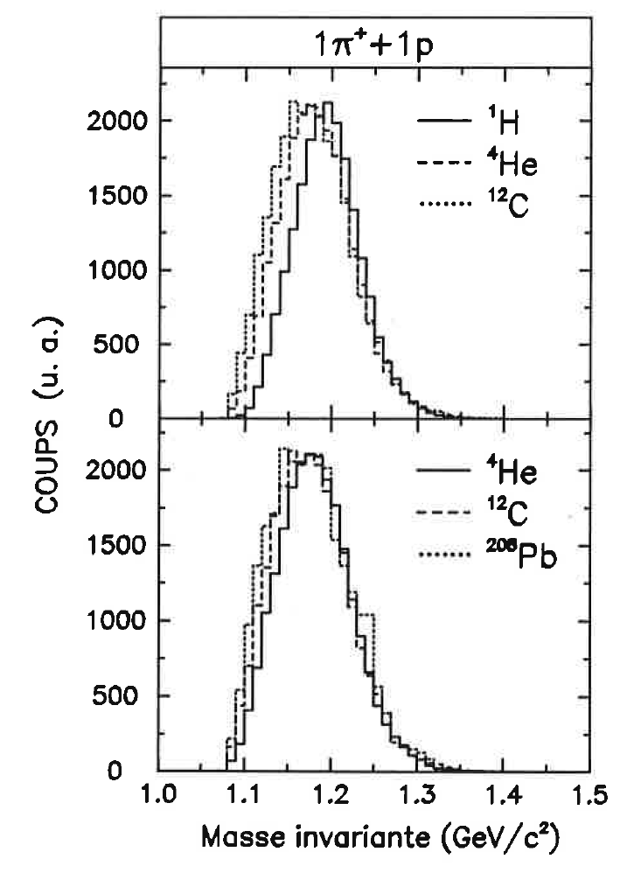
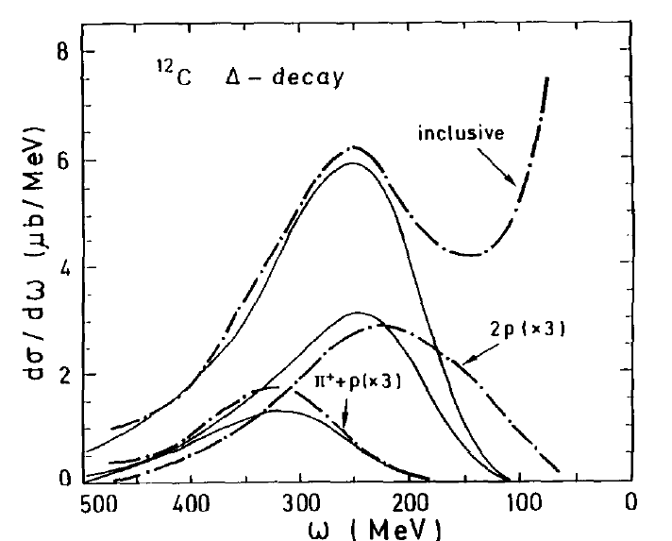
Δ Decay measurements
Inclusive: confirmation of Spes4 results
π⁺p: no shift in energy transfer,
but small shift of the invariant mass
2p (absorption process) provide most of the
energy transfer shift, investigation of angular
distributions, sensitive to S/L contributions
Roughly reproduced by Cascade calculations
with shifted Δ mass (M_{Δ}=1200 MeV)
and increased width (Γ= 200 MeV,
i.e. ΔN→NN cross section (x2) )
K. Sneppen, C. Gaarde, Phys.Rev. C50 (1994)338
T. Hennino et al. PLB 283(1992)42
B. Ramstein et al. , EPJ. A16 (2003) 583-597
S. Tarlé-Rousteau, PhD, Orsay 1995.

Slide 12
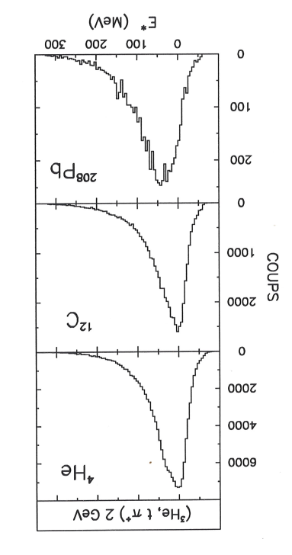
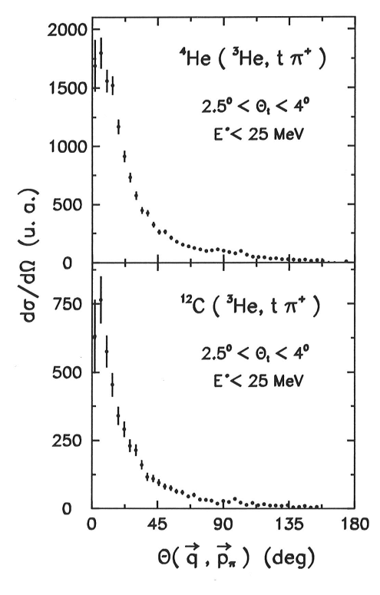
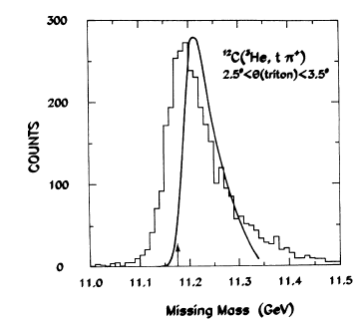




Coherent process
T. Hennino et al. PLB 303 (1993) 236.
Cascade
$$\vec{p\text{t} }$$
$$\vec{p\text{3}\text{He} }$$
$$\vec{pπ }$$
$$\vec{q }$$
Evidence for coherent pion production
in (³He,tπ⁺) on ⁴He and ¹²C
Enhancement of excitation energy
distribution in the ground state region l
in contrast to Cascade calculations
Extrapolated coherent pion yield
R ∼ 10.5 % (⁴HE)
R ∼ 5.4 % (¹²C)
E*<25 MeV: Angular distribution
is forward peak
Notes:
Vérifier les facteurs

Slide 13
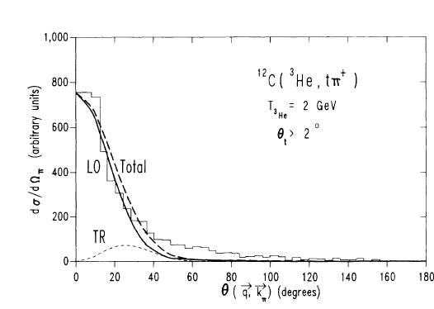
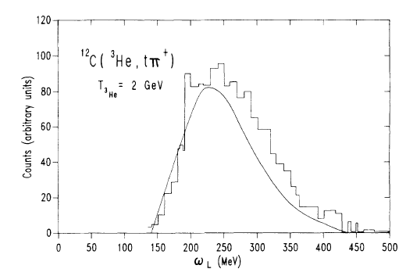
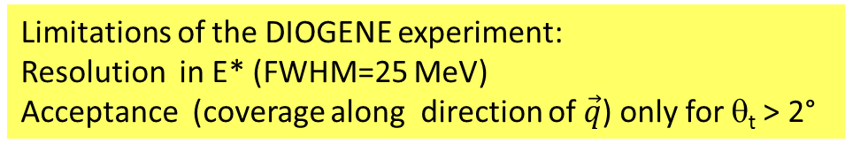

Coherent pions: ideal probes of Δ-hole correlations
Spin-longitudinal
Spin-transverse
dσ/dΩ~ (target FF) x ($cos2⁡(θ\left(\vec{q,}\vec{p}π \right)$ + $sin2⁡(θ\left(\vec{q,}\vec{p}π \right)$)
E*<25 MeV
Δ-hole approach: T. Udagawa et al. PRC 49 (1994)3162.
Yield of coherent pions and angular
distributions well reproduced with g’_{ΔΔ}=1/3
E*<25 MeV
Virtual pion rescattering approaches :
M. Kagarlis and V. Dmitriev, PLB 408 (1997)
P. Fernandez de Cordoba, Nucl.Phys. A592 (1995) 472-486
Limitations of the DIOGENE experiment:
Resolution in E* (FWHM=25 MeV)
Acceptance (coverage along direction of $\vec{q}$) only for θ_{t} > 2°

Slide 14
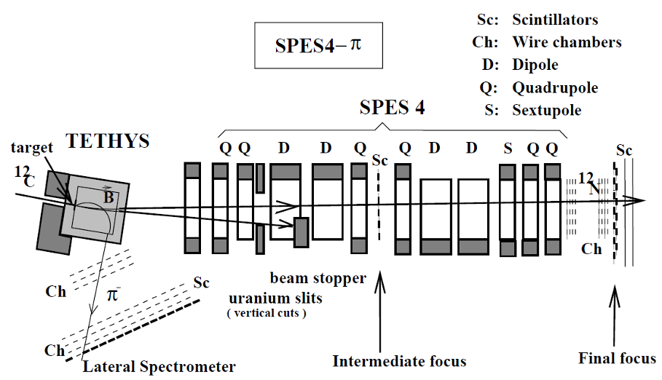
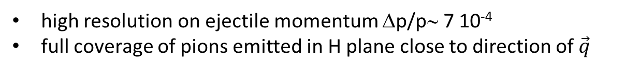
SPES4π: a dedicated experiment for the study of coherent pion production
Saclay-Orsay-Copenhagen
Varsaw-Gatchina
(³He,t) C, CH₂, Ca targets
(¹²C,¹²N) C target
Δθ_{H}=15 mrad
Δθ_{v}=±5.7 mrad
high resolution on ejectile momentum Δp/p∼ 7 10⁻⁴
full coverage of pions emitted in H plane close to direction of $\vec{q}$
Notes:
Acceptance SPES4 en vertical ? Limitations tx de comptage, ROPER

Slide 15
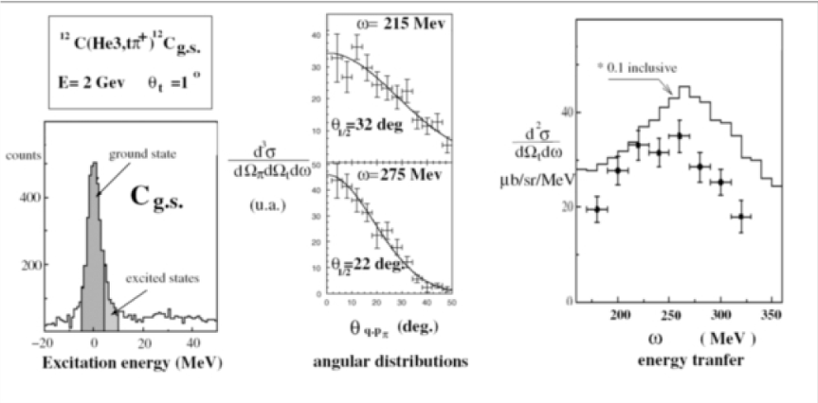
SPES4π results for (³He,t)
L. Farhi PHD, université Paris XI, 1997
R. Dahl, PHD, NBI Copenhagen, 1999
Consistent with DIOGENE results
Better resolution in E*
Better precision on angular distribution
Notes:
Shift seulement 30 MeV ?

Slide 16
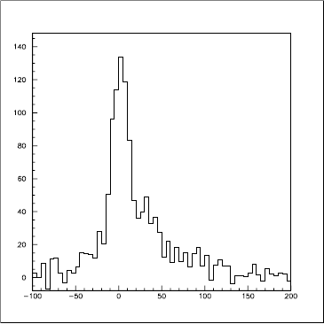
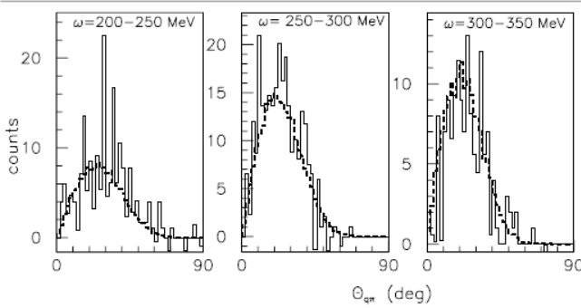
SPES4π results for (¹²C,¹²N) 1.1 GeV/nucleon
¹²C (¹²C,¹²N) ¹²C π⁻
E* (12C) <18 MeV
σ~8 MeV/c²
E*(MeV)
Angular distribution in agreement with L/T ~ 1
J.L. Boyard, NPA 755 (2005) 507c
J. Janssen, master thesis, NBI Copenhagen, 1998
Evidence for coherent pion production
in (¹²C,¹²N) on ¹²C with a contribution of 6%
But limited E* resolution and bad sensitivity in angle

Slide 17
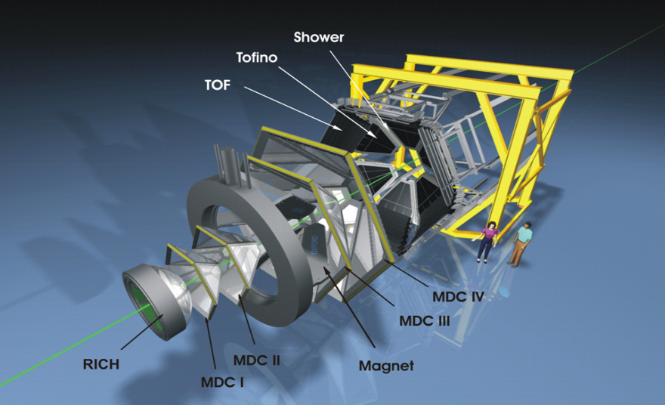
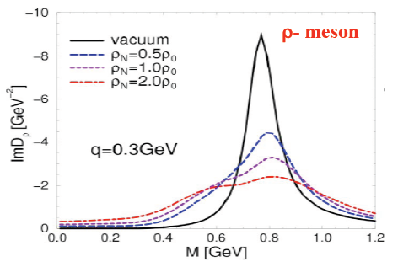

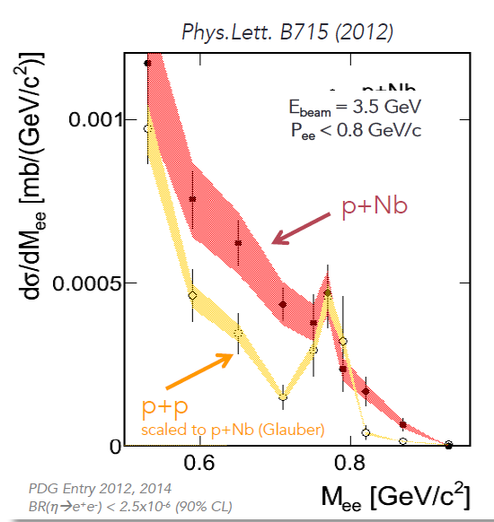
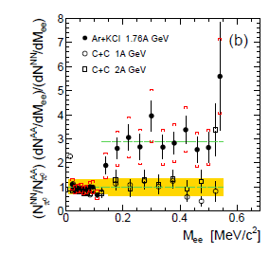
Leap forward in time…HADES at GSI
Modifications of ρ meson spectral function
Rapp, Chanfray and Wambach NPA 617, (1997) 472
R. Rapp and J. Wambach EPJA6, (1999) 415
Phys.Rev.C84:014902,2011
Observed dielectron yield excess
due to regeneration of baryonic resonances

Slide 18
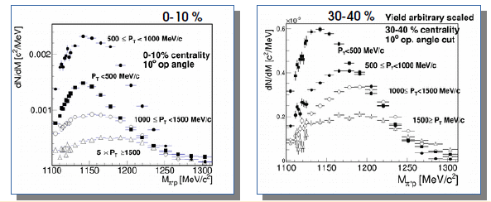
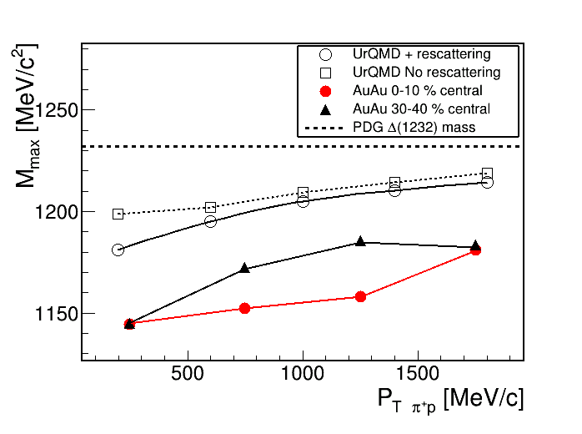
Δs in nuclei:
HADES measurements in hadronic channels
Preliminary HADES results Au+Au 1.25 AGeV
can be reconstructed from correlated (π,p) pairs
Iterative method for combinatorial background subtraction (G. Kornakov, GSI)
preliminary
preliminary
mass is shifted downwards
(much lower than UrQMD)
P_{t} and centrality dependence is observed
URQMD: Bass et al. PLB, (1984) 335.

Slide 19
Conclusion
A brief overview of old measurements in Saturne
We (T. Hennino and myself) are ready to look for more
information if needed.
Studies of resonances in charge exchange reactions in nuclei
indicate strong medium effects
→ worth to be revisited with
    better resolution/angular coverage
    new theoretical approaches
Complementarity with HADES to be exploited
Good luck for the WASA at GSI project !
Notes:
Oset, Chanfray

Slide 20
Thank you

