Slide 1
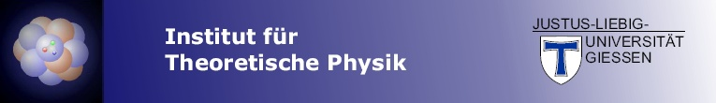
Baryon Resonances in Nuclear Matter and Neutron Stars
WASA@FRS , November 2017
H. Lenske

Slide 2
Agenda:
Resonance excitation in nucleus-nucleus reactions
The excited nucleon in nuclei: N*N⁻¹ modes of excitation
Nuclear response functions with resonances: N*RPA
Astrophysics: „resonance puzzle“ in neutron stars

Slide 3
N* Resonance Spectroscopy

Slide 4
Nucleon Resonances in πN Scattering
…see e.g. the Giessen Coupled Channels Model (GiM)
(V. Shklyar, Xu Cao, H.L. et al.)

Slide 5
Evidence for Resonances in Nuclei

Slide 6
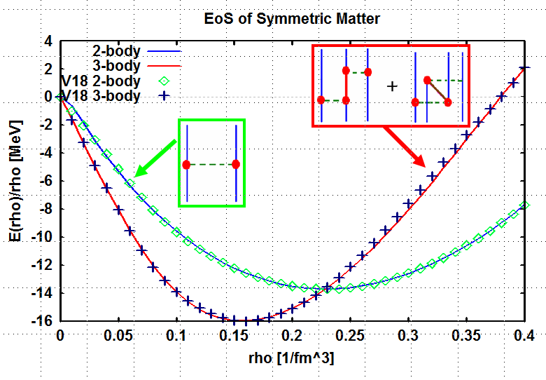
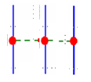
Δ-Resonance and Nuclear Matter Binding Energy
χEFT 3-body Force

Slide 7
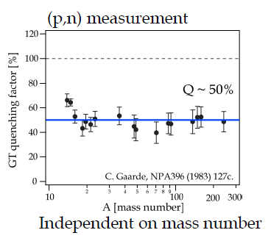
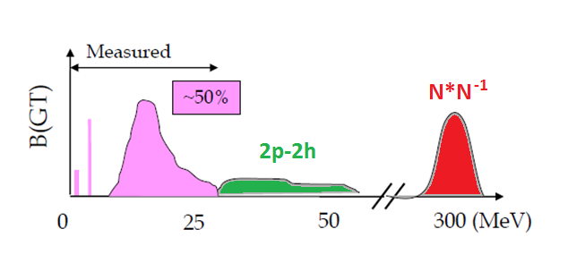
Δ-Resonance and the GT-Quenching Problem:
~50% of the Ikeda Sum Rule is missing

Slide 8
Resonance Excitation in
Nucleus-Nucleus Reactions
…SATURNE@Saclay
and
Synchro-Phasetron@Dubna
(1980ties and 1990ties)

Slide 9
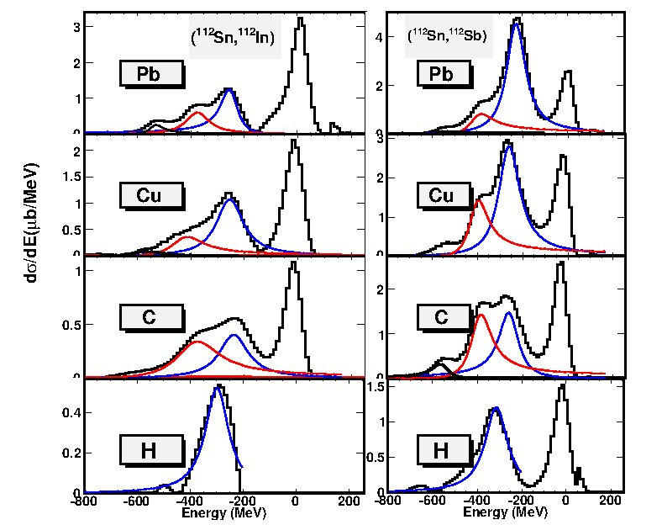
Nucleon Resonances in Nuclei at the FRS@1AGeV
Projectile:
Projectile:
Target:
Target:
Data: J. Benlliure and the S363 collaboration

Slide 10

Theory of Peripheral Heavy Ion Reactions
$$\text{a}\text{+}\text{A} \text{and} \text{b}\text{+}\text{B} \text{Elastic} \text{Interactions}\text{:}$$
$$\text{Projectile}\text{−}\text{Target} \text{Nucleon}\text{−}\text{Nucleon} \text{Interaction}\text{:}$$
$$\text{Hadronic} \text{Tensor}\text{:}$$

Slide 11
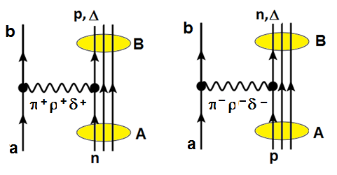
Projectile-Target Nucleon-Nucleon Interactions
Charge Changing ΔQ=±1 Excitation of Quasi-elastic NN⁻¹, and N*N⁻¹ States
Operator Structure for (NN⁻¹, N*N⁻¹) excitations:
…and quasielastic knockout and multistep reactions!

Slide 12
Resonances in Nuclear Matter

Slide 13
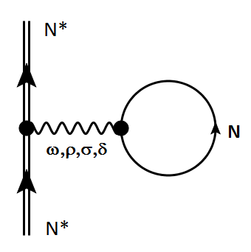
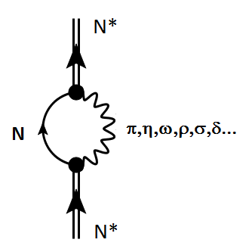
Δ/N* Dynamics in Nuclear Matter
+
Diffractive Self-energy
→ Hartree-Potential
Dynamical Self-Energy
→ dispersive (optical) potential
…see e.g.:
E. Oset, L.L. Salcedo, NPA 468 (1987) 631; G.E. Brown, W. Weise, Phys. Rept. 22 (1975) 279

Slide 14
Δ In-Medium Self-Energy
Conclusion:
Width: weak dependence on ρ
Shift : strong dependence on ρ

Slide 15
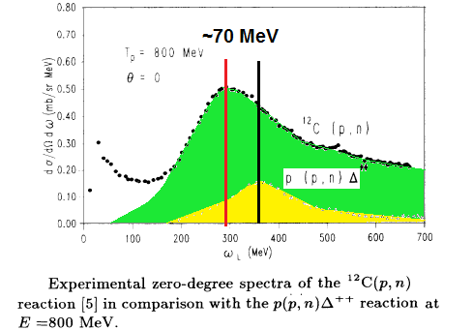
Inclusive ¹²C(p,n)-reaction @SATURNE

Slide 16
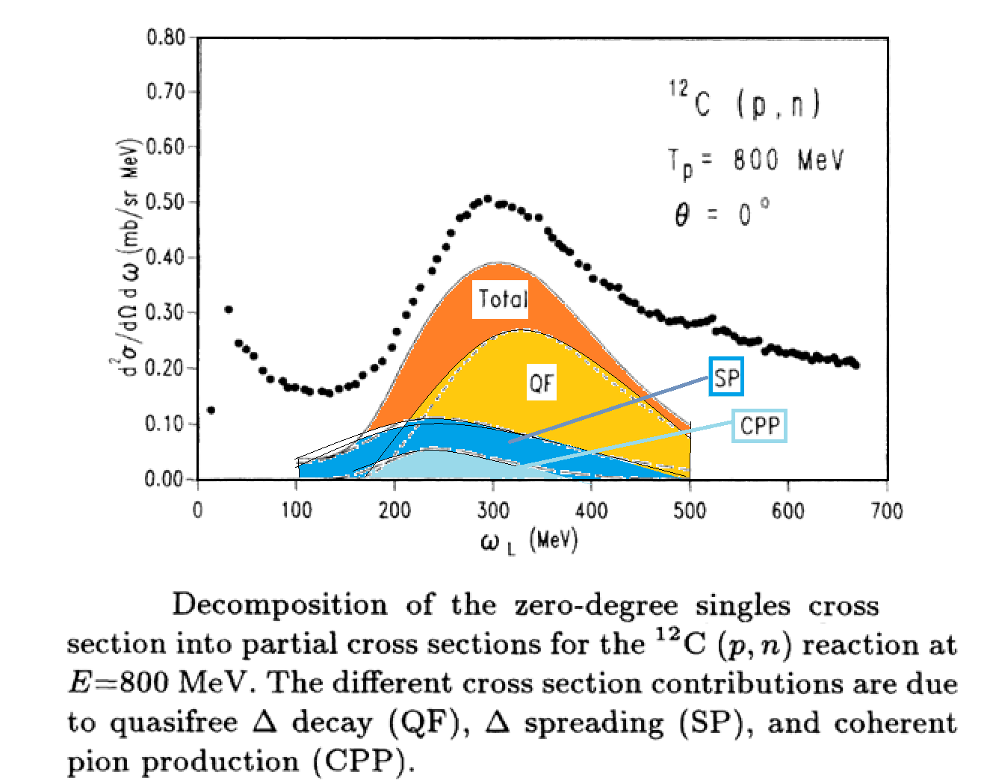
The origin of the apparent mass shift in stable nuclei…
…a combination of medium and reaction effects
T. Udagawa et al. PRC 49:3162 (1994)

Slide 17
Nuclear Response Functions

Slide 18
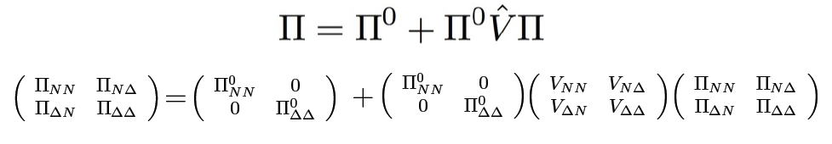
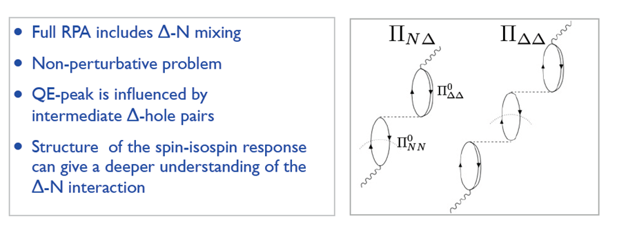
Resonance Excitation in Nuclei: „N*RPA“

Slide 19
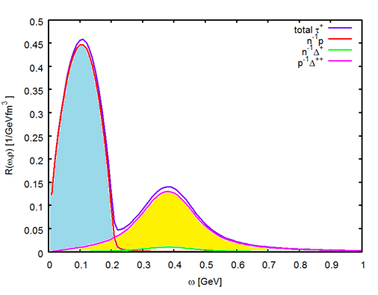

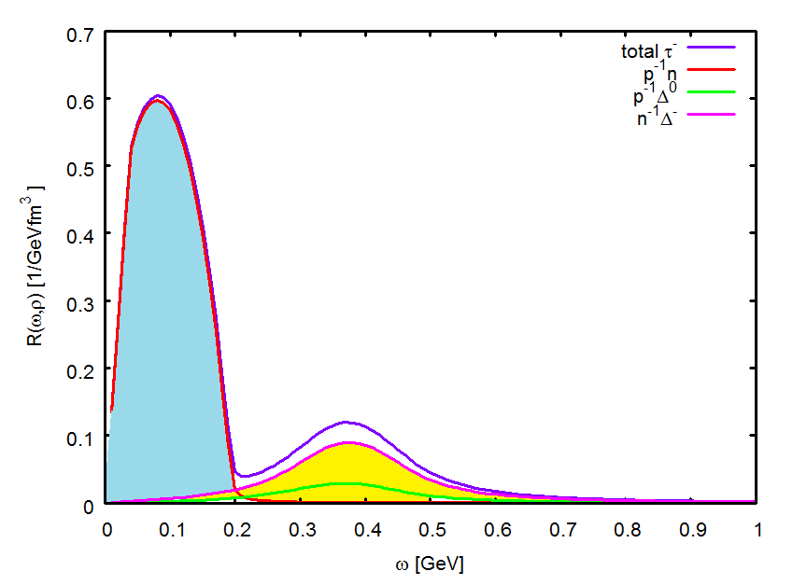
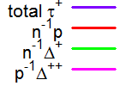
N*RPA:
Z→Z-1
¹²⁴Sn → ¹²⁴In
(q=400MeV/c)
N*RPA:
Z→Z+1
¹²⁴Sn → ¹²⁴Sb
(q=400MeV/c)

Slide 20
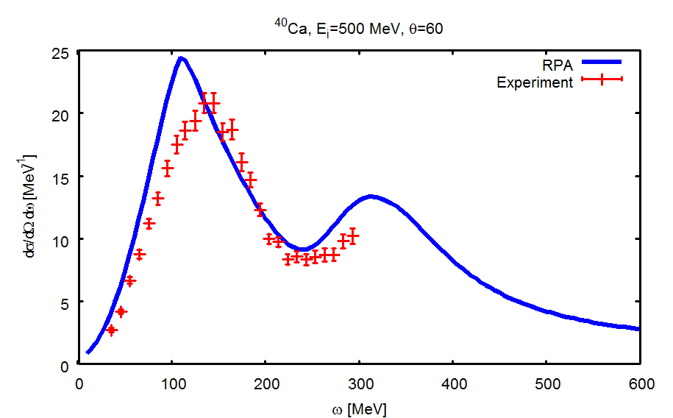
Delta-Resonance Excitation in
Inclusive (e,e‘) Scattering

Slide 21
Decay Spectroscopy

Slide 22
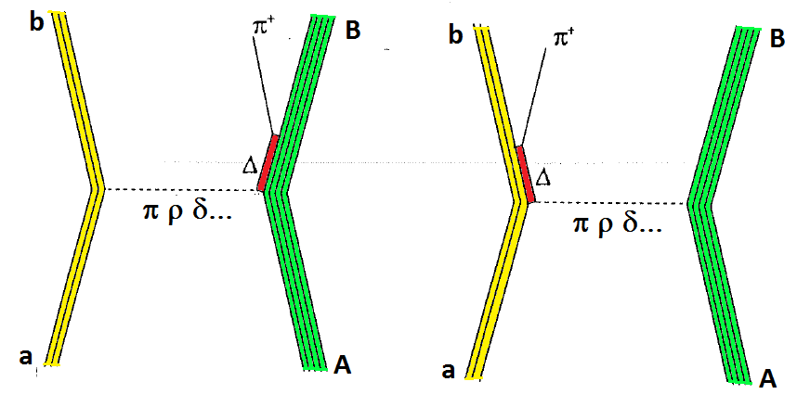
Exclusive Reactions:
Resonance Excitation and Meson Production in Ion-Ion Collisions

Slide 23

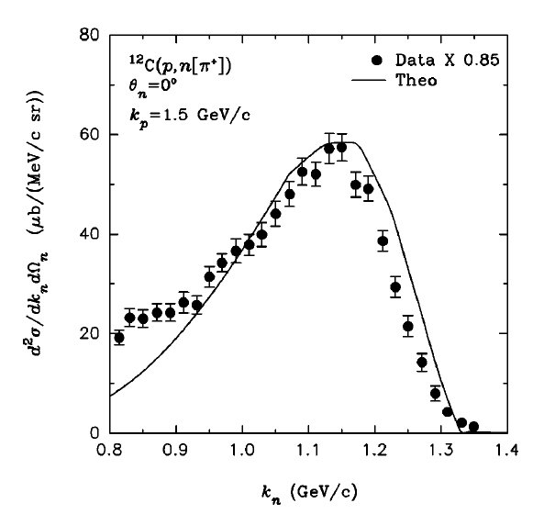
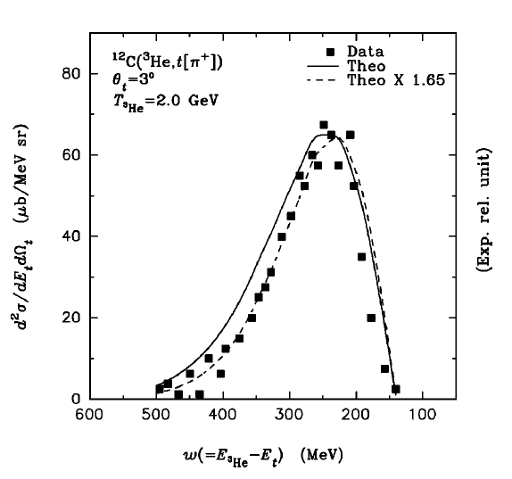
Exclusive reaction: Single-Pion Decay Spectroscopy
      (p,n) reaction at KEK, T_{lab} = 830Mev on ¹²C
      (³He,t) reaction at Saturne, T_{lab} = 2GeV on ¹²C
FANCY@KEK 88% of 4π
DIOGENE@SATURNE ~100% of 4π
J. Chiba et al., Phys. Rev. Lett. 67, 1982 (1991)
T. Hennino et al., Phys. Lett. B 283, 42 (1992)
Theory: S. Das, PRC 66:014604 (2002)

Slide 24
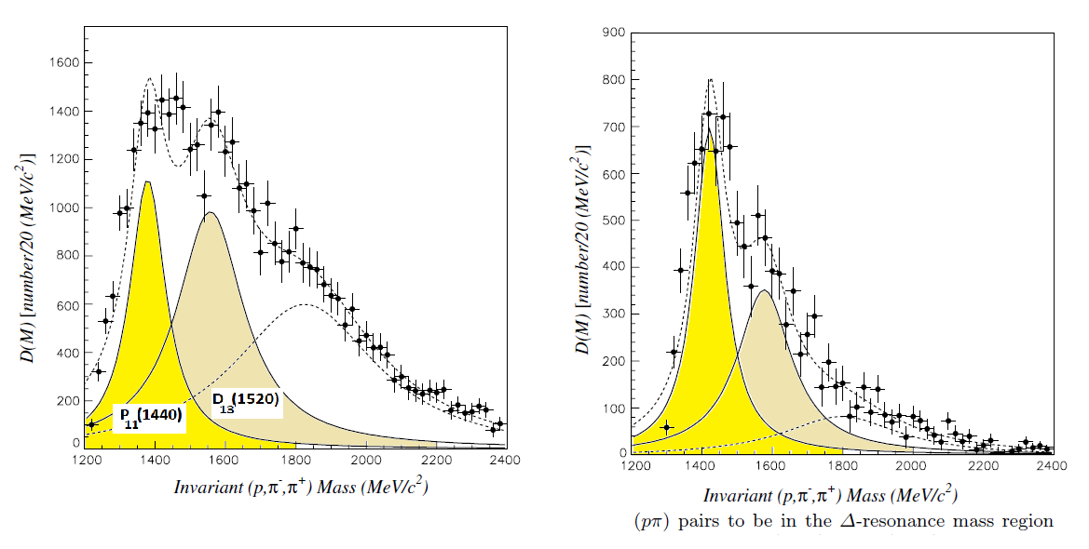
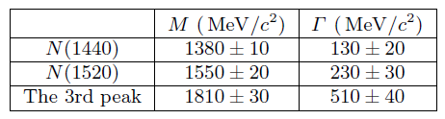
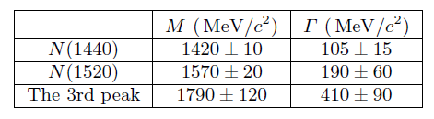
Decay Spectroscopy of Higher Resonances in A+A Collisions
(Single and) Double-pion Decay Spectroscopy
¹²C+¹²C @ p_{lab}=4.2 GeV/c, Synchro-Phasetron Data

Slide 25
N* Resonances in
Neutron Stars

Slide 26
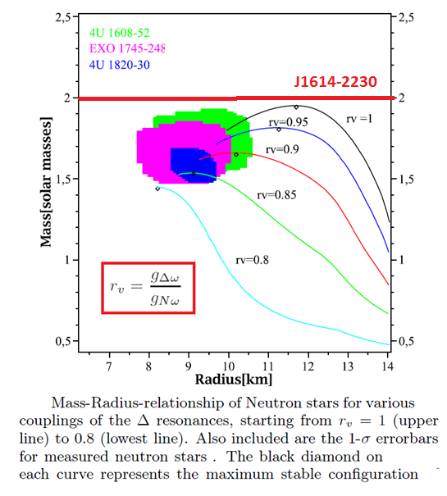
Δ‘s in Neutron Stars
Schürhoff, Schramm,Dexheimer, 2010

Slide 27
Resonances and Hyperons in Neutron Star Matter
A. Drago et al. Eur. Phys. J. A (2016) 52

Slide 28
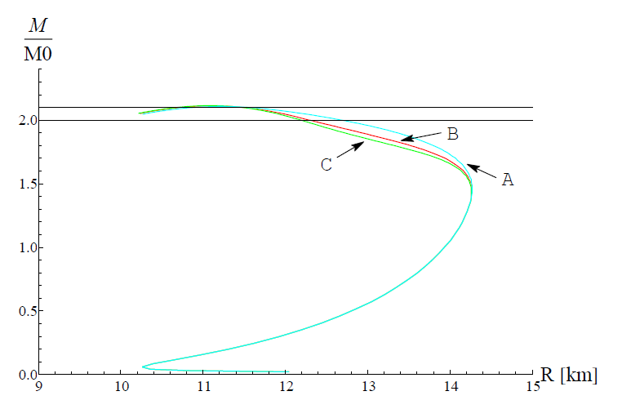
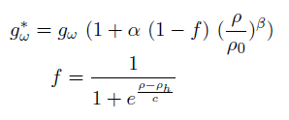
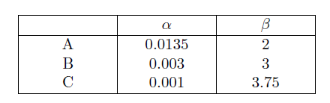
Mass-Radius Relation for a Neutron Star „Driving up the mass by Vector Repulsion“
M=2.10M_{o}
M=1.97M_{o}
J. Wilhelm, H.L, EPJ WoC 107

Slide 29
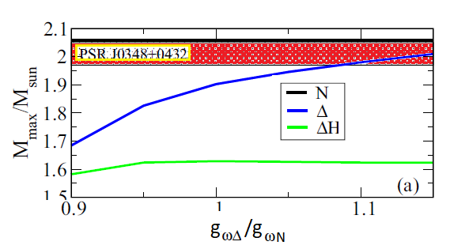
Resonances and Hyperons in Neutron Star Matter
Maximum Mass of a Neutron Star
…as a function of the ω−Δ vector meson coupling constant
A. Drago et al. Phys. Rev. C 9:065809 (2014)

Slide 30
Summary and Outlook
Resonances as nuclear structure probes
Resonances and nuclear isospin dynamics
Resonances and nuclear response functions
Resonance tagging by decay spectroscopy
Resonances beyond Δ(1232)
Resonance „puzzle“ in neutron stars
Credits to Andreas Fedoseew and Isaac Vidana
…supported by
DFG, GSI, HIC for FAIR, BMBF

Slide 31
Backup

Slide 32
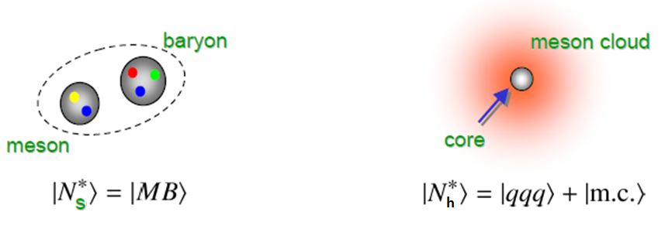
QCD Wave Function of a Resonance
hadronic (soft scale) molecular-type components |N_{s}>
QCD (hard scale) confined components |N_{h}>
Strong Medium Dependence
Weak Medium Dependence

Slide 33
N* Resonances and Neutrino-Nucleus Interactions

Slide 34
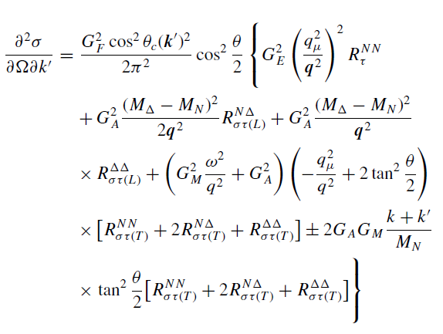
Neutrino-Nucleus Cross Sections and
NΔ-Response Functions:
ν_{ℓ}+N→Δ→N+π Reactions

Slide 35
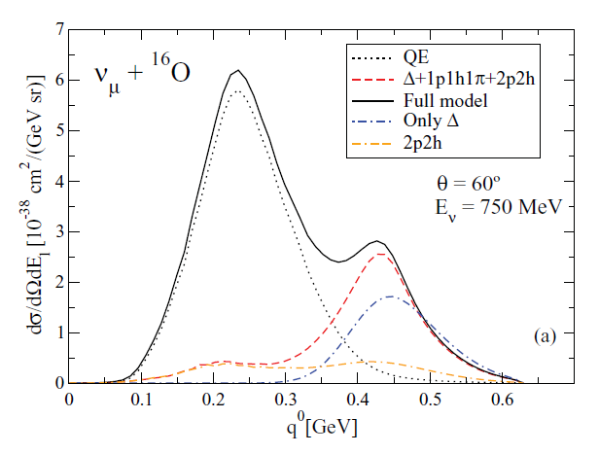

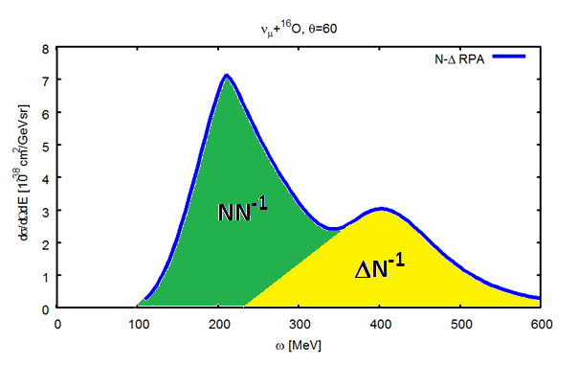
Inclusive CC cross section
Gießen
„N-Δ RPA“

