Slide 1
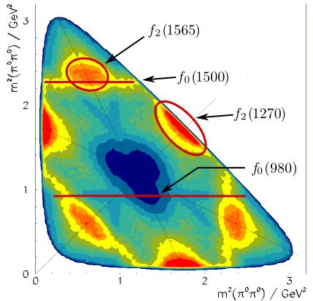
Physics Analysis Concepts with PandaRoot (4)
PANDA Lecture Week 2017
GSI, Dec 11 - 15, 2017
Klaus Götzen GSI Darmstadt

Slide 2
Topics
Event Filtering (FairFilteredPrimaryGenerator)
Useful Event and Kinematic Variables (PndEventShape)
Creating Output
Simplified N-Tuple output (RhoTuple)
QA-Tools (PndRhoTupleQA)
Simplified Analysis Tools
Quick Analysis Tools (quick(fsim)ana.C)
Multi Variate Analysis (TMVATrainer/TMVATester)

Slide 3
EVENT FILTERING

Slide 4
Event Filtering
Usually $σBackground ≫σSignal$(e.g. ∼mb vs. ∼nb)
Since (full) simulation of reactions computational intensive:
Idea: Reject events already at generator level likely being rejected at reco/analysis level
Saves a lot of computing power!
Caveat: Due to missing secondaries, rejecting criteria must be chosen carefully
Comprehensive tutorial at
https://panda-wiki.gsi.de/foswiki/bin/view/Computing/PandaRootEventFilterTutorial

Slide 5
Event Filter Usage - (Selected) Filters
FairEvtFilterOnSingleParticleCounts
AndMinMaxAllParticles (min, max)
AndMinMaxCharged (min, max, type)
type: FairEvtFilter::kPlus / kMinus / kCharged / kNeutral
AndMinMaxPdg (min, max, pdg1 [, pdg2, ..., pdg8])
AndPRange / AndPtRange / AndPzRange (min, max)
AndThetaRange / AndPhiRange (min, max)
AndVzRange / AndVRhoRange / AndRadiusRange (min, max)
PndEvtFilterOnInvMassCounts
SetPdgCodesToCombine (pdg1, pdg2 [,pdg3, pdg4, pdg5])
SetMinMaxInvMass (m_{min}, m_{max})
SetMinMaxCounts (min, max)
FairFilteredPrimaryGenerator (allows logical combination of filters)
AndFilter / AndNotFilter (filterName)
OrFilter / OrNotFilter (filterName)
AddVetoFilter (filterName) (has higher priority)
Each MinMax can also be
Min or Max only, placing
just one limit.

Slide 6
Event Filter Usage
Event filter setup in simulation macro (Full or Fast Simulation)
FairFilteredPrimaryGenerator* primGen = new FairFilteredPrimaryGenerator();
FairEvtFilterOnSingleParticleCounts* chrgFilter
= new FairEvtFilterOnSingleParticleCounts("chrgFilter");
chrgFilter->AndMaxCharge(3, FairEvtFilter::kCharged);
FairEvtFilterOnSingleParticleCounts* neutFilter
= new FairEvtFilterOnSingleParticlesCounts("neutFilter");
neutFilter->AndMaxCharge(6, FairEvtFilter::kNeutral);
PndEvtFilterOnInvMassCounts* eeInv= new PndEvtFilterOnInvMassCounts("eeInvMFilter");
eeInv->SetPdgCodesToCombine( 11, -11);
eeInv->SetMinMaxInvMass( 2.0, 4.0 );
eeInv->SetMinCounts(1);
primGen->AddVetoFilter(chrgFilter);
primGen->AndFilter(neutFilter);
primGen->AndFilter(eeInv);
primGen->SetFilterMaxTries(100000);
less than 4 charged
at most 6 neutral
at least on e⁺e⁻ cand.
with 2 < m < 4 GeV/c²
Vetos events with less than 4 charged
Combine all with logical AND
Maximum tries before counted as failed

Slide 7
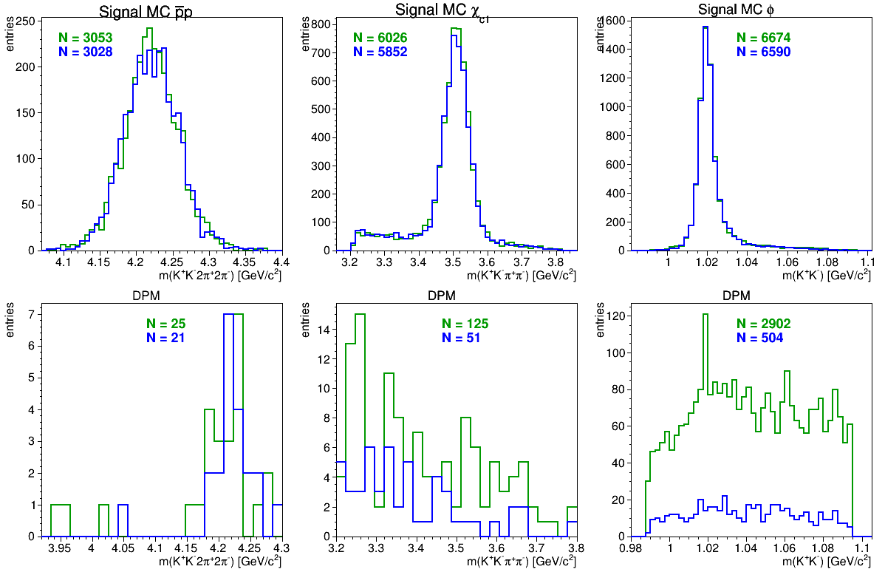
Event Filter Example: ${\overline{p}p→χ}_{c1}π^{+}π^{−}$
Reconstruct ${\overline{p}p→χ}_{c1}π^{+}π^{−}→(φπ^{+}π^{−})π^{+}π^{−}→K^{+}K^{−}{2π}^{+}2π^{−}$
Filter: N(t⁺) ≥ 3, N(t⁻) ≥ 3, |m_{KK} − m_{φ}| < 50MeV, |m_{2K2π} − m_{χc}| < 300MeV
→ Unfiltered DPM: 1.1M ev; filtered DPM: 0.1M ev (→ 11x less simulation!!)
Signal
MC
Background
(DPM)

Slide 8
Event Filter Example: ${\overline{p}p→χ}_{c1}π^{+}π^{−}$
Reconstruct ${\overline{p}p→χ}_{c1}π^{+}π^{−}→(φπ^{+}π^{−})π^{+}π^{−}→K^{+}$ $K^{−}{2π}^{+}2π^{−}$
Filter: N(t⁺) ≥ 3, N(t⁻) ≥ 3, |m_{KK} − m_{φ}| < 50MeV, |m_{2K2π} − m_{χc}| < 300MeV
→ Unfiltered DPM: 1.1M ev; filtered DPM: 0.1M ev (→ 11x less simulation!!)
Signal
MC
well
consistent!
sub.-combs
differ!
Background
(DPM)

Slide 9
EVENT SHAPE VARIABLES

Slide 10
Event Shape Variables
Sometimes signal and background differ in overall event shape
Useful Event Shape variables (always computed in CMS) are
Thrust
Sphericity
(A)planarity
Circularity
Fox-Wolfram Moments

Slide 11
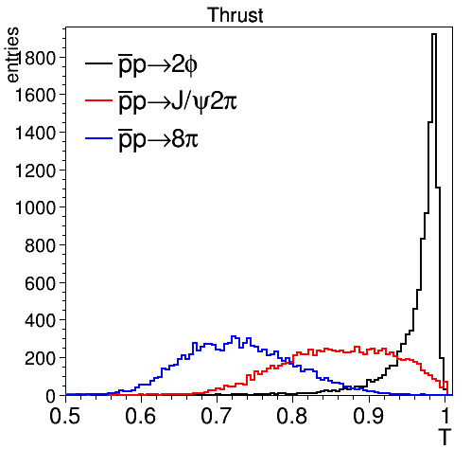
Thrust (- Vector)
Thrust-axis = "Jet direction" of event $T= \max_{\left|n\right|=1}{\frac{\sum_{i}{|n∙p_{i}|}}{\sum_{i}{|p_{i}|}}}$ with thrust axis $n$ and $\frac{1}{2}≤T≤1$
isotropic
jet-like

Slide 12
Sphericity - (A)planarity - Circularity
Base for all is the sphericity tensor $S^{αβ}$ $S^{αβ}=\frac{\sum_{i}{p_{i}^{α}∙p_{i}^{β}}}{\sum_{i}{{|p_{i}^{}|}^{2}}}$ with $α,β=1,2,3$ and eigenvalues $λ_{1},$ $λ_{2}{, λ}_{3}$
Sphericity $S=\frac{3}{2}(λ_{2}+λ_{3})$ with $0≤S≤1$
Aplanarity $A=\frac{3}{2}λ_{3}$ with $0≤A≤\frac{1}{2}$
Planarity $P=λ_{2}−λ_{3}$ with $0≤P≤\frac{1}{2}$
Circularity $C= \frac{2∙\min{(λ_{1},λ_{2})}}{λ_{1}+λ_{2}}$ with $0≤C≤1$
isotropic
jet-like
isotropic
planar

Slide 13
Fox-Wolfram Moments
Fox-Wolfram Moments are defined by $H_{l}=\sum_{i,j}{\frac{|p_{i}|∙|p_{j}|}{E_{vis}^{2}}}∙P_{l}(cos{θ_{ij})}$ with
$θ_{ij}$= opening angle of particles i,j
$E_{vis}$ = visible energy
$P_{l}(cos{θ_{ij})}$ = Legendre polynomials
Balanced events: $H_{1}=0$
Jet-like events: $H_{l}≈1$ for l=even and $H_{l}≈0$ for l=odd

Slide 14
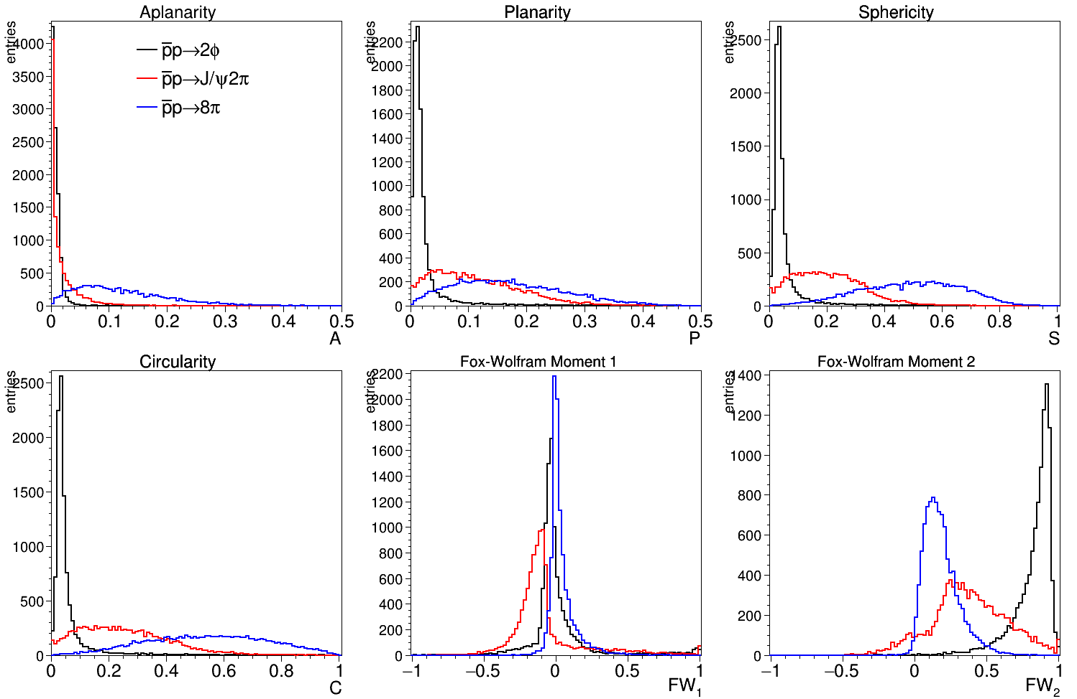
Sphericity - (A)planarity - Circularity - Fox Wolfram Mom

Slide 15
Event (Shape) Variables in PandaROOT/Rho
Class PndEventShape offers many variables
Global multiplictities: NParticles, NCharged, NNeutral
Event shape variables
Sphericity, Planarity, Aplanarity, Circularity, Thrust, ThrustVector
FoxWolfMomH(order), FoxWolfMomR(order)
Minimum/maximum energy and (transverse) momentum (lab, cms)
PmaxLab/Cms, PminLab/Cms, EmaxNeutLab/Cms, PmaxChrgLab/Cms,...
(Transverse) momentum and energy sums (lab, cms)
PtSumLab, NeutESumLab/Cms, ChrgPSumLab/Cms
Multiplicities with (transv.) min/max momentum/energy (lab, cms)
MultPminLab/Cms, MultPmaxLab/Cms, MultPtminLab/Cms, MultPtmaxLab/Cms
MultChrgPminLab/Cms, MultChrgPmaxLab/Cms, MultNeutEminLab/Cms
PID multiplicities with minimum probability and momentum (lab, cms)
MultElectronPminCms, MultMuonPminCms,....
(Transv.) momentum and energy sums with min momentum/energy (lab, cms)
SumPminLab/Cms, SumNeutEminLab/Cms,...
PndEventShape(RhoCandList &all, TLorentzVector pbp_sys, double neutMinE=0, double chrgMinP=0)

Slide 16
SPECIAL KINEMATICS

Slide 17
Special Kinematics
Some signal reactions exhibt special properties for selection
Prominent cases are
Double resonance production close to threshold Examples: $\overline{p}p→D\overline{D}$, $\overline{p}p→Λ_{c}^{+}{\overline{Λ}}_{c}^{−}$, $\overline{p}p→D\overline{D^{∗}}$, ...
Cascaded decays with low momentum particle emission Example: $D^{∗+}→D^{0}π^{+}$,$D_{s}^{∗+}→D_{s}^{+}γ$, $χ_{c1}^{}→J/ψ γ$

Slide 18
Double Resonance Production at Threshold
Fixed and known E_{cm} → resolution of invariant mass correlates with missing mass $m_{miss}=\sqrt{{\left(E_{p\overline{p}}−E_{rec}\right)}^{2}−{\left({{\vec{p}}_{p\overline{p}}−\vec{p}}_{rec}^{}\right)}^{2}}$
Example: $\overline{p}p→D\overline{D}, D/\overline{D}→K^{∓}π^{±}$ @ E_{cm} = 3.75 GeV
invariant mass and missing mass resolution about 24 MeV
but very narrow correlation ellipsis
σ_{inv} = 23 MeV
σ_{mm} = 24 MeV

Slide 19
Beam Energy Substituted Mass m_{ES}
In case of resonance - anti-resonance production (like $D\overline{D}$) → can infer the resonance's energy from the beam energy
So called energy-subsituted mass is (* = in cm-frame)
$m_{ES}=\sqrt{{\left(\frac{E_{cm}^{∗}}{2}\right)}^{2}−{\left(p_{rec}^{∗}\right)}^{2}}$ , combined with $∆E={\left(\frac{E_{cm}^{∗}}{2}\right)}^{2}−E_{rec}$
Much better S:N and thus relative error!
σ_{ES} = 2 MeV
N = 12703 ± 139
σ_{ΔE} = 24 MeV
N = 12200 ± 427

Slide 20
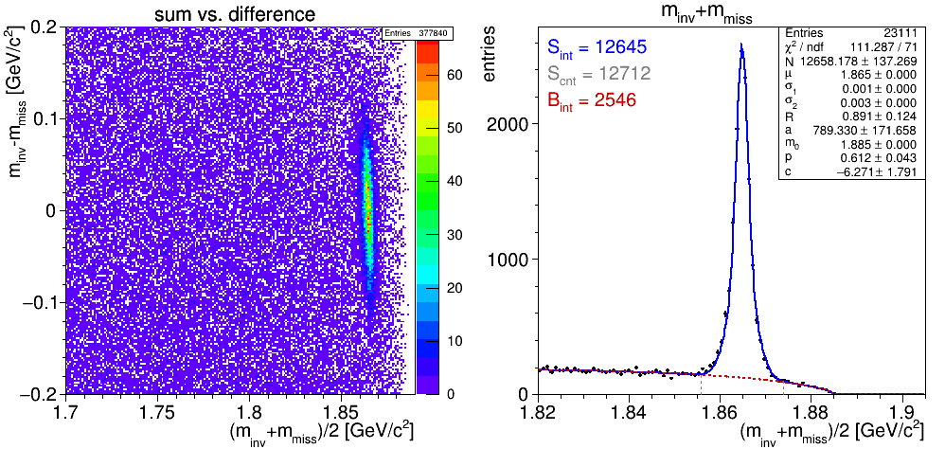
Double Resonance Production at Threshold
Very similar result by using m_{inv} and m_{miss} directly
Works also for R' production (e.g. D*) with different masses
Plot difference vs. sum (or for R sum/2; peaks at corr. mass)
σ_{sum} =2 MeV

Slide 21
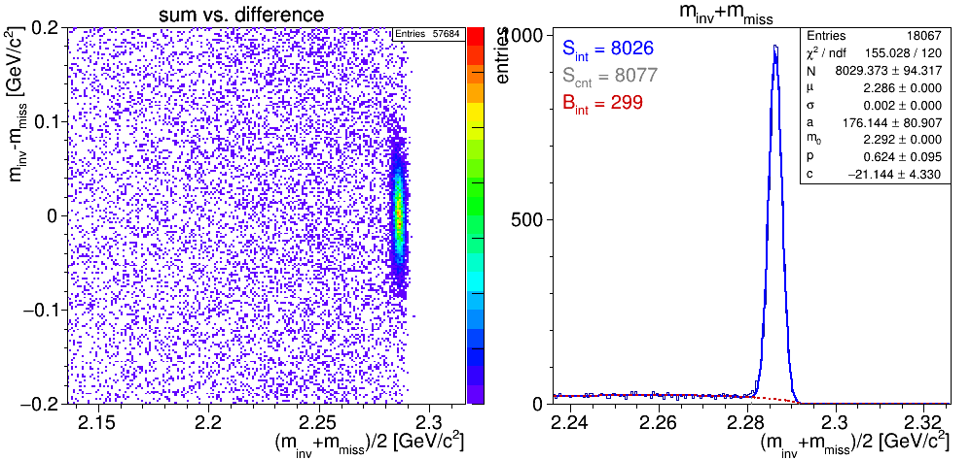
Double Resonance Production at Threshold
Very similar result by using m_{inv} and m_{miss} directly
Works also for R' production (e.g. D*) with different masses
Plot difference vs. sum (or for R sum/2; peaks at corr. mass)
Also works for other cases like e.g. $Λ_{c}\overline{Λ_{c}}$
σ_{sum} =2 MeV

Slide 22
Cascaded Decays with Slow Particles
Consider decay $D^{∗+}→D^{0}π^{+}$
Experimental resolution of D^{*+} dominated by that of D⁰ due to combinatoric reconstruction
Strong correlation between mass distributions
very narrow correlation ellipsis
σ_{D*} = 32 MeV
σ_{D} = 24 MeV

Slide 23
Cascaded Decays with Slow Particles
Good quantity is the mass difference m(D*) - m(D)
Close to threshold (small nominal difference)
Very narrow structure to be selected on
Much better S:N and rel. error
${\left(\frac{ΔN}{N}\right)}_{before}=\frac{679}{8980}=7.5\%⟶$ ${\left(\frac{ΔN}{N}\right)}_{after}=\frac{90}{7311}=1.2\%$
σ_{dif} = 0.4 – 0.9 MeV

Slide 24
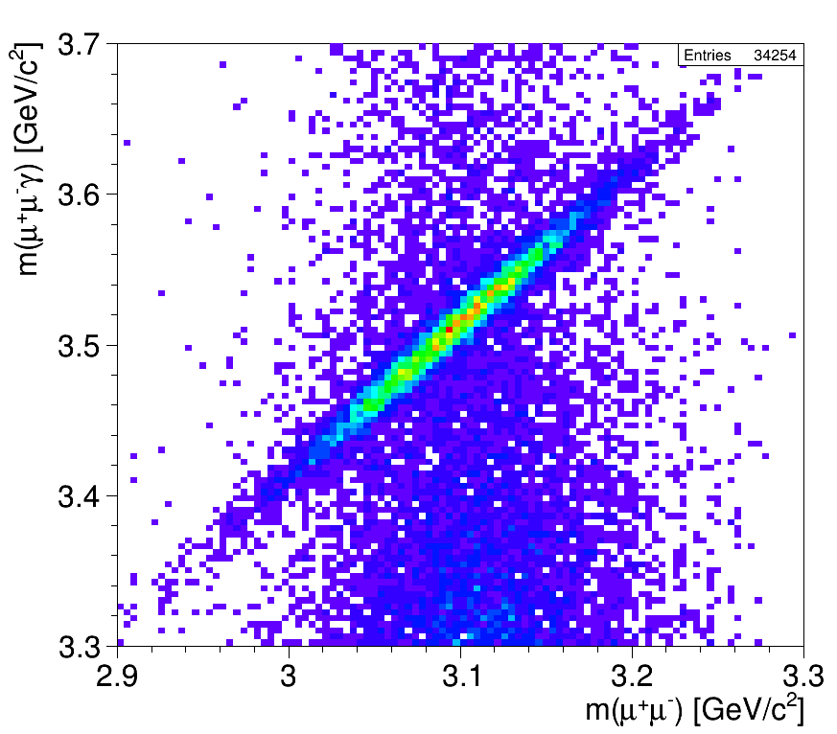
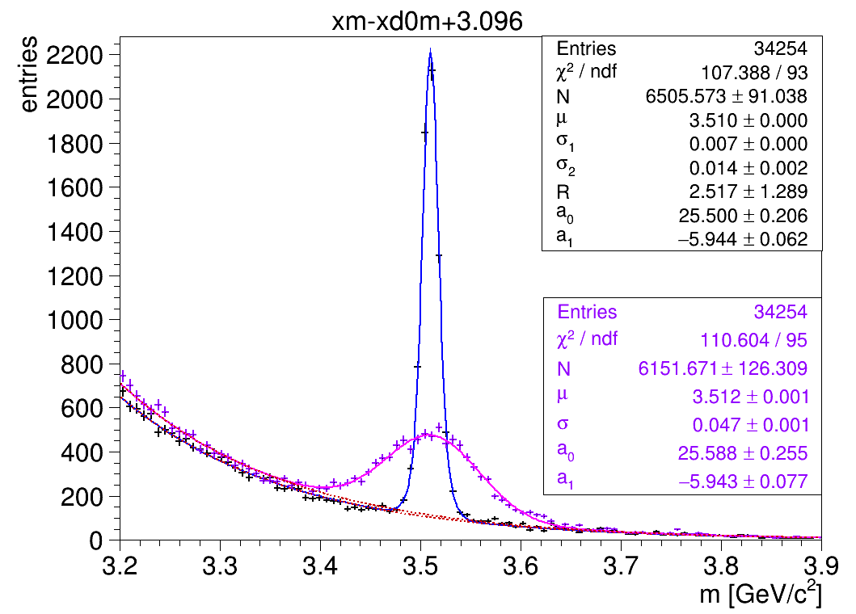
Cascaded Decays with Slow Particles
Another example: $χ_{c1}^{}→J/{ψ(→μ^{+}μ^{−})} γ$
Compare mass m(μ⁺μ⁻γ) with m(μ⁺μ⁻γ) - m(μ⁺μ⁻) + m_{J/ψ,PDG}
Resolution better by factor 4
Correlation between masses

Slide 25
CREATING OUTPUT

Slide 26
TTrees with RhoTuple
Creating TTree output without overhead
RhoTuple *ntp = new RhoTuple("ntp","J/psi analysis");
...
// ... in event loop ...
for (j=0;j<jpsi.GetLength();++j)
{
// *** store event number and candidate number in current event
ntp->Column("ev", (Float_t) evnumber );
ntp->Column("cand", (Float_t) j );
// *** basic information about J/psi
ntp->Column("jpsim", (Float_t) jpsi[j]->M() );
ntp->Column("jpsip", (Float_t) jpsi[j]->P() );
ntp->Column("jpsipt",(Float_t) jpsi[j]->P4().Pt() );
ntp->Column("jpsiE", (Float_t) jpsi[j]->E() );
....
ntp->DumpData();
}
...
// ... end of macro ...
TFile *f=new TFile("ntp.root","RECREATE");
ntp->GetInternalTree()->Write();
f->Close();
Just create new branches on the fly!
Actually write out what is currently set

Slide 27
PndRhoTupleQA - TTree made simple
Provides QA functions for persisting values in TTree
// *** QA for candidates
void qaCand(TString pre, RhoCandidate *cc, RhoTuple *n, bool skip=false);
void qaP4(TString pre, TLorentzVector c, RhoTuple *n, bool skip=false);
void qaP4Cms(TString pre, TLorentzVector c, RhoTuple *n, bool skip=false);
void qaP4Cov(TString pre, RhoCandidate *c, RhoTuple *n, bool skip=false);
// *** QA for composites
void qaComp(TString pre, RhoCandidate *c, RhoTuple *n);
void qaKs0(TString pre, RhoCandidate *c, RhoTuple *n);
void qaPi0(TString pre, RhoCandidate *c, RhoTuple *n);
// *** QA of event shape
void qaEventShape(TString pre, PndEventShape *evsh, RhoTuple *n);
void qaEventShapeShort(TString pre, PndEventShape *evsh, RhoTuple *n);
// *** QA for parts of eventshape
void qaESPidMult(TString pre, PndEventShape *evsh, double prob, double pmin, RhoTuple *n);
void qaESMult(TString pre, PndEventShape *evsh, RhoTuple *n);
void qaESSum(TString pre, PndEventShape *evsh, RhoTuple *n);
void qaESMinMax(TString pre, PndEventShape *evsh, RhoTuple *n);
void qaESEventVars(TString pre, PndEventShape *evsh, RhoTuple *n);
// *** QA track, vtx, PID, decay
void qaVtx(TString pre, RhoCandidate *c, RhoTuple *n);
void qaPoca(TString pre, RhoCandidate *c, RhoTuple *n);
....
Very handy function
to store composite info!

Slide 28
PndRhoTupleQA - Application
In situ it might look like this:
double pbarmom = 15.0;
PndAnalysis *ana = new PndAnalysis();
PndRhoTupleQA qa(ana, pbarmom);
RhoTuple *ntp = new RhoTuple("ntp","J/psi analysis");
...
// ... in event loop ...
for (j=0;j<jpsi.GetLength();++j)
{
// *** store event number and candidate number in current event
ntp->Column("ev", (Float_t) evnumber );
ntp->Column("cand", (Float_t) j );
// *** all information about composite J/psi,
// **** including info about daughters, 2-body quantities and MC truth
qa.qaComp("x", jpsi[j], ntp);
// *** and fill ntuple
ntp->DumpData();
}

Slide 29
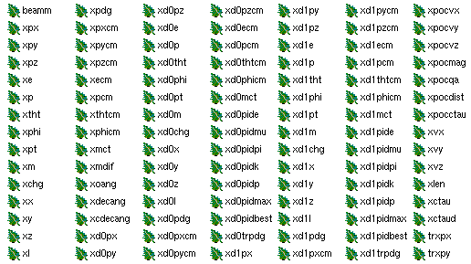
PndRhoTupleQA - Application
This creates branches:
In situ it might look like this:
double pbarmom = 15.0;
PndAnalysis *ana = new PndAnalysis();
PndRhoTupleQA qa(ana, pbarmom);
RhoTuple *ntp = new RhoTuple("ntp","J/psi analysis");
...
// ... in event loop ...
for (j=0;j<jpsi.GetLength();++j)
{
// *** store event number and candidate number in current event
ntp->Column("ev", (Float_t) evnumber, -999.0f);
ntp->Column("cand", (Float_t) j, -999.0f);
// *** all information about composite J/psi,
// **** including info about daughters, 2-body quantities and MC truth
qa.qaComp("x", jpsi[j], ntp);
// *** and fill ntuple
ntp->DumpData();
}

Slide 30
PndRhoTupleQA - Application
This creates branches:
In situ it might look like this:
infos about daugther 0
double pbarmom = 15.0;
PndAnalysis *ana = new PndAnalysis();
PndRhoTupleQA qa(ana, pbarmom);
RhoTuple *ntp = new RhoTuple("ntp","J/psi analysis");
...
// ... in event loop ...
for (j=0;j<jpsi.GetLength();++j)
{
// *** store event number and candidate number in current event
ntp->Column("ev", (Float_t) evnumber, -999.0f);
ntp->Column("cand", (Float_t) j, -999.0f);
// *** all information about composite J/psi,
// **** including info about daughters, 2-body quantities and MC truth
qa.qaComp("x", jpsi[j], ntp);
// *** and fill ntuple
ntp->DumpData();
}

Slide 31
QUICK ANALYSIS TOOLS

Slide 32
Quick Analysis
Based on PndSimpleCombiner & PndSimpleCombinerTask
very simple and compact analysis approach
runs analysis in FairTask (more reliable)
Reco e.g. of mode ψ' → J/ψ (→ μ⁺μ⁻) π⁺π⁻ incl. vertex and 4C fit can be done by (tutorials/analysis):
root -l -b -q 'quickana.C(
„signal_pid.root", // input file
6.232, // p [GeV/c]
"J/psi->mu+ mu-; pbarpSystem->J/psi pi+ pi-", // decay tree reco
0, // #events (0=all)
"fit4c<100:fitvtx:mwin(J/psi)=0.8:pidmu=Tight")' // some parameters
Attaching file signal_pid_ana.root as _file0...
root [1] .ls
TFile** signal_pid_ana.root
TFile* signal_pid_ana.root
KEY: TFolder cbmout;1 Main Output Folder
KEY: TList BranchList;1 Doubly linked list
KEY: FairFileHeader FileHeader;1
KEY: TTree ntp0;1 J/psi->mu+ mu-
KEY: TTree ntp1;1 pbarpSystem->J/psi pi+ pi-

Slide 33
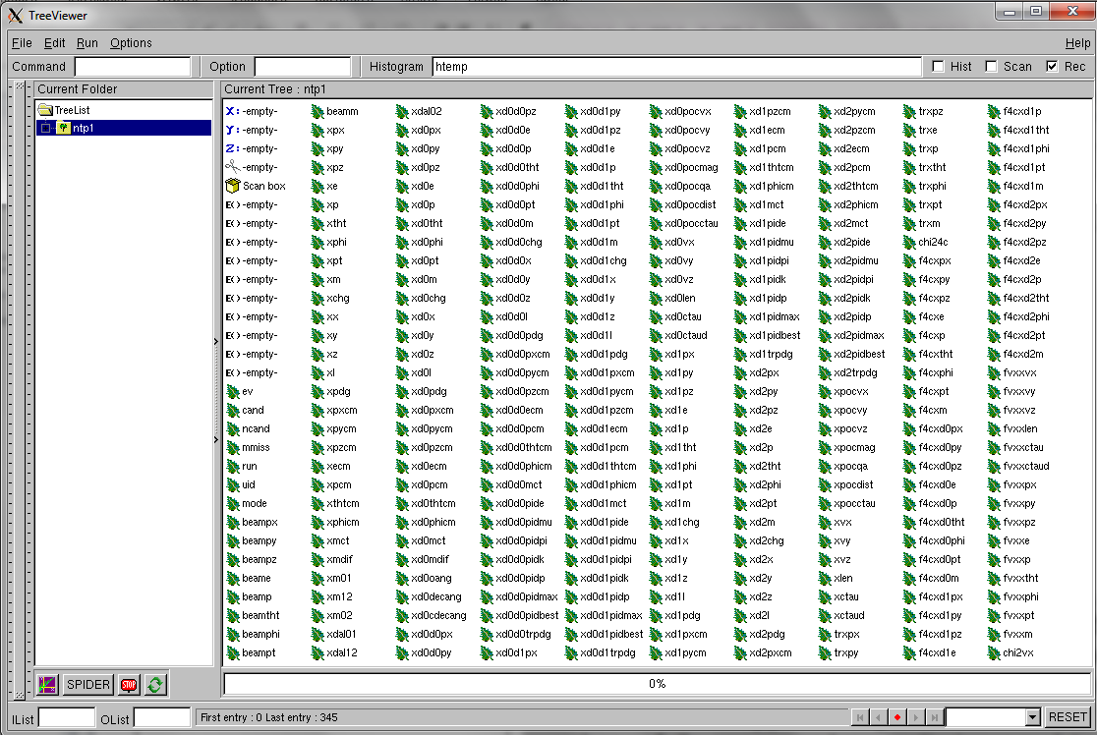
Quick Analysis
Based on PndSimpleCombiner & PndSimpleCombinerTask
very simple and compact analysis approach
runs analysis in FairTask (more stable)
Reco e.g. of mode ψ' → J/ψ (→ μ⁺μ⁻) π⁺π⁻ incl. vertex and 4C fit can be done by (tutorials/analysis):
root -l -b -q 'quickana.C(
„signal_pid.root", // input file
6.232, // p [GeV/c]
"J/psi->mu+ mu-; pbarpSystem->J/psi pi+ pi-", // decay tree reco
0, // #events (0=all)
"fit4c:fitvtx:mwin(J/psi)=0.8" )' // some parameters
Attaching file pid_complete_ana.root as _file0...
root [1] .ls
TFile** pid_complete_ana.root
TFile* pid_complete_ana.root
KEY: TFolder cbmout;1 Main Output Folder
KEY: TList BranchList;1 Doubly linked list
KEY: FairFileHeader FileHeader;1
KEY: TTree ntp0;1 J/psi->mu+ mu-
KEY: TTree ntp1;1 pbarpSystem->J/psi pi+ pi-

Slide 34
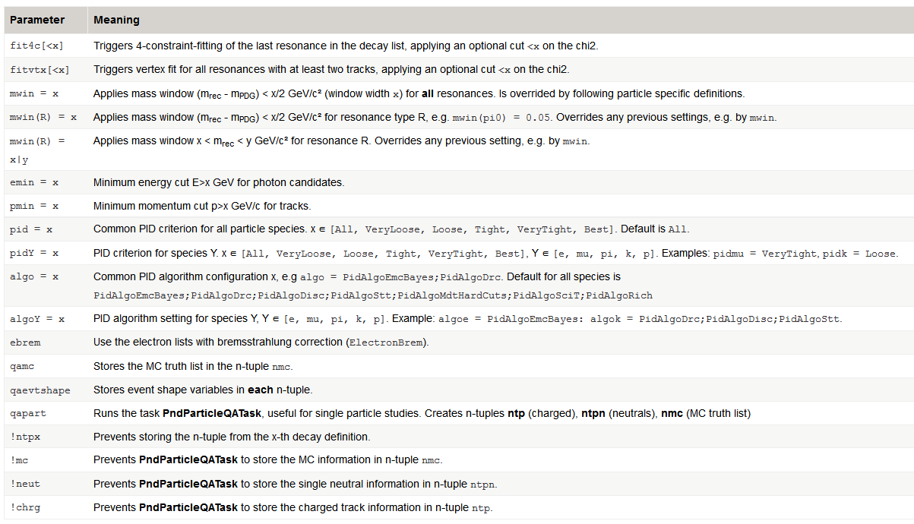
Quick Analysis Parameters
https://panda-wiki.gsi.de/foswiki/bin/view/Computing/PandaRootRhoTutorial#A_5._Quick_analysis
fitting
mass cuts
energy/momentum cut
PID control
output control

Slide 35
Quick Fast Simulation & Analysis
Same channel with Fast Sim → no simulation stage needed!
Events are generated on-the-fly
root -l -b -q 'quickfsimana.C(
"jpsi", // output prefix
"pp_Jpsi2pi_Jpsi_mumu.dec", // generator
6.232, // p [GeV/c]
"J/psi -> mu+ mu-; pbarpSystem -> J/psi pi+ pi-", // decay tree reco
1000, // # events generated
"fit4c<100:fitvtx:mwin=0.8:pidmu=Tight", // parameters
0, 1, 23 )' // no software trigger, #run=1, #mode=23
TFile** jpsi_0_ana.root
TFile* jpsi_0_ana.root
KEY: TFolder cbmroot;1 Main Folder
KEY: TList BranchList;1 Doubly linked list
KEY: FairFileHeader FileHeader;1
KEY: TTree ntp0;1 J/psi -> mu+ mu-
KEY: TTree ntp1;1 pbarpSystem -> J/psi pi+ pi-
KEY: TTree cbmsim;1 /cbmroot

Slide 36
Quick Fast Simulation & Analysis
Generator configuration
'xyz.dec[:iniRes]' : decay file w/ optional initial resonance
'DPM[1/2]' : DPM; option 1 = inel. + el., 2 = el. only
'FTF[1]' : FTF; option 1 = inel. + elastic
'BOX:type(pdg,mult):p(min,max):[c]tht(min,max):phi(min,max)'
Configure species/multiplicity and one or multiple kin. ranges
Decay pattern (names as in TDatabasePDG)
Bottom up definition → last decay step first
Wrong : "D_s+ -> phi pi+; phi -> K+ K-"
Correct: "phi -> K+ K-; D_s+ -> phi pi+"
Suppress automatic charged conjugate with 'nocc'
"D_s+ -> phi pi+ nocc" (only reconstructs D_{s}⁺)
Parameters
as shown for Quick Analysis

Slide 37
Quick Fast Simulation & Analysis - Examples
Generator | Decay pattern |  | Parameters
mysignal.dec | J/psi -> e+ e-; pbp -> J/psi pi+ pi- |  | fit4c:mwin=0.3:qamc:qaevtshape
signal events; do 4C fit; apply mass window; store MC and event shape info in addition
DPM | J/psi -> e+ e-; pbp -> J/psi pi+ pi- |  | fit4c:mwin=0.3:qamc:qaevtshape
create background events applying the same analysis
mysignal.dec |  |  | persist
only run/stores FastSim output (PndPidCandidates) for signal events; no analysis reco
FTF |  |  | nevt
stores only TTree with event variables for FTF background
box:type[13,1]:p[2]:tht[0,60] |  |  | qapart:!neut:!mc
single muons; p = 2 GeV/c, 0° < tht < 60°; QA info for charged particles only
mysignal.dec | K_S0 -> pi+ pi-; D0 -> K_S0 K+ K- |  | fitvtx:mwin(K_S0)=0.1:!ntp0
vertex fit; 0.1 GeV mass wind. K_S; no mass wind. D0; suppress K_S0 ntuple output

Slide 38
Multi Variate Analysis with TMVA
Once you have created ROOT output
Need to discriminate signal from background
Either do by inspecting variables by hand or use some automatic tool after indentification of potential good variables: ⇒ TMVA = ROOT Multi Variate Analysis Toolset [https://root.cern.ch/tmva]
Simple demo available: TMVATrainer.C, TMVATrainer_608.C, TMVATester.C allow to test
Boosted Decision Trees (BDT)
Multi Layer Perceptron (MLP)
Conventional Likelihood Methode (Likelihood)
Interface change in
ROOT Ver. > 6.08

Slide 39
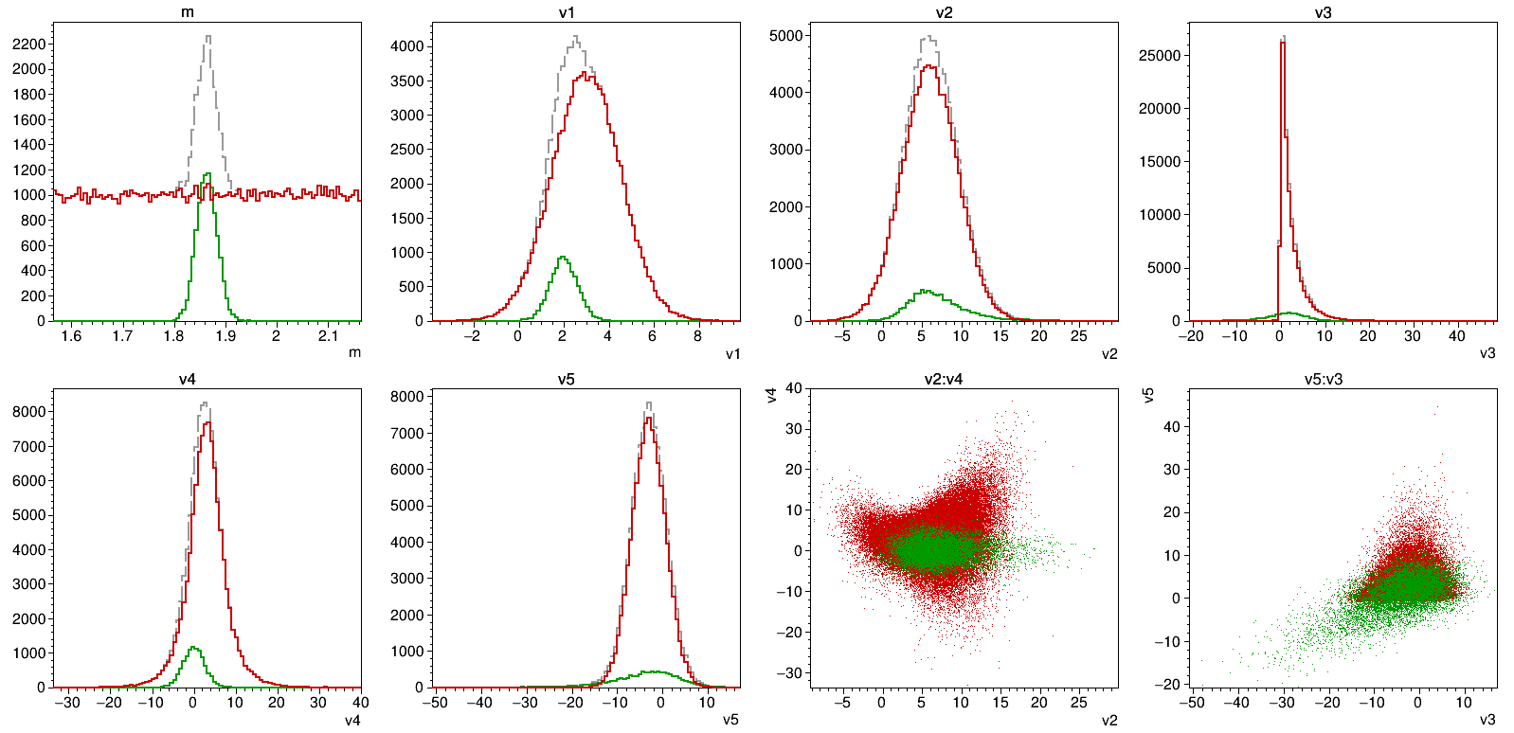
Multi Variate Analysis with TMVA
For demonstration, need some test data; create with
tutorials/thailand2017> root -l -b -q makeTMVADemoData.C // -> demodata.root
→ "mass" m + 5 add. variables (and flag 'signal' to distinguish classes)
signal
bkg
m
v1
v2
v3
v4
v5
v2:v4 (correlation)
v3:v5 (correlation)

Slide 40
Multi Variate Analysis with TMVA
Training of the classifier (using 80% of data for training)
Running the classifier
Plots classifier output after training, ROC curve* and quality (*Receiver output characteristics = quality figure for binary classifiers)
> root -l -b -q TMVATrainer.C("demodata.root", // the input ROOT file
"ntp", // name of the TTree
"signal>0", // cut selection signal
"v1 v2 v3 v4 v5", // list of variables
"BDT", // BDT, MLP, LH
"") // optional precut
> root -l TMVATester.C("demodata.root", // the input ROOT file
"ntp", // name of the TTree
"signal>0", // cut selection signal
"weights/..BDT...xml", // weights file
"") // optional precut

Slide 41
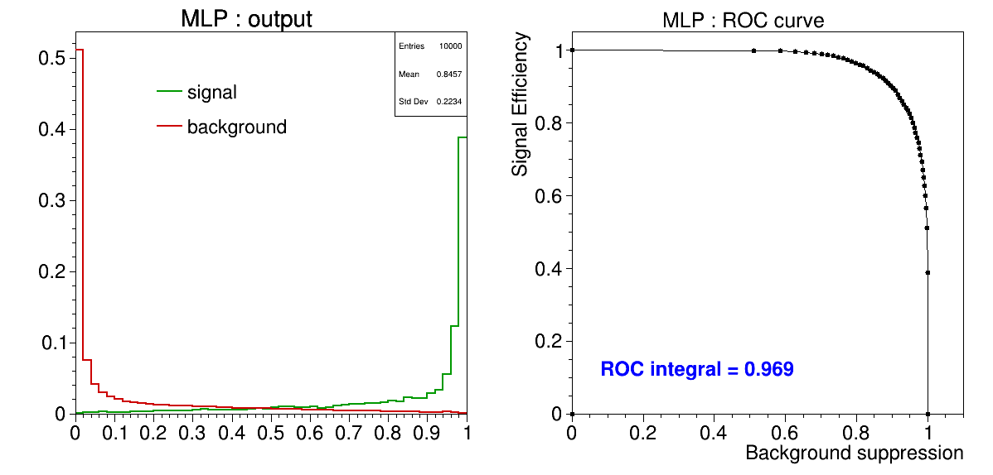
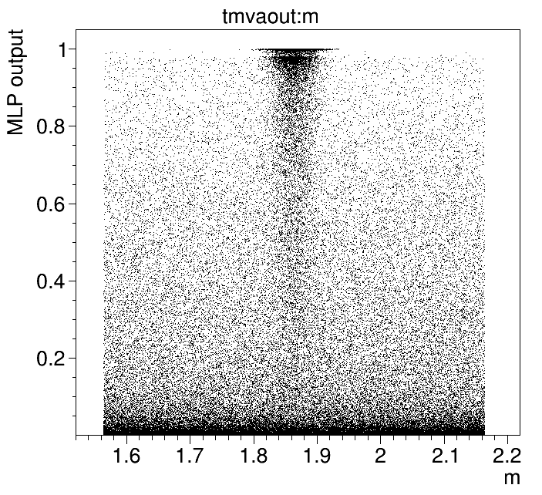
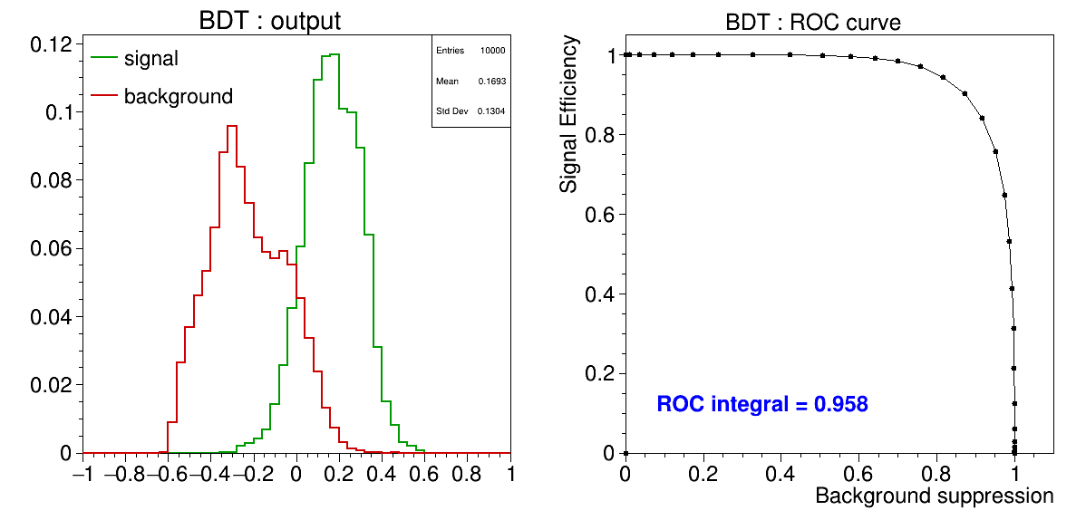
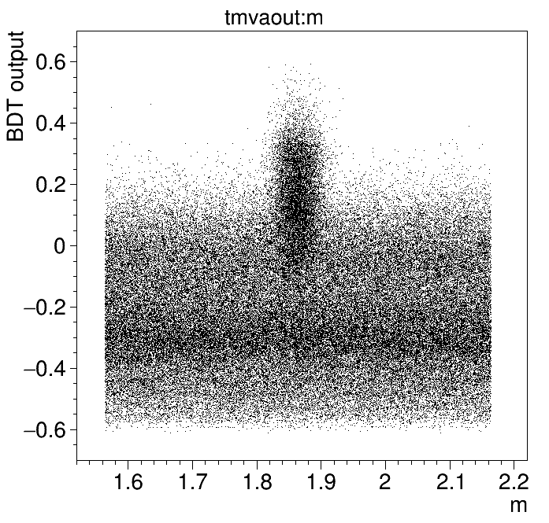
Multi Variate Analysis with TMVA
MLP and BDT classifier performance:
MLP
BDT

Slide 42
EXERCISES

Slide 43
Exercises Suggestions
Rho Tutorial website: http://panda-wiki.gsi.de/cgi-bin/view/Computing/PandaRootRhoTutorial
Take a look to tutorials/thailand2017/README Exercises: #10 - #12
Try event-filter in fast/full sim. macros and study impact
Simulate some events with quickfsimana.C
Create signal and background for some channel
Merge both analysis ROOT files with hadd
Study different variables
Train different TMVA classifiers on merged ROOT file

Slide 44
Exercises Preparation
Preparation/hints in tutorials/thailand2017/README
FIRST setup environment: source ~/workshop/build/PandaRoot_trunk.../config.sh
To have some data for tutorial macros, do one of the following a) . ./tut_runall.sh 1000 # sim/reco 1000 events pbarp -> J/psi pi+ pi- b) cp data/signal_p*root . # preproduced default data
Macros named 'tut_ana...C' are stubs and should be completed by you.
At places marked with ' #### EXERCISE: ...' some code needs to be added; Run macros (default or different input data) with > root -l tut_ana...C # signal_pid.root, signal_par.root > root -l 'tut_ana...C(0,"mydata")' # mydata_pid.root, mydata_par.root
If getting stuck, sample solutions are in the subfolder 'solution' Run solution macros directly (default or different input data) with > root -l solution/tut_ana...C > root -l 'solution/tut_ana...C(0,"mydata")'

